Slide 1
Graph Essentials
Social Media Mining

Slide 2
Graph Basics

Slide 3
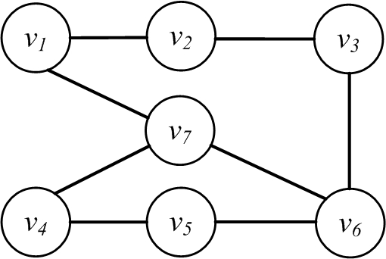
Nodes and Edges
A network is a graph
nodes, actors, or vertices (plural of vertex)
Connections, edges or ties
Edge
Node

Slide 4
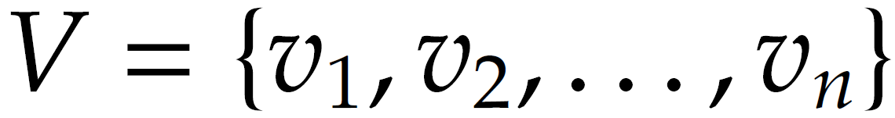
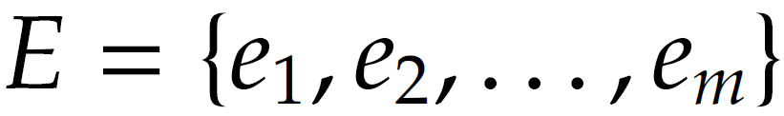
Nodes and Edges
In a social graph, nodes are people and any pair of people connected denotes the friendship, relationships, social ties between them
In a web graph, “nodes” represent sites and the connection between nodes indicates web-links between them
  The size of the graph is |V|= n
  Number of edges (size of the edge-set|E|=m

Slide 5
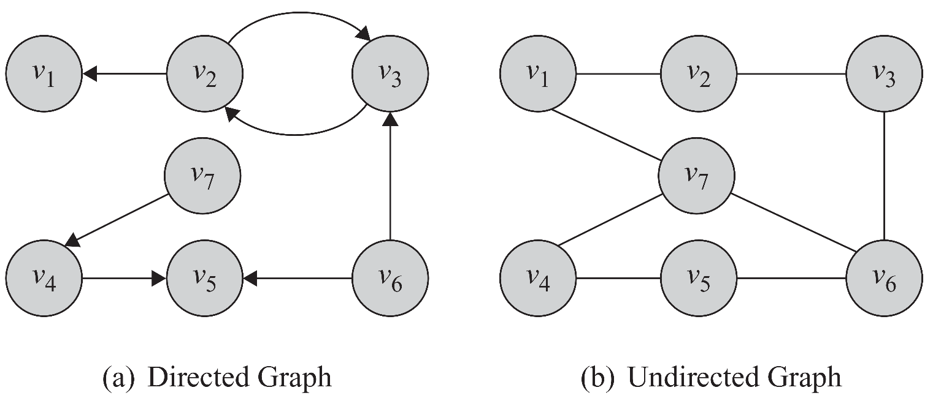
Directed Edges and Directed Graphs
Edges can have directions. A directed edge is sometimes called an arc
Edges are represented using their end-points e(v2,v1). In undirected graphs both representations are the same

Slide 6
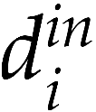
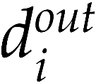
Neighborhood and Degree (In-degree, out-degree)
For any node v, the set of nodes it is connected to via an edge is called its neighborhood and is represented as N(v)
The number of edges connected to one node is the degree of that node (the size of its neighborhood)
  Degree of a node i is usually presented using notation di
  In case of directed graphs
    In-degrees is the number of edges pointing towards a node
    Out-degree is the number of edges pointing away from a node

Slide 7
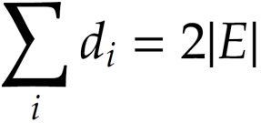
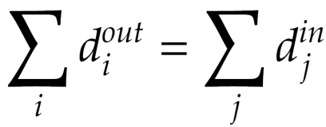
Degree and Degree Distribution
Theorem 1. The summation of degrees in an undirected graph is twice the number of edges
Lemma 1. The number of nodes with odd degree is even
Lemma 2. In any directed graph, the summation of in-degrees is equal to the summation of out-degrees,

Slide 8
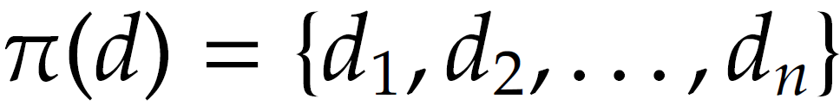
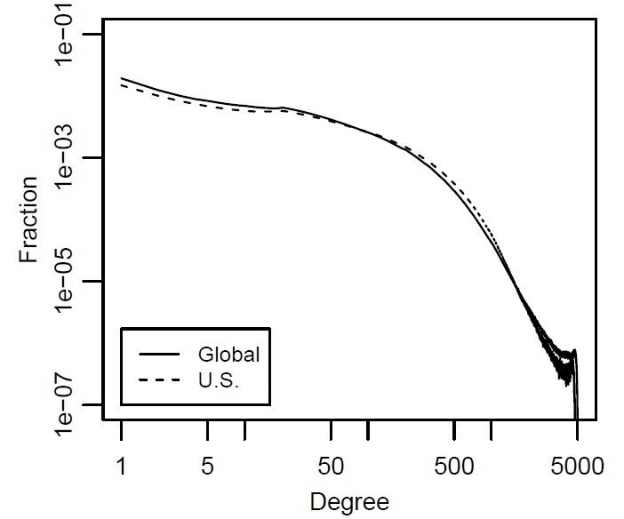
Degree Distribution
When dealing with very large graphs, how nodes’ degrees are distributed is an important concept to analyze and is called Degree Distribution
Where is the number of nodes with degree d
Degree distribution can be computed from degree sequence:
Degree distribution histogram
  The x-axis represents the degree and the y-axis represents the number of nodes (frequency) having that degree

Slide 9
Subgraph
Graph G can be represented as a pair G(V, E), where V is the node set and E is the edge set
G’(V’, E’) is a subgraph of G(V, E) (induced subgraph)
6
4
5
5
1
3
1
3
2
2

Slide 10
Graph Representation
Adjacency Matrix
Adjacency List
Edge List

Slide 11
Adjacency Matrix
1, if there is an edge between nodes vi and vj
0, otherwise
Diagonal Entries are self-links or loops
Social media networks have
very sparse adjacency matrices

Slide 12
Adjacency List
In an adjacency list for every node, we maintain a list of all the nodes that it is connected to
The list is usually sorted based on the node order or other preferences

Slide 13
Edge List
In this representation, each element is an edge and is usually represented as (u, v), denoting that node u is connected to node v via an edge

Slide 14
Types of Graphs
Null, Empty, Directed/Undirected/Mixed, Simple/Multigraph, Weighted, Signed Graph

Slide 15
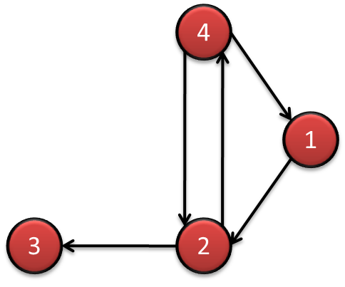
Directed-Undirected
4
1
3
2
The adjacency matrix for directed graphs is not symmetric (A ≠ A^{T})
  (A_{ij} ≠ A_{ji})
The adjacency matrix for undirected graphs is symmetric (A = A^{T})

Slide 16
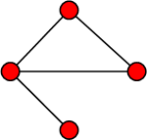
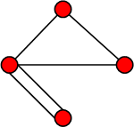
Simple Graphs and Multigraphs
Simple graphs are graphs where only a single edge can be between any pair of nodes
Multigraphs are graphs where you can have multiple edges between two nodes and loops
The adjacency matrix for multigraphs can include numbers larger than one, indicating multiple edges between nodes
Simple graph
Multigraph
Notes:
It is important for social network analysis as a pair can have more than one relations.

Slide 17
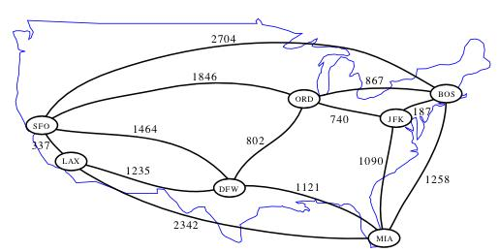
Weighted Graph
A weighted graph is one where edges are associated with weights
  For example, a graph could represent a map where nodes are cities and edges are routes between them
    The weight associated with each edge could represent the distance between these cities
    G(V, E, W)
Notes:
Image: http://www.cs.ucr.edu/~neal/2004/cs141/?ShortestPathsByDijkstras

Slide 18
Signed Graph
When weights are binary (0/1, -1/1, +/-) we have a signed graph
It is used to represent friends or foes
It is also used to represent social status

Slide 19
Connectivity in Graphs
Adjacent nodes/Edges, Walk/Path/Trail/Tour/Cycle,

Slide 20
Adjacent nodes and Incident Edges
Two nodes are adjacent if they are connected via an edge.
Two edges are incident, if they share on end-point
When the graph is directed, edge directions must match for edges to be incident

Slide 21
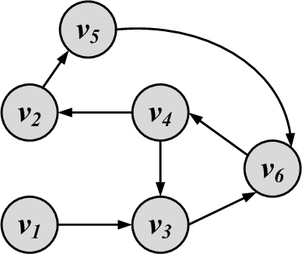
Walk, Path, Trail, Tour, and Cycle
Walk: A walk is a sequence of incident edges visited one after another
  Open walk: A walk does not end where it starts
  Close walk: A walk returns to where it starts
Representing a walk:
  A sequence of edges: e₁, e₂, …, e_{n}
  A sequence of nodes: v₁, v₂, …, v_{n}
Length of walk: the number of visited edges
Length of walk= 8

Slide 22
Path
A walk where nodes and edges are distinct is called a path and a closed path is called a cycle
The length of a path or cycle is the number of edges visited in the path or cycle
Length of path= 4

Slide 23
Random walk
A walk that in each step the next node is selected randomly among the neighbors
  The weight of an edge can be used to define the probability of visiting it
  For all edges that start at v_{i} the following equation holds

Slide 24
Connectivity
A node v_{i} is connected to node v_{j} (or reachable from v_{j}) if it is adjacent to it or there exists a path from v_{i} to v_{j.}
A graph is connected, if there exists a path between any pair of nodes in it
  In a directed graph, a graph is strongly connected if there exists a directed path between any pair of nodes
  In a directed graph, a graph is weakly connected if there exists a path between any pair of nodes, without following the edge directions
A graph is disconnected, if it not connected.

Slide 25
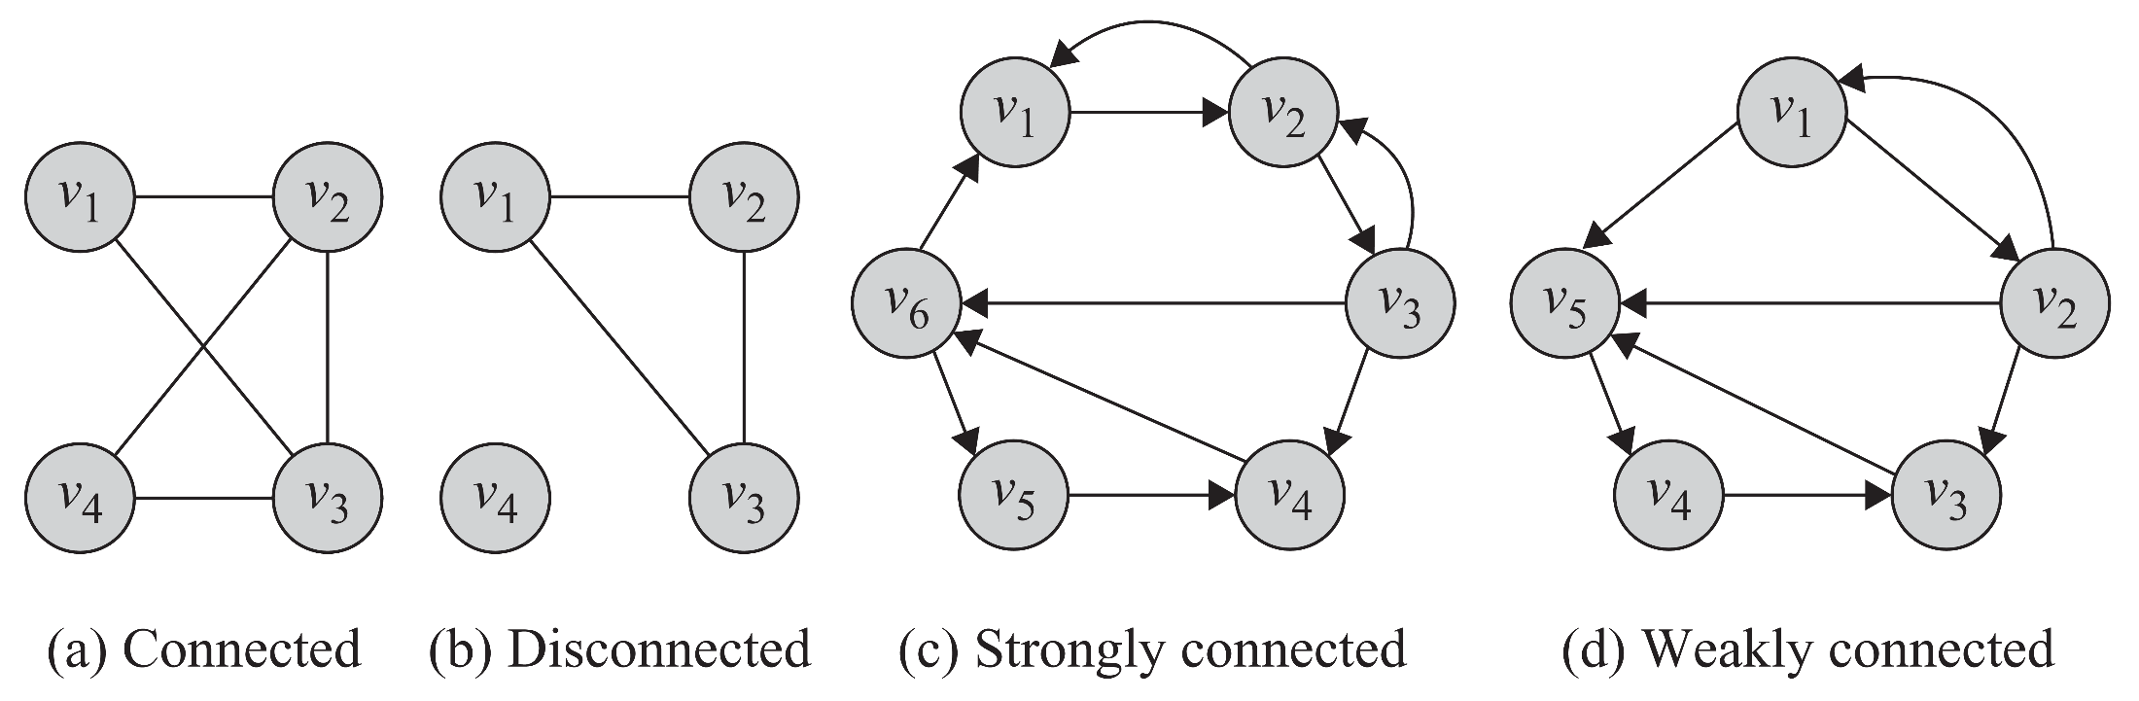
Connectivity: Example

Slide 26
Component
A component in an undirected graph is a connected subgraph, i.e., there is a path between every pair of nodes inside the component
In directed graphs, we have a strongly connected components when there is a path from u to v and one from v to u for every pair (u,v).
The component is weakly connected if replacing directed edges with undirected edges results in a connected component

Slide 27
Component Examples:
3 components
3 Strongly-connected
components

Slide 28
Shortest Path
Shortest Path is the path between two nodes that has the shortest length.
The concept of the neighborhood of a node can be generalized using shortest paths. An n-hop neighborhood of a node is the set of nodes that are within n hops distance from the node.

Slide 29
Diameter
The diameter of a graph is the length of the longest shortest path between any pair of nodes between any pairs of nodes in the graph
How big is the diameter of the web?

Slide 30
Special Graphs

Slide 31
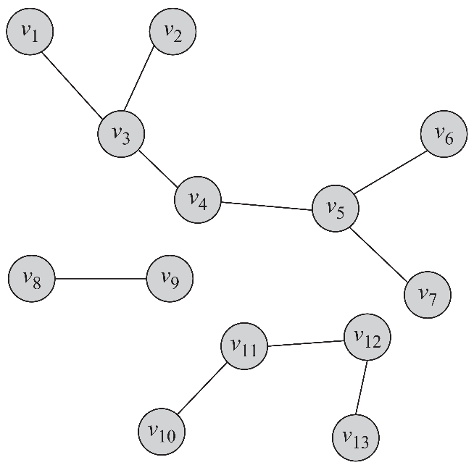
Trees and Forests
Trees are special cases of undirected graphs
A tree is a graph structure that has no cycle in it
In a tree, there is exactly one path between any pair of nodes
In a tree: |V| = |E| + 1
A set of disconnected
trees is called a forest
A forest containing 3 trees

Slide 32
Special Subgraphs

Slide 33
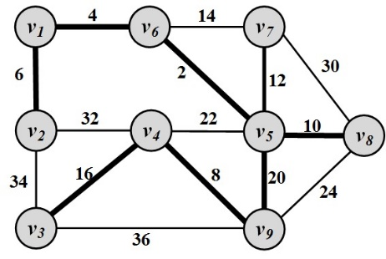
Spanning Trees
For any connected graph, the spanning tree is a subgraph and a tree that includes all the nodes of the graph
There may exist multiple spanning trees for a graph.
For a weighted graph and one of its spanning tree, the weight of that spanning tree is the summation of the edge weights in the tree.
Among the many spanning trees found for a weighted graph, the one with the minimum weight
is called the
minimum spanning tree (MST)

Slide 34
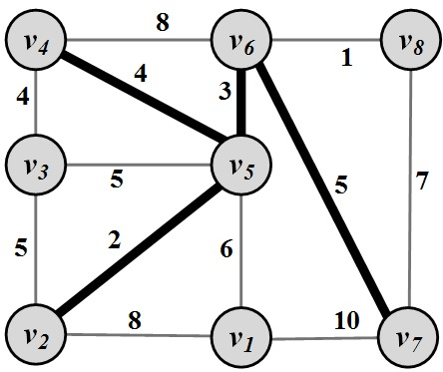
Steiner Trees
Given a weighted graph G : (V, E, W) and a subset of nodes V’ ⊆ V (terminal nodes ), the Steiner tree problem aims to find a tree such that it spans all the V’ nodes and the weight of this tree is minimized

Slide 35
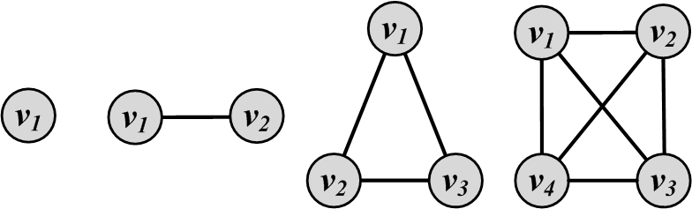
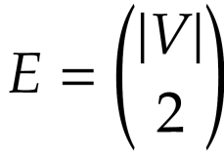
Complete Graphs
A complete graph is a graph where for a set of nodes V, all possible edges exist in the graph
In a complete graph, any pair of nodes are connected via an edge

Slide 36
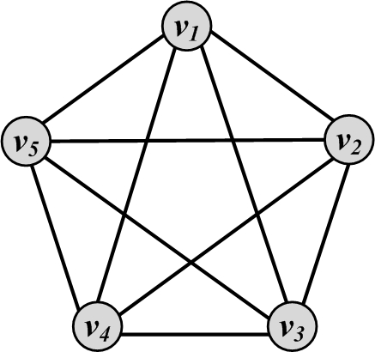
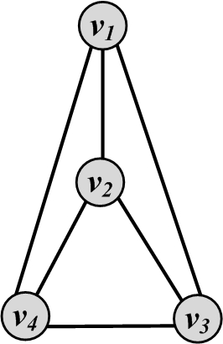
Planar Graphs
A graph that can be drawn in such a way that no two edges cross each other (other than the endpoints) is called planar
Planar Graph
Non-planar Graph

Slide 37
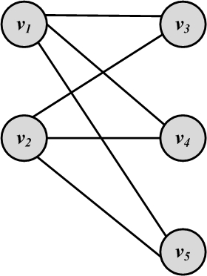
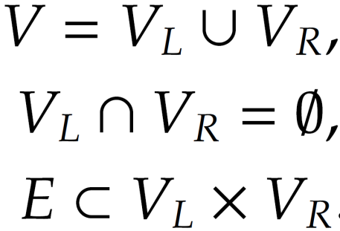
Bipartite Graphs
A bipartite graph G(V; E) is a graph where the node set can be partitioned into two sets such that, for all edges, one end-point is in one set and the other end-point is in the other set.

Slide 38
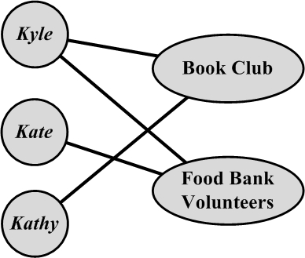
Affiliation Networks
An affiliation network is a bipartite graph. If an individual is associated with an affiliation, an edge connects the corresponding nodes.

Slide 39
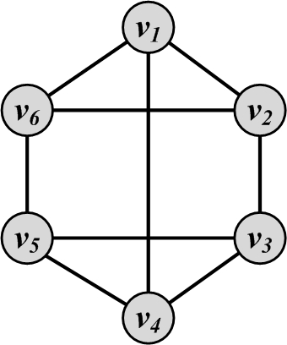
Regular Graphs
A regular graph is one in which all nodes have the same degree
Regular graphs can be connected or disconnected
In a k-regular graph, all nodes have degree k
Complete graphs are examples of regular graphs

Slide 40
Egocentric Networks
An egocentric network consists of a focal actor (ego), and a set of alters who have ties with the ego

Slide 41
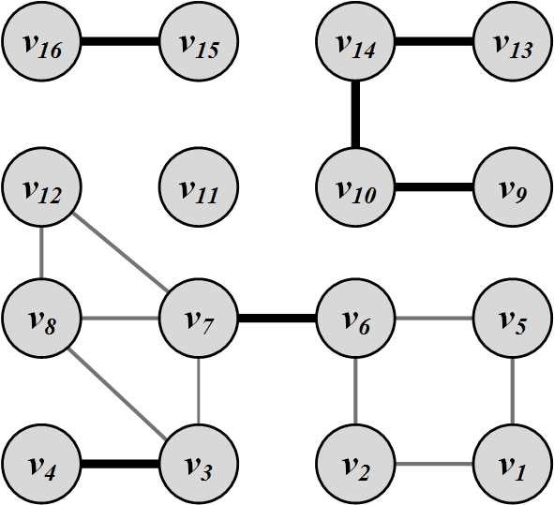
Bridges (cut-edges)
Bridges are edges whose removal will increase the number of connected components

Slide 42
Graph Algorithms

Slide 43
Graph/Network Traversal Algorithms

Slide 44
Graph/Tree Traversal
Traversal
1. All users are visited; and
2. No user is visited more than once.
There are two main techniques:
  Depth-First Search (DFS)
  Breadth-First Search (BFS)

Slide 45
Depth-First Search (DFS)
Depth-First Search (DFS) starts from a node i, selects one of its neighbors j from N(i) and performs Depth-First Search on j before visiting other neighbors in N(i).
The algorithm can be used both for trees and graphs
  The algorithm can be implemented using a stack structure

Slide 46
DFS Algorithm

Slide 47
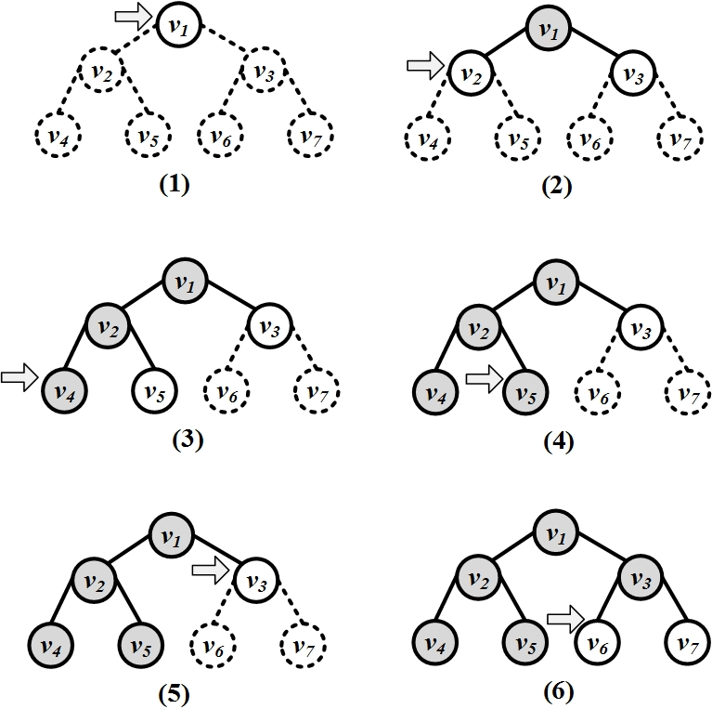
Depth-First Search (DFS): An Example

Slide 48
Breadth-First Search (BFS)
BFS starts from a node, visits all its immediate neighbors first, and then moves to the second level by traversing their neighbors.
The algorithm can be used both for trees and graphs
  The algorithm can be implemented using a queue structure

Slide 49
BFS Algorithm

Slide 50
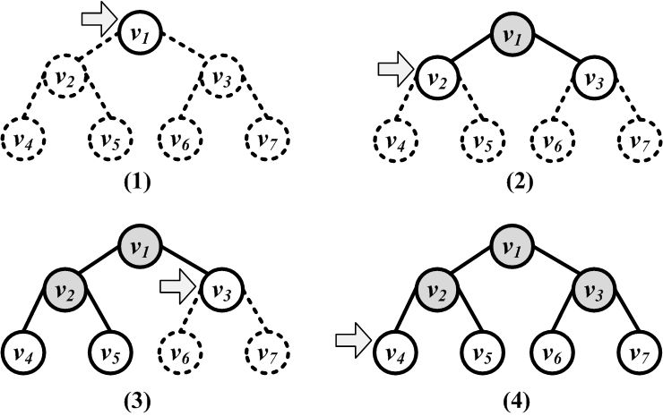
Breadth-First Search (BFS)

Slide 51
Shortest Path
When a graph is connected, there is a chance that multiple paths exist between any pair of nodes
  In many scenarios, we want the shortest path between two nodes in a graph
Dijkstra’s Algorithm
  It is designed for weighted graphs with non-negative edges
  It finds shortest paths that start from a provided node s to all other nodes
  It finds both shortest paths and their respective lengths

Slide 52
Dijkstra’s Algorithm: Finding the shortest path
Initiation:
  Assign zero to the source node and infinity to all other nodes
  Mark all nodes unvisited
  Set the source node as current
For the current node, consider all of its unvisited neighbors and calculate their tentative distances
  If tentative distance (current node’s distance + edge weight) is smaller than neighbor’s distance, then Neighbor’s distance = tentative distance
After considering all of the neighbors of the current node, mark the current node as visited and remove it from the unvisited set
  A visited node will never be checked again and its distance recorded now is final and minimal
If the destination node has been marked visited or if the smallest tentative distance among the nodes in the unvisited set is infinity, then stop
Set the unvisited node marked with the smallest tentative distance as the next "current node" and go to step 2

Slide 53
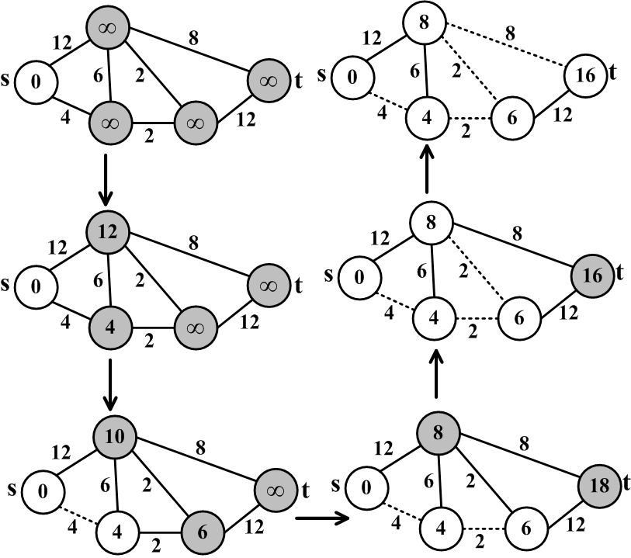
Dijkstra’s Algorithm Execution Example

Slide 54
Dijkstra’s Algorithm
Dijkstra’s algorithm is source-dependent and finds the shortest paths between the source node and all other nodes. To generate all-pair shortest paths, one can run dijsktra’s algorithm n times or use other algorithms such as Floyd-Warshall algorithm.
If we want to compute the shortest path from source v to destination d, we can stop the algorithm once the shortest path to the destination node has been determined

Slide 55
Other slides
Notes:
http://www-personal.umich.edu/~mejn/networks/
James Moody, Race, school integration, and friendship segregation in America, American Journal of Sociology 107, 679-716 (2001): Yellow = girls, Green = boys, Red = sexually active
High school dating: Data drawn from Peter S. Bearman, James Moody, and Katherine Stovel, Chains of affection: The structure of adolescent romantic and sexual networks, American Journal of Sociology 110, 44-91 (2004) image was made by M Newman

Slide 56
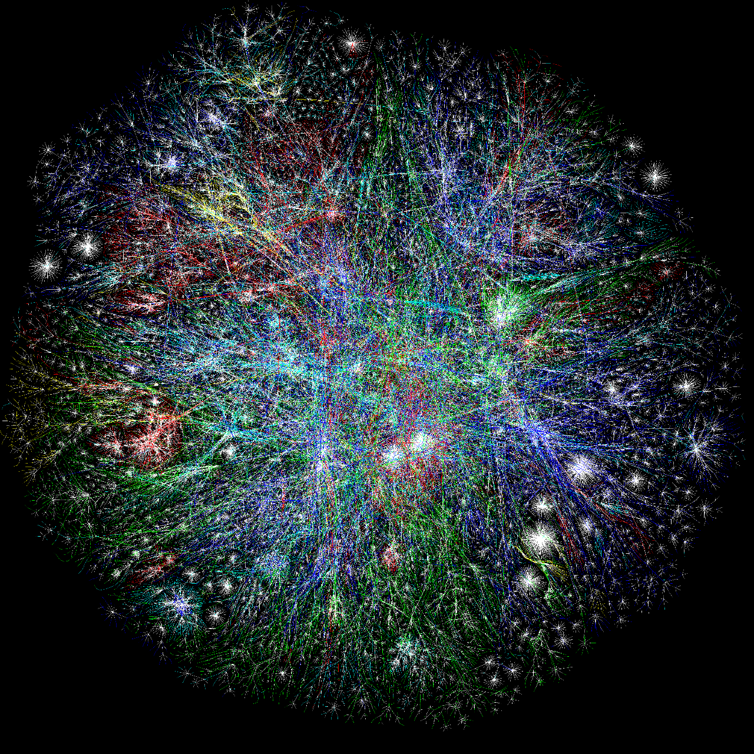
Internet

Slide 57
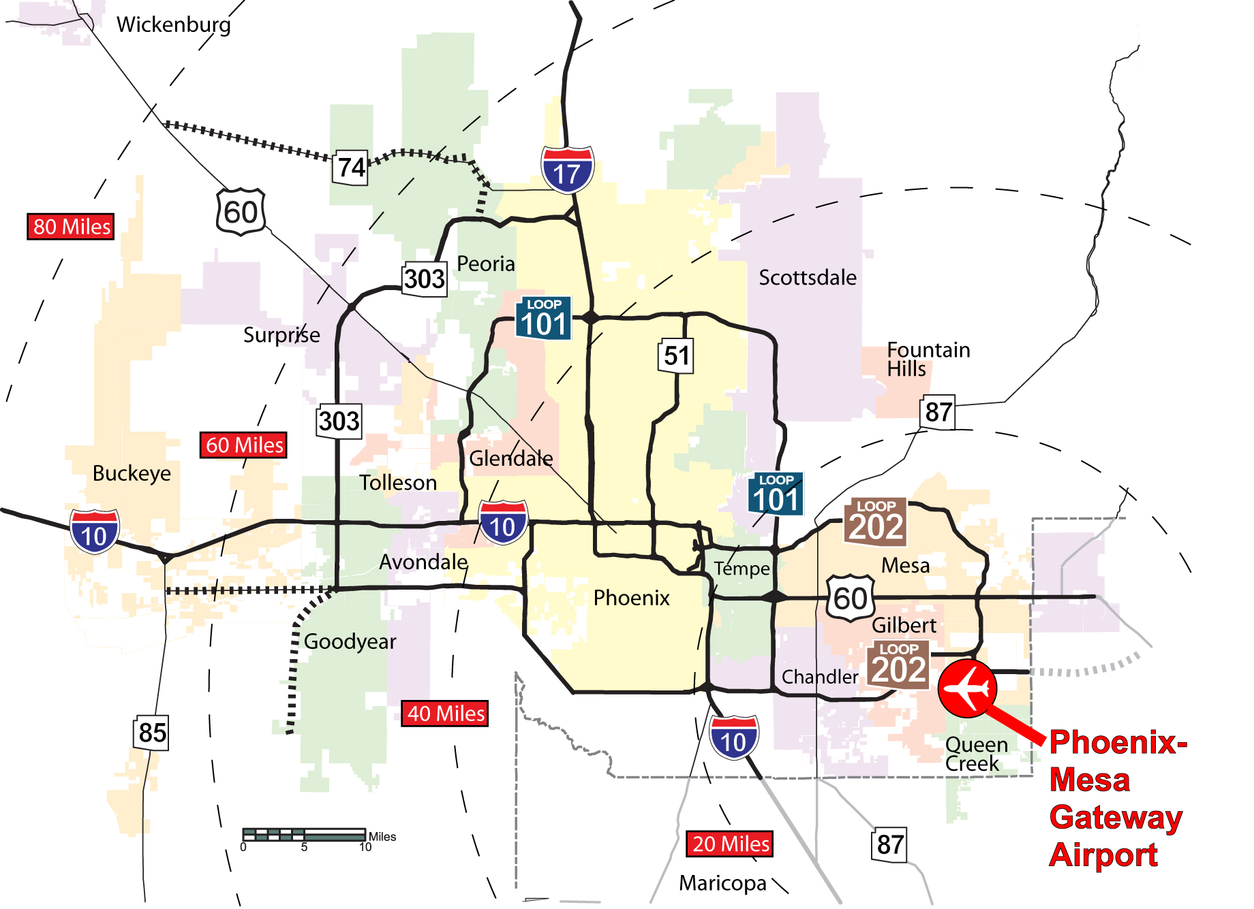
Phoenix Road Network
Notes:
http://www.autoblog.com/2011/12/21/new-art-reimagines-u-s-road-network-system-as-a-subway-map/

Slide 58
Social Networks and Social Network Analysis
A social network
  A network where elements have a social structure
    A set of actors (such as individuals or organizations)
    A set of ties (connections between individuals)
Social networks examples:
  your family network, your friend network, your colleagues ,etc.
To analyze these networks we can use Social Network Analysis (SNA)
Social Network Analysis is an interdisciplinary field from social sciences, statistics, graph theory, complex networks, and now computer science
Notes:
http://en.wikipedia.org/wiki/Social_network
Network science studies the laws and patterns of different networks in one context.

Slide 59
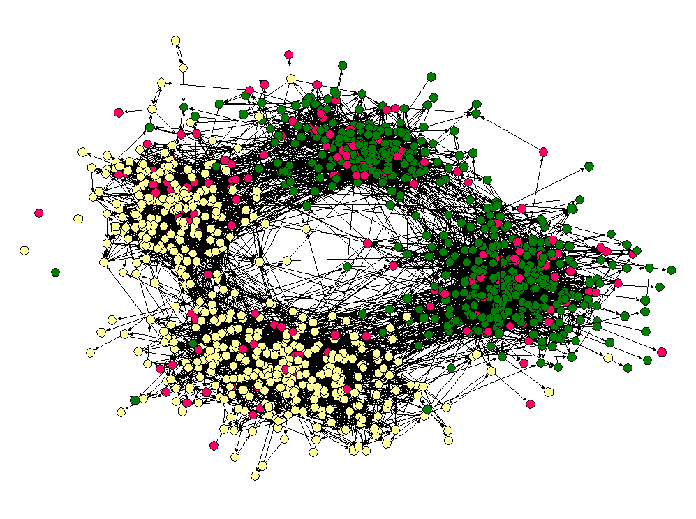
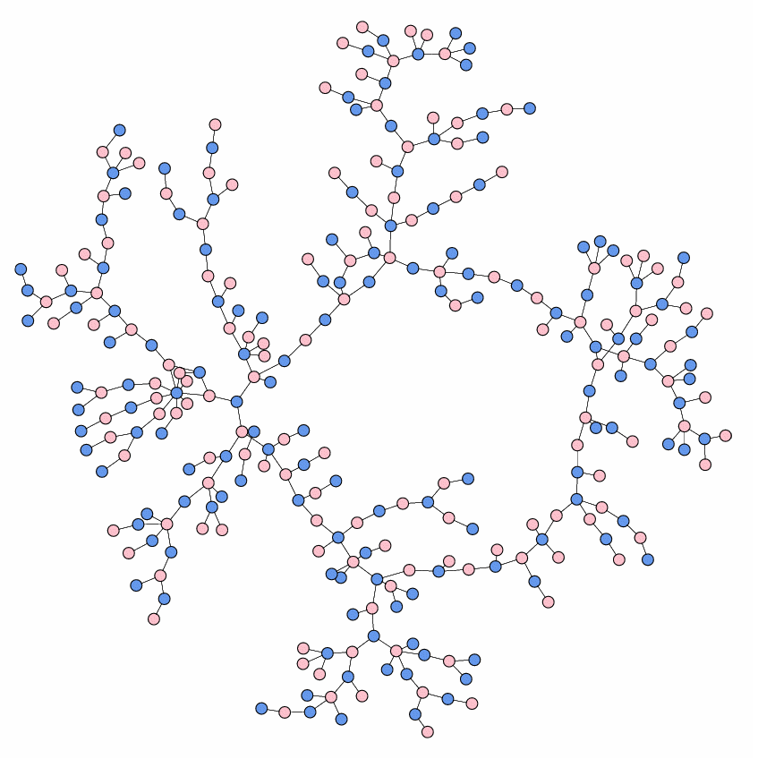
Social Networks: Examples
High school friendship
High school dating
Notes:
http://www-personal.umich.edu/~mejn/networks/
James Moody, Race, school integration, and friendship segregation in America, American Journal of Sociology 107, 679-716 (2001): Yellow = girls, Green = boys, Red = sexually active
High school dating: Data drawn from Peter S. Bearman, James Moody, and Katherine Stovel, Chains of affection: The structure of adolescent romantic and sexual networks, American Journal of Sociology 110, 44-91 (2004) image was made by M Newman

Slide 60
Webgraph
A webgraph is a way of representing how internet sites are connected on the web
In general, a web graph is a directed multigraph
Nodes represent sites and edges represent links between sites.
Two sites can have multiple links pointing to each other and can have loops (links pointing to themselves)

Slide 61
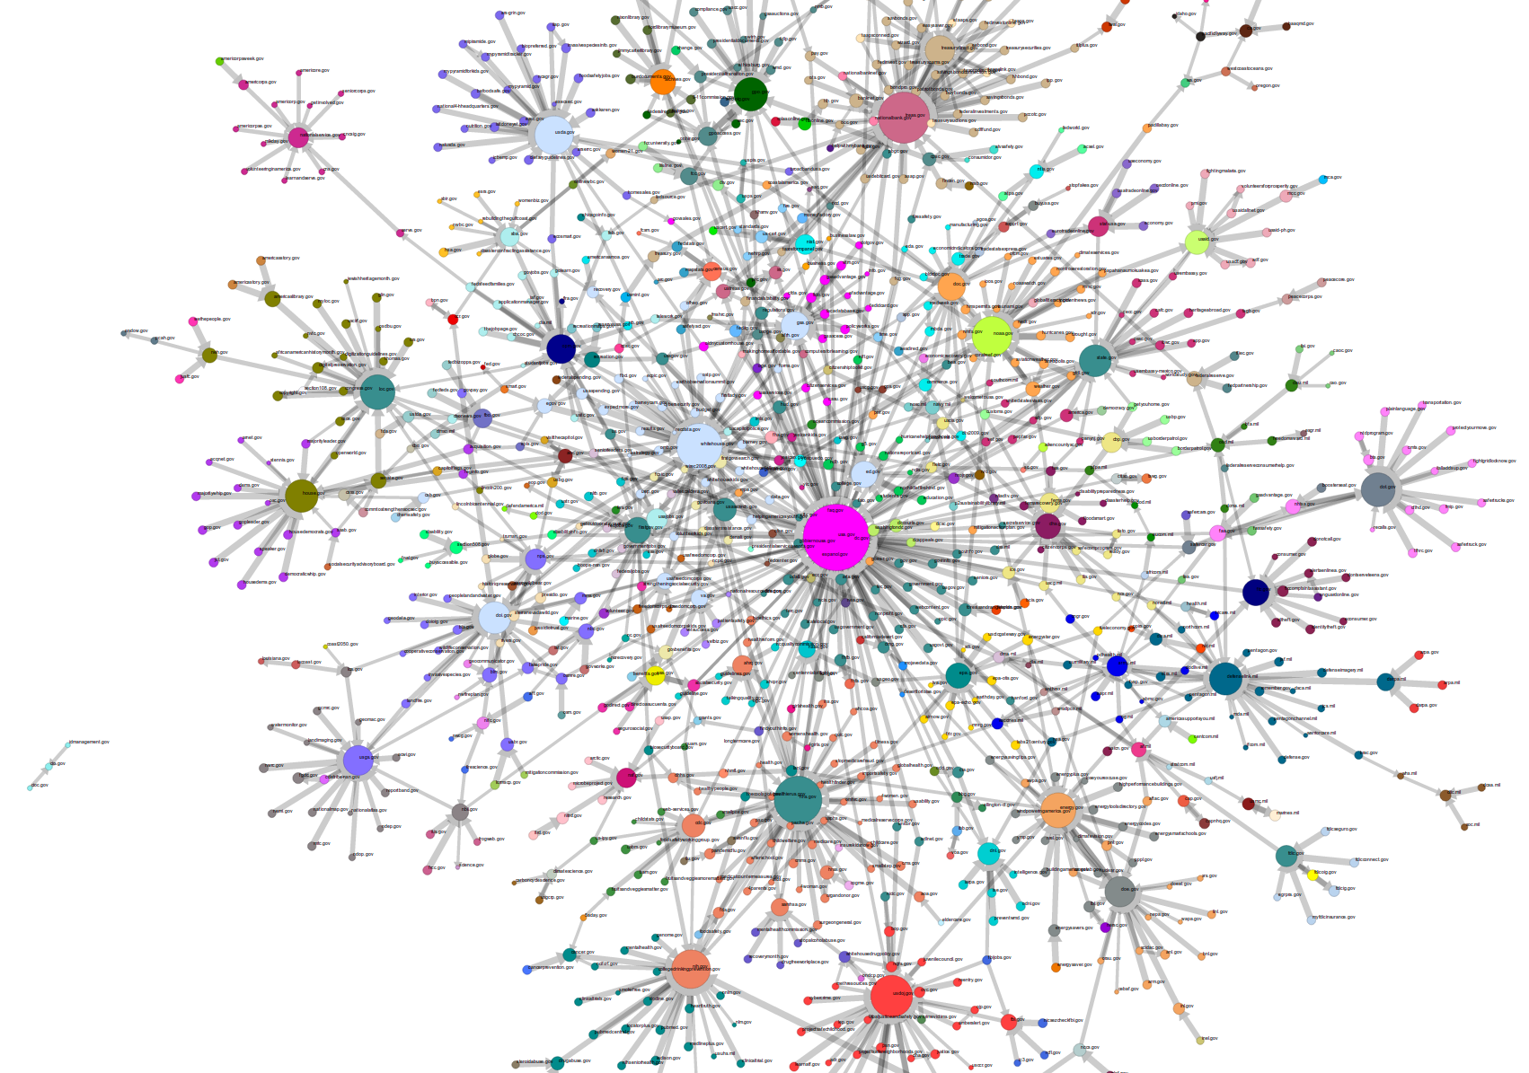
Webgraph: Government Agencies
Notes:
Image: http://research.library.unt.edu/eotcd/wiki/File:gov_20.png

Slide 62
Prim’s Algorithm: Finding Minimum Spanning Tree
It finds minimal spanning trees in a weighted graph
  It starts by selecting a random node and adding it to the spanning tree.
  It then grows the spanning tree by selecting edges which have one endpoint in the existing spanning tree and one endpoint among the nodes that are not selected yet. Among the possible edges, the one with the minimum weight is added to the set (along with its end-point).
  This process is iterated until the graph is fully spanned

Slide 63
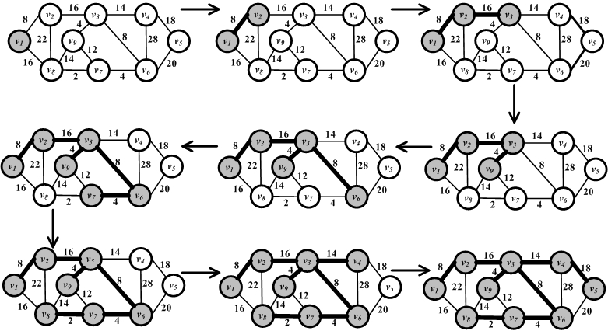
Prim’s Algorithm Execution Example

Slide 64
Bridge Detection

