Slide 1
Online Social Networks and Media
Link Analysis

Slide 2
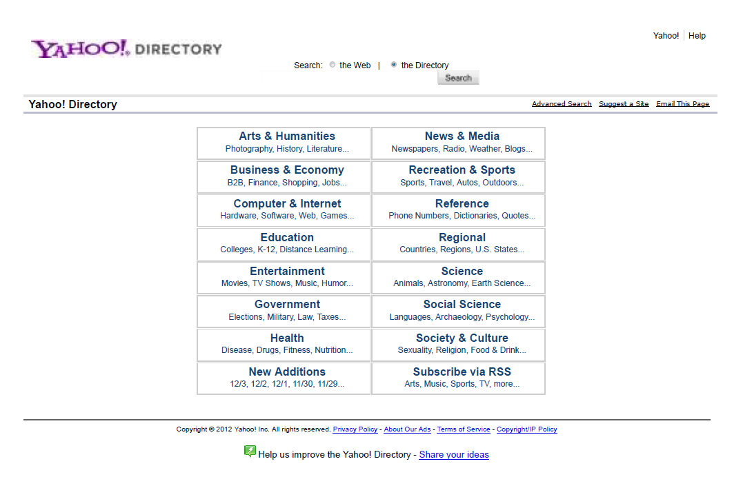
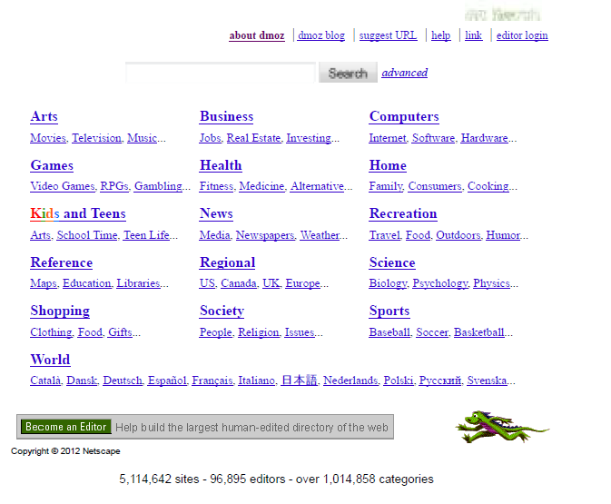
How to Organize the Web
First try: Human curated Web directories
  Yahoo, DMOZ, LookSmart

Slide 3
How to organize the web
Second try: Web Search
  Information Retrieval investigates:
    Find relevant docs in a small and trusted set e.g., Newspaper articles, Patents, etc. (“needle-in-a-haystack”)
    Limitation of keywords (synonyms, polysemy, etc)
But: Web is huge, full of untrusted documents, random things, web spam, etc.
  Everyone can create a web page of high production value
  Rich diversity of people issuing queries
  Dynamic and constantly-changing nature of web content

Slide 4
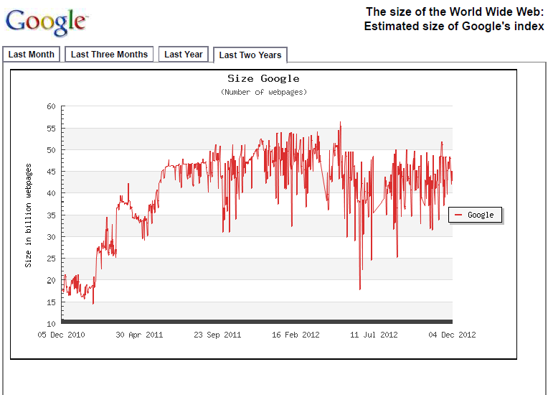
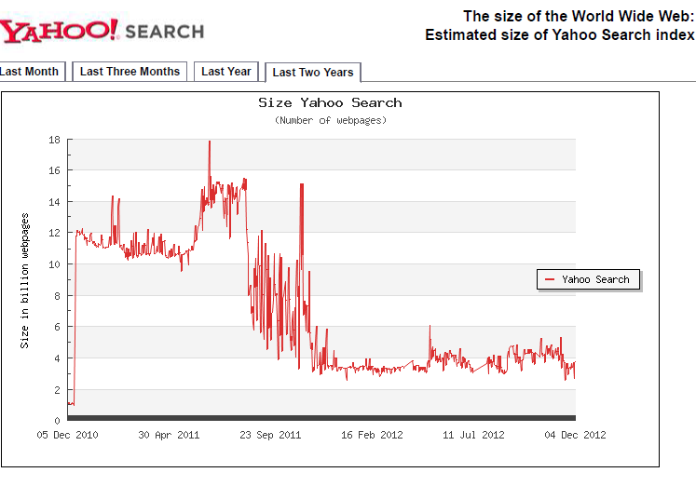
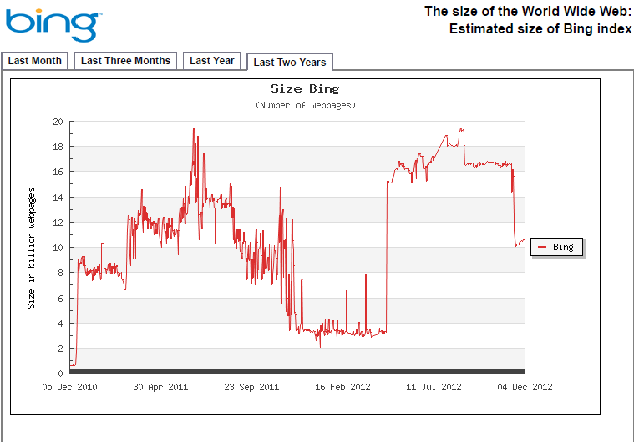
Size of the Search Index
http://www.worldwidewebsize.com/

Slide 5
How to organize the web
Third try (the Google era): using the web graph
  Shift from relevance to authoritativeness
  It is not only important that a page is relevant, but that it is also important on the web
For example, what kind of results would we like to get for the query “covid19”?

Slide 6
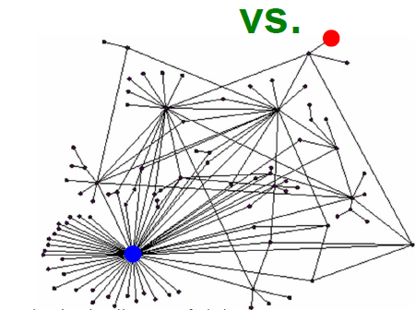
Link Analysis
Not all web pages are created equal on the web
The links act as endorsements:
  When page p links to q it endorses the content of the content of q
What is the simplest way to measure importance of a page on the web?

Slide 7
Rank by Popularity
Rank pages according to the number of incoming edges (in-degree, degree centrality)
$$v_{2}$$
Red Page
Yellow Page
Blue Page
Purple Page
Green Page
$$v_{1}$$
$$v_{3}$$
$$v_{5}$$
$$v_{4}$$

Slide 8
Popularity
It is not important only how many link to you, but also how important are the people that link to you.
Good authorities are pointed by good authorities
  Recursive definition of importance

Slide 9
THE PageRank ALGORITHM

Slide 10

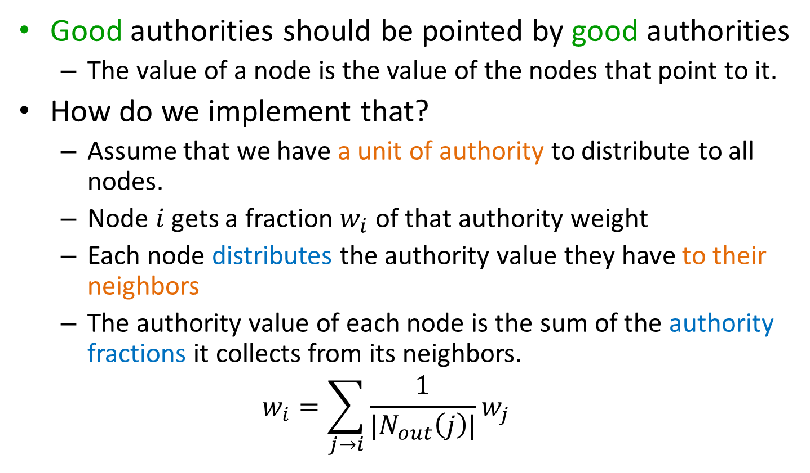
PageRank
Good authorities should be pointed by good authorities
  The value of a node is the value of the nodes that point to it.
How do we implement that?
  Assume that we have a unit of authority to distribute to all nodes.
  Node $i$ gets a fraction $w_{i}$ of that authority weight
  Each node distributes the authority value they have to their neighbors
  The authority value of each node is the sum of the authority fractions it collects from its neighbors.
  $$w_{i}=\sum_{j→i}{\frac{1}{|N_{out}\left(j\right)|}w_{j}}$$
$w_{v}:$ the PageRank value of node $v$
Recursive definition

Slide 11
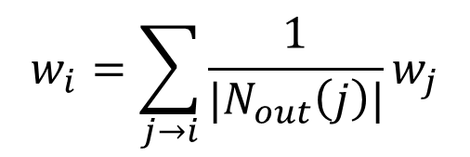
An example
$$w_{i}=\sum_{j→i}{\frac{1}{|N_{out}\left(j\right)|}w_{j}}$$
$$v_{2}$$
$$v_{1}$$
$$v_{3}$$
w₁ = 1/3 w₄ + 1/2 w₅
w₂ = 1/2 w₁ + w₃ + 1/3 w₄
w₃ = 1/2 w₁ + 1/3 w₄
w₄ = 1/2 w₅
$$v_{5}$$
$$v_{4}$$
w₅ = w₂
We can obtain the weights by solving this system of equations
w₁ + w₂ + w₃ + w₄ + w₅ = 1

Slide 12
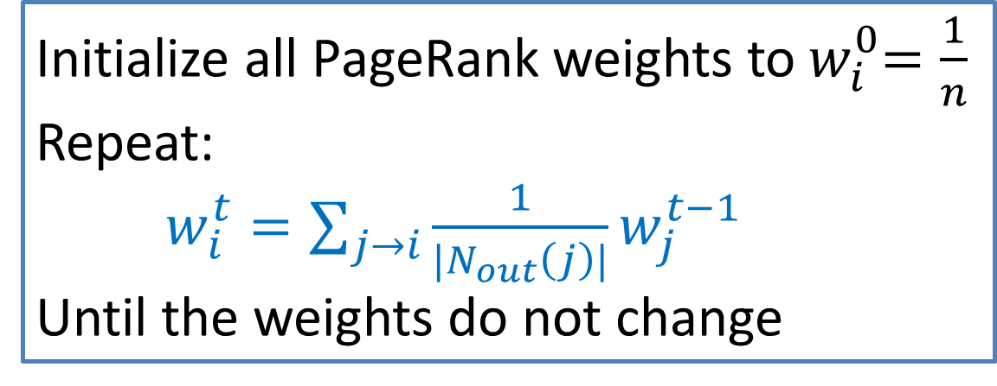
Computing PageRank weights
A simpler way to compute the weights is by iteratively updating the weights using the equations
PageRank Algorithm
This process converges
Initialize all PageRank weights to${ w}_{i}^{0}=\frac{1}{n}$
Repeat:
$w_{i}^{t}=\sum_{j→i}{\frac{1}{|N_{out}\left(j\right)|}w_{j}^{t−1}}$
Until the weights do not change

Slide 13

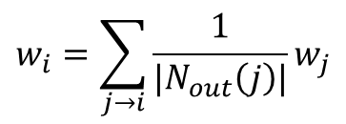


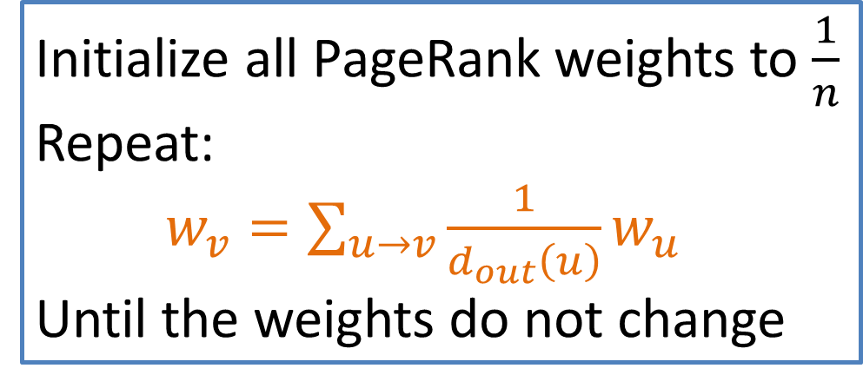
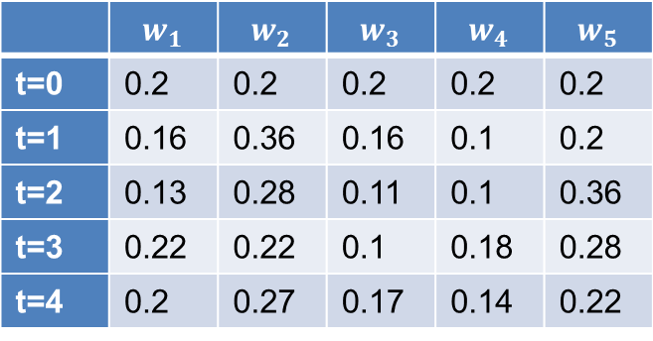
Example
$$w_{i}=\sum_{j→i}{\frac{1}{|N_{out}\left(j\right)|}w_{j}}$$
w₁ = 1/3 w₄ + 1/2 w₅
$$v_{2}$$
w₂ = 1/2 w₁ + w₃ + 1/3 w₄
$$v_{1}$$
$$v_{3}$$
w₃ = 1/2 w₁ + 1/3 w₄
w₄ = 1/2 w₅
w₅ = w₂
 | $$w_{1}$$ | $$w_{2}$$ | $$w_{3}$$ | $$w_{4}$$ | $$w_{5}$$
t=0 | 0.2 | 0.2 | 0.2 | 0.2 | 0.2
t=1 | 0.16 | 0.36 | 0.16 | 0.1 | 0.2
t=2 | 0.13 | 0.28 | 0.11 | 0.1 | 0.36
t=3 | 0.22 | 0.22 | 0.1 | 0.18 | 0.28
t=4 | 0.2 | 0.27 | 0.17 | 0.14 | 0.22
$$v_{5}$$
$$v_{4}$$
Think of the weight as a fluid: there is constant amount of it in the graph, but it moves around until it stabilizes

Slide 14
The PageRank algorithm
Think of the nodes in the graph as containers of capacity of 1 liter.
We distribute a liter of liquid equally to all containers

Slide 15
The PageRank algorithm
The edges act like pipes that transfer liquid between nodes.

Slide 16
The PageRank algorithm
The edges act like pipes that transfer liquid between nodes.
The contents of each node are distributed to its neighbors.

Slide 17
The PageRank algorithm
The edges act like pipes that transfer liquid between nodes.
The contents of each node are distributed to its neighbors.

Slide 18
The PageRank algorithm
The edges act like pipes that transfer liquid between nodes.
The contents of each node are distributed to its neighbors.

Slide 19
The PageRank algorithm
The system will reach an equilibrium state where the amount of liquid in each node remains constant.

Slide 20
The PageRank algorithm
The amount of liquid in each node determines the importance of the node.
Large quantity means large incoming flow from nodes with large quantity of liquid.

Slide 21
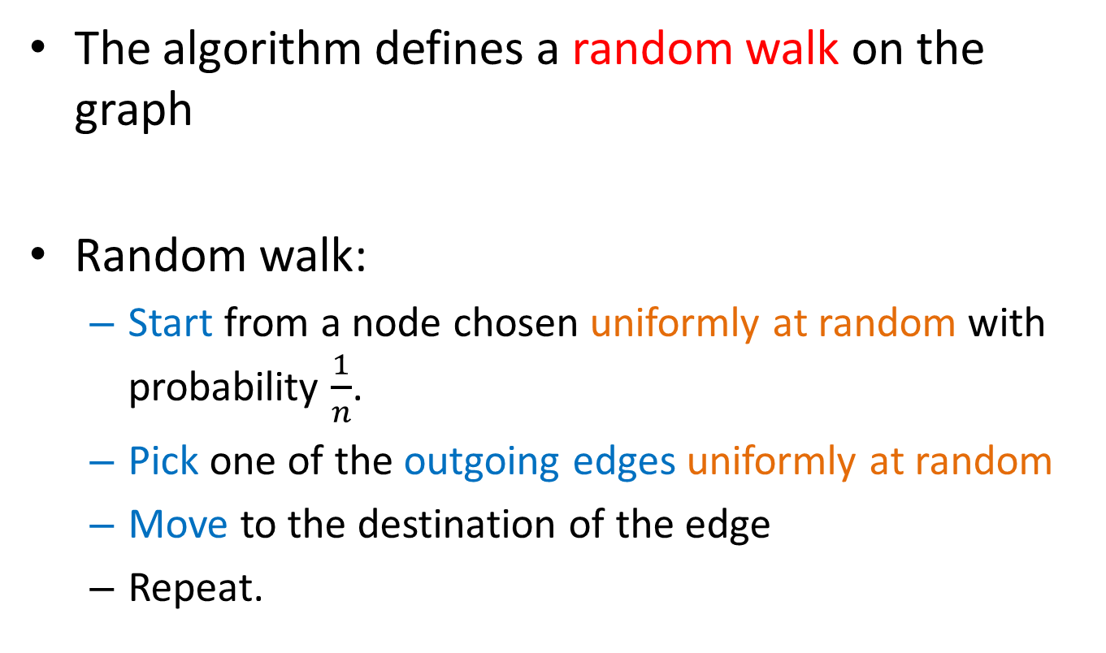
Random Walks on Graphs
The algorithm defines a random walk on the graph
Random walk:
  Start from a node chosen uniformly at random with probability $\frac{1}{n}$.
  Pick one of the outgoing edges uniformly at random
  Move to the destination of the edge
  Repeat.

Slide 22
Example
Step 0
$$v_{2}$$
$$v_{1}$$
$$v_{3}$$
$$v_{5}$$
$$v_{4}$$

Slide 23
Example
Step 0
$$v_{2}$$
$$v_{1}$$
$$v_{3}$$
$$v_{5}$$
$$v_{4}$$

Slide 24
Example
Step 1
$$v_{2}$$
$$v_{1}$$
$$v_{3}$$
$$v_{5}$$
$$v_{4}$$

Slide 25
Example
Step 1
$$v_{2}$$
$$v_{1}$$
$$v_{3}$$
$$v_{5}$$
$$v_{4}$$

Slide 26
Example
Step 2
$$v_{2}$$
$$v_{1}$$
$$v_{3}$$
$$v_{5}$$
$$v_{4}$$

Slide 27
Example
Step 2
$$v_{2}$$
$$v_{1}$$
$$v_{3}$$
$$v_{5}$$
$$v_{4}$$

Slide 28
Example
Step 3
$$v_{2}$$
$$v_{1}$$
$$v_{3}$$
$$v_{5}$$
$$v_{4}$$

Slide 29
Example
Step 3
$$v_{2}$$
$$v_{1}$$
$$v_{3}$$
$$v_{5}$$
$$v_{4}$$

Slide 30
Example
Step 4…
$$v_{2}$$
$$v_{1}$$
$$v_{3}$$
$$v_{5}$$
$$v_{4}$$

Slide 31

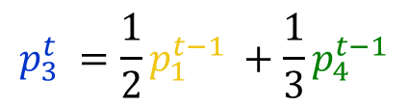
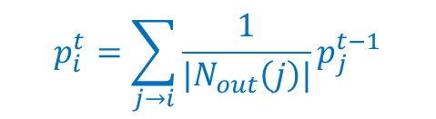
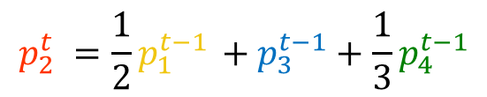

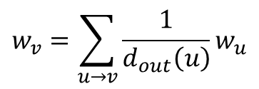

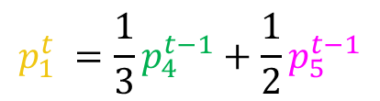




Random walk
Question: what is the probability $p_{i}^{t}$ of being at node $i$after $t$ steps?
$$v_{2}$$
$$p_{1}^{0} =\frac{1}{5}$$
$$p_{1}^{t} =\frac{1}{3}p_{4}^{t−1}+\frac{1}{2}p_{5}^{t−1}$$
$$v_{1}$$
$$v_{3}$$
$$p_{2}^{0} =\frac{1}{5}$$
$$p_{2}^{t} =\frac{1}{2}p_{1}^{t−1} +p_{3}^{t−1}+\frac{1}{3}p_{4}^{t−1}$$
$$p_{3}^{0}=\frac{1}{5}$$
$$p_{3}^{t} =\frac{1}{2}p_{1}^{t−1} +\frac{1}{3}p_{4}^{t−1}$$
$$p_{4}^{0}=\frac{1}{5}$$
$$p_{4}^{t} =\frac{1}{2}p_{5}^{t−1}$$
$$v_{5}$$
$$v_{4}$$
$$p_{5}^{0}=\frac{1}{5}$$
$$p_{i}^{t}=\sum_{j→i}{\frac{1}{|N_{out}\left(j\right)|}p_{j}^{t−1}}$$
$$p_{5}^{t} = p_{2}^{t−1}$$
The equations are the same as those for the PageRank iterative computation

Slide 32

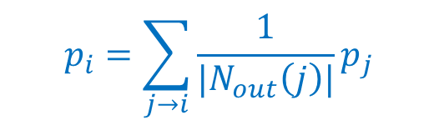




Random walk
$$v_{2}$$
At convergence:
$$v_{1}$$
$$v_{3}$$
$$p_{i}=\sum_{j→i}{\frac{1}{|N_{out}\left(j\right)|}p_{j}}$$
$$v_{5}$$
$$v_{4}$$
We get the same equation as for PageRank
The PageRank of node $i$ is the probability that the random walk is at node $i$ after a very large (infinite) number of steps

Slide 33
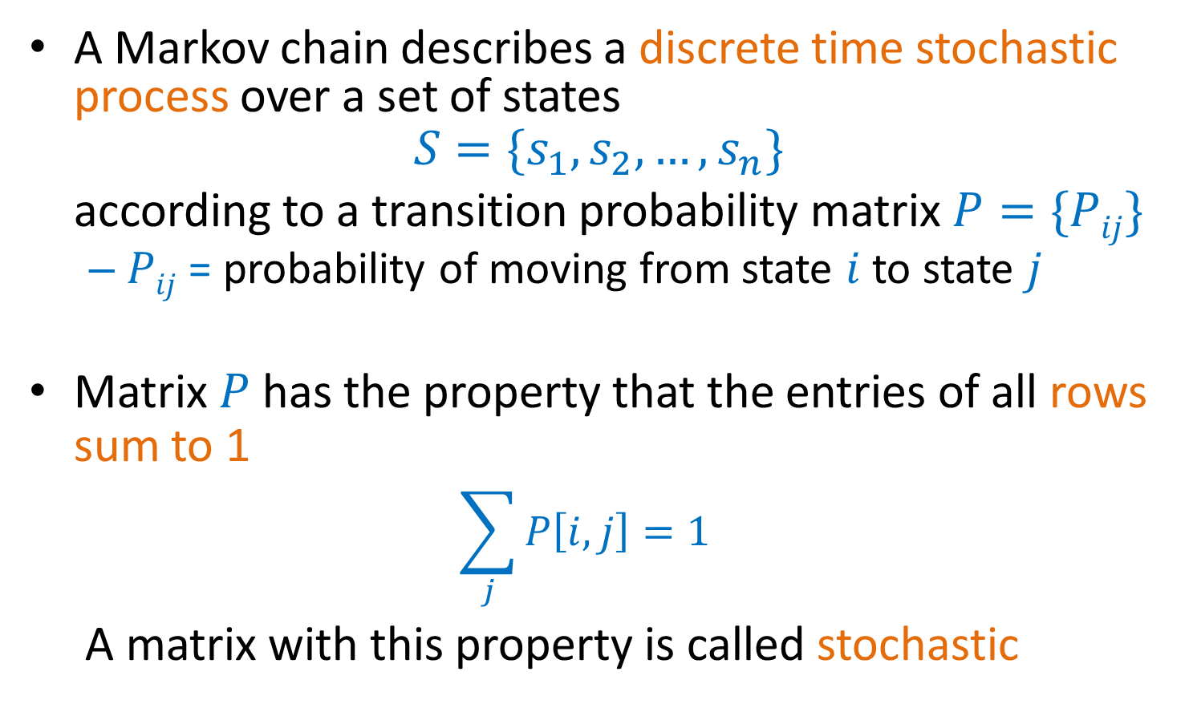
Markov chains
A Markov chain describes a discrete time stochastic process over a set of states
$$S=\{s_{1}, s_{2},…, s_{n}\}$$
according to a transition probability matrix $P=\{Pij\}$
  $Pij$ = probability of moving from state $i$to state $j$
Matrix $P$ has the property that the entries of all rows sum to 1
  $$\sum_{j}{P\left[i,j\right]=1}$$
A matrix with this property is called stochastic

Slide 34
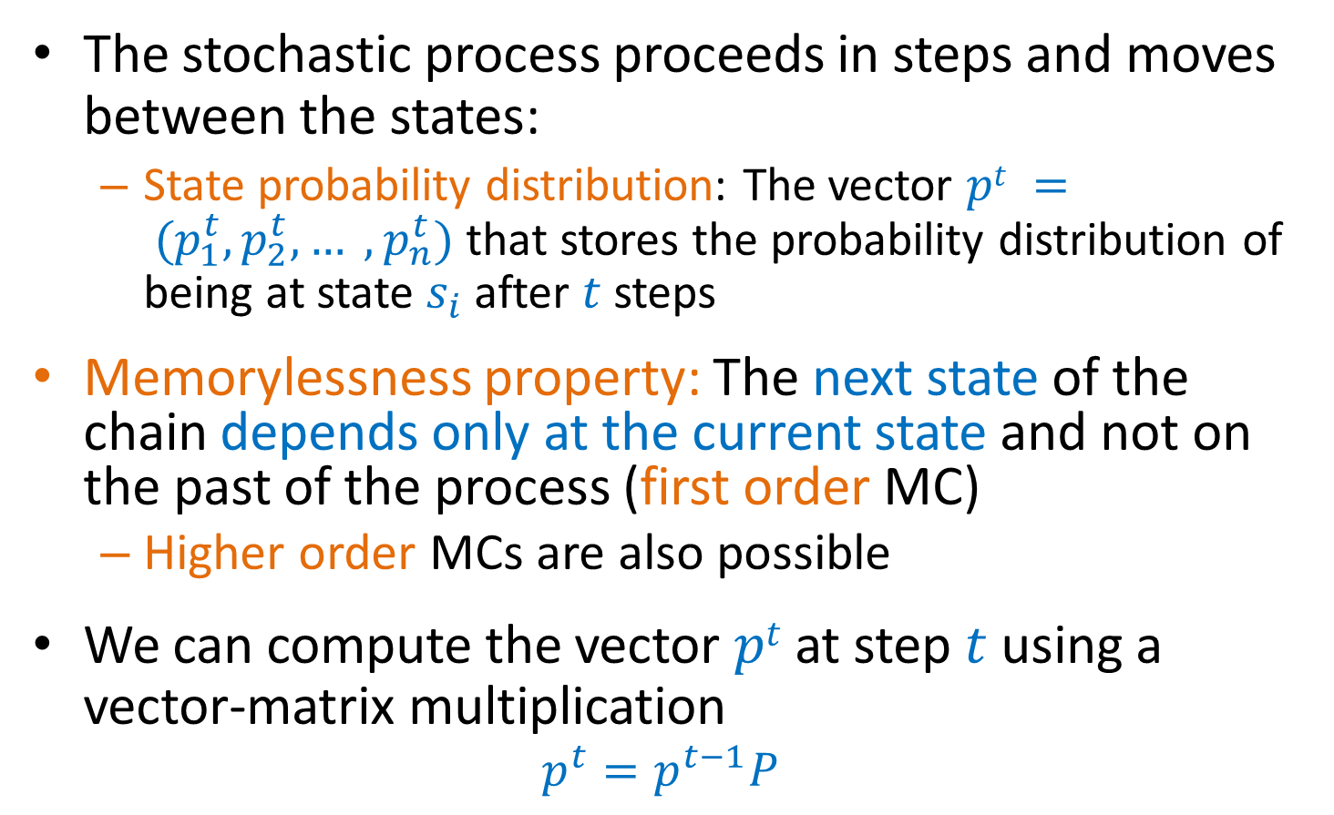
Markov chains
The stochastic process proceeds in steps and moves between the states:
  State probability distribution: The vector $pt = (p_{1}^{t},p_{2}^{t}, … ,p_{n}^{t})$that stores the probability distribution of being at state $s_{i}$ after $t$ steps
Memorylessness property: The next state of the chain depends only at the current state and not on the past of the process (first order MC)
  Higher order MCs are also possible
We can compute the vector $pt$ at step $t$ using a vector-matrix multiplication
  $$p^{t}=p^{t−1}P$$

Slide 35
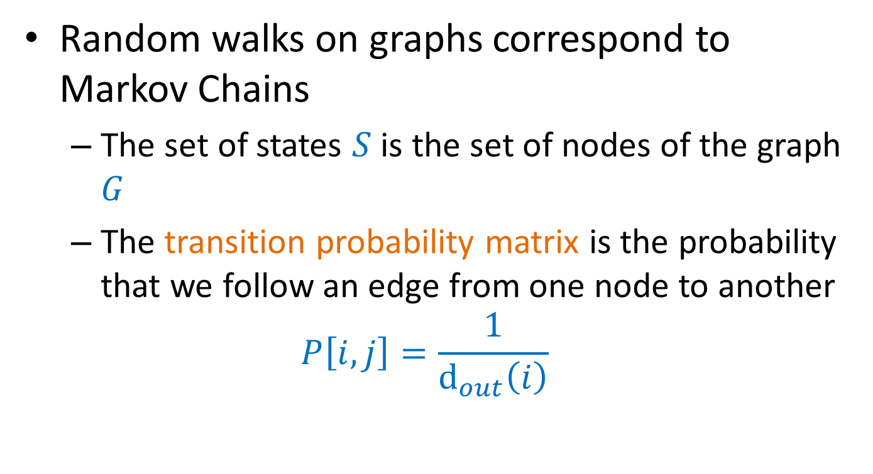
Random walks
Random walks on graphs correspond to Markov Chains
  The set of states $S$ is the set of nodes of the graph $G$
  The transition probability matrix is the probability that we follow an edge from one node to another
  $$P\left[i,j\right]=\frac{1}{d_{out}\left(i\right)}$$

Slide 36





An example
$$v_{2}$$
$$v_{1}$$
$$v_{3}$$
$$v_{5}$$
$$v_{4}$$

Slide 37
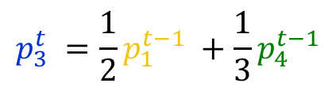
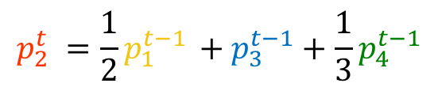

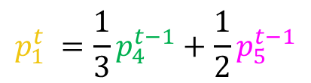

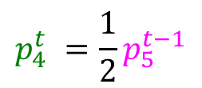
An example
$$v_{2}$$
$$v_{1}$$
$$v_{3}$$
$$p_{1}^{t} =\frac{1}{3}p_{4}^{t−1}+\frac{1}{2}p_{5}^{t−1}$$
$$p_{2}^{t} =\frac{1}{2}p_{1}^{t−1} +p_{3}^{t−1}+\frac{1}{3}p_{4}^{t−1}$$
$$v_{5}$$
$$v_{4}$$
$$p_{3}^{t} =\frac{1}{2}p_{1}^{t−1} +\frac{1}{3}p_{4}^{t−1}$$
$$p^{t}=p^{t−1}P$$
$$p_{4}^{t} =\frac{1}{2}p_{5}^{t−1}$$
$$p_{5}^{t} = p_{2}^{t−1}$$

Slide 38
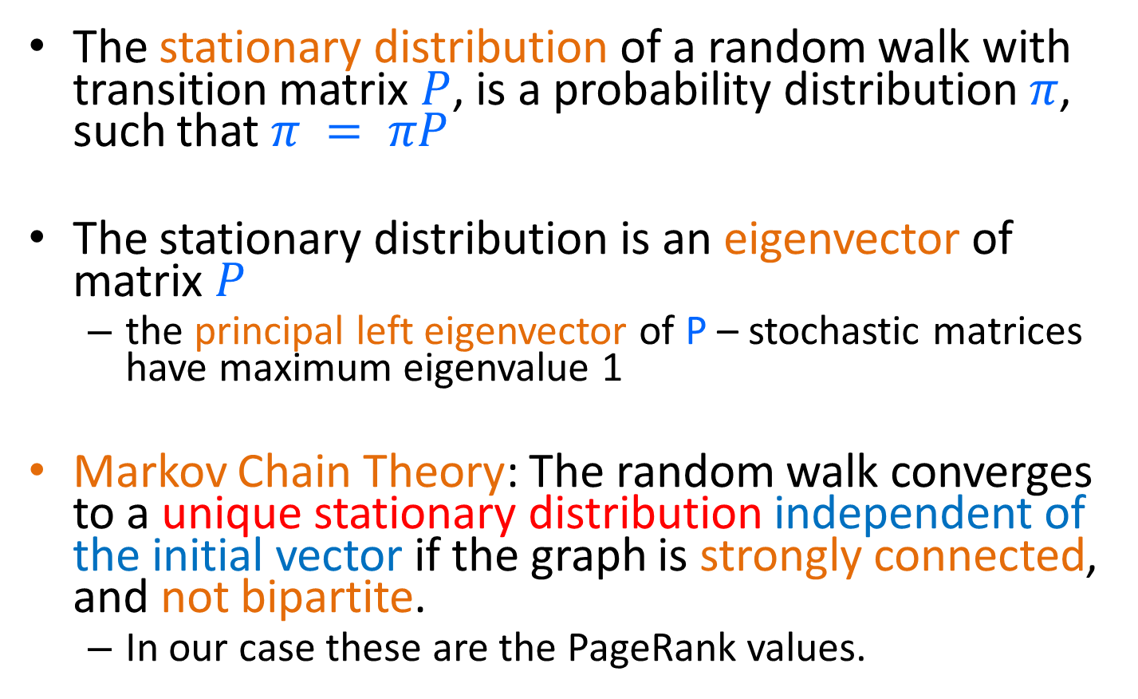
Stationary distribution
The stationary distribution of a random walk with transition matrix $P$, is a probability distribution $π$, such that $π = πP$
The stationary distribution is an eigenvector of matrix $P$
  the principal left eigenvector of P – stochastic matrices have maximum eigenvalue 1
Markov Chain Theory: The random walk converges to a unique stationary distribution independent of the initial vector if the graph is strongly connected, and not bipartite.
  In our case these are the PageRank values.

Slide 39
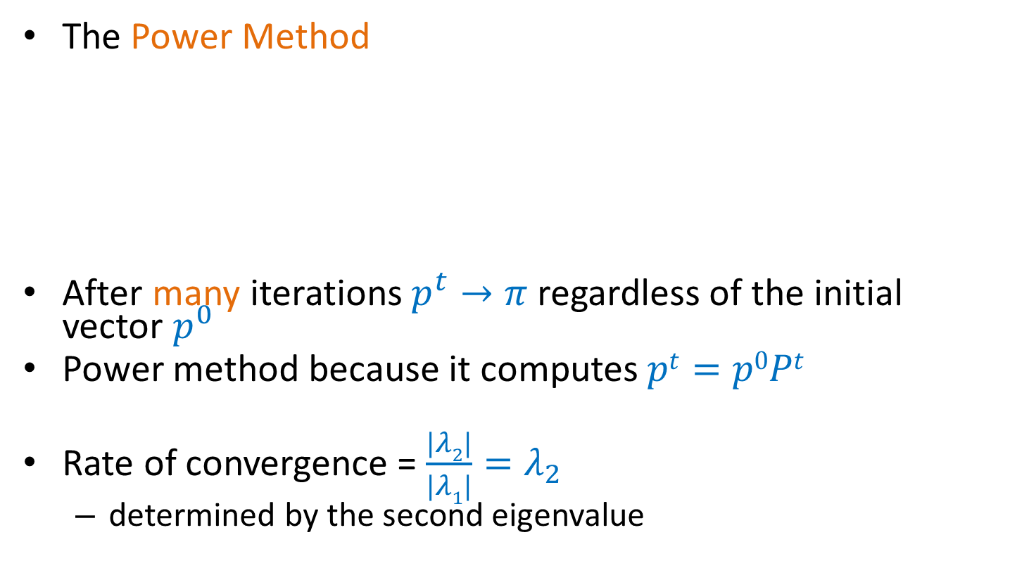
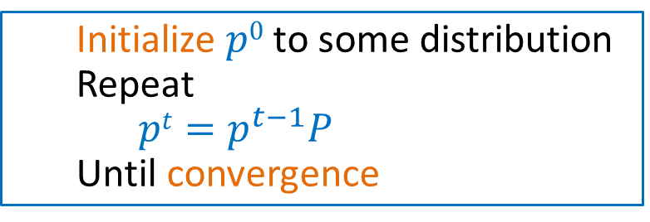
Computing the stationary distribution
The Power Method
After many iterations $p^{t}→π$regardless of the initial vector $p^{0}$
Power method because it computes $pt=p0Pt$
Rate of convergence = $\frac{|λ2|}{|λ1|}=λ_{2}$
  determined by the second eigenvalue
  Initialize $p0$ to some distribution
  Repeat
  $pt=p^{t−1}P$
  Until convergence

Slide 40
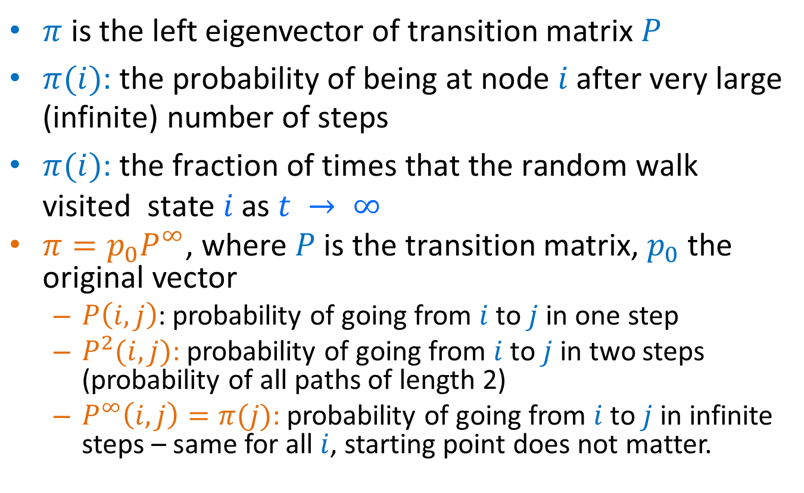
The stationary distribution
$π$ is the left eigenvector of transition matrix $P$
$π(i)\text{: }\text{the} \text{probability} \text{of} \text{being} \text{at} \text{node} i \text{after} \text{very} \text{large}\text{ (}\text{infinite}\text{) }\text{number} \text{of} \text{steps}$
$π(i)\text{: }\text{the} \text{fraction} \text{of} \text{times} \text{that} \text{the} \text{random} \text{walk} \text{visited} \text{state} i \text{as} t → ∞$
$π=p_{0}P^{∞}$, where $P$ is the transition matrix, $p_{0}$ the original vector
  $P\left(i,j\right)$: probability of going from $i$ to $j$ in one step
  $P^{2}(i,j)$: probability of going from $i$to $j$ in two steps (probability of all paths of length 2)
  $P^{∞}\left(i,j\right)=π(j)$: probability of going from $i$ to $j$ in infinite steps – same for all $i$, starting point does not matter.

Slide 41
The PageRank random walk
Vanilla random walk
  make the adjacency matrix stochastic and run a random walk

Slide 42
The PageRank random walk
What about sink nodes?
  what happens when the random walk moves to a node without any outgoing inks?

Slide 43

The PageRank random walk
Replace these row vectors with a vector $v$
  typically, the uniform vector
P’ = P + dv^{T}
Outer product

Slide 44
The PageRank random walk
What about loops?
  Spider traps

Slide 45

The PageRank random walk
Add a random jump to a node chosen according to the vector $v$ with prob $1−α$
  typically, to $v$ is a uniform probability vector
P’’ = αP’ + (1-α)uv^{T}, where u is the vector of all 1s
Random walk with restarts

Slide 46
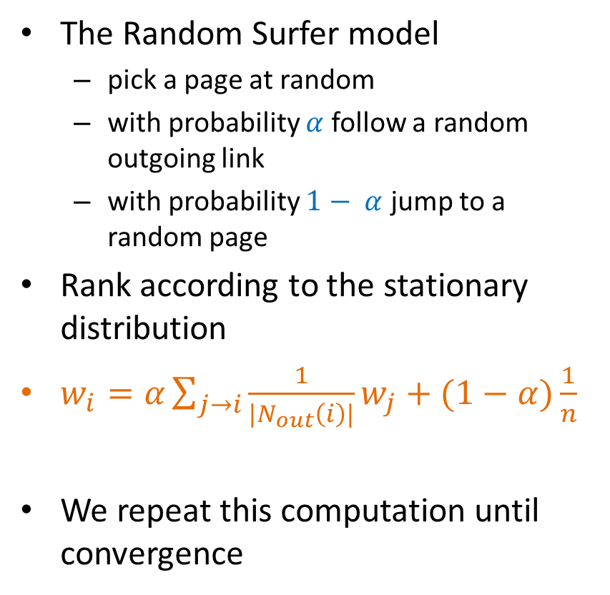

PageRank algorithm [BP98]
The Random Surfer model
  pick a page at random
  with probability $α$ follow a random outgoing link
  with probability $1− α$ jump to a random page
Rank according to the stationary distribution
$w_{i}=α\sum_{j→i}{\frac{1}{|N_{out}\left(i\right)|}w_{j}}+(1−α)\frac{1}{n}$
We repeat this computation until convergence
Red Page
Purple Page
Yellow Page
Blue Page
Green Page
$α = 0.85$in most cases

Slide 47
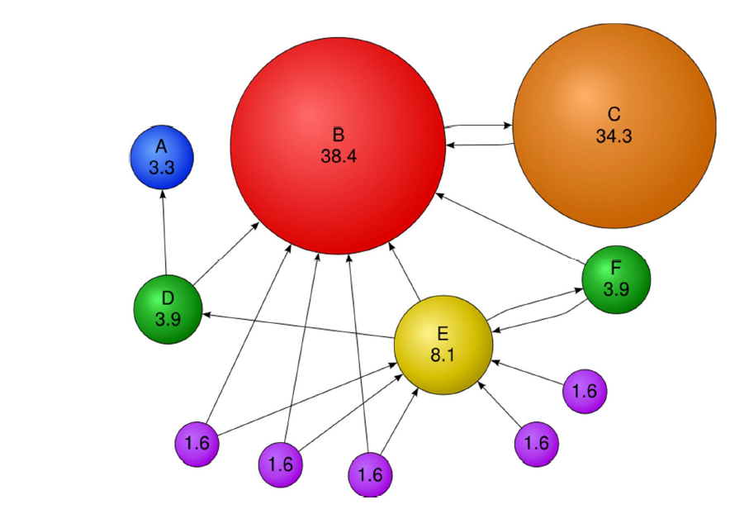
PageRank: Example

Slide 48
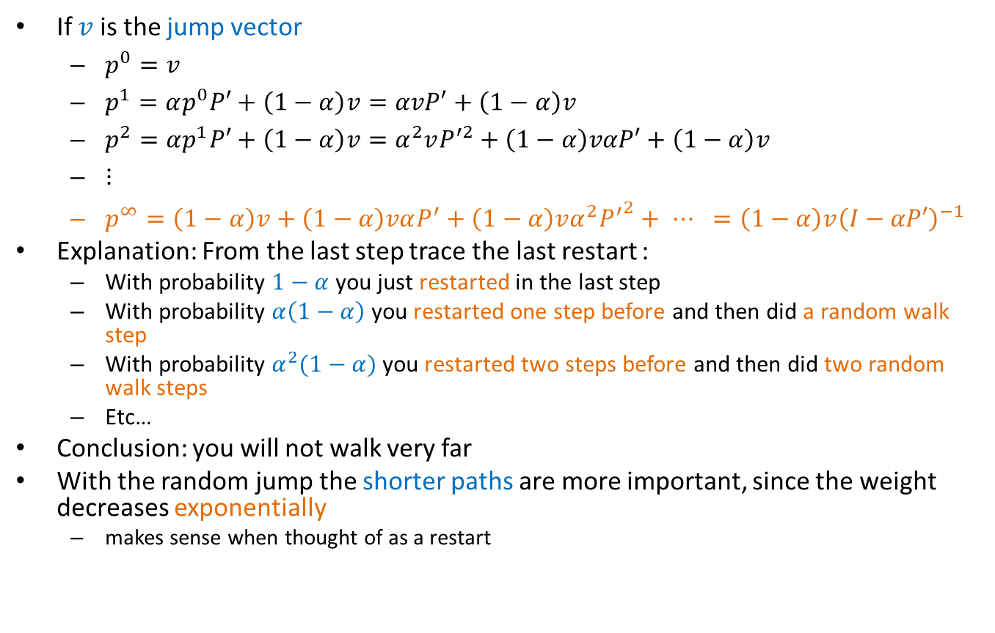
Stationary distribution with random jump
If $v$ is the jump vector
  $p^{0}=v$
  $p^{1}=αp^{0}P′+\left(1−α\right)v=αvP′+\left(1−α\right)v$
  $p^{2}=αp^{1}P′+\left(1−α\right)v=α^{2}vP^{′2}+\left(1−α\right)vαP′+\left(1−α\right)v$
  $⋮$
  $p^{∞}=\left(1−α\right)v+\left(1−α\right)vαP^{′}+\left(1−α\right)vα^{2}{P^{′}}^{2}+ ⋯ =\left(1−α\right)v{\left(I−αP′\right)}^{−1}$
Explanation: From the last step trace the last restart :
  With probability $1−α$ you just restarted in the last step
  With probability $α\left(1−α\right)$ you restarted one step before and then did a random walk step
  With probability $α^{2}(1−α)$you restarted two steps before and then did two random walk steps
  Etc…
Conclusion: you will not walk very far
With the random jump the shorter paths are more important, since the weight decreases exponentially
  makes sense when thought of as a restart

Slide 49
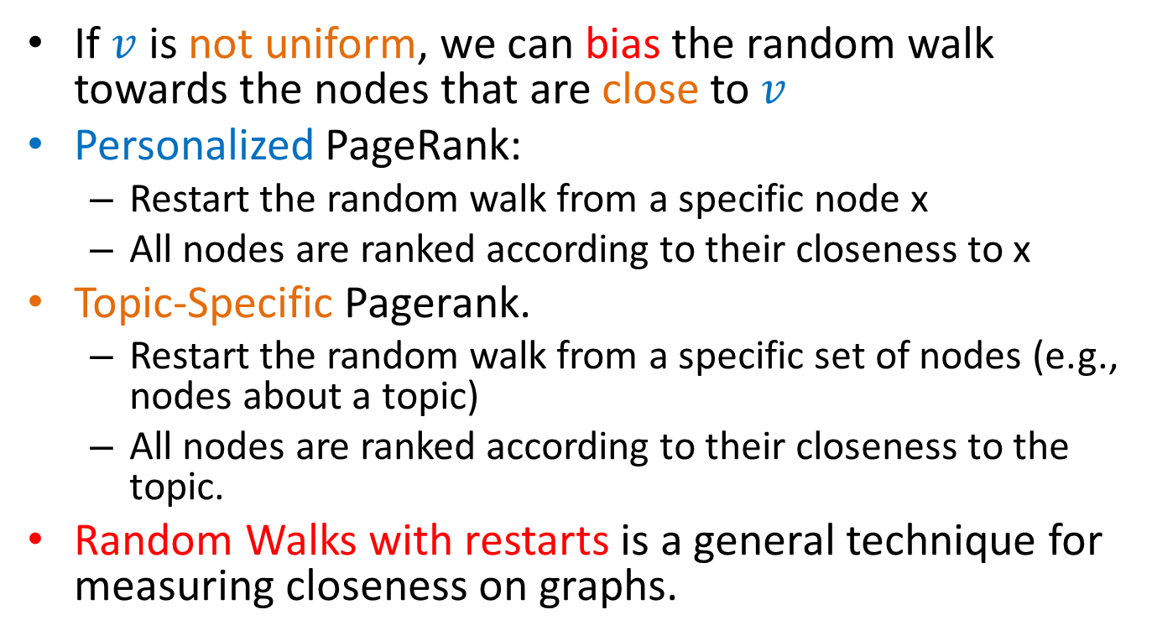
Random walks with restarts
If $v$ is not uniform, we can bias the random walk towards the nodes that are close to $v$
Personalized PageRank:
  Restart the random walk from a specific node x
  All nodes are ranked according to their closeness to x
Topic-Specific Pagerank.
  Restart the random walk from a specific set of nodes (e.g., nodes about a topic)
  All nodes are ranked according to their closeness to the topic.
Random Walks with restarts is a general technique for measuring closeness on graphs.

Slide 50
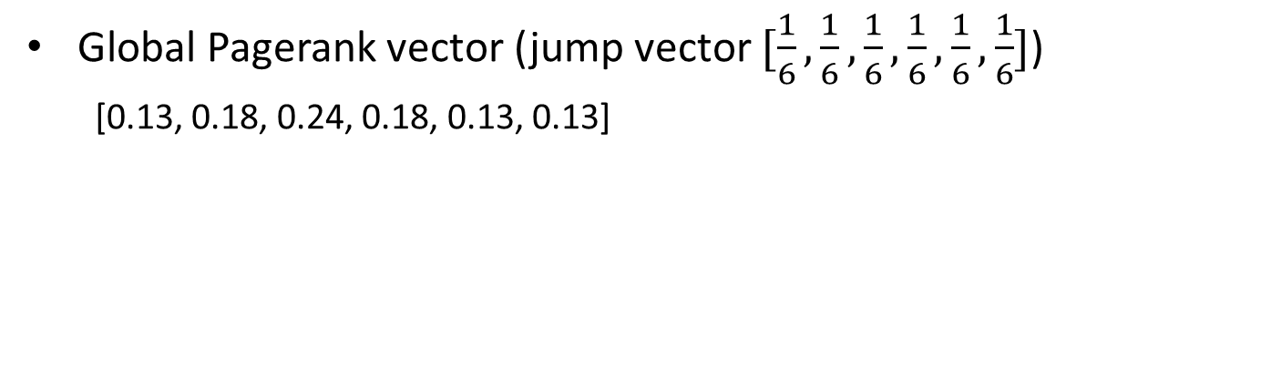
Personalized Pagerank Example
2
4
1
6
3
5
Global Pagerank vector (jump vector $[\frac{1}{6},\frac{1}{6},\frac{1}{6},\frac{1}{6},\frac{1}{6},\frac{1}{6}]$)
  [0.13, 0.18, 0.24, 0.18, 0.13, 0.13]

Slide 51
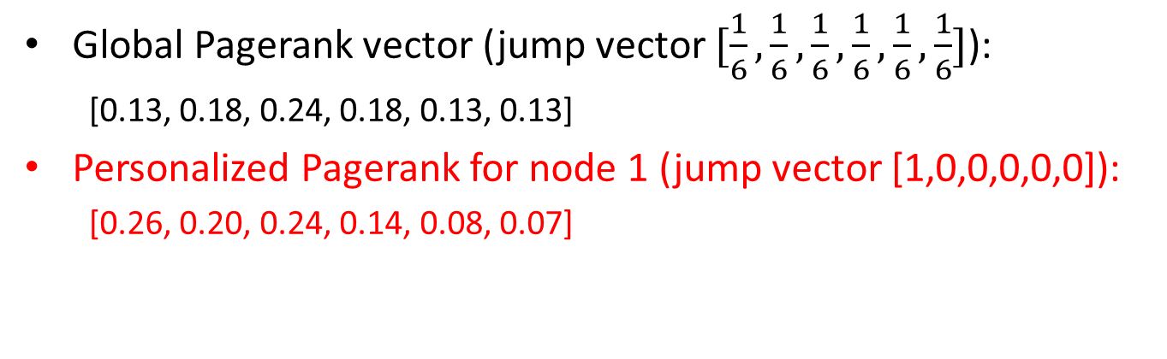
Personalized Pagerank Example
2
4
1
6
3
5
Global Pagerank vector (jump vector $[\frac{1}{6},\frac{1}{6},\frac{1}{6},\frac{1}{6},\frac{1}{6},\frac{1}{6}]$):
  [0.13, 0.18, 0.24, 0.18, 0.13, 0.13]
Personalized Pagerank for node 1 (jump vector [1,0,0,0,0,0]):
  [0.26, 0.20, 0.24, 0.14, 0.08, 0.07]

Slide 52
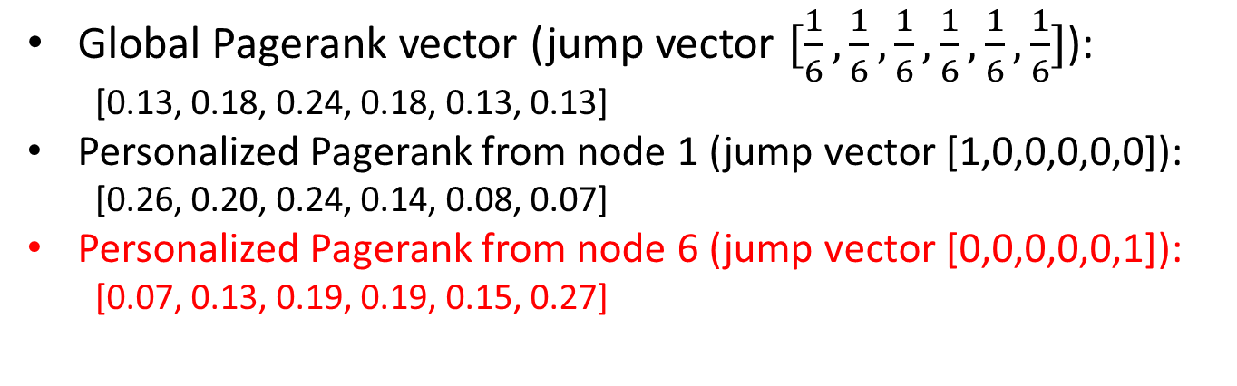
Personalized Pagerank Example
2
4
1
6
3
5
Global Pagerank vector (jump vector $[\frac{1}{6},\frac{1}{6},\frac{1}{6},\frac{1}{6},\frac{1}{6},\frac{1}{6}]$):
  [0.13, 0.18, 0.24, 0.18, 0.13, 0.13]
Personalized Pagerank from node 1 (jump vector [1,0,0,0,0,0]):
  [0.26, 0.20, 0.24, 0.14, 0.08, 0.07]
Personalized Pagerank from node 6 (jump vector [0,0,0,0,0,1]):
  [0.07, 0.13, 0.19, 0.19, 0.15, 0.27]

Slide 53
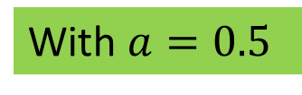
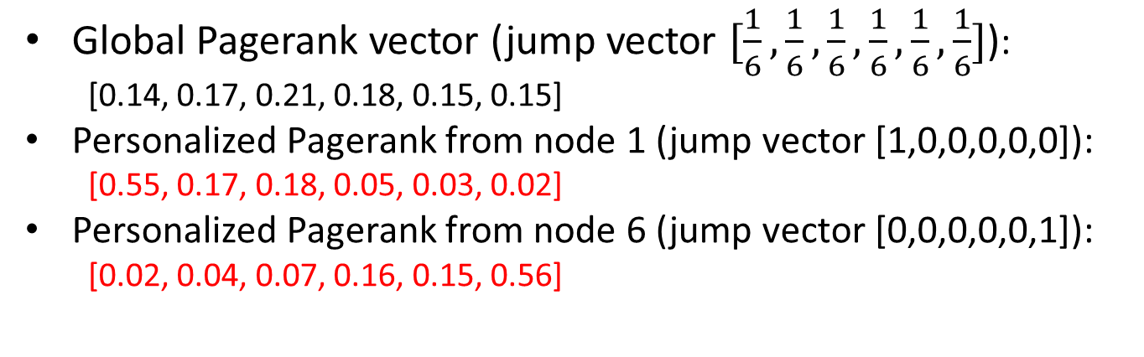
Personalized Pagerank Example
2
4
1
6
With $a=0.5$
3
5
Global Pagerank vector (jump vector $[\frac{1}{6},\frac{1}{6},\frac{1}{6},\frac{1}{6},\frac{1}{6},\frac{1}{6}]$):
  [0.14, 0.17, 0.21, 0.18, 0.15, 0.15]
Personalized Pagerank from node 1 (jump vector [1,0,0,0,0,0]):
  [0.55, 0.17, 0.18, 0.05, 0.03, 0.02]
Personalized Pagerank from node 6 (jump vector [0,0,0,0,0,1]):
  [0.02, 0.04, 0.07, 0.16, 0.15, 0.56]

Slide 54
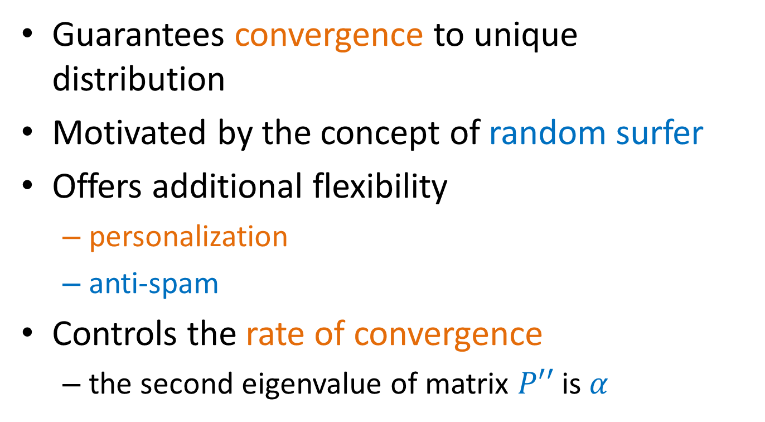
Effects of random jump
Guarantees convergence to unique distribution
Motivated by the concept of random surfer
Offers additional flexibility
  personalization
  anti-spam
Controls the rate of convergence
  the second eigenvalue of matrix $P′′$is $α$

Slide 55
Random walks on undirected graphs
For undirected graphs, the stationary distribution of a random walk is proportional to the degrees of the nodes
  Thus, in this case a random walk is the same as degree popularity
This is not longer true if we do random jumps
  Now the short paths play a greater role, and the previous distribution does not hold.
  Random walks with restarts to a single node are commonly used on undirected graphs for measuring similarity between nodes

Slide 56
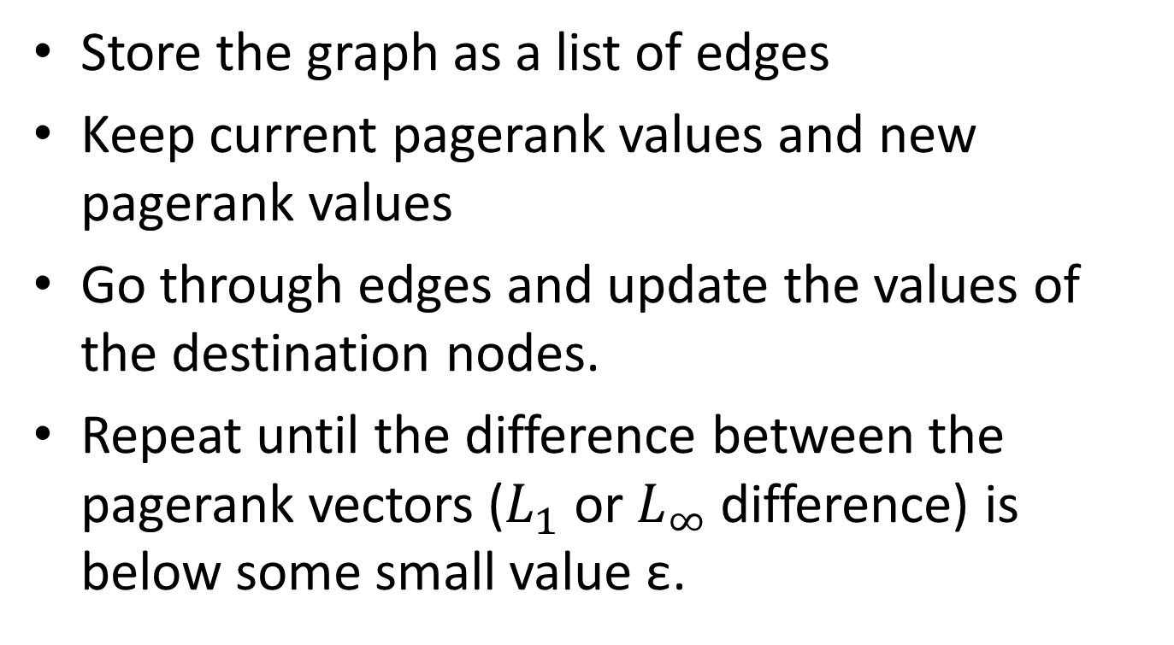
PageRank implementation
Store the graph as a list of edges
Keep current pagerank values and new pagerank values
Go through edges and update the values of the destination nodes.
Repeat until the difference between the pagerank vectors ($L_{1}$ or $L_{∞}$ difference) is below some small value ε.

Slide 57
A (Matlab/Numpy-friendly) PageRank algorithm
Performing vanilla power method is now too expensive – the matrix is not sparse
q⁰ = v
t = 1
repeat
t = t +1
until δ < ε
Efficient computation of y = (P’’)^{T} x
P = normalized adjacency matrix
P’ = P + dv^{T}, where d_{i} is 1 if i is sink and 0 o.w.
P’’ = αP’ + (1-α)uv^{T}, where u is the vector of all 1s

Slide 58
PageRank history
Huge advantage for Google in the early days
  It gave a way to get an idea for the value of a page, which was useful in many different ways
    Put an order to the web.
  After a while it became clear that the anchor text was probably more important for ranking
  Also, link spam became a new (dark) art
Flood of research
  Numerical analysis got rejuvenated
  Huge number of variations
  Efficiency became a great issue.
  Huge number of applications in different fields
    Random walk is often referred to as PageRank.

Slide 59
THE HITS ALGORITHM

Slide 60
The HITS algorithm
Another algorithm proposed around the same time as PageRank for using the hyperlinks to rank pages
  Kleinberg: then an intern at IBM Almaden
  IBM never made anything out of it

Slide 61
Query dependent input
Root set obtained from a text-only search engine
Root Set

Slide 62
Query dependent input
Root Set
IN
OUT

Slide 63
Query dependent input
Root Set
IN
OUT

Slide 64
Query dependent input
Base Set
Root Set
IN
OUT

Slide 65
Hubs and Authorities [K98]
Authority is not necessarily transferred directly between authorities
Pages have double identity
  hub identity
  authority identity
Good hubs point to good authorities
Good authorities are pointed by good hubs
hubs
authorities

Slide 66
Hubs and Authorities
Two kind of weights:
  Hub weight
  Authority weight
The hub weight is the sum of the authority weights of the authorities pointed to by the hub
The authority weight is the sum of the hub weights that point to this authority.

Slide 67

HITS Algorithm
Initialize all weights to 1.
Repeat until convergence
  O operation : hubs collect the weight of the authorities
$$h_{i}^{t}=\sum_{j:i→j}{a_{i}^{t−1}}$$
  I operation: authorities collect the weight of the hubs
$$a_{i}^{t}=\sum_{j:j→i}{h_{j}^{t−1}}$$
  Normalize weights under some norm
Note: The order of the operations is not important. You could do them in parallel or sequentially, the result will still be the same.

Slide 68
Example
Initialize
1
1
1
1
1
1
1
1
1
1
hubs
authorities

Slide 69
Example
Step 1: O operation
1
1
2
1
3
1
2
1
1
1
hubs
authorities

Slide 70
Example
Step 1: I operation
1
6
2
5
3
5
2
2
1
1
hubs
authorities

Slide 71
Example
Step 1: Normalization (Max norm)
1/3
1
2/3
5/6
1
5/6
2/3
2/6
1/3
1/6
hubs
authorities

Slide 72
Example
Step 2: O step
1
1
11/6
5/6
16/6
5/6
7/6
2/6
1/6
1/6
hubs
authorities

Slide 73
Example
Step 2: I step
1
33/6
11/6
27/6
16/6
23/6
7/6
7/6
1/6
1/6
hubs
authorities

Slide 74
Example
Step 2: Normalization
6/16
1
11/16
27/33
1
23/33
7/16
7/33
1/16
1/33
hubs
authorities

Slide 75
Example
Convergence
0.4
1
0.75
0.8
1
0.6
0.3
0.14
0
0
hubs
authorities

Slide 76

HITS and eigenvectors
The HITS algorithm is a power-method eigenvector computation
In vector terms
  $at = A^{T}h^{t−1}$and $ht = Aa^{t−1}$
  $a^{t}= ATAa^{t−1}$and $ht = AA^{T}h^{t−1}$
  Repeated iterations will converge to the eigenvectors
The authority weight vector $a$ is the eigenvector of $ATA$and the hub weight vector $h$ is the eigenvector of $AAT$
The vectors $a$ and $h$ are called the singular vectors of the matrix A

Slide 77
Singular Value Decomposition
r : rank of matrix A
σ₁≥ σ₂≥ … ≥σ_{r} : singular values (square roots of eig-vals AA^{T}, A^{T}A)
: left singular vectors (eig-vectors of AA^{T})
: right singular vectors (eig-vectors of A^{T}A)
[n×r]
[r×r]
[r×n]

Slide 78

Why does the Power Method work?
If a matrix R is real and symmetric, it has real eigenvalues and eigenvectors: $\left(λ_{1},w_{1}\right), \left(λ_{2}, w_{2}\right), …, (λ_{r}, w_{r})$
  r is the rank of the matrix
  ${|λ}_{1}\left|≥{|λ}_{2}\right|≥⋯≥\left|λ_{r}\right|$
For any matrix R, the eigenvectors $w_{1},w_{2},…,w_{r}$ of R define a basis of the vector space
  For any vector $x$, $Rx=α_{1}w_{1}+a_{2}w_{2}+⋯+a_{r}w_{r}$
After t multiplications we have:
  $R^{t}x={λ_{1}^{t−1}α}_{1}w_{1}+{λ_{2}^{t−1}a}_{2}w_{2}+⋯+{λ_{r}^{t−1}a}_{r}w_{r}$
Normalizing (divide by $λ_{1}^{t−1}$) leaves only the term $w_{1}$.

Slide 79
The SALSA algorithm
Perform a random walk on the bipartite graph of hubs and authorities alternating between the two
hubs
authorities

Slide 80
The SALSA algorithm
Start from an authority chosen uniformly at random
  e.g. the red authority
hubs
authorities

Slide 81
The SALSA algorithm
Start from an authority chosen uniformly at random
  e.g. the red authority
Choose one of the in-coming links uniformly at random and move to a hub
  e.g. move to the yellow authority with probability 1/3
hubs
authorities

Slide 82
The SALSA algorithm
Start from an authority chosen uniformly at random
  e.g. the red authority
Choose one of the in-coming links uniformly at random and move to a hub
  e.g. move to the yellow authority with probability 1/3
Choose one of the out-going links uniformly at random and move to an authority
  e.g. move to the blue authority with probability 1/2
hubs
authorities

Slide 83

The SALSA algorithm
Formally we have probabilities:
  $a_{i}$: probability of being at authority $i$
  $h_{j}$: probability of being at hub $j$
The probability of being at authority $i$ is computed as:
$$a_{i}=\sum_{j∈N_{in}(i)}{\frac{1}{d_{out}\left(j\right)}h_{j}}$$
The probability of being at hub $j$ is computed as
$$h_{j}=\sum_{i∈N_{out}(j)}{\frac{1}{d_{in}\left(i\right)}a_{i}}$$
Repeated computation converges

Slide 84



The SALSA algorithm [LM00]
In matrix terms
  $Ac$ = the matrix $A$ where columns are normalized to sum to 1
  $Ar$ = the matrix $A$ where rows are normalized to sum to 1
The hub computation
  $h = A_{c} a$
The authority computation
  $a = ArT h = ArT Ac a$
In MC terms the transition matrix
  $P = Ar AcT$
hubs
authorities
$$h2 = 1/3 a1 + 1/2 a2$$
$$a1 = h1 + 1/2 h2 + 1/3 h3$$

