Slide 1
Online Social Networks and Media
Graph ML

Slide 2
Graph Machine Learning
Outline
Part I: Introduction, Traditional ML
Part II: Graph Embeddings
Part III: GNNs
Part IV (if time permits): Knowledge Graphs
Slides used based on:
CS224W: Machine Learning with Graphs
Jure Leskovec, Stanford University
http://cs224w.stanford.edu

Slide 3
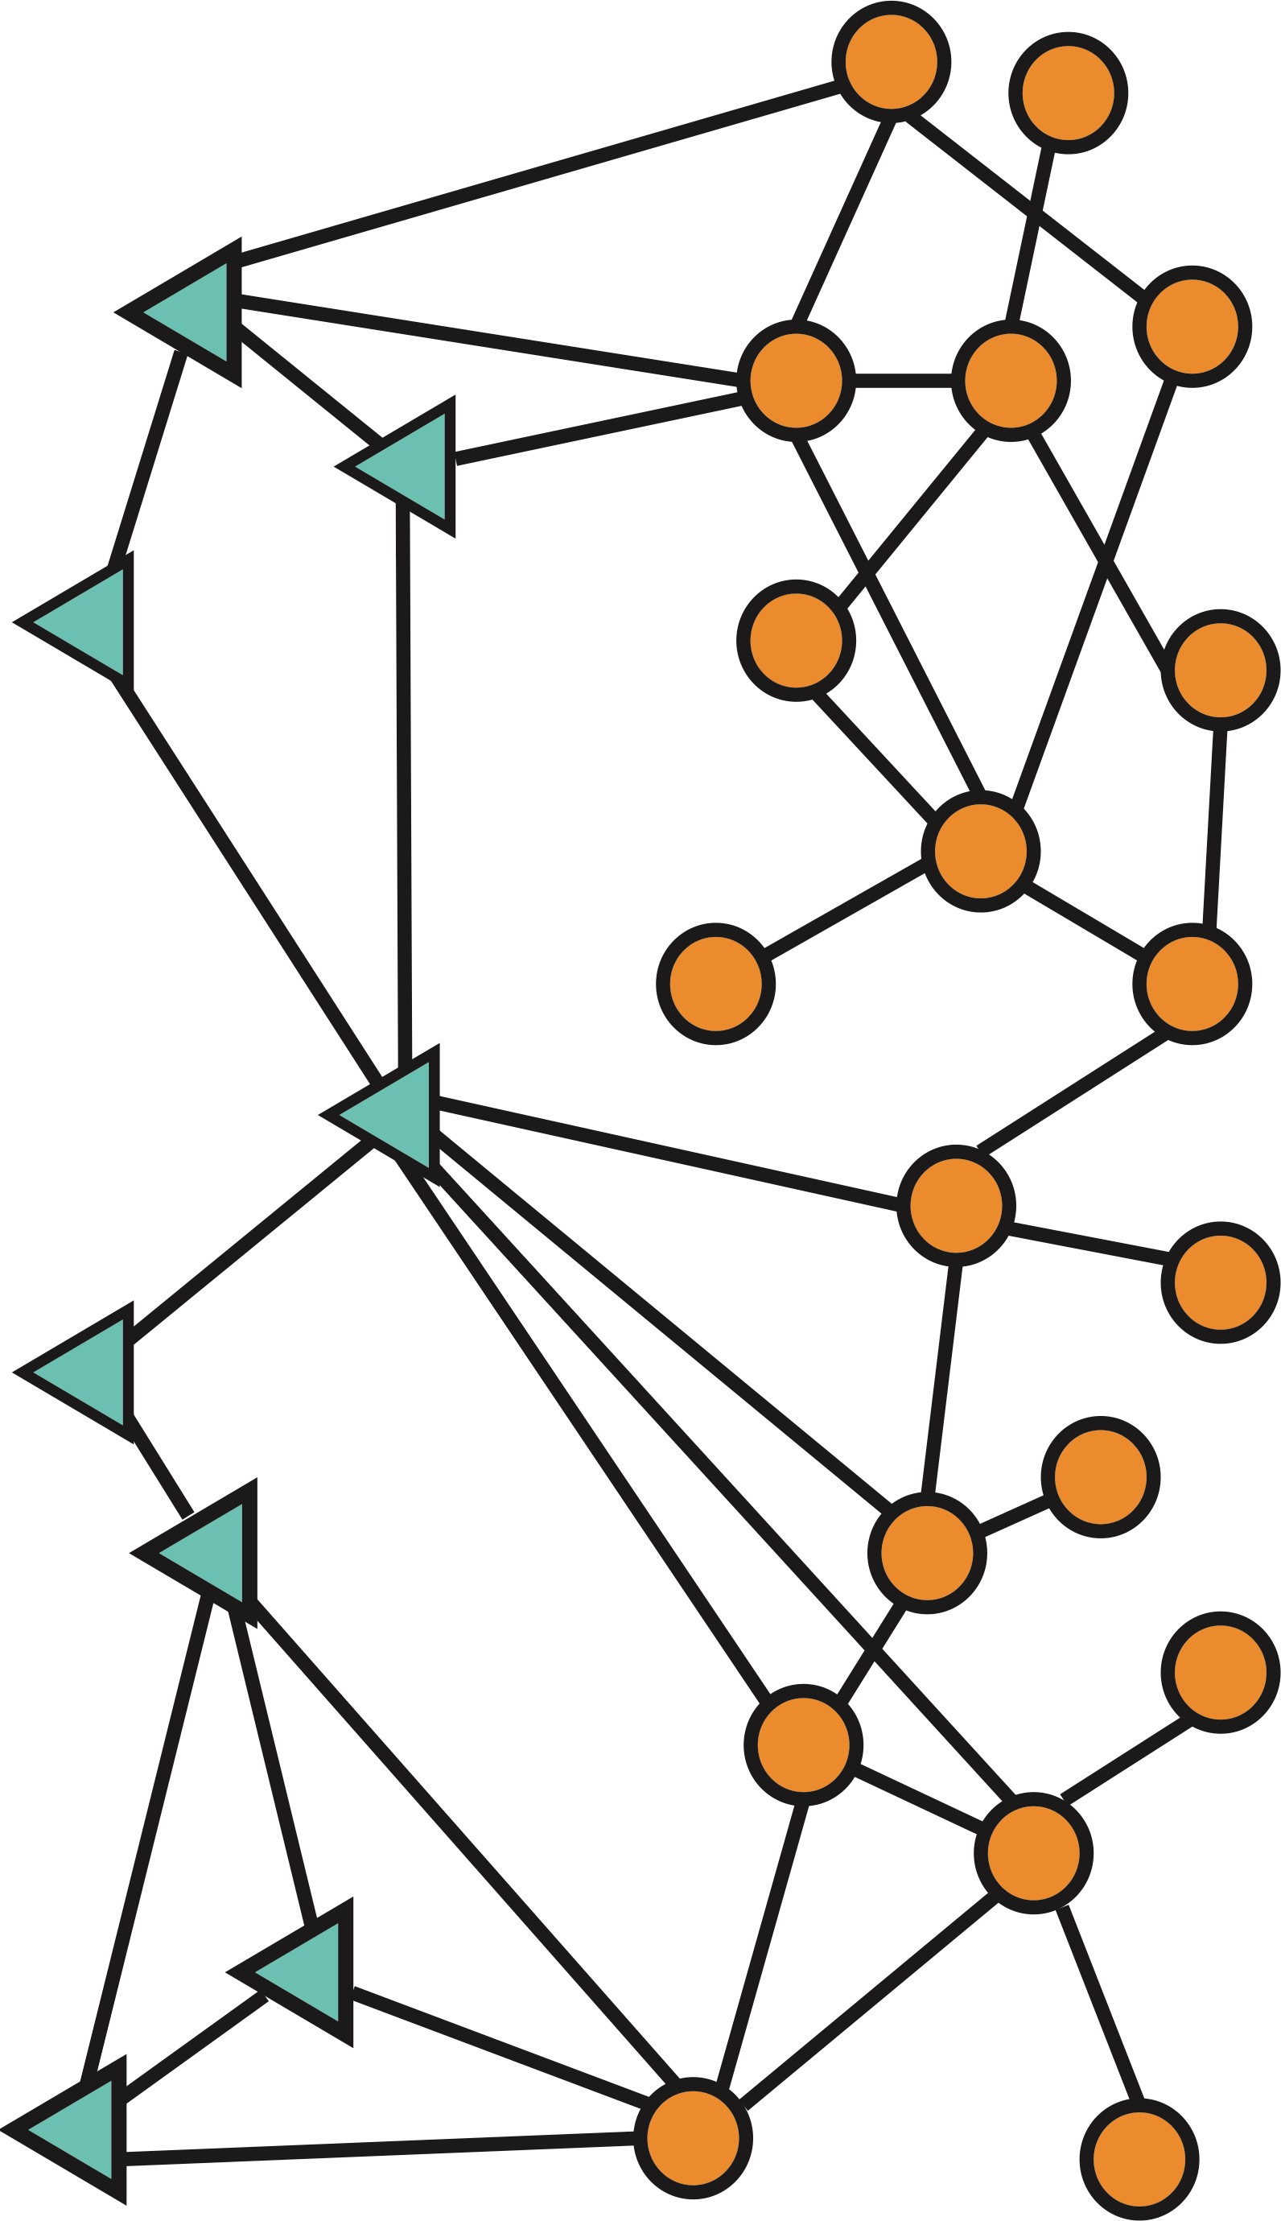
Types of ML tasks in graphs
Node
level
Graph-level prediction,
Graph generation
Community (subgraph)
level
Edge (link) level

Slide 4
Example Tasks
Tasks we will be able to solve:
Node classification
  Predict the type of a given node
Link prediction
  Predict whether two nodes are linked
Community detection
  Identify densely linked clusters of nodes
Network similarity
  How similar are two (sub)networks

Slide 5
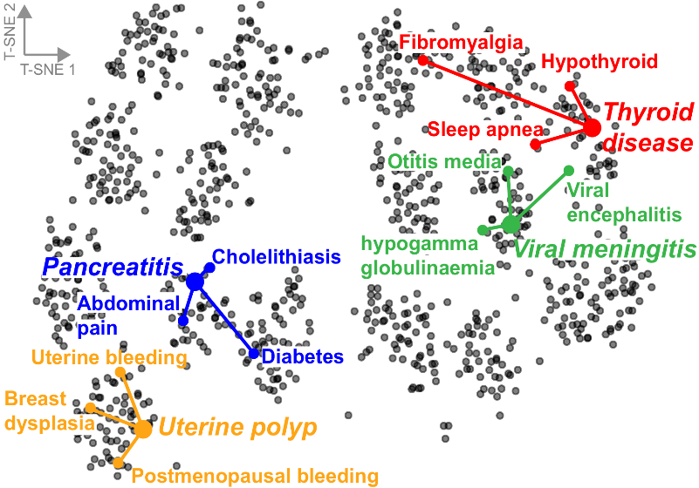
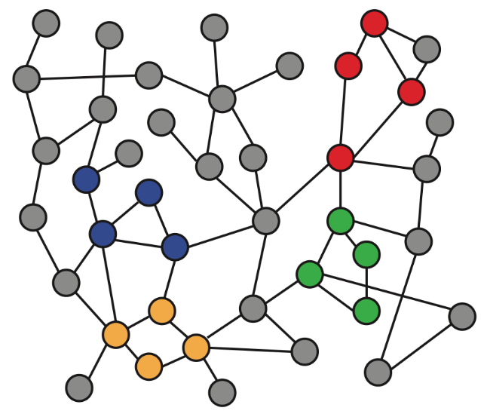

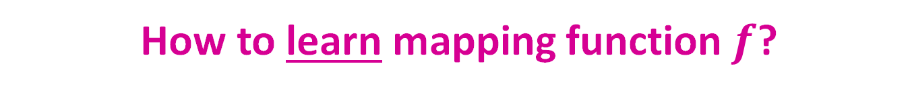
Recap: Node Embeddings
Intuition: Map nodes to $d$-dimensional embeddings such that similar nodes in the graph are embedded close together
f ( ) =
Input graph
2D node embeddings
How to learn mapping function $f$?

Slide 6
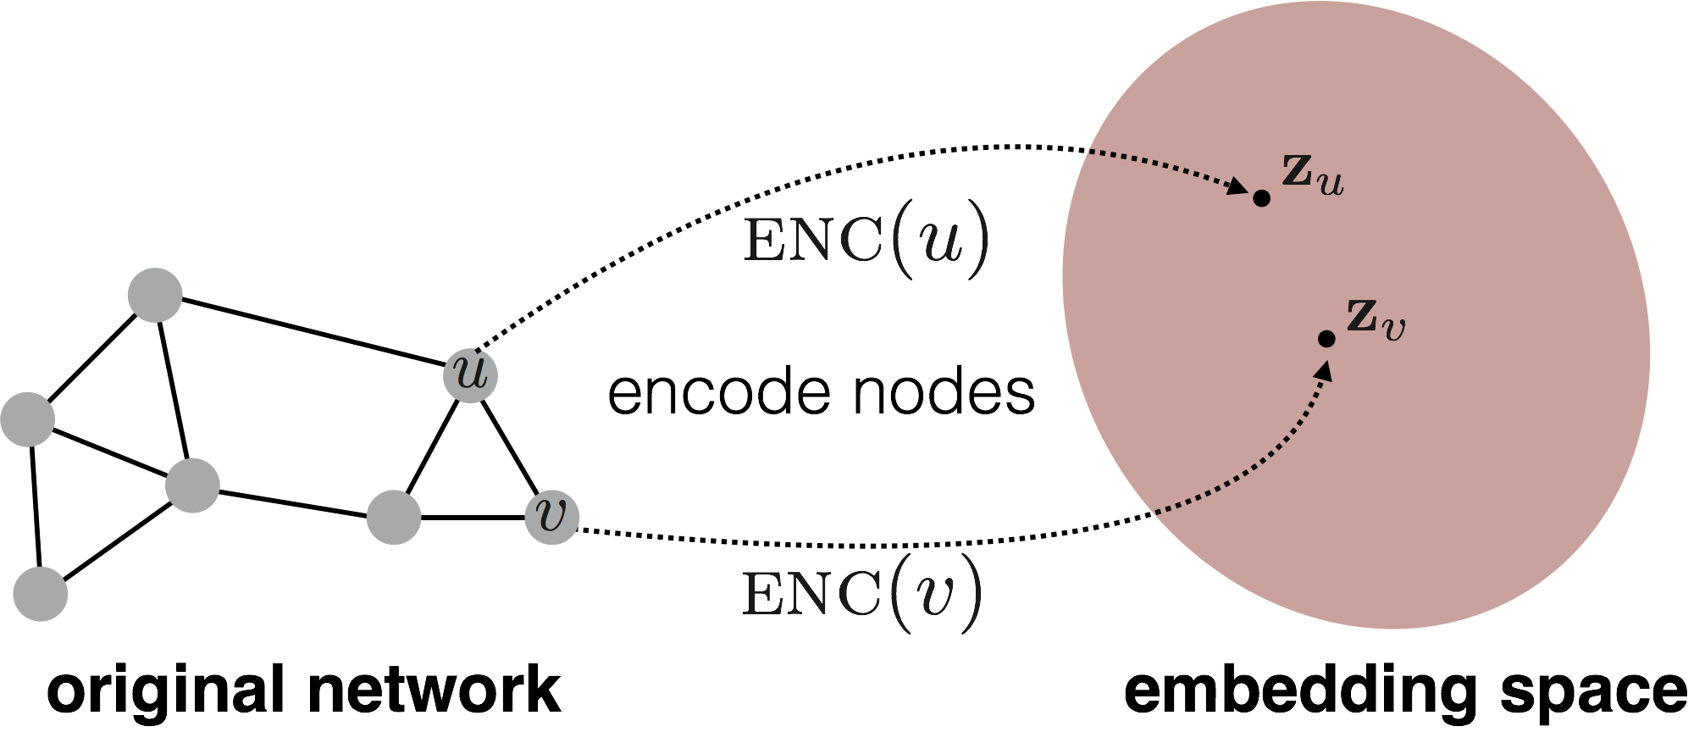

Recap: Node Embeddings
Goal:
$$similarity\left(u,v\right) ≈ z_{v}^{Τ}z_{u}$$
Need to define!
d-dimensional
embedding space
Input network

Slide 7
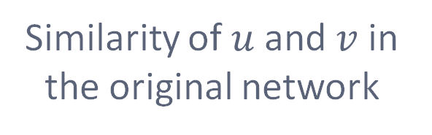

Recap: Two Key Components
Encoder: Maps each node to a low-dimensional vector
Similarity function: Specifies how the relationships in vector space map to the relationships in the original network
d-dimensional embedding
$$ENC\left(v\right)=z_{v}$$
node in the input graph
$$similarity\left(u,v\right) ≈ z_{v}^{Τ}z_{u}$$
Decoder
Similarity of $u$ and $v$ in the original network
dot product between node embeddings
Notes:
Note again that other distance measures other than dot products could be used (e.g., Euclidean distance), but the dot product is the standard measure of similarity used.

Slide 8

Recap: “Shallow” Encoding
Simplest encoding approach: Encoder is just an embedding-lookup
embedding vector for a specific node
embedding matrix
Dimension/size of embeddings
$$Z=$$
one column per node

Slide 9
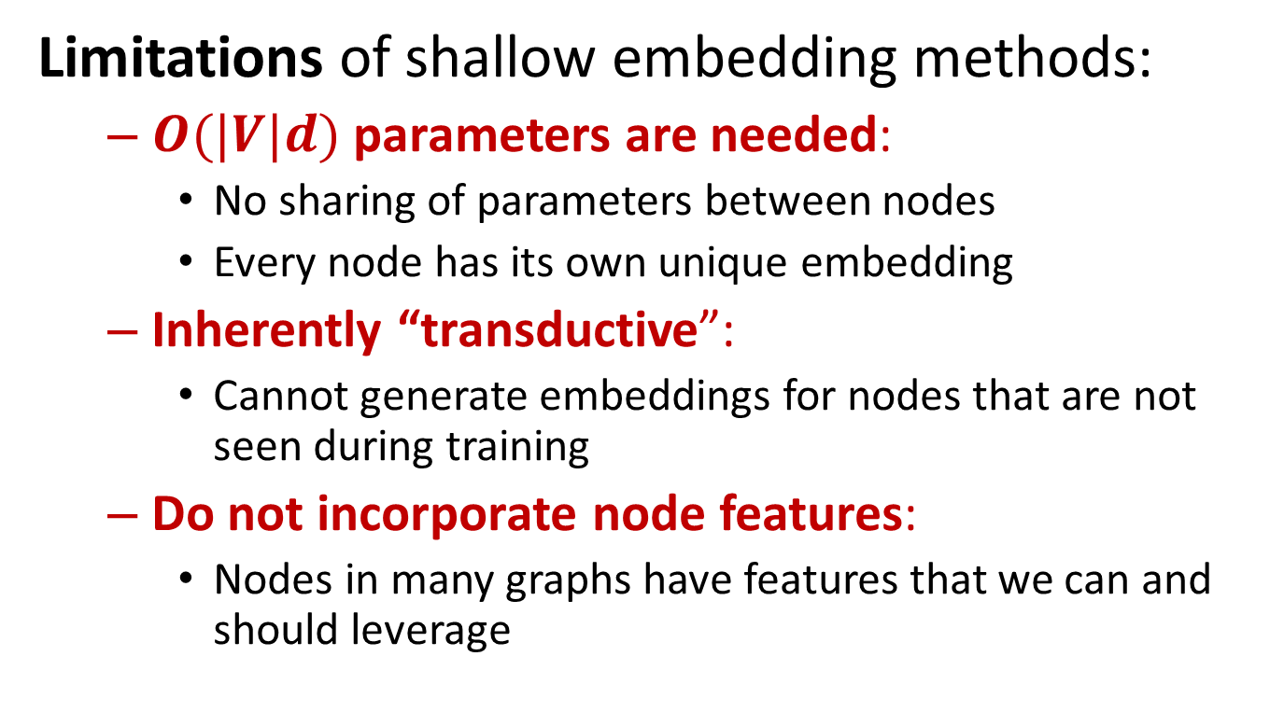
Recap: Shallow Encoders
Limitations of shallow embedding methods:
  $O(|V|d)$parameters are needed:
    No sharing of parameters between nodes
    Every node has its own unique embedding
  Inherently “transductive”:
    Cannot generate embeddings for nodes that are not seen during training
  Do not incorporate node features:
    Nodes in many graphs have features that we can and should leverage

Slide 10
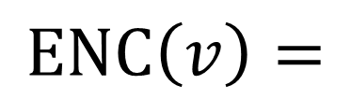
Deep Graph Encoders
Deep learning methods based on graph neural networks (GNNs):
Note: All these deep encoders can be combined with node similarity functions defined in previous lectures
multiple layers of
non-linear transformations
based on graph structure
$$ENC\left(v\right)=$$

Slide 11
Part III:
General Framework
A single GNN layer: Aggregation and Message
Layer connectivity: Stacking
Graph manipulations
Learning objectives

Slide 12
Overview and general framework

Slide 13
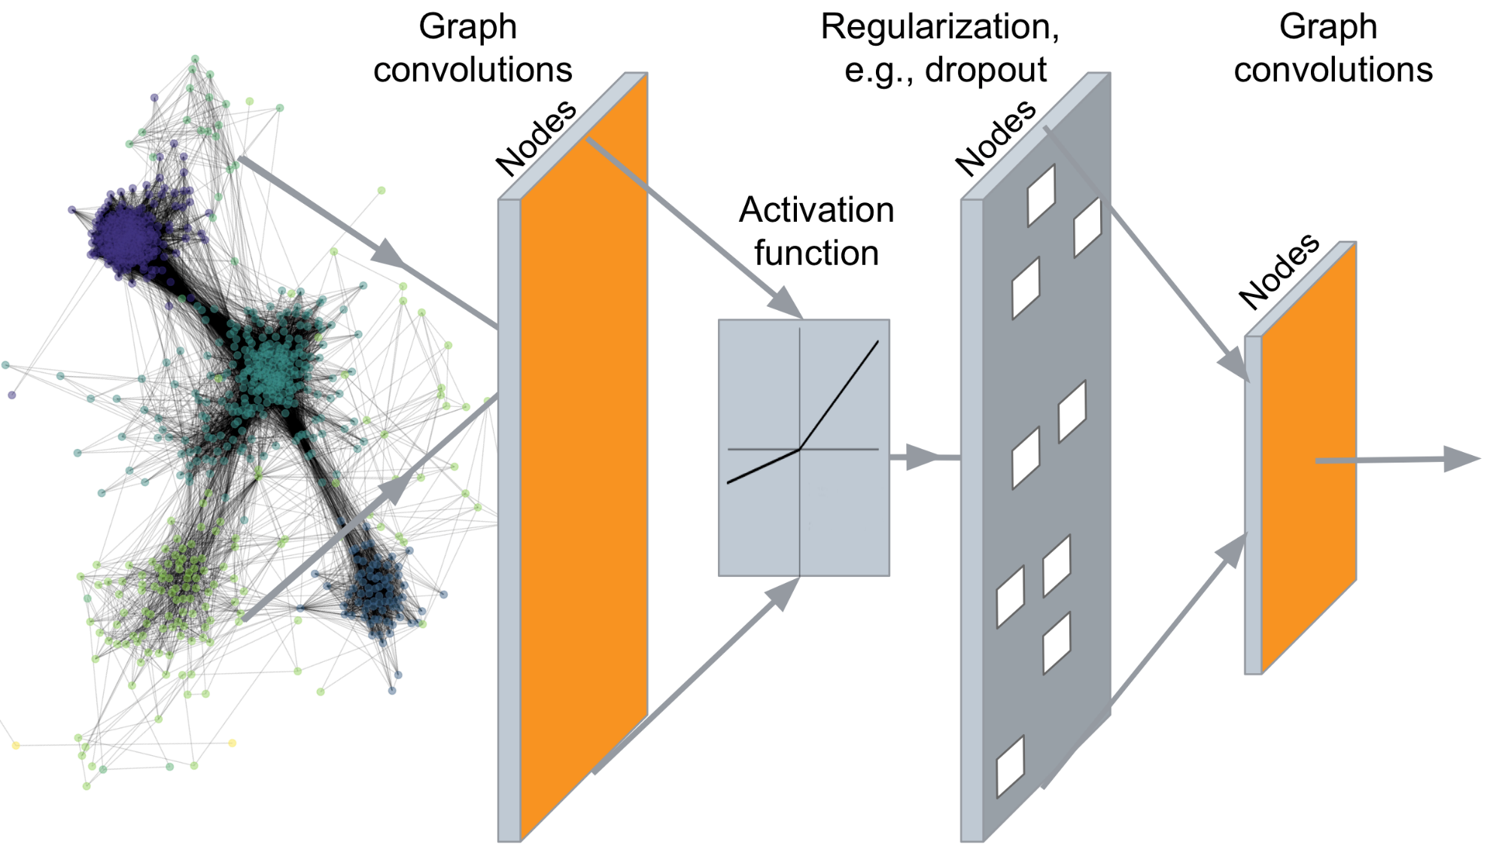
Deep Graph Encoders
…
Output: Node embeddings. Also, we can embed subgraphs, and graphs

Slide 14
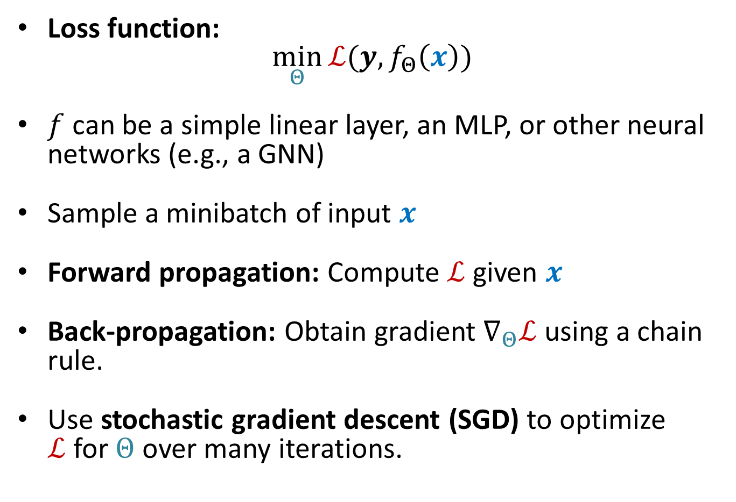
Basics of Deep Learning
Loss function:
$\min_{Θ}{ℒ(y, f_{Θ}\left(x\right))}$
$f$ can be a simple linear layer, an MLP, or other neural networks (e.g., a GNN)
Sample a minibatch of input $x$
Forward propagation: Compute $ℒ$ given $x$
Back-propagation: Obtain gradient $∇_{Θ}ℒ$ using a chain rule.
Use stochastic gradient descent (SGD) to optimize $ℒ$for $Θ$ over many iterations.

Slide 15
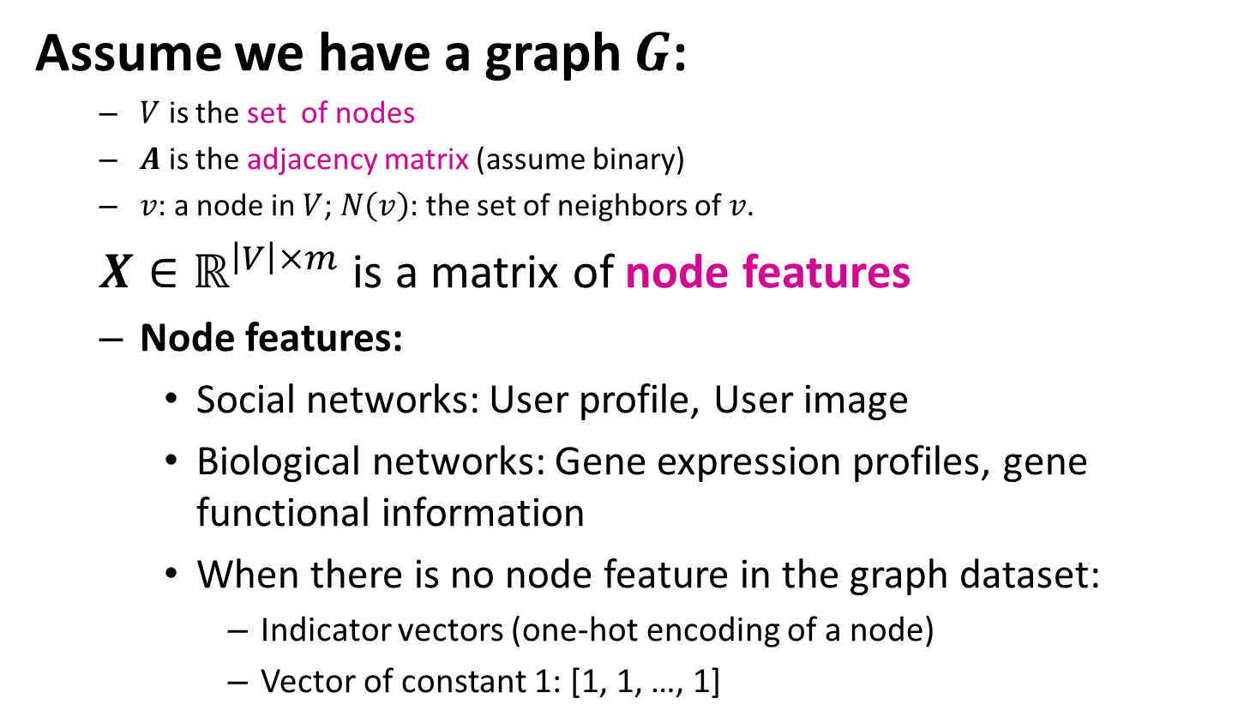
Setup
Assume we have a graph $G$:
  $V$ is the set of nodes
  $A$ is the adjacency matrix (assume binary)
  $v$: a node in $V$; $N\left(v\right)$: the set of neighbors of $v$.
  $X∈{\text{ℝ}}^{\left|V\right|×m}$ is a matrix of node features
  Node features:
    Social networks: User profile, User image
    Biological networks: Gene expression profiles, gene functional information
    When there is no node feature in the graph dataset:
      Indicator vectors (one-hot encoding of a node)
      Vector of constant 1: [1, 1, …, 1]

Slide 16
Idea: Convolutional Networks
CNN on an image:
Nice description of CNNs: https://towardsdatascience.com/a-comprehensive-guide-to-convolutional-neural-networks-the-eli5-way-3bd2b1164a53
Can we generalize convolutions beyond simple lattices?
Leverage node features/attributes (e.g., text, images)

Slide 17

Why is it hard?
arbitrary size and complex topological structure
Graphs are far more complex!
vs.
Text
Networks
Images
Graphs look like this:
or this:
  No fixed notion of (spatial) locality or sliding window on the graph
  No fixed node ordering or reference point
  Often dynamic and have multimodal features

Slide 18

A Naïve Approach
Join adjacency matrix and features
Feed them into a deep neural net:
Issues with this idea:
Issues with this idea:
  $O(|V|)$ parameters
  Not applicable to graphs of different sizes
  Sensitive to node ordering

Slide 19
Permutation Invariance
Graph does not have a canonical order of the nodes!
We can have many different order plans.

Slide 20


Permutation Invariance
Graph does not have a canonical order of the nodes!
Node features $X_{1}$
Adjacency matrix $A_{1}$
Order plan 1
B
A
A
B
C
D
E
F
B
A
A
B
C
C
C
D
D
F
E
E
D
E
F
F

Slide 21


Permutation Invariance
Graph does not have a canonical order of the nodes!
Node features $X_{1}$
Adjacency matrix $A_{1}$
Order plan 1
B
A
A
B
C
D
E
F
B
A
A
B
C
C
C
D
D
F
E
E
D
E
F
F
Node features $X_{2}$
Adjacency matrix $A_{2}$
Order plan 2
F
A
A
B
C
D
E
F
B
A
E
B
D
C
C
D
D
A
E
E
C
B
F
F

Slide 22

Permutation Invariance
Graph does not have a canonical order of the nodes!
Node features $X_{1}$
Adjacency matrix $A_{1}$
Order plan 1
B
A
A
B
C
D
E
F
B
A
A
B
C
C
C
D
D
Graph and node representations
should be the same for Order plan 1
and Order plan 2
F
E
E
D
E
F
F
Node feature $X_{2}$
Adjacency matrix $A_{2}$
Order plan 2
F
A
A
B
C
D
E
F
B
A
E
B
D
C
C
D
D
A
E
E
C
B
F
F

Slide 23
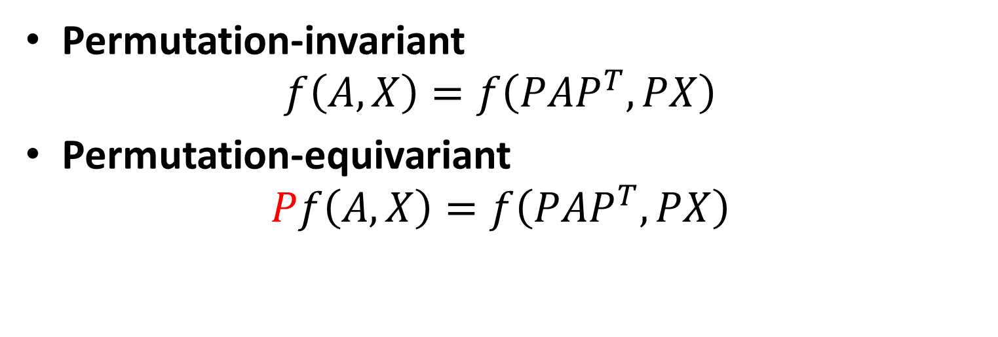
Invariance and Equivariance
Permutation-invariant
$$f\left(A,X\right)=f\left(PAP^{T},PX\right)$$
Permutation-equivariant
$$Pf\left(A,X\right)=f\left(PAP^{T},PX\right)$$
Permute the input, the output stays the same.
Permute the input, output also permutes accordingly.

Slide 24
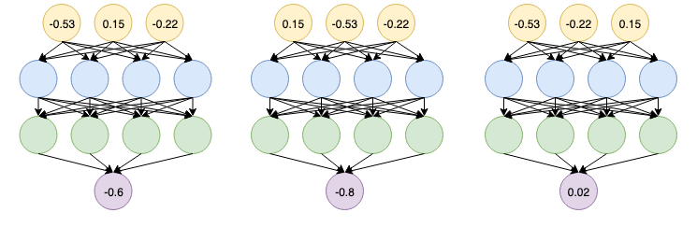
Graph Neural Network Overview
Are other neural network architectures, e.g., MLPs, permutation invariant / equivariant?
No
Switching the order of the input leads to different outputs!

Slide 25
Graph Neural Network Overview
Are other neural network architectures, e.g., MLPs, permutation invariant / equivariant?
No.
This explains why the naïve MLP approach
fails for graphs!

Slide 26
Graph Neural Network Overview
[Bronstein, ICLR 2021 keynote]
Graph neural networks consist of multiple permutation equivariant/invariant functions.
B
B
B
A
C
A
C
A
C
F
D
E
F
D
E
F
D
E
Permutation equivariant
Permutation equivariant
Permutation invariant

Slide 27


Graph Convolutional Networks
[Kipf and Welling, ICLR 2017]
Idea: The neighborhood of a node defines a computation graph
$$i$$
$$i$$
Determine node
computation graph
Propagate and
transform information
Learn how to propagate information across the graph to compute node features

Slide 28
Idea: Aggregate Neighbors
Key idea: Generate node embeddings based on local network neighborhoods

Slide 29
Idea: Aggregate Neighbors
Intuition: Nodes aggregate information from their neighbors using neural networks
Neural networks

Slide 30
Idea: Aggregate Neighbors
Intuition: Network neighborhood defines a computation graph
Every node defines a computation graph based on its neighborhood!

Slide 31

Deep Model: Many Layers
Model can be of arbitrary depth:
  Nodes have embeddings at each layer
  Layer-0 embedding of node $v$ is its input feature, $xv$
  Layer-$k$ embedding gets information from nodes that are $k$ hops away
Layer-0
Layer-1
Layer-2

Slide 32
Neighborhood Aggregation
Neighborhood aggregation: Key distinctions are in how different approaches aggregate information across the layers
?
What is in the box?
?
?
?

Slide 33
Neighborhood Aggregation
Basic approach: Average information from neighbors and apply a neural network
(1) average messages from neighbors
(2) apply neural network

Slide 34


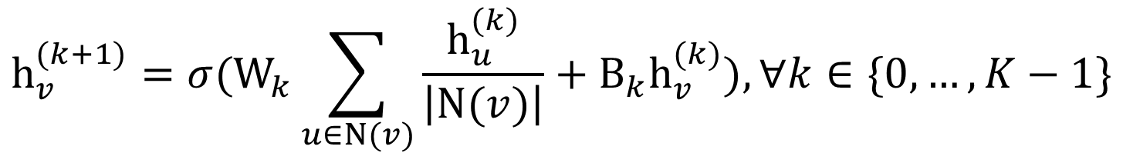

The Math: Deep Encoder
Basic approach: Average neighbor messages and apply a neural network
Initial 0-th layer embeddings are equal to node features
embedding of $v$at layer $k$
$$h_{v}^{0}=x_{v}$$
$$h_{v}^{(k+1)}=σ(W_{k}\sum_{u∈N(v)}{\frac{h_{u}^{(k)}}{\left|N(v)\right|}+B_{k}h_{v}^{(k)}), ∀k∈\{0,…,K−1\}}$$
Total number of layers
$$z_{v}=h_{v}^{(K)}$$
Average of neighbor’s previous layer embeddings
Embedding after K layers of neighborhood aggregation
Non-linearity (e.g., ReLU)
Notice summation is a permutation invariant pooling/aggregation.

Slide 35

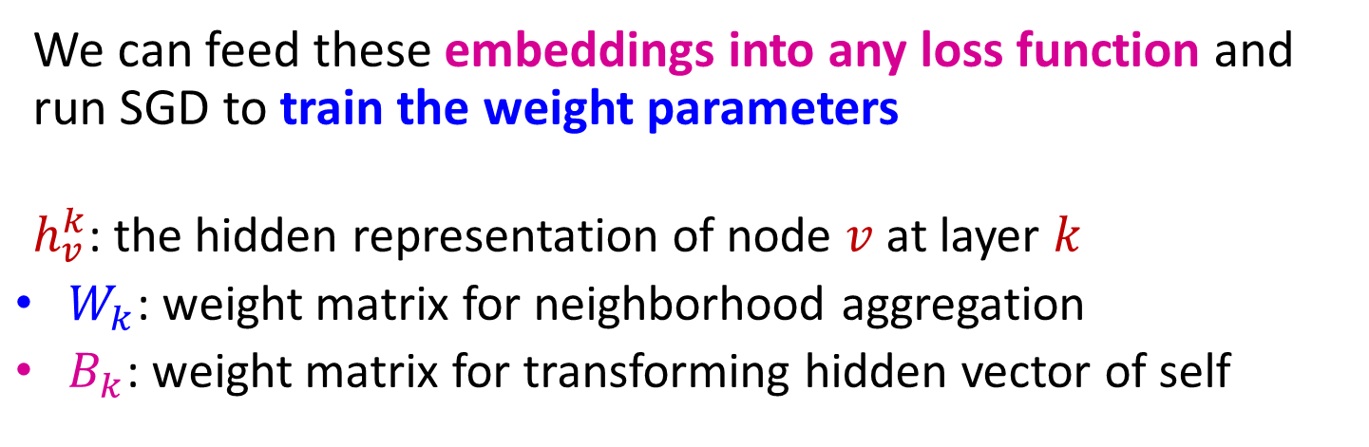
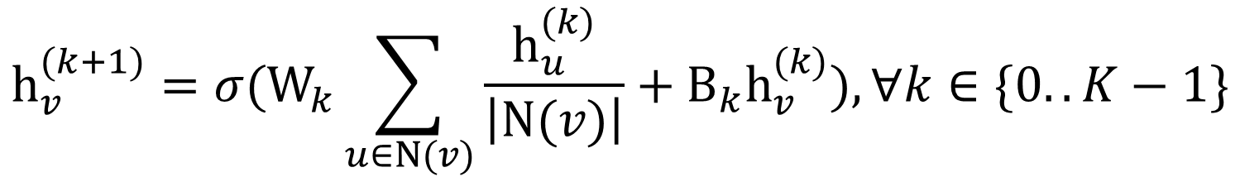

Model Parameters
Trainable weight matrices (i.e., what we learn)
weight matrices are shared
$$h_{v}^{(0)}=x_{v}$$
$$h_{v}^{(k+1)}=σ(W_{k}\sum_{u∈N(v)}{\frac{h_{u}^{(k)}}{\left|N(v)\right|}+B_{k}h_{v}^{(k)}), ∀k∈\{0..K−1\}}$$
$$z_{v}=h_{v}^{(K)}$$
Final node embedding
We can feed these embeddings into any loss function and run SGD to train the weight parameters
$h_{v}^{k}$: the hidden representation of node $v$ at layer $k$
$W_{k}$: weight matrix for neighborhood aggregation
$B_{k}$: weight matrix for transforming hidden vector of self

Slide 36
GCN: Invariance and Equivariance
What are the invariance and equivariance properties for a GCN?
Given a node, the GCN that computes its embedding is permutation invariant
Shared NN weights
B
B
A
C
D
A
C
F
D
D
E
Target Node
Average of neighbor’s previous layer embeddings - Permutation invariant

Slide 37

Training the Model
How do we train the GCN to
generate embeddings?
Need to define a loss function on the embeddings.
$$z_{A}$$

Slide 38
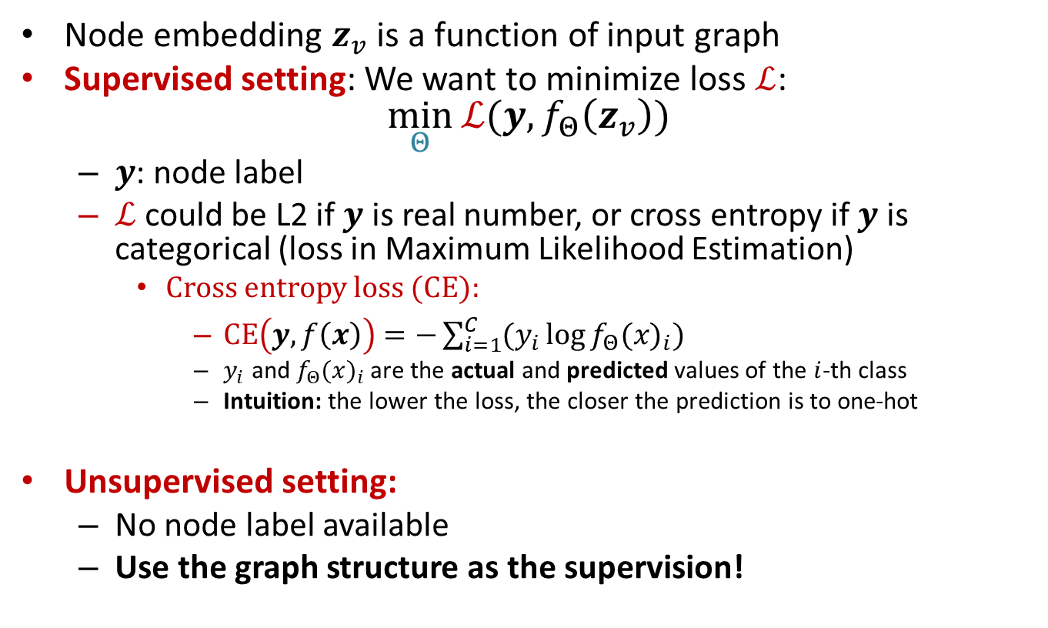
How to Train A GNN
Node embedding $z_{v}$ is a function of input graph
Supervised setting: We want to minimize loss $ℒ$:
$\min_{Θ}{ℒ(y, f_{Θ}\left(z_{v}\right))}$
  $y$: node label
  $ℒ$ could be L2 if $y$ is real number, or cross entropy if $y$ is categorical (loss in Maximum Likelihood Estimation)
    Cross entropy loss (CE):
      $CE\left(y, f\left(x\right)\right)=−\sum_{i=1}^{C}{(y_{i}\log{f_{Θ}(x)_{i}})}$
      $y_{i}$ and $f_{Θ}(x)_{i}$ are the actual and predicted values of the $i$-th class
      Intuition: the lower the loss, the closer the prediction is to one-hot
Unsupervised setting:
  No node label available
  Use the graph structure as the supervision!

Slide 39
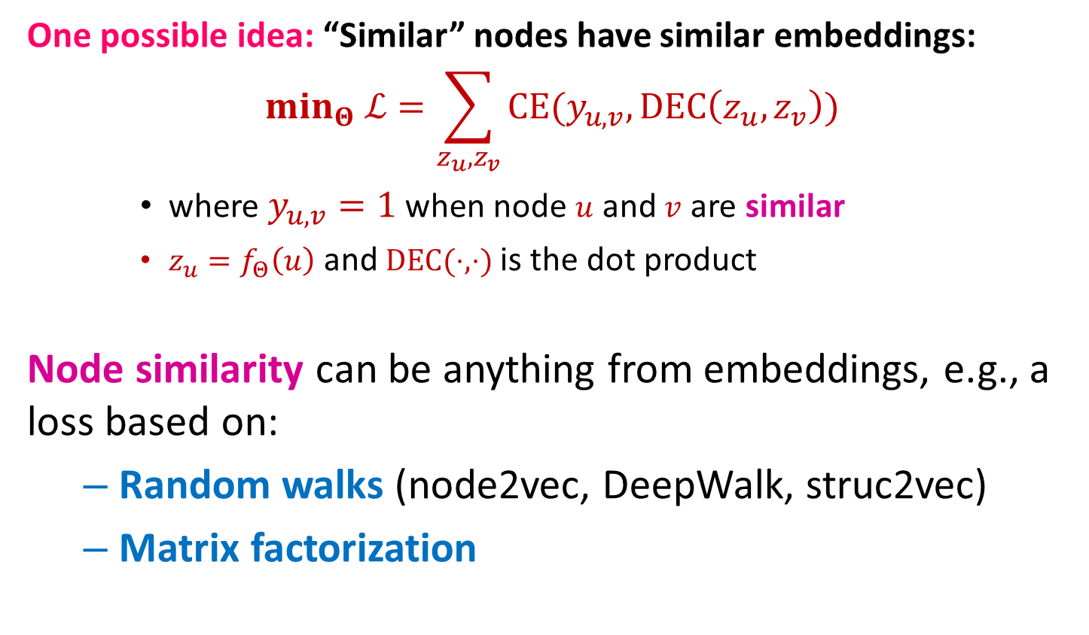
Unsupervised Training
One possible idea: “Similar” nodes have similar embeddings:
$$min_{Θ} ℒ=\sum_{z_{u}, z_{v}}{CE(y_{u,v}, DEC\left(z_{u},z_{v}\right))}$$
    where $y_{u,v}=1$when node $u$ and $v$ are similar
    $z_{u}=f_{Θ}\left(u\right)$ and $DEC(⋅,⋅)$ is the dot product
Node similarity can be anything from embeddings, e.g., a loss based on:
  Random walks (node2vec, DeepWalk, struc2vec)
  Matrix factorization

Slide 40
Supervised Training
Directly train the model for a supervised task (e.g., node classification)
Safe or toxic drug?
Safe or toxic drug?
E.g., a drug-drug interaction network

Slide 41
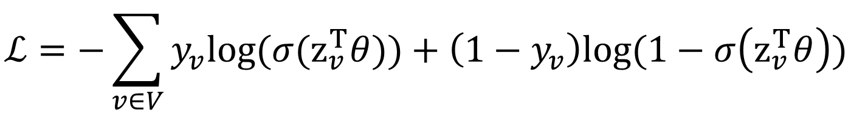
Supervised Training
Directly train the model for a supervised task (e.g., node classification)
Use cross entropy loss
$$ℒ=−\sum_{v∈V}{y_{v}log⁡(σ(z_{v}^{T}θ}))+\left(1−y_{v}\right)log⁡(1−σ\left(z_{v}^{T}θ\right))$$
Encoder output: node embedding
Classification weights
Node class
label
Safe or toxic drug?

Slide 42

Model Design: Overview
(1) Define a neighborhood aggregation function
$$z_{A}$$
(2) Define a loss function on the embeddings

Slide 43
Model Design: Overview
(3) Train on a set of nodes, i.e.,
a batch of compute graphs

Slide 44
Model Design: Overview
(4) Generate embeddings
for nodes as needed
Even for nodes we never trained on!

Slide 45
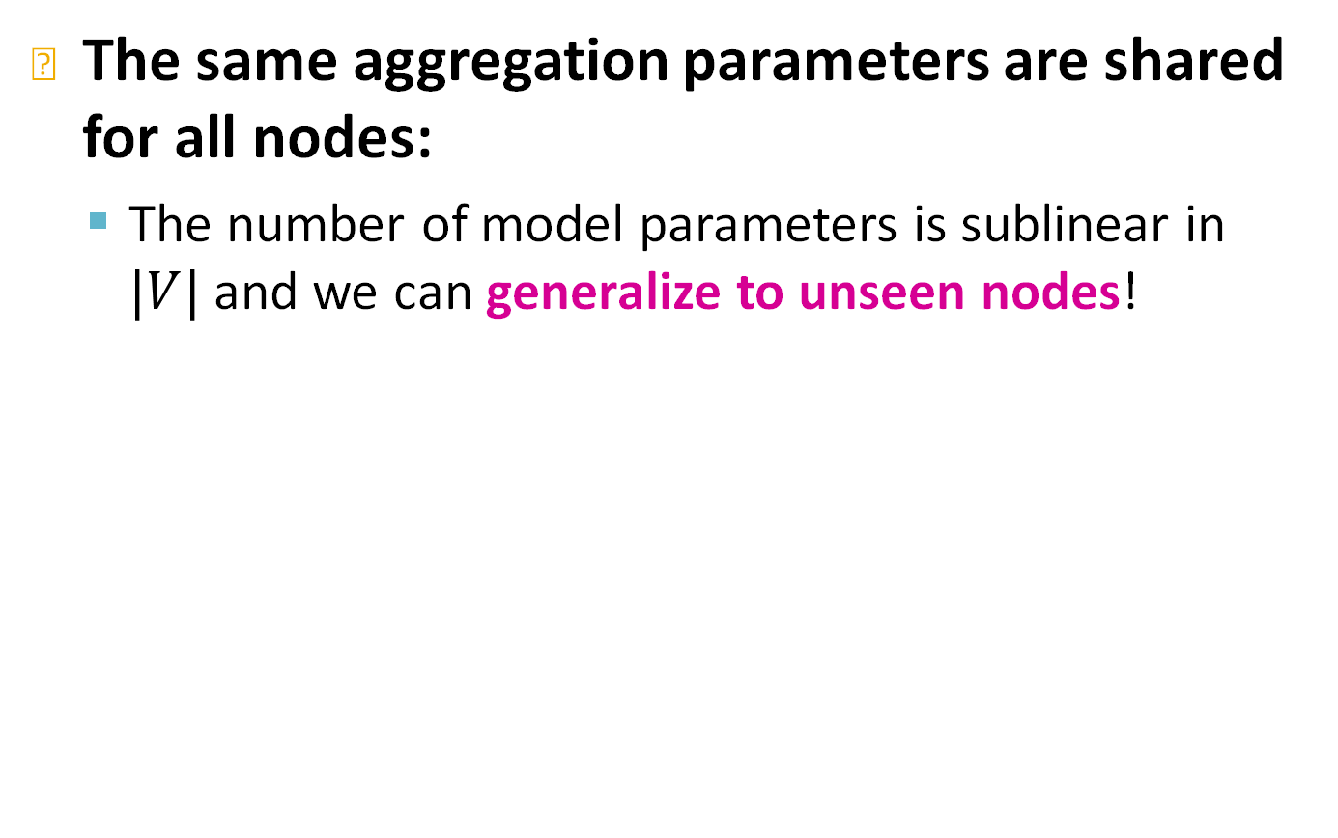


Inductive Capability
The same aggregation parameters are shared for all nodes:
  The number of model parameters is sublinear in $|V|$ and we can generalize to unseen nodes!
$$W_{k}$$
$$B_{k}$$

Slide 46
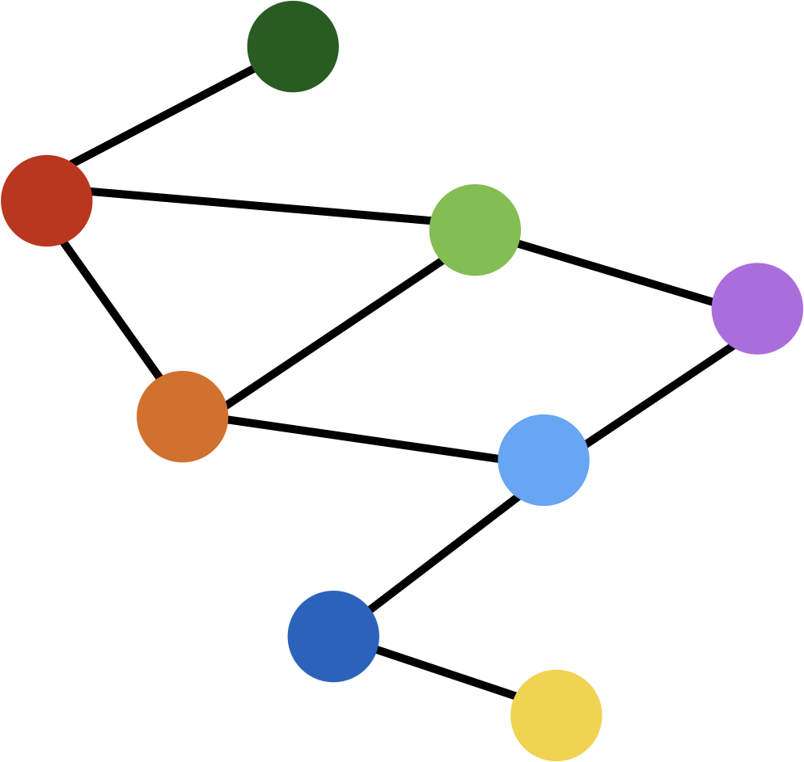
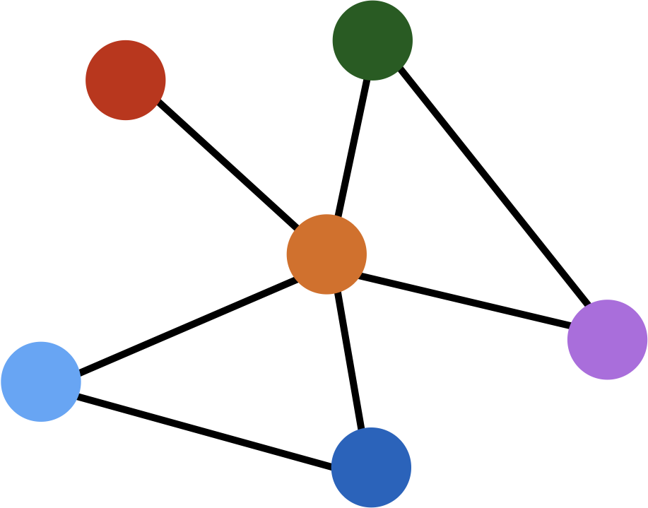

Inductive Capability: New Graphs
$$z_{u}$$
Train on one graph
Generalize to new graph
Inductive node embedding Generalize to entirely unseen graphs
E.g., train on protein interaction graph from model organism A and generate embeddings on newly collected data about organism B

Slide 47
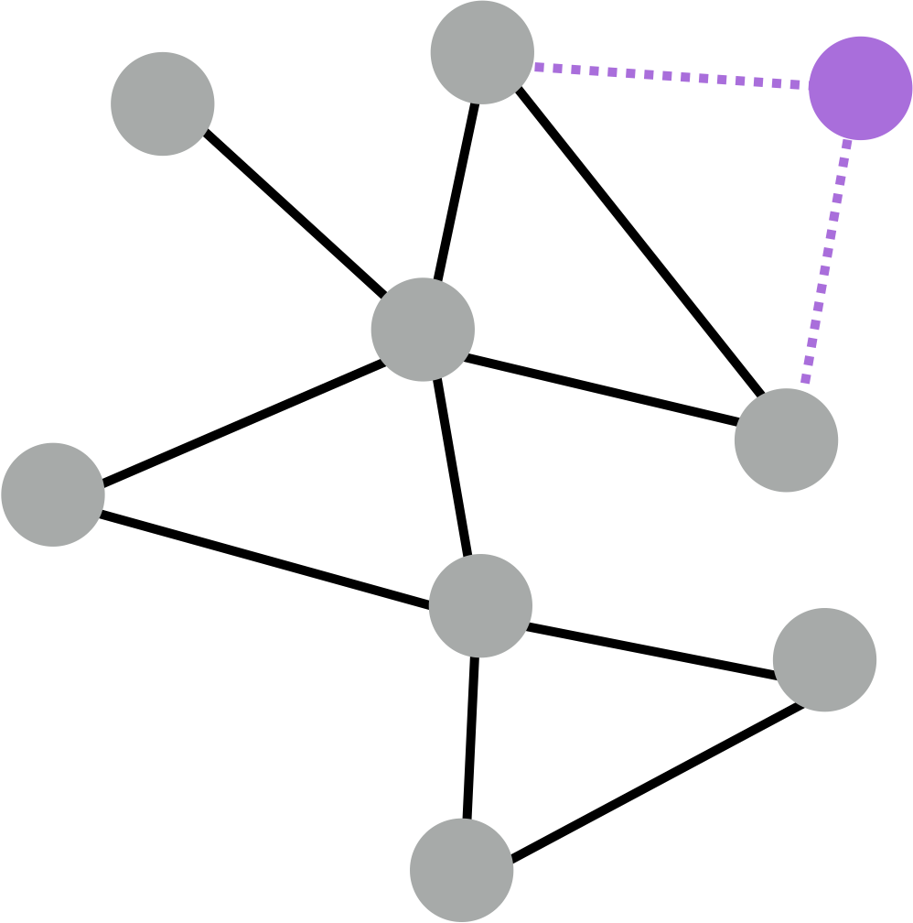
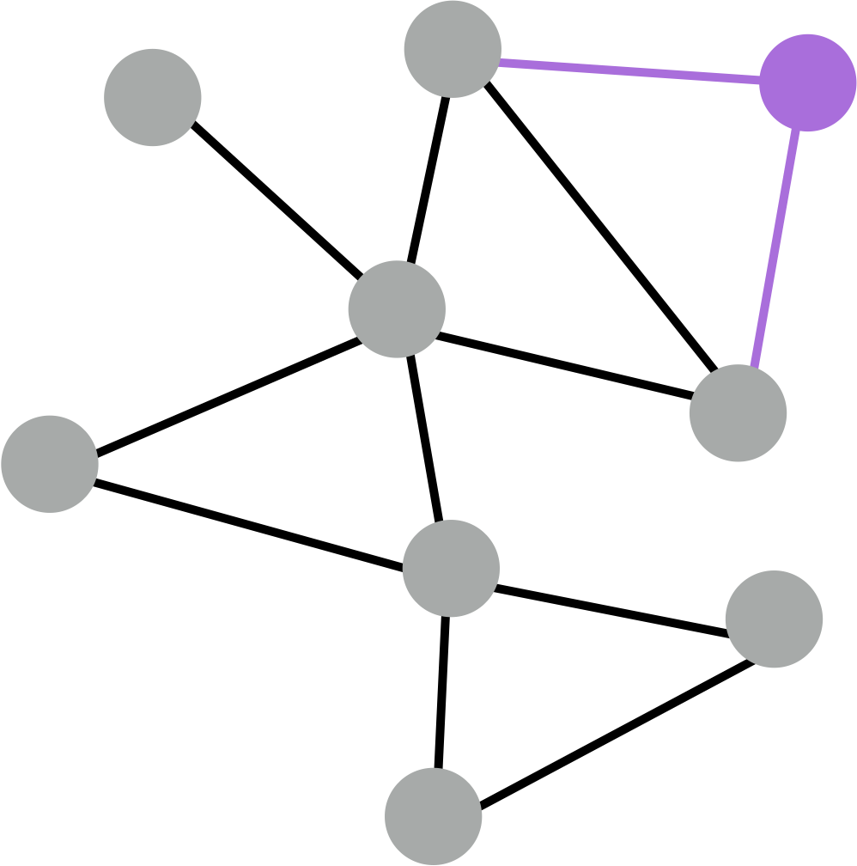
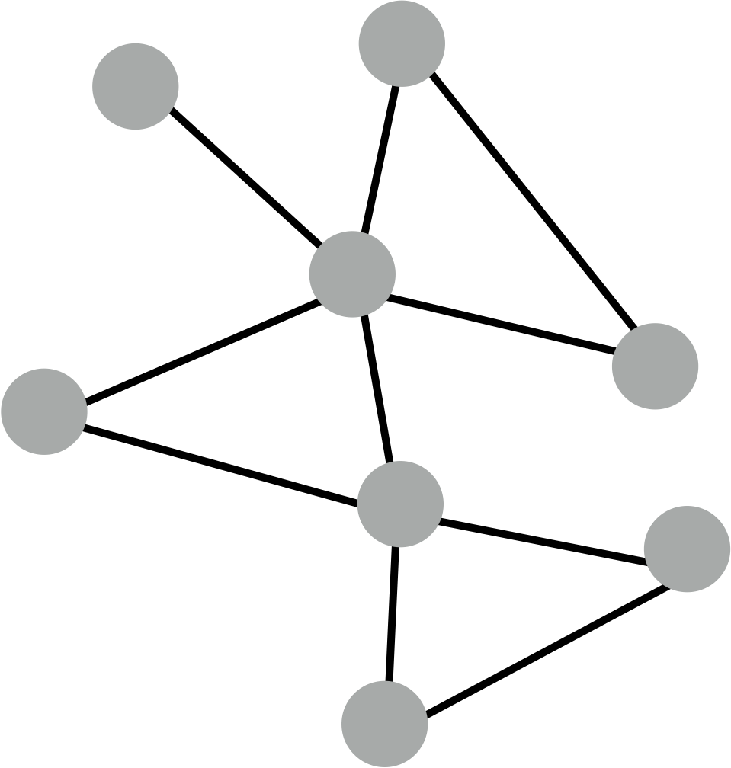

Inductive Capability: New Nodes
$$z_{u}$$
Generate embedding for new node
Train with snapshot
New node arrives
Many application settings constantly encounter previously unseen nodes:
    E.g., Reddit, YouTube, Google Scholar
Need to generate new embeddings “on the fly”

Slide 48
Summary so far
How to build CNNs for graphs
use local neighborhood of a node
Next: more details using a general GNN framework

Slide 49
A General GNN Framework
J. You, R. Ying, J. Leskovec. Design Space of Graph Neural Networks, NeurIPS 2020
(5) Learning objective
(2) Aggregation
GNN Layer 2
(1) Message
(3) Layer connectivity
GNN Layer 1
(4) Graph augmentation

Slide 50
Outline
General Framework
A single GNN layer: Aggregation and Message
Layer Connectivity: Stacking
Graph manipulations
Learning objectives

Slide 51
A single gnn layer

Slide 52
A GNN Layer
J. You, R. Ying, J. Leskovec. Design Space of Graph Neural Networks, NeurIPS 2020
GNN Layer = Message + Aggregation
Different instantiations under this perspective
GCN, GraphSAGE, GAT, …
(2) Aggregation
GNN Layer 2
(1) Message

Slide 53
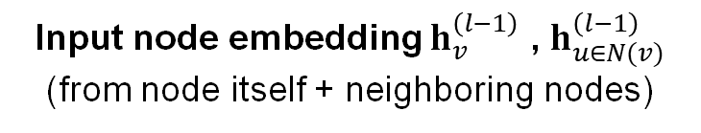



A Single GNN Layer
Idea of a GNN Layer:
  Compress a set of vectors into a single vector
  Two-step process:
    (1) Message
    (2) Aggregation
Output node embedding $h_{v}^{\left(l\right)}$
Node $v$
$l$-th GNN Layer
(2) Aggregation
(1) Message
Input node embedding $h_{v}^{\left(l−1\right)}$ , $h_{u∈N(v)}^{\left(l−1\right)}$
(from node itself + neighboring nodes)

Slide 54
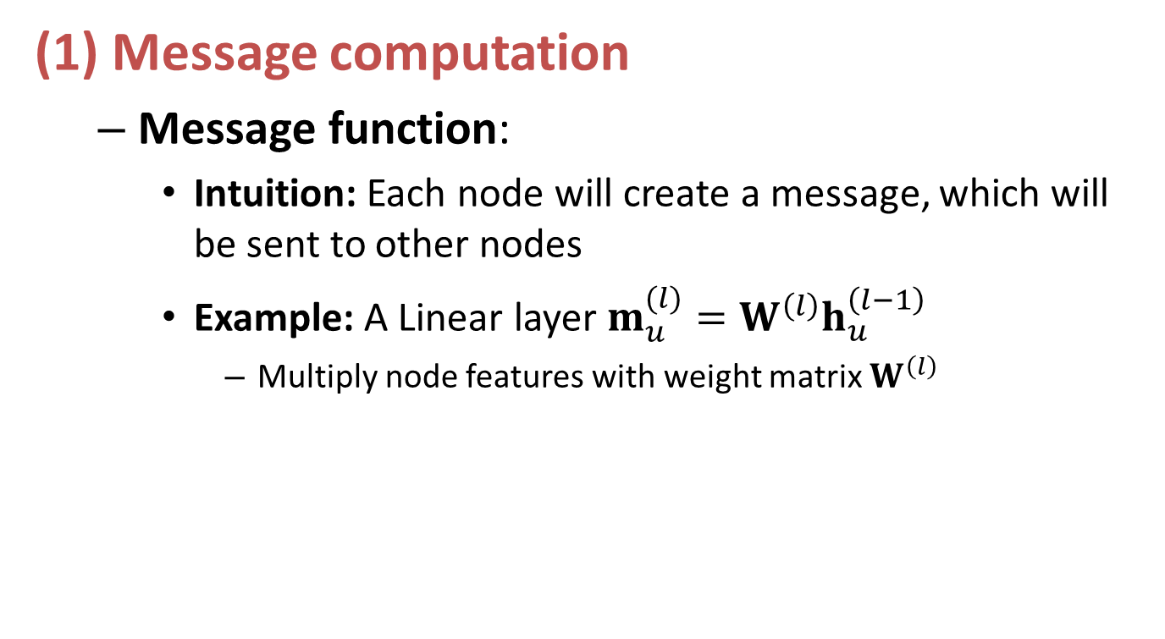
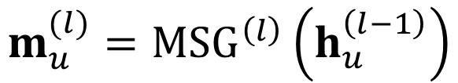

Message Computation
(1) Message computation
  Message function:
    Intuition: Each node will create a message, which will be sent to other nodes
    Example: A Linear layer $m_{u}^{(l)}=W^{\left(l\right)}h_{u}^{\left(l−1\right)}$
      Multiply node features with weight matrix $W^{\left(l\right)}$
$$m_{u}^{(l)}={MSG}^{\left(l\right)}\left(h_{u}^{\left(l−1\right)}\right)$$
Node $v$
(2) Aggregation
(1) Message

Slide 55
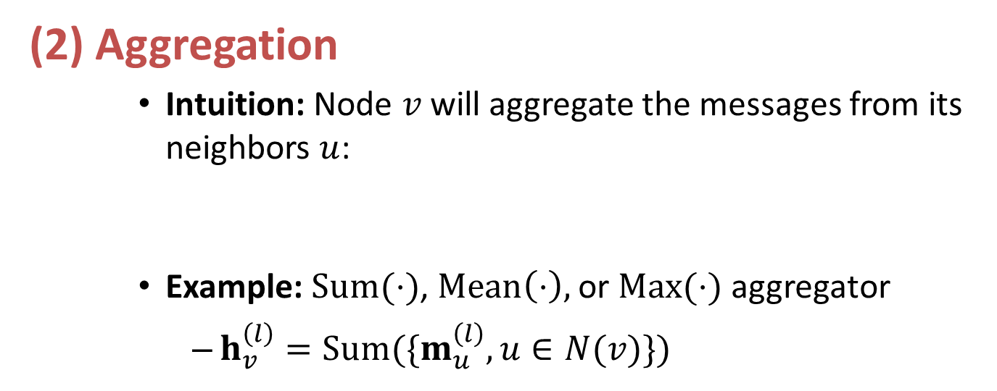
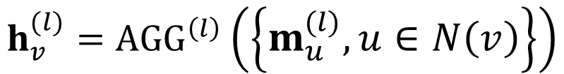
Message Aggregation
(2) Aggregation
    Intuition: Node $v$will aggregate the messages from its neighbors $u$:
    Example: $Sum(⋅)$, $Mean\left(⋅\right),$ or $Max(⋅)$ aggregator
      $h_{v}^{\left(l\right)}=Sum(\{m_{u}^{\left(l\right)}, u∈N(v)\})$
$$h_{v}^{(l)}={AGG}^{\left(l\right)}\left(\left\{m_{u}^{\left(l\right)}, u∈N\left(v\right)\right\}\right)$$
Node $v$
(2) Aggregation
(1) Message

Slide 56
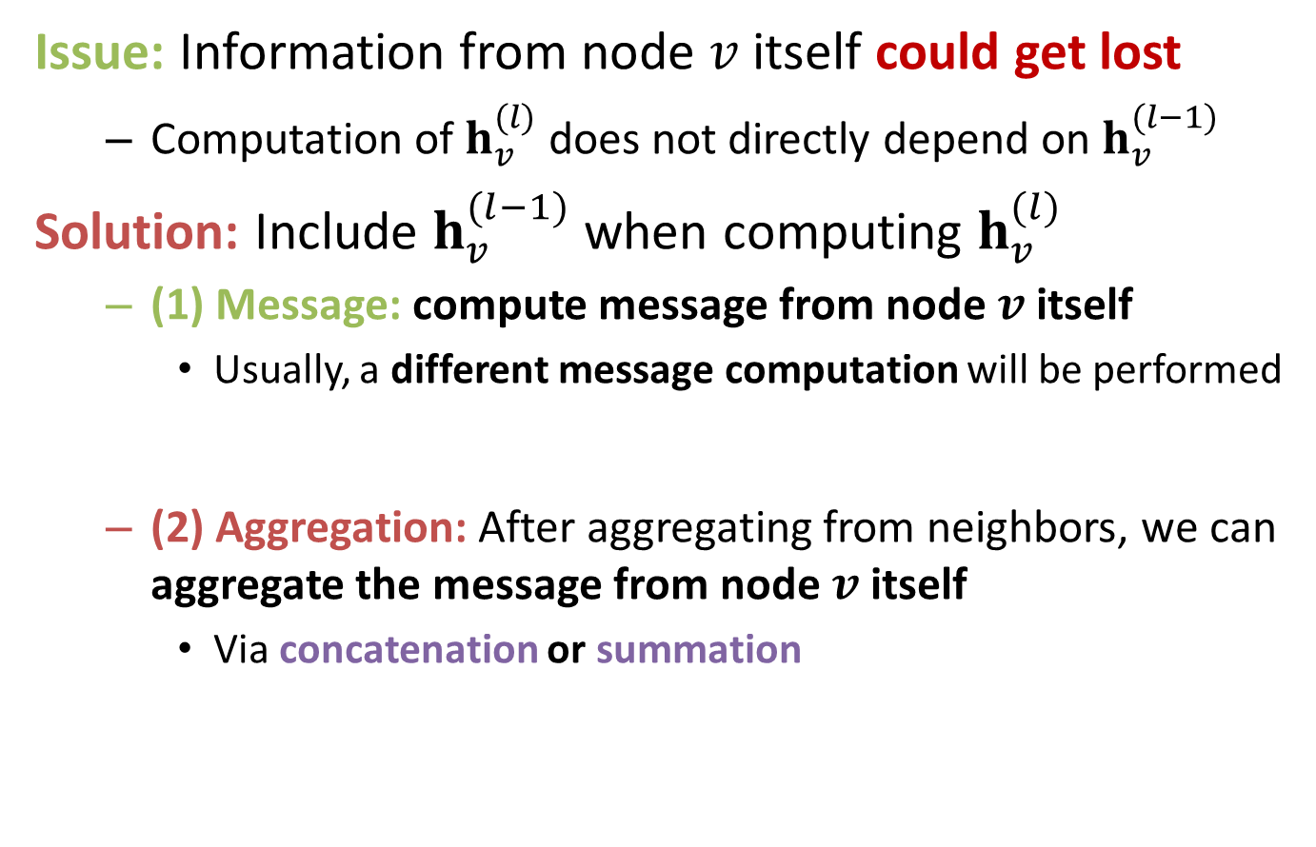
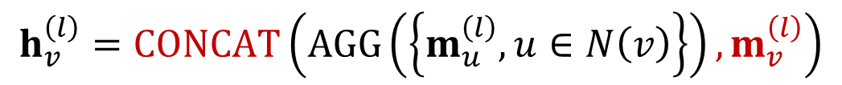


Message Aggregation: Issue
Issue: Information from node $v$ itself could get lost
  Computation of $h_{v}^{(l)}$does not directly depend on $h_{v}^{(l−1)}$
Solution: Include $h_{v}^{(l−1)}$ when computing $h_{v}^{(l)}$
  (1) Message: compute message from node $v$ itself
    Usually, a different message computation will be performed
  (2) Aggregation: After aggregating from neighbors, we can aggregate the message from node $v$ itself
    Via concatenation or summation
$$m_{u}^{(l)}=W^{\left(l\right)}h_{u}^{\left(l−1\right)}$$
$$m_{v}^{(l)}=B^{\left(l\right)}h_{v}^{\left(l−1\right)}$$
Then aggregate from node itself
$$h_{v}^{\left(l\right)}=CONCAT\left(AGG\left(\left\{m_{u}^{\left(l\right)}, u∈N\left(v\right)\right\}\right), m_{v}^{\left(l\right)}\right)$$
First aggregate from neighbors

Slide 57
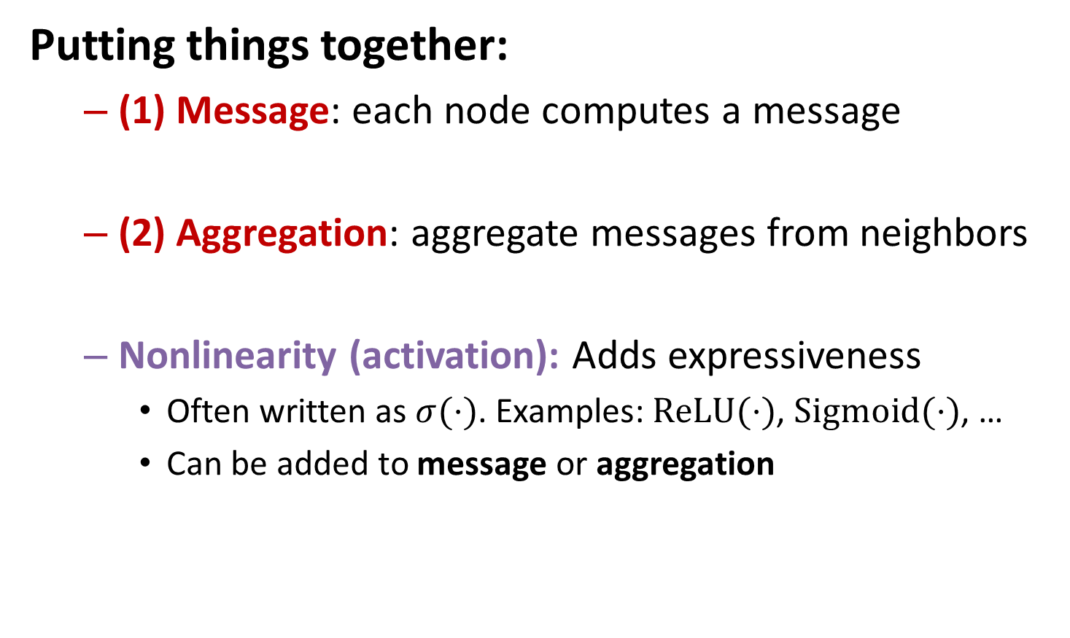

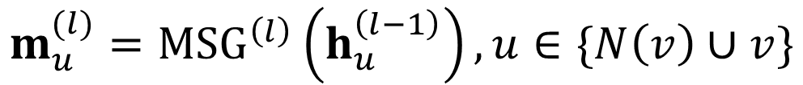
A Single GNN Layer
Putting things together:
  (1) Message: each node computes a message
  (2) Aggregation: aggregate messages from neighbors
  Nonlinearity (activation): Adds expressiveness
    Often written as $σ(⋅)$. Examples: $ReLU(⋅)$, $Sigmoid(⋅)$, …
    Can be added to message or aggregation
$$m_{u}^{(l)}={MSG}^{\left(l\right)}\left(h_{u}^{\left(l−1\right)}\right), u∈\{N\left(v\right)∪v\}$$
$$h_{v}^{(l)}={AGG}^{\left(l\right)}\left(\left\{m_{u}^{\left(l\right)}, u∈N\left(v\right)\right\},m_{v}^{\left(l\right)}\right)$$

Slide 58
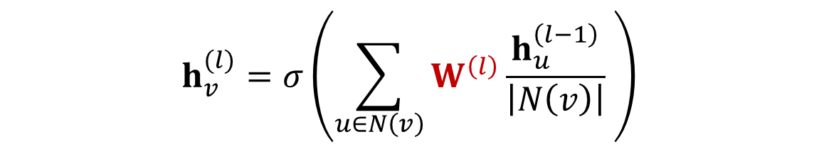
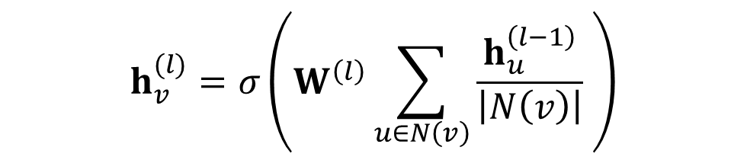
Classical GNN Layers: GCN (1)
T. Kipf, M. Welling. Semi-Supervised Classification with Graph Convolutional Networks, ICLR 2017
(1) Graph Convolutional Networks (GCN)
How to write this as Message + Aggregation?
$$h_{v}^{(l)}=σ\left(W^{\left(l\right)}\sum_{u∈N\left(v\right)}{\frac{h_{u}^{\left(l−1\right)}}{\left|N\left(v\right)\right|} }\right)$$
Message
$$h_{v}^{(l)}=σ\left(\sum_{u∈N\left(v\right)}{W^{\left(l\right)}\frac{h_{u}^{\left(l−1\right)}}{\left|N\left(v\right)\right|} }\right)$$
Aggregation

Slide 59


Classical GNN Layers: GCN (2)
(1) Graph Convolutional Networks (GCN)
Message:
  Each Neighbor: $m_{u}^{(l)}=\frac{1}{\left|N\left(v\right)\right|}W^{\left(l\right)}h_{u}^{\left(l−1\right)}$
Aggregation:
  Sum over messages from neighbors, then apply activation
  $h_{v}^{\left(l\right)}=σ\left(Sum\left(\left\{m_{u}^{\left(l\right)}, u∈N\left(v\right)\right\}\right)\right)$
$$h_{v}^{(l)}=σ\left(\sum_{u∈N\left(v\right)}{W^{\left(l\right)}\frac{h_{u}^{\left(l−1\right)}}{\left|N\left(v\right)\right|} }\right)$$
Normalized by node degree
(In the GCN paper they use a slightly different normalization)
In GCN the input graph is assumed to have self-edges that are included in the summation.

Slide 60
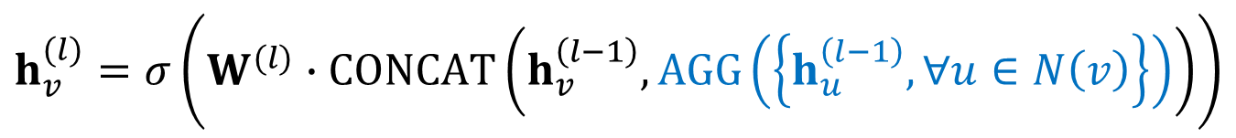
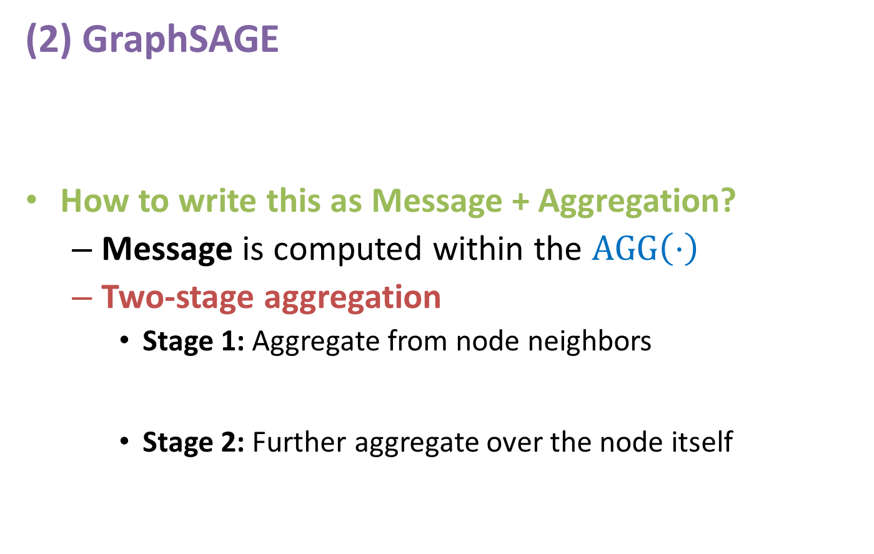


Classical GNN Layers: GraphSAGE
Hamilton et al. Inductive Representation Learning on Large Graphs, NeurIPS 2017
(2) GraphSAGE
How to write this as Message + Aggregation?
  Message is computed within the $AGG\left(⋅\right)$
  Two-stage aggregation
    Stage 1: Aggregate from node neighbors
    Stage 2: Further aggregate over the node itself
$$h_{v}^{(l)}=σ\left(W^{(l)}∙CONCAT\left(h_{v}^{\left(l−1\right)}, AGG\left(\left\{h_{u}^{\left(l−1\right)},∀u∈N\left(v\right)\right\}\right)\right)\right)$$
$$h_{N(v)}^{(l)}←AGG\left(\left\{h_{u}^{(l−1)},∀u∈N\left(v\right)\right\}\right)$$
$$h_{v}^{(l)}←σ\left(W^{(l)}⋅CONCAT(h_{v}^{\left(l−1\right)},h_{N(v)}^{(l)})\right)$$

Slide 61

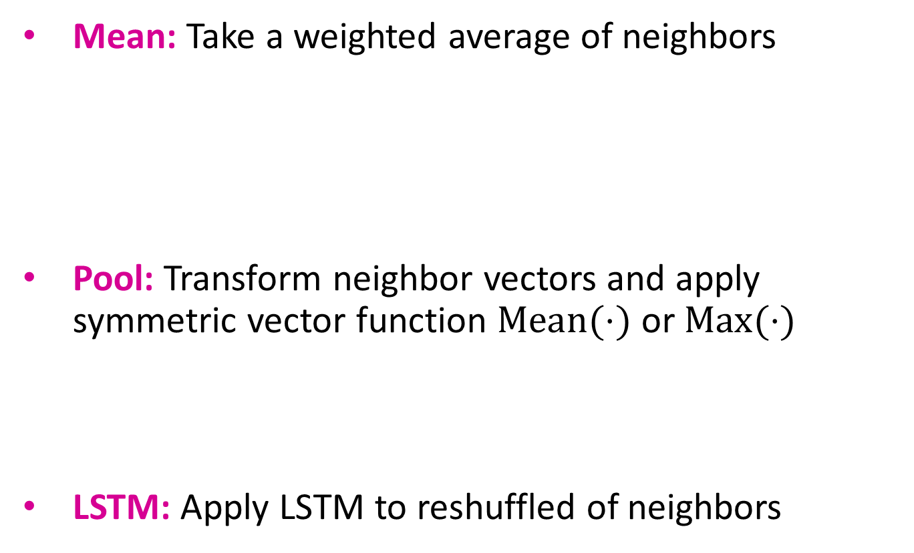
GraphSAGE Neighbor Aggregation
Mean: Take a weighted average of neighbors
Pool: Transform neighbor vectors and apply symmetric vector function $Mean(⋅)$ or $Max(⋅)$
LSTM: Apply LSTM to reshuffled of neighbors
$$AGG=\sum_{u∈N(v)}{\frac{h_{u}^{(l−1)}}{\left|N(v)\right|}}$$
Message computation
Aggregation
$$AGG=Mean(\{MLP(h_{u}^{(l−1)}),∀u∈N(v)\})$$
Aggregation
Message computation
applied to a random permutation
$$AGG=LSTM([h_{u}^{(l−1)},∀u∈π\left(N\left(v\right)\right)])$$
Aggregation

Slide 62
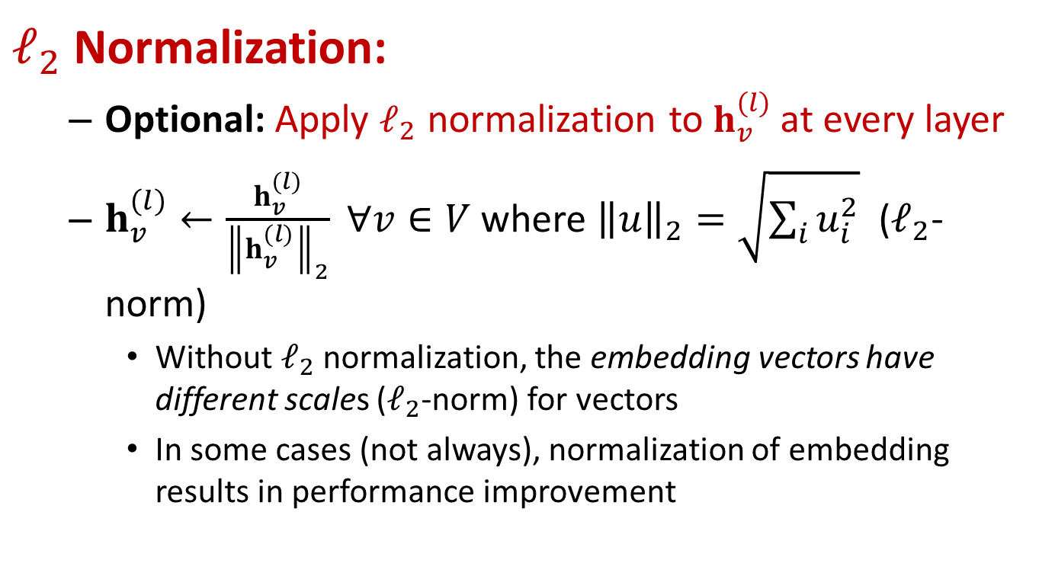
GraphSAGE: L2 Normalization
$ℓ_{2}$ Normalization:
  Optional: Apply $ℓ_{2}$ normalization to $h_{v}^{(l)}$at every layer
  $h_{v}^{(l)}←\frac{h_{v}^{(l)}}{{\left\|h_{v}^{(l)}\right\|}_{2}} ∀v∈V$ where ${\left\|u\right\|}_{2}=\sqrt{\sum_{i}{u_{i}^{2}}}$ ($ℓ_{2}$-norm)
    Without $ℓ_{2}$ normalization, the embedding vectors have different scales ($ℓ_{2}$-norm) for vectors
    In some cases (not always), normalization of embedding results in performance improvement

Slide 63
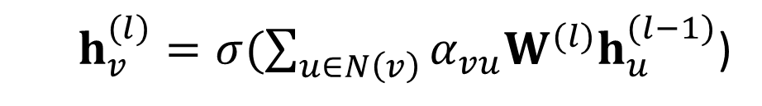

Classical GNN Layers: GAT (1)
[Velickovic et al., ICLR 2018; Vaswani et al., NIPS 2017]
(3) Graph Attention Networks
weighting factor (importance) of the message of node $u$ to node $v$
In GCN and GraphSAGE:
  $α_{vu}=\frac{1}{\left|N\left(v\right)\right|}$ defined explicitly based on the structural properties of the graph (node degree)
  All neighbors $u∈N(v)$ are equally important to node $v$
  $h_{v}^{(l)}=σ(\sum_{u∈N\left(v\right)}{α_{vu}W^{(l)}h_{u}^{(l−1)}}$)
Attention weights

Slide 64


Classical GNN Layers: GAT (2)
(3) Graph Attention Networks
Not all node’s neighbors are equally important
  Attention is inspired by cognitive attention.
  The attention $α_{vu}$focuses on the important parts of the input data and fades out the rest.
    Idea: the NN should devote more computing power on that small but important part of the data.
    Which part of the data is more important depends on the context and is learned through training.
  $h_{v}^{(l)}=σ(\sum_{u∈N\left(v\right)}{α_{vu}W^{(l)}h_{u}^{(l−1)}}$)
Attention weights

Slide 65

Graph Attention Networks
[Velickovic et al., ICLR 2018; Vaswani et al., NIPS 2017]
Can weighting factors $α_{vu}$ be learned?
Goal: Specify arbitrary importance to different neighbors of each node in the graph
Idea: ﻿Compute embedding $h_{v}^{(l)}$ of each node in the graph following an attention strategy:
  ﻿Nodes attend over their neighborhoods’ message
  Implicitly specifying different weights to different nodes in a neighborhood

Slide 66





Attention Mechanism (1)
Let $α_{vu}$ be computed as a byproduct of an attention mechanism $a$:
  (1) Let $a$ compute attention coefficients $e_{vu}$ across pairs of nodes $u$, $v$ based on their messages:
  $$e_{vu}=a(W^{(l)}h_{u}^{(l−1)},W^{(l)}h_{v}^{(l−1)})$$
    $e_{vu}$ indicates the importance of $u^{′}s$message to node $v$
$$h_{B}^{(l−1)}$$
$$e_{AB}$$
$$h_{A}^{(l−1)}$$
  $$e_{AB}=a(W^{(l)}h_{A}^{(l−1)},W^{(l)}h_{B}^{(l−1)})$$

Slide 67







Attention Mechanism (2)
  Normalize $e_{vu}$ into the final attention weight $α_{vu}$
    Use the softmax function, so that $\sum_{u∈N\left(v\right)}{α_{vu}}=1$:
  $$α_{vu}=\frac{exp⁡(e_{vu})}{\sum_{k∈N\left(v\right)}{exp⁡(e_{vk})}}$$
  Weighted sum based on the final attention weight $α_{vu}$:
  $h_{v}^{(l)}=σ(\sum_{u∈N\left(v\right)}{α_{vu}W^{(l)}h_{u}^{(l−1)}}$)
$$α_{AB}$$
$$h_{B}^{(l−1)}$$
Weighted sum using $α_{AB}$, $α_{AC}$, $α_{AD}$:
$h_{A}^{(l)}=σ(α_{AB}W^{(l)}h_{B}^{(l−1)}\text{+}α_{AC}W^{(l)}h_{C}^{(l−1)}$+ $α_{AD}W^{(l)}h_{D}^{(l−1)}\text{)}$
$$α_{AC}$$
$$h_{C}^{(l−1)}$$
$$α_{AD}$$

Slide 68





Attention Mechanism (3)
What is the form of attention mechanism $a$?
  The approach is agnostic to the choice of $a$
    E.g., use a simple single-layer neural network
      $a$ have trainable parameters (weights in the Linear layer)
  Parameters of $a$ are trained jointly:
    Learn the parameters together with weight matrices (i.e., other parameter of the neural net $W^{(l)}$) in an end-to-end fashion
Concatenate
Linear
  $$e_{AB}=a\left(W^{(l)}h_{A}^{(l−1)},W^{(l)}h_{B}^{(l−1)}\right)=Linear\left(Concat\left(W^{(l)}h_{A}^{(l−1)},W^{(l)}h_{B}^{(l−1)}\right)\right)$$
$$e_{AB}$$
$$h_{A}^{(l−1)}$$
$$h_{B}^{(l−1)}$$

Slide 69


Attention Mechanism (4)
Multi-head attention: Stabilizes the learning process of attention mechanism
  Create multiple attention scores (each replica with a different set of parameters):
  0utputs are aggregated:
    By concatenation or summation
    $h_{v}^{(l)}=AGG(h_{v}^{(l)}\left[1\right],h_{v}^{(l)}\left[2\right],h_{v}^{(l)}\left[3\right])$
  $h_{v}^{(l)}[1]=σ(\sum_{u∈N\left(v\right)}{α_{vu}^{1}W^{(l)}h_{u}^{(l−1)}}$)
  $h_{v}^{(l)}[2]=σ(\sum_{u∈N\left(v\right)}{α_{vu}^{2}W^{(l)}h_{u}^{(l−1)}}$)
  $h_{v}^{(l)}[3]=σ(\sum_{u∈N\left(v\right)}{α_{vu}^{3}W^{(l)}h_{u}^{(l−1)}}$)

Slide 70

Benefits of Attention Mechanism
Key benefit: Allows for (implicitly) specifying different importance values $(α_{vu})$ to different neighbors
Computationally efficient:
  Computation of attentional coefficients can be parallelized across all edges of the graph
  Aggregation may be parallelized across all nodes
Storage efficient:
  Sparse matrix operations do not require more than
  $O(V+E)$ entries to be stored
  Fixed number of parameters, irrespective of graph size
Localized:
  Only attends over local network neighborhoods
Inductive capability:
  It is a shared edge-wise mechanism
  It does not depend on the global graph structure

Slide 71

GNN Layer in Practice
J. You, R. Ying, J. Leskovec. Design Space of Graph Neural Networks, NeurIPS 2020
In practice, these classic GNN layers are a great starting point
  We can often get better performance by considering a general GNN layer design
  Concretely, we can include modern deep learning modules that proved to be useful in many domains
A suggested GNN Layer

Slide 72
GNN Layer in Practice
J. You, R. Ying, J. Leskovec. Design Space of Graph Neural Networks, NeurIPS 2020
Many modern deep learning modules can be incorporated into a GNN layer
  Attention/Gating:
    Control the importance of a message
  Batch Normalization:
    Stabilize neural network training
  Dropout:
    Prevent overfitting
  More:
    Any other useful deep learning modules
A suggested GNN Layer

Slide 73








Batch Normalization
S. Loffe, C.Szegedy. Batch Normalization: Accelerating Deep Network Training by Reducing Internal Covariate Shift, ICML 2015
Goal: Stabilize neural networks training
Idea: Given a batch of inputs (node embeddings)
  Re-center the node embeddings into zero mean
  Re-scale the variance into unit variance
$$μ_{j}=\frac{1}{N}\sum_{i=1}^{N}{X_{i,j}}$$
Input: $X∈ℝ^{N×d}$
$N$ node embeddings
Step 1:
Compute the
mean and variance over $N$ embeddings
$$σ_{j}^{2}=\frac{1}{N}\sum_{i=1}^{N}{{\left(X_{i,j}−μ_{j}\right)}^{2}}$$
Trainable Parameters: $γ,β∈$ $ℝ^{D}$
Step 2:
Normalize the feature using computed mean and variance
$${\hat{X}}_{i,j}=\frac{X_{i,j}−μ_{j}}{\sqrt{σ_{j}^{2}+ε}}$$
Output: $Y∈ℝ^{N×d}$
Normalized node embeddings
$$Y_{i,j}=γ_{j}{\hat{X}}_{i,j}+β_{j}$$

Slide 74

Dropout
Srivastava et al. Dropout: A Simple Way to Prevent Neural Networks from Overfitting, JMLR 2014
Goal: Regularize a neural net to prevent overfitting.
Idea:
  During training: with some probability $p$, randomly set neurons to zero (turn off)
  During testing: Use all the neurons for computation
Dropout
Removed neurons
Notes:
To address overfitting. The term “dropout” refers to dropping out the nodes (input and hidden layer) in a neural. All the forward and backwards connections with a dropped node are temporarily removed, thus creating a new network architecture out of the parent network. The nodes are dropped by a dropout probability of p.
According to the original implementation during inference, we do not use a dropout layer. This means that all the units are considered during the prediction step. But, because of taking all the units/neurons from a layer, the final weights will be larger than expected and to deal with this problem, weights are first scaled by the chosen dropout rate. With this, the network would be able to make accurate predictions.
To be more precise, if a unit is retained with probability p during training, the outgoing weights of that unit are multiplied by p during the prediction stage.

Slide 75




Dropout for GNNs
In GNN, Dropout is applied to the linear layer in the message function
  A simple message function with linear layer: $m_{u}^{(l)}=W^{\left(l\right)}h_{u}^{\left(l−1\right)}$
$$W^{\left(l\right)}$$
Dropout
$$h_{u}^{\left(l−1\right)}$$
$$m_{u}^{(l)}$$
Visualization of a linear layer

Slide 76










Activation (Non-linearity)
Apply activation to $i$-th dimension of embedding $x$
Rectified linear unit (ReLU)
  $$ReLU\left(x_{i}\right)=max⁡(x_{i}, 0)$$
  Most commonly used
Sigmoid
  $$σ\left(x_{i}\right)=\frac{1}{1+e^{−x_{i}}}$$
  Used only when you want to restrict the range of your embeddings
Parametric ReLU
  $$PReLU\left(x_{i}\right)=\max\left(x_{i}, 0\right)+a_{i}min(x_{i}, 0)$$
  $a_{i}$ is a trainable parameter
  Empirically performs better than ReLU
$$y$$
$$y=x$$
$$0$$
$$x$$
  $$y=\frac{1}{1+e^{−x}}$$
$$y$$
$$1$$
$$0$$
$$x$$
$$y$$
$$y=x$$
$$0$$
$$x$$
$$y=ax$$

Slide 77
GNN Layer in Practice
Summary: Modern deep learning modules can be included into a GNN layer for better performance
Designing novel GNN layers is still an active research frontier
You can explore diverse GNN designs or try out your own ideas in GraphGym
A GNN Layer

Slide 78
Summary
Single GNN layer:
  Message
  Aggregation
Apply ML modules
  Attention
  Drop out
  Normalization
  Non-linearity

Slide 79
Outline
General Framework
A single GNN layer: Aggregation and Message
Layer Connectivity: Stacking
Graph manipulations
Learning objectives

Slide 80
Stacking layers

Slide 81
Stacking GNN Layers
J. You, R. Ying, J. Leskovec. Design Space of Graph Neural Networks, NeurIPS 2020
How to connect GNN layers into a GNN?
Stack layers sequentially
Ways of adding skip connections
GNN Layer 2
(3) Layer connectivity
GNN Layer 1

Slide 82






Stacking GNN Layers
How to construct a Graph Neural Network?
  The standard way: Stack GNN layers sequentially
  Input: Initial raw node feature $x_{v}$
  Output: Node embeddings $h_{v}^{(L)}$ after $L$ GNN layers
$$h_{v}^{(0)}=x_{v}$$
$$h_{v}^{(1)}$$
$$h_{v}^{(2)}$$
$$h_{v}^{(3)}$$

Slide 83
The Over-Smoothing Problem
The issue of stacking many GNN layers
  GNN suffers from the over-smoothing problem
The over-smoothing problem: all the node embeddings converge to the same value
  This is bad because we want to use node embeddings to differentiate nodes
Why does the over-smoothing problem happen?

Slide 84

Receptive Field of a GNN
Receptive field: the set of nodes that determine the embedding of a node of interest
  In a $K$-layer GNN, each node has a receptive field of $K$-hop neighborhood
Receptive field for 1-layer GNN
Receptive field for 2-layer GNN
Receptive field for 3-layer GNN

Slide 85
Receptive Field of a GNN
Receptive field overlap for two nodes
  The shared neighbors quickly grows when we increase the number of hops (num of GNN layers)
1-hop neighbor overlap
Only 1 node
2-hop neighbor overlap
About 20 nodes
3-hop neighbor overlap
Almost all the nodes!

Slide 86
Receptive Field & Over-smoothing
We can explain over-smoothing via the notion of the receptive field
  We know the embedding of a node is determined by its receptive field
    If two nodes have highly-overlapped receptive fields, then their embeddings are highly similar
  Stack many GNN layers → nodes will have highly-overlapped receptive fields → node embeddings will be highly similar → suffer from the over-smoothing problem
How do we overcome over-smoothing problem?

Slide 87

Design GNN Layer Connectivity
What do we learn from the over-smoothing problem?
Lesson 1: Be cautious when adding GNN layers
  Unlike neural networks in other domains (CNN for image classification), adding more GNN layers do not always help
  Step 1: Analyze the necessary receptive field to solve your problem. E.g., by computing the diameter of the graph
  Step 2: Set number of GNN layers $L$ to be a bit more than the receptive field we like. Do not set $L$ to be unnecessarily large!
Question: How to enhance the expressive power of a GNN, if the number of GNN layers is small?

Slide 88
Expressive Power for Shallow GNNs
How to make a shallow GNN more expressive?
Solution 1: Increase the expressive power within each GNN layer
  In our previous examples, each transformation or aggregation function only include one linear layer
  We can make aggregation/transformation become a deep neural network!
If needed, each box could include a 3-layer MLP

Slide 89

Expressive Power for Shallow GNNs
How to make a shallow GNN more expressive?
Solution 2: Add layers that do not pass messages
  A GNN does not necessarily only contain GNN layers
    E.g., we can add MLP layers (applied to each node) before and after GNN layers, as pre-process layers and post-process layers
Pre-processing layers: Important when encoding node features is necessary.
E.g., when nodes represent images/text
Post-processing layers: Important when reasoning/transformation over node embeddings are needed
E.g., graph classification, knowledge graphs
In practice, adding these layers works great!

Slide 90



Design GNN Layer Connectivity
He et al. Deep Residual Learning for Image Recognition, CVPR 2015
What if my problem still requires many GNN layers?
Lesson 2: Add skip connections in GNNs
  Observation from over-smoothing: Node embeddings in earlier GNN layers can sometimes better differentiate nodes
  Solution: We can increase the impact of earlier layers on the final node embeddings, by adding shortcuts in GNN
Duplicate into two branches
Idea of skip connections:
Before adding shortcuts:
$$F\left(x\right)$$
After adding shortcuts:
$$F\left(x\right)+x$$
Sum two branches

Slide 91



Idea of Skip Connections
Why do skip connections work?
  Intuition: Skip connections create a mixture of models
  $N$ skip connections → $2^{N}$ possible paths
  Each path could have up to $N$ modules
  We automatically get a mixture of shallow GNNs and deep GNNs
All the possible paths:
$$2∗2∗2=2^{3}=8$$
Path 2: skip this module
Path 1: include this module
Veit et al. Residual Networks Behave Like Ensembles of Relatively Shallow Networks, ArXiv 2016

Slide 92






Example: GCN with Skip Connections
A standard GCN layer
$h_{v}^{(l)}=σ\left(\sum_{u∈N\left(v\right)}{W^{\left(l\right)}\frac{h_{u}^{\left(l−1\right)}}{\left|N\left(v\right)\right|} }\right)$
A GCN layer with skip connection
$h_{v}^{(l)}=σ\left(\sum_{u∈N\left(v\right)}{W^{\left(l\right)}\frac{h_{u}^{\left(l−1\right)}}{\left|N\left(v\right)\right|} }+h_{v}^{(l−1)}\right)$
This is our $F\left(x\right)$
$$F(x)$$
$$+$$
$$x$$

Slide 93






Other Options of Skip Connections
Xu et al. Representation learning on graphs with jumping knowledge networks, ICML 2018
Input:$h_{v}^{(0)}$
Other options: Directly skip to the last layer
  The final layer directly aggregates from the all the node embeddings in the previous layers
$$h_{v}^{(1)}$$
$$h_{v}^{(2)}$$
$$h_{v}^{(3)}$$
Output:$h_{v}^{(final)}$

Slide 94
Summary so far
A general perspective for GNNs
  GNN Layer:
    Transformation + Aggregation
    Classic GNN layers: GCN, GraphSAGE, GAT
  Layer connectivity:
    Deciding number of layers
    Skip connections

Slide 95
Outline
General Framework
A single GNN layer: Aggregation and Message
Layer Connectivity: Stacking
Graph manipulations
Learning objectives

Slide 96
Graph manipulations

Slide 97

General GNN Framework
J. You, R. Ying, J. Leskovec. Design Space of Graph Neural Networks, NeurIPS 2020
Idea: Raw input graph $≠$ computational graph
Graph feature augmentation
Graph structure manipulation
(4) Graph manipulation

Slide 98

Why Manipulate Graphs
Our assumption so far has been
Raw input graph $=$ computational graph
Reasons for breaking this assumption
  Feature level:
    The input graph lacks features → feature augmentation
  Structure level:
    The graph is too sparse → inefficient message passing
    The graph is too dense → message passing is too costly
    The graph is too large → cannot fit the computational graph into a GPU
  It is just unlikely that the input graph happens to be the optimal computation graph for embeddings

Slide 99
Graph Manipulation Approaches
Graph Feature manipulation
  The input graph lacks features → feature augmentation
Graph Structure manipulation
  The graph is too sparse → Add virtual nodes/edges
  The graph is too dense → Sample neighbors when doing message passing
  The graph is too large → Sample subgraphs to compute embeddings

Slide 100
Feature Augmentation on Graphs
Why do we need feature augmentation?
(1) Input graph does not have node features
  This is common when we only have the adjacency matrix
Standard approaches:
(a) Assign constant values to nodes
1
1
1
1
1
1

Slide 101
Feature Augmentation on Graphs
(b) Assign unique IDs to nodes
  These IDs are converted into one-hot vectors
2
One-hot vector for node with ID=5
1
3
ID = 5
6
  [0, 0, 0, 0, 1, 0]
4
5
Total number of IDs = 6

Slide 102
Feature Augmentation on Graphs
Feature augmentation: constant vs. one-hot
 | Constant node feature | One-hot node feature
Expressive power | Medium. All the nodes are identical, but GNN can still learn from the graph structure | High. Each node has a unique ID, so node-specific information can be stored
Inductive learning (Generalize to unseen nodes) | High. Simple to generalize to new nodes: we assign constant feature to them, then apply our GNN | Low. Cannot generalize to new nodes: new nodes introduce new IDs, GNN doesn’t know how to embed unseen IDs
Computational cost | Low. Only 1 dimensional feature | High. High dimensional feature, cannot apply to large graphs
Use cases | Any graph, inductive settings (generalize to new nodes) | Small graph, transductive settings (no new nodes)

Slide 103





Feature Augmentation on Graphs
Why do we need feature augmentation?
(2) Certain structures are hard to learn by GNN
Example: Cycle count feature
  Can GNN learn the length of a cycle that $v_{1}$ resides in?
  Unfortunately, no
$v_{1}$ resides in a cycle with length 3
$v_{1}$ resides in a cycle with length 4
$$v_{1}$$
$$v_{1}$$

Slide 104




Feature Augmentation on Graphs
J. You, J. Gomes-Selman, R. Ying, J. Leskovec. Identity-aware Graph Neural Networks, AAAI 2021
Why do we need feature augmentation?
(2) Certain structures are hard to learn by GNN
Solution:
  We can use cycle count as augmented node features
Augmented node feature for $v_{1}$
Augmented node feature for $v_{1}$
We start from cycle with length 0
  [0, 0, 0, 1, 0, 0]
  [0, 0, 0, 0, 1, 0]
$v_{1}$ resides in a cycle with length 3
$v_{1}$ resides in a cycle with length 4
$$v_{1}$$
$$v_{1}$$

Slide 105
Feature Augmentation on Graphs
Why do we need feature augmentation?
(2) Certain structures are hard to learn by GNN
Other commonly used augmented features:
  Clustering coefficient
  PageRank
  Centrality
  …
Any feature we have introduced when we talked about traditional ML approaches

Slide 106

Add Virtual Nodes / Edges
Motivation: Augment sparse graphs
(1) Add virtual edges
  Common approach: Connect 2-hop neighbors via virtual edges
  Intuition: Instead of using adjacency matrix $A$ for GNN computation, use $A+A^{2}$
Authors
Papers
  Use cases: Bipartite graphs
    Author-to-papers (they authored)
    2-hop virtual edges make an author-author collaboration graph

Slide 107
Add Virtual Nodes / Edges
Motivation: Augment sparse graphs
(2) Add virtual nodes
  The virtual node will connect to all the nodes in the graph
    Suppose in a sparse graph, two nodes have shortest path distance of 10
    After adding the virtual node, all the nodes will have a distance of 2
      Node A – Virtual node – Node B
  Benefits: Greatly improves message passing in sparse graphs
The virtual node

Slide 108
Node Neighborhood Sampling
Hamilton et al. Inductive Representation Learning on Large Graphs, NeurIPS 2017
Our approach so far:
  All the neighbors are used for message passing
Problem: Dense/large graphs, high-degree nodes
New idea: (Randomly) determine a node’s neighborhood for message passing

Slide 109

Neighborhood Sampling Example
For example, we can randomly choose 2 neighbors to pass messages
  Only nodes $B$ and $D$ will pass message to $A$

Slide 110

Neighborhood Sampling Example
Next time when we compute the embeddings, we can sample different neighbors
  Only nodes $C$ and $D$ will pass message to $A$

Slide 111
Neighborhood Sampling Example
Ying et al. Graph Convolutional Neural Networks for Web-Scale Recommender Systems, KDD 2018
In expectation, we can get embeddings similar to the case where all the neighbors are used
  Benefits: Greatly reduce computational cost
  And in practice it works great!

Slide 112
Outline
General Framework
A single GNN layer: Aggregation and Message
Layer Connectivity: Stacking
Graph augmentation
Learning objectives

Slide 113
Learning with gnns

Slide 114
A General GNN Framework
J. You, R. Ying, J. Leskovec. Design Space of Graph Neural Networks, NeurIPS 2020
(5) Learning objective
How do we train a GNN?

Slide 115

GNN Training Pipeline
So far what we have covered
Evaluation metrics
Input Graph
Graph Neural Network
Node embeddings
Prediction head
Predictions
Labels
Loss function
Output of a GNN: set of node embeddings
$$\{h_{v}^{\left(L\right)}, ∀v∈G\}$$

Slide 116

GNN Prediction Heads
Idea: Different task levels require different prediction heads
Node-level prediction
Graph-level prediction
Edge-level prediction

Slide 117
GNN Training Pipeline (1)
Evaluation metrics
Input Graph
Graph Neural Network
Node embeddings
Prediction head
Predictions
Labels
Loss function
(1) Different prediction heads:
Node-level tasks
Edge-level tasks
Graph-level tasks

Slide 118

Prediction Heads: Node-level
Node-level prediction: We can directly make prediction using node embeddings
After GNN computation, we have $d$-dim node embeddings: $\{h_{v}^{\left(L\right)}∈ℝ^{d}, ∀v∈G\}$
Suppose we want to make $k$-way prediction
  Classification: classify among $k$ categories
  Regression: regress on $k$ targets
${\hat{y}}_{v}={Head}_{node}(h_{v}^{\left(L\right)})=W^{(H)}h_{v}^{(L)}$
  $W^{(H)}∈$ $ℝ^{k×d}$: We map node embeddings from $h_{v}^{(L)}∈ℝ^{d}$ to ${\hat{y}}_{v}∈ℝ^{k}$so that we can compute the loss
Output of the classifier

Slide 119



Prediction Heads: Edge-level
Edge-level prediction: Make prediction using pairs of node embeddings
Suppose we want to make $k$-way prediction
$${\hat{y}}_{uv}= {Head}_{edge}(h_{u}^{\left(L\right)},h_{v}^{\left(L\right)})$$
What are the options for ${Head}_{edge}(h_{u}^{\left(L\right)},h_{v}^{\left(L\right)})$?
$$h_{u}^{\left(L\right)}$$
?
$$h_{v}^{\left(L\right)}$$

Slide 120




Prediction Heads: Edge-level
Options for ${Head}_{edge}(h_{u}^{\left(L\right)},h_{v}^{\left(L\right)})$:
(1) Concatenation + Linear
  We have seen this in graph attention
  ${\hat{y}}_{uv}=Linear(Concat(h_{u}^{\left(L\right)},h_{v}^{\left(L\right)}))$
  Here $Linear(⋅)$ will map $2d$-dimensional embeddings (since we concatenated embeddings) to $k$-dim embeddings ($k$-way prediction)
Concatenate
Linear
$$\hat{y_{uv}}$$
$$h_{u}^{(l−1)}$$
$$h_{v}^{(l−1)}$$

Slide 121

Prediction Heads: Edge-level
Options for ${Head}_{edge}(h_{u}^{\left(L\right)},h_{v}^{\left(L\right)})$:
(2) Dot product
  ${\hat{y}}_{uv}={{(h}_{u}^{\left(L\right)})}^{T}h_{v}^{\left(L\right)}$
  This approach only applies to $1$-way prediction (e.g., link prediction: predict the existence of an edge)
  Applying to $k$-way prediction:
    Similar to multi-head attention: $W^{(1)},…,W^{(k)}$ trainable
    $${\hat{y}}_{uv}^{(1)}={{(h}_{u}^{\left(L\right)})}^{T}W^{(1)}h_{v}^{\left(L\right)}$$
    $$…$$
    $${\hat{y}}_{uv}^{(k)}={{(h}_{u}^{\left(L\right)})}^{T}W^{(k)}h_{v}^{\left(L\right)}$$
    ${\hat{y}}_{uv}=Concat({\hat{y}}_{uv}^{(1)},…,{\hat{y}}_{uv}^{(k)})$ $∈ℝ^{k}$

Slide 122


Prediction Heads: Graph-level
Graph-level prediction: Make prediction using all the node embeddings in our graph
Suppose we want to make $k$-way prediction
${\hat{y}}_{G}= {Head}_{graph}(\{h_{v}^{\left(L\right)}∈ℝ^{d}, ∀v∈G\})$
Graph-level prediction
${Head}_{graph}(⋅)$ is similar to $AGG(⋅)$ in a GNN layer!

Slide 123

Prediction Heads: Graph-level
K. Xu, W. Hu, J. Leskovec, S. Jegelka. How Powerful Are Graph Neural Networks, ICLR 2019
Options for ${Head}_{graph}(\{h_{v}^{\left(L\right)}∈ℝ^{d}, ∀v∈G\})$
(1) Global mean pooling
$${\hat{y}}_{G}=Mean(\{h_{v}^{\left(L\right)}∈ℝ^{d}, ∀v∈G\})$$
(2) Global max pooling
$${\hat{y}}_{G}=Max(\{h_{v}^{\left(L\right)}∈ℝ^{d}, ∀v∈G\})$$
(3) Global sum pooling
$${\hat{y}}_{G}=Sum(\{h_{v}^{\left(L\right)}∈ℝ^{d}, ∀v∈G\})$$
These options work great for small graphs
For large graphs, hierarchical aggregation

Slide 124
GNN Training Pipeline (2)
(2) Where does ground-truth come from?
Supervised labels
Unsupervised signals
Evaluation metrics
Input Graph
Graph Neural Network
Node embeddings
Prediction head
Predictions
Labels
Loss function

Slide 125
Supervised vs Unsupervised
Supervised learning on graphs
  Labels come from external sources
    E.g., predict drug likeness of a molecular graph
Unsupervised learning on graphs
  Signals come from graphs themselves
    E.g., link prediction: predict if two nodes are connected
Sometimes the differences are blurry
  We still have “supervision” in unsupervised learning
    E.g., train a GNN to predict node clustering coefficient
  An alternative name for “unsupervised” is “self-supervised”

Slide 126

Supervised Labels on Graphs
Supervised labels come from the specific use cases. For example:
  Node labels $y_{v}$: in a citation network, which subject area does a node belong to
  Edge labels $y_{uv}$: in a transaction network, whether an edge is dishonest
  Graph labels $y_{G}$: among molecular graphs, the drug likeness of graphs
Advice: Reduce your task to node / edge / graph labels, since they are easy to work with
  E.g., we knew some nodes form a cluster. We can treat the cluster that a node belongs to as a node label

Slide 127

Unsupervised Signals on Graphs
The problem: sometimes we only have a graph, without any external labels
The solution: “self-supervised learning”, we can find supervision signals within the graph.
  For example, we can let GNN predict the following:
  Node-level $y_{v}$. Node statistics: such as clustering coefficient, PageRank, …
  Edge-level $y_{uv}$. Link prediction: hide the edge between two nodes, predict if there should be a link
  Graph-level $y_{G}$. Graph statistics: for example, predict if two graphs are isomorphic
  These tasks do not require any external labels!

Slide 128
GNN Training Pipeline (3)
Evaluation metrics
Input Graph
Graph Neural Network
Node embeddings
Prediction head
Predictions
Labels
Loss function
(3) How do we compute the final loss?
Classification loss
Regression loss

Slide 129

Settings for GNN Training
The setting: We have $N$ data points
  Each data point can be a node/edge/graph
  Node-level: prediction ${\hat{y}}_{v}^{(i)}$, label $y_{v}^{(i)}$
  Edge-level: prediction ${\hat{y}}_{uv}^{(i)}$, label $y_{uv}^{(i)}$
  Graph-level: prediction ${\hat{y}}_{G}^{(i)}$, label $y_{G}^{(i)}$
  We will use prediction ${\hat{y}}^{(i)}$, label $y^{\left(i\right)}$ to refer predictions at all levels

Slide 130

Classification or Regression
Classification: labels $y^{\left(i\right)}$ with discrete value
  E.g., Node classification: which category does a node belong to
Regression: labels $y^{\left(i\right)}$ with continuous value
  E.g., predict the drug likeness of a molecular graph
GNNs can be applied to both settings
Differences: loss function & evaluation metrics

Slide 131



Classification Loss
Cross entropy (CE) is a very common loss function in classification
$K$-way prediction for $i$-th data point:
$$CE\left(y^{(i)}, {\hat{y}}^{(i)}\right)=−\sum_{j=1}^{K}{y_{j}^{(i)} log⁡({\hat{y}}_{j}^{(i)})}$$
where:
$y^{(i)} ε ℝ^{K}=$ one-hot label encoding
${\hat{y}}^{(i)}ε ℝ^{K}=$ prediction after $Softmax(⋅)$
Total loss over all $N$ training examples
  $$Loss=\sum_{i=1}^{N}{CE\left(y^{(i)}, {\hat{y}}^{(i)}\right)}$$
$i$-th data point
$j$-th class
Label
Prediction
E.g.
0 | 0 | 1 | 0 | 0
E.g.
0.1 | 0.3 | 0.4 | 0.1 | 0.1

Slide 132



Regression Loss
For regression tasks we often use Mean Squared Error (MSE) a.k.a. L2 loss
$K$-way regression for data point (i):
$$MSE\left(y^{(i)}, {\hat{y}}^{(i)}\right)=\sum_{j=1}^{K}{{{(y}_{j}^{(i)}− {\hat{y}}_{j}^{\left(i\right)})}^{2}}$$
where:
$y^{(i)} ε ℝ^{k}=$ Real valued vector of targets
${\hat{y}}^{(i)}ε ℝ^{k}=$Real valued vector of predictions
Total loss over all $N$ training examples
  $$Loss=\sum_{i=1}^{N}{MSE\left(y^{(i)}, {\hat{y}}^{(i)}\right)}$$
$i$-th data point
$j$-th target
E.g.
1.4 | 2.3 | 1.0 | 0.5 | 0.6
E.g.
0.9 | 2.8 | 2.0 | 0.3 | 0.8

Slide 133
GNN Training Pipeline (4)
(4) How do we measure the success of a GNN?
Accuracy
ROC AUC
Evaluation metrics
Input Graph
Graph Neural Network
Node embeddings
Prediction head
Predictions
Labels
Loss function

Slide 134

Evaluation Metrics: Regression
We use standard evaluation metrics for GNN
  In practice we will use sklearn for implementation
  Suppose we make predictions for $N$ data points
Evaluate regression tasks on graphs:
  Root mean square error (RMSE)
  $$\sqrt{\sum_{i=1}^{N}{\frac{{\left(y^{(i)}−{\hat{y}}^{(i)}\right)}^{2}}{N}}}$$
  Mean absolute error (MAE)
  $$\frac{\sum_{i=1}^{N}{\left|y^{(i)}−{\hat{y}}^{(i)}\right|}}{N}$$

Slide 135

Evaluation Metrics: Classification
Evaluate classification tasks on graphs:
(1) Multi-class classification
  We simply report the accuracy
  $$\frac{1\left[argmax\left({\hat{y}}^{(i)}\right)=y^{(i)}\right]}{N}$$
(2) Binary classification
  Metrics sensitive to classification threshold
    Accuracy
    Precision / Recall
    If the range of prediction is $[0,1]$, we will use 0.5 as threshold
  Metric Agnostic to classification threshold
    OC AUC

Slide 136


Metrics for Binary Classification
Accuracy:
$$\frac{TP+TN}{TP+TN+FP+FN}=\frac{TP+TN}{|Dataset|}$$
Precision (P):
$$\frac{TP}{TP+FP}$$
Recall (R):
$$\frac{TP}{TP+FN}$$
F1-Score:
$$\frac{2P∗R}{P+R}$$
Confusion matrix
Sklearn Classification Report

Slide 137




(4) Evaluation Metrics
ROC Curve: Captures the tradeoff in TPR and FPR as the classification threshold is varied for a binary classifier.
$$TPR=Recall= \frac{TP}{TP+FN}$$
$$TPR$$
$$FPR=\frac{FP}{FP+TN}$$
Note: the dashed line represents performance of a random classifier
Image Credit: Wikipedia
$$FPR$$

Slide 138
(4) Evaluation Metrics
ROC AUC: Area under the ROC Curve.
Intuition: The probability that a classifier will rank a randomly chosen positive instance higher than a randomly chosen negative one
Content Credit: Wikipedia

Slide 139
GNN Training Pipeline (5)
Evaluation metrics
Input Graph
Graph Neural Network
Node embeddings
Prediction head
Predictions
Labels
Loss function
(5) How do we split our dataset into train / validation / test set?
Dataset split

Slide 140
Dataset Split: Fixed/Random Split
Fixed split: We will split our dataset once
  Training set: used for optimizing GNN parameters
  Validation set: develop model/hyperparameters
  Test set: held out until we report final performance
Random split: we will randomly split our dataset into training/validation/test
  We report average performance over different random seeds

Slide 141
Why Splitting Graphs is Special
Suppose we want to split an image dataset
  Image classification: Each data point is an image
  Here data points are independent
    Image 5 will not affect our prediction on image 1
Training
Validation
Test
2
1
3
6
5
4

Slide 142
Why Splitting Graphs is Special
Splitting a graph dataset is different!
  Node classification: Each data point is a node
  Here data points are NOT independent
    Node 5 will affect our prediction on node 1, because it will participate in message passing → affect node 1’s embedding
What are our options?
Training
Validation
Test
2
1
3
6
5
4

Slide 143
Why Splitting Graphs is Special
Solution 1 (Transductive setting): The input graph can be observed in all the dataset splits (training, validation and test set).
We will only split the (node) labels
  At training time, we compute embeddings using the entire graph, and train using node 1&2’s labels
  At validation time, we compute embeddings using the entire graph, and evaluate on node 3&4’s labels
Training
Validation
Test
2
1
3
6
5
4

Slide 144
Why Splitting Graphs is Special
Solution 2 (Inductive setting): We break the edges between splits to get multiple graphs
  Now we have 3 graphs that are independent. Node 5 will not affect our prediction on node 1 any more
  At training time, we compute embeddings using the graph over node 1&2, and train using node 1&2’s labels
  At validation time, we compute embeddings using the graph over node 3&4, and evaluate on node 3&4’s labels
Training
Validation
Test
2
1
3
6
5
4

Slide 145
Transductive/Inductive Settings
Transductive setting: training/validation/test sets are on the same graph
  The dataset consists of one graph
  The entire graph can be observed in all dataset splits, we only split the labels
  Only applicable to node/edge prediction tasks
Inductive setting: training/validation/test sets are on different graphs
  The dataset consists of multiple graphs
  Each split can only observe the graph(s) within the split. A successful model should generalize to unseen graphs
  Applicable to node/edge/graph tasks

Slide 146
Example: Node Classification
Transductive node classification
  All the splits can observe the entire graph structure, but can only observe the labels of their respective nodes
Training
Validation
Test
Inductive node classification
  Suppose we have a dataset of 3 graphs
  Each split contains an independent graph
Training
Validation
Test

Slide 147
Example: Graph Classification
Only the inductive setting is well defined for graph classification
  Because we have to test on unseen graphs
  Suppose we have a dataset of 5 graphs. Each split will contain independent graph(s).
Training Validation Test

Slide 148
Example: Link Prediction
Goal of link prediction: predict missing edges
Setting up link prediction is tricky:
  Link prediction is an unsupervised/self-supervised task. We need to create the labels and dataset splits on our own
  Concretely, we need to hide some edges from the GNN and the let the GNN predict if the edges exist
2
2
2
1
3
1
3
1
3
?
5
4
5
4
5
4
Original graph
Input graph to GNN
Predictions made by GNN

Slide 149
Setting up Link Prediction
2
1
3
Message edges
Supervision edges
5
4
Original graph
For link prediction, we will split edges twice
Step 1: Assign 2 types of edges in the original graph
  Message edges: Used for GNN message passing
  Supervision edges: Use for computing objectives

Slide 150



Setting up Link Prediction
Step 2: Split edges into train/validation/test
Option 1: Inductive link prediction split
  Suppose we have a dataset of 3 graphs. Each inductive split will contain an independent graph
2
7
12
1
3
6
8
11
13
$$G_{1}$$
$$G_{2}$$
$$G_{3}$$
5
4
10
9
15
14
Training set
Validation set
Test set

Slide 151



Setting up Link Prediction
Step 2: Split edges into train/validation/test
Option 1: Inductive link prediction split
  Suppose we have a dataset of 3 graphs. Each inductive split will contain an independent graph
  In train or val or test set, each graph will have 2 types of edges: message edges + supervision edges
    Supervision edges are not the input to GNN
Message
edge
Supervision
edge
2
7
12
1
3
6
8
11
13
$$G_{1}$$
$$G_{2}$$
$$G_{3}$$
5
4
10
9
15
14
Training set
Validation set
Test set

Slide 152
Setting up Link Prediction
Option 2: Transductive link prediction split:
  This is the default setting when people talk about link prediction
  Suppose we have a dataset of 1 graph
2
1
3
5
4

Slide 153
Setting up Link Prediction
Option 2: Transductive link prediction split:
  By definition of “transductive”, the entire graph can be observed in all dataset splits
    But since edges are both part of graph structure and the supervision, we need to hold out validation/test edges
    To train the training set, we further need to hold out supervision edges for the training set
2
1
3
5
4

Slide 154
Setting up Link Prediction
Option 2: Transductive link prediction split:
2
2
2
1
3
1
3
1
3
5
4
5
4
5
4
(1) At training time:
Use training message edges to predict training supervision edges
(2) At validation time:
Use training message edges & training supervision edges to predict validation edges
(3) At test time:
Use training message edges & training supervision edges & validation edges to predict test edges
After training, supervision edges are known to GNN. Therefore, an ideal model should use supervision edges in message passing at validation time.
The same applies to the test time.

Slide 155
GNN Training Pipeline
Dataset split
Evaluation metrics
Input Graph
Graph Neural Network
Node embeddings
Prediction head
Predictions
Labels
Loss function
Implementation resources:
GraphGym further implements the full pipeline to facilitate GNN design

Slide 156
Summary
We introduce a general GNN framework:
  GNN Layer:
    Transformation + Aggregation
    Classic GNN layers: GCN, GraphSAGE, GAT
  Layer connectivity:
    The over-smoothing problem
    Solution: skip connections
  Graph Augmentation:
    Feature augmentation
    Structure augmentation
  Learning Objectives
    The full training pipeline of a GNN

Slide 157
Acknowledgement
Most slides from
CS224W: Machine Learning with Graphs, Jure Leskovec, Stanford University, http://cs224w.stanford.edu

