Slide 1
Online Social Networks and Media
Graph ML I

Slide 2
Graph Machine Learning
Outline
Part I: Introduction, Traditional ML
Part II: Graph Embeddings
Part III: GNNs
Part IV (if time permits): Knowledge Graphs
Slides used based on:
CS224W: Machine Learning with Graphs
Jure Leskovec, Stanford University
http://cs224w.stanford.edu

Slide 3
Part I: Types of ML Tasks Traditional ML Feature Engineering

Slide 4
Tools
PyG (PyTorch Geometric):
The ultimate library for Graph Neural Networks
We further recommend:
GraphGym: Platform for designing Graph Neural Networks.
Modularized GNN implementation, simple hyperparameter tuning, flexible user customization
Other network analytics tools: SNAP.PY, NetworkX

Slide 5
Types of ML tasks in graphs

Slide 6
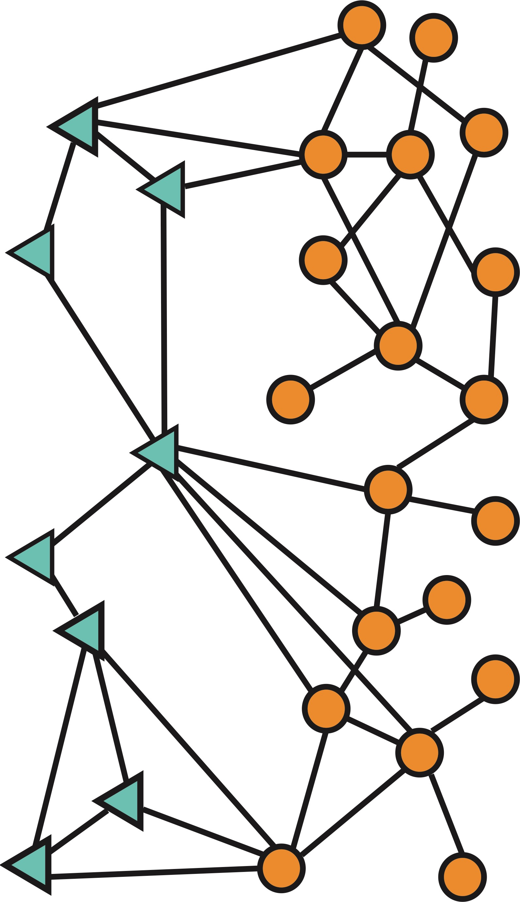
Types of ML tasks in graphs
Node
level
Graph-level prediction,
Graph generation
Community (subgraph)
level
Edge (link) level

Slide 7
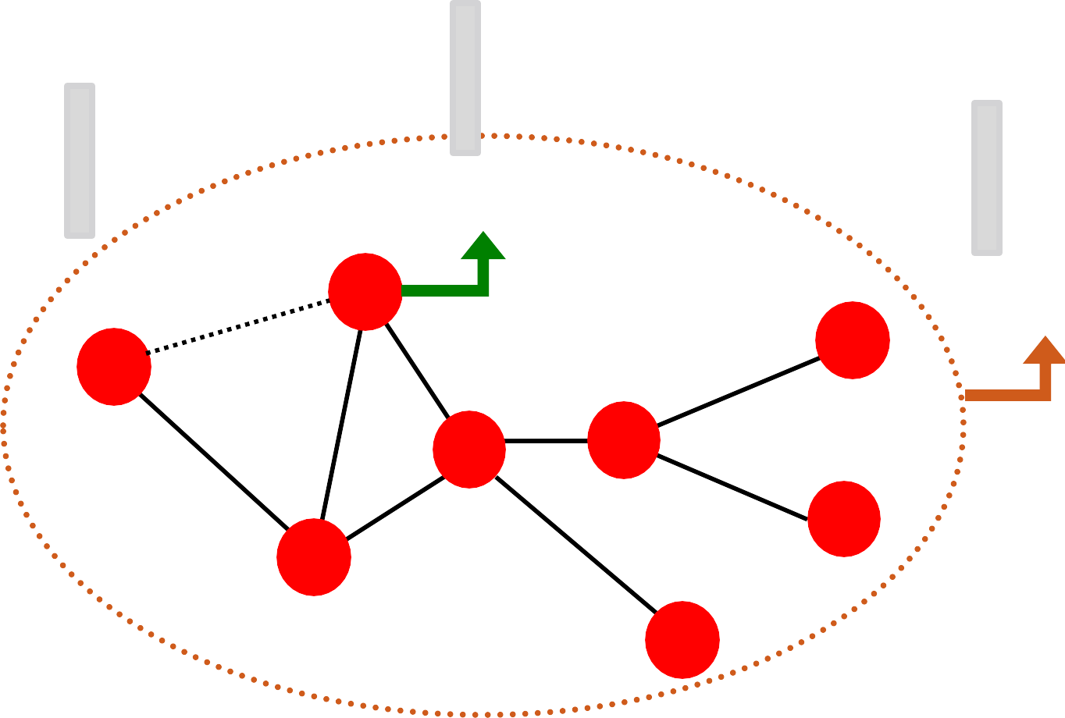
Traditional ML Pipeline
Design features for nodes/links/graphs
Obtain features for all training data
∈ ℝ^{𝐷}
∈ ℝ^{𝐷}
∈ ℝ^{𝐷}
Node features
B
Link features
A
Graph features
F
D
E
G
C
H

Slide 8
Traditional ML Pipeline
Train an ML model:
Random forest
SVM
Neural network, etc.
𝒙_{𝟏} 𝑦₁
Apply the model:
Given a new node/link/graph, obtain its features and make a prediction
𝒙 𝑦
𝒙_{𝑵}
𝑦_{𝑁}

Slide 9
Node Level Tasks (example)
?
?
?
?
Machine Learning
?
Node classification

Slide 10
Feature Design
Using effective features over graphs is the key to achieving good model performance.
Traditional ML pipeline uses hand- designed features.
We will overview traditional features for:
Node-level prediction
Link-level prediction
Graph-level prediction
For simplicity, we focus on undirected graphs.

Slide 11
Goal: Make predictions for a set of objects
Design choices:
Features: d-dimensional vectors
Objects: Nodes, edges, sets of nodes, entire graphs
Objective function:
What task are we aiming to solve?

Slide 12
NODE LEVEL FEATURES AND TASKS

Slide 13
Goal: Characterize the structure and position of a node in the network:
Node Level Features
Node degree
Node centrality
Clustering coefficient
Graphlets
A
Node feature
B
F
D
E
G
C
H

Slide 14
Node degree
The degree 𝑘_{𝑣} of node 𝑣 is the number of edges (neighboring nodes) the node has.
Treats all neighboring nodes equally.
𝑘_{𝐵} = 2
𝑘_{𝐴} = 1
A
B
𝑘_{𝐷} = 4
F
D
E
G
C
𝑘_{𝐶} = 3
H

Slide 15
Node centrality
Node degree counts the neighboring nodes without capturing their importance.
Node centrality 𝑐_{𝑣} takes the node importance in a graph into account
Different ways to model importance:
Eigenvector (Pagerank) centrality
Betweenness centrality
Closeness centrality
and many others…
Engienvector centrality

Slide 16
Pagerank centrality
A node 𝑣 is important if surrounded by important neighboring nodes 𝑢 ∈ 𝑁(𝑣).
We model the centrality of node 𝑣 as the sum of the centrality of neighboring nodes:
$$p\left(v\right)= \sum_{u → v}{\frac{p(u)}{OutDegree(u)}}$$

Slide 17
Betweness centrality
A node is important if it lies on many shortest paths between other nodes.
Example:
𝑐_{𝐴} = 𝑐_{𝐵} = 𝑐_{𝐸} = 0
𝑐_{𝐶} = 3
(A-C-B, A-C-D, A-C-D-E)
B
A
D
E
𝑐_{𝐷} = 3
(A-C-D-E, B-D-E, C-D-E)
C

Slide 18
Closeness centrality
A node is important if it has small shortest path lengths to all other nodes.
Example:
B
𝑐_{𝐴} = 1/(2 + 1 + 2 + 3) = 1/8
(A-C-B, A-C, A-C-D, A-C-D-E)
A
D
E
𝑐 = 1/(2 + 1 + 1 + 1) = 1/5
𝐷
(D-C-A, D-B, D-C, D-E)
C

Slide 19
Clustering coefficient
Measures how connected the neighboring nodes of $v$ are:
#(node pairs among 𝑘_{𝑣} neighboring nodes)
In our examples below the denominator is 6 (4 choose 2).
Examples:
𝑣
𝑣
𝑣
𝑒_{𝑣} = 1
𝑒_{𝑣} = 0.5
𝑒_{𝑣} = 0

Slide 20
Graphlets
Observation: Clustering coefficient counts the #(triangles) in the ego-network
𝑣
𝑣
𝑣
𝑣
𝑒_{𝑣} = 0.5
3 triangles (out of 6 node triplets)
We can generalize the above by counting #(pre-specified subgraphs), i.e., graphlets.

Slide 21
Graphlets
Goal: Describe network structure around node 𝑢
Graphlets are small subgraphs that describe the structure of node 𝑢’s network neighborhood
B
A
𝑢
E
Analogy:
C
Degree counts #(edges) that a node touches
Clustering coefficient counts #(triangles) that a node touches.
Graphlet Degree Vector (GDV): Graphlet-base features for nodes
GDV counts #(graphlets) that a node touches

Slide 22
Graphlets
Def: Induced subgraph is another graph, formed from a subset of vertices and all the edges connecting the vertices in that subset.
B
B
A
Induced subgraph:
Not induced
subgraph:
B
𝑢
E
𝑢
𝑢
C
C
C

Slide 23
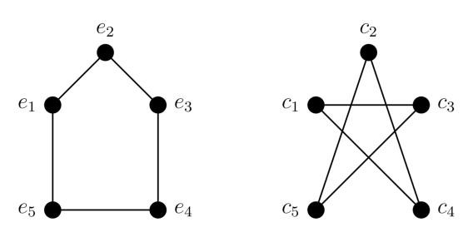
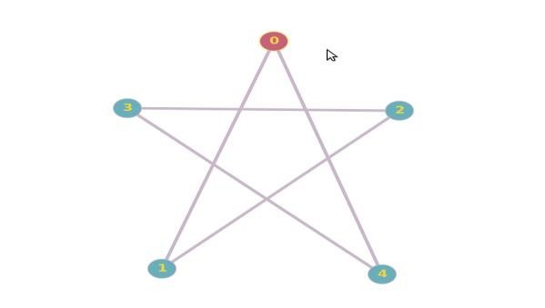
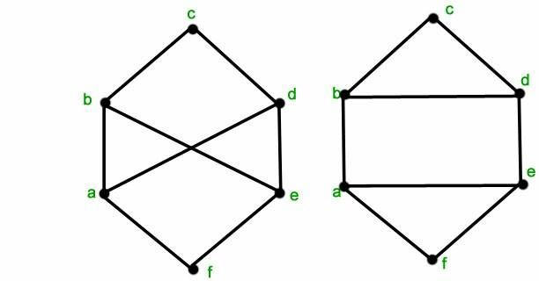
Graphlets
Def: Graph Isomorphism
Two graphs which contain the same number of nodes connected in the same way are said to be isomorphic.
(one-to-one mapping of their nodes)
Isomorphic
Node mapping: (e2,c2), (e1, c5),
(e3,c4), (e5,c3), (e4,c1)
Non-Isomorphic
The right graph has cycles of length 3 but the left graph does not, so the graphs cannot be isomorphic.
Source: Mathoverflow

Slide 24
Przulj et al., Bioinformatics 2004
Graphlets
Graphlets: Rooted connected induced non-isomorphic subgraphs:
All possible graphlets on up to 3 nodes
Graphlet Degree Vector (GDV): A count vector of graphlets rooted at a given node.

Slide 25
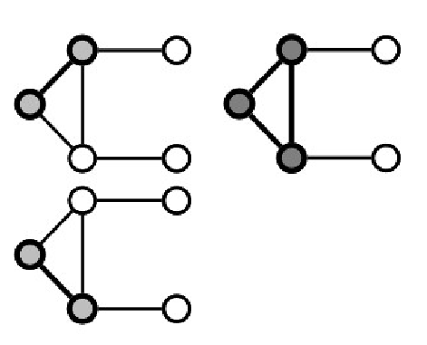
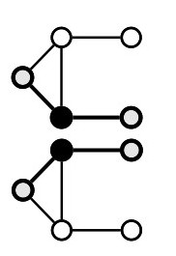
Graphlets
Example:
All possible graphlets on up to 3 nodes
$$u$$
Graphlet instances of node u:
$$a$$
$$b$$
$$c$$
$$d$$
Graphlets of node 𝑢:
𝑎, 𝑏, 𝑐, 𝑑
[2,1,0,2]
28

Slide 26
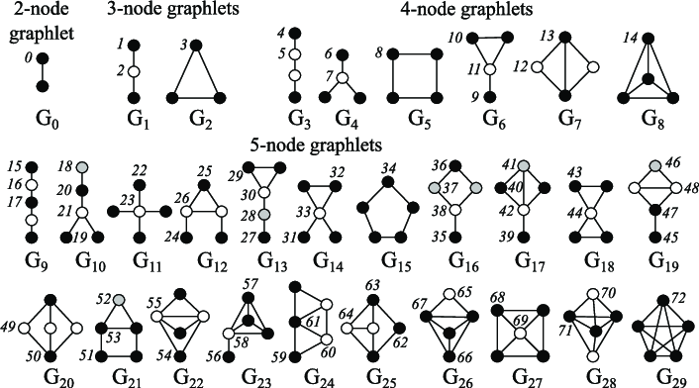
Przulj et al., Bioinformatics 2004
Graphlets
B
A
𝑢
E
C
𝑢 has graphlets: 0, 1, 2, 3, 5,
10, 11, …
Graphlet id (Root/
“position” of node 𝑢)
There are 73 different graphlets on up to 5 nodes

Slide 27
Graphlets
Considering graphlets of size 2-5 nodes we get:
Vector of 73 coordinates is a signature of a node that describes the topology of node's neighborhood
Graphlet degree vector provides a measure of a node’s local network topology:
Comparing vectors of two nodes provides a more detailed measure of local topological similarity than node degrees or clustering coefficient
B
A
𝑢
E
𝑢 has graphlets: 0, 1, 2, 3, 5, 10, 11, …
C
C

Slide 28
Node Level Features
We have introduced different ways to obtain node features.
They can be categorized as:
Importance-based features:
Node degree
Different node centrality measures
Structure-based features:
Node degree
Clustering coefficient
Graphlet count vector

Slide 29
Node Level Features
Importance-based features: capture the importance of a node in a graph
Node degree:
Simply counts the number of neighboring nodes
Node centrality:
Models importance of neighboring nodes in a graph
Different modeling choices: eigenvector centrality, betweenness centrality, closeness centrality
Useful for predicting influential nodes in a graph
Example: predicting celebrity users in a social network

Slide 30
Node Level Features
Structure-based features: Capture topological properties of local neighborhood around a node.
Node degree:
Counts the number of neighboring nodes
Clustering coefficient:
Measures how connected neighboring nodes are
Graphlet degree vector:
Counts the occurrences of different graphlets
Useful for predicting a particular role a node plays in a graph:
Example: Predicting protein functionality in a protein-protein interaction network.

Slide 31
Node Level Tasks
?
?
?
?
Machine Learning
?
Node classification

Slide 32
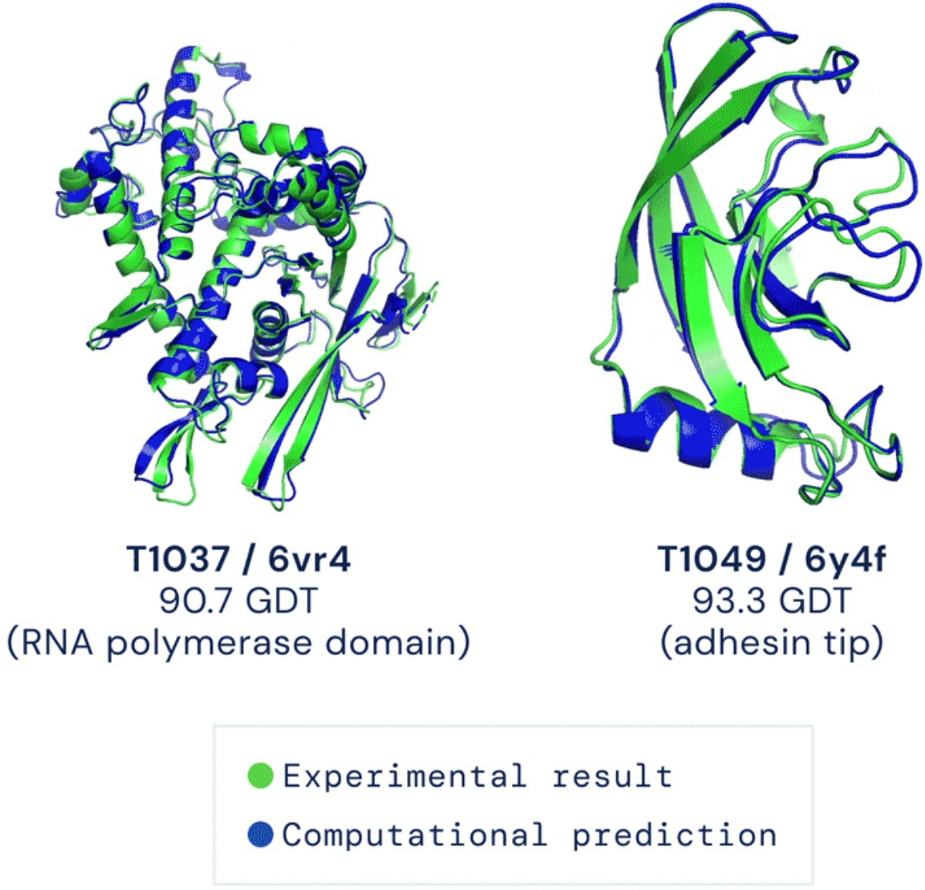
Computationally predict the 3D structure of a protein based solely on its amino acid sequence:
For each node predict its 3D coordinates
Protein Folding
Image credit: DeepMind

Slide 33
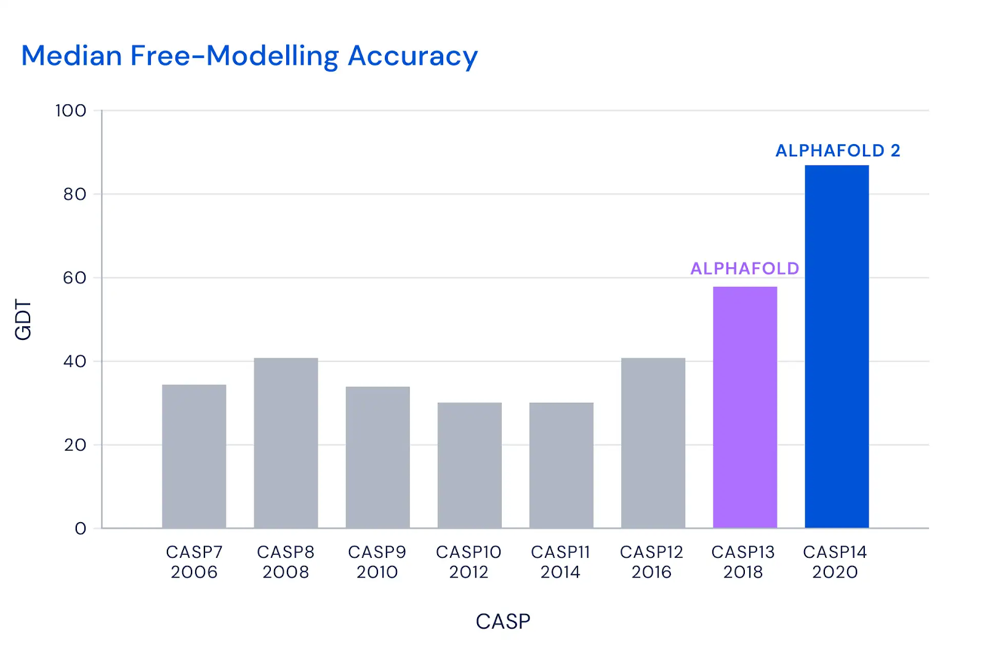
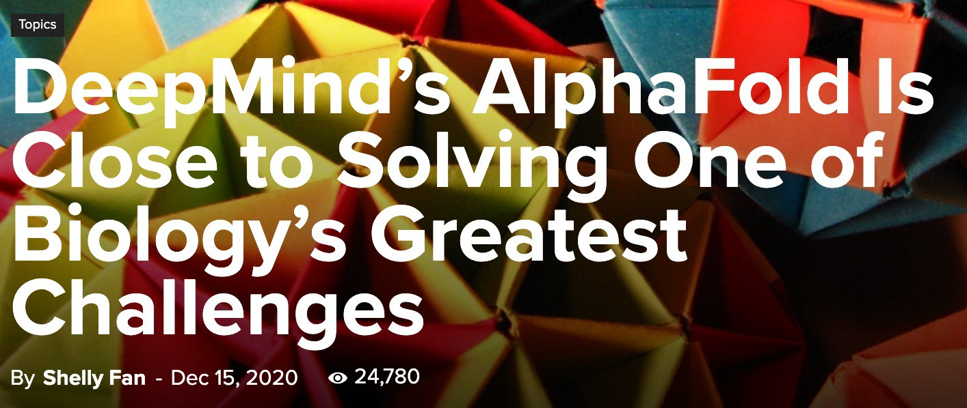
Image credit: DeepMind
Image credit: SingularityHub

Slide 34
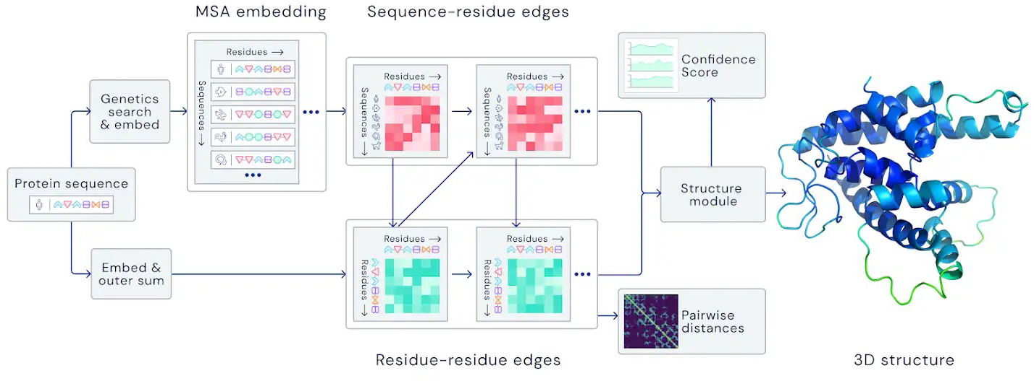
Key idea: “Spatial graph”
Nodes: Amino acids in a protein sequence
Edges: Proximity between amino acids (residues)
Spatial graph
Image credit: DeepMind

Slide 35
LINK PREDICTION

Slide 36
Link Prediction
The task is to predict new links based on the existing links.
Two ways: (a) define a score for each pair of nodes, rank pairs, return top K ones, (b) build a classifier with input pair of nodes, output probability of existence
?
B
F
A
D
E
G
C
?
H

Slide 37
Link Prediction
The key is to design features for a pair of nodes.
(for computing the score, as input to the classifier
First, score
?
B
F
A
D
E
G
C
?
H

Slide 38
Link Prediction
(1) Links missing at random:
Missing/unknown, incomplete information
Remove a random set of links and then aim to predict them

Slide 39
Link Prediction
(2) Temporal Links Prediction
Given 𝐺[𝑡₀, 𝑡′ ] a graph defined by edges
0
up to time 𝑡′ , output a ranked list L
0
of edges (not in 𝐺[𝑡₀, 𝑡′ ]) that are
0
′
predicted to appear in time 𝐺[𝑡₁, 𝑡₁]
𝐺[𝑡 , 𝑡′ ]
1
0 0
𝐺[𝑡₁, 𝑡′ ]
1

Slide 40
Score-based Link Prediction
Methodology:
For each pair of nodes (x,y) compute score c(x,y)
For example, c(x,y) could be the # of common neighbors of x and y
Sort pairs (x,y) by the decreasing score c(x,y)
Predict top n pairs as new links
Evaluation:
X
n = |E_{new}|: # new edges that appear during
the test period [𝑡₁, 𝑡′]
Take top n elements of L and count correct edges

Slide 41
Link Level Features
Distance-based feature
Local neighborhood overlap
Global neighborhood overlap
Link feature
A
B
F
D
E
G
C
H

Slide 42
Distance-based Features
Shortest-path distance between two nodes
Example:
B
F
𝑆_{𝐵𝐻} = 𝑆_{𝐵𝐸} = 𝑆_{𝐴𝐵} = 2
A
D
E
𝑆_{𝐵𝐺} = 𝑆_{𝐵𝐹} = 3
G
C
H
H
However, this does not capture the degree of neighborhood overlap:
Node pair (B, H) has 2 shared neighboring nodes, while pairs (B, E) and (A, B) only have 1 such node.

Slide 43
Local Neighborhood Features: Captures # neighboring nodes shared between two nodes
Local Neighborhood Overlap Features
Example:
Common neighbors:
$$c(A, B)$$
$$|N\left(v_{1}∩ v_{2}\right)|$$
B
𝑁
A
𝐵
Jaccard coefficient:
D
E
$$\frac{|N\left(v_{1}∩ v_{2}\right)| }{|N\left(v_{1}∪ v_{2}\right)| }$$
C
𝑁
𝐴
F

Slide 44
Local Neighborhood Overlap Features
Adamic-Adar index:
$$\sum_{u ∈N\left(v_{1}\right) ∩ {N(v}_{2})}{\frac{1}{log⁡(k_{u})}}$$
B
𝑁
A
𝐵
D
E
C
𝑁
𝐴
F

Slide 45
Global Neighborhood Overlap Features
Limitation of local neighborhood features:
Metric is always zero if the two nodes do not have any neighbors in common.
B
𝑁_{𝐸}
A
D
E
𝑁_{𝐴} ∩ 𝑁_{𝐸} = 𝜙
|𝑁_{𝐴} ∩ 𝑁_{𝐸} | = 0
C
𝑁_{𝐴}
F
However, the two nodes may still potentially connect in the future.
Global neighborhood overlap metrics resolve the limitation by considering the entire graph.

Slide 46
Global Neighborhood Overlap Features
Katz index: counts the number of walks of all lengths between a given pair of nodes.
How to compute #walks between two nodes?
Use powers of the adjacency matrix!

Slide 47
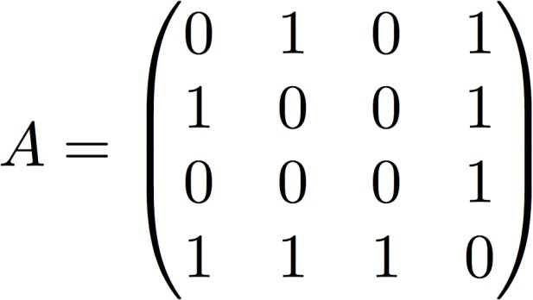
Global Neighborhood Overlap Features
Computing #walks between two nodes
Recall: 𝑨_{𝑢𝑣} = 1 if 𝑢 ∈ 𝑁(𝑣)
Let 𝑷^{(𝑲)} = #walks of length 𝑲 between 𝒖 and 𝒗
𝒖𝒗
We will show 𝑷^{(𝑲)} = 𝑨^{𝒌}
𝑷^{(𝟏)} = #walks of length 1 (direct neighborhood)
𝒖𝒗
between 𝑢 and 𝑣 = 𝑨_{𝒖𝒗}
_{𝑷}(𝟏) _{= 𝑨}
𝟏𝟐
𝟏𝟐
4
3
2
1

Slide 48
Global Neighborhood Overlap Features
How to compute ?
Step 1: Compute #walks of length 1 between each of 𝒖’s neighbor and 𝒗
Step 2: Sum up these #walks across u’s neighbors
𝑷^{(𝟐)} = Σ 𝑨 ∗ 𝑷^{(𝟏)} = Σ 𝑨 ∗ 𝑨 = 𝑨^{𝟐}
𝒖𝒗 𝒊 𝒖𝒊 𝒊 𝒖𝒊 𝒊𝒗
𝒖𝒗
𝒊𝒗
#walks of length 1 between Node 1’s neighbors and Node 2
_{𝑷}(𝟐) _{= 𝑨2}
Node 1’s neighbors
𝟏𝟐
12
Power of adjacency

Slide 49
Global Neighborhood Overlap Features
How to compute #walks between two nodes?
Use adjacency matrix powers
𝑨_{𝑢𝑣} specifies #walks of length 1 (direct neighborhood) between 𝑢 and 𝑣.
𝑨^{𝟐} specifies #walks of length 2 (neighbor of
𝑢𝑣
neighbor) between 𝑢 and 𝑣.
And, 𝑨^{𝒍}
specifies #walks of length 𝒍.
𝑢𝑣

Slide 50
Global Neighborhood Overlap Features
Katz index between 𝑣₁ and 𝑣₂ is calculated as
Sum over all walk lengths
#walks of length 𝑙
between 𝑣₁ and 𝑣₂
0 < 𝛽 < 1: discount factor
Katz index matrix is computed in closed-form:
= σ∞
_{𝛽}𝑖 _{𝑨}𝑖
𝑖=0
by geometric series of matrices

Slide 51
Link Level Features
Distance-based features:
Uses the shortest path length between two nodes but does not capture how neighborhood overlaps.
Local neighborhood overlap:
Captures how many neighboring nodes are shared by two nodes.
Becomes zero when no neighbor nodes are shared.
Global neighborhood overlap:
Uses global graph structure to score two nodes.
Katz index counts #walks of all lengths between two nodes.

Slide 52
Classification for Link Prediction
Predict link $e=(v, u)$
Input
Features describing $v$ and $u$
Output
Prediction
positive class: link
negative class: no-link

Slide 53
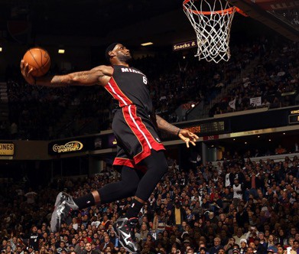
Example: Recommender Systems
Users interacts with items
Watch movies, buy merchandise, listen to music
Nodes: Users and items
Edges: User-item interactions
Goal: Recommend items users might like
Users
Interactions
“You might also like”
Items
52

Slide 54
Many patients take multiple drugs to treat complex or co-existing diseases:
Example: Drug Side Effects
46% of people ages 70-79 take more than 5 drugs
Many patients take more than 20 drugs to treat heart disease, depression, insomnia, etc.
Task: Given a pair of drugs predict
adverse side effects
,
30%
prob.
65%
prob.

Slide 55
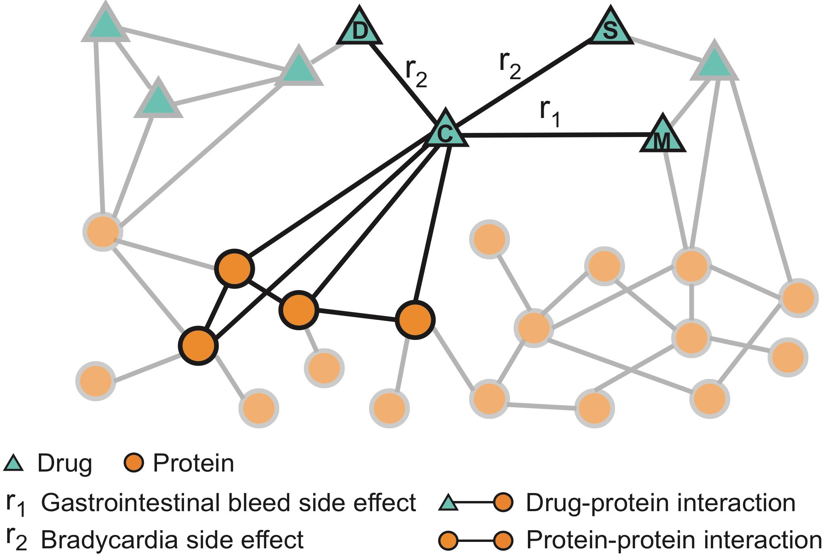
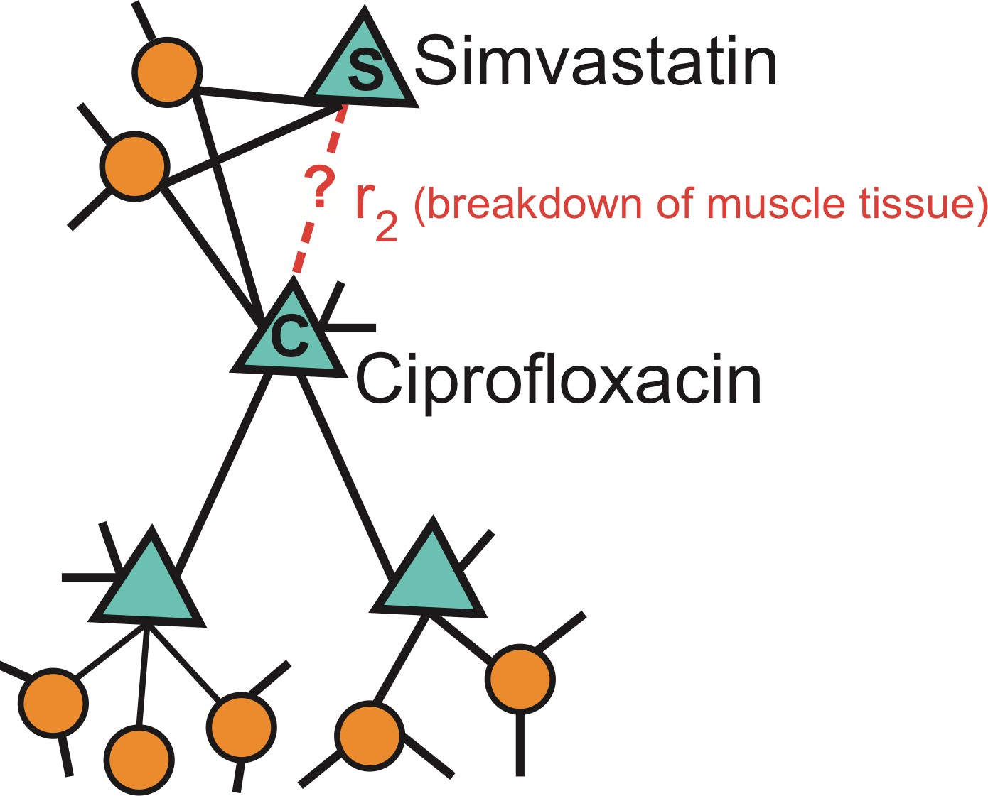
Zitnik et al., Modeling Polypharmacy Side Effects with Graph Convolutional Networks, Bioinformatics 2018
Example: Drug Side Effects
Nodes: Drugs & Proteins
Edges: Interactions
Query: How likely will Simvastatin and Ciprofloxacin, when taken together, break down muscle tissue?

Slide 56
GRAPH LEVEL FEATURES AND TASKS

Slide 57
Graph Level Features
Goal: We want features that characterize the structure of an entire graph.
For example:
B
F
A
D
E
G
C
H

Slide 58
Graph Kernels
Graph Kernels: Measure similarity between two graphs
Kernel $K\left(G, G^{′}\right)$∈ ℝ measures similarity
Kernel matrix 𝑲 = 𝐾 𝐺, 𝐺′
′ must always be
𝐺,𝐺
positive semidefinite (i.e., has positive eigenvalues)
There exists a feature representation 𝜙(∙) such that
𝐾 𝐺, 𝐺′ = 𝜙 G ^{T}𝜙 𝐺′
Once the kernel is defined, off-the-shelf ML model, such as kernel SVM, can be used to make predictions.

Slide 59
Graph Kernels
Graph Kernels: Measure similarity between two graphs:
Graphlet Kernel [1]
Weisfeiler-Lehman Kernel [2]
Other kernels are also proposed in the literature
(beyond the scope of this lecture)
Random-walk kernel
Shortest-path graph kernel
And many more…
Shervashidze, Nino, et al. "Efficient graphlet kernels for large graph comparison." Artificial Intelligence and Statistics. 2009.
Shervashidze, Nino, et al. "Weisfeiler-lehman graph kernels." Journal of Machine Learning Research 12.9 (2011).

Slide 60
Graph Kernels
Goal: Design graph feature vector 𝜙(G)
Key idea: Bag-of-Words (BoW) for a graph
BoW simply uses the word counts as features for documents (no ordering considered).
Naïve extension to a graph: Regard nodes as words.
Since both graphs have 4 red nodes, we get the
same feature vector for two different graphs
𝜙( ) = 𝜙

Slide 61
Graph Kernels
What if we use Bag of node degrees?
Deg1: Deg2: Deg3:
𝜙( ) = count(
𝜙( ) = count(
) = [1, 2, 1]
Obtains different features for different graphs!
) = [0, 2, 2]
Both Graphlet Kernel and Weisfeiler-Lehman (WL) Kernel use Bag-of-* representation of graph, where * is more sophisticated than node degrees!

Slide 62
Graphlet Features
Key idea: Count the number of different graphlets in a graph.
Note: Definition of graphlets here is slightly different from node-level features.
The two differences are:
Nodes in graphlets here do not need to be connected (allows for isolated nodes)
The graphlets here are not rooted.

Slide 63
Let 𝓖_{𝒌} = (𝒈_{𝟏,} 𝒈_{𝟐}, … , 𝒈_{𝒏𝒌}) be a list of graphlets of size 𝒌.
Graphlet Features
For 𝑘 = 3 , there are 4 graphlets.
𝑔₁ 𝑔₂ 𝑔₃
𝑔₄
For 𝑘 = 4 , there are 11 graphlets.
Shervashidze et al., AISTATS 2011

Slide 64
Graphlet Features
Given graph 𝐺, and a graphlet list 𝒢_{𝑘}= (𝑔_{1,} 𝑔₂, … , 𝑔_{𝑛𝑘}), define the graphlet count
vector 𝒇_{𝐺} ∈ ℝ^{𝑛𝑘} as
(𝒇_{𝐺})_{𝑖}= #(𝑔_{𝑖} ⊆ 𝐺) for 𝑖 = 1,2, … , 𝑛_{𝑘}.

Slide 65
Graphlet Features
Example for 𝑘 = 3.
𝑔₁
𝑔₂
𝑔₃
𝑔₄
𝐺
𝒇_{𝐺} = (1,
3,
6,
0)^{T}

Slide 66
Graphlet Kernel
Given two graphs, 𝐺 and 𝐺′, graphlet kernel is computed as
𝐾 𝐺, 𝐺′ = 𝒇_{𝐺}^{T}𝒇 ′
𝐺
Problem: if 𝐺 and 𝐺′ have different sizes, that will greatly skew the value.
Solution: normalize each feature vector
𝐾 𝐺, 𝐺′ = 𝒉_{𝐺}^{T}𝒉 ′
𝐺

Slide 67
Graphlet Kernel
Limitation: Counting graphlets is expensive
Counting size-𝑘 graphlets for a graph with size 𝑛 by enumeration takes 𝑛^{𝑘}.
This is unavoidable in the worst-case since subgraph isomorphism test (judging whether a graph is a subgraph of another graph) is NP-hard.
If the node degree of a graph is bounded by 𝑑, an 𝑂(𝑛𝑑^{𝑘−1}) algorithm exists to count all the graphlets of size 𝑘.
Can we design a more efficient graph kernel?

Slide 68
Weisfeiler-Lehman Kernel
Goal: Design an efficient graph feature descriptor 𝜙(G)
Idea: Use neighborhood structure to iteratively enrich node vocabulary.
Generalized version of Bag of node degrees since node degrees are one-hop neighborhood information.
Algorithm to achieve this:
Color refinement

Slide 69
Color Refinement
Given: A graph 𝐺 with a set of nodes 𝑉.
Assign an initial color 𝑐 ⁰ 𝑣 to each node 𝑣.
Iteratively refine node colors by
𝑐 ^{𝑘+1} 𝑣 = HASH 𝑐 ^{𝑘} 𝑣 , 𝑐 ^{𝑘} 𝑢 ,
𝑢∈𝑁 𝑣
where HASH maps different inputs to different colors.
After 𝐾 steps of color refinement, 𝑐 ^{𝐾} 𝑣
summarizes the structure of 𝐾-hop neighborhood

Slide 70
Color Refinement
Assign initial colors
1
1
𝐺₂
1
1
𝐺₁
1
1
1
1
1 1
Aggregate neighboring colors
1
1
1,111
1,11
1,11
1,111
1,1111
1,111
1,1111
1,111
1,1
1,1
1,1
1,1

Slide 71
Color Refinement
Aggregated colors
1,111 1,11
1,11 1,111
1,1111
1,111
1,1111
1,111
1,1
1,1
1,1
1,1
Hash aggregated colors
Hash table
4
3
3
4
1,1 | --> | 2
1,11 | --> | 3
1,111 | --> | 4
1,1111 | --> | 5
5
4
5
4
2
2
2
2

Slide 72
Color Refinement
Aggregated colors
4
3
3
4
5
4
5
4
2 2
Hash aggregated colors
2
2
3,45
4,345
4,345
3,44
5,2244
4,345
5,2344
4,245
2,5
2,5
2,5
2,4

Slide 73
Color Refinement
Aggregated colors
3,45 4,345
4,345 3,44
5,2244
4,345
5,2344
4,245
2,5
2,5
2,5 2,4
Hash table
2,4 --> 6
Hash aggregated colors
11
8
9
11
2,5 | --> | 7
3,44 | --> | 8
3,45 | --> | 9
4,245 | --> | 10
4,345 | --> | 11
5,2244 | --> | 12
5,2344 | --> | 13
12
11
13
10
7
7
7
6

Slide 74
Weisfeiler-Lehman Kernel
After color refinement, WL kernel counts number of nodes with a given color.
Colors 1,2,3,4,5,6,7,8,9,10,11,12,13
= [6,2,1,2,1,0,2,1,0, 0,0,2,1]
Colors 1,2,3,4,5,6,7,8,9,10,11,12,13= [6,2,1,2,1,1,1,0,1, 1,1,0,1]

Slide 75
K( , )
Weisfeiler-Lehman Kernel
The WL kernel value is computed by the inner product of the color count vectors:
=
= 49

Slide 76
Weisfeiler-Lehman Kernel
WL kernel is computationally efficient
The time complexity for color refinement at each step is linear in #(edges), since it involves aggregating neighboring colors.
When computing a kernel value, only colors appeared in the two graphs need to be tracked.
Thus, #(colors) is at most the total number of nodes.
Counting colors takes linear-time w.r.t. #(nodes).
In total, time complexity is linear in #(edges).

Slide 77
Graph Kernels
Graphlet Kernel
Graph is represented as Bag-of-graphlets
Computationally expensive
Weisfeiler-Lehman Kernel
Apply 𝐾-step color refinement algorithm to enrich node colors
Different colors capture different 𝐾-hop neighborhood structures
Graph is represented as Bag-of-colors
Computationally efficient
Closely related to Graph Neural Networks (as we will see!)

Slide 78
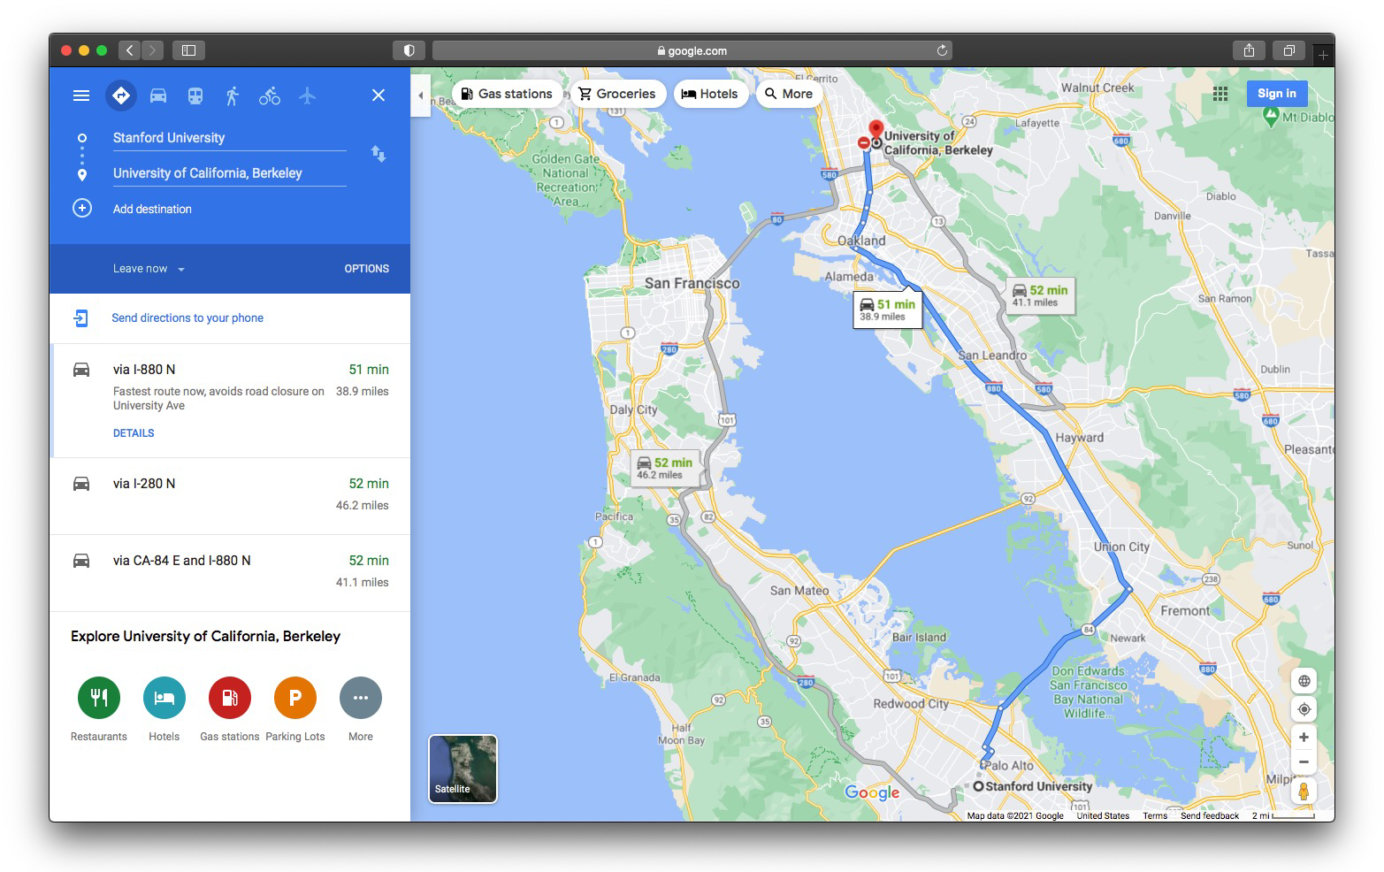
Example 1: Traffic Prediction
a

Slide 79
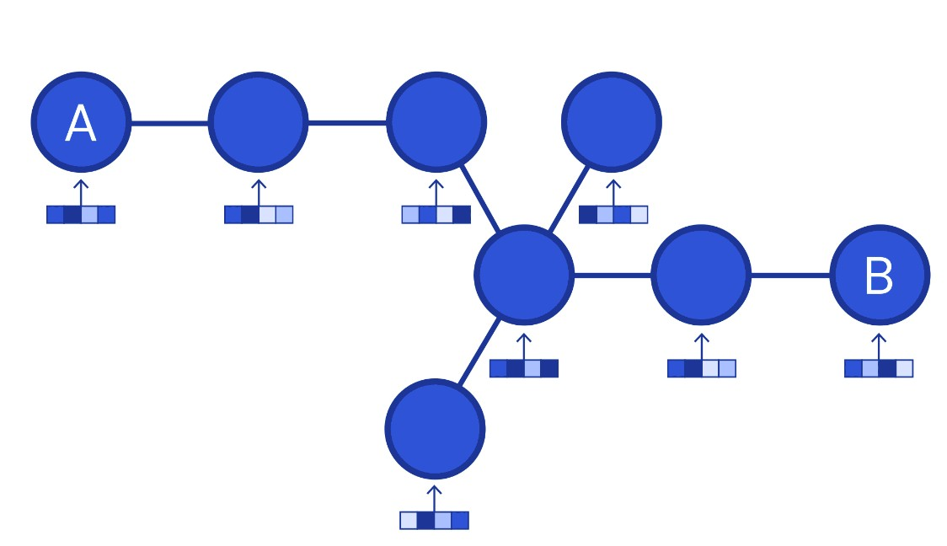
Traffic Prediction
Road networks as graphs
Nodes: Road segments
Edges: Connectivity between road segments
Prediction: Time of Arrival (ETA)
Image credit: DeepMind

Slide 80
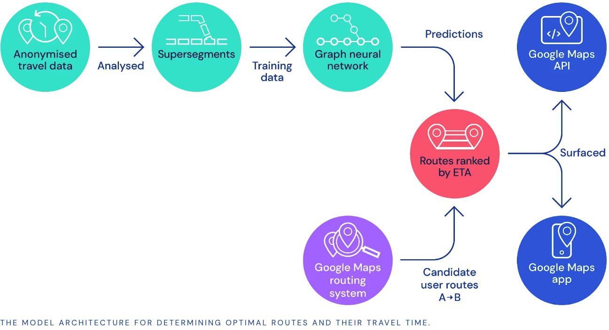
Predicting Time of Arrival with GNNS
Traffic Prediction with GNNs
Used in Google Maps
Image credit: DeepMind

Slide 81
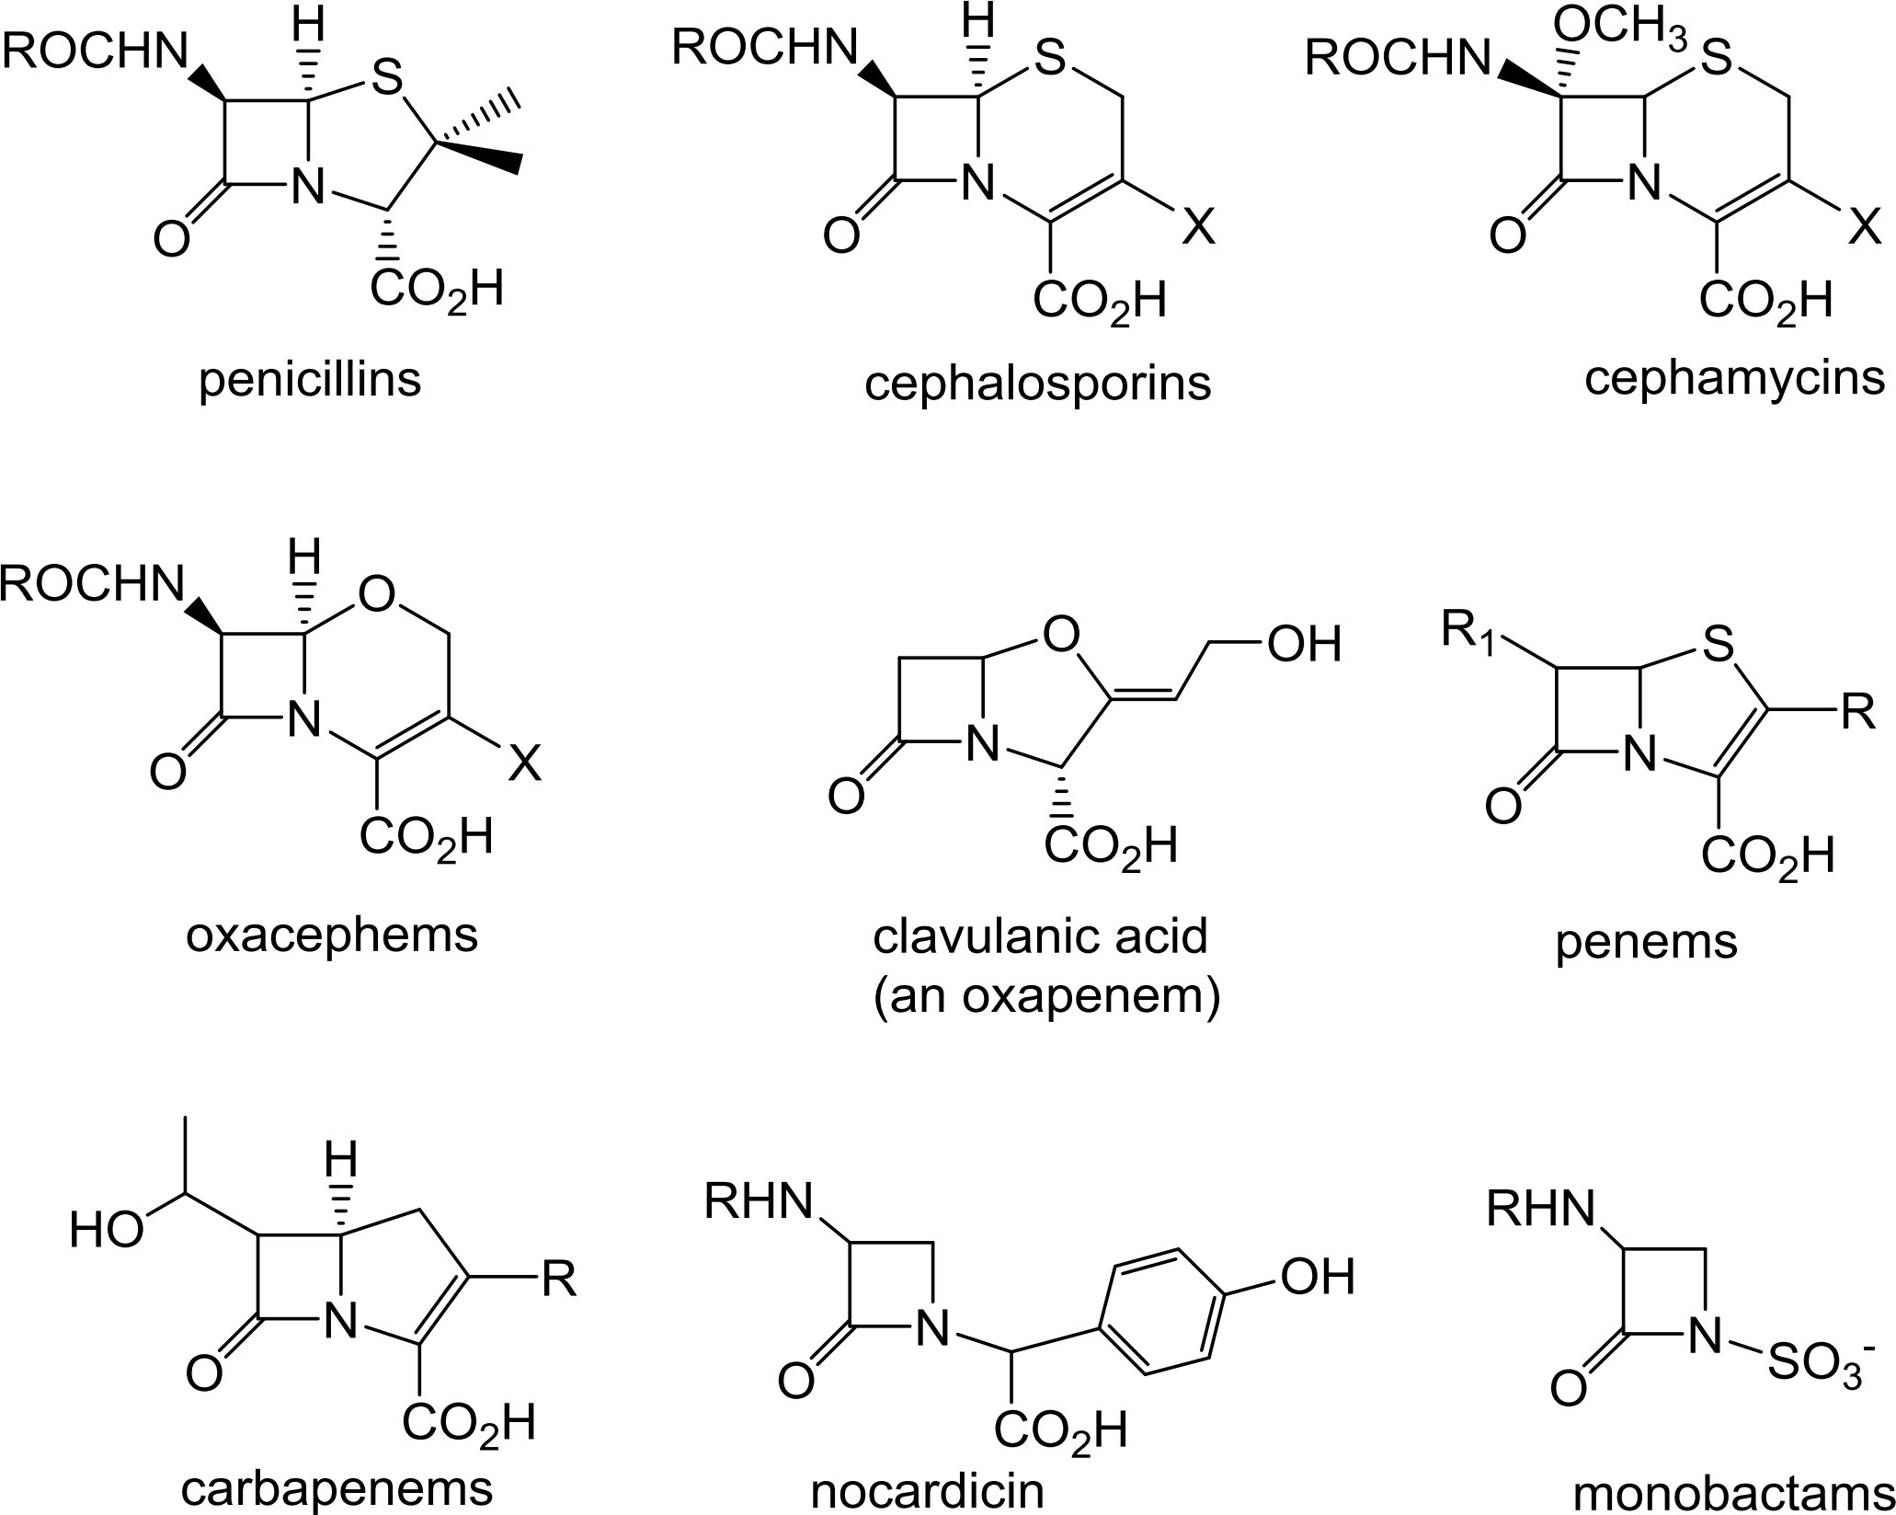
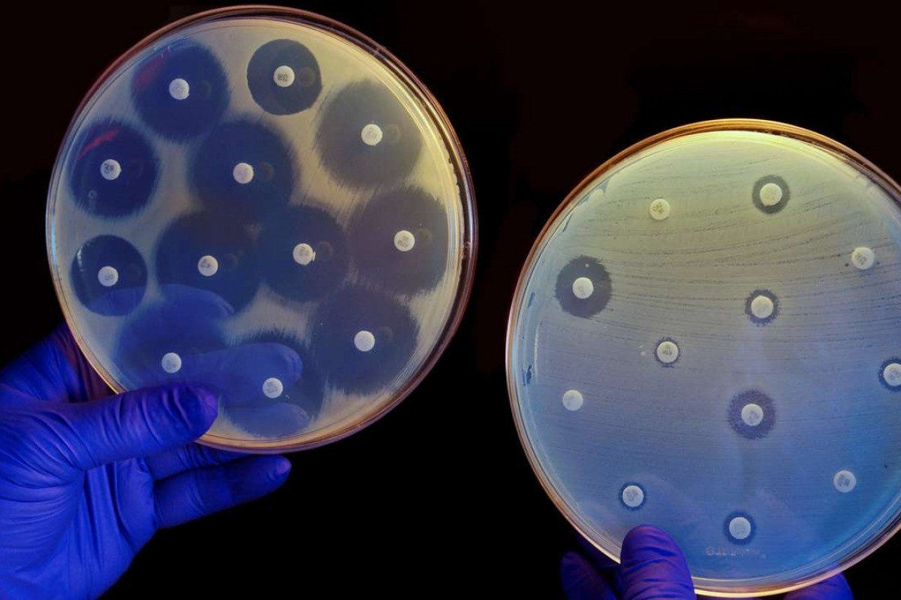
Example 2: Drug Prediction
Antibiotics are small molecular graphs
Nodes: Atoms
Edges: Chemical bonds
Konaklieva, Monika I. "Molecular targets of β-lactam-based antimicrobials: beyond the usual suspects." Antibiotics 3.2 (2014): 128-142.
Image credit: CNN

Slide 82
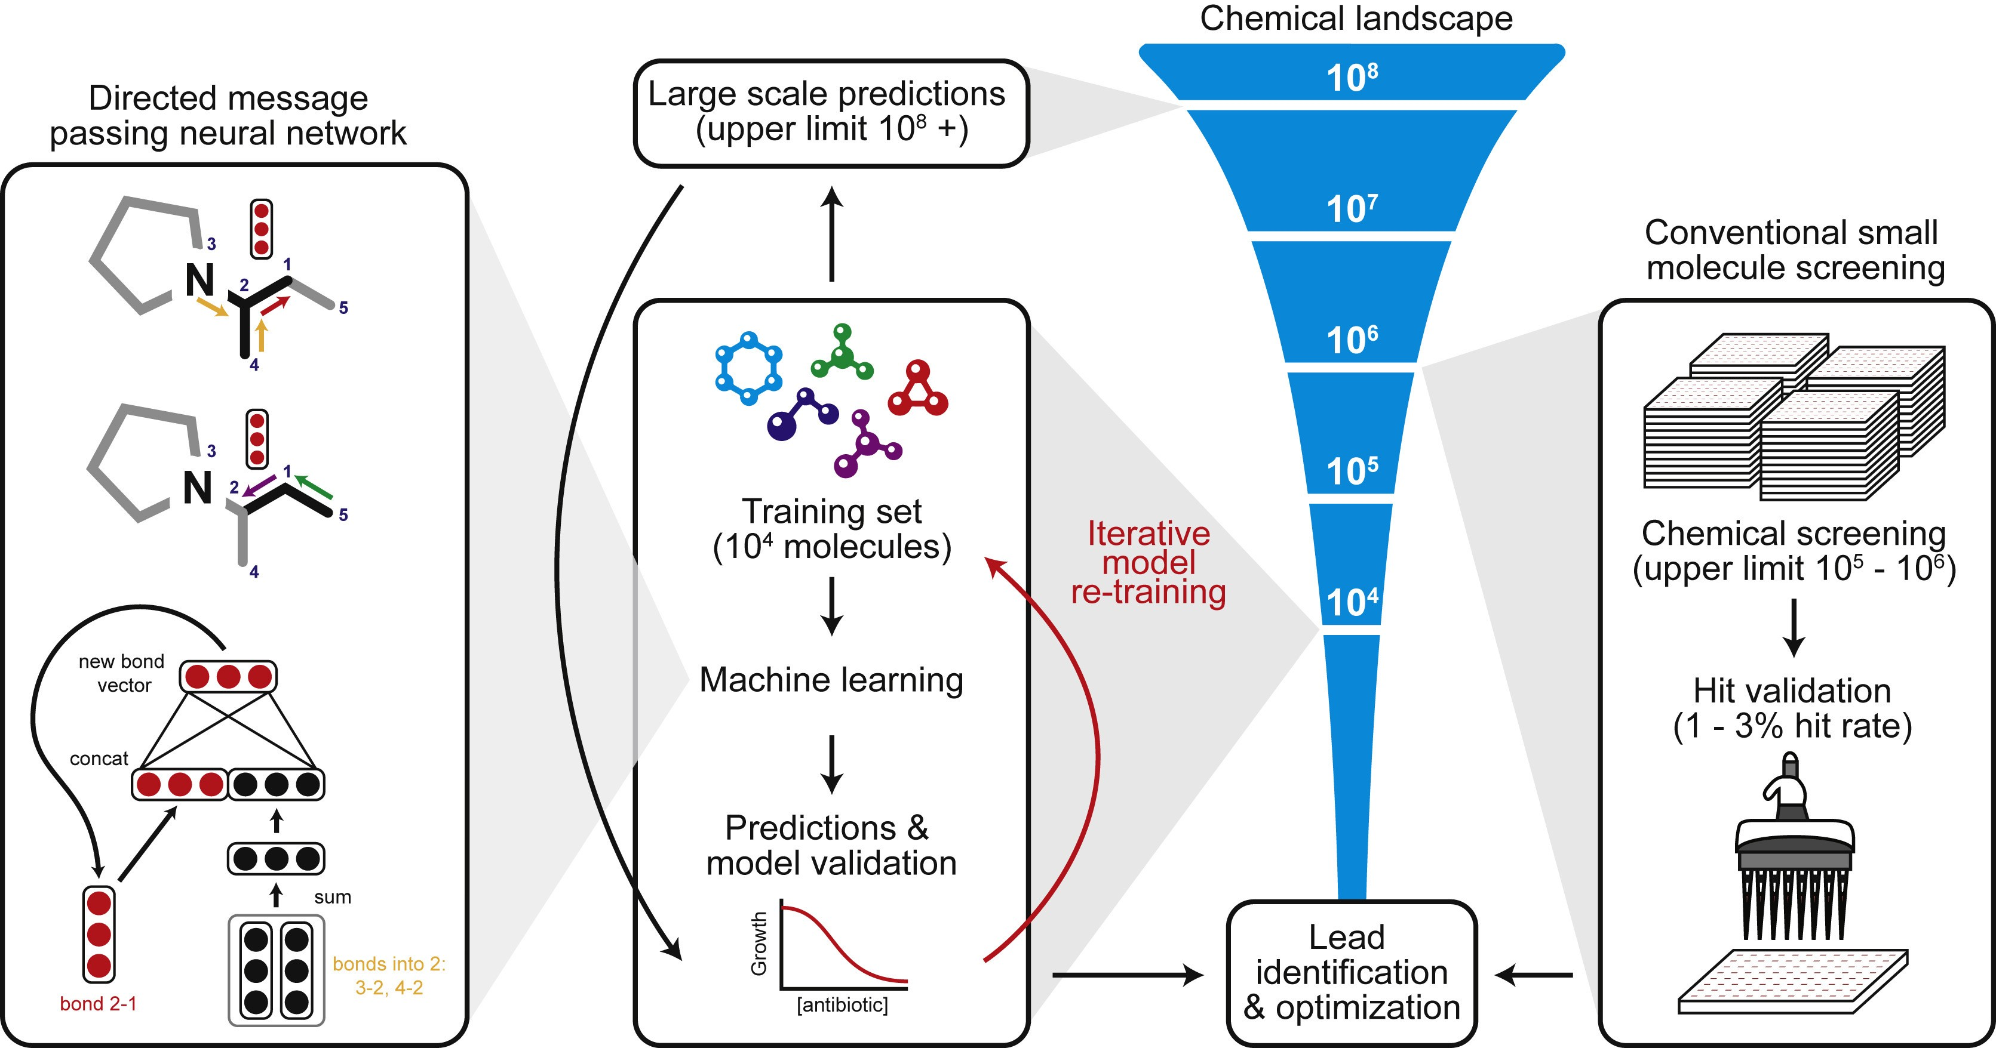
Stokes et al., A Deep Learning Approach to Antibiotic Discovery, Cell 2020
Drug Prediction
A Graph Neural Network graph classification model
Predict promising molecules from a pool of candidates
Stokes, Jonathan M., et al. "A deep learning approach to antibiotic discovery." Cell 180.4 (2020): 688-702.

Slide 83
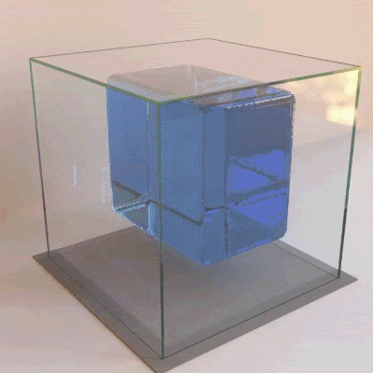
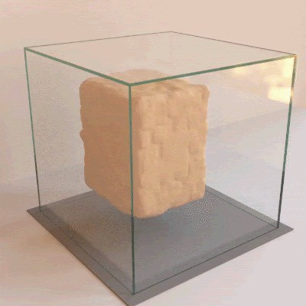
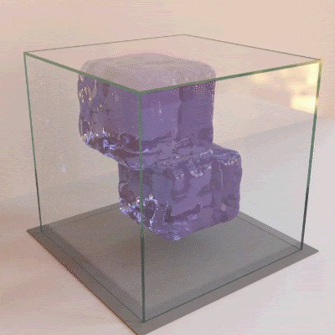
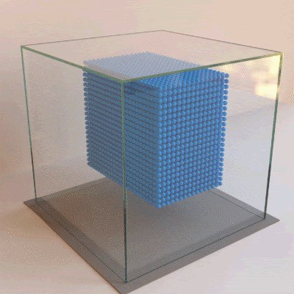
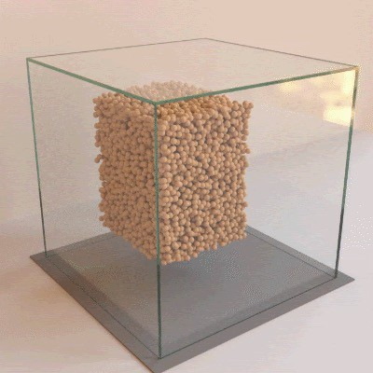
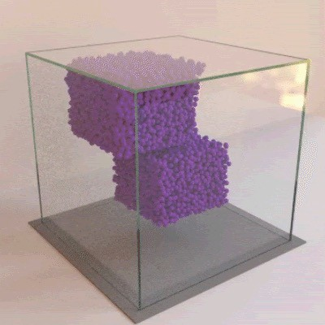
Physical simulation as a graph:
Sanchez-Gonzalez et al., Learning to simulate complex physics with graph networks, ICML 2020
Example 3: Physical Simulation
Nodes: Particles
Edges: Interaction between particles

Slide 84
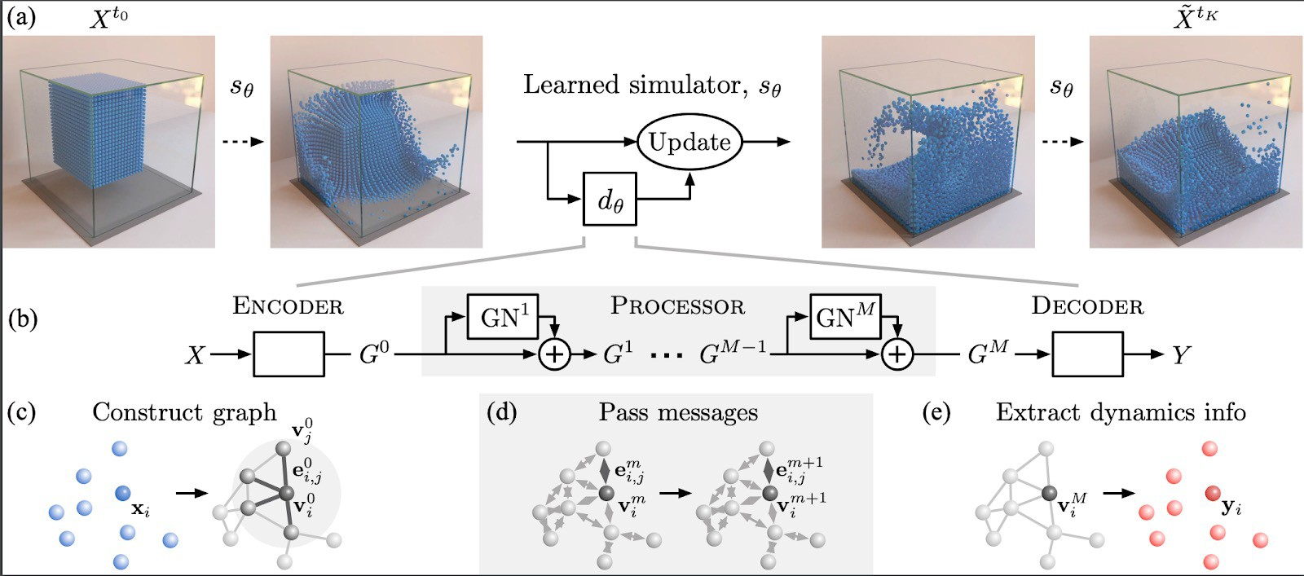
A graph evolution task:
Sanchez-Gonzalez et al., Learning to simulate complex physics with graph networks, ICML 2020
Physical Simulation
Goal: Predict how a graph will evolve over
time

Slide 85
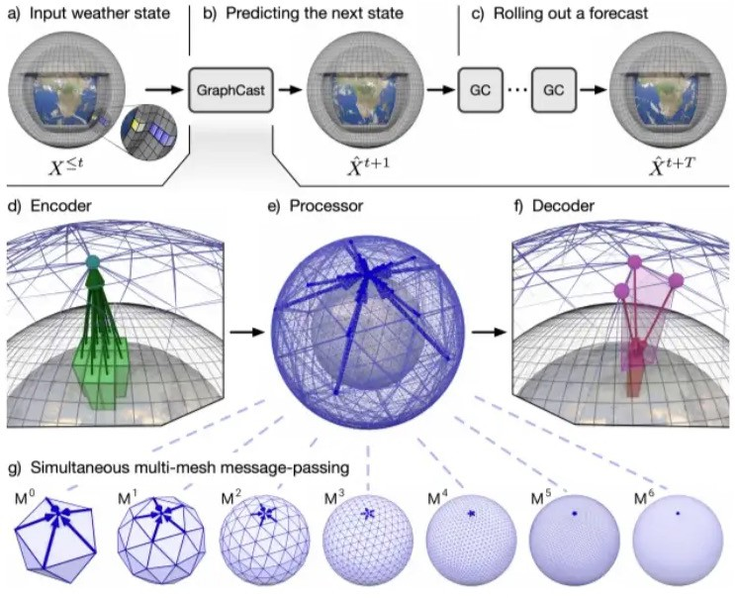
Application: Weather Forecasting
https://medium.com/syncedreview/deepmind-googles-ml-based-graphcast-outperforms-the-world-s-best-medium-range-weather- 9d114460aa0c

Slide 86
Summary
Traditional ML Pipeline
Hand-crafted feature + ML model
Hand-crafted features for graph data
Node-level:
Node degree, centrality, clustering coefficient, graphlets
Link-level:
Distance-based feature
local/global neighborhood overlap
Graph-level:
Graphlet kernel, WL kernel

Slide 87
Acknowledgement
Most slides from
CS224W: Machine Learning with Graphs, Jure Leskovec, Stanford University, http://cs224w.stanford.edu

