Slide 1
DATA MINING
Similarity & Distance
Similarity and Distance
Recommender Systems

Slide 2
SIMILARITY AND DISTANCE
Thanks to:
Tan, Steinbach, and Kumar, “Introduction to Data Mining”
Rajaraman and Ullman, “Mining Massive Datasets”

Slide 3
Similarity and Distance
For many different problems we need to quantify how close two objects are.
Examples:
  For an item bought by a customer, find other similar items
  Group together the customers of a site so that similar customers are shown the same ad.
  Group together web documents so that you can separate the ones that talk about politics and the ones that talk about sports.
  Find all the near-duplicate mirrored web documents.
  Find credit card transactions that are very different from previous transactions.
To solve these problems, we need a definition of similarity, or distance.
  The definition depends on the type of data that we have

Slide 4
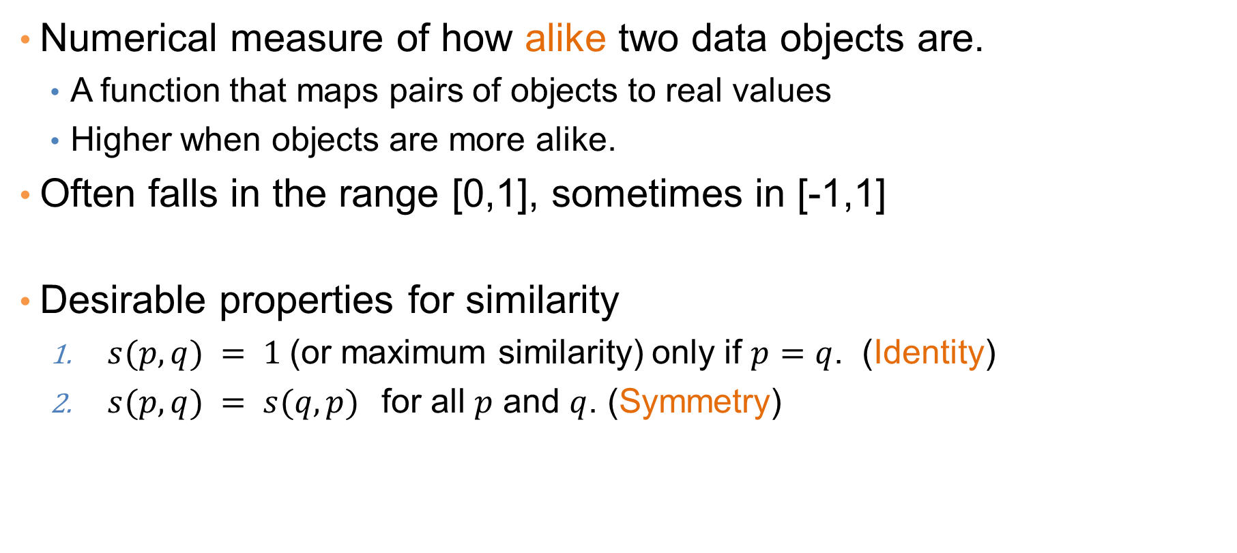
Similarity
Numerical measure of how alike two data objects are.
  A function that maps pairs of objects to real values
  Higher when objects are more alike.
Often falls in the range [0,1], sometimes in [-1,1]
Desirable properties for similarity
  $s(p, q) = 1$(or maximum similarity) only if $p=q$. (Identity)
  $s(p, q) = s(q, p)$for all $p$ and $q$. (Symmetry)

Slide 5
Similarity between sets
Consider the following documents
Which ones are more similar?
How would you quantify their similarity?
apple releases new ipod
apple releases new ipad
new apple pie recipe

Slide 6
Similarity: Intersection
Number of words in common
Sim(D,D) = 3, Sim(D,D) = Sim(D,D) =2
What about this document?
Sim(D,D) = Sim(D,D) = 3
apple releases new ipod
apple releases new ipad
new apple pie recipe
Akis releases new book with apple pie recipes

Slide 7
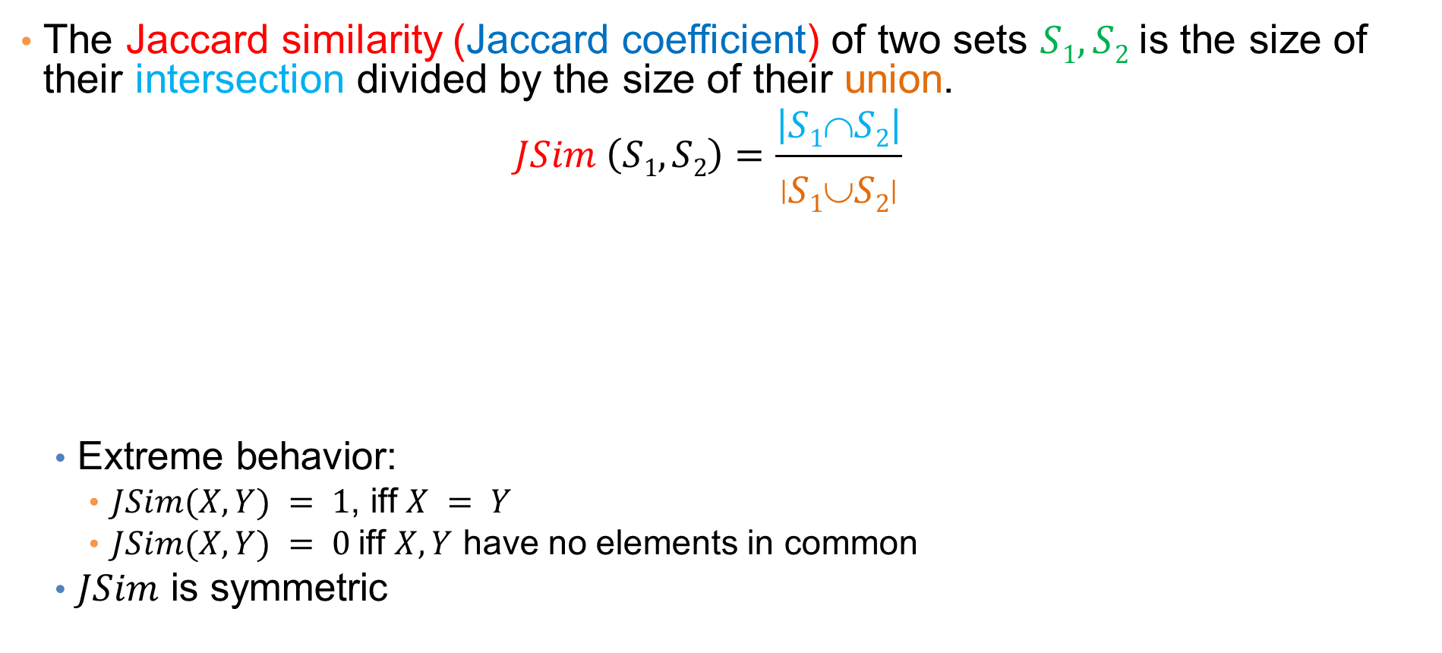
Jaccard Similarity
The Jaccard similarity (Jaccard coefficient) of two sets $S1, S2$is the size of their intersection divided by the size of their union.
  $$JSim \left(S1, S2\right)=\frac{\left|S1∩S2\right|}{\left|S1∪S2\right|}$$
  Extreme behavior:
    $JSim(X,Y) = 1$, iff $X = Y$
    $JSim(X,Y) = 0$iff $X,Y$ have no elements in common
  $JSim$ is symmetric
Probabilistic interpretation:
The Jaccard similarity of two sets is the probability that a randomly selected element from the union is in the intersection
3 in intersection.
8 in union.
Jaccard similarity = 3/8

Slide 8
Jaccard Similarity between sets
The distance for the documents
JSim(D,D) = 3/5
JSim(D,D) = JSim(D,D) = 2/6
JSim(D,D) = JSim(D,D) = 3/9
apple releases new ipod
apple releases new ipad
new apple pie recipe
Akis releases new book with apple pie recipes

Slide 9
Similarity between vectors
Documents (and sets in general) can also be represented as vectors
document | Apple | Microsoft | Obama | Election
D1 | 10 | 20 | 0 | 0
D2 | 30 | 60 | 0 | 0
D3 | 60 | 30 | 0 | 0
D4 | 0 | 0 | 10 | 20
How do we measure the similarity of two vectors?
  We could view them as sets of words. Jaccard Similarity will show that D4 is different form the rest
  But all pairs of the other three documents are equally similar
We want to capture how well the two vectors are aligned

Slide 10
Example
document | Apple | Microsoft | Obama | Election
D1 | 10 | 20 | 0 | 0
D2 | 30 | 60 | 0 | 0
D3 | 60 | 30 | 0 | 0
D4 | 0 | 0 | 10 | 20
apple
Documents D1, D2 are in the “same direction”
Document D3 is on the same plane as D1, D2
Document D4 is orthogonal to the rest
microsoft
{Obama, election}

Slide 11
Example
document | Apple | Microsoft | Obama | Election
D1 | 10 | 20 | 0 | 0
D2 | 30 | 60 | 0 | 0
D3 | 60 | 30 | 0 | 0
D4 | 0 | 0 | 10 | 20
apple
Documents D1, D2 are in the “same direction”
Document D3 is on the same plane as D1, D2
Document D4 is orthogonal to the rest
microsoft
{Obama, election}

Slide 12
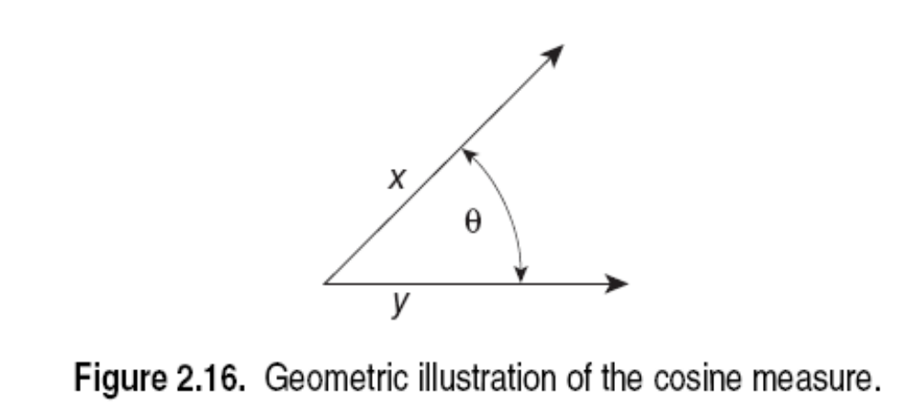
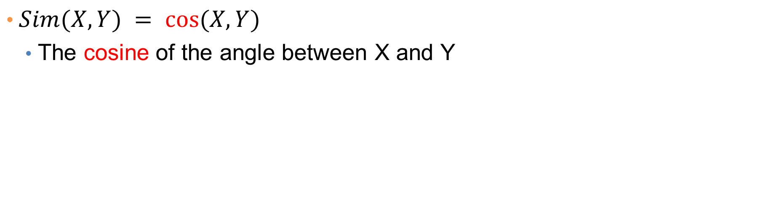
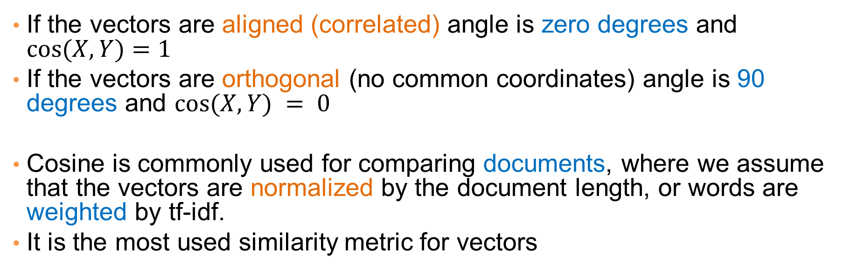
Cosine Similarity
$Sim(X,Y) = cos⁡(X,Y)$
  The cosine of the angle between X and Y
If the vectors are aligned (correlated) angle is zero degrees and $cos⁡(X,Y)=1$
If the vectors are orthogonal (no common coordinates) angle is 90 degrees and $cos⁡(X,Y) = 0$
Cosine is commonly used for comparing documents, where we assume that the vectors are normalized by the document length, or words are weighted by tf-idf.
It is the most used similarity metric for vectors

Slide 13
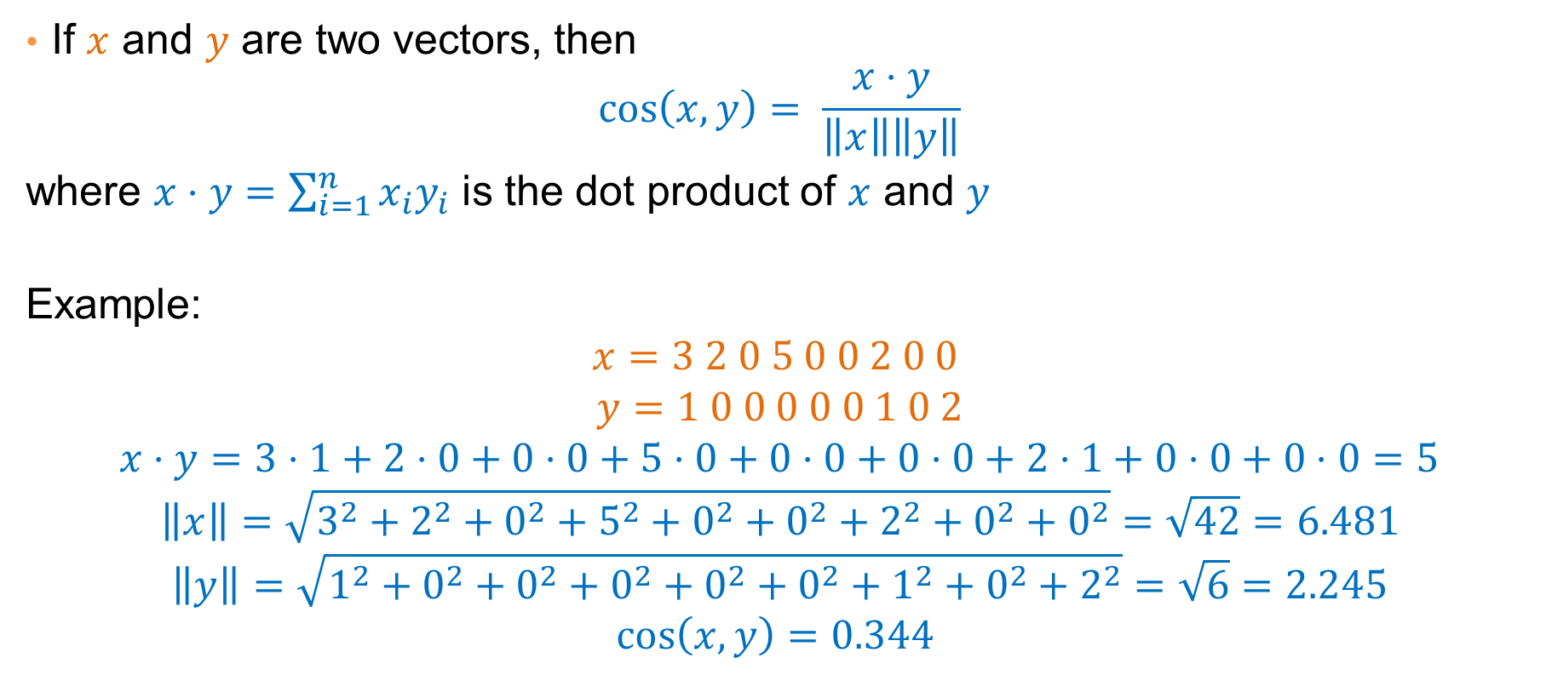
Cosine Similarity – Math
If $x$ and $y$ are two vectors, then
$$\cos\left(x,y\right)= \frac{x⋅y}{\left\|x\right\|\left\|y\right\|}$$
where $x⋅y=\sum_{i=1}^{n}{x_{i}y_{i}}$ is the dot product of $x$ and $y$
Example:
$$x=3 2 0 5 0 0 2 0 0$$
$$y=1 0 0 0 0 0 1 0 2$$
$$x⋅y=3⋅1+2⋅0+0⋅0+5⋅0+0⋅0+0⋅0+2⋅1+0⋅0+0⋅0=5$$
$$\left\|x\right\|=\sqrt{3^{2}+2^{2}+0^{2}+5^{2}+0^{2}+0^{2}+2^{2}+0^{2}+0^{2}}=\sqrt{42}=6.481$$
$$\left\|y\right\|=\sqrt{1^{2}+0^{2}+0^{2}+0^{2}+0^{2}+0^{2}+1^{2}+0^{2}+2^{2}}=\sqrt{6}=2.245$$
$$\cos\left(x,y\right)=0.344$$
Note: We only need to consider the non-zero entries of the vectors
What if we have 0/1 vectors?

Slide 14
Example
document | Apple | Microsoft | Obama | Election
D1 | 10 | 20 | 0 | 0
D2 | 30 | 60 | 0 | 0
D3 | 60 | 30 | 0 | 0
D4 | 0 | 0 | 10 | 20
apple
Cos(D1,D2) = 1
Cos (D3,D1) = Cos(D3,D2) = 4/5
Cos(D4,D1) = Cos(D4,D2) = Cos(D4,D3) = 0
microsoft
{Obama, election}

Slide 15
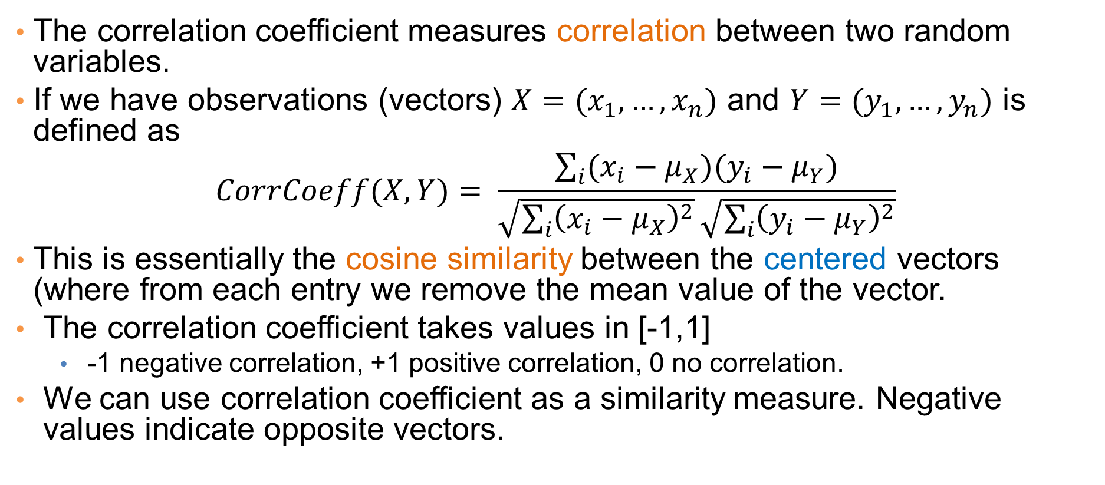
Correlation Coefficient
The correlation coefficient measures correlation between two random variables.
If we have observations (vectors) $X=(x_{1},…,x_{n})$ and $Y=(y_{1},…,y_{n})$ is defined as
$$CorrCoeff(X,Y)= \frac{\sum_{i}{(x_{i}−μ_{X})(y_{i}−μ_{Y})}}{\sqrt{\sum_{i}{{\left(x_{i}−μ_{X}\right)}^{2}}}\sqrt{\sum_{i}{{\left(y_{i}−μ_{Y}\right)}^{2}}}}$$
This is essentially the cosine similarity between the centered vectors (where from each entry we remove the mean value of the vector.
The correlation coefficient takes values in [-1,1]
  -1 negative correlation, +1 positive correlation, 0 no correlation.
We can use correlation coefficient as a similarity measure. Negative values indicate opposite vectors.

Slide 16
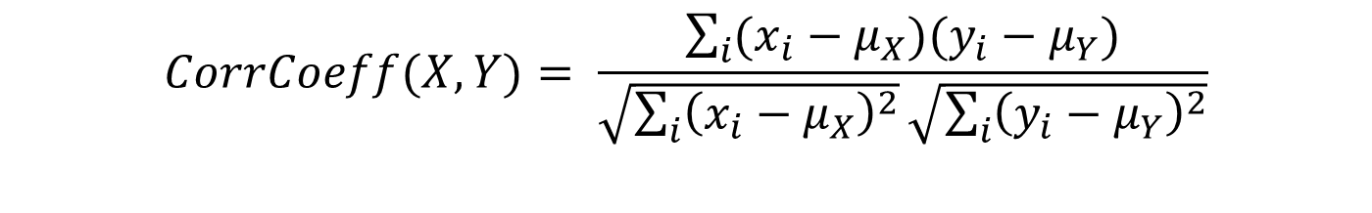
Correlation Coefficient
Normalized vectors
document | Apple | Microsoft | Obama | Election
D1 | -5 | +5 | 0 | 0
D2 | -15 | +15 | 0 | 0
D3 | +15 | -15 | 0 | 0
D4 | 0 | 0 | -5 | +5
$$CorrCoeff(X,Y)= \frac{\sum_{i}{(x_{i}−μ_{X})(y_{i}−μ_{Y})}}{\sqrt{\sum_{i}{{\left(x_{i}−μ_{X}\right)}^{2}}}\sqrt{\sum_{i}{{\left(y_{i}−μ_{Y}\right)}^{2}}}}$$
CorrCoeff(D1,D2) = 1
CorrCoeff(D1,D3) = CorrCoeff(D2,D3) = -1
CorrCoeff(D1,D4) = CorrCoeff(D2,D4) = CorrCoeff(D3,D4) = 0

Slide 17
Distance
Numerical measure of how different two data objects are
  A function that maps pairs of objects to real values
  Lower when objects are more alike
  Higher when two objects are different
Minimum distance is 0, when comparing an object with itself.
Upper limit varies

Slide 18
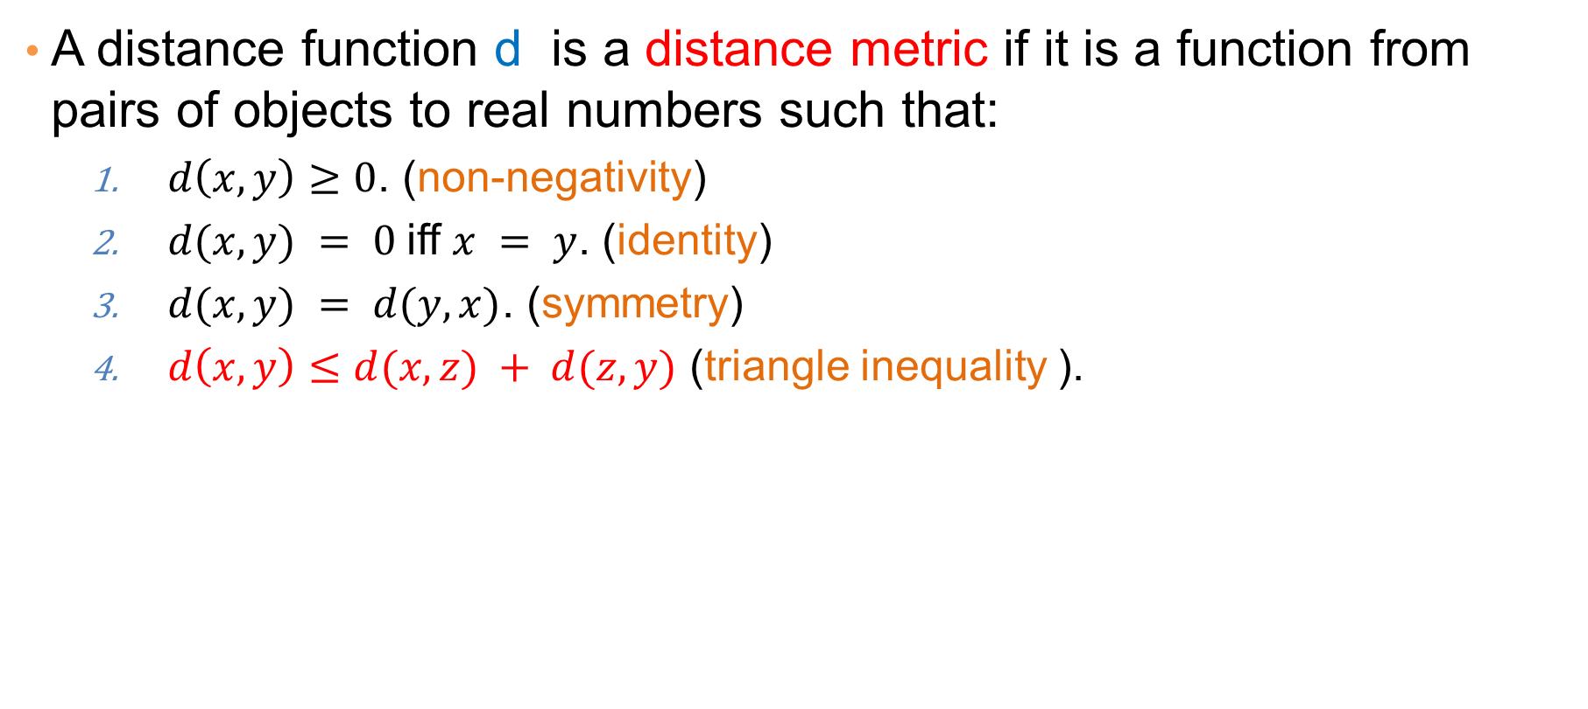
Distance Metric
A distance function d is a distance metric if it is a function from pairs of objects to real numbers such that:
  $d\left(x,y\right)≥0$. (non-negativity)
  $d(x,y) = 0$iff $x = y$. (identity)
  $d(x,y) = d(y,x)$. (symmetry)
  $d\left(x,y\right)≤d(x,z) + d(z,y)$ (triangle inequality ).

Slide 19
Triangle Inequality
Triangle inequality guarantees that the distance function is well-behaved.
  The direct connection is the shortest distance
It is useful also for proving useful properties about the data.

Slide 20
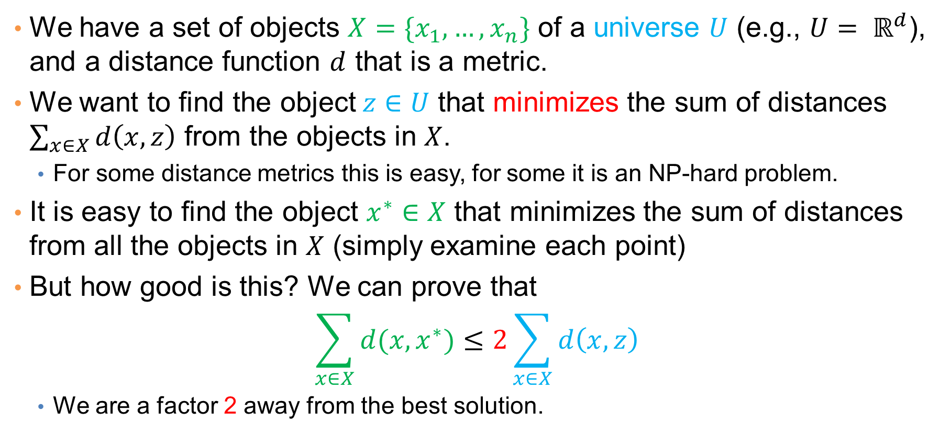
Example
We have a set of objects $X=\{x_{1},…,x_{n}\}$ of a universe $U$ (e.g., $U= ℝ^{d}$), and a distance function $d$ that is a metric.
We want to find the object$z∈U$ that minimizes the sum of distances $\sum_{x∈X}{d\left(x,z\right)}$ from the objects in $X$.
  For some distance metrics this is easy, for some it is an NP-hard problem.
It is easy to find the object $x^{∗}∈X$ that minimizes the sum of distances from all the objects in $X$ (simply examine each point)
But how good is this? We can prove that
$$\sum_{x∈X}{d(x,x^{∗})}≤2\sum_{x∈X}{d\left(x,z\right)}$$
  We are a factor 2 away from the best solution.

Slide 21
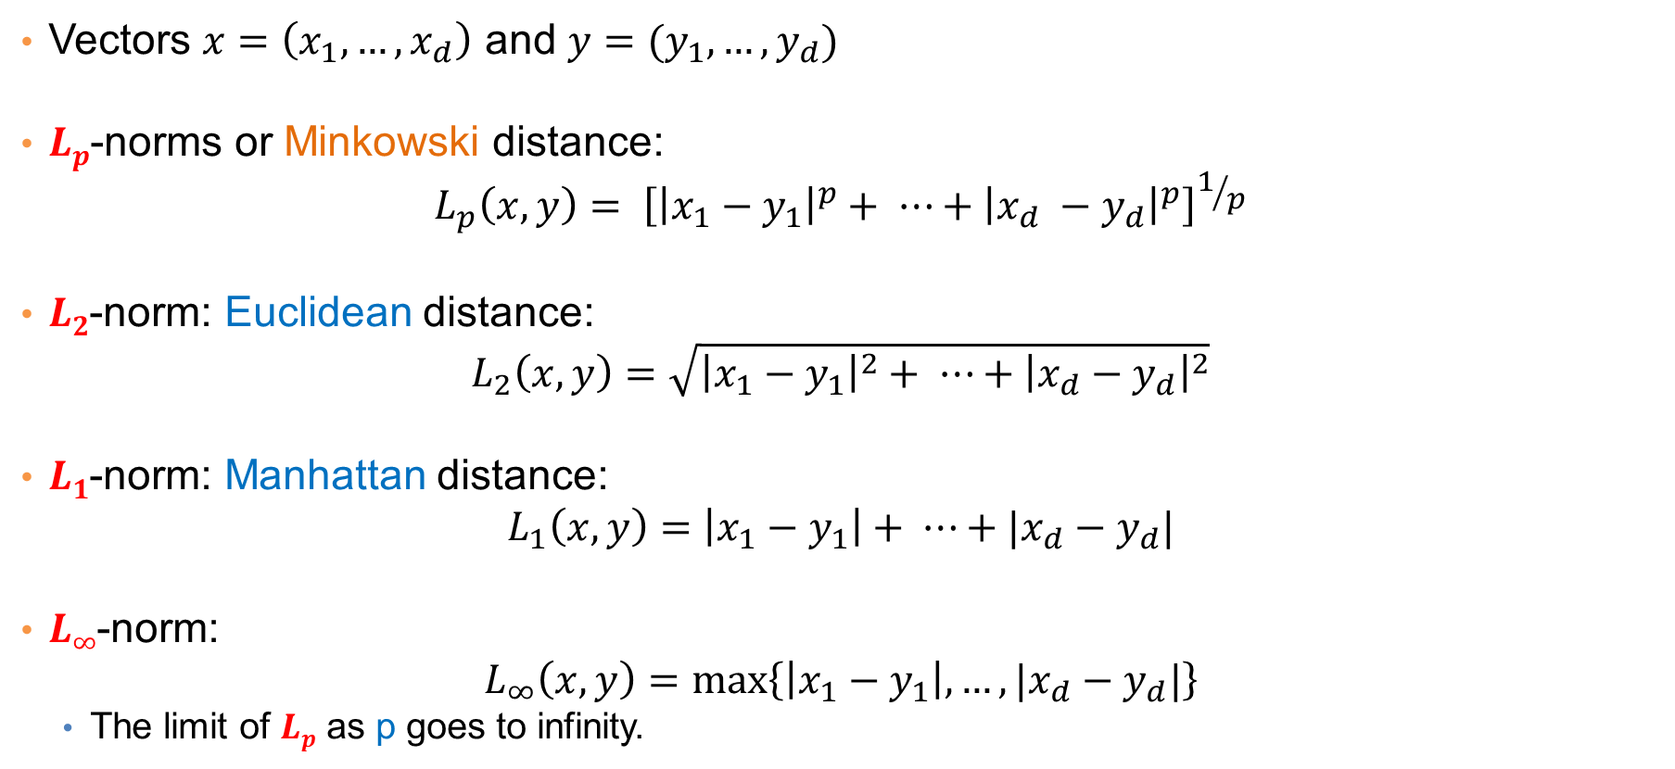
Distances for real vectors
Vectors $x=\left(x_{1},…,x_{d}\right)$ and $y=(y_{1},…,y_{d})$
$Lp$-norms or Minkowski distance:
$$L_{p}\left(x,y\right)= {\left[{\left|x_{1}−y_{1}\right|}^{p}+ ⋯+{\left|x_{d} −y_{d}\right|}^{p}\right]}^{1/p}$$
$L2$-norm: Euclidean distance:
$$L_{2}\left(x,y\right)=\sqrt{{\left|x_{1}−y_{1}\right|}^{2}+ ⋯+{\left|x_{d}−y_{d}\right|}^{2}}$$
$L1$-norm: Manhattan distance:
$$L_{1}\left(x,y\right)=\left|x_{1}−y_{1}\right|+ ⋯+|x_{d}−y_{d}|$$
$L∞$-norm:
$$L_{∞}\left(x,y\right)=\max\left\{\left|x_{1}−y_{1}\right|,…,|x_{d}−y_{d}|\right\}$$
  The limit of $Lp$ as p goes to infinity.
L_{p} norms are known to be distance metrics

Slide 22
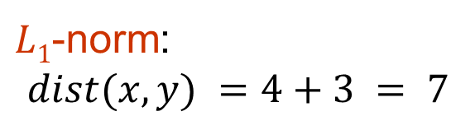
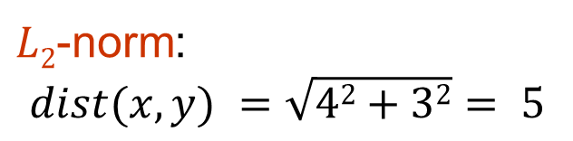
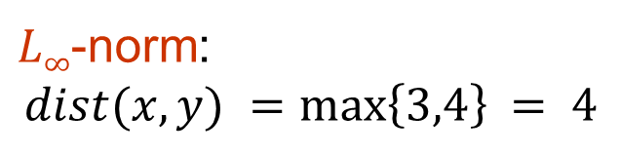
Example of Distances
y = (9,8)
$L2$-norm:
$$dist(x,y) =\sqrt{42+32}= 5$$
5
3
$L1$-norm:
$$dist(x,y) =4+3 = 7$$
4
x = (5,5)
$L∞$-norm:
$$dist(x,y) =\max\left\{3,4\right\}⁡= 4$$

Slide 23

Example
r
$$x= (x_{1},…,x_{n})$$
Green: All points y at distance $L1(x,y) = r$from point $x$
Blue: All points y at distance $L2(x,y) = r$from point $x$
Red: All points y at distance $L∞(x,y) = r$from point $x$

Slide 24
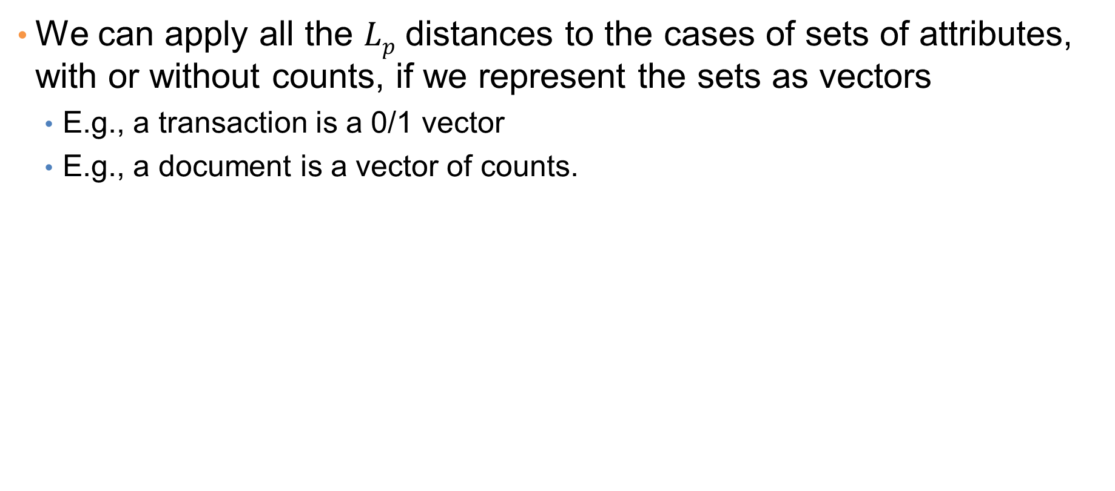
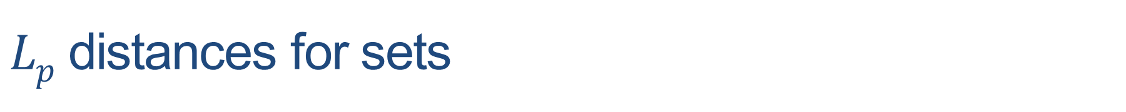
$Lp$ distances for sets
We can apply all the $Lp$ distances to the cases of sets of attributes, with or without counts, if we represent the sets as vectors
  E.g., a transaction is a 0/1 vector
  E.g., a document is a vector of counts.

Slide 25
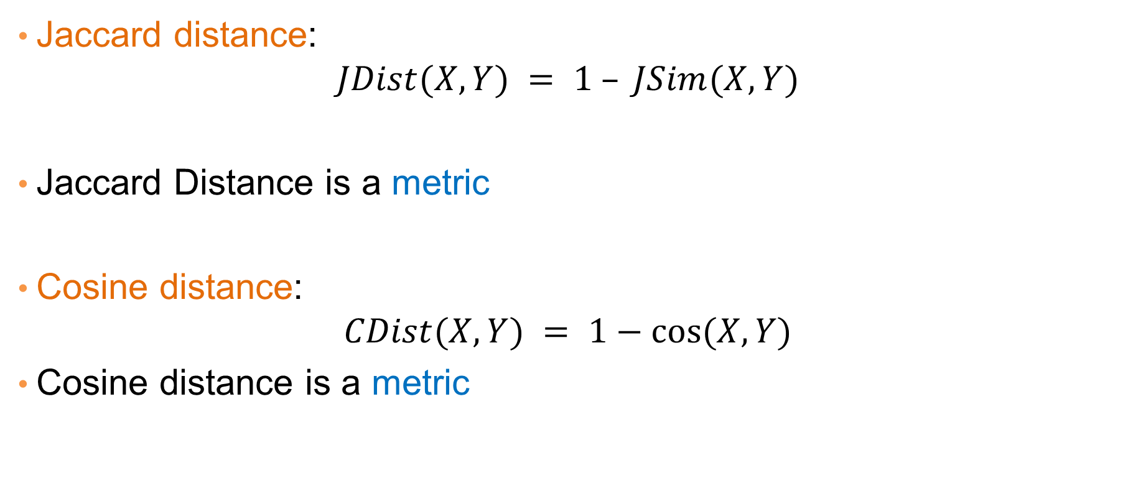
Similarities into distances
Jaccard distance:
$$JDist(X,Y) = 1 – JSim(X,Y)$$
Jaccard Distance is a metric
Cosine distance:
$$CDist(X,Y) = 1−cos⁡(X,Y)$$
Cosine distance is a metric

Slide 26
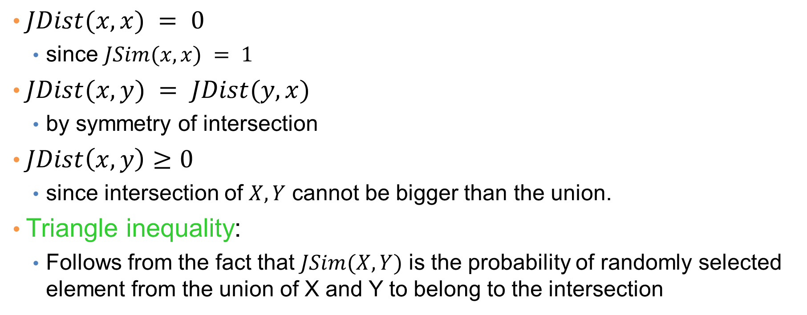
Why Jaccard Distance Is a Distance Metric
$JDist(x,x) = 0$
  since $JSim(x,x) = 1$
$JDist(x,y) = JDist(y,x)$
  by symmetry of intersection
$JDist\left(x,y\right)≥0$
  since intersection of $X,Y$ cannot be bigger than the union.
Triangle inequality:
  Follows from the fact that $JSim(X,Y)$ is the probability of randomly selected element from the union of X and Y to belong to the intersection

Slide 27
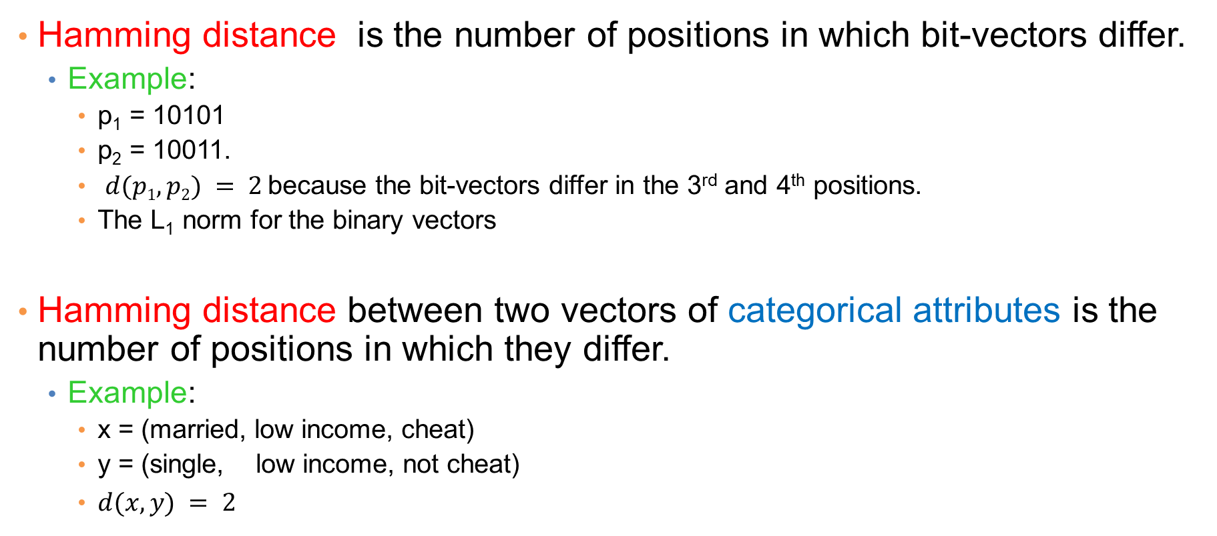
Hamming Distance
Hamming distance is the number of positions in which bit-vectors differ.
  Example:
    p₁ = 10101
    p₂ = 10011.
    $d(p1, p2) = 2$because the bit-vectors differ in the 3rd and 4th positions.
    The L₁ norm for the binary vectors
Hamming distance between two vectors of categorical attributes is the number of positions in which they differ.
  Example:
    x = (married, low income, cheat)
    y = (single, low income, not cheat)
    $d(x,y) = 2$

Slide 28
Why Hamming Distance Is a Distance Metric
d(x,x) = 0 since no positions differ.
d(x,y) = d(y,x) by symmetry of “different from.”
d(x,y) > 0 since strings cannot differ in a negative number of positions.
Triangle inequality: changing x to z and then to y is one way to change x to y.
For binary vectors if follows from the fact that L₁ norm is a metric

Slide 29
Distance between strings
How do we define similarity between strings?
Important for recognizing and correcting typing errors and analyzing DNA sequences.
weird wierd
intelligent unintelligent
Athena Athina

Slide 30
Edit Distance for strings
The edit distance of two strings is the number of inserts and deletes of characters needed to turn one into the other.
Example: x = abcde ; y = bcduve.
  Turn x into y by deleting a, then inserting u and v after d.
  Edit distance = 3.
Minimum number of operations can be computed using dynamic programming
Common distance measure for comparing DNA sequences

Slide 31
Why Edit Distance Is a Distance Metric
d(x,x) = 0 because 0 edits suffice.
d(x,y) = d(y,x) because insert/delete are inverses of each other.
d(x,y) > 0: no notion of negative edits.
Triangle inequality: changing x to z and then to y is one way to change x to y. The minimum is no more than that

Slide 32
Variant Edit Distances
Allow insert, delete, and mutate.
  Change one character into another.
Minimum number of inserts, deletes, and mutates also forms a distance measure.
Same for any set of operations on strings.
  Example: substring reversal or block transposition is used for DNA sequences
  Example: character transposition is used for spelling

Slide 33


Distance between sets of points
How do we measure the distance between the two sets?

Slide 34
Distance between sets of points
How do we measure the distance between the two sets?
Minimum distance over all pairs

Slide 35
Distance between sets of points
How do we measure the distance between the two sets?
Minimum distance over all pairs
Maximum distance over all pairs

Slide 36
Distance between sets of points
How do we measure the distance between the two sets?
Minimum distance over all pairs
Maximum distance over all pairs
Average distance over all pairs

Slide 37
Distance between sets of points
How do we measure the distance between the two sets?
Minimum distance over all pairs
Maximum distance over all pairs
Average distance over all pairs
Distance between averages

Slide 38
Distance between sets of points
How do we measure the distance between the two sets?
Minimum distance over all pairs
Maximum distance over all pairs
Average distance over all pairs
Distance between averages
Hausdorff distance:
For each red point $x$ compute the distance to the closest Blue point: $d\left(x,Blue\right)=\min_{y∈Blue}{d(x,y)}$

Slide 39
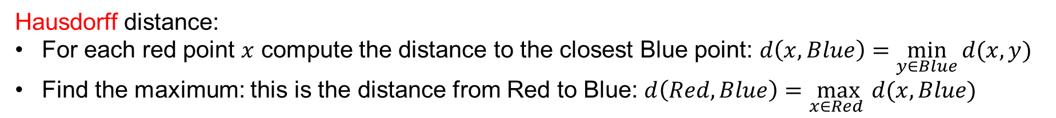
Distance between sets of points
How do we measure the distance between the two sets?
Minimum distance over all pairs
Maximum distance over all pairs
Average distance over all pairs
Distance between averages
Hausdorff distance:
For each red point $x$ compute the distance to the closest Blue point: $d\left(x,Blue\right)=\min_{y∈Blue}{d(x,y)}$
Find the maximum: this is the distance from Red to Blue: $d\left(Red,Blue\right)=\max_{x∈Red }{d(x,Blue)}$

Slide 40
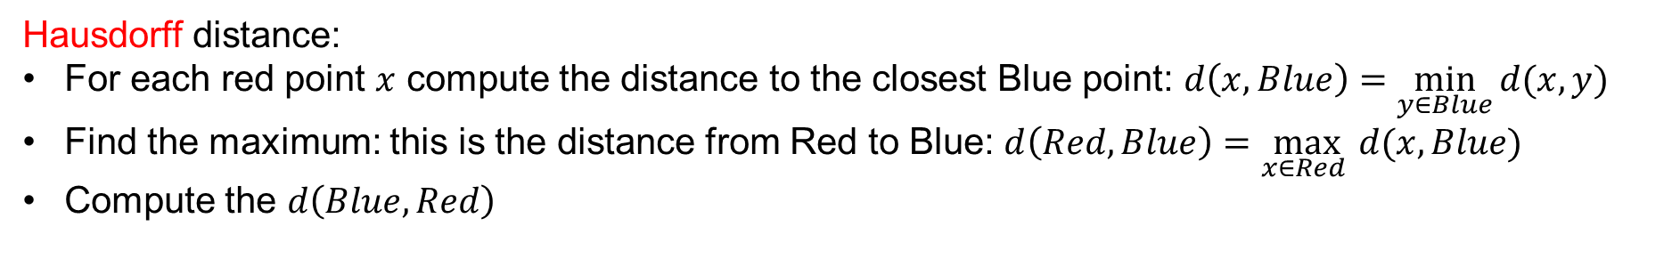
Distance between sets of points
How do we measure the distance between the two sets?
Minimum distance over all pairs
Maximum distance over all pairs
Average distance over all pairs
Distance between averages
Hausdorff distance:
For each red point $x$ compute the distance to the closest Blue point: $d\left(x,Blue\right)=\min_{y∈Blue}{d(x,y)}$
Find the maximum: this is the distance from Red to Blue: $d\left(Red,Blue\right)=\max_{x∈Red }{d(x,Blue)}$
Compute the $d\left(Blue, Red\right)$

Slide 41
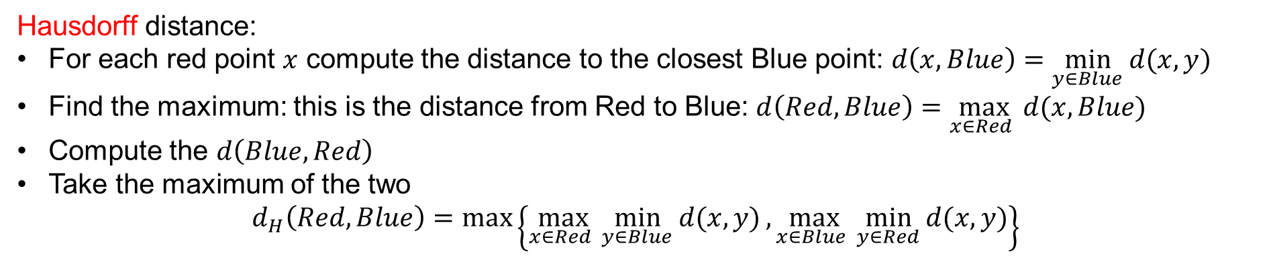
Distance between sets of points
How do we measure the distance between the two sets?
Minimum distance over all pairs
Maximum distance over all pairs
Average distance over all pairs
Distance between averages
Hausdorff distance:
For each red point $x$ compute the distance to the closest Blue point: $d\left(x,Blue\right)=\min_{y∈Blue}{d(x,y)}$
Find the maximum: this is the distance from Red to Blue: $d\left(Red,Blue\right)=\max_{x∈Red }{d(x,Blue)}$
Compute the $d\left(Blue, Red\right)$
Take the maximum of the two
$$d_{H}\left(Red,Blue\right)=\max\left\{\max_{x∈Red }{\min_{y∈Blue}{d(x,y)}},\max_{x∈Blue }{\min_{y∈Red}{d(x,y)}}\right\}$$

Slide 42
Distances between distributions
Sometimes data can be represented as a distribution (e.g., a document is a distribution over the words)
How do we measure distance between distributions?
document | Apple | Microsoft | Obama | Election
D1 | 0.35 | 0.5 | 0.1 | 0.05
D2 | 0.4 | 0.4 | 0.1 | 0.1
D3 | 0.05 | 0.05 | 0.6 | 0.3

Slide 43



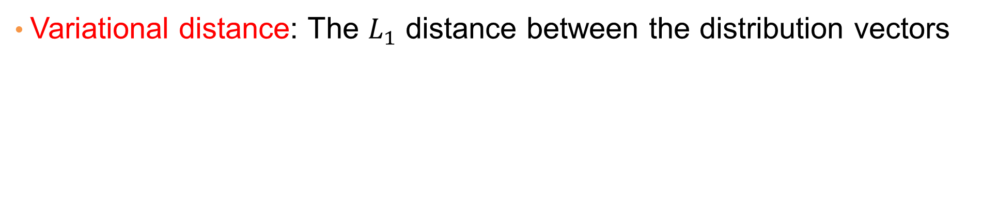




















Variational distance
Variational distance: The $L_{1}$ distance between the distribution vectors
document | Apple | Microsoft | Obama | Election
D1 | 0.35 | 0.5 | 0.1 | 0.05
D2 | 0.4 | 0.4 | 0.1 | 0.1
D3 | 0.05 | 0.05 | 0.6 | 0.3
Dist(D1,D2) = 0.05+0.1+0.05 = 0.2
Dist(D2,D3) = 0.35+0.35+0.5+ 0.2 = 1.4
Dist(D1,D3) = 0.3+0.45+0.5+ 0.25 = 1.5

Slide 44
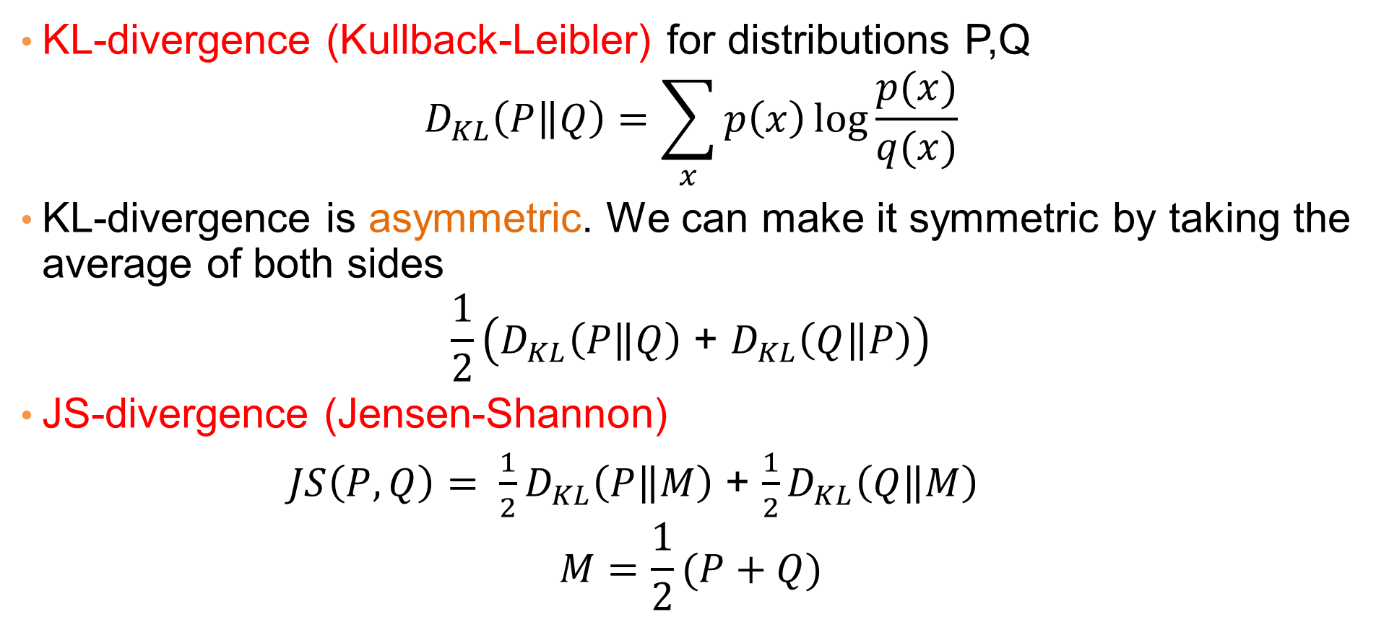
Information theoretic distances
document | Apple | Microsoft | Obama | Election
D1 | 0.35 | 0.5 | 0.1 | 0.05
D2 | 0.4 | 0.4 | 0.1 | 0.1
D3 | 0.05 | 0.05 | 0.6 | 0.3
KL-divergence (Kullback-Leibler) for distributions P,Q
$$D_{KL}\left(P\left\|Q\right.\right)=\sum_{x}{p\left(x\right)\log{\frac{p(x)}{q(x)}}}$$
KL-divergence is asymmetric. We can make it symmetric by taking the average of both sides
$$\frac{1}{2}\left(D_{KL}\left(P\left\|Q\right.\right)\text{ + }D_{KL}\left(Q\left\|P\right.\right)\right)$$
JS-divergence (Jensen-Shannon)
$JS\left(P,Q\right)= \frac{1}{2}D_{KL}\left(P\left\|M\right.\right)$ + $\frac{1}{2}D_{KL}\left(Q\left\|M\right.\right)$
$$M=\frac{1}{2}(P+Q)$$
Average distribution

Slide 45
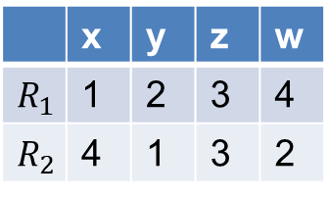
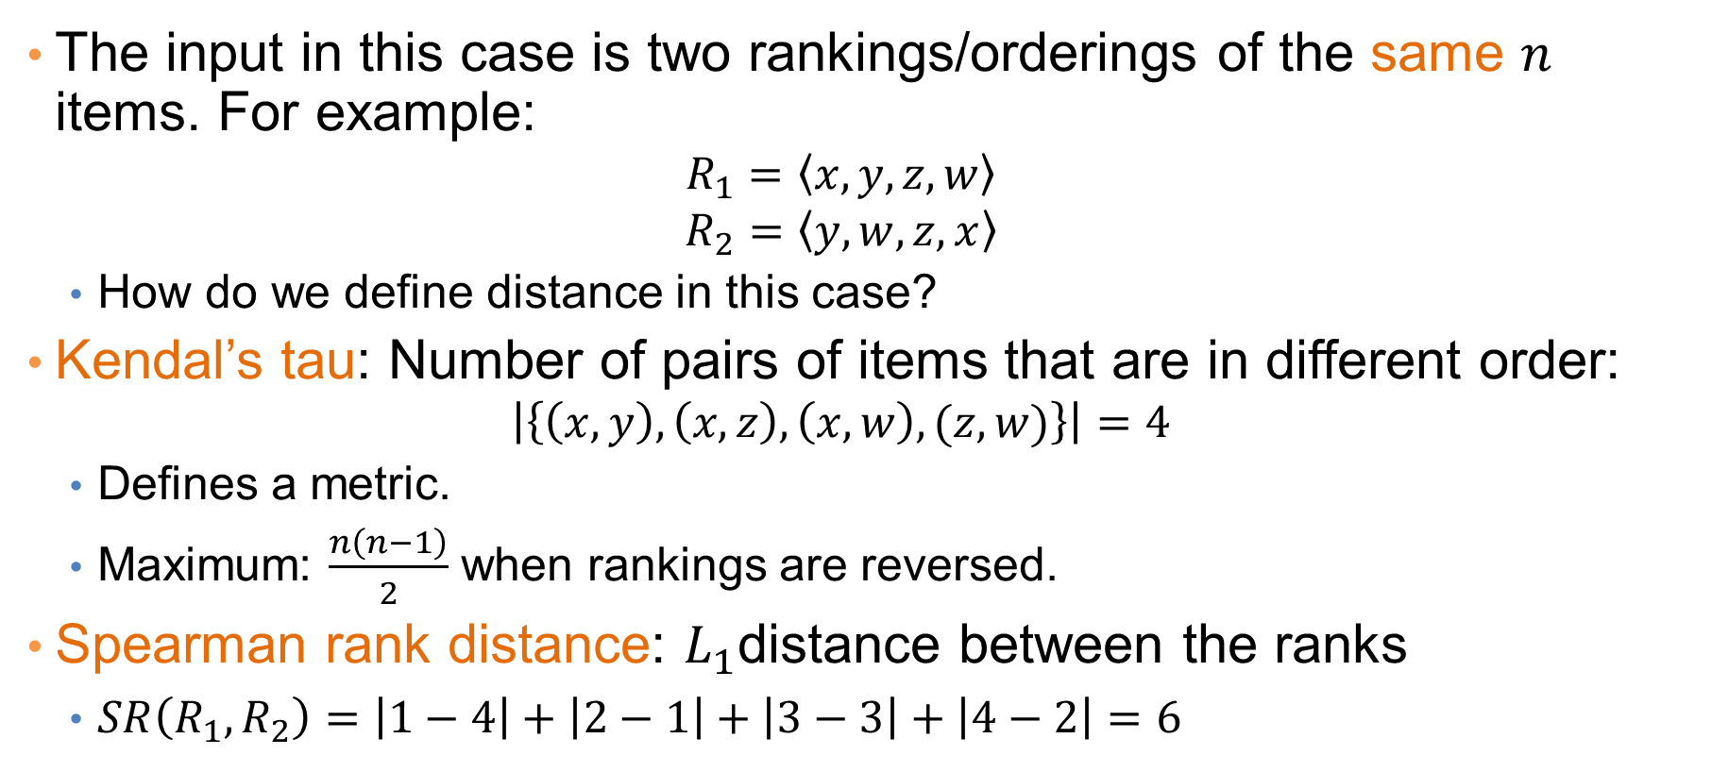
Ranking distances
The input in this case is two rankings/orderings of the same $n$ items. For example:
  $$R_{1}=\left\langle x,y,z,w\right\rangle$$
  $$R_{2}=\left\langle y,w,z,x\right\rangle$$
  How do we define distance in this case?
Kendal’s tau: Number of pairs of items that are in different order:
  $$\left|\left\{\left(x,y\right),\left(x,z\right),\left(x,w\right),(z,w)\right\}\right|=4$$
  Defines a metric.
  Maximum: $\frac{n\left(n−1\right)}{2}$ when rankings are reversed.
Spearman rank distance: $L_{1}$distance between the ranks
  $SR\left(R_{1}, R_{2}\right)=\left|1−4\right|+\left|2−1\right|+\left|3−3\right|+\left|4−2\right|=6$
 | x | y | z | w
$$R_{1}$$ | 1 | 2 | 3 | 4
$$R_{2}$$ | 4 | 1 | 3 | 2

Slide 46
Why is similarity important?
We saw many definitions of similarity and distance
How do we make use of similarity in practice?
What issues do we have to deal with?

Slide 47
Applications of Similarity:
Recommendation Systems

Slide 48
An important problem
Recommendation systems
  When a user buys an item (initially books) we want to recommend other items that the user may like
  When a user rates a movie, we want to recommend movies that the user may like
  When a user likes a song, we want to recommend other songs that they may like
A big success story for data mining
Exploits the long tail
  How Into Thin Air made Touching the Void popular

Slide 49
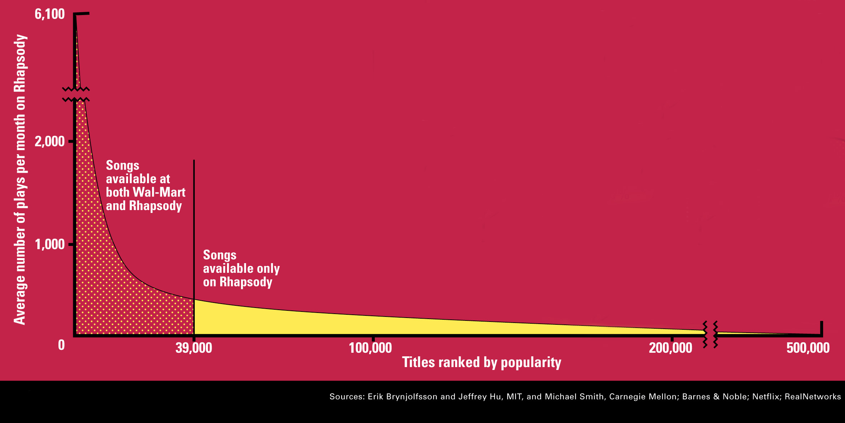
The Long Tail
Source: Chris Anderson (2004)

Slide 50
Utility (Preference) Matrix
 | Harry Potter 1 | Harry Potter 2 | Harry Potter 3 | Twilight | Star Wars 1 | Star Wars 2 | Star Wars 3
A | 4 |  |  | 5 | 1
B | 5 | 5 | 4
C |  |  |  | 2 | 4 | 5
D |  | 3 |  |  |  |  | 3
Rows: Users
Columns: Movies (in general Items)
Values: The rating of the user for the movie
How can we fill the empty entries of the matrix?

Slide 51
Recommendation Systems
Content-based:
  Represent the items into a feature space and
  Recommend items to customer C similar to previous items rated highly by C
Examples
  Movie recommendations:
    recommend movies with same actor(s), director, genre, …
  Documents: websites, blogs, news:
    recommend other documents with “similar” content

Slide 52
Content-based prediction
 | Harry Potter 1 | Harry Potter 2 | Harry Potter 3 | Twilight | Star Wars 1 | Star Wars 2 | Star Wars 3
A | 4 |  |  | 5 | 1
B | 5 | 5 | 4
C |  |  |  | 2 | 4 | 5
D |  | 3 |  |  |  |  | 3
Someone who likes one of the Harry Potter (or Star Wars)
movies is likely to like the rest
  Same actors, similar story, same genre

Slide 53

Intuition
Item profiles
likes
build
recommend
match
Red
Circles
Triangles
User profile

Slide 54
Approach
Map items into a feature space:
  For movies:
    Actors, directors, genre, rating, year,…
    Challenge: make all features compatible.
  For documents?
  Current approaches use different types of embeddings.
To compare items with users we need to map users to the same feature space. How?
  Take all the movies that the user has seen and take the average vector
    Other aggregation functions are also possible.
Recommend to user C the most similar item i computing similarity in the common feature space
  Distributional distance measures also work well.

Slide 55
Limitations of content-based approach
Finding the appropriate features
  e.g., images, movies, music
  Embeddings and deep learning can help
Overspecialization
  Never recommends items outside user’s content profile
  People might have multiple interests
Recommendations for new users: cold-start problem
  How to build a profile?

Slide 56
Collaborative filtering
 | Harry Potter 1 | Harry Potter 2 | Harry Potter 3 | Twilight | Star Wars 1 | Star Wars 2 | Star Wars 3
A | 4 |  |  | 5 | 1
B | 5 | 5 | 4
C |  |  |  | 2 | 4 | 5
D |  | 3 |  |  |  |  | 3
Two users are similar if they rate the same items in a similar way
Recommend to user C, the items liked by many of the most similar users.

Slide 57
User Similarity
 | Harry Potter 1 | Harry Potter 2 | Harry Potter 3 | Twilight | Star Wars 1 | Star Wars 2 | Star Wars 3
A | 4 |  |  | 5 | 1
B | 5 | 5 | 4
C |  |  |  | 2 | 4 | 5
D |  | 3 |  |  |  |  | 3
Which pair of users do you consider as the most similar?
What is the right definition of similarity?

Slide 58
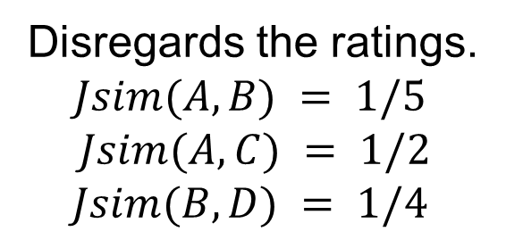
User Similarity
 | Harry Potter 1 | Harry Potter 2 | Harry Potter 3 | Twilight | Star Wars 1 | Star Wars 2 | Star Wars 3
A | 1 |  |  | 1 | 1
B | 1 | 1 | 1
C |  |  |  | 1 | 1 | 1
D |  | 1 |  |  |  |  | 1
Jaccard Similarity: users are sets of movies
Disregards the ratings.
$$Jsim(A,B) = 1/5$$
$$Jsim(A,C) = 1/2$$
$$Jsim(B,D) = 1/4$$

Slide 59
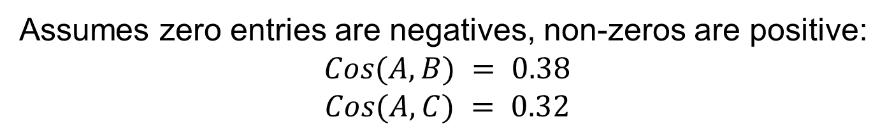
User Similarity
 | Harry Potter 1 | Harry Potter 2 | Harry Potter 3 | Twilight | Star Wars 1 | Star Wars 2 | Star Wars 3
A | 4 |  |  | 5 | 1
B | 5 | 5 | 4
C |  |  |  | 2 | 4 | 5
D |  | 3 |  |  |  |  | 3
Cosine Similarity:
Assumes zero entries are negatives, non-zeros are positive:
$$Cos(A,B) = 0.38$$
$$Cos(A,C) = 0.32$$

Slide 60
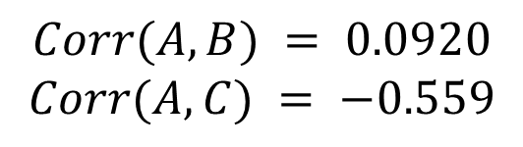
User Similarity
 | Harry Potter 1 | Harry Potter 2 | Harry Potter 3 | Twilight | Star Wars 1 | Star Wars 2 | Star Wars 3
A | 2/3 |  |  | 5/3 | -7/3
B | 1/3 | 1/3 | -2/3
C |  |  |  | -5/3 | 1/3 | 4/3
D |  | 0 |  |  |  |  | 0
Normalized Cosine Similarity:
  Subtract the mean rating per user (without the zeros) and then compute Cosine (correlation coefficient)
$$Corr(A,B) = 0.0920$$
$$Corr(A,C) = −0.559$$

Slide 61
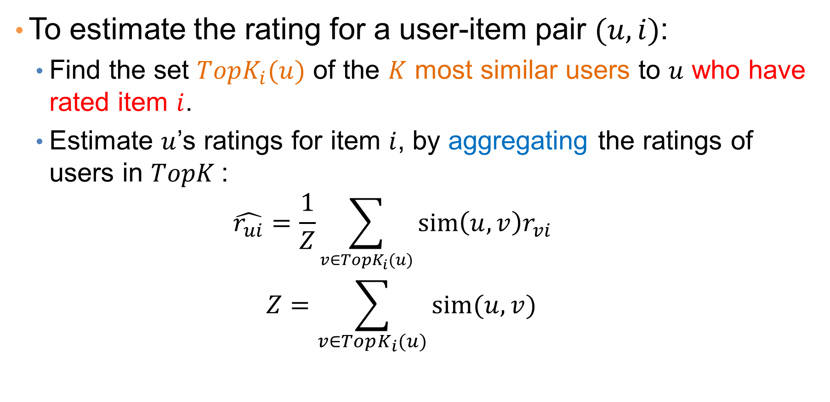
User-based Collaborative Filtering
To estimate the rating for a user-item pair $(u,i)$:
  Find the set $TopK_{i}(u)$ of the $K$ most similar users to $u$ who have rated item $i$.
  Estimate $u$’s ratings for item $i$, by aggregating the ratings of users in $TopK$:
  $$\hat{r_{ui}}=\frac{1}{Z}\sum_{v∈TopK_{i}(u)}{sim\left(u,v\right)r_{vi}}$$
  $$Z=\sum_{v∈TopK_{i}(u)}{sim(u,v)}$$

Slide 62

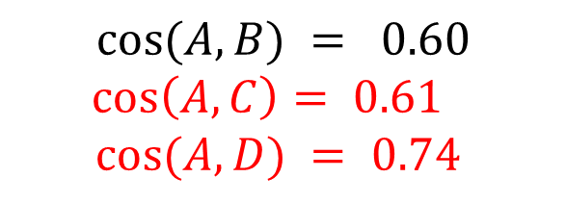

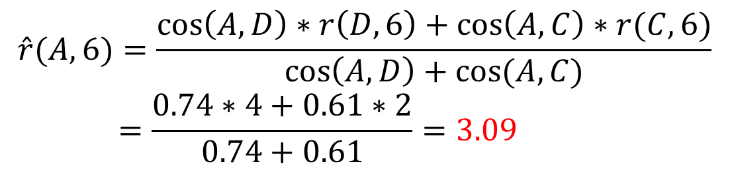
Example
User-Item Matrix $r$
 | 1 | 2 | 3 | 4 | 5 | 6
A | 5 | 3 | 2 | - | 5 | ?
B | 3 | 1 | - | - | - | 2
C | 2 | 5 | 5 | 3 | 1 | 2
D | 3 | 1 | - | - | 4 | 4
Predict $r(A,6)$
$$cos⁡(A,B) = 0.60$$
$$\cos\left(A,C\right)= 0.61$$
$$cos⁡(A,D) = 0.74$$
Top-2 neighbors of A: D, C
$$\hat{r}(A,6)=\frac{\cos\left(A,D\right)∗r\left(D,6\right)+\cos\left(A,C\right)∗r(C,6)}{\cos\left(A,D\right)+cos⁡(A,C)}$$
$$=\frac{0.74∗4+0.61∗2}{0.74+0.61}=3.09$$

Slide 63
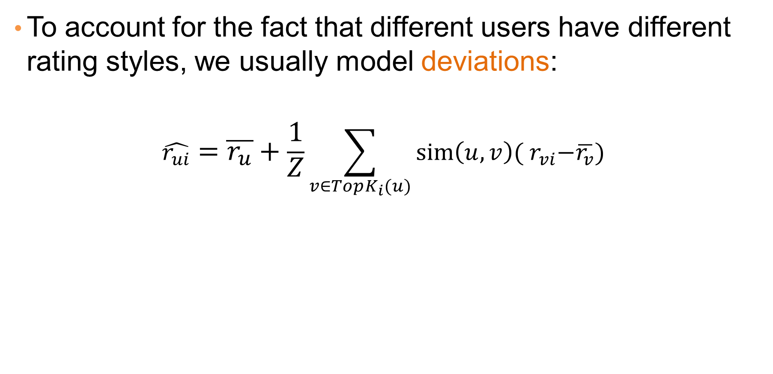
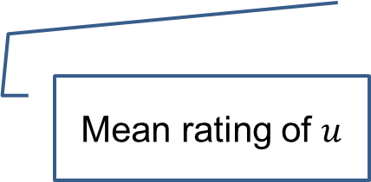
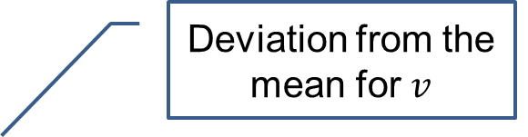
User-based Collaborative Filtering
To account for the fact that different users have different rating styles, we usually model deviations:
$$\hat{r_{ui}}=\overline{r_{u}}+\frac{1}{Z}\sum_{v∈TopK_{i}(u)}{sim\left(u,v\right){( r}_{vi}−\overline{r_{v}})}$$
Deviation from the mean for $v$
Mean rating of $u$
Weighted mean deviation of the similar users
Note: Similarity can be computed with or without centering (subtracting the mean)

Slide 64
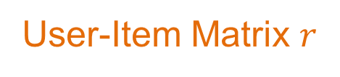
Example
User-Item Matrix $r$
 | 1 | 2 | 3 | 4 | 5 | 6
A | 5 | 3 | 2 | - | 5 | ?
B | 3 | 1 | - | - | - | 2
C | 2 | 5 | 5 | 3 | 1 | 2
D | 3 | 1 | - | - | 4 | 4
Mean
3.75
2
3
3

Slide 65

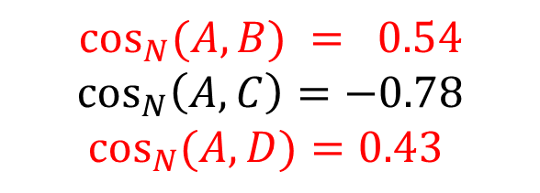
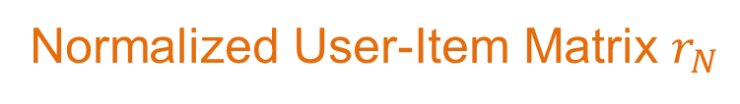
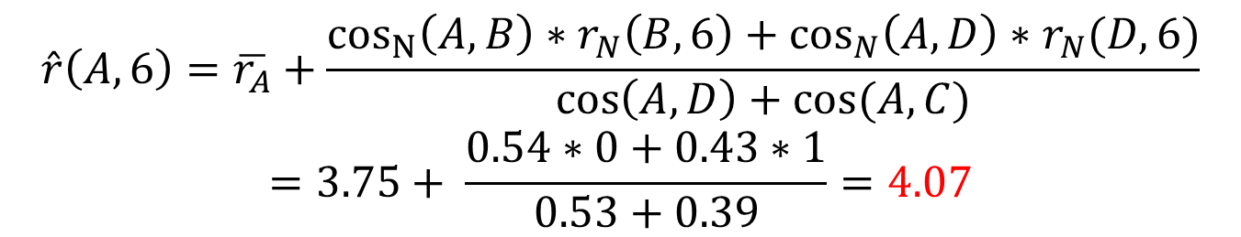
Example
Normalized User-Item Matrix $r_{N}$
 | 1 | 2 | 3 | 4 | 5 | 6
A | 1.25 | -0.75 | -1.75 | - | 1.25 | ?
B | 1 | -1 | - | - | - | 0
C | -1 | 2 | 1 | 1 | -2 | -1
D | 0 | -2 | - | - | 1 | 1
Mean
3.75
2
3
3
Predict $r(A,6)$
$$\cos_{N}⁡(A,B) = 0.54$$
$$\cos_{N}\left(A,C\right)=−0.78$$
$$\cos_{N}{(A,D)}=0.43$$
Top-2 neighbors of A: B,D
$$\hat{r}\left(A,6\right)=\overline{r_{A}}+\frac{\cos_{N}\left(A,B\right)∗r_{N}\left(B,6\right)+\cos_{N}\left(A,D\right)∗r_{N}(D,6)}{\cos\left(A,D\right)+cos⁡(A,C)}$$
$$=3.75+ \frac{0.54∗0+0.43∗1}{0.53+0.39}=4.07$$

Slide 66
Item-based Collaborative Filtering
There is a duality in the use of the preference matrix. In the same way we define user similarity (rows), we can also define item similarity (columns)
  Intuition: Two items are similar if they are rated in the same way by many users.
  Better defined similarity since it captures the notion of genre of an item: Items rated by the same users define a genre
    Better since items usually (but not always) have a single genre, while users may have multiple interests.

Slide 67
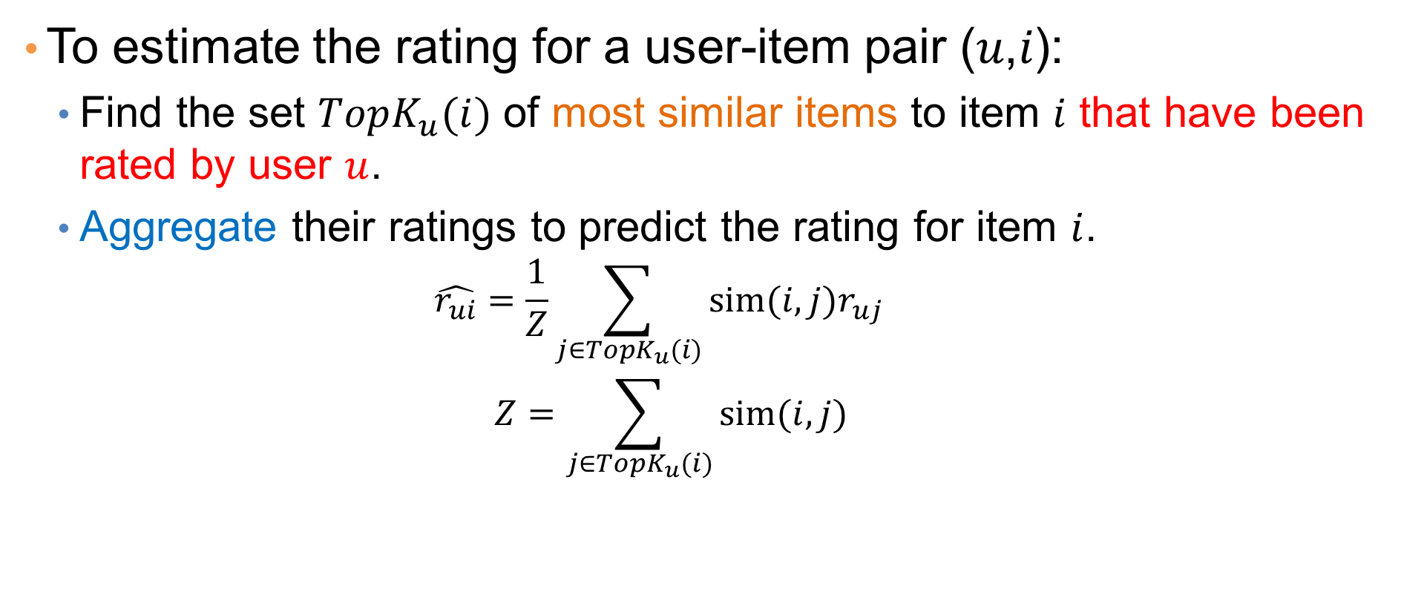
Item-based Collaborative Filtering
To estimate the rating for a user-item pair (𝑢,𝑖):
  Find the set $TopK_{u}(i)$ of most similar items to item $i$ that have been rated by user $u$.
  Aggregate their ratings to predict the rating for item $i$.
  $$\hat{r_{ui}}=\frac{1}{Z}\sum_{j∈TopK_{u}(i)}{sim(i,j)r_{uj}}$$
  $$Z=\sum_{j∈TopK_{u}(i)}{sim(i,j)}$$

Slide 68
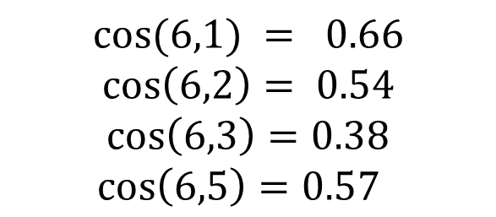
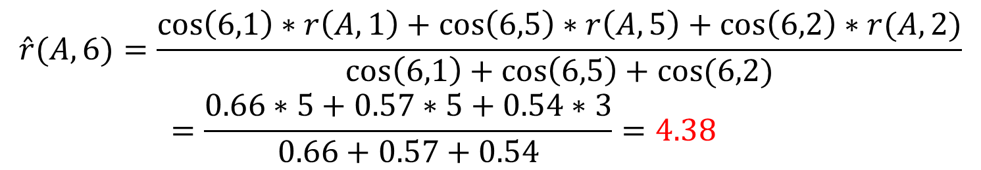
Example
User-Item Matrix $r$
 | 1 | 2 | 3 | 4 | 5 | 6
A | 5 | 3 | 2 | - | 5 | ?
B | 3 | 1 | - | - | - | 2
C | 2 | 5 | 5 | 3 | 1 | 2
D | 3 | 1 | - | - | 4 | 4
Predict $r(A,6)$
$$cos⁡(6,1) = 0.66$$
$$\cos\left(6,2\right)= 0.54$$
$$\cos\left(6,3\right)=0.38$$
$$\cos\left(6,5\right)=0.57$$
Top-3 neighbors of 6: 1,5,2
$$\hat{r}(A,6)=\frac{\cos\left(6,1\right)∗r\left(A,1\right)+\cos\left(6,5\right)∗r\left(A,5\right)+\cos\left(6,2\right)∗r(A,2)}{\cos\left(6,1\right)+\cos\left(6,5\right)+\cos{(6,2)}}$$
$$=\frac{0.66∗5+0.57∗5+0.54∗3}{0.66+0.57+0.54}=4.38$$

Slide 69
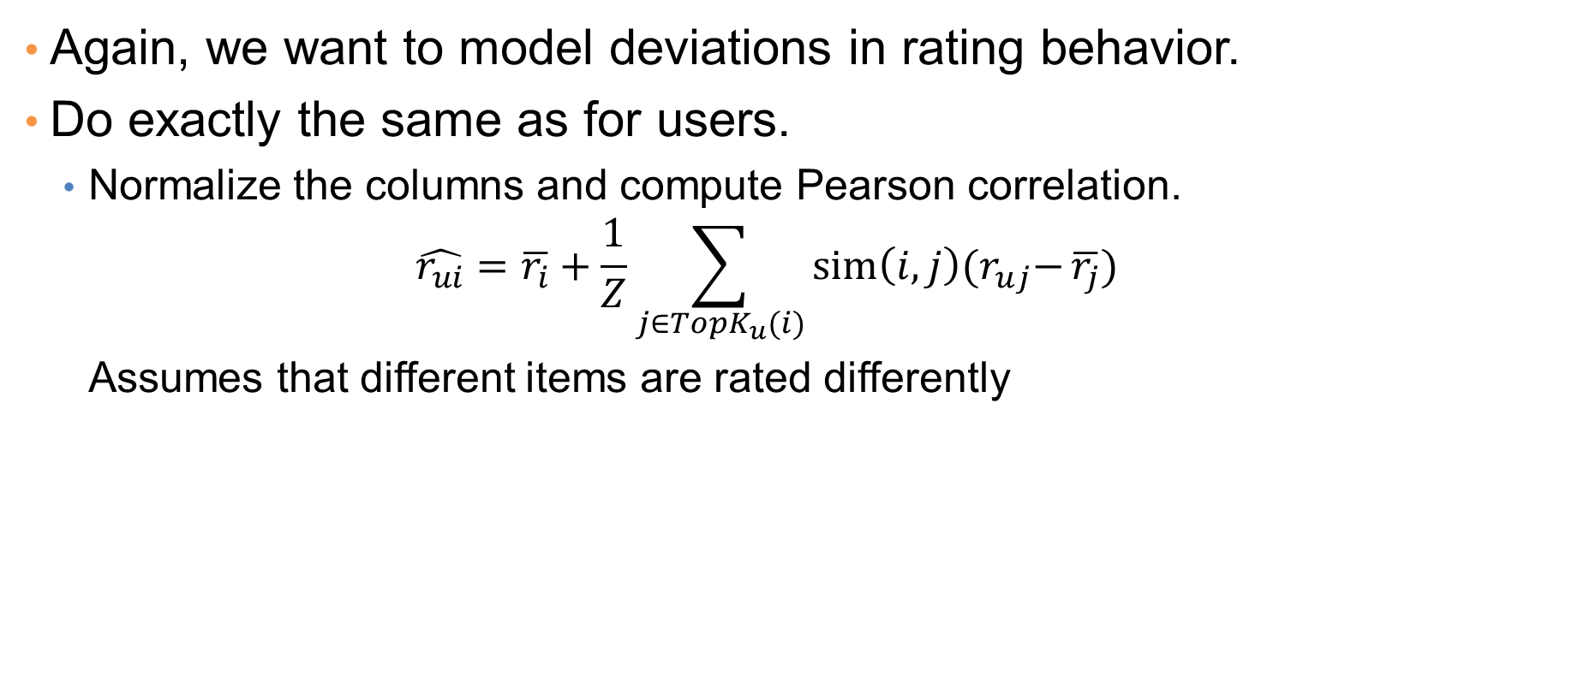
Item-based Collaborative Filtering
Again, we want to model deviations in rating behavior.
Do exactly the same as for users.
  Normalize the columns and compute Pearson correlation.
  $$\hat{r_{ui}}=\overline{r_{i}}+\frac{1}{Z}\sum_{j∈TopK_{u}(i)}{sim\left(i,j\right){(r}_{uj}−}\overline{r_{j}})$$
  Assumes that different items are rated differently

Slide 70
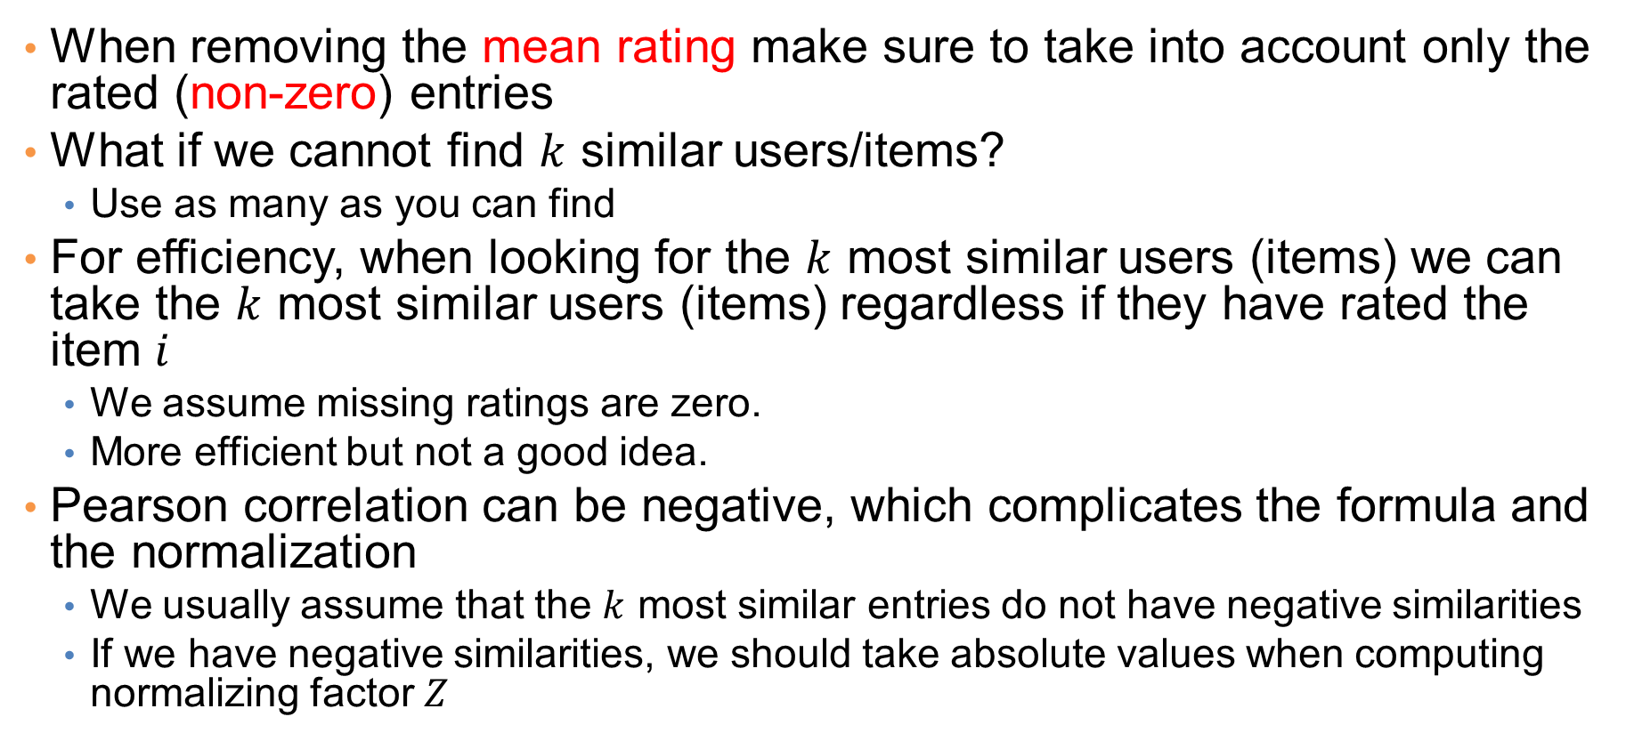
Implementation details
When removing the mean rating make sure to take into account only the rated (non-zero) entries
What if we cannot find $k$ similar users/items?
  Use as many as you can find
For efficiency, when looking for the $k$ most similar users (items) we can take the $k$ most similar users (items) regardless if they have rated the item $i$
  We assume missing ratings are zero.
  More efficient but not a good idea.
Pearson correlation can be negative, which complicates the formula and the normalization
  We usually assume that the $k$ most similar entries do not have negative similarities
  If we have negative similarities, we should take absolute values when computing normalizing factor $Z$

Slide 71
Pros and cons of collaborative filtering
Works for any kind of items
  No feature selection needed
Cold-start problem: New user, or new item
Sparsity of rating matrix
  Cluster-based smoothing?

Slide 72
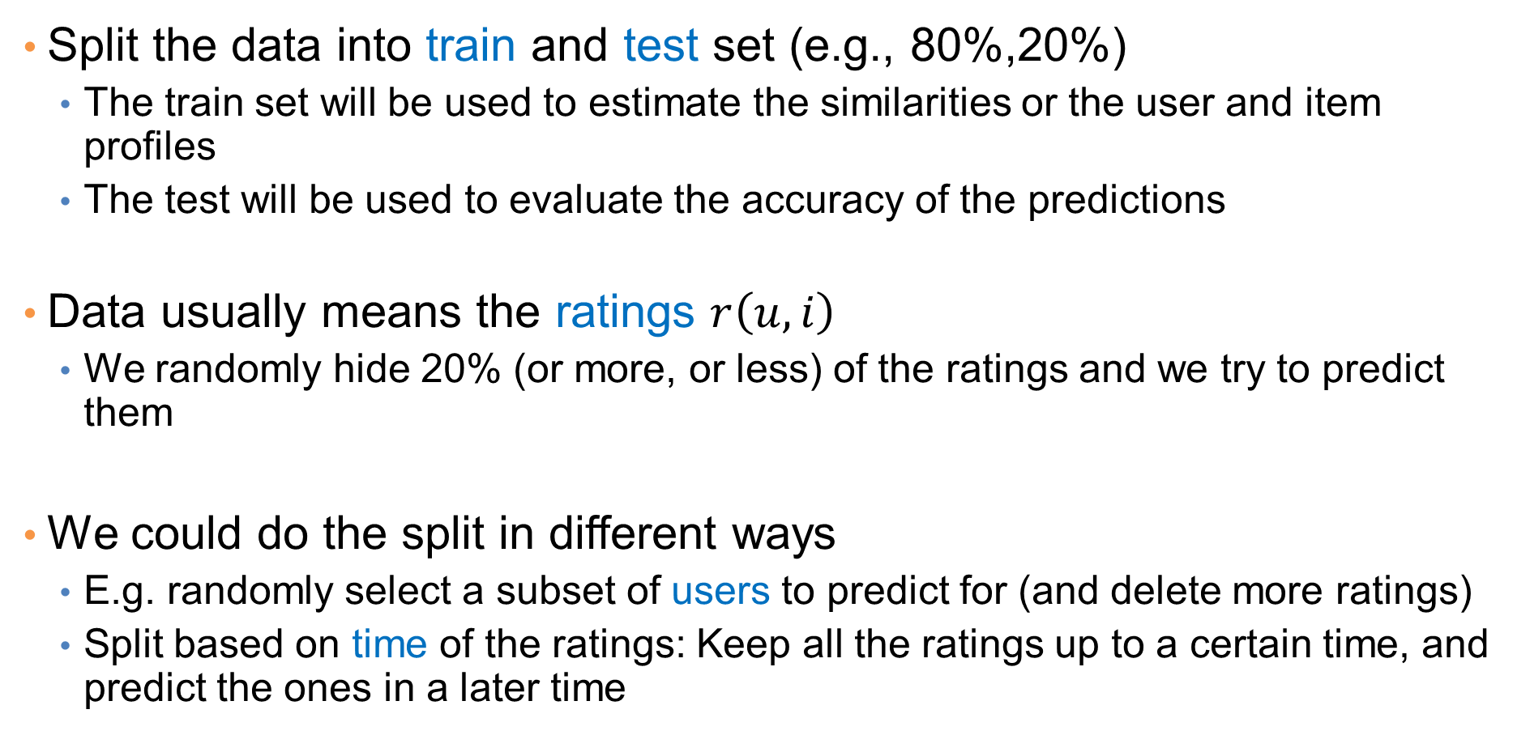
Evaluation
Split the data into train and test set (e.g., 80%,20%)
  The train set will be used to estimate the similarities or the user and item profiles
  The test will be used to evaluate the accuracy of the predictions
Data usually means the ratings $r\left(u,i\right)$
  We randomly hide 20% (or more, or less) of the ratings and we try to predict them
We could do the split in different ways
  E.g. randomly select a subset of users to predict for (and delete more ratings)
  Split based on time of the ratings: Keep all the ratings up to a certain time, and predict the ones in a later time

Slide 73
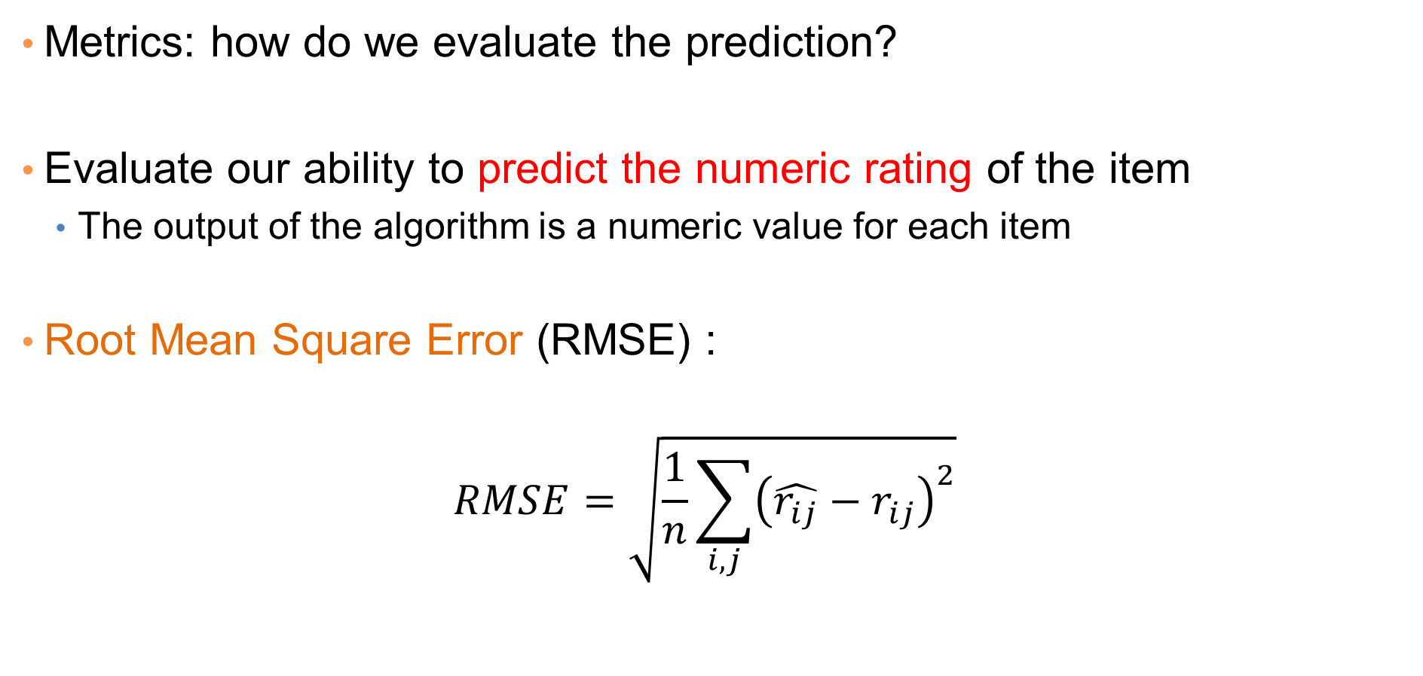
Evaluation
Metrics: how do we evaluate the prediction?
Evaluate our ability to predict the numeric rating of the item
  The output of the algorithm is a numeric value for each item
Root Mean Square Error (RMSE) :
$$RMSE=\sqrt{\frac{1}{n}\sum_{i,j}{{\left(\hat{r_{ij}}−r_{ij}\right)}^{2}}}$$

Slide 74
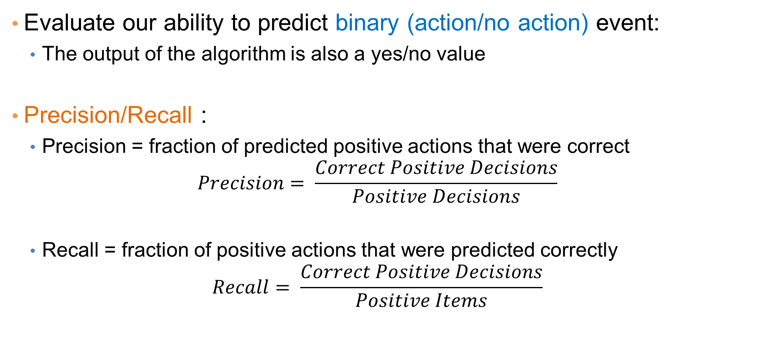
Evaluation
Evaluate our ability to predict binary (action/no action) event:
  The output of the algorithm is also a yes/no value
Precision/Recall :
  Precision = fraction of predicted positive actions that were correct
  $$Precision= \frac{Correct Positive Decisions}{Positive Decisions}$$
  Recall = fraction of positive actions that were predicted correctly
  $$Recall= \frac{Correct Positive Decisions}{Positive Items}$$

Slide 75
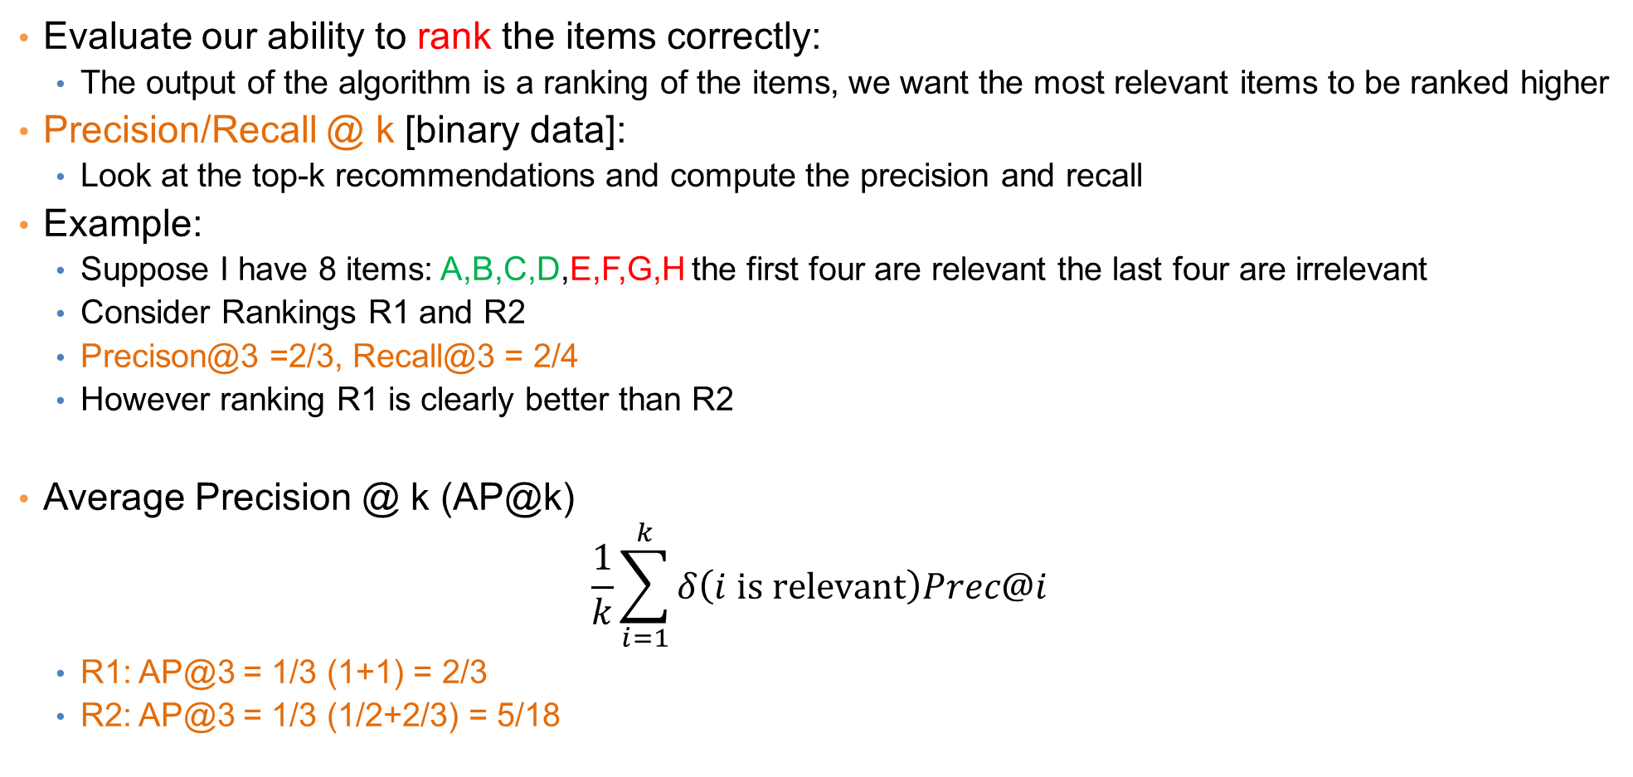
Evaluation
Evaluate our ability to rank the items correctly:
  The output of the algorithm is a ranking of the items, we want the most relevant items to be ranked higher
Precision/Recall @ k [binary data]:
  Look at the top-k recommendations and compute the precision and recall
Example:
  Suppose I have 8 items: A,B,C,D,E,F,G,H the first four are relevant the last four are irrelevant
  Consider Rankings R1 and R2
  Precison@3 =2/3, Recall@3 = 2/4
  However ranking R1 is clearly better than R2
Average Precision @ k (AP@k)
$$\frac{1}{k}\sum_{i=1}^{k}{δ\left(i is relevant\right)Prec@i}$$
  R1: AP@3 = 1/3 (1+1) = 2/3
  R2: AP@3 = 1/3 (1/2+2/3) = 5/18
rank | R1 | R2
1 | A | F
2 | C | A
3 | F | D
4 | B | G
5 | E | C
6 | G | B
7 | D | E
8 | H | H

Slide 76
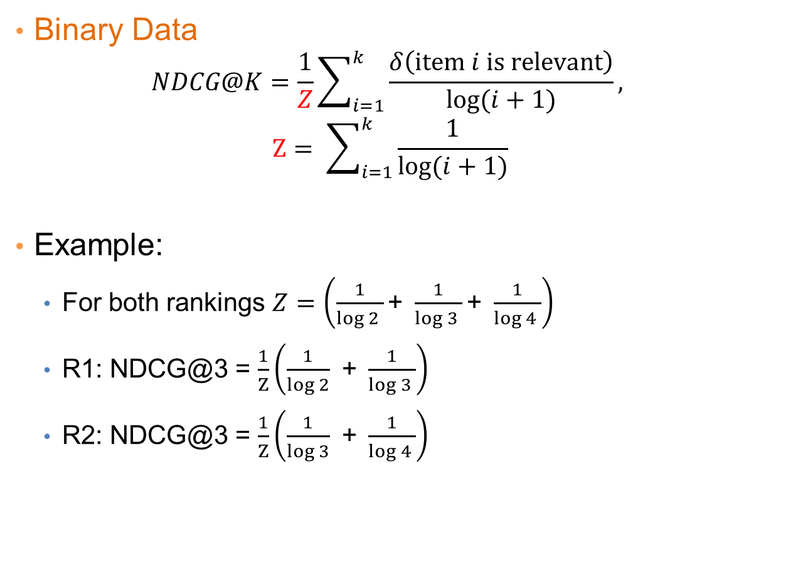
Evaluation – NDCG@K
Binary Data
  $$NDCG@K=\frac{1}{Z}\sum_{i=1}^{k}{\frac{δ\left(item i is relevant\right)}{\log{(i+1)}}},$$
  $$Z= \sum_{i=1}^{k}{\frac{1}{\log{(i+1)}}}$$
Example:
  For both rankings $Z=\left(\frac{1}{\log{2 }}\text{+ }\frac{1}{\log{3 }}\text{+ }\frac{1}{\log{4 }}\right)$
  R1: NDCG@3 = $\frac{1}{Z}\left(\frac{1}{\log{2}}\text{ + }\frac{1}{\log{3 }}\right)$
  R2: NDCG@3 = $\frac{1}{Z}\left(\frac{1}{\log{3}}\text{ + }\frac{1}{\log{4 }}\right)$
rank | R1 | R2 | Best
1 | A | F | A
2 | C | A | B
3 | F | D | C
4 | B | G | D
5 | E | C | E
6 | G | B | F
7 | D | E | G
8 | H | H | H
Score of the best ranking

Slide 77




Evaluation – NDCG@K
Rated Data
  $$NDCG@K=\frac{1}{Z}\sum_{i=1}^{k}{\frac{\exp\left(r_{i}\right)−1}{\log{(i+1)}}}$$
  $$Z= \sum_{i=1}^{k}{\frac{\exp\left(r_{i}^{∗}\right)−1}{\log{(i+1)}}}$$
Example:
  Assume the ratings of the items shown
  For both rankings $Z=\left(\frac{\exp\left(5\right)−1}{\log{2 }}\text{+ }\frac{\exp\left(4\right)−1}{\log{3 }}\text{+ }\frac{\exp\left(3\right)−1}{\log{4 }}\right)$
  R1: NDCG@3 = $\frac{1}{Z}\left(\frac{\exp\left(5\right)−1}{\log{2}}\text{ + }\frac{\exp\left(3\right)−1}{\log{3 }}\right)$
  R2: NDCG@3 = $\frac{1}{Z}\left(\frac{\exp\left(5\right)−1}{\log{3}}\text{ + }\frac{\exp\left(2\right)−1}{\log{4 }}\right)$
rank | R1 | R2 | Best | rating
1 | A | F | A | $$5$$
2 | C | A | B | $$4$$
3 | F | D | C | $$3$$
4 | B | G | D | $$2$$
5 | E | C | E | $$1$$
6 | G | B | F | $$0$$
7 | D | E | G | $$0$$
8 | H | H | H | $$0$$
$r_{i}$=true rating of$i^{th}$ item in the ranking
Score of the best ranking
$r_{i}^{∗}$=true rating of$i^{th}$ best item

Slide 78














Evaluation: AUC – Area Under the ROC Curve
The ROC curve considers every position of the ranking and plots the relevant percentage (true positive rate) against the non-relevant percentage (false positive rate)
It then takes the area under the plotted curve
It computes the fraction of (relevant, non-relevant) pairs where the relevant item is ranked higher than the non-relevant item.
Example:
  Suppose I have 8 items: A,B,C,D,E,F,G,H the first four are relevant the last four are irrelevant
    16 pairs of (relevant, non-relevant) pairs
  The recommender orders them in the following order: A,B,E,F,C,G,D,H
 |  | TPR | FPR
1 | A | $$\frac{1}{4}$$ | 0
2 | B | $$\frac{2}{4}$$ | 0
3 | E | $$\frac{2}{4}$$ | $$\frac{1}{4}$$
4 | F | $$\frac{2}{4}$$ | $$\frac{2}{4}$$
5 | C | $$\frac{3}{4}$$ | $$\frac{2}{4}$$
6 | G | $$\frac{3}{4}$$ | $$\frac{3}{4}$$
7 | D | $$\frac{4}{4}$$ | $$\frac{3}{4}$$
8 | H | $$\frac{4}{4}$$ | $$\frac{4}{4}$$
TRP = True Positive Rate
The fraction of the relevant items found so far
$$\frac{4}{4}$$
7
8
$$\frac{3}{4}$$
5
6
$$\frac{2}{4}$$
2
3
4
$$\frac{1}{4}$$
1
$$\frac{1}{4}$$
$$\frac{2}{4}$$
$$\frac{3}{4}$$
$$\frac{4}{4}$$
FRP = False Positive Rate
The fraction of the non-relevant items found so far
AUC = $\frac{1}{16}\left(2×2+3×1+4×1\right)$

Slide 79


The Netflix Challenge
1M prize to improve the prediction accuracy by 10%

