Slide 1
DATA MINING
Supervised Learning
Regression
Classification - Decision Trees
Classification Issues:
Expressiveness, Generalization, Imbalance
Classification Evaluation

Slide 2
Supervised learning
In supervised learning, except for the feature variables that describe the data, we also have a target variable
The goal is to learn a function (model) that can estimate/predict the value of the target variable given the features
  We learn the function using a labeled training set.
Regression: The target variable (but also the features) is numerical and continuous
  The price of a stock, the GDP of a country, the grade in a class, the height of a child, the life expectancy etc
Classification: The target variable is discrete
  Does a taxpayer cheat or not? Will the stock go up or down? Will the student pass or fail? Is a transaction fraudulent or not? What is the topic of an article?

Slide 3
Applications
Descriptive modeling: Explanatory tool to understand the data:
  Regression: How does the change in the value of different factors affect our target variable?
    What factors contribute to the price of a stock?
    What factors contribute to the GDP of a country?
  Classification: Understand what attributes distinguish between objects of different classes
    Why do people cheat on their taxes?
    What words make a post offensive?
Predictive modeling: Predict a class of a previously unseen record
  Regression: What will the life-expectancy of a patient be? What will the price of a stock be?
  Classification: Will the patient survive or not? Will the stock go up or down?. Is this an offensive post?
Predictive modeling is in the heart of the data science revolution.

Slide 4
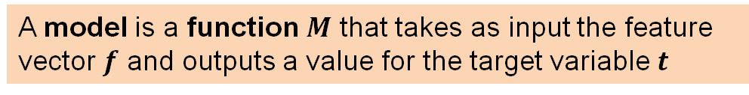





Supervised Learning Overview
$$f_{1}$$
$$f_{2}$$
$$f_{3}$$
$$f_{4}$$
$$f_{1}$$
$$f_{2}$$
$$f_{3}$$
$$f_{4}$$
$$t$$
Learning algorithm
Model
Training data
Train
Apply
Predict
Test data
Evaluate
$$t$$
A model is a function $M$ that takes as input the feature vector $f$ and outputs a value for the target variable $t$

Slide 5
Linear Regression

Slide 6
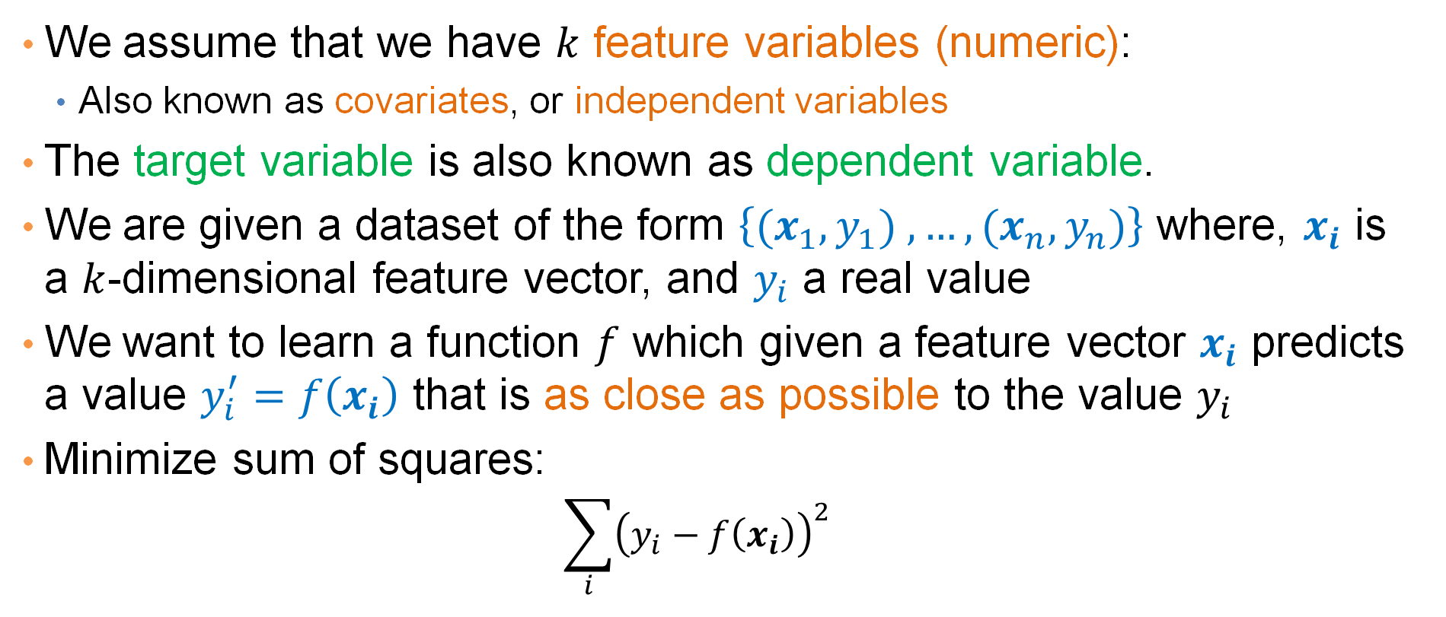
Regression
We assume that we have $k$ feature variables (numeric):
  Also known as covariates, or independent variables
The target variable is also known as dependent variable.
We are given a dataset of the form $\left\{{(x}_{1},y_{1}) ,…,{(x}_{n},y_{n})\right\}$ where, $x_{i}$ is a $k$-dimensional feature vector, and $y_{i}$ a real value
We want to learn a function $f$ which given a feature vector $x_{i}$ predicts a value $y_{i}^{′}=f\left(x_{i}\right)$ that is as close as possible to the value $y_{i}$
Minimize sum of squares:
  $$\sum_{i}{{\left(y_{i}−f\left(x_{i}\right)\right)}^{2}}$$

Slide 7
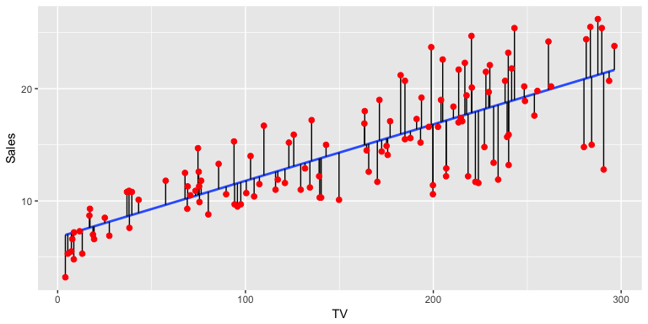
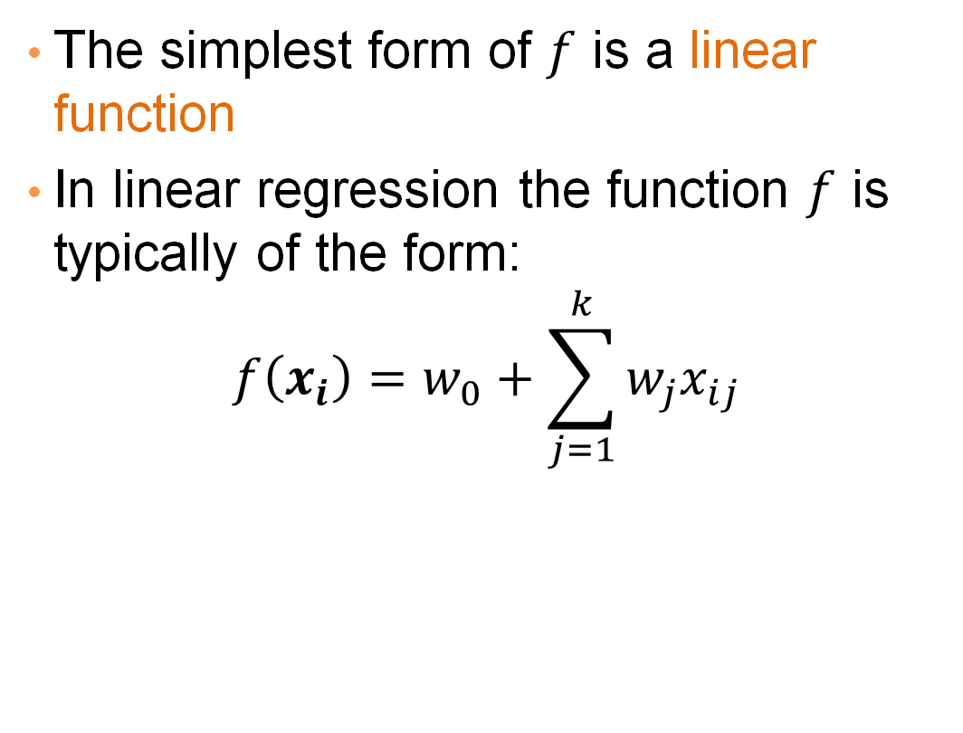
Linear regression
The simplest form of $f$ is a linear function
In linear regression the function $f$ is typically of the form:
$$f\left(x_{i}\right)=w_{0}+\sum_{j=1}^{k}{w_{j}x_{ij}}$$

Slide 8
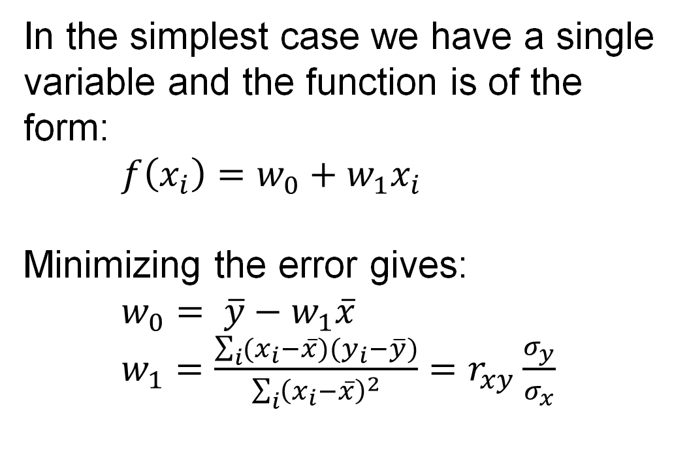
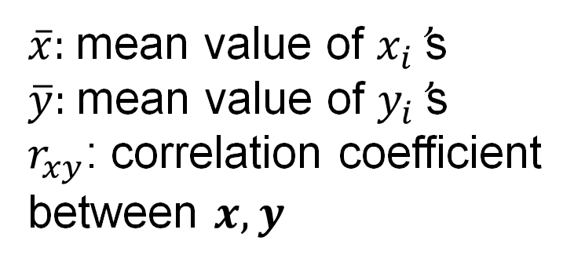
One-dimensional linear regression
In the simplest case we have a single variable and the function is of the form:
$f\left(x_{i}\right)=w_{0}+w_{1}x_{i}$
Minimizing the error gives:
$w_{0}= \overline{y}−w_{1}\overline{x}$
$w_{1}=\frac{\sum_{i}{(x_{i}−\overline{x})(y_{i}−\overline{y})}}{\sum_{i}{{\left(x_{i}−\overline{x}\right)}^{2}}}=r_{xy}\frac{σ_{y}}{σ_{x}}$
$\overline{x}$: mean value of $x_{i}$’s
$\overline{y}$: mean value of $y_{i}$’s
$r_{xy}$: correlation coefficient between $x,y$

Slide 9
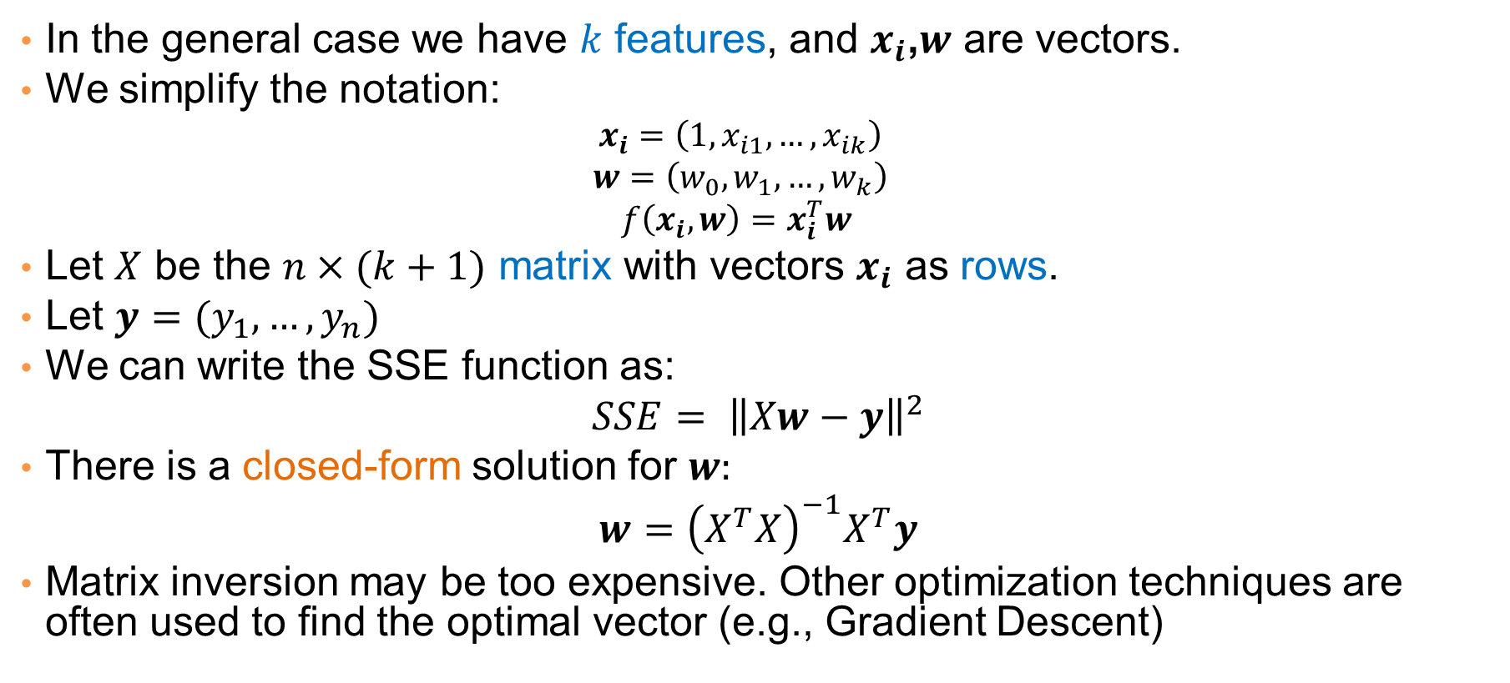
Multiple linear regression
In the general case we have $k$ features, and $x_{i}$,$w$ are vectors.
We simplify the notation:
  $$x_{i}=\left(1,x_{i1},…,x_{ik}\right)$$
  $$w=\left(w_{0},w_{1},…,w_{k}\right)$$
  $$f\left(x_{i},w\right)=x_{i}^{T}w$$
Let $X$ be the $n×(k+1)$ matrix with vectors $x_{i}$ as rows.
Let $y=(y_{1},…,y_{n})$
We can write the SSE function as:
$$SSE= {\left\|Xw−y\right\|}^{2}$$
There is a closed-form solution for $w:$
$$w={\left(X^{T}X\right)}^{−1}X^{T}y$$
Matrix inversion may be too expensive. Other optimization techniques are often used to find the optimal vector (e.g., Gradient Descent)

Slide 10
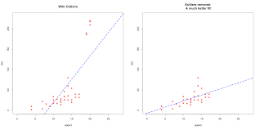
Outliers
Regression is sensitive to outliers:
  The line will “tilt” to accommodate very extreme values
Solution: remove the outliers
  But make sure that they do not capture useful information

Slide 11
Normalization
In the regression problem some times our features may have very different scales:
  For example: predict the GDP of a country using as features the percentage of home owners and the income
  The weights in this case will not be interpretable
Solution: Normalize the features by replacing the values with the z-scores
  Remove the mean and divide by the standard deviation

Slide 12
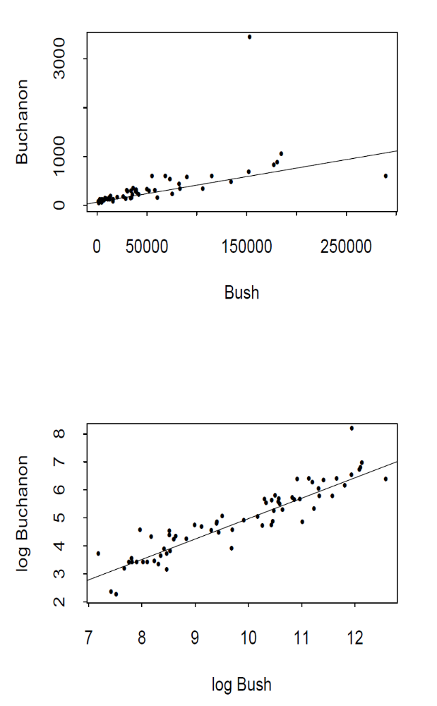
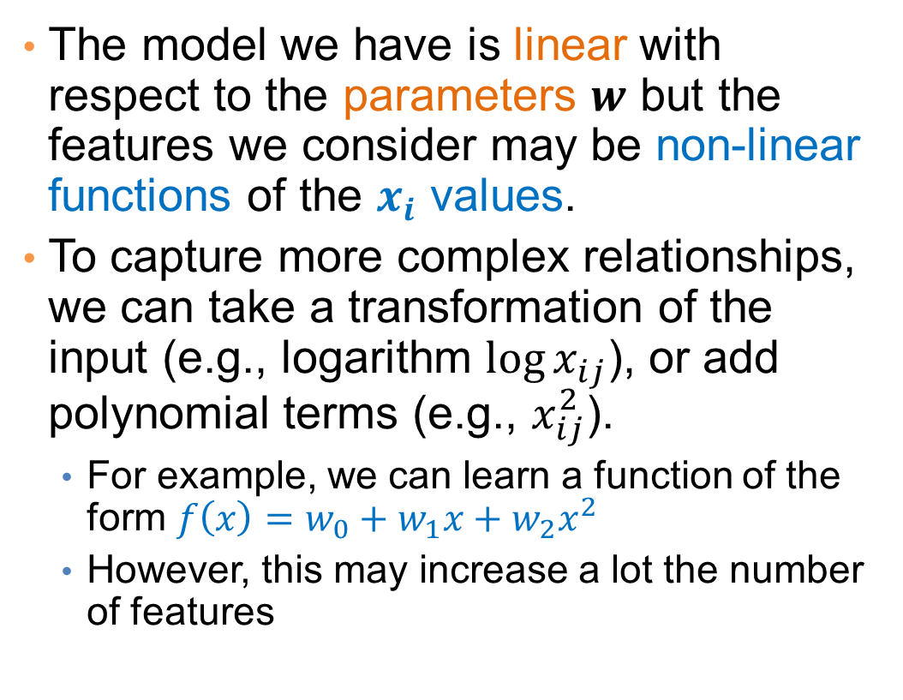
More complex models
The model we have is linear with respect to the parameters $w$ but the features we consider may be non-linear functions of the $x_{i}$ values.
To capture more complex relationships, we can take a transformation of the input (e.g., logarithm ${\log{x}}_{ij}$), or add polynomial terms (e.g., $x_{ij}^{2}$).
  For example, we can learn a function of the form $f\left(x\right)=w_{0}+w_{1}x+w_{2}x^{2}$
  However, this may increase a lot the number of features

Slide 13
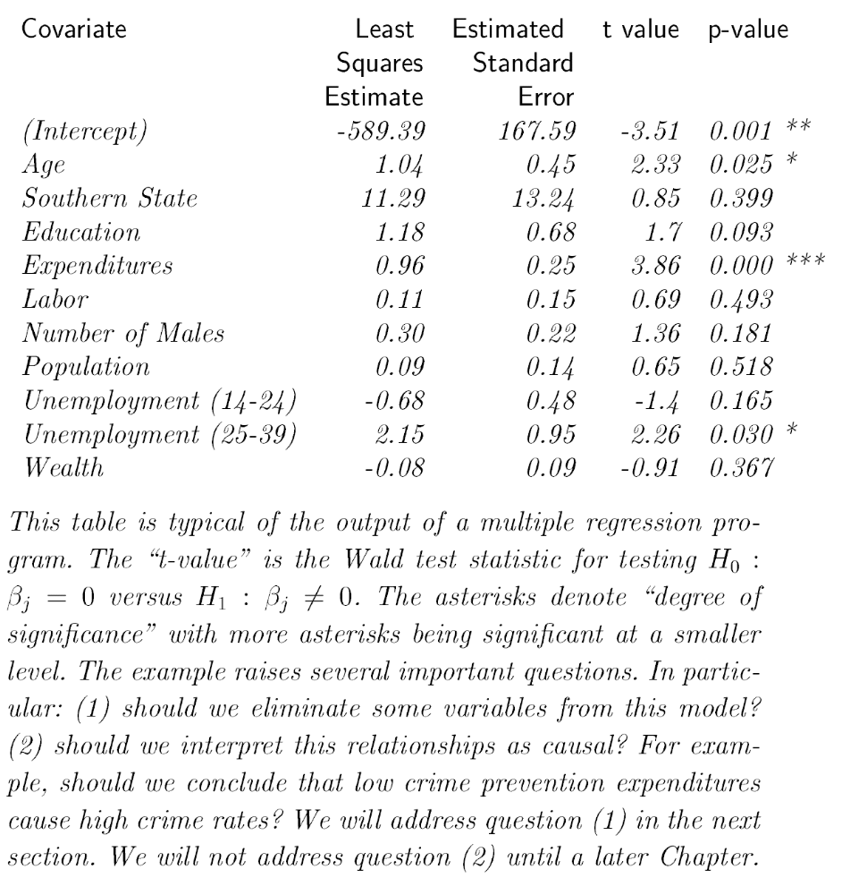
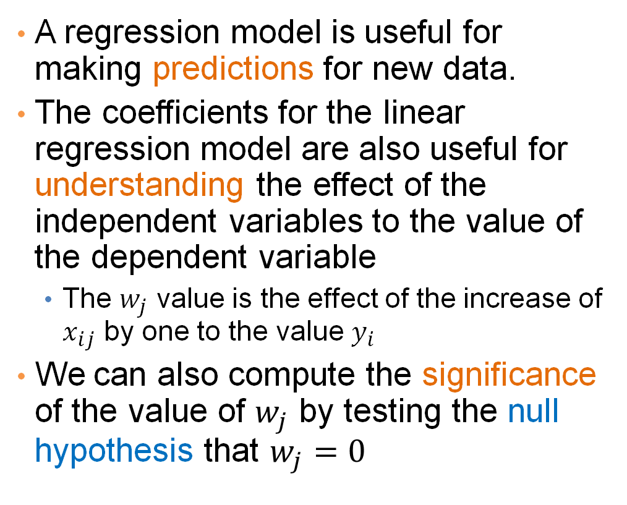
Interpretation and significance
A regression model is useful for making predictions for new data.
The coefficients for the linear regression model are also useful for understanding the effect of the independent variables to the value of the dependent variable
  The $w_{j}$ value is the effect of the increase of $x_{ij}$ by one to the value $y_{i}$
We can also compute the significance of the value of $w_{j}$ by testing the null hypothesis that $w_{j}=0$
Predicting Crime rate

Slide 14
Classification

Slide 15
Classification
Similar to the regression problem we have features and a target variable that we want to model/predict
The target variable is now discrete. It is often called the class label
  In the simplest case, it is a binary variable.
In classification the features may also be categorical.

Slide 16
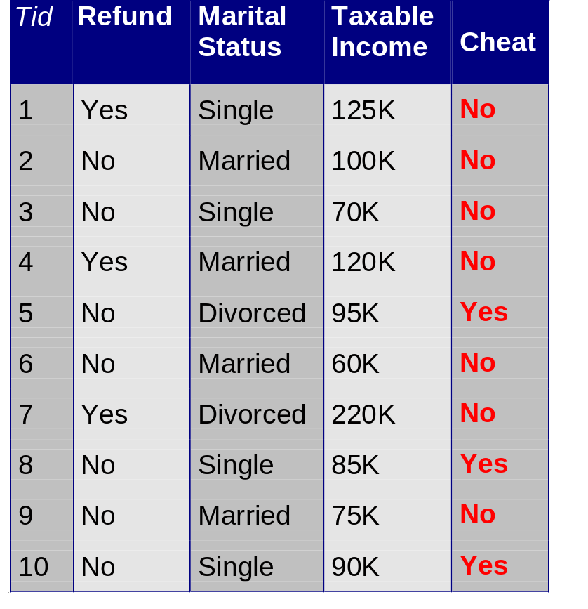
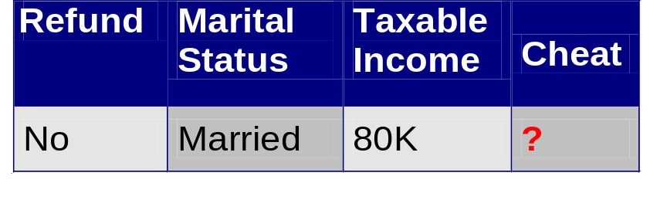
Example: Catching tax-evasion
Tax-return data for year 2011
A new tax return for 2012
Is this a cheating tax return?
An instance of the classification problem: learn a method for discriminating between records of different classes (cheaters vs non-cheaters)

Slide 17
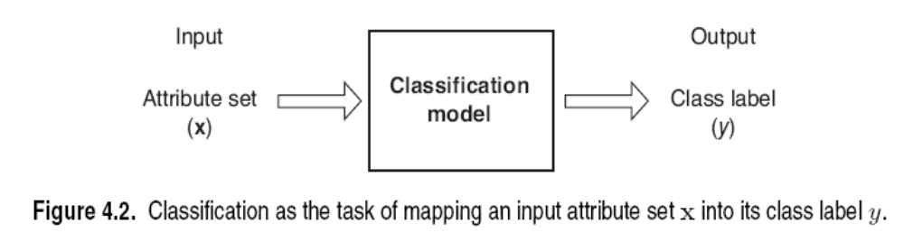
Classification
Classification is the task of learning a target function f that maps attribute set x to one of the predefined class labels y
The function may be defined as an algorithm (e.g., if Single and Income < 125K then No)
categorical
categorical
continuous
class
One of the attributes is the class attribute
In this case: Cheat
Two class labels (or classes): Yes (1), No (0)

Slide 18
Examples of Classification Tasks
Predicting tumor cells as benign or malignant
Classifying credit card transactions as legitimate or fraudulent
Categorizing news stories as finance, weather, entertainment, sports
Identifying spam email, spam web pages, adult content
Understanding if a web query has commercial intent or not
Classification is everywhere in data science
Big data has the answers to all questions.

Slide 19
General approach to classification
Obtain a training set consisting of records with known class labels
Training set is used to build a classification model
A labeled test set of previously unseen data records is used to evaluate the quality of the model.
The classification model is applied to new records with unknown class labels
Important intermediate step: Decide on what features to use

Slide 20
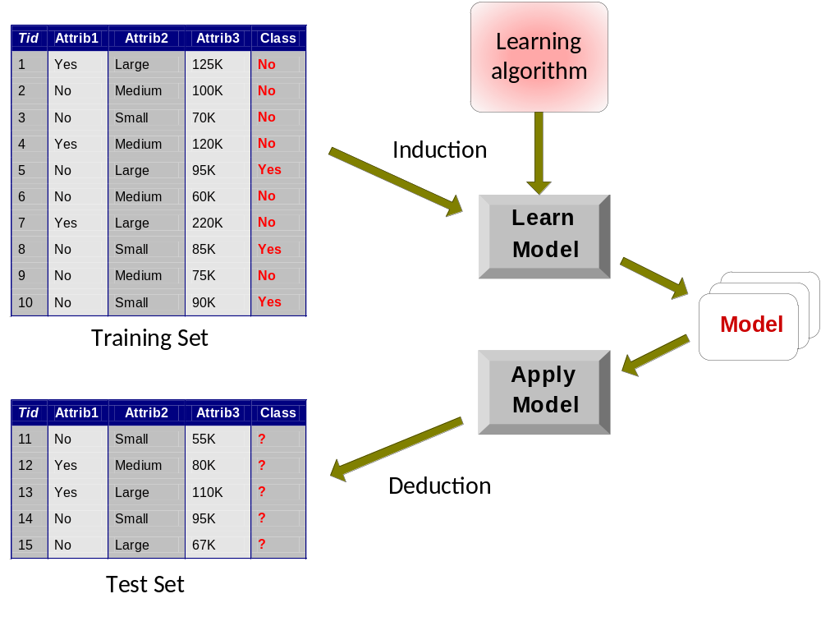
Illustrating Classification Task

Slide 21
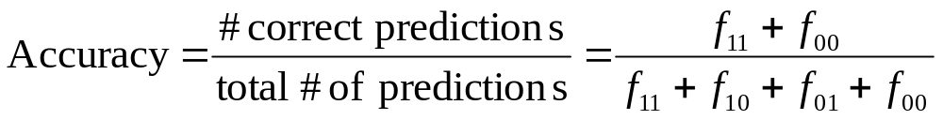

Evaluation of classification models
Counts of test records that are correctly (or incorrectly) predicted by the classification model
Confusion matrix
Predicted Class
 | Class = 1 | Class = 0
Class = 1 | f₁₁ | f₁₀
Class = 0 | f₀₁ | f₀₀
Actual Class

Slide 22
Classification Techniques
Decision Tree based Methods
Rule-based Methods
Memory based reasoning
Neural Networks
Naïve Bayes and Bayesian Belief Networks
Support Vector Machines
Logistic Regression

Slide 23
DECISION TREES

Slide 24
Decision Trees
Decision tree
  A flow-chart-like tree structure
  Internal node denotes a test on an attribute
  Branch represents an outcome of the test
  Leaf nodes represent class labels or class distribution

Slide 25
Example of a Decision Tree
categorical
categorical
continuous
class
Splitting Attributes
Refund
Yes
No
Test outcome
NO
MarSt
Single, Divorced
Married
TaxInc
NO
< 80K
> 80K
NO
YES
Class labels
Training Data
Model: Decision Tree

Slide 26
Another Example of Decision Tree
categorical
categorical
continuous
class
MarSt
Single, Divorced
Married
NO
Refund
Yes
No
NO
TaxInc
< 80K
> 80K
NO
YES
There could be more than one tree that fits the same data!

Slide 27

Decision Tree Classification Task
Decision Tree

Slide 28
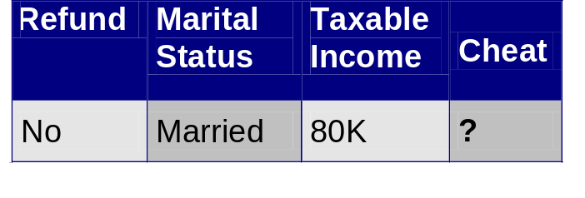
Apply Model to Test Data
Test Data
Start from the root of tree.
Refund
Yes
No
NO
MarSt
Single, Divorced
Married
TaxInc
NO
< 80K
> 80K
NO
YES

Slide 29
Apply Model to Test Data
Test Data
Refund
Yes
No
NO
MarSt
Single, Divorced
Married
TaxInc
NO
< 80K
> 80K
NO
YES

Slide 30
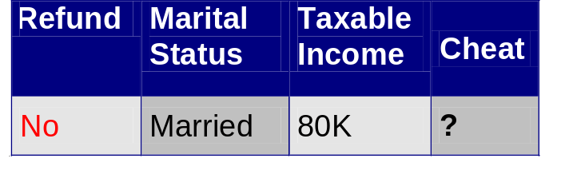
Apply Model to Test Data
Test Data
Refund
Yes
No
NO
MarSt
Single, Divorced
Married
TaxInc
NO
< 80K
> 80K
NO
YES

Slide 31
Apply Model to Test Data
Test Data
Refund
Yes
No
NO
MarSt
Single, Divorced
Married
TaxInc
NO
< 80K
> 80K
NO
YES

Slide 32
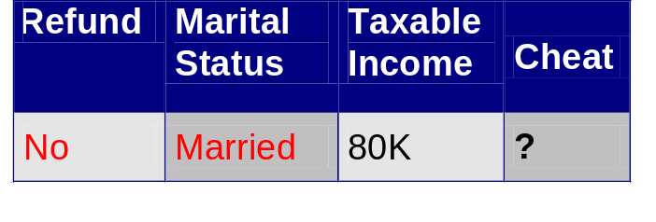
Apply Model to Test Data
Test Data
Refund
Yes
No
NO
MarSt
Single, Divorced
Married
TaxInc
NO
< 80K
> 80K
NO
YES

Slide 33
Apply Model to Test Data
Test Data
Refund
Yes
No
NO
MarSt
Single, Divorced
Married
Assign Cheat to “No”
TaxInc
NO
< 80K
> 80K
NO
YES

Slide 34
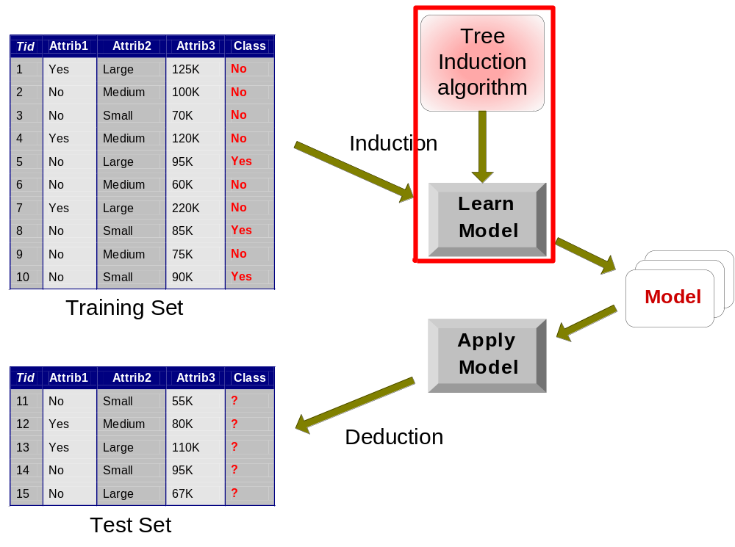
Decision Tree Classification Task
Decision Tree

Slide 35
Tree Induction
Goal: Find the tree that has low classification error in the training data (training error)
Finding the best decision tree (lowest training error) is NP-hard
Greedy strategy.
  Split the records based on an attribute test that optimizes certain criterion.
Many Algorithms:
  Hunt’s Algorithm (one of the earliest)
  CART
  ID3, C4.5
  SLIQ,SPRINT

Slide 36
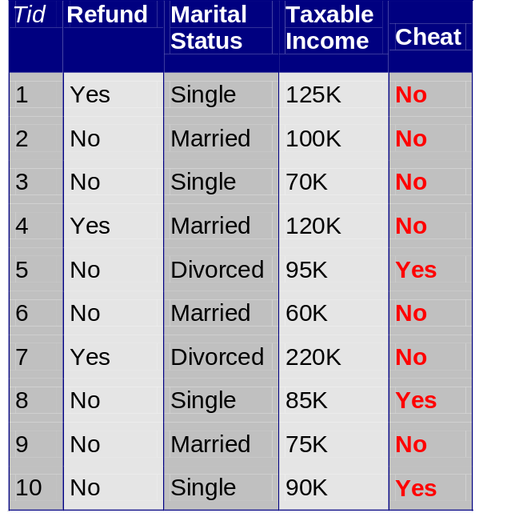
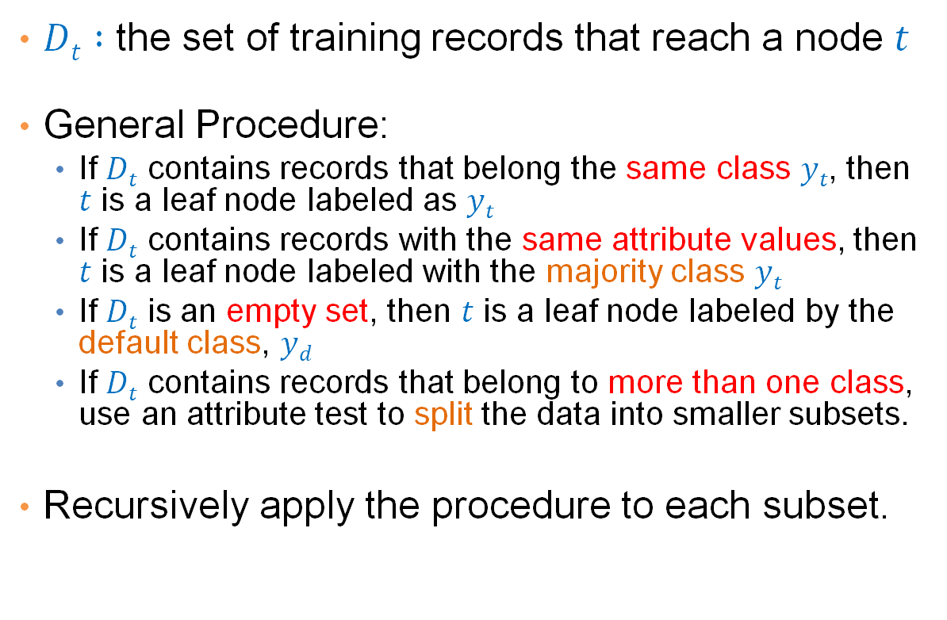

General Structure of Hunt’s Algorithm
$Dt :$ the set of training records that reach a node $t$
General Procedure:
  If $Dt$ contains records that belong the same class $yt$, then $t$ is a leaf node labeled as $yt$
  If $Dt$ contains records with the same attribute values, then $t$ is a leaf node labeled with the majority class $yt$
  If $Dt$ is an empty set, then $t$ is a leaf node labeled by the default class, $yd$
  If $Dt$ contains records that belong to more than one class, use an attribute test to split the data into smaller subsets.
Recursively apply the procedure to each subset.
$$Dt$$
?

Slide 37
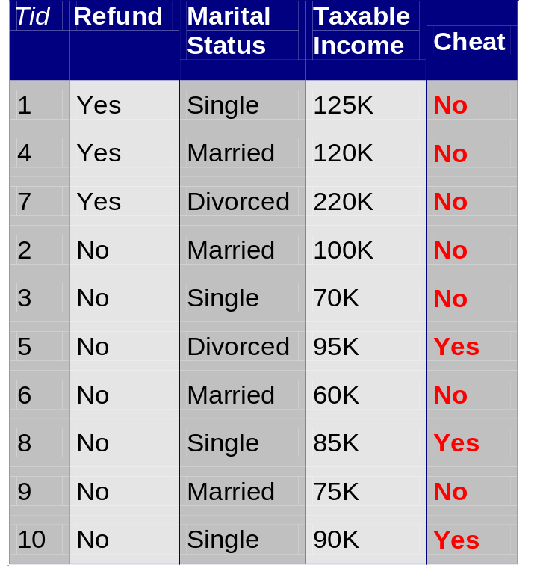
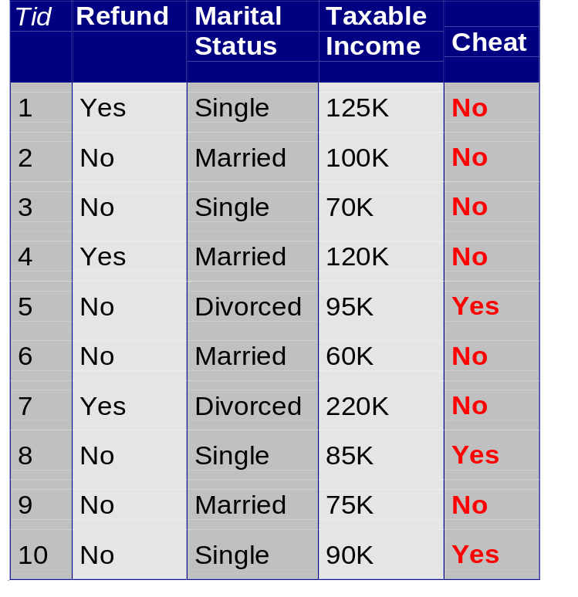
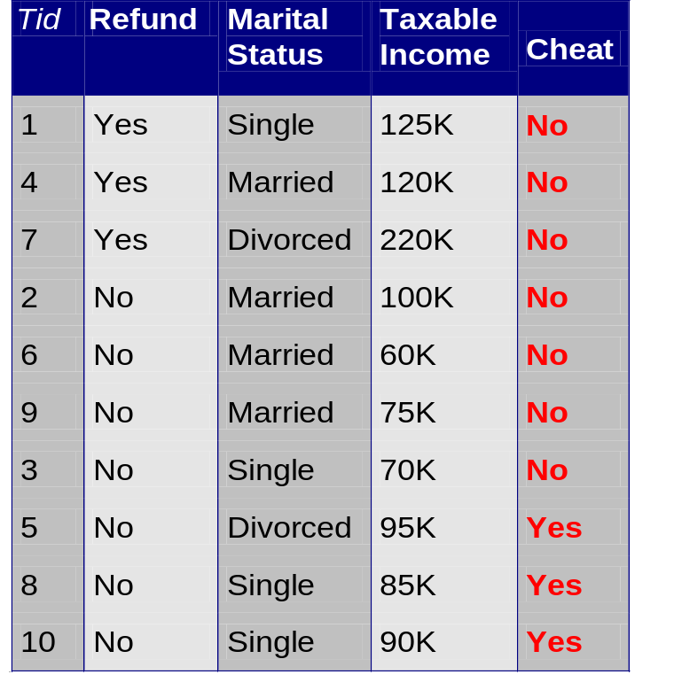
Hunt’s Algorithm
Refund
Don’t
Cheat
Yes
No
Don’t
Cheat
Don’t
Cheat
Refund
Refund
Yes
No
Yes
No
Don’t
Cheat
Marital
Status
Don’t
Cheat
Marital
Status
Single,
Divorced
Single,
Divorced
Married
Married
Cheat
Don’t
Cheat
Taxable
Income
Don’t
Cheat
< 80K
>= 80K
Don’t
Cheat
Cheat

Slide 38
Constructing decision-trees (pseudocode)
GenDecTree(Sample S, Features F)
If stopping_condition(S,F) = true then
  leaf = createNode()
  leaf.label= Classify(S)
  return leaf
root = createNode()
root.test_condition = findBestSplit(S,F)
V = {v| v a possible outcome of root.test_condition}
for each value vєV:
  S_{v}: = {s | root.test_condition(s) = v and s є S};
  child = GenDecTree(S_{v} ,F) ;
  Add child as a descent of root and label the edge (root→child) as v
return root

Slide 39
Tree Induction
Issues
  How to Classify a leaf node
    Assign the majority class
    If leaf is empty, assign the default class – the class that has the highest popularity (overall or in the parent node).
  Determine how to split the records
    How to specify the attribute test condition?
    How to determine the best split?
  Determine when to stop splitting

Slide 40
How to Specify Test Condition?
Depends on attribute types
  Nominal
  Ordinal
  Continuous
Depends on number of ways to split
  2-way split
  Multi-way split

Slide 41
Splitting Based on Nominal Attributes
Multi-way split: Use as many partitions as distinct values.
Binary split: Divides values into two subsets.
Need to find optimal partitioning.
CarType
Family
Luxury
Sports
CarType
OR
CarType
{Sports, Luxury}
{Family,
Luxury}
{Family}
{Sports}

Slide 42
Splitting Based on Ordinal Attributes
Multi-way split: Use as many partitions as distinct values.
Binary split: Divides values into two subsets – respects the order. Need to find optimal partitioning.
What about this split?
Size
Small
Large
Medium
Size
Size
{Small, Medium}
OR
{Medium,
Large}
{Large}
{Small}
Size
{Small, Large}
{Medium}

Slide 43
Splitting Based on Continuous Attributes
Different ways of handling
  Discretization to form an ordinal categorical attribute
    Static – discretize once at the beginning
    Dynamic – ranges can be found by equal interval bucketing, equal frequency bucketing (percentiles), or clustering.
  Binary Decision: (A < v) or (A ≥ v)
    consider all possible splits and finds the best cut
    can be more computationally intensive

Slide 44
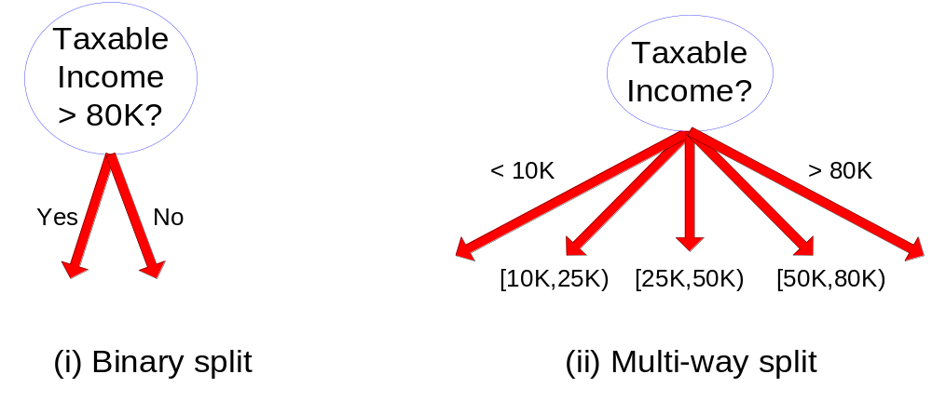
Splitting Based on Continuous Attributes

Slide 45
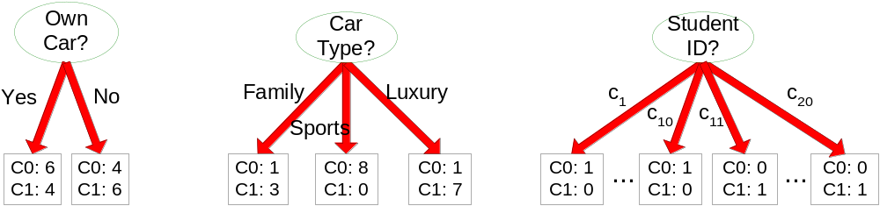
How to determine the Best Split
Before Splitting: 10 records of class 0,
10 records of class 1
Which test condition is the best?

Slide 46
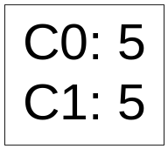
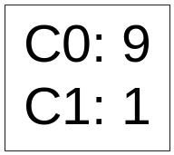
How to determine the Best Split
Greedy approach:
  Creation of nodes with homogeneous class distribution is preferred
Need a measure of node impurity:
Ideas?
Non-homogeneous,
High degree of impurity
Homogeneous,
Low degree of impurity

Slide 47
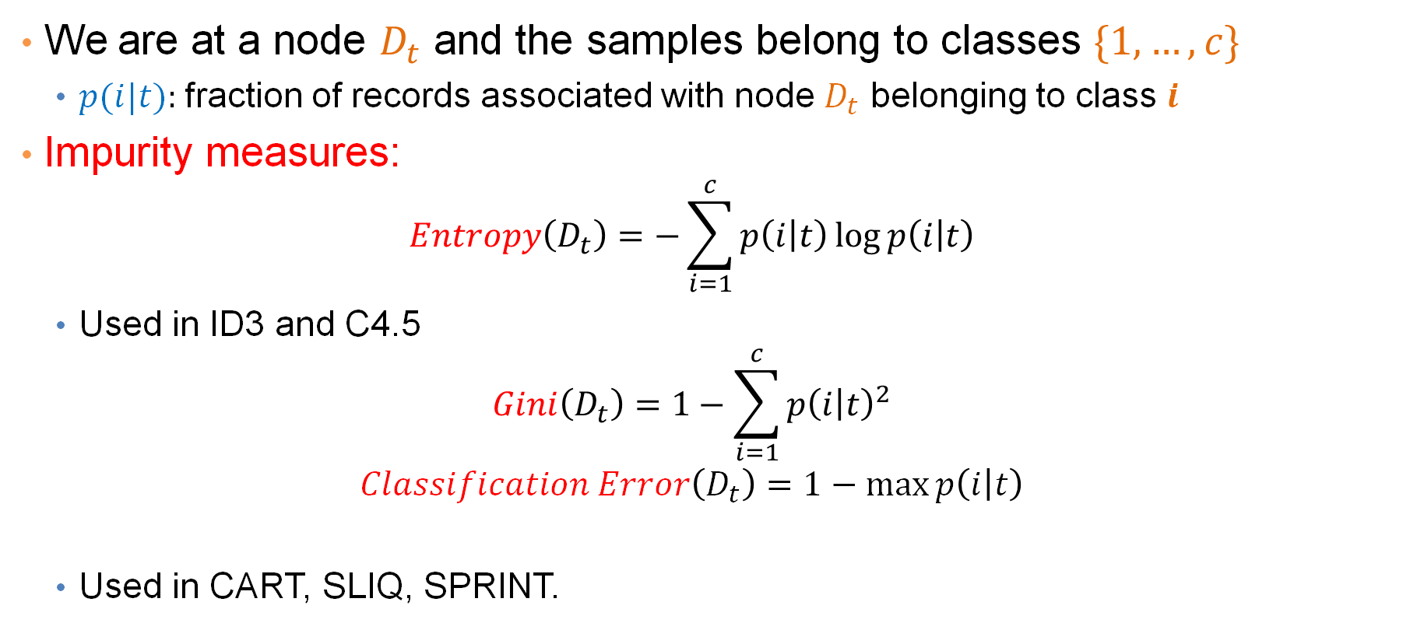
Measuring Node Impurity
We are at a node $D_{t}$ and the samples belong to classes $\{1,…,c\}$
  $p(i|t):$fraction of records associated with node $D_{t}$ belonging to class $i$
Impurity measures:
  $$Entropy\left(D_{t}\right)=−\sum_{i=1}^{c}{p\left(i | t\right)\log{p\left(i | t\right)}}$$
  Used in ID3 and C4.5
  $$Gini\left(D_{t}\right)=1−\sum_{i=1}^{c}{p{\left(i | t\right)}^{2}}$$
  $$Classification Error\left(D_{t}\right)=1−\max{p\left(i | t\right)}$$
  Used in CART, SLIQ, SPRINT.

Slide 48
Example: C4.5
Simple depth-first construction.
Uses Information Gain
Sorts Continuous Attributes at each node.
Needs entire data to fit in memory.
Unsuitable for Large Datasets.
  Needs out-of-core sorting.
You can download the software from:
http://www.cse.unsw.edu.au/~quinlan/c4.5r8.tar.gz

Slide 49
Other Classification issues
Expressiveness
Overfitting
Evaluation

Slide 50
Expressiveness

Slide 51
Expressiveness
A classifier defines a function that discriminates between two (or more) classes.
The expressiveness of a classification model is the class of functions that it can model, and the kind of data that it can separate
When we have discrete (or binary) values, we are interested in the class of boolean functions that can be modeled
When the data-points are real vectors, we talk about the decision boundary that the classifier can model
  The decision boundary is the (multi-dimensional) surface defined by the function of the classifier that separates the YES and NO decisions

Slide 52
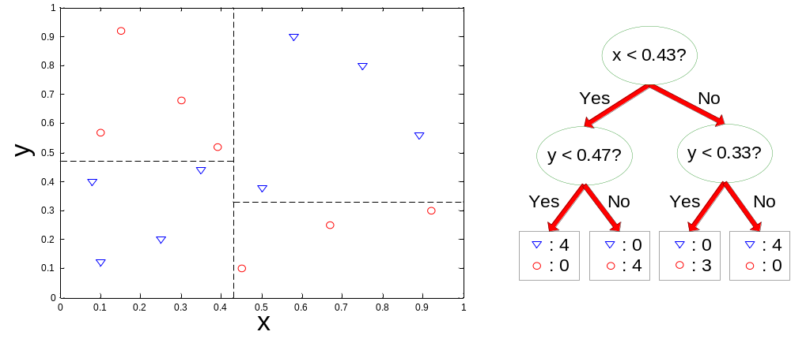
Decision Boundary for Decision Trees
Consider a decision tree on real data where the test conditions involve a single attribute at a time, and a Yes/No question
Each test defines a line parallel to an axis (the one corresponding to the test attribute)
The decision boundary is a collection of lines parallel to the axes

Slide 53
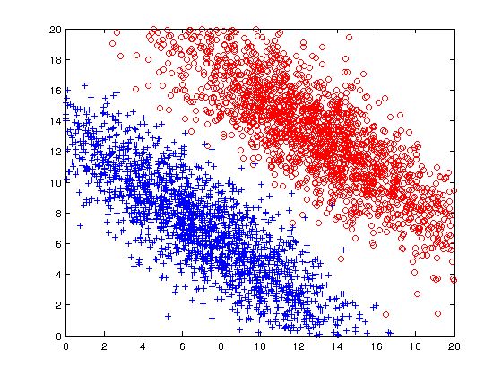
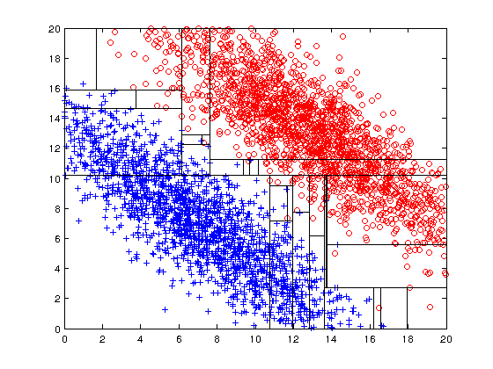
Limitations of single attribute-based decision boundaries
Both positive (+) and negative (o) classes generated from skewed Gaussians with centers at (8,8) and (12,12) respectively.
The resulting boundary is very complex.

Slide 54
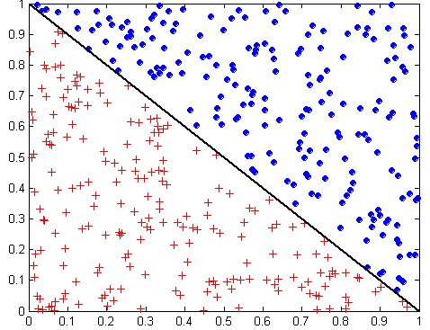
Oblique Decision Trees
x + y < 1
Class = +
Class =
Test condition may involve multiple attributes
More expressive representation
Finding optimal test condition is computationally expensive

Slide 55
Expressiveness
Decision tree provides expressive representation for learning discrete-valued function
  But they do not generalize well to certain types of Boolean functions
    Example: parity function:
      Class = 1 if there is an even number of Boolean attributes with truth value = True
      Class = 0 if there is an odd number of Boolean attributes with truth value = True
    For accurate modeling (better than 50%), must have a complete tree
Less expressive for modeling continuous variables
  Particularly when test condition involves only a single attribute at-a-time

Slide 56
Generalization

Slide 57
Generalization
Generalization refers to the ability of the classifier to correctly classify data that it has not already seen.
  The assumption is that the new data is similar to training data
  It comes from the same distribution/model as the training data
How do we measure how well a model generalizes?
Classification errors:
  Training errors (apparent errors): Errors committed on the training set
    This is what we can control when creating the classifier. We hope that the training error is indicative of the generalization error, but as we will see this is not always the case
  Test errors: Errors committed on the test set
    This is a true measure of generalization, and this is what we want to be small, but we do not have access to the test error at training time.

Slide 58
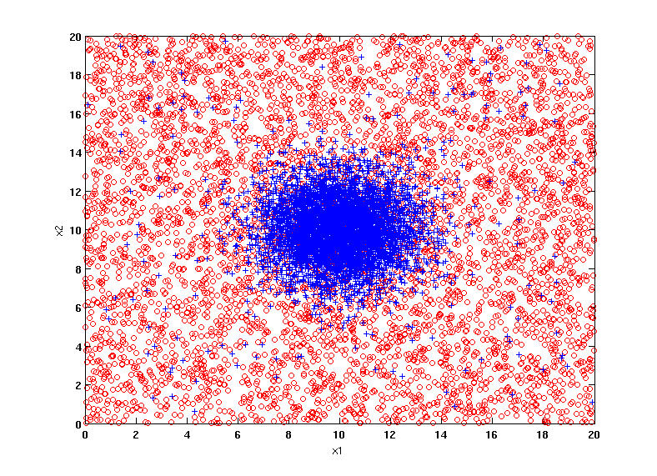
Example Data Set
Two class problem:
+ : 5400 instances
5000 instances generated from a Gaussian centered at (10,10)
400 noisy instances added
o : 5400 instances
Generated from a uniform distribution
10 % of the data used for training and 90% of the data used for testing

Slide 59
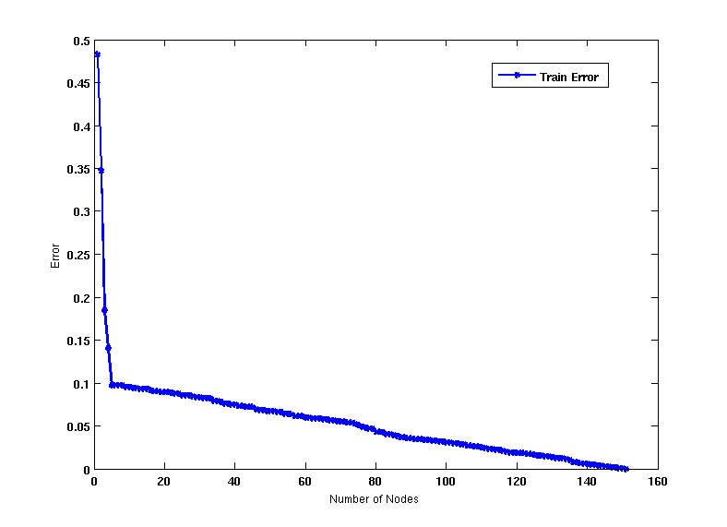
Increasing number of nodes in Decision Trees

Slide 60
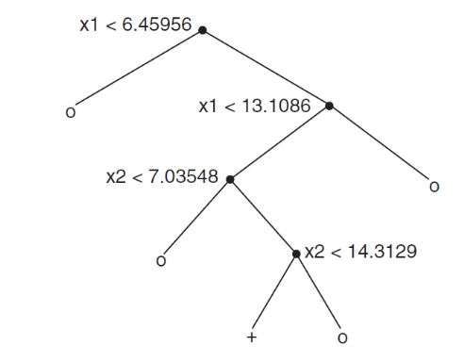
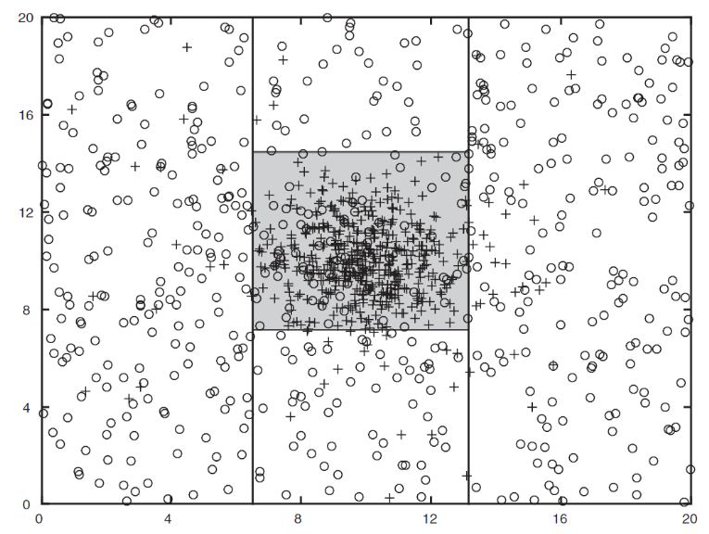
Decision Tree with 4 nodes
Decision Tree
Decision boundaries on Training data

Slide 61
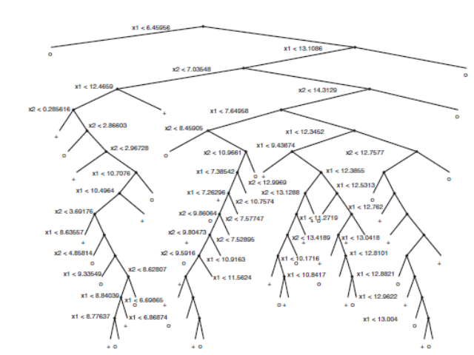
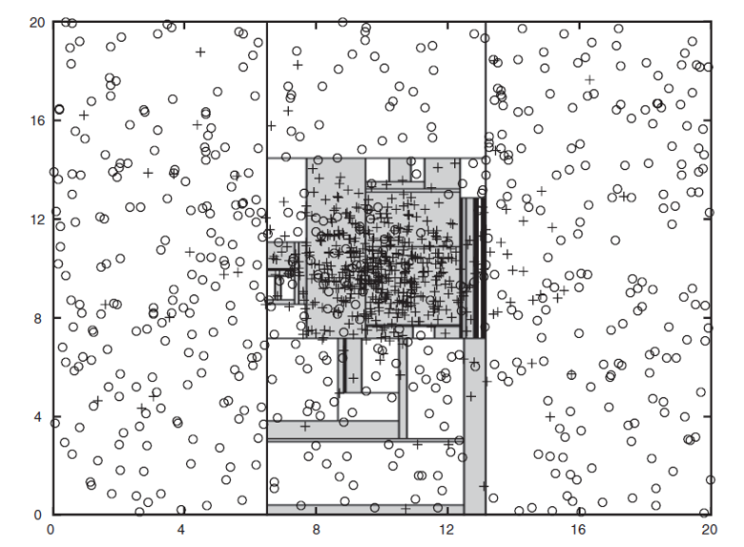
Decision Tree with 50 nodes
Decision Tree
Decision Tree
Decision boundaries on Training data

Slide 62
Which tree is better?
Decision Tree with 4 nodes
Which tree is better ?
Decision Tree with 50 nodes

Slide 63
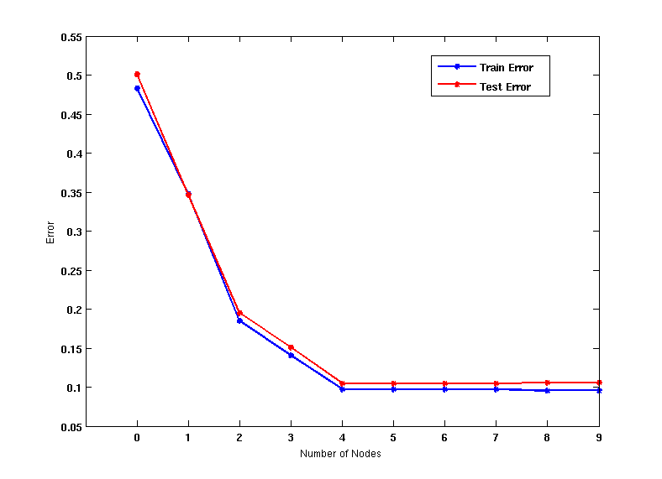
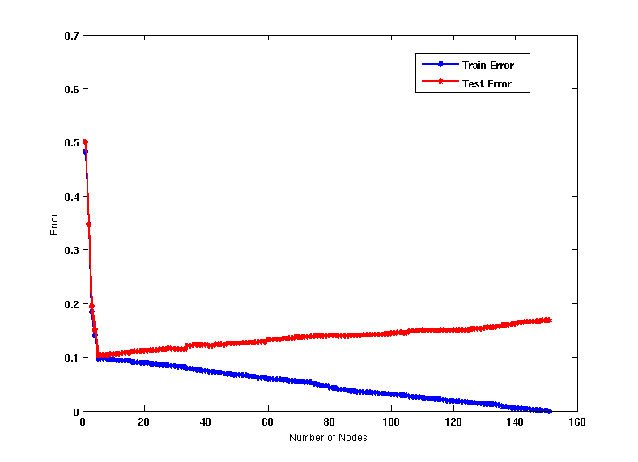
Generalization
When model is too simple, both training and test errors are large: Underfitting
When model is too complex, training error is small but test error is large: Overfitting

Slide 64
Bias – Variance tradeoff
Bias: Measures how good the model is with respect to the training data
  High Bias: Underfitting.
  We have a poor model, for example, a tree with a single decision node, or a linear function when modeling a more complex curve
Variance: Measures how sensitive the model error is with respect to changes in the training data
  High Variance: Overfitting.
  We have a very complex model, for example, a tree with a single sample per leaf, or a very high-degree polynomial curve. Small changes in the data cause errors in the model
There is a tradeoff between these two: decreasing one will increase the other.

Slide 65
Reasons for poor Generalization
Not enough training data
Not representative training data
Erroneous training data
A model that is too complex for the data we have.
  Multiple Comparison Procedure

Slide 66
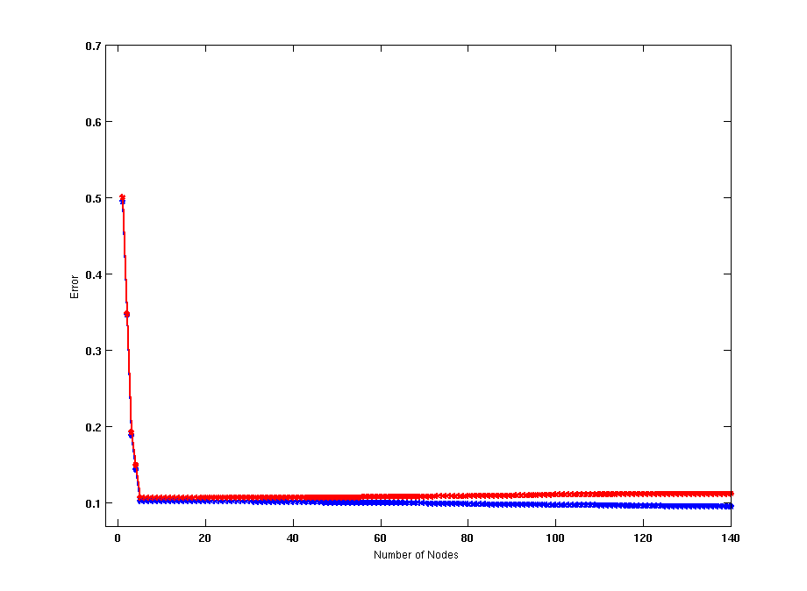
Model Overfitting
Using twice the number of data instances
Increasing the size of training data reduces the difference between training and testing errors at a given size of model

Slide 67
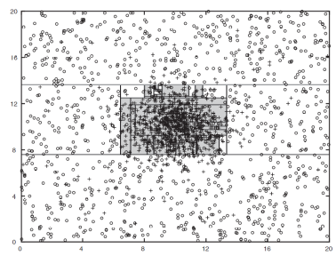
Model Overfitting
Decision Tree with 50 nodes
Decision Tree with 50 nodes
Using twice the number of data instances
Increasing the size of training data reduces the difference between training and testing errors at a given size of model

Slide 68
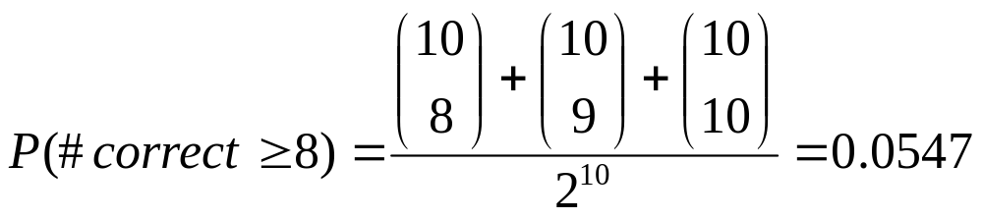
Effect of Multiple Comparison Procedure
Consider the task of predicting whether stock market will rise/fall in the next 10 trading days
Random guessing:
  P(correct) = 0.5
Make 10 random guesses in a row:
Day 1 | Up
Day 2 | Down
Day 3 | Down
Day 4 | Up
Day 5 | Down
Day 6 | Down
Day 7 | Up
Day 8 | Up
Day 9 | Up
Day 10 | Down

Slide 69
Effect of Multiple Comparison Procedure
Approach:
  Get 50 analysts
  Each analyst makes 10 random guesses
  Choose the analyst that makes the most correct predictions
Probability that at least one analyst makes at least 8 correct predictions

Slide 70
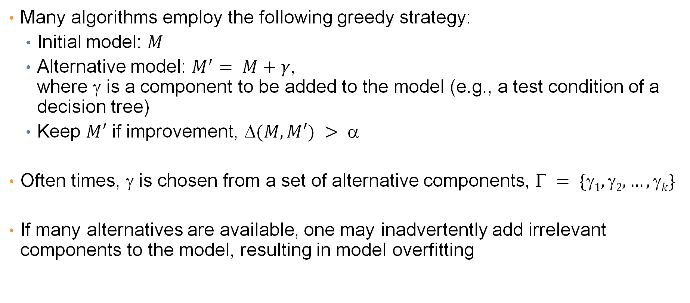
Effect of Multiple Comparison Procedure
Many algorithms employ the following greedy strategy:
  Initial model: $M$
  Alternative model: $M^{′}= M+γ$,
  where γ is a component to be added to the model (e.g., a test condition of a decision tree)
  Keep $M′$ if improvement, $(M,M′) > $
Often times, γ is chosen from a set of alternative components, $ = \{1, 2, …, k\}$
If many alternatives are available, one may inadvertently add irrelevant components to the model, resulting in model overfitting

Slide 71
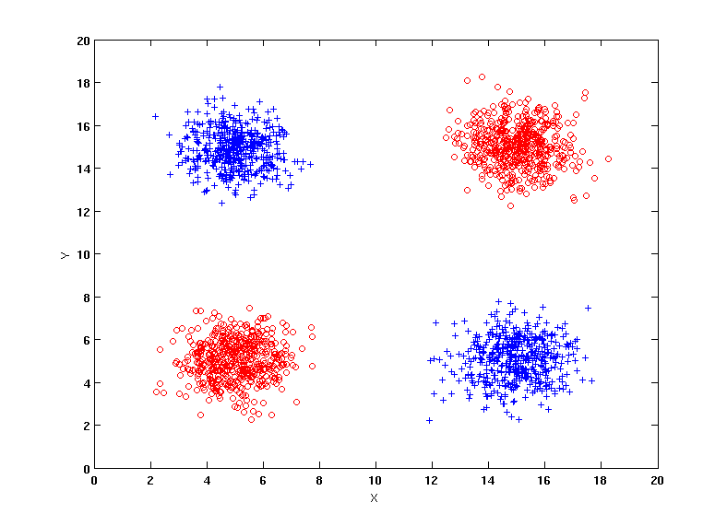
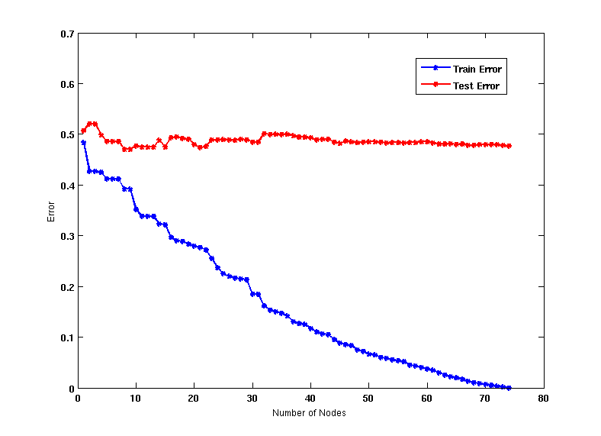
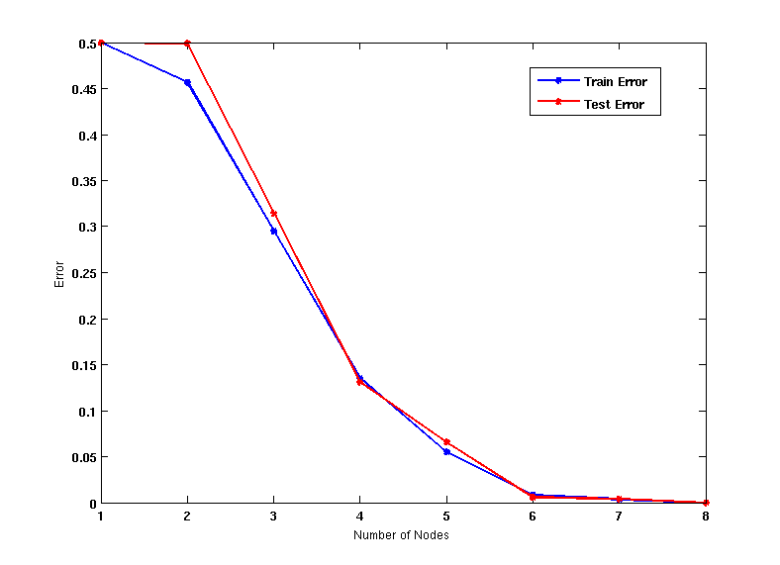
Effect of Multiple Comparison - Example
Use additional 100 noisy variables generated from a uniform distribution along with X and Y as attributes.
Use 30% of the data for training and 70% of the data for testing
Using only X and Y as attributes

Slide 72
In summary
When we have a small number of samples, and a very large number of features then it is likely that we will create a model that overfits the data and does not generalize well.
Models that overfit perform very well on training data because they (over)fit them perfectly, but they have low test error, since they cannot generalize to new instances

Slide 73
Notes on Overfitting
Overfitting results in decision trees that are more complex than necessary
Training error no longer provides a good estimate of test error, that is, how well the tree will perform on previously unseen records
We say that the model does not generalize well
Need ways for estimating the generalization error and select the model.

Slide 74
Model Selection
Performed during model building
Purpose is to ensure that model is not overly complex (to avoid overfitting)
Need to estimate generalization error
  Using Validation Set
  Incorporating Model Complexity

Slide 75
Model Selection: Using Validation Set
Divide training data into two parts:
  Training set:
    Use for model building
  Validation set:
    Use for estimating generalization error
    Note: validation set is not the same as test set since it affects the creation of the model (e.g. in tuning the size of the decision tree)
Drawback:
  Less data available for training

Slide 76

Model Selection: Incorporating Model Complexity
Occam’s razor: All other things being equal, the simplest explanation/solution is the best.
  A good principle for life as well
Given two models of similar generalization errors, one should prefer the simpler model over the more complex model
For complex models, there is a greater chance that it was fitted accidentally
Therefore, one should include model complexity when evaluating a model
  Gen. Error(Model) = Train. Error(Model, Train. Data)
  + $α×$ Complexity(Model)

Slide 77


Estimating the Complexity of Decision Trees
Resubstitution Estimate:
  Using training error as an optimistic estimate of generalization error
  Referred to as optimistic error estimate
$$e(TL) = 4/24$$
$$e(TR) = 6/24$$

Slide 78

Estimating the Complexity of Decision Trees
Pessimistic Error Estimate of decision tree T with k leaf nodes:
  $$err_{gen}\left(T\right)=err\left(T\right)+Ω×\frac{k}{N_{train}}$$
  $err(T)$: error rate on all training records
  $Ω$: trade-off hyper-parameter (similar to $α$)
    Relative cost of adding a leaf node
  $k$: number of leaf nodes
  $Ntrain$: total number of training records

Slide 79


Estimating the Complexity of Decision Trees: Example
$$e(T_{L}) = 4/24$$
$$e(T_{R}) = 6/24$$
$$ = 1$$
$$egen(T_{L}) = 4/24 + 1∗7/24 = 11/24 = 0.458$$
$$egen(T_{R}) = 6/24 + 1∗4/24 = 10/24 = 0.417$$

Slide 80



Minimum Description Length (MDL)
Cost(Model,Data) = Cost(Model) + Cost(Data|Model)
  Cost is the number of bits needed for encoding.
  Search for the least costly model.
Cost(Model) encodes the decision tree
  node encoding (number of children) plus splitting condition encoding.
Cost(Data|Model) encodes the misclassification errors.

Slide 81

Example
Regression: find a polynomial for describing a set of values
  Model complexity (model cost): polynomial coefficients
  Goodness of fit (data cost): difference between real value and the polynomial value
Minimum model cost
High data cost
High model cost
Minimum data cost
Low model cost
Low data cost
MDL avoids overfitting automatically!
Source: Grunwald et al. (2005) Tutorial on MDL.

Slide 82
Model selection for Decision Trees
Pre-Pruning (Early Stopping Rule)
  Stop the algorithm before it becomes a fully-grown tree
  Typical stopping conditions for a node:
    Stop if all instances belong to the same class
    Stop if all the attribute values are the same
  More restrictive conditions:
    Stop if number of instances is less than some user-specified threshold
    Stop if class distribution of instance classes are independent of the available features (e.g., using χ ² test)
    Stop if expanding the current node does not improve impurity measures (e.g., Gini or information gain).

Slide 83
Model selection for Decision Trees
Post-pruning
  Grow decision tree to its entirety
  Trim the nodes of the decision tree in a bottom-up fashion
  If generalization error improves after trimming, replace sub-tree by a leaf node (subtree pruning) or by the most probable subtree (subtree raising).
  Class label of leaf node is determined from majority class of instances in the sub-tree
  Can use MDL for post-pruning
    NP hard problem

Slide 84

Example of Post-Pruning
Optimistic (Training) Error (Before splitting) = 10/30
Pessimistic Error = (10 + 0.5)/30 = 10.5/30
Optimistic (Training) Error (After splitting) = 9/30
Pessimistic Error (After splitting) = (9 + 4 × 0.5)/30 = 11/30
PRUNE!
Class = Yes | 20
Class = No | 10
Error = 10/30
Class = Yes | 8
Class = No | 4
Class = Yes | 3
Class = No | 4
Class = Yes | 4
Class = No | 1
Class = Yes | 5
Class = No | 1

Slide 85

Examples of Post-pruning

Slide 86
EVALUATION

Slide 87
Model Evaluation
Metrics for Performance Evaluation
  How to evaluate the performance of a model?
Methods for Performance Evaluation
  How to obtain reliable estimates?
Methods for Model Comparison
  How to compare the relative performance among competing models?

Slide 88
Metrics for Performance Evaluation
Focus on the predictive capability of a model
  Rather than how fast it takes to classify or build models, scalability, etc.
Confusion Matrix:
 | PREDICTED CLASS
ACTUAL CLASS |  | Class=Yes | Class=No
 | Class=Yes | a | b
 | Class=No | c | d
a: TP (true positive)
b: FN (false negative)
c: FP (false positive)
d: TN (true negative)

Slide 89

Metrics for Performance Evaluation…
 | PREDICTED CLASS
ACTUAL CLASS |  | Class=Yes | Class=No
 | Class=Yes | a (TP) | b (FN)
 | Class=No | c (FP) | d (TN)
Most widely-used metric:

Slide 90

Precision-Recall
Count | PREDICTED CLASS
ACTUAL CLASS |  | Class=Yes | Class=No
 | Class=Yes | a | b
 | Class=No | c | d
Assumption: The class YES is the one we care about.
Precision is biased towards C(Yes|Yes) & C(Yes|No)
Recall is biased towards C(Yes|Yes) & C(No|Yes)
F-measure is biased towards all except C(No|No)

Slide 91


More Measures of Classification Performance
 | PREDICTED CLASS
ACTUAL CLASS |  | Yes | No
 | Yes | TP | FN
 | No | FP | TN
$α$ is the probability that we reject the null hypothesis when it is true (we say Yes when it is No)
This is a Type I error or a false positive rate (FP).
β is the probability that we accept the null hypothesis when it is false (we say No when it is Yes)
This is a Type II error or a false negative rate (FN).
(recall for negative class)

Slide 92


ROC (Receiver Operating Characteristic)
Developed in 1950s for signal detection theory to analyze noisy signals
  Characterize the trade-off between positive hits and false alarms
ROC curve plots TPR (true positive rate) (on the y-axis) against FPR (false positive rate) (on the x-axis)
Look at the positive predictions of the classifier and compute:
The fraction of true positive instances are predicted correctly? (1-Type II error rate)
 | PREDICTED CLASS
Actual |  | Yes | No
 | Yes | a (TP) | b (FN)
 | No | c (FP) | d (TN)
$$TPR=\frac{TP}{TP+FN}=\frac{TP}{ALL POSITIVE}$$
The fraction of true negative instances were predicted incorrectly?
(Type I error rate)
$$FPR=\frac{FP}{FP+TN}=\frac{FP}{ALL NEGATIVE}$$
We want to strike a balance between these two
Notes:
TPR = sensitivity
FPR = 1- selectivity

Slide 93
ROC (Receiver Operating Characteristic)
Performance of a classifier represented as a point on the ROC curve
Changing some parameter of the algorithm, sample distribution, or cost matrix changes the location of the point

Slide 94


ROC Curve
- 1-dimensional data set containing 2 classes (positive and negative)
- any points located at x > t is classified as positive
At threshold t:
TP=0.5, FN=0.5, FP=0.12, FN=0.88

Slide 95
ROC Curve
(TP,FP):
(0,0): declare everything
to be negative class
(1,1): declare everything
to be positive class
(1,0): ideal
Changing the model parameters moves points from the NO column to the YES column
Diagonal line:
  Random guessing
    randomly select x% points to make positive
  Below diagonal line:
    prediction is opposite of the true class
 | PREDICTED CLASS
Actual |  | Yes | No
 | Yes | a (TP) | b (FN)
 | No | c (FP) | d (TN)
Notes:
Random guessing = Each record is classified to positive class with probability p

Slide 96

Using ROC for Model Comparison
No model consistently outperform the other
  M₁ is better for small FPR
  M₂ is better for large FPR
Area Under the ROC curve (AUC)
  Ideal: Area = 1
  Random guess:
    Area = 0.5

Slide 97

Precision-Recall plot
Usually for parameterized models, it controls the precision/recall tradeoff

Slide 98
ROC curve vs Precision-Recall curve
Area Under the Curve (AUC) as a single number for evaluation

Slide 99
Methods of Performance Estimation
Holdout
  Reserve 2/3 for training and 1/3 for testing
Random subsampling
  One sample may be biased -- Repeated holdout
Cross validation
  Partition data into k disjoint subsets
  k-fold: train on k-1 partitions, test on the remaining one
  Leave-one-out: k=n
  Guarantees that each record is used the same number of times for training and testing
Bootstrap
  Sampling with replacement
  ~63% of records used for training, ~27% for testing

Slide 100
Class imbalance
Consider a 2-class problem
  Number of Class 0 examples = 9990
  Number of Class 1 examples = 10
If model predicts everything to be class 0, accuracy is 9990/10000 = 99.9%
  Accuracy is misleading because model does not detect any class 1 example
    Zero sensitivity/precision. Many Type-II errors
  Precision and recall are better measures in this case

Slide 101
Dealing with class Imbalance
Class imbalance is a problem in training:
  If the class we are interested in is very rare, then the classifier will ignore it.
Solution
  We can balance the class distribution
    Sample from the larger class so that the size of the two classes is the same
    Replicate the data of the class of interest so that the classes are balanced
      Over-fitting issues
  We can modify the optimization criterion by using a cost sensitive metric

Slide 102
Cost Matrix
 | PREDICTED CLASS
ACTUAL CLASS | C(i|j) | Class=Yes | Class=No
 | Class=Yes | C(Yes|Yes) | C(No|Yes)
 | Class=No | C(Yes|No) | C(No|No)
C(i|j): Cost of classifying class j example as class i

Slide 103


Weighted
Accuracy
CONFUSION MATRIX | PREDICTED CLASS
ACTUAL CLASS |  | Class=Yes | Class=No
 | Class=Yes | a (TP) | b (FN)
 | Class=No | c (FP) | d (TN)
COST MATRIX | PREDICTED CLASS
ACTUAL CLASS | C(i|j) | Class=Yes | Class=No
 | Class=Yes | $$w_{1}$$ C(Yes|Yes) | $$w_{2}$$ C(No|Yes)
 | Class=No | $$w_{3}$$ C(Yes|No) | $$w_{4}$$ C(No|No)
Weighted Accuracy = $\frac{w_{1}a+w_{4}d}{w_{1}a+w_{2}b+w_{3}c+w_{4}d}$

Slide 104
Computing Cost of Classification
Cost Matrix | PREDICTED CLASS
ACTUAL CLASS | C(i|j) | + | -
 | + | 1 | 100
 | - | 1 | 1
Model M₁ | PREDICTED CLASS
ACTUAL CLASS |  | + | -
 | + | 150 | 40
 | - | 60 | 250
Model M₂ | PREDICTED CLASS
ACTUAL CLASS |  | + | -
 | + | 250 | 45
 | - | 5 | 200
Accuracy = 80%
Weighted Accuracy = 8.9%
Accuracy = 90%
Weighted Accuracy= 9%

Slide 105

Classification
Cost
CONFUSION MATRIX | PREDICTED CLASS
ACTUAL CLASS |  | Class=Yes | Class=No
 | Class=Yes | a (TP) | b (FN)
 | Class=No | c (FP) | d (TN)
COST MATRIX | PREDICTED CLASS
ACTUAL CLASS | C(i|j) | Class=Yes | Class=No
 | Class=Yes | $$w_{1}$$ C(Yes|Yes) | $$w_{2}$$ C(No|Yes)
 | Class=No | $$w_{3}$$ C(Yes|No) | $$w_{4}$$ C(No|No)
Classification Cost = $w_{1}a+w_{2}b+w_{3}c+w_{4}d$
Some weights can also be negative

Slide 106
Computing Cost of Classification
Cost Matrix | PREDICTED CLASS
ACTUAL CLASS | C(i|j) | + | -
 | + | -1 | 100
 | - | 1 | 0
Model M₁ | PREDICTED CLASS
ACTUAL CLASS |  | + | -
 | + | 150 | 40
 | - | 60 | 250
Model M₂ | PREDICTED CLASS
ACTUAL CLASS |  | + | -
 | + | 250 | 45
 | - | 5 | 200
Accuracy = 80%
Cost = 3910
Accuracy = 90%
Cost = 4255

Slide 107
Cost vs Accuracy
Count | PREDICTED CLASS
ACTUAL CLASS |  | Class=Yes | Class=No
 | Class=Yes | a | b
 | Class=No | c | d
Accuracy is proportional to cost if
1. C(Yes|No)=C(No|Yes) = q
2. C(Yes|Yes)=C(No|No) = p
N = a + b + c + d
Accuracy = (a + d)/N
Cost = p (a + d) + q (b + c)
= p (a + d) + q (N – a – d)
= q N – (q – p)(a + d)
= N [q – (q-p) × Accuracy]
Cost | PREDICTED CLASS
ACTUAL CLASS |  | Class=Yes | Class=No
 | Class=Yes | p | q
 | Class=No | q | p

