Slide 1
Data Mining
DATA EXPLORATION and STATISTICS
Exploratory data analysis
Basic Statistics

Slide 2
Exploratory data analysis
In many cases after collecting the data we want to know “what do the data look like?”
This simple question is hard to answer when dealing with millions of records with millions of attributes
To answer it we perform measurements that capture properties of the data and give an aggregate picture
We also produce plots with distributions of these metrics

Slide 3
Exploratory analysis of data – Summary Statistics
Summary statistics: numbers that summarize properties of the data
Summarized properties include frequency, location and spread
  Examples: location - mean
  spread - standard deviation
Most summary statistics can be calculated in a single pass through the data
Computing data statistics is one of the first steps in understanding our data

Slide 4
Frequency and Mode
The frequency of an attribute value is the percentage of time the value occurs in the data set
  For example, given the attribute ‘gender’ and a representative population of people, the gender ‘female’ occurs about 50% of the time.
The mode of an attribute is the most frequent attribute value
The notions of frequency and mode are typically used with categorical data or discrete numerical data
We can visualize the data frequencies using a value histogram
Frequency, and frequency histogram are the empirical analogues of probability and probability distribution

Slide 5
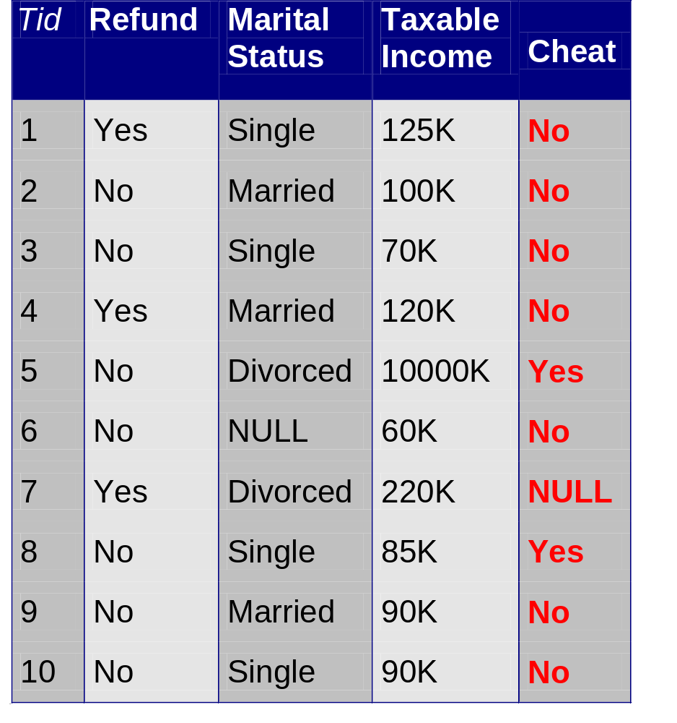
Example
Marital Status
Single | Married | Divorced | NULL
4 | 3 | 2 | 1
Attribute value frequencies
Mode: Single

Slide 6
Example
Marital Status
Single | Married | Divorced | NULL
40% | 30% | 20% | 10%
Attribute value distribution

Slide 7
Example
We can choose to ignore NULL values
Marital Status
Single | Married | Divorced
45% | 33% | 22%
Attribute value histogram
(we could also plot the frequency values)

Slide 8
Data histograms

Slide 9
Data histograms
For real numerical values we use binning to create the histogram
In most plotting libraries, we specify the number of bins and the method creates an equiwidth histogram

Slide 10
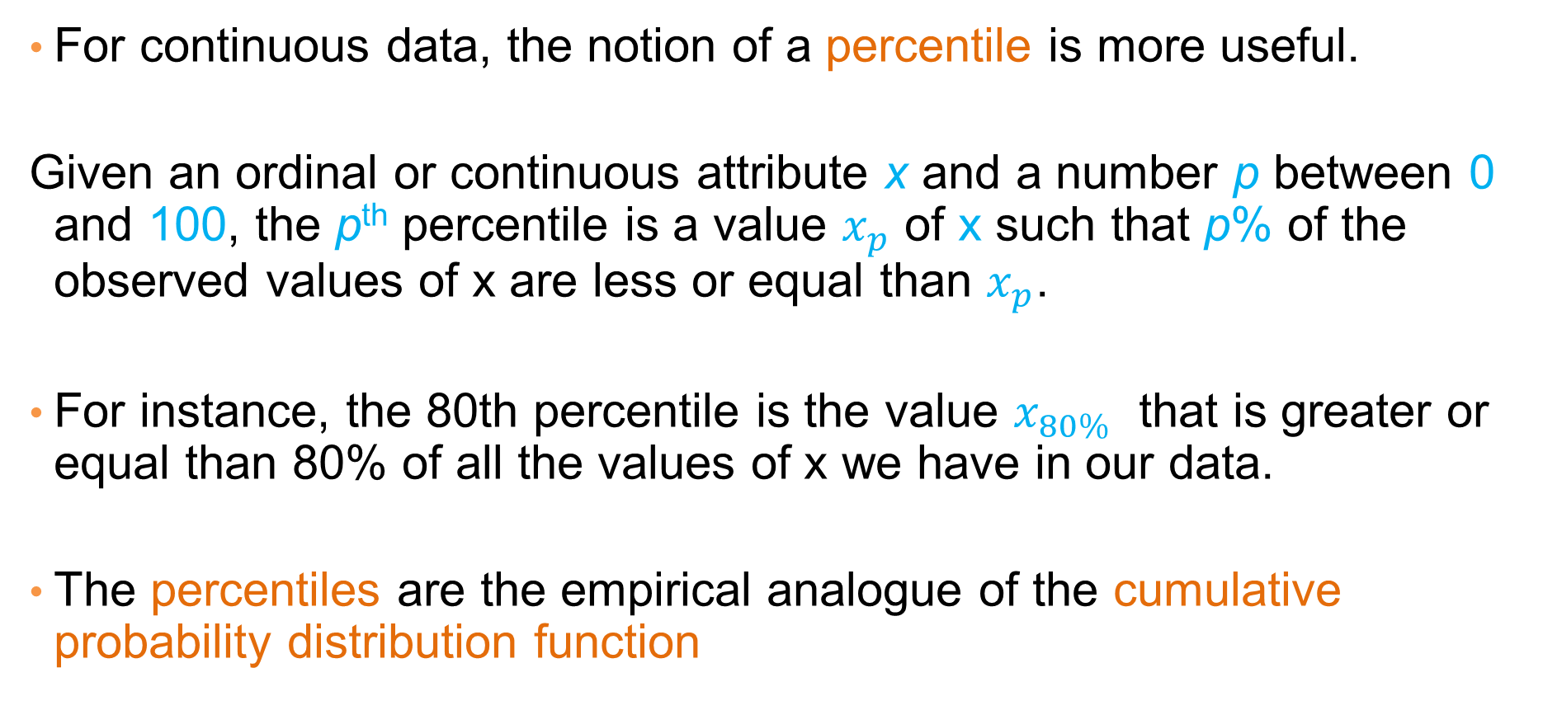
Percentiles
For continuous data, the notion of a percentile is more useful.
Given an ordinal or continuous attribute x and a number p between 0 and 100, the p^{th} percentile is a value $x_{p}$ of x such that p% of the observed values of x are less or equal than $x_{p}$.
For instance, the 80th percentile is the value $x_{80\%}$ that is greater or equal than 80% of all the values of x we have in our data.
The percentiles are the empirical analogue of the cumulative probability distribution function

Slide 11

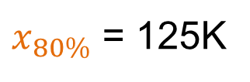
Example
 | Taxable Income
1 | 10000K
2 | 220K
3 | 125K
4 | 120K
5 | 100K
6 | 90K
7 | 90K
8 | 85K
9 | 70K
10 | 60K
$x_{80\%}$ = 125K

Slide 12
Plotting the cumulative distribution
 | Taxable Income
1 | 500K
2 | 220K
3 | 125K
4 | 120K
5 | 100K
6 | 90K
7 | 90K
8 | 85K
9 | 70K
10 | 60K
Plotting the fraction of entries that have value less or equal to x, for all possible values x of income in the data
Plotting the fraction of entries that have value greater or equal to x, for all possible values x of income in the data

Slide 13
Rank-Value plot
 | Taxable Income
1 | 500K
2 | 220K
3 | 125K
4 | 120K
5 | 100K
6 | 90K
7 | 90K
8 | 85K
9 | 70K
10 | 60K
Plotting the values of the income (y-axis) against their rank (x-axis)
The rank of a value is its order when all values are sorted in decreasing order
Also known as Zipf plot

Slide 14
Frequency-count plots
In some cases, we have to put some more work
Example: market-basked data
Id | Basket contents
1 | milk, coffee
2 | milk, coffee, sugar
3 | milk, coffee, sugar, cookies
4 | milk, tea, bread, butter, jam
5 | milk, bread, butter, honey
6 | milk, cream, honey, flour, eggs
7 | milk, coffee, eggs, bacon
8 | milk
9 | milk, coffee, sugar, eggs, bacon, bread
10 | eggs, bacon, bread
How do we describe this data?

Slide 15
Frequency-count plots
Example: market-basked data
length | count
1 | 1
2 | 1
3 | 2
4 | 3
5 | 2
6 | 1
Basket length
Id | Basket contents
1 | milk, coffee
2 | milk, coffee, sugar
3 | milk, coffee, sugar, cookies
4 | milk, tea, bread, butter, jam
5 | milk, bread, butter, honey
6 | milk, cream, honey, flour, eggs
7 | milk, coffee, eggs, bacon
8 | milk
9 | milk, coffee, sugar, eggs, bacon, bread
10 | eggs, bacon, bread
Id | length
1 | 2
2 | 3
3 | 4
4 | 5
5 | 4
6 | 5
7 | 4
8 | 1
9 | 6
10 | 3

Slide 16
Frequency-count plots
Item counts
Item | count
milk | 9
coffee | 6
eggs | 4
bread | 4
sugar | 3
bacon | 3
butter | 2
honey | 2
cookies | 1
tea | 1
jam | 1
cream | 1
Example: market-basked data
Id | Basket contents
1 | milk, coffee
2 | milk, coffee, sugar
3 | milk, coffee, sugar, cookies
4 | milk, tea, bread, butter, jam
5 | milk, bread, butter, honey
6 | milk, coffee, cream, honey, eggs
7 | milk, coffee, eggs, bacon
8 | milk
9 | milk, coffee, sugar, eggs, bacon, bread
10 | eggs, bacon, bread

Slide 17
Frequency-count plots
Example: market-basked data
Item | count
milk | 9
coffee | 6
eggs | 4
bread | 4
sugar | 3
bacon | 3
butter | 2
honey | 2
cookies | 1
tea | 1
jam | 1
cream | 1
Count histogram
Count | Frequency
1 | 4
2 | 2
3 | 2
4 | 2
6 | 1
9 | 1

Slide 18
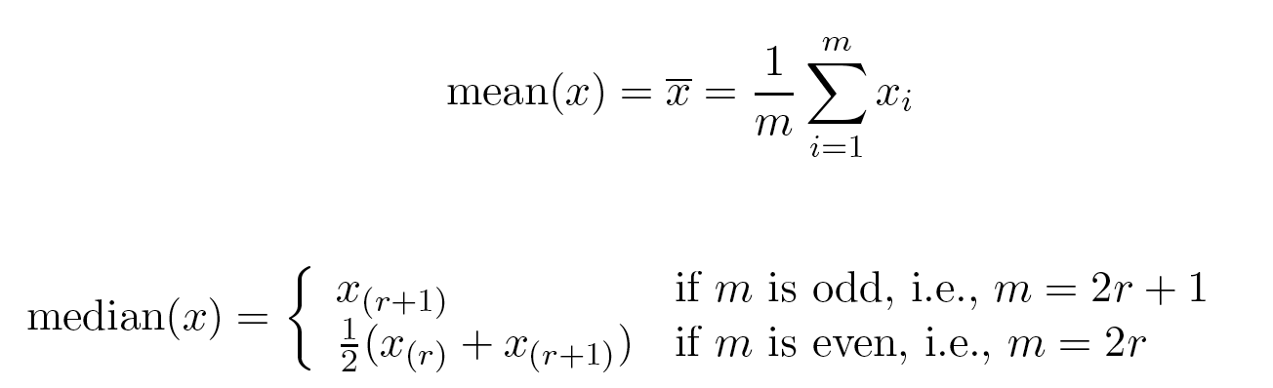
Measures of Location: Mean and Median
The mean is the most common measure of the location of a set of points.
However, the mean is very sensitive to outliers.
Thus, the median is also commonly used.
Or the trimmed mean: the mean after removing min and max values

Slide 19
Example
Mean: 1090K
Trimmed mean (remove min, max): 105K
Median: (90+100)/2 = 95K

Slide 20
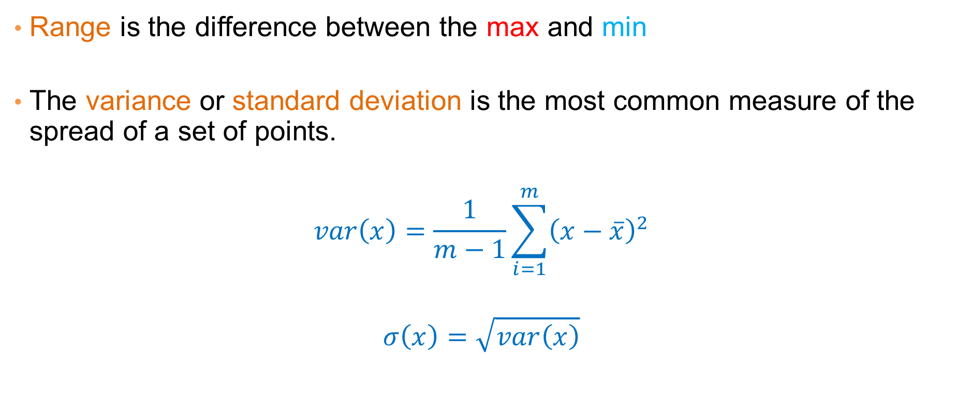
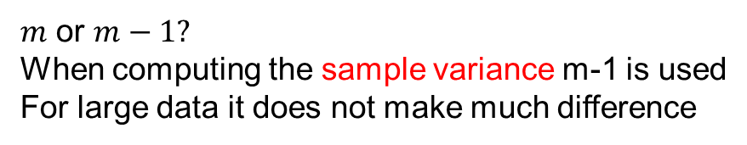
Measures of Spread: Range and Variance
Range is the difference between the max and min
The variance or standard deviation is the most common measure of the spread of a set of points.
$$var\left(x\right)=\frac{1}{m−1}\sum_{i=1}^{m}{{\left(x−\overline{x}\right)}^{2}}$$
$$σ\left(x\right)=\sqrt{var\left(x\right)}$$
$m$ or $m−1?$
When computing the sample variance m-1 is used
For large data it does not make much difference

Slide 21
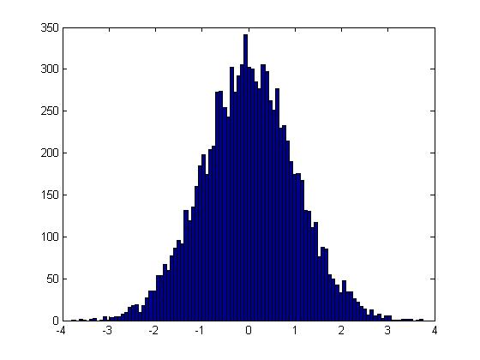
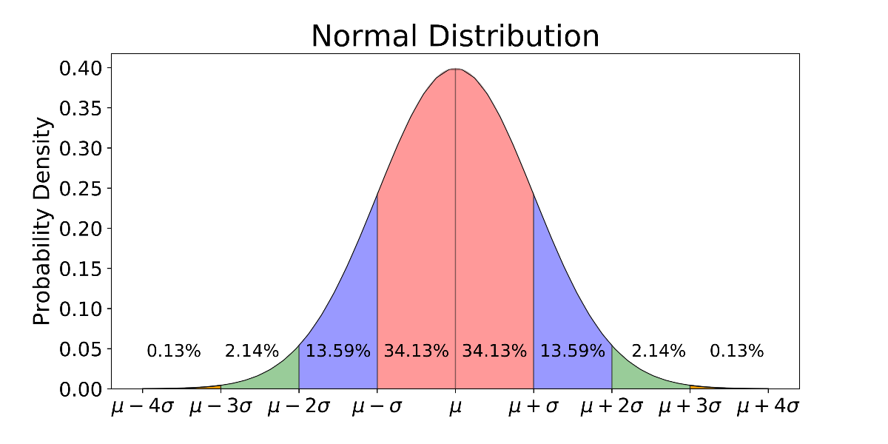
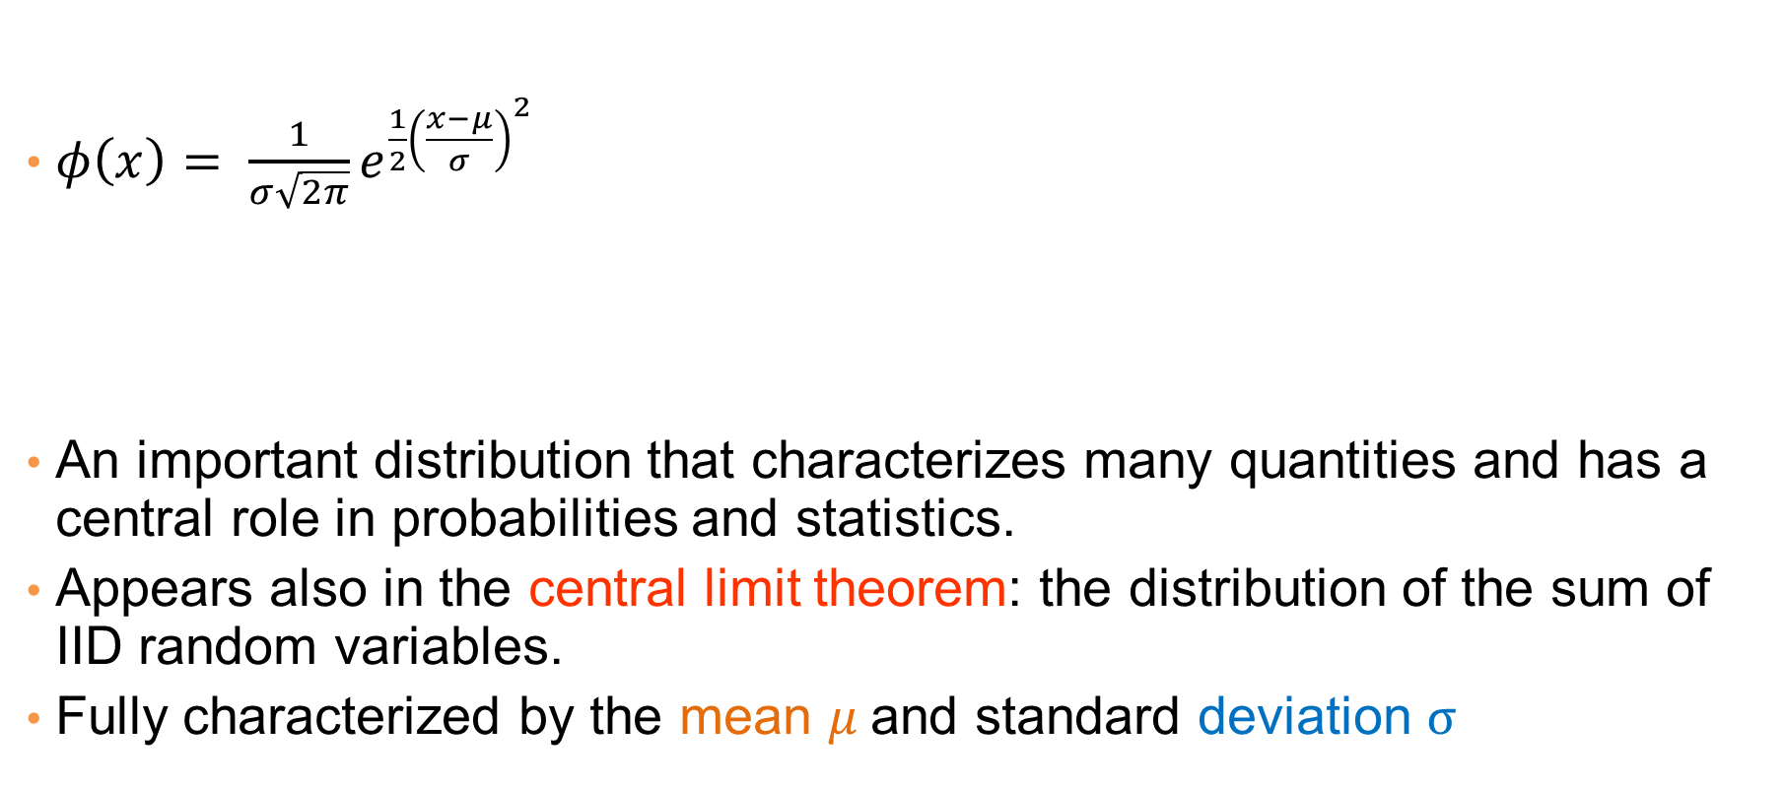
Normal Distribution
$φ\left(x\right)= \frac{1}{σ\sqrt{2π}}e^{\frac{1}{2}{\left(\frac{x−μ}{σ}\right)}^{2}}$
An important distribution that characterizes many quantities and has a central role in probabilities and statistics.
Appears also in the central limit theorem: the distribution of the sum of IID random variables.
Fully characterized by the mean $μ$and standard deviation $σ$
This is a value histogram

Slide 22
Not everything is normally distributed
Plot of number of words with x number of occurrences
If this was a normal distribution we would not have number of occurrences as large as 28K
y: number of words with x number of occurrences
x: number of occurrences

Slide 23
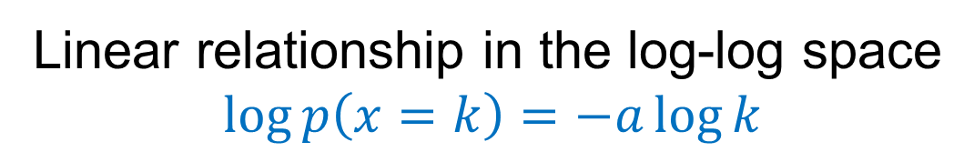
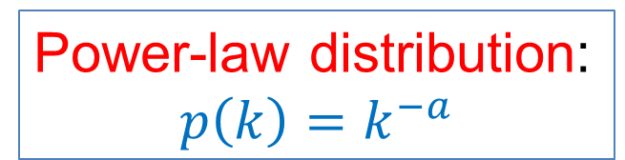
Power-law distribution
We can understand the distribution of words if we take the log-log plot
Power-law distribution:
$$p\left(k\right)=k^{−a}$$
y: logarithm of number of words with x number of occurrences
The slope of the line gives us the exponent α
x: logarithm of number of occurrences
Linear relationship in the log-log space
$$\log{p\left(x=k\right)}=−a\log{k}$$

Slide 24
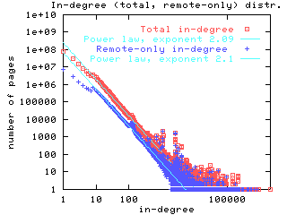
Power-laws are everywhere
Incoming and outgoing links of web pages, number of friends in social networks, number of occurrences of words, file sizes, city sizes, income distribution, popularity of products and movies
  Signature of human activity?
  A mechanism that explains everything?
  Rich get richer process
Related distribution: log-normal
  Taking the log of the values gives a
  normal distribution

Slide 25
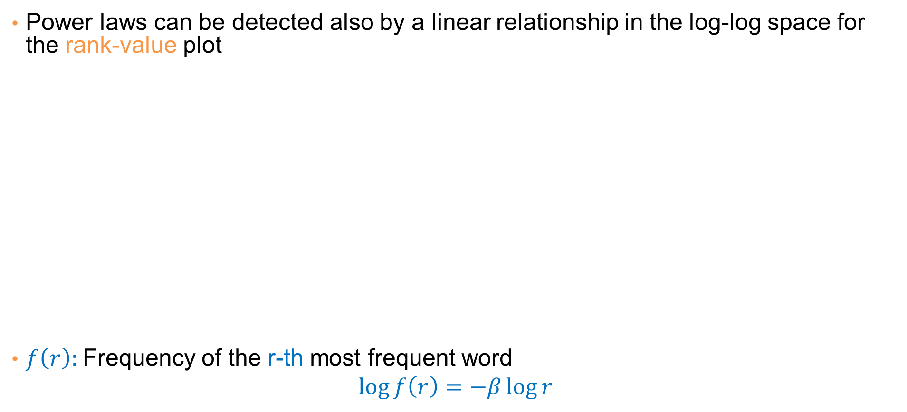
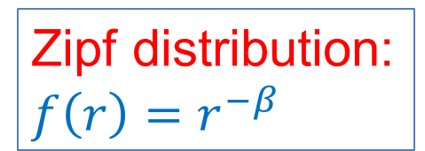
Zipf’s law
Power laws can be detected also by a linear relationship in the log-log space for the rank-value plot
$f\left(r\right):$Frequency of the r-th most frequent word
$$\log{f\left(r\right)}=−β\log{r}$$
y: number of occurrences of the r-th most frequent word
Zipf distribution:
$f\left(r\right)=r^{−β}$
r: rank of word according to frequency (1st, 2nd …)

Slide 26
The importance of correct representation
Consider the following three plots which are histograms of values. What do you observe? What can you tell of the underlying function?

Slide 27
The importance of correct representation
Putting all three plots together makes it clearer to see the differences
Green falls more slowly. Blue and Red seem more or less the same

Slide 28
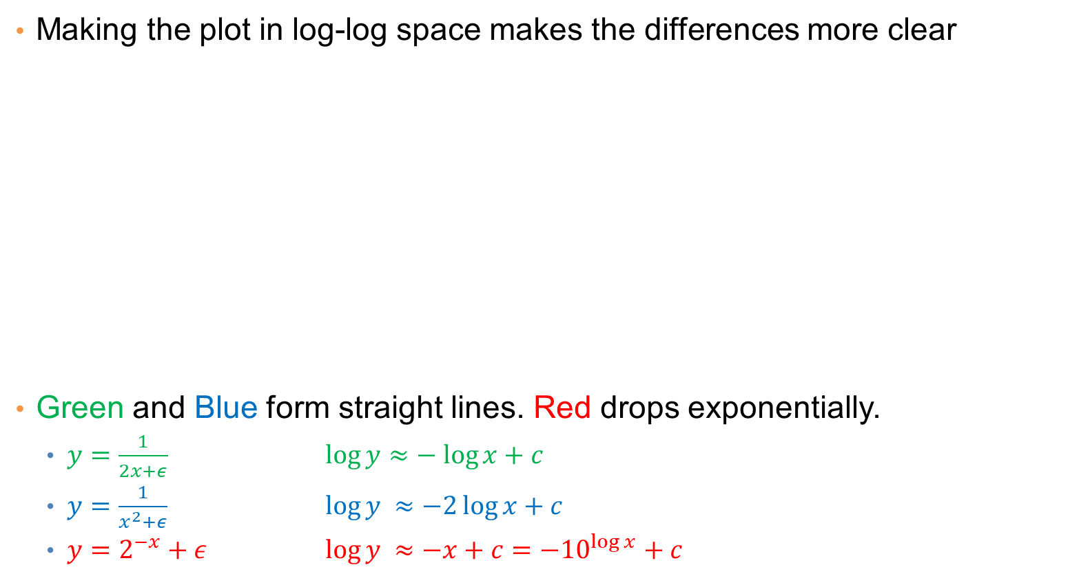
The importance of correct representation
Making the plot in log-log space makes the differences more clear
Green and Blue form straight lines. Red drops exponentially.
  $y=\frac{1}{2x+ε}$ $\log{y≈− log{x+c}}$
  $y=\frac{1}{x^{2}+ε}$ $\log{y ≈−2\log{x+c}}$
  $y=2^{−x}+ε$ $\log{y ≈−x+c={−10}^{\log{x}}+c}$
Linear relationship in log-log means polynomial in linear-linear
The slope in the log-log is the exponent of the polynomial
Exponential relationship remains exponential in log-log

Slide 29
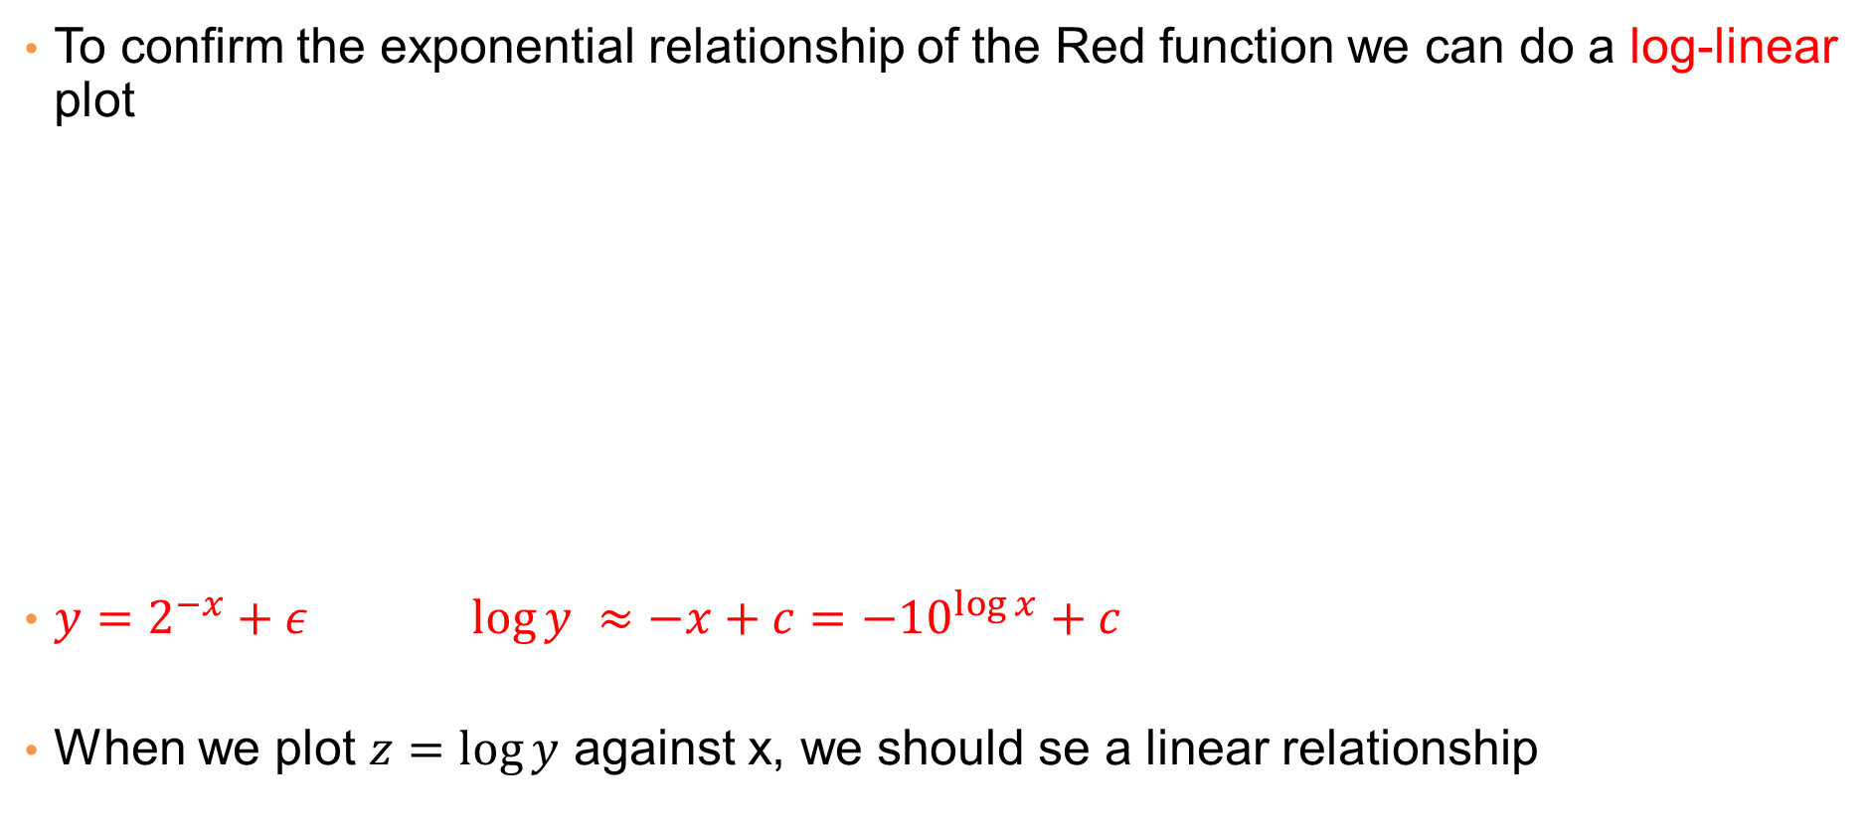
The importance of correct representation
To confirm the exponential relationship of the Red function we can do a log-linear plot
$y=2^{−x}+ε$ $\log{y ≈−x+c={−10}^{\log{x}}+c}$
When we plot $z=\log{y}$ against x, we should se a linear relationship
In a log-linear plot, we plot the logarithm of the Y values against the X values

Slide 30
Attribute relationships
In many cases it is interesting to look at two attributes together to understand if they are correlated. For example:
  How does marital status relate with tax cheating?
  Does refund correlate with average income?
  Is there a relationship between years of study and income?
How do we measure and visualize these relationships?

Slide 31
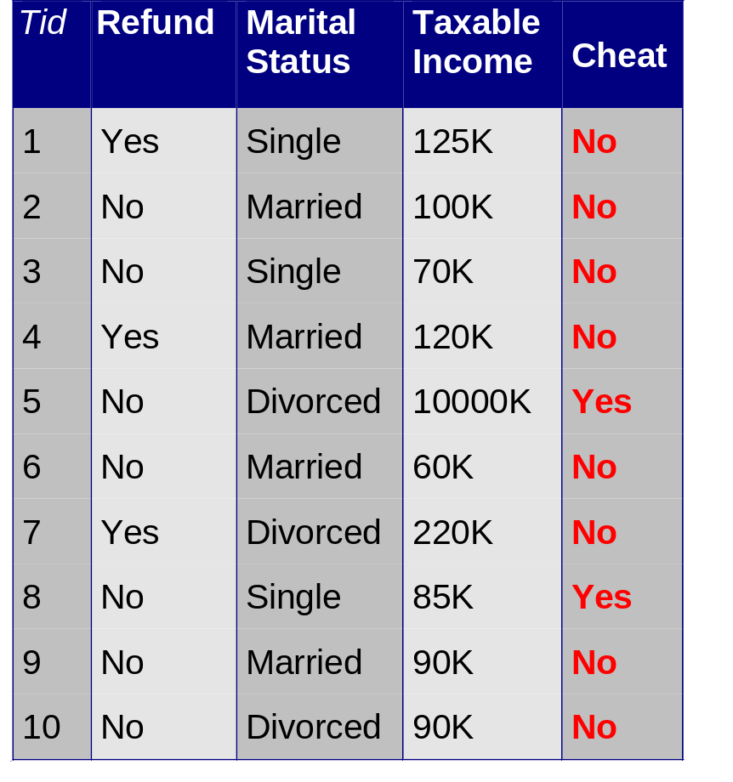
Correlating categorical attributes
Confusion or Contingency Matrix
 | No | Yes
Single | 2 | 1
Married | 4 | 0
Divorced | 2 | 1

Slide 32
Correlating categorical attributes
Confusion Matrix
 | No | Yes
Single | 2 | 1
Married | 4 | 0
Divorced | 2 | 1
Joint Distribution Matrix
 | No | Yes
Single | 0.2 | 0.1
Married | 0.4 | 0.0
Divorced | 0.2 | 0.1
 | No | Yes
Single | 0.2 | 0.1
Married | 0.4 | 0.0
Divorced | 0.2 | 0.1
It can also be represented as a heatmap

Slide 33
Correlating categorical attributes
Joint Distribution Matrix
 | No | Yes
Single | 0.2 | 0.1 | 0.3
Married | 0.4 | 0.0 | 0.4
Divorced | 0.2 | 0.1 | 0.3
 | 0.8 | 0.2 | 1
Marginal distribution for Marital Status
Marginal distribution for Cheat

Slide 34
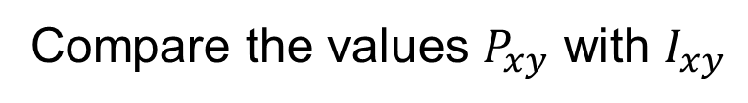


Correlating categorical attributes
How do we know if there are interesting correlations?
Joint Distribution Matrix $P$
Independence Matrix $I$
 | No | Yes
Single | 0.2 | 0.1 | 0.3
Married | 0.4 | 0.0 | 0.4
Divorced | 0.2 | 0.1 | 0.3
 | 0.8 | 0.2 | 1
 | No | Yes
Single | 0.24 | 0.06 | 0.3
Married | 0.32 | 0.08 | 0.4
Divorced | 0.24 | 0.06 | 0.3
 | 0.8 | 0.2 | 1
Compare the values $P_{xy}$ with $I_{xy}$
The product of the two marginal values 0.3*0.8

Slide 35
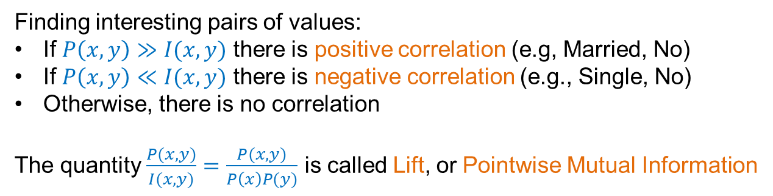


Correlating categorical attributes – Values correlation
We now want to find out if the co-occurrence of two values is interesting. We will check if the events of their occurrence are independent
Joint Distribution Matrix $P$
Independence Matrix $I$
 | No | Yes
Single | 0.2 | 0.1 | 0.3
Married | 0.4 | 0.0 | 0.4
Divorced | 0.2 | 0.1 | 0.3
 | 0.8 | 0.2 | 1
 | No | Yes
Single | 0.24 | 0.06 | 0.3
Married | 0.32 | 0.08 | 0.4
Divorced | 0.24 | 0.06 | 0.3
 | 0.8 | 0.2 | 1
Finding interesting pairs of values:
If $P\left(x,y\right)≫I(x,y)$ there is positive correlation (e.g, Married, No)
If $P\left(x,y\right)≪I(x,y)$ there is negative correlation (e.g., Single, No)
Otherwise, there is no correlation
The quantity $\frac{P(x,y)}{I(x,y)}=\frac{P(x,y)}{P\left(x\right)P(y)}$ is called Lift, or Pointwise Mutual Information

Slide 36
Correlating categorical attributes – Chi-square test
We now want to test if there is a correlation between the attributes Marital Status and Cheat
We will view the two attributes as random variables, and we will test if the random variables are independent
We will compare the Observed Contingency Matrix against the Expected Contingency Matrix if the attributes were independent
Observed
Contingency Matrix C
Expected
Contingency Matrix E
 | No | Yes
Single | 20 | 10
Married | 40 | 0
Divorced | 20 | 10
 | No | Yes
Single | 24 | 6
Married | 32 | 8
Divorced | 24 | 6

Slide 37
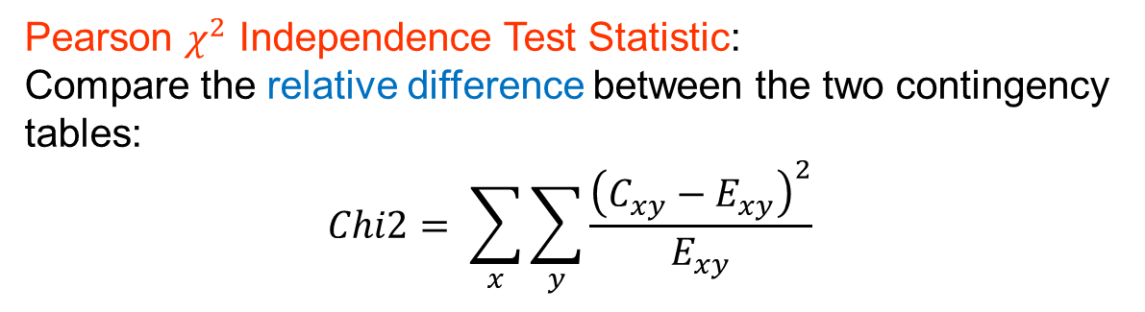
Correlating categorical attributes – Chi-square test
Observed
Contingency Matrix C
Expected
Contingency Matrix E
 | No | Yes
Single | 20 | 10
Married | 40 | 0
Divorced | 20 | 10
 | No | Yes
Single | 24 | 6
Married | 32 | 8
Divorced | 24 | 6
Pearson $χ^{2}$ Independence Test Statistic:
Compare the relative difference between the two contingency tables:
$$Chi2= \sum_{x}{\sum_{y}{\frac{{\left(C_{xy}−E_{xy}\right)}^{2}}{E_{xy}}}}$$
For the two attributes to be correlated this should be large. But how large is large enough? When is the difference statistically significant?

Slide 38
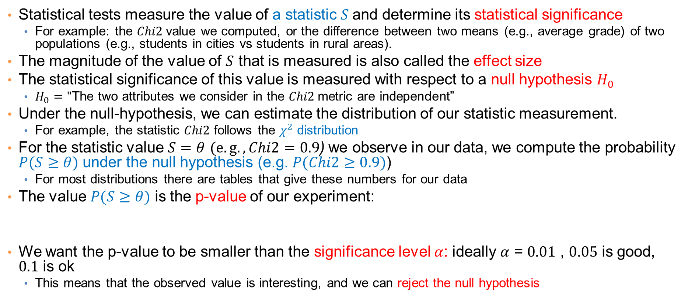
Statistical tests
Statistical tests measure the value of a statistic $S$and determine its statistical significance
  For example: the $Chi2$value we computed, or the difference between two means (e.g., average grade) of two populations (e.g., students in cities vs students in rural areas).
The magnitude of the value of $S$ that is measured is also called the effect size
The statistical significance of this value is measured with respect to a null hypothesis $H_{0}$
  $H_{0}="$The two attributes we consider in the $Chi2$metric are independent”
Under the null-hypothesis, we can estimate the distribution of our statistic measurement.
  For example, the statistic $Chi2$ follows the $χ^{2}$ distribution
For the statistic value $S=θ$ $(e.g., Chi2=0.9$) we observe in our data, we compute the probability $P(S≥θ)$ under the null hypothesis (e.g. $P(Chi2≥0.9)$)
  For most distributions there are tables that give these numbers for our data
The value $P(S≥θ)$ is the p-value of our experiment:
We want the p-value to be smaller than the significance level $α$: ideally $α$ = $0.01$ , $0.05$ is good, $0.1$ is ok
  This means that the observed value is interesting, and we can reject the null hypothesis
The p-value is the probability under $H_{0}$ (independence) of observing a value of the test statistic $S$the same as, or more extreme than the one that was actually observed

Slide 39
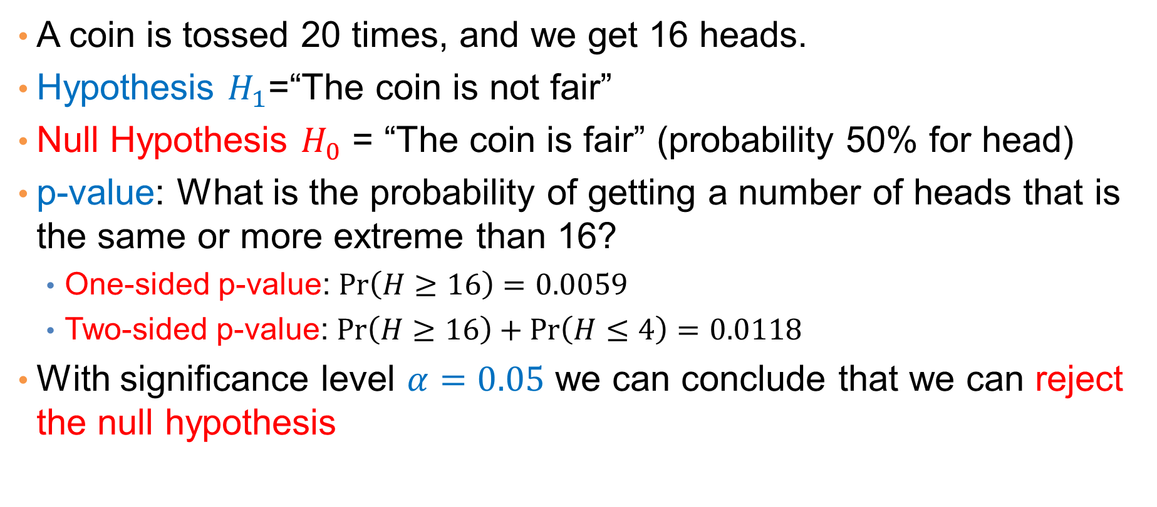
Hypothesis Testing and p-values – A simple example
A coin is tossed 20 times, and we get 16 heads.
Hypothesis $H_{1}$=“The coin is not fair”
Null Hypothesis $H_{0}$ = “The coin is fair” (probability 50% for head)
p-value: What is the probability of getting a number of heads that is the same or more extreme than 16?
  One-sided p-value: $\operatorname{Pr}\left(H≥16\right)=0.0059$
  Two-sided p-value: $\operatorname{Pr}\left(H≥16\right)+\operatorname{Pr}\left(H≤4\right)=0.0118$
With significance level $α=0.05$ we can conclude that we can reject the null hypothesis

Slide 40
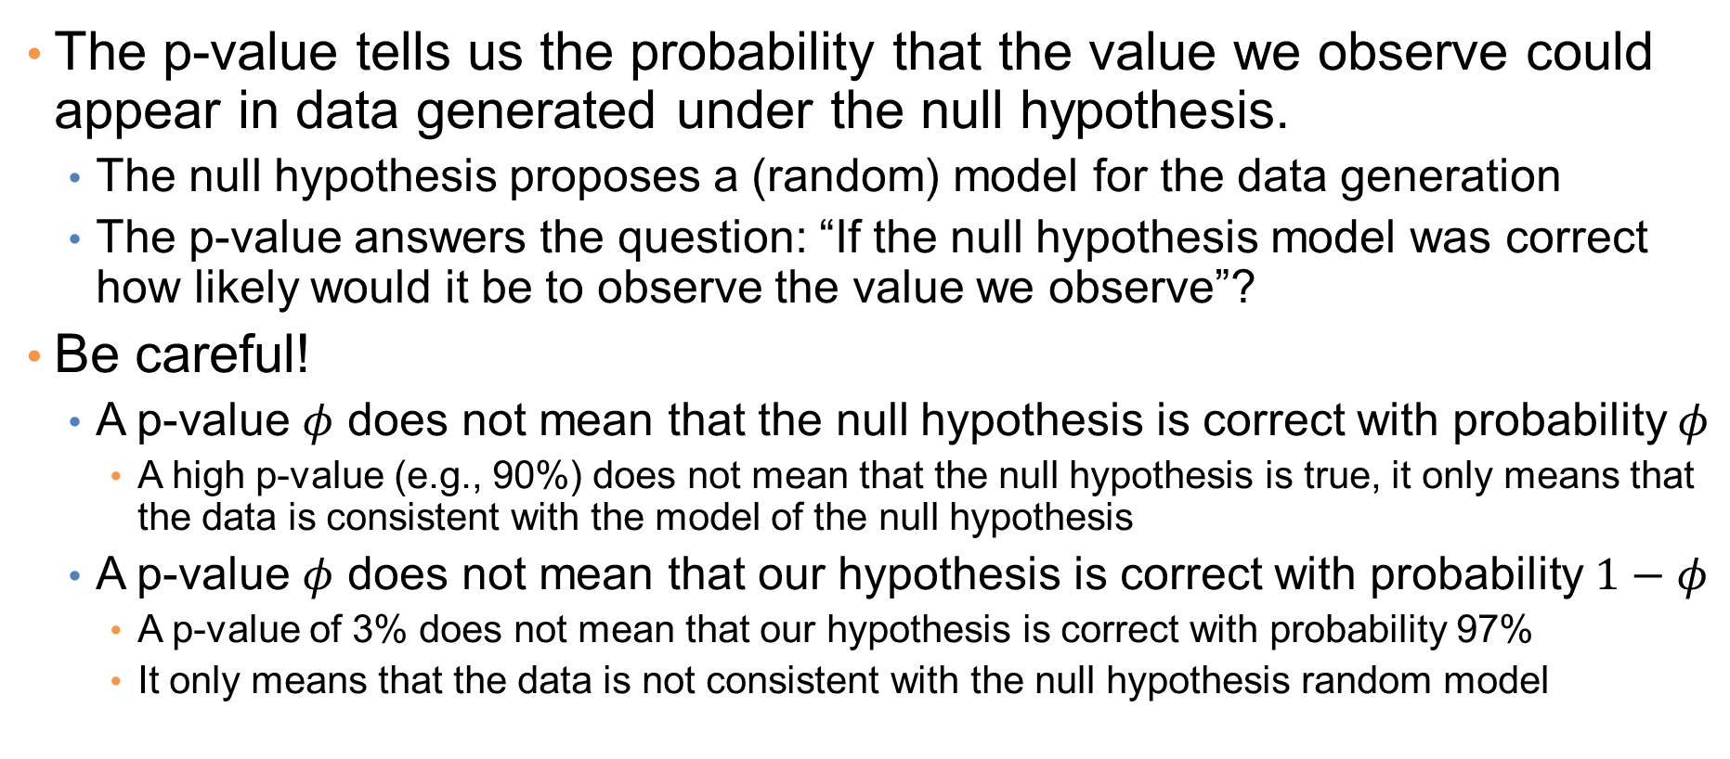
P-values
The p-value tells us the probability that the value we observe could appear in data generated under the null hypothesis.
  The null hypothesis proposes a (random) model for the data generation
  The p-value answers the question: “If the null hypothesis model was correct how likely would it be to observe the value we observe”?
Be careful!
  A p-value $φ$ does not mean that the null hypothesis is correct with probability $φ$
    A high p-value (e.g., 90%) does not mean that the null hypothesis is true, it only means that the data is consistent with the model of the null hypothesis
  A p-value $φ$ does not mean that our hypothesis is correct with probability $1−φ$
    A p-value of 3% does not mean that our hypothesis is correct with probability 97%
    It only means that the data is not consistent with the null hypothesis random model

Slide 41
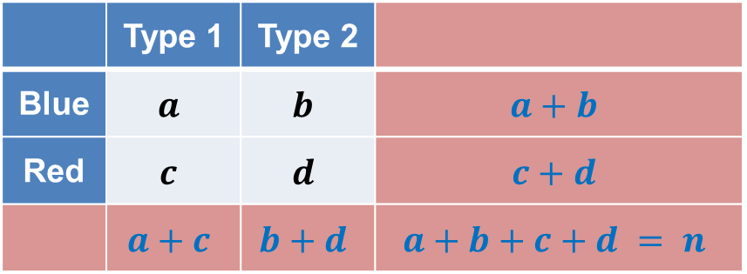
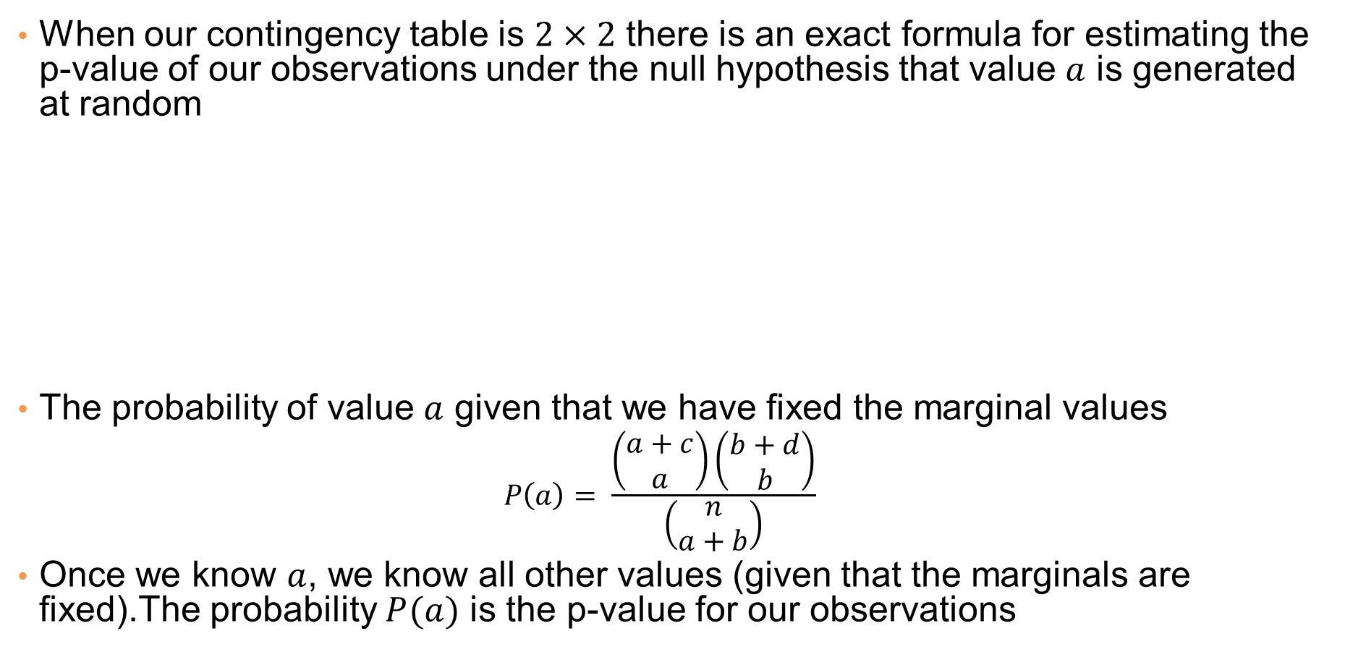
Exact Fisher Test
When our contingency table is $2×2$ there is an exact formula for estimating the p-value of our observations under the null hypothesis that value $a$ is generated at random
The probability of value $a$ given that we have fixed the marginal values
  $$P\left(a\right)= \frac{\left(\begin{matrix}a+c \\ a\end{matrix}\right)\left(\begin{matrix}b+d \\ b\end{matrix}\right)}{\left(\begin{matrix}n \\ a+b\end{matrix}\right)}$$
Once we know $a$, we know all other values (given that the marginals are fixed).The probability $P(a)$ is the p-value for our observations
 | Type 1 | Type 2
Blue | $$a$$ | $$b$$ | $$a+b$$
Red | $$c$$ | $$d$$ | $$c+d$$
 | $$a+c$$ | $$b+d$$ | $$a+b+c+d = n$$

Slide 42
Correlating categorical and numerical attributes

Slide 43
Categorical and numerical attributes
After removing the outlier value
How informative are the means?

Slide 44
Categorical and numerical attributes
Compute error bars
Error bars give a measure of the variability of the mean

Slide 45
Error bars
Error bars may be:
  The range
  The standard deviation
  The standard error
  The 95% confidence interval
Inferential error bars get more informative the more data we collect.
We should always specify what the error bars mean in a plot.
Descriptive error bars: They tell us something about the underlying distribution of the data
Inferential error bars: They tell us something about the quality of the estimation of the mean

Slide 46
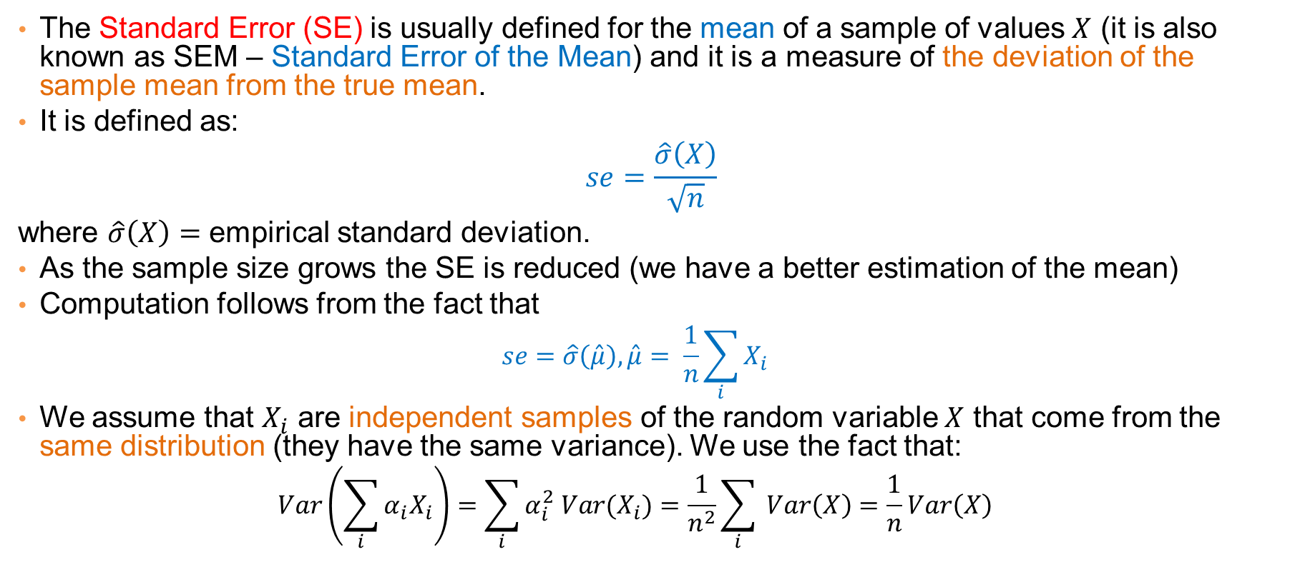
Standard Error (of the Mean)
The Standard Error (SE) is usually defined for the mean of a sample of values $X$ (it is also known as SEM – Standard Error of the Mean) and it is a measure of the deviation of the sample mean from the true mean.
It is defined as:
$$se=\frac{\hat{σ}\left(X\right)}{\sqrt{n}}$$
where $\hat{σ}\left(X\right)=$ empirical standard deviation.
As the sample size grows the SE is reduced (we have a better estimation of the mean)
Computation follows from the fact that
  $$se=\hat{σ}\left(\hat{μ}\right),\hat{μ}= \frac{1}{n}\sum_{i}{X_{i}}$$
We assume that $X_{i}$ are independent samples of the random variable $X$ that come from the same distribution (they have the same variance). We use the fact that:
  $$Var\left(\sum_{i}{α_{i}X_{i}}\right)=\sum_{i}{α_{i}^{2} Var(X_{i})}=\frac{1}{n^{2}}\sum_{i}{ Var\left(X\right)}=\frac{1}{n}Var\left(X\right)$$
Notes:
The variance of $\hat{μ}$ is computed as $Var\left(\hat{μ}\right)= \frac{1}{n^{2}}nVar\left(X\right)=\frac{1}{n}Var(X)$

Slide 47
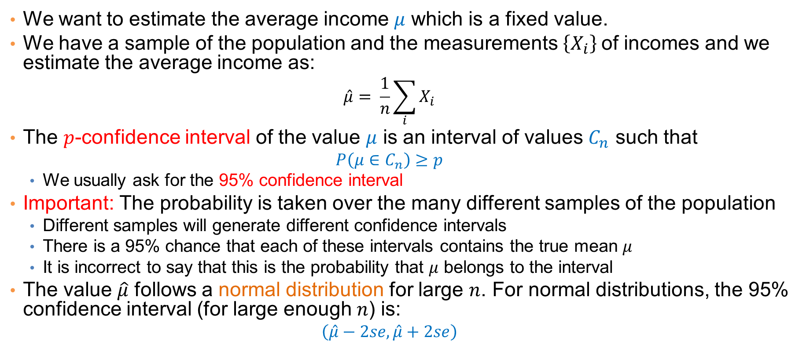
Confidence interval
We want to estimate the average income $μ$ which is a fixed value.
We have a sample of the population and the measurements $\left\{X_{i}\right\}$of incomes and we estimate the average income as:
  $$\hat{μ}= \frac{1}{n}\sum_{i}{X_{i}}$$
The $p$-confidence interval of the value $μ$ is an interval of values $C_{n}$ such that
  $$P\left(μ∈C_{n}\right)≥p$$
  We usually ask for the 95% confidence interval
Important: The probability is taken over the many different samples of the population
  Different samples will generate different confidence intervals
  There is a 95% chance that each of these intervals contains the true mean $μ$
  It is incorrect to say that this is the probability that $μ$ belongs to the interval
The value $\hat{μ}$ follows a normal distribution for large $n$. For normal distributions, the 95% confidence interval (for large enough $n$) is:
  $$\left(\hat{μ}−2se, \hat{μ}+2se\right)$$
Notes:
Given a sample of data $\{X_{i}\}$ we can generate a mean value $\hat{μ}$ a confidence interval $\left(\hat{μ}−2se, \hat{μ}+2se\right)$. There is a true value of the mean $μ$. The probability that the interval will contain $μ$ is 95%
An important observation is that the true value $μ$ is fixed, and the random experiment generates a sample $\left\{X_{i}\right\}.$The probability that the true mean is in the interval is over all possible samples (95% of our samples will contain the true mean)

Slide 48
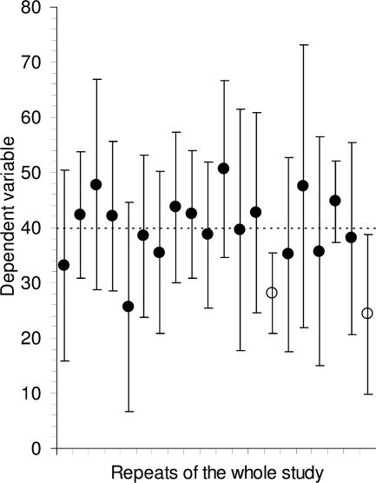
Example
If we obtain an estimate of the mean for 20 different population samples, we will obtain 20 different 95%-confidence intervals.
We expect that 1/20 of these intervals will not contain the true mean (the dotted line)

Slide 49
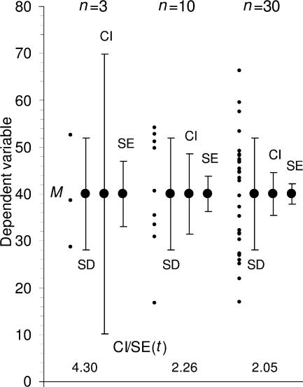
Error bars example
The different error bars and how they change as the sample size increases
Out of the four different error bars, the confidence interval is probably the most informative.

Slide 50
Statistical significance
Given the means of two populations an important question is whether the difference we observe is statistically significant
There are statistical tests for testing the difference of the means

Slide 51
Statistical significance via error bar overlap
It is not always safe to declare that there is statistical significance when error bars do not overlap
  We may have statistically significant differences when there is overlap, or no statistical significance when there is no overlap
We can say that there is statistically significant difference of means when sample sizes are comparable, and the 95%-confidence intervals do not overlap
There are a little more complex rules for the standard error.

Slide 52
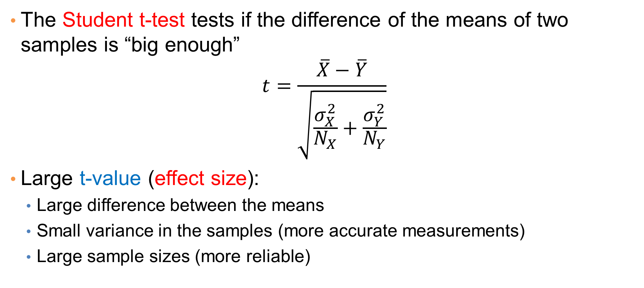
Statistical tests – The Student t-test
The Student t-test tests if the difference of the means of two samples is “big enough”
$$t=\frac{\overline{X}−\overline{Y}}{\sqrt{\frac{σ_{X}^{2}}{N_{X}}+\frac{σ_{Y}^{2}}{N_{Y}}}}$$
Large t-value (effect size):
  Large difference between the means
  Small variance in the samples (more accurate measurements)
  Large sample sizes (more reliable)

Slide 53
Statistical tests – The Student t-test
The Student t-test produces a p-value:
  Under the null hypothesis that the two distributions have zero difference in mean the t-value follows a Normal Distribution with zero mean
  This is what we care about, the t-value is usually not looked at
Student t-test additional implicit assumptions:
  (near) Gaussian distribution of the data,
  (near) same variance,
  similar sample sizes.
There is paired and unpaired Student t-test
  Example of paired: behavior before and after a treatment.

Slide 54
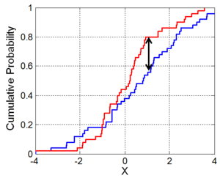
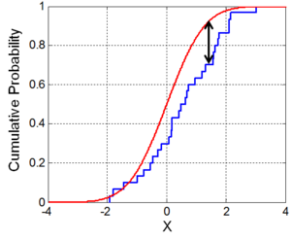
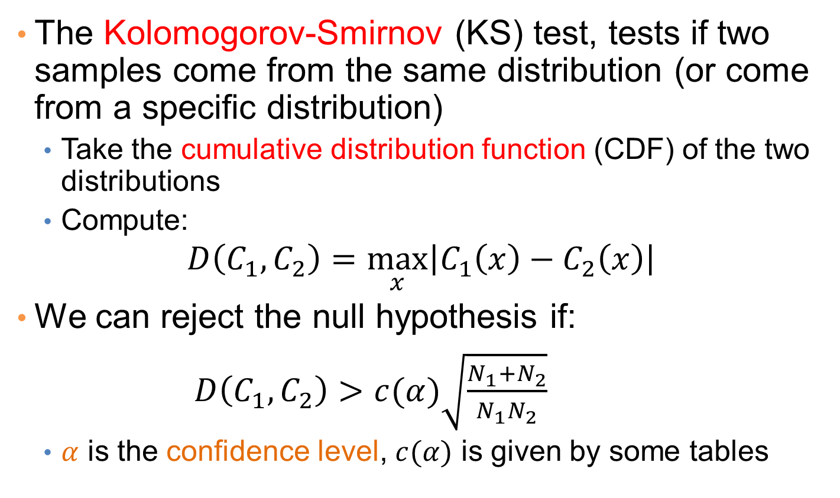
Statistical tests – The KS-test
The Kolomogorov-Smirnov (KS) test, tests if two samples come from the same distribution (or come from a specific distribution)
  Take the cumulative distribution function (CDF) of the two distributions
  Compute:
$$D\left(C_{1},C_{2}\right)=\max_{x}\left|C_{1}\left(x\right)−C_{2}\left(x\right)\right|$$
We can reject the null hypothesis if:
$D\left(C_{1},C_{2}\right)>c(α)\sqrt{\frac{N_{1}+N_{2}}{N_{1}N_{2}}}$
  $α$ is the confidence level, $c(α)$ is given by some tables

Slide 55
Hypothesis Testing – Permutation tests
Most tests make some assumption about the underlying distribution of the data.
A non-parametric statistical test is the permutation test
Create random instances of the data by randomly permuting values
  E.g., permute the Cheat labels randomly
Compute the statistic of interest for the permuted data
  E.g., the average income of the cheaters
Repeat this several times (at least 1000)
Compute the empirical p-value: the fraction of permutations where we have a value that is equal or more extreme than the one observed.

Slide 56
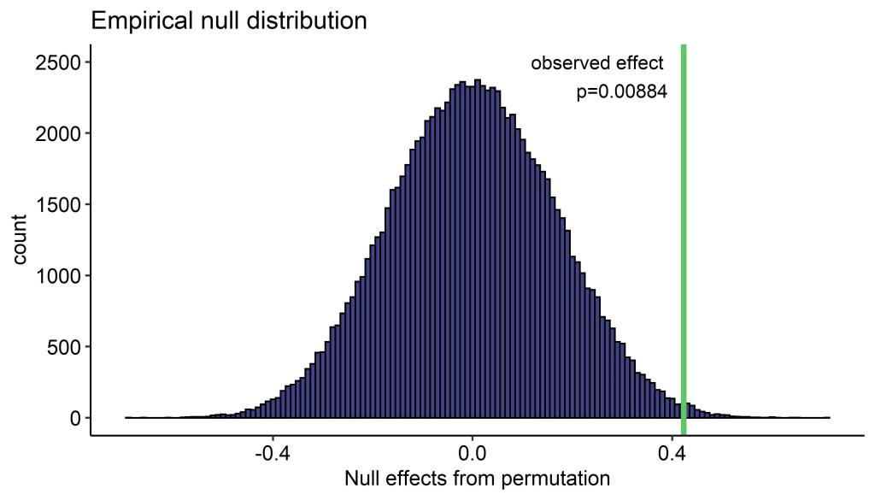
Example

Slide 57
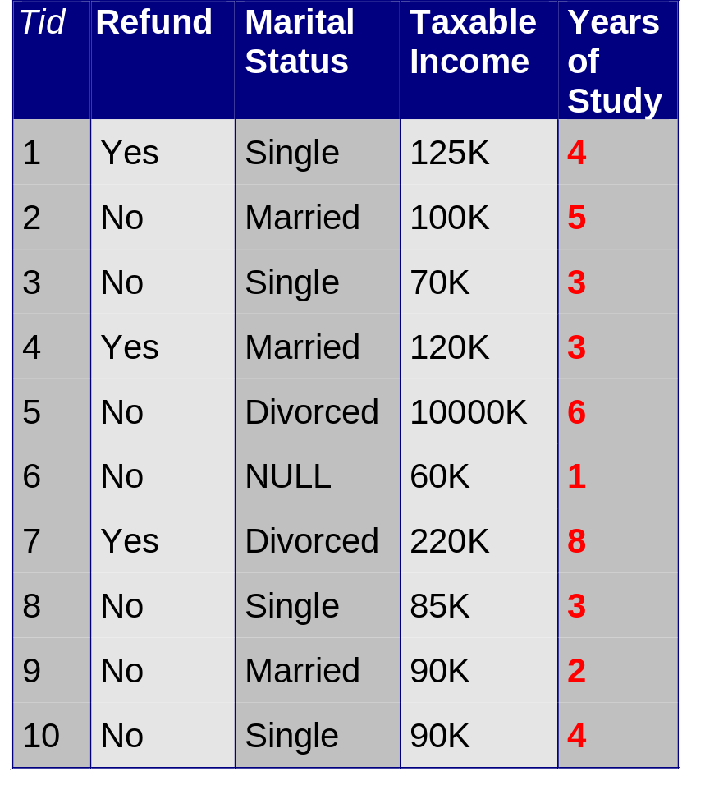
Correlating numerical attributes
Scatter plot:
X axis is one attribute, Y axis is the other
For each entry we have two values
Plot the entries as two-dimensional points

Slide 58
Correlating numerical attributes
Scatter plot:
X axis is one attribute, Y axis is the other
For each entry we have two values
Plot the entries as two-dimensional points
Log-scale in y-axis makes the plot look a little better

Slide 59
Plotting attributes against each other
Scatter plot:
X axis is one attribute, Y axis is the other
For each entry we have two values
Plot the entries as two-dimensional points
After removing the outlier value there is a clear correlation

Slide 60
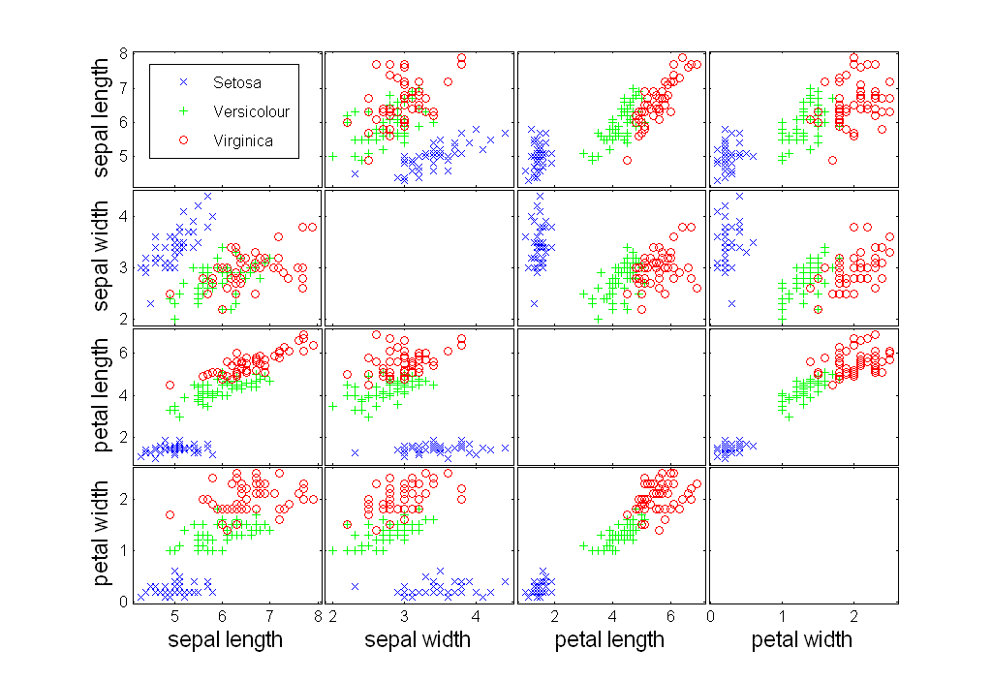
Scatter Plot Array of Iris Attributes

Slide 61
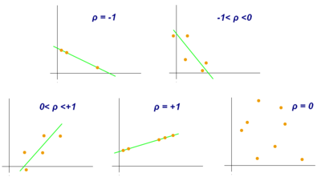
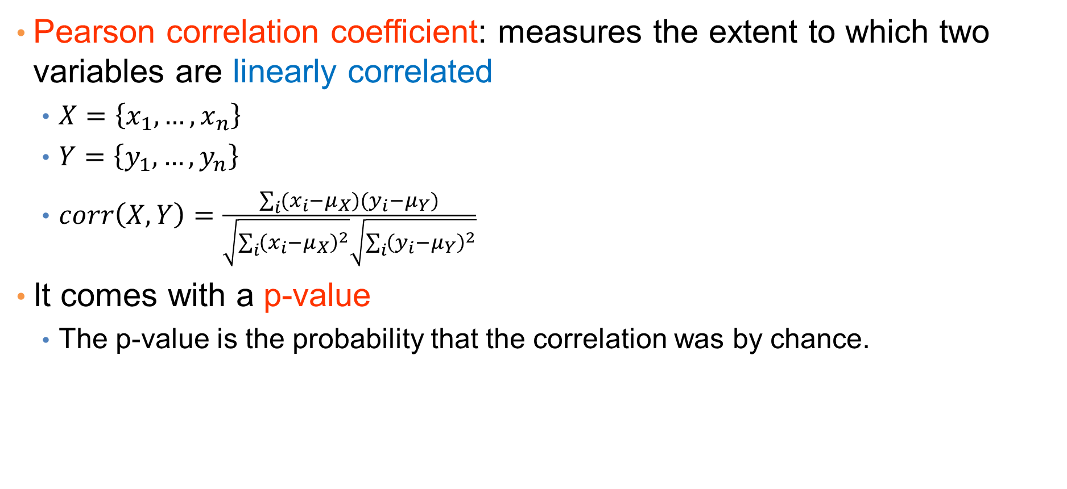
Measuring correlation
Pearson correlation coefficient: measures the extent to which two variables are linearly correlated
  $X=\left\{x_{1},…,x_{n}\right\}$
  $Y=\left\{y_{1},…,y_{n}\right\}$
  $corr\left(X,Y\right)=\frac{\sum_{i}{(x_{i}−μ_{X})(y_{i}−μ_{Y})}}{\sqrt{\sum_{i}{{\left(x_{i}−μ_{X}\right)}^{2}}}\sqrt{\sum_{i}{{\left(y_{i}−μ_{Y}\right)}^{2}}}}$
It comes with a p-value
  The p-value is the probability that the correlation was by chance.
Must have pairs of observations

Slide 62
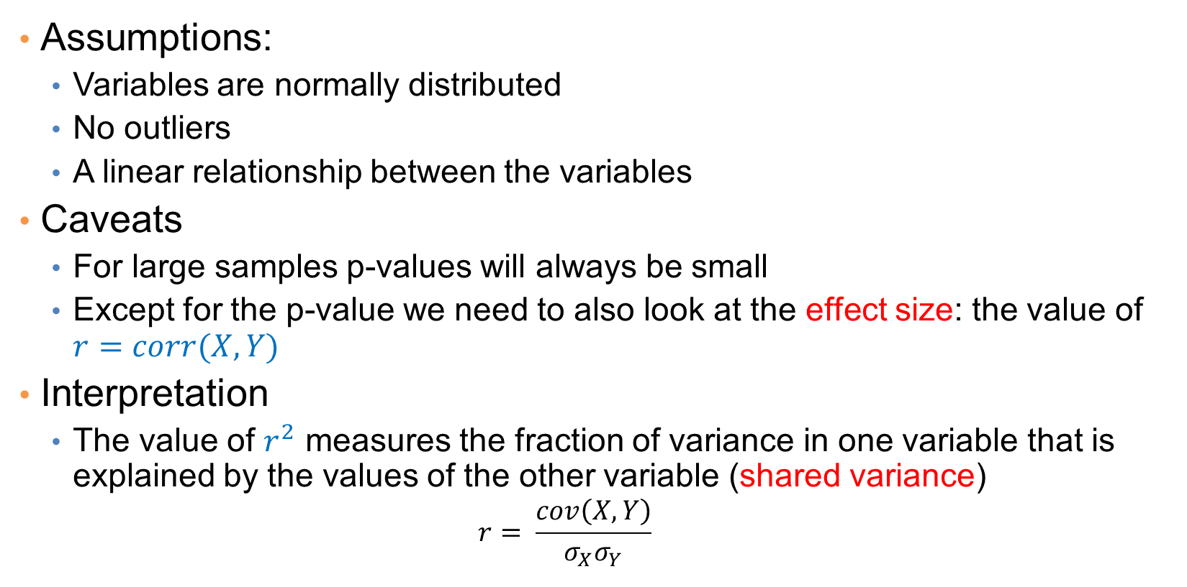
Pearson correlation
Assumptions:
  Variables are normally distributed
  No outliers
  A linear relationship between the variables
Caveats
  For large samples p-values will always be small
  Except for the p-value we need to also look at the effect size: the value of $r=corr(X,Y)$
Interpretation
  The value of $r^{2}$ measures the fraction of variance in one variable that is explained by the values of the other variable (shared variance)
    $$r= \frac{cov\left(X,Y\right)}{σ_{X}σ_{Y}}$$

Slide 63
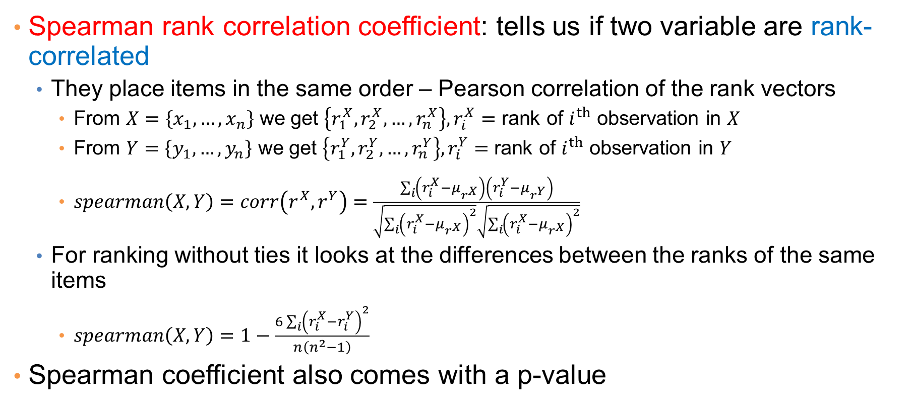
Rank correlation
Spearman rank correlation coefficient: tells us if two variable are rank-correlated
  They place items in the same order – Pearson correlation of the rank vectors
    From $X=\left\{x_{1},…,x_{n}\right\}$ we get $\left\{r_{1}^{X},r_{2}^{X},…,r_{n}^{X}\right\}, r_{i}^{X}=$ rank of $i^{th}$ observation in $X$
    From $Y=\left\{y_{1},…,y_{n}\right\}$ we get $\left\{r_{1}^{Y},r_{2}^{Y},…,r_{n}^{Y}\right\}, r_{i}^{Y}=$ rank of $i^{th}$ observation in $Y$
    $spearman\left(X,Y\right)=corr\left(r^{X},r^{Y}\right)=\frac{\sum_{i}{\left(r_{i}^{X}−μ_{r^{X}}\right)\left(r_{i}^{Y}−μ_{r^{Y}}\right)}}{\sqrt{\sum_{i}{{\left(r_{i}^{X}−μ_{r^{X}}\right)}^{2}}}\sqrt{\sum_{i}{{\left(r_{i}^{X}−μ_{r^{X}}\right)}^{2}}}}$
  For ranking without ties it looks at the differences between the ranks of the same items
    $spearman\left(X,Y\right)=1−\frac{6\sum_{i}{{\left(r_{i}^{X}−r_{i}^{Y}\right)}^{2}}}{n\left(n^{2}−1\right)}$
Spearman coefficient also comes with a p-value

Slide 64
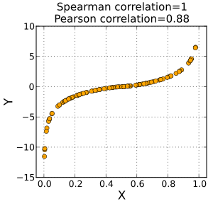
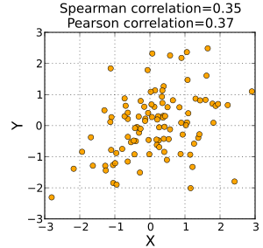
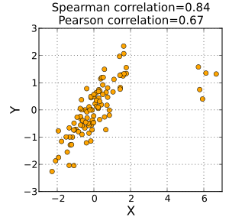
Rank correlation
Spearman coefficient does not assume a linear relationship, but a monotonic one
Monotonic but not linear relationship:
Perfect Spearman correlation
Elliptical distribution
Pearson and Spearman are more-or-less the same
Pearson is more sensitive to outliers

Slide 65
Statistical significance vs Scientific significance
Statistics place a lot of emphasis on the p-values and the statistical significance
However, it may be that p-values are small but the finding is not of scientific interest
  A difference or a correlation may be statistically significant, but too small to be of scientific interest
  We need to evaluate the results beyond simply looking at the p-values.
  We also need to look at the effect size, or the impact of the computed difference.

Slide 66
Plotting attributes together
City | Product 1 | Product 2
New York | 100 | 60
Chicago | 70 | 150
San Francisco | 30 | 80
How would you visualize the differences between the product sales per city?

Slide 67
Plotting attributes together
Year | Product 1 | Product 2
2011 | 100 | 200
2012 | 200 | 250
2013 | 180 | 300
2014 | 300 | 350
2015 | 500 | 490
2016 | 600 | 500
2017 | 650 | 550
2018 | 640 | 540
2019 | 700 | 500
2020 | 200 | 100
How would you visualize the differences between the product sales over time?

