Slide 1
DATA MINING
The Data Mining Pipeline
What is data?
The data mining pipeline: collection, preprocessing, mining, and post-processing
Sampling, feature extraction and normalization

Slide 2
What is data mining again?
“Data Mining is the study of collecting, processing, analyzing, and gaining useful insights from data” – Charu Aggarwal
Essentially, anything that has to do with data is data mining
Data
Value
Data Mining

Slide 3
DATA

Slide 4
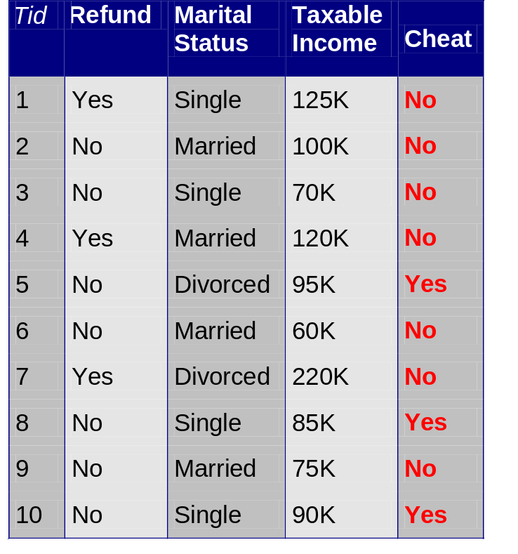
What is Data?
Attributes
Collection of data objects and their attributes
An attribute is a property or characteristic of an object
  Examples: name, date of birth, height, occupation.
  Attribute is also known as variable, field, characteristic, or feature
For each object the attributes take some values.
The collection of attribute-value pairs describes a specific object
  Object is also known as record, point, case, sample, entity, or instance
Objects
Size (n): Number of objects
Dimensionality (d): Number of attributes
Density/Sparsity: Number of populated
object-attribute pairs

Slide 5
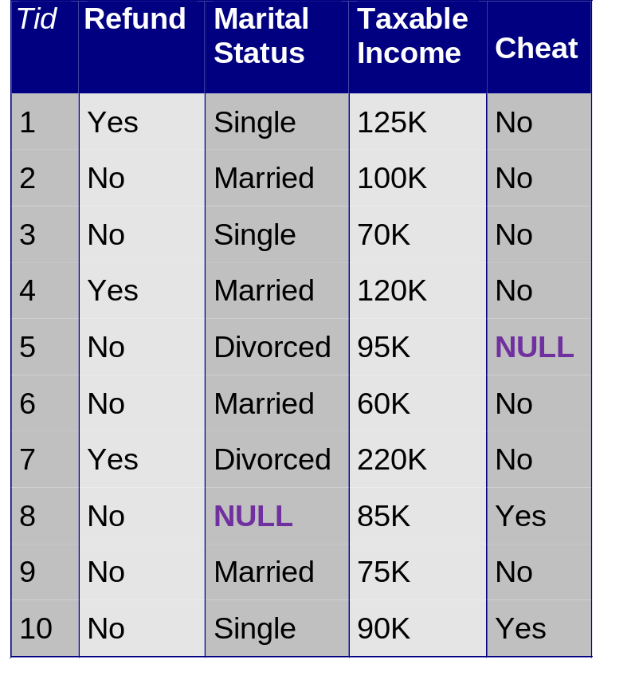
Relational data
Example of a relational table
The term comes from DataBases, where we assume data is stored in a relational table with a fixed schema (fixed set of attributes)
  In Databases, it is usually assumed that the table is dense (few null values)
There are a lot of data in this form
  E.g., census data
There are also a lot of data which do not fit well in this form
  Sparse data: Many missing values
  Not easy to define a fixed schema
Attributes = Table columns
Objects = Table rows

Slide 6
Types of Attributes
There are different types of attributes
  Numeric
    Examples: dates, temperature, time, length, value, count.
    Discrete (counts) vs Continuous (temperature)
    Special case: Binary/Boolean attributes (yes/no, exists/not exists)
  Categorical
    Examples: eye color, zip codes, strings, rankings (e.g, good, fair, bad), height in {tall, medium, short}
    Nominal (no order or comparison) vs Ordinal (order but not comparable)

Slide 7
Numeric Relational Data
If data objects have the same fixed set of numeric attributes, then the data objects can be thought of as points/vectors in a multi-dimensional space, where each dimension represents a distinct attribute
Such data set can be represented by an n-by-d data matrix, where there are n rows, one for each object, and d columns, one for each attribute
 | Temperature | Humidity | Pressure
O1 | 30 | 0.8 | 90
O2 | 32 | 0.5 | 80
O3 | 24 | 0.3 | 95
30 | 0.8 | 90
32 | 0.5 | 80
24 | 0.3 | 95

Slide 8
Numeric data from embeddings
Embeddings define a representation of the data objects in a high-dimensional vector space
  Representation learning: Learn representations that preserve/highlight some property of the data, typically similarity
In this numerical data, each dimension corresponds to a feature, but we do not know what this feature means
The resulting data matrix is very dense, with high dimension.

Slide 9
Vector Databases
This is a special case of numerical data, where each object is a multidimensional numerical vector.
Different from before, the vectors do not store the attribute values for the object, but rather the embedding of the object as it is produced by some Machine Learning algorithm.
Embedding vectors are fully dense and have no clear interpretation.
They have been shown to be remarkably successful in capture semantic relationships between objects.

Slide 10
Numeric data
Thinking of numeric data as points or vectors is very convenient
  For small dimensions we can plot the data
  We can use geometric analogues to define concepts like distance or similarity
  We can use linear algebra to process the data matrix
  We will often talk about points or vectors

Slide 11
Categorical Relational Data
Data that consists of a collection of records, each of which consists of a fixed set of categorical attributes
ID Number | Zip Code | Marital Status | Income Bracket
1129842 | 45221 | Single | High
2342345 | 45223 | Married | Low
1234542 | 45221 | Divorced | High
1243535 | 45224 | Single | Medium

Slide 12
Mixed Relational Data
Data that consists of a collection of records, each of which consists of a fixed set of both numeric and categorical attributes
ID Number | Zip Code | Age | Marital Status | Income | Income Bracket
1129842 | 45221 | 55 | Single | 250000 | High
2342345 | 45223 | 25 | Married | 30000 | Low
1234542 | 45221 | 45 | Divorced | 200000 | High
1243535 | 45224 | 43 | Single | 150000 | Medium

Slide 13
Mixed Relational Data
Data that consists of a collection of records, each of which consists of a fixed set of both numeric and categorical attributes
ID Number | Zip Code | Age | Marital Status | Income | Income Bracket | Refund
1129842 | 45221 | 55 | Single | 250000 | High | No
2342345 | 45223 | 25 | Married | 30000 | Low | Yes
1234542 | 45221 | 45 | Divorced | 200000 | High | No
1243535 | 45224 | 43 | Single | 150000 | Medium | No

Slide 14
Mixed Relational Data
Data that consists of a collection of records, each of which consists of a fixed set of both numeric and categorical attributes
Takes numerical values but it is actually categorical
ID Number | Zip Code | Age | Marital Status | Income | Income Bracket | Refund
1129842 | 45221 | 55 | Single | 250000 | High | 0
2342345 | 45223 | 25 | Married | 30000 | Low | 1
1234542 | 45221 | 45 | Divorced | 200000 | High | 0
1243535 | 45224 | 43 | Single | 150000 | Medium | 0
Boolean attributes can be thought as both numeric and categorical
When appearing together with other attributes they make more sense as categorical
They are often represented as numeric though

Slide 15
Mixed Relational Data
Sometimes it is convenient to represent categorical attributes as boolean.
  Add a Boolean attribute for each possible value of the attribute
ID | Zip 45221 | Zip 45223 | Zip 45224 | Age | Single | Married | Divorced | Income | Refund
1129842 | 1 | 0 | 0 | 55 | 0 | 0 | 0 | 250000 | 0
2342345 | 0 | 1 | 0 | 25 | 0 | 1 | 0 | 30000 | 1
1234542 | 1 | 0 | 0 | 45 | 0 | 0 | 1 | 200000 | 0
1243535 | 0 | 0 | 1 | 43 | 0 | 0 | 0 | 150000 | 0
We can now view the whole vector as numeric

Slide 16
Mixed Relational Data
Sometimes it is convenient to represent numerical attributes as categorical.
  Group the values of the numerical attributes into bins
ID Number | Zip Code | Age | Marital Status | Income | Income Bracket | Refund
1129842 | 45221 | 50s | Single | High | High | 0
2342345 | 45223 | 20s | Married | Low | Low | 1
1234542 | 45221 | 40s | Divorced | High | High | 0
1243535 | 45224 | 40s | Single | Medium | Medium | 0

Slide 17
Binning
Idea: split the range of the domain of the numerical attribute into bins (intervals).
Every bucket defines a categorical value
How do we decide the number of bins?
  Depends on the granularity of the data that we want
  Sometimes domain knowledge is also used
Low
Medium
High
50,000
200,000

Slide 18
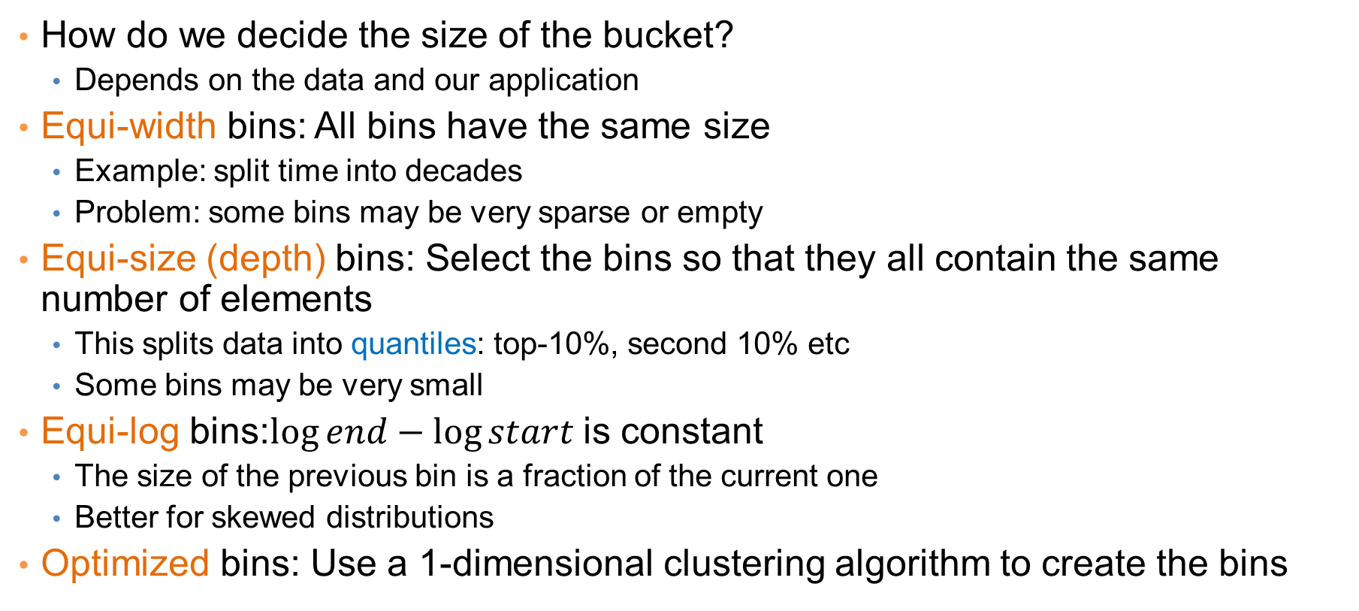
Bucketization
How do we decide the size of the bucket?
  Depends on the data and our application
Equi-width bins: All bins have the same size
  Example: split time into decades
  Problem: some bins may be very sparse or empty
Equi-size (depth) bins: Select the bins so that they all contain the same number of elements
  This splits data into quantiles: top-10%, second 10% etc
  Some bins may be very small
Equi-log bins:$\log{end}−\log{start}$ is constant
  The size of the previous bin is a fraction of the current one
  Better for skewed distributions
Optimized bins: Use a 1-dimensional clustering algorithm to create the bins

Slide 19
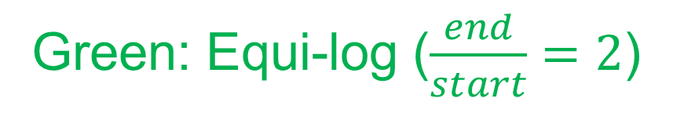
Example
[
]
0
20
40
60
80
100
Blue: Equi-width [20,40,60,80]
Red: Equi-depth (2 points per bin)
Green: Equi-log ($\frac{end}{start}=2$)

Slide 20
Physical data storage
Stored in a Relational Database
  Assumes a strict schema and relatively dense data (few missing/Null values)
Tab or Comma separated files (TSV/CSV), Excel sheets, relational tables
  Assumes a strict schema and relatively dense data (few missing/Null values)
Flat file with triplets (record id, attribute, attribute value)
  A very flexible data format, allows multiple values for the same attribute (e.g., phone number)
JSON, XML format
  Standards for data description that are more flexible than relational tables
  There exist parsers for reading such data.

Slide 21
Examples
Comma Separated File
Triple-store
Can be processed with simple parsers, or loaded to excel or a database
Easy to deal with missing values
id,Name,Surname,Age,Zip
1,John,Smith,25,10021
2,Mary,Jones,50,96107
3,Joe ,Doe,80,80235
1, Name, John
1, Surname, Smith
1, Age, 25
1, Zip, 10021
2, Name, Mary
2, Surname, Jones
2, Age, 50
2, Zip, 96107
3, Name, Joe
3, Surname, Doe
3, Age, 80
3, Zip, 80235

Slide 22
Examples
XML EXAMPLE – Record of a person
<person>
<firstName>John</firstName>
<lastName>Smith</lastName>
<age>25</age>
<address>
<streetAddress>21 2nd Street</streetAddress>
<city>New York</city>
<state>NY</state>
<postalCode>10021</postalCode>
</address>
<phoneNumbers>
<phoneNumber>
<type>home</type>
<number>212 555-1234</number>
</phoneNumber>
<phoneNumber>
<type>fax</type>
<number>646 555-4567</number>
</phoneNumber>
</phoneNumbers>
<gender>
<type>male</type>
</gender>
</person>
JSON EXAMPLE – Record of a person
{
"firstName": "John",
"lastName": "Smith",
"isAlive": true,
"age": 25,
"address": {
"streetAddress": "21 2nd Street",
"city": "New York",
"state": "NY",
"postalCode": "10021-3100"
},
"phoneNumbers": [
{
"type": "home",
"number": "212 555-1234"
},
{
"type": "office",
"number": "646 555-4567"
}
],
"children": [],
"spouse": null
}

Slide 23
JSON Databases
There are specialized Databases for semi-structured data such as JSON data
Commonly used DBs:
  MongoDB
  CouchDB
  MySQL
The query language is very similar to SQL used for relational data.

Slide 24
Beyond relational data: Set data
Each record is a set of items from a space of possible items
Example: Transaction data
  Also called market-basket data
TID | Items
1 | Bread, Coke, Milk
2 | Beer, Bread
3 | Beer, Coke, Diaper, Milk
4 | Beer, Bread, Diaper, Milk
5 | Coke, Diaper, Milk

Slide 25
Set data
Each record is a set of items from a space of possible items
Example: Document data
  Also called bag-of-words representation
Doc Id | Words
1 | the, dog, followed, the, cat
2 | the, cat, chased, the, cat
3 | the, man, walked, the, dog

Slide 26
Vector representation of market-basket data
Market-basket data can be represented, or thought of, as numeric vector data
  The vector is defined over the set of all possible items
  The values are binary (the item appears or not in the set)
TID | Bread | Coke | Milk | Beer | Diaper
1 | 1 | 1 | 1 | 0 | 0
2 | 1 | 0 | 0 | 1 | 0
3 | 0 | 1 | 1 | 1 | 1
4 | 1 | 0 | 1 | 1 | 1
5 | 0 | 1 | 1 | 0 | 1
TID | Items
1 | Bread, Coke, Milk
2 | Beer, Bread
3 | Beer, Coke, Diaper, Milk
4 | Beer, Bread, Diaper, Milk
5 | Coke, Diaper, Milk
Sparsity: Most entries are zero. Most baskets contain few items

Slide 27
Vector representation of document data
Document data can be represented, or thought of, as numeric vector data
  The vector is defined over the set of all possible words
  The values are the counts (number of times a word appears in the document)
Doc Id | the | dog | follows | cat | chases | man | walks
1 | 2 | 1 | 1 | 1 | 0 | 0 | 0
2 | 2 | 0 | 0 | 2 | 1 | 0 | 0
3 | 1 | 1 | 0 | 0 | 0 | 1 | 1
Doc Id | Words
1 | the, dog, follows, the, cat
2 | the, cat, chases, the, cat
3 | the, man, walks, the, dog
Sparsity: Most entries are zero. Most documents contain few of the words

Slide 28
Physical data storage
Usually set data is stored in flat files
  One line per set
0 1 2 3 4 5 6 7 8 9 10 11 12 13 14 15 16 17 18 19 20 21 22 23 24 25 26 27 28 29
30 31 32
33 34 35
36 37 38 39 40 41 42 43 44 45 46
38 39 47 48
38 39 48 49 50 51 52 53 54 55 56 57 58
32 41 59 60 61 62
3 39 48
I heard so many good things about this place so I was pretty juiced to try it. I'm from Cali and I heard Shake Shack is comparable to IN-N-OUT and I gotta say, Shake Shake wins hands down. Surprisingly, the line was short and we waited about 10 MIN. to order. I ordered a regular cheeseburger, fries and a black/white shake. So yummerz. I love the location too! It's in the middle of the city and the view is breathtaking. Definitely one of my favorite places to eat in NYC.
I'm from California and I must say, Shake Shack is better than IN-N-OUT, all day, err'day.

Slide 29
Dependent data
In tables we usually consider each object independent of each other.
In some cases, there are explicit dependencies between the data
  Ordered/Temporal data: We know the time order of the data
  Spatial data: Data that is placed on specific locations
  Spatiotemporal data: data with location and time
  Networked/Graph data: data with pairwise relationships between entities

Slide 30
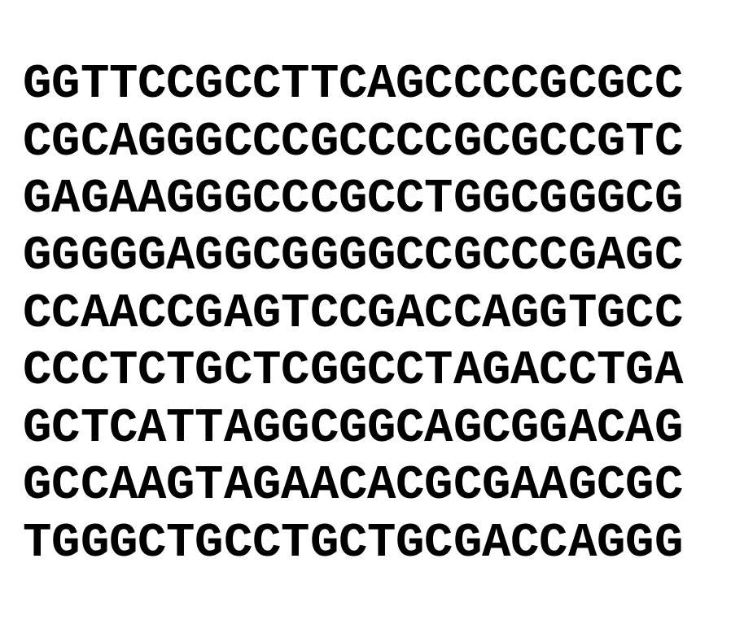
Ordered Data
Genomic sequence data
Data is a long ordered string

Slide 31
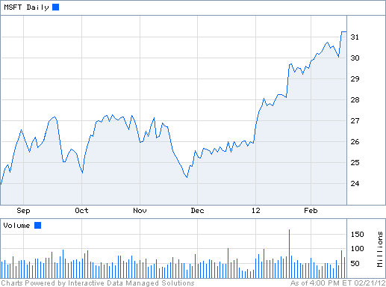
Ordered Data
Time series
  Sequence of ordered (over “time”) numeric values.

Slide 32
Ordered Data
Sequence data: Similar to the time series but in this case, we have categorical values rather than numerical ones.
Example: Event logs
fcrawler.looksmart.com - - [26/Apr/2000:00:00:12 -0400] "GET /contacts.html HTTP/1.0" 200 4595 "-" "FAST-WebCrawler/2.1-pre2 (ashen@looksmart.net)"
fcrawler.looksmart.com - - [26/Apr/2000:00:17:19 -0400] "GET /news/news.html HTTP/1.0" 200 16716 "-" "FAST-WebCrawler/2.1-pre2 (ashen@looksmart.net)"
ppp931.on.bellglobal.com - - [26/Apr/2000:00:16:12 -0400] "GET /download/windows/asctab31.zip HTTP/1.0" 200 1540096 "http://www.htmlgoodies.com/downloads/freeware/webdevelopment/15.html" "Mozilla/4.7 [en]C-SYMPA (Win95; U)"
123.123.123.123 - - [26/Apr/2000:00:23:48 -0400] "GET /pics/wpaper.gif HTTP/1.0" 200 6248 "http://www.jafsoft.com/asctortf/" "Mozilla/4.05 (Macintosh; I; PPC)"
123.123.123.123 - - [26/Apr/2000:00:23:47 -0400] "GET /asctortf/ HTTP/1.0" 200 8130 "http://search.netscape.com/Computers/Data_Formats/Document/Text/RTF" "Mozilla/4.05 (Macintosh; I; PPC)"
123.123.123.123 - - [26/Apr/2000:00:23:48 -0400] "GET /pics/5star2000.gif HTTP/1.0" 200 4005 "http://www.jafsoft.com/asctortf/" "Mozilla/4.05 (Macintosh; I; PPC)"
123.123.123.123 - - [26/Apr/2000:00:23:50 -0400] "GET /pics/5star.gif HTTP/1.0" 200 1031 "http://www.jafsoft.com/asctortf/" "Mozilla/4.05 (Macintosh; I; PPC)"
123.123.123.123 - - [26/Apr/2000:00:23:51 -0400] "GET /pics/a2hlogo.jpg HTTP/1.0" 200 4282 "http://www.jafsoft.com/asctortf/" "Mozilla/4.05 (Macintosh; I; PPC)"
123.123.123.123 - - [26/Apr/2000:00:23:51 -0400] "GET /cgi-bin/newcount?jafsof3&width=4&font=digital&noshow HTTP/1.0" 200 36 "http://www.jafsoft.com/asctortf/" "Mozilla/4.05 (Macintosh; I; PPC)"

Slide 33
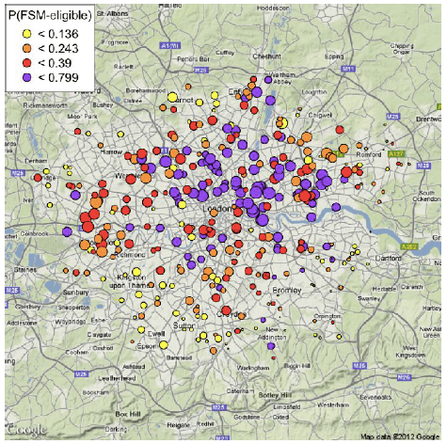
Spatial data
Attribute values that can be arranged with geographic co-ordinates
  Measurements of temperature/pressure in different locations.
  Sales numbers in different stores
  The majority party in the country states (categorical)
Such data can be nicely visualized.

Slide 34
Spatiotemporal data
Data that have both spatial and temporal aspects
  Measurements in different locations over time
    Pressure, Temperature, Humidity
  Measurements that move in space over time
    Traffic, Trajectories of moving objects

Slide 35
Graph Data
Graph data: a collection of entities and their pairwise relationships.
Examples:
  Web pages and hyperlinks
  Facebook users and friendships
  The connections between brain neurons
  Genes that regulate each other
2
1
In this case the data consists of pairs:
Who links to whom
3
We may have undirected links
5
4

Slide 36
Graph Data
Graph data: a collection of entities and their pairwise relationships.
Examples:
  Web pages and hyperlinks
  Facebook users and friendships
  The connections between brain neurons
  Genes that regulate each oterh
2
1
3
In this case the data consists of pairs:
Who links to whom
5
4
Or directed links

Slide 37
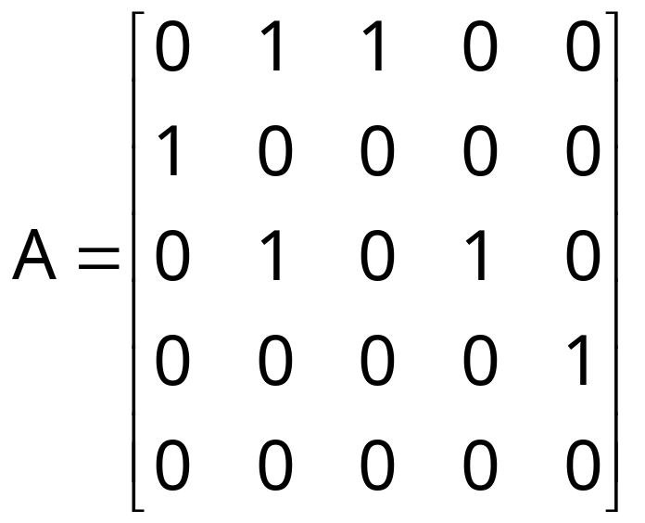
Representation
Adjacency matrix
  Very sparse, very wasteful, but useful conceptually
2
1
3
5
4

Slide 38
Representation
Adjacency list
  Not so easy to maintain
2
1: [2, 3]
2: [1, 3]
3: [1, 2, 4]
4: [3, 5]
5: [4]
1
3
5
4

Slide 39
Representation
List of pairs
  The simplest and most efficient representation
2
(1,2)
(2,3)
(1,3)
(3,4)
(4,5)
1
3
5
4

Slide 40
Types of data: summary
Numeric data: Each object is a point in a multidimensional space
Categorical data: Each object is a vector of categorical values
Set data: Each object is a set of values (with or without counts)
  Sets can also be represented as binary vectors, or vectors of counts
Dependent data:
  Ordered sequences: Each object is an ordered sequence of values.
  Spatial data: objects are fixed on specific geographic locations
  Graph data: A collection of pairwise relationships
The data matrix:
  In almost all types of data we can find a way to transform the data into a matrix, where the rows correspond to different records, and the columns to numeric attributes

Slide 41
Data Mining Pipeline

Slide 42
The data mining pipeline
When talking about Data Mining we usually think of the Data Analysis part, but the Data Mining pipeline has several steps
Data Collection
Data Preprocessing
Data Analysis
Result
Post-processing
In this course we will focus mostly on Data Analysis: methods and algorithms for extracting useful knowledge from the data.

Slide 43
Data Collection

Slide 44
The data mining pipeline
Data Collection
Data Preprocessing
Data Mining
Result
Post-processing
Collecting the data is the start of the Data Mining pipeline
It can be a hard problem; we will not focus on it in this course.

Slide 45
The different ways of obtaining data
Generate your own data
  Data may be generated through logging of a process, or some other activity (e.g., scientific measurements)
  Important to collect the right amount of information.
Use existing collections
  Today there are a lot of data collections available online
  Open data, corporate data releases, Wikis, scientific data sharing
  Existing data collections are subject to some choices made by the creator of the collection
Obtaining data online
  Public APIs: A lot of online platforms (e.g., Twitter) provide APIs for accessing their data (under several restrictions). You obtain structured data fast
  Crawling & Scraping: Use a program that traverses web pages and downloads them (crawling), and then extracts the useful content from them (scraping)
    You should follow the politeness etiquette when crawling.
    Messy and not so robust, as page layouts change often

Slide 46
Data labels
For many supervised learning tasks (classification), you need labeled data, which will be used for training and testing
Examples:
  For a collection of tweets, label them as offensive or not
  For a collection of sentences label them as having a positive, negative, or neutral sentiment towards a specific item
  For a collection of search results, label them as relevant or not relevant to the query
These labels constitute the “ground truth” that we are trying to predict.
Obtaining such labels is a difficult task that usually requires manual work.
  Companies employ workers for this task

Slide 47
Data collection example
Suppose that you want to collect data from Twitter about the elections in USA
  How do you go about it?
Twitter Streaming/Search API:
  Get a sample of all tweets that are posted on Twitter
  Example of JSON object
REST API:
  Get information about specific users.
There are several decisions that we need to make before we start collecting the data.
  Time and Storage resources
Notes:
Getting everything is too much. We need to narrow it down:
Filter by language, by location, by hashtags
Use API to get only part of the information that we care about.
Find the two candidates and their followers. Get the tweets of these users only.
Get the tweets of the candidates and see who retweets them.

Slide 48
PREPROCESSING
Sampling – reservoir sampling
Feature extraction – TF-IDF
Data Normalization

Slide 49
The data mining pipeline
Data Collection
Data Preprocessing
Data Analysis
Result
Post-processing
Preprocessing: Real data is large, noisy, incomplete and inconsistent. We need to preprocess it before we use it
The preprocessing step determines the input to the data mining algorithm
    It is often the most important step for the analysis
  A dirty work, but someone has to do it.

Slide 50
Preprocessing steps
Reducing the data: Sampling, Dimensionality Reduction
Data cleaning: deal with missing or inconsistent information
Feature extraction and selection: create a useful representation of the data by extracting useful features

Slide 51
SAMPLING –
DIMENSIONALITY REDUCTION

Slide 52
Sampling
Sampling is the main technique employed for data selection.
  It is often used for both the preliminary investigation of the data and the final data analysis.
Statisticians sample because obtaining the entire set of data of interest is too expensive or time consuming.
  Example: What is the average height of a person in Greece?
    We cannot measure the height of everybody
Sampling is used in data mining because processing the entire set of data of interest is too expensive or time consuming.
  Example: We have 1M documents. What fraction of pairs has at least 100 words in common?
    Computing number of common words for all pairs requires 10¹² comparisons
  Example: What fraction of tweets in a year contain the word “Greece”?
    500M tweets per day, if 100 characters on average, 86.5TB to store all tweets

Slide 53
Sampling …
The key principle for effective sampling is the following:
  using a sample will work almost as well as using the entire data sets, if the sample is representative
  A sample is representative if it has approximately the same property (of interest) as the original set of data
  Otherwise, we say that the sample introduces some bias
  What happens if we take a sample from the university campus to compute the average height of a person in Ioannina?

Slide 54
Types of Sampling
Simple Random Sampling
  There is an equal probability of selecting any particular item
Sampling without replacement
  As each item is selected, it is removed from the population
Sampling with replacement
  Objects are not removed from the population as they are selected for the sample.
    In sampling with replacement, the same object can be picked up more than once. This makes analytical computation of probabilities easier
    E.g., we have 100 people, 51 are women P(W) = 0.51, 49 men P(M) = 0.49. If I pick two persons what is the probability P(W,W) that both are women?
      Sampling with replacement: P(W,W) = 0.51²
      Sampling without replacement: P(W,W) = 51/100 * 50/99

Slide 55
Types of Sampling
Stratified sampling
  Split the data into several groups; then draw random samples from each group.
    Ensures that all groups are represented.
  Example 1. I want to understand the differences between legitimate and fraudulent credit card transactions. 0.1% of transactions are fraudulent. What happens if I select 1000 transactions at random?
    I get 1 fraudulent transaction (in expectation). Not enough to draw any conclusions. Solution: sample 1000 legitimate and 1000 fraudulent transactions
  Example 2. I want to answer the question: Do web pages that are linked have on average more words in common than those that are not? I have 1M pages, and 5M links, what happens if I select 10K pairs of pages at random?
    Most likely I will not get any links.
    Solution: sample 10K random pairs, and 10K links
Probability Reminder: If an event has probability p of happening and I do N trials, the expected number of times the event occurs is pN

Slide 56
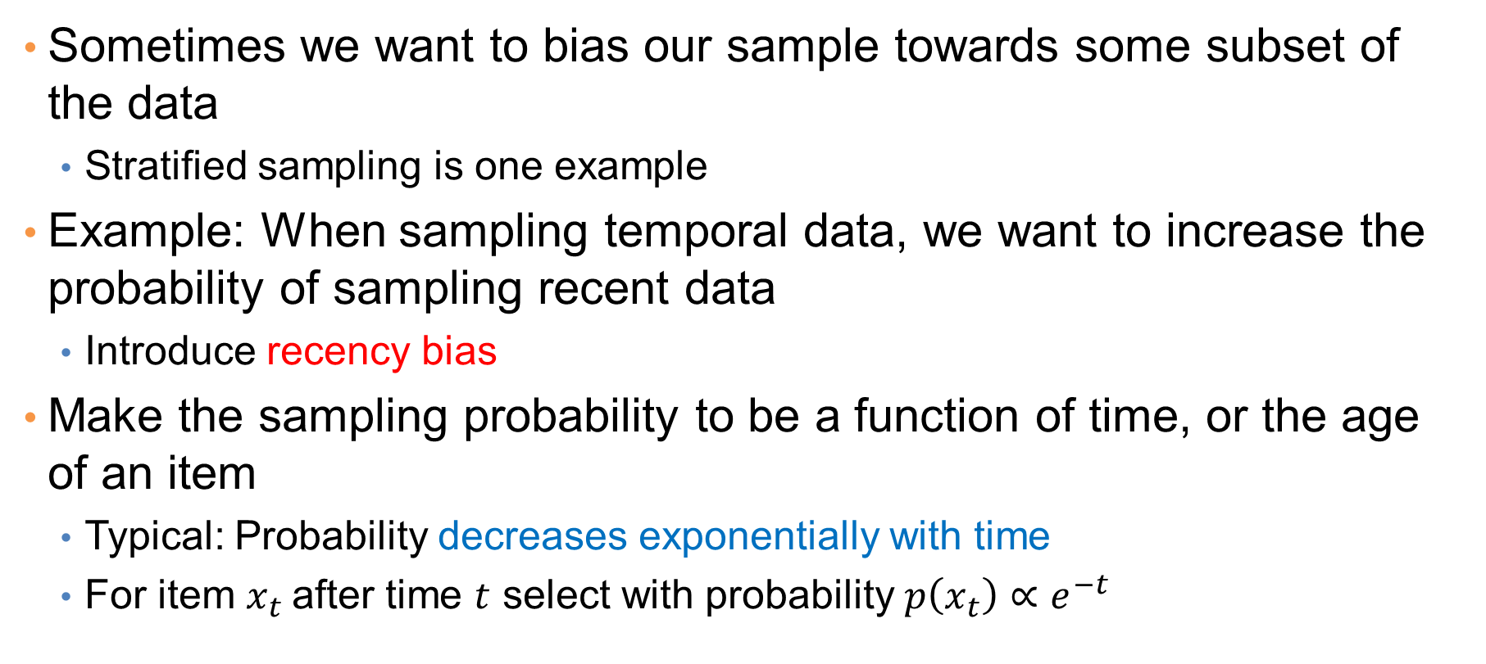
Biased sampling
Sometimes we want to bias our sample towards some subset of the data
  Stratified sampling is one example
Example: When sampling temporal data, we want to increase the probability of sampling recent data
  Introduce recency bias
Make the sampling probability to be a function of time, or the age of an item
  Typical: Probability decreases exponentially with time
  For item $x_{t}$after time $t$ select with probability $p\left(x_{t}\right)∝e^{−t}$

Slide 57
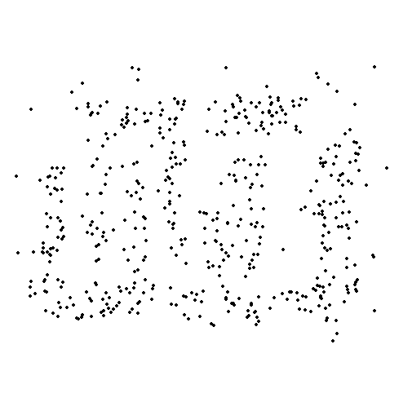

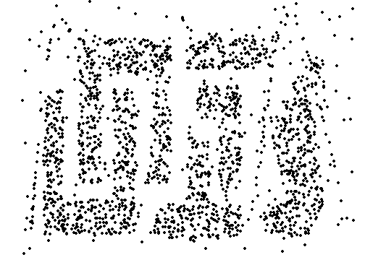
Sample Size
8000 points 2000 Points 500 Points

Slide 58

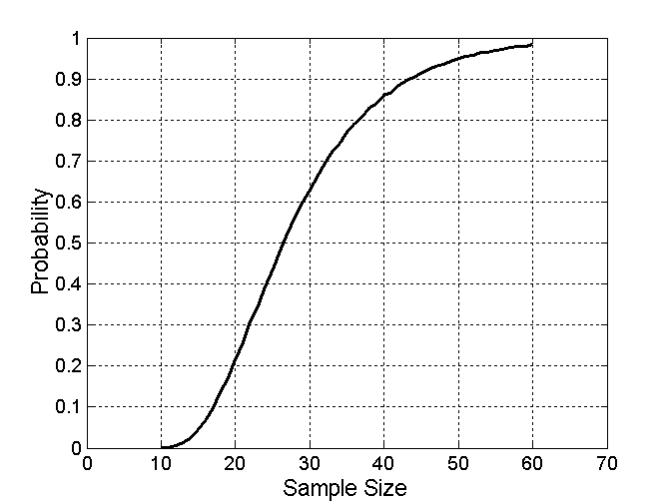
Sample Size
What sample size is necessary to get at least one object from each of 10 groups.

Slide 59
A data mining challenge
You have N items and you want to sample one item uniformly at random. How do you do that?
The items are coming in a stream: you do not know the size of the stream in advance, and there is not enough memory to store the stream in memory. You can only keep a constant amount of items in memory
How do you sample?
  Hint: if the stream ends after reading k items the last item in the stream should have probability 1/k to be selected.
Reservoir Sampling:
  (Used to be) a standard interview question for many companies

Slide 60
Reservoir sampling
Algorithm (in plain English):
  Obtain the items from the stream one at the time.
  Select the 1st item and store it in the item variable
  When seeing the k-th item select it with probability 1/k and replace the existing selection.
The algorithm stores only one item, and one integer number (the count of items seen so far)

Slide 61

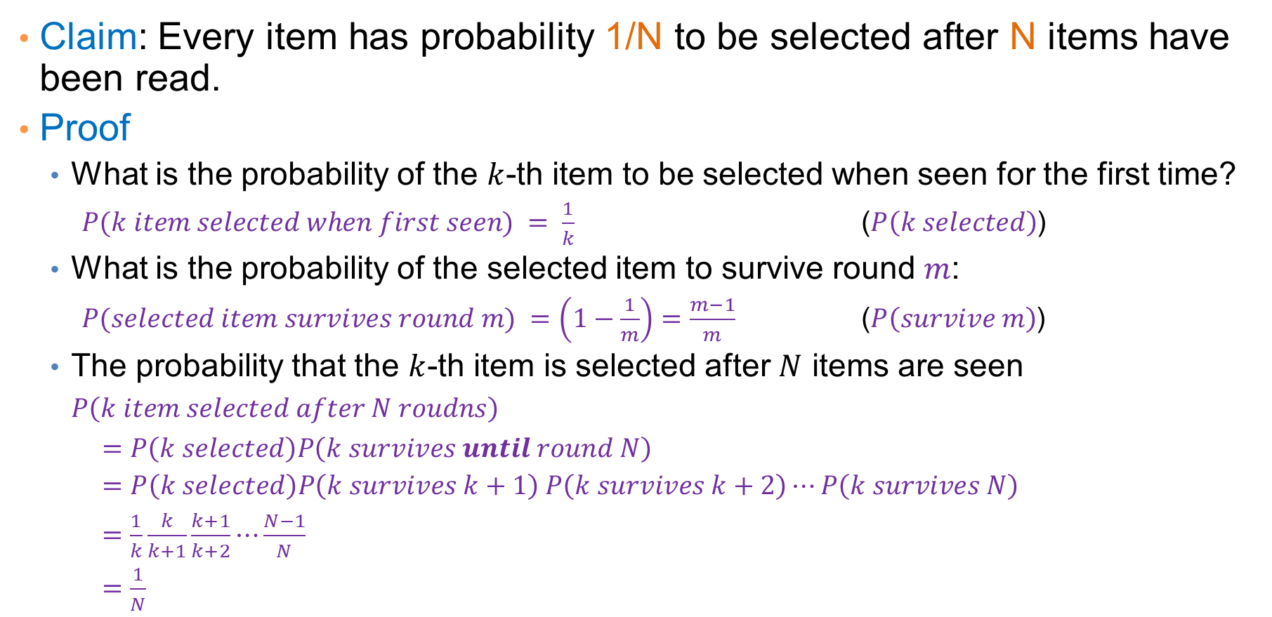
Reservoir sampling proof
Claim: Every item has probability 1/N to be selected after N items have been read.
Proof
  What is the probability of the $k$-th item to be selected when seen for the first time?
    $P(k item selected when first seen) = \frac{1}{k}$ ($P\left(k selected\right)$)
  What is the probability of the selected item to survive round $m$:
    $P(selected item survives round m) =$ $\left(1−\frac{1}{m}\right)=\frac{m−1}{m}$ ($P\left(survive m\right)$)
  The probability that the $k$-th item is selected after $N$ items are seen
  $P\left(k item selected after N roudns\right)$
  $=P\left(k selected\right)P\left(k survives until round N\right)$
  $=P\left(k selected\right)P\left(k survives k+1\right)$ $P\left(k survives k+2\right)⋯P\left(k survives N\right)$
  $=\frac{1}{k}\frac{k}{k+1}\frac{k+1}{k+2}⋯\frac{N−1}{N}$
  $=\frac{1}{N}$
The proof holds for any $k, 1≤k≤N$

Slide 62

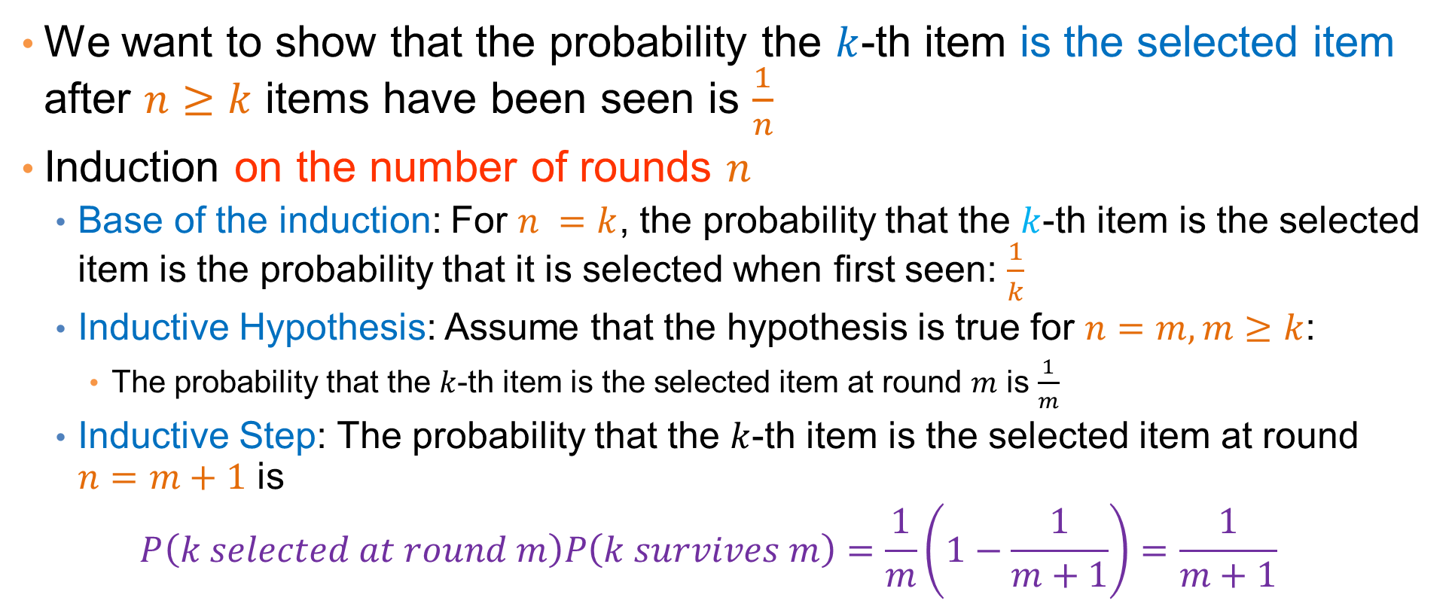
Proof by Induction
We want to show that the probability the $k$-th item is the selected item after $n≥k$ items have been seen is $\frac{1}{n}$
Induction on the number of rounds $n$
  Base of the induction: For $n =k$, the probability that the $k$-th item is the selected item is the probability that it is selected when first seen: $\frac{1}{k}$
  Inductive Hypothesis: Assume that the hypothesis is true for $n=m, m≥k$:
    The probability that the $k$-th item is the selected item at round $m$ is $\frac{1}{m}$
  Inductive Step: The probability that the $k$-th item is the selected item at round $n=m+1$ is
  $$P\left(k selected at round m\right)P\left(k survives m\right)=\frac{1}{m}\left(1−\frac{1}{m+1}\right)=\frac{1}{m+1}$$
The proof holds for any $k, 1≤k≤N$

Slide 63
Dimensionality Reduction
Sampling reduces the number or records. We can also reduce the dimension of the data, the number of attributes
Real data is high-dimensional: typically, it has several hundreds, thousands, or even million of attributes.
  Documents represented as vectors of word counts (millions)
  Facebook users represented as vectors of friends (billions)
  Customers represented as vectors of products (hundreds of thousands)
Data is extremely sparse and noisy
Dimensionality reduction aims to:
  Reduce the amount of data
  Extract the useful information.

Slide 64
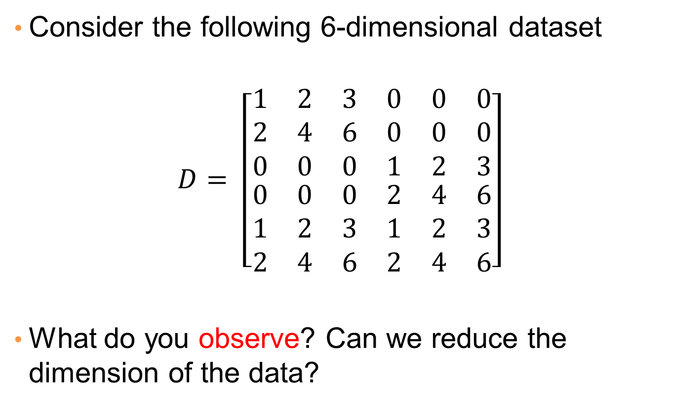
Example
Consider the following 6-dimensional dataset
$$D= \left[\begin{matrix}\begin{matrix}1 & 2 & 3 \\ 2 & 4 & 6 \\ 0 & 0 & 0\end{matrix} & \begin{matrix}0 & 0 & 0 \\ 0 & 0 & 0 \\ 1 & 2 & 3\end{matrix} \\ \begin{matrix}0 & 0 & 0 \\ 1 & 2 & 3 \\ 2 & 4 & 6\end{matrix} & \begin{matrix}2 & 4 & 6 \\ 1 & 2 & 3 \\ 2 & 4 & 6\end{matrix}\end{matrix}\right]$$
What do you observe? Can we reduce the dimension of the data?

Slide 65
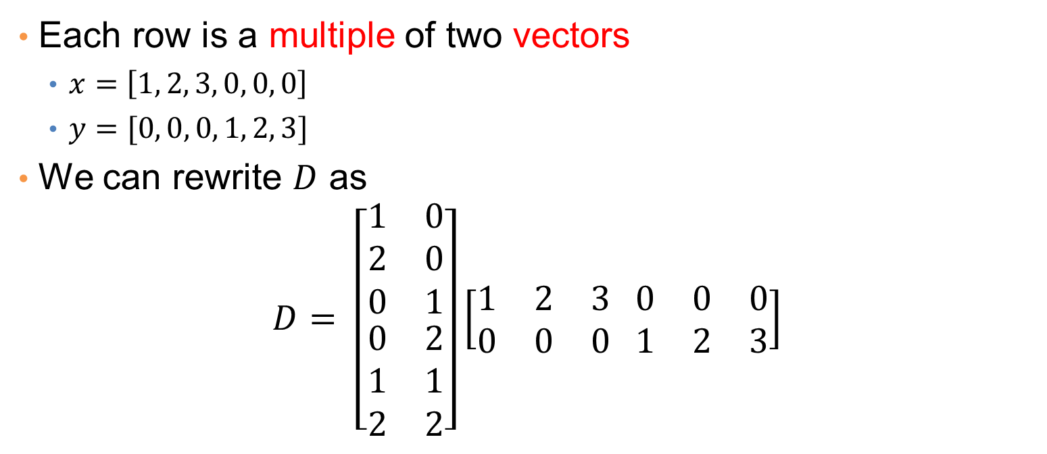
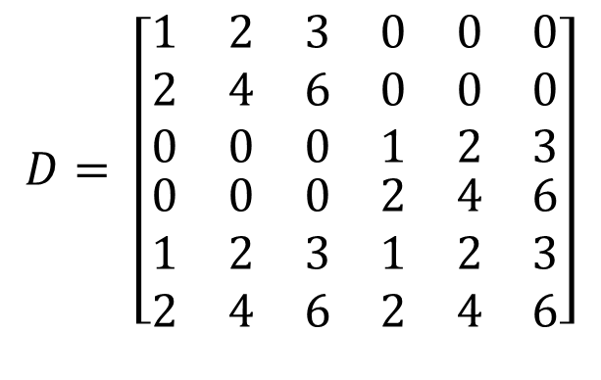
Example
$$D= \left[\begin{matrix}\begin{matrix}1 & 2 & 3 \\ 2 & 4 & 6 \\ 0 & 0 & 0\end{matrix} & \begin{matrix}0 & 0 & 0 \\ 0 & 0 & 0 \\ 1 & 2 & 3\end{matrix} \\ \begin{matrix}0 & 0 & 0 \\ 1 & 2 & 3 \\ 2 & 4 & 6\end{matrix} & \begin{matrix}2 & 4 & 6 \\ 1 & 2 & 3 \\ 2 & 4 & 6\end{matrix}\end{matrix}\right]$$
Each row is a multiple of two vectors
  $x=\left[1, 2, 3, 0, 0, 0\right]$
  $y=[0, 0, 0, 1, 2, 3]$
We can rewrite $D$ as
$$D= \left[\begin{matrix}\begin{matrix}1 & 0 \\ 2 & 0 \\ 0 & 1\end{matrix} \\ \begin{matrix}0 & 2 \\ 1 & 1 \\ 2 & 2\end{matrix}\end{matrix}\right]\left[\begin{matrix}1 & 2 & 3 \\ 0 & 0 & 0 \end{matrix} \begin{matrix}0 & 0 & 0 \\ 1 & 2 & 3\end{matrix}\right]$$

Slide 66
Data Cleaning

Slide 67
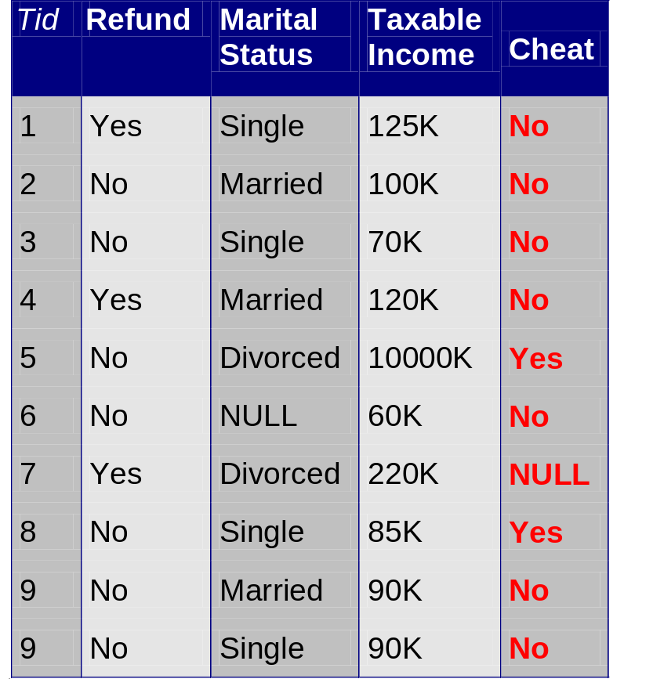
Data Quality
Examples of data quality problems:
  Noise and outliers
  Missing values
  Duplicate data
A mistake or a millionaire?
Missing values
Inconsistent duplicate entries

Slide 68
Data cleaning
How do we deal with data that are noisy?
The benefit of having a lot of data is that we can throw out data that we suspect are problematic or that we do not consider to be useful
For example:
  Throw out all records with missing values, or duplicate values.
  Throw out extreme, or atypical cases
    In database data, throw out records with outlier values
    In tweet text data throw out tweets with less than 3 words
    In transaction data, throw out baskets with very few items, and throw out products (attributes) that are bought by everyone and products that are bought by very few
    In social network data, keep only users with enough friends but not too many
We should always be careful not to throw out useful information.

Slide 69
Data Cleaning
Deal with compatibility issues
  Units may be different in different parts of the data (centimeters vs meters, or meters vs feet)
  Time measurements should be brought into the same time zone.
  Normalize names:
    Panayiotis Tsaparas, P. Tsaparas, and P. N. Tsaparas are all the same person
  Financial units should be normalized
    Different currencies
    Prices over time

Slide 70
Data Cleaning
Deal with missing values:
  Ignore the data
  Replace with random value
    Not a good idea, but you can understand how the missing value affects the output
  Replace with the mean
    Relatively common practice.
    Should be careful of cases where this does not make sense (e.g., year of birth/death)
  Replace with nearest neighbor value
  Replace with cluster mean
  Infer the value

Slide 71
Data Cleaning
Deal with missing values: Examples
2 | 1 | 8 | 3
-2 | 0 | -4 | -3
2.5 | 1 | 7 | ?
2 | 1 | 8 | 4
3 | 1.5 | 6 | 6
4 | 2 | 5 | 8
2 | 1 | 4 | 4
2.5 | 1 | 7 | ?
What value would you fill?
What value would you fill?
Use nearest neighbor and fill in 3
The last column is twice the first one: fill in 5
2 | 1 | 8 | 3
3 | 1.5 | 6 | 2
-2 | 0 | -4 | -3
-1 | 1 | -3 | -1
2.5 | 1 | 7 | ?
What value would you fill?
What value would you fill for timestamp 3?
Use cluster mean and fill in 2.5
Linear interpolation
1
2
3
4
5
6
Time

Slide 72
Data Cleaning
Deal with outliers:
  Remove them
  Try to correct them using common sense
  Transform the data
    In some data (e.g., wealth, social media followers) extreme values are expected and interesting
    In such skewed distributions we typically use the logarithm of the values, or apply binning

Slide 73
Data Cleaning
When using the data, we should be careful of cases where our results are too good to be true, or too bad to be true

Slide 74
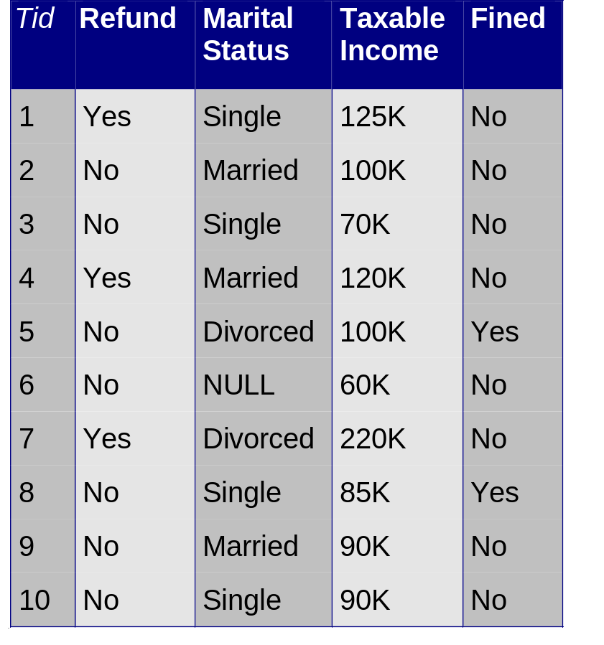
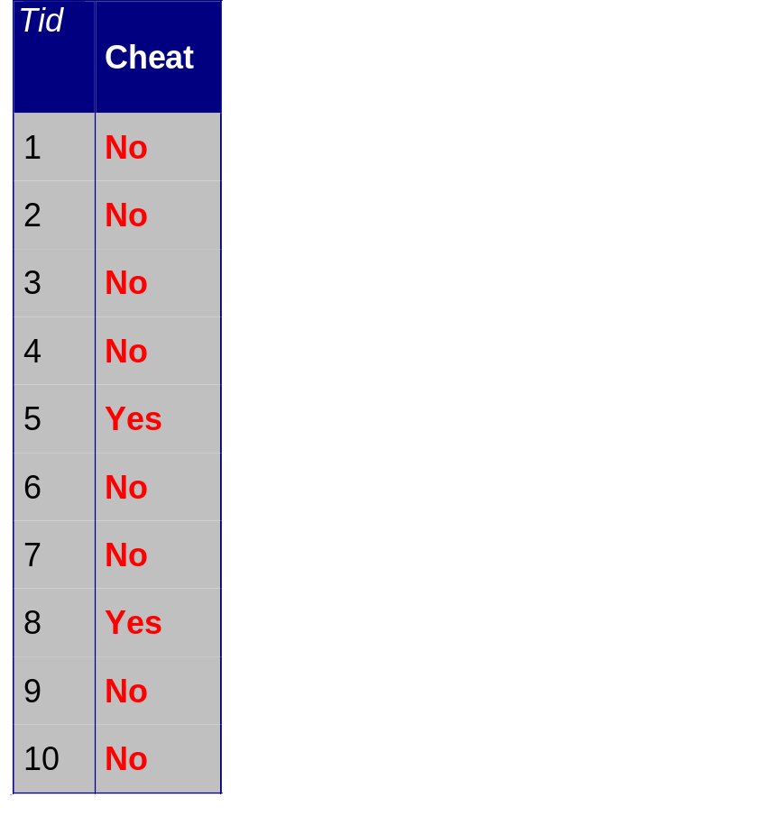
Data Cleaning
When using the data, we should be careful of cases where our results are too good to be true, or too bad to be true
We trained a classifier to predict if a taxpayer will cheat and we got perfect results. Is our classifier great or is there some problem with the data?
The attribute Fined is the same as the class label we want to predict

Slide 75
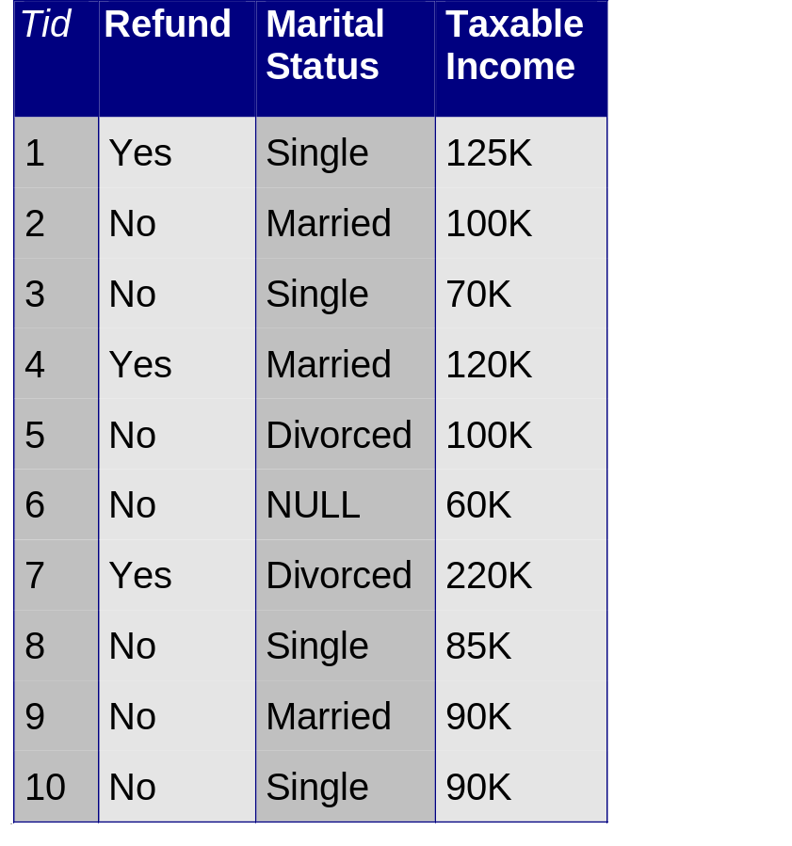
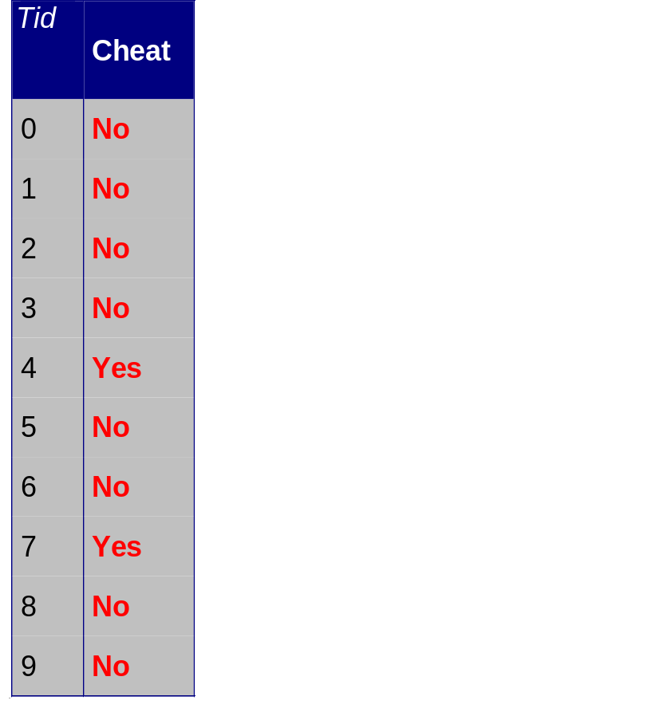
Data Cleaning
When using the data, we should be careful of cases where our results are too good to be true, or too bad to be true
We trained a classifier to predict if a taxpayer will cheat and we got bad results. Is our classifier that bad?
The ids for the class labels are not aligned with the ids of the data

Slide 76
FEATURE EXTRACTION
A case study with text data
TF-IDF word weighting

Slide 77
Data preprocessing: feature extraction
The data we obtain are not necessarily as a relational table
Data may be in a very raw format
  Examples: text, speech, mouse movements, etc
We need to extract the features/attributes from the data and build the data matrix
Feature extraction:
  Selecting the characteristics by which we want to represent our data
  It requires some domain knowledge about the data
  It depends on the application
Deep Learning Embeddings help with this step.

Slide 78

Example: Text data
Text data is a collection of strings
  We need to do additional effort to extract the useful information
We will now see some basic text processing ideas.
Example: Mine the restaurant reviews of users on Yelp

Slide 79
Mining Task
Collect all reviews for the top-10 most reviewed restaurants in NY in Yelp
Feature extraction: Find few words that best describe the restaurants.
{"votes": {"funny": 0, "useful": 2, "cool": 1},
"user_id": "Xqd0DzHaiyRqVH3WRG7hzg",
"review_id": "15SdjuK7DmYqUAj6rjGowg",
"stars": 5, "date": "2007-05-17",
"text": "I heard so many good things about this place so I was pretty juiced to try it. I'm from Cali and I heard Shake Shack is comparable to IN-N-OUT and I gotta say, Shake Shake wins hands down. Surprisingly, the line was short and we waited about 10 MIN. to order. I ordered a regular cheeseburger, fries and a black/white shake. So yummerz. I love the location too! It's in the middle of the city and the view is breathtaking. Definitely one of my favorite places to eat in NYC.",
"type": "review",
"business_id": "vcNAWiLM4dR7D2nwwJ7nCA"}

Slide 80
Example data
I heard so many good things about this place so I was pretty juiced to try it. I'm from Cali and I heard Shake Shack is comparable to IN-N-OUT and I gotta say, Shake Shake wins hands down. Surprisingly, the line was short and we waited about 10 MIN. to order. I ordered a regular cheeseburger, fries and a black/white shake. So yummerz. I love the location too! It's in the middle of the city and the view is breathtaking. Definitely one of my favorite places to eat in NYC.
I'm from California and I must say, Shake Shack is better than IN-N-OUT, all day, err'day.
Would I pay $15+ for a burger here? No. But for the price point they are asking for, this is a definite bang for your buck (though for some, the opportunity cost of waiting in line might outweigh the cost savings) Thankfully, I came in before the lunch swarm descended and I ordered a shake shack (the special burger with the patty + fried cheese &amp; portabella topping) and a coffee milk shake. The beef patty was very juicy and snugly packed within a soft potato roll. On the downside, I could do without the fried portabella-thingy, as the crispy taste conflicted with the juicy, tender burger. How does shake shack compare with in-and-out or 5-guys? I say a very close tie, and I think it comes down to personal affliations. On the shake side, true to its name, the shake was well churned and very thick and luscious. The coffee flavor added a tangy taste and complemented the vanilla shake well. Situated in an open space in NYC, the open air sitting allows you to munch on your burger while watching people zoom by around the city. It's an oddly calming experience, or perhaps it was the food coma I was slowly falling into. Great place with food at a great price.

Slide 81
Decisions, decisions…
We need to make some decisions about our data collection
  What data should we collect? How much? For how long?
  What data should we keep?
  How should we weight the different pieces of data?
We should make our decisions clear upfront. Most decisions are task-dependent. Some information may be lost but we can usually live with it (most of the times)
An actual review
AAAAAAAAAAAAA
AAAAAAAAAAAAAAAAAAAAAAAAA AAAAAAAAAAAAAAAAAAAAAAAAA AAA

Slide 82
Text normalization
Each review is a long string. We need to transform it into words
Basic preprocessing:
  “normalize” the data (remove punctuation, make into lower case, clear white spaces, other?)
  Break into words
There are existing libraries that do these steps.
Sometimes, we can break into n-grams, or combinations of words.

Slide 83
First cut
Keep the most popular words
the 27514
and 14508
i 13088
a 12152
to 10672
of 8702
ramen 8518
was 8274
is 6835
it 6802
in 6402
for 6145
but 5254
that 4540
you 4366
with 4181
pork 4115
my 3841
this 3487
wait 3184
not 3016
we 2984
at 2980
on 2922
the 16710
and 9139
a 8583
i 8415
to 7003
in 5363
it 4606
of 4365
is 4340
burger 432
was 4070
for 3441
but 3284
shack 3278
shake 3172
that 3005
you 2985
my 2514
line 2389
this 2242
fries 2240
on 2204
are 2142
with 2095
the 16010
and 9504
i 7966
to 6524
a 6370
it 5169
of 5159
is 4519
sauce 4020
in 3951
this 3519
was 3453
for 3327
you 3220
that 2769
but 2590
food 2497
on 2350
my 2311
cart 2236
chicken 2220
with 2195
rice 2049
so 1825
the 14241
and 8237
a 8182
i 7001
to 6727
of 4874
you 4515
it 4308
is 4016
was 3791
pastrami 3748
in 3508
for 3424
sandwich 2928
that 2728
but 2715
on 2247
this 2099
my 2064
with 2040
not 1655
your 1622
so 1610
have 1585
Most frequent words are stop words

Slide 84
Second cut
Remove stop words
  Stop-word lists can be found online.
a,about,above,after,again,against,all,am,an,and,any,are,aren't,as,at,be,because,been,before,being,below,between,both,but,by,can't,cannot,could,couldn't,did,didn't,do,does,doesn't,doing,don't,down,during,each,few,for,from,further,had,hadn't,has,hasn't,have,haven't,having,he,he'd,he'll,he's,her,here,here's,hers,herself,him,himself,his,how,how's,i,i'd,i'll,i'm,i've,if,in,into,is,isn't,it,it's,its,itself,let's,me,more,most,mustn't,my,myself,no,nor,not,of,off,on,once,only,or,other,ought,our,ours,ourselves,out,over,own,same,shan't,she,she'd,she'll,she's,should,shouldn't,so,some,such,than,that,that's,the,their,theirs,them,themselves,then,there,there's,these,they,they'd,they'll,they're,they've,this,those,through,to,too,under,until,up,very,was,wasn't,we,we'd,we'll,we're,we've,were,weren't,what,what's,when,when's,where,where's,which,while,who,who's,whom,why,why's,with,won't,would,wouldn't,you,you'd,you'll,you're,you've,your,yours,yourself,yourselves,

Slide 85
Second cut
Remove stop words
  Stop-word lists can be found online.
ramen 8572
pork 4152
wait 3195
good 2867
place 2361
noodles 2279
ippudo 2261
buns 2251
broth 2041
like 1902
just 1896
get 1641
time 1613
one 1460
really 1437
go 1366
food 1296
bowl 1272
can 1256
great 1172
best 1167
burger 4340
shack 3291
shake 3221
line 2397
fries 2260
good 1920
burgers 1643
wait 1508
just 1412
cheese 1307
like 1204
food 1175
get 1162
place 1159
one 1118
long 1013
go 995
time 951
park 887
can 860
best 849
sauce 4023
food 2507
cart 2239
chicken 2238
rice 2052
hot 1835
white 1782
line 1755
good 1629
lamb 1422
halal 1343
just 1338
get 1332
one 1222
like 1096
place 1052
go 965
can 878
night 832
time 794
long 792
people 790
pastrami 3782
sandwich 2934
place 1480
good 1341
get 1251
katz's 1223
just 1214
like 1207
meat 1168
one 1071
deli 984
best 965
go 961
ticket 955
food 896
sandwiches 813
can 812
beef 768
order 720
pickles 699
time 662

Slide 86
Second cut
Remove stop words
  Stop-word lists can be found online.
ramen 8572
pork 4152
wait 3195
good 2867
place 2361
noodles 2279
ippudo 2261
buns 2251
broth 2041
like 1902
just 1896
get 1641
time 1613
one 1460
really 1437
go 1366
food 1296
bowl 1272
can 1256
great 1172
best 1167
burger 4340
shack 3291
shake 3221
line 2397
fries 2260
good 1920
burgers 1643
wait 1508
just 1412
cheese 1307
like 1204
food 1175
get 1162
place 1159
one 1118
long 1013
go 995
time 951
park 887
can 860
best 849
sauce 4023
food 2507
cart 2239
chicken 2238
rice 2052
hot 1835
white 1782
line 1755
good 1629
lamb 1422
halal 1343
just 1338
get 1332
one 1222
like 1096
place 1052
go 965
can 878
night 832
time 794
long 792
people 790
pastrami 3782
sandwich 2934
place 1480
good 1341
get 1251
katz's 1223
just 1214
like 1207
meat 1168
one 1071
deli 984
best 965
go 961
ticket 955
food 896
sandwiches 813
can 812
beef 768
order 720
pickles 699
time 662
Commonly used words in reviews, not so interesting

Slide 87
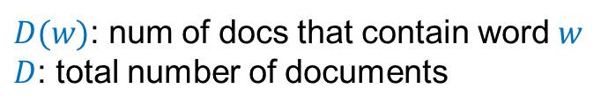
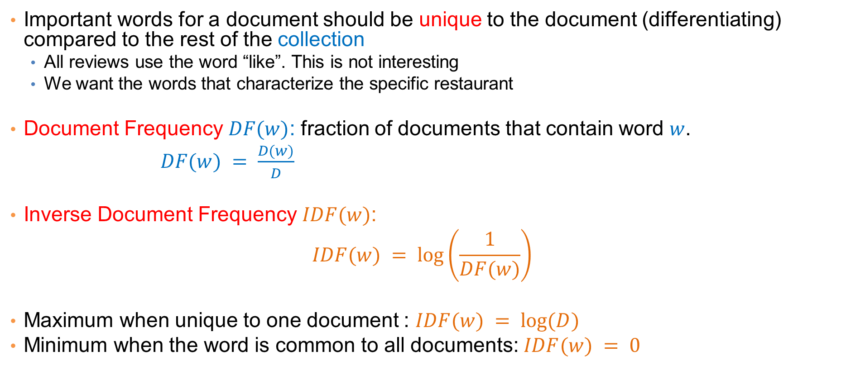
IDF: Inverse Document Frequency
Important words for a document should be unique to the document (differentiating) compared to the rest of the collection
  All reviews use the word “like”. This is not interesting
  We want the words that characterize the specific restaurant
Document Frequency $DF(w)$: fraction of documents that contain word $w$.
$DF(w) = \frac{D(w)}{D}$
Inverse Document Frequency $IDF(w)$:
$$IDF(w) = log⁡\left(\frac{1}{DF(w)}\right)$$
Maximum when unique to one document : $IDF(w) = log⁡(D)$
Minimum when the word is common to all documents: $IDF(w) = 0$
$D(w)$: num of docs that contain word $w$
$D$: total number of documents

Slide 88
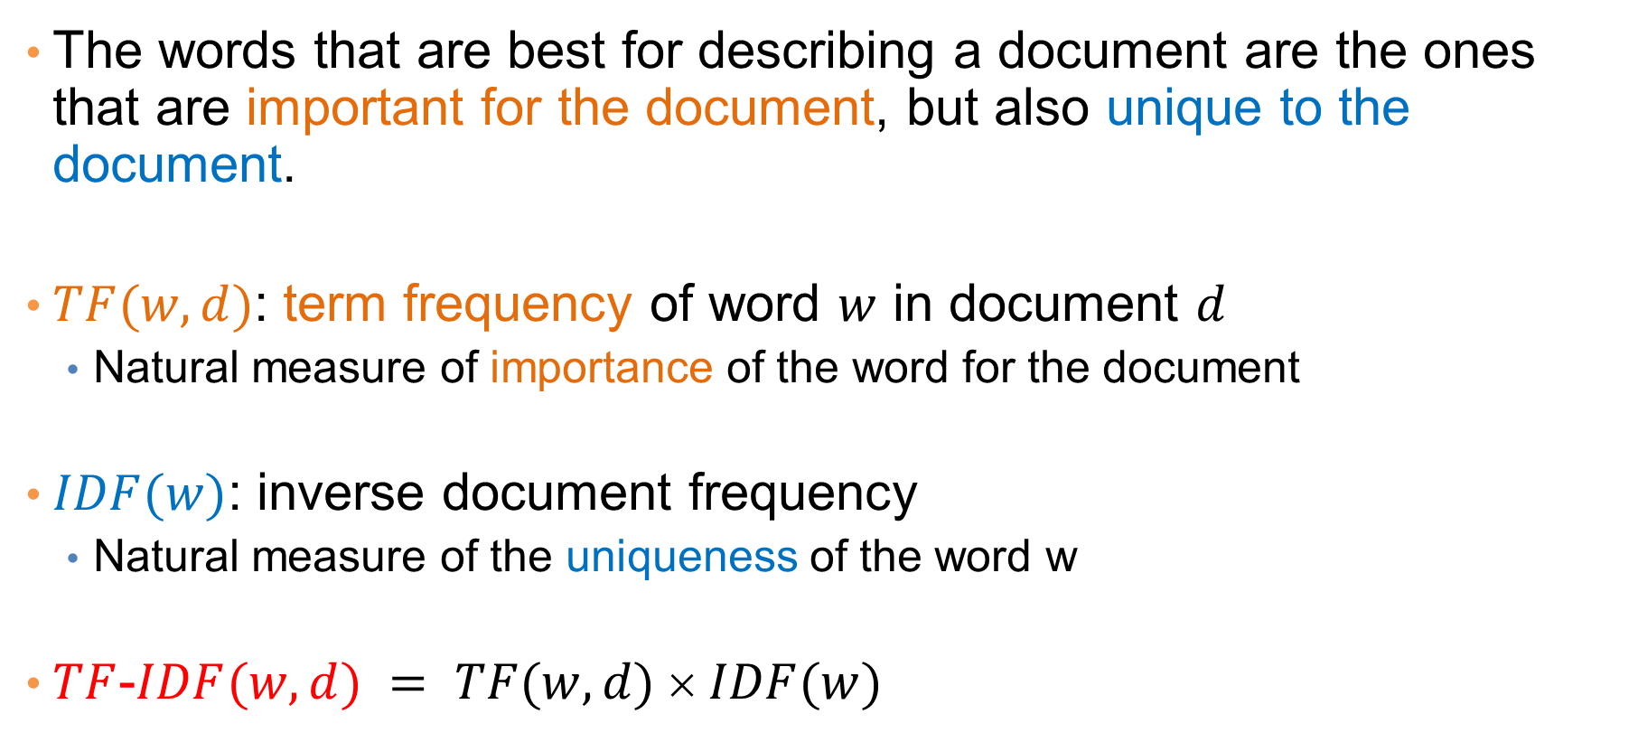
TF-IDF
The words that are best for describing a document are the ones that are important for the document, but also unique to the document.
$TF(w,d)$: term frequency of word $w$ in document $d$
  Natural measure of importance of the word for the document
$IDF(w)$: inverse document frequency
  Natural measure of the uniqueness of the word w
$TF$-$IDF(w,d) = TF(w,d)  IDF(w)$

Slide 89
Third cut
Ordered by TF-IDF
ramen 3057.41761944282 7
akamaru 2353.24196503991 1
noodles 1579.68242449612 5
broth 1414.71339552285 5
miso 1252.60629058876 1
hirata 709.196208642166 1
hakata 591.76436889947 1
shiromaru 587.1591987134 1
noodle 581.844614740089 4
tonkotsu 529.594571388631 1
ippudo 504.527569521429 8
buns 502.296134008287 8
ippudo's 453.609263319827 1
modern 394.839162940177 7
egg 367.368005696771 5
shoyu 352.295519228089 1
chashu 347.690349042101 1
karaka 336.177423577131 1
kakuni 276.310211159286 1
ramens 262.494700601321 1
bun 236.512263803654 6
wasabi 232.366751234906 3
dama 221.048168927428 1
brulee 201.179739054263 2
fries 806.085373301536 7
custard 729.607519421517 3
shakes 628.473803858139 3
shroom 515.779060830666 1
burger 457.264637954966 9
crinkle 398.34722108797 1
burgers 366.624854809247 8
madison 350.939350307801 4
shackburger 292.428306810 1
'shroom 287.823136624256 1
portobello 239.8062489526 2
custards 211.837828555452 1
concrete 195.169925889195 4
bun 186.962178298353 6
milkshakes 174.9964670675 1
concretes 165.786126695571 1
portabello 163.4835416025 1
shack's 159.334353330976 2
patty 152.226035882265 6
ss 149.668031044613 1
patties 148.068287943937 2
cam 105.949606780682 3
milkshake 103.9720770839 5
lamps 99.011158998744 1
lamb 985.655290756243 5
halal 686.038812717726 6
53rd 375.685771863491 5
gyro 305.809092298788 3
pita 304.984759446376 5
cart 235.902194557873 9
platter 139.459903080044 7
chicken/lamb 135.8525204 1
carts 120.274374158359 8
hilton 84.2987473324223 4
lamb/chicken 82.8930633 1
yogurt 70.0078652365545 5
52nd 67.5963923222322 2
6th 60.7930175345658 9
4am 55.4517744447956 5
yellow 54.4470265206673 8
tzatziki 52.9594571388631 1
lettuce 51.3230168022683 8
sammy's 50.656872045869 1
sw 50.5668577816893 3
platters 49.9065970003161 5
falafel 49.4796995212044 4
sober 49.2211422635451 7
moma 48.1589121730374 3
pastrami 1931.94250908298 6
katz's 1120.62356508209 4
rye 1004.28925735888 2
corned 906.113544700399 2
pickles 640.487221580035 4
reuben 515.779060830666 1
matzo 430.583412389887 1
sally 428.110484707471 2
harry 226.323810772916 4
mustard 216.079238853014 6
cutter 209.535243462458 1
carnegie 198.655512713779 3
katz 194.387844446609 7
knish 184.206807439524 1
sandwiches 181.415707218 8
brisket 131.945865389878 4
fries 131.613054313392 7
salami 127.621117258549 3
knishes 124.339595021678 1
delicatessen 117.488967607 2
deli's 117.431839742696 1
carver 115.129254649702 1
brown's 109.441778045519 2
matzoh 108.22149937072 1

Slide 90
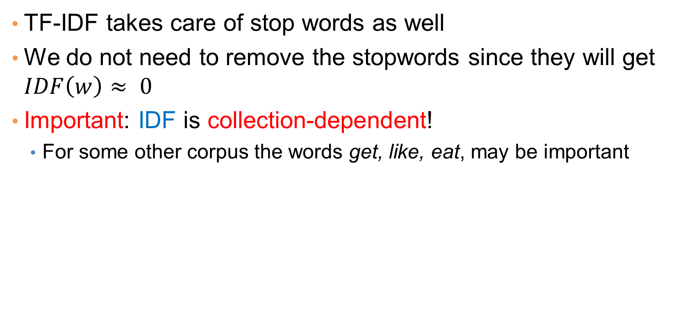
Third cut
TF-IDF takes care of stop words as well
We do not need to remove the stopwords since they will get $IDF\left(w\right)≈ 0$
Important: IDF is collection-dependent!
  For some other corpus the words get, like, eat, may be important

Slide 91
The preprocessing pipeline for our text mining task
Use Yelp/FS API to obtain data
(or download)
Data collection
Data Preprocessing
A collection of documents as text
Throw away very short reviews
Subset of the collection
Normalize text and break into words
Documents as sets of words
Documents as numerical vectors
Compute TF-IDF values
Keep top words for each document
Create the dictionary
Documents as subsets of words
Remove: stopwords, very frequent words, and very rare words
Data Mining

Slide 92
Word and document representations
Using TF-IDF values has a very long history in text mining
  Assigns a numerical value to each word, and a vector to a document
Recent trend: Use word embeddings
  Map every word into a multidimensional vector
Use the notion of context: the words that surround a word in a phrase
  Similar words appear in similar contexts
  Similar words should be mapped to close-by vectors
Example: words “movie” and “film”
Both words are likely to appear with similar words
  director, actor, actress, scenario, script, Oscar, cinemas etc
movie
film
The actor for the movie Joker is candidate for an Oscar

Slide 93
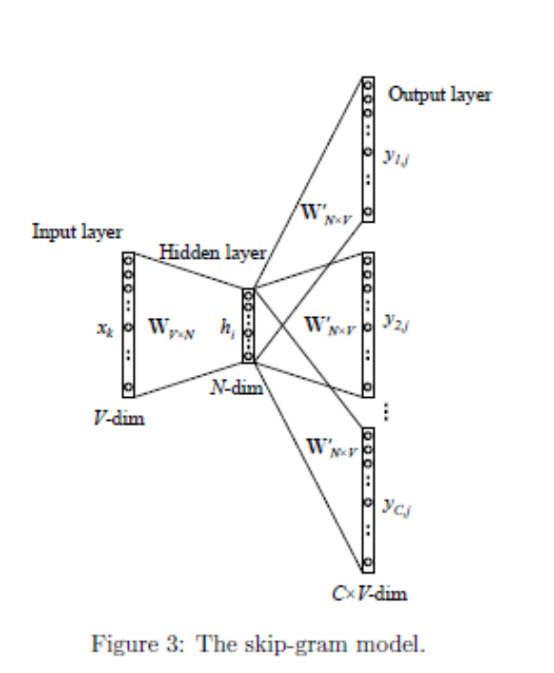
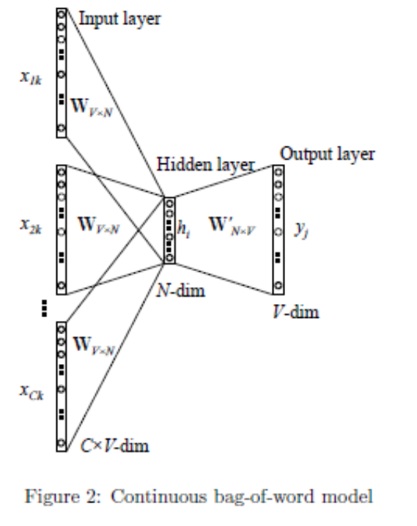
word2vec
Two approaches
CBOW: Learn an embedding for words so that given the context you can predict the missing word
Skip-Gram: Learn an embedding for words such that given a word you can predict the context
Much more sophisticated methods have been developed since then, but they rely on the same principle

Slide 94
Embeddings - Representation Learning
Word embeddings is one case of representation learning, which is becoming increasingly popular and tends to replace feature extraction
General idea:
  Take objects in some for form (text, image, video, graph)
  Define a (self) learning task
    E.g., predict the next word, or a hidden word in text
    E.g., predict the completion of an image, or the next frame in a video
  Use an intermediate product of the learning algorithm (typically a layer in a NN) as the representation of the object
  Represent objects with dense numerical vectors of high dimension.
  The representations encode properties of the data, such as similarity
There are also linear transformations of the data but non-linear ones have been shown to be much more powerful.

Slide 95
DATA NORMALIZATION

Slide 96
Normalization of numeric data
In many cases it is important to normalize the data rather than use the raw values
The kind of normalization that we use depends on what we want to achieve

Slide 97
Column normalization
In this data, different attributes take very different range of values. When computing distance/similarity the small values will disappear
We need to make them comparable
Temperature | Humidity | Pressure
30 | 0.8 | 90
32 | 0.5 | 80
24 | 0.3 | 95

Slide 98
Column Normalization
Divide (the values of a column) by the maximum value for each attribute
  Brings everything in the [0,1] range, maximum is 1
Temperature | Humidity | Pressure
0.9375 | 1 | 0.9473
1 | 0.625 | 0.8421
0.75 | 0.375 | 1
new value = old value / max value in the column
Temperature | Humidity | Pressure
30 | 0.8 | 90
32 | 0.5 | 80
24 | 0.3 | 95

Slide 99
Column Normalization
Subtract the minimum value and divide by the difference of the maximum value and minimum value for each attribute
  Brings everything in the [0,1] range, maximum is one, minimum is zero
Temperature | Humidity | Pressure
0.75 | 1 | 0.33
1 | 0.6 | 0
0 | 0 | 1
new value = (old value – min column value) / (max col. value –min col. value)
Temperature | Humidity | Pressure
30 | 0.8 | 90
32 | 0.5 | 80
24 | 0.3 | 95

Slide 100
Column Normalization
Subtract the mean value for each column – centering of features
  All columns have mean zero
Temperature | Humidity | Pressure
1.33 | 0.27 | 1.67
3.33 | -0.03 | -8.33
-4.67 | -0.23 | 6.67
Temperature | Humidity | Pressure
30 | 0.8 | 90
32 | 0.5 | 80
24 | 0.3 | 95
28.67 | 0.53 | 88.33
mean
new value = (old value – avg column value)

Slide 101

Column Normalization
Subtract the mean value for each column – centering of features
  All columns have mean zero
Divide with the length of the centered column vector
  All columns are unit vectors
Temperature | Humidity | Pressure
30 | 0.8 | 90
32 | 0.5 | 80
24 | 0.3 | 95
28.67 | 0.53 | 88.33
Temperature | Humidity | Pressure
0.23 | 0.75 | 0.15
0.57 | -0.09 | -0.77
-0.79 | -0.66 | 0.62
mean
Temperature | Humidity | Pressure
1.33 | 0.27 | 1.67
3.33 | -0.03 | -8.33
-4.67 | -0.23 | 6.67
5.89 | 0.36 | 10.80
new value = $\frac{old value −mean value}{\sqrt{\sum{{\left(old value_{i}−mean value\right)}^{2}}}}$
length

Slide 102


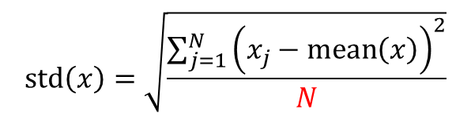
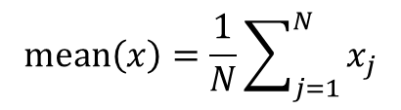
Column Normalization
There is a relationship between z-score and centered unit vectors, what is it?
Subtract the mean value for each column – centering of features
  All columns have mean zero
Divide with the standard deviation of the column vector
  Computes the z-score
  Number of standard deviations away from the mean
$$mean\left(x\right)=\frac{1}{N}\sum_{j=1}^{N}{x_{j}}$$
$$std\left(x\right)=\sqrt{\frac{\sum_{j=1}^{N}{{\left(x_{j}−mean\left(x\right)\right)}^{2}}}{N}}$$
Temperature | Humidity | Pressure
0.23 | 0.75 | 0.15
0.57 | -0.09 | -0.77
-0.79 | -0.66 | 0.62
Z-score: $z_{i}=\frac{x_{i}−mean(x)}{std(x)}$
Temperature | Humidity | Pressure
30 | 0.8 | 90
32 | 0.5 | 80
24 | 0.3 | 95
28.67 | 0.53 | 88.33
3.40 | 0.21 | 6.24
new value = $\frac{old value −mean value}{standard deviation}$
mean
std

Slide 103
Row Normalization
Are these documents similar?
 | Word 1 | Word 2 | Word 3
Doc 1 | 28 | 50 | 22
Doc 2 | 12 | 25 | 13

Slide 104
Row Normalization
Are these documents similar?
Divide by the sum of values for each document (row in the matrix)
  Transform a vector into a distribution*
 | Word 1 | Word 2 | Word 3
Doc 1 | 0.28 | 0.5 | 0.22
Doc 2 | 0.24 | 0.5 | 0.26
new value = old value / Σ old values in the row
*For example, the value of cell (Doc1, Word2) is the probability that a randomly chosen word of Doc1 is Word2
 | Word 1 | Word 2 | Word 3
Doc 1 | 28 | 50 | 22
Doc 2 | 12 | 25 | 13

Slide 105
Row Normalization
Do these two users rate movies in a similar way?
 | Movie 1 | Movie 2 | Movie 3
User 1 | 1 | 2 | 3
User 2 | 2 | 3 | 4

Slide 106
Row Normalization
Do these two users rate movies in a similar way?
Subtract the mean value for each user (row) – centering of the data rows
  Captures the deviation from the average behavior
 | Movie 1 | Movie 2 | Movie 3
User 1 | -1 | 0 | +1
User 2 | -1 | 0 | +1
new value = (old value – mean row value) [/ (max row value –min row value)]
 | Movie 1 | Movie 2 | Movie 3 | Mean
User 1 | 1 | 2 | 3 | 2
User 2 | 2 | 3 | 4 | 3

Slide 107
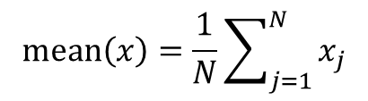
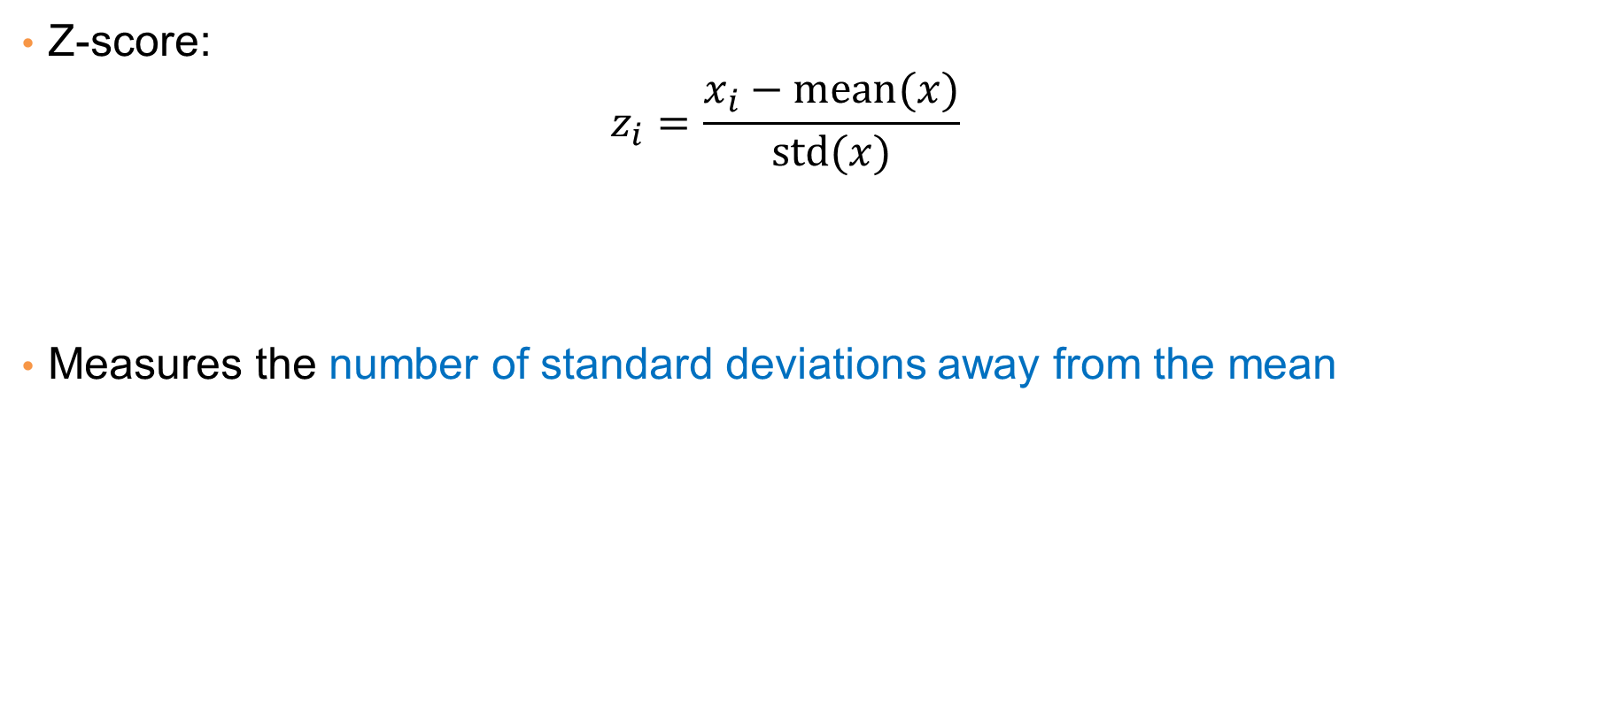
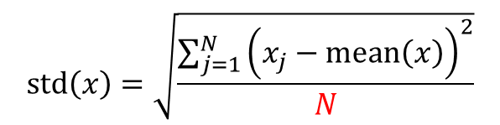
Row Normalization
$$mean\left(x\right)=\frac{1}{N}\sum_{j=1}^{N}{x_{j}}$$
Z-score:
  $$z_{i}=\frac{x_{i}−mean(x)}{std(x)}$$
Measures the number of standard deviations away from the mean
$$std\left(x\right)=\sqrt{\frac{\sum_{j=1}^{N}{{\left(x_{j}−mean\left(x\right)\right)}^{2}}}{N}}$$
Average “distance” from the mean
N may be N-1: population vs sample
 | Movie 1 | Movie 2 | Movie 3
User 1 | 1.01 | -0.87 | -0.22
User 2 | -1.01 | 0.55 | 0.93
 | Movie 1 | Movie 2 | Movie 3 | Mean | STD
User 1 | 5 | 2 | 3 | 3.33 | 1.53
User 2 | 1 | 3 | 4 | 2.66 | 1.53

Slide 108
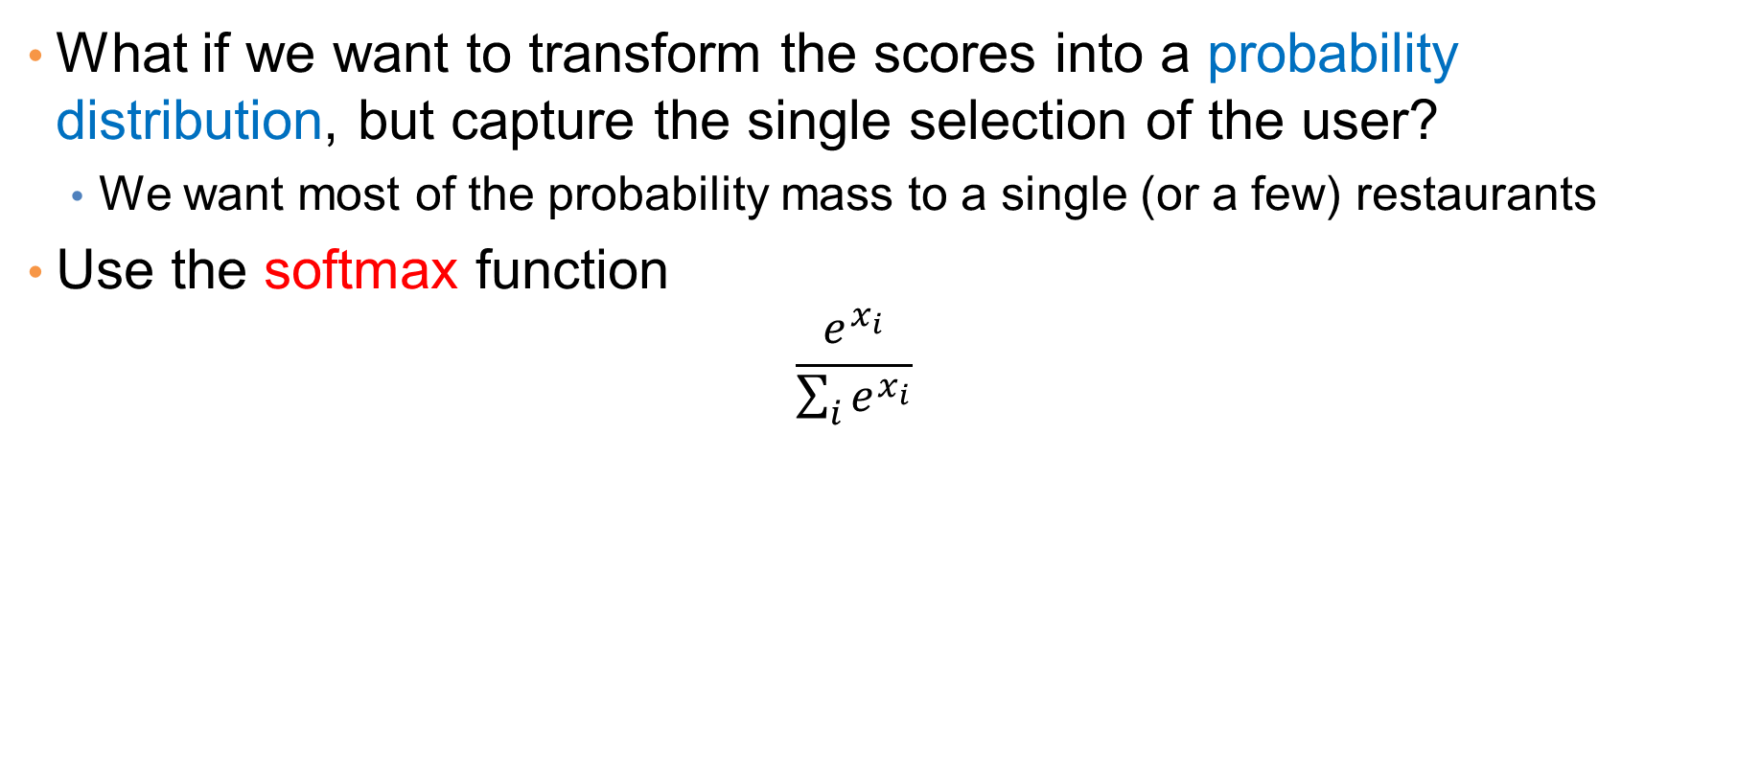
Softmax function
What if we want to transform the scores into a probability distribution, but capture the single selection of the user?
  We want most of the probability mass to a single (or a few) restaurants
Use the softmax function
  $$\frac{e^{x_{i}}}{\sum_{i}{e^{x_{i}}}}$$
 | Restaurant 1 | Restaurant 2 | Restaurant 3
User 1 | 0.72 | 0.10 | 0.18
User 2 | 0.07 | 0.31 | 0.62
 | Restaurant 1 | Restaurant 2 | Restaurant 3
User 1 | 5 | 2 | 3
User 2 | 1 | 3 | 4

Slide 109
Row Normalization
What if we want to transform the score into a probability that the user will visit the restaurant again
  Different from “probability that the user will select one among the three”.
  It is not a distribution over the restaurants, it is a distribution that over the events “will visit again”/ “will not visit again”
One idea: Normalize by the max score:
Problem with that?
  We have probability 1, too strong
 | Restaurant 1 | Restaurant 2 | Restaurant 3
User 1 | 1 | 0.4 | 0.6
User 2 | 0.25 | 0.75 | 1
 | Restaurant 1 | Restaurant 2 | Restaurant 3
User 1 | 5 | 2 | 3
User 2 | 1 | 3 | 4

Slide 110
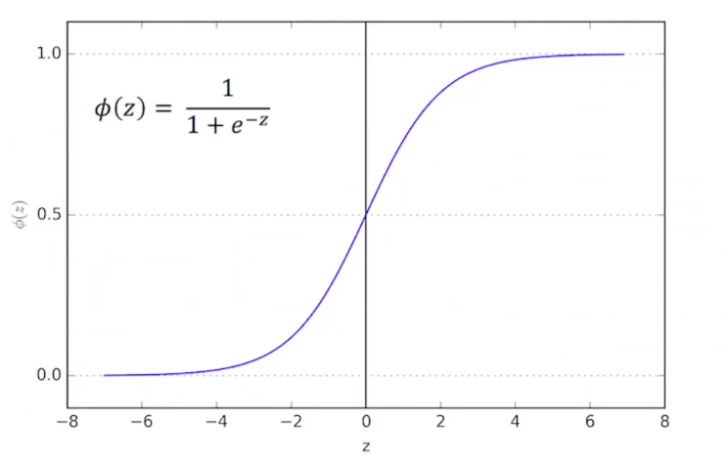
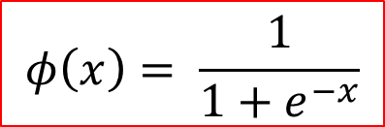
Logistic function
Another idea: Use the logistic function:
  Maps reals to the [0,1] range
  Mimics the step function
  In the class of sigmoid functions
$$φ\left(x\right)= \frac{1}{1+e^{−x}}$$
 | Restaurant 1 | Restaurant 2 | Restaurant 3
User 1 | 0.99 | 0.88 | 0.95
User 2 | 0.73 | 0.95 | 0.98
Problem: Too big values for all restaurants
 | Restaurant 1 | Restaurant 2 | Restaurant 3
User 1 | 5 | 2 | 3
User 2 | 1 | 3 | 4

Slide 111
Logistic function
Another idea: Use the logistic function:
  Maps reals to the [0,1] range
  Mimics the step function
  In the class of sigmoid functions
$$φ\left(x\right)= \frac{1}{1+e^{−x}}$$
 | Restaurant 1 | Restaurant 2 | Restaurant 3
User 1 | 0.84 | 0.20 | 0.42
User 2 | 0.16 | 0.58 | 0.79
Subtract the mean
Mean value gets 50-50 probability
 | Restaurant 1 | Restaurant 2 | Restaurant 3
User 1 | 1.67 | -1.33 | -0.33
User 2 | -1.67 | 0.33 | 1.33

Slide 112
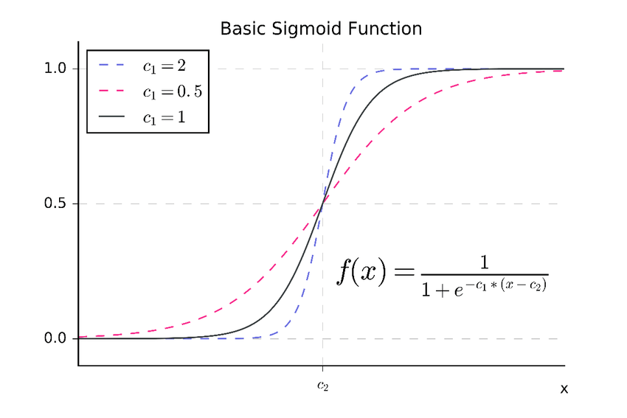
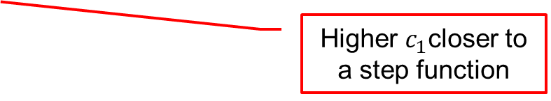
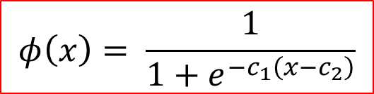
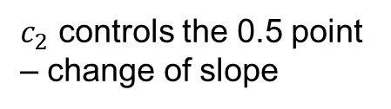
Sigmoid function
General sigmoid function:
  We can control the zero point and the slope
$$φ\left(x\right)= \frac{1}{1+e^{−c_{1}\left(x−c_{2}\right)}}$$
Higher $c_{1}$closer to a step function
$c_{2}$ controls the 0.5 point – change of slope

Slide 113
Logarithm function
Sometimes a data row/column may have a very wide range of values. Normalizing in this case will obliviate small values.
User id | Income
1 | 6000
2 | 6500
3 | 7000
4 | 4000
5 | 8000
6 | 9000
7 | 18000
8 | 36000
9 | 600000
10 | 1000000
Average = 170K

Slide 114
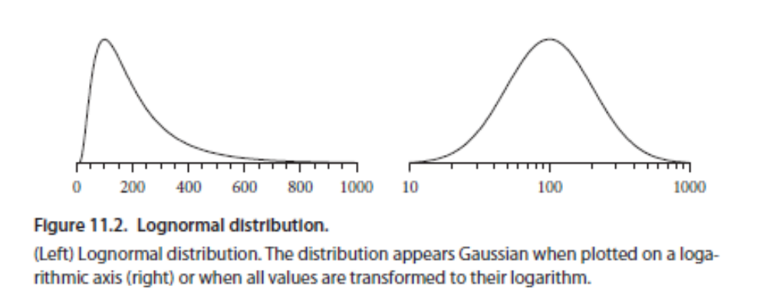
Logarithm function
We can bring the values to the same scale by applying a logarithm to the column values.
User id | Income | Log Income
1 | 6000 | 3.778151
2 | 6500 | 3.812913
3 | 7000 | 3.845098
4 | 4000 | 3.60206
5 | 8000 | 3.90309
6 | 9000 | 3.954243
7 | 18000 | 4.255273
8 | 36000 | 4.556303
9 | 600000 | 5.778151
10 | 1000000 | 6

Slide 115
Practical advices for pre-processing
Never delete raw data!
  It is usually painful to collect, so raw data is precious. Always keep a copy so you can go back and change the processing
Keep the output of intermediate steps
  Useful for making small changes at different points in the pipeline and not run everything from scratch
Carefully document the pre-processing steps
  The output you will get is for the specific pre-processing you have applied.
  For example, if you remove outliers, you lose any information they may carry
  If you throw out some parts of the data (e.g., reviews not in English) you now have a biased sample of your data, and this bias should be documented

Slide 116
POST-PROCESSING

Slide 117
The data mining pipeline
Data Collection
Data Preprocessing
Data Analysis
Result
Post-processing
Post-Processing: Make the data actionable and useful to the user
  Evaluation
  Visualization
  Statistical analysis of importance of results

Slide 118
Post-processing – Evaluation
Evaluation is big part of the data mining process.
It is part of the data analysis step, since we need to have some quality guarantees for the produced models.
Sometimes it can also take place at post-processing time, especially if we want to evaluate a model in practice/production

Slide 119
Evaluation in deployment
When a model is used and deployed in practice, we need to evaluate how it performs “in vivo”
  If the data we worked with are representative, we expect the model to perform as “in vitro”
  But real-life conditions can be unexpected.
A/B testing: The typical approach for testing models in practice. Typically applied for online applications.
  Some part of the traffic, chosen uniformly at random, is reserved for the test
  Some measurable quantity – metric – is monitored.
  The new model is compared against the existing model on this metric.
Labeled data may need to be collected for the additional evaluation

Slide 120
Evaluation beyond quality
Models are trained to optimize some metric of quality for the specific task
  E.g., accuracy of prediction for classification, coherence for clustering.
At post-processing time, we may want to evaluate against other metrics
Example: Fairness and bias
  A classification algorithm may be highly accurate but always make bad decisions for minorities.
  We want to understand the performance of the model against these metrics
  Go back and design models with additional requirements.
Again, additional labeled data may be required.

Slide 121
Post-processing – Visualization
The human eye is a powerful analytical tool
If we visualize the data properly, we can discover patterns and demonstrate trends
Visualization is the way to present the data so that patterns can be seen
  E.g., histograms and plots are a form of visualization
  There are multiple techniques (a field on its own)
Beyond analysis, visualization is a way for a data scientist to present their work
  Very important, otherwise the work is lost

Slide 122
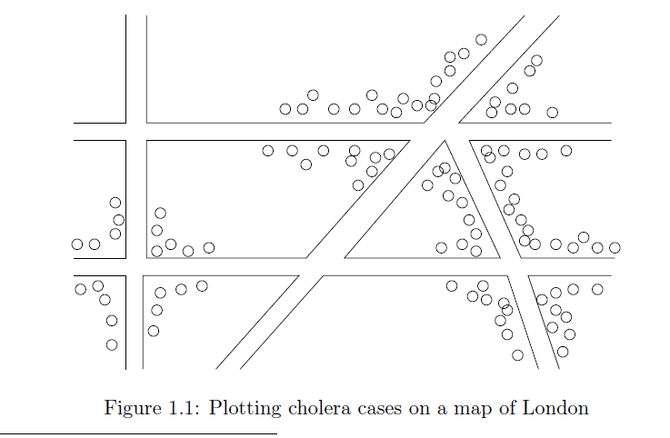
Visualization on a map
John Snow, London 1854

Slide 123
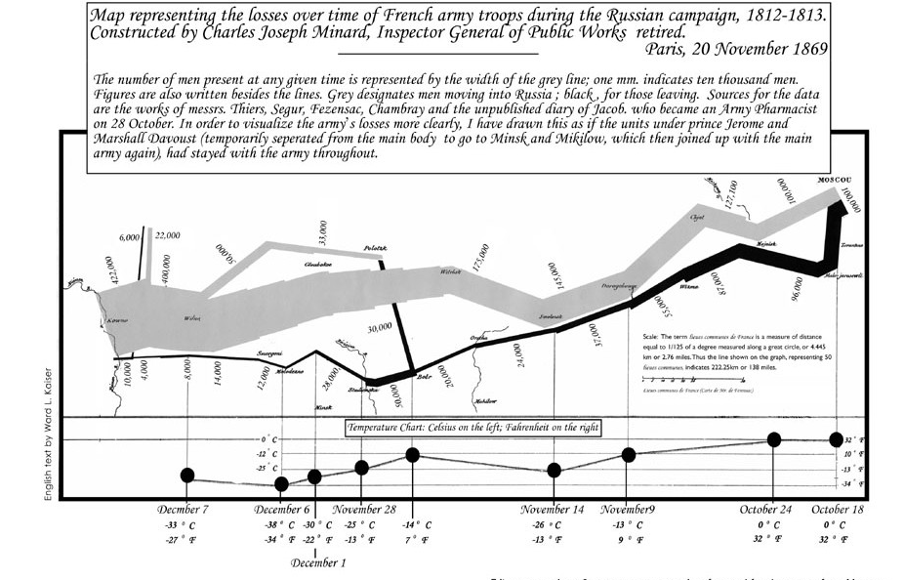
Charles Minard map
Six types of data in one plot: size of army, temperature, direction, location, dates etc

Slide 124
Another interesting visualization
China growth over the years
XKCD: Earth Temperature Over Time

Slide 125
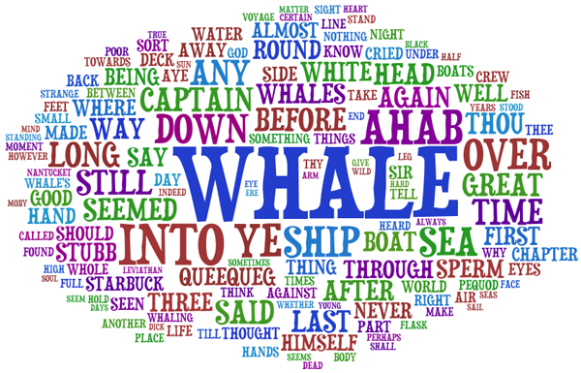
Word Clouds
A fancy way to visualize a document or collection of documents.

Slide 126
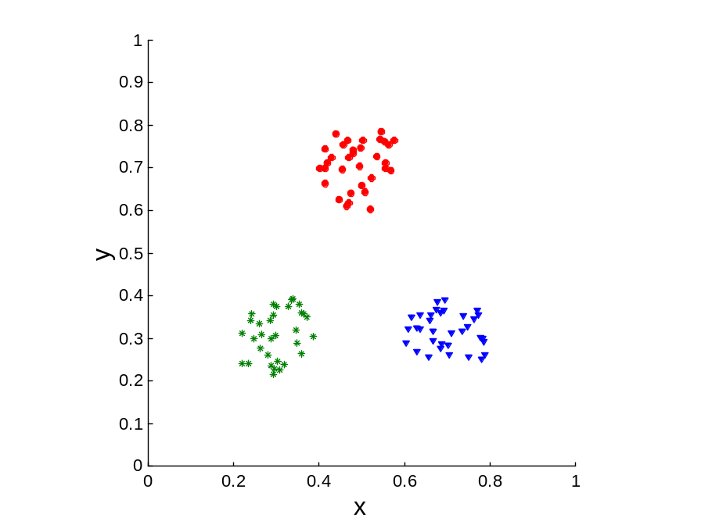
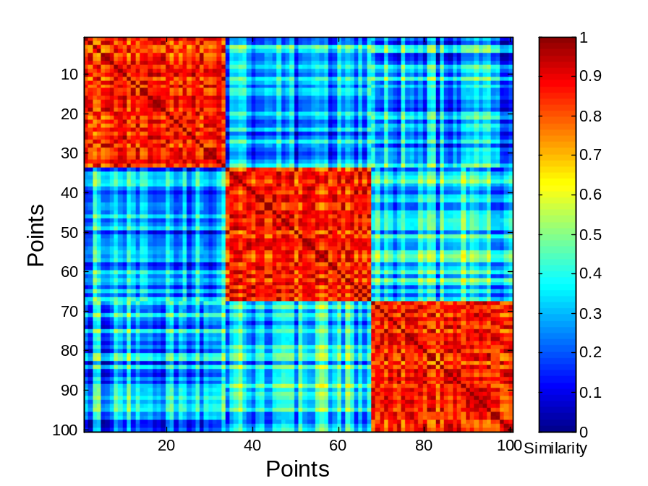
Heatmaps
Plot a point-to-point similarity matrix using a heatmap:
  Deep red = high values (hot)
  Dark blue = low values (cold)
The clustering structure becomes clear in the heatmap

Slide 127
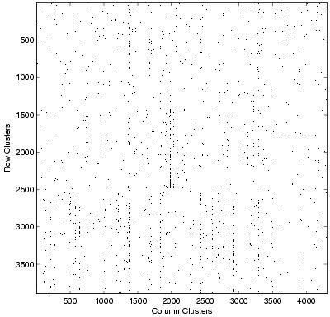
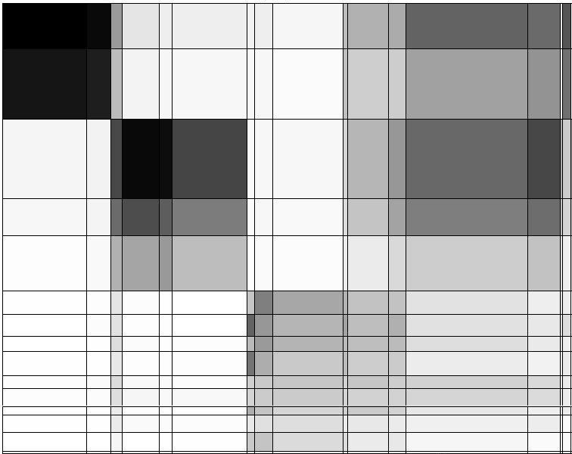
Heatmaps
Heatmap (grey scale) of the data matrix
  Document-word frequencies
Documents
Words
Before clustering
After clustering

Slide 128
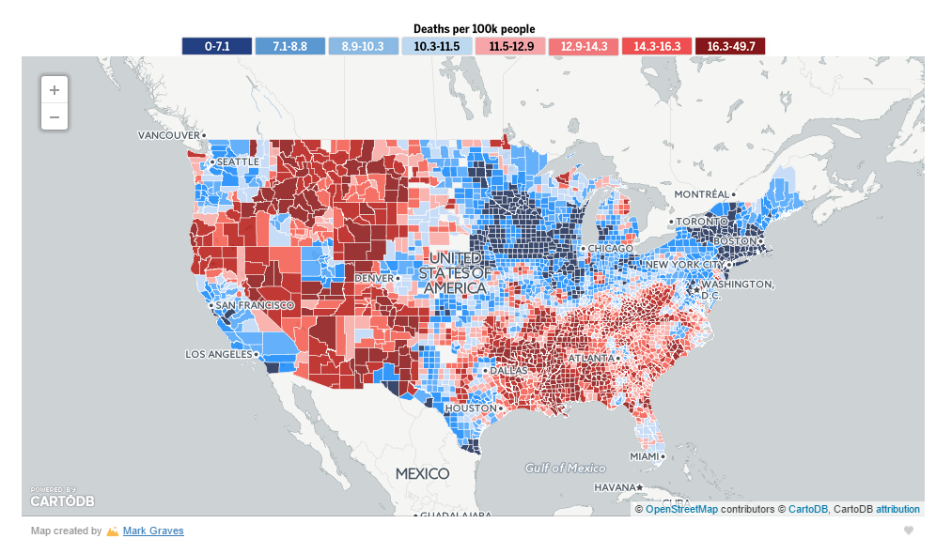
Heatmaps
A very popular way to visualize spatial data
http://projects.oregonlive.com/ucc-shooting/gun-deaths.php

Slide 129
Dimensionality Reduction
The human eye is limited to processing visualizations in two (at most three) dimensions
One of the great challenges in visualization is to visualize high-dimensional data into a two-dimensional space
We can use dimensionality reduction for this task
Similar to this are distance preserving embeddings

Slide 130


Example
$$D= \left[\begin{matrix}\begin{matrix}1 & 2 & 3 \\ 2 & 4 & 6 \\ 0 & 0 & 0\end{matrix} & \begin{matrix}0 & 0 & 0 \\ 0 & 0 & 0 \\ 1 & 2 & 3\end{matrix} \\ \begin{matrix}0 & 0 & 0 \\ 1 & 2 & 3 \\ 2 & 4 & 6\end{matrix} & \begin{matrix}2 & 4 & 6 \\ 1 & 2 & 3 \\ 2 & 4 & 6\end{matrix}\end{matrix}\right]$$
Each row is a multiple of two vectors
  $x=\left[1, 2, 3, 0, 0, 0\right]$
  $y=[0, 0, 0, 1, 2, 3]$
We can rewrite $D$ as
$$D= \left[\begin{matrix}\begin{matrix}1 & 0 \\ 2 & 0 \\ 0 & 1\end{matrix} \\ \begin{matrix}0 & 2 \\ 1 & 1 \\ 2 & 2\end{matrix}\end{matrix}\right]\left[\begin{matrix}1 & 2 & 3 \\ 0 & 0 & 0 \end{matrix} \begin{matrix}0 & 0 & 0 \\ 1 & 2 & 3\end{matrix}\right]$$
$$y=[0, 0, 0, 1, 2, 3]$$
$$x=\left[1, 2, 3, 0, 0, 0\right]$$
Three types of data points

Slide 131
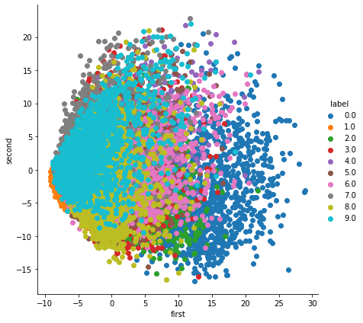

Non-linear dimensionality reduction
The idea in the previous dimensionality reduction, and visualization was to change the axes through linear transformations
There are also non-linear techniques for dimensionality reduction that lead to better visualization
t-SNE is considered the state-of-the-art
Non-linear Transformation
Linear Transformation

Slide 132
Post-processing – Statistical Significance
When we extract knowledge from a large dataset we need to make sure that what we found is not an artifact of randomness
  E.g., we find that many people buy milk and toilet paper together.
  But many (more) people buy milk and toilet paper independently
Statistical tests compare the results of an experiment with those generated by a null hypothesis
  E.g., a null hypothesis is that people select items independently.
A result is interesting if it cannot be produced by randomness.
  An important problem is to define the null hypothesis correctly: What is random?

Slide 133
Meaningfulness of Answers
A big data-mining risk is that you will “discover” patterns that are meaningless.
Statisticians call it Bonferroni’s principle: (roughly) if you look in more places for interesting patterns than your amount of data will support, you are bound to find crap.
The Rhine Paradox: a great example of how not to conduct scientific research.
  CS345A Data Mining on the Web: Anand Rajaraman, Jeff Ullman

Slide 134
Rhine Paradox – (1)
Joseph Rhine was a parapsychologist in the 1950’s who hypothesized that some people had Extra-Sensory Perception.
He devised (something like) an experiment where subjects were asked to guess 10 hidden cards – red or blue.
He discovered that almost 1 in 1000 had ESP – they were able to get all 10 right!
  CS345A Data Mining on the Web: Anand Rajaraman, Jeff Ullman

Slide 135
Rhine Paradox – (2)
He told these people they had ESP and called them in for another test of the same type.
Alas, he discovered that almost all of them had lost their ESP.
  Why?
What did he conclude?
  Answer on next slide.
  CS345A Data Mining on the Web: Anand Rajaraman, Jeff Ullman

Slide 136
Rhine Paradox – (3)
He concluded that you shouldn’t tell people they have ESP; it causes them to lose it.
  CS345A Data Mining on the Web: Anand Rajaraman, Jeff Ullman

