Slide 1
DATA MINING
Link Analysis Ranking
PageRank – Random walks
HITS

Slide 2
Network Science
A number of complex systems can be modeled as networks (graphs).
  The Web
  (Online) Social Networks
  Biological systems
  Communication networks (internet, email)
  The Economy
We cannot truly understand such complex systems unless we understand the underlying network.
  Everything is connected, studying individual entities gives only a partial view of a system
Data mining for networks is a very popular area
  Application to the Web is one of the success stories for network data mining.

Slide 3
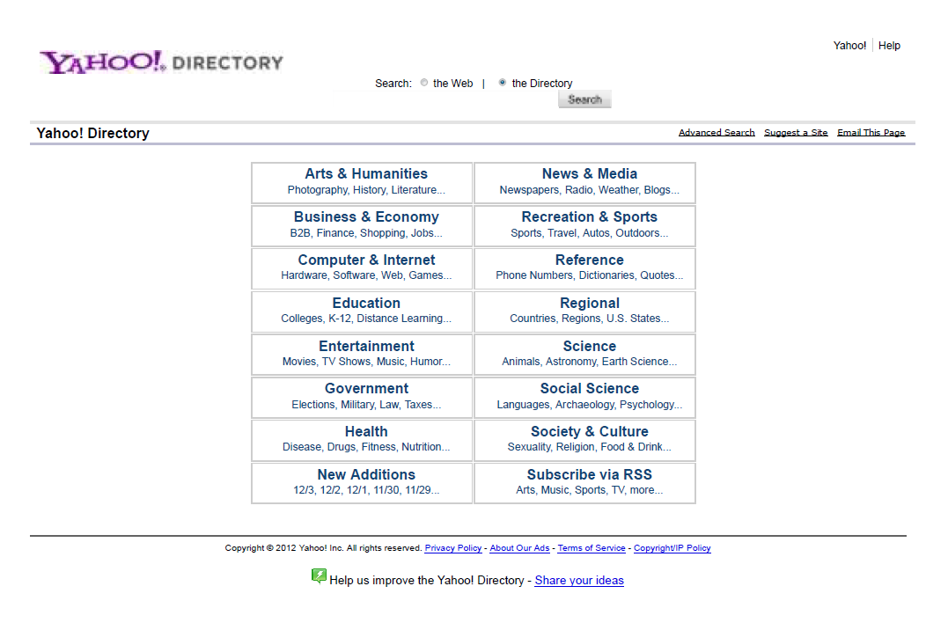
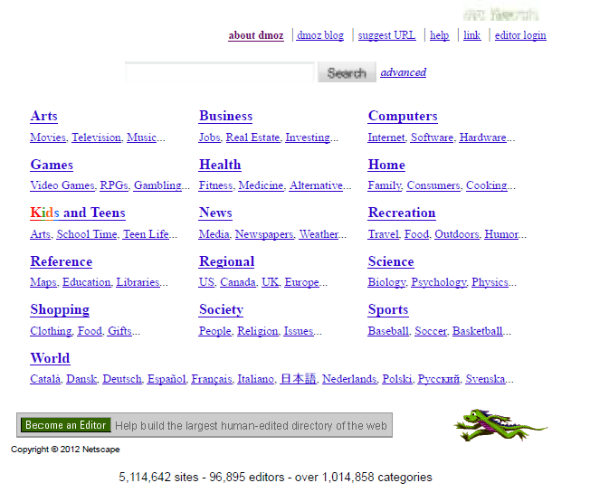
A case study: Searching the web
First try: Manually curated Web Directories

Slide 4
A case study: Searching the web
Second try: Web Search
  Information Retrieval investigates:
    Find relevant docs in a small and trusted set e.g., Newspaper articles, Patents, etc. (“needle-in-a-haystack”)
    Limitation of keywords (synonyms, polysemy, etc)
  But: Web is huge, full of untrusted documents, random things, web spam, etc.
    Everyone can create a web page of high production value
    Rich diversity of people issuing queries
    Dynamic and constantly-changing nature of web content

Slide 5
A case study: Searching the web
Third try (the Google era): using the web graph
  Sift from relevance to authoritativeness
  It is not only important that a page is relevant, but that it is also important on the web
For example, what kind of results would we like to get for the query “game of thrones”?

Slide 6
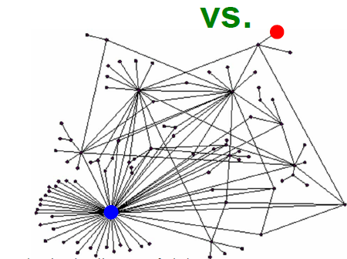
Link Analysis Ranking
Use the graph structure to determine the relative importance of the nodes
  Applications: Ranking on graphs (Web, Twitter, FB, etc)
Intuition: An edge from node p to node q denotes endorsement
  Node p endorses/recommends/confirms the authority/centrality/importance of node q
  Use the graph of recommendations to assign an authority value to every node
What is the simplest way to measure importance of a page on the web?

Slide 7





Rank by Popularity
Rank pages according to the number of incoming edges (in-degree, degree centrality)
$$v_{2}$$
Red Page
Yellow Page
Blue Page
Purple Page
Green Page
$$v_{1}$$
$$v_{3}$$
$$v_{5}$$
$$v_{4}$$

Slide 8
Popularity
It is not important only how many link to you, but how important are the people that link to you.
Good authorities are pointed by good authorities
  Recursive definition of importance

Slide 9
PageRank

Slide 10
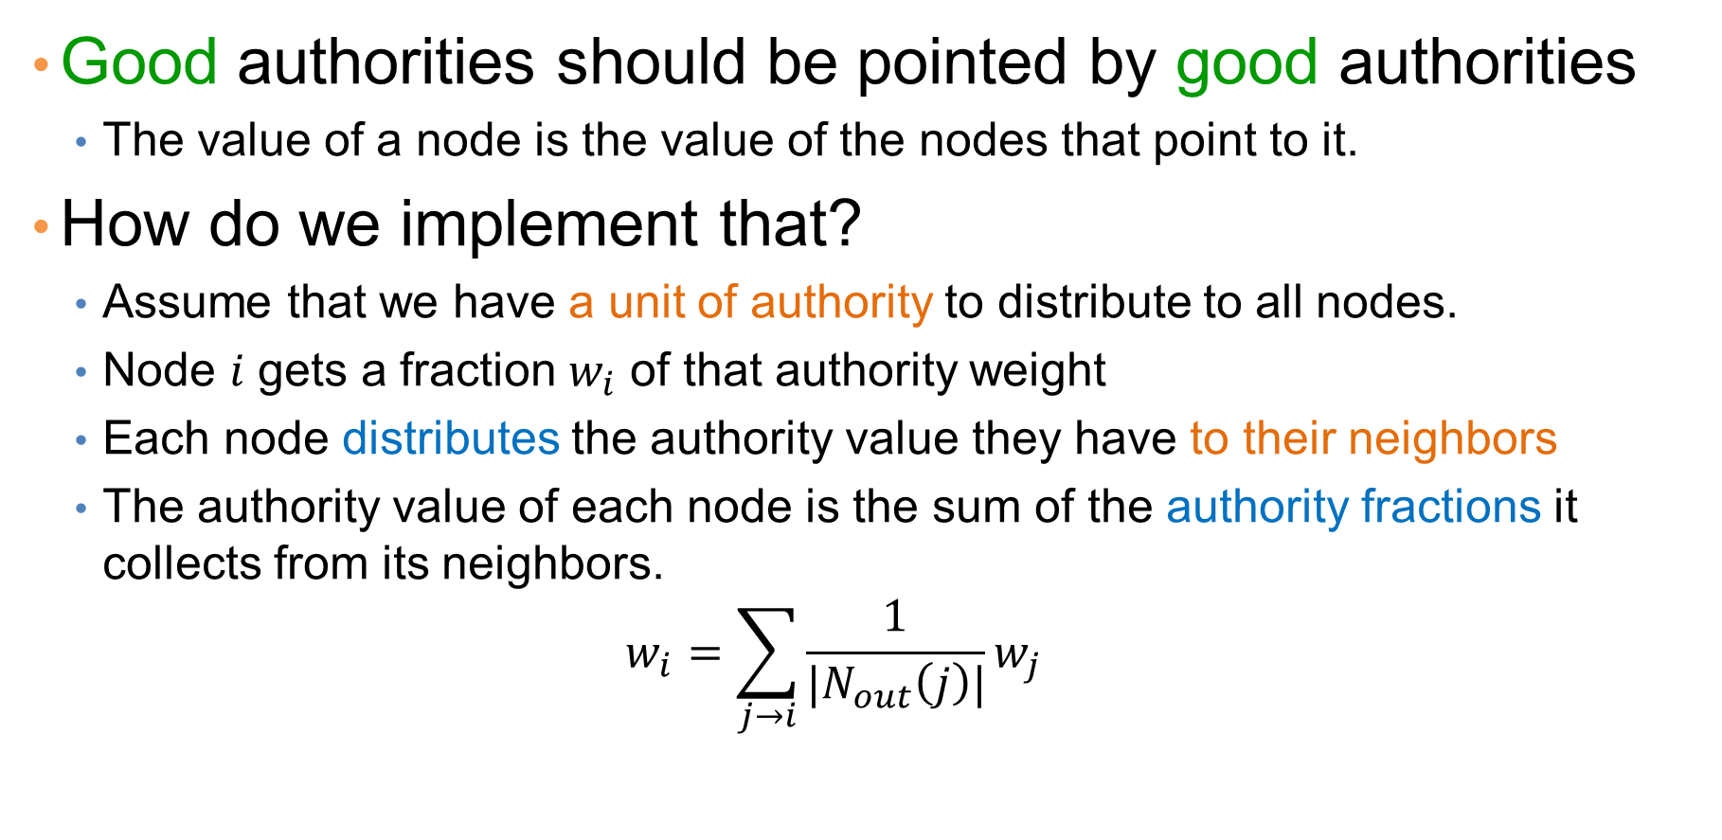
PageRank
Good authorities should be pointed by good authorities
  The value of a node is the value of the nodes that point to it.
How do we implement that?
  Assume that we have a unit of authority to distribute to all nodes.
  Node $i$ gets a fraction $w_{i}$ of that authority weight
  Each node distributes the authority value they have to their neighbors
  The authority value of each node is the sum of the authority fractions it collects from its neighbors.
  $$w_{i}=\sum_{j→i}{\frac{1}{|N_{out}\left(j\right)|}w_{j}}$$
Recursive definition

Slide 11

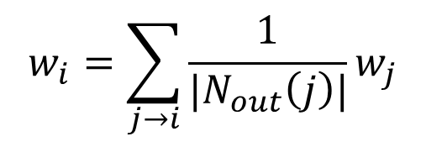




Example
$$w_{i}=\sum_{j→i}{\frac{1}{|N_{out}\left(j\right)|}w_{j}}$$
$$v_{2}$$
$$v_{1}$$
$$v_{3}$$
w₁ = 1/3 w₄ + 1/2 w₅
w₂ = 1/2 w₁ + w₃ + 1/3 w₄
w₃ = 1/2 w₁ + 1/3 w₄
w₄ = 1/2 w₅
w₅ = w₂
$$v_{5}$$
$$v_{4}$$
w₁ + w₂ + w₃ + w₄ + w₅ = 1
We can obtain the weights by solving this system of equations

Slide 12
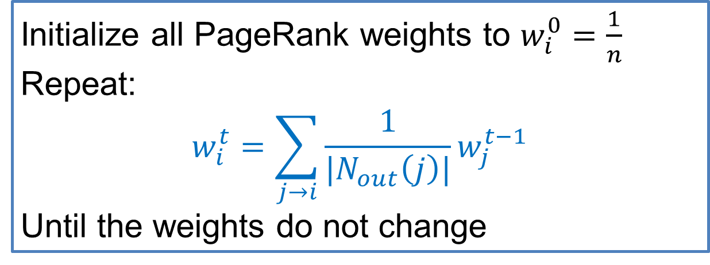
Computing PageRank weights
A simpler way to compute the weights is by iteratively updating the weights using the equations
PageRank Algorithm
This process converges
Initialize all PageRank weights to $w_{i}^{0}=\frac{1}{n}$
Repeat:
$$w_{i}^{t}=\sum_{j→i}{\frac{1}{|N_{out}\left(j\right)|}w_{j}^{t−1}}$$
Until the weights do not change

Slide 13
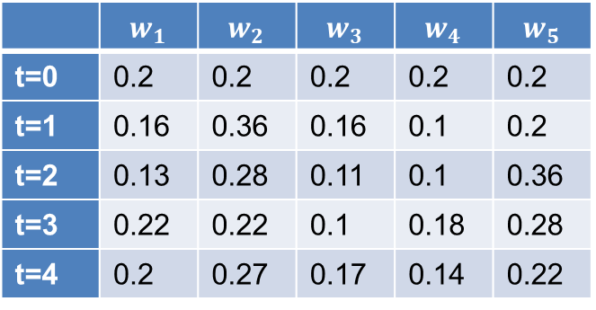
Example
w₁ = 1/3 w₄ + 1/2 w₅
$$v_{2}$$
w₂ = 1/2 w₁ + w₃ + 1/3 w₄
$$v_{1}$$
$$v_{3}$$
w₃ = 1/2 w₁ + 1/3 w₄
w₄ = 1/2 w₅
w₅ = w₂
 | $$w_{1}$$ | $$w_{2}$$ | $$w_{3}$$ | $$w_{4}$$ | $$w_{5}$$
t=0 | 0.2 | 0.2 | 0.2 | 0.2 | 0.2
t=1 | 0.16 | 0.36 | 0.16 | 0.1 | 0.2
t=2 | 0.13 | 0.28 | 0.11 | 0.1 | 0.36
t=3 | 0.22 | 0.22 | 0.1 | 0.18 | 0.28
t=4 | 0.2 | 0.27 | 0.17 | 0.14 | 0.22
$$v_{5}$$
$$v_{4}$$
Think of the weight as a fluid: there is constant amount of it in the graph, but it moves around until it stabilizes

Slide 14
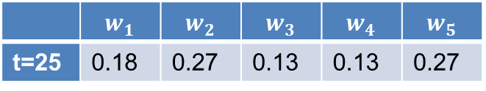
Example
w₁ = 1/3 w₄ + 1/2 w₅
$$v_{2}$$
w₂ = 1/2 w₁ + w₃ + 1/3 w₄
$$v_{1}$$
$$v_{3}$$
w₃ = 1/2 w₁ + 1/3 w₄
w₄ = 1/2 w₅
w₅ = w₂
$$v_{5}$$
$$v_{4}$$
 | $$w_{1}$$ | $$w_{2}$$ | $$w_{3}$$ | $$w_{4}$$ | $$w_{5}$$
t=25 | 0.18 | 0.27 | 0.13 | 0.13 | 0.27
Think of the weight as a fluid: there is constant amount of it in the graph, but it moves around until it stabilizes

Slide 15
The PageRank algorithm
Think of the nodes in the graph as containers of capacity of 1 liter.
We distribute a liter of liquid equally to all containers

Slide 16
The PageRank algorithm
The edges act like pipes that transfer liquid between nodes.

Slide 17
The PageRank algorithm
The edges act like pipes that transfer liquid between nodes.
The contents of each node are distributed to its neighbors.

Slide 18
The PageRank algorithm
The edges act like pipes that transfer liquid between nodes.
The contents of each node are distributed to its neighbors.

Slide 19
The PageRank algorithm
The edges act like pipes that transfer liquid between nodes.
The contents of each node are distributed to its neighbors.

Slide 20
The PageRank algorithm
The system will reach an equilibrium state where the amount of liquid in each node remains constant.

Slide 21
The PageRank algorithm
The amount of liquid in each node determines the importance of the node.
Large quantity means large incoming flow from nodes with large quantity of liquid.

Slide 22
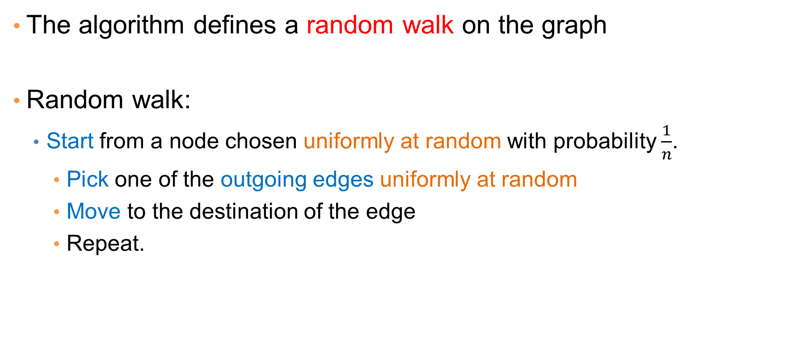
Random Walks on Graphs
The algorithm defines a random walk on the graph
Random walk:
  Start from a node chosen uniformly at random with probability $\frac{1}{n}$.
    Pick one of the outgoing edges uniformly at random
    Move to the destination of the edge
    Repeat.

Slide 23





Example
Step 0
$$v_{2}$$
$$v_{1}$$
$$v_{3}$$
$$v_{5}$$
$$v_{4}$$

Slide 24
Example
Step 0
$$v_{2}$$
$$v_{1}$$
$$v_{3}$$
$$v_{5}$$
$$v_{4}$$

Slide 25
Example
Step 1
$$v_{2}$$
$$v_{1}$$
$$v_{3}$$
$$v_{5}$$
$$v_{4}$$

Slide 26
Example
Step 1
$$v_{2}$$
$$v_{1}$$
$$v_{3}$$
$$v_{5}$$
$$v_{4}$$

Slide 27
Example
Step 2
$$v_{2}$$
$$v_{1}$$
$$v_{3}$$
$$v_{5}$$
$$v_{4}$$

Slide 28
Example
Step 2
$$v_{2}$$
$$v_{1}$$
$$v_{3}$$
$$v_{5}$$
$$v_{4}$$

Slide 29
Example
Step 3
$$v_{2}$$
$$v_{1}$$
$$v_{3}$$
$$v_{5}$$
$$v_{4}$$

Slide 30
Example
Step 3
$$v_{2}$$
$$v_{1}$$
$$v_{3}$$
$$v_{5}$$
$$v_{4}$$

Slide 31
Example
Step 4…
$$v_{2}$$
$$v_{1}$$
$$v_{3}$$
$$v_{5}$$
$$v_{4}$$

Slide 32
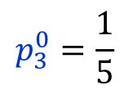
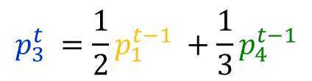
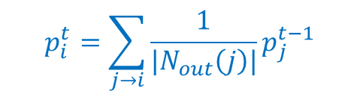


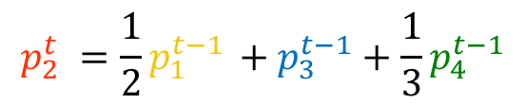
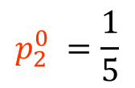
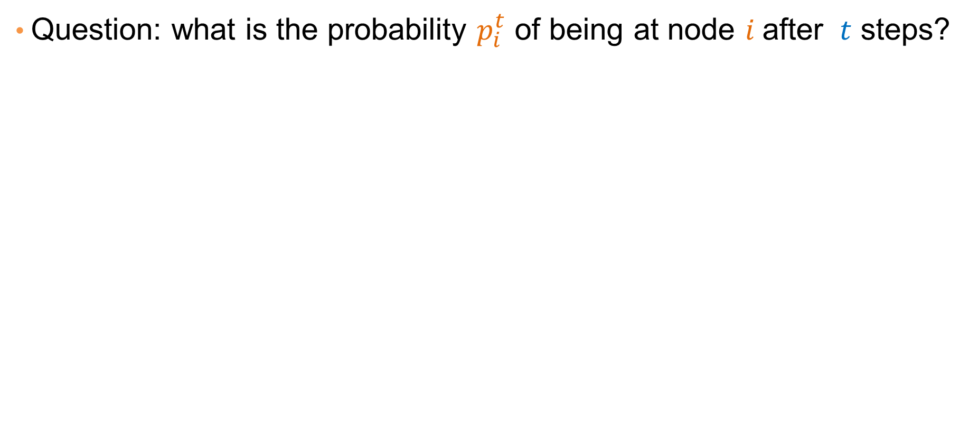
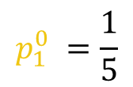

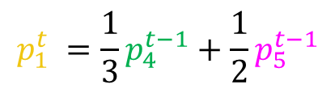


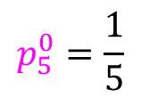

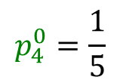
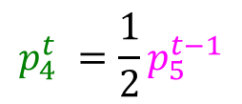
Random walk
Question: what is the probability $p_{i}^{t}$ of being at node $i$after $t$ steps?
$$v_{2}$$
$$p_{1}^{0} =\frac{1}{5}$$
$$p_{1}^{t} =\frac{1}{3}p_{4}^{t−1}+\frac{1}{2}p_{5}^{t−1}$$
$$v_{1}$$
$$v_{3}$$
$$p_{2}^{0} =\frac{1}{5}$$
$$p_{2}^{t} =\frac{1}{2}p_{1}^{t−1} +p_{3}^{t−1}+\frac{1}{3}p_{4}^{t−1}$$
$$p_{3}^{0}=\frac{1}{5}$$
$$p_{3}^{t} =\frac{1}{2}p_{1}^{t−1} +\frac{1}{3}p_{4}^{t−1}$$
$$p_{4}^{0}=\frac{1}{5}$$
$$p_{4}^{t} =\frac{1}{2}p_{5}^{t−1}$$
$$v_{5}$$
$$v_{4}$$
$$p_{5}^{0}=\frac{1}{5}$$
$$p_{5}^{t} = p_{2}^{t−1}$$
$$p_{i}^{t}=\sum_{j→i}{\frac{1}{|N_{out}\left(j\right)|}p_{j}^{t−1}}$$
The equations are the same as those for the PageRank iterative computation

Slide 33
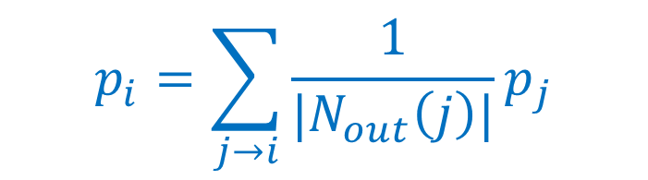
Random walk
At convergence:
$$v_{2}$$
$$v_{1}$$
$$p_{i}=\sum_{j→i}{\frac{1}{|N_{out}\left(j\right)|}p_{j}}$$
$$v_{3}$$
We get the same equation as for PageRank
$$v_{5}$$
$$v_{4}$$
The PageRank of node $i$ is the probability that the random walk is at node $i$ after a very large (infinite) number of steps

Slide 34
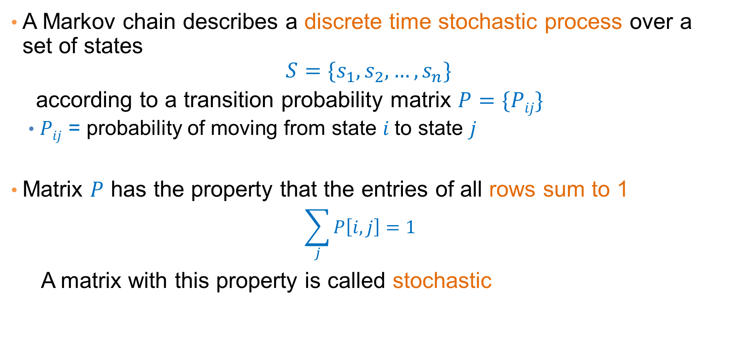
Markov chains
A Markov chain describes a discrete time stochastic process over a set of states
$$S=\{s_{1}, s_{2},…, s_{n}\}$$
according to a transition probability matrix $P=\{Pij\}$
  $Pij$ = probability of moving from state $i$to state $j$
Matrix $P$ has the property that the entries of all rows sum to 1
  $$\sum_{j}{P\left[i,j\right]=1}$$
A matrix with this property is called stochastic

Slide 35
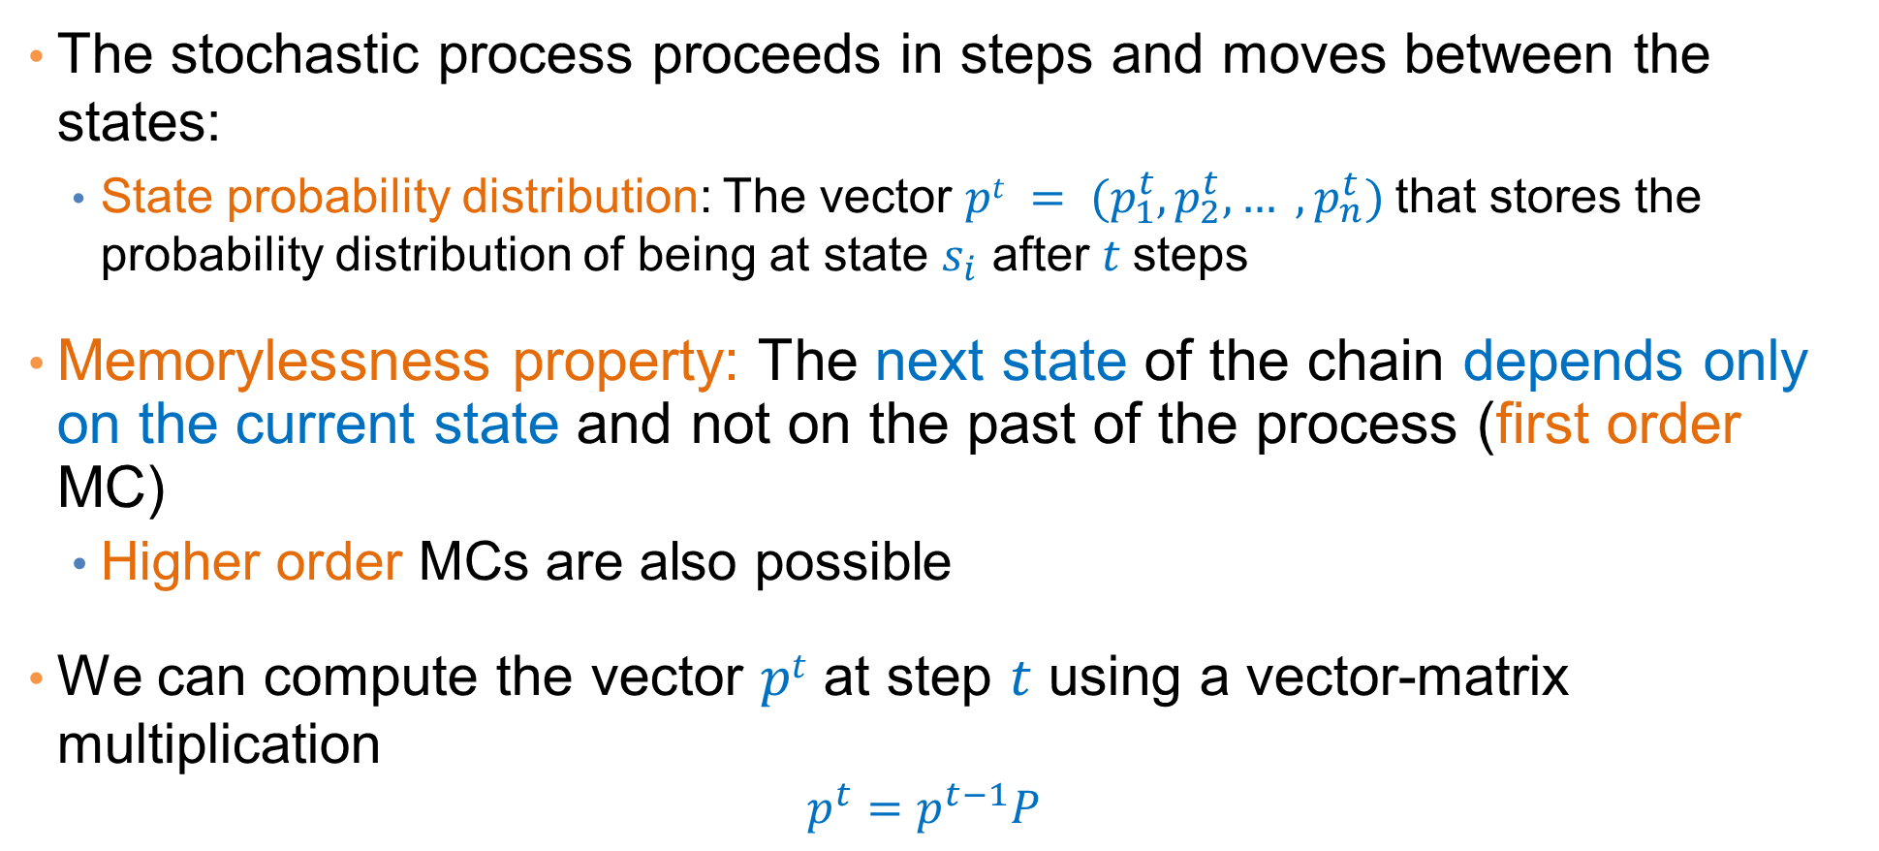
Markov chains
The stochastic process proceeds in steps and moves between the states:
  State probability distribution: The vector $pt = (p_{1}^{t},p_{2}^{t}, … ,p_{n}^{t})$that stores the probability distribution of being at state $s_{i}$ after $t$ steps
Memorylessness property: The next state of the chain depends only on the current state and not on the past of the process (first order MC)
  Higher order MCs are also possible
We can compute the vector $pt$ at step $t$ using a vector-matrix multiplication
  $$p^{t}=p^{t−1}P$$

Slide 36
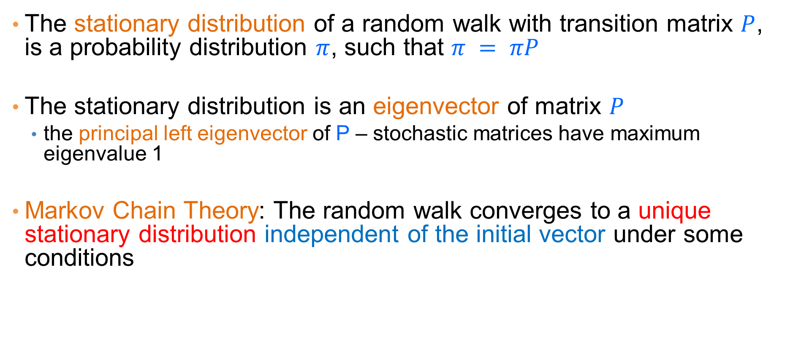
Stationary distribution
The stationary distribution of a random walk with transition matrix $P$, is a probability distribution $π$, such that $π = πP$
The stationary distribution is an eigenvector of matrix $P$
  the principal left eigenvector of P – stochastic matrices have maximum eigenvalue 1
Markov Chain Theory: The random walk converges to a unique stationary distribution independent of the initial vector under some conditions

Slide 37
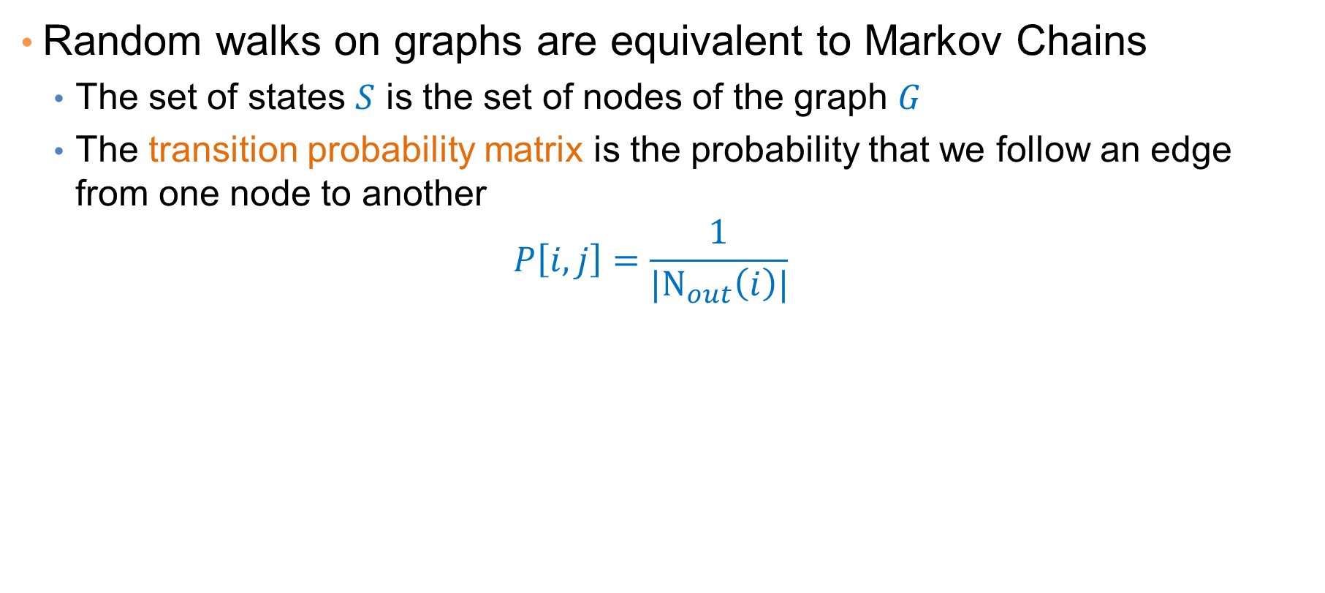
Random walks
Random walks on graphs are equivalent to Markov Chains
  The set of states $S$ is the set of nodes of the graph $G$
  The transition probability matrix is the probability that we follow an edge from one node to another
  $$P\left[i,j\right]=\frac{1}{{|N}_{out}\left(i\right)|}$$

Slide 38
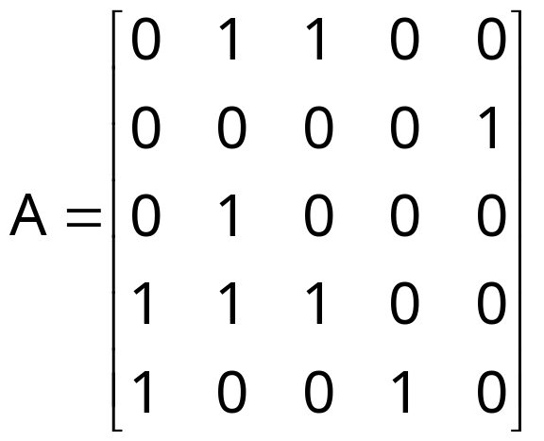
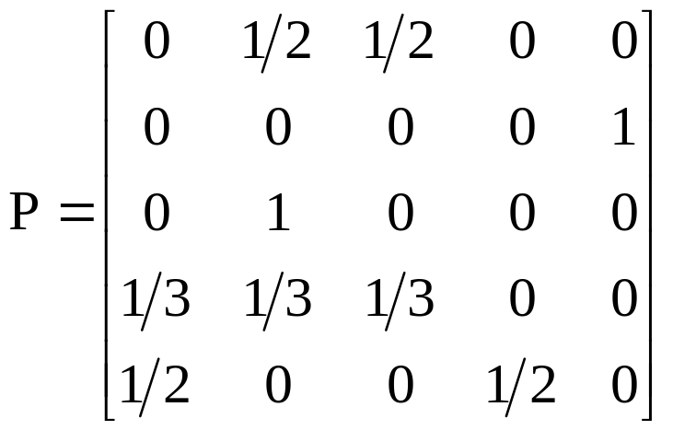





The Pagerank random walk and Markov Chain
$$v_{2}$$
$$v_{1}$$
$$v_{3}$$
$$v_{5}$$
$$v_{4}$$

Slide 39

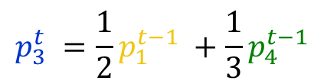
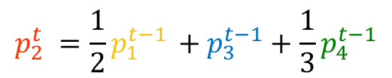

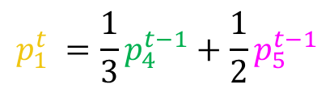


The Pagerank random walk and Markov Chain
$$v_{2}$$
$$v_{1}$$
$$v_{3}$$
$$p_{1}^{t} =\frac{1}{3}p_{4}^{t−1}+\frac{1}{2}p_{5}^{t−1}$$
$$p_{2}^{t} =\frac{1}{2}p_{1}^{t−1} +p_{3}^{t−1}+\frac{1}{3}p_{4}^{t−1}$$
$$v_{5}$$
$$v_{4}$$
$$p_{3}^{t} =\frac{1}{2}p_{1}^{t−1} +\frac{1}{3}p_{4}^{t−1}$$
$$p_{4}^{t} =\frac{1}{2}p_{5}^{t−1}$$
$$p^{t}=p^{t−1}P$$
$$p_{5}^{t} = p_{2}^{t−1}$$

Slide 40
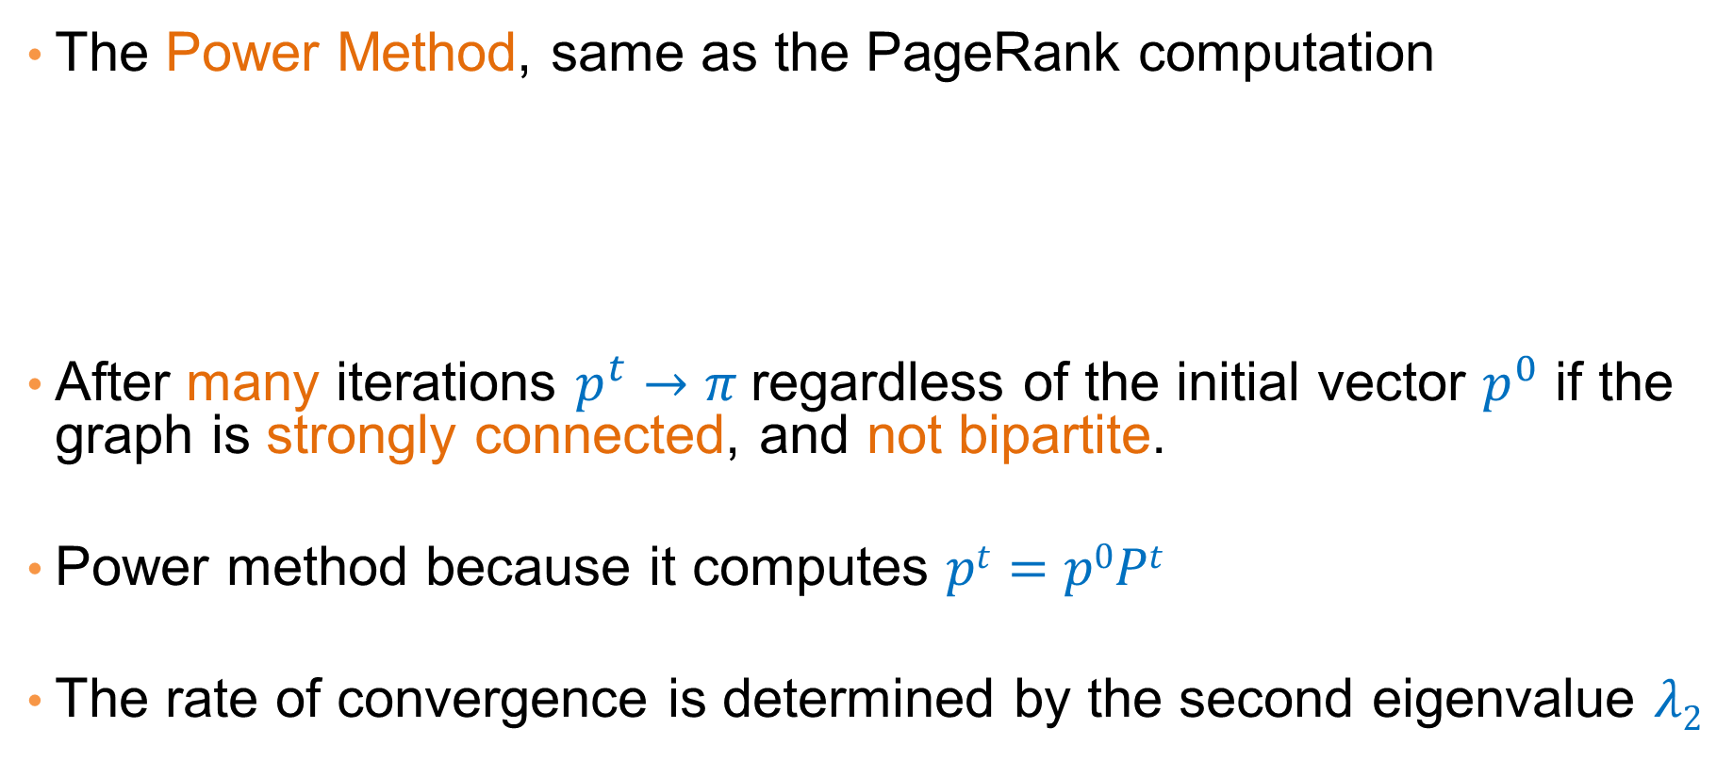
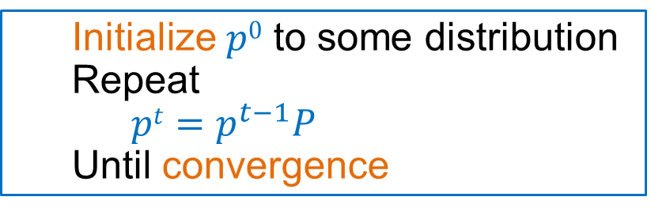
Computing the stationary distribution
The Power Method, same as the PageRank computation
After many iterations $p^{t}→π$regardless of the initial vector $p^{0}$ if the graph is strongly connected, and not bipartite.
Power method because it computes $pt=p0Pt$
The rate of convergence is determined by the second eigenvalue $λ2$
  Initialize $p0$ to some distribution
  Repeat
  $pt=p^{t−1}P$
  Until convergence

Slide 41
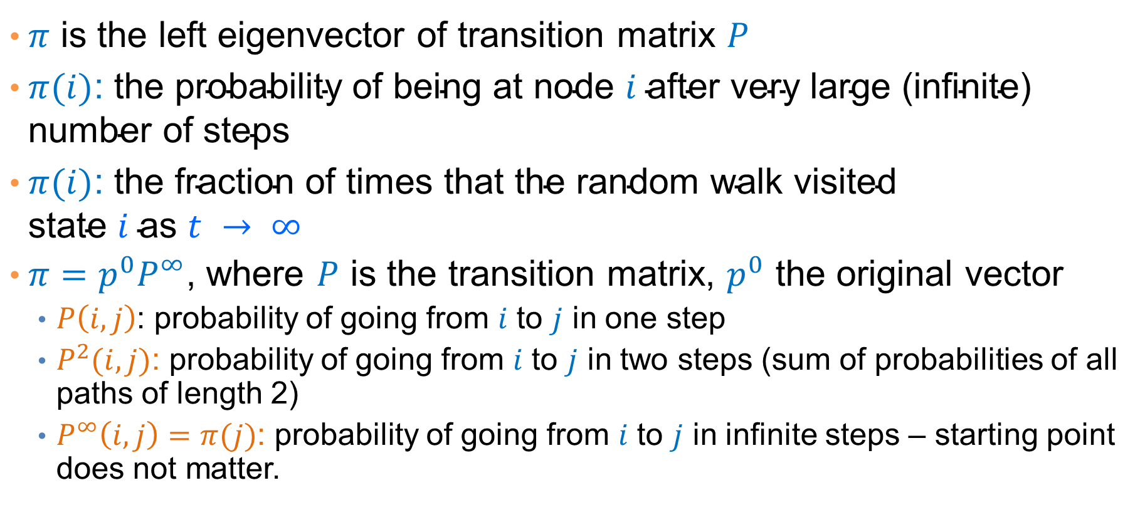
The stationary distribution
$π$ is the left eigenvector of transition matrix $P$
$π(i)\text{: }\text{the} \text{probability} \text{of} \text{being} \text{at} \text{node} i \text{after} \text{very} \text{large}\text{ (}\text{infinite}\text{) }\text{number} \text{of} \text{steps}$
$π(i)\text{: }\text{the} \text{fraction} \text{of} \text{times} \text{that} \text{the} \text{random} \text{walk} \text{visited} \text{state} i \text{as} t → ∞$
$π=p^{0}P^{∞}$, where $P$ is the transition matrix, $p^{0}$ the original vector
  $P\left(i,j\right)$: probability of going from $i$ to $j$ in one step
  $P^{2}(i,j)$: probability of going from $i$ to $j$ in two steps (sum of probabilities of all paths of length 2)
  $P^{∞}\left(i,j\right)=π(j)$: probability of going from $i$ to $j$ in infinite steps – starting point does not matter.

Slide 42
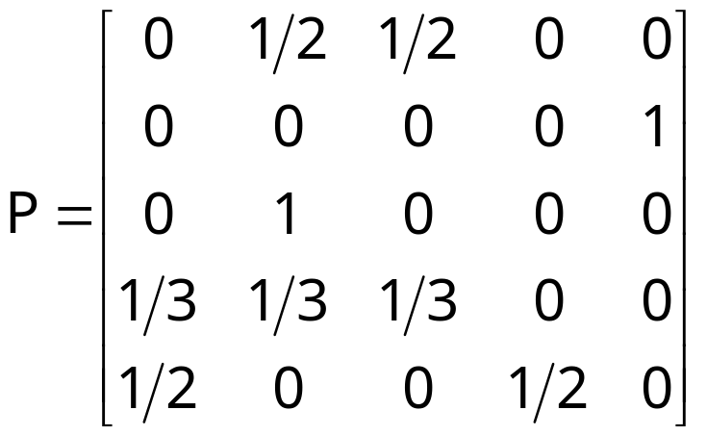
The PageRank random walk
Vanilla random walk
  make the adjacency matrix stochastic and run a random walk

Slide 43
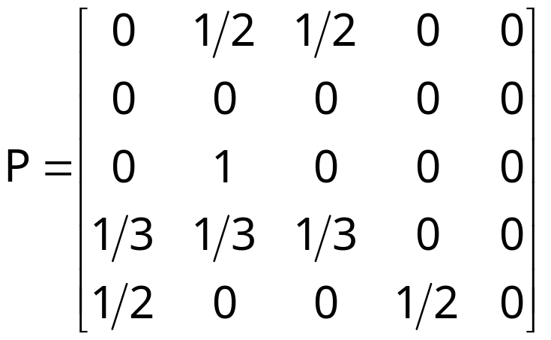
The PageRank random walk
What about sink nodes?
  what happens when the random walk moves to a node without any outgoing inks?

Slide 44
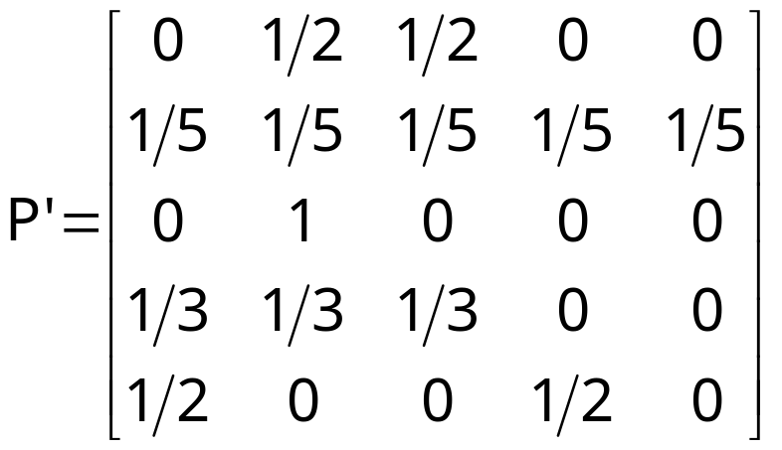
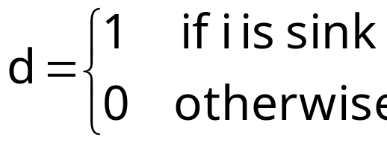

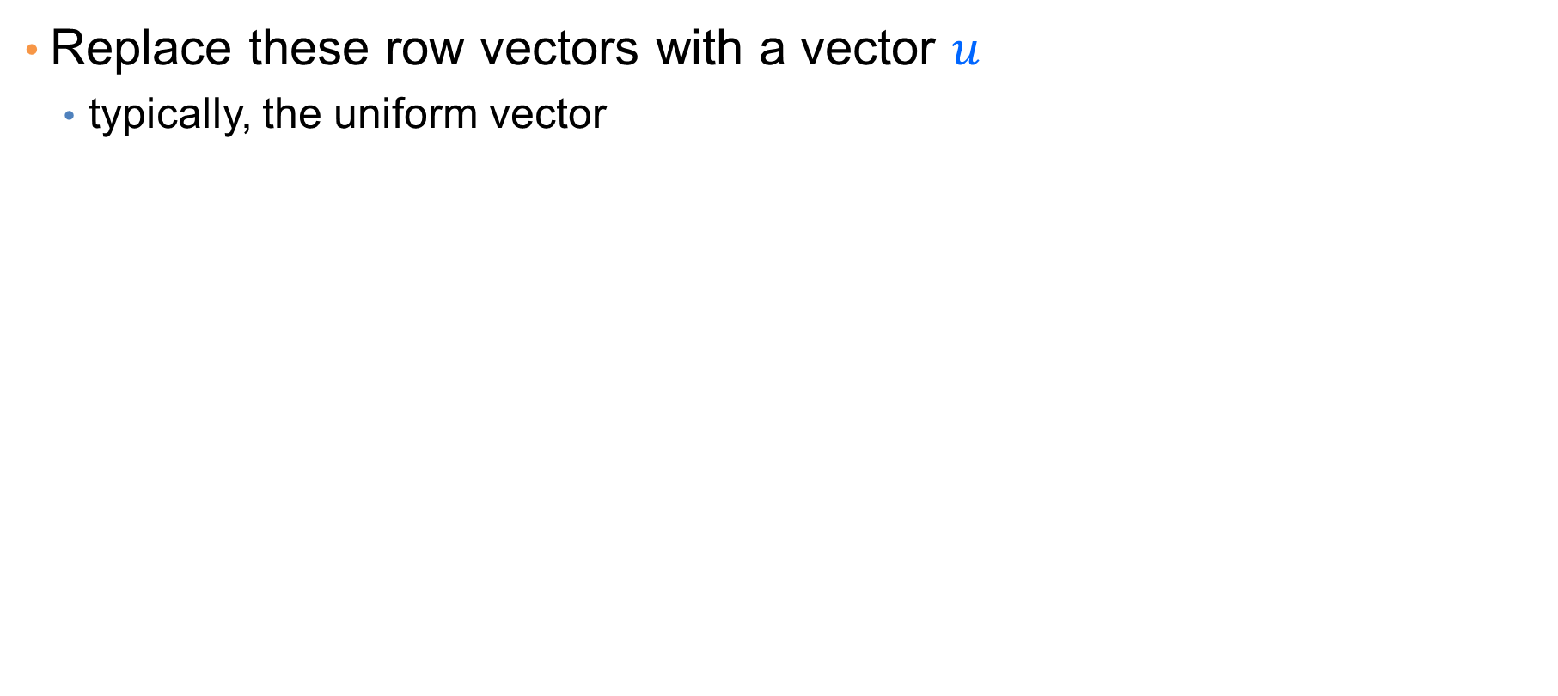
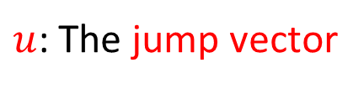
The PageRank random walk
Replace these row vectors with a vector $u$
  typically, the uniform vector
Outer product
$$P’ = P + duT$$
$u$: The jump vector

Slide 45
The PageRank random walk
What about loops?
  Spider traps

Slide 46
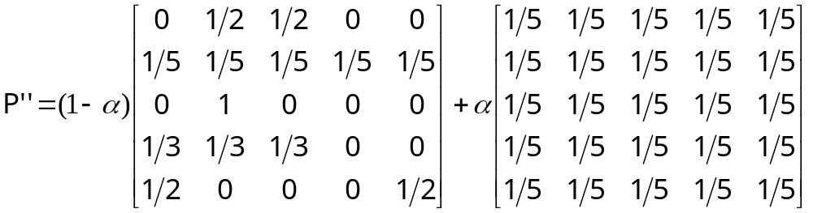

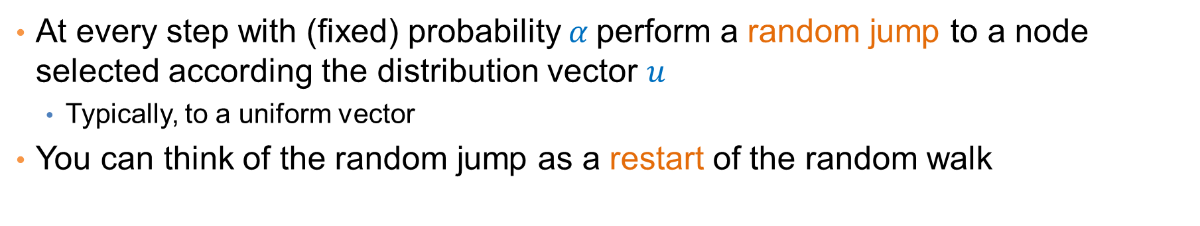
The PageRank random walk
At every step with (fixed) probability $α$perform a random jump to a node selected according the distribution vector $u$
  Typically, to a uniform vector
You can think of the random jump as a restart of the random walk
$P′′ = (1−α)P′ + α1uT$, where 1 is the vector of all 1s
$a:$jump/restart probability
Random walk with restarts

Slide 47
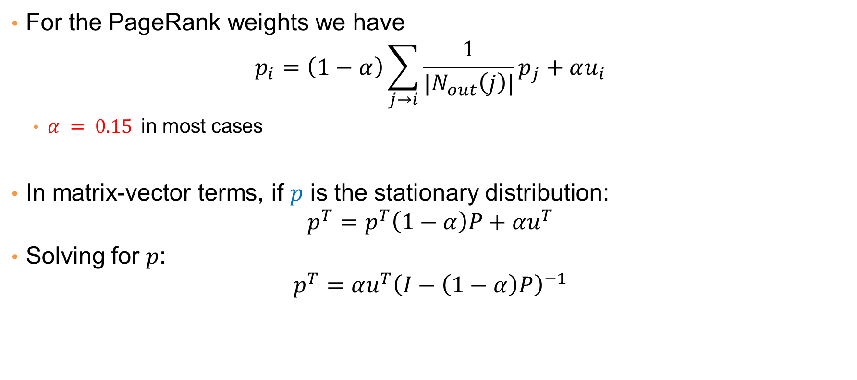
The PageRank weights
For the PageRank weights we have
$$p_{i}=\left(1−α\right)\sum_{j→i}{\frac{1}{{|N}_{out}\left(j\right)|}p_{j}}+αu_{i}$$
  $α = 0.15$in most cases
In matrix-vector terms, if $p$ is the stationary distribution:
$$p^{T}=p^{T}\left(1−α\right)P+αu^{T}$$
Solving for $p$:
$$p^{T}=αu^{T}{\left(I−\left(1−α\right)P\right)}^{−1}$$

Slide 48
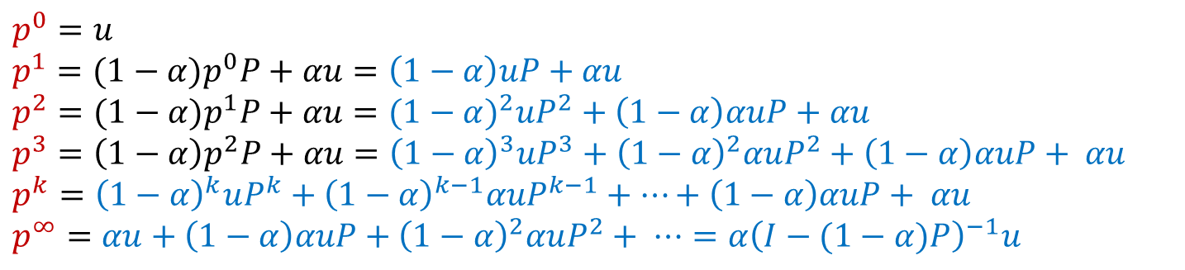
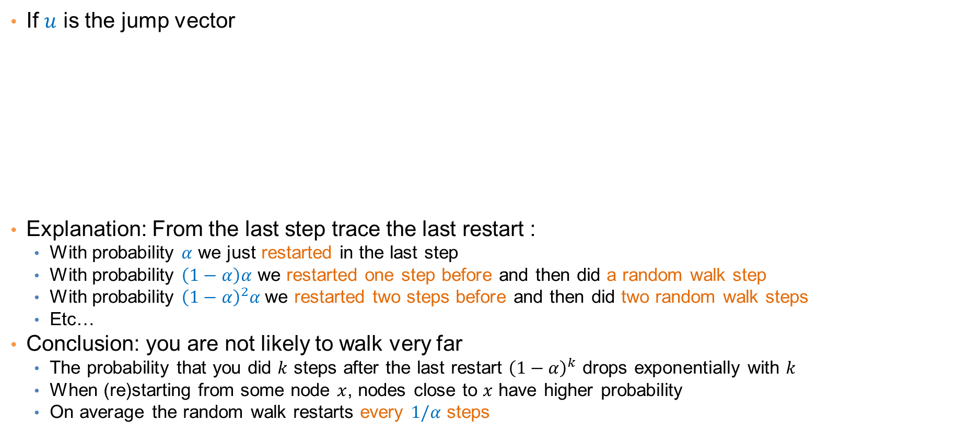
Stationary distribution with random jump
If $u$ is the jump vector
Explanation: From the last step trace the last restart :
  With probability $α$ we just restarted in the last step
  With probability $\left(1−α\right)α$ we restarted one step before and then did a random walk step
  With probability ${\left(1−α\right)}^{2}α$we restarted two steps before and then did two random walk steps
  Etc…
Conclusion: you are not likely to walk very far
  The probability that you did $k$ steps after the last restart ${\left(1−α\right)}^{k}$ drops exponentially with $k$
  When (re)starting from some node $x$, nodes close to $x$ have higher probability
  On average the random walk restarts every $1/α$ steps
$p^{0}=u$
$p^{1}=(1−α)p^{0}P+αu=\left(1−α\right)uP+αu$
$p^{2}=(1−α)p^{1}P+αu={(1−α)}^{2}uP^{2}+\left(1−α\right)αuP+αu$
$p^{3}=\left(1−α\right)p^{2}P+αu={\left(1−α\right)}^{3}uP^{3}+{\left(1−α\right)}^{2}αuP^{2}+\left(1−α\right)αuP+ αu$
$$p^{k}={\left(1−α\right)}^{k}uP^{k}+{\left(1−α\right)}^{k−1}αuP^{k−1}+⋯+\left(1−α\right)αuP+ αu$$
$p^{∞}=αu+\left(1−α\right)αuP+{\left(1−α\right)}^{2}αuP^{2}+ ⋯=α{\left(I−(1−α)P\right)}^{−1}u$

Slide 49
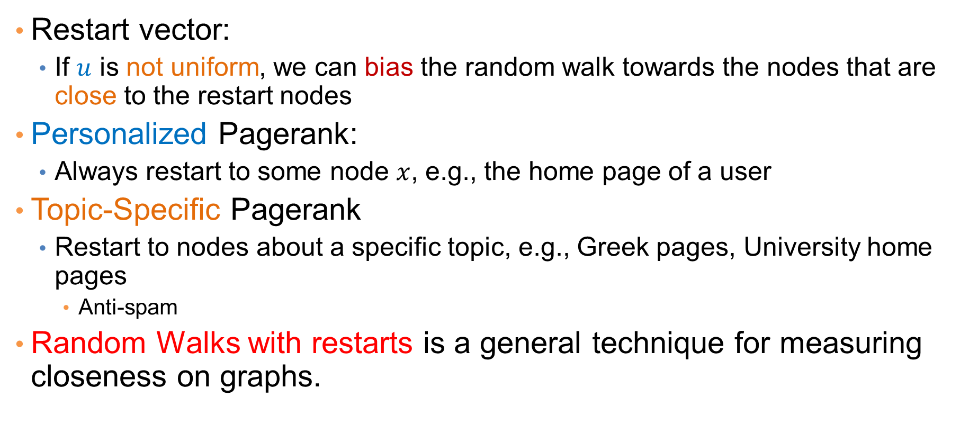
Random walks with restarts
Restart vector:
  If $u$ is not uniform, we can bias the random walk towards the nodes that are close to the restart nodes
Personalized Pagerank:
  Always restart to some node $x$, e.g., the home page of a user
Topic-Specific Pagerank
  Restart to nodes about a specific topic, e.g., Greek pages, University home pages
    Anti-spam
Random Walks with restarts is a general technique for measuring closeness on graphs.

Slide 50
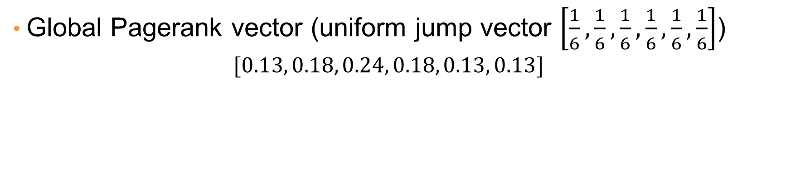
Personalized Pagerank Example
2
4
1
6
3
5
Global Pagerank vector (uniform jump vector $\left[\frac{1}{6},\frac{1}{6},\frac{1}{6},\frac{1}{6},\frac{1}{6},\frac{1}{6}\right]$)
  $$[0.13, 0.18, 0.24, 0.18, 0.13, 0.13]$$

Slide 51
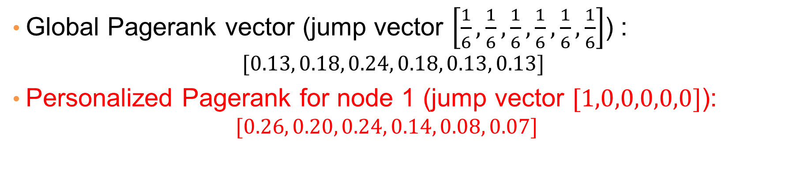
Personalized Pagerank Example
2
4
1
6
3
5
Global Pagerank vector (jump vector $\left[\frac{1}{6},\frac{1}{6},\frac{1}{6},\frac{1}{6},\frac{1}{6},\frac{1}{6}\right]$) :
  $$[0.13, 0.18, 0.24, 0.18, 0.13, 0.13]$$
Personalized Pagerank for node 1 (jump vector $[1,0,0,0,0,0]$):
  $$[0.26, 0.20, 0.24, 0.14, 0.08, 0.07]$$

Slide 52
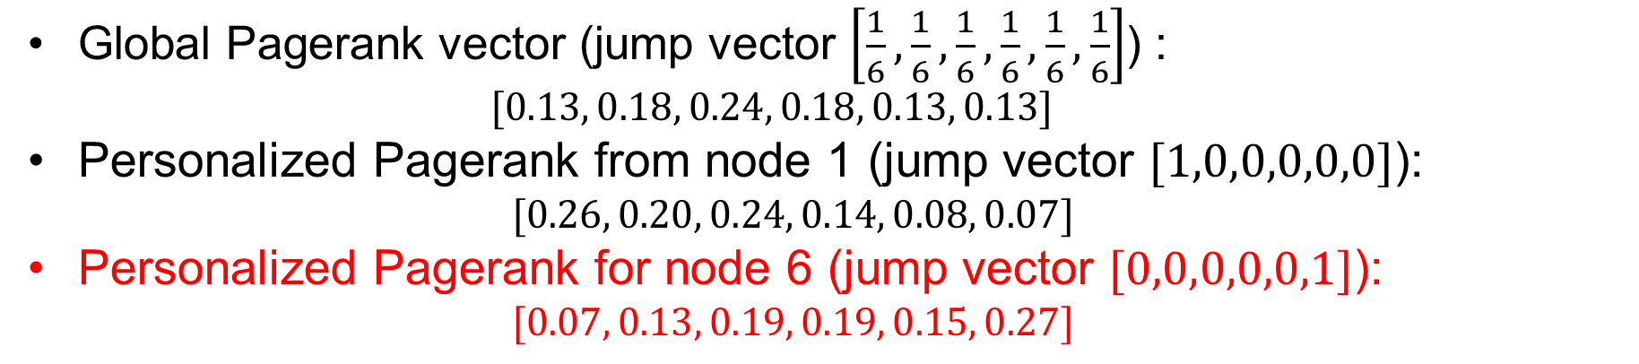
Personalized Pagerank Example
2
4
1
6
3
5
Global Pagerank vector (jump vector $\left[\frac{1}{6},\frac{1}{6},\frac{1}{6},\frac{1}{6},\frac{1}{6},\frac{1}{6}\right]$) :
  $$[0.13, 0.18, 0.24, 0.18, 0.13, 0.13]$$
Personalized Pagerank from node 1 (jump vector $[1,0,0,0,0,0]$):
  $$[0.26, 0.20, 0.24, 0.14, 0.08, 0.07]$$
Personalized Pagerank for node 6 (jump vector $[0,0,0,0,0,1]$):
  $$[0.07, 0.13, 0.19, 0.19, 0.15, 0.27]$$

Slide 53
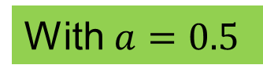
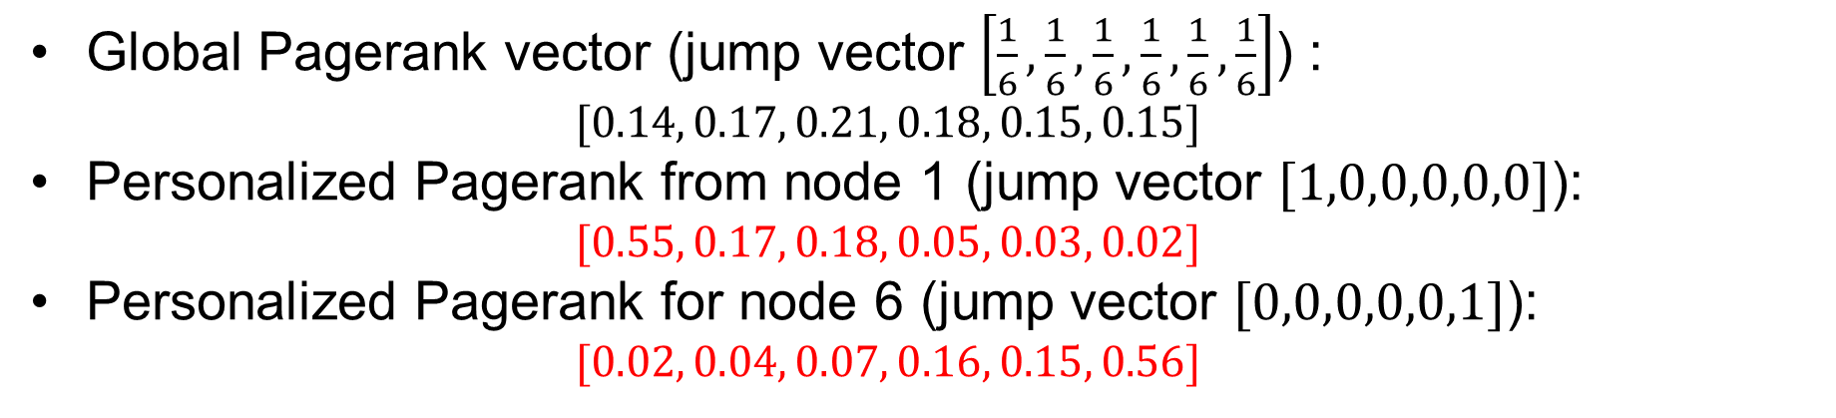
Personalized Pagerank Example
2
4
1
6
With $a=0.5$
3
5
Global Pagerank vector (jump vector $\left[\frac{1}{6},\frac{1}{6},\frac{1}{6},\frac{1}{6},\frac{1}{6},\frac{1}{6}\right]$) :
  $$[0.14, 0.17, 0.21, 0.18, 0.15, 0.15]$$
Personalized Pagerank from node 1 (jump vector $[1,0,0,0,0,0]$):
  $$[0.55, 0.17, 0.18, 0.05, 0.03, 0.02]$$
Personalized Pagerank for node 6 (jump vector $[0,0,0,0,0,1]$):
  $$[0.02, 0.04, 0.07, 0.16, 0.15, 0.56]$$

Slide 54

Random walks on undirected graphs
For undirected graphs, the stationary distribution is proportional to the degrees of the nodes
$$π\left(i\right)= \frac{d_{i}}{2m}$$
  In this case a random walk is the same as degree popularity
This is no longer true if we do random jumps
  Now the short paths play a greater role, and the previous distribution does not hold.
  Random walks with restarts to a single node are commonly used on undirected graphs for measuring similarity between nodes

Slide 55

Pagerank implementation
Store the graph in adjacency list, or list of edges
Keep current pagerank values and new pagerank values
Go through edges and update the values of the destination nodes.
Repeat until the difference ($L_{1}$ or $L_{∞}$ difference) is below some small value ε.

Slide 56



A (Matlab/Numpy-friendly) PageRank algorithm
Performing vanilla power method is now too expensive – the matrix is not sparse
q⁰ = u
t = 1
repeat
t = t +1
until δ < ε
Efficient computation of y = (P’’)^{T} x
P = normalized adjacency matrix
P’ = P + du^{T}, where d_{i} is 1 if i is sink and 0 o.w.
P’’ = (1-α)P’ + α1u^{T}, where 1 is the vector of all 1s

Slide 57
Pagerank history
Huge advantage for Google in the early days
  It gave a way to get an idea for the value of a page, which was useful in many different ways
    Put an order to the web.
  After a while it became clear that the anchor text was probably more important for ranking
  Also, link spam became a new (dark) art
Flood of research
  Numerical analysis got rejuvenated
  Huge number of variations
  Efficiency became a great issue.
  Huge number of applications in different fields
    Random walk is often referred to as PageRank.

Slide 58
THE HITS ALGORITHM

Slide 59
The HITS algorithm
Another algorithm proposed around the same time as Pagerank for using the hyperlinks to rank pages
  Kleinberg: then an intern at IBM Almaden
  IBM never made anything out of it

Slide 60
Query dependent input
Root set obtained from a text-only search engine
Root Set

Slide 61
Query dependent input
Root Set
IN
OUT

Slide 62
Query dependent input
Root Set
IN
OUT

Slide 63
Query dependent input
Base Set
Root Set
IN
OUT

Slide 64
Hubs and Authorities [K98]
Authority is not necessarily transferred directly between authorities
Pages have double identity
  hub identity
  authority identity
Good hubs point to good authorities
Good authorities are pointed by good hubs
hubs
authorities

Slide 65
Hubs and Authorities
Two kind of weights:
  Hub weight
  Authority weight
The hub weight is the sum of the authority weights of the authorities pointed to by the hub
The authority weight is the sum of the hub weights that point to this authority.

Slide 66


HITS Algorithm
Initialize all weights to 1.
Repeat until convergence
  O operation : hubs collect the weight of the authorities
  I operation: authorities collect the weight of the hubs
  Normalize weights under some norm
$$h_{i}^{t}=\sum_{j:i→j}{a_{j}^{t−1}}$$
$$a_{i}^{t}=\sum_{j:j→i}{h_{j}^{t−1}}$$
The order of updates does not matter after many iterations.

Slide 67
Example
Initialize
1
1
1
1
1
1
1
1
1
1
hubs
authorities

Slide 68
Example
Step 1: O operation
1
1
2
1
3
1
2
1
1
1
hubs
authorities

Slide 69
Example
Step 1: I operation
1
6
2
5
3
5
2
2
1
1
hubs
authorities

Slide 70
Example
Step 1: Normalization (Max norm)
1/3
1
2/3
5/6
1
5/6
2/3
2/6
1/3
1/6
hubs
authorities

Slide 71
Example
Step 2: O step
1
1
11/6
5/6
16/6
5/6
7/6
2/6
1/6
1/6
hubs
authorities

Slide 72
Example
Step 2: I step
1
33/6
11/6
27/6
16/6
23/6
7/6
7/6
1/6
1/6
hubs
authorities

Slide 73
Example
Step 2: Normalization
6/16
1
11/16
27/33
1
23/33
7/16
7/33
1/16
1/33
hubs
authorities

Slide 74
Example
Convergence
0.4
1
0.75
0.8
1
0.6
0.3
0.14
0
0
hubs
authorities

Slide 75

HITS and eigenvectors
The HITS algorithm is a power-method eigenvector computation
In vector terms
  $at = A^{T}h^{t−1}$and $ht = Aa^{t−1}$
  $a^{t}= ATAa^{t−1}$and $ht = AA^{T}h^{t−1}$
  Repeated iterations will converge to the eigenvectors
The authority weight vector $a$ is the eigenvector of $ATA$
The hub weight vector $h$ is the eigenvector of $AAT$
The vectors $a$ and $h$ are the singular vectors of the matrix A

Slide 76




Singular Value Decomposition
r : rank of matrix A
σ₁≥ σ₂≥ … ≥σ_{r} : singular values (square roots of eig-vals AA^{T}, A^{T}A)
: left singular vectors (eig-vectors of AA^{T})
: right singular vectors (eig-vectors of A^{T}A)
[n×r]
[r×r]
[r×n]

Slide 77

Why does the Power Method work?
If a matrix R is real and symmetric, it has real eigenvalues and eigenvectors: $\left(λ_{1},w_{1}\right), \left(λ_{2}, w_{2}\right), … , (λ_{r}, w_{r})$
  r is the rank of the matrix
  ${|λ}_{1}\left|≥{|λ}_{2}\right|≥⋯≥\left|λ_{r}\right|$
For any matrix R, the eigenvectors $w_{1},w_{2},…,w_{r}$ of R define a basis of the vector space
  For any vector $x$, $Rx=α_{1}w_{1}+a_{2}w_{2}+⋯+a_{r}w_{r}$
After t multiplications we have:
  $$R^{t}x={λ_{1}^{t−1}α}_{1}w_{1}+{λ_{2}^{t−1}a}_{2}w_{2}+⋯+{λ_{2}^{t−1}a}_{r}w_{r}$$
Normalizing leaves only the term $w_{1}$.

Slide 78
OTHER ALGORITHMS

Slide 79
The SALSA algorithm
Perform a random walk on the bipartite graph of hubs and authorities alternating between the two
What does this random walk converges to?
hubs
authorities

Slide 80
The SALSA algorithm
Start from an authority chosen uniformly at random
  e.g. the red authority
hubs
authorities

Slide 81
The SALSA algorithm
Start from an authority chosen uniformly at random
  e.g. the red authority
Choose one of the in-coming links uniformly at random and move to a hub
  e.g. move to the yellow authority with probability 1/3
hubs
authorities

Slide 82
The SALSA algorithm
Start from an authority chosen uniformly at random
  e.g. the red authority
Choose one of the in-coming links uniformly at random and move to a hub
  e.g. move to the yellow authority with probability 1/3
Choose one of the out-going links uniformly at random and move to an authority
  e.g. move to the blue authority with probability 1/2
hubs
authorities

Slide 83

The SALSA algorithm
Formally we have probabilities:
  $a_{i}$: probability of being at authority $i$
  $h_{j}$: probability of being at hub $j$
The probability of being at authority i is computed as:
$$a_{i}^{t}=\sum_{j∈N_{in}(i)}{\frac{1}{d_{out}\left(j\right)}h_{j}^{t−1}}$$
The probability of being at hub $j$ is computed as
$$h_{j}^{t}=\sum_{i∈N_{out}(j)}{\frac{1}{d_{in}\left(i\right)}a_{i}^{t−1}}$$
Repeated computation converges

Slide 84



The SALSA algorithm
In matrix terms
  $Ac$ = the matrix $A$ where columns are normalized to sum to 1
  $Ar$ = the matrix $A$ where rows are normalized to sum to 1
The hub computation
  $h = A_{c} a$
The authority computation
  $a = ArT h = ArT Ac a$
In MC terms the transition matrix
  $P = Ar AcT$
hubs
authorities
$$h2 = 1/3 a1 + 1/2 a2$$
$$a1 = h1 + 1/2 h2 + 1/3 h3$$

Slide 85


Social network analysis
Evaluate the centrality of individuals in social networks
  degree centrality
    the (weighted) degree of a node
  distance centrality
    the average (weighted) distance of a node to the rest in the graph
  betweenness centrality
    the average number of (weighted) shortest paths that use node v

Slide 86
Counting paths – Katz 53
The importance of a node is measured by the weighted sum of paths that lead to this node
A^{m}[i,j] = number of paths of length m from i to j
Compute
converges when b < λ₁(A)
Rank nodes according to the column sums of the matrix P

Slide 87
Bibliometrics
Impact factor (E. Garfield 72)
  counts the number of citations received for papers of the journal in the previous two years
Pinsky-Narin 76
  perform a random walk on the set of journals
  P_{ij} = the fraction of citations from journal i that are directed to journal j

