Slide 1
DATA MINING
Clustering
The k-means algorithm
Hierarchical Clustering
The DBSCAN algorithm
Evaluation

Slide 2
What is a Clustering?
A grouping of objects such that the objects in a group (cluster) are similar (or related) to one another and different from (or unrelated to) the objects in other groups (clusters)
Inter-cluster distances are maximized
Intra-cluster distances are minimized

Slide 3
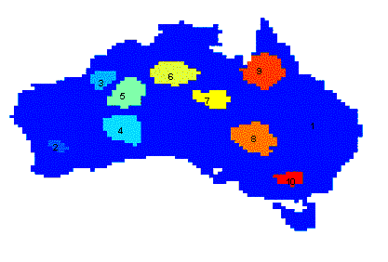
Why Cluster Analysis
Understanding
  Group related documents for browsing, genes and proteins that have similar functionality, stocks with similar price fluctuations, users with same behavior
Summarization
  Reduce the size of large data sets
Applications
  Recommendation systems
  Search Personalization
Clustering precipitation in Australia

Slide 4
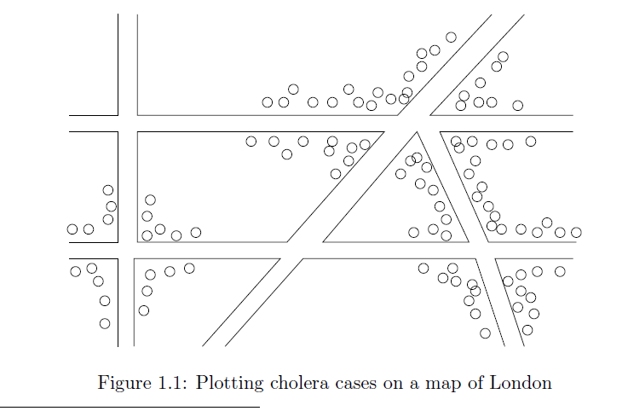
Early applications of cluster analysis
John Snow, London 1854

Slide 5
Types of Clusterings
Important distinction between hierarchical and partitional sets of clusters
Partitional Clustering
  A division data objects into subsets (clusters) such that each data object is in exactly one subset
Hierarchical clustering
  A set of nested clusters organized as a hierarchical tree

Slide 6
Partitional Clustering
Original Points
A Partitional Clustering

Slide 7










Hierarchical Clustering
$$C_{5}$$
$$C_{4}$$
$$C_{3}$$
$$C_{1}$$
$$C_{5}$$
$$C_{4}$$
$$C_{3}$$
$$C_{2}$$
$$C_{1}$$
$$C_{2}$$
Hierarchical Clustering dendrogram
Hierarchical Clustering

Slide 8
Other types of clustering
Exclusive (or non-overlapping) versus non-exclusive (or overlapping)
  In non-exclusive clusterings, points may belong to multiple clusters.
    Points that belong to multiple classes, or ‘border’ points
Fuzzy (or soft) versus non-fuzzy (or hard)
  In fuzzy clustering, a point belongs to every cluster with some weight between 0 and 1
    Weights usually must sum to 1 (often interpreted as probabilities)
Partial versus complete
  In some cases, we only want to cluster some of the data

Slide 9
Clustering objectives
Well-Separated Clusters:
  A cluster is a set of points such that any point in a cluster is closer (or more similar) to every other point in the cluster than to any point not in the cluster.
3 well-separated clusters

Slide 10
Clustering objectives
Center-based Clusters:
  A cluster is a set of objects such that an object in a cluster is closer (more similar) to the “center” of a cluster, than to the center of any other cluster
  The center of a cluster is often a centroid, the minimizer of distances from all the points in the cluster, or a medoid, the most “representative” point of a cluster
4 center-based clusters

Slide 11
Clustering objectives
Contiguous Clusters (Nearest neighbor or Transitive)
  A cluster is a set of points such that a point in a cluster is closer (or more similar) to one or more other points in the cluster than to any point not in the cluster.
8 contiguous clusters

Slide 12
Clustering Objectives
Density-based clusters
  A cluster is a dense region of points, which is separated by low-density regions, from other regions of high density.
  Used when the clusters are irregular or intertwined, and when noise and outliers are present.
6 density-based clusters

Slide 13
Clustering objectives
Shared Property or Conceptual Clusters
  Finds clusters that share some common property or represent a particular concept.
A cluster is defined as a set of points that lie on a circle

Slide 14
Clustering objectives
Clustering as an optimization problem
  Finds clusters that minimize or maximize an objective function.
  Consider all possible ways of dividing the points into clusters and compute the `goodness' of each clustering using the objective function to find the best one.
    Usually, finding the best is NP-hard (no polynomial algorithm).
  Can have global or local objectives.
    Hierarchical clustering algorithms typically have local objectives
    Partitional algorithms typically have global objectives
  A variation of the global objective function approach is to fit the data to a parameterized (probabilistic) model.
    The parameters for the model are determined from the data, and they determine the clustering
    E.g., Mixture models assume that the data is a ‘mixture' of a number of statistical distributions.

Slide 15
Clustering Algorithms
K-means and its variants
Hierarchical clustering
DBSCAN

Slide 16
K-means

Slide 17
K-means Clustering
Partitional clustering approach
Each cluster is associated with a centroid (center point)
Each point is assigned to the cluster with the closest centroid
Number of clusters, K, must be specified
The objective is to:
  find K centroids and
  the assignment of points to clusters/centroids
  so as to minimize the sum of distances of the points to their respective centroid

Slide 18
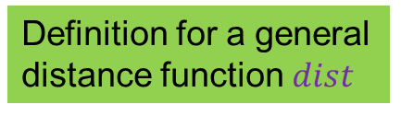
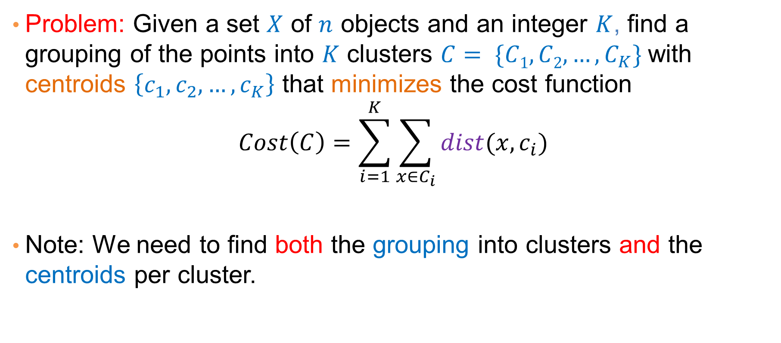
K-means Clustering as an optimization problem
Problem: Given a set $X$ of $n$ objects and an integer $K$, find a grouping of the points into $K$ clusters $C= \{C1, C2,…,C_{K}\}$with centroids $\left\{c_{1},c_{2},…,c_{K}\right\}$ that minimizes the cost function
$$Cost\left(C\right)=\sum_{i=1}^{K}{\sum_{x∈C_{i}}{dist(x,c_{i})}}$$
Note: We need to find both the grouping into clusters and the centroids per cluster.
Definition for a general distance function $dist$

Slide 19
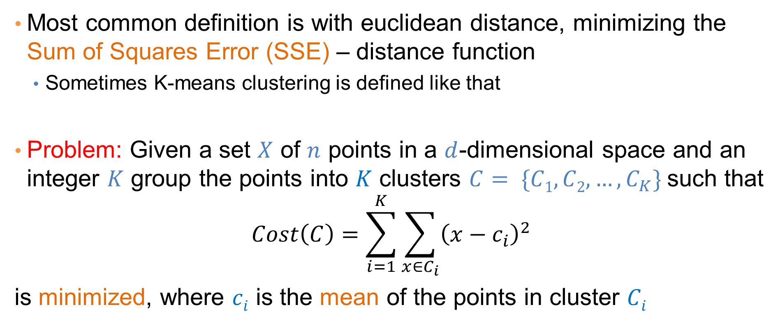
K-means Clustering
Most common definition is with euclidean distance, minimizing the Sum of Squares Error (SSE) – distance function
  Sometimes K-means clustering is defined like that
Problem: Given a set $X$ of $n$ points in a $d$-dimensional space and an integer $K$ group the points into $K$ clusters $C= \{C1, C2,…,C_{K}\}$such that
$$Cost\left(C\right)=\sum_{i=1}^{K}{\sum_{x∈C_{i}}{{\left(x−c_{i}\right)}^{2}}}$$
is minimized, where $ci$ is the mean of the points in cluster $Ci$
Sum of Squares Error (SSE)

Slide 20
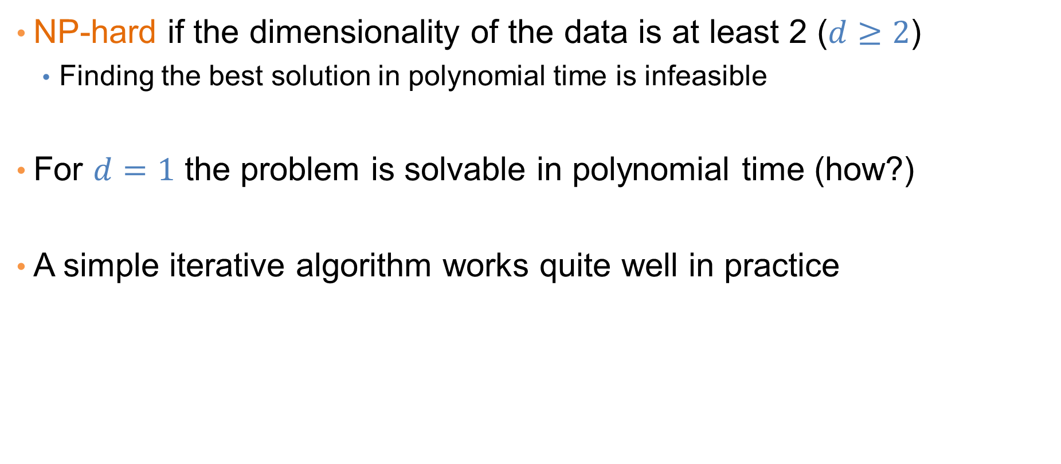
Complexity of the k-means problem
NP-hard if the dimensionality of the data is at least 2 ($d≥2$)
  Finding the best solution in polynomial time is infeasible
For $d=1$ the problem is solvable in polynomial time (how?)
A simple iterative algorithm works quite well in practice

Slide 21
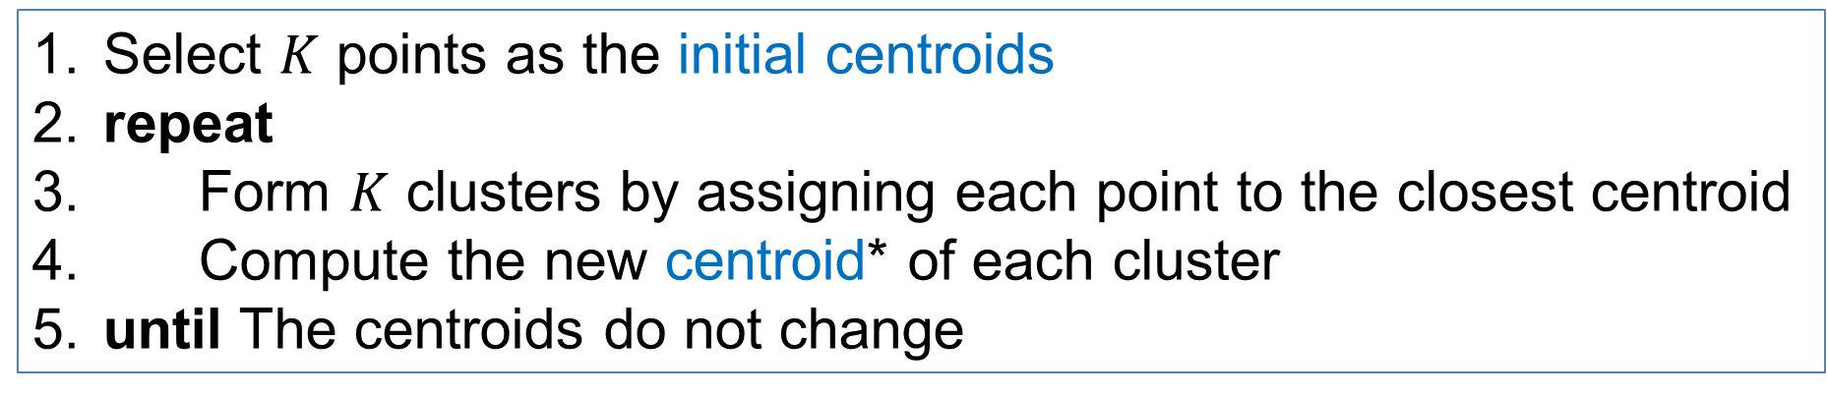
K-means Algorithm
Also known as Lloyd’s algorithm.
K-means is sometimes synonymous with this algorithm
Select $K$ points as the initial centroids
repeat
Form $K$ clusters by assigning each point to the closest centroid
Compute the new centroid* of each cluster
until The centroids do not change
*The centroid of a set of points is the point that is minimizes the sum of distances from the points in the set

Slide 22
Example

Slide 23
Example

Slide 24
K-means Algorithm – Initialization
Initial centroids are often chosen randomly.
  Clusters produced vary from one run to another.

Slide 25
Two different K-means Clusterings
Original Points
Optimal Clustering
Sub-optimal Clustering

Slide 26
Importance of Choosing Initial Centroids

Slide 27
Importance of Choosing Initial Centroids …

Slide 28
Dealing with Initialization
Do multiple runs and select the clustering with the smallest error
Select original set of points by methods other than random. E.g., pick the most distant (from each other) points as cluster centers (K-means++ algorithm)

Slide 29
K-means Algorithm – Centroids
‘Closeness’ is measured by some similarity or distance function
  E.g., Euclidean distance (SSE), cosine similarity, correlation, etc.
The centroid depends on the distance function
  The minimizer for the distance function
Centroid:
  The mean of the points in the cluster for SSE, and cosine similarity
  The median for Manhattan distance.
Finding the centroid is not always easy
  It can be an NP-hard problem for some distance functions
    E.g., median for multiple dimensions

Slide 30
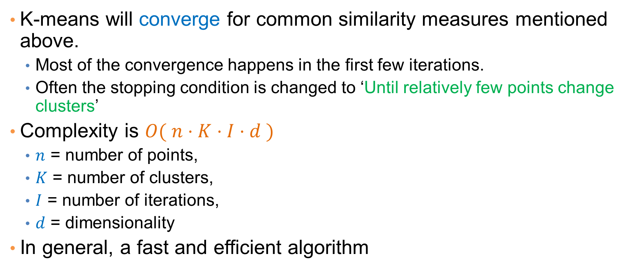
K-means Algorithm – Convergence
K-means will converge for common similarity measures mentioned above.
  Most of the convergence happens in the first few iterations.
  Often the stopping condition is changed to ‘Until relatively few points change clusters’
Complexity is $O( n⋅K⋅I⋅d )$
  $n$ = number of points,
  $K$ = number of clusters,
  $I$ = number of iterations,
  $d$ = dimensionality
In general, a fast and efficient algorithm

Slide 31
Limitations of K-means
K-means has problems when clusters are of different:
  sizes
  densities
  non-globular shapes
K-means has problems when the data contains outliers.

Slide 32
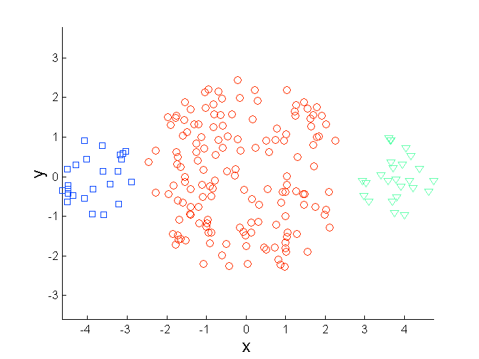
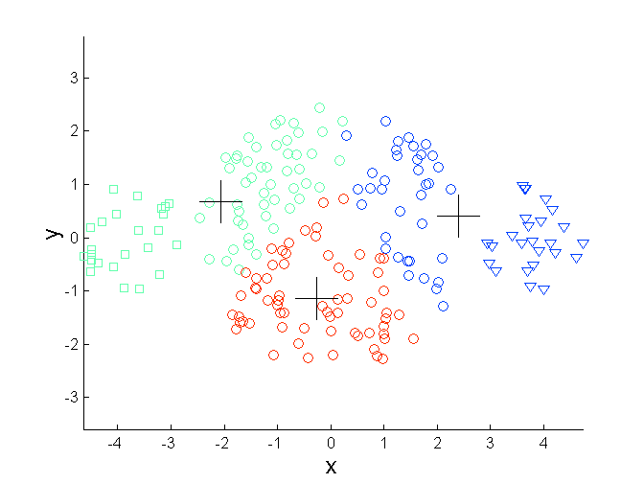
Limitations of K-means: Differing Sizes
Original Points
K-means (3 Clusters)

Slide 33
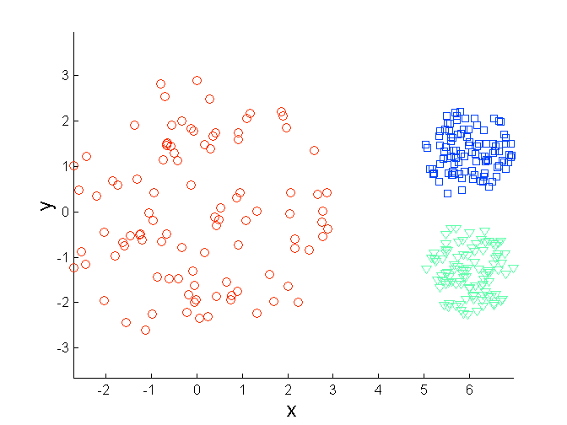
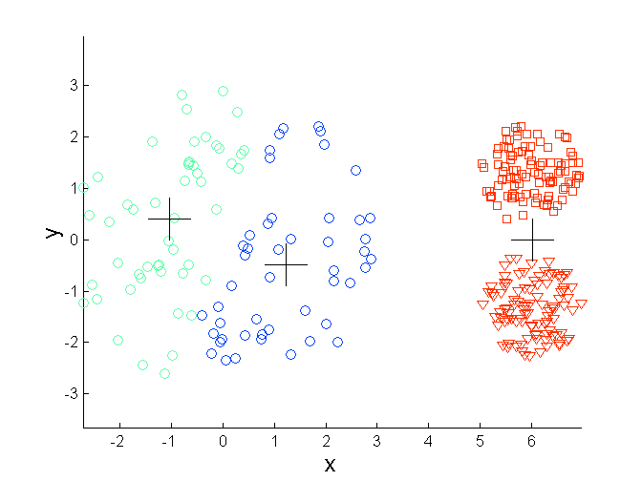
Limitations of K-means: Differing Density
Original Points
K-means (3 Clusters)

Slide 34
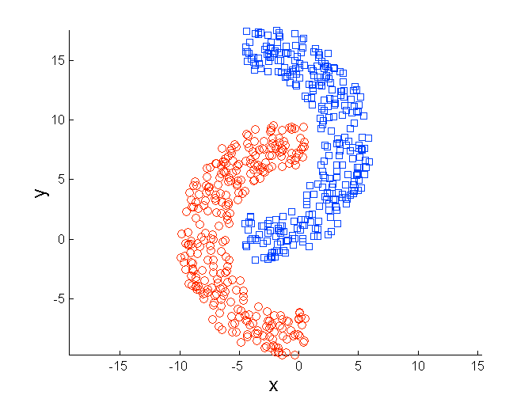
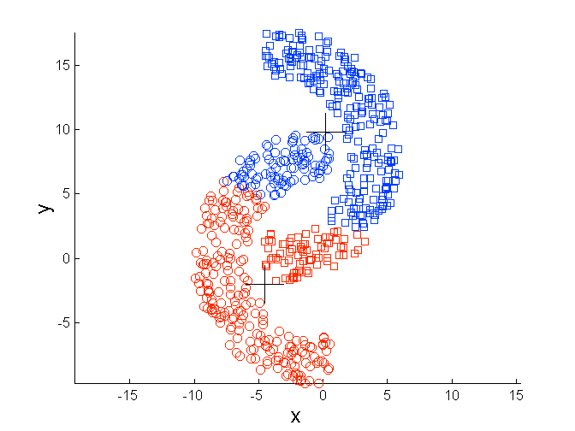
Limitations of K-means: Non-globular Shapes
Original Points
K-means (2 Clusters)

Slide 35
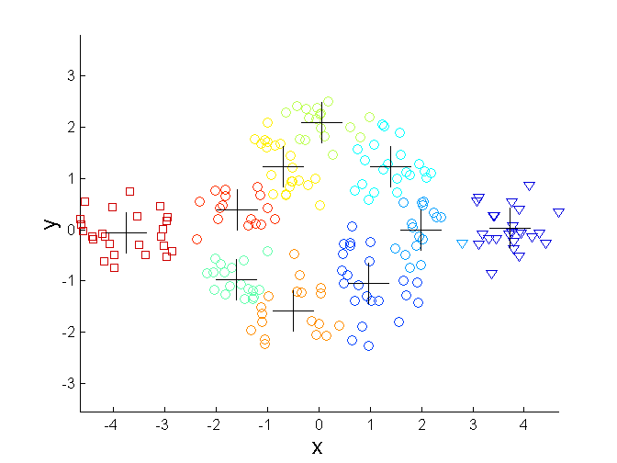
Overcoming K-means Limitations
Original Points K-means Clusters
One solution is to use many clusters.
  Find parts of clusters, but need to put together.

Slide 36
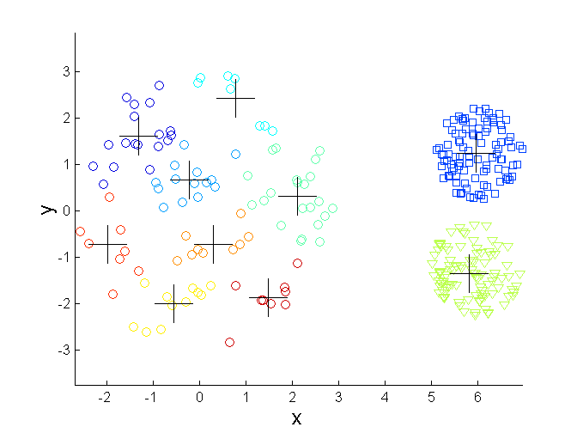
Overcoming K-means Limitations
Original Points K-means Clusters

Slide 37
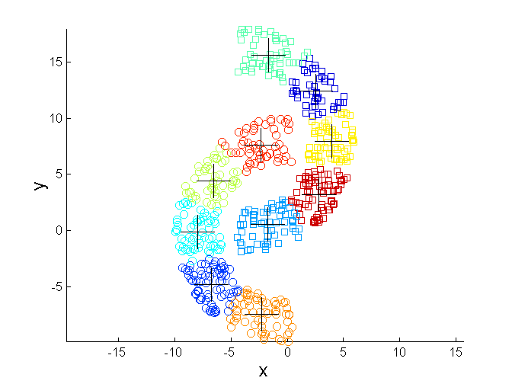
Overcoming K-means Limitations
Original Points K-means Clusters

Slide 38
Variations
K-medoids: Similar problem definition as in K-means, but the centroid of the cluster is defined to be one of the points in the cluster (the medoid).
K-centers: Similar problem definition as in K-means, but the goal now is to minimize the maximum diameter of the clusters
  diameter of a cluster is maximum distance between any two points in the cluster.

Slide 39
HIERARCHICAL CLUSTERING

Slide 40
Hierarchical Clustering
Two main types of hierarchical clustering
  Agglomerative:
    Start with the points as individual clusters
    At each step, merge the closest pair of clusters until only one cluster (or k clusters) left
  Divisive:
    Start with one, all-inclusive cluster
    At each step, split a cluster until each cluster contains a point (or there are k clusters)
Traditional hierarchical algorithms use a similarity or distance matrix
  Merge or split one cluster at a time

Slide 41
Hierarchical Clustering
Produces a set of nested clusters organized as a hierarchical tree
Can be visualized as a dendrogram
  A tree like diagram that records the sequences of merges or splits

Slide 42
Strengths of Hierarchical Clustering
Do not have to assume any particular number of clusters
  Any desired number of clusters can be obtained by ‘cutting’ the dendogram at the proper level
Dendrograms may correspond to meaningful taxonomies
  Example in biological sciences (e.g., animal kingdom, phylogeny reconstruction, …)

Slide 43
Agglomerative Clustering Algorithm
Most popular hierarchical clustering technique
Basic algorithm is straightforward
  Compute the proximity matrix
  Let each data point be a cluster
  Repeat
  Merge the two closest clusters
  Update the proximity matrix
  Until only a single cluster remains
Key operation is the computation of the proximity of two clusters
  Different approaches to defining the distance between clusters distinguish the different algorithms

Slide 44
Starting Situation
Start with single-point clusters and a proximity matrix between points
p1
p2
p3
p4
p5
. . .
p1
p2
p3
p4
p5
.
.
.
Proximity Matrix

Slide 45
Intermediate Situation
After some merging steps, we have some clusters and a proximity matrix between clusters
C1
C2
C3
C4
C5
C1
C2
C3
C3
C4
C4
C5
C1
Proximity Matrix
C2
C5

Slide 46
Intermediate Situation
We want to merge the two closest clusters (C2 and C5) and update the proximity matrix.
C1
C2
C3
C4
C5
C1
C2
C3
C3
C4
C4
C5
Proximity Matrix
C1
C2
C5

Slide 47
After Merging
The question is “How do we update the proximity matrix?”
C2 U C5
C1
C3
C4
C1
?
C2 U C5
? ? ? ?
C3
C3
?
C4
C4
?
C1
Proximity Matrix
C2 U C5

Slide 48
How to Define Inter-Cluster Similarity
p1
p2
p3
p4
p5
. . .
p1
Similarity?
p2
p3
p4
p5
MIN
MAX
Group Average
Distance Between Centroids
Other methods driven by an objective function
  Ward’s Method uses squared error
.
.
.
Proximity Matrix

Slide 49
How to Define Inter-Cluster Similarity
p1
p2
p3
p4
p5
. . .
p1
p2
p3
p4
p5
MIN
MAX
Group Average
Distance Between Centroids
Other methods driven by an objective function
  Ward’s Method uses squared error
.
.
.
Proximity Matrix

Slide 50
How to Define Inter-Cluster Similarity
p1
p2
p3
p4
p5
. . .
p1
p2
p3
p4
p5
MIN
MAX
Group Average
Distance Between Centroids
Other methods driven by an objective function
  Ward’s Method uses squared error
.
.
.
Proximity Matrix

Slide 51
How to Define Inter-Cluster Similarity
p1
p2
p3
p4
p5
. . .
p1
p2
p3
p4
p5
MIN
MAX
Group Average
Distance Between Centroids
Other methods driven by an objective function
  Ward’s Method uses squared error
.
.
.
Proximity Matrix

Slide 52
How to Define Inter-Cluster Similarity
p1
p2
p3
p4
p5
. . .
p1
×
×
p2
p3
p4
p5
MIN
MAX
Group Average
Distance Between Centroids
Other methods driven by an objective function
  Ward’s Method uses squared error
.
.
.
Proximity Matrix

Slide 53
Single Link – Complete Link
Another way to view the processing of the hierarchical algorithm is that we create links between the elements in order of increasing distance
  The MIN – Single Link, will merge two clusters when a single pair of elements between the two clusters is linked
  The MAX – Complete Linkage will merge two clusters when all pairs of elements between the two clusters have been linked.

Slide 54
Hierarchical Clustering: MIN
 | 1 | 2 | 3 | 4 | 5 | 6
1 | 0 | .24 | .22 | .37 | .34 | .23
2 | .24 | 0 | .15 | .20 | .14 | .25
3 | .22 | .15 | 0 | .15 | .28 | .11
4 | .37 | .20 | .15 | 0 | .29 | .22
5 | .34 | .14 | .28 | .29 | 0 | .39
6 | .23 | .25 | .11 | .22 | .39 | 0
 | 1 | 2 | 3 | 4 | 5 | 6
1 | 0 | .24 | .22 | .37 | .34 | .23
2 | .24 | 0 | .15 | .20 | .14 | .25
3 | .22 | .15 | 0 | .15 | .28 | .11
4 | .37 | .20 | .15 | 0 | .29 | .22
5 | .34 | .14 | .28 | .29 | 0 | .39
6 | .23 | .25 | .11 | .22 | .39 | 0
 | 1 | 2 | 3 | 4 | 5 | 6
1 | 0 | .24 | .22 | .37 | .34 | .23
2 | .24 | 0 | .15 | .20 | .14 | .25
3 | .22 | .15 | 0 | .15 | .28 | .11
4 | .37 | .20 | .15 | 0 | .29 | .22
5 | .34 | .14 | .28 | .29 | 0 | .39
6 | .23 | .25 | .11 | .22 | .39 | 0
 | 1 | 2 | 3 | 4 | 5 | 6
1 | 0 | .24 | .22 | .37 | .34 | .23
2 | .24 | 0 | .15 | .20 | .14 | .25
3 | .22 | .15 | 0 | .15 | .28 | .11
4 | .37 | .20 | .15 | 0 | .29 | .22
5 | .34 | .14 | .28 | .29 | 0 | .39
6 | .23 | .25 | .11 | .22 | .39 | 0
 | 1 | 2 | 3 | 4 | 5 | 6
1 | 0 | .24 | .22 | .37 | .34 | .23
2 | .24 | 0 | .15 | .20 | .14 | .25
3 | .22 | .15 | 0 | .15 | .28 | .11
4 | .37 | .20 | .15 | 0 | .29 | .22
5 | .34 | .14 | .28 | .29 | 0 | .39
6 | .23 | .25 | .11 | .22 | .39 | 0
 | 1 | 2 | 3 | 4 | 5 | 6
1 | 0 | .24 | .22 | .37 | .34 | .23
2 | .24 | 0 | .15 | .20 | .14 | .25
3 | .22 | .15 | 0 | .15 | .28 | .11
4 | .37 | .20 | .15 | 0 | .29 | .22
5 | .34 | .14 | .28 | .29 | 0 | .39
6 | .23 | .25 | .11 | .22 | .39 | 0
 | 1 | 2 | 3 | 4 | 5 | 6
1 | 0 | .24 | .22 | .37 | .34 | .23
2 | .24 | 0 | .15 | .20 | .14 | .25
3 | .22 | .15 | 0 | .15 | .28 | .11
4 | .37 | .20 | .15 | 0 | .29 | .22
5 | .34 | .14 | .28 | .29 | 0 | .39
6 | .23 | .25 | .11 | .22 | .39 | 0
5
1
3
5
2
1
2
3
6
4
4
Nested Clusters
Dendrogram

Slide 55
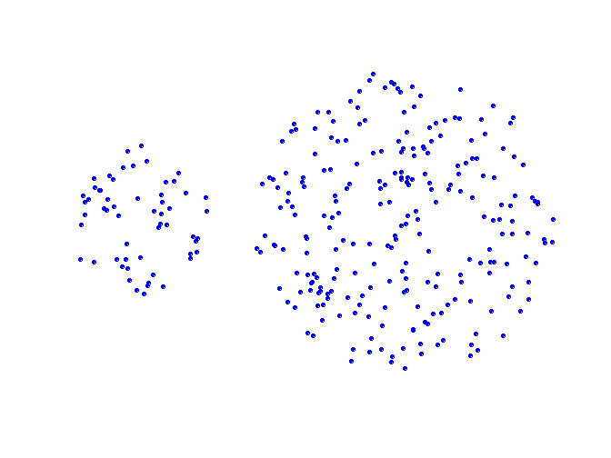
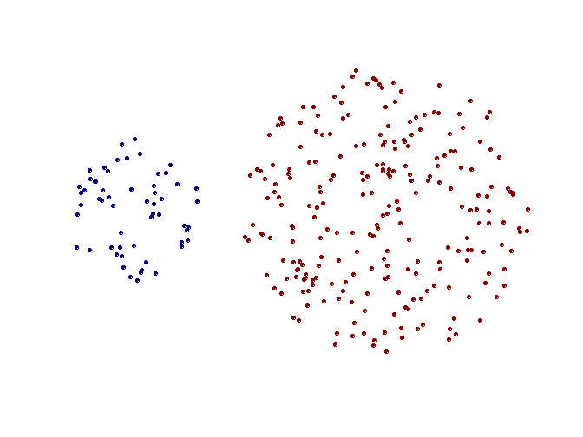
Strength of MIN
Original Points
Two Clusters
Can handle non-elliptical shapes

Slide 56
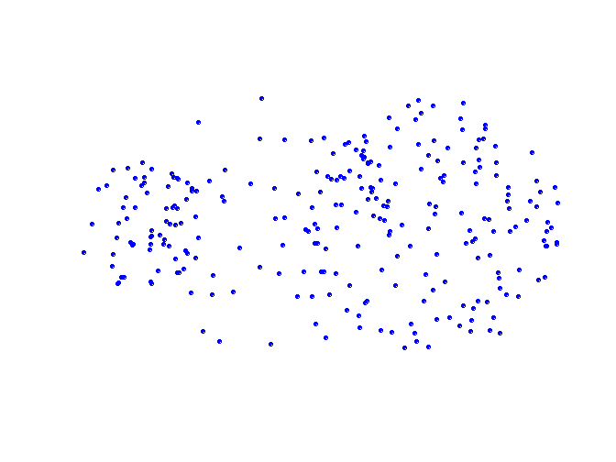
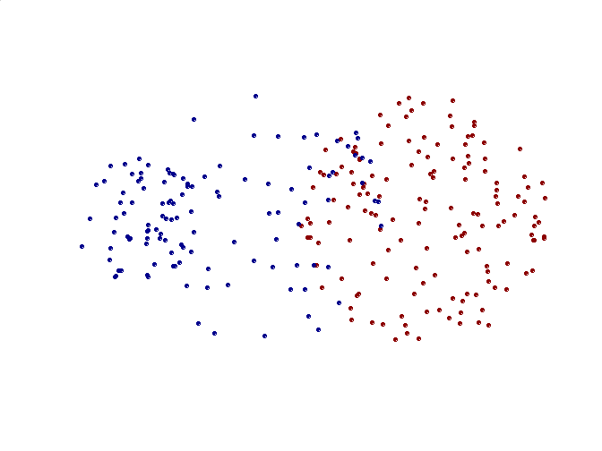
Limitations of MIN
Original Points
Two Clusters
Sensitive to noise and outliers

Slide 57
Hierarchical Clustering: MAX
 | 1 | 2 | 3 | 4 | 5 | 6
1 | 0 | .24 | .22 | .37 | .34 | .23
2 | .24 | 0 | .15 | .20 | .14 | .25
3 | .22 | .15 | 0 | .15 | .28 | .11
4 | .37 | .20 | .15 | 0 | .29 | .22
5 | .34 | .14 | .28 | .29 | 0 | .39
6 | .23 | .25 | .11 | .22 | .39 | 0
 | 1 | 2 | 3 | 4 | 5 | 6
1 | 0 | .24 | .22 | .37 | .34 | .23
2 | .24 | 0 | .15 | .20 | .14 | .25
3 | .22 | .15 | 0 | .15 | .28 | .11
4 | .37 | .20 | .15 | 0 | .29 | .22
5 | .34 | .14 | .28 | .29 | 0 | .39
6 | .23 | .25 | .11 | .22 | .39 | 0
 | 1 | 2 | 3 | 4 | 5 | 6
1 | 0 | .24 | .22 | .37 | .34 | .23
2 | .24 | 0 | .15 | .20 | .14 | .25
3 | .22 | .15 | 0 | .15 | .28 | .11
4 | .37 | .20 | .15 | 0 | .29 | .22
5 | .34 | .14 | .28 | .29 | 0 | .39
6 | .23 | .25 | .11 | .22 | .39 | 0
 | 1 | 2 | 3 | 4 | 5 | 6
1 | 0 | .24 | .22 | .37 | .34 | .23
2 | .24 | 0 | .15 | .20 | .14 | .25
3 | .22 | .15 | 0 | .15 | .28 | .11
4 | .37 | .20 | .15 | 0 | .29 | .22
5 | .34 | .14 | .28 | .29 | 0 | .39
6 | .23 | .25 | .11 | .22 | .39 | 0
 | 1 | 2 | 3 | 4 | 5 | 6
1 | 0 | .24 | .22 | .37 | .34 | .23
2 | .24 | 0 | .15 | .20 | .14 | .25
3 | .22 | .15 | 0 | .15 | .28 | .11
4 | .37 | .20 | .15 | 0 | .29 | .22
5 | .34 | .14 | .28 | .29 | 0 | .39
6 | .23 | .25 | .11 | .22 | .39 | 0
 | 1 | 2 | 3 | 4 | 5 | 6
1 | 0 | .24 | .22 | .37 | .34 | .23
2 | .24 | 0 | .15 | .20 | .14 | .25
3 | .22 | .15 | 0 | .15 | .28 | .11
4 | .37 | .20 | .15 | 0 | .29 | .22
5 | .34 | .14 | .28 | .29 | 0 | .39
6 | .23 | .25 | .11 | .22 | .39 | 0
 | 1 | 2 | 3 | 4 | 5 | 6
1 | 0 | .24 | .22 | .37 | .34 | .23
2 | .24 | 0 | .15 | .20 | .14 | .25
3 | .22 | .15 | 0 | .15 | .28 | .11
4 | .37 | .20 | .15 | 0 | .29 | .22
5 | .34 | .14 | .28 | .29 | 0 | .39
6 | .23 | .25 | .11 | .22 | .39 | 0
 | 1 | 2 | 3 | 4 | 5 | 6
1 | 0 | .24 | .22 | .37 | .34 | .23
2 | .24 | 0 | .15 | .20 | .14 | .25
3 | .22 | .15 | 0 | .15 | .28 | .11
4 | .37 | .20 | .15 | 0 | .29 | .22
5 | .34 | .14 | .28 | .29 | 0 | .39
6 | .23 | .25 | .11 | .22 | .39 | 0
 | 1 | 2 | 3 | 4 | 5 | 6
1 | 0 | .24 | .22 | .37 | .34 | .23
2 | .24 | 0 | .15 | .20 | .14 | .25
3 | .22 | .15 | 0 | .15 | .28 | .11
4 | .37 | .20 | .15 | 0 | .29 | .22
5 | .34 | .14 | .28 | .29 | 0 | .39
6 | .23 | .25 | .11 | .22 | .39 | 0
 | 1 | 2 | 3 | 4 | 5 | 6
1 | 0 | .24 | .22 | .37 | .34 | .23
2 | .24 | 0 | .15 | .20 | .14 | .25
3 | .22 | .15 | 0 | .15 | .28 | .11
4 | .37 | .20 | .15 | 0 | .29 | .22
5 | .34 | .14 | .28 | .29 | 0 | .39
6 | .23 | .25 | .11 | .22 | .39 | 0
 | 1 | 2 | 3 | 4 | 5 | 6
1 | 0 | .24 | .22 | .37 | .34 | .23
2 | .24 | 0 | .15 | .20 | .14 | .25
3 | .22 | .15 | 0 | .15 | .28 | .11
4 | .37 | .20 | .15 | 0 | .29 | .22
5 | .34 | .14 | .28 | .29 | 0 | .39
6 | .23 | .25 | .11 | .22 | .39 | 0
4
1
2
5
5
2
3
6
3
1
4
Nested Clusters
Dendrogram

Slide 58
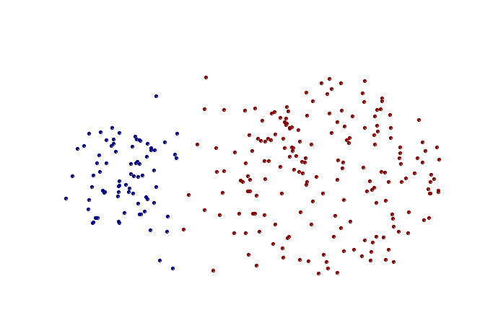
Strength of MAX
Original Points
Two Clusters
Less susceptible to noise and outliers

Slide 59
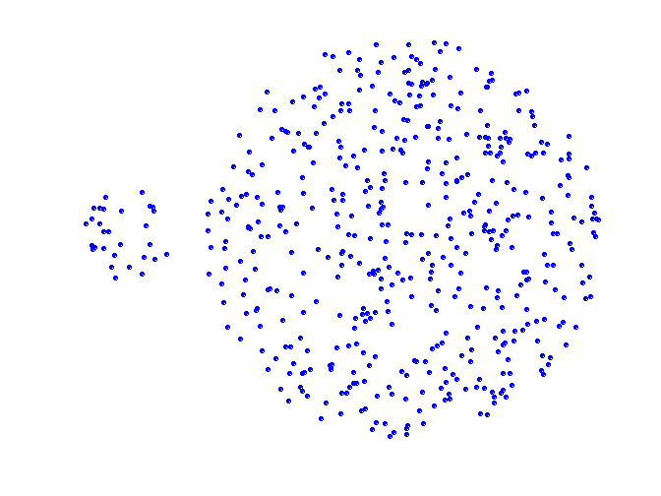
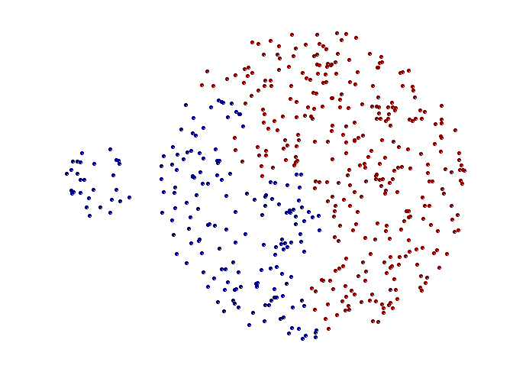
Limitations of MAX
Original Points
Two Clusters
Tends to break large clusters
Biased towards globular clusters

Slide 60
Hierarchical Clustering: Group Average
 | 1 | 2 | 3 | 4 | 5 | 6
1 | 0 | .24 | .22 | .37 | .34 | .23
2 | .24 | 0 | .15 | .20 | .14 | .25
3 | .22 | .15 | 0 | .15 | .28 | .11
4 | .37 | .20 | .15 | 0 | .29 | .22
5 | .34 | .14 | .28 | .29 | 0 | .39
6 | .23 | .25 | .11 | .22 | .39 | 0
5
4
1
2
5
2
3
6
1
4
3
Nested Clusters
Dendrogram

Slide 61
Hierarchical Clustering: Group Average
Compromise between Single and Complete Link
Strengths
  Less susceptible to noise and outliers
Limitations
  Biased towards globular clusters

Slide 62
Cluster Similarity: Ward’s Method
Similarity of two clusters is based on the increase in squared error (SSE) when two clusters are merged
  Similar to group average if distance between points is sum of squares distance
Hierarchical analogue of K-means
  Can be used to initialize K-means
Less susceptible to noise and outliers
Biased towards globular cluster

Slide 63
Hierarchical Clustering: Comparison
5
1
4
1
3
2
5
5
5
2
1
MIN
2
MAX
2
3
6
3
3
6
1
4
4
4
5
5
1
4
1
2
2
5
2
Ward’s Method
5
2
3
6
Group Average
3
3
6
4
1
1
4
4
3

Slide 64
Hierarchical Clustering: Time and Space requirements
O(N²) space since it uses the proximity matrix.
  N is the number of points.
O(N³) time in many cases
  There are N steps and at each step the size, N², proximity matrix must be updated and searched
  Complexity can be reduced to O(N² log(N) ) time for some approaches

Slide 65
Hierarchical Clustering: Problems and Limitations
Computational complexity in time and space
Once a decision is made to combine two clusters, it cannot be undone
No objective function is directly minimized
Different schemes have problems with one or more of the following:
  Sensitivity to noise and outliers
  Difficulty handling different sized clusters and convex shapes
  Breaking large clusters

Slide 66
DBSCAN

Slide 67
DBSCAN: Density-Based Clustering
DBSCAN is a Density-Based Clustering algorithm
Reminder: In density-based clustering we partition points into dense regions separated by not-so-dense regions.
Important Questions:
  How do we measure density?
  What is a dense region?
DBSCAN:
  Density at point p: number of points within a circle of radius Eps
  Dense Region: A circle of radius Eps that contains at least MinPts points

Slide 68
DBSCAN
Characterization of points
  A point is a core point if it has more than a specified number of points (MinPts) within Eps
    These points belong in a dense region and are at the interior of a cluster
  A border point has fewer than MinPts within Eps, but is in the neighborhood of a core point.
  A noise point is any point that is not a core point or a border point.

Slide 69
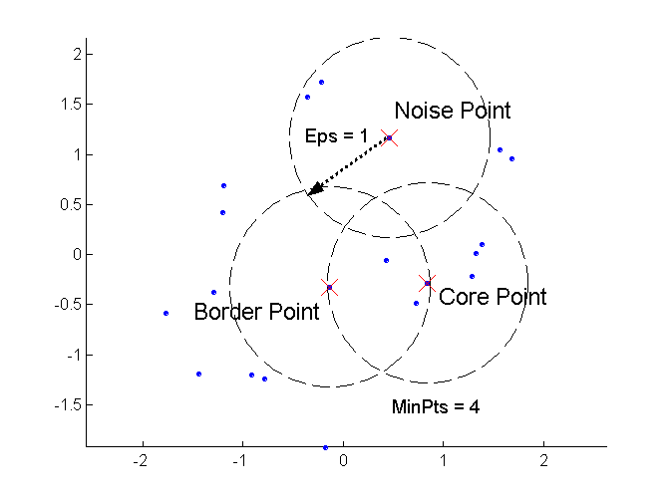
DBSCAN: Core, Border, and Noise Points

Slide 70
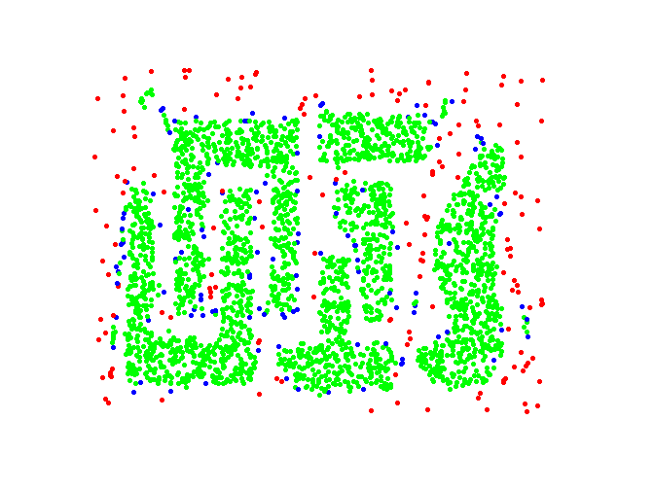
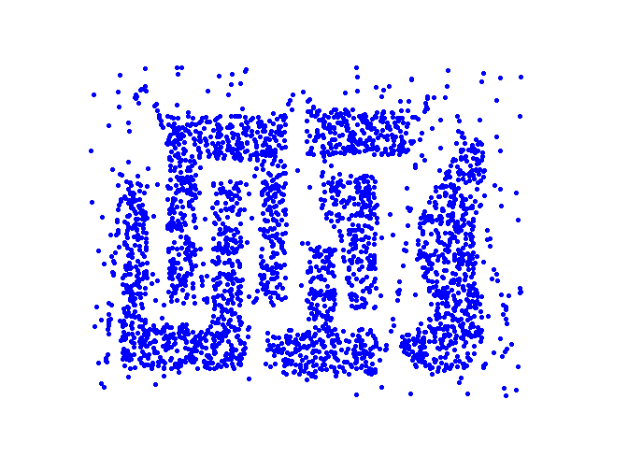
DBSCAN: Core, Border and Noise Points
Original Points
Point types: core, border and noise
Eps = 10, MinPts = 4

Slide 71
Density-Connected points
Density edge
  We place an edge between two core points q and p if they are within distance Eps.
Density-connected
  A point p is density-connected to a point q if there is a path of edges from p to q
p
p₁
q
p
q
o

Slide 72
DBSCAN Algorithm
Label points as core, border and noise
Eliminate noise points
For every core point p that has not been assigned to a cluster
  Create a new cluster with the point p and all the points that are density-connected to p.
Assign border points to the cluster of the closest core point.

Slide 73
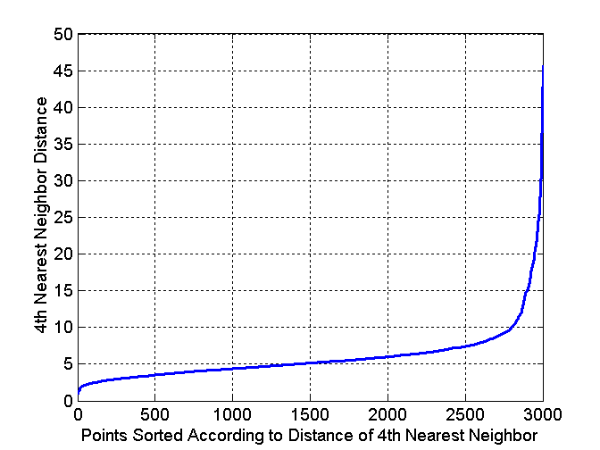
DBSCAN: Determining Eps and MinPts
Idea: for points in a cluster, their k^{th} nearest neighbors are at roughly the same distance
Noise points have the k^{th} nearest neighbor at farther distance
So, plot sorted distance of every point to its k^{th} nearest neighbor
Find the distance d where there is a “knee” in the curve
  Eps = d, MinPts = k
Eps ~ 7-10
MinPts = 4

Slide 74
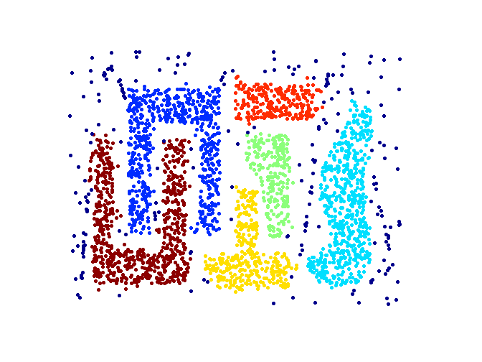
When DBSCAN Works Well
Original Points
Clusters
Resistant to Noise
Can handle clusters of different shapes and sizes

Slide 75
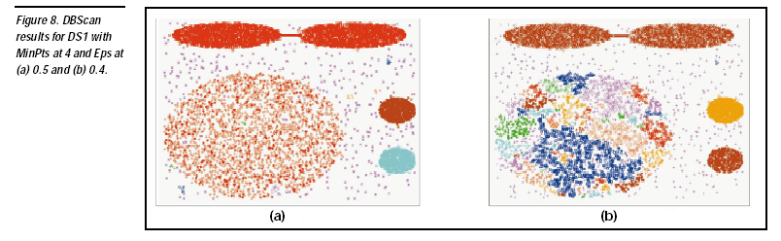

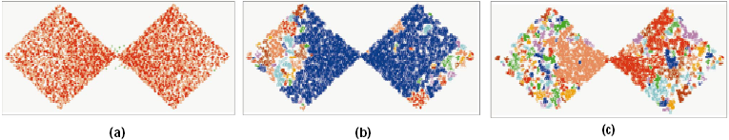
DBSCAN: Sensitive to Parameters

Slide 76
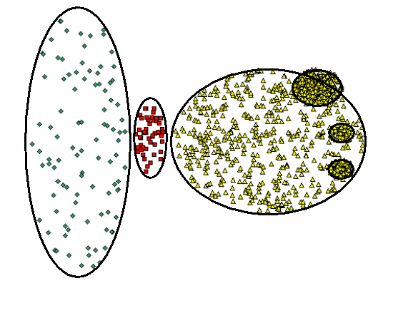
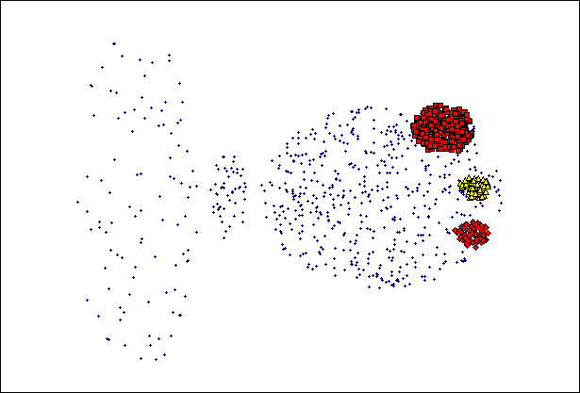
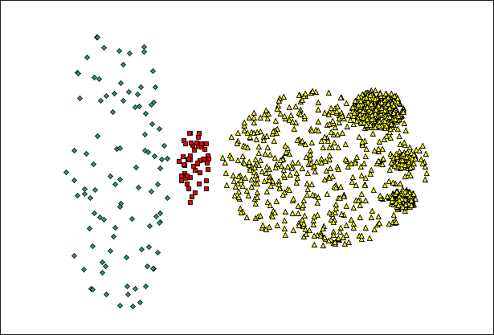
When DBSCAN Does NOT Work Well
(MinPts=4, Eps=9.75).
Original Points
Varying densities
High-dimensional data
(MinPts=4, Eps=9.92)

Slide 77
Other algorithms
PAM, CLARANS: Solutions for the k-medoids problem
BIRCH: Constructs a hierarchical tree that acts a summary of the data, and then clusters the leaves.
MST: Clustering using the Minimum Spanning Tree.
ROCK: clustering categorical data by neighbor and link analysis
LIMBO, COOLCAT: Clustering categorical data using information theoretic tools.
CURE: Hierarchical algorithm uses different representation of the cluster
CHAMELEON: Hierarchical algorithm uses closeness and interconnectivity for merging

Slide 78
CLUSTERING Evaluation

Slide 79
Clustering Evaluation
We need to evaluate the “goodness” of the resulting clusters?
But “clustering lies in the eye of the beholder”!

Slide 80
Quality of Clustering can be Ambiguous
How many clusters?
Six Clusters
Two Clusters
Four Clusters

Slide 81
Clustering Evaluation
Then why do we want to evaluate them?
  To avoid finding patterns in noise
  To compare clusterings, or clustering algorithms
  To compare against a “ground truth”

Slide 82
Different Aspects of Cluster Validation
Internal Evaluation: Evaluating how well the results of a cluster analysis fit the data without reference to external information.
  - Use only the data
Determining the clustering tendency of a set of data, i.e., distinguishing whether non-random structure actually exists in the data.
Determining the ‘correct’ number of clusters.
External Evaluation: Comparing the results of a cluster analysis to externally known results, e.g., to externally given class labels.

Slide 83
Measures of Cluster Validity
Numerical measures that are applied to judge various aspects of cluster validity, are classified into the following three types.
  External Index: Used to measure the extent to which cluster labels match externally supplied class labels.
    E.g., entropy, precision, recall
  Internal Index: Used to measure the goodness of a clustering structure without reference to external information.
    E.g., Sum of Squared Error (SSE)
Sometimes these are referred to as criteria instead of indices
  However, sometimes criterion is the general strategy and index is the numerical measure that implements the criterion.

Slide 84
Metrics for cluster and clustering validity
For the following we will see some metrics for the clustering validity.
The metrics can be applied for the evaluation of either a cluster, or a clustering
In cluster validity, we evaluate a group of points, as to whether they were correctly placed together.
  We usually check if the group is homogeneous (for some notion of homogeneity)
In clustering validity, we evaluate a collection of clusters
  We often use the (weighted) average of cluster validity
  There are also metrics that look at the relationships between the clusters, e.g., how well-separated the clusters are.

Slide 85
Cluster Validity with Internal Criteria

Slide 86
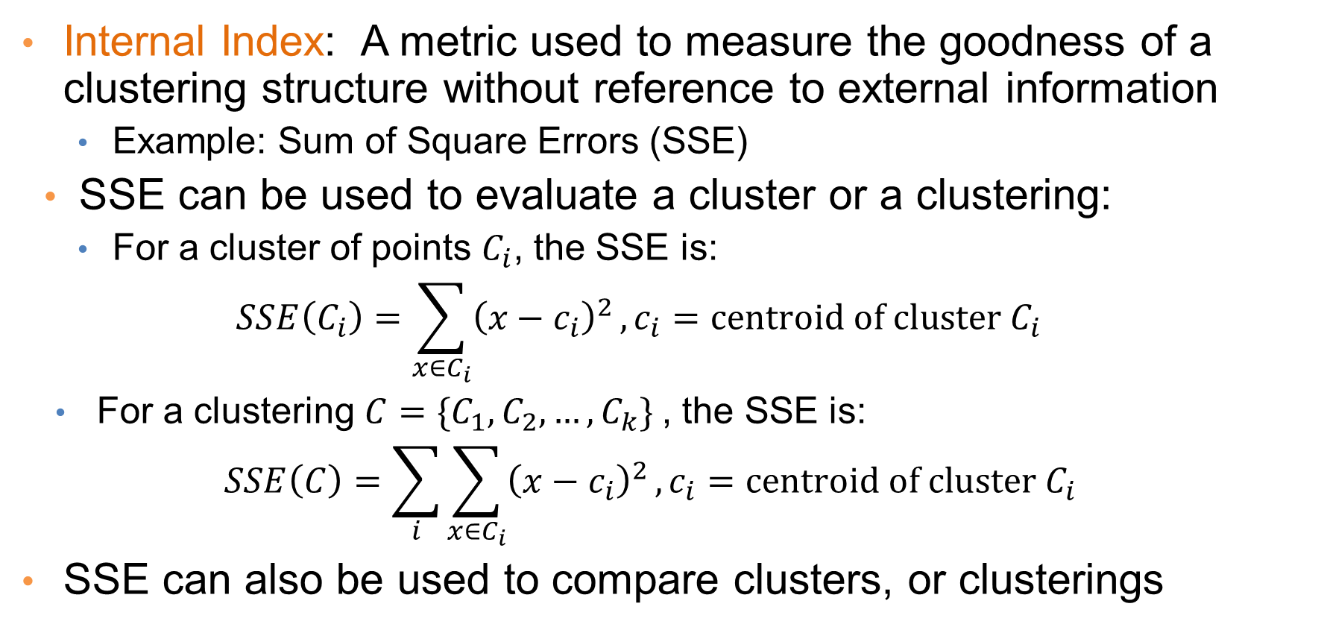
Internal Measures
Internal Index: A metric used to measure the goodness of a clustering structure without reference to external information
  Example: Sum of Square Errors (SSE)
SSE can be used to evaluate a cluster or a clustering:
  For a cluster of points $C_{i}$, the SSE is:
  $$SSE\left(C_{i}\right)=\sum_{x∈C_{i}}{{\left(x−c_{i}\right)}^{2}}, c_{i}=centroid of cluster C_{i}$$
  For a clustering ${C=\{C}_{1},C_{2},…, C_{k}\}$, the SSE is:
  $$SSE\left(C\right)=\sum_{i}{\sum_{x∈C_{i}}{{\left(x−c_{i}\right)}^{2}}}, c_{i}=centroid of cluster C_{i}$$
SSE can also be used to compare clusters, or clusterings

Slide 87
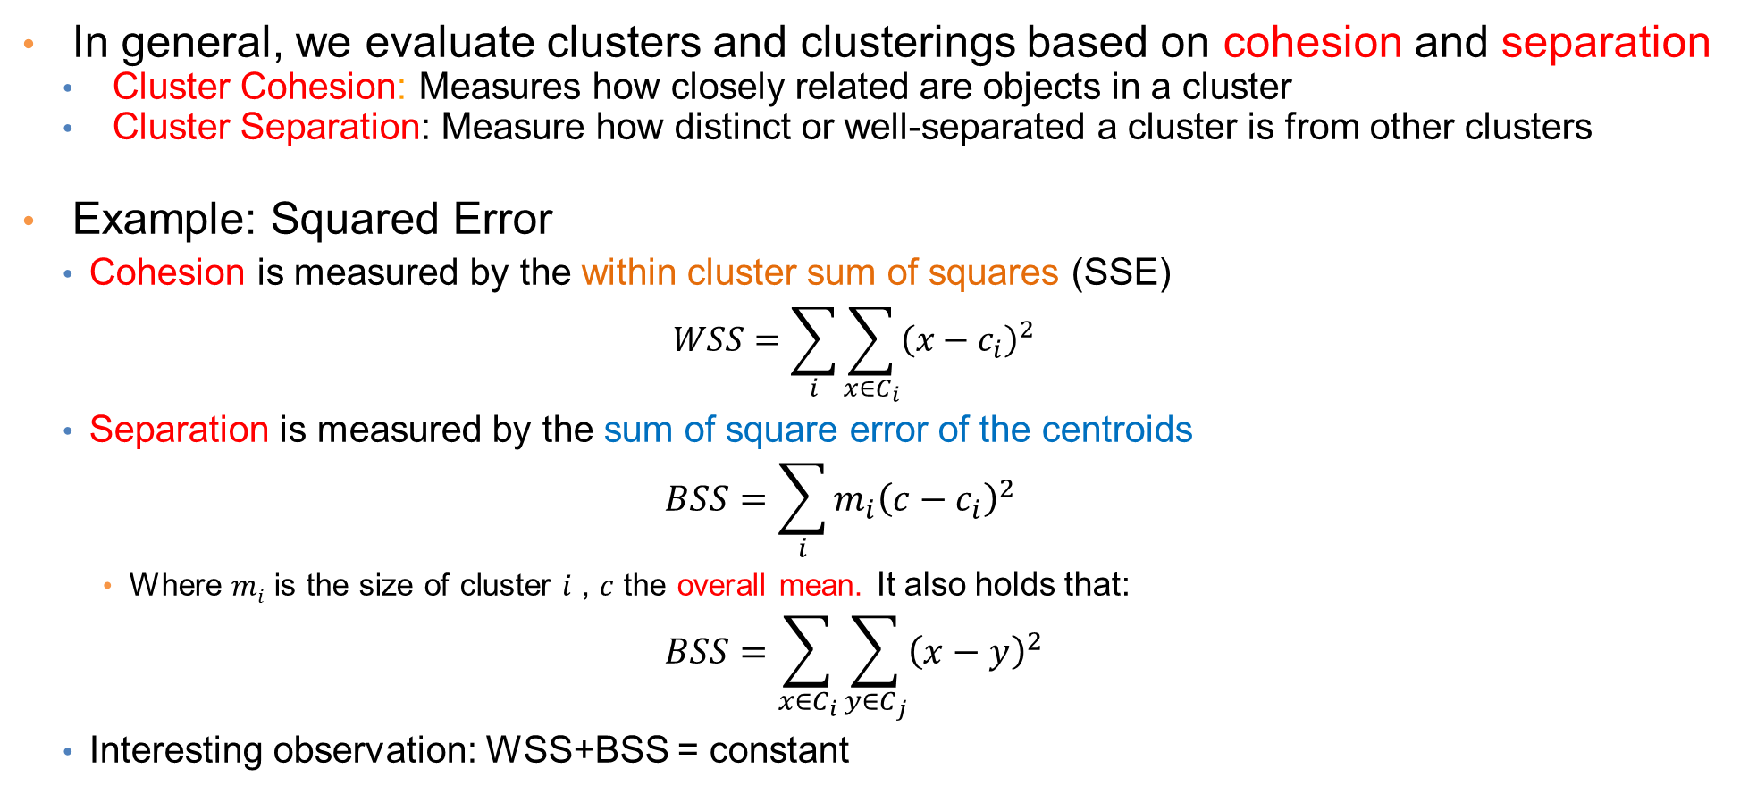
Cohesion and Separation
In general, we evaluate clusters and clusterings based on cohesion and separation
  Cluster Cohesion: Measures how closely related are objects in a cluster
  Cluster Separation: Measure how distinct or well-separated a cluster is from other clusters
Example: Squared Error
  Cohesion is measured by the within cluster sum of squares (SSE)
  $$WSS=\sum_{i}{\sum_{x∈C_{i}}{{\left(x−c_{i}\right)}^{2}}}$$
  Separation is measured by the sum of square error of the centroids
  $$BSS=\sum_{i}{m_{i}{\left(c−c_{i}\right)}^{2}}$$
    Where $mi$ is the size of cluster $i$ , $c$ the overall mean. It also holds that:
  $$BSS=\sum_{x∈C_{i}}{\sum_{y∈C_{j}}{{\left(x−y\right)}^{2}}}$$
  Interesting observation: WSS+BSS = constant
We want this to be small
We want this to be large

Slide 88
Cohesion and Separation
A proximity-graph-based approach can also be used for cohesion and separation.
  Cluster cohesion is the sum of the weight of all links within a cluster.
  Cluster separation is the sum of the weights between nodes in the cluster and nodes outside the cluster.
cohesion
separation

Slide 89
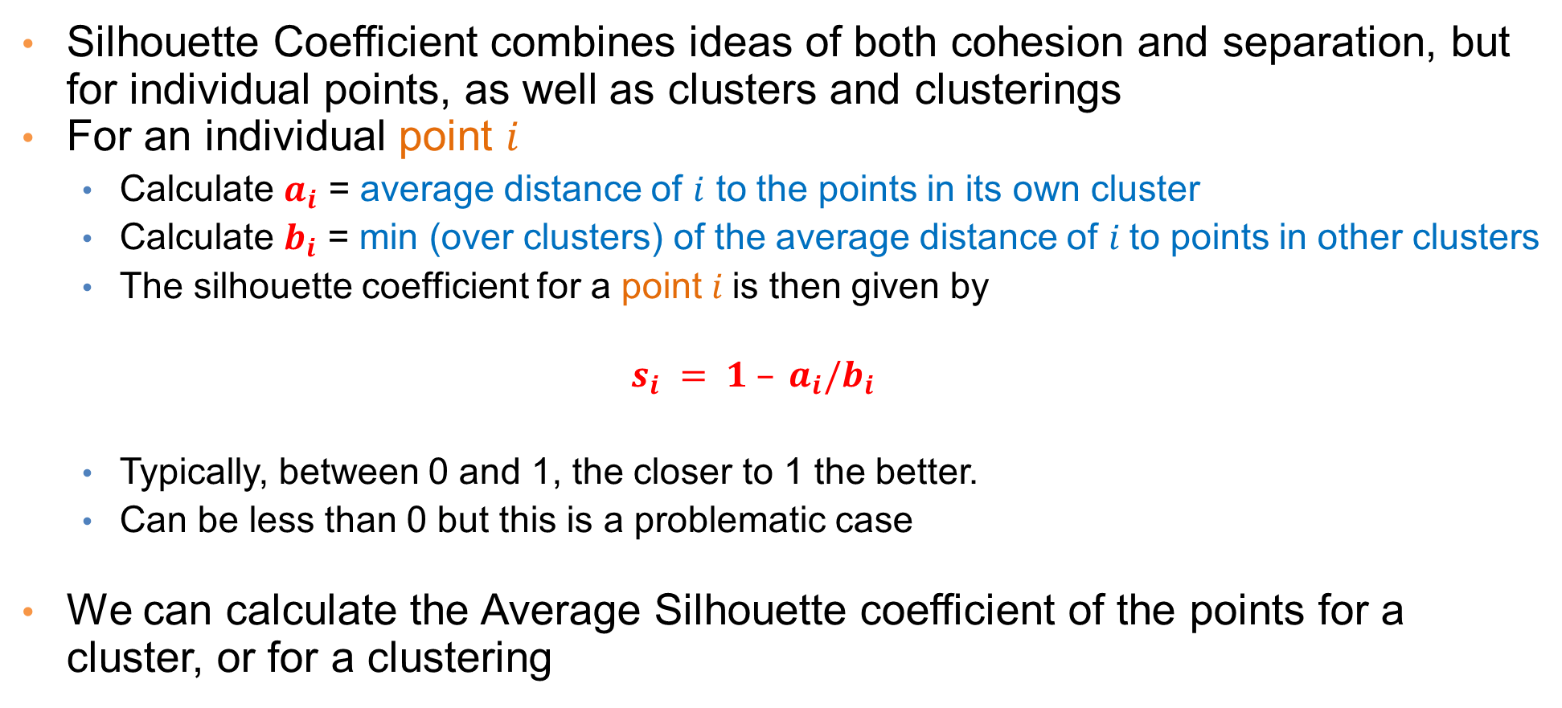
Silhouette Coefficient
Silhouette Coefficient combines ideas of both cohesion and separation, but for individual points, as well as clusters and clusterings
For an individual point $i$
  Calculate $a_{i}$ = average distance of $i$ to the points in its own cluster
  Calculate $b_{i}$ = min (over clusters) of the average distance of $i$to points in other clusters
  The silhouette coefficient for a point $i$is then given by
  $$s_{i} = 1 – a_{i}/b_{i}$$
  Typically, between 0 and 1, the closer to 1 the better.
  Can be less than 0 but this is a problematic case
We can calculate the Average Silhouette coefficient of the points for a cluster, or for a clustering

Slide 90
Silhouette Coefficient Example

Slide 91
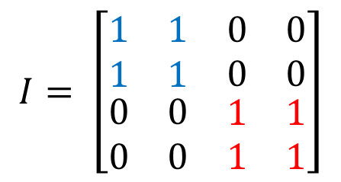
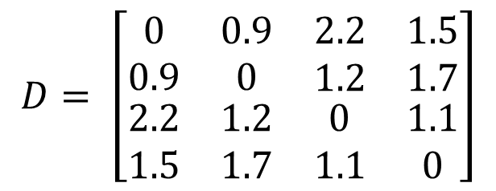
Measuring Cluster Validity Via Correlation
B
Two matrices
  Similarity or Distance Matrix
    One row and one column for each data point
    An entry is the similarity or distance of the associated pair of points
  “Incidence” Matrix
    One row and one column for each data point
    An entry is 1 if the associated pair of points belong to the same cluster
    An entry is 0 if the associated pair of points belongs to different clusters
C
A
D
A B C D
$$D= \left[\begin{matrix}\begin{matrix}0 & 0.9 \\ 0.9 & 0\end{matrix} & \begin{matrix}2.2 & 1.5 \\ 1.2 & 1.7\end{matrix} \\ \begin{matrix}2.2 & 1.2 \\ 1.5 & 1.7\end{matrix} & \begin{matrix}0 & 1.1 \\ 1.1 & 0\end{matrix}\end{matrix}\right]$$
A
B
C
D
A B C D
$$I= \left[\begin{matrix}\begin{matrix}1 & 1 \\ 1 & 1\end{matrix} & \begin{matrix}0 & 0 \\ 0 & 0\end{matrix} \\ \begin{matrix}0 & 0 \\ 0 & 0\end{matrix} & \begin{matrix}1 & 1 \\ 1 & 1\end{matrix}\end{matrix}\right]$$
A
B
C
D

Slide 92
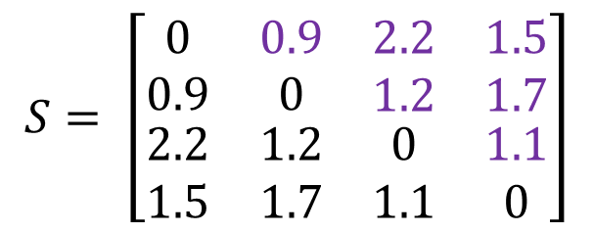
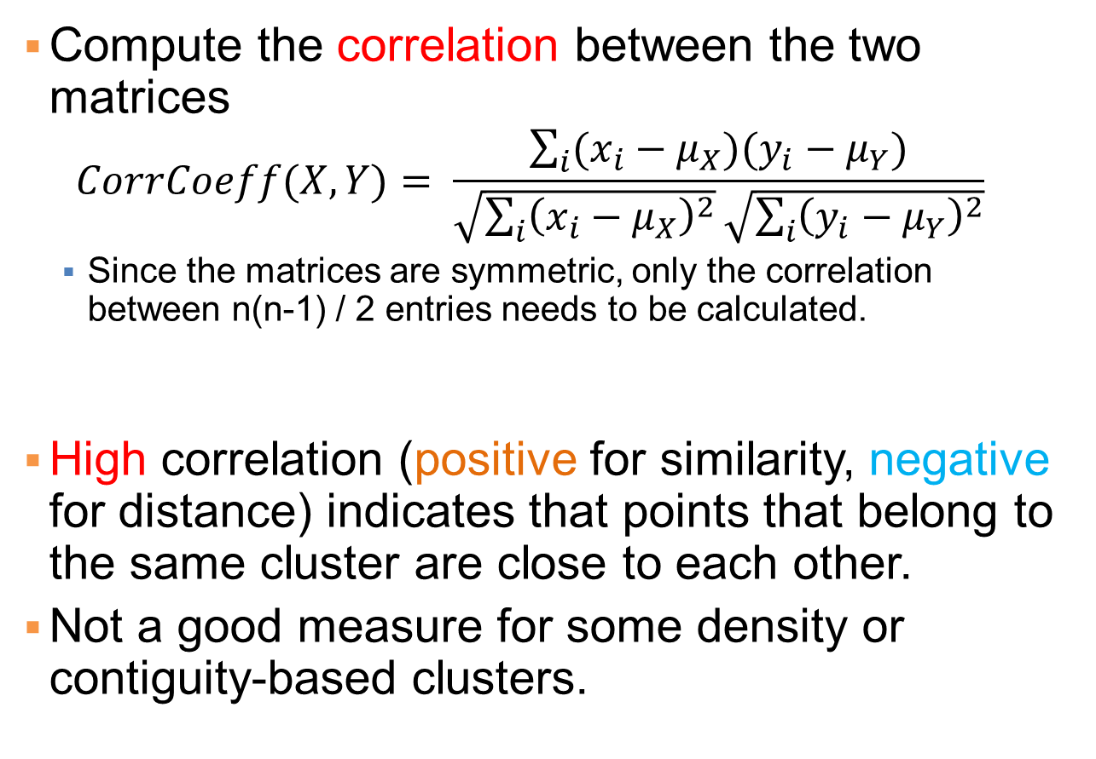
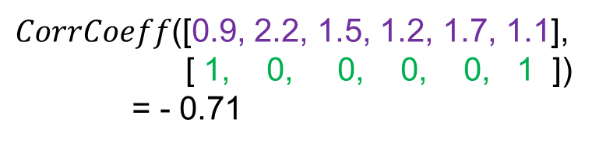
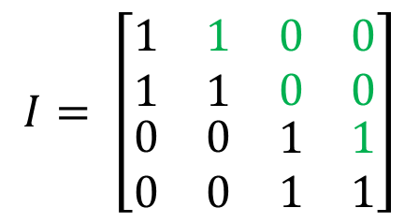
Measuring Cluster Validity Via Correlation
A B C D
$$S= \left[\begin{matrix}\begin{matrix}0 & 0.9 \\ 0.9 & 0\end{matrix} & \begin{matrix}2.2 & 1.5 \\ 1.2 & 1.7\end{matrix} \\ \begin{matrix}2.2 & 1.2 \\ 1.5 & 1.7\end{matrix} & \begin{matrix}0 & 1.1 \\ 1.1 & 0\end{matrix}\end{matrix}\right]$$
A
B
C
D
Compute the correlation between the two matrices
  $$CorrCoeff(X,Y)= \frac{\sum_{i}{(x_{i}−μ_{X})(y_{i}−μ_{Y})}}{\sqrt{\sum_{i}{{\left(x_{i}−μ_{X}\right)}^{2}}}\sqrt{\sum_{i}{{\left(y_{i}−μ_{Y}\right)}^{2}}}}$$
  Since the matrices are symmetric, only the correlation between n(n-1) / 2 entries needs to be calculated.
High correlation (positive for similarity, negative for distance) indicates that points that belong to the same cluster are close to each other.
Not a good measure for some density or contiguity-based clusters.
A B C D
$$I= \left[\begin{matrix}\begin{matrix}1 & 1 \\ 1 & 1\end{matrix} & \begin{matrix}0 & 0 \\ 0 & 0\end{matrix} \\ \begin{matrix}0 & 0 \\ 0 & 0\end{matrix} & \begin{matrix}1 & 1 \\ 1 & 1\end{matrix}\end{matrix}\right]$$
A
B
C
D
$CorrCoeff$([0.9, 2.2, 1.5, 1.2, 1.7, 1.1],
[ 1, 0, 0, 0, 0, 1 ])
= - 0.71

Slide 93
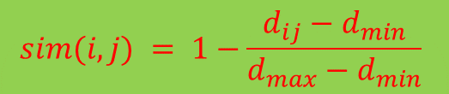
Using Similarity Matrix for Cluster Validation
Order the similarity matrix with respect to cluster labels and inspect visually.
Corr = -0.9235
$$sim(i,j) = 1−\frac{d_{ij}−d_{min}}{d_{max}−d_{min}}$$

Slide 94
Using Similarity Matrix for Cluster Validation
Clusters in random data are not so crisp
Corr = -0.5810
K-means

Slide 95
Using Similarity Matrix for Cluster Validation
DBSCAN
Clusters in more complicated figures are not well separated
This technique can only be used for small datasets since it requires a quadratic computation

Slide 96
Internal measures – caveats
Internal measures have the problem that the clustering algorithm did not set out to optimize this measure, so it is will not necessarily do well with respect to the measure.
  Essentially, we check whether one criterion correlates well with another
An internal measure can also be used as an objective function for clustering
The algorithm that optimizes this criterion is expected to do well.

Slide 97
Statistical Framework for Cluster(ING) Validity

Slide 98
Framework for Cluster Validity
Need a framework to interpret any measure.
  For example, if our measure of evaluation has the value, 10, is that good, fair, or poor?
Statistics provide a framework for cluster validity
  The more “non-random” a clustering result is, the more likely it represents valid structure in the data
  Can compare the index value for a clustering with the values of the index that result from clustering random data, or from random clusterings.
    If the value of the index is unlikely, then the clustering results are valid
  Comparing against clustering of random data tells us if there is valid clustering structure in the data
  Comparing against random clusterings tells us if the clustering algorithm is meaningful
    Although a random clustering is a weak alternative.
For comparing the results of two different clusterings, a framework is less necessary, but we may want to know whether the difference between two index values is significant

Slide 99
Statistical Framework for SSE
Example
  Compare SSE of 0.005 against three clusters in random data
  Histogram of SSE for three clusters in 500 random data sets of 100 random points distributed in the range 0.2 – 0.8 for x and y
    Value 0.005 is very unlikely
SSE = 0.005

Slide 100
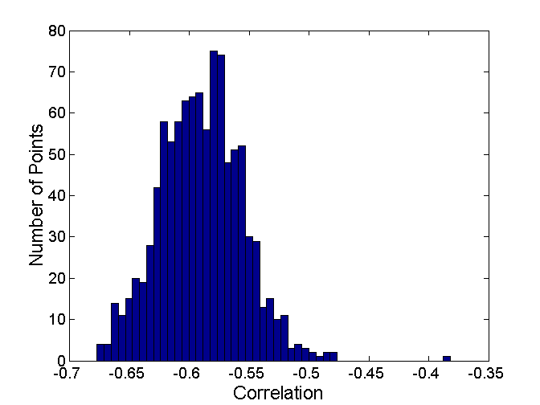
Statistical Framework for Correlation
Correlation of incidence and proximity matrices for the K-means clusterings of the following two data sets.
Corr = -0.9235
Corr = -0.5810

Slide 101
Empirical p-value
What we do is similar to a permutation test:
We have a measurement v (e.g., the SSE value)
We compute N measurements on random datasets
We compute the empirical p-value as the fraction of measurements in the random data that have value less or equal than value v (or greater or equal if we want to maximize)
  i.e., the value in the random dataset is at least as good as that in the real data
We usually require that p-value ≤ 0.05
Hard question: what is the right notion of a random dataset?

Slide 102
Estimating the “Right” number of clusters

Slide 103
Estimating the “right” number of clusters
Typical approach: find a “knee” in an internal measure curve.
Question: why not the k that minimizes the SSE?
  Forward reference: minimize a measure, but with a “simple” clustering
Desirable property: the clustering algorithm does not require the number of clusters to be specified (e.g., DBSCAN)

Slide 104
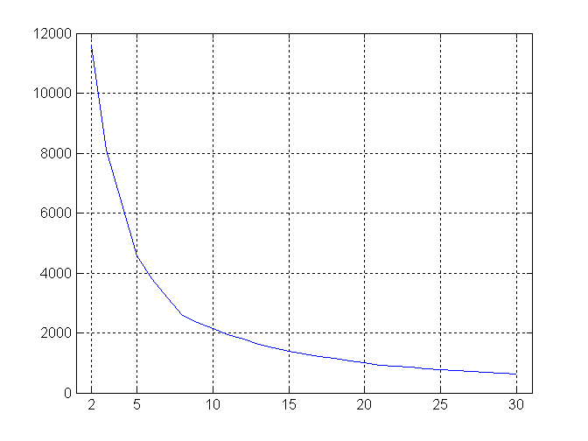
Estimating the “right” number of clusters
SSE curve for a more complicated data set
SSE of clusters found using K-means

Slide 105
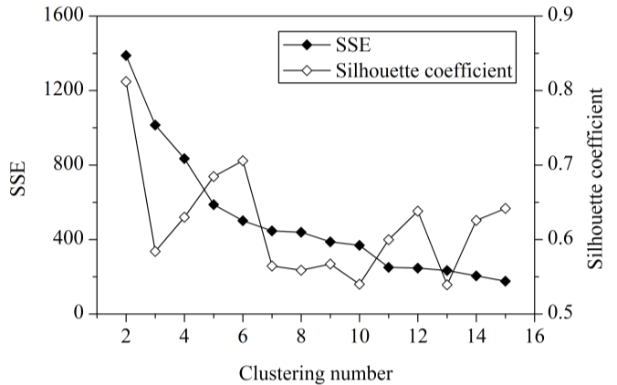
Estimating the “right” number of clusters
A metric that is better suited for this task is the average silhouette coefficient which does not change monotonically with the number of clusters
In this example 6 seems to be a good number of clusters since it has high silhouette coefficient and low SSE
2 has the highest silhouette coefficient but highest SSE.
12 could be another alternative

Slide 106
Evaluation with External “Ground Truth”

Slide 107
External Measures for Clustering Validity
Assume that the data is labeled with some class labels
  E.g., documents are classified into topics, people classified according to their income, politicians classified according to the political party.
  This is called the “ground truth”
In this case we want the clusters to be homogeneous with respect to classes
  Each cluster should contain elements of mostly one class
  Each class should ideally be assigned to a single cluster
This does not always make sense
  Clustering is not the same as classification
  …but this is what people use most of the time

Slide 108
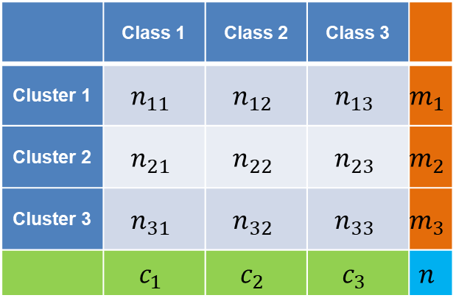
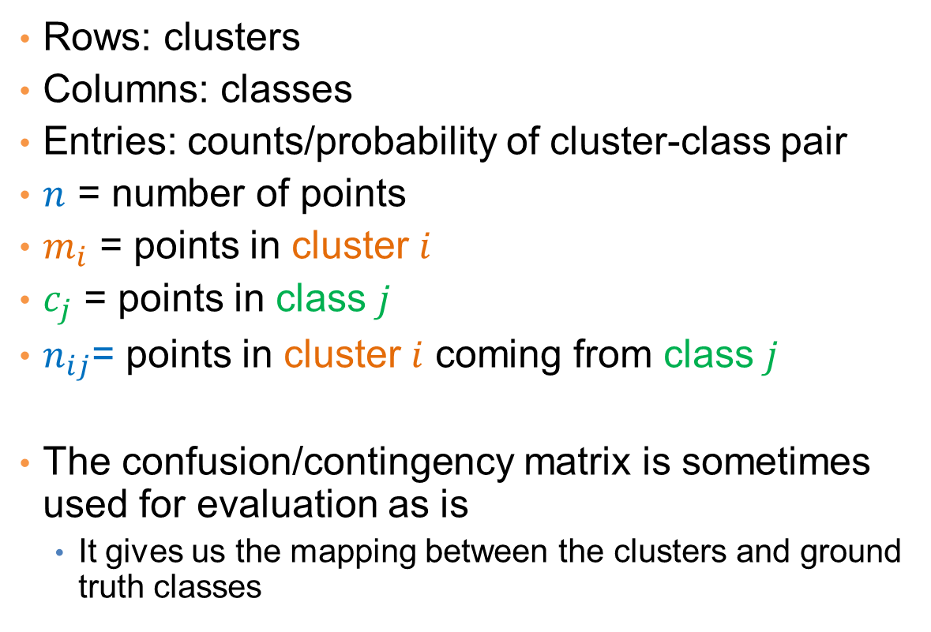
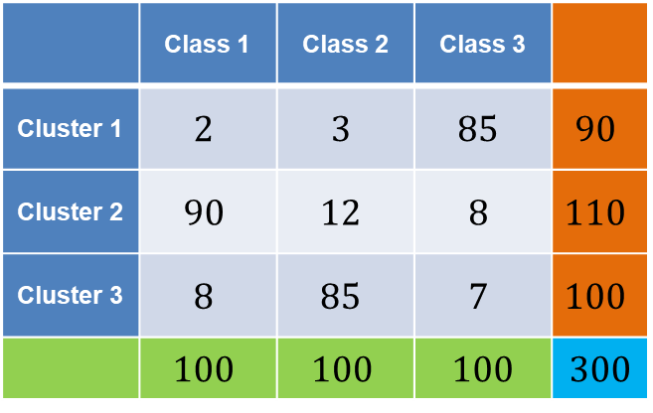
Confusion/Contingency matrix
Confusion/Contingency matrix of
clusters and classes (counts)
 | Class 1 | Class 2 | Class 3
Cluster 1 | $$n_{11}$$ | $$n_{12}$$ | $$n_{13}$$ | $$m_{1}$$
Cluster 2 | $$n_{21}$$ | $$n_{22}$$ | $$n_{23}$$ | $$m_{2}$$
Cluster 3 | $$n_{31}$$ | $$n_{32}$$ | $$n_{33}$$ | $$m_{3}$$
 | $$c_{1}$$ | $$c_{2}$$ | $$c_{3}$$ | $$n$$
Rows: clusters
Columns: classes
Entries: counts/probability of cluster-class pair
$n$ = number of points
$m_{i}$ = points in cluster $i$
$c_{j}$ = points in class $j$
$n_{ij}$= points in cluster $i$ coming from class $j$
The confusion/contingency matrix is sometimes used for evaluation as is
  It gives us the mapping between the clusters and ground truth classes
Example
 | Class 1 | Class 2 | Class 3
Cluster 1 | $$2$$ | $$3$$ | $$85$$ | $$90$$
Cluster 2 | $$90$$ | $$12$$ | $$8$$ | $$110$$
Cluster 3 | $$8$$ | $$85$$ | $$7$$ | $$100$$
 | $$100$$ | $$100$$ | 100 | 300

Slide 109



Measures of cluster homogeneity
 | Class 1 | Class 2 | Class 3
Cluster 1 | $$p_{11}$$ | $$p_{12}$$ | $$p_{13}$$ | $$m_{1}$$
Cluster 2 | $$p_{21}$$ | $$p_{22}$$ | $$p_{23}$$ | $$m_{2}$$
Cluster 3 | $$p_{31}$$ | $$p_{32}$$ | $$p_{33}$$ | $$m_{3}$$
 | $$c_{1}$$ | $$c_{2}$$ | $$c_{3}$$ | $$n$$
Compute probabilities:
$$p_{ij}=\frac{n_{ij}}{m_{i}}$$
  The probability that a randomly selected point from cluster $i$ comes from class $j$.
  Probabilities of rows sum to 1
Purity:
  Of a cluster $i$: $p_{i}=\max_{j}{p_{ij}}$
  Of a clustering: $p(C)= \sum_{i=1}^{K}{\frac{m_{i}}{n}p_{i}}$
Entropy:
  Of a cluster $i$: $e_{i}=−\sum_{j=1}^{L}{p_{ij}\log{p_{ij}}}$
    Highest when uniform, zero when single class
  Of a clustering: $e= \sum_{i=1}^{K}{\frac{m_{i}}{n}e_{i}}$
 | Class 1 | Class 2 | Class 3
Cluster 1 | $$0.02$$ | $$0.03$$ | 0.95 | $$90$$
Cluster 2 | $$0.82$$ | $$0.11$$ | $$0.07$$ | $$110$$
Cluster 3 | $$0.08$$ | $$0.85$$ | $$0.07$$ | $$100$$
 | $$100$$ | $$100$$ | 100 | 300
Purity: (0.94, 0.81, 0.85)
– overall 0.86
Entropy: (0.33, 0.85, 0.76)
– overall 0.66

Slide 110



Classification-based Measures
 | Class 1 | Class 2 | Class 3
Cluster 1 | $$n_{11}$$ | $$n_{12}$$ | $$n_{13}$$ | $$m_{1}$$
Cluster 2 | $$n_{21}$$ | $$n_{22}$$ | $$n_{23}$$ | $$m_{2}$$
Cluster 3 | $$n_{31}$$ | $$n_{32}$$ | $$n_{33}$$ | $$m_{3}$$
 | $$c_{1}$$ | $$c_{2}$$ | $$c_{3}$$ | $$n$$
Precision:
  Of cluster $i$ with respect to class $j$:
  $$Prec\left(i,j\right)=\frac{n_{ij}}{m_{i}}=p_{ij}$$
  Percentage of the cluster $i$ that comes from class $j$
Recall:
  Of cluster $i$ with respect to class $j$:
  $$Rec\left(i,j\right)=\frac{n_{ij}}{c_{j}}$$
  Percentage of class $j$ that goes to cluster $i$
F-measure:
  Harmonic Mean of Precision and Recall:
  $$F\left(i,j\right)= \frac{2∗Prec\left(i,j\right)∗Rec(i,j)}{Prec\left(i,j\right)+Rec(i,j)}$$
 | Class 1 | Class 2 | Class 3
Cluster 1 | $$2$$ | $$3$$ | $$85$$ | $$90$$
Cluster 2 | $$90$$ | $$12$$ | $$8$$ | $$110$$
Cluster 3 | $$8$$ | $$85$$ | $$7$$ | $$100$$
 | $$100$$ | $$100$$ | 100 | 300

Slide 111




Precision-recall for cluster-class cobinations
Precision of cluster $i$ with respect to class $j$: $Prec\left(i,j\right)=\frac{n_{ij}}{m_{i}}=p_{ij}$
  Percentage of the cluster $i$ that comes from class $j$
Recall of cluster $i$ with respect to class $j$: $Rec\left(i,j\right)=\frac{n_{ij}}{c_{j}}$
  Percentage of class $j$ that goes to cluster $i$
 | Class 1 | Class 2 | Class 3
Cluster 1 | $$2$$ | $$3$$ | $$85$$ | $$90$$
Cluster 2 | $$90$$ | $$12$$ | $$8$$ | $$110$$
Cluster 3 | $$8$$ | $$85$$ | $$7$$ | $$100$$
 | $$100$$ | $$100$$ | 100 | 300
 | Class 1 | Class 2 | Class 3
Cluster 1 | $$0.02$$ | $$0.03$$ | 0.95
Cluster 2 | $$0.82$$ | $$0.11$$ | $$0.07$$
Cluster 3 | $$0.08$$ | $$0.85$$ | $$0.07$$
 | Class 1 | Class 2 | Class 3
Cluster 1 | $$0.02$$ | $$0.03$$ | 0.85
Cluster 2 | $$0.90$$ | $$0.12$$ | $$0.08$$
Cluster 3 | $$0.08$$ | $$0.85$$ | $$0.07$$
Precision Table
Recall Table

Slide 112


Precision/Recall for clusters and clusterings
Assign to cluster $i$ the class $k_{i}$ such that $k_{i}=\arg{\max_{j}{n_{ij}}}$
Precision:
  Of cluster $i$: $Prec\left(i\right)=\frac{n_{ik_{i}}}{m_{i}}$
  Of the clustering: $Prec(C)=\sum_{i}{\frac{m_{i}}{n}}Prec(i)$
Recall:
  Of cluster $i$: $Rec\left(i\right)=\frac{n_{ik_{i}}}{c_{k_{i}}}$
  Of the clustering: $Rec\left(C\right)=\sum_{i}{\frac{m_{i}}{n}}Rec(i)$
F-measure:
  Harmonic Mean of Precision and Recall
 | Class 1 | Class 2 | Class 3
Cluster 1 | $$2$$ | $$3$$ | $$85$$ | $$90$$
Cluster 2 | $$90$$ | $$12$$ | $$8$$ | $$110$$
Cluster 3 | $$8$$ | $$85$$ | $$7$$ | $$100$$
 | $$100$$ | $$100$$ | 100 | 300
Precision: (0.94, 0.81, 0.85)
– overall 0.86
Recall: (0.85, 0.9, 0.85)
- overall 0.87

Slide 113


Good and bad clustering
 | Class 1 | Class 2 | Class 3
Cluster 1 | $$2$$ | $$3$$ | $$85$$ | $$90$$
Cluster 2 | $$90$$ | $$12$$ | $$8$$ | $$110$$
Cluster 3 | $$8$$ | $$85$$ | $$7$$ | $$100$$
 | $$100$$ | $$100$$ | 100 | 300
 | Class 1 | Class 2 | Class 3
Cluster 1 | $$20$$ | $$35$$ | $$35$$ | $$90$$
Cluster 2 | $$30$$ | $$42$$ | $$38$$ | $$110$$
Cluster 3 | $$38$$ | $$35$$ | $$27$$ | $$100$$
 | $$100$$ | $$100$$ | 100 | 300
Purity: (0.94, 0.81, 0.85)
– overall 0.86
Precision: (0.94, 0.81, 0.85)
– overall 0.86
Recall: (0.85, 0.9, 0.85)
- overall 0.87
Purity: (0.38, 0.38, 0.38)
– overall 0.38
Precision: (0.38, 0.38, 0.38)
– overall 0.38
Recall: (0.35, 0.42, 0.38)
– overall 0.39

Slide 114

Another clustering
 | Class 1 | Class 2 | Class 3
Cluster 1 | $$0$$ | $$0$$ | $$35$$ | $$35$$
Cluster 2 | $$50$$ | $$77$$ | $$38$$ | $$165$$
Cluster 3 | $$38$$ | $$35$$ | $$27$$ | $$100$$
 | $$100$$ | $$100$$ | 100 | 300
Cluster 1:
  Purity: 1
  Precision: 1
  Recall: 0.35

Slide 115

External Measures of Cluster Validity: Entropy and Purity

Slide 116
Final Comment on Cluster Validity
“The validation of clustering structures is the most difficult and frustrating part of cluster analysis.
Without a strong effort in this direction, cluster analysis will remain a black art accessible only to those true believers who have experience and great courage.”
Algorithms for Clustering Data, Jain and Dubes

