Slide 1
DATA MINING TUTORIAL
Introduction to Python Libraries

Slide 2
Python
In the last few years there is an increasing community that creates Data Mining tools in Python
Python is overwhelmingly used today for data science tasks
It is also heavily used in industry
We will use Python for this class.
There are tons of resources online for Python.
For an introduction you can also look at the slides of the Introduction to Programming course by prof. N. Mamoulis
I assume you have installed Python to your laptop by now and you have a good knowledge of programming in python.

Slide 3
Anaconda
Installing libraries in Python can be complicated, so you should download the Anaconda Scientific Python distribution which will install most of the libraries that we will use.
Use Python 3.0
Installing Anaconda installs a lot of libraries and also:
Anaconda Navigator
Jupyter Notebook: An interactive web-based interface for running python.
Anaconda Powershell: terminal for running commands

Slide 4
Jupyter Notebook
Installing Anaconda will also install Jupyter Notebook.
If you wish to install it in a different way, together with the relevant libraries you are free to do so.
We will use Notebook for our examples and it is required for the assignments.
In almost all assignments you are required to submit a Notebook.

Slide 6
The Anaconda Navigator

Slide 7
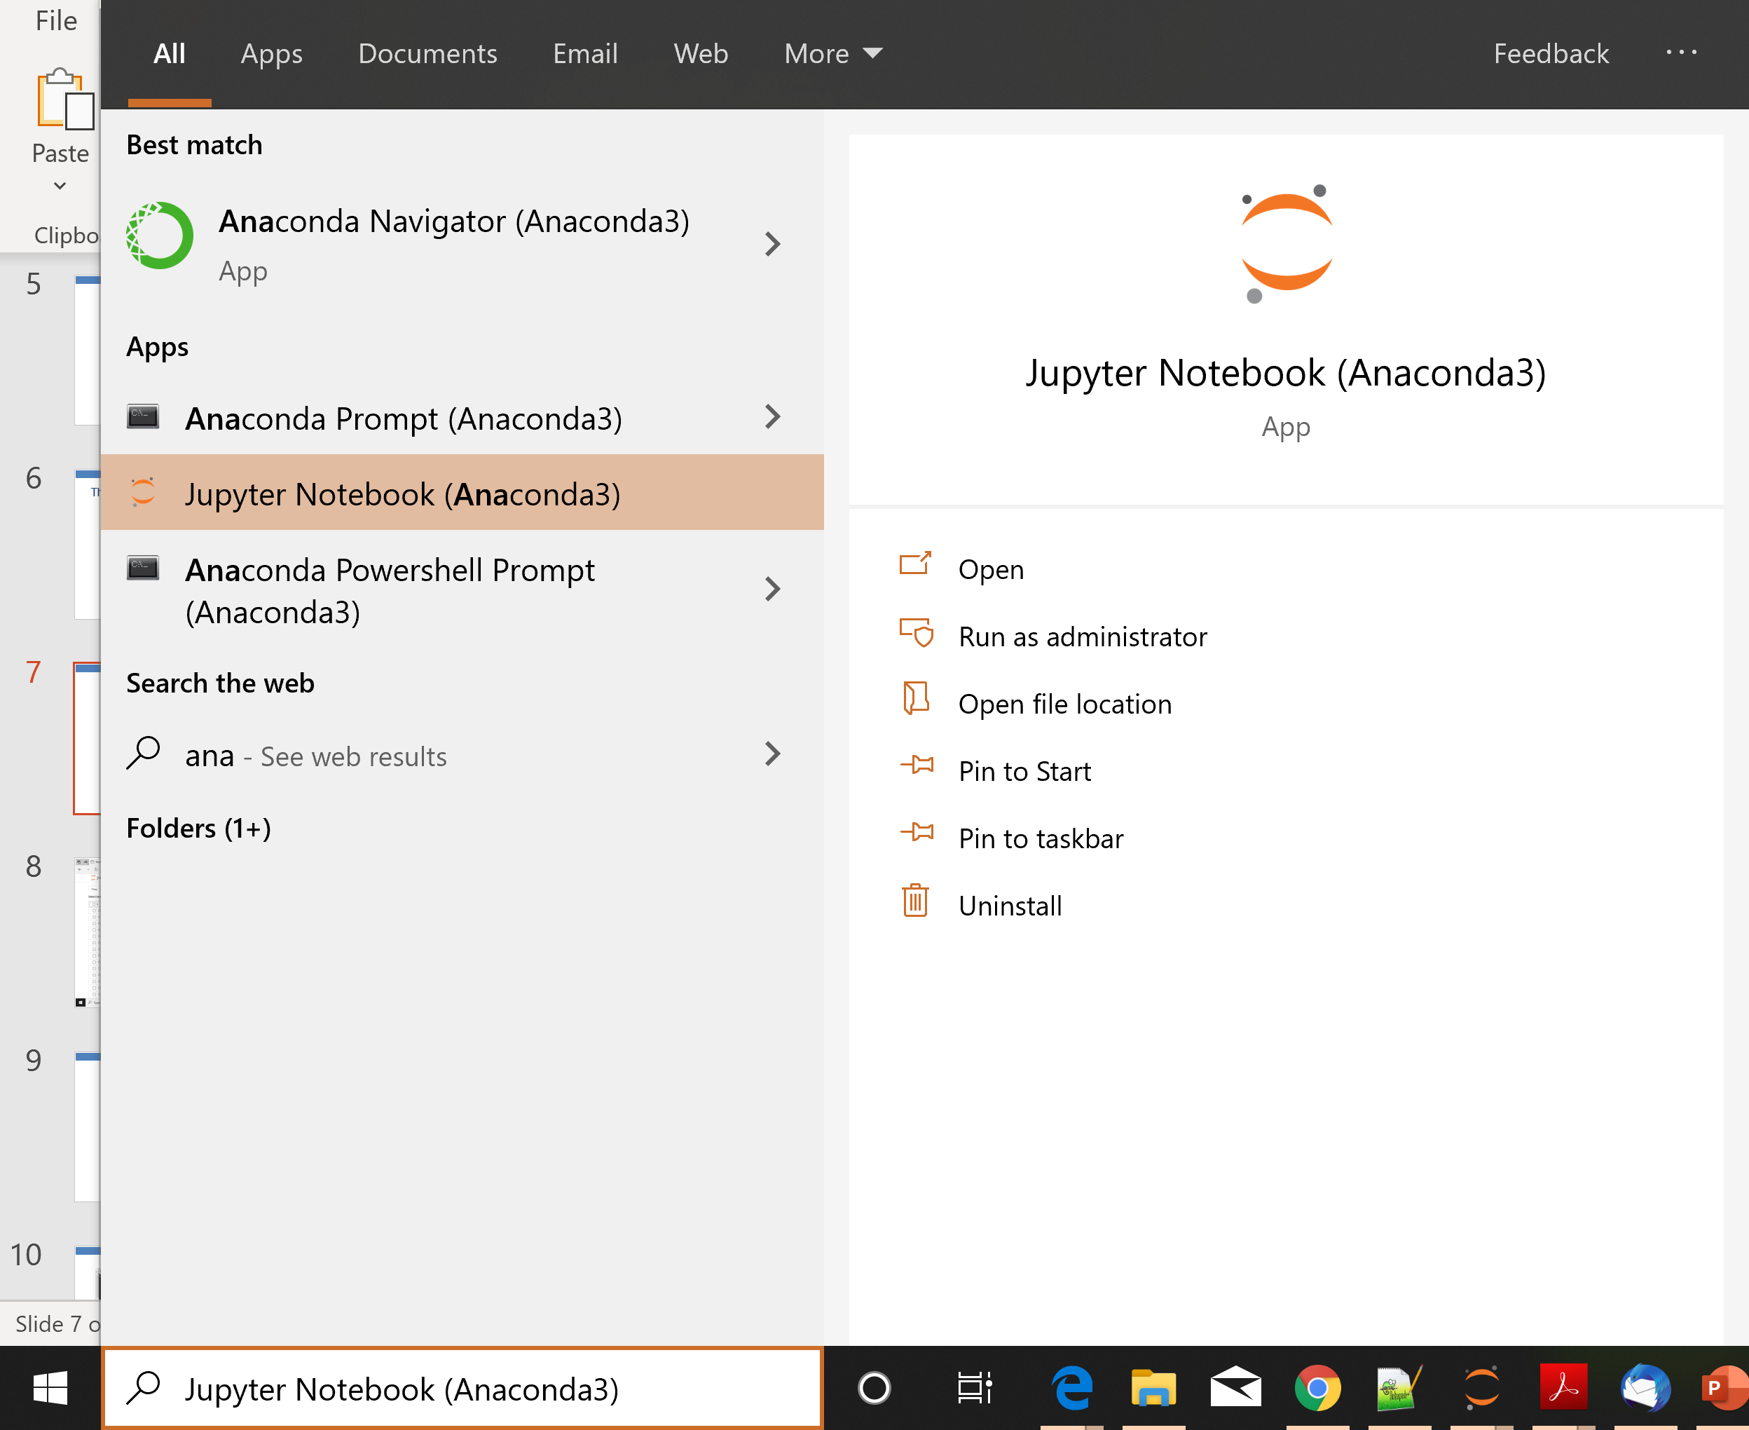

Slide 8
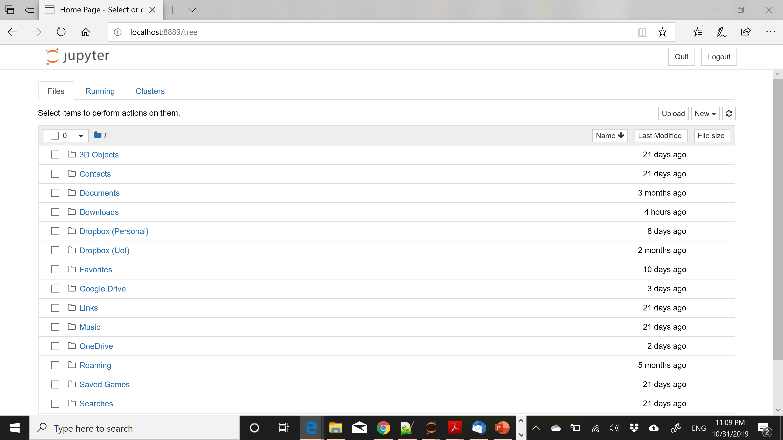

Slide 11
Installing Packages
You can install packages from the Anaconda terminal using the command:
conda install <name of package>
For example, Seaborn is a package for Statistical Data Visualization.
conda install seaborn
panda-datareader is a package for loading online datasets.
conda install pandas-datareader

Slide 12
Notebooks
Jupyter Notebook offers an interactive web-based interface for running code.
The Notebook runs inside a browser.
It allows you to interact with the code, running different parts of the code
The results also appear in the browser, so you can have together the code and the results
You can also add text, commenting on the results.
We will now see some details on how to create notebooks

Slide 13
Changing the notebook default directory
This used to be important before but now Jupyter Notebook takes you to the home directory
From the Anaconda terminal type the command:
jupyter notebook --generate-config
This will generate .jupiter/jupyter_notebook_config.py file under your home directory.
Find, un-comment and modify the line
# c.NotebookApp.notebook_dir = '‘ in the config file to point to the desired directory

Slide 14
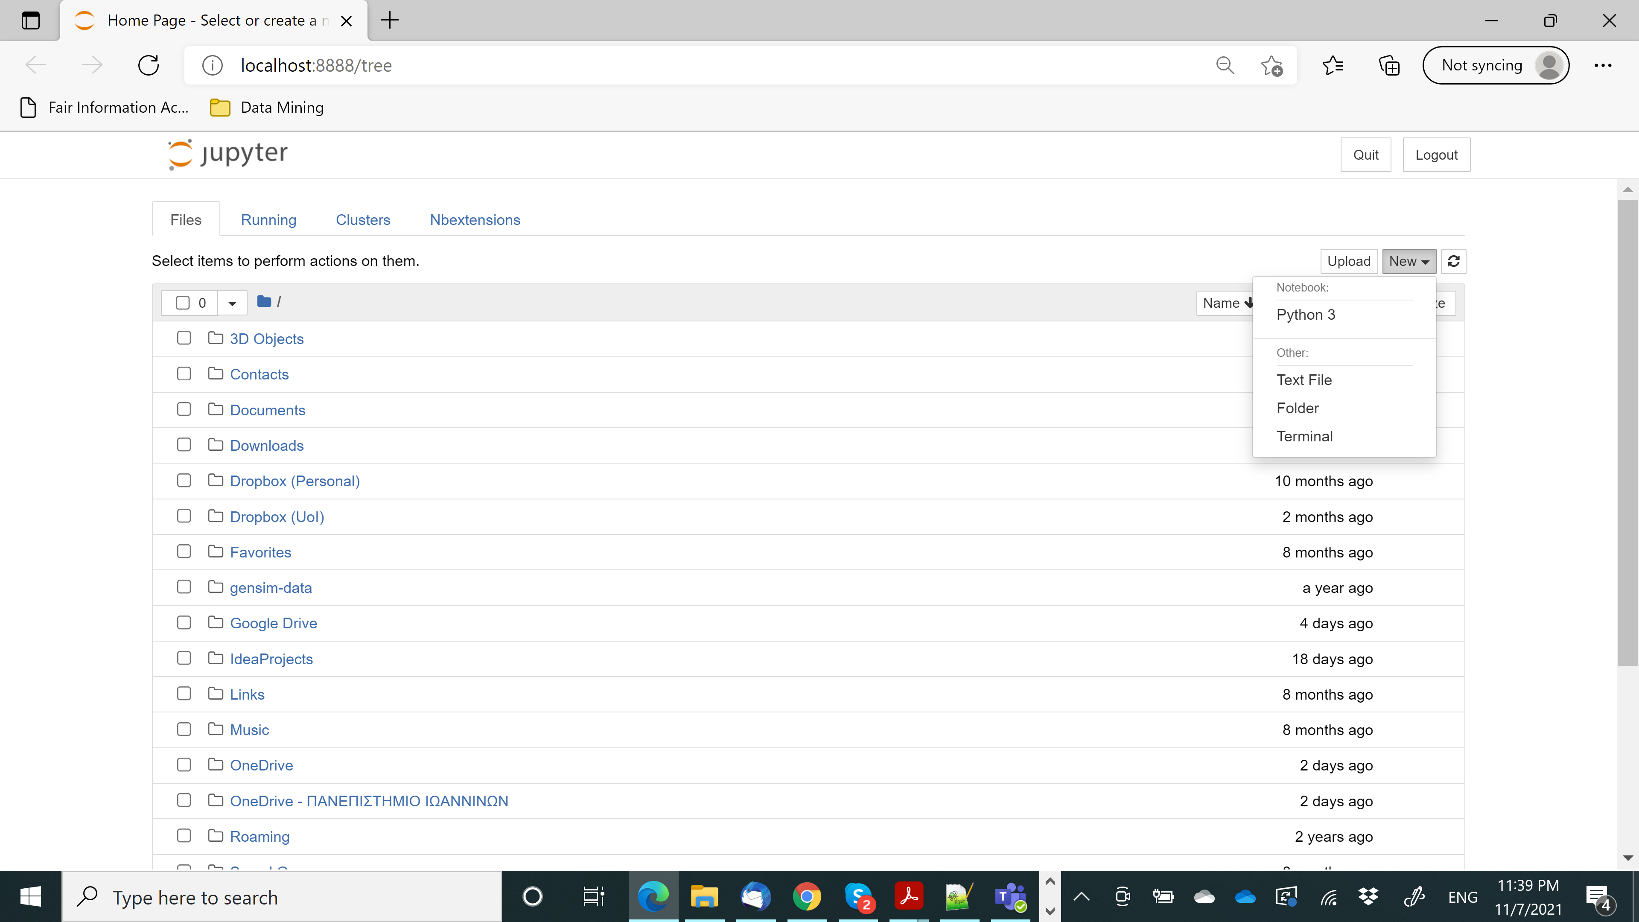

Slide 15
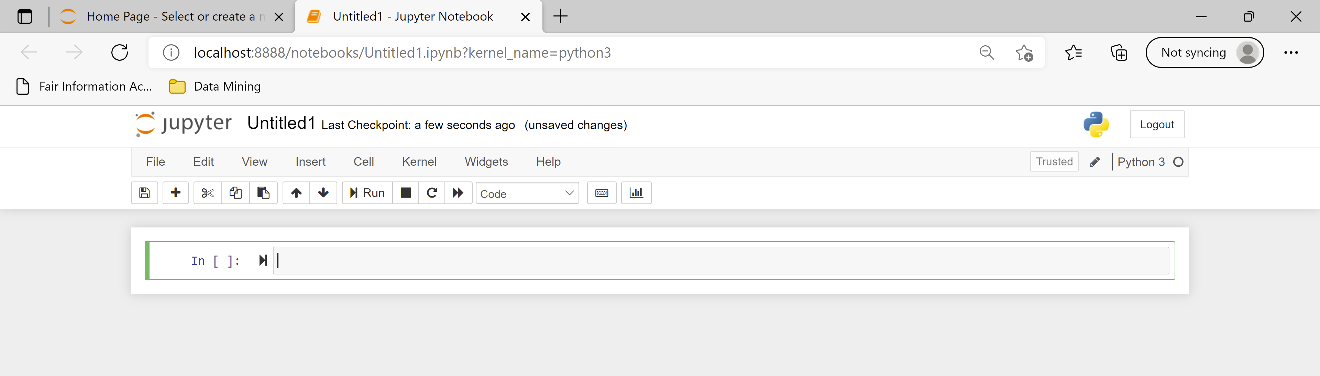
The notebook is organized in cells
In each cell you can write either code or text
The default behavior is code

Slide 16
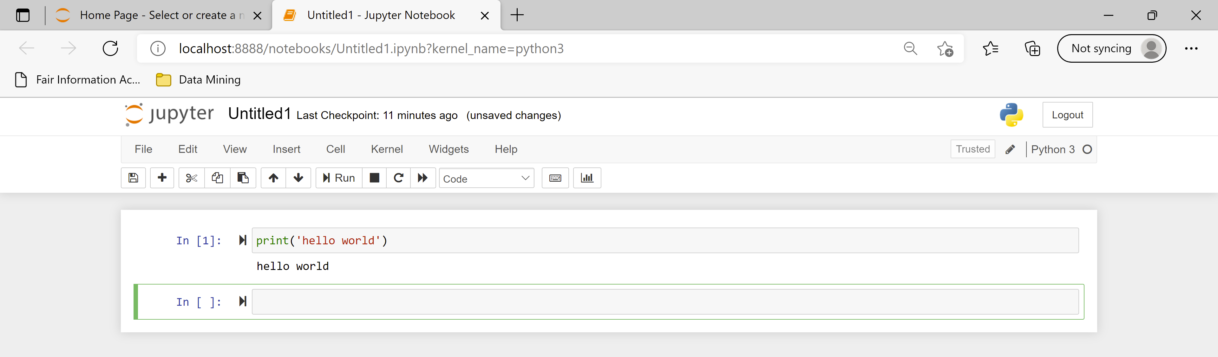
You can run the code using the Run button or with Ctrl+Enter
Note that now we have both the code and the output in the notebook

Slide 17
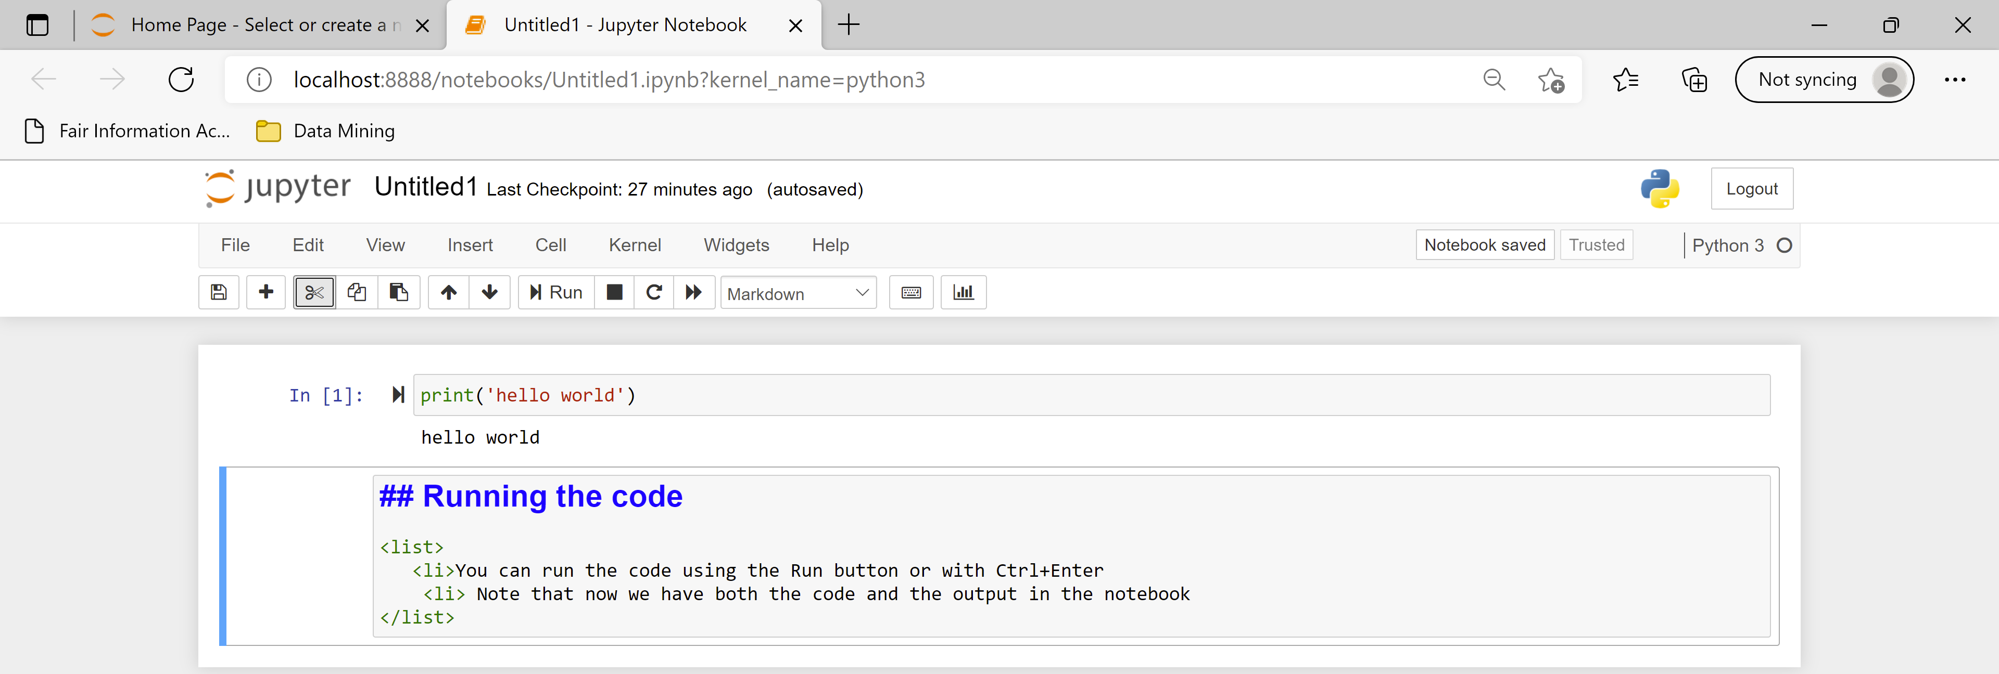
You can also write text in Markdown language
You can combine HTML, and Latex, and there are some other commands
You can learn more about Markdown by searching online, e.g.:
Learn How to Write Markdown & LaTeX in The Jupyter Notebook | by Khelifi Ahmed Aziz | Towards Data Science
You need to Run the Markdown cell as well

Slide 18
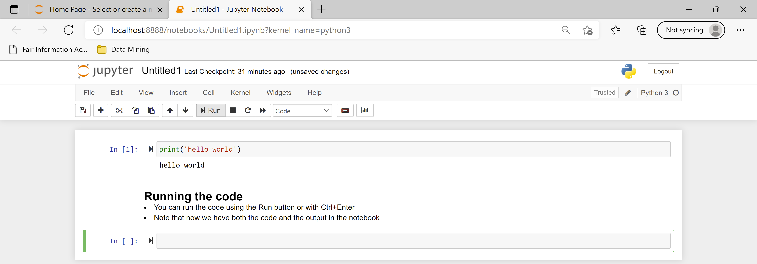

Slide 19
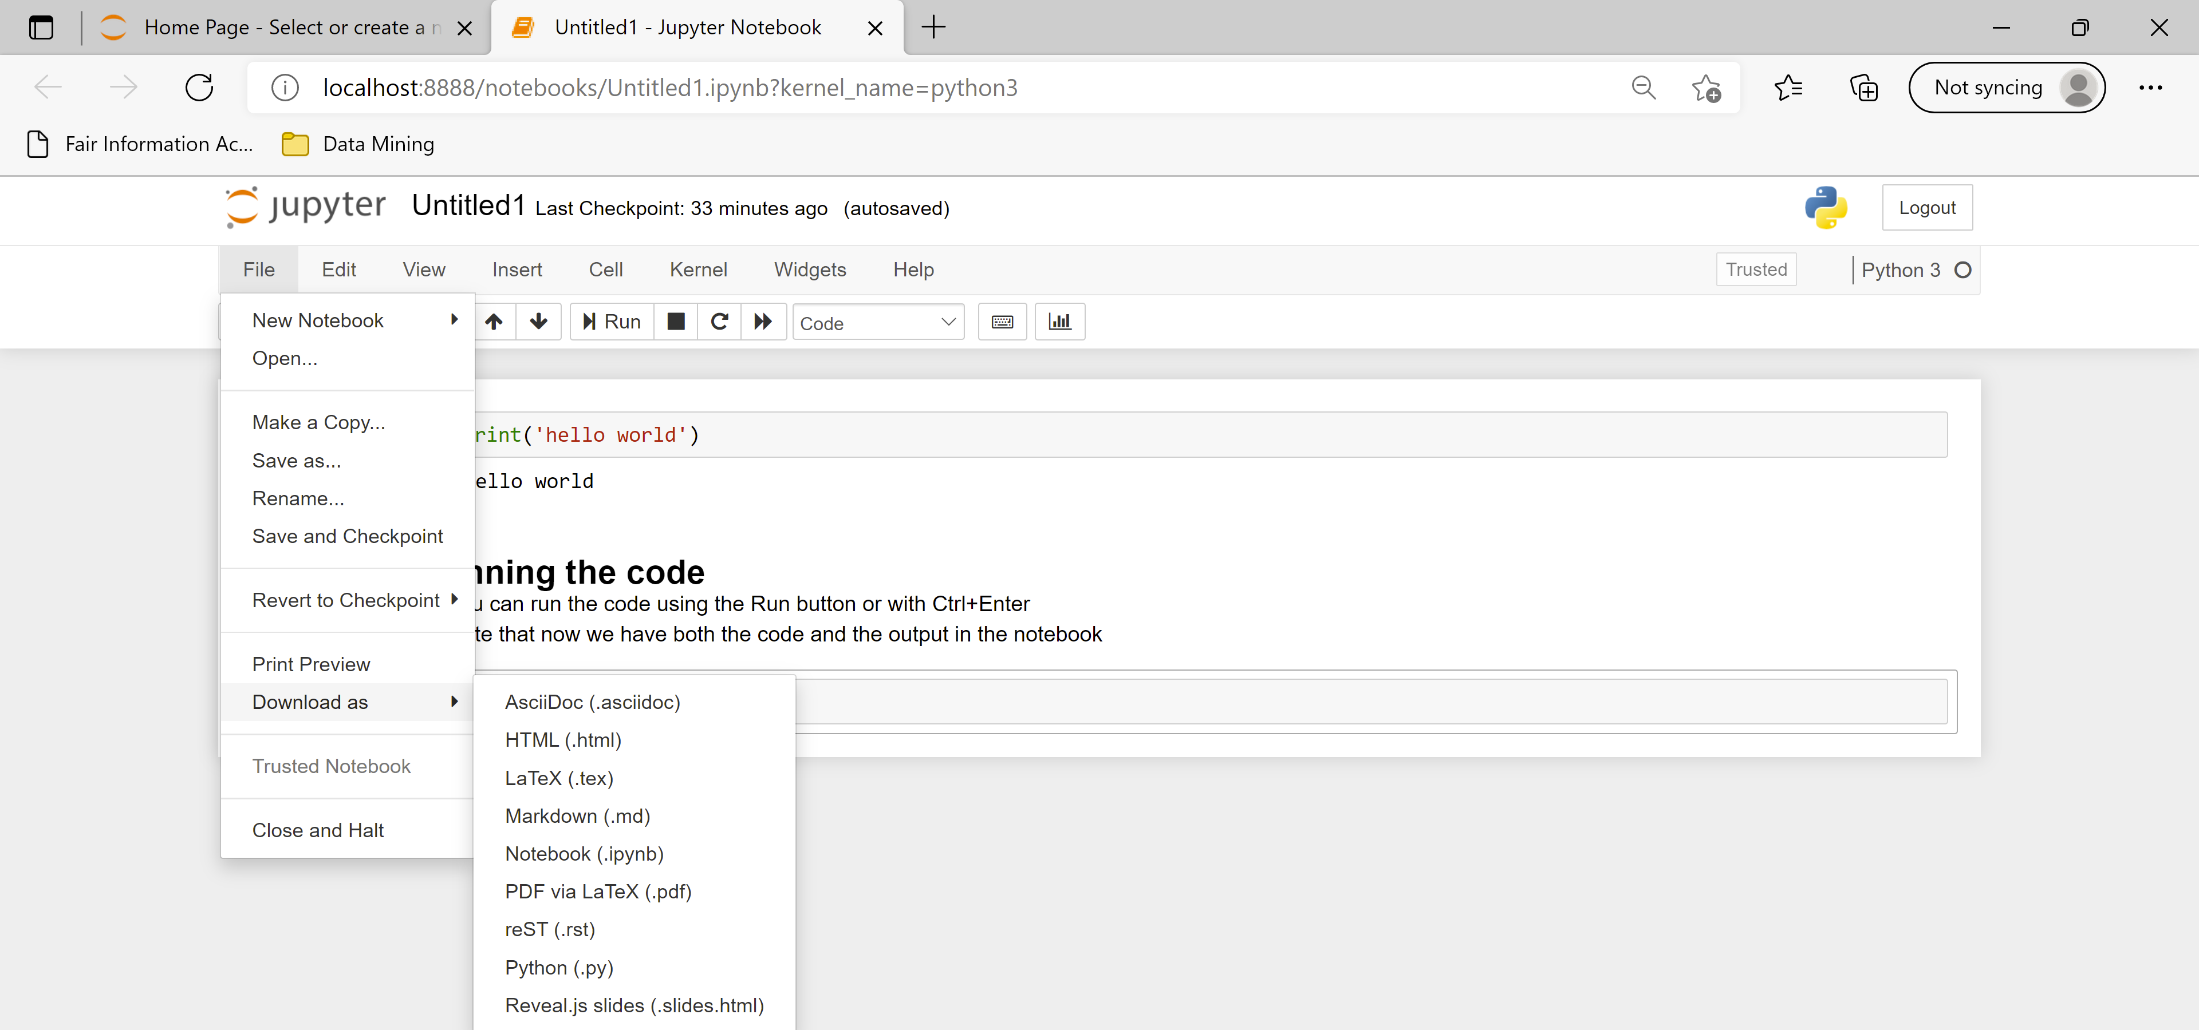
You can export the notebook into HTML or PDF

Slide 20
Attention!
A notebook is run interactively, each time running a specific cell
The state of the program remains in memory while the notebook is running
Each cell has access to the current state of the memory
You can jump between cells in a non-linear way
You should be aware of the state of the memory of the notebook when you run a specific cell.

Slide 21
A simple example
The order in which the cells are executed is shown in the increasing numbers (not always useful)
The second in order cell is executed third
So it as access to z, and uses the value 4 for x

Slide 22
Restarting

