Slide 1
Online Social Networks and Media
Graph Partitioning:
cuts, spectral clustering, density

Slide 2
Outline
PART II
Cuts
Spectral Clustering
Dense Subgraphs

Slide 3
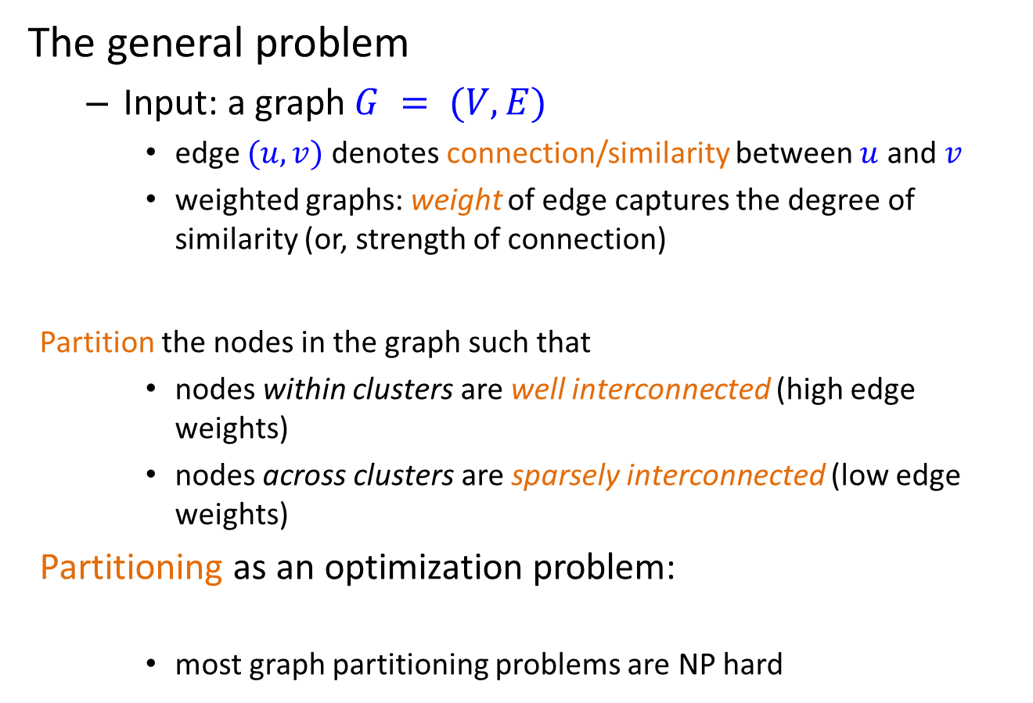
Graph partitioning
The general problem
  Input: a graph $G = (V, E)$
    edge $(u, v)$denotes connection/similarity between $u$ and $v$
    weighted graphs: weight of edge captures the degree of similarity (or, strength of connection)
    Partition the nodes in the graph such that
    nodes within clusters are well interconnected (high edge weights)
    nodes across clusters are sparsely interconnected (low edge weights)
  Partitioning as an optimization problem:
    most graph partitioning problems are NP hard

Slide 4
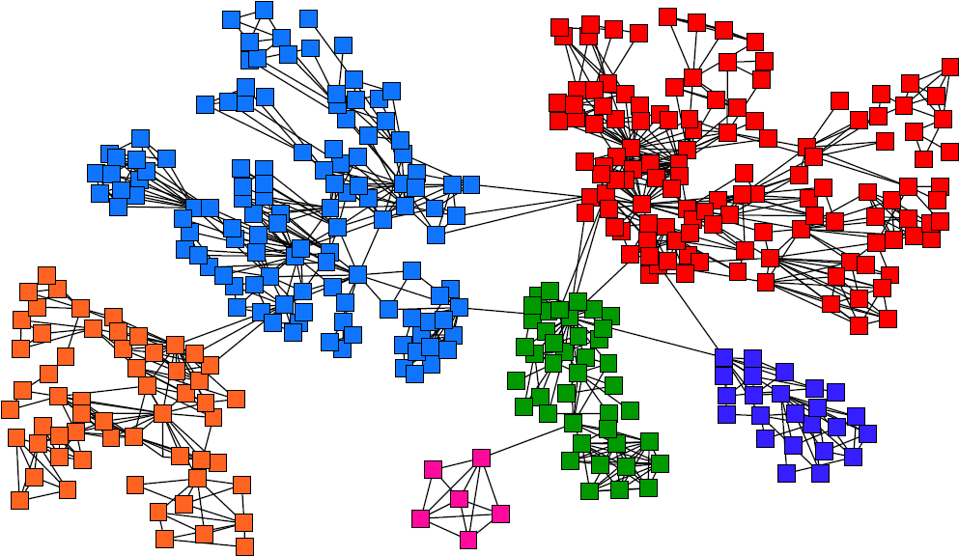
Graph Partitioning

Slide 5
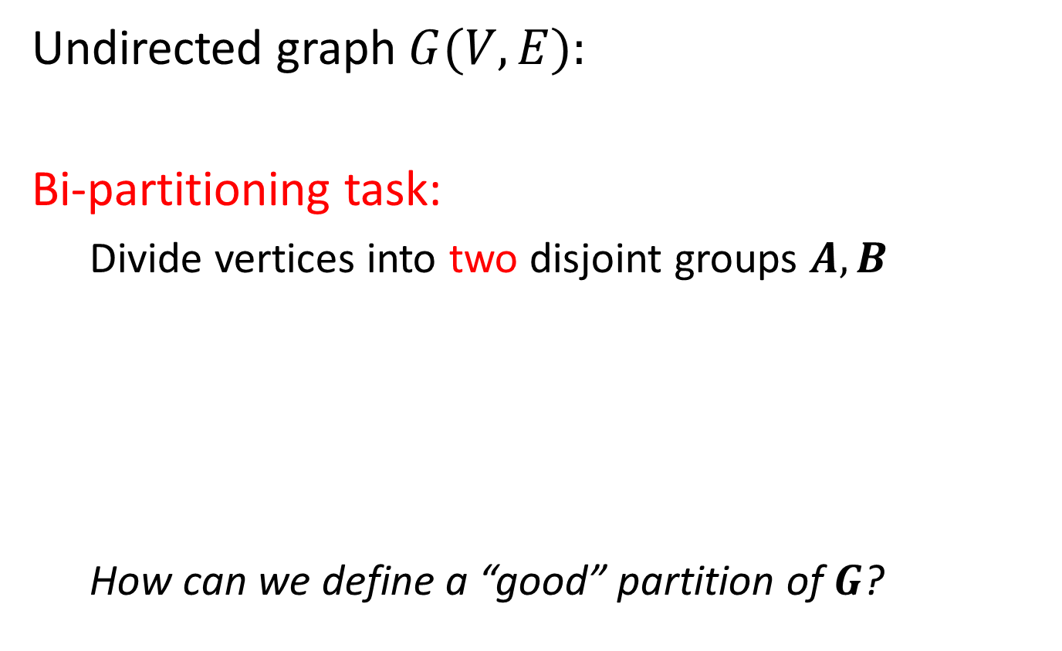
Graph Partitioning
Undirected graph $G(V,E):$
Bi-partitioning task:
  Divide vertices into two disjoint groups $A, B$
  How can we define a “good” partition of $G$?
1
5
2
6
4
3
A
5
B
1
2
6
3
4

Slide 6
Graph Partitioning
What makes a good partition?
  Maximize the number of within-group
  connections
  Minimize the number of between-group connections
5
1
2
6
4
3
A
B

Slide 7
Graph Cuts
Express partitioning objectives as a function of the “edge cut” of the partition
Cut: Set of edges with only one vertex in a group:
A
B
5
1
cut(A,B) = 2
2
6
4
3

Slide 8
Min Cut
min-cut: the min number of edges such that when removed cause the graph to become disconnected
Minimizes the number of connections between partition
arg min_{A,B} cut(A,B)
This problem can be solved in polynomial time
Min-cut/Max-flow algorithm
U
V-U

Slide 9
Does this work?

Slide 10
Min Cut
“Optimal cut”
Minimum cut
Problem:
  Only considers external cluster connections
  Does not consider internal cluster connectivity

Slide 11
Graph Bisection
Since the minimum cut does not always yield good results, we need extra constraints to make the problem meaningful.
Graph Bisection refers to the problem of partitioning the nodes of the graph into two equal sets.
Notes:
The problem find a partition with equal number of nodes and minimum cut is NP-hard

Slide 12
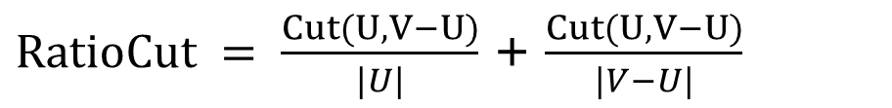
Ratio Cut
  Ratio Cut
  Normalize cut by the size of the groups
$RatioCut = \frac{Cut(U,V−U)}{|U|}$ + $\frac{Cut(U,V−U)}{|V−U|}$

Slide 13
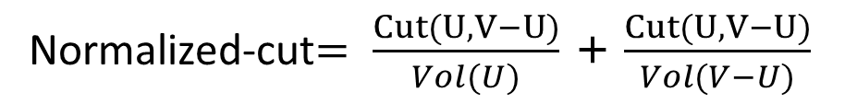
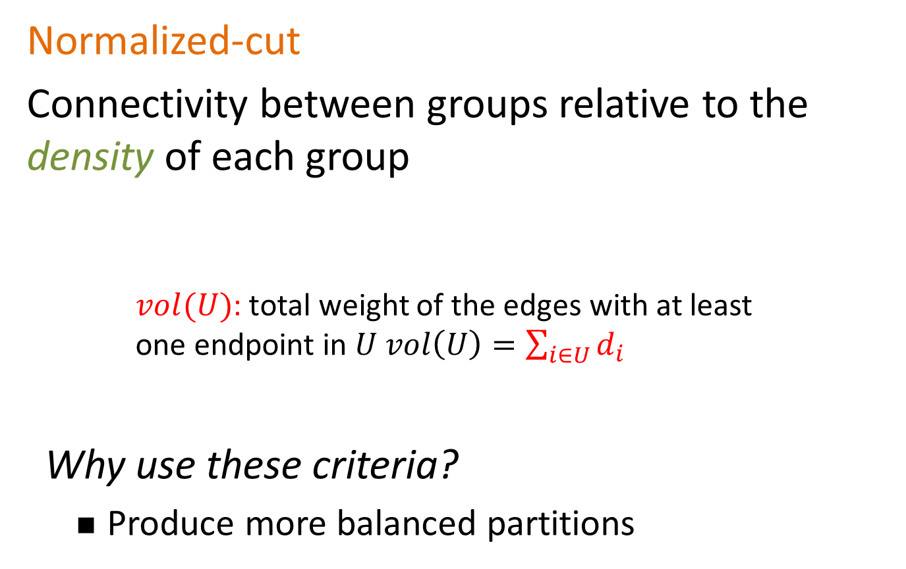
Normalized Cut
Normalized-cut
Connectivity between groups relative to the density of each group
    $vol(U)$: total weight of the edges with at least
    one endpoint in $U vol\left(U\right)=\sum_{i∈U}{d_{i}}$
Why use these criteria?
  Produce more balanced partitions
Normalized-cut$= \frac{Cut(U,V−U)}{Vol(U)}$ + $\frac{Cut(U,V−U)}{Vol(V−U)}$

Slide 14
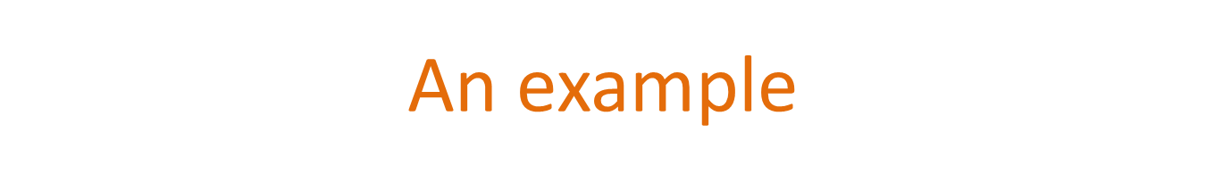
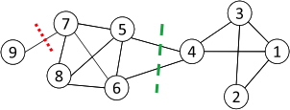
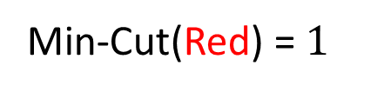
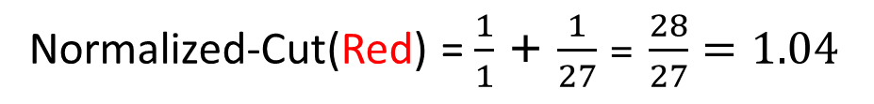
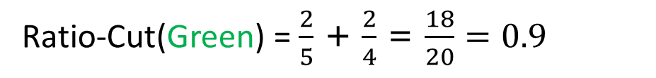
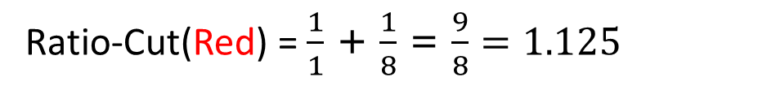
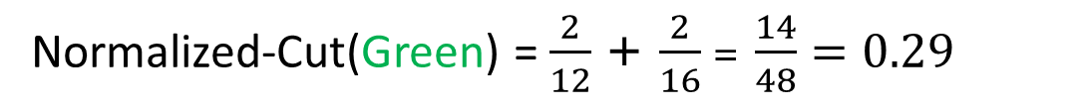
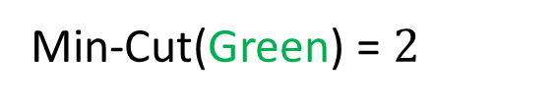
Min-Cut(Red) = $1$
Ratio-Cut(Red) = $\frac{1}{1}$ + $\frac{1}{8}$ = $\frac{9}{8}=1.125$
Normalized-Cut(Red) = $\frac{1}{1}$ + $\frac{1}{27}$ = $\frac{28}{27}=1.04$
Min-Cut(Green) = $2$
Ratio-Cut(Green) = $\frac{2}{5}$ + $\frac{2}{4}$ = $\frac{18}{20}=0.9$
Normalized-Cut(Green) = $\frac{2}{12}$ + $\frac{2}{16}$ = $\frac{14}{48}=0.29$
Normalized is smaller due to density

Slide 15
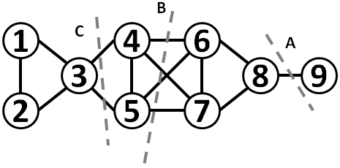
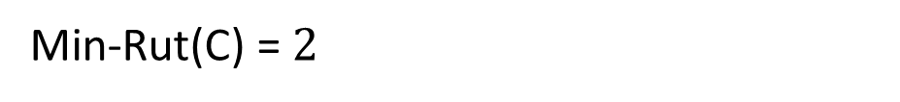
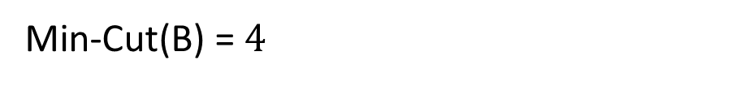
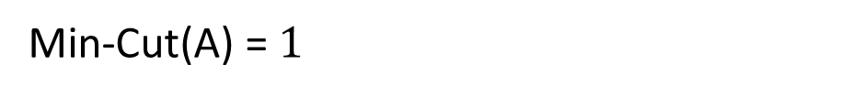
An example
Min-Cut(A) = $1$
Min-Cut(B) = $4$
Min-Rut(C) = $2$

Slide 16
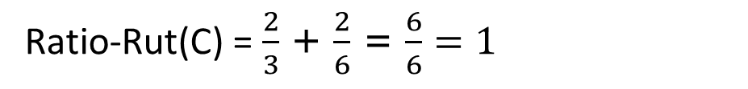
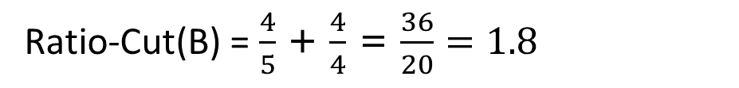
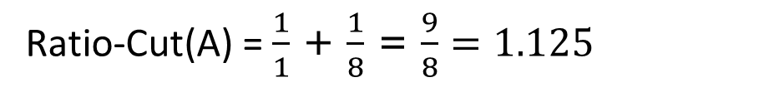
An example
Ratio-Cut(A) = $\frac{1}{1}$ + $\frac{1}{8}$ = $\frac{9}{8}=1.125$
Ratio-Cut(B) = $\frac{4}{5}$ + $\frac{4}{4}$ = $\frac{36}{20}=1.8$
Ratio-Rut(C) = $\frac{2}{3}$ + $\frac{2}{6}$ = $\frac{6}{6}=1$

Slide 17
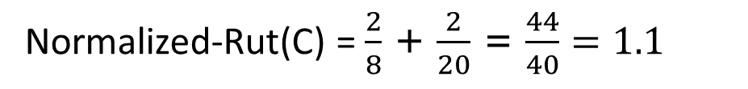
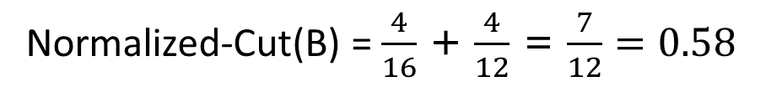
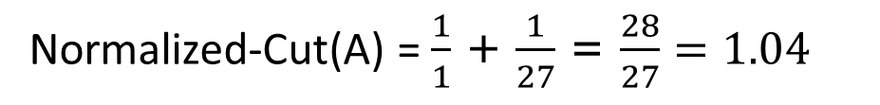
An example
Normalized-Cut(A) = $\frac{1}{1}$ + $\frac{1}{27}$ = $\frac{28}{27}=1.04$
Normalized-Cut(B) = $\frac{4}{16}$ + $\frac{4}{12}$ = $\frac{7}{12}=0.58$
Normalized-Rut(C) = $\frac{2}{8}$ + $\frac{2}{20}$ = $\frac{44}{40}=1.1$

Slide 18
Graph conductance
Connectivity of group A with the rest of the network relative to the density of the group
The lower the conductance, the better the cluster
Notes:
Min, A is less than half the nodes

Slide 19
Graph Bisection
The problem find a partition with equal number of nodes and minimum cut is NP-hard
Kernighan-Lin algorithm: Start with random equal partitions and then swap nodes to improve some quality metric (e.g., cut, modularity, etc).
Notes:
The problem find a partition with equal number of nodes and minimum cut is NP-hard

Slide 20
Graph Cuts
Ratio and normalized cuts can be reformulated in matrix format and solved using spectral clustering

Slide 21
SPECTRAL CLUSTERING

Slide 22
Adjacency matrix
Simplest form: Split the graph into two pieces, many connections within, few across
Nodes
Nodes
Network
Adjacency matrix
How do we identify this structure?
Partition the graph, so that the resulting pieces have low conductance

Slide 23
Matrix Representation
Adjacency matrix (A):
  n× n matrix
  A=[a_{ij}], a_{ij}=1 if edge between node i and j
 | 1 | 2 | 3 | 4 | 5 | 6
1 | 0 | 1 | 1 | 0 | 1 | 0
2 | 1 | 0 | 1 | 0 | 0 | 0
3 | 1 | 1 | 0 | 1 | 0 | 0
4 | 0 | 0 | 1 | 0 | 1 | 1
5 | 1 | 0 | 0 | 1 | 0 | 1
6 | 0 | 0 | 0 | 1 | 1 | 0
5
1
2
6
4
3
How many non-zeros in each row?
If the graph is weighted, a_{ij}= w_{ij}

Slide 24

Spectral Graph Partitioning
x is a vector in ℜ^{n} with components $(x1,…, xn)$
  Think of it as a label/value of each node of $G$
    Value x_{i} corresponds to node i in the graph
What is the meaning of A⋅ x?
Entry y_{i} is a sum of labels x_{j} of neighbors of i

Slide 25

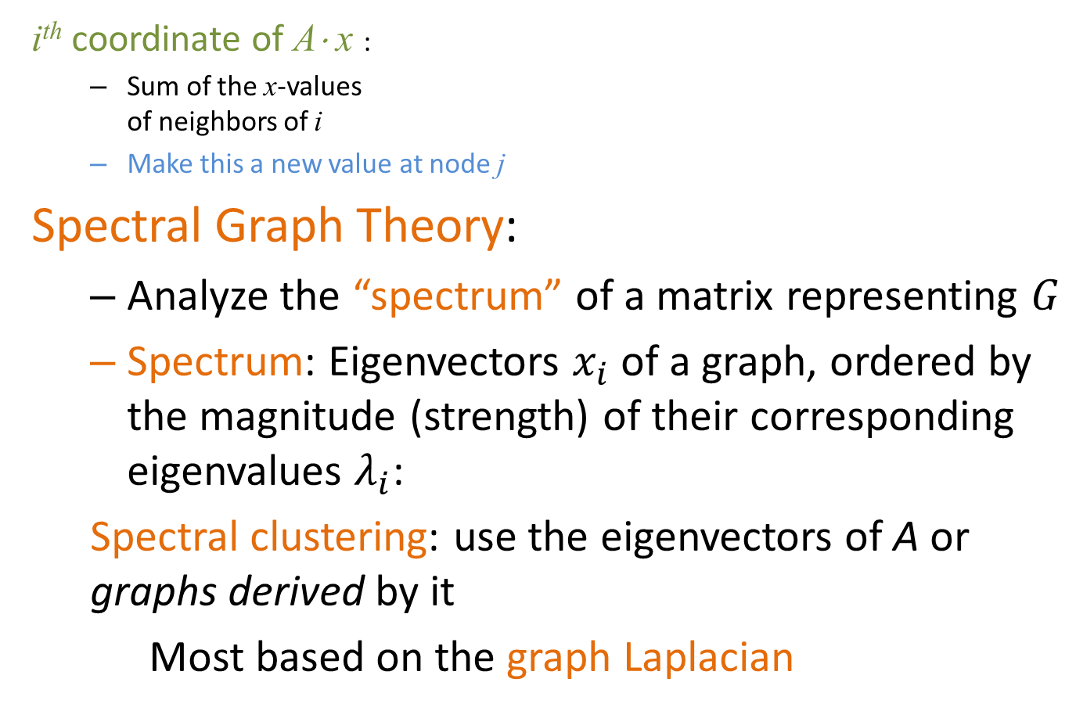
Spectral Analysis
i^{th} coordinate of A⋅ x :
  Sum of the x-values
  of neighbors of i
  Make this a new value at node j
Spectral Graph Theory:
  Analyze the “spectrum” of a matrix representing $G$
  Spectrum: Eigenvectors $x_{i}$ of a graph, ordered by the magnitude (strength) of their corresponding eigenvalues $λ_{i}$:
  Spectral clustering: use the eigenvectors of A or graphs derived by it
  Most based on the graph Laplacian
$$A⋅x=λ⋅x$$
Notes:
Eigenvectors are vectors that survive when I multiple them with the matrix

Slide 26
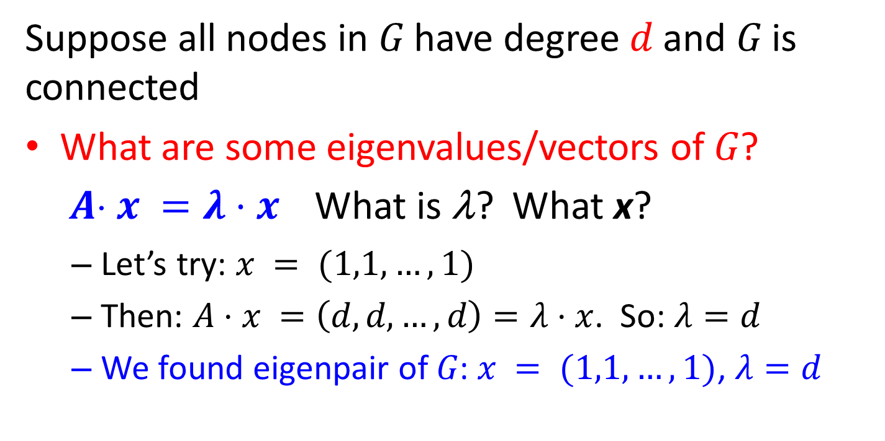
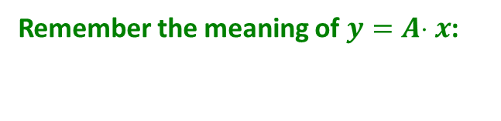
Example: d-regular graph
Suppose all nodes in $G$ have degree $d$ and $G$ is connected
What are some eigenvalues/vectors of $G$? $A x =λ⋅x$ What is λ? What x?
  Let’s try: $x = (1,1,…,1)$
  Then: $A⋅x =\left(d,d,…,d\right)=λ⋅x$. So: $λ=d$
  We found eigenpair of $G$: $x = (1,1,…,1)$, $λ=d$
Remember the meaning of $y=A x$:

Slide 27
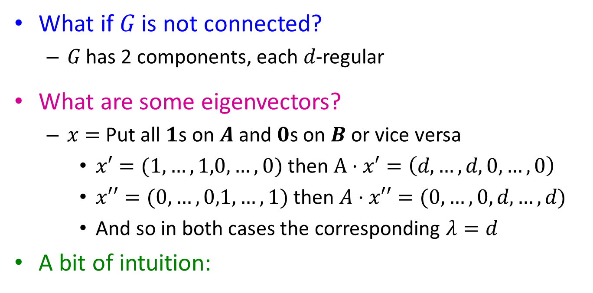
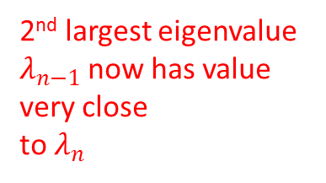


Example: Graph on 2 components
What if $G$ is not connected?
  $G$ has 2 components, each $d$-regular
What are some eigenvectors?
  $x=$ Put all $1$s on $A$ and $0$s on $B$ or vice versa
    $x′=(1,…,1,0,…,0)$ then $A⋅x′=\left(d,…,d,0,…,0\right)$
    $x′′=(0,…,0,1,…,1)$ then $A⋅x′′=(0,…,0,d,…,d)$
    And so in both cases the corresponding $λ=d$
A bit of intuition:
A
B
|A|
|B|
A
B
A
B
2nd largest eigenvalue $λ_{n−1}$now has value very close
to $λ_{n}$
$$λ_{n}=λ_{n−1}$$
$$λ_{n}−λ_{n−1}≈0$$
What is the right matrix to apply this intuition?
Notes:
regular graph with 2 connected components, I have the eigenvalue d with multiplicity 2, this means that this corresponds to two eigenvectors.
What if the two components are barely connected?
The two eigenvalues similar values – if disconnected, we know what the eigenvectors will be 1s for A, 0s for B, if barely connected, we hope they do not change too much
Block A 0
0 B

Slide 28
Matrix Representations
Adjacency matrix (A):
  n× n matrix
  A=[a_{ij}], a_{ij}=1 if edge between node i and j
Important properties:
  Symmetric matrix
  Eigenvectors are real and orthogonal
5
 | 1 | 2 | 3 | 4 | 5 | 6
1 | 0 | 1 | 1 | 0 | 1 | 0
2 | 1 | 0 | 1 | 0 | 0 | 0
3 | 1 | 1 | 0 | 1 | 0 | 0
4 | 0 | 0 | 1 | 0 | 1 | 1
5 | 1 | 0 | 0 | 1 | 0 | 1
6 | 0 | 0 | 0 | 1 | 1 | 0
1
2
6
4
3
Notes:
Orthogonal: dot product is zero

Slide 29
Matrix Representations
Degree matrix (D):
  n× n diagonal matrix
  D=[d_{ii}], d_{ii} = degree of node i
 | 1 | 2 | 3 | 4 | 5 | 6
1 | 3 | 0 | 0 | 0 | 0 | 0
2 | 0 | 2 | 0 | 0 | 0 | 0
3 | 0 | 0 | 3 | 0 | 0 | 0
4 | 0 | 0 | 0 | 3 | 0 | 0
5 | 0 | 0 | 0 | 0 | 3 | 0
6 | 0 | 0 | 0 | 0 | 0 | 2
5
1
2
6
4
3

Slide 30
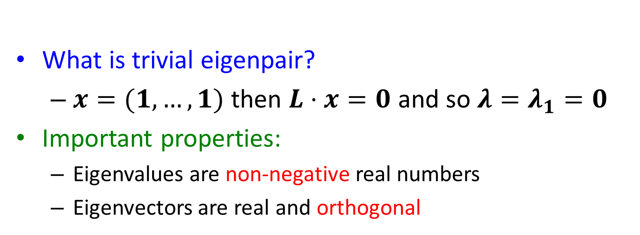

Graph Laplacian
Laplacian matrix (L):
  n× n symmetric matrix
 | 1 | 2 | 3 | 4 | 5 | 6
1 | 3 | -1 | -1 | 0 | -1 | 0
2 | -1 | 2 | -1 | 0 | 0 | 0
3 | -1 | -1 | 3 | -1 | 0 | 0
4 | 0 | 0 | -1 | 3 | -1 | -1
5 | -1 | 0 | 0 | -1 | 3 | -1
6 | 0 | 0 | 0 | -1 | -1 | 2
$$L = D − A$$
1
5
2
6
4
3
What is trivial eigenpair?
  $x=(1,…,1)$ then $L⋅x=0$ and so ${λ=λ}_{1}=0$
Important properties:
  Eigenvalues are non-negative real numbers
  Eigenvectors are real and orthogonal
Notes:
Sum of entries at each row (and column) equal to 0

Slide 31
Graph Laplacian
If the graph is disconnected
If there are two connected components, the same argument as for the adjacency matrix applies, and λ₁ = λ₂ = 0
The multiplicity of eigenvalue 0 is equal to the number of connected components

Slide 32
The second smallest eigenvalue
Fact: For a symmetric matrix M
What is the meaning of min x^{T} L x on G?

Slide 33
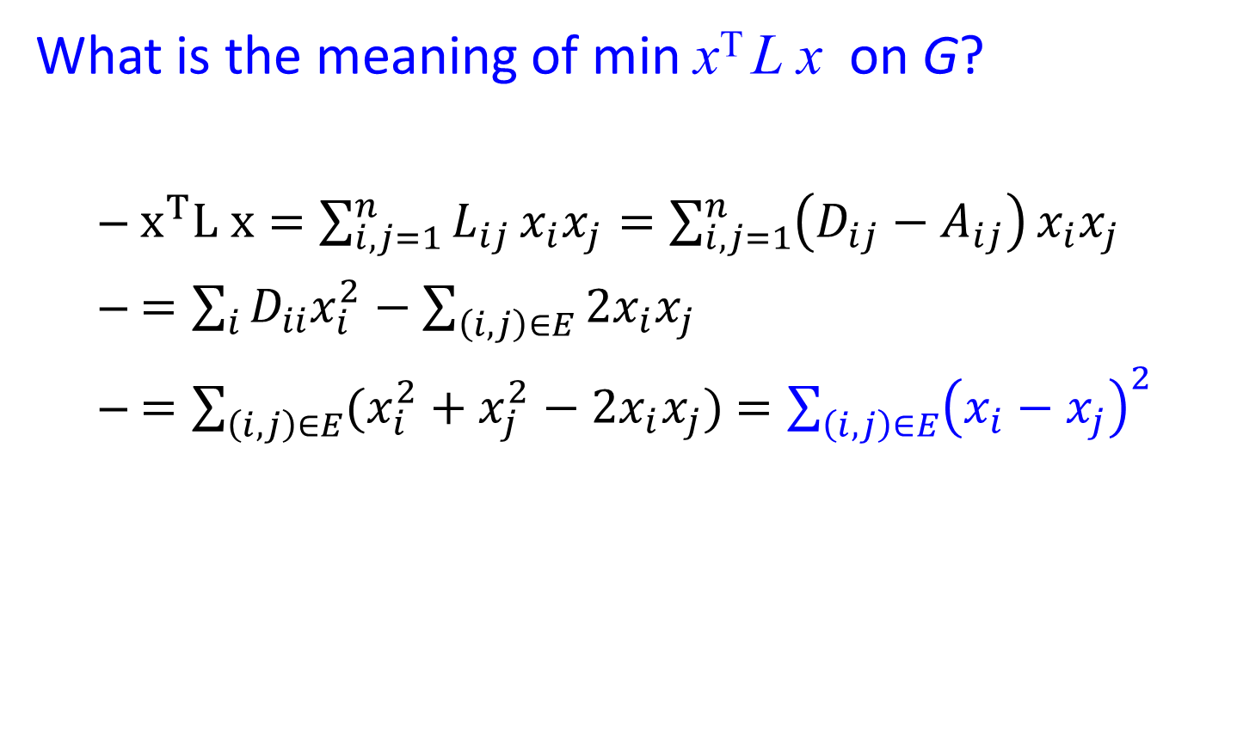
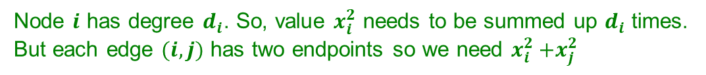
λ₂ as an optimization problem
What is the meaning of min x^{T} L x on G?
  $x^{T}L x=\sum_{i,j=1}^{n}{L_{ij}}x_{i}x_{j}=\sum_{i,j=1}^{n}{\left(D_{ij}−A_{ij}\right)}x_{i}x_{j}$
  $=\sum_{i}{D_{ii}x_{i}^{2}}−\sum_{\left(i,j\right)∈E}{2x_{i}x_{j}}$
  $=\sum_{\left(i,j\right)∈E}{(x_{i}^{2}+x_{j}^{2}−2x_{i}x_{j})}$ $=\sum_{\left(i,j\right)∈E}{{\left(x_{i}−x_{j}\right)}^{2}}$
Node $i$ has degree $d_{i}$. So, value $x_{i}^{2}$ needs to be summed up $d_{i}$ times.
But each edge $(i, j)$ has two endpoints so we need $x_{i}^{2}{+x}_{j}^{2}$
Notes:
Sum_i Dii xi^2 = \sum_ij xi^2 + xj^2
Node i has degree Dii so for each edge I sum xi^2 once.
But edge has 2 endpoints so I have to take + xj^2

Slide 34
λ₂ as an optimization problem
The expression:
is
When is this expression minimized?
“similar values” for connected edges

Slide 35
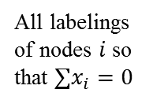
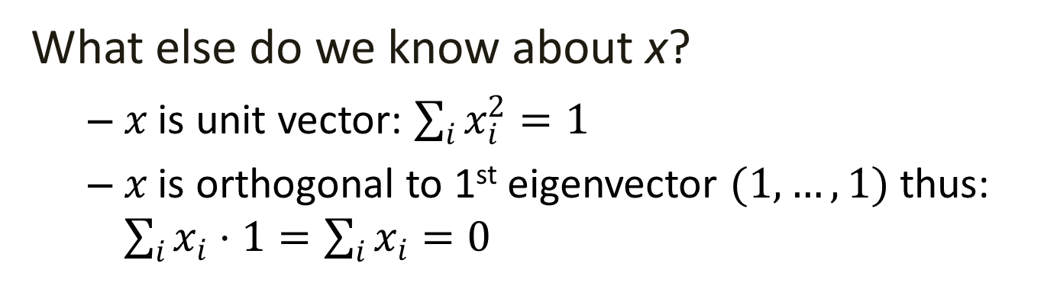
λ₂ as an optimization problem
What else do we know about x?
  $x$ is unit vector: $\sum_{i}{x_{i}^{2}=1}$
  $x$ is orthogonal to 1st eigenvector $(1,…,1)$thus: $\sum_{i}{x_{i}⋅1}=\sum_{i}{x_{i}}=0$
All labelings of nodes $i$ so that $∑x_{i}=0$
=1
If i and j are connected, we want x_{i} and x_{j} to subtract each other, have the “same sign”
We want to assign values $x_{i}$ to nodes i such that few edges cross 0.
Notes:
Dots are the nodes of the graph – want to put some of the left side of zero, some of the right side of zero – why sum must be equal to 1, not all left not all right because some must be zero
Need to minimize sum of the differences of labels of endpoints of all edges – better to have the same sign, penalty for edges that cross zero
Put them in a real lines, in such a way

Slide 36


λ₂ as an optimization problem
All labelings of nodes $i$ so that $∑x_{i}=0$
Minimum when connected nodes get the same sign (similar values)
This minimization problem tries to place (embed) nodes of the graph on the real line so that the number of edges that span across 0 is as small as possible
Tightly connected nodes on the same side of the real line
i
j
x
$$x_{i}$$
0
$$x_{j}$$
Balance to minimize
Notes:
Dots are the nodes of the graph – want to put some of the left side of zero, some of the right side of zero – why sum must be equal to 1, not all left not all right because some must be zero
Need to minimize sum of the differences of labels of endpoints of all edges – better to have the same sign, penalty for edges that cross zero
Put them in a real lines, in such a way

Slide 37
0

Slide 38


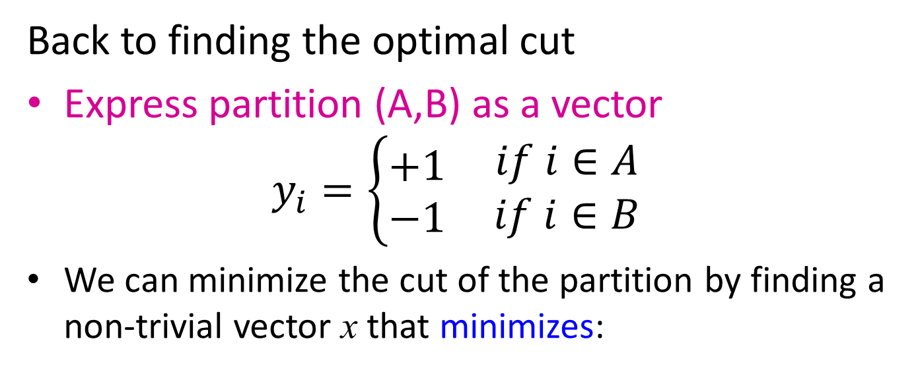
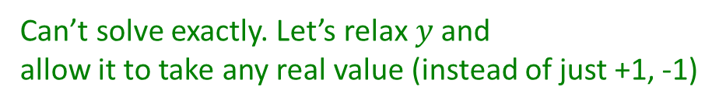
Find Optimal Cut [Fiedler’73]
Back to finding the optimal cut
Express partition (A,B) as a vector
$$y_{i}=\left\{\begin{matrix}+1 \\ −1\end{matrix} \begin{matrix}if i∈A \\ if i∈B\end{matrix}\right.$$
We can minimize the cut of the partition by finding a non-trivial vector x that minimizes:
Can’t solve exactly. Let’s relax $y$ and
allow it to take any real value (instead of just +1, -1)
$$y_{i}=−1$$
0
j
$$y_{j}=+1$$
Notes:
Example

Slide 39
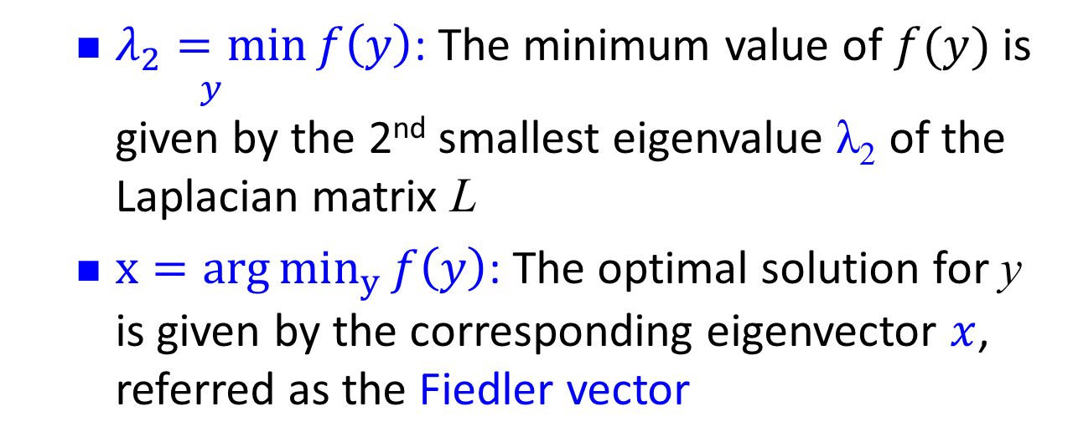


Rayleigh Theorem
i
0
j
x
$$x_{i}$$
$$x_{j}$$
  $\underset{y}{λ_{2}=min}{f\left(y\right)}$: The minimum value of $f(y)$ is given by the 2nd smallest eigenvalue λ₂ of the Laplacian matrix L
  $x=arg{min_{y}{f\left(y\right)}}$: The optimal solution for y is given by the corresponding eigenvector $x$, referred as the Fiedler vector

Slide 40
Example
1
5
2
6
4
3
Eigenvalues
0.0
1.0
3.0
3..0
4..0
5.0
0.4
0.3
-0.5
-0.2
-0.4
-0.5
0.4
0.6
0.4
-0.4
0.4
0.0
Eigenvectors
0.4
0.3
0.1
0.6
-0.4
0.5
0.4
-0.3
0.1
0.6
0.4
-0.5
0.4
-0.3
-0.5
-0.2
0.4
0.5
0.4
-0.6
0.4
-0.4
-0.4
0.0

Slide 41
Spectral Partitioning Algorithm
Three basic stages:
  Pre-processing
    Construct a matrix representation of the graph
  Decomposition
    Compute eigenvalues and eigenvectors of the matrix
  Grouping
    Assign points to two or more clusters, based on the new representation

Slide 42
Spectral Partitioning Algorithm
Pre-processing:
  Build Laplacian
  matrix L of the
  graph
Decomposition:
  Find eigenvalues λ
  and eigenvectors x
  of the matrix L
  Map vertices to
  corresponding
  components of λ₂
 | 1 | 2 | 3 | 4 | 5 | 6
1 | 3 | -1 | -1 | 0 | -1 | 0
2 | -1 | 2 | -1 | 0 | 0 | 0
3 | -1 | -1 | 3 | -1 | 0 | 0
4 | 0 | 0 | -1 | 3 | -1 | -1
5 | -1 | 0 | 0 | -1 | 3 | -1
6 | 0 | 0 | 0 | -1 | -1 | 2
0.0
0.4
0.3
-0.5
-0.2
-0.4
-0.5
1.0
0.4
0.6
0.4
-0.4
0.4
0.0
λ =
3.0
X =
0.4
0.3
0.1
0.6
-0.4
0.5
3.0
0.4
-0.3
0.1
0.6
0.4
-0.5
4.0
0.4
-0.3
-0.5
-0.2
0.4
0.5
5.0
0.4
-0.6
0.4
-0.4
-0.4
0.0
1
0.3
2
0.6
3
0.3
How do we now find the clusters?
4
-0.3
5
-0.3
6
-0.6

Slide 43
Spectral Partitioning Algorithm
Grouping:
  Sort components of reduced 1-dimensional vector
  Identify clusters by splitting the sorted vector in two
How to choose a splitting point?
  Naïve approaches:
    Split at 0 or median value
  More expensive approaches:
    Attempt to minimize normalized cut in 1-dimension
    (sweep over ordering of nodes induced by the eigenvector)
Split at 0:
Cluster A: Positive points
Cluster B: Negative points
1
0.3
A
B
2
0.6
3
0.3
4
-0.3
1
0.3
4
-0.3
5
-0.3
2
0.6
5
-0.3
6
-0.6
3
0.3
6
-0.6

Slide 44
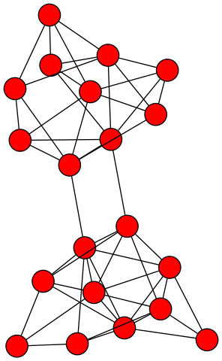
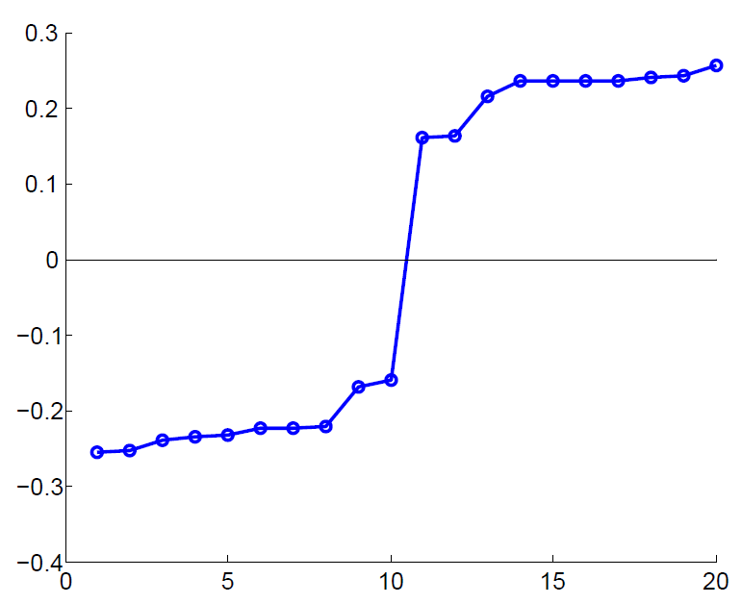
Example: Spectral Partitioning
Value of x₂
Rank in x₂

Slide 45
2
7
1
8
3
6
4
5

Slide 46
2
7
1
8
3
6
4
5
-0.383
-0.247
0
0.247
0.383

Slide 47
2
7
1
8
3
6
4
5
-0.383
-0.247
0
0.247
0.383

Slide 48
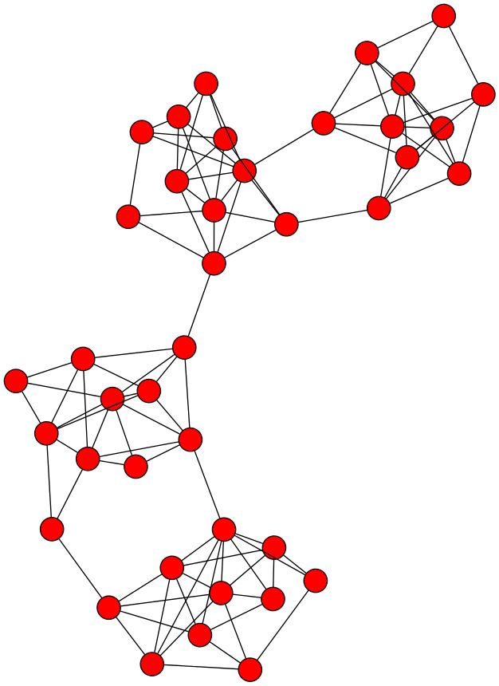
k-Way Spectral Clustering
How do we partition a graph into k clusters?

Slide 49
k-Way Spectral Clustering
How do we partition a graph into k clusters?
Recursively apply a bi-partitioning algorithm in a hierarchical divisive manner
    Disadvantages: Inefficient, unstable

Slide 50
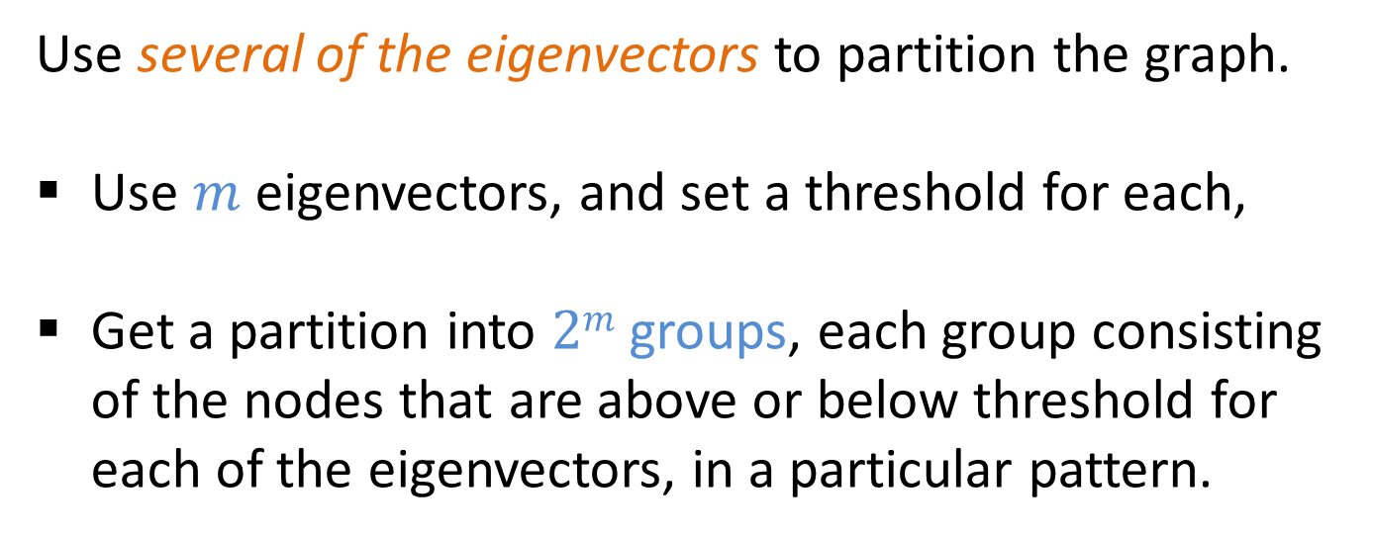
k-Way Spectral Clustering
Use several of the eigenvectors to partition the graph.
Use $m$ eigenvectors, and set a threshold for each,
Get a partition into $2m$ groups, each group consisting of the nodes that are above or below threshold for each of the eigenvectors, in a particular pattern.

Slide 51
Example
1
5
2
6
4
3
Eigenvalues
0.0
1.0
3.0
3..0
4..0
5.0
0.4
0.3
-0.5
-0.2
-0.4
-0.5
0.4
0.6
0.4
-0.4
0.4
0.0
Eigenvectors
0.4
0.3
0.1
0.6
-0.4
0.5
0.4
-0.3
0.1
0.6
0.4
-0.5
0.4
-0.3
-0.5
-0.2
0.4
0.5
0.4
-0.6
0.4
-0.4
-0.4
0.0
If we use both the 2nd and 3rd eigenvectors,
nodes 5 and 6 (negative in both) 2 and 3 (positive in both)
1 and 4 alone
Note that each eigenvector except the first is the vector x that minimizes x^{T}Lx, subject to the constraint that it is orthogonal to all previous eigenvectors.
Thus, while each eigenvector tries to produce a minimum-sized cut, successive eigenvectors have to satisfy more and more constraints => the cuts progressively worse.

Slide 52
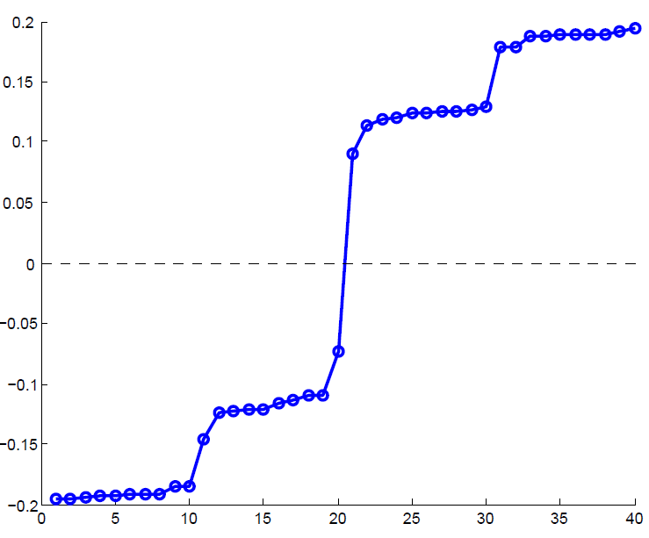
Example: Spectral Partitioning
Components of x₂
Value of x₂
Rank in x₂

Slide 53
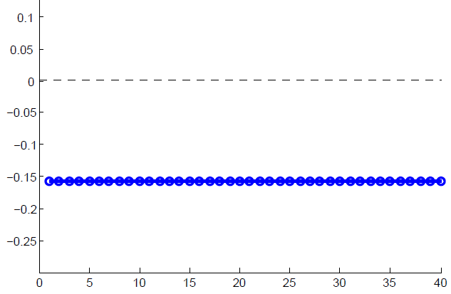
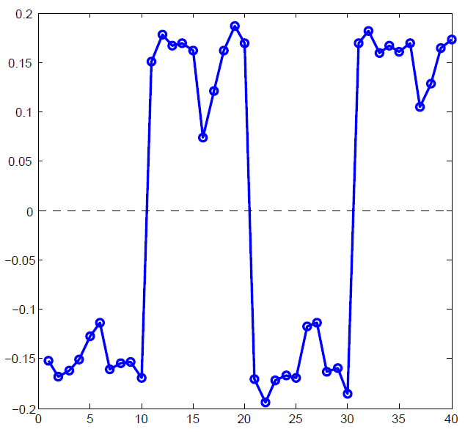
Example: Spectral partitioning
Components of x₁
Components of x₃

Slide 54
Spectral Clustering
Use the lowest k eigenvalues of L to construct the n x k graph G’ that has these eigenvectors as columns
The n-rows represent the graph vertices in a k-dimensional Euclidean space
Group these vertices in k clusters using k-means clustering or similar techniques

Slide 55
k-Way Spectral Clustering
Pre-processing:
  Build Laplacian
  matrix L of the
  graph
Decomposition:
  Find eigenvalues λ and eigenvectors x
  of the matrix L
 | 1 | 2 | 3 | 4 | 5 | 6
1 | 3 | -1 | -1 | 0 | -1 | 0
2 | -1 | 2 | -1 | 0 | 0 | 0
3 | -1 | -1 | 3 | -1 | 0 | 0
4 | 0 | 0 | -1 | 3 | -1 | -1
5 | -1 | 0 | 0 | -1 | 3 | -1
6 | 0 | 0 | 0 | -1 | -1 | 2
0.0
0.4
0.3
-0.5
-0.2
-0.4
-0.5
1.0
0.4
0.6
0.4
-0.4
0.4
0.0
λ =
3.0
X =
0.4
0.3
0.1
0.6
-0.4
0.5
3.0
0.4
-0.3
0.1
0.6
0.4
-0.5
4.0
0.4
-0.3
-0.5
-0.2
0.4
0.5
5.0
0.4
-0.6
0.4
-0.4
-0.4
0.0
k = 3

Slide 56



Cuts and spectral clustering
Relaxing Ncut leads to normalized spectral clustering, while relaxing RatioCut leads to unnormalized spectral clustering

Slide 57
Normalized Graph Laplacians
L_{rw} closely connected to random walks

Slide 58
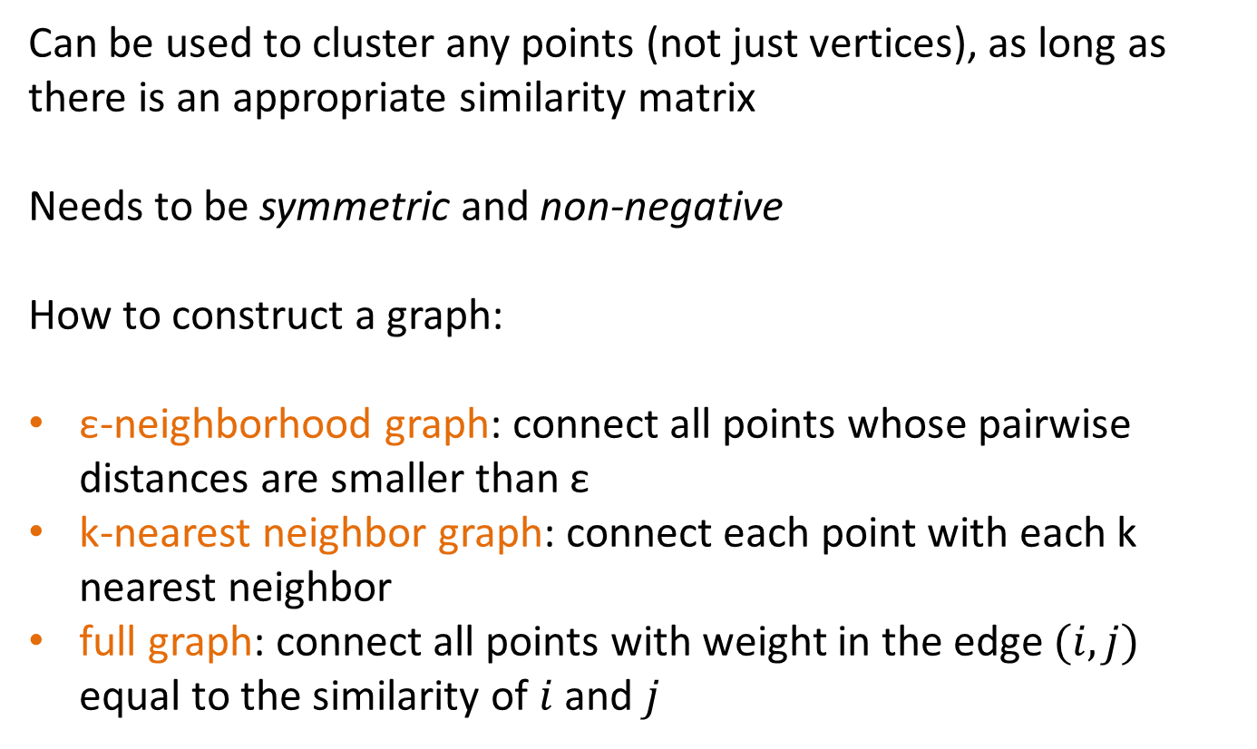
Spectral clustering (besides graphs)
Can be used to cluster any points (not just vertices), as long as there is an appropriate similarity matrix
Needs to be symmetric and non-negative
How to construct a graph:
ε-neighborhood graph: connect all points whose pairwise distances are smaller than ε
k-nearest neighbor graph: connect each point with each k nearest neighbor
full graph: connect all points with weight in the edge $(i, j)$ equal to the similarity of $i$ and $j$

Slide 59
Summary
The values of x minimize
For weighted matrices
The ordering according to the x_{i} values will group similar (connected) nodes together

Slide 60
Outline
PART II
Cuts
Spectral Clustering
Dense Subgraphs

Slide 61
Maximum Densest SUBGRAPH
Thanks to Aris Gionis

Slide 62
Finding Dense Subgraphs
Dense subgraph: A collection of vertices such that there are a lot of edges between them
  E.g., find the subset of email users that talk the most between them
  Or, find the subset of genes that are most commonly expressed together
Similar to community identification but we do not require that the dense subgraph is sparsely connected with the rest of the graph.

Slide 63
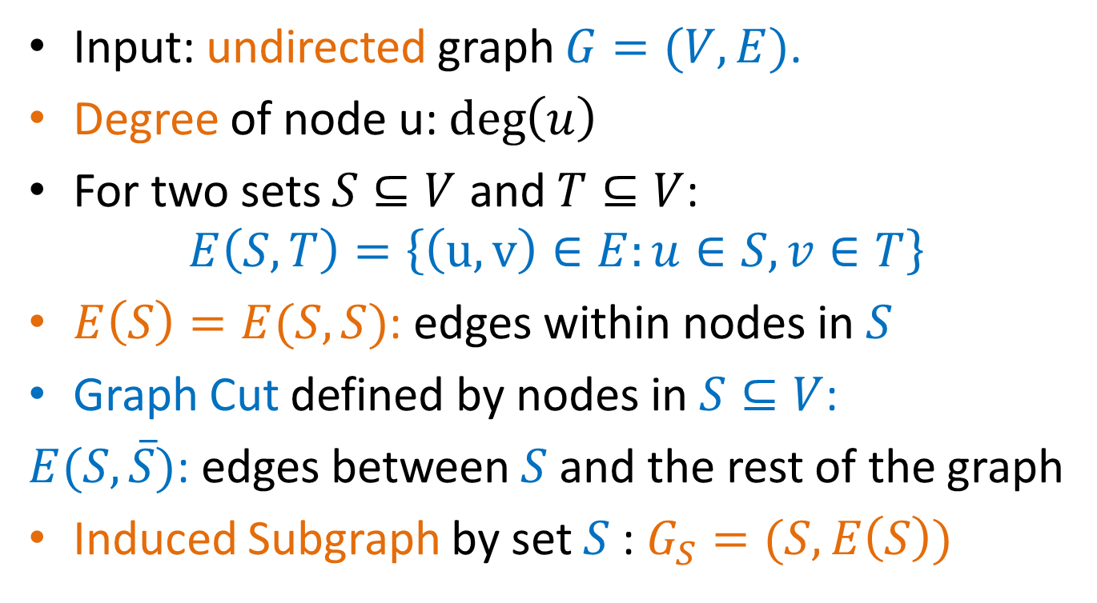
Definitions
Input: undirected graph $G=(V,E)$.
Degree of node u: $\deg\left(u\right)$
For two sets $S⊆V$ and $T⊆V$:
$$E\left(S,T\right)=\left\{\left(u,v\right)∈E:u∈S, v∈T\right\}$$
$E\left(S\right)=E(S,S)$: edges within nodes in $S$
Graph Cut defined by nodes in $S⊆V$:
$E(S,\overline{S})$: edges between $S$ and the rest of the graph
Induced Subgraph by set $S$: $G_{S}=(S,E\left(S\right))$

Slide 64
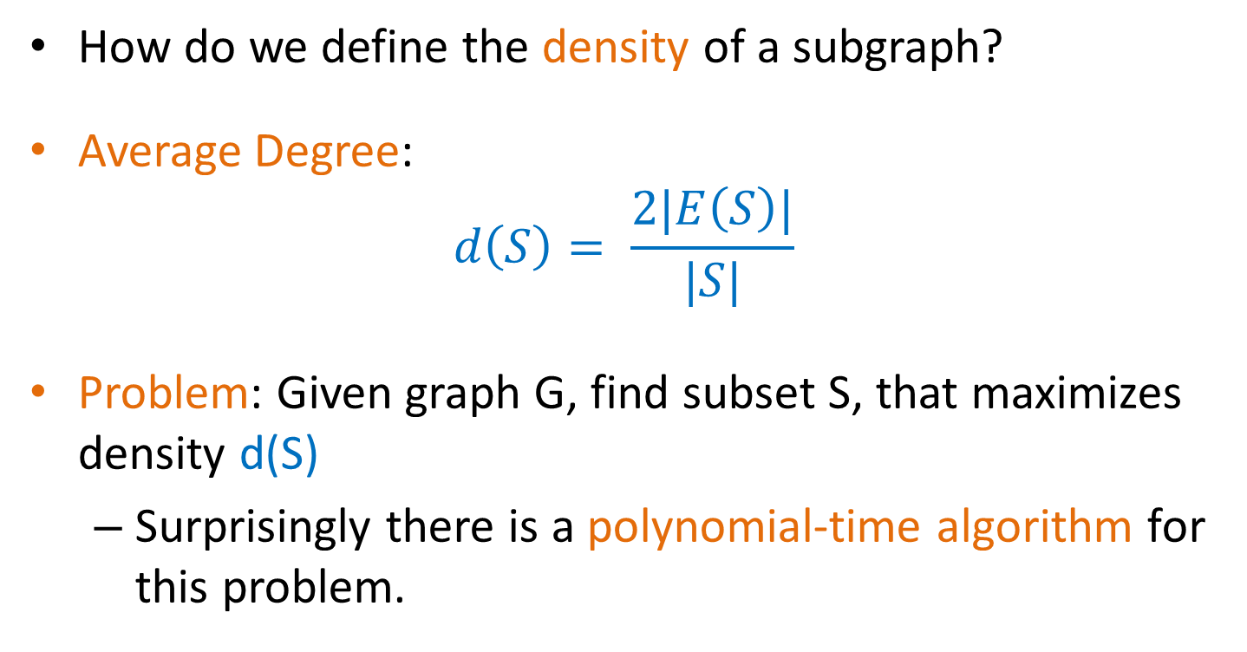
Definitions
How do we define the density of a subgraph?
Average Degree:
$$d\left(S\right)= \frac{2|E\left(S\right)|}{|S|}$$
Problem: Given graph G, find subset S, that maximizes density d(S)
  Surprisingly there is a polynomial-time algorithm for this problem.

Slide 65
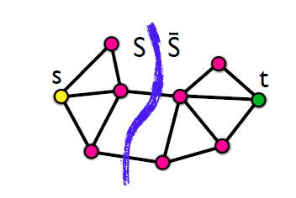
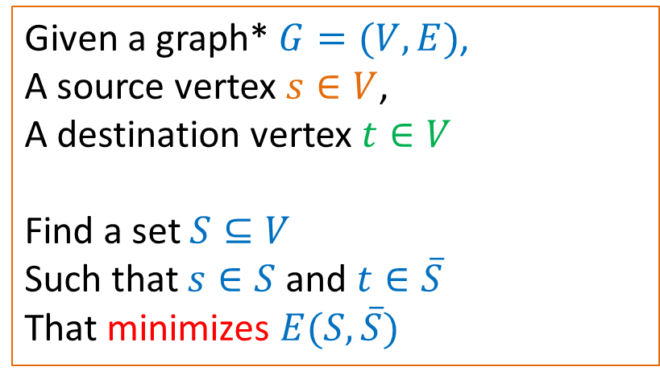
Min-Cut Problem
Given a graph* $G=(V,E)$,
A source vertex $s∈V$,
A destination vertex $t∈V$
Find a set $S⊆V$
Such that $s∈S$ and $t∈\overline{S}$
That minimizes $E(S,\overline{S})$
* The graph may be weighted
Min-Cut = Max-Flow: the minimum cut maximizes the flow that can be sent from s to t. There is a polynomial time solution.
the maximum amount of flow passing from the source to the sink is equal to the total weight of the edges in the minimum cut

Slide 66
Algorithm (Goldberg)
Given the input graph G, and value c
Create the min-cut instance graph
Compute the min-cut
If the set S is not empty, return YES
Else return NO
How do we find the set with maximum density?

Slide 67
Min-cut algorithm
The min-cut algorithm finds the optimal solution in polynomial time O(nm), but this is too expensive for real networks.
We will now describe a simpler approximation algorithm that is very fast
  Approximation algorithm: the ratio of the density of the set produced by our algorithm and that of the optimal is bounded.
    The ratio is at most ½
    The optimal set is at most twice as dense as that of the approximation algorithm.
Any ideas for the algorithm?

Slide 68

Greedy Algorithm
Given the graph $G =(V,E)$
$S_{0}=V$
For $i=1…|V|$
  Find node $v∈S$ with the minimum degree
  $S_{i}=S_{i−1}∖\{v\}$
3. Output the densest set $S_{i}$

Slide 69










Example

Slide 70

Analysis
Density of optimal set: $d_{opt}=\max_{S⊆V}{d(S)}$
Density of greedy algorithm $d_{g}$
$d_{opt}≤{2⋅d}_{g}$

Slide 71
Summary
Spectral clustering
Using the eigenvectors of the Laplacian (or, normalized Laplacian)
split around 0
use the k-eigenvectors
Dense subgraphs

Slide 72
Questions?

Slide 73
Basic References
Jure Leskovec, Anand Rajaraman, Jeff Ullman, Mining of Massive Datasets, Chapter 10, http://www.mmds.org/
Reza Zafarani, Mohammad Ali Abbasi, Huan Liu, Social Media Mining: An Introduction, Chapter 6, http://dmml.asu.edu/smm/
Santo Fortunato: Community detection in graphs. CoRR abs/0906.0612v2 (2010)
Ulrike von Luxburg: A Tutorial on Spectral Clustering. CoRR abs/0711.0189 (2007)
G Palla, A. L. Barabási, T Vicsek, Quantyfying Social Group Evolution. Nature 446 (7136), 664-667

Slide 74
Extra material

Slide 75



Decision problem
Consider the decision problem:
  Is there a set $S$ with $d\left(S\right)≥c$?
$d\left(S\right)≥c$
$2\left|E\left(S\right)\right|≥c|S|$
$\sum_{v∈S}{\deg\left(v\right)−E\left(S,\overline{S}\right)≥c|S|}$
$2\left|E\right|−\sum_{v∈\overline{S}}{\deg\left(v\right)}−E\left(S,\overline{S}\right)≥c\left|S\right|$
$\sum_{v∈\overline{S}}{\deg\left(v\right)}+E\left(S,\overline{S}\right)+c\left|S\right|≤2|E|$

Slide 76


Transform to min-cut
For a value $c$ we do the following transformation
We ask for a min s-t cut in the new graph

Slide 77


Transformation to min-cut
There is a cut that has value $2|E|$

Slide 78


Transformation to min-cut
Every other cut has value:
$\sum_{v∈\overline{S}}{\deg\left(v\right)}+E\left(S,\overline{S}\right)+c\left|S\right|$

Slide 79

Transformation to min-cut
If $\sum_{v∈\overline{S}}{\deg\left(v\right)}+E\left(S,\overline{S}\right)+c\left|S\right|≤2|E|$ then $S≠∅$ and $d\left(S\right)≥c$

Slide 80

Analysis
We will prove that the optimal set has density at most 2 times that of the set produced by the Greedy algorithm.
Density of optimal set: $d_{opt}=\max_{S⊆V}{d(S)}$
Density of greedy algorithm $d_{g}$
We want to show that $d_{opt}≤{2⋅d}_{g}$

Slide 81


Upper bound
We will first upper-bound the solution of optimal
Assume an arbitrary assignment of an edge $(u,v)$to either $u$ or $v$
Define:
  $IN\left(u\right)$= # edges assigned to u
  $Δ=\max_{u∈V}{IN(u)}$
We can prove that
  $d_{opt}≤2⋅Δ$
This is true for any assignment of the edges!
Notes:
Let S be the set with maximum density each edge of S must be assigned to a node in S thus
|E(S)| <= (|S| d_max) (Δ = d_max))
Thus d_max >= |E(S)|/|S|

Slide 82

Lower bound
We will now prove a lower bound for the density of the set produced by the greedy algorithm.
For the lower bound we consider a specific assignment of the edges that we create as the greedy algorithm progresses:
  When removing node $u$ from $S$, assign all the edges to $u$
So: $IN\left(u\right)=$ degree of $u$ in $S$ $≤d\left(S\right)≤d_{g}$
This is true for all $u$ so $Δ≤d_{g}$
It follows that $d_{opt}≤2⋅d_{g}$
Notes:
Initially, all edges are unassigned – when a minimum node u is removed from S all edges from u to S are assigned to u
Each time we delete the minimum degree thus the density of the remaining d_g is the largest of all

Slide 83

The k-densest subgraph
The k-densest subgraph problem: Find the set of $k$ nodes $S$, such that the density $d(S)$ is maximized.
  The k-densest subgraph problem is NP-hard!

