Slide 1
Online Social Networks and Media
Community detection

Slide 2
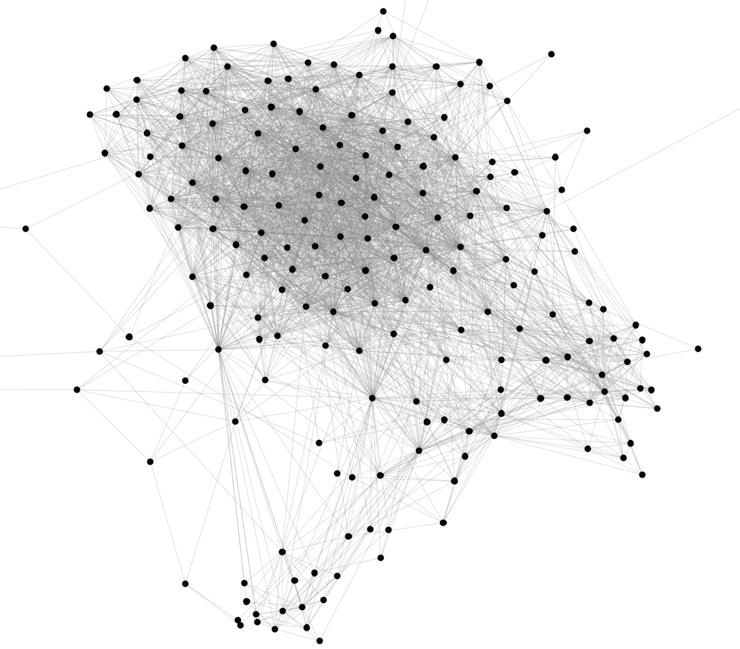
Notes:
Graphs are not random – identify their structure

Slide 3
Introduction
Real networks are not random graphs
Communities
aka: groups, clusters, cohesive subgroups, modules
(informal) Definition: groups of vertices which probably share common properties and/or play similar roles within the graph
Some are explicit (emic) (e.g., Facebook (groups), LinkedIn (groups, associations), etc), we are interested in implicit (etic) ones
Notes:
Examples of explicit communities in well-known social media sites include the following:
Facebook. In Facebook, there exist a variety of explicit communities, such as groups and communities. In these communities, users can post
messages and images, comment on other messages, like posts, and
view activities of others.
Yahoo! Groups. In Yahoo! groups, individuals join a group mailing
list where they can receive emails from all or a selection of group
members (administrators) directly.
LinkedIn. LinkedIn provides its users with a feature called Groups
and Associations. Users can join professional groups where they can
post and share information related to the group.

Slide 4
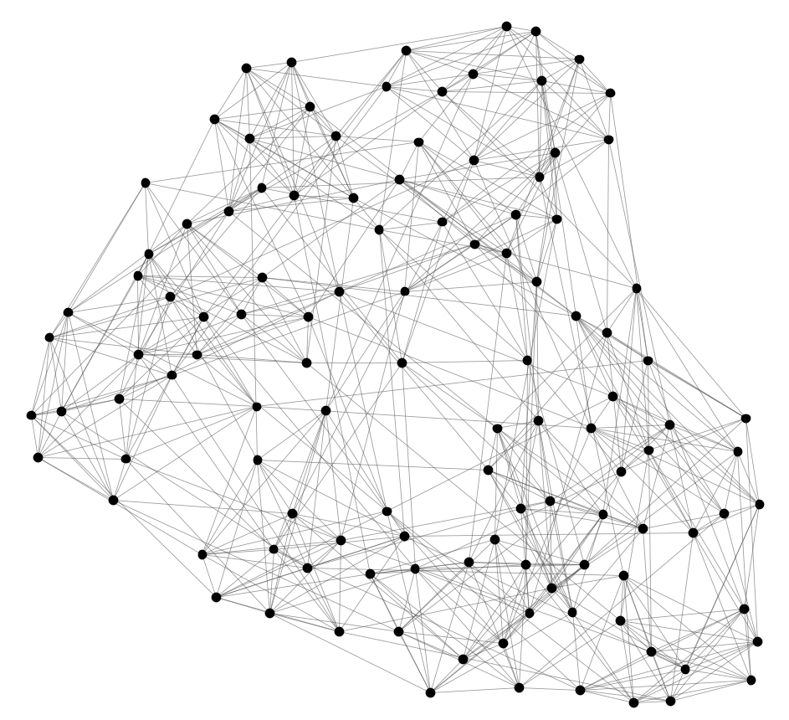
Can we identify node groups?
(communities, modules, clusters)
Nodes: Football Teams
Edges: Games played

Slide 5
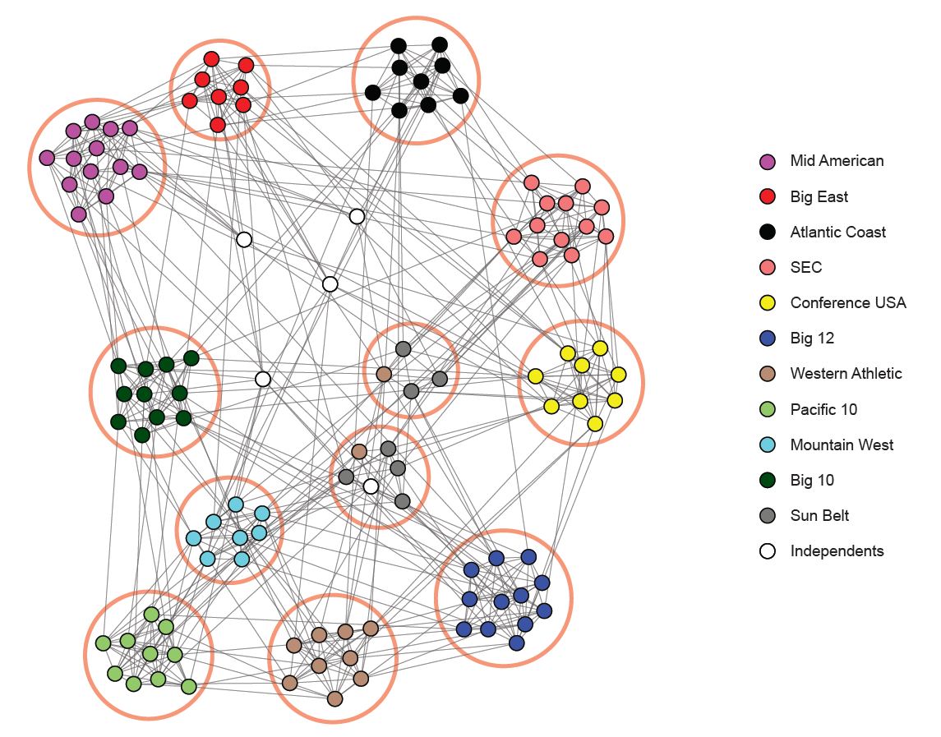
NCAA Football Network
NCAA conferences
Nodes: Football Teams
Edges: Games played

Slide 6
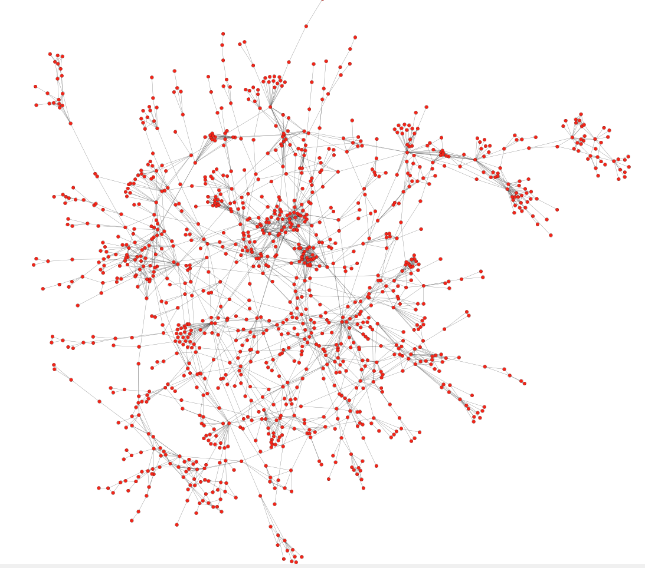
Protein-Protein Interactions
Can we identify functional modules?
Nodes: Proteins
Edges: Physical interactions
Notes:
Proteins that are involved in the same disease tend to interact with each other
inspired the disease module hypothesis [14], stating that each disease can be linked to a well-defined neighborhood of the cellular network.

Slide 7
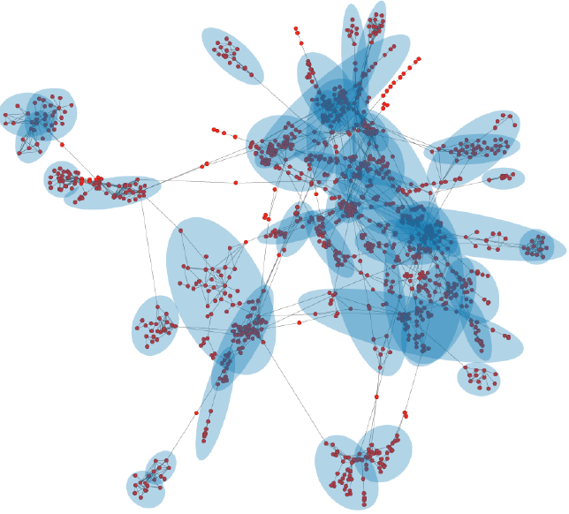
Protein-Protein Interactions
Functional modules
Nodes: Proteins
Edges: Physical interactions

Slide 8
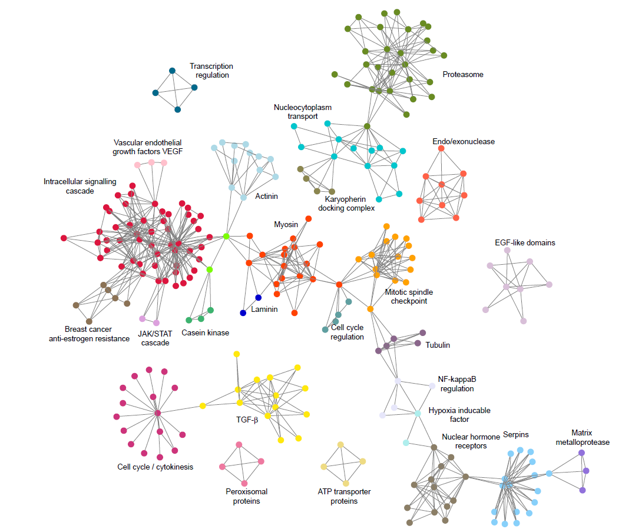
Protein-Protein Interactions

Slide 9
Facebook Network
Can we identify social communities?
Nodes: Facebook Users
Edges: Friendships

Slide 10
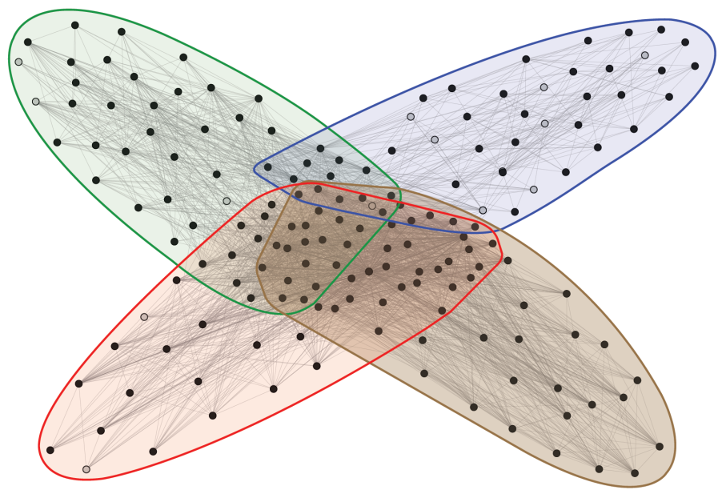
Facebook Network
Social communities
High school
Summer
internship
Stanford (Squash)
Stanford (Basketball)
Nodes: Facebook Users
Edges: Friendships

Slide 11
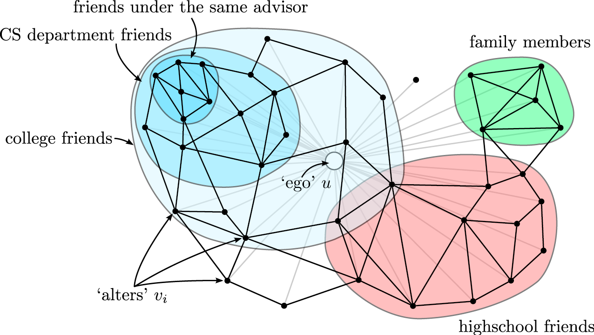
Twitter & Facebook
social circles, circles of trust

Slide 12
Outline
PART I
Introduction: what, why, types?
Cliques
Background: How it relates to “cluster analysis” (node/edge similarity)
Betweeness centrality
Modularity, label propagation
How to evaluate
PART II (next lecture)
Cuts, Spectral clustering, Denser subgraphs
+ signed networks

Slide 13
Why? (some applications)
Knowledge discovery
Groups based on common interests, behavior, etc (e.g., Canadians who call USA, readings tastes, etc)
  Recommendations, marketing
Collective behavior observable at the group, not the individual level, local view is noisy and ad hoc
Classification of the nodes by identifying modules and their boundaries
To improve performance: partition a large graph into many machines, assigning web clients to web servers, routing in ad hoc networks, etc
Summary, visual representation of the graph

Slide 14
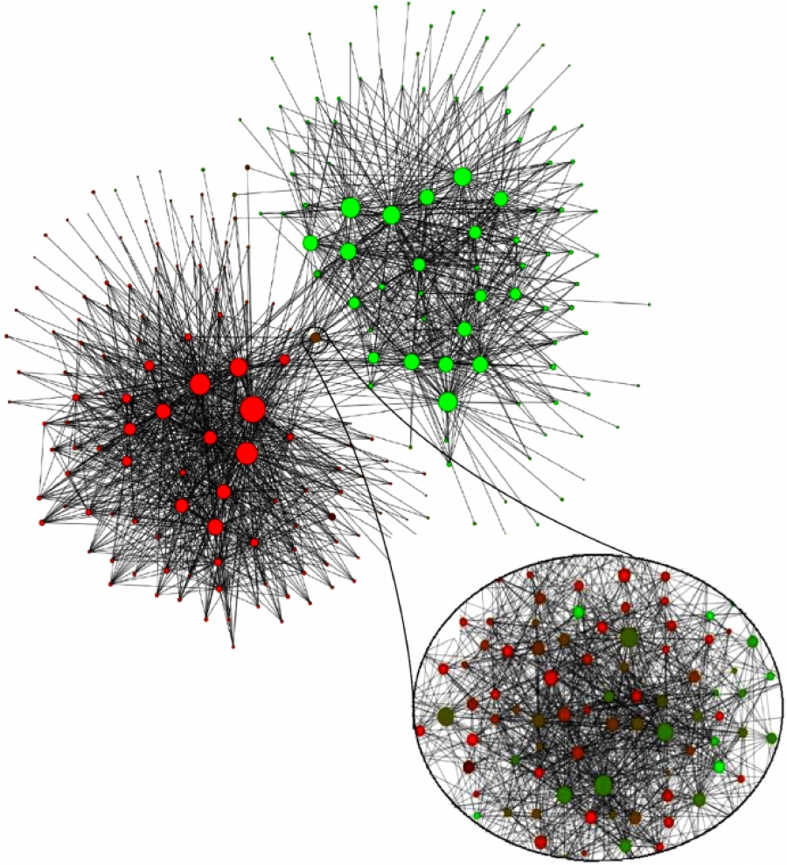
Example: communities in Belgium
59% Flemish, speaking Dutch 40% Walloons speaking French
Community structure in Belgium
2 million mobile phone users
Nodes correspond to communities (>100 members)
Red French, Green Dutch
Connecting community Brussels
Notes:
Communities extracted from the call pattern of the consumers of the largest Belgian mobile phone company. The network has about two million mobile phone users. The nodes correspond to communities, the size of each node being proportional to the number of individuals in the corresponding community. The color of each community on a red–green scale represents the language spoken in the particular community, red for French and green for Dutch. Only communities of more than 100 individuals are shown. The community that connects the two main clusters consists of several smaller communities with less obvious language separation, capturing the culturally mixed Brussels, the country’s capital. After [2].

Slide 15
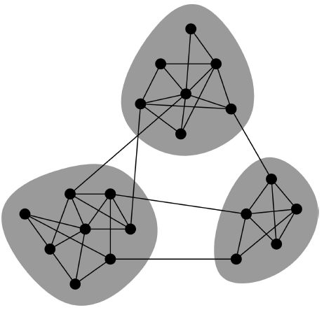
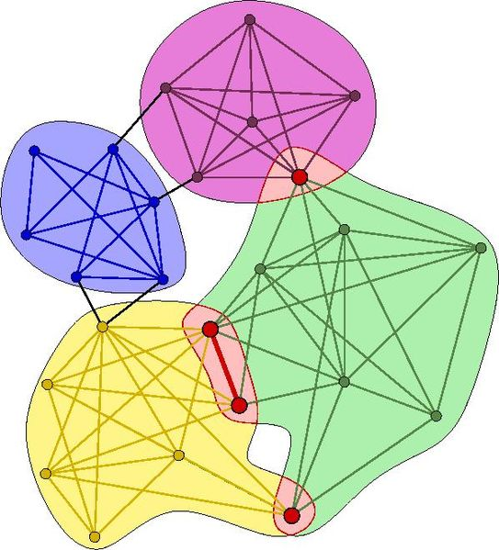
Community Types
Non-overlapping vs. overlapping communities

Slide 16
Non-overlapping Communities
Adjacency matrix
Nodes
Nodes
Network

Slide 17
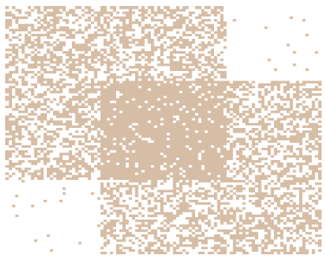
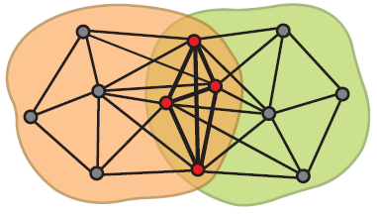
Overlapping Communities
What is the structure of community overlaps:
Edge density in the overlaps is higher!
Communities as “tiles”

Slide 18
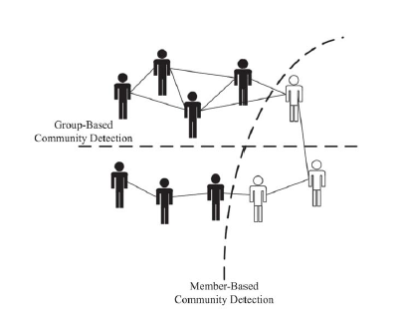
Community Types
Member-based (local) vs. group-based

Slide 19
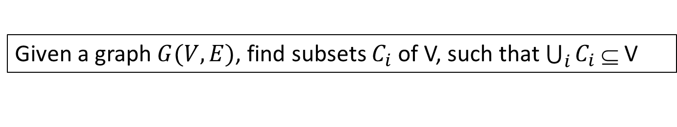
Community Detection
Given a graph $G(V, E)$, find subsets $C_{i}$ of V, such that $\bigcup_{i}{C_{i} }$⊆ V
Assumptions
Undirected graphs
Edges may have
  weights, (easily extended)
  labels
  content or attributes shared by individuals (in the same location, of the same gender, etc)
Nodes may have labels, attributed, or labeled graphs
Multipartite graphs – e.g., affiliation networks, citation networks, customers-products: reduced to unipartited projections of each vertex class

Slide 20
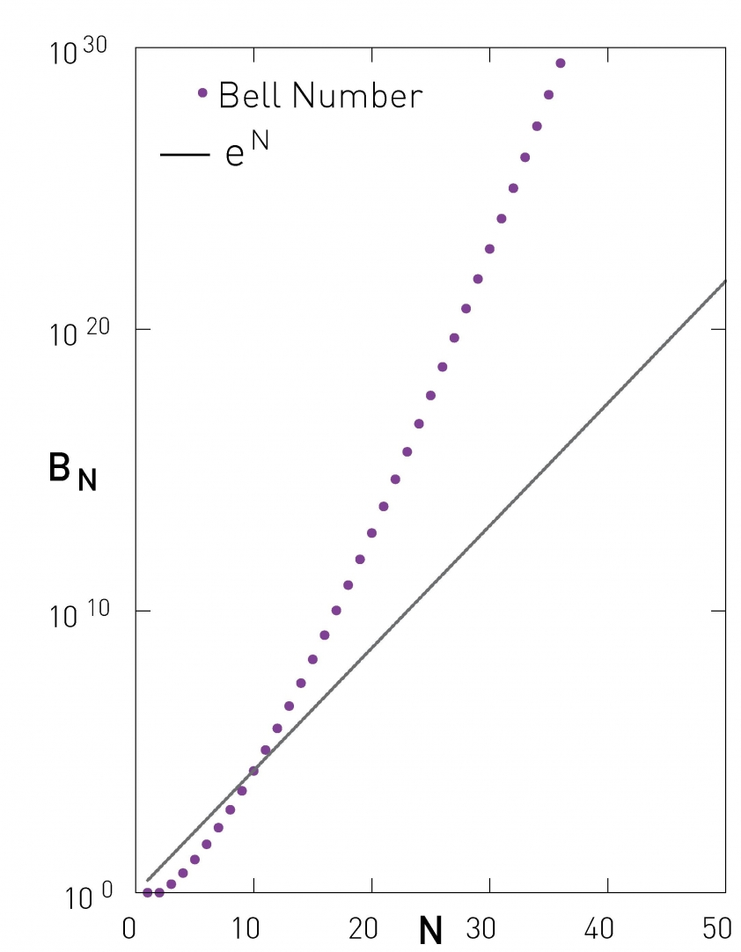
Hardness
Bell Number
Number of all possible partitions of N nodes
N
For N = 50, 1040 partitions
Notes:
The number of partitions of a network of size N is provided by the Bell number (9.6). The figure compares the Bell number to an exponential function, illustrating that the number of possible partitions grows faster than exponentially. Given that there are over 1040 partitions for a network of size N=50, brute-force approaches that aim to identify communities by inspecting all possible partitions are computationally infeasible.

Slide 21
Community Detection
We will see three approaches
Node degree (familiarity)
  cliques
Node similarity
  cluster
Node reachability
  betweeness

Slide 22
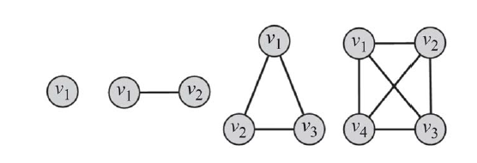
Cliques (degree similarity)
Clique: a maximum complete subgraph in which all pairs of vertices are connected by an edge.
A clique of size k is a subgraph of k vertices where the degree of all vertices in the induced subgraph is k -1 .
Cliques vs complete graphs

Slide 23
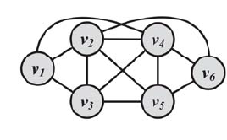
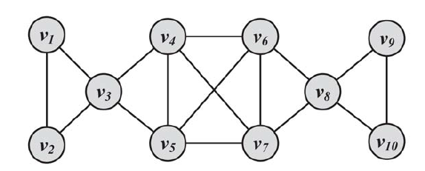
Cliques (degree similarity)
Search for:
the maximum clique: the one with the largest number of vertices) or
all maximal cliques: cliques that are not subgraphs of a larger clique; i.e., cannot be expanded further.
Both problems are NP-hard, as is verifying whether a graph
contains a clique larger than size k.
Notes:
Φαίνεται ότι στο δεξιά όλοι maximal – καλό παράδειγμα για τον αλγόριθμο που θέλει enumeration

Slide 24
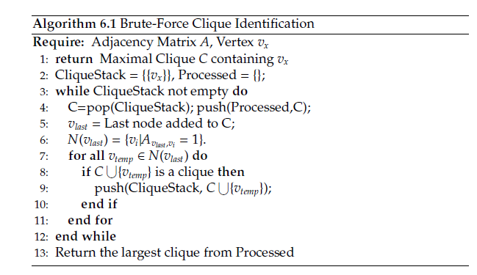
Cliques
/* Check all neighbors of last node sequentially
if connected with all members in the clique new clique -> push */
Enumerate all cliques (in alphabetical order)
Checks all permutations!
For (complete graph) 100 vertices, 2⁹⁹- 1 different cliques
Notes:
The algorithm starts with an empty stack of cliques. This stack is Initialized with the node vx that is being analyzed (a clique of size 1). Then, from the stack, a clique is popped (C). The last node added to clique C is selected (vlast). All the neighbors of vlast are added to the popped clique C sequentially, and if the new set of nodes creates a larger clique (i.e., the newly added node is connected to all of the other members), then the new clique is pushed back into the stack. This procedure is followed until nodes can no longer be added.
Generate cliques in alphabetic order
Classic paper is Algorithm 457: finding all cliques of an undirected graph
https://dl.acm.org/citation.cfm?id=362367

Slide 25
Cliques
Pruning
Prune all vertices (and incident edges) with degrees less than k - 1.
Effective due to the power-law distribution of vertex degrees
Exact cliques are rarely observed in real networks.
E.g., a clique of 1,000 vertices has (999x1000)/2 = 499,500 edges.
A single edge removal results in a subgraph that is no longer a clique.
That represents less than 0.0002% of the edges

Slide 26
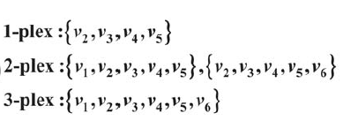
Relaxing Cliques
All vertices have a minimum degree but not necessarily k -1
k-plex
For a set of vertices V₀, for all u, d_{u} ≥ |V₀| - k
where d_{u} is the degree of v in the induced subgraph
What is k for a clique?
Maximal
Notes:
a clique of size k is a 1-plex

Slide 27
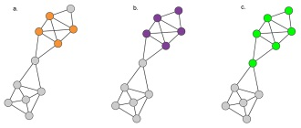
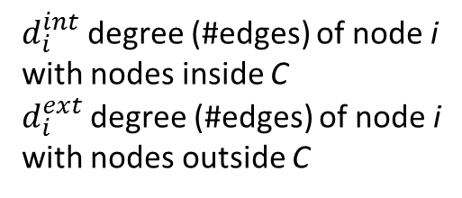
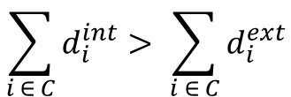


Relaxing Cliques
Clique
$$∀ i ∈C, d_{i}^{int}=\left|C\right|−1$$
$d_{i}^{int}$degree (#edges) of node i with nodes inside C
$d_{i}^{ext}$degree (#edges) of node i with nodes outside C
Strong community
$$∀ i ∈C, d_{i}^{int}>d_{i}^{ext}$$
Weak community
$$\sum_{i ∈ C}{d_{i}^{int}> \sum_{i ∈ C}{d_{i}^{ext}}}$$
Notes:
Hierarchical slides – take the example

Slide 28
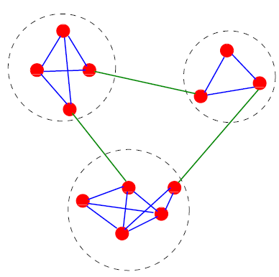
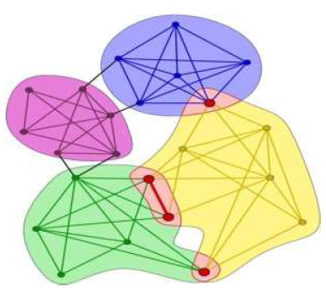
Clique Percolation Method (CPM): Using cliques as seeds
Assumption: communities are formed from a set of cliques and edges that connect these cliques.
k = 4

Slide 29
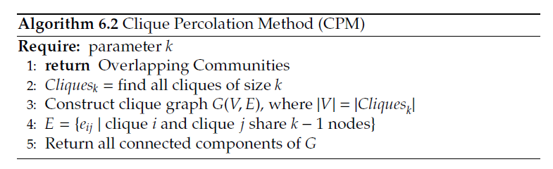
Clique Percolation Method (CPM): Using cliques as seeds
Given k, find all cliques of size k.
Create graph (clique graph) where all cliques are vertices, and two cliques that share k - 1 vertices are connected via an edge.
Communities are the connected components of this graph.

Slide 30
Clique Percolation Method (CPM): Using cliques as seeds
Input graph, let k = 3

Slide 31
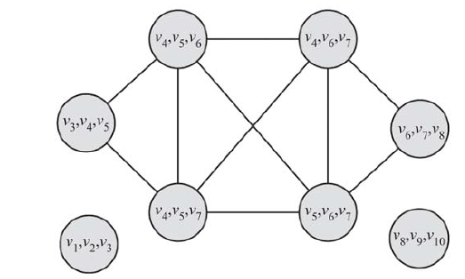
Clique Percolation Method (CPM): Using cliques as seeds
Clique graph for k = 3
(v1, v2, ,v3), (v8, v9, v10), and (v3, v4, v5, v6, v7, v8)

Slide 32
Clique Percolation Method (CPM): Using cliques as seeds
Result
(v1, v2, ,v3), (v8, v9, v10), and (v3, v4, v5, v6, v7, v8)
Note: the example protein network was detected using a CPM algorithm

Slide 33
Clique Percolation Method (CPM)
By construction, overlapping communities
Instead of k = 3, maximal cliques
Theoretical complexity grows exponential with size, but efficient on sparse graphs

Slide 34
Outline
PART I
Introduction: what, why, types?
Cliques
Background: cluster analysis (node/edge similarity)
Hierarchical clustering (betweenness)
Modularity
How to evaluate

Slide 35
What is Cluster Analysis?
Finding groups of objects such that the objects in a group are similar (or related) to one another and different from (or unrelated to) the objects in other groups
Inter-cluster distances are maximized
Intra-cluster distances are minimized

Slide 36
Types of Clustering
Important distinction between hierarchical and partitional sets of clusters
Partitional Clustering
  Division of data objects into subsets (clusters)
  Assumes that the number of clusters is given
Hierarchical clustering
  A set of nested clusters organized as a hierarchical tree

Slide 37
Partitional Clustering
Original Points
A Partitional Clustering

Slide 38
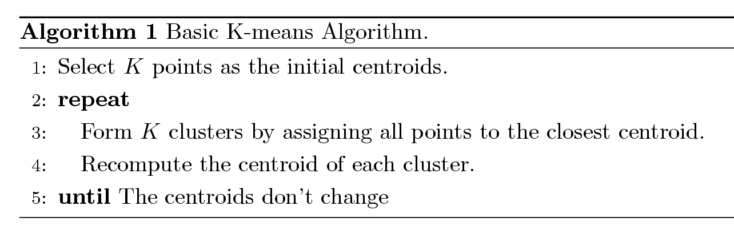
Example Partitioning:
K-means Clustering
Input: Number of clusters, K
Each cluster is associated with a centroid (center point)
Each point is assigned to the cluster with the closest centroid

Slide 39
Example

Slide 40
K-means Clustering
Initial centroids are often chosen randomly.
  Clusters produced vary from one run to another.
The centroid is (typically) the mean of the points in the cluster.
Closeness - Similarity is measured by Euclidean distance, cosine similarity, correlation, etc.
K-means will converge for common similarity measures mentioned above.
    Most of the convergence happens in the first few iterations.
    Often the stopping condition is changed to ‘Until relatively few points change clusters’
Complexity is O( n * K * I * d )
  n = number of points, K = number of clusters,
  I = number of iterations, d = number of attributes

Slide 41
K-means Clusters
Most common measure is Sum of Squared Error (SSE)
  For each point, the error is the distance to the nearest cluster
  To get SSE, we square these errors and sum them.
  x is a data point in cluster C_{i} and m_{i} is the representative point for cluster C_{i}
    can show that m_{i} corresponds to the center (mean) of the cluster
  Given two clusters, we can choose the one with the smallest error
  One easy way to reduce SSE is to increase K, the number of clusters
    A good clustering with smaller K can have a lower SSE than a poor clustering with higher K
Notes:
In contrast to the k-means algorithm, k-medoids chooses datapoints as centers (medoids or exemplars) and works with a generalization of the Manhattan Norm to define distance between datapoints instead of l2
Medoid point with the minimal average dissimilarity

Slide 42
Vertex similarity
Define similarity between two vertices
Place similar vertices in the same cluster
Use traditional cluster analysis

Slide 43


Vertex similarity
Structural equivalence: based on the overlap between their neighborhoods
Normalized to [0, 1], e.g.,
Notes:
Η διαίρεση για να αντιμετωπίσει πχ πολύ δημοφιλείς
Διαφορετικό 3 κοινούς με κάποιον που έχει 1000 και με κάποιον που έχει μόνο 5

Slide 44
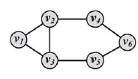

Vertex similarity

Slide 45

Other definitions of vertex similarity
Use the adjacency matrix A,
Common neighbors (paths of length two)
We can also use $A^{2}$

Slide 46




Other definitions of vertex similarity
If we map vertices u, v to n-dimensional points A, B in the Euclidean space,

Slide 47
Other definitions of vertex similarity
Many more – we shall revisit this issue when we talk about graph embeddings
Also useful when there are attributes associated with nodes or edges to combine distances

Slide 48
Hierarchical Clustering
Produces a set of nested clusters organized as a hierarchical tree
Can be visualized as a dendrogram
  A tree like diagram that records the sequences of merges or splits

Slide 49
Hierarchical Clustering
Two main types of hierarchical clustering
  Agglomerative:
    Start with each node as an individual cluster (called singletons)
    At each step, merge the closest pair of clusters until only one cluster (or k clusters) is left
  Divisive:
    Start with one, all-inclusive cluster = the whole graph
    At each step, split a cluster until each cluster contains a single node (or there are k clusters)
Traditional hierarchical algorithms use a similarity or distance matrix
  Merge or split one cluster at a time

Slide 50
Agglomerative Clustering Algorithm
Popular hierarchical clustering technique
Basic algorithm is straightforward
  [Compute the proximity matrix]
  Let each node be a cluster
  Repeat
  Merge the two closest clusters
  [Update the proximity matrix]
  Until only a single cluster remains

Slide 51
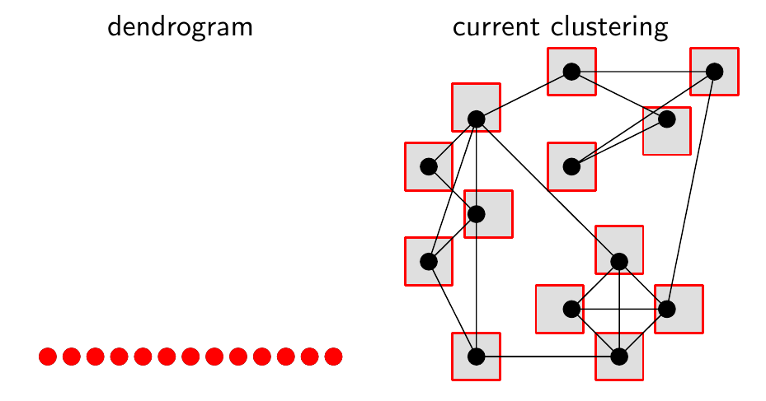
Agglomerative

Slide 52
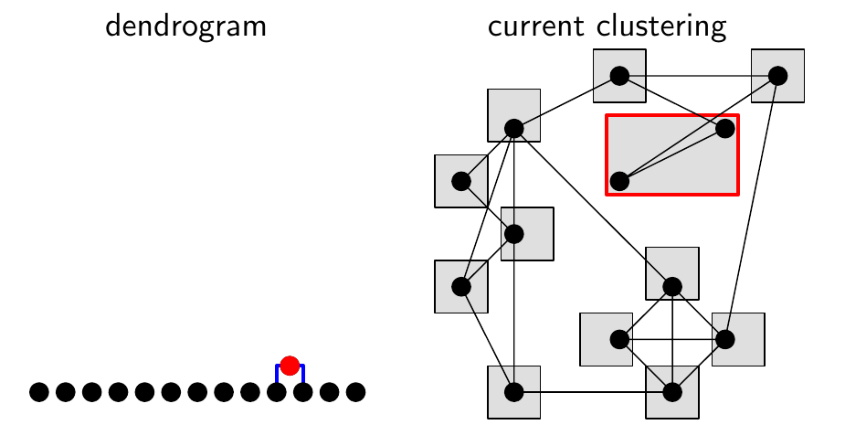
Agglomerative

Slide 53
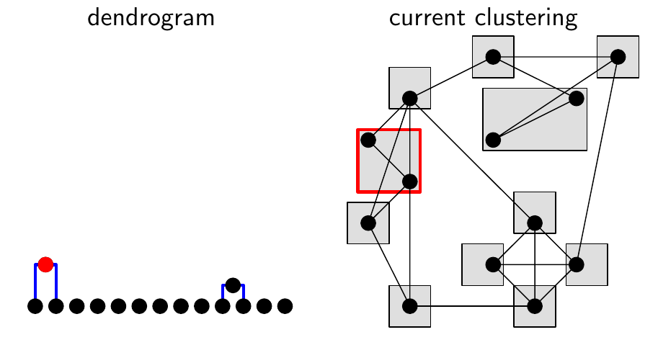
Agglomerative

Slide 54
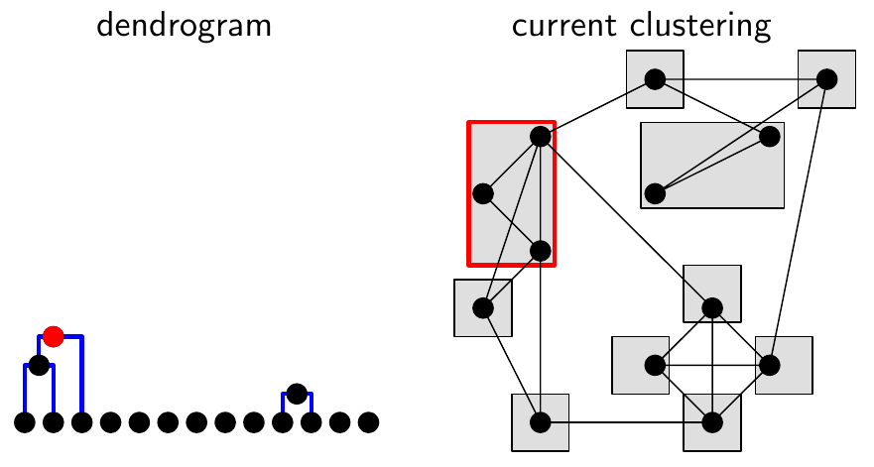
Agglomerative

Slide 55
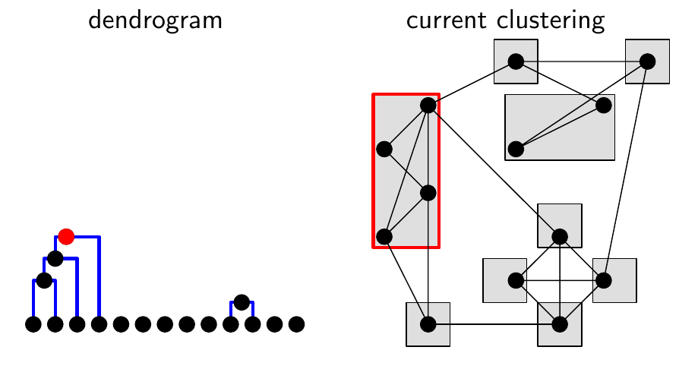
Agglomerative

Slide 56
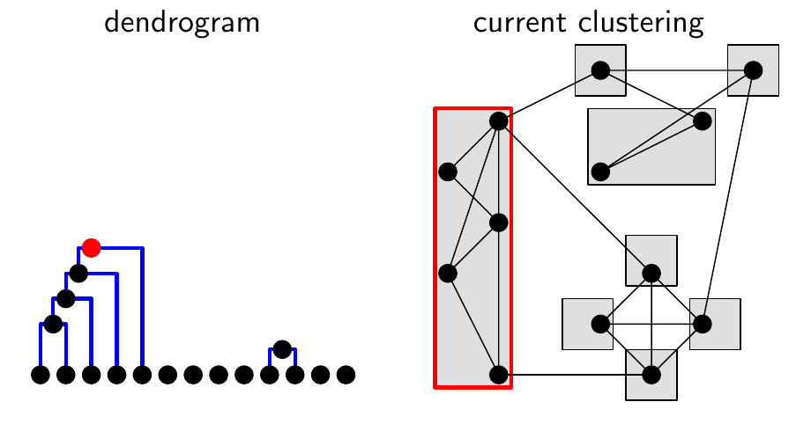
Agglomerative

Slide 57
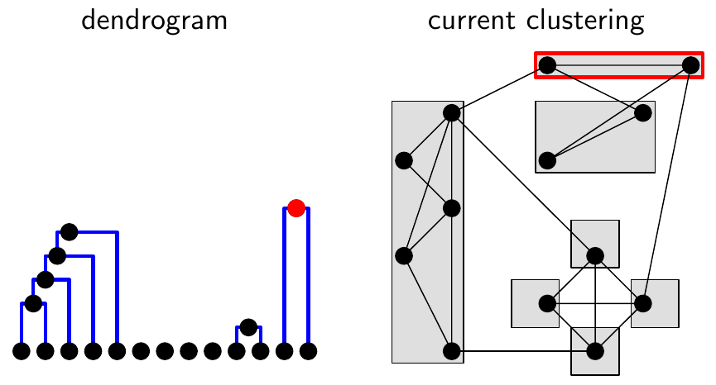
Agglomerative

Slide 58
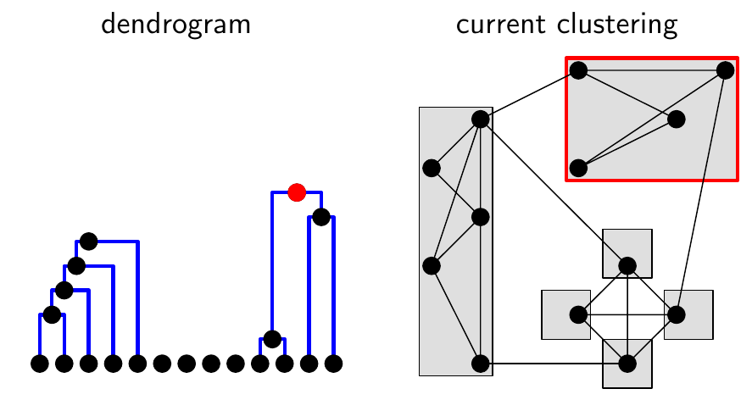
Agglomerative

Slide 59
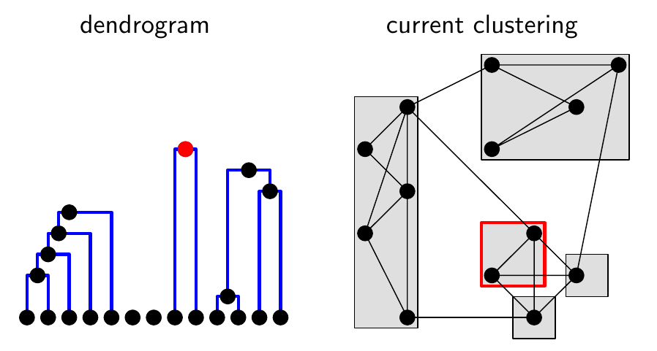
Agglomerative

Slide 60
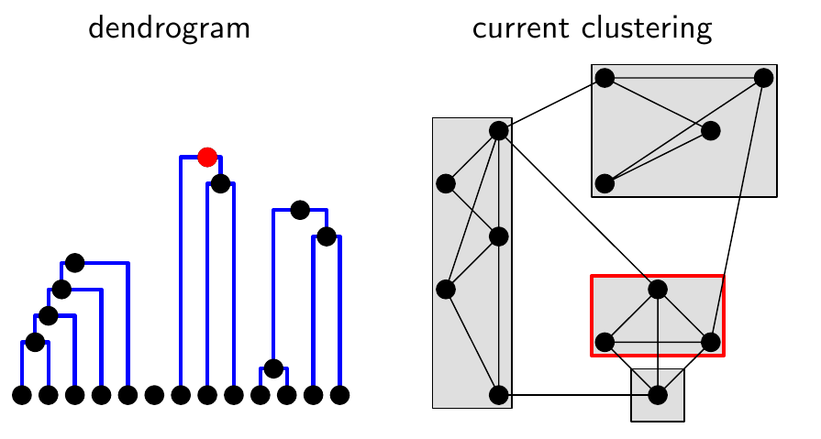
Agglomerative

Slide 61
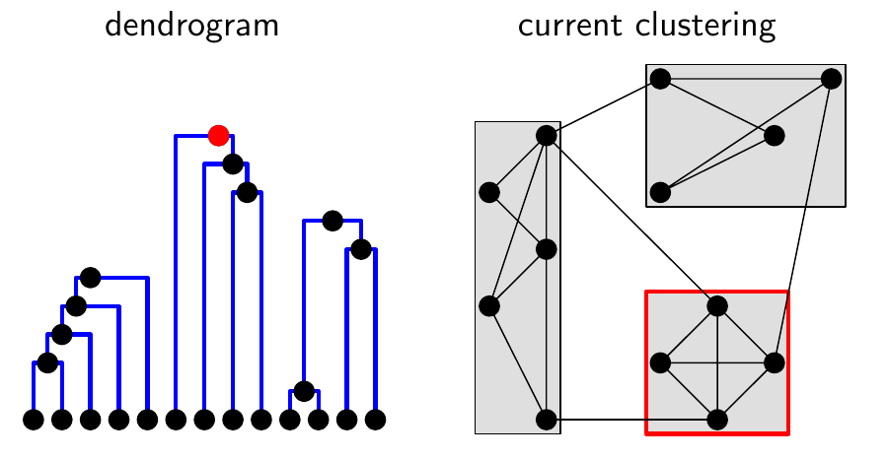
Agglomerative

Slide 62
Agglomerative

Slide 63
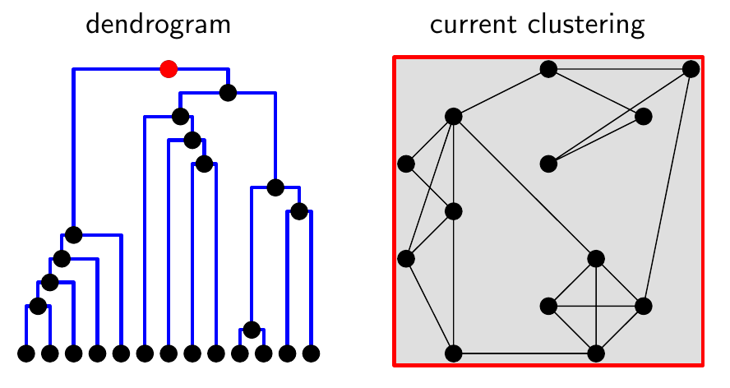
Agglomerative

Slide 64
Strengths of Hierarchical Clustering
Do not have to assume any particular number of clusters
  Any desired number of clusters can be obtained by ‘cutting’ the dendogram at the proper level
They may correspond to meaningful taxonomies
  Example in biological sciences (e.g., animal kingdom, phylogeny reconstruction, …)

Slide 65
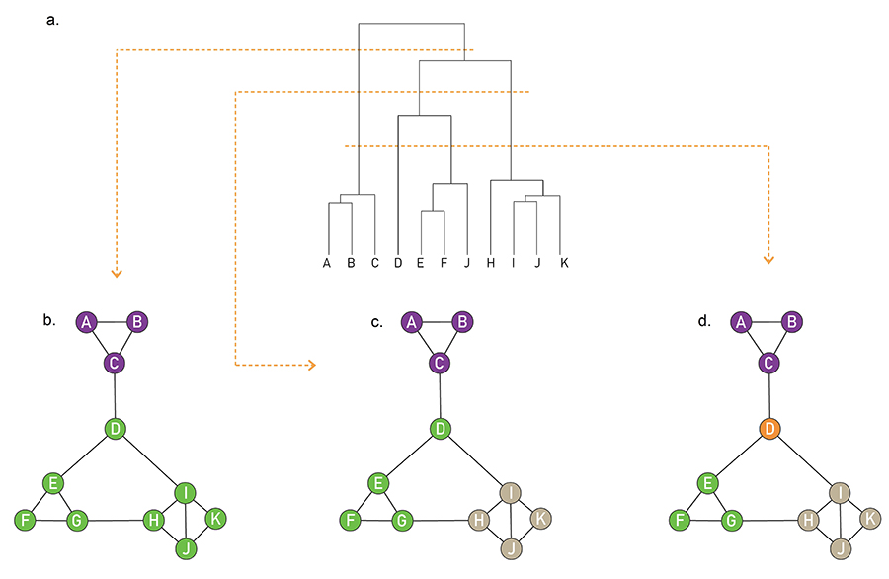
Where to cut?
Notes:
65

Slide 66
Agglomerative Clustering Algorithm
Key operation is the computation of the proximity of two clusters
  Different approaches to defining the distance between clusters distinguish the different algorithms

Slide 67
How to Define Inter-Cluster Similarity
p1
p2
p3
p4
p5
. . .
p1
p2
p3
p4
p5
Similarity?
.
.
.
Proximity Matrix

Slide 68
How to Define Inter-Cluster Similarity
p1
p2
p3
p4
p5
. . .
p1
p2
p3
p4
p5
MIN or single link
based on the two most similar (closest) points in the different clusters
sensitive to outliers
.
.
.
Proximity Matrix

Slide 69
How to Define Inter-Cluster Similarity
p1
p2
p3
p4
p5
. . .
p1
p2
p3
p4
p5
MAX or complete linkage
Similarity of two clusters is based on the two least similar (most distant) points in the different clusters
.
.
.
Proximity Matrix
Tends to break large clusters
Biased towards globular clusters

Slide 70
How to Define Inter-Cluster Similarity
p1
p2
p3
p4
p5
. . .
p1
p2
p3
p4
p5
.
.
.
Group Average
Proximity of two clusters is the average of pairwise proximity between points in the two clusters.
Proximity Matrix

Slide 71
Outline
PART I
Introduction: what, why, types?
Cliques
Background: How it relates to “cluster analysis” (node/edge similarity)
Betweeness centrality
Modularity, label propagation
How to evaluate

Slide 72
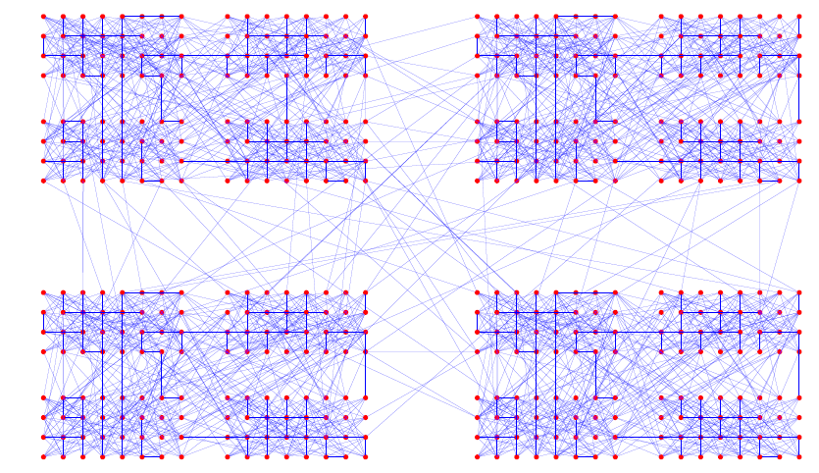
Example of a Hierarchically Structured Graph

Slide 73
Divisive Algorithms
Which edge to remove?

Slide 74
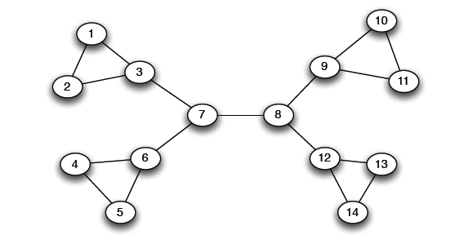
The Girvan Newman method
Hierarchical divisive method
  Start with the whole graph
  Find edges whose removal “partitions” the graph
  Repeat with each subgraph until single vertices
Which edge?

Slide 75
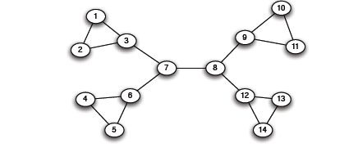
The Girvan Newman method
Use bridges or cut-edge (if removed, the nodes become disconnected)
Which one to choose?

Slide 76
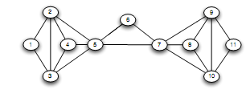
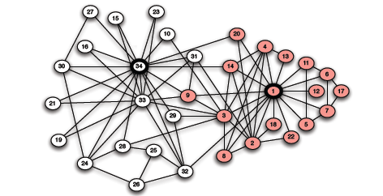
The Girvan Newman method
There may be none!

Slide 77
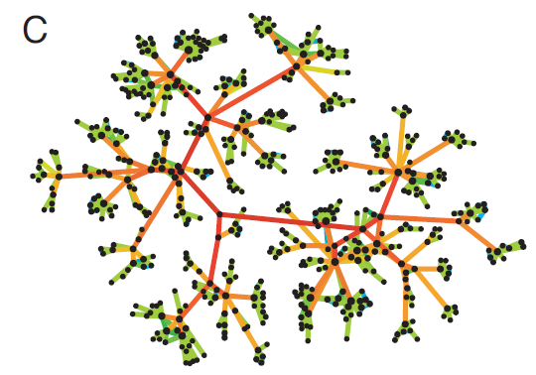
Strength of Weak Ties
Edge betweenness: Number of
shortest paths passing over the edge
Intuition:
Assuming communication through shortest paths, captures traffic
Edge betweenness
in a real network

Slide 78
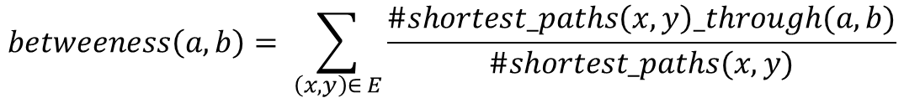
Edge Betweenness
Betweenness of an edge (a, b): number of pairs of nodes x and y such that the edge (a, b) lies on their shortest path
There can be multiple shortest paths, take the fraction that includes (a, b)
$$betweeness\left(a, b\right)= \sum_{\left(x, y\right)∈ E}{\frac{\#shortest_paths\left(x,y\right)_through(a, b)}{\#shortest_paths(x, y)}}$$
3x11 = 33
1x12 = 12
7x7 = 49
1
edges that have a high probability to occur on a randomly chosen shortest path between two randomly chosen nodes
Notes:
To 7.5 είναι
Για το δεξί άκρο
όλοι οι αριστεροι + το αριστερό άκρο = 5
+ ο πάνω δεξιά με αυτούς του 5 δια 2

Slide 79

Edge Betweenness
$$betweeness\left(a, b\right)= \sum_{\left(x, y\right)∈ E}{\frac{\#shortest_paths\left(x,y\right)_through(a, b)}{\#shortest_paths(x, y)}}$$
b=16
b=7.5
Notes:
To 7.5 είναι
Για το δεξί άκρο
όλοι οι αριστεροι + το αριστερό άκρο = 5
+ ο πάνω δεξιά με αυτούς του 5 δια 2

Slide 80
The Girvan Newman method
[Girvan-Newman ‘02]
        Undirected unweighted networks
  Repeat until no edges are left:
    Calculate betweenness of edges
    Remove edges with highest betweenness
  Connected components are communities
  Gives a hierarchical decomposition of the network

Slide 81
Girvan Newman method: An example
Betweenness(7, 8)= 7x7 = 49
Betweenness(3, 7)=Betweenness(6, 7)=Betweenness(8, 9) = Betweenness(8, 12)= 3x11=33
Betweenness(1, 3) = 1x12=12

Slide 82

Girvan-Newman: Example
12
1
33
49
Need to re-compute betweenness at every step

Slide 83

Girvan Newman method: An example
Betweenness(1, 3) = 1x5=5
Betweenness(3,7)=Betweenness(6,7)=Betweenness(8,9) = Betweenness(8,12)= 3x4=12

Slide 84

Girvan Newman method: An example
Betweenness of every edge = 1

Slide 85

Girvan Newman method: An example

Slide 86




Girvan-Newman: Example
Step 1:
Step 2:
Step 3:
Hierarchical network decomposition:

Slide 87

Another example
5x5=25

Slide 88

Another example
5x6=30
5x6=30

Slide 89

Another example

Slide 90


Girvan-Newman: Results
Zachary’s Karate club:
Hierarchical decomposition

Slide 91

Girvan-Newman: Results
Communities in physics collaborations

Slide 92


How to Compute Betweenness?
Want to compute betweenness of paths starting at node $A$

Slide 93
Computing Betweenness
Perform a BFS starting from A
Determine the number of shortest path from A to each other node
Based on these numbers, determine the amount of flow from A to all other nodes that uses each edge

Slide 94


Computing Betweenness: step 1
Initial network
BFS on A

Slide 95

Computing Betweenness: step 2
Count how many shortest paths from A to a specific node
Top-down

Slide 96
Computing Betweenness: step 3
Compute betweenness by working up the tree: If there are multiple paths count them fractionally
Bottom-up

Slide 97
Computing Betweenness: step 3
Count the flow through each edge
Portion of the shortest paths to I that go through (F, I) = 2/3 +
Portion of the shortest paths to K that go through (F, I)
(2/3) (1/2) = 1/3
= 1
1/3+(1/3)1/2 = 1/2
Portion of the shortest paths to K that go through (I, K) = 3/6 = 1/2

Slide 98


Computing Betweenness: step 3
(X, Y)
p_{X}
X
Y
p_{Y}
.. .
Y₁
Y_{m}
$$flow\left(X, Y\right)= \frac{p_{X}}{p_{y}}+ \sum_{Y_{i }child of Y}{\frac{p_{X}}{p_{y}} flow(Y, Y_{i})}$$

Slide 99
Computing Betweenness
Repeat the process for all nodes
Sum over all BFSs

Slide 100



Example

Slide 101


Example

Slide 102
Computing Betweenness
Issues
Test for connectivity?
Re-compute all paths, or only those affected
Parallel computation
Sampling

Slide 103
Centrality measures
Degree centrality

Slide 105
Outline
PART I
Introduction: what, why, types?
Cliques and vertex similarity
Background: Cluster analysis
Betweeness centrality
Modularity, label propagation
How to evaluate

Slide 106

Modularity
Communities: sets of
tightly connected nodes
Define: Modularity $Q$
  A measure of how well
  a network is partitioned
  into communities
  Given a partitioning of the
  network into groups $s  S$:
  Q ∝ ∑_{s∈ S} [ (# edges within group s) –
  (expected # edges within group s) ]
Need a null model!
a copy of the original graph keeping some of its structural properties but without community structure

Slide 107



Null Model: Configuration Model
Given real $G$ on $n$ nodes and $m$ edges,
construct rewired network $G’$
  Same degree distribution but
  random connections
  Consider $G’$ as a multigraph
  The expected number of edges between nodes
  $i$ and $j$ of degrees $d_{i}$and $d_{j}$ equals to: $d_{i}⋅\frac{d_{j}}{2m}=\frac{d_{i}d_{j}}{2m}$
i
j
For any edge going out of i randomly, the probability of this edge getting connected to node j is $\frac{d_{j}}{2m}$
Because the degree for i is d_{i}, we have d_{i} number of such edges
Note:
$$\sum_{u∈N}{d_{u}}=2m$$
Notes:
dj / sum of all di

Slide 108

Null Model: Configuration Model
i
j
    The expected number of edges in (multigraph) G’:
      $=\frac{1}{2}\sum_{i∈N}{\sum_{j∈N}{\frac{d_{i}d_{j}}{2m}}}=\frac{1}{2}⋅\frac{1}{2m}\sum_{i∈N}{d_{i}\left(\sum_{j∈N}{d_{j}}\right)}=$
      $=\frac{1}{4m}2m⋅2m=m$

Slide 109

Modularity
Modularity of partitioning S of graph G:
  Q ∝ ∑_{s∈ S} [ (# edges within group s) –
  (expected # edges within group s) ]
  $Q\left(G,S\right)=\frac{1}{2m}\sum_{s∈S}{\sum_{i∈s}{\sum_{j∈s}{\left(A_{ij}−\frac{d_{i}d_{j}}{2m}\right)}}}$
Modularity values take range [−1, 1]
  It is positive if the number of edges within
  groups exceeds the expected number
  0.3-0.7 < Q means significant community structure
A_{ij} = 1 if i→j,
0 else
Normalizing cost.: -1<Q<1

Slide 110
Modularity
Greedy method of Newman (one of the many ways to use modularity)
Agglomerative hierarchical clustering method
Start with a state in which each vertex is the sole member of one of n communities
Repeatedly join communities together in pairs, choosing at each step the join that results in the greatest increase (or smallest decrease) in Q.
Since the joining of a pair of communities between which there are no edges can never result in an increase in modularity, we need only consider those pairs between which there are edges, of which there will at any time be at most m

Slide 111

Modularity: Number of clusters
Modularity is useful for selecting the
number of clusters:
Q
Notes:
HW: Question – come up with a graph where GIRVAN-NEWMAN MODULARITY IS NOT UNIMODAL

Slide 112
Modularity: Cluster quality
When a given clustering is “good”?
Also, it is both a local (per individual cluster) and global measure
Notes:
HW: Question – come up with a graph where GIRVAN-NEWMAN MODULARITY IS NOT UNIMODAL

Slide 113
Outline
PART I
Introduction: what, why, types?
Cliques and vertex similarity
Background: Cluster analysis
Betweeness centrality
Modularity, label propagation
How to evaluate

Slide 114
Label propagation
Vertices are initially given unique labels (e.g., their vertex labels).
At each iteration,
sweep over all vertices, in random sequential order:
each vertex takes the label shared by the majority of its neighbors.
If no unique majority, one of the majority label is picked at random.
Stop (convergence) when each vertex has the majority label of its neighbors
Communities: groups of vertices having identical labels at convergence

Slide 115
Label propagation
Labels propagate across the graph: most labels will disappear, others will dominate.
By construction, each vertex has more neighbors in its community than in any other community.
Due to many possible ties, different partitions
  Perform many propagations from the same initial condition, with different random seeds
  Aggregate partition label each vertex with the set of all labels it has in different partitions → overlapping communities

Slide 116
Outline
PART I
Introduction: what, why, types?
Cliques and vertex similarity
Background: Cluster analysis
Betweeness centrality
Modularity, label propagation
How to evaluate

Slide 117
Community Evaluation
With ground truth
Without ground truth

Slide 118

Evaluation with ground truth
Zachary’s Karate Club
Club president (34) (circles) and instructor (1) (rectangles)

Slide 119


Metrics: purity
the fraction of instances that have labels equal to the label of the community’s majority
(5+6+4)/20 = 0.75

Slide 120
Metrics
Based on pair counting: the number of pairs of vertices which are classified in the same (different) clusters in the two partitions.
True Positive (TP) Assignment: when similar members are assigned to the same community. This is a correct decision.
True Negative (TN) Assignment: when dissimilar members are assigned to different communities. This is a correct decision.
False Negative (FN) Assignment: when similar members are assigned to different communities. This is an incorrect decision.
False Positive (FP) Assignment: when dissimilar members are assigned to the same community. This is an incorrect decision.
Notes:
St

Slide 121

Metrics: pairs
For TP, we need to compute the number of pairs with the same label that are in the same community

Slide 122

Metrics: pairs
For TN: compute the number of dissimilar pairs in dissimilar communities

Slide 123


Metrics: pairs
For FP, compute dissimilar pairs that are in the same community.
For FN, compute similar members that are in different communities.

Slide 124
Metrics: pairs
Precision (P): the fraction of pairs that have been correctly assigned to the same community.
TP/(TP+FP)
Recall (R): the fraction of pairs assigned to the same community of all the pairs that should have been in the same community.
TP/(TP+FN)
F-measure
2PR/(P+R)

Slide 125
Evaluation without ground truth
Cluster Cohesion: Measures how closely related are objects in a cluster
Cluster Separation: Measure how distinct or well-separated a cluster is from other clusters
Example: Squared Error
  Cohesion is measured by the within cluster sum of squares (SSE)
  Separation is measured by the between cluster sum of squares
      Where |C_{i}| is the size of cluster i

Slide 126


Evaluation without ground truth
$$cohesion\left(C\right)= \frac{\#internal edges of C}{N_{C}(N_{C}−1)/2}$$
$$seperation\left(C\right)= \frac{\#inter−cluster edges of C}{N_{C}(N−N_{C})}$$

Slide 127
Evaluation without ground truth
Modularity
Both as a local (per individual community) and as a global measure

Slide 128

Evaluation without ground truth
With semantics:
(ad hoc) analyze other attributes (e.g., profile, content generated) for coherence
human subjects (user study) Mechanical Turk
Visual representation (similarity/adjacency matric, word clouds, etc)

Slide 129
Basic References
Jure Leskovec, Anand Rajaraman, Jeff Ullman, Mining of Massive Datasets, Chapter 10, http://www.mmds.org/
Reza Zafarani, Mohammad Ali Abbasi, Huan Liu, Social Media Mining: An Introduction, Chapter 6, http://dmml.asu.edu/smm/
Santo Fortunato: Community detection in graphs. CoRR abs/0906.0612v2 (2010)
Pang-Ning Tan, Michael Steinbach, Vipin Kumar, Introduction to Data Mining, Chapter 8, http://www.users.cs.umn.edu/~kumar/dmbook/index.php
Albert-László Barabasi, Network Science, Chapter 9, http://networksciencebook.com/

Slide 130
Questions?

