Slide 1
Online Social Networks and Media
Introduction

Slide 2
Instructors:
Ευαγγελία Πιτουρά
http://www.cs.uoi.gr/~pitoura
Παναγιώτης Τσαπάρας
http://www.cs.uoi.gr/~tsap
Goal
Understand the importance of networks in life, technology and applications
Study the theory underlying social networks
Learn about algorithms that make use of network structure
Learn about the tools to analyze them
Today:
Some logistics
A taste of the topics to be covered
Introduction to graph theory and notebooks

Slide 3
Logistics
Textbooks:
Easley and Kleinberg free text-book on Networks, Crowds and Markets
M. E. J. Newman, The structure and function of complex networks, SIAM Reviews, 45(2): 167-256, 2003
Reza Zafarani, Mohammad Ali Abbasi, Huan Liu, free text-book on Social Media Mining
Michele Coscia, The Atlas for the Aspiring Network Scientist
Web page:
www.cs.uoi.gr/~tsap/teaching/cs-d6
20% Presentations and class participation
30% Assignments
50% Term Project (in 2 Phases)
No Final Exam

Slide 4
CONSIDER the Following complex Systems

Slide 5
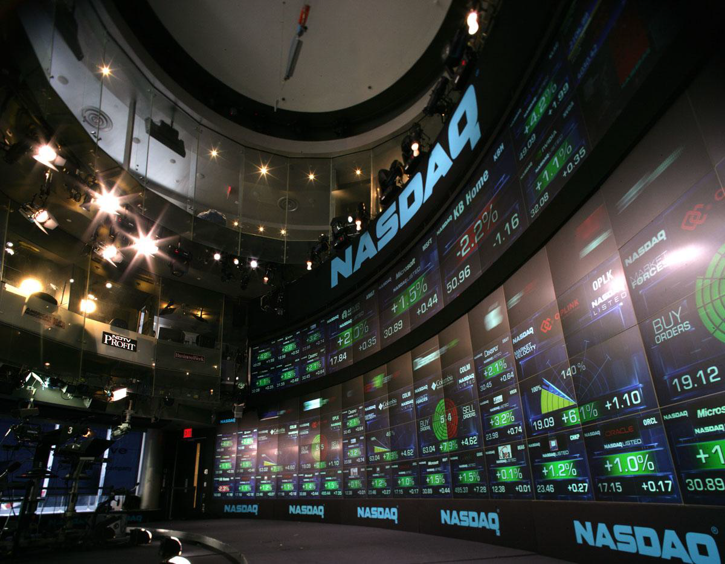
The Economy

Slide 6
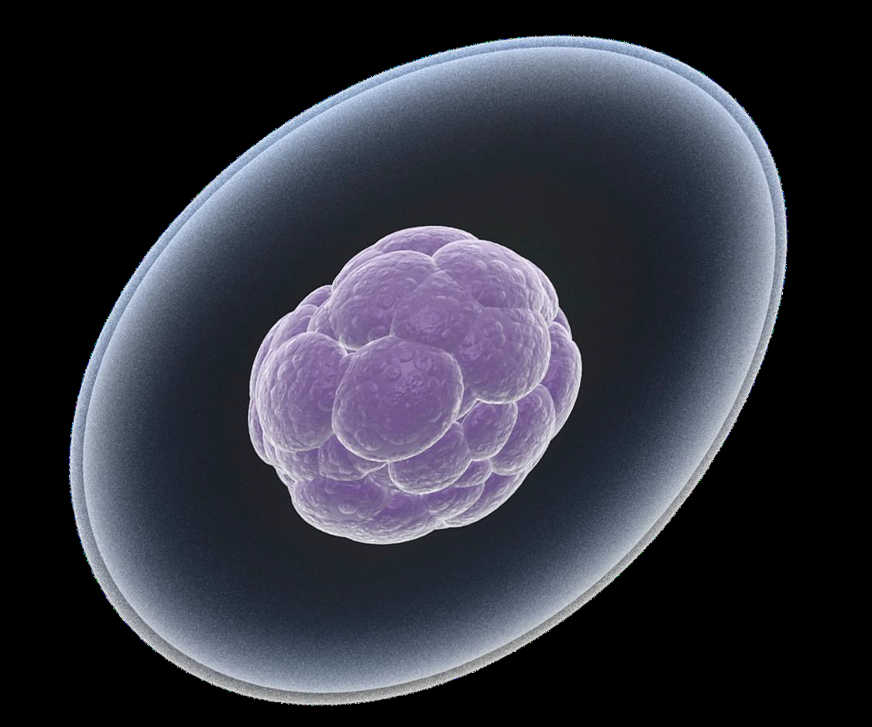
The Human Cell

Slide 7
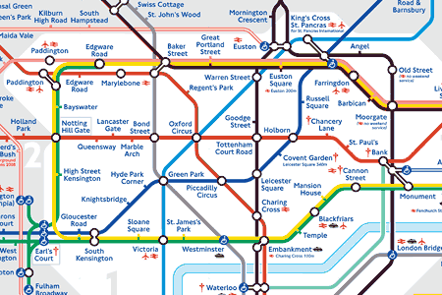
Traffic and roads

Slide 8
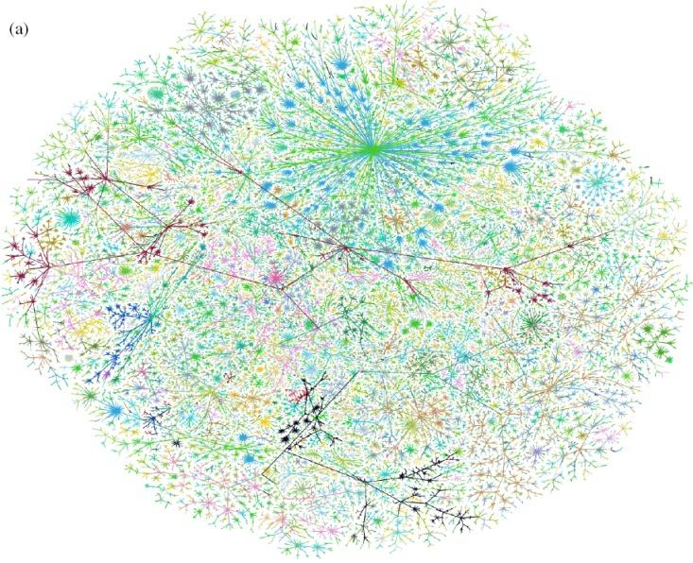
Internet

Slide 9
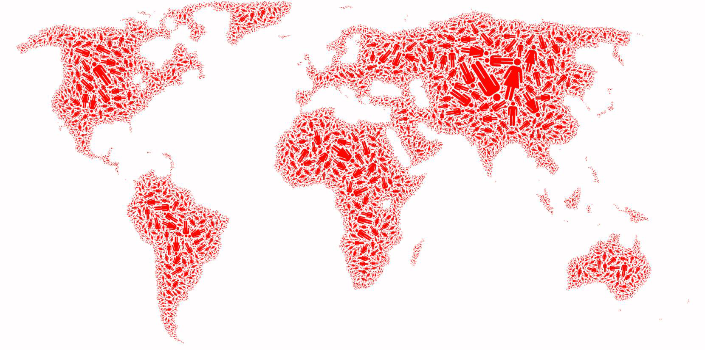
Society

Slide 10
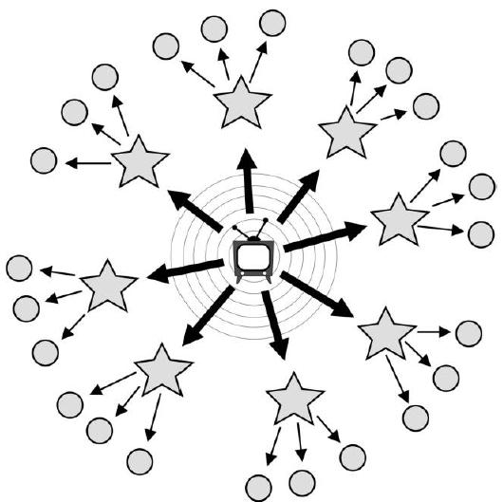
Media and Information

Slide 11
What do THEY Have in Common?

Slide 12
The Network!
All of these systems can be modeled as networks

Slide 13
What is a network?
Network: a collection of entities that are interconnected with links.

Slide 14
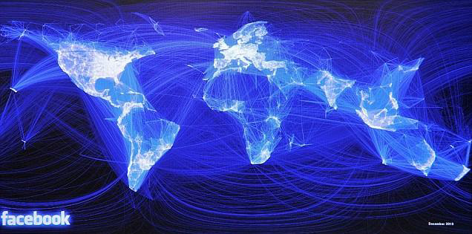
Social networks
Entities: People
Links: Friendships

Slide 15
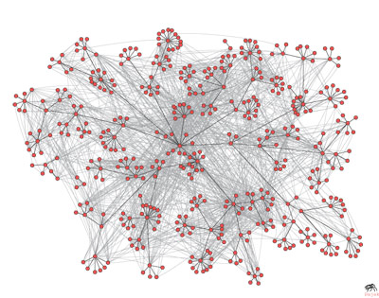
Communication networks
Entities: People
Links: email exchange

Slide 16
Communication networks
Entities: Internet nodes
Links: communication between nodes

Slide 17
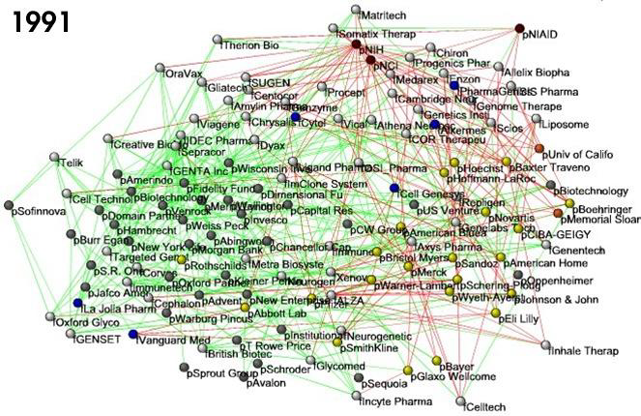
Financial Networks
Entities: Companies
Links: relationships (financial, collaboration)

Slide 18
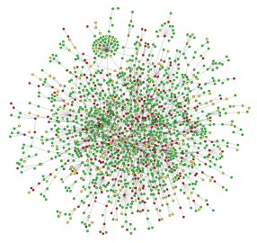
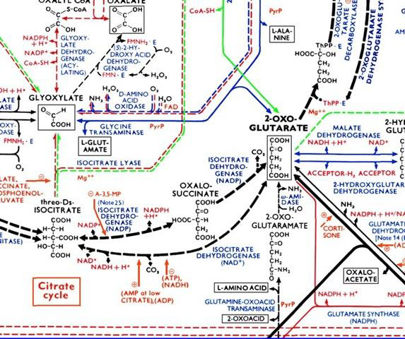
Biological networks
Entities: Proteins
Links: interactions
Entities: metabolites, enzymes
Links: chemical reactions

Slide 19
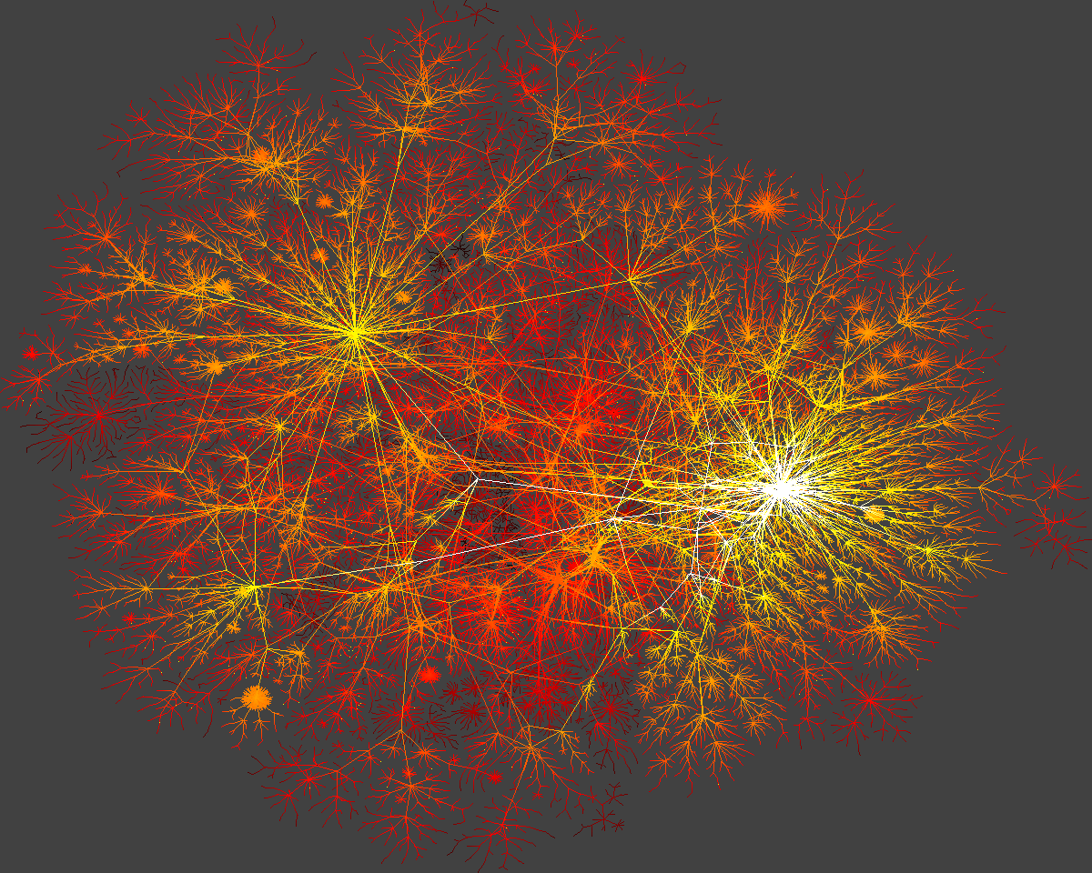
Information networks
Entities: Web Pages
Links: Links

Slide 20
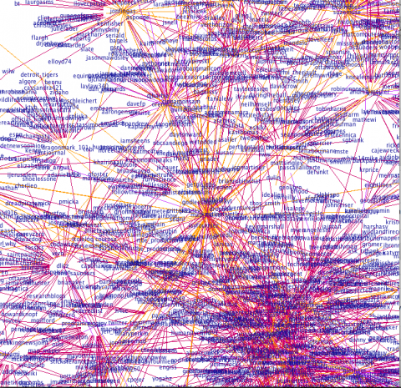
Information/Media networks
Entities: Twitter users
Links: Follows/conversations

Slide 21
Many more
Wikipedia
Brain
Highways
Software
Etc…

Slide 22
Why networks are important?
We cannot truly understand a complex system unless we understand the underlying network.
  Everything is connected, studying individual entities gives only a partial view of a system
Two main themes:
  What are the structural properties of the network?
  How do processes happen in the network?
  How can we use networks to extract knowledge

Slide 23
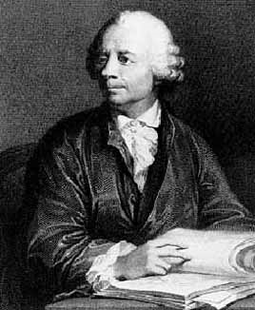
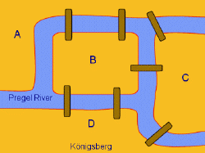
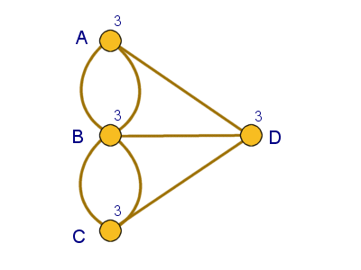
Graphs
In mathematics, networks are called graphs, the entities are nodes, and the links are edges
Graph theory starts in the 18th century, with Leonhard Euler
  The problem of Königsberg bridges
  Since then graphs have been studied extensively.

Slide 24
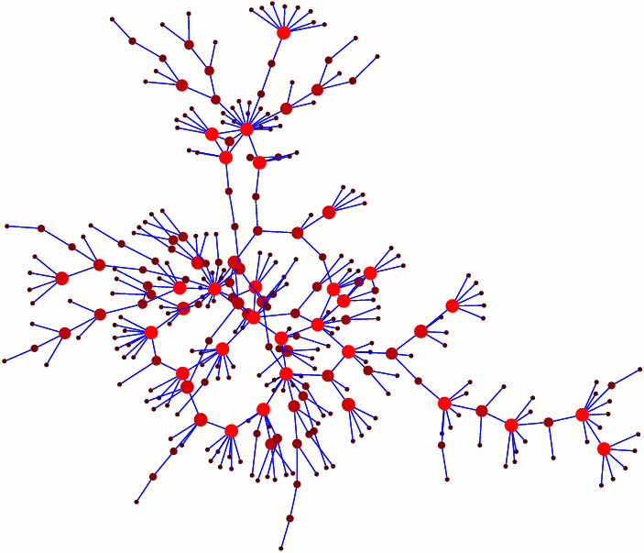
Networks in the past
Graphs have been used in the past to model existing networks (e.g., networks of highways, social networks)
  usually these networks were small
  network can be studied visual inspection can reveal a lot of information

Slide 25
Networks now
More and larger networks appear
  Products of technology
    e.g., Internet, Web, Facebook, Twitter
  Result of our ability to collect more, better, and more complex data
    e.g., gene regulatory networks
  Result of the willingness of users to contribute data
    e.g., users making their relationships public online
Networks of thousands, millions, or billions of nodes
  Impossible to process visually
  Problems become harder
  Processes are more complex
Networks as a source of data rather than combinatorial objects

Slide 26
Topics
Measuring Real Networks
Modeling the evolution and creation of networks
Identifying important nodes in the network
Understanding information cascades and virus contagions
Finding communities in graphs
Link Prediction
Storing and processing huge networks
Network embeddings
Machine learning in networks
Network Fairness
Other special topics

Slide 27
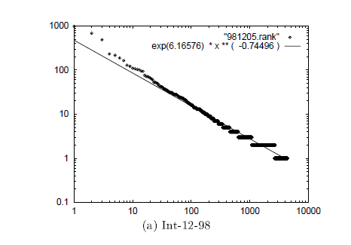
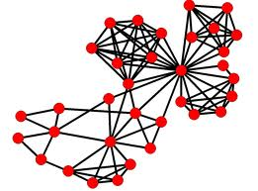
Understanding large graphs
What does a network look like?
  Measure different properties to understand the structure
degree of nodes
Triangles in the graph

Slide 28
Real network properties
Most nodes have only a small number of neighbors (degree), but there are some nodes with very high degree (power-law degree distribution)
  scale-free networks
If a node x is connected to y and z, then y and z are likely to be connected
  high clustering coefficient
Most nodes are just a few edges away on average.
  small world networks
Networks from very diverse areas (from internet to biological networks) have similar properties
  Is it possible that there is a unifying underlying generative process?

Slide 29
Generating random graphs
Classic graph theory model (Erdös-Renyi)
  each edge is generated independently with probability p
Very well studied model but not realistic:
  most vertices have about the same degree
  the probability of two nodes being linked is independent of whether they share a neighbor
  the average paths are short

Slide 30
Modeling real networks
Real life networks are not “random”
Can we define a model that generates graphs with statistical properties similar to those in real life?
The rich-get-richer model
We need to accurately model the mechanisms that govern the evolution of networks (for prediction, simulations, understanding)

Slide 31

Ranking of nodes on the Web
Is my home page as important as the facebook page?
We need algorithms to compute the importance of nodes in a graph
The PageRank Algorithm
  A success story of network use
It is impossible to create a web search engine without understanding the web graph

Slide 32
Information/Virus Cascade
How do viruses spread between individuals? How can we stop them?
How does information propagate in social and information networks? What items become viral? Who are the influencers and trend-setters?
We need models and algorithms to answer these questions
Online advertising relies heavily on online social networks and word-of-mouth marketing.
COVID-19 demonstrated the importance of understanding virus spread.

Slide 33
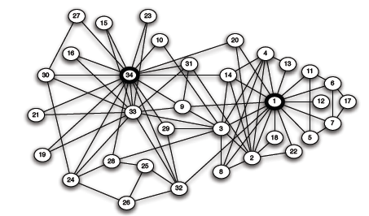
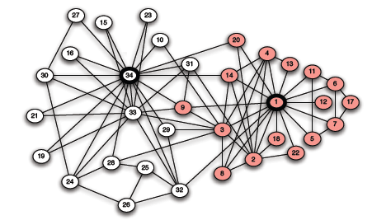
Clustering and Finding Communities
What is community?
  “Cohesive subgroups are subsets of actors among whom there are relatively strong, direct, intense, frequent, or positive ties.” [Wasserman & Faust ‘97]
Karate club example
[W. Zachary, 1970]
How do we define and discover communities in large graphs?

Slide 34
Clustering and Finding Communities
Input: a graph G=(V,E)
  edge (u, v) denotes similarity between u and v
  weighted graphs: weight of edge captures the degree of similarity
Clustering: Partition the nodes in the graph such that nodes within clusters are well interconnected (high edge weights), and nodes across clusters are sparsely interconnected (low edge weights)

Slide 35
Homophily
Homophily:“Birds of a feather flock together”. People with similar interests tend to connect to each other
  Caused by two related social forces [Friedkin98, Lazarsfeld54]
    Social influence: People become similar to those they interact with
    Selection: People seek out similar people to interact with
Homophily is widely observed in social networks and has important implications on the network
Applications in online marketing
  viral marketing relies upon social influence affecting behavior
  recommender systems predict behavior based on similarity
How does homophily affect the properties and the processes in the network?

Slide 36
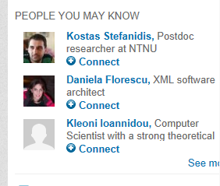
Link Prediction
Given a snapshot of a social network at time t, we seek to accurately predict the edges that will be added to the network during the interval from time t to a given future time t'.
Applications:
  Accelerate the growth of a social network (e.g., Facebook, LinkedIn, Twitter) that would otherwise take longer to form.
  Identify suspect relationships
How do we predict future links?
How do we make friendship recommendations?

Slide 37
Network Embeddings
Project the nodes of the network into a multidimensional real space, such that the nodes that are close to each other in the network (or, semantically similar) are mapped to near-by points in this space
An application of machine learning on graphs.
Multiple applications for:
  Link prediction
  Node classification
  More
  Zachary’s Karate Club Network:
2-dimensional node embedding
Image from: Perozzi et al.. DeepWalk: Online Learning of Social Representations. KDD 2014.

Slide 38
Machine Learning on Graphs
The network information can be used for Machine Learning tasks such as classification:
  “You will be known by the company you keep”: Use the network information to classify the nodes of the graph.
  Simple label propagation techniques have been used very successfully in the past
Graph Machine Learning (GML): Application of sophisticated ML techniques on graphs. The AI revolution has also reached networks
  GNN: Graph Neural Networks. Incorporate the network structure into the Neural Network computation.

Slide 39
Network content
Users on online social networks generate content.
Mining the content in conjunction with the network can be useful
  Do friends post similar content on Facebook?
  Can we understand a user’s interests by looking at those of their friends?
    The importance of homophily
  Social recommendations: Can we predict a movie rating using the social network?

Slide 40
Social Media
Today Social Media (Twitter, Facebook, Instagram) have supplanted the traditional media sources
  Information is generated and disseminated mostly online by users
  Twitter has become a global “sensor” detecting and reporting everything
  Social media have become the main platform for disseminating ideas
Interesting problems:
  Automatically detect events using Twitter
  Sentiment mining
  Misinformation and fake news detection

Slide 41

The dark side of Social Networks
Do algorithms make fair and correct decisions?
Do algorithms create filter bubbles and echo chambers, increase polarization, and promote misinformation?
Are online social networks and media a threat to democracy and our mental health?

Slide 42

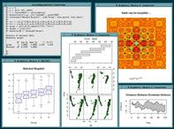


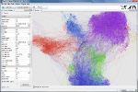
Tools
NetworkX: a Python language software package for the creation, manipulation, and study of the structure, dynamics, and functions of complex networks. http://networkx.lanl.gov/
Stanford Network Analysis Platform (SNAP): general purpose, high performance system for analysis and manipulation of large networks written in C++ http://snap.stanford.edu/snap/index.html
R: free software environment for statistical computing and graphics. http://www.r-project.org/
Gephi: interactive visualization and exploration platform for all kinds of networks and complex systems, dynamic and hierarchical graphs
http://gephi.org/

Slide 43
Frameworks for Processing Large Graphs
Large scale (in some cases billions of vertices, trillions of edges)
How to process graphs in parallel?
Write your own code
Use MapReduce (general parallel processing) *
Pregel (bulk synchronous parallel model) introduced by Google in 2010*
Giraph http://incubator.apache.org/giraph/ (part of Hadoop software)
Storage?
*J. Dean, S. Ghemawat. MapReduce: Simplified Data Processing on Large Clusters. OSDI 2004: 137-150
** G. Malewicz, M. H. Austern, A. J. C. Bik, J. C. Dehnert, I. Horn, N. Leiser: Pregel: a system for large-scale graph processing. SIGMOD Conference 2010: 135-146

Slide 44
Data
Collected using available APIs (Twitter, Facebook, etc)
Using existing collections, e.g., from SNAP (more in the webpage), permission may be required
Stanford Large Network Dataset Collection
60 large social and information network datasets
Coauthorship and Citation Networks
DBLP: Collaboration network of computer scientists
KDD Cup Dataset
Internet Topology
AS Graphs: AS-level connectivities inferred from Oregon route-views, Looking glass data and Routing registry data
Yelp Data
Yelp Review Data: reviews of the 250 closest businesses for 30 universities for students and academics to explore and research
Youtube dataset
Youtube data: YouTube videos as nodes. Edge a->b means video b is in the related video list (first 20 only) of a video a.
Amazon product copurchasing networks and metadata
Amazon Data: The data was collected by crawling Amazon website and contains product metadata and review information about 548,552 different products (Books, music CDs, DVDs and VHS video tapes).
Wikipedia
Wikipedia page to page link data: A list of all page-to-page links in Wikipedia
DBPedia: The DBpedia data set uses a large multi-domain ontology which has been derived from Wikipedia.
Edits and talks: Complete edit history (all revisions, all pages) of Wikipedia since its inception till January 2008.
Movie Ratings
IMDB database: Movie ratings from IMDB
User rating data: Movie ratings from MovieLens

Slide 45
Acknowledgements
Thanks to Jure Leskovec for some of the material from his course notes.
M. E. J. Newman, The structure and function of complex networks, SIAM Reviews, 45(2): 167-256, 2003

Slide 46
Graph Theory Reminder
For a more extensive reminder
(pptx, pdf)

Slide 47
Undirected Graph
Graph G=(V,E)
  V = set of vertices (nodes)
  E = set of edges
2
1
3
undirected graph
V = {1, 2, 3, 4, 5}
E={(1,2),(1,3),(2,3),(3,4),(4,5)}
5
4

Slide 48
Directed Graph
Graph G=(V,E)
  V = set of vertices (nodes)
  E = set of edges
2
1
3
directed graph
V = {1, 2, 3, 4, 5}
E={‹1,2›, ‹2,1› ‹1,3›, ‹3,2›, ‹3,4›, ‹4,5›}
5
4

Slide 49

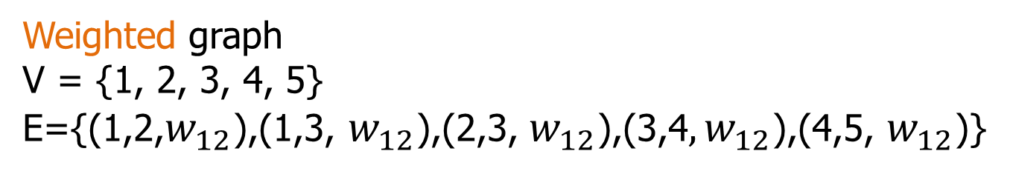




Weighted Graph
Graph G=(V,E)
  V = set of vertices (nodes)
  E = set of edges and their weights
2
$$w_{12}$$
$$w_{23}$$
1
$$w_{13}$$
3
Weights can be either distances or similarities
$$w_{34}$$
5
$$w_{45}$$
4
Weighted graph
V = {1, 2, 3, 4, 5}
E={(1,2,$w_{12}$),(1,3, $w_{12}$),(2,3, $w_{12}$),(3,4$,w_{12}$),(4,5, $w_{12}$)}

Slide 50
Undirected graph
2
Neighborhood N(i) of node i
  Set of nodes adjacent to i
1
3
degree d(i) of node i
  Size of N(i)
  number of edges incident on i
5
4

Slide 51
Undirected graph
degree sequence
  [d(1),d(2),d(3),d(4),d(5)]
  [2,2,3,2,1]
2
degree histogram
  [(1:1),(2:3),(3,1)]
1
3
5
4
degree distribution
  [(1:0.2),(2:0.6),(3,0.2)]

Slide 52
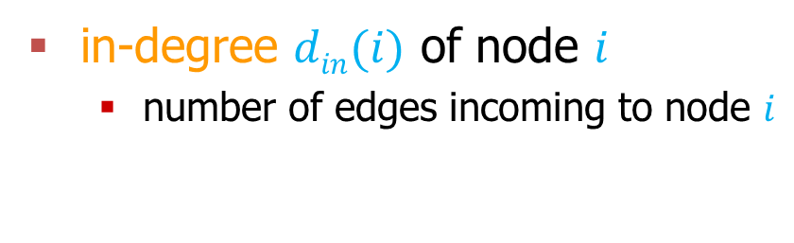
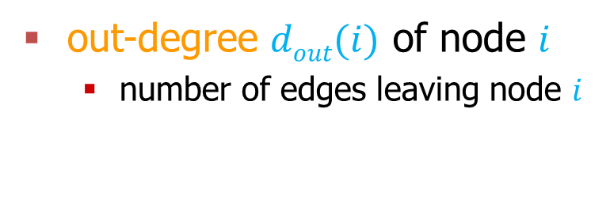
Directed Graph
in-degree $din(i)$ of node $i$
  number of edges incoming to node $i$
2
out-degree $dout(i)$ of node $i$
  number of edges leaving node $i$
1
3
in-degree sequence
  [1,2,1,1,1]
out-degree sequence
  [2,1,2,1,0]
in-degree histogram
  [(1:4),(2:1)]
out-degree histogram
  [(0:1),(1:2),(2:2)]
5
4

Slide 53
Graph Traversals
A traversal is a procedure for visiting (going through) all the nodes in a graph

Slide 54
Depth First Search Traversal
Depth-First Search (DFS) starts from a node i, selects one of its neighbors j from N(i) and performs Depth-First Search on j before visiting other neighbors in N(i).
  The algorithm can be implemented using a stack structure

Slide 55
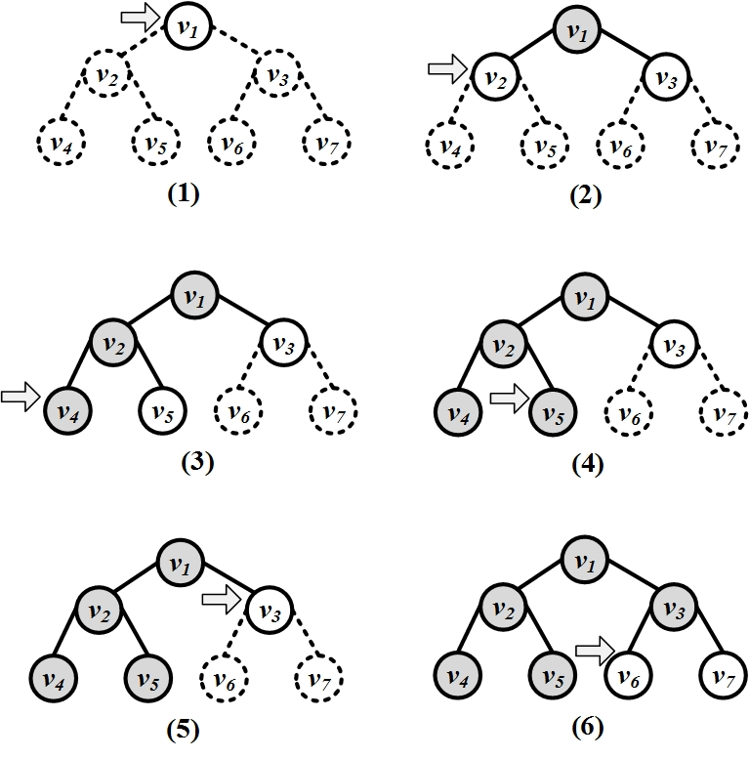
Example for a tree graph

Slide 56
Breadth First Search Traversal
Breadth-First-Search (BFS) starts from a node, visits all its immediate neighbors first, and then moves to the second level by traversing their neighbors.
  The algorithm can be implemented using a queue structure

Slide 57
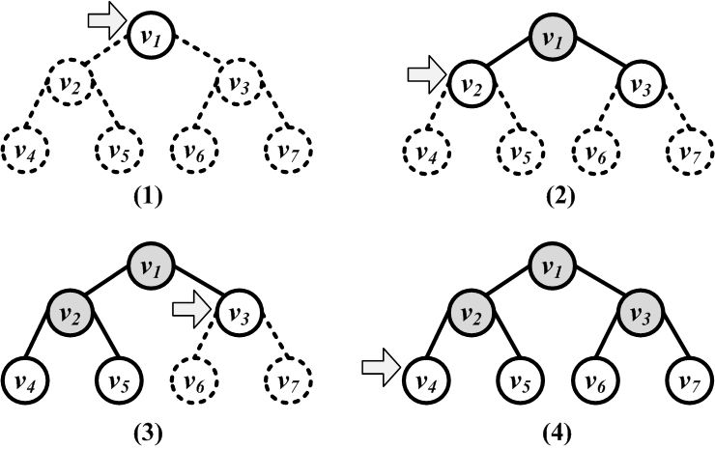
Example of BFS on a tree

Slide 58
Paths
Path from node i to node j: a sequence of edges (directed or undirected) from node i to node j
  path length: number of edges on the path
  nodes i and j are connected
  cycle: a path that starts and ends at the same node
2
2
1
1
3
3
5
4
5
4

Slide 59
Shortest Paths
Shortest Path from node i to node j
  also known as BFS path, or geodesic path
  We can find all shortest paths from a node using BFS
2
2
1
1
3
3
5
4
5
4

Slide 60
Shortest paths on weighted graphs
Shortest paths on weighted graphs are harder to construct
  There are several well known algorithms for finding single-source, or all-pairs shortest paths
  For example: Dijkstra’s Algorithm

Slide 61
Diameter
The longest shortest path in the graph
2
2
1
1
3
3
5
4
5
4

Slide 62
Undirected graph
Connected graph: a graph where there every pair of nodes is connected
Disconnected graph: a graph that is not connected
Connected Components: subsets of vertices that are connected
2
1
3
5
4

Slide 63
Directed Graph
2
Strongly connected graph: there exists a path from every i to every j
1
Weakly connected graph: If edges are made to be undirected the graph is connected
3
5
4

Slide 64
Subgraphs
Subgraph: Given V’ ⊆ V, and E’ ⊆ E, the graph G’=(V’,E’) is a subgraph of G.
Induced subgraph: Given V’ ⊆ V, let E’ ⊆ E is the set of all edges between the nodes in V’. The graph G’=(V’,E’), is an induced subgraph of G
2
1
3
5
4

Slide 65
Fully Connected Graph
Clique K_{n}
A graph that has all possible n(n-1)/2 edges
2
1
3
5
4

Slide 66
Trees
Connected Undirected graphs without cycles
2
1
3
5
4

Slide 67
Bipartite graphs
Graphs where the set of nodes V can be partitioned into two sets L and R, such that there are edges only between nodes in L and R, and there is no edge within L or R

Slide 68
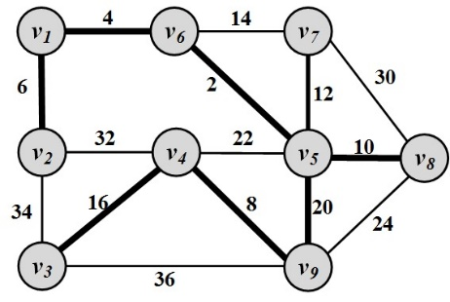
Spanning Tree
For any connected graph, the spanning tree is a subgraph and a tree that includes all the nodes of the graph
There may exist multiple spanning trees for a graph.
For a weighted graph and one of its spanning tree, the weight of that spanning tree is the summation of the edge weights in the tree.
Among the many spanning trees found for a weighted graph, the one with the minimum weight
is called the
minimum spanning tree (MST)

Slide 69
Graph Representation
Adjacency Matrix
  symmetric matrix for undirected graphs
2
1
3
5
4

Slide 70
Graph Representation
Adjacency Matrix
  unsymmetric matrix for undirected graphs
2
1
3
5
4

Slide 71
Graph Representation
Adjacency List
  For each node keep a list with neighboring nodes
2
1: [2, 3]
2: [1, 3]
3: [1, 2, 4]
4: [3, 5]
5: [4]
1
3
5
4

Slide 72
Graph Representation
Adjacency List
  For each node keep a list of the nodes it points to
2
1: [2, 3]
2: [1]
3: [2, 4]
4: [5]
5: [null]
1
3
5
4

Slide 73
Graph Representation
List of edges
  Keep a list of all the edges in the graph
2
(1,2)
(2,3)
(1,3)
(3,4)
(4,5)
1
3
5
4

Slide 74
Graph Representation
List of Edges
  Keep a list of all the directed edges in the graph
2
(1,2)
(2,1)
(1,3)
(3,2)
(3,4)
(4,5)
1
3
5
4

Slide 75
P and NP
P: the class of problems that can be solved in polynomial time
NP: the class of problems that can be verified in polynomial time, but there is no known solution in polynomial time
NP-hard: problems that are at least as hard as any problem in NP

Slide 76
Introduction to Notebooks

Slide 77
Notebooks
Notebooks offer an interactive Python programming environment for coding, that combines code, text, and output.
It is often used in Data Science for presenting the analysis output
We will use Notebooks in class for testing in practice the different algorithms and models we present.
For the course assignment you will maintain one or more notebooks that you will update with assignments on the latest material we cover in class.

Slide 78
Python
In the last few years there is an increasing community that creates Data Mining tools in Python
  Python is overwhelmingly used today for data science tasks
  It is also heavily used in industry
  We will use Python for this class.
There are tons of resources online for Python.
For an introduction you can also look at the slides of the Introduction to Programming course by prof. N. Mamoulis
I will assume you have installed Python to your laptop, and that you have a good knowledge of programming in Python.

Slide 79
Anaconda
Installing libraries in Python can be complicated, so you should download the Anaconda Scientific Python distribution which will install most of the libraries that we will use.
  Use Python 3.0
Installing Anaconda installs a lot of libraries and also:
  Anaconda Navigator
  Jupyter Notebook: An interactive web-based interface for running python.
  Anaconda Powershell: terminal for running commands

Slide 80
Jupyter Notebook
Installing Anaconda will also install Jupyter Notebook.
If you wish to install it in a different way, together with the relevant libraries you are free to do so.
We will use Notebook for our examples and it is required for the assignments.
  In almost all assignments you are required to submit a Notebook.

Slide 81
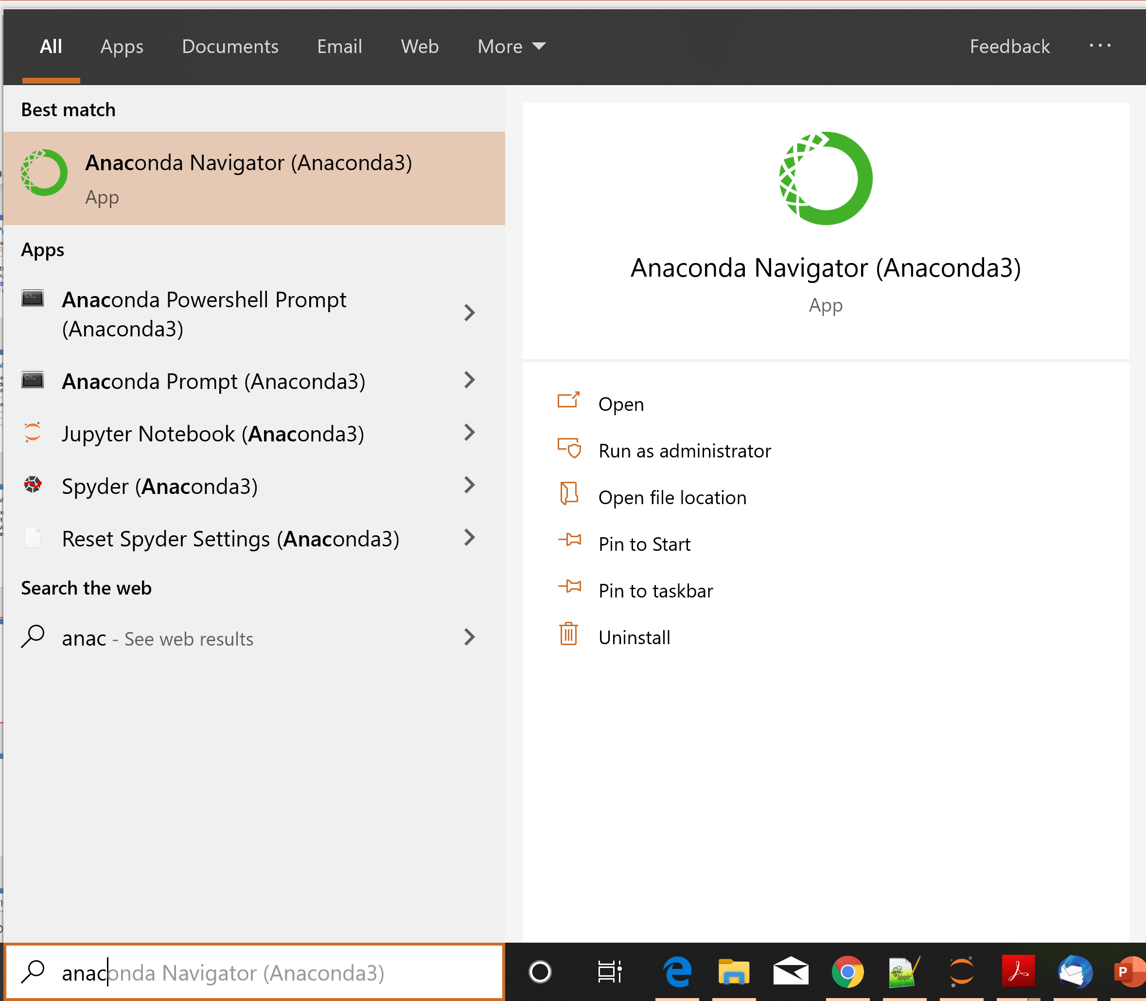

Slide 82

The Anaconda Navigator

Slide 83
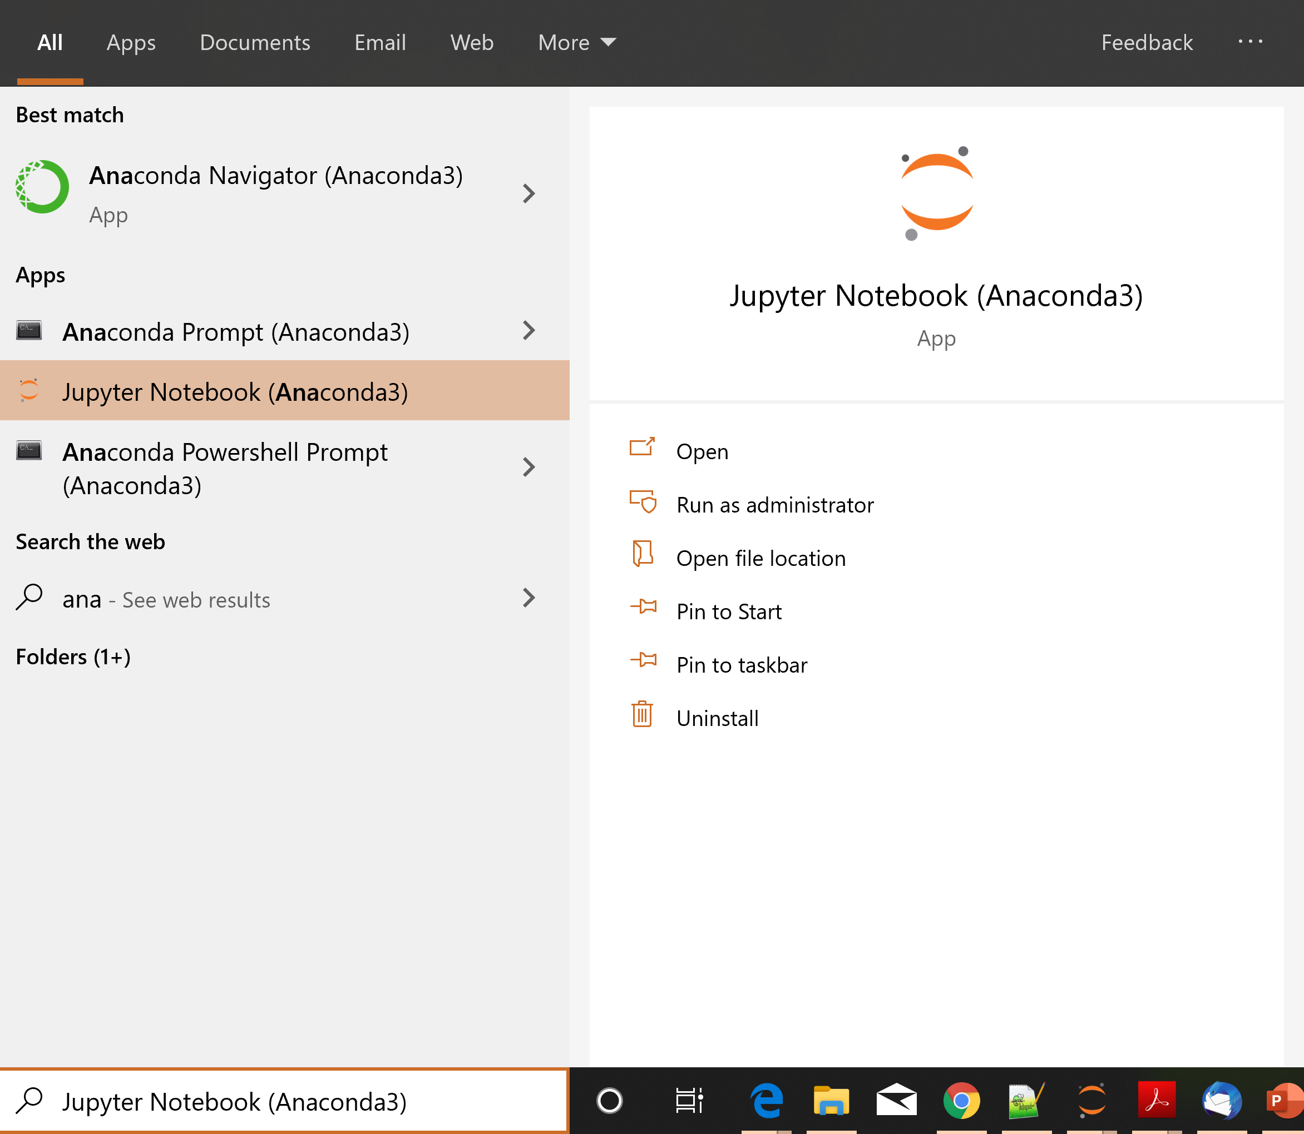

Slide 84
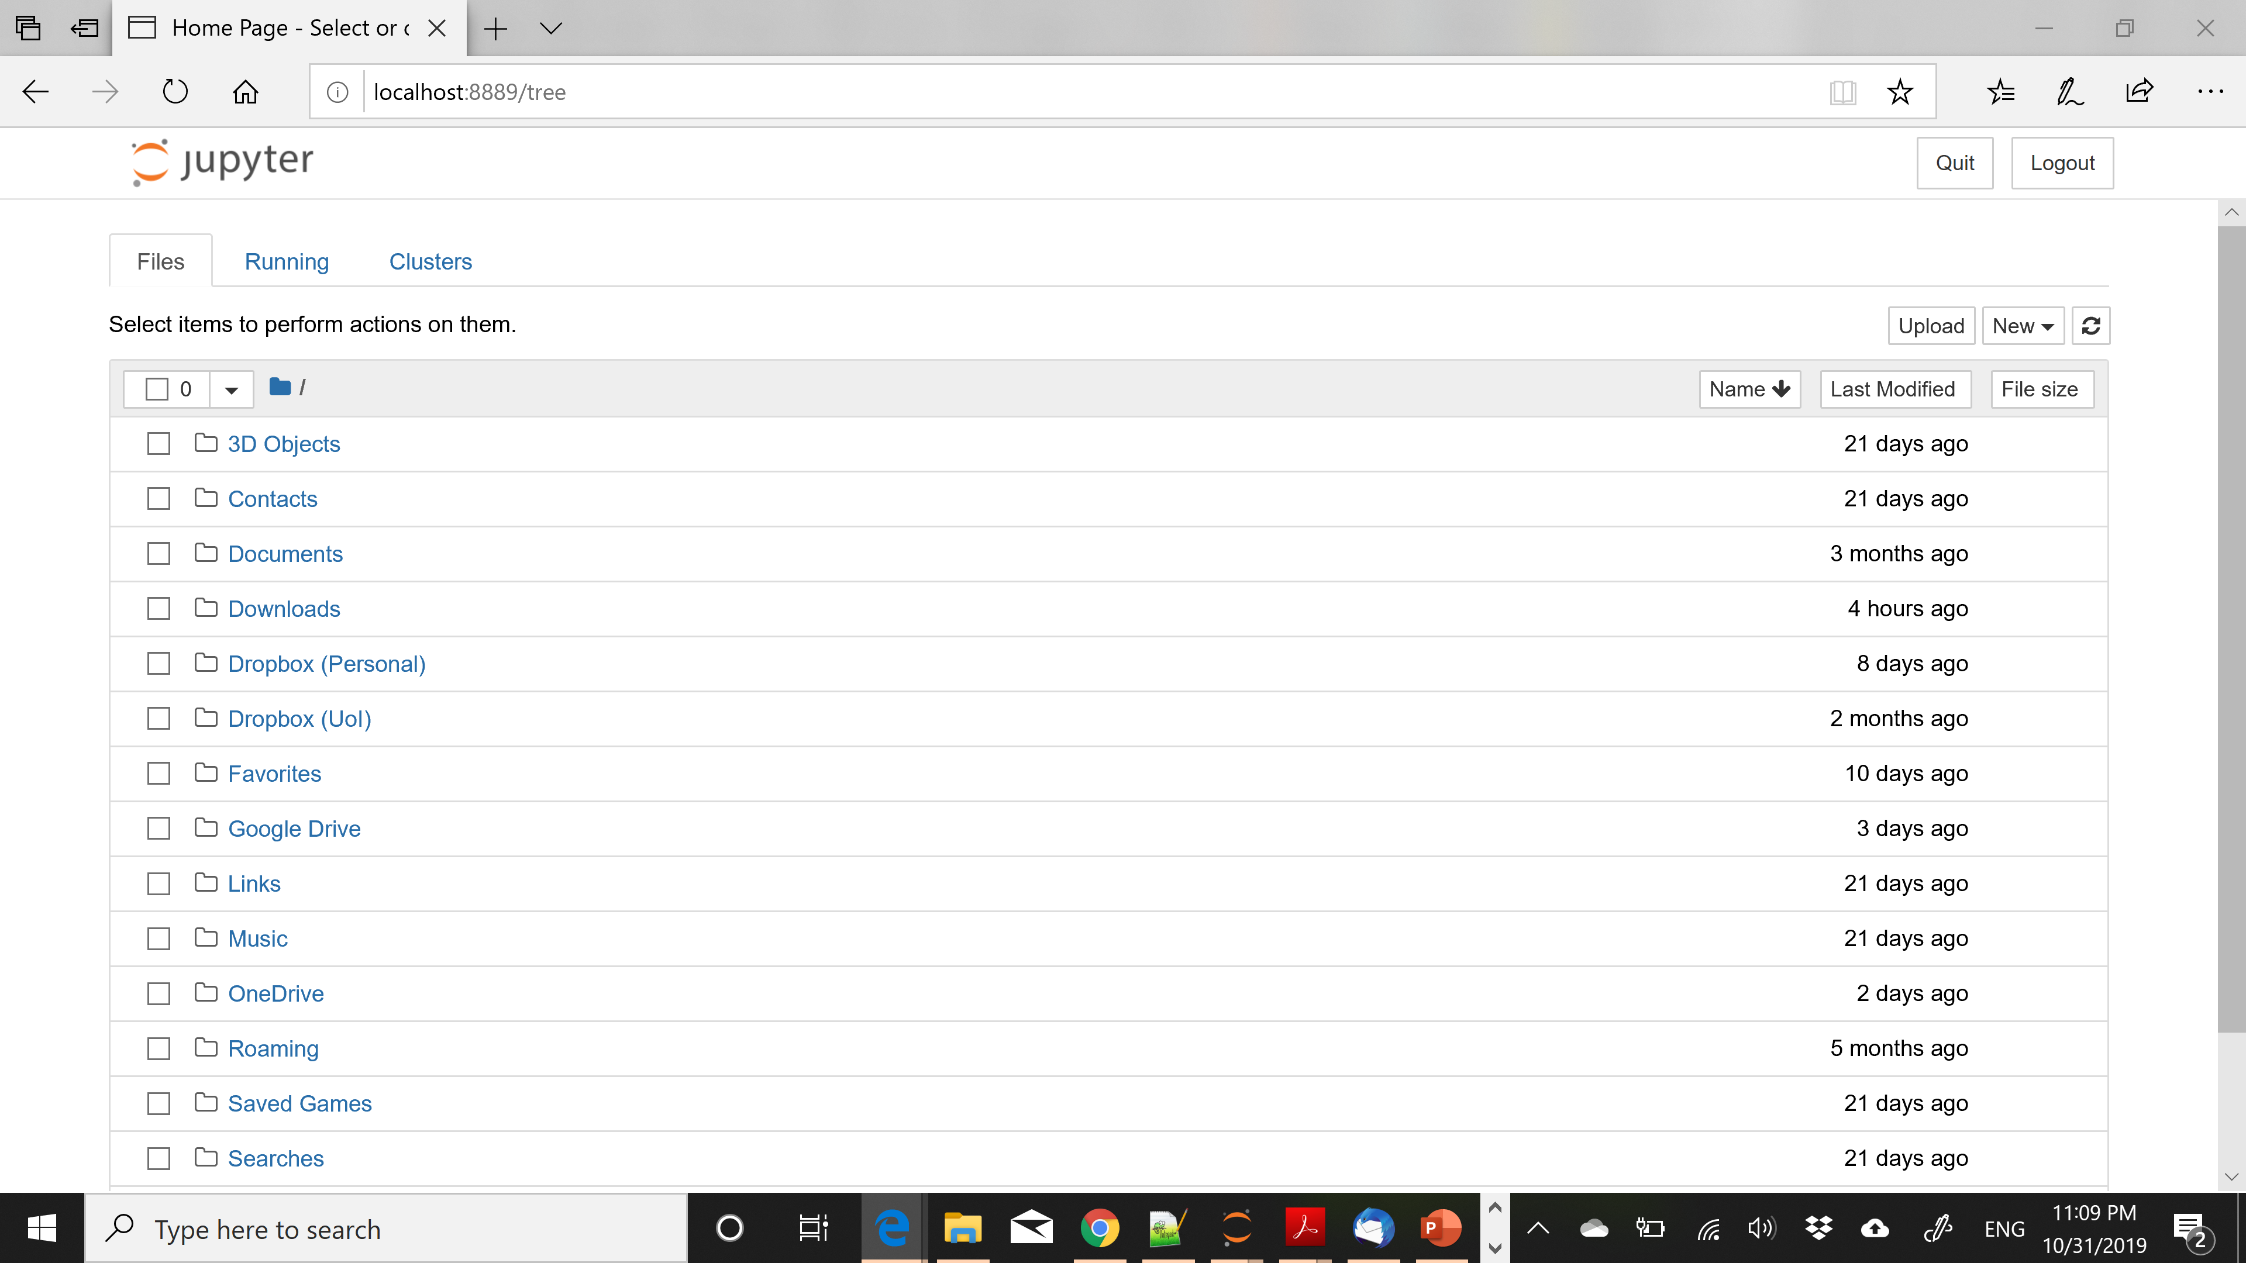

Slide 85
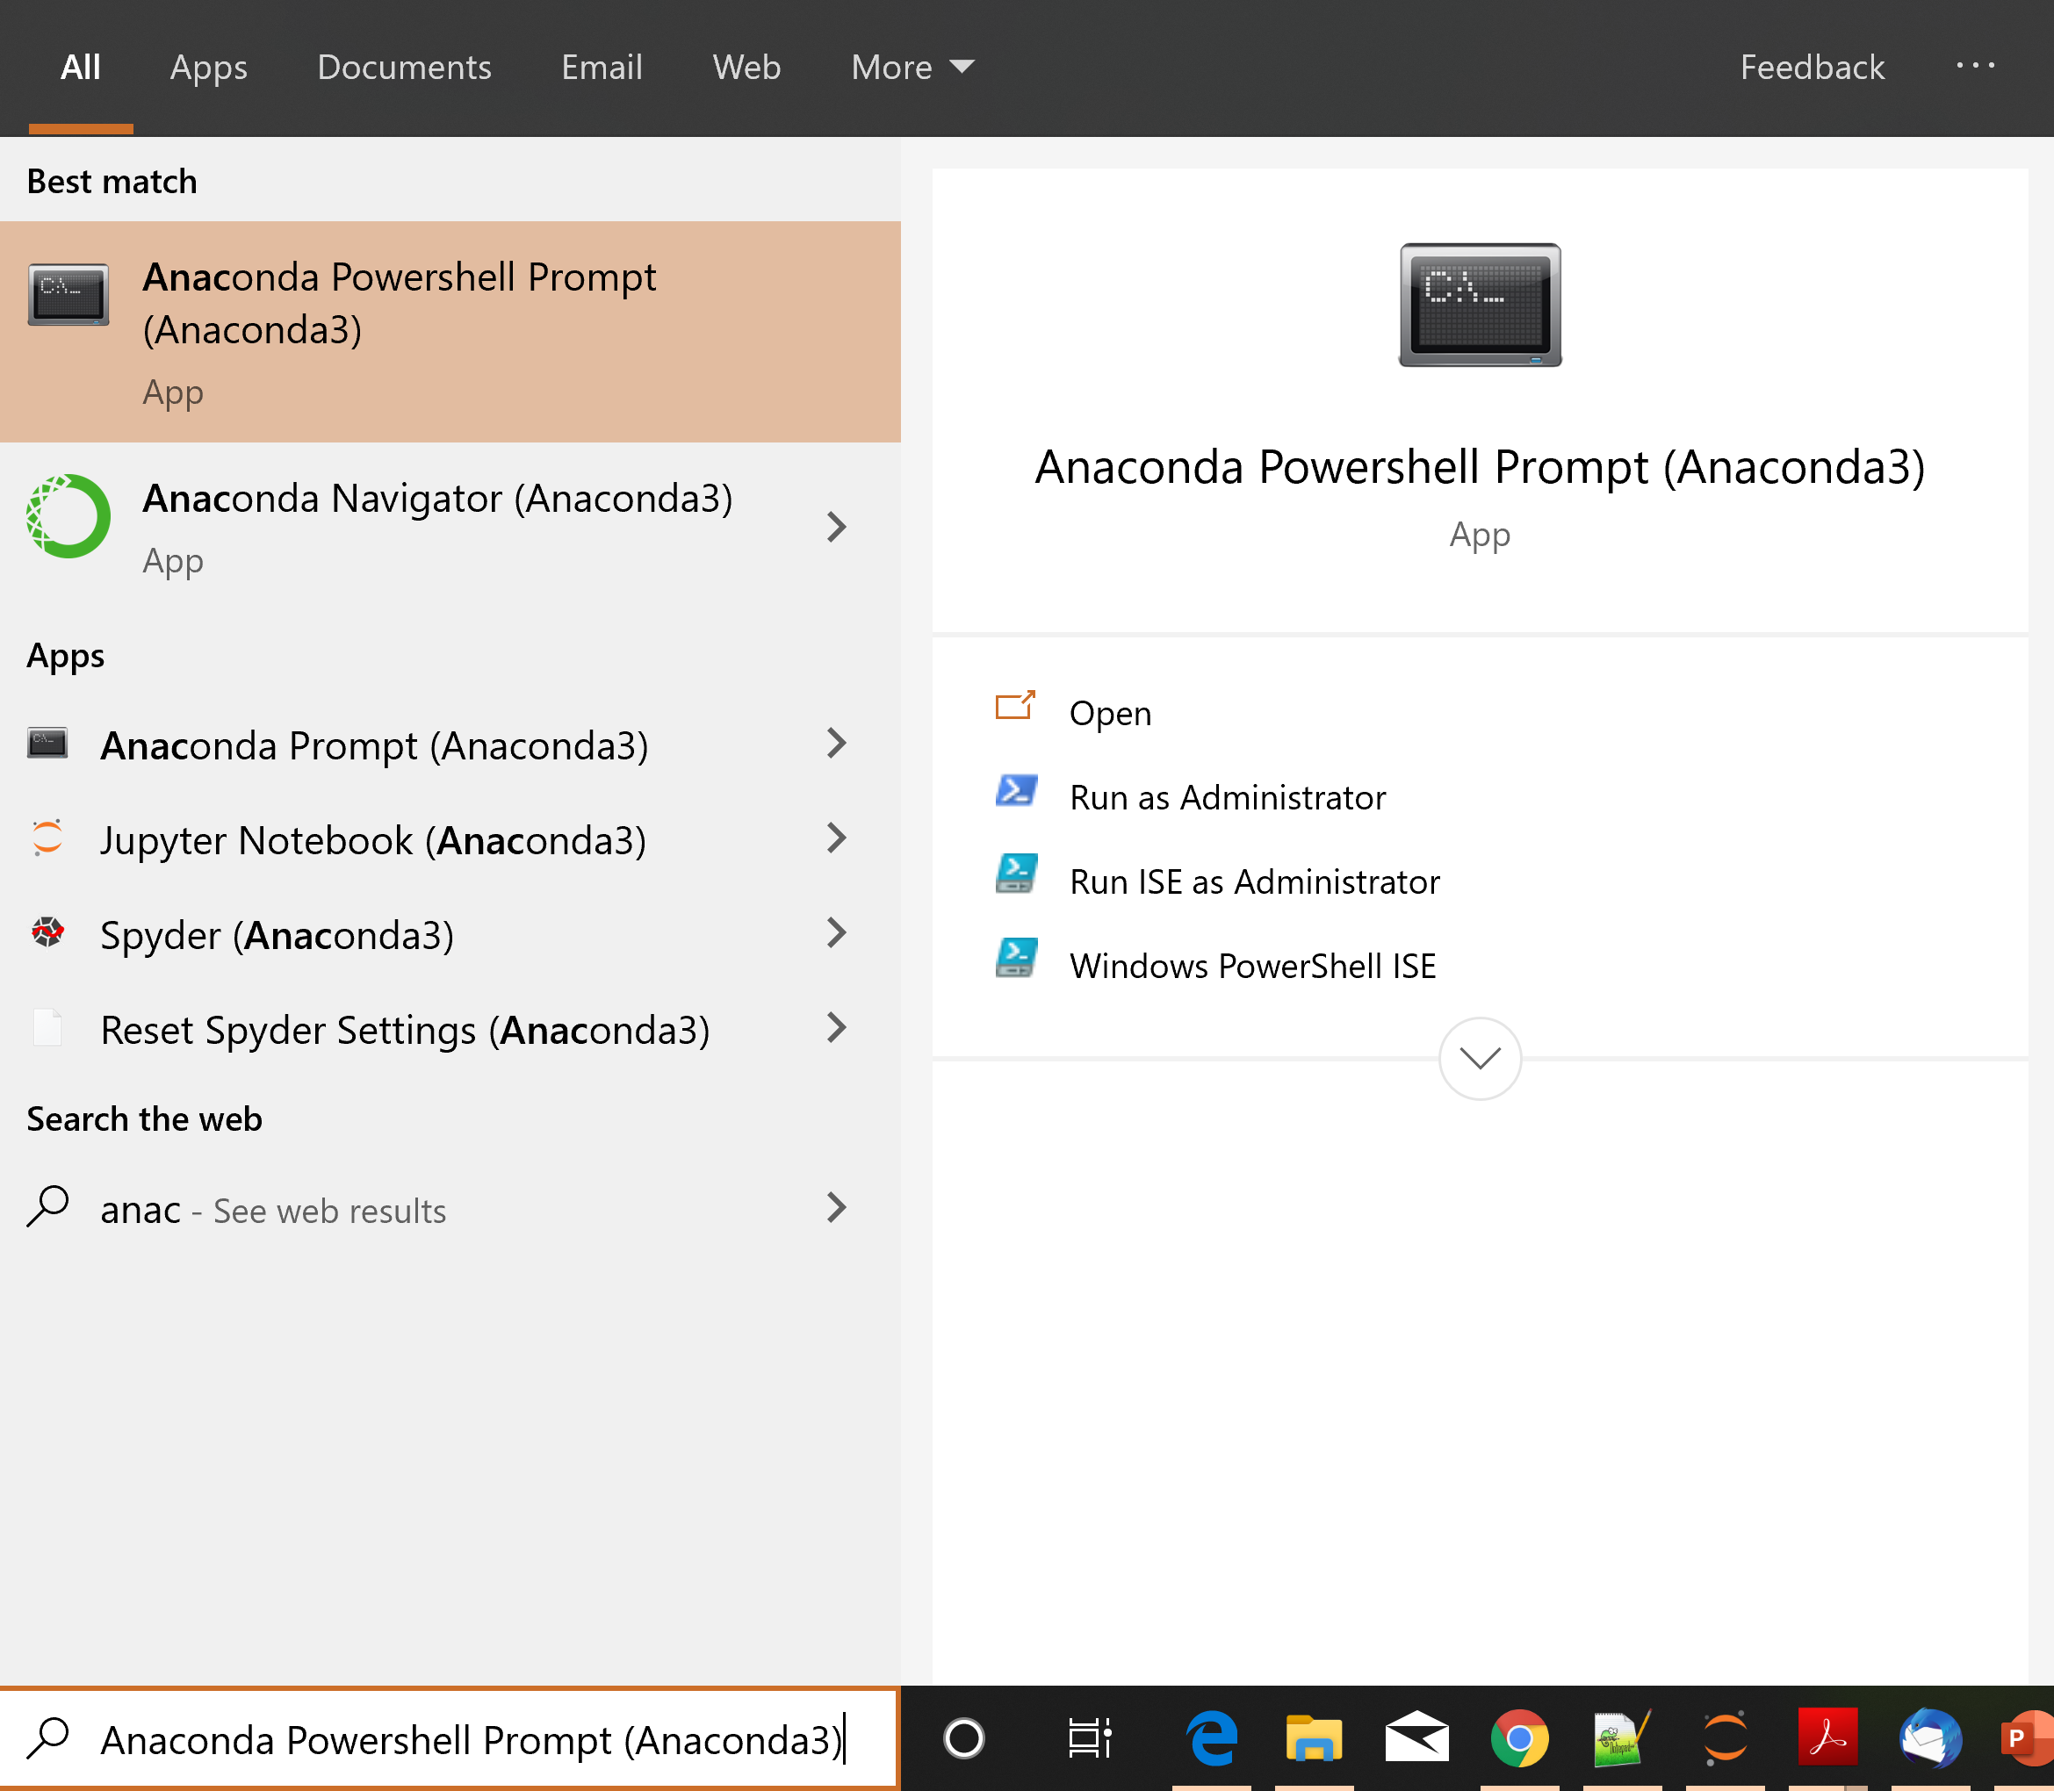

Slide 86
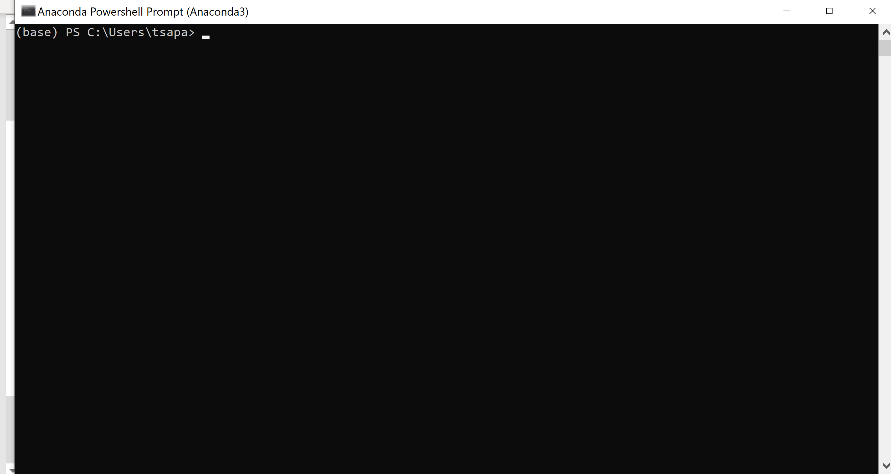

Slide 87
Installing Packages
You can install packages from the Anaconda terminal using the conda install command:
  conda install <name of package>
For example, Seaborn is a package for Statistical Data Visualization.
  conda install seaborn
panda-datareader is a package for loading online datasets.
  conda install pandas-datareader
You can also use the pip install command.
  pip install snap-stanford

Slide 88
Notebooks
Jupyter Notebook offers an interactive web-based interface for running code.
The Notebook runs inside a browser.
It allows you to interact with the code, running different parts of the code
The results also appear in the browser, so you can have together the code and the results
You can also add text, commenting on the results.
We will now see some details on how to create notebooks

Slide 89
Changing the notebook default directory
This used to be important before but now Jupyter Notebook takes you to the home directory
From the Anaconda terminal type the command:
  jupyter notebook --generate-config
This will generate .jupiter/jupyter_notebook_config.py file under your home directory.
Find, un-comment and modify the line
# c.NotebookApp.notebook_dir = '‘ in the config file to point to the desired directory

Slide 90
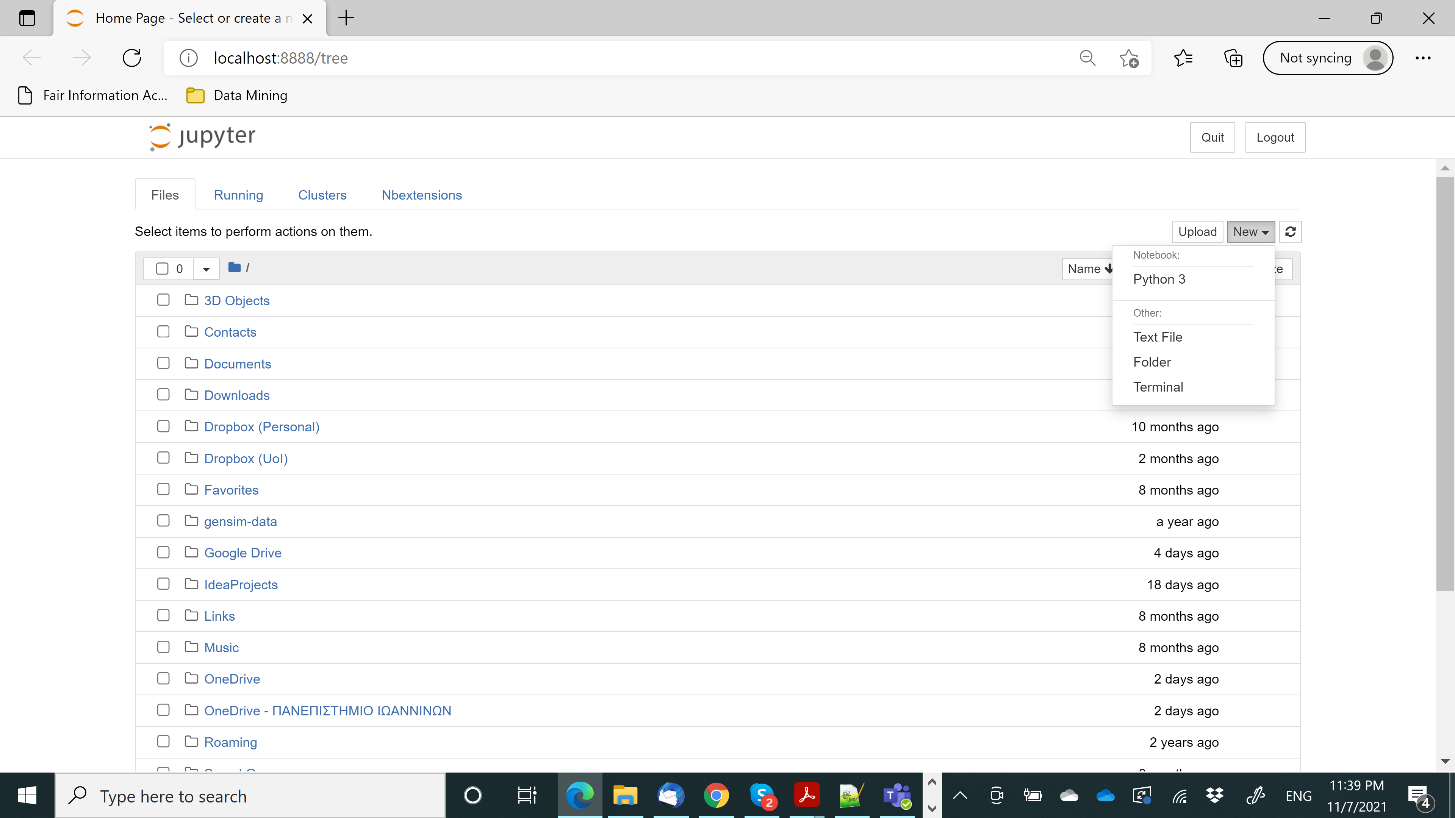

Slide 91
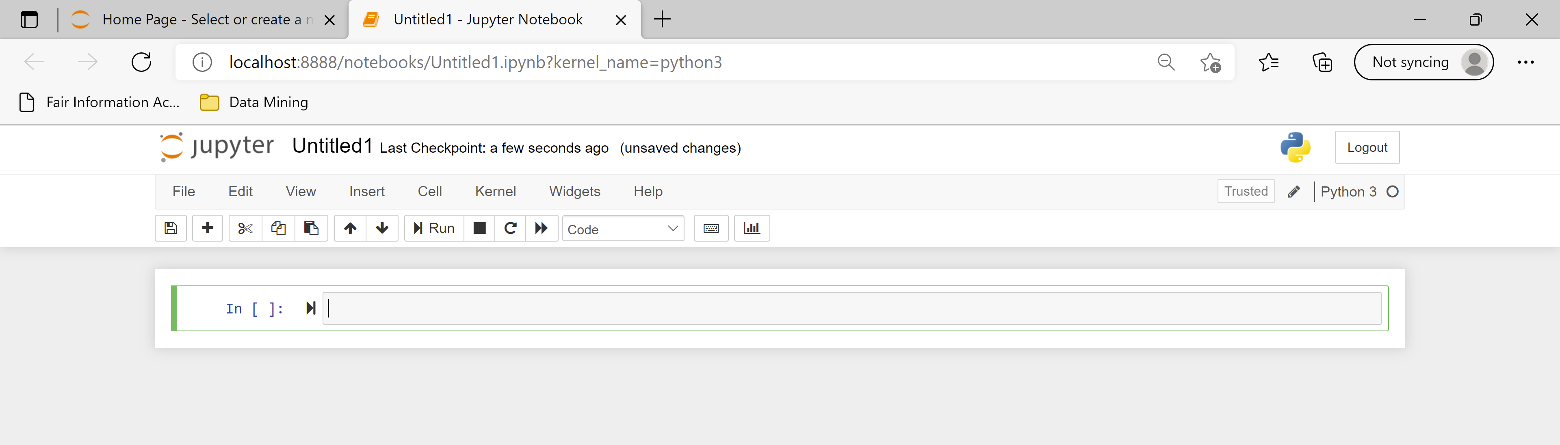
The notebook is organized in cells
In each cell you can write either code or text
The default behavior is code

Slide 92
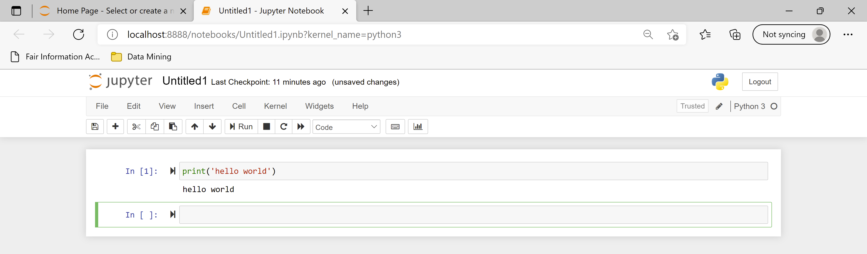
You can run the code using the Run button or with Ctrl+Enter
Note that now we have both the code and the output in the notebook

Slide 93
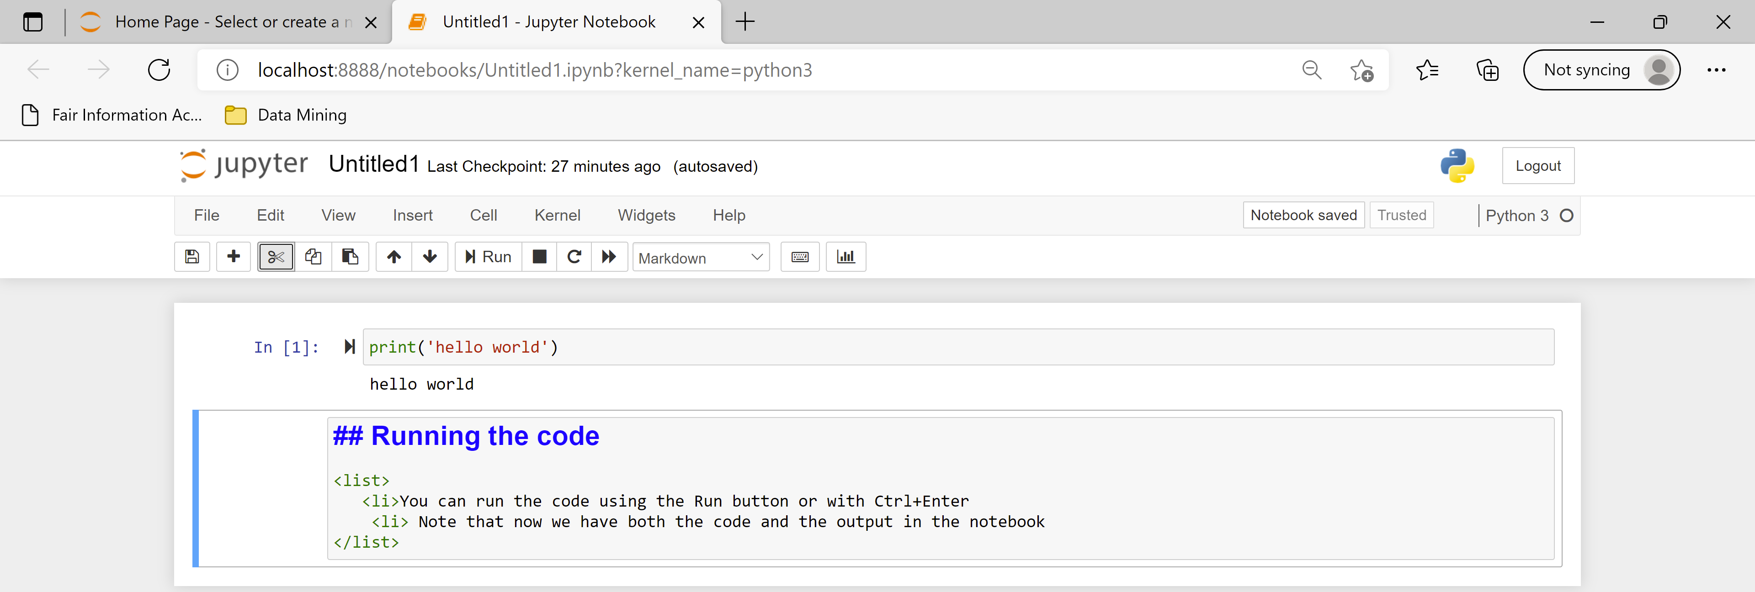
You can also write text in Markdown language
  You can combine HTML, and Latex, and there are some other commands
You can learn more about Markdown by searching online, e.g.:
  Learn How to Write Markdown & LaTeX in The Jupyter Notebook | by Khelifi Ahmed Aziz | Towards Data Science
You need to Run the Markdown cell as well

Slide 94
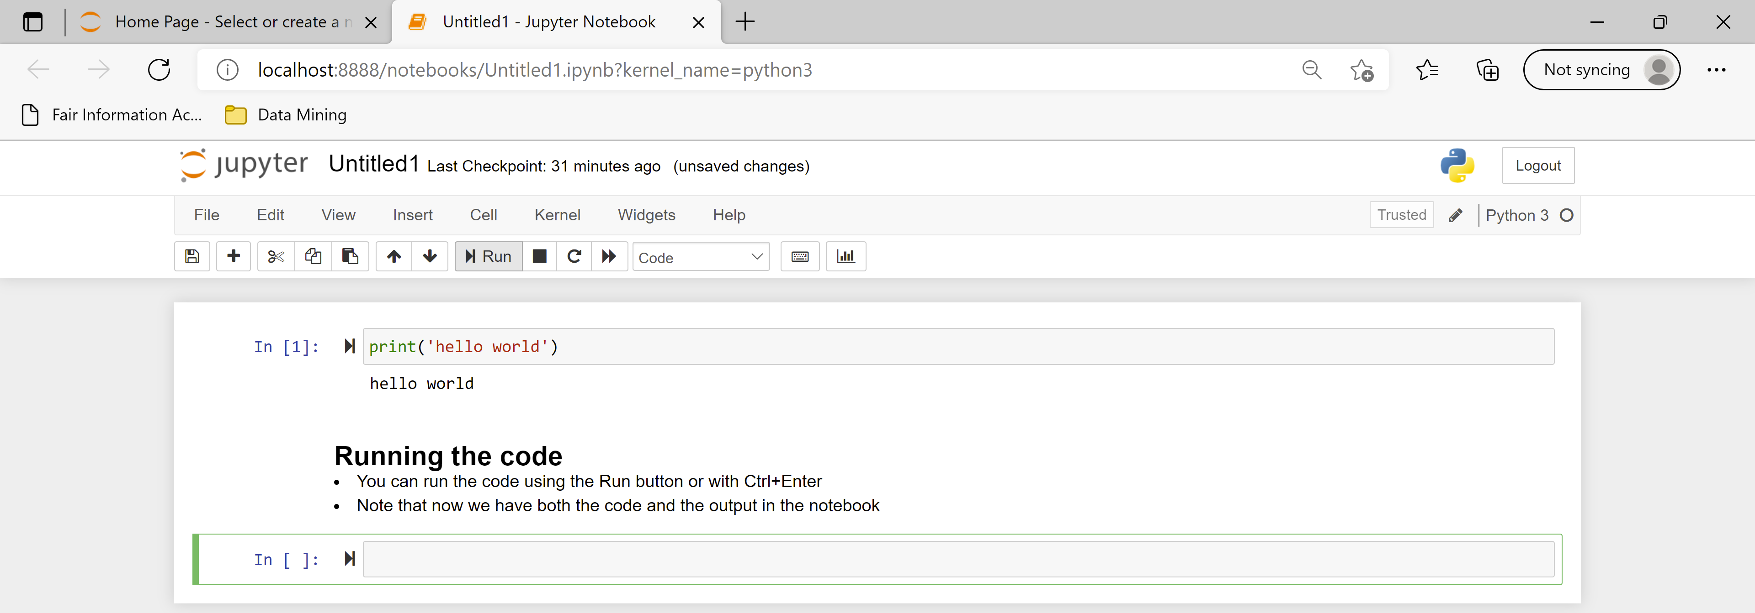

Slide 95
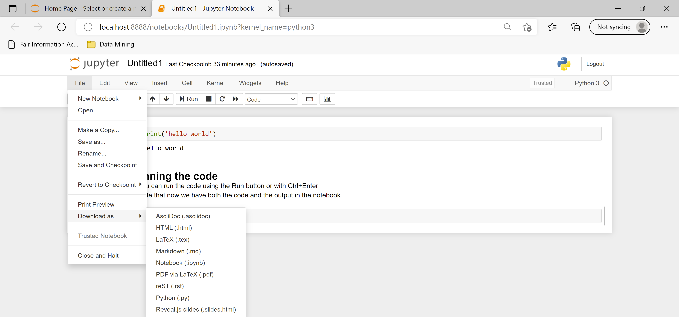
You can export the notebook into HTML or PDF

Slide 96
Attention!
A notebook is run interactively, each time running a specific cell
The state of the program remains in memory while the notebook is running
Each cell has access to the current state of the memory
You can jump between cells in a non-linear way
You should be aware of the state of the memory of the notebook when you run a specific cell.

Slide 97

A simple example
The order in which the cells are executed is shown in the increasing numbers (not always useful)
The second in order cell is executed third
  So it as access to z, and uses the value 4 for x

Slide 98
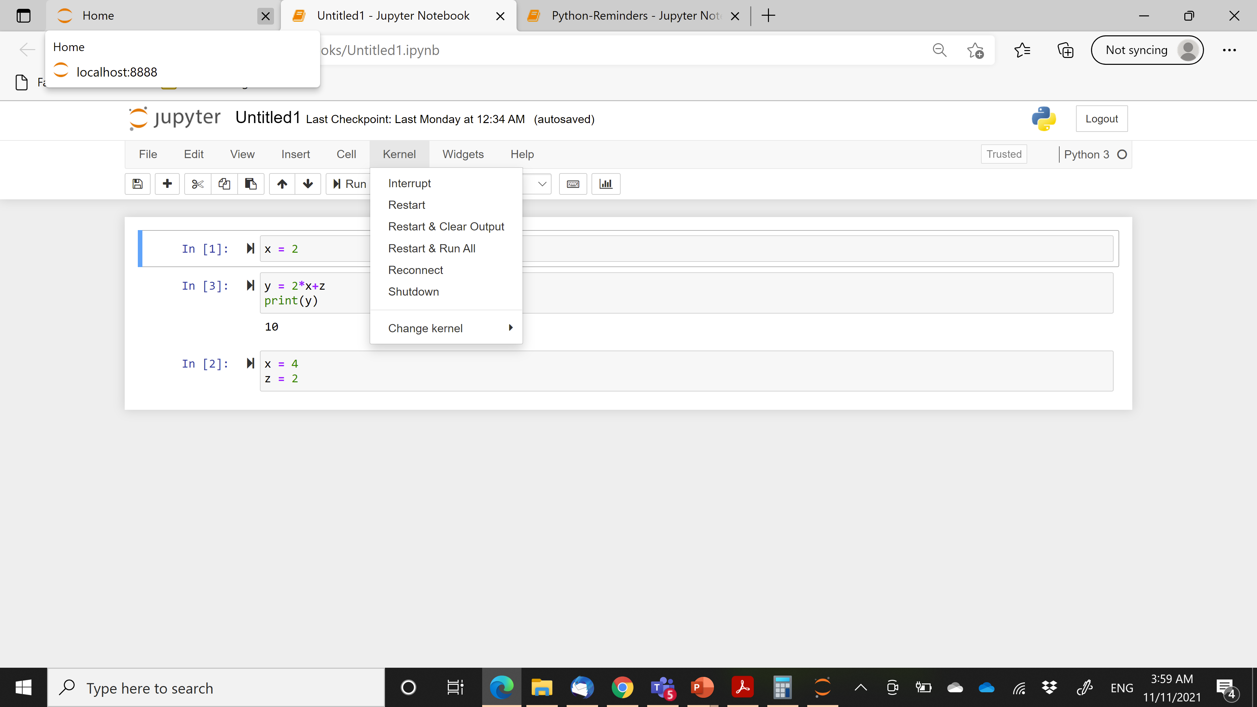
Restarting

Slide 99
Useful Links
You can find some more information about notebooks in the tutorials for the Data Mining class
Useful libraries for network processing:
  NetworkX
  Snap

