Slide 1
DATA MINING
Classification
Neural Networks
Word Embeddings
Classification Issues
Classification Evaluation
Supervised Learning Pipeline

Slide 2
Neural Networks
(Thanks to Philipp Koehn for the material borrowed from his slides)

Slide 3
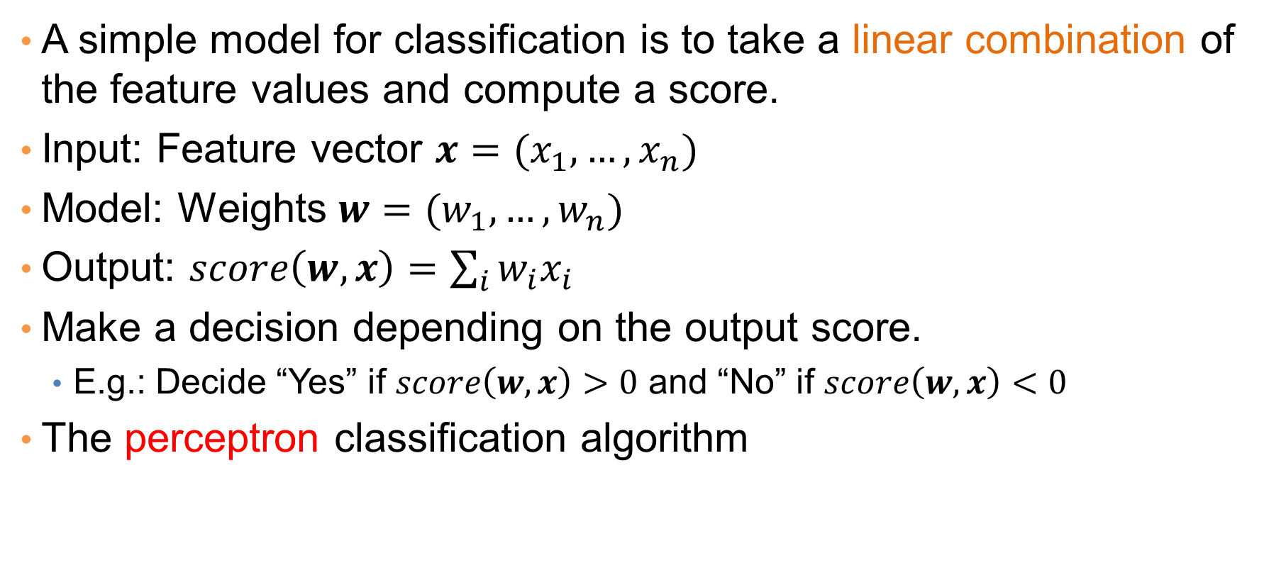
Linear Classification
A simple model for classification is to take a linear combination of the feature values and compute a score.
Input: Feature vector $x=(x_{1},…,x_{n})$
Model: Weights $w=(w_{1},…, w_{n})$
Output: $score\left(w,x\right)=\sum_{i}{w_{i}x_{i}}$
Make a decision depending on the output score.
  E.g.: Decide “Yes” if $score\left(w,x\right)>0$ and “No” if $score\left(w,x\right)<0$
The perceptron classification algorithm

Slide 4











Linear Classification
We can represent this as a network
Edges correspond to weights
$$x_{1}$$
$$w_{1}$$
Input nodes correspond to features
$$x_{2}$$
$$w_{2}$$
$$x_{3}$$
$$w_{3}$$
$$score(w,x)$$
$$x_{4}$$
$$w_{4}$$
$$w_{5}$$
“Output” node with incoming edges computes the score
$$x_{5}$$

Slide 5
Linear models
Linear models partition the space according to a hyperplane
But they cannot model everything

Slide 6
Multiple layers
We can add more layers:
  Each arrow has a weight
  Nodes compute scores from incoming edges and give input to outgoing edges
Did we gain anything?

Slide 7
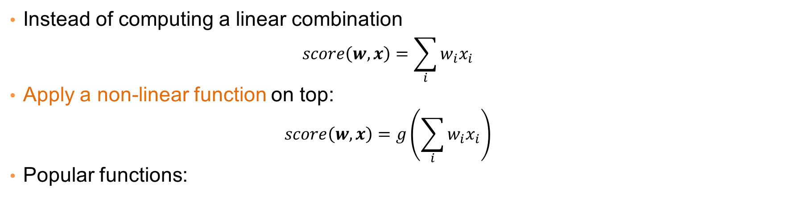
Non-linearity
Instead of computing a linear combination
  $$score\left(w,x\right)=\sum_{i}{w_{i}x_{i}}$$
Apply a non-linear function on top:
  $$score\left(w,x\right)=g\left(\sum_{i}{w_{i}x_{i}}\right)$$
Popular functions:
These functions play the role of a soft “switch” (threshold function)

Slide 8
Side note
Logistic regression classifier:
  Single layer with a logistic function

Slide 9
Deep learning
Networks with multiple layers
Each layer can be thought of as a processing step
Multiple layers allow for the computation of more complex functions

Slide 10



Example
A network that implements XOR
Hidden node $h_{0}$ is OR
Output node $h_{1}−h_{0}$
Hidden node $h_{1}$ is AND
Bias term

Slide 11
Error
The computed value is 0.76 but the correct value is 1
  There is an error in the computation
  How do we set the weights so as to minimize this error?

Slide 12
Gradient Descent
The error is a function of the weights
We want to find the weights that minimize the error
Compute gradient: gives the direction to the minimum
Adjust weights, moving at the direction of the gradient.

Slide 13
Gradient Descent

Slide 14
Gradient Descent

Slide 15
Backpropagation
How can we compute the gradients? Backpropagation!
Main idea:
  Start from the final layer: compute the gradients for the weights of the final layer.
  Use these gradients to compute the gradients of previous layers using the chain rule
  Propagate the error backwards
Backpropagation essentially is an application of the chain rule for differentiation.

Slide 16


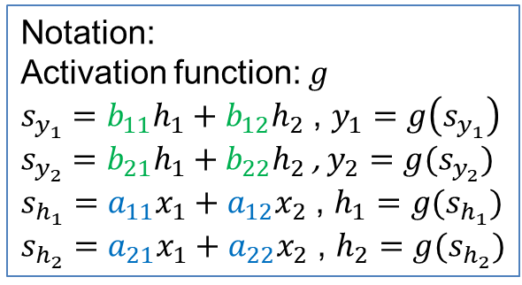





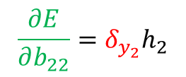

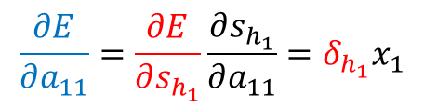
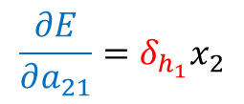


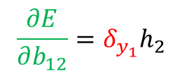



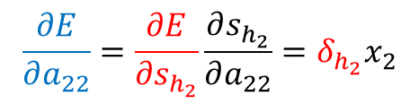

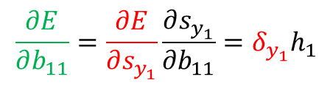



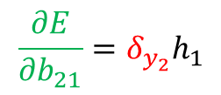

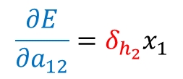
$$a_{11}$$
$$b_{11}$$
$$x_{1}$$
$$h_{1}$$
$$y_{1}$$
Error: $E={\left\|y−t\right\|}^{2}={\left(y_{1}−t_{1}\right)}^{2}+{\left(y_{2}−t_{2}\right)}^{2}$
$$a_{12}$$
$$b_{12}$$
$$\frac{∂E}{∂b_{11}}=\frac{∂E}{∂s_{y_{1}}}\frac{∂s_{y_{1}}}{∂b_{11}}=δ_{y_{1}}h_{1}$$
$$a_{21}$$
$$b_{21}$$
$$x_{2}$$
$$a_{22}$$
$$h_{2}$$
$$y_{2}$$
$$b_{22}$$
$δ_{y_{1}}$= $\frac{∂E}{∂s_{y_{1}}}$= $\frac{∂E}{∂y_{1}}\frac{∂y_{1}}{∂s_{y_{1}}}=2\left(y_{1}−t_{1}\right)g′(s_{y_{1}})$
Notation:
Activation function: $g$
$s_{y_{1}}=b_{11}h_{1}+b_{12}h_{2}$ , $y_{1}=g\left(s_{y_{1}}\right)$
$s_{y_{2}}=b_{21}h_{1}+b_{22}h_{2}$ , $y_{2}=g(s_{y_{2}})$
$s_{h_{1}}=a_{11}x_{1}+a_{12}x_{2}$ , $h_{1}=g(s_{h_{1}})$
$s_{h_{2}}=a_{21}x_{1}+a_{22}x_{2}$ , $h_{2}=g(s_{h_{2}})$
$$\frac{∂E}{∂b_{21}}=δ_{y_{2}}h_{1}$$
$δ_{y_{2}}$= $\frac{∂E}{∂s_{y_{2}} }$= $2\left(y_{2}−t_{2}\right)g′(s_{y_{2}})$
$$\frac{∂E}{∂b_{12}}=δ_{y_{1}}h_{2}$$
$$\frac{∂E}{∂b_{22}}=δ_{y_{2}}h_{2}$$
$$\frac{∂E}{∂a_{11}}=\frac{∂E}{∂s_{h_{1}}}\frac{∂s_{h_{1}}}{∂a_{11}}=δ_{h_{1}}x_{1}$$
$$\frac{∂E}{∂a_{22}}=\frac{∂E}{∂s_{h_{2}}}\frac{∂s_{h_{2}}}{∂a_{22}}=δ_{h_{2}}x_{2}$$
$$\frac{∂E}{∂a_{21}}=δ_{h_{1}}x_{2}$$
$$\frac{∂E}{∂a_{12}}=δ_{h_{2}}x_{1}$$
$$δ_{h_{1}}=\frac{∂E}{∂s_{h_{1}}}=\frac{∂E}{∂h_{1}}\frac{∂h_{1}}{∂s_{h_{1}}}=\left(\frac{∂E}{∂s_{y_{1}}}\frac{∂s_{y_{1}}}{∂h_{1}}+\frac{∂E}{∂s_{y_{2}}}\frac{∂s_{y_{2}}}{∂h_{1}}\right)g^{′}\left(s_{h_{1}}\right)=\left(δ_{y_{1}}b_{11}+δ_{y_{2}}b_{21}\right)g′(s_{h_{1}})$$
$$δ_{h_{2}}=\left(δ_{y_{1}}b_{12}+δ_{y_{2}}b_{22}\right)g′(s_{h_{2}})$$

Slide 17






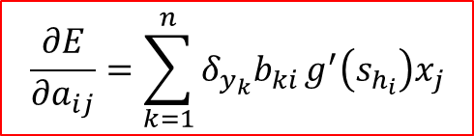

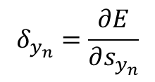
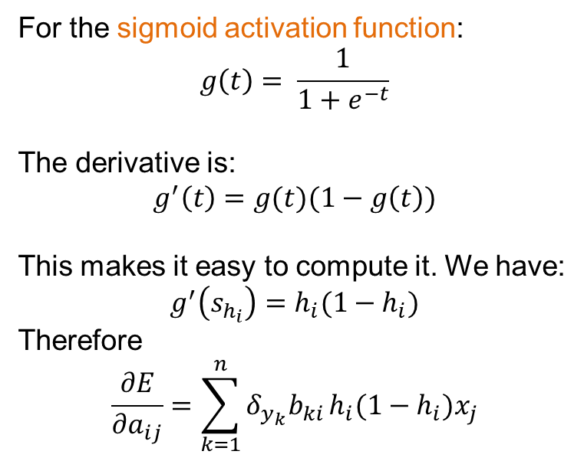



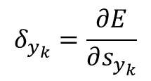

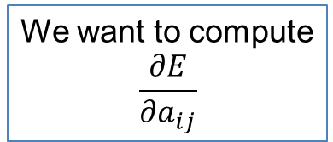


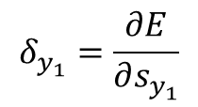

Backpropagation
We have already computed the $δ_{y_{k}}$’s
$$δ_{y_{1}}=\frac{∂E}{∂s_{y_{1}}}$$
$$δ_{y_{k}}=\frac{∂E}{∂s_{y_{k}}}$$
$$δ_{y_{n}}=\frac{∂E}{∂s_{y_{n}}}$$
$$\frac{∂E}{∂a_{ij}}=\sum_{k=1}^{n}{δ_{y_{k}}b_{ki}}g^{′}\left(s_{h_{i}}\right)x_{j}$$
$$y_{1}$$
$$y_{k}$$
$$y_{n}$$
$$s_{y_{1}}$$
$$s_{y_{k}}$$
$$s_{y_{n}}$$
For the sigmoid activation function:
$$g\left(t\right)= \frac{1}{1+e^{−t}}$$
The derivative is:
$$g^{′}\left(t\right)=g(t)(1−g\left(t\right))$$
This makes it easy to compute it. We have:
$$g^{′}\left(s_{h_{i}}\right)=h_{i}(1−h_{i})$$
Therefore
$$\frac{∂E}{∂a_{ij}}=\sum_{k=1}^{n}{δ_{y_{k}}b_{ki}}h_{i}(1−h_{i})x_{j}$$
$$b_{1i}$$
$$b_{ki}$$
$$b_{ni}$$
We want to compute
$$\frac{∂E}{∂a_{ij}}$$
$$h_{i}$$
$$s_{h_{i}}$$
$$a_{ij}$$
$$x_{j}$$

Slide 18
Stochastic gradient descent
Ideally the loss should be the average loss over all training data.
We would need to compute the loss for all training data every time we update the gradients.
  However, this is expensive.
Stochastic gradient descent: Consider one input point at the time. Each point is considered only once.
Intermediate solution: Use mini-batches of data points.

Slide 19
Word EMBeddings
Thanks to Chris Manning for the slides

Slide 20
Basic Idea
You can get a lot of value by representing a word by means of its neighbors
“You shall know a word by the company it keeps”
(J. R. Firth 1957: 11)
One of the most successful ideas of modern statistical NLP
  government debt problems turning into banking crises as has happened in
  saying that Europe needs unified banking regulation to replace the hodgepodge
   These words will represent banking 

Slide 21






Basic idea
Define a model that aims to predict between a center word $wc$ and context words in some window of length $m$ in terms of word vectors
$w_{c−2}$
$w_{c−1}$
$w_{c}$
$w_{c+1}$
$w_{c+2}$
… turning into banking crises as …
Center word
context words
context words
window of size 2 each side
Notes:
The central new idea is that you change the word representation, as well as the other parameters of the model.
I’m going to directly and concretely build one, concrete prediction models. You may already know of some other things you might do, and we’ll come back to other possibilities next week, but this way of doing it is one of the best ways known.

Slide 22
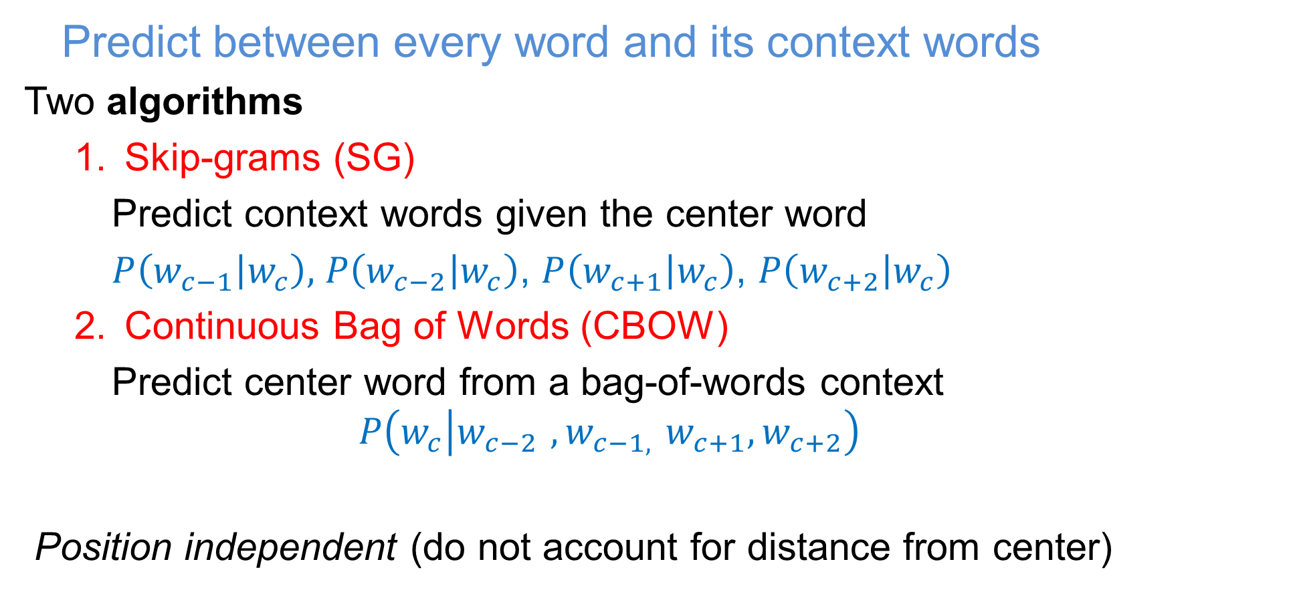
Word2Vec
  Predict between every word and its context words
Two algorithms
  Skip-grams (SG)
    Predict context words given the center word
    $P\left(w_{c−1} | w_{c}\right),$ $P\left(w_{c−2} | w_{c}\right)$, $P\left(w_{c+1} | w_{c}\right)$, $P\left(w_{c+2} | w_{c}\right)$
  Continuous Bag of Words (CBOW)
    Predict center word from a bag-of-words context
    $$P\left(w_{c} | w_{c−2 }{, w}_{c−1, }w_{c+1}, w_{c+2}\right)$$
    Position independent (do not account for distance from center)

Slide 23

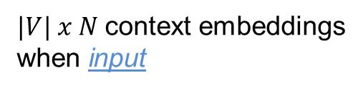




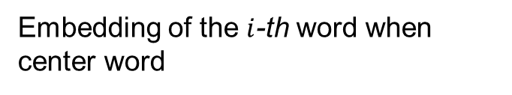



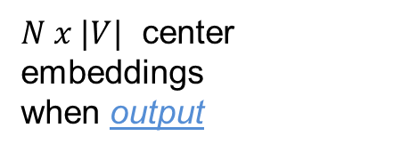
CBOW
  Use a window of context words to predict the center word
Learn two matrices ($N$ size of embedding, $|V|$ number of words)
$$W$$
Embedding of the $i$-th word when center word
$$N$$
$$W’$$
$$i$$
$$i$$
Embedding of the i-th word when context word
$$N$$
$$|V|$$
$$|V|$$
$N x |V|$ center embeddings
when output
$|V| x N$context embeddings
when input

Slide 24

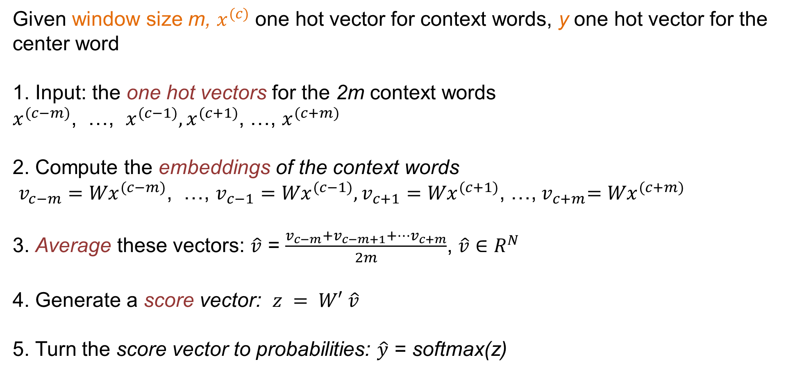
CBOW
Given window size m, $x^{(c)}$ one hot vector for context words, y one hot vector for the center word
1. Input: the one hot vectors for the 2m context words
$x^{(c−m)}$, …, $x^{(c−1)},x^{(c+1)}$, …, $x^{(c+m)}$
2. Compute the embeddings of the context words
$v_{c−m}{=Wx}^{(c−m)}$, …, $v_{c−1}{=Wx}^{(c−1)},v_{c+1}{=Wx}^{(c+1)}$, …,${ v}_{c+m}{=Wx}^{(c+m)}$
3. Average these vectors: $\hat{v}$ = $\frac{v_{c−m}+v_{c−m+1}+…v_{c+m}}{2m}$, $\hat{v}∈R^{N}$
4. Generate a score vector: $z = W′ \hat{v}$
5. Turn the score vector to probabilities: $\hat{y}$ = softmax(z)
Softmax
$$p_{i}= \frac{e^{v_{i}}}{\sum_{j}{e^{v_{j}}}}$$
We want this to be close to 1 for the center word

Slide 25
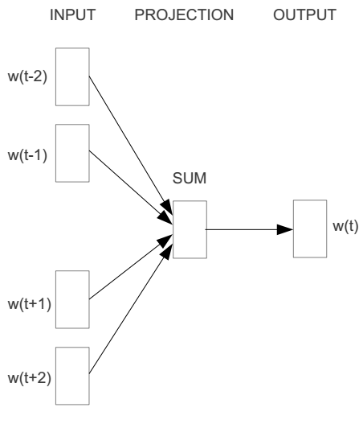
E.g. “The cat sat on floor”
  Window size = 2
the
cat
sat
on
floor

Slide 26
Index of cat in vocabulary
Input layer
0
1
Output layer
0
0
Hidden layer
0
0
0
cat
0
0
0
0
one-hot
vector
…
0
0
0
one-hot
vector
0
sat
0
0
0
0
1
on
1
…
0
0
0
0
0
…
0

Slide 27



Index of cat in vocabulary
Input layer
V-dim
We must learn W and W’
0
1
Output layer
0
0
0
Hidden layer
0
0
cat
0
$$W_{V×N}$$
0
0
0
one-hot
vector
…
0
0
$${W′}_{N×V}$$
0
one-hot
vector
0
sat
0
0
0
0
$$W_{V×N}$$
1
on
1
…
0
N-dim
0
0
V-dim
0
0
…
V-dim
0

Slide 28
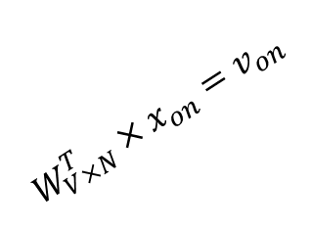

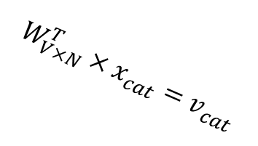



$$W_{V×N}^{T} ×x_{cat}=v_{cat}$$
0.1 | 2.4 | 1.6 | 1.8 | 0.5 | 0.9 | … | … | … | 3.2
0.5 | 2.6 | 1.4 | 2.9 | 1.5 | 3.6 | … | … | … | 6.1
… | … | … | … | … | … | … | … | … | …
… | … | … | … | … | … | … | … | … | …
0.6 | 1.8 | 2.7 | 1.9 | 2.4 | 2.0 | … | … | … | 1.2
0
2.4
2.6
…
…
1.8
1
Input layer
0
$$×$$
0
$$=$$
0
V-dim
0
0
Output layer
0
1
0
0
…
0
0
0
Hidden layer
cat
0
0
0
$$W_{V×N}^{T}×x_{cat}=v_{cat}$$
0
0
0
one-hot
vector
…
0
0
$$\hat{v}=\frac{v_{cat}+v_{on}}{2}$$
0
one-hot
vector
0
sat
0
0
0
0
$$W_{V×N}^{T}×x_{on}=v_{on}$$
1
1
N-dim
…
on
0
0
0
V-dim
0
0
…
0
V-dim

Slide 29



$$W_{V×N}^{T} ×x_{on}=v_{on}$$
0.1 | 2.4 | 1.6 | 1.8 | 0.5 | 0.9 | … | … | … | 3.2
0.5 | 2.6 | 1.4 | 2.9 | 1.5 | 3.6 | … | … | … | 6.1
… | … | … | … | … | … | … | … | … | …
… | … | … | … | … | … | … | … | … | …
0.6 | 1.8 | 2.7 | 1.9 | 2.4 | 2.0 | … | … | … | 1.2
0
1.8
2.9
…
…
1.9
0
Input layer
0
$$×$$
1
$$=$$
V-dim
0
0
Output layer
0
1
0
0
0
0
…
0
Hidden layer
0
cat
0
0
0
$$W_{V×N}^{T}×x_{cat}=v_{cat}$$
0
0
0
one-hot
vector
…
0
0
$$\hat{v}=\frac{v_{cat}+v_{on}}{2}$$
0
one-hot
vector
0
sat
0
0
0
0
$$W_{V×N}^{T}×x_{on}=v_{on}$$
1
1
N-dim
…
on
0
0
0
V-dim
0
0
…
0
V-dim

Slide 30





Input layer
V-dim
0
Output layer
1
We want $\hat{y}$ close to ${\hat{y}}_{sat}$
0
0
0
Hidden layer
0.01
0.02
0.00
0.02
0.01
0.02
0.01
0.7
…
0.00
cat
0
0
0
$$W_{V×N}^{T}×x_{cat}=v_{cat}$$
0
0
0
one-hot
vector
…
0
$$\hat{y}=softmax(z)$$
0
0
$$W_{V×N}^{′}×\hat{v}=z$$
sat
0
0
0
0
0
$$W_{V×N}^{T}×x_{on}=v_{on}$$
1
1
…
on
0
$$\hat{v}$$
0
0
${\hat{y}}_{sat}$
0
N-dim
0
V-dim
…
0
V-dim

Slide 31


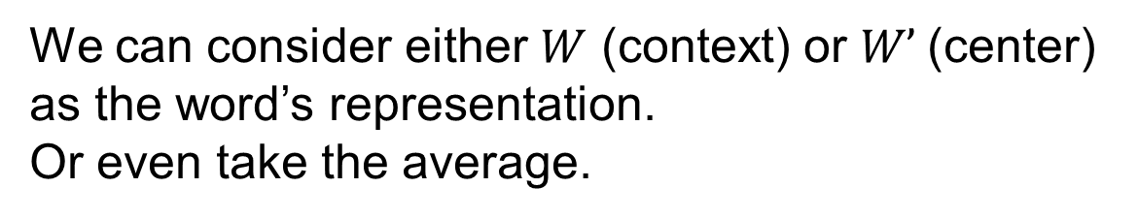


$$W_{V×N}$$
Input layer
0.1 | 2.4 | 1.6 | 1.8 | 0.5 | 0.9 | … | … | … | 3.2
0.5 | 2.6 | 1.4 | 2.9 | 1.5 | 3.6 | … | … | … | 6.1
… | … | … | … | … | … | … | … | … | …
… | … | … | … | … | … | … | … | … | …
0.6 | 1.8 | 2.7 | 1.9 | 2.4 | 2.0 | … | … | … | 1.2
V-dim
The word embeddings
0
1
0
0
Output layer
0
Hidden layer
0
0
0
$$W_{V×N}$$
0
0
0
…
0
0
$${W′}_{N×V}$$
0
0
0
0
0
0
$$W_{V×N}$$
1
1
…
0
N-dim
0
0
V-dim
0
0
…
V-dim
0
We can consider either $W$ (context) or $W’$(center) as the word’s representation.
Or even take the average.

Slide 32
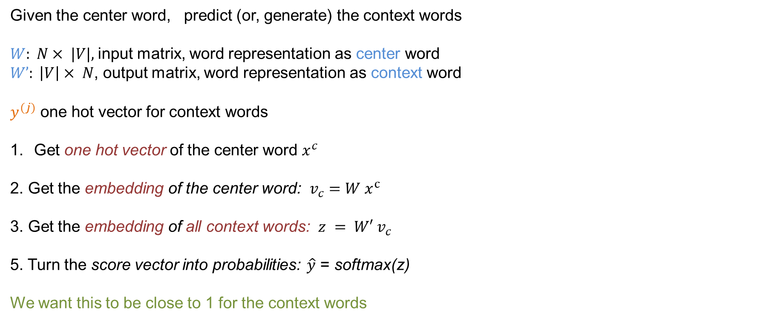
Skipgram
Given the center word, predict (or, generate) the context words
$W: N× |V|,$input matrix, word representation as center word
$W’: \left|V\right|× N$, output matrix, word representation as context word
$y^{(j)}$ one hot vector for context words
Get one hot vector of the center word $x^{c}$
2. Get the embedding of the center word: $v_{c}=W x^{c}$
3. Get the embedding of all context words: $z = W′ v_{c}$
5. Turn the score vector into probabilities: $\hat{y}$ = softmax(z)
We want this to be close to 1 for the context words

Slide 33
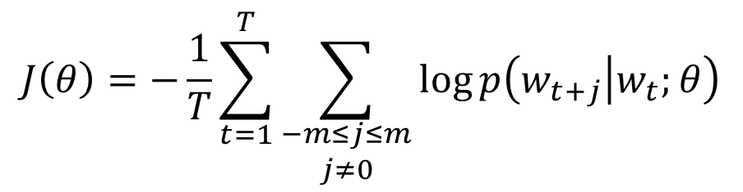
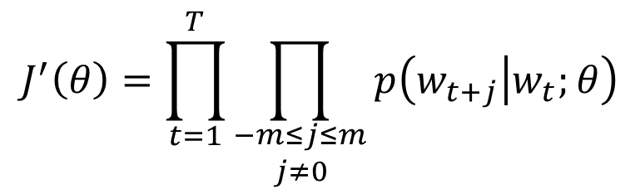
Skipgram
For each word t = 1 … T, predict surrounding words in a window of “radius” m of every word.
Objective function: Maximize the probability of any context word given the current center word:
where θ represents all variables we will optimize
$$J^{′}\left(θ\right)=\prod_{t=1}^{T}{\prod_{\begin{aligned}−m≤j≤m \\ j≠0\end{aligned}}{p\left(w_{t+j} | w_{t};θ\right)}}$$
likelihood
$$J\left(θ\right)=−\frac{1}{T}\sum_{t=1}^{T}{\sum_{\begin{aligned}−m≤j≤m \\ j≠0\end{aligned}}{\log{p\left(w_{t+j} | w_{t};θ\right)}}}$$
Negative
Log Likelihood

Slide 34

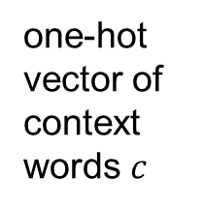
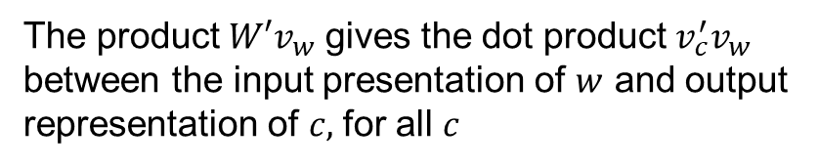

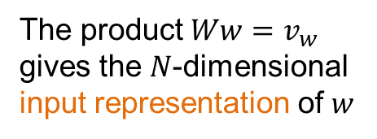

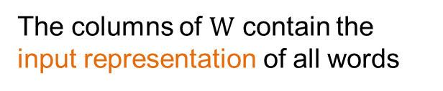
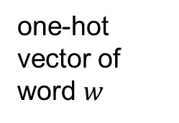
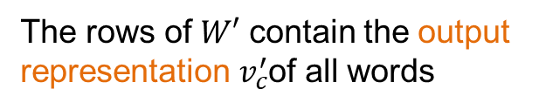
The product $W′v_{w}$ gives the dot product $v_{c}^{′}v_{w}$ between the input presentation of $w$ and output representation of $c,$for all $c$
one-hot vector of context words $c$
The columns of $W$ contain the input representation of all words
7.3
0.2
0
$${W′}_{V×N}$$
9.2
0.7
1
Input layer
2.2
0.01
0
$$W_{N×V}$$
0.5
softmax
0.01
0
0
Hidden layer
0.1 | 2.4 | 1.6 | 1.8 | 0.5 | 0.9 | … | … | … | 3.2
0.5 | 2.6 | 1.4 | 2.9 | 1.5 | 3.6 | … | … | … | 6.1
… | … | … | … | … | … | … | … | … | …
… | … | … | … | … | … | … | … | … | …
0.6 | 1.8 | 2.7 | 1.9 | 2.4 | 2.0 | … | … | … | 1.2
2.1
0.01
0
0.9
0.00
0
cat
0
5.2
0.02
0
2.1
0.01
0
sat
0
0.1 | 2.4 | 1.6 | 1.8 | 0.5 | 0.9 | … | … | … | 3.2
0.5 | 2.6 | 1.4 | 2.9 | 1.5 | 3.6 | … | … | … | 6.1
… | … | … | … | … | … | … | … | … | …
… | … | … | … | … | … | … | … | … | …
0.6 | 1.8 | 2.7 | 1.9 | 2.4 | 2.0 | … | … | … | 1.2
0
…
…
…
one-hot vector of word $w$
0
1.2
0.00
0
0
We want these to be close
0
V-dim
1
0.1 | 2.4 | 1.6 | 1.8 | 0.5 | 0.9 | … | … | … | 3.2
0.5 | 2.6 | 1.4 | 2.9 | 1.5 | 3.6 | … | … | … | 6.1
… | … | … | … | … | … | … | … | … | …
… | … | … | … | … | … | … | … | … | …
0.6 | 1.8 | 2.7 | 1.9 | 2.4 | 2.0 | … | … | … | 1.2
…
7.3
0.2
0
0
9.2
0.7
0
N-dim
2.2
0
on
0.5
softmax
0.01
V-dim
0.01
1
2.1
0.01
0
0.9
0.00
0
The product $Ww=v_{w}$
gives the $N$-dimensional input representation of $w$
$${W′}_{V×N}$$
5.2
0.02
0
2.1
0.01
0
…
…
…
The rows of $W′$ contain the output representation $v_{c}^{′}$of all words
1.2
0.00
0
Output layer

Slide 35
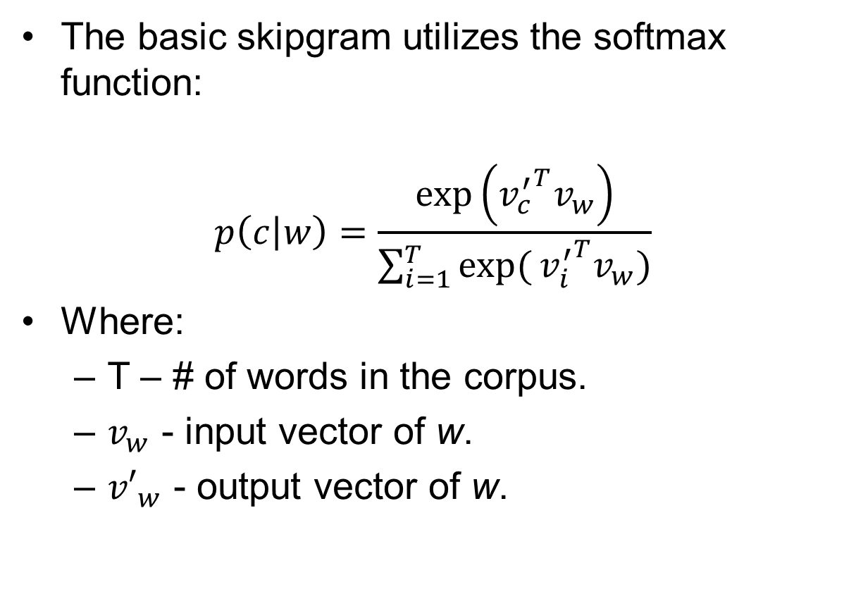
The basic skipgram utilizes the softmax function:
$$p\left(c | w\right)=\frac{\exp\left({v_{c}^{′}}^{T}v_{w}\right)}{\sum_{i=1}^{T}{exp⁡(}{v_{i}^{′}}^{T}v_{w})}$$
Where:
  T – # of words in the corpus.
  $v_{w}$ - input vector of w.
  ${v′}_{w}$ - output vector of w.
Word | Input | Output
King | [0.2,0.9,0.1] | [0.5,0.4,0.5]
Queen | [0.2,0.8,0.2] | [0.4,0.5,0.5]
Apple | [0.9,0.5,0.8] | [0.3,0.9,0.1]
Orange | [0.9,0.4,0.9] | [0.1,0.7,0.2]

Slide 36
An example

Slide 37
These representations are very good at encoding similarity and dimensions of similarity!
Analogies testing dimensions of similarity can be solved quite well just by doing vector subtraction in the embedding space
  Syntactically
  x_{apple} − x_{apples} ≈ x_{car} − x_{cars} ≈ x_{family} − x_{families}
  Similarly for verb and adjective morphological forms
  Semantically (Semeval 2012 task 2)
  x_{shirt} − x_{clothing} ≈ x_{chair} − x_{furniture}
  x_{king} − x_{man} ≈ x_{queen} − x_{woman}

Slide 38
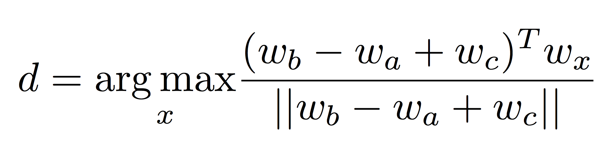
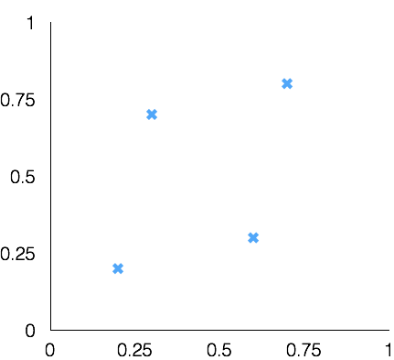
Test for linear relationships, examined by Mikolov et al.
a:b :: c:?
man:woman :: king:?
+
king
[ 0.30 0.70 ]
king
−
man
[ 0.20 0.20 ]
+
woman
[ 0.60 0.30 ]
woman
queen
[ 0.70 0.80 ]
man

Slide 39
Other Classification issues
Expressiveness
Overfitting
Evaluation

Slide 40
Generalization

Slide 41
Generalization
Generalization refers to the ability of the classifier to correctly classify data that it has not already seen.
  The assumption is that the new data come from the same distribution/model as the training data
How do we measure how well a model generalizes?
Classification errors:
  Training errors (apparent errors): Errors committed on the training set
    This is what we can control when creating the classifier. We hope that the training error is indicative of the generalization error, but as we will see this is not always the case
  Test errors: Errors committed on the test set
    This is a true measure of generalization, and this is what we want to be small, but we do not have access to the test error at training time.

Slide 42
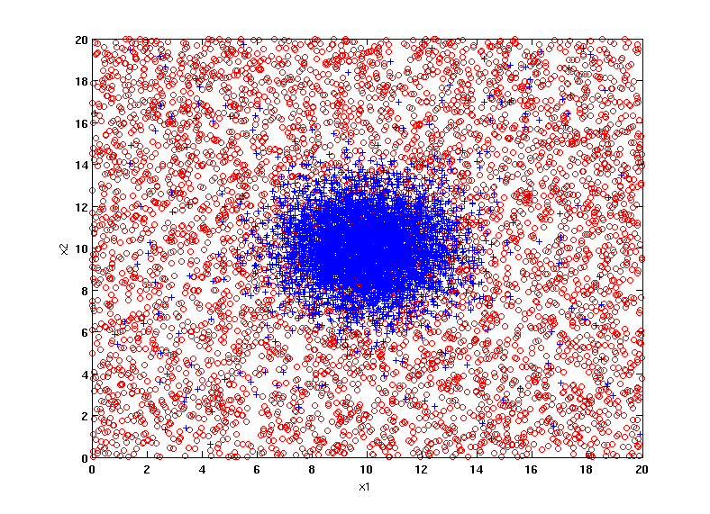
Example Data Set
Two class problem:
+ : 5400 instances
5000 instances generated from a Gaussian centered at (10,10)
400 noisy instances added
o : 5400 instances
Generated from a uniform distribution
10 % of the data used for training and 90% of the data used for testing

Slide 43
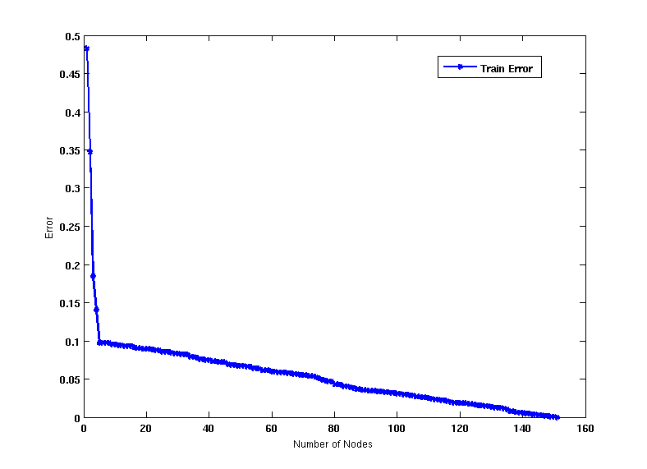
Increasing number of nodes in Decision Trees

Slide 44
Decision Tree with 4 nodes
Decision Tree
Decision boundaries on Training data

Slide 45
Decision Tree with 50 nodes
Decision Tree
Decision Tree
Decision boundaries on Training data

Slide 46
Which tree is better?
Decision Tree with 4 nodes
Which tree is better ?
Decision Tree with 50 nodes

Slide 47
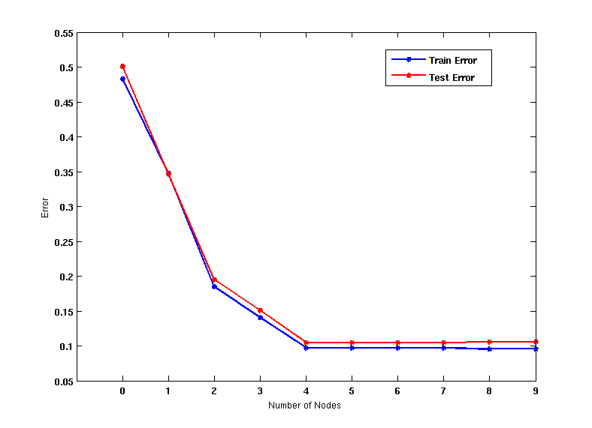
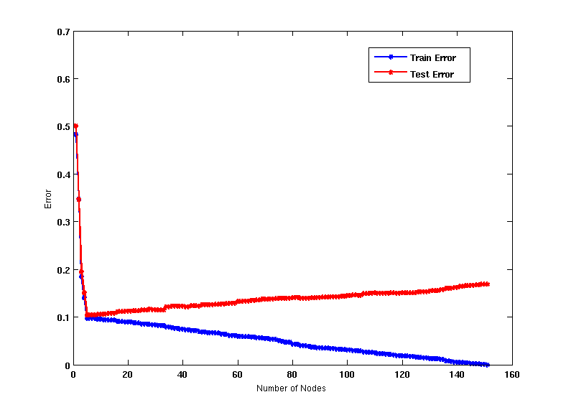
Generalization
When model is too simple, both training and test errors are large: Underfitting
When model is too complex, training error is small but test error is large: Overfitting

Slide 48
Bias – Variance tradeoff
Bias: Measures how good the model is with respect to the training data
  High Bias: Underfitting.
  We have a poor model, for example, a tree with a single decision node, or a linear function when modeling a more complex curve
Variance: Measures how sensitive the model error is with respect to changes in the training data
  High Variance: Overfitting.
  We have a very complex model, for example, a tree with a single sample per leaf, or a very high-degree polynomial curve. Small changes in the data cause errors in the model
There is a tradeoff between these two: decreasing one will increase the other.

Slide 49
Reasons for poor Generalization
Not enough training data
Not representative training data
Erroneus training data
A model that is too complex for the data we have.
  Multiple Comparison Procedure

Slide 50
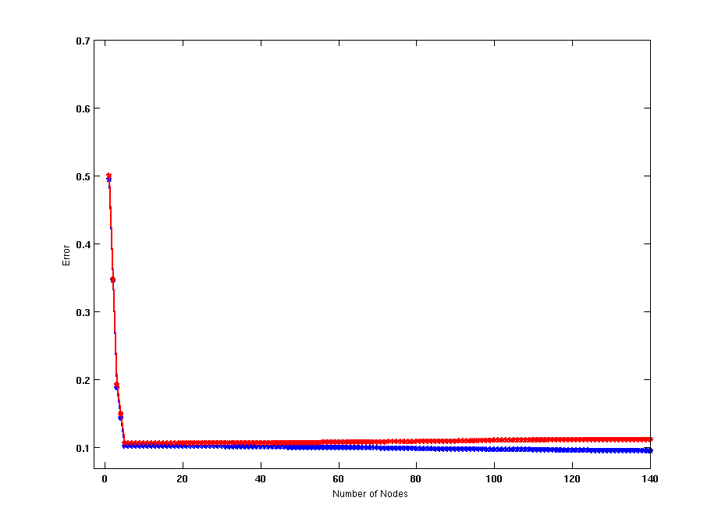
Model Overfitting
Using twice the number of data instances
Increasing the size of training data reduces the difference between training and testing errors at a given size of model

Slide 51
Model Overfitting
Decision Tree with 50 nodes
Decision Tree with 50 nodes
Using twice the number of data instances
Increasing the size of training data reduces the difference between training and testing errors at a given size of model

Slide 52
Effect of Multiple Comparison Procedure
Consider the task of predicting whether stock market will rise/fall in the next 10 trading days
Random guessing:
  P(correct) = 0.5
Make 10 random guesses in a row:
Day 1 | Up
Day 2 | Down
Day 3 | Down
Day 4 | Up
Day 5 | Down
Day 6 | Down
Day 7 | Up
Day 8 | Up
Day 9 | Up
Day 10 | Down

Slide 53
Effect of Multiple Comparison Procedure
Approach:
  Get 50 analysts
  Each analyst makes 10 random guesses
  Choose the analyst that makes the most number of correct predictions
Probability that at least one analyst makes at least 8 correct predictions

Slide 54
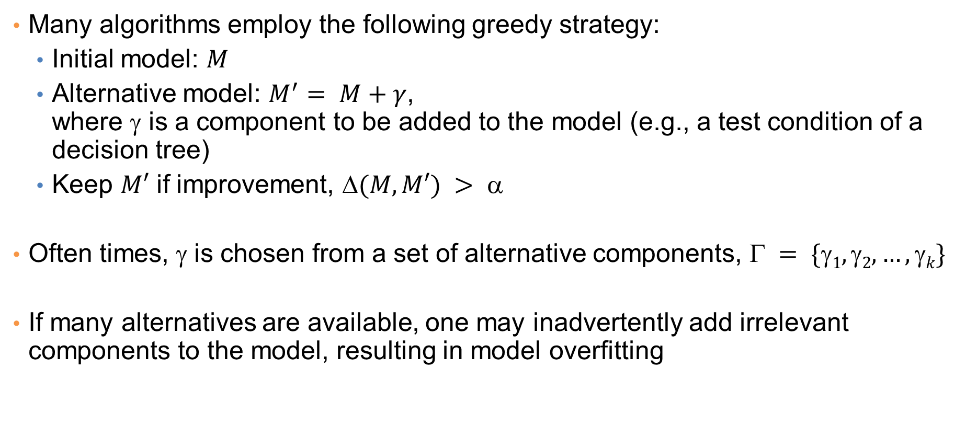
Effect of Multiple Comparison Procedure
Many algorithms employ the following greedy strategy:
  Initial model: $M$
  Alternative model: $M^{′}= M+γ$,
  where γ is a component to be added to the model (e.g., a test condition of a decision tree)
  Keep $M′$ if improvement, $(M,M′) > $
Often times, γ is chosen from a set of alternative components, $ = \{1, 2, …, k\}$
If many alternatives are available, one may inadvertently add irrelevant components to the model, resulting in model overfitting

Slide 55
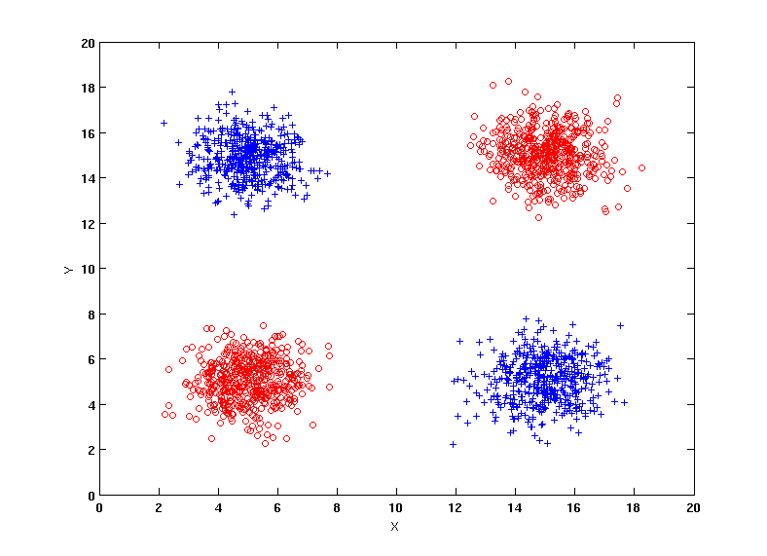
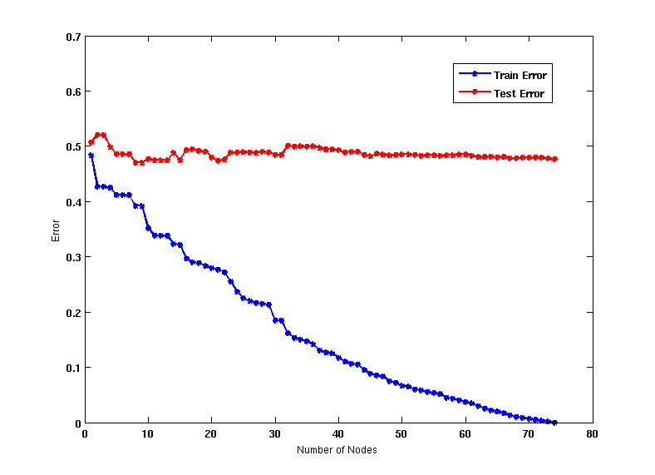
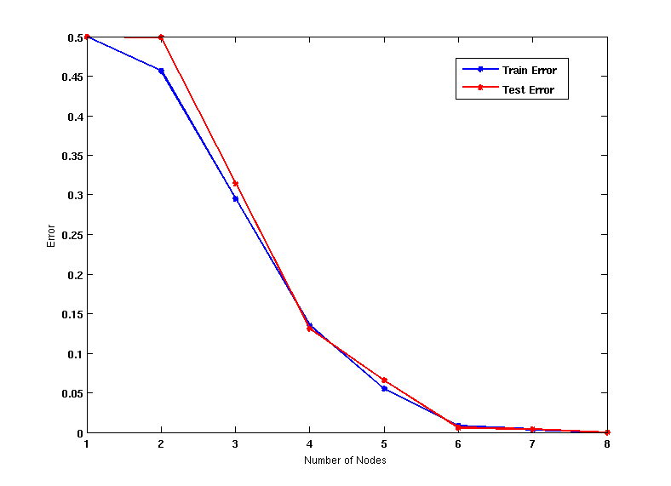
Effect of Multiple Comparison - Example
Use additional 100 noisy variables generated from a uniform distribution along with X and Y as attributes.
Use 30% of the data for training and 70% of the data for testing
Using only X and Y as attributes

Slide 56
In summary
When we have a small number of samples, and a very large number of features then it is likely that we will create a model that overfits the data and does not generalize well.

Slide 57
Notes on Overfitting
Overfitting results in decision trees that are more complex than necessary
Training error no longer provides a good estimate of test error, that is, how well the tree will perform on previously unseen records
We say that the model does not generalize well
Need ways for estimating the generalization error and select the model.

Slide 58
Model Selection
Performed during model building
Purpose is to ensure that model is not overly complex (to avoid overfitting)
Need to estimate generalization error
  Using Validation Set
  Incorporating Model Complexity

Slide 59
Model Selection: Using Validation Set
Divide training data into two parts:
  Training set:
    Use for model building
  Validation set:
    Use for estimating generalization error
    Note: validation set is not the same as test set since it affects the creation of the model (e.g. in tuning the size of the decision tree)
Drawback:
  Less data available for training

Slide 60
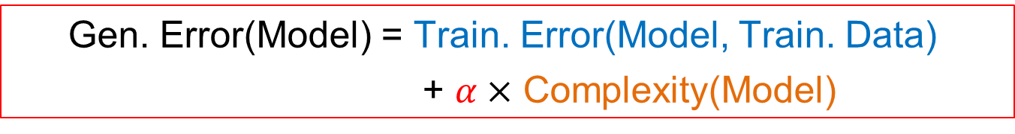
Model Selection: Incorporating Model Complexity
Occam’s razor: All other things being equal, the simplest explanation/solution is the best.
  A good principle for life as well
Given two models of similar generalization errors, one should prefer the simpler model over the more complex model
For complex models, there is a greater chance that it was fitted accidentally
Therefore, one should include model complexity when evaluating a model
  Gen. Error(Model) = Train. Error(Model, Train. Data)
  + $α×$ Complexity(Model)

Slide 61

Estimating the Complexity of Decision Trees
Resubstitution Estimate:
  Using training error as an optimistic estimate of generalization error
  Referred to as optimistic error estimate
$$e(TL) = 4/24$$
$$e(TR) = 6/24$$

Slide 62

Estimating the Complexity of Decision Trees
Pessimistic Error Estimate of decision tree T with k leaf nodes:
  $$err_{gen}\left(T\right)=err\left(T\right)+Ω×\frac{k}{N_{train}}$$
  $err(T)$: error rate on all training records
  $Ω$: trade-off hyper-parameter (similar to $α$)
    Relative cost of adding a leaf node
  $k$: number of leaf nodes
  $Ntrain$: total number of training records

Slide 63


Estimating the Complexity of Decision Trees: Example
$$e(TL) = 4/24$$
$$e(TR) = 6/24$$
$$ = 1$$
$$egen(TL) = 4/24 + 1∗7/24 = 11/24 = 0.458$$
$$egen(TR) = 6/24 + 1∗4/24 = 10/24 = 0.417$$

Slide 64
Minimum Description Length (MDL)
Cost(Model,Data) = Cost(Model) + Cost(Data|Model)
  Cost is the number of bits needed for encoding.
  Search for the least costly model.
Cost(Model) encodes the decision tree
  node encoding (number of children) plus splitting condition encoding.
Cost(Data|Model) encodes the misclassification errors.

Slide 65
Example
Regression: find a polynomial for describing a set of values
  Model complexity (model cost): polynomial coefficients
  Goodness of fit (data cost): difference between real value and the polynomial value
Minimum model cost
High data cost
High model cost
Minimum data cost
Low model cost
Low data cost
MDL avoids overfitting automatically!
Source: Grunwald et al. (2005) Tutorial on MDL.

Slide 66
Model selection for Decision Trees
Pre-Pruning (Early Stopping Rule)
  Stop the algorithm before it becomes a fully-grown tree
  Typical stopping conditions for a node:
    Stop if all instances belong to the same class
    Stop if all the attribute values are the same
  More restrictive conditions:
    Stop if number of instances is less than some user-specified threshold
    Stop if class distribution of instance classes are independent of the available features (e.g., using χ ² test)
    Stop if expanding the current node does not improve impurity measures (e.g., Gini or information gain).

Slide 67
Model selection for Decision Trees
Post-pruning
  Grow decision tree to its entirety
  Trim the nodes of the decision tree in a bottom-up fashion
  If generalization error improves after trimming, replace sub-tree by a leaf node (subtree pruning) or by the most probable subtree (subtree raising).
  Class label of leaf node is determined from majority class of instances in the sub-tree
  Can use MDL for post-pruning
    NP hard problem

Slide 68
Example of Post-Pruning
Optimistic (Training) Error (Before splitting) = 10/30
Pessimistic Error = (10 + 0.5)/30 = 10.5/30
Optimistic (Training) Error (After splitting) = 9/30
Pessimistic Error (After splitting) = (9 + 4 × 0.5)/30 = 11/30
PRUNE!
Class = Yes | 20
Class = No | 10
Error = 10/30
Class = Yes | 8
Class = No | 4
Class = Yes | 3
Class = No | 4
Class = Yes | 4
Class = No | 1
Class = Yes | 5
Class = No | 1

Slide 69
Examples of Post-pruning

Slide 70
EVALUATION

Slide 71
Model Evaluation
Metrics for Performance Evaluation
  How to evaluate the performance of a model?
Methods for Performance Evaluation
  How to obtain reliable estimates?
Methods for Model Comparison
  How to compare the relative performance among competing models?

Slide 72
Metrics for Performance Evaluation
Focus on the predictive capability of a model
  Rather than how fast it takes to classify or build models, scalability, etc.
Confusion Matrix:
 | PREDICTED CLASS
ACTUAL CLASS |  | Class=Yes | Class=No
 | Class=Yes | a | b
 | Class=No | c | d
a: TP (true positive)
b: FN (false negative)
c: FP (false positive)
d: TN (true negative)

Slide 73
Metrics for Performance Evaluation…
 | PREDICTED CLASS
ACTUAL CLASS |  | Class=Yes | Class=No
 | Class=Yes | a (TP) | b (FN)
 | Class=No | c (FP) | d (TN)
Most widely-used metric:

Slide 74
Precision-Recall
Count | PREDICTED CLASS
ACTUAL CLASS |  | Class=Yes | Class=No
 | Class=Yes | a | b
 | Class=No | c | d
Assumption: The class YES is the one we care about.
Precision is biased towards C(Yes|Yes) & C(Yes|No)
Recall is biased towards C(Yes|Yes) & C(No|Yes)
F-measure is biased towards all except C(No|No)

Slide 75

More Measures of Classification Performance
 | PREDICTED CLASS
ACTUAL CLASS |  | Yes | No
 | Yes | TP | FN
 | No | FP | TN
α is the probability that we reject the null hypothesis when it is true.
This is a Type I error or a false positive (FP).
β is the probability that we accept the null hypothesis when it is false.
This is a Type II error or a false negative (FN).
(recall for negative class)

Slide 76
ROC (Receiver Operating Characteristic)
Developed in 1950s for signal detection theory to analyze noisy signals
  Characterize the trade-off between positive hits and false alarms
ROC curve plots TPR (true positive rate) (on the y-axis) against FPR (false positive rate) (on the x-axis)
Look at the positive predictions of the classifier and compute:
 | PREDICTED CLASS
Actual |  | Yes | No
 | Yes | a (TP) | b (FN)
 | No | c (FP) | d (TN)
What fraction of true positive instances are predicted correctly? (1-Type II error rate)
What fraction of true negative instances were predicted incorrectly? (Type I error rate)
We want to strike a balance between these two
Notes:
TPR = sensitivity
FPR = 1- selectivity

Slide 77
ROC (Receiver Operating Characteristic)
Performance of a classifier represented as a point on the ROC curve
Changing some parameter of the algorithm, sample distribution, or cost matrix changes the location of the point

Slide 78


ROC Curve
- 1-dimensional data set containing 2 classes (positive and negative)
- any points located at x > t is classified as positive
At threshold t:
TP=0.5, FN=0.5, FP=0.12, FN=0.88

Slide 79
ROC Curve
(TP,FP):
(0,0): declare everything
to be negative class
(1,1): declare everything
to be positive class
(1,0): ideal
Diagonal line:
  Random guessing
  Below diagonal line:
    prediction is opposite of the true class
 | PREDICTED CLASS
Actual |  | Yes | No
 | Yes | a (TP) | b (FN)
 | No | c (FP) | d (TN)
Notes:
Random guessing = Each record is classified to positive class with probability p

Slide 80

Using ROC for Model Comparison
No model consistently outperform the other
  M₁ is better for small FPR
  M₂ is better for large FPR
Area Under the ROC curve (AUC)
  Ideal: Area = 1
  Random guess:
    Area = 0.5

Slide 81

Precision-Recall plot
Usually for parameterized models, it controls the precision/recall tradeoff

Slide 82
ROC curve vs Precision-Recall curve
Area Under the Curve (AUC) as a single number for evaluation

Slide 83
Methods of Performance Estimation
Holdout
  Reserve 2/3 for training and 1/3 for testing
Random subsampling
  One sample may be biased -- Repeated holdout
Cross validation
  Partition data into k disjoint subsets
  k-fold: train on k-1 partitions, test on the remaining one
  Leave-one-out: k=n
  Guarantees that each record is used the same number of times for training and testing
Bootstrap
  Sampling with replacement
  ~63% of records used for training, ~27% for testing

Slide 84
Class imbalance
Consider a 2-class problem
  Number of Class 0 examples = 9990
  Number of Class 1 examples = 10
If model predicts everything to be class 0, accuracy is 9990/10000 = 99.9 %
  Accuracy is misleading because model does not detect any class 1 example
  Precision and recall are better measures

Slide 85
Dealing with class Imbalance
Class imbalance is a problem in training:
  If the class we are interested in is very rare, then the classifier will ignore it.
Solution
  We can balance the class distribution
    Sample from the larger class so that the size of the two classes is the same
    Replicate the data of the class of interest so that the classes are balanced
      Over-fitting issues
  We can modify the optimization criterion by using a cost sensitive metric

Slide 86
Cost Matrix
 | PREDICTED CLASS
ACTUAL CLASS | C(i|j) | Class=Yes | Class=No
 | Class=Yes | C(Yes|Yes) | C(No|Yes)
 | Class=No | C(Yes|No) | C(No|No)
C(i|j): Cost of classifying class j example as class i

Slide 87


Weighted
Accuracy
CONFUSION MATRIX | PREDICTED CLASS
ACTUAL CLASS |  | Class=Yes | Class=No
 | Class=Yes | a (TP) | b (FN)
 | Class=No | c (FP) | d (TN)
COST MATRIX | PREDICTED CLASS
ACTUAL CLASS | C(i|j) | Class=Yes | Class=No
 | Class=Yes | $$w_{1}$$ C(Yes|Yes) | $$w_{2}$$ C(No|Yes)
 | Class=No | $$w_{3}$$ C(Yes|No) | $$w_{4}$$ C(No|No)
Weighted Accuracy = $\frac{w_{1}a+w_{4}d}{w_{1}a+w_{2}b+w_{3}c+w_{4}d}$

Slide 88
Computing Cost of Classification
Cost Matrix | PREDICTED CLASS
ACTUAL CLASS | C(i|j) | + | -
 | + | 1 | 100
 | - | 1 | 1
Model M₁ | PREDICTED CLASS
ACTUAL CLASS |  | + | -
 | + | 150 | 40
 | - | 60 | 250
Model M₂ | PREDICTED CLASS
ACTUAL CLASS |  | + | -
 | + | 250 | 45
 | - | 5 | 200
Accuracy = 80%
Weighted Accuracy = 8.9%
Accuracy = 90%
Weighted Accuracy= 9%

Slide 89

Classification
Cost
CONFUSION MATRIX | PREDICTED CLASS
ACTUAL CLASS |  | Class=Yes | Class=No
 | Class=Yes | a (TP) | b (FN)
 | Class=No | c (FP) | d (TN)
COST MATRIX | PREDICTED CLASS
ACTUAL CLASS | C(i|j) | Class=Yes | Class=No
 | Class=Yes | $$w_{1}$$ C(Yes|Yes) | $$w_{2}$$ C(No|Yes)
 | Class=No | $$w_{3}$$ C(Yes|No) | $$w_{4}$$ C(No|No)
Classification Cost = $w_{1}a+w_{2}b+w_{3}c+w_{4}d$
Some weights can also be negative

Slide 90
Computing Cost of Classification
Cost Matrix | PREDICTED CLASS
ACTUAL CLASS | C(i|j) | + | -
 | + | -1 | 100
 | - | 1 | 0
Model M₁ | PREDICTED CLASS
ACTUAL CLASS |  | + | -
 | + | 150 | 40
 | - | 60 | 250
Model M₂ | PREDICTED CLASS
ACTUAL CLASS |  | + | -
 | + | 250 | 45
 | - | 5 | 200
Accuracy = 80%
Cost = 3910
Accuracy = 90%
Cost = 4255

Slide 91
Cost vs Accuracy
Count | PREDICTED CLASS
ACTUAL CLASS |  | Class=Yes | Class=No
 | Class=Yes | a | b
 | Class=No | c | d
Accuracy is proportional to cost if
1. C(Yes|No)=C(No|Yes) = q
2. C(Yes|Yes)=C(No|No) = p
N = a + b + c + d
Accuracy = (a + d)/N
Cost = p (a + d) + q (b + c)
= p (a + d) + q (N – a – d)
= q N – (q – p)(a + d)
= N [q – (q-p) × Accuracy]
Cost | PREDICTED CLASS
ACTUAL CLASS |  | Class=Yes | Class=No
 | Class=Yes | p | q
 | Class=No | q | p

Slide 92
Supervised Learning

Slide 93
Learning
Supervised Learning: learn a model from the data using labeled data.
  Classification and Regression are the prototypical examples of supervised learning tasks. Other are possible (e.g., ranking)
Unsupervised Learning: learn a model – extract structure from unlabeled data.
  Clustering and Association Rules are prototypical examples of unsupervised learning tasks.
Semi-supervised Learning: learn a model for the data using both labeled and unlabeled data.

Slide 94
Supervised Learning Steps
Model the problem
  What is you are trying to predict? What kind of optimization function do you need? Do you need classes or probabilities?
Extract Features
  How do you find the right features that help to discriminate between the classes?
Obtain labeled data
  Obtain a collection of labeled data. Make sure it is large enough, accurate and representative. Ensure that classes are well represented.
Decide on the technique
  What is the right technique for your problem?
Apply in practice
  Can the model be trained for very large data? How do you test how you do in practice? How do you improve?

Slide 95
Modeling the problem
Sometimes it is not obvious. Consider the following three problems
  Detecting if an email is spam
  Categorizing the queries in a search engine
  Ranking the results of a web search
  Predicting the reply to a question.

Slide 96
Feature extraction
Feature extraction, or feature engineering is the most tedious but also the most important step
  How do you separate the players of the Greek national team from those of the Swedish national team?
One line of thought: throw features to the classifier and the classifier will figure out which ones are important
  More features, means that you need more training data
Another line of thought: Feature Selection: Select carefully the features using various functions and techniques
  Computationally intensive
Deep Neural Networks
  They use raw data for classification
  They learn a representation from the data

Slide 97
Training data
An overlooked problem: How do you get labeled data for training your model?
  E.g., how do you get training data for ranking web search results?
  Chicken and egg problem
Usually requires a lot of manual effort and domain expertise and carefully planned labeling
  Results are not always of high quality (lack of expertise)
  And they are not sufficient (low coverage of the space)
Recent trends:
  Find a source that generates the labeled data for you, or use the data themselves for the prediction task
  Crowd-sourcing techniques

Slide 98
Dealing with small amounts of labeled data
Semi-supervised learning techniques have been developed for this purpose.
Self-training: Train a classifier on the data, and then feed back the high-confidence output of the classifier as input
Co-training: train two “independent” classifiers and feed the output of one classifier as input to the other.
Regularization: Treat learning as an optimization problem where you define relationships between the objects you want to classify, and you exploit these relationships
  Example: Image restoration

Slide 99
Technique
The choice of technique depends on the problem requirements (do we need a probability estimate?) and the problem specifics (does independence assumption hold? do we think classes are linearly separable?)
For many cases finding the right technique may be trial and error
For many cases the exact technique does not matter.

Slide 100

Big Data Trumps Better Algorithms
If you have enough data then the algorithms are not so important
The web has made this possible.
  Especially for text-related tasks
  Search engine uses the collective human intelligence
Google lecture: Theorizing from the Data

Slide 101
Apply-Test
How do you scale to very large datasets?
  Distributed computing – map-reduce implementations of machine learning algorithms (Mahaut, over Hadoop)
How do you test something that is running online?
  You cannot get labeled data in this case
  A/B testing
How do you deal with changes in data?
  Active learning

