Slide 1
DATA MINING
Supervised LEarning
Regression
Classification
Decision Trees
Evaluation

Slide 2
Supervised learning
In supervised learning, except for the feature variables that describe the data, we also have a target variable
The goal is to learn a function (model) that can predict the value of the target variable given the features
  We learn the function using a labeled training set.
Regression: The target variable is numerical and continuous
  The price of a stock, the grade in a class, the height of a child, the life expectancy etc
Classification: The target variable is discrete
  Will the stock go up or down? Will the student pass or fail? Is a transaction fraudulent or not? What is the topic of an article?
Predictive modeling is in the heart of the data science revolution.

Slide 3
Linear Regression

Slide 4
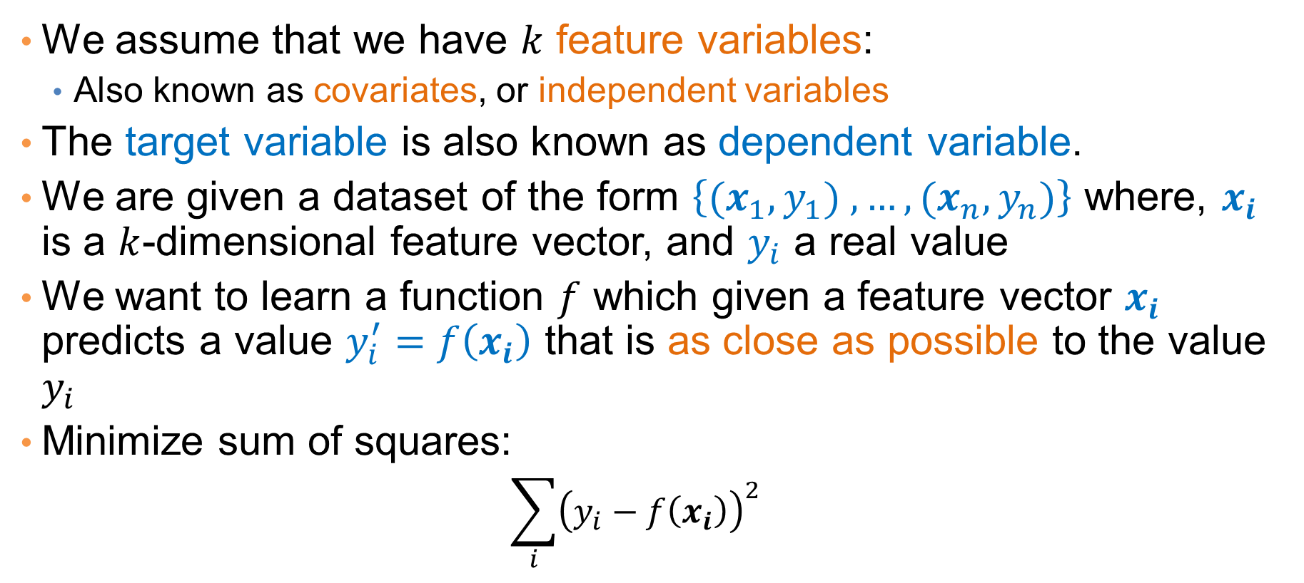
Regression
We assume that we have $k$ feature variables:
  Also known as covariates, or independent variables
The target variable is also known as dependent variable.
We are given a dataset of the form $\left\{{(x}_{1},y_{1}) ,…,{(x}_{n},y_{n})\right\}$ where, $x_{i}$ is a $k$-dimensional feature vector, and $y_{i}$ a real value
We want to learn a function $f$ which given a feature vector $x_{i}$ predicts a value $y_{i}^{′}=f\left(x_{i}\right)$ that is as close as possible to the value $y_{i}$
Minimize sum of squares:
  $$\sum_{i}{{\left(y_{i}−f\left(x_{i}\right)\right)}^{2}}$$

Slide 5
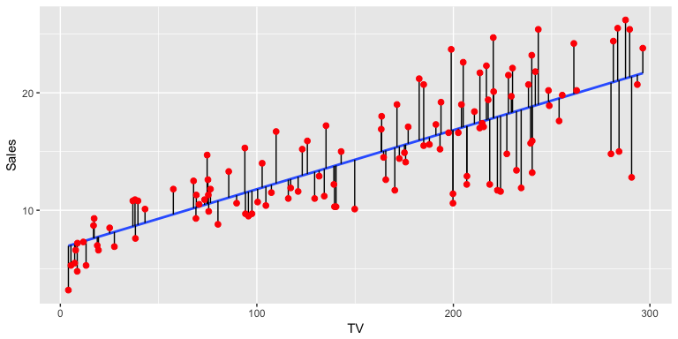
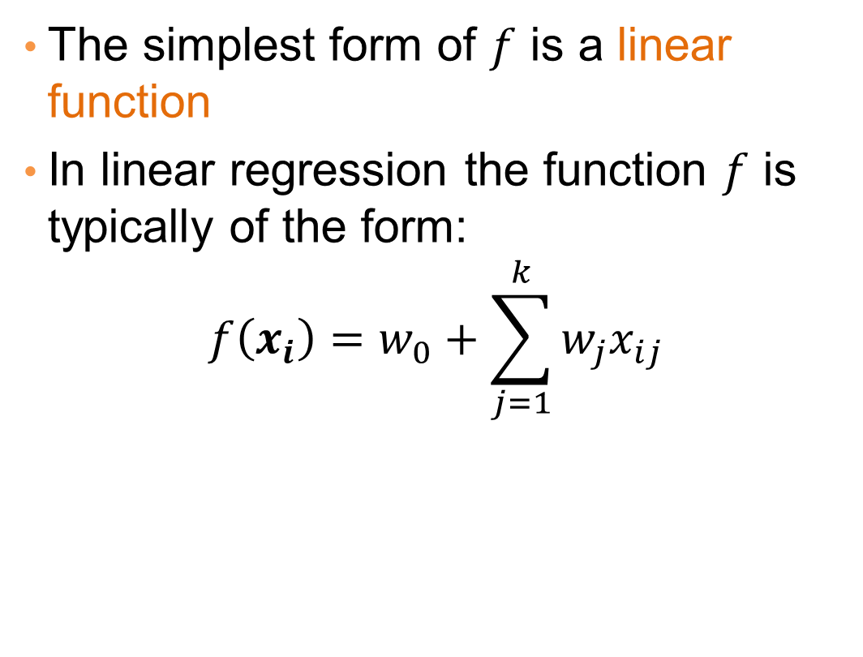
Linear regression
The simplest form of $f$ is a linear function
In linear regression the function $f$ is typically of the form:
$$f\left(x_{i}\right)=w_{0}+\sum_{j=1}^{k}{w_{j}x_{ij}}$$

Slide 6
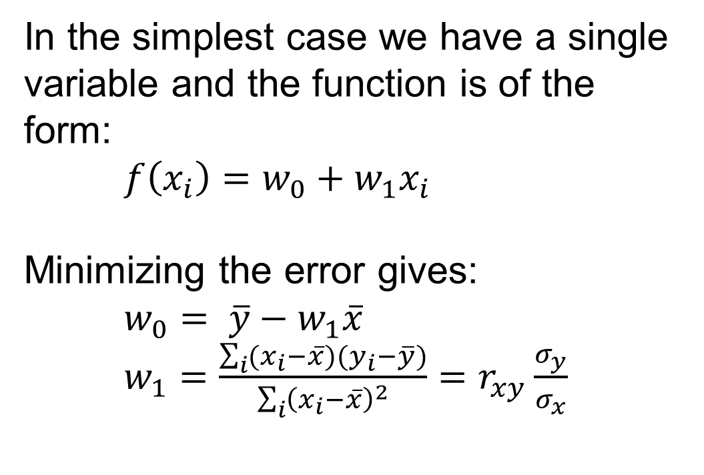
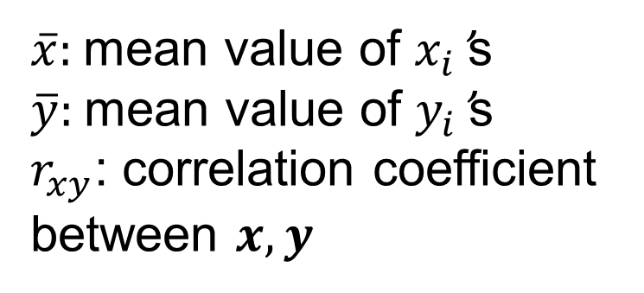
One-dimensional linear regression
In the simplest case we have a single variable and the function is of the form:
$f\left(x_{i}\right)=w_{0}+w_{1}x_{i}$
Minimizing the error gives:
$w_{0}= \overline{y}−w_{1}\overline{x}$
$w_{1}=\frac{\sum_{i}{(x_{i}−\overline{x})(y_{i}−\overline{y})}}{\sum_{i}{{\left(x_{i}−\overline{x}\right)}^{2}}}=r_{xy}\frac{σ_{y}}{σ_{x}}$
$\overline{x}$: mean value of $x_{i}$’s
$\overline{y}$: mean value of $y_{i}$’s
$r_{xy}$: correlation coefficient between $x,y$

Slide 7
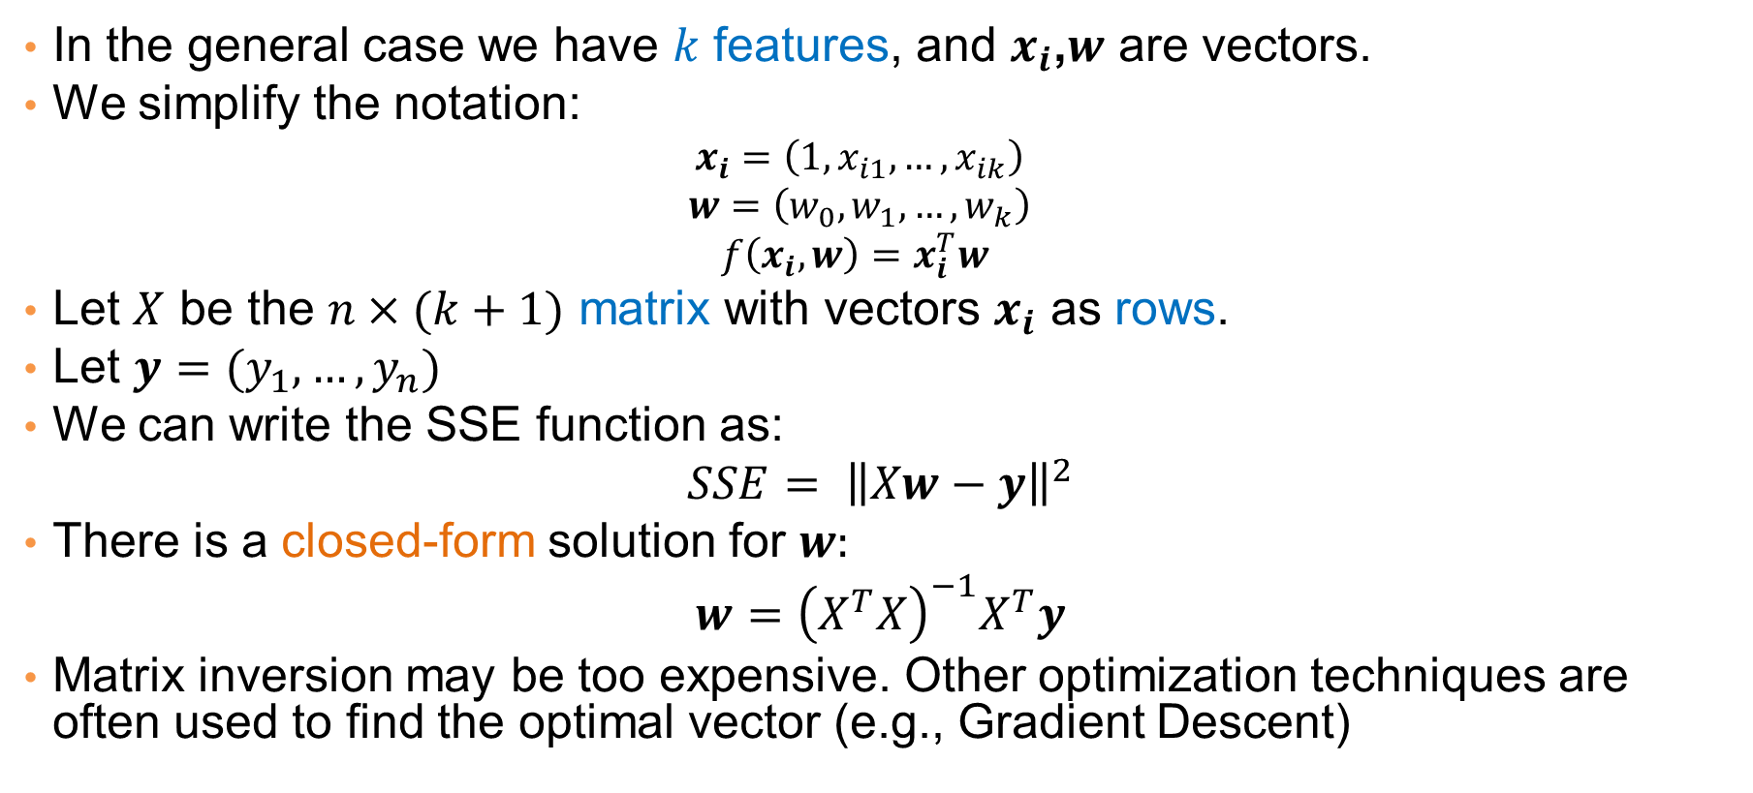
Multiple linear regression
In the general case we have $k$ features, and $x_{i}$,$w$ are vectors.
We simplify the notation:
  $$x_{i}=\left(1,x_{i1},…,x_{ik}\right)$$
  $$w=\left(w_{0},w_{1},…,w_{k}\right)$$
  $$f\left(x_{i},w\right)=x_{i}^{T}w$$
Let $X$ be the $n×(k+1)$ matrix with vectors $x_{i}$ as rows.
Let $y=(y_{1},…,y_{n})$
We can write the SSE function as:
$$SSE= {\left\|Xw−y\right\|}^{2}$$
There is a closed-form solution for $w:$
$$w={\left(X^{T}X\right)}^{−1}X^{T}y$$
Matrix inversion may be too expensive. Other optimization techniques are often used to find the optimal vector (e.g., Gradient Descent)

Slide 8
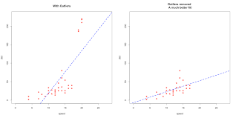
Outliers
Regression is sensitive to outliers:
  The line will “tilt” to accommodate very extreme values
Solution: remove the outliers
  But make sure that they do not capture useful information

Slide 9
Normalization
In the regression problem some times our features may have very different scales:
  For example: predict the GDP of a country using as features the percentage of home owners and the income
  The weights in this case will not be interpretable
Solution: Normalize the features by replacing the values with the z-scores

Slide 10
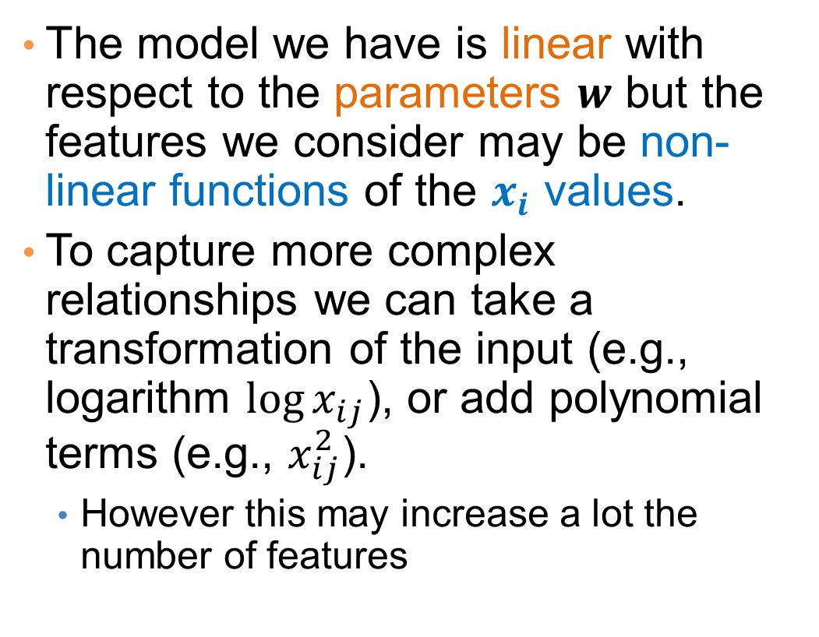
More complex models
The model we have is linear with respect to the parameters $w$ but the features we consider may be non-linear functions of the $x_{i}$ values.
To capture more complex relationships we can take a transformation of the input (e.g., logarithm ${\log{x}}_{ij}$), or add polynomial terms (e.g., $x_{ij}^{2}$).
  However this may increase a lot the number of features

Slide 11
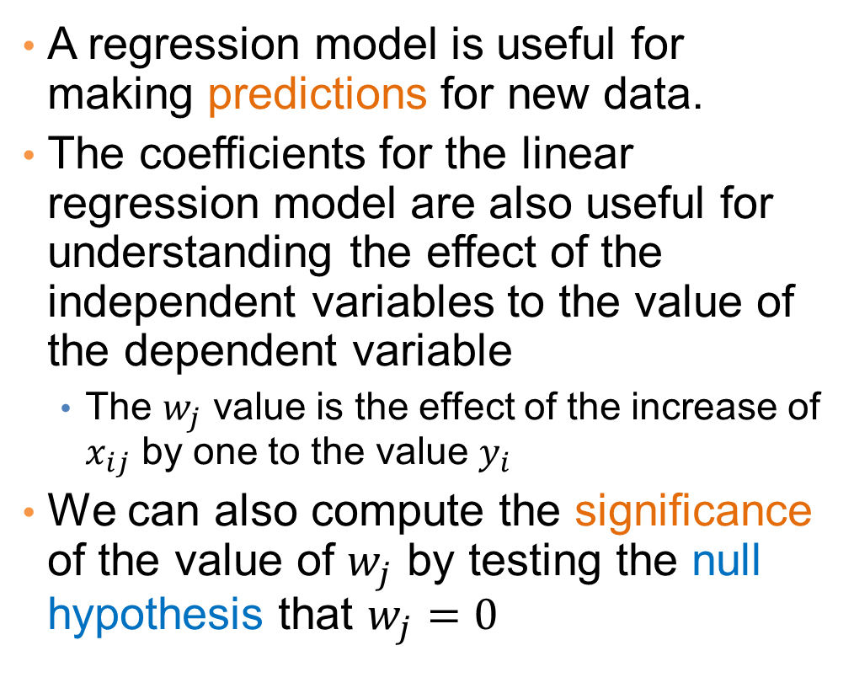
Interpretation and significance
A regression model is useful for making predictions for new data.
The coefficients for the linear regression model are also useful for understanding the effect of the independent variables to the value of the dependent variable
  The $w_{j}$ value is the effect of the increase of $x_{ij}$ by one to the value $y_{i}$
We can also compute the significance of the value of $w_{j}$ by testing the null hypothesis that $w_{j}=0$
Predicting Crime rate

Slide 12
Classification

Slide 13
Classification
Similar to the regression problem we have features and a target variable that we want to model/predict
The target variable is now discrete. It is often called the class label
  In the simplest case, it is a binary variable.

Slide 14
Example: Catching tax-evasion
Tax-return data for year 2011
A new tax return for 2012
Is this a cheating tax return?
An instance of the classification problem: learn a method for discriminating between records of different classes (cheaters vs non-cheaters)

Slide 15
Classification
Classification is the task of learning a target function f that maps attribute set x to one of the predefined class labels y
categorical
categorical
continuous
class
One of the attributes is the class attribute
In this case: Cheat
Two class labels (or classes): Yes (1), No (0)

Slide 16
Why classification?
The target function f is known as a classification model
Descriptive modeling: Explanatory tool to distinguish between objects of different classes (e.g., understand why people cheat on their taxes, or what makes a hipster)
Predictive modeling: Predict a class of a previously unseen record

Slide 17
Examples of Classification Tasks
Predicting tumor cells as benign or malignant
Classifying credit card transactions as legitimate or fraudulent
Categorizing news stories as finance, weather, entertainment, sports, etc
Identifying spam email, spam web pages, adult content
Understanding if a web query has commercial intent or not
Classification is everywhere in data science
Big data has the answers to all questions.

Slide 18
General approach to classification
Obtain a training set consisting of records with known class labels
Training set is used to build a classification model
A labeled test set of previously unseen data records is used to evaluate the quality of the model.
The classification model is applied to new records with unknown class labels
Important intermediate step: Decide on what features to use

Slide 19
Illustrating Classification Task

Slide 20
Evaluation of classification models
Counts of test records that are correctly (or incorrectly) predicted by the classification model
Confusion matrix
Predicted Class
 | Class = 1 | Class = 0
Class = 1 | f₁₁ | f₁₀
Class = 0 | f₀₁ | f₀₀
Actual Class

Slide 21
Classification Techniques
Decision Tree based Methods
Rule-based Methods
Memory based reasoning
Neural Networks
Naïve Bayes and Bayesian Belief Networks
Support Vector Machines
Logistic Regression

Slide 22
Classification Techniques
Decision Tree based Methods
Rule-based Methods
Memory based reasoning
Neural Networks
Naïve Bayes and Bayesian Belief Networks
Support Vector Machines

Slide 23
Decision Trees
Decision tree
  A flow-chart-like tree structure
  Internal node denotes a test on an attribute
  Branch represents an outcome of the test
  Leaf nodes represent class labels or class distribution

Slide 24
Example of a Decision Tree
categorical
categorical
continuous
class
Splitting Attributes
Refund
Yes
No
Test outcome
NO
MarSt
Single, Divorced
Married
TaxInc
NO
< 80K
> 80K
NO
YES
Class labels
Training Data
Model: Decision Tree

Slide 25
Another Example of Decision Tree
categorical
categorical
continuous
class
MarSt
Single, Divorced
Married
NO
Refund
Yes
No
NO
TaxInc
< 80K
> 80K
NO
YES
There could be more than one tree that fits the same data!

Slide 26
Decision Tree Classification Task
Decision Tree

Slide 27
Apply Model to Test Data
Test Data
Start from the root of tree.
Refund
Yes
No
NO
MarSt
Single, Divorced
Married
TaxInc
NO
< 80K
> 80K
NO
YES

Slide 28
Apply Model to Test Data
Test Data
Refund
Yes
No
NO
MarSt
Single, Divorced
Married
TaxInc
NO
< 80K
> 80K
NO
YES

Slide 29
Apply Model to Test Data
Test Data
Refund
Yes
No
NO
MarSt
Single, Divorced
Married
TaxInc
NO
< 80K
> 80K
NO
YES

Slide 30
Apply Model to Test Data
Test Data
Refund
Yes
No
NO
MarSt
Single, Divorced
Married
TaxInc
NO
< 80K
> 80K
NO
YES

Slide 31
Apply Model to Test Data
Test Data
Refund
Yes
No
NO
MarSt
Single, Divorced
Married
TaxInc
NO
< 80K
> 80K
NO
YES

Slide 32
Apply Model to Test Data
Test Data
Refund
Yes
No
NO
MarSt
Single, Divorced
Married
Assign Cheat to “No”
TaxInc
NO
< 80K
> 80K
NO
YES

Slide 33
Decision Tree Classification Task
Decision Tree

Slide 34
Tree Induction
Goal: Find the tree that has low classification error in the training data (training error)
Finding the best decision tree (lowest training error) is NP-hard
Greedy strategy.
  Split the records based on an attribute test that optimizes certain criterion.
Many Algorithms:
  Hunt’s Algorithm (one of the earliest)
  CART
  ID3, C4.5
  SLIQ,SPRINT

Slide 35
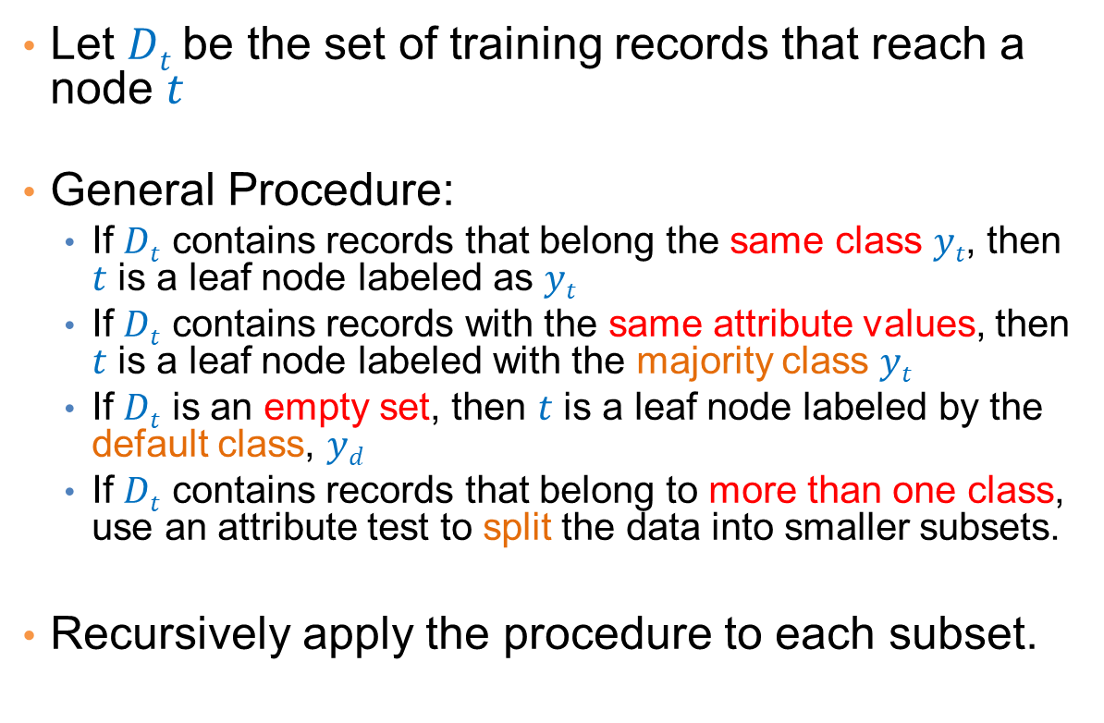

General Structure of Hunt’s Algorithm
Let $Dt$be the set of training records that reach a node $t$
General Procedure:
  If $Dt$ contains records that belong the same class $yt$, then $t$ is a leaf node labeled as $yt$
  If $Dt$ contains records with the same attribute values, then $t$ is a leaf node labeled with the majority class $yt$
  If $Dt$ is an empty set, then $t$ is a leaf node labeled by the default class, $yd$
  If $Dt$ contains records that belong to more than one class, use an attribute test to split the data into smaller subsets.
Recursively apply the procedure to each subset.
$$Dt$$
?

Slide 36
Hunt’s Algorithm
Refund
Don’t
Cheat
Yes
No
Don’t
Cheat
Don’t
Cheat
Refund
Refund
Yes
No
Yes
No
Don’t
Cheat
Marital
Status
Don’t
Cheat
Marital
Status
Single,
Divorced
Single,
Divorced
Married
Married
Cheat
Don’t
Cheat
Taxable
Income
Don’t
Cheat
< 80K
>= 80K
Don’t
Cheat
Cheat

Slide 37
Constructing decision-trees (pseudocode)
GenDecTree(Sample S, Features F)
If stopping_condition(S,F) = true then
  leaf = createNode()
  leaf.label= Classify(S)
  return leaf
root = createNode()
root.test_condition = findBestSplit(S,F)
V = {v| v a possible outcome of root.test_condition}
for each value vєV:
  S_{v}: = {s | root.test_condition(s) = v and s є S};
  child = GenDecTree(S_{v} ,F) ;
  Add child as a descent of root and label the edge (root→child) as v
return root

Slide 38
Tree Induction
Issues
  How to Classify a leaf node
    Assign the majority class
    If leaf is empty, assign the default class – the class that has the highest popularity (overall or in the parent node).
  Determine how to split the records
    How to specify the attribute test condition?
    How to determine the best split?
  Determine when to stop splitting

Slide 39
How to Specify Test Condition?
Depends on attribute types
  Nominal
  Ordinal
  Continuous
Depends on number of ways to split
  2-way split
  Multi-way split

Slide 40
Splitting Based on Nominal Attributes
Multi-way split: Use as many partitions as distinct values.
Binary split: Divides values into two subsets.
Need to find optimal partitioning.
CarType
Family
Luxury
Sports
CarType
OR
CarType
{Sports, Luxury}
{Family,
Luxury}
{Family}
{Sports}

Slide 41
Splitting Based on Ordinal Attributes
Multi-way split: Use as many partitions as distinct values.
Binary split: Divides values into two subsets – respects the order. Need to find optimal partitioning.
What about this split?
Size
Small
Large
Medium
Size
Size
{Small, Medium}
OR
{Medium,
Large}
{Large}
{Small}
Size
{Small, Large}
{Medium}

Slide 42
Splitting Based on Continuous Attributes
Different ways of handling
  Discretization to form an ordinal categorical attribute
    Static – discretize once at the beginning
    Dynamic – ranges can be found by equal interval bucketing, equal frequency bucketing (percentiles), or clustering.
  Binary Decision: (A < v) or (A ≥ v)
    consider all possible splits and finds the best cut
    can be more computationally intensive

Slide 43
Splitting Based on Continuous Attributes

Slide 44
How to determine the Best Split
Before Splitting: 10 records of class 0,
10 records of class 1
Which test condition is the best?

Slide 45
How to determine the Best Split
Greedy approach:
  Creation of nodes with homogeneous class distribution is preferred
Need a measure of node impurity:
Ideas?
Non-homogeneous,
High degree of impurity
Homogeneous,
Low degree of impurity

Slide 46
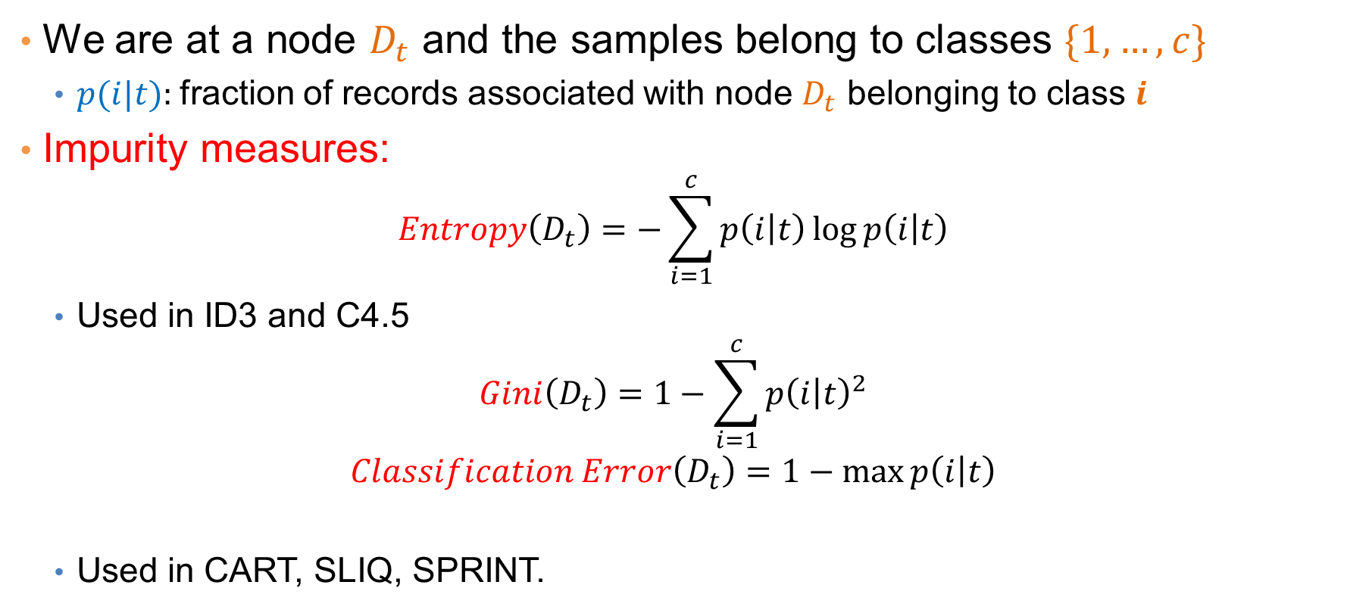
Measuring Node Impurity
We are at a node $D_{t}$ and the samples belong to classes $\{1,…,c\}$
  $p(i|t):$fraction of records associated with node $D_{t}$ belonging to class $i$
Impurity measures:
  $$Entropy\left(D_{t}\right)=−\sum_{i=1}^{c}{p\left(i | t\right)\log{p\left(i | t\right)}}$$
  Used in ID3 and C4.5
  $$Gini\left(D_{t}\right)=1−\sum_{i=1}^{c}{p{\left(i | t\right)}^{2}}$$
  $$Classification Error\left(D_{t}\right)=1−\max{p\left(i | t\right)}$$
  Used in CART, SLIQ, SPRINT.

Slide 47
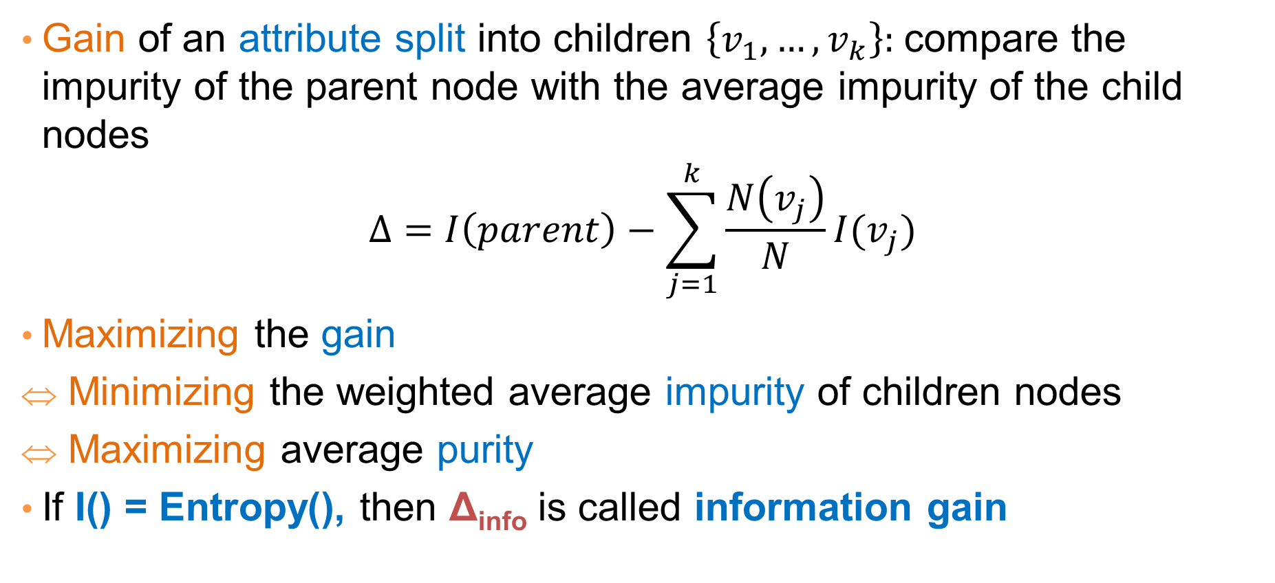
Gain
Gain of an attribute split into children $\left\{v_{1}, …,v_{k}\right\}:$compare the impurity of the parent node with the average impurity of the child nodes
$$Δ=I\left(parent\right)−\sum_{j=1}^{k}{\frac{N\left(v_{j}\right)}{N}I(v_{j})}$$
Maximizing the gain
Minimizing the weighted average impurity of children nodes
Maximizing average purity
If I() = Entropy(), then Δ_{info} is called information gain

Slide 48
Example
P(C1) = 0/6 = 0 P(C2) = 6/6 = 1
Gini = 1 – P(C1)² – P(C2)² = 1 – 0 – 1 = 0
Entropy = – 0 log 0 – 1 log 1 = – 0 – 0 = 0
Error = 1 – max (0, 1) = 1 – 1 = 0
P(C1) = 1/6 P(C2) = 5/6
Gini = 1 – (1/6)² – (5/6)² = 0.278
Entropy = – (1/6) log₂ (1/6) – (5/6) log₂ (1/6) = 0.65
Error = 1 – max (1/6, 5/6) = 1 – 5/6 = 1/6
P(C1) = 2/6 P(C2) = 4/6
Gini = 1 – (2/6)² – (4/6)² = 0.444
Entropy = – (2/6) log₂ (2/6) – (4/6) log₂ (4/6) = 0.92
Error = 1 – max (2/6, 4/6) = 1 – 4/6 = 1/3

Slide 49
Impurity measures
All of the impurity measures take value zero (minimum) for the case of a pure node where a single value has probability 1
All of the impurity measures take maximum value when the class distribution in a node is uniform.

Slide 50
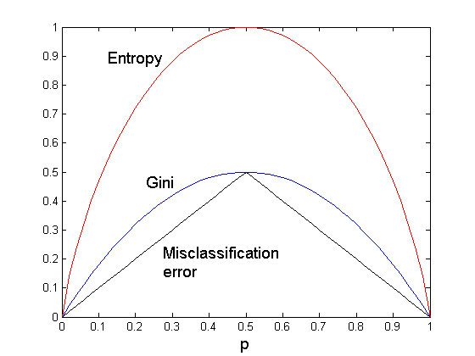
Comparison among Splitting Criteria
For a 2-class problem:
The different impurity measures are consistent

Slide 51
Categorical Attributes
For binary values split in two
For multivalued attributes, for each distinct value, gather counts for each class in the dataset
  Use the count matrix to make decisions
Multi-way split
Two-way split
(find best partition of values)

Slide 52
Continuous Attributes
Use Binary Decisions based on one value
Choices for the splitting value
  Number of possible splitting values
  = Number of distinct values
Each splitting value has a count matrix associated with it
  Class counts in each of the partitions, A < v and A ≥ v
Exhaustive method to choose best v
  For each v, scan the database to gather count matrix and compute the impurity index
  Computationally Inefficient! Repetition of work.

Slide 53
Continuous Attributes
For efficient computation: for each attribute,
  Sort the attribute on values
  Linearly scan these values, each time updating the count matrix and computing impurity
  Choose the split position that has the least impurity
Sorted Values
Split Positions

Slide 54
Splitting based on impurity
Impurity measures favor attributes with large number of values
A test condition with large number of outcomes may not be desirable
  # of records in each partition is too small to make predictions

Slide 55
Splitting based on INFO

Slide 56
Gain Ratio
Splitting using information gain
    Parent Node, p is split into k partitions
    n_{i} is the number of records in partition i
  Adjusts Information Gain by the entropy of the partition (SplitINFO). Higher entropy partition (large number of small partitions) is penalized!
  Used in C4.5
  Designed to overcome the disadvantage of impurity

Slide 57
Stopping Criteria for Tree Induction
Stop expanding a node when all the records belong to the same class
Stop expanding a node when all the records have similar attribute values
Early termination (to be discussed later)

Slide 58
Decision Tree Based Classification
Advantages:
  Inexpensive to construct
  Extremely fast at classifying unknown records
  Easy to interpret for small-sized trees
  Accuracy is comparable to other classification techniques for many simple data sets

Slide 59
Example: C4.5
Simple depth-first construction.
Uses Information Gain
Sorts Continuous Attributes at each node.
Needs entire data to fit in memory.
Unsuitable for Large Datasets.
  Needs out-of-core sorting.
You can download the software from:
http://www.cse.unsw.edu.au/~quinlan/c4.5r8.tar.gz

Slide 60
Other Classification issues
Expressiveness
Overfitting
Evaluation

Slide 61
Expressiveness

Slide 62
Expressiveness
A classifier defines a function that discriminates between two (or more) classes.
The expressiveness of a classifier is the class of functions that it can model, and the kind of data that it can separate
  When we have discrete (or binary) values, we are interested in the class of boolean functions that can be modeled
  If the data-points are real vectors we talk about the decision boundary that the classifier can model

Slide 63
Decision Boundary
Border line between two neighboring regions of different classes is known as decision boundary
Decision boundary is parallel to axes because test condition involves a single attribute at-a-time

Slide 64
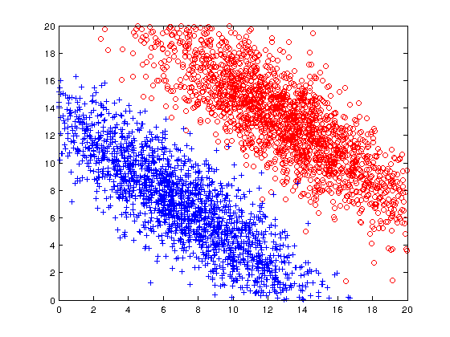
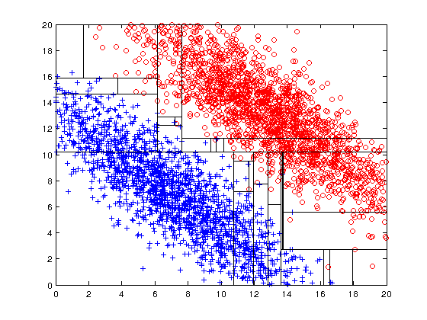
Limitations of single attribute-based decision boundaries
Both positive (+) and negative (o) classes generated from skewed Gaussians with centers at (8,8) and (12,12) respectively.
The resulting boundary is very complex.

Slide 65
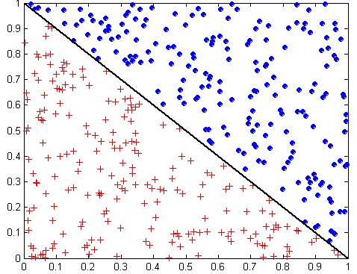
Oblique Decision Trees
x + y < 1
Class = +
Class =
Test condition may involve multiple attributes
More expressive representation
Finding optimal test condition is computationally expensive

Slide 66
Expressiveness
Decision tree provides expressive representation for learning discrete-valued function
  But they do not generalize well to certain types of Boolean functions
    Example: parity function:
      Class = 1 if there is an even number of Boolean attributes with truth value = True
      Class = 0 if there is an odd number of Boolean attributes with truth value = True
    For accurate modeling, must have a complete tree
Less expressive for modeling continuous variables
  Particularly when test condition involves only a single attribute at-a-time

Slide 67
OVERFITTING

Slide 68
Classification Errors
Training errors (apparent errors)
  Errors committed on the training set
Test errors
  Errors committed on the test set
Generalization errors
  Expected error of a model over random selection of records from same distribution

Slide 69
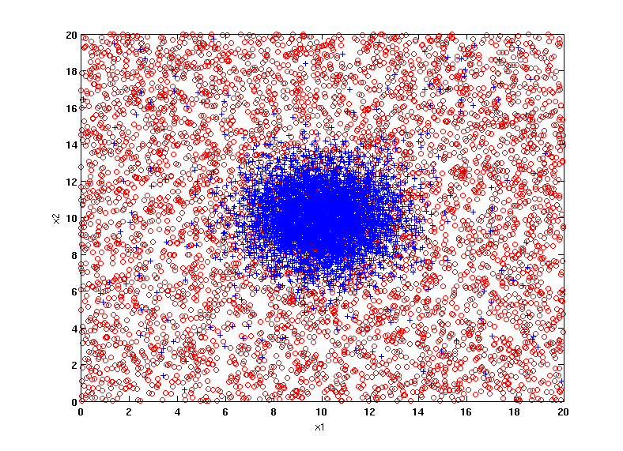
Example Data Set
Two class problem:
+ : 5400 instances
5000 instances generated from a Gaussian centered at (10,10)
400 noisy instances added
o : 5400 instances
Generated from a uniform distribution
10 % of the data used for training and 90% of the data used for testing

Slide 70
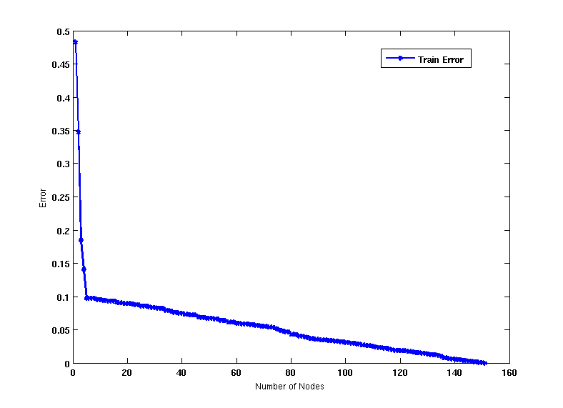
Increasing number of nodes in Decision Trees

Slide 71
Decision Tree with 4 nodes
Decision Tree
Decision boundaries on Training data

Slide 72
Decision Tree with 50 nodes
Decision Tree
Decision Tree
Decision boundaries on Training data

Slide 73
Which tree is better?
Decision Tree with 4 nodes
Which tree is better ?
Decision Tree with 50 nodes

Slide 74
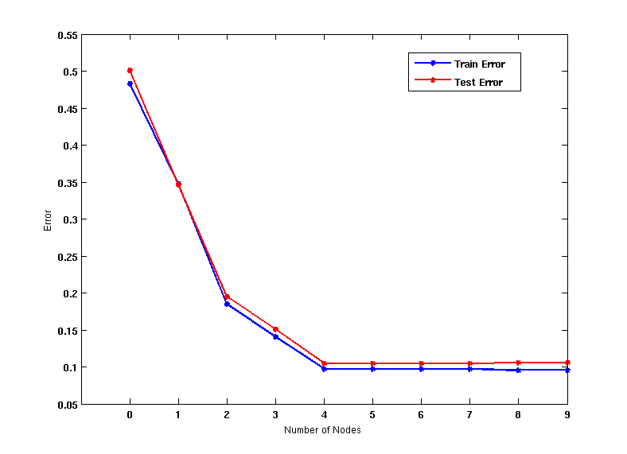
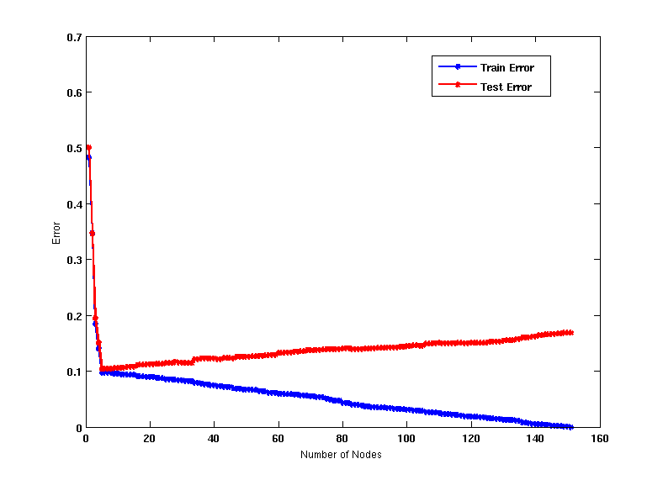
Model Overfitting
As the model becomes more and more complex, test errors can start increasing even though training error may be decreasing
Underfitting: when model is too simple, both training and test errors are large
Overfitting: when model is too complex, training error is small but test error is large

Slide 75
Bias – Variance tradeoff
Bias: Measures how good the model is with respect to the training data
  High Bias: Underfitting.
  We have a poor model (e.g., a tree with a single decision node)
Variance: Measures how sensitive the model error is with respect to changes in the training data
  High Variance: Overfitting.
  We have a very specific model (e.g., a tree with a single sample per leaf). Small changes in the data cause errors in the model
There is a tradeoff between these two: decreasing one will increase the other.

Slide 76
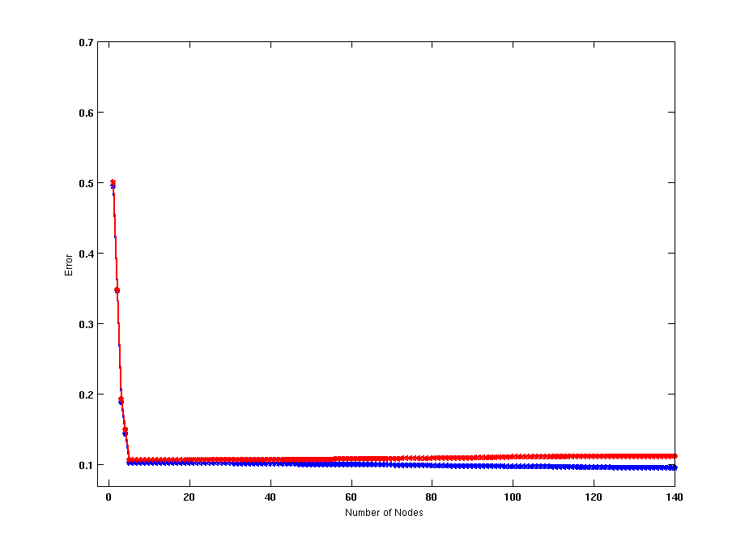
Model Overfitting
Using twice the number of data instances
Increasing the size of training data reduces the difference between training and testing errors at a given size of model

Slide 77
Model Overfitting
Decision Tree with 50 nodes
Decision Tree with 50 nodes
Using twice the number of data instances
Increasing the size of training data reduces the difference between training and testing errors at a given size of model

Slide 78
Reasons for Model Overfitting
Limited Training Size
High Model Complexity
  Multiple Comparison Procedure

Slide 79
Effect of Multiple Comparison Procedure
Consider the task of predicting whether stock market will rise/fall in the next 10 trading days
Random guessing:
  P(correct) = 0.5
Make 10 random guesses in a row:
Day 1 | Up
Day 2 | Down
Day 3 | Down
Day 4 | Up
Day 5 | Down
Day 6 | Down
Day 7 | Up
Day 8 | Up
Day 9 | Up
Day 10 | Down

Slide 80
Effect of Multiple Comparison Procedure
Approach:
  Get 50 analysts
  Each analyst makes 10 random guesses
  Choose the analyst that makes the most number of correct predictions
Probability that at least one analyst makes at least 8 correct predictions

Slide 81
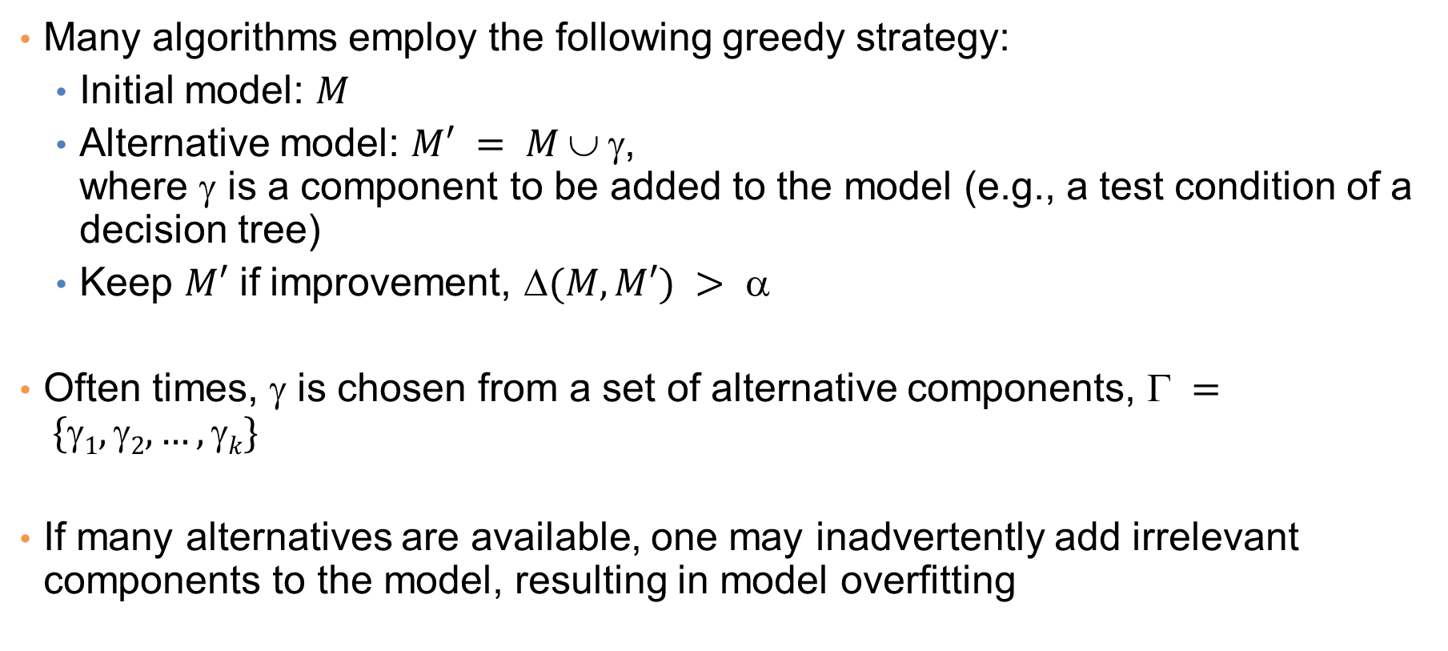
Effect of Multiple Comparison Procedure
Many algorithms employ the following greedy strategy:
  Initial model: $M$
  Alternative model: $M′ = M  $,
  where γ is a component to be added to the model (e.g., a test condition of a decision tree)
  Keep $M′$ if improvement, $(M,M′) > $
Often times, γ is chosen from a set of alternative components, $ = \{1, 2, …, k\}$
If many alternatives are available, one may inadvertently add irrelevant components to the model, resulting in model overfitting

Slide 82
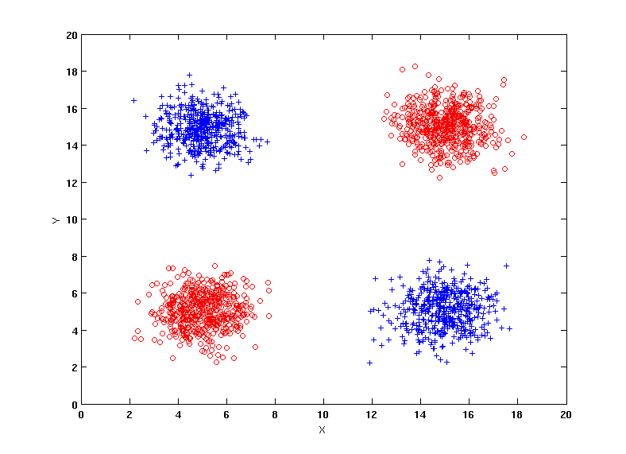
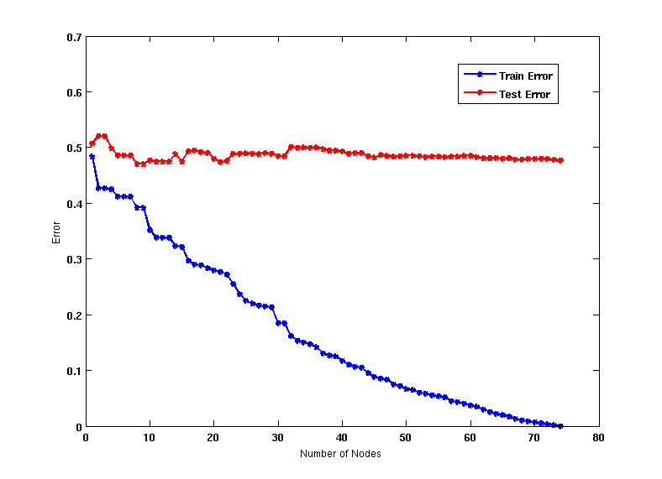
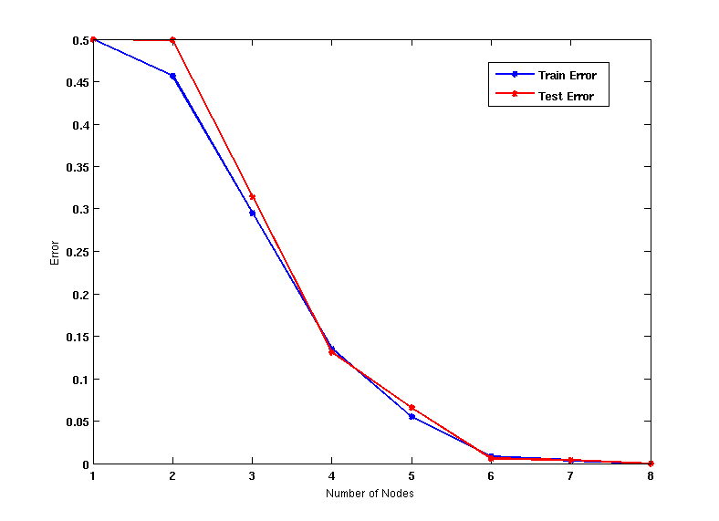
Effect of Multiple Comparison - Example
Use additional 100 noisy variables generated from a uniform distribution along with X and Y as attributes.
Use 30% of the data for training and 70% of the data for testing
Using only X and Y as attributes

Slide 83
Notes on Overfitting
Overfitting results in decision trees that are more complex than necessary
Training error no longer provides a good estimate of test error, that is, how well the tree will perform on previously unseen records
We say that the model does not generalize well
Generalization: The ability of the model to predict data points that it has not already seen.
Need ways for estimating generalization errors

Slide 84
Model Selection
Performed during model building
Purpose is to ensure that model is not overly complex (to avoid overfitting)
Need to estimate generalization error
  Using Validation Set
  Incorporating Model Complexity

Slide 85
Model Selection: Using Validation Set
Divide training data into two parts:
  Training set:
    Use for model building
  Validation set:
    Use for estimating generalization error
    Note: validation set is not the same as test set since it affects the creation of the model (e.g. in tuning a parameter)
Drawback:
  Less data available for training

Slide 86
Occam’s Razor
Occam’s razor: All other things being equal, the simplest explanation/solution is the best.
  A good principle for life as well
Given two models of similar generalization errors, one should prefer the simpler model over the more complex model
For complex models, there is a greater chance that it was fitted accidentally by errors in data
Therefore, one should include model complexity when evaluating a model

Slide 87
Minimum Description Length (MDL)
Cost(Model,Data) = Cost(Model) + Cost(Data|Model)
  Search for the least costly model.
Cost(Model) encodes the decision tree
  node encoding (number of children) plus splitting condition encoding.
Cost(Data|Model) encodes the misclassification errors.

Slide 88
Example
Regression: find a polynomial for describing a set of values
  Model complexity (model cost): polynomial coefficients
  Goodness of fit (data cost): difference between real value and the polynomial value
Minimum model cost
High data cost
High model cost
Minimum data cost
Low model cost
Low data cost
MDL avoids overfitting automatically!
Source: Grunwald et al. (2005) Tutorial on MDL.

Slide 89
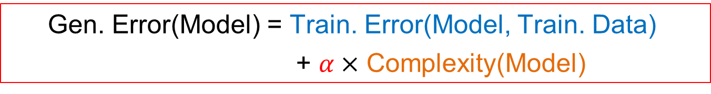
Model Selection: Incorporating Model Complexity
Occam’s razor: All other things being equal, the simplest explanation/solution is the best.
  A good principle for life as well
Given two models of similar generalization errors, one should prefer the simpler model over the more complex model
For complex models, there is a greater chance that it was fitted accidentally
Therefore, one should include model complexity when evaluating a model
  Gen. Error(Model) = Train. Error(Model, Train. Data)
  + $α×$ Complexity(Model)

Slide 90

Estimating the Complexity of Decision Trees
Resubstitution Estimate:
  Using training error as an optimistic estimate of generalization error
  Referred to as optimistic error estimate
$$e(TL) = 4/24$$
$$e(TR) = 6/24$$

Slide 91
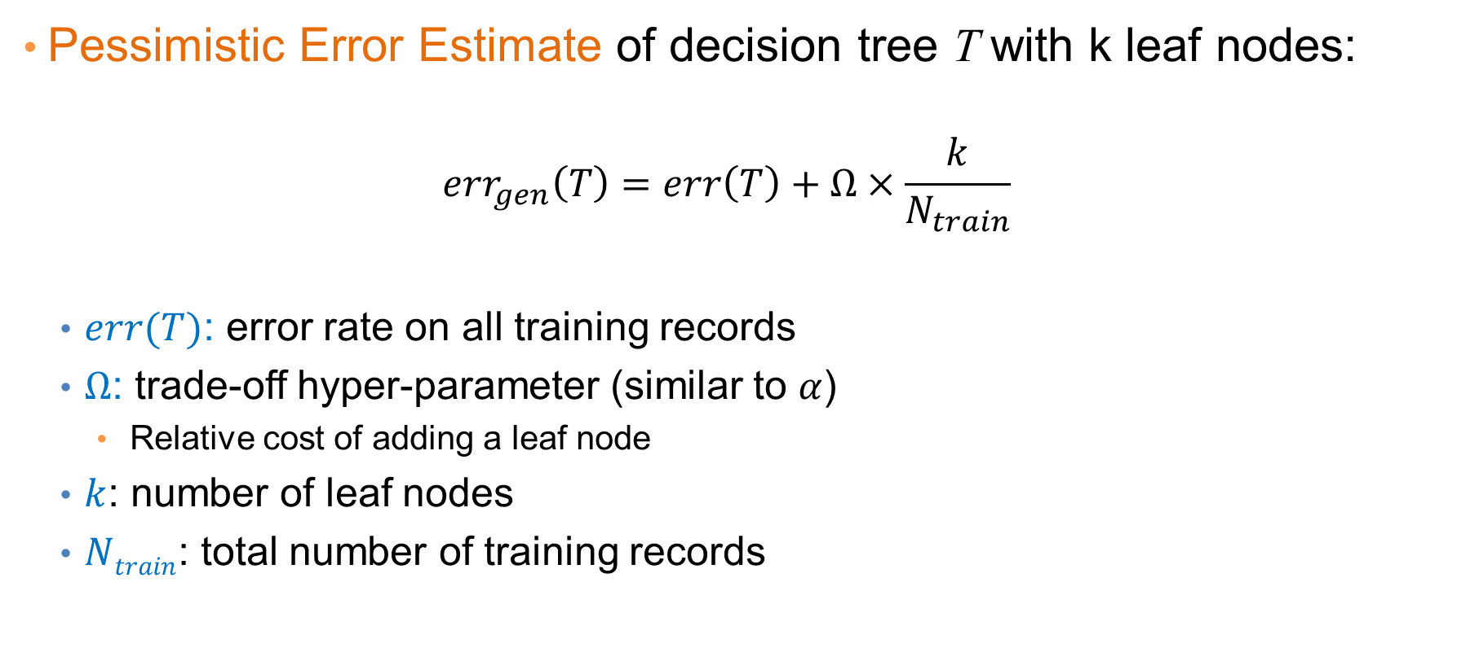
Estimating the Complexity of Decision Trees
Pessimistic Error Estimate of decision tree T with k leaf nodes:
  $$err_{gen}\left(T\right)=err\left(T\right)+Ω×\frac{k}{N_{train}}$$
  $err(T)$: error rate on all training records
  $Ω$: trade-off hyper-parameter (similar to $α$)
    Relative cost of adding a leaf node
  $k$: number of leaf nodes
  $Ntrain$: total number of training records

Slide 92
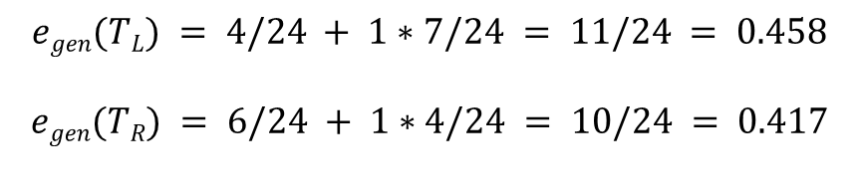
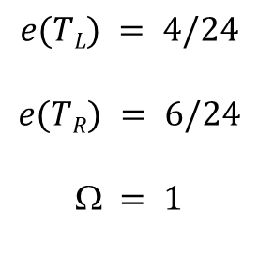
Estimating the Complexity of Decision Trees: Example
$$e(TL) = 4/24$$
$$e(TR) = 6/24$$
$$ = 1$$
$$egen(TL) = 4/24 + 1∗7/24 = 11/24 = 0.458$$
$$egen(TR) = 6/24 + 1∗4/24 = 10/24 = 0.417$$

Slide 93
Minimum Description Length (MDL)
Cost(Model,Data) = Cost(Model) + Cost(Data|Model)
  Cost is the number of bits needed for encoding.
  Search for the least costly model.
Cost(Model) encodes the decision tree
  node encoding (number of children) plus splitting condition encoding.
Cost(Data|Model) encodes the misclassification errors.

Slide 94
Example
Regression: find a polynomial for describing a set of values
  Model complexity (model cost): polynomial coefficients
  Goodness of fit (data cost): difference between real value and the polynomial value
Minimum model cost
High data cost
High model cost
Minimum data cost
Low model cost
Low data cost
MDL avoids overfitting automatically!
Source: Grunwald et al. (2005) Tutorial on MDL.

Slide 95
Model selection for Decision Trees
Pre-Pruning (Early Stopping Rule)
  Stop the algorithm before it becomes a fully-grown tree
  Typical stopping conditions for a node:
    Stop if all instances belong to the same class
    Stop if all the attribute values are the same
  More restrictive conditions:
    Stop if number of instances is less than some user-specified threshold
    Stop if class distribution of instance classes are independent of the available features (e.g., using χ ² test)
    Stop if expanding the current node does not improve impurity measures (e.g., Gini or information gain).

Slide 96
Model selection for Decision Trees
Post-pruning
  Grow decision tree to its entirety
  Trim the nodes of the decision tree in a bottom-up fashion
  If generalization error improves after trimming, replace sub-tree by a leaf node (subtree pruning) or by the most probable subtree (subtree raising).
  Class label of leaf node is determined from majority class of instances in the sub-tree
  Can use MDL for post-pruning
    NP hard problem

Slide 97
Example of Post-Pruning
Optimistic (Training) Error (Before splitting) = 10/30
Pessimistic Error = (10 + 0.5)/30 = 10.5/30
Optimistic (Training) Error (After splitting) = 9/30
Pessimistic Error (After splitting) = (9 + 4 × 0.5)/30 = 11/30
PRUNE!
Class = Yes | 20
Class = No | 10
Error = 10/30
Class = Yes | 8
Class = No | 4
Class = Yes | 3
Class = No | 4
Class = Yes | 4
Class = No | 1
Class = Yes | 5
Class = No | 1

Slide 98
Examples of Post-pruning

Slide 99
MODEL EVALUATION

Slide 100
Model Evaluation
Metrics for Performance Evaluation
  How to evaluate the performance of a model?
Methods for Performance Evaluation
  How to obtain reliable estimates?
Methods for Model Comparison
  How to compare the relative performance among competing models?

Slide 101
Metrics for Performance Evaluation
Focus on the predictive capability of a model
  Rather than how fast it takes to classify or build models, scalability, etc.
Confusion Matrix:
 | PREDICTED CLASS
ACTUAL CLASS |  | Class=Yes | Class=No
 | Class=Yes | a | b
 | Class=No | c | d
a: TP (true positive)
b: FN (false negative)
c: FP (false positive)
d: TN (true negative)

Slide 102
Metrics for Performance Evaluation…
 | PREDICTED CLASS
ACTUAL CLASS |  | Class=Yes | Class=No
 | Class=Yes | a (TP) | b (FN)
 | Class=No | c (FP) | d (TN)
Most widely-used metric:

Slide 103
Precision-Recall
Count | PREDICTED CLASS
ACTUAL CLASS |  | Class=Yes | Class=No
 | Class=Yes | a | b
 | Class=No | c | d
Assumption: The class YES is the one we care about.
Precision is biased towards C(Yes|Yes) & C(Yes|No)
Recall is biased towards C(Yes|Yes) & C(No|Yes)
F-measure is biased towards all except C(No|No)

Slide 104
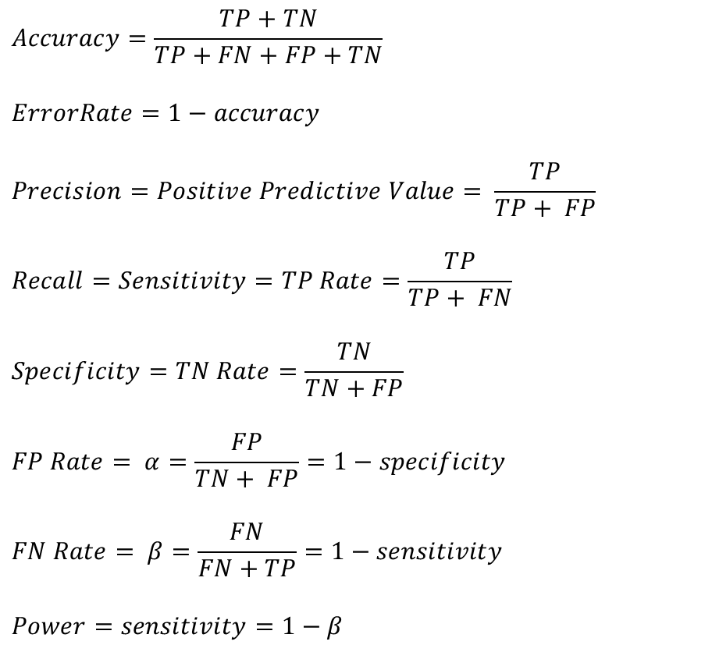
More Measures of Classification Performance
 | PREDICTED CLASS
ACTUAL CLASS |  | Yes | No
 | Yes | TP | FN
 | No | FP | TN
α is the probability that we reject the null hypothesis when it is true.
This is a Type I error or a false positive (FP).
β is the probability that we accept the null hypothesis when it is false.
This is a Type II error or a false negative (FN).

Slide 105
ROC (Receiver Operating Characteristic)
Developed in 1950s for signal detection theory to analyze noisy signals
  Characterize the trade-off between positive hits and false alarms
ROC curve plots TPR (true positive rate) (on the y-axis) against FPR (false positive rate) (on the x-axis)
Look at the positive predictions of the classifier and compute:
 | PREDICTED CLASS
Actual |  | Yes | No
 | Yes | a (TP) | b (FN)
 | No | c (FP) | d (TN)
What fraction of true positive instances are predicted correctly? (1-Type II error rate)
What fraction of true negative instances were predicted incorrectly? (Type I error rate)
We want to strike a balance between these two
Notes:
TPR = sensitivity
FPR = 1- selectivity

Slide 106
ROC (Receiver Operating Characteristic)
Performance of a classifier represented as a point on the ROC curve
Changing some parameter of the algorithm, sample distribution, or cost matrix changes the location of the point

Slide 107
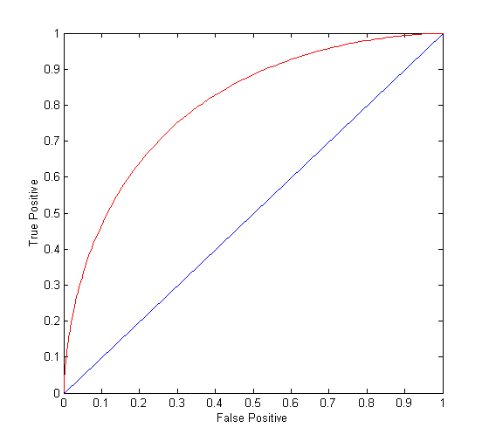
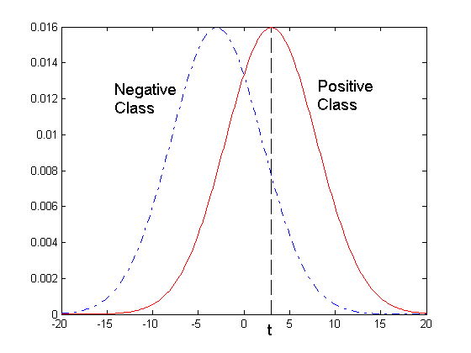
ROC Curve
- 1-dimensional data set containing 2 classes (positive and negative)
- any points located at x > t is classified as positive
At threshold t:
TP=0.5, FN=0.5, FP=0.12, FN=0.88

Slide 108
ROC Curve
(TP,FP):
(0,0): declare everything
to be negative class
(1,1): declare everything
to be positive class
(1,0): ideal
Diagonal line:
  Random guessing
  Below diagonal line:
    prediction is opposite of the true class
 | PREDICTED CLASS
Actual |  | Yes | No
 | Yes | a (TP) | b (FN)
 | No | c (FP) | d (TN)
Notes:
Random guessing = Each record is classified to positive class with probability p

Slide 109
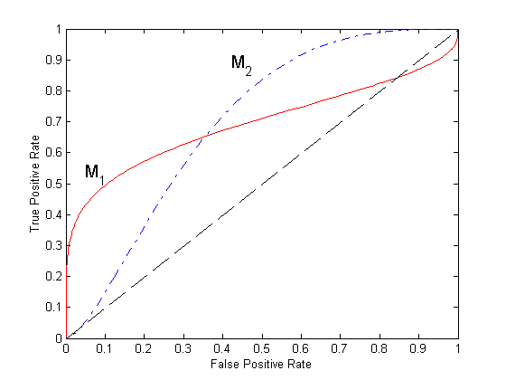
Using ROC for Model Comparison
No model consistently outperform the other
  M₁ is better for small FPR
  M₂ is better for large FPR
Area Under the ROC curve (AUC)
  Ideal: Area = 1
  Random guess:
    Area = 0.5

Slide 110
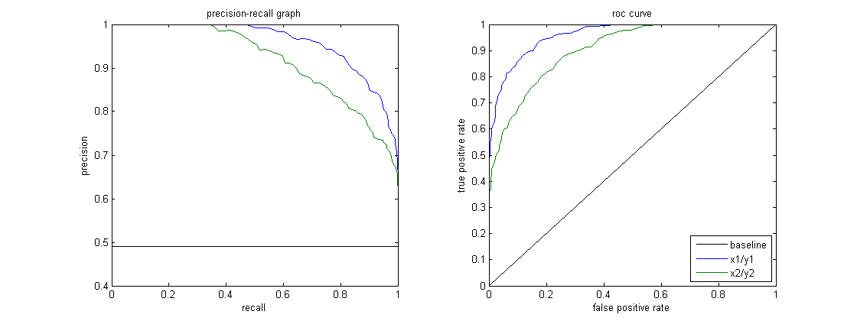
Precision-Recall plot
Usually for parameterized models, it controls the precision/recall tradeoff

Slide 111
ROC curve vs Precision-Recall curve
Area Under the Curve (AUC) as a single number for evaluation

Slide 112
Methods of Performance Estimation
Holdout
  Reserve 2/3 for training and 1/3 for testing
Random subsampling
  One sample may be biased -- Repeated holdout
Cross validation
  Partition data into k disjoint subsets
  k-fold: train on k-1 partitions, test on the remaining one
  Leave-one-out: k=n
  Guarantees that each record is used the same number of times for training and testing
Bootstrap
  Sampling with replacement
  ~63% of records used for training, ~27% for testing

Slide 113
Class imbalance
Consider a 2-class problem
  Number of Class 0 examples = 9990
  Number of Class 1 examples = 10
If model predicts everything to be class 0, accuracy is 9990/10000 = 99.9 %
  Accuracy is misleading because model does not detect any class 1 example
  Precision and recall are better measures

Slide 114
Dealing with class Imbalance
Class imbalance is a problem in training:
  If the class we are interested in is very rare, then the classifier will ignore it.
Solution
  We can balance the class distribution
    Sample from the larger class so that the size of the two classes is the same
    Replicate the data of the class of interest so that the classes are balanced
      Over-fitting issues
  We can modify the optimization criterion by using a cost sensitive metric

Slide 115
Cost Matrix
 | PREDICTED CLASS
ACTUAL CLASS | C(i|j) | Class=Yes | Class=No
 | Class=Yes | C(Yes|Yes) | C(No|Yes)
 | Class=No | C(Yes|No) | C(No|No)
C(i|j): Cost of classifying class j example as class i

Slide 116
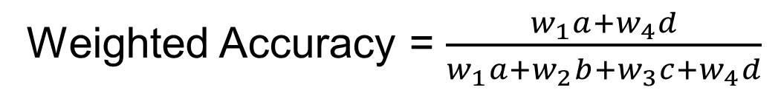
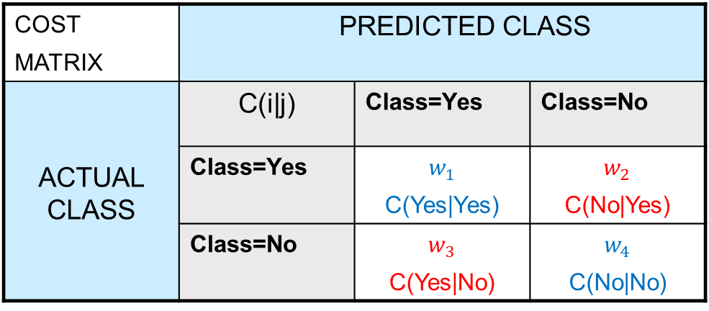
Weighted
Accuracy
CONFUSION MATRIX | PREDICTED CLASS
ACTUAL CLASS |  | Class=Yes | Class=No
 | Class=Yes | a (TP) | b (FN)
 | Class=No | c (FP) | d (TN)
COST MATRIX | PREDICTED CLASS
ACTUAL CLASS | C(i|j) | Class=Yes | Class=No
 | Class=Yes | $$w_{1}$$ C(Yes|Yes) | $$w_{2}$$ C(No|Yes)
 | Class=No | $$w_{3}$$ C(Yes|No) | $$w_{4}$$ C(No|No)
Weighted Accuracy = $\frac{w_{1}a+w_{4}d}{w_{1}a+w_{2}b+w_{3}c+w_{4}d}$

Slide 117
Computing Cost of Classification
Cost Matrix | PREDICTED CLASS
ACTUAL CLASS | C(i|j) | + | -
 | + | 1 | 100
 | - | 1 | 1
Model M₁ | PREDICTED CLASS
ACTUAL CLASS |  | + | -
 | + | 150 | 40
 | - | 60 | 250
Model M₂ | PREDICTED CLASS
ACTUAL CLASS |  | + | -
 | + | 250 | 45
 | - | 5 | 200
Accuracy = 80%
Weighted Accuracy = 8.9%
Accuracy = 90%
Weighted Accuracy= 9%

Slide 118
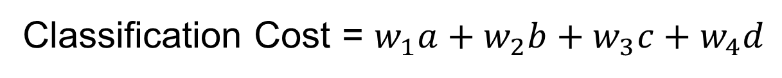
Classification
Cost
CONFUSION MATRIX | PREDICTED CLASS
ACTUAL CLASS |  | Class=Yes | Class=No
 | Class=Yes | a (TP) | b (FN)
 | Class=No | c (FP) | d (TN)
COST MATRIX | PREDICTED CLASS
ACTUAL CLASS | C(i|j) | Class=Yes | Class=No
 | Class=Yes | $$w_{1}$$ C(Yes|Yes) | $$w_{2}$$ C(No|Yes)
 | Class=No | $$w_{3}$$ C(Yes|No) | $$w_{4}$$ C(No|No)
Classification Cost = $w_{1}a+w_{2}b+w_{3}c+w_{4}d$
Some weights can also be negative

Slide 119
Computing Cost of Classification
Cost Matrix | PREDICTED CLASS
ACTUAL CLASS | C(i|j) | + | -
 | + | -1 | 100
 | - | 1 | 0
Model M₁ | PREDICTED CLASS
ACTUAL CLASS |  | + | -
 | + | 150 | 40
 | - | 60 | 250
Model M₂ | PREDICTED CLASS
ACTUAL CLASS |  | + | -
 | + | 250 | 45
 | - | 5 | 200
Accuracy = 80%
Cost = 3910
Accuracy = 90%
Cost = 4255

Slide 120
Cost vs Accuracy
Count | PREDICTED CLASS
ACTUAL CLASS |  | Class=Yes | Class=No
 | Class=Yes | a | b
 | Class=No | c | d
Accuracy is proportional to cost if
1. C(Yes|No)=C(No|Yes) = q
2. C(Yes|Yes)=C(No|No) = p
N = a + b + c + d
Accuracy = (a + d)/N
Cost = p (a + d) + q (b + c)
= p (a + d) + q (N – a – d)
= q N – (q – p)(a + d)
= N [q – (q-p) × Accuracy]
Cost | PREDICTED CLASS
ACTUAL CLASS |  | Class=Yes | Class=No
 | Class=Yes | p | q
 | Class=No | q | p

