Slide 1
DATA MINING
The Data Mining Pipeline
What is data?
The data mining pipeline: collection, preprocessing, mining, and post-processing
Sampling, feature extraction and normalization
Exploratory analysis of data – basic statistics

Slide 2
What is data mining again?
“Data Mining is the study of collecting, processing, analyzing, and gaining useful insights from data” – Charu Aggarwal
Essentially, anything that has to do with data is data mining
Data
Value
Data Mining

Slide 3
What is Data Mining?
Data mining is the use of efficient techniques for the analysis of very large collections of data and the extraction of useful and possibly unexpected patterns in data.
“Data mining is the analysis of (often large) observational data sets to find unsuspected relationships and to summarize the data in novel ways that are both understandable and useful to the data analyst” (Hand, Mannila, Smyth)
“Data mining is the discovery of models for data” (Rajaraman, Ullman)
  We can have the following types of models
    Models that explain the data (e.g., a single function)
    Models that predict the future data instances.
    Models that summarize the data
    Models the extract the most prominent features of the data.

Slide 4
Why do we need data mining?
Really huge amounts of complex data generated from multiple sources and interconnected in different ways
  Scientific data from different disciplines
    Weather, astronomy, physics, biological microarrays, genomics
  Huge text collections
    The Web, scientific articles, news, tweets, facebook postings.
  Transaction data
    Retail store records, credit card records
  Behavioral data
    Mobile phone data, query logs, browsing behavior, ad clicks
  Networked data
    The Web, Social Networks, IM networks, email network, biological networks.
  All these types of data can be combined in many ways
    Facebook has a network, text, images, user behavior, ad transactions.
We need to analyze this data to extract knowledge
  Knowledge can be used for commercial or scientific purposes.
  Our solutions should scale to the size of the data
“Data is the new oil” – Clive Humby
  Data Science: Use data to improve any process.

Slide 5
What is Data?
Attributes
Collection of data objects and their attributes
An attribute is a property or characteristic of an object
  Examples: name, date of birth, height, occupation.
  Attribute is also known as variable, field, characteristic, or feature
For each object the attributes take some values.
The collection of attribute-value pairs describes a specific object
  Object is also known as record, point, case, sample, entity, or instance
Objects
Size (n): Number of objects
Dimensionality (d): Number of attributes
Sparsity: Number of populated
object-attribute pairs

Slide 6
Relational data
Example of a relational table
The term comes from DataBases, where we assume data is stored in a relational table with a fixed schema (fixed set of attributes)
  In Databases, it is usually assumed that the table is dense (few null values)
There are a lot of data in this form
  E.g., census data
There are also a lot of data which do not fit well in this form
  Sparse data: Many missing values
  Not easy to define a fixed schema
Attributes = Table columns
Objects = Table rows

Slide 7
Types of Attributes
There are different types of attributes
  Numeric
    Examples: dates, temperature, time, length, value, count.
    Discrete (counts) vs Continuous (temperature)
    Special case: Binary/Boolean attributes (yes/no, exists/not exists)
  Categorical
    Examples: eye color, zip codes, strings, rankings (e.g, good, fair, bad), height in {tall, medium, short}
    Nominal (no order or comparison) vs Ordinal (order but not comparable)

Slide 8
Numeric Relational Data
If data objects have the same fixed set of numeric attributes, then the data objects can be thought of as points/vectors in a multi-dimensional space, where each dimension represents a distinct attribute
Such data set can be represented by an n-by-d data matrix, where there are n rows, one for each object, and d columns, one for each attribute
30 | 0.8 | 90
32 | 0.5 | 80
24 | 0.3 | 95
 | Temperature | Humidity | Pressure
O1 | 30 | 0.8 | 90
O2 | 32 | 0.5 | 80
O3 | 24 | 0.3 | 95

Slide 9
Numeric data
Thinking of numeric data as points or vectors is very convenient
  For small dimensions we can plot the data
  We can use geometric analogues to define concepts like distance or similarity
  We can use linear algebra to process the data matrix
  We will often talk about points or vectors

Slide 10
Categorical Relational Data
Data that consists of a collection of records, each of which consists of a fixed set of categorical attributes
ID Number | Zip Code | Marital Status | Income Bracket
1129842 | 45221 | Single | High
2342345 | 45223 | Married | Low
1234542 | 45221 | Divorced | High
1243535 | 45224 | Single | Medium

Slide 11
Mixed Relational Data
Data that consists of a collection of records, each of which consists of a fixed set of both numeric and categorical attributes
ID Number | Zip Code | Age | Marital Status | Income | Income Bracket
1129842 | 45221 | 55 | Single | 250000 | High
2342345 | 45223 | 25 | Married | 30000 | Low
1234542 | 45221 | 45 | Divorced | 200000 | High
1243535 | 45224 | 43 | Single | 150000 | Medium

Slide 12
Mixed Relational Data
Data that consists of a collection of records, each of which consists of a fixed set of both numeric and categorical attributes
ID Number | Zip Code | Age | Marital Status | Income | Income Bracket | Refund
1129842 | 45221 | 55 | Single | 250000 | High | No
2342345 | 45223 | 25 | Married | 30000 | Low | Yes
1234542 | 45221 | 45 | Divorced | 200000 | High | No
1243535 | 45224 | 43 | Single | 150000 | Medium | No

Slide 13
Mixed Relational Data
Data that consists of a collection of records, each of which consists of a fixed set of both numeric and categorical attributes
Takes numerical values but it is actually categorical
ID Number | Zip Code | Age | Marital Status | Income | Income Bracket | Refund
1129842 | 45221 | 55 | Single | 250000 | High | 0
2342345 | 45223 | 25 | Married | 30000 | Low | 1
1234542 | 45221 | 45 | Divorced | 200000 | High | 0
1243535 | 45224 | 43 | Single | 150000 | Medium | 0
Boolean attributes can be thought as both numeric and categorical
When appearing together with other attributes they make more sense as categorical
They are often represented as numeric though

Slide 14
Mixed Relational Data
Some times it is convenient to represent categorical attributes as boolean.
  Add a Boolean attribute for each possible value of the attribute
ID | Zip 45221 | Zip 45223 | Zip 45224 | Age | Single | Married | Divorced | Income | Refund
1129842 | 1 | 0 | 0 | 55 | 0 | 0 | 0 | 250000 | 0
2342345 | 0 | 1 | 0 | 25 | 0 | 1 | 0 | 30000 | 1
1234542 | 1 | 0 | 0 | 45 | 0 | 0 | 1 | 200000 | 0
1243535 | 0 | 0 | 1 | 43 | 0 | 0 | 0 | 150000 | 0
We can now view the whole vector as numeric

Slide 15
Mixed Relational Data
Some times it is convenient to represent numerical attributes as categorical.
  Group the values of the numerical attributes into bins
ID Number | Zip Code | Age | Marital Status | Income | Income Bracket | Refund
1129842 | 45221 | 50s | Single | High | High | 0
2342345 | 45223 | 20s | Married | Low | Low | 1
1234542 | 45221 | 40s | Divorced | High | High | 0
1243535 | 45224 | 40s | Single | Medium | Medium | 0

Slide 16
Binning
Idea: split the range of the domain of the numerical attribute into bins (intervals).
Every bucket defines a categorical value
How do we decide the number of bins?
  Depends on the granularity of the data that we want
Low
Medium
High
50,000
200,000

Slide 17
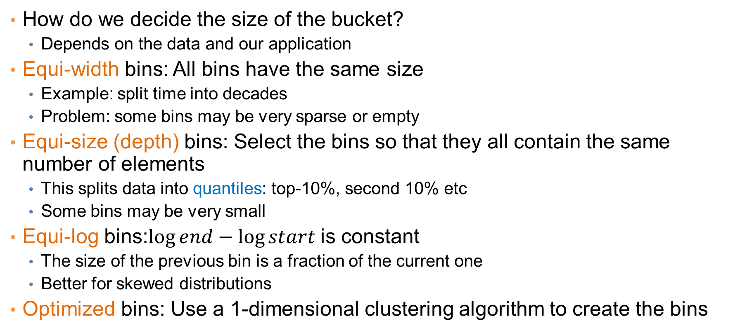
Bucketization
How do we decide the size of the bucket?
  Depends on the data and our application
Equi-width bins: All bins have the same size
  Example: split time into decades
  Problem: some bins may be very sparse or empty
Equi-size (depth) bins: Select the bins so that they all contain the same number of elements
  This splits data into quantiles: top-10%, second 10% etc
  Some bins may be very small
Equi-log bins:$\log{end}−\log{start}$ is constant
  The size of the previous bin is a fraction of the current one
  Better for skewed distributions
Optimized bins: Use a 1-dimensional clustering algorithm to create the bins

Slide 18
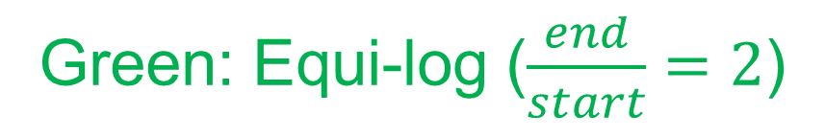
Example
Blue: Equi-width [20,40,60,80]
Red: Equi-depth (2 points per bin)
Green: Equi-log ($\frac{end}{start}=2$)

Slide 19
Physical data storage
Stored in a Relational Database
  Assumes a strict schema and relatively dense data (few missing/Null values)
Tab or Comma separated files (TSV/CSV), Excel sheets, relational tables
  Assumes a strict schema and relatively dense data (few missing/Null values)
Flat file with triplets (record id, attribute, attribute value)
  A very flexible data format, allows multiple values for the same attribute (e.g., phone number)
JSON, XML format
  Standards for data description that are more flexible than relational tables
  There exist parsers for reading such data.

Slide 20
Examples
Comma Separated File
Triple-store
Can be processed with simple parsers, or loaded to excel or a database
Easy to deal with missing values
id,Name,Surname,Age,Zip
1,John,Smith,25,10021
2,Mary,Jones,50,96107
3,Joe ,Doe,80,80235
1, Name, John
1, Surname, Smith
1, Age, 25
1, Zip, 10021
2, Name, Mary
2, Surname, Jones
2, Age, 50
2, Zip, 96107
3, Name, Joe
3, Surname, Doe
3, Age, 80
3, Zip, 80235

Slide 21
Examples
XML EXAMPLE – Record of a person
<person>
<firstName>John</firstName>
<lastName>Smith</lastName>
<age>25</age>
<address>
<streetAddress>21 2nd Street</streetAddress>
<city>New York</city>
<state>NY</state>
<postalCode>10021</postalCode>
</address>
<phoneNumbers>
<phoneNumber>
<type>home</type>
<number>212 555-1234</number>
</phoneNumber>
<phoneNumber>
<type>fax</type>
<number>646 555-4567</number>
</phoneNumber>
</phoneNumbers>
<gender>
<type>male</type>
</gender>
</person>
JSON EXAMPLE – Record of a person
{
"firstName": "John",
"lastName": "Smith",
"isAlive": true,
"age": 25,
"address": {
"streetAddress": "21 2nd Street",
"city": "New York",
"state": "NY",
"postalCode": "10021-3100"
},
"phoneNumbers": [
{
"type": "home",
"number": "212 555-1234"
},
{
"type": "office",
"number": "646 555-4567"
}
],
"children": [],
"spouse": null
}

Slide 22
Beyond relational data: Set data
Each record is a set of items from a space of possible items
Example: Transaction data
  Also called market-basket data
TID | Items
1 | Bread, Coke, Milk
2 | Beer, Bread
3 | Beer, Coke, Diaper, Milk
4 | Beer, Bread, Diaper, Milk
5 | Coke, Diaper, Milk

Slide 23
Set data
Each record is a set of items from a space of possible items
Example: Document data
  Also called bag-of-words representation
Doc Id | Words
1 | the, dog, followed, the, cat
2 | the, cat, chased, the, cat
3 | the, man, walked, the, dog

Slide 24
Vector representation of market-basket data
Market-basket data can be represented, or thought of, as numeric vector data
  The vector is defined over the set of all possible items
  The values are binary (the item appears or not in the set)
TID | Bread | Coke | Milk | Beer | Diaper
1 | 1 | 1 | 1 | 0 | 0
2 | 1 | 0 | 0 | 1 | 0
3 | 0 | 1 | 1 | 1 | 1
4 | 1 | 0 | 1 | 1 | 1
5 | 0 | 1 | 1 | 0 | 1
TID | Items
1 | Bread, Coke, Milk
2 | Beer, Bread
3 | Beer, Coke, Diaper, Milk
4 | Beer, Bread, Diaper, Milk
5 | Coke, Diaper, Milk
Sparsity: Most entries are zero. Most baskets contain few items

Slide 25
Vector representation of document data
Document data can be represented, or thought of, as numeric vector data
  The vector is defined over the set of all possible words
  The values are the counts (number of times a word appears in the document)
Doc Id | the | dog | follows | cat | chases | man | walks
1 | 2 | 1 | 1 | 1 | 0 | 0 | 0
2 | 2 | 0 | 0 | 2 | 1 | 0 | 0
3 | 1 | 1 | 0 | 0 | 0 | 1 | 1
Doc Id | Words
1 | the, dog, follows, the, cat
2 | the, cat, chases, the, cat
3 | the, man, walks, the, dog
Sparsity: Most entries are zero. Most documents contain few of the words

Slide 26
Physical data storage
Usually set data is stored in flat files
  One line per set
0 1 2 3 4 5 6 7 8 9 10 11 12 13 14 15 16 17 18 19 20 21 22 23 24 25 26 27 28 29
30 31 32
33 34 35
36 37 38 39 40 41 42 43 44 45 46
38 39 47 48
38 39 48 49 50 51 52 53 54 55 56 57 58
32 41 59 60 61 62
3 39 48
I heard so many good things about this place so I was pretty juiced to try it. I'm from Cali and I heard Shake Shack is comparable to IN-N-OUT and I gotta say, Shake Shake wins hands down. Surprisingly, the line was short and we waited about 10 MIN. to order. I ordered a regular cheeseburger, fries and a black/white shake. So yummerz. I love the location too! It's in the middle of the city and the view is breathtaking. Definitely one of my favorite places to eat in NYC.
I'm from California and I must say, Shake Shack is better than IN-N-OUT, all day, err'day.

Slide 27
Dependent data
In tables we usually consider each object independent of each other.
In some cases, there are explicit dependencies between the data
  Ordered/Temporal data: We know the time order of the data
  Spatial data: Data that is placed on specific locations
  Spatiotemporal data: data with location and time
  Networked/Graph data: data with pairwise relationships between entities

Slide 28
Ordered Data
Genomic sequence data
Data is a long ordered string

Slide 29
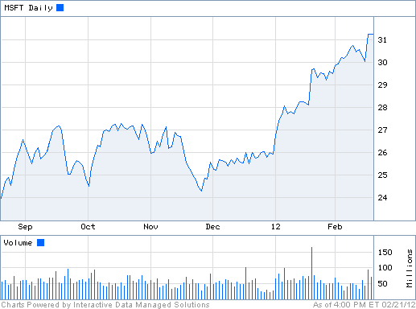
Ordered Data
Time series
  Sequence of ordered (over “time”) numeric values.

Slide 30
Ordered Data
Sequence data: Similar to the time series but in this case we have categorical values rather than numerical ones.
Example: Event logs
fcrawler.looksmart.com - - [26/Apr/2000:00:00:12 -0400] "GET /contacts.html HTTP/1.0" 200 4595 "-" "FAST-WebCrawler/2.1-pre2 (ashen@looksmart.net)"
fcrawler.looksmart.com - - [26/Apr/2000:00:17:19 -0400] "GET /news/news.html HTTP/1.0" 200 16716 "-" "FAST-WebCrawler/2.1-pre2 (ashen@looksmart.net)"
ppp931.on.bellglobal.com - - [26/Apr/2000:00:16:12 -0400] "GET /download/windows/asctab31.zip HTTP/1.0" 200 1540096 "http://www.htmlgoodies.com/downloads/freeware/webdevelopment/15.html" "Mozilla/4.7 [en]C-SYMPA (Win95; U)"
123.123.123.123 - - [26/Apr/2000:00:23:48 -0400] "GET /pics/wpaper.gif HTTP/1.0" 200 6248 "http://www.jafsoft.com/asctortf/" "Mozilla/4.05 (Macintosh; I; PPC)"
123.123.123.123 - - [26/Apr/2000:00:23:47 -0400] "GET /asctortf/ HTTP/1.0" 200 8130 "http://search.netscape.com/Computers/Data_Formats/Document/Text/RTF" "Mozilla/4.05 (Macintosh; I; PPC)"
123.123.123.123 - - [26/Apr/2000:00:23:48 -0400] "GET /pics/5star2000.gif HTTP/1.0" 200 4005 "http://www.jafsoft.com/asctortf/" "Mozilla/4.05 (Macintosh; I; PPC)"
123.123.123.123 - - [26/Apr/2000:00:23:50 -0400] "GET /pics/5star.gif HTTP/1.0" 200 1031 "http://www.jafsoft.com/asctortf/" "Mozilla/4.05 (Macintosh; I; PPC)"
123.123.123.123 - - [26/Apr/2000:00:23:51 -0400] "GET /pics/a2hlogo.jpg HTTP/1.0" 200 4282 "http://www.jafsoft.com/asctortf/" "Mozilla/4.05 (Macintosh; I; PPC)"
123.123.123.123 - - [26/Apr/2000:00:23:51 -0400] "GET /cgi-bin/newcount?jafsof3&width=4&font=digital&noshow HTTP/1.0" 200 36 "http://www.jafsoft.com/asctortf/" "Mozilla/4.05 (Macintosh; I; PPC)"

Slide 31
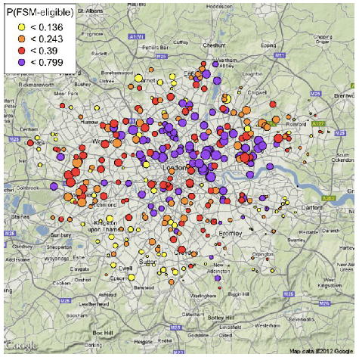
Spatial data
Attribute values that can be arranged with geographic co-ordinates
  Measurements of temperature/pressure in different locations.
  Sales numbers in different stores
  The majority party in the country states (categorical)
Such data can be nicely visualized.

Slide 32
Spatiotemporal data
Data that have both spatial and temporal aspects
  Measurements in different locations over time
    Pressure, Temperature, Humidity
  Measurements that move in space over time
    Traffic, Trajectories of moving objects

Slide 33
Graph Data
Graph data: a collection of entities and their pairwise relationships.
Examples:
  Web pages and hyperlinks
  Facebook users and friendships
  The connections between brain neurons
  Genes that regulate each oterh
2
1
In this case the data consists of pairs:
Who links to whom
3
We may have directed links
5
4

Slide 34
Graph Data
Graph data: a collection of entities and their pairwise relationships.
Examples:
  Web pages and hyperlinks
  Facebook users and friendships
  The connections between brain neurons
  Genes that regulate each oterh
2
In this case the data consists of pairs:
Who links to whom
1
3
Or undirected links
5
4

Slide 35
Representation
Adjacency matrix
  Very sparse, very wasteful, but useful conceptually
2
1
3
5
4

Slide 36
Representation
Adjacency list
  Not so easy to maintain
2
1: [2, 3]
2: [1, 3]
3: [1, 2, 4]
4: [3, 5]
5: [4]
1
3
5
4

Slide 37
Representation
List of pairs
  The simplest and most efficient representation
2
(1,2)
(2,3)
(1,3)
(3,4)
(4,5)
1
3
5
4

Slide 38
Types of data: summary
Numeric data: Each object is a point in a multidimensional space
Categorical data: Each object is a vector of categorical values
Set data: Each object is a set of values (with or without counts)
  Sets can also be represented as binary vectors, or vectors of counts
Dependent data:
  Ordered sequences: Each object is an ordered sequence of values.
  Spatial data: objects are fixed on specific geographic locations
  Graph data: A collection of pairwise relationships

Slide 39
The data analysis pipeline
Mining is not the only step in the analysis process
Data Collection
Data Preprocessing
Data Mining
Result
Post-processing
The data mining part is about the analytical methods and algorithms for extracting useful knowledge from the data.

Slide 40
The data analysis pipeline
Data Collection
Data Preprocessing
Data Mining
Result
Post-processing
Today there is an abundance of data online (Twitter, Wikipedia, Web, Open data initiatives, etc)
Collecting the data is a separate task
  Customized crawlers, use of public APIs. Respect of crawling etiquette
Which data should we collect?
  We cannot necessarily collect everything so we need to make some choices before starting.
How should we store them?
In many cases when collecting data we also need to label them
  E.g., how do we identify fraudulent transactions?
  E.g., how do we elicit user preferences?

Slide 41
The data analysis pipeline
Data Collection
Data Preprocessing
Data Mining
Result
Post-processing
Preprocessing: Real data is large, noisy, incomplete and inconsistent.
  Reducing the data: Sampling, Dimensionality Reduction
  Data cleaning: deal with missing or inconsistent information
  Feature extraction and selection: create a useful representation of the data by extracting useful features
The preprocessing step determines the input to the data mining algorithm
    A dirty work, but someone has to do it.
    It is often the most important step for the analysis

Slide 42
The data analysis pipeline
Data Collection
Data Preprocessing
Data Mining
Result
Post-processing
Post-Processing: Make the data actionable and useful to the user
  Statistical analysis of importance of results
  Visualization

Slide 43
The data analysis pipeline
Mining is not the only step in the analysis process
Data Collection
Data Preprocessing
Data Mining
Result
Post-processing
  Pre- and Post-processing are often data mining tasks as well

Slide 44
Data collection
Suppose that you want to collect data from Twitter about the elections in USA
  How do you go about it?
Twitter Streaming/Search API:
  Get a sample of all tweets that are posted on Twitter
  Example of JSON object
REST API:
  Get information about specific users.
There are several decisions that we need to make before we start collecting the data.
  Time and Storage resources
Notes:
Getting everything is too much. We need to narrow it down:
Filter by language, by location, by hashtags
Use API to get only part of the information that we care about.
Find the two candidates and their followers. Get the tweets of these users only.
Get the tweets of the candidates and see who retweets them.

Slide 45
Data Quality
Examples of data quality problems:
  Noise and outliers
  Missing values
  Duplicate data
A mistake or a millionaire?
Missing values
Inconsistent duplicate entries

Slide 46
Sampling
Sampling is the main technique employed for data selection.
  It is often used for both the preliminary investigation of the data and the final data analysis.
Statisticians sample because obtaining the entire set of data of interest is too expensive or time consuming.
  Example: What is the average height of a person in Greece?
    We cannot measure the height of everybody
Sampling is used in data mining because processing the entire set of data of interest is too expensive or time consuming.
  Example: We have 1M documents. What fraction of pairs has at least 100 words in common?
    Computing number of common words for all pairs requires 10¹² comparisons
  Example: What fraction of tweets in a year contain the word “Greece”?
    500M tweets per day, if 100 characters on average, 86.5TB to store all tweets

Slide 47
Sampling …
The key principle for effective sampling is the following:
  using a sample will work almost as well as using the entire data sets, if the sample is representative
  A sample is representative if it has approximately the same property (of interest) as the original set of data
  Otherwise we say that the sample introduces some bias
  What happens if we take a sample from the university campus to compute the average height of a person at Ioannina?

Slide 48
Types of Sampling
Simple Random Sampling
  There is an equal probability of selecting any particular item
Sampling without replacement
  As each item is selected, it is removed from the population
Sampling with replacement
  Objects are not removed from the population as they are selected for the sample.
    In sampling with replacement, the same object can be picked up more than once. This makes analytical computation of probabilities easier
    E.g., we have 100 people, 51 are women P(W) = 0.51, 49 men P(M) = 0.49. If I pick two persons what is the probability P(W,W) that both are women?
      Sampling with replacement: P(W,W) = 0.51²
      Sampling without replacement: P(W,W) = 51/100 * 50/99

Slide 49
Types of Sampling
Stratified sampling
  Split the data into several groups; then draw random samples from each group.
    Ensures that all groups are represented.
  Example 1. I want to understand the differences between legitimate and fraudulent credit card transactions. 0.1% of transactions are fraudulent. What happens if I select 1000 transactions at random?
    I get 1 fraudulent transaction (in expectation). Not enough to draw any conclusions. Solution: sample 1000 legitimate and 1000 fraudulent transactions
  Example 2. I want to answer the question: Do web pages that are linked have on average more words in common than those that are not? I have 1M pages, and 1M links, what happens if I select 10K pairs of pages at random?
    Most likely I will not get any links.
    Solution: sample 10K random pairs, and 10K links
Probability Reminder: If an event has probability p of happening and I do N trials, the expected number of times the event occurs is pN

Slide 50
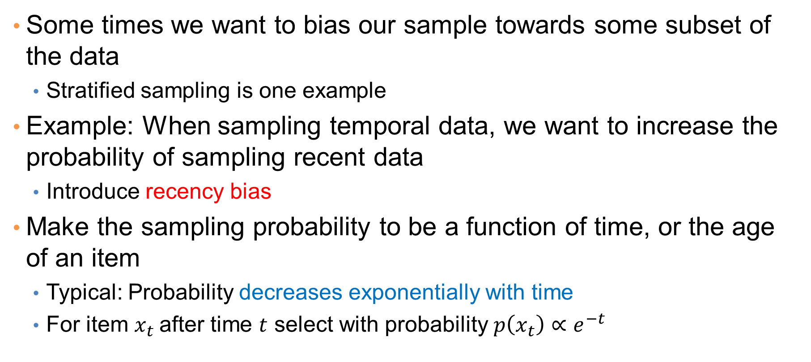
Biased sampling
Some times we want to bias our sample towards some subset of the data
  Stratified sampling is one example
Example: When sampling temporal data, we want to increase the probability of sampling recent data
  Introduce recency bias
Make the sampling probability to be a function of time, or the age of an item
  Typical: Probability decreases exponentially with time
  For item $x_{t}$after time $t$ select with probability $p\left(x_{t}\right)∝e^{−t}$

Slide 51
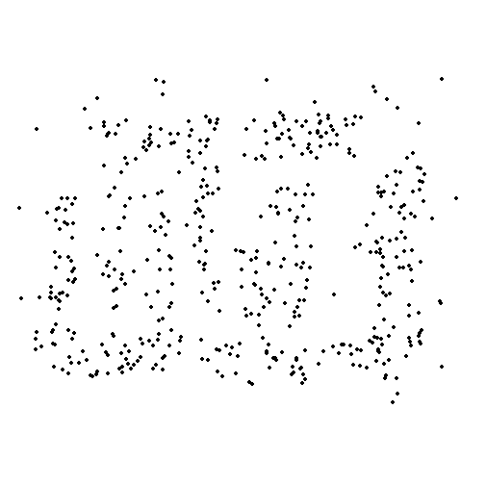

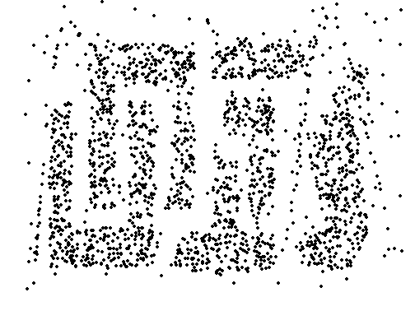
Sample Size
8000 points 2000 Points 500 Points

Slide 52

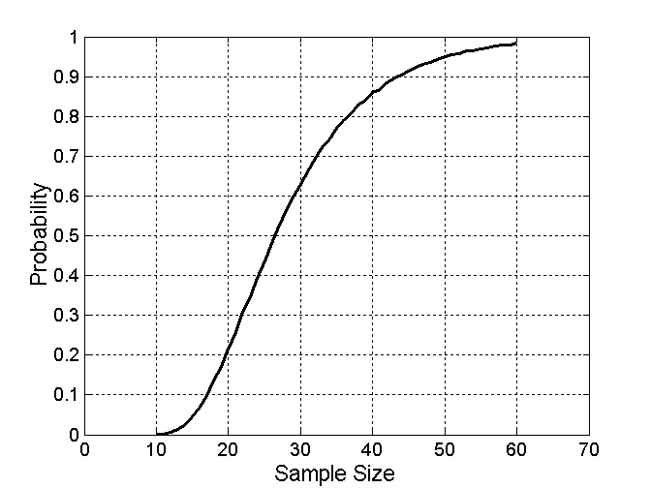
Sample Size
What sample size is necessary to get at least one object from each of 10 groups.

Slide 53
A data mining challenge
You have N items and you want to sample one item uniformly at random. How do you do that?
The items are coming in a stream: you do not know the size of the stream in advance, and there is not enough memory to store the stream in memory. You can only keep a constant amount of items in memory
How do you sample?
  Hint: if the stream ends after reading k items the last item in the stream should have probability 1/k to be selected.
Reservoir Sampling:
  Standard interview question for many companies

Slide 54
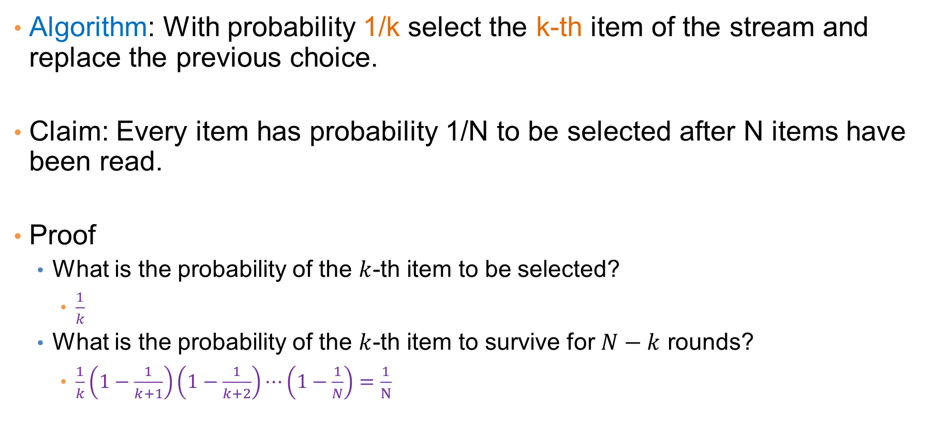
Reservoir sampling
Algorithm: With probability 1/k select the k-th item of the stream and replace the previous choice.
Claim: Every item has probability 1/N to be selected after N items have been read.
Proof
  What is the probability of the $k$-th item to be selected?
    $\frac{1}{k}$
  What is the probability of the $k$-th item to survive for $N−k$ rounds?
    $\frac{1}{k}\left(1−\frac{1}{k+1}\right)\left(1−\frac{1}{k+2}\right)⋯\left(1−\frac{1}{N}\right)=\frac{1}{N}$

Slide 55
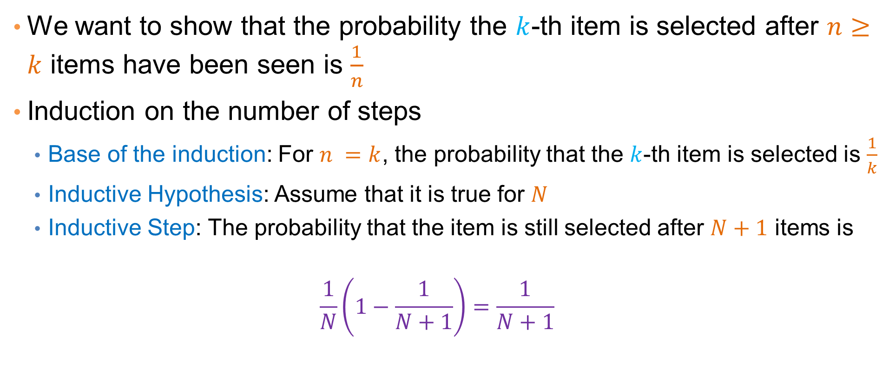
Proof by Induction
We want to show that the probability the $k$-th item is selected after $n≥k$ items have been seen is $\frac{1}{n}$
Induction on the number of steps
  Base of the induction: For $n =k$, the probability that the $k$-th item is selected is $\frac{1}{k}$
  Inductive Hypothesis: Assume that it is true for $N$
  Inductive Step: The probability that the item is still selected after $N+1$ items is
  $$\frac{1}{N}\left(1−\frac{1}{N+1}\right)=\frac{1}{N+1}$$

Slide 56
Data preprocessing: feature extraction
The data we obtain are not necessarily as a relational table
Data may be in a very raw format
  Examples: text, speech, mouse movements, etc
We need to extract the features from the data
Feature extraction:
  Selecting the characteristics by which we want to represent our data
  It requires some domain knowledge about the data
  It depends on the application
Deep learning: eliminates this step.

Slide 57


A data preprocessing example
Suppose we want to mine the comments/reviews of people on Yelp or Foursquare.

Slide 58
Mining Task
Collect all reviews for the top-10 most reviewed restaurants in NY in Yelp
Feature extraction: Find few terms that best describe the restaurants.
{"votes": {"funny": 0, "useful": 2, "cool": 1},
"user_id": "Xqd0DzHaiyRqVH3WRG7hzg",
"review_id": "15SdjuK7DmYqUAj6rjGowg",
"stars": 5, "date": "2007-05-17",
"text": "I heard so many good things about this place so I was pretty juiced to try it. I'm from Cali and I heard Shake Shack is comparable to IN-N-OUT and I gotta say, Shake Shake wins hands down. Surprisingly, the line was short and we waited about 10 MIN. to order. I ordered a regular cheeseburger, fries and a black/white shake. So yummerz. I love the location too! It's in the middle of the city and the view is breathtaking. Definitely one of my favorite places to eat in NYC.",
"type": "review",
"business_id": "vcNAWiLM4dR7D2nwwJ7nCA"}

Slide 59
Example data
I heard so many good things about this place so I was pretty juiced to try it. I'm from Cali and I heard Shake Shack is comparable to IN-N-OUT and I gotta say, Shake Shake wins hands down. Surprisingly, the line was short and we waited about 10 MIN. to order. I ordered a regular cheeseburger, fries and a black/white shake. So yummerz. I love the location too! It's in the middle of the city and the view is breathtaking. Definitely one of my favorite places to eat in NYC.
I'm from California and I must say, Shake Shack is better than IN-N-OUT, all day, err'day.
Would I pay $15+ for a burger here? No. But for the price point they are asking for, this is a definite bang for your buck (though for some, the opportunity cost of waiting in line might outweigh the cost savings) Thankfully, I came in before the lunch swarm descended and I ordered a shake shack (the special burger with the patty + fried cheese &amp; portabella topping) and a coffee milk shake. The beef patty was very juicy and snugly packed within a soft potato roll. On the downside, I could do without the fried portabella-thingy, as the crispy taste conflicted with the juicy, tender burger. How does shake shack compare with in-and-out or 5-guys? I say a very close tie, and I think it comes down to personal affliations. On the shake side, true to its name, the shake was well churned and very thick and luscious. The coffee flavor added a tangy taste and complemented the vanilla shake well. Situated in an open space in NYC, the open air sitting allows you to munch on your burger while watching people zoom by around the city. It's an oddly calming experience, or perhaps it was the food coma I was slowly falling into. Great place with food at a great price.

Slide 60
First cut
Do simple processing to “normalize” the data (remove punctuation, make into lower case, clear white spaces, other?)
Break into words, keep the most popular words
the 27514
and 14508
i 13088
a 12152
to 10672
of 8702
ramen 8518
was 8274
is 6835
it 6802
in 6402
for 6145
but 5254
that 4540
you 4366
with 4181
pork 4115
my 3841
this 3487
wait 3184
not 3016
we 2984
at 2980
on 2922
the 16710
and 9139
a 8583
i 8415
to 7003
in 5363
it 4606
of 4365
is 4340
burger 432
was 4070
for 3441
but 3284
shack 3278
shake 3172
that 3005
you 2985
my 2514
line 2389
this 2242
fries 2240
on 2204
are 2142
with 2095
the 16010
and 9504
i 7966
to 6524
a 6370
it 5169
of 5159
is 4519
sauce 4020
in 3951
this 3519
was 3453
for 3327
you 3220
that 2769
but 2590
food 2497
on 2350
my 2311
cart 2236
chicken 2220
with 2195
rice 2049
so 1825
the 14241
and 8237
a 8182
i 7001
to 6727
of 4874
you 4515
it 4308
is 4016
was 3791
pastrami 3748
in 3508
for 3424
sandwich 2928
that 2728
but 2715
on 2247
this 2099
my 2064
with 2040
not 1655
your 1622
so 1610
have 1585

Slide 61
First cut
Do simple processing to “normalize” the data (remove punctuation, make into lower case, clear white spaces, other?)
Break into words, keep the most popular words
the 27514
and 14508
i 13088
a 12152
to 10672
of 8702
ramen 8518
was 8274
is 6835
it 6802
in 6402
for 6145
but 5254
that 4540
you 4366
with 4181
pork 4115
my 3841
this 3487
wait 3184
not 3016
we 2984
at 2980
on 2922
the 16710
and 9139
a 8583
i 8415
to 7003
in 5363
it 4606
of 4365
is 4340
burger 432
was 4070
for 3441
but 3284
shack 3278
shake 3172
that 3005
you 2985
my 2514
line 2389
this 2242
fries 2240
on 2204
are 2142
with 2095
the 16010
and 9504
i 7966
to 6524
a 6370
it 5169
of 5159
is 4519
sauce 4020
in 3951
this 3519
was 3453
for 3327
you 3220
that 2769
but 2590
food 2497
on 2350
my 2311
cart 2236
chicken 2220
with 2195
rice 2049
so 1825
the 14241
and 8237
a 8182
i 7001
to 6727
of 4874
you 4515
it 4308
is 4016
was 3791
pastrami 3748
in 3508
for 3424
sandwich 2928
that 2728
but 2715
on 2247
this 2099
my 2064
with 2040
not 1655
your 1622
so 1610
have 1585
Most frequent words are stop words

Slide 62
Second cut
Remove stop words
  Stop-word lists can be found online.
a,about,above,after,again,against,all,am,an,and,any,are,aren't,as,at,be,because,been,before,being,below,between,both,but,by,can't,cannot,could,couldn't,did,didn't,do,does,doesn't,doing,don't,down,during,each,few,for,from,further,had,hadn't,has,hasn't,have,haven't,having,he,he'd,he'll,he's,her,here,here's,hers,herself,him,himself,his,how,how's,i,i'd,i'll,i'm,i've,if,in,into,is,isn't,it,it's,its,itself,let's,me,more,most,mustn't,my,myself,no,nor,not,of,off,on,once,only,or,other,ought,our,ours,ourselves,out,over,own,same,shan't,she,she'd,she'll,she's,should,shouldn't,so,some,such,than,that,that's,the,their,theirs,them,themselves,then,there,there's,these,they,they'd,they'll,they're,they've,this,those,through,to,too,under,until,up,very,was,wasn't,we,we'd,we'll,we're,we've,were,weren't,what,what's,when,when's,where,where's,which,while,who,who's,whom,why,why's,with,won't,would,wouldn't,you,you'd,you'll,you're,you've,your,yours,yourself,yourselves,

Slide 63
Second cut
Remove stop words
  Stop-word lists can be found online.
ramen 8572
pork 4152
wait 3195
good 2867
place 2361
noodles 2279
ippudo 2261
buns 2251
broth 2041
like 1902
just 1896
get 1641
time 1613
one 1460
really 1437
go 1366
food 1296
bowl 1272
can 1256
great 1172
best 1167
burger 4340
shack 3291
shake 3221
line 2397
fries 2260
good 1920
burgers 1643
wait 1508
just 1412
cheese 1307
like 1204
food 1175
get 1162
place 1159
one 1118
long 1013
go 995
time 951
park 887
can 860
best 849
sauce 4023
food 2507
cart 2239
chicken 2238
rice 2052
hot 1835
white 1782
line 1755
good 1629
lamb 1422
halal 1343
just 1338
get 1332
one 1222
like 1096
place 1052
go 965
can 878
night 832
time 794
long 792
people 790
pastrami 3782
sandwich 2934
place 1480
good 1341
get 1251
katz's 1223
just 1214
like 1207
meat 1168
one 1071
deli 984
best 965
go 961
ticket 955
food 896
sandwiches 813
can 812
beef 768
order 720
pickles 699
time 662

Slide 64
Second cut
Remove stop words
  Stop-word lists can be found online.
ramen 8572
pork 4152
wait 3195
good 2867
place 2361
noodles 2279
ippudo 2261
buns 2251
broth 2041
like 1902
just 1896
get 1641
time 1613
one 1460
really 1437
go 1366
food 1296
bowl 1272
can 1256
great 1172
best 1167
burger 4340
shack 3291
shake 3221
line 2397
fries 2260
good 1920
burgers 1643
wait 1508
just 1412
cheese 1307
like 1204
food 1175
get 1162
place 1159
one 1118
long 1013
go 995
time 951
park 887
can 860
best 849
sauce 4023
food 2507
cart 2239
chicken 2238
rice 2052
hot 1835
white 1782
line 1755
good 1629
lamb 1422
halal 1343
just 1338
get 1332
one 1222
like 1096
place 1052
go 965
can 878
night 832
time 794
long 792
people 790
pastrami 3782
sandwich 2934
place 1480
good 1341
get 1251
katz's 1223
just 1214
like 1207
meat 1168
one 1071
deli 984
best 965
go 961
ticket 955
food 896
sandwiches 813
can 812
beef 768
order 720
pickles 699
time 662
Commonly used words in reviews, not so interesting

Slide 65
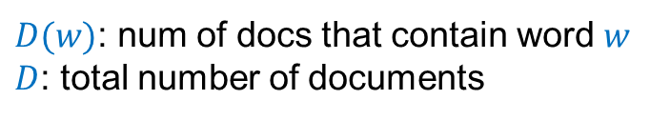
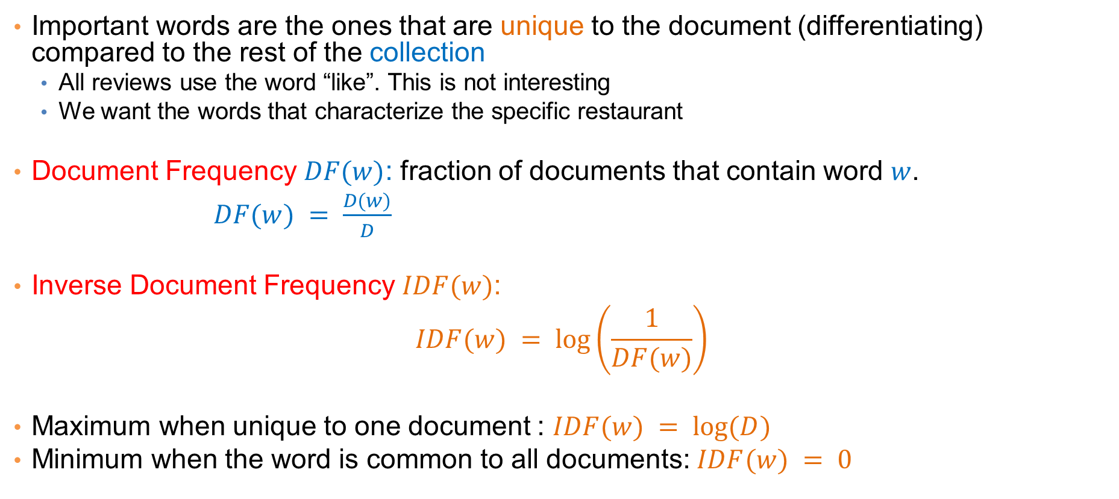
IDF
Important words are the ones that are unique to the document (differentiating) compared to the rest of the collection
  All reviews use the word “like”. This is not interesting
  We want the words that characterize the specific restaurant
Document Frequency $DF(w)$: fraction of documents that contain word $w$.
$DF(w) = \frac{D(w)}{D}$
Inverse Document Frequency $IDF(w)$:
$$IDF(w) = log⁡\left(\frac{1}{DF(w)}\right)$$
Maximum when unique to one document : $IDF(w) = log⁡(D)$
Minimum when the word is common to all documents: $IDF(w) = 0$
$D(w)$: num of docs that contain word $w$
$D$: total number of documents

Slide 66
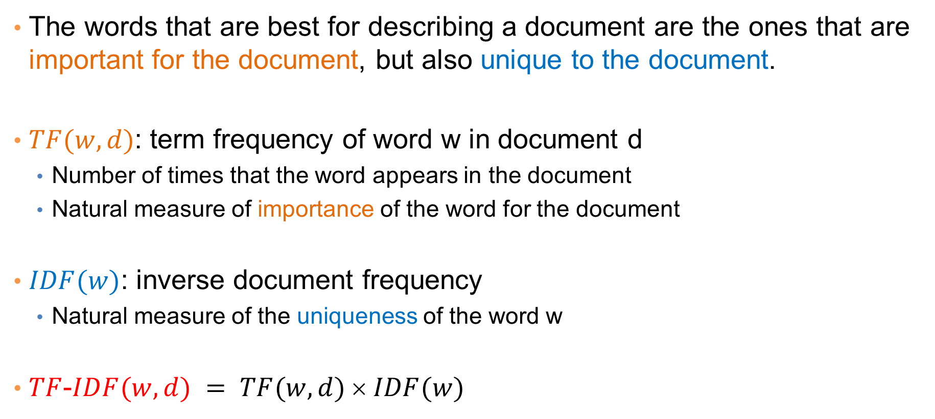
TF-IDF
The words that are best for describing a document are the ones that are important for the document, but also unique to the document.
$TF(w,d)$: term frequency of word w in document d
  Number of times that the word appears in the document
  Natural measure of importance of the word for the document
$IDF(w)$: inverse document frequency
  Natural measure of the uniqueness of the word w
$TF$-$IDF(w,d) = TF(w,d)  IDF(w)$

Slide 67
Third cut
Ordered by TF-IDF
ramen 3057.41761944282 7
akamaru 2353.24196503991 1
noodles 1579.68242449612 5
broth 1414.71339552285 5
miso 1252.60629058876 1
hirata 709.196208642166 1
hakata 591.76436889947 1
shiromaru 587.1591987134 1
noodle 581.844614740089 4
tonkotsu 529.594571388631 1
ippudo 504.527569521429 8
buns 502.296134008287 8
ippudo's 453.609263319827 1
modern 394.839162940177 7
egg 367.368005696771 5
shoyu 352.295519228089 1
chashu 347.690349042101 1
karaka 336.177423577131 1
kakuni 276.310211159286 1
ramens 262.494700601321 1
bun 236.512263803654 6
wasabi 232.366751234906 3
dama 221.048168927428 1
brulee 201.179739054263 2
fries 806.085373301536 7
custard 729.607519421517 3
shakes 628.473803858139 3
shroom 515.779060830666 1
burger 457.264637954966 9
crinkle 398.34722108797 1
burgers 366.624854809247 8
madison 350.939350307801 4
shackburger 292.428306810 1
'shroom 287.823136624256 1
portobello 239.8062489526 2
custards 211.837828555452 1
concrete 195.169925889195 4
bun 186.962178298353 6
milkshakes 174.9964670675 1
concretes 165.786126695571 1
portabello 163.4835416025 1
shack's 159.334353330976 2
patty 152.226035882265 6
ss 149.668031044613 1
patties 148.068287943937 2
cam 105.949606780682 3
milkshake 103.9720770839 5
lamps 99.011158998744 1
lamb 985.655290756243 5
halal 686.038812717726 6
53rd 375.685771863491 5
gyro 305.809092298788 3
pita 304.984759446376 5
cart 235.902194557873 9
platter 139.459903080044 7
chicken/lamb 135.8525204 1
carts 120.274374158359 8
hilton 84.2987473324223 4
lamb/chicken 82.8930633 1
yogurt 70.0078652365545 5
52nd 67.5963923222322 2
6th 60.7930175345658 9
4am 55.4517744447956 5
yellow 54.4470265206673 8
tzatziki 52.9594571388631 1
lettuce 51.3230168022683 8
sammy's 50.656872045869 1
sw 50.5668577816893 3
platters 49.9065970003161 5
falafel 49.4796995212044 4
sober 49.2211422635451 7
moma 48.1589121730374 3
pastrami 1931.94250908298 6
katz's 1120.62356508209 4
rye 1004.28925735888 2
corned 906.113544700399 2
pickles 640.487221580035 4
reuben 515.779060830666 1
matzo 430.583412389887 1
sally 428.110484707471 2
harry 226.323810772916 4
mustard 216.079238853014 6
cutter 209.535243462458 1
carnegie 198.655512713779 3
katz 194.387844446609 7
knish 184.206807439524 1
sandwiches 181.415707218 8
brisket 131.945865389878 4
fries 131.613054313392 7
salami 127.621117258549 3
knishes 124.339595021678 1
delicatessen 117.488967607 2
deli's 117.431839742696 1
carver 115.129254649702 1
brown's 109.441778045519 2
matzoh 108.22149937072 1

Slide 68

Third cut
TF-IDF takes care of stop words as well
We do not need to remove the stopwords since they will get $IDF(w) = 0$
Important: IDF is collection-dependent!
  For some other corpus the words get, like, eat, may be important

Slide 69
Decisions, decisions…
When mining real data you often need to make some decisions
  What data should we collect? How much? For how long?
  Should we throw out some data that does not seem to be useful?
    Too frequent data (stop words), too infrequent (errors?), erroneous data, missing data, outliers
  How should we weight the different pieces of data?
Most decisions are application dependent. Some information may be lost but we can usually live with it (most of the times)
We should make our decisions clear since they affect our findings.
Dealing with real data is hard…
An actual review
AAAAAAAAAAAAA
AAAAAAAAAAAAAAAAAAAAAAAAA AAAAAAAAAAAAAAAAAAAAAAAAA AAA

Slide 70
The preprocessing pipeline for our text mining task
Use Yelp/FS API to obtain data
(or download)
Data collection
Data Preprocessing
A collection of documents as text
Throw away very short reviews
Subset of the collection
Normalize text and break into words
Documents as sets of words
Documents as vectors
Compute TF-IDF values
Keep top-k words for each document
Documents as subsets of words
Remove stopwords, very frequent words, and very rare words
Data Mining

Slide 71
Word and document representations
Using TF-IDF values has a very long history in text mining
  Assigns a numerical value to each word, and a vector to a document
Recent trend: Use word embeddings
  Map every word into a multidimensional vector
Use the notion of context: the words that surround a word in a phrase
  Similar words appear in similar contexts
  Similar words should be mapped to close-by vectors
Example: words “movie” and “film”
Both words are likely to appear with similar words
  director, actor, actress, scenario, script, Oscar, cinemas etc
movie
film
The actor for the movie Joker is candidate for an Oscar

Slide 72
word2vec
Two approaches
CBOW: Learn an embedding for words so that given the context you can predict the missing word
Skip-Gram: Learn an embedding for words such that given a word you can predict the context

Slide 73
Normalization of numeric data
In many cases it is important to normalize the data rather than use the raw values
The kind of normalization that we use depends on what we want to achieve

Slide 74
Column normalization
In this data, different attributes take very different range of values. For distance/similarity the small values will disappear
We need to make them comparable
Temperature | Humidity | Pressure
30 | 0.8 | 90
32 | 0.5 | 80
24 | 0.3 | 95

Slide 75
Column Normalization
Divide (the values of a column) by the maximum value for each attribute
  Brings everything in the [0,1] range, maximum is 1
Temperature | Humidity | Pressure
0.9375 | 1 | 0.9473
1 | 0.625 | 0.8421
0.75 | 0.375 | 1
new value = old value / max value in the column
Temperature | Humidity | Pressure
30 | 0.8 | 90
32 | 0.5 | 80
24 | 0.3 | 95

Slide 76
Column Normalization
Subtract the minimum value and divide by the difference of the maximum value and minimum value for each attribute
  Brings everything in the [0,1] range, maximum is one, minimum is zero
Temperature | Humidity | Pressure
0.75 | 1 | 0.33
1 | 0.6 | 0
0 | 0 | 1
new value = (old value – min column value) / (max col. value –min col. value)
Temperature | Humidity | Pressure
30 | 0.8 | 90
32 | 0.5 | 80
24 | 0.3 | 95

Slide 77
Row Normalization
Are these documents similar?
 | Word 1 | Word 2 | Word 3
Doc 1 | 28 | 50 | 22
Doc 2 | 12 | 25 | 13

Slide 78
Row Normalization
Are these documents similar?
Divide by the sum of values for each document (row in the matrix)
  Transform a vector into a distribution*
 | Word 1 | Word 2 | Word 3
Doc 1 | 0.28 | 0.5 | 0.22
Doc 2 | 0.24 | 0.5 | 0.26
new value = old value / Σ old values in the row
*For example, the value of cell (Doc1, Word2) is the probability that a randomly chosen word of Doc1 is Word2
 | Word 1 | Word 2 | Word 3
Doc 1 | 28 | 50 | 22
Doc 2 | 12 | 25 | 13

Slide 79
Row Normalization
Do these two users rate movies in a similar way?
 | Movie 1 | Movie 2 | Movie 3
User 1 | 1 | 2 | 3
User 2 | 2 | 3 | 4

Slide 80
Row Normalization
Do these two users rate movies in a similar way?
Subtract the mean value for each user (row) – centering of data
  Captures the deviation from the average behavior
 | Movie 1 | Movie 2 | Movie 3
User 1 | -1 | 0 | +1
User 2 | -1 | 0 | +1
new value = (old value – mean row value) [/ (max row value –min row value)]
 | Movie 1 | Movie 2 | Movie 3
User 1 | 1 | 2 | 3
User 2 | 2 | 3 | 4

Slide 81
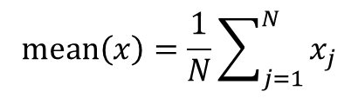

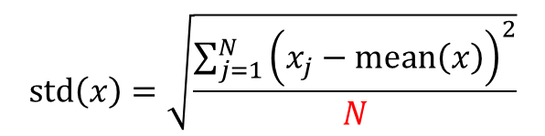
Row Normalization
$$mean\left(x\right)=\frac{1}{N}\sum_{j=1}^{N}{x_{j}}$$
Z-score:
  $$z_{i}=\frac{x_{i}−mean(x)}{std(x)}$$
Measures the number of standard deviations away from the mean
$$std\left(x\right)=\sqrt{\frac{\sum_{j=1}^{N}{{\left(x_{j}−mean\left(x\right)\right)}^{2}}}{N}}$$
Average “distance” from the mean
N may be N-1: population vs sample
 | Movie 1 | Movie 2 | Movie 3
User 1 | 1.01 | -0.87 | -0.22
User 2 | -1.01 | 0.55 | 0.93
 | Movie 1 | Movie 2 | Movie 3 | Mean | STD
User 1 | 5 | 2 | 3 | 3.33 | 1.53
User 2 | 1 | 3 | 4 | 2.66 | 1.53

Slide 82
Row Normalization
What if we want to transform the scores into probabilities?
  E.g., probability that the user will visit the restaurant again
  Different from “probability that the user will select one among the three”
One idea: Normalize by the max score:
Problem with that?
  We have probability 1, too strong
 | Restaurant 1 | Restaurant 2 | Restaurant 3
User 1 | 1 | 0.4 | 0.6
User 2 | 0.25 | 0.75 | 1
 | Restaurant 1 | Restaurant 2 | Restaurant 3
User 1 | 5 | 2 | 3
User 2 | 1 | 3 | 4

Slide 83
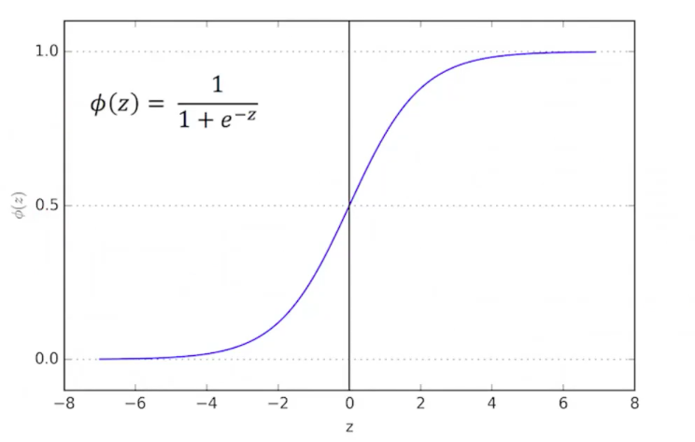
Row Normalization
Another idea: Use the logistic function:
  Maps reals to the [0,1] range
  Mimics the step function
  In the class of sigmoid functions
 | Restaurant 1 | Restaurant 2 | Restaurant 3
User 1 | 0.99 | 0.88 | 0.95
User 2 | 0.73 | 0.95 | 0.98
Too big values for all restaurants
 | Restaurant 1 | Restaurant 2 | Restaurant 3
User 1 | 5 | 2 | 3
User 2 | 1 | 3 | 4

Slide 84
Row Normalization
Another idea: Use the logistic function:
  Maps reals to the [0,1] range
  Mimics the step function
  In the class of sigmoid functions
 | Restaurant 1 | Restaurant 2 | Restaurant 3
User 1 | 0.99 | 0.88 | 0.95
User 2 | 0.73 | 0.95 | 0.98
Subtract the mean
Mean value gets 50-50 probability
 | Restaurant 1 | Restaurant 2 | Restaurant 3
User 1 | 5 | 2 | 3
User 2 | 1 | 3 | 4

Slide 85
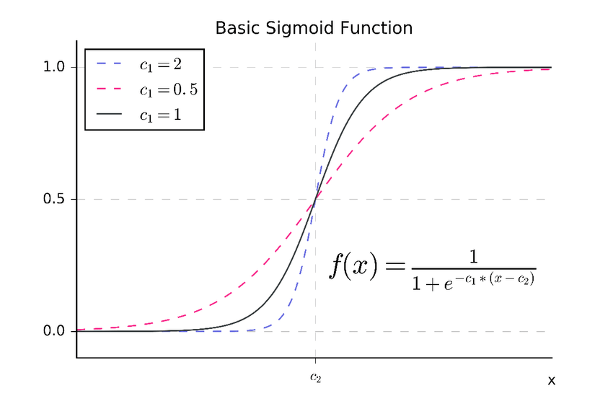
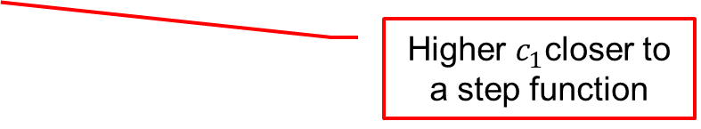
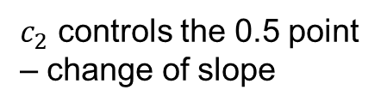
Row Normalization
General sigmoid function:
  We can control the zero point and the slope
Higher $c_{1}$closer to a step function
$c_{2}$ controls the 0.5 point – change of slope

Slide 86

Row Normalization
What if we want to transform the scores into probabilities that sum to one, but we capture the single selection of the user?
Use the softmax function
  $$\frac{e^{x_{i}}}{\sum_{i}{e^{x_{i}}}}$$
 | Restaurant 1 | Restaurant 2 | Restaurant 3
User 1 | 0.72 | 0.10 | 0.18
User 2 | 0.07 | 0.31 | 0.62
 | Restaurant 1 | Restaurant 2 | Restaurant 3
User 1 | 5 | 2 | 3
User 2 | 1 | 3 | 4

Slide 87
Exploratory analysis of data
Summary statistics: numbers that summarize properties of the data
Summarized properties include frequency, location and spread
  Examples: location - mean
  spread - standard deviation
Most summary statistics can be calculated in a single pass through the data
Computing data statistics is one of the first steps in understanding our data

Slide 88
Frequency and Mode
The frequency of an attribute value is the percentage of time the value occurs in the data set
  For example, given the attribute ‘gender’ and a representative population of people, the gender ‘female’ occurs about 50% of the time.
The mode of an attribute is the most frequent attribute value
The notions of frequency and mode are typically used with categorical data
We can visualize the data frequencies using a value histogram

Slide 89
Example
Marital Status
Single | Married | Divorced | NULL
4 | 3 | 2 | 1
Mode: Single

Slide 90
Example
Marital Status
Single | Married | Divorced | NULL
40% | 30% | 20% | 10%

Slide 91
Example
We can choose to ignore NULL values
Marital Status
Single | Married | Divorced
44% | 33% | 22%

Slide 92
Data histograms
Use binning for numerical values

Slide 93
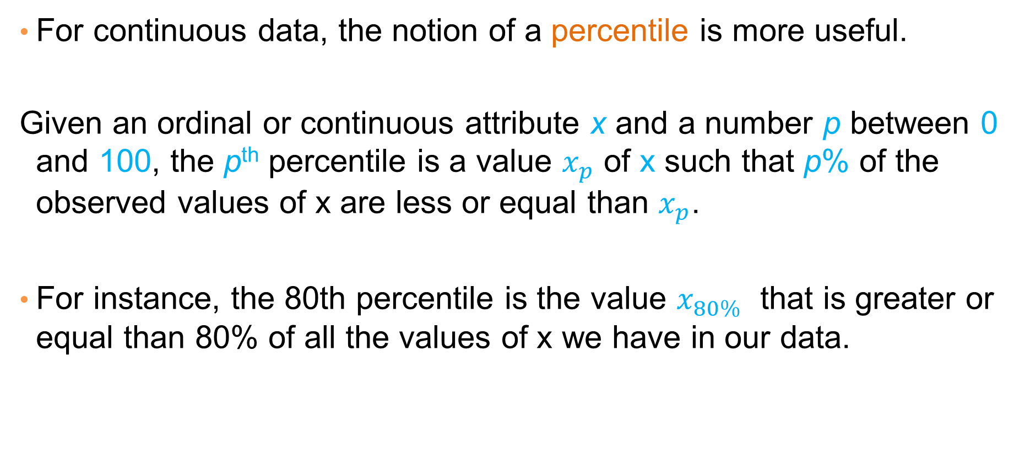
Percentiles
For continuous data, the notion of a percentile is more useful.
Given an ordinal or continuous attribute x and a number p between 0 and 100, the p^{th} percentile is a value $x_{p}$ of x such that p% of the observed values of x are less or equal than $x_{p}$.
For instance, the 80th percentile is the value $x_{80\%}$ that is greater or equal than 80% of all the values of x we have in our data.

Slide 94
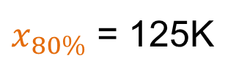
Example
Taxable Income
10000K
220K
125K
120K
100K
90K
90K
85K
70K
60K
$x_{80\%}$ = 125K

Slide 95
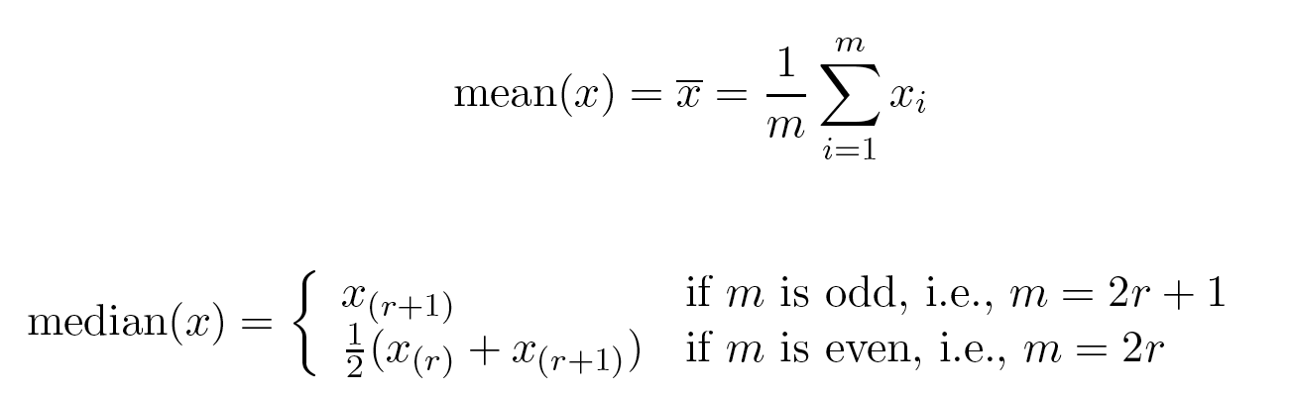
Measures of Location: Mean and Median
The mean is the most common measure of the location of a set of points.
However, the mean is very sensitive to outliers.
Thus, the median or a trimmed mean is also commonly used.

Slide 96
Example
Mean: 1090K
Trimmed mean (remove min, max): 105K
Median: (90+100)/2 = 95K

Slide 97
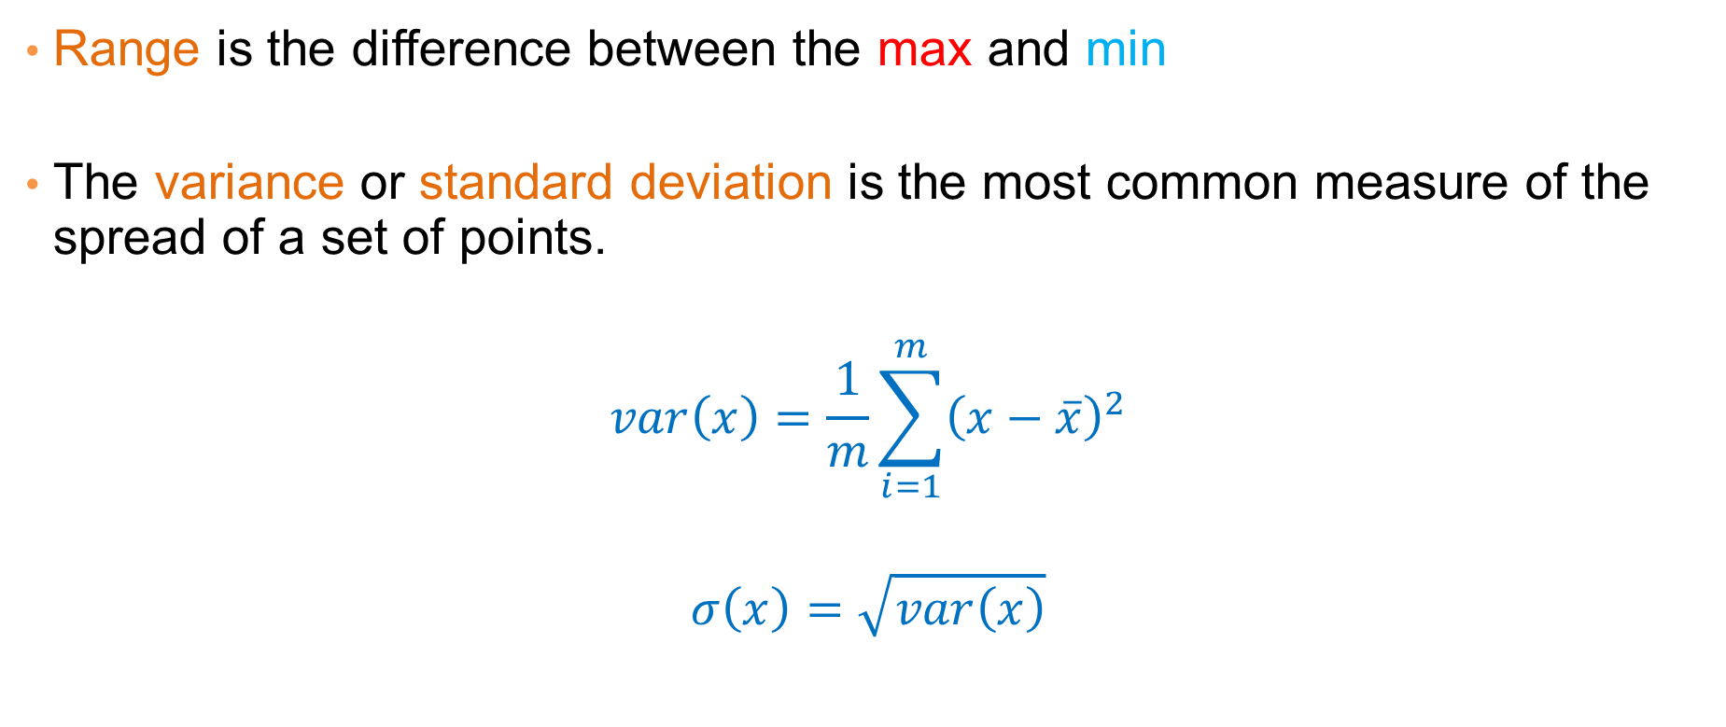
Measures of Spread: Range and Variance
Range is the difference between the max and min
The variance or standard deviation is the most common measure of the spread of a set of points.
$$var\left(x\right)=\frac{1}{m}\sum_{i=1}^{m}{{\left(x−\overline{x}\right)}^{2}}$$
$$σ\left(x\right)=\sqrt{var\left(x\right)}$$

Slide 98
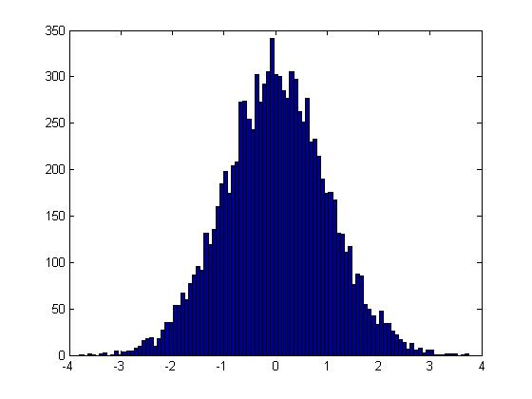
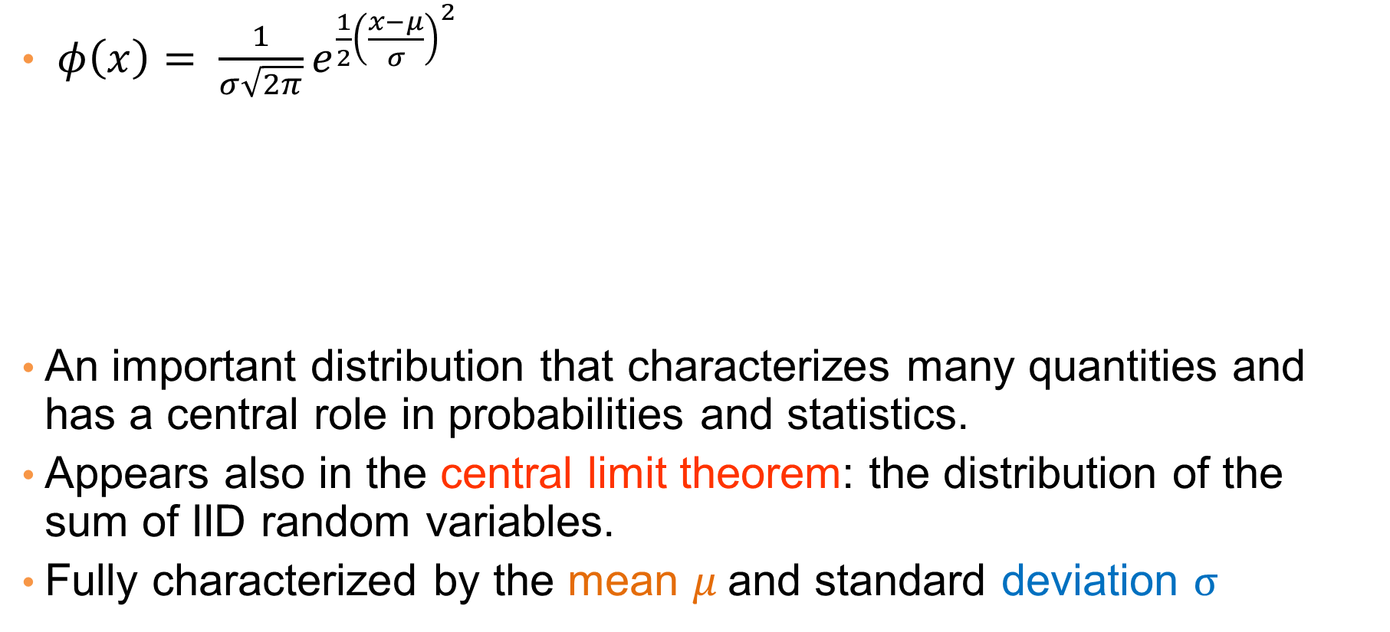
Normal Distribution
$φ\left(x\right)= \frac{1}{σ\sqrt{2π}}e^{\frac{1}{2}{\left(\frac{x−μ}{σ}\right)}^{2}}$
An important distribution that characterizes many quantities and has a central role in probabilities and statistics.
Appears also in the central limit theorem: the distribution of the sum of IID random variables.
Fully characterized by the mean $μ$and standard deviation $σ$
This is a value histogram

Slide 99
Not everything is normally distributed
Plot of number of words with x number of occurrences
If this was a normal distribution we would not have number of occurrences as large as 28K
y: number of words with x number of occurrences
x: number of occurrences

Slide 100
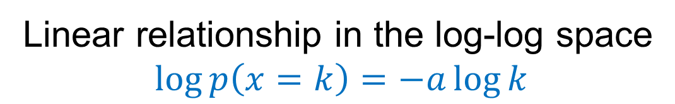

Power-law distribution
We can understand the distribution of words if we take the log-log plot
Power-law distribution:
$$p\left(k\right)=k^{−a}$$
y: logarithm of number of words with x number of occurrences
The slope of the line gives us the exponent α
x: logarithm of number of occurrences
Linear relationship in the log-log space
$$\log{p\left(x=k\right)}=−a\log{k}$$

Slide 101
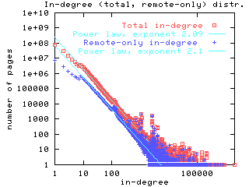
Power-laws are everywhere
Incoming and outgoing links of web pages, number of friends in social networks, number of occurrences of words, file sizes, city sizes, income distribution, popularity of products and movies
  Signature of human activity?
  A mechanism that explains everything?
  Rich get richer process

Slide 102


Zipf’s law
Power laws can be detected also by a linear relationship in the log-log space for the rank-frequency plot
$f\left(r\right):$Frequency of the r-th most frequent word
$$\log{f\left(r\right)}=−β\log{r}$$
y: number of occurrences of the r-th most frequent word
Zipf distribution:
$f\left(r\right)=r^{−β}$
r: rank of word according to frequency (1st, 2nd …)

Slide 103
The importance of correct representation
Consider the following three plots which are histograms of values. What do you observe? What can you tell of the underlying function?

Slide 104
The importance of correct representation
Putting all three plots together makes it clearer to see the differences
Green falls more slowly. Blue and Red seem more or less the same

Slide 105

The importance of correct representation
Making the plot in log-log space makes the differences more clear
Green and Blue form straight lines. Red drops exponentially.
  $y=\frac{1}{2x+ε}$ $\log{y≈− log{x+c}}$
  $y=\frac{1}{x^{2}+ε}$ $\log{y ≈−2\log{x+c}}$
  $y=2^{−x}+ε$ $\log{y ≈−x+c={−10}^{\log{x}}+c}$
Linear relationship in log-log means polynomial in linear-linear
The slope in the log-log is the exponent of the polynomial

Slide 106
Attribute relationships
In many cases it is interesting to look at two attributes together to understand if they are correlated
  E.g., how does your marital status relate with tax cheating?
  E.g., Does refund correlate with average income?
  Is there a relationship between years of study and income?
How do we visualize these relationships?

Slide 107
Plotting attributes against each other
Confusion Matrix
 | No | Yes
Single | 2 | 1
Married | 4 | 0
Divorced | 1 | 1

Slide 108
Plotting attributes against each other
Confusion Matrix
 | No | Yes
Single | 2 | 1
Married | 4 | 0
Divorced | 1 | 1
Joint Distribution Matrix
 | No | Yes
Single | 0.2 | 0.1
Married | 0.4 | 0.0
Divorced | 0.1 | 0.1
 | No | Yes
Single | 0.2 | 0.1
Married | 0.4 | 0.0
Divorced | 0.1 | 0.1

Slide 109
Plotting attributes against each other
Joint Distribution Matrix
 | No | Yes
Single | 0.2 | 0.1 | 0.3
Married | 0.4 | 0.0 | 0.4
Divorced | 0.1 | 0.1 | 0.2
 | 0.8 | 0.2 | 1
Marginal distribution for Marital Status
Marginal distribution for Cheat

Slide 110
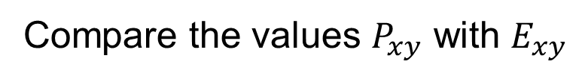
Plotting attributes against each other
How do we know if there are interesting correlations?
Joint Distribution Matrix P
Independence Matrix E
 | No | Yes
Single | 0.2 | 0.1 | 0.3
Married | 0.4 | 0.0 | 0.4
Divorced | 0.1 | 0.1 | 0.2
 | 0.8 | 0.2 | 1
 | No | Yes
Single | 0.24 | 0.06 | 0.3
Married | 0.32 | 0.08 | 0.4
Divorced | 0.16 | 0.04 | 0.2
 | 0.8 | 0.2 | 1
Compare the values $P_{xy}$ with $E_{xy}$
The product of the two marginal values 0.2*0.8

Slide 111
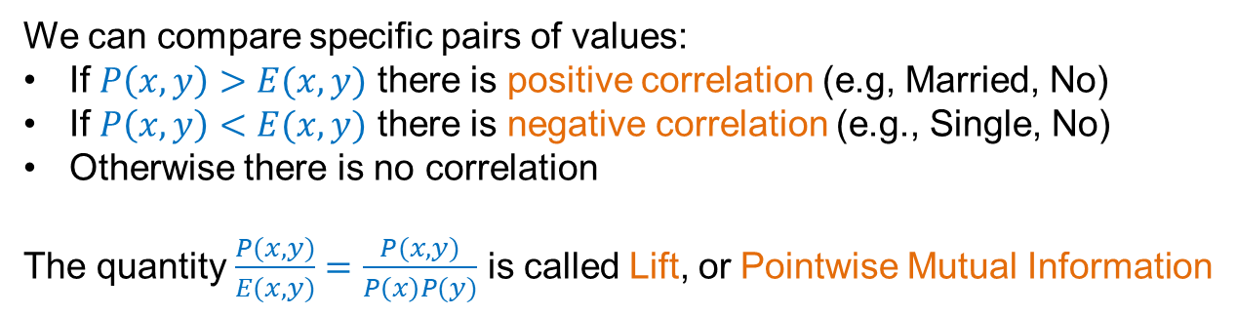
Plotting attributes against each other
Joint Distribution Matrix P
Independence Matrix E
 | No | Yes
Single | 0.2 | 0.1 | 0.3
Married | 0.4 | 0.0 | 0.4
Divorced | 0.1 | 0.1 | 0.2
 | 0.8 | 0.2 | 1
 | No | Yes
Single | 0.24 | 0.06 | 0.3
Married | 0.32 | 0.08 | 0.4
Divorced | 0.16 | 0.04 | 0.2
 | 0.8 | 0.2 | 1
We can compare specific pairs of values:
If $P\left(x,y\right)>E(x,y)$ there is positive correlation (e.g, Married, No)
If $P\left(x,y\right)<E(x,y)$ there is negative correlation (e.g., Single, No)
Otherwise there is no correlation
The quantity $\frac{P(x,y)}{E(x,y)}=\frac{P(x,y)}{P\left(x\right)P(y)}$ is called Lift, or Pointwise Mutual Information

Slide 112
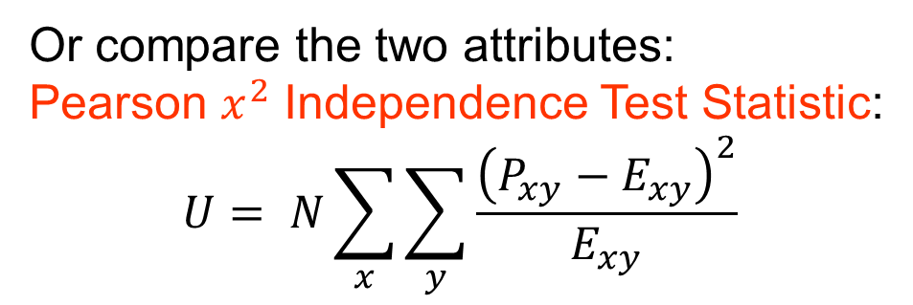
Plotting attributes against each other
Joint Distribution Matrix P
Independence Matrix E
 | No | Yes
Single | 0.2 | 0.1 | 0.3
Married | 0.4 | 0.0 | 0.4
Divorced | 0.1 | 0.1 | 0.2
 | 0.8 | 0.2 | 1
 | No | Yes
Single | 0.24 | 0.06 | 0.3
Married | 0.32 | 0.08 | 0.4
Divorced | 0.16 | 0.04 | 0.2
 | 0.8 | 0.2 | 1
Or compare the two attributes:
Pearson $x^{2}$ Independence Test Statistic:
$$U= N\sum_{x}{\sum_{y}{\frac{{\left(P_{xy}−E_{xy}\right)}^{2}}{E_{xy}}}}$$

Slide 113
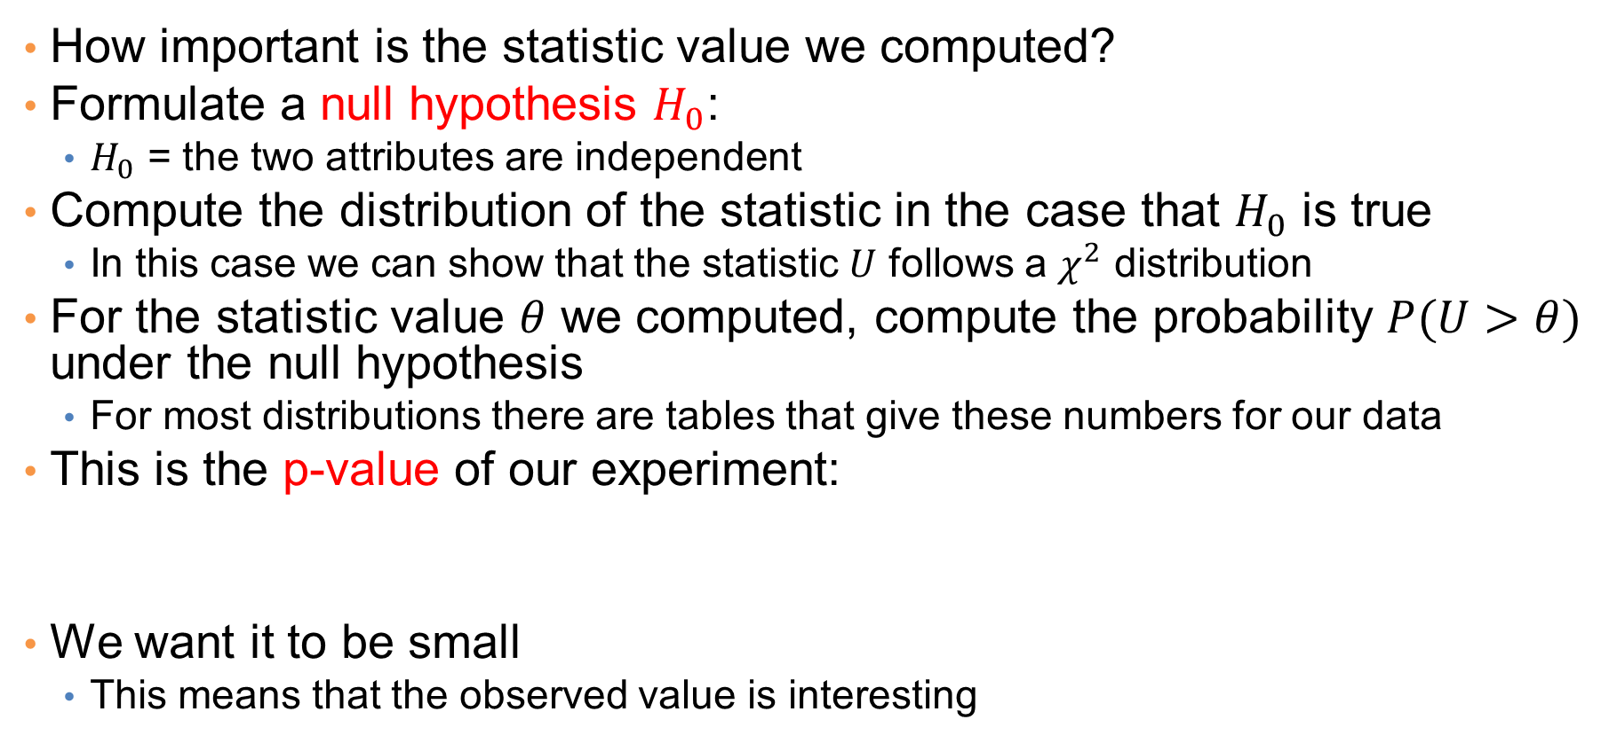
Hypothesis testing
How important is the statistic value we computed?
Formulate a null hypothesis $H_{0}$:
  $H_{0}$ = the two attributes are independent
Compute the distribution of the statistic in the case that $H_{0}$ is true
  In this case we can show that the statistic $U$ follows a $χ^{2}$ distribution
For the statistic value $θ$ we computed, compute the probability $P(U>θ)$ under the null hypothesis
  For most distributions there are tables that give these numbers for our data
This is the p-value of our experiment:
We want it to be small
  This means that the observed value is interesting
The p-value is the probability (under $H_{0}$) of observing a value of the test statistic the same as, or more extreme than what was actually observed

Slide 114
Categorical and numerical attributes

Slide 115
Categorical and numerical attributes
After removing the outlier value
Is this difference significant?

Slide 116
Categorical and numerical attributes
Compute error bars

Slide 117
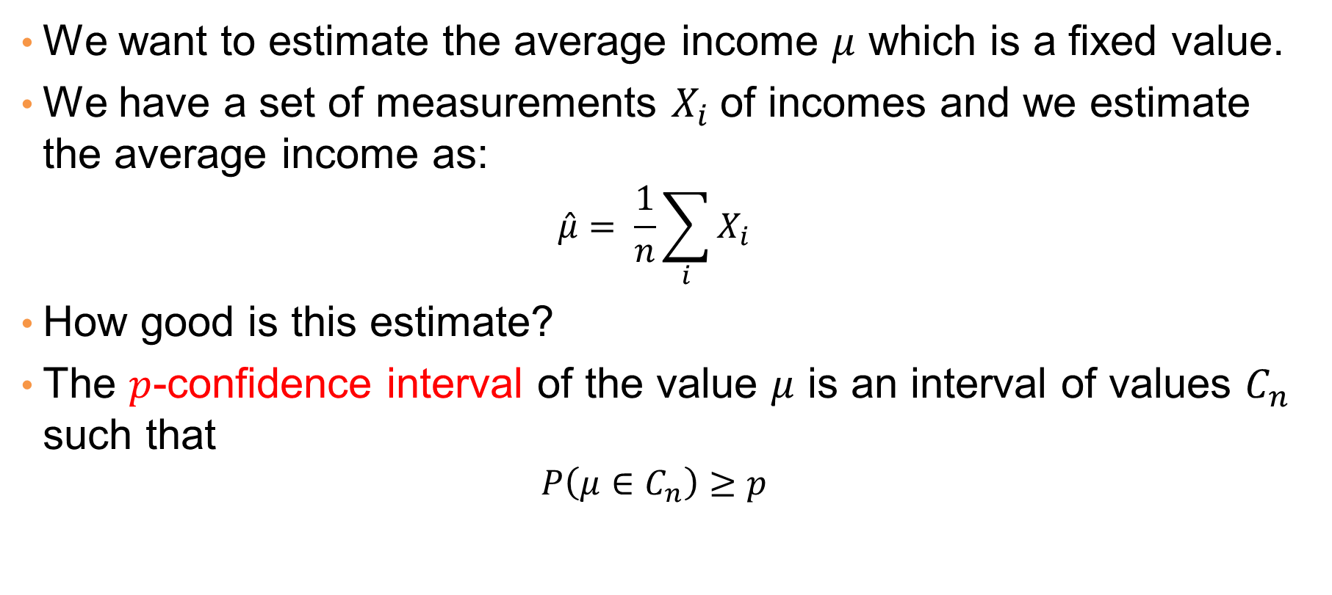
Confidence interval
We want to estimate the average income $μ$ which is a fixed value.
We have a set of measurements $X_{i}$of incomes and we estimate the average income as:
  $$\hat{μ}= \frac{1}{n}\sum_{i}{X_{i}}$$
How good is this estimate?
The $p$-confidence interval of the value $μ$ is an interval of values $C_{n}$ such that
  $$P\left(μ∈C_{n}\right)≥p$$

Slide 118
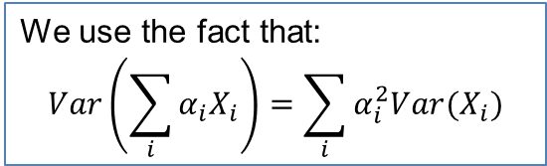
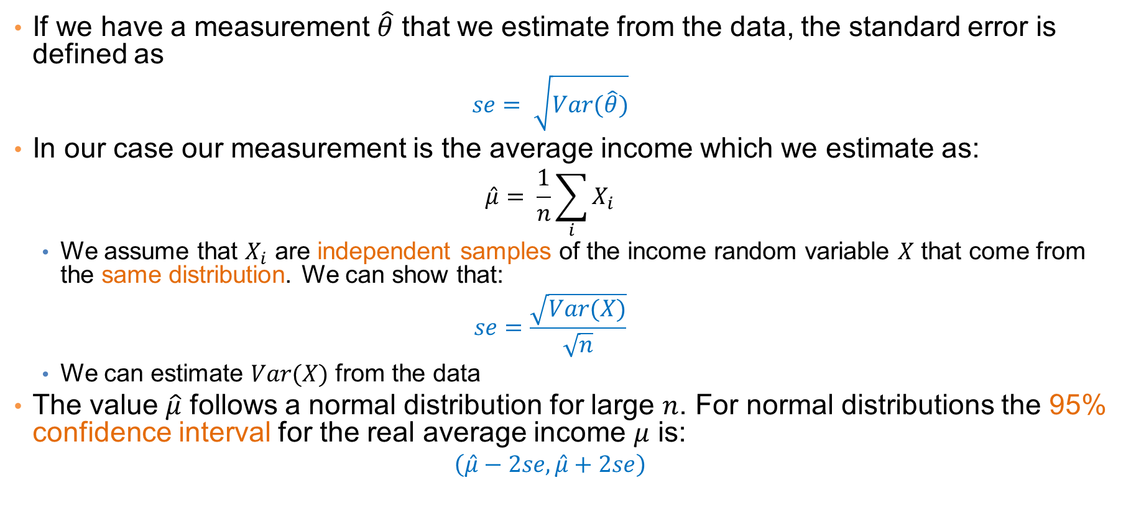
Standard error
If we have a measurement $\hat{θ}$ that we estimate from the data, the standard error is defined as
  $$se= \sqrt{Var(\hat{θ})}$$
In our case our measurement is the average income which we estimate as:
  $$\hat{μ}= \frac{1}{n}\sum_{i}{X_{i}}$$
  We assume that $X_{i}$ are independent samples of the income random variable $X$ that come from the same distribution. We can show that:
  $$se=\frac{\sqrt{Var(X)}}{\sqrt{n}}$$
  We can estimate $Var(X)$ from the data
The value $\hat{μ}$ follows a normal distribution for large $n$. For normal distributions the 95% confidence interval for the real average income $μ$ is:
  $$\left(\hat{μ}−2se, \hat{μ}+2se\right)$$
We use the fact that:
$$Var\left(\sum_{i}{α_{i}X_{i}}\right)=\sum_{i}{α_{i}^{2}Var(X_{i})}$$

Slide 119
Statistical tests
There are statistical tests for testing if two samples come from distributions with the same mean (or median)
These tests can also provide us with a p-value
Wald test:
  Tests the null hypothesis that our variable takes a specific value
    E.g., the difference of the means or medians is zero
Student t-test:
  Test of the means of two normal distributions
Permutation test:
  Sample permutations of the merged data points and compute an empirical p-value

Slide 120
Correlating numerical attributes
Scatter plot:
X axis is one attribute, Y axis is the other
For each entry we have two values
Plot the entries as two-dimensional points

Slide 121
Plotting attributes against each other
Scatter plot:
X axis is one attribute, Y axis is the other
For each entry we have two values
Plot the entries as two-dimensional points
After removing the outlier value there is a clear correlation

Slide 122
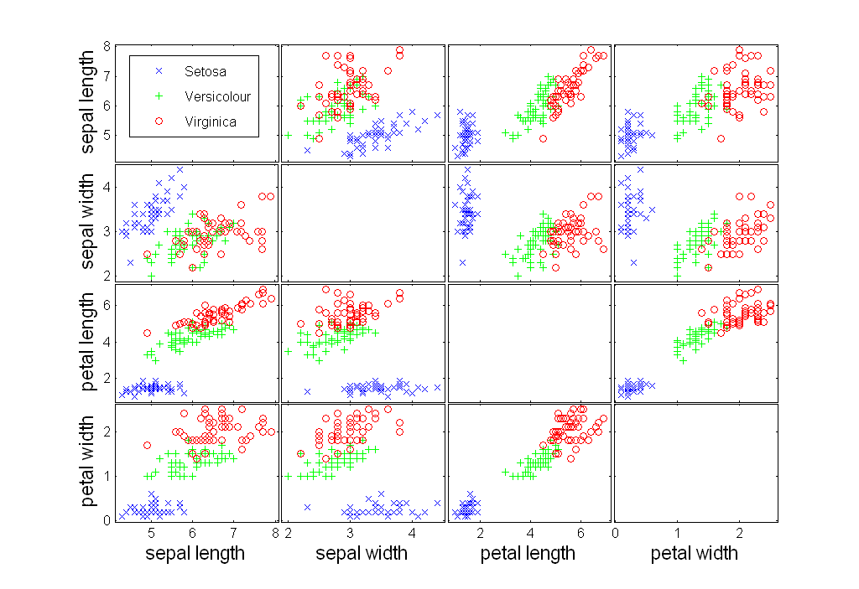
Scatter Plot Array of Iris Attributes

Slide 123
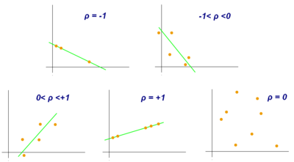
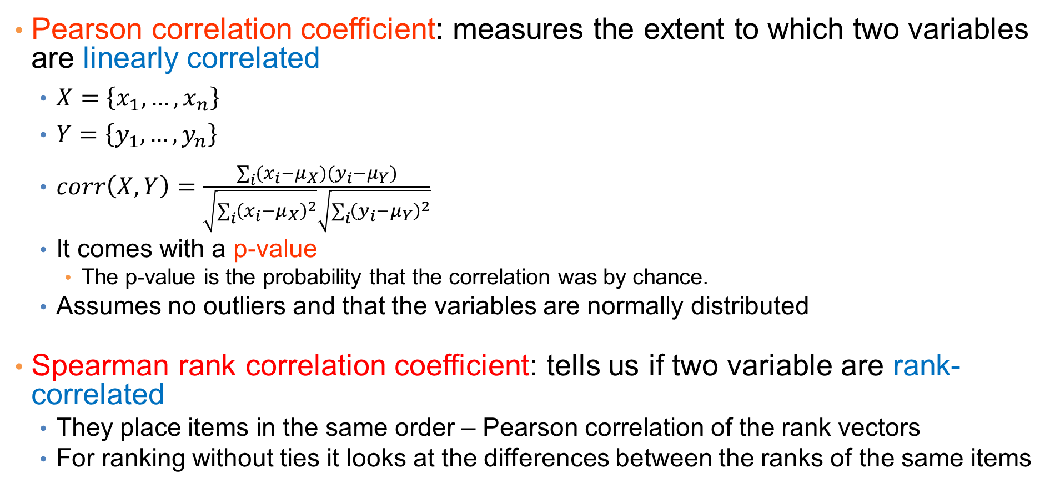
Measuring correlation
Pearson correlation coefficient: measures the extent to which two variables are linearly correlated
  $X=\left\{x_{1},…,x_{n}\right\}$
  $Y=\left\{y_{1},…,y_{n}\right\}$
  $corr\left(X,Y\right)=\frac{\sum_{i}{(x_{i}−μ_{X})(y_{i}−μ_{Y})}}{\sqrt{\sum_{i}{{\left(x_{i}−μ_{X}\right)}^{2}}}\sqrt{\sum_{i}{{\left(y_{i}−μ_{Y}\right)}^{2}}}}$
  It comes with a p-value
    The p-value is the probability that the correlation was by chance.
  Assumes no outliers and that the variables are normally distributed
Spearman rank correlation coefficient: tells us if two variable are rank-correlated
  They place items in the same order – Pearson correlation of the rank vectors
  For ranking without ties it looks at the differences between the ranks of the same items
Must have pairs of observations

Slide 124
Post-processing
Visualization
  The human eye is a powerful analytical tool
  If we visualize the data properly, we can discover patterns and demonstrate trends
  Visualization is the way to present the data so that patterns can be seen
    E.g., histograms and plots are a form of visualization
    There are multiple techniques (a field on its own)

Slide 125
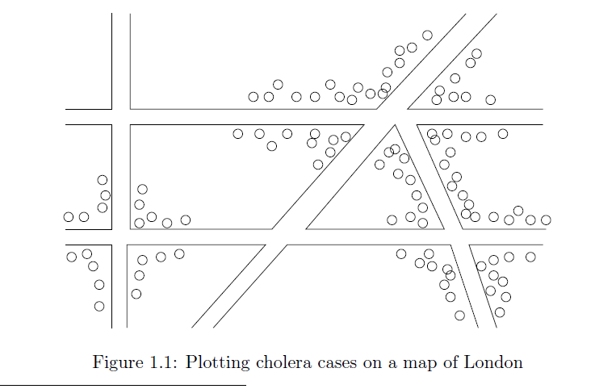
Visualization on a map
John Snow, London 1854

Slide 126
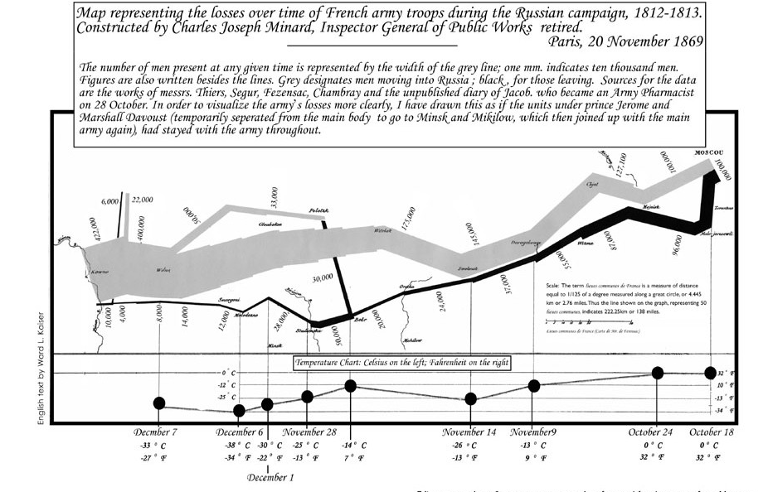
Charles Minard map
Six types of data in one plot: size of army, temperature, direction, location, dates etc

Slide 127
Another interesting visualization
China growth over the years

Slide 128
Dimensionality Reduction
The human eye is limited to processing visualizations in two (at most three) dimensions
One of the great challenges in visualization is to visualize high-dimensional data into a two-dimensional space
  Dimensionality reduction
  Distance preserving embeddings
Dimensionality reduction is also a preprocessing technique:
  Reduce the amount of data
  Extract the useful information.

Slide 129
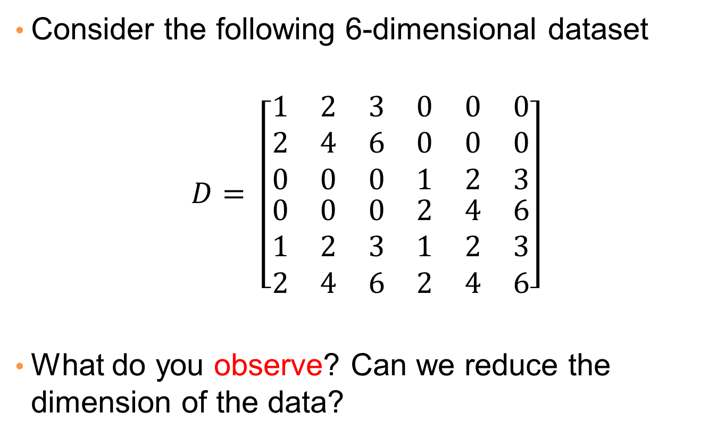
Example
Consider the following 6-dimensional dataset
$$D= \left[\begin{matrix}\begin{matrix}1 & 2 & 3 \\ 2 & 4 & 6 \\ 0 & 0 & 0\end{matrix} & \begin{matrix}0 & 0 & 0 \\ 0 & 0 & 0 \\ 1 & 2 & 3\end{matrix} \\ \begin{matrix}0 & 0 & 0 \\ 1 & 2 & 3 \\ 2 & 4 & 6\end{matrix} & \begin{matrix}2 & 4 & 6 \\ 1 & 2 & 3 \\ 2 & 4 & 6\end{matrix}\end{matrix}\right]$$
What do you observe? Can we reduce the dimension of the data?

Slide 130
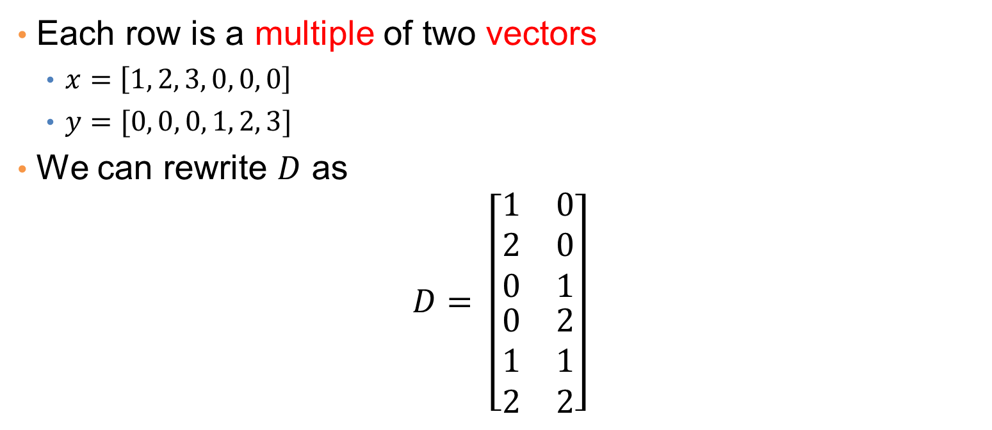

Example
$$D= \left[\begin{matrix}\begin{matrix}1 & 2 & 3 \\ 2 & 4 & 6 \\ 0 & 0 & 0\end{matrix} & \begin{matrix}0 & 0 & 0 \\ 0 & 0 & 0 \\ 1 & 2 & 3\end{matrix} \\ \begin{matrix}0 & 0 & 0 \\ 1 & 2 & 3 \\ 2 & 4 & 6\end{matrix} & \begin{matrix}2 & 4 & 6 \\ 1 & 2 & 3 \\ 2 & 4 & 6\end{matrix}\end{matrix}\right]$$
Each row is a multiple of two vectors
  $x=\left[1, 2, 3, 0, 0, 0\right]$
  $y=[0, 0, 0, 1, 2, 3]$
We can rewrite $D$ as
$$D= \left[\begin{matrix}\begin{matrix}1 & 0 \\ 2 & 0 \\ 0 & 1\end{matrix} \\ \begin{matrix}0 & 2 \\ 1 & 1 \\ 2 & 2\end{matrix}\end{matrix}\right]$$
Three types of data points

Slide 131
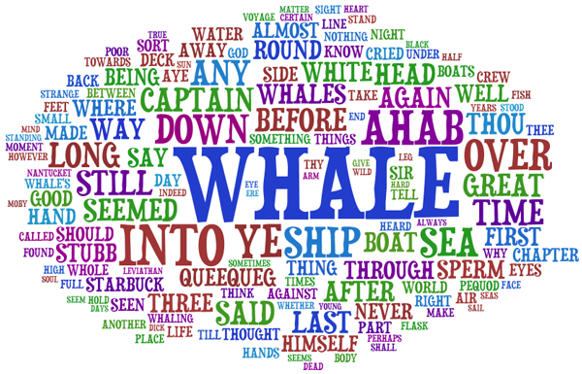
Word Clouds
A fancy way to visualize a document or collection of documents.

Slide 132
Heatmaps
Plot a point-to-point similarity matrix using a heatmap:
  Deep red = high values (hot)
  Dark blue = low values (cold)
The clustering structure becomes clear in the heatmap

Slide 133


Heatmaps
Heatmap (grey scale) of the data matrix
  Document-word frequencies
Documents
Words
Before clustering
After clustering

Slide 134

Heatmaps
A very popular way to visualize data
http://projects.oregonlive.com/ucc-shooting/gun-deaths.php

Slide 135
Statistical Significance
When we extract knowledge from a large dataset we need to make sure that what we found is not an artifact of randomness
  E.g., we find that many people buy milk and toilet paper together.
  But many (more) people buy milk and toilet paper independently
Statistical tests compare the results of an experiment with those generated by a null hypothesis
  E.g., a null hypothesis is that people select items independently.
A result is interesting if it cannot be produced by randomness.
  An important problem is to define the null hypothesis correctly: What is random?

Slide 136
Meaningfulness of Answers
A big data-mining risk is that you will “discover” patterns that are meaningless.
Statisticians call it Bonferroni’s principle: (roughly) if you look in more places for interesting patterns than your amount of data will support, you are bound to find crap.
The Rhine Paradox: a great example of how not to conduct scientific research.
  CS345A Data Mining on the Web: Anand Rajaraman, Jeff Ullman

Slide 137
Rhine Paradox – (1)
Joseph Rhine was a parapsychologist in the 1950’s who hypothesized that some people had Extra-Sensory Perception.
He devised (something like) an experiment where subjects were asked to guess 10 hidden cards – red or blue.
He discovered that almost 1 in 1000 had ESP – they were able to get all 10 right!
  CS345A Data Mining on the Web: Anand Rajaraman, Jeff Ullman

Slide 138
Rhine Paradox – (2)
He told these people they had ESP and called them in for another test of the same type.
Alas, he discovered that almost all of them had lost their ESP.
  Why?
What did he conclude?
  Answer on next slide.
  CS345A Data Mining on the Web: Anand Rajaraman, Jeff Ullman

Slide 139
Rhine Paradox – (3)
He concluded that you shouldn’t tell people they have ESP; it causes them to lose it.
  CS345A Data Mining on the Web: Anand Rajaraman, Jeff Ullman

