Slide 1
Online Social Networks and Media
Positive and Negative Edges
Strong and Weak Edges

Slide 2
POSITIVE AND NEGATIVE TIES

Slide 3
Structural Balance Theory
originated in social psychology in the mid-20th-century, by Heider in the 1940s
graph-theoretic approach by Cartwright and Harary in the 1960s
considers the possible ways in which triangles on three individuals can be signed
  Lets look at all possible relationships between 3 people => 4 cases
  See if all are equally possible (local property)

Slide 4
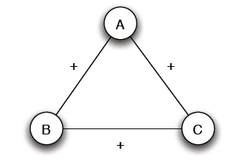
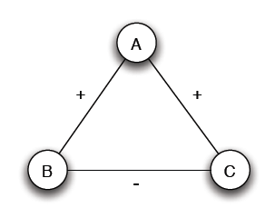
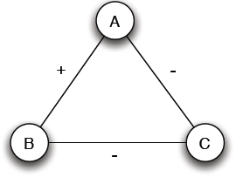
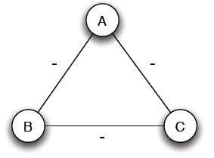
Structural Balance
Case (a): 3 +
Case (b): 2 +, 1 -
Mutual friends
A is friend with B and C, but B and C do not get well together
Case (c): 1 +, 2 -
Case (d): 3 -
Mutual enemies
A and B are friends with a mutual enemy

Slide 5
Structural Balance
Case (a): 3 +
Case (b): 2 +, 1 -
Stable or balanced
Unstable
A is friend with B and C, but B and C do not get well together
Implicit force to make B and C friends (- => +) or turn one of the + to -
Mutual friends
“the friend of my friend is my friend,”
Case (c): 1 +, 2 -
Case (d): 3 -
Stable or balanced
Unstable
A and B are friends with a mutual enemy
“the enemy of my enemy is my friend”
Mutual enemies
Forces to team up against the third (turn 1 – to +)

Slide 6
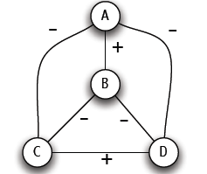
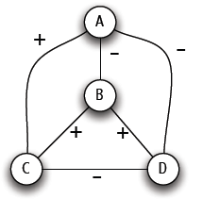
Structural Balance
A labeled complete graph is balanced if every one of its triangles is balanced
Structural Balance Property: For every set of three nodes, if we consider the three edges connecting them, either all three of these are labeled +, or else exactly one of them is labeled – (odd number of +)
What does a balanced network look like?

Slide 7
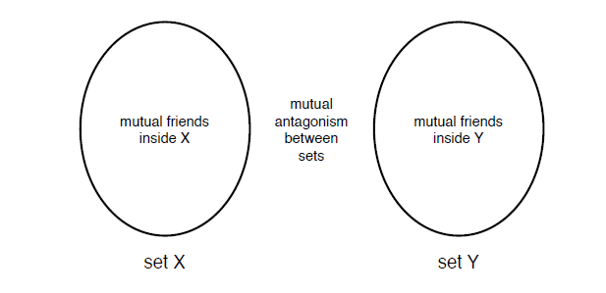
The Structure of Balanced Networks
Balance Theorem: If a labeled complete graph is balanced,
all pairs of nodes are friends, or
the nodes can be divided into two groups X and Y, such that every pair of nodes in X like each other, every pair of nodes in Y like each other, and every one in X is the enemy of every one in Y.
From a local to a global property
Proof ...
Notes:
Take node A. Let X be all friends of A and Y all enemies of A. Every two nodes in X are friends. Every two nodes in Y are friends. Every node in X is an enemy of every node in Y.

Slide 8
Applications of Structural Balance
How a network evolves over time
Political science: International relationships

Slide 9
Applications of Structural Balance
The conflict of Bangladesh’s separation from Pakistan in 1972 (1)
₋
USSR
N. Vietnam
USA
Pakistan
-
-
-
₊
Bangladesh
China
-
India
USA support to Pakistan?
“[T]he United States’s somewhat surprising support of Pakistan ... becomes less surprising when one considers that the USSR was China’s enemy, China was India’s foe, and India had traditionally bad relations with Pakistan. Since the U.S. was at that time improving its relations with China, it supported the enemies of China’s enemies.
Further reverberations of this strange political constellation became inevitable: North Vietnam made friendly gestures toward India, Pakistan severed diplomatic relations with those countries of the Eastern Bloc which recognized Bangladesh, and China vetoed the acceptance of Bangladesh into the U.N.”

Slide 10
Applications of Structural Balance
International relationships (I)
The conflict of Bangladesh’s separation from Pakistan in 1972 (II)
₊
₋
USSR
N. Vietnam
USA
Pakistan
-
-
₊
-
Bangladesh
China
-
India
China?

Slide 11
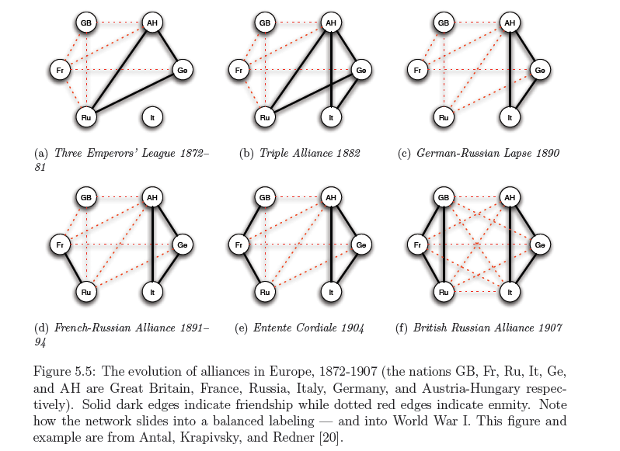
Applications of Structural Balance
International relationships (II)

Slide 12
A Weaker Form of Structural Balance
Allow this
Weak Structural Balance Property: There is no set of three nodes such that the edges among them consist of exactly two positive edges and one negative edge

Slide 13
A Weaker Form of Structural Balance
Weakly Balance Theorem: If a labeled complete graph is weakly balanced, its nodes can be divided into groups in such a way that every two nodes belonging to the same group are friends, and every two nodes belonging to different groups are enemies.
From a local to a global property
Proof …

Slide 14
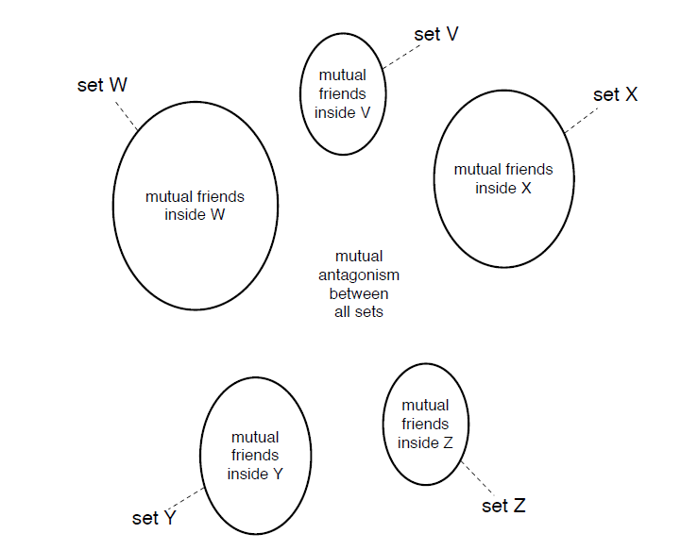
A Weaker Form of Structural Balance
Notes:
Let node A and X all its friends. X is our first group. All nodes in A are friends with each other. All nodes in X are enemies with everyone not in X. Ignore set X and repeat.

Slide 15
Generalizing
Non-complete graphs
Instead of all triangles, “most” triangles, approximately divide the graph
We shall use the original (“non-weak” definition of structural balance)

Slide 16
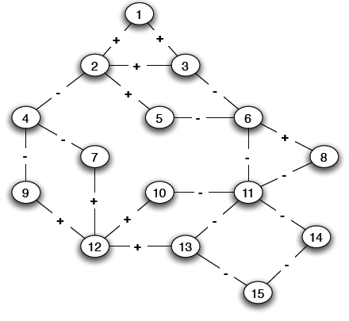
Structural Balance in Arbitrary Graphs
Thee possible relations
Positive edge
Negative edge
Absence of an edge
What is a good definition of balance in a non-complete graph?

Slide 17
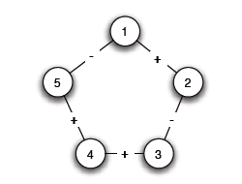
Balance Definition for General Graphs
Based on triangles (local view)
Division of the network (global view)
A (non-complete) graph is balanced if it can be completed by adding edges to form a signed complete graph that is balanced
-
+

Slide 18
Balance Definition for General Graphs
+

Slide 19
Balance Definition for General Graphs
Based on triangles (local view)
Division of the network (global view)
A (non-complete) graph is balanced if it possible to divide the nodes into two sets X and Y, such that any edge with both ends inside X or both ends inside Y is positive and any edge with one end in X and one end in Y is negative
The two definition are equivalent:
An arbitrary signed graph is balanced under the first definition, if and only if, it is balanced under the second definitions

Slide 20
Balance Definition for General Graphs
Algorithm for dividing the nodes?

Slide 21
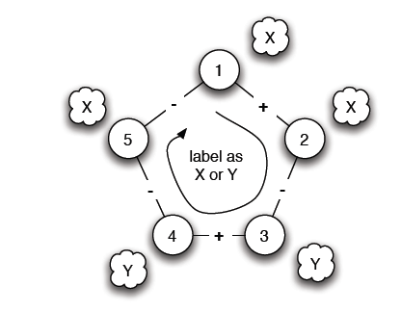
Balance Characterization
What prevents a network from being balanced?
Start from a node and place nodes in X or Y
Every time we cross a negative edge, change the set
Cycle with odd number of negative edges
Notes:
Start with A, X friends of A, Y enemies of A. Start with A in X, if + remain in set, if – switch sets. If cycle with odd numbers, then problem, Need even to return back to friends.

Slide 22
Balance Definition for General Graphs
Cycle with odd number of - => unbalanced
Is there such a cycle with an odd number of -?
Notes:
s, 2, 3, 6, 11, 13, 12, 9, 4

Slide 23
Balance Definition for General Graphs
Cycle with odd number of - => unbalanced
Is there such a cycle with an odd number of -?
Notes:
s, 2, 3, 6, 11, 13, 12, 9, 4

Slide 24
Balance Characterization
Claim: A signed graph is balanced, if and only if, it contains no cycles with an odd number of negative edges
(proof by construction)
Find a balanced division: partition into sets X and Y, all edges inside X and Y positive, crossing edges negative
Either succeeds or Stops with a cycle containing an odd number of -
Two steps:
Convert the graph into a reduced one with only negative edges
Solve the problem in the reduced graph

Slide 25
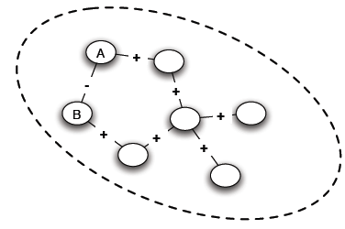
Balance Characterization: Step 1
a. Find connected components (supernodes) by considering only positive edges
b. Check: Do supernodes contain a negative edge between any pair of their nodes
(i) Yes -> odd cycle
(ii) No -> each supernode either X or Y
Notes:
If there is a negative edge between A and B, then connected thus an all positive path from A to B

Slide 26
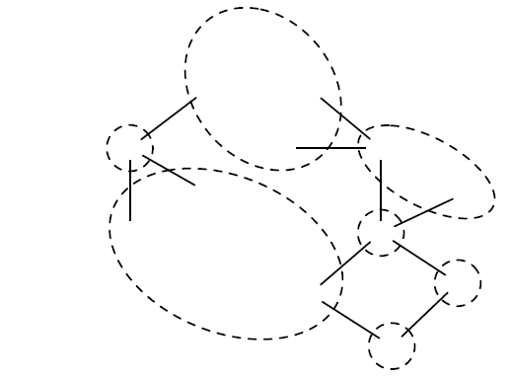
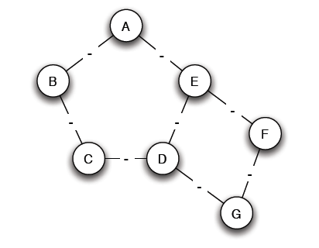
Balance Characterization: Step 1
c. Reduced problem: a node for each supernode, an edge between two supernodes if an edge in the original

Slide 27
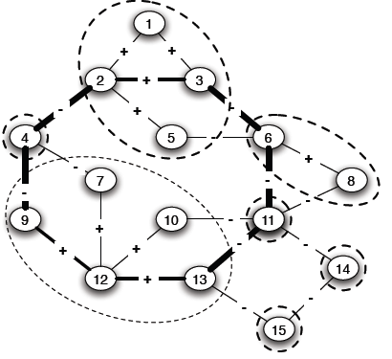
Balance Characterization: Step 2
Note: Only negative edges among supernodes
Start labeling by either X and Y
If successful, then label the nodes of the supernode correspondingly
A cycle with an odd number, corresponds to a (possibly larger) odd cycle in the original

Slide 28
Balance Characterization: Step 2
Determining whether the graph is bipartite (there is no edge between nodes in X or Y, the only edges are from nodes in X to nodes in Y)
Use Breadth-First-Search (BFS)
Two type of edges: (1) between nodes in adjacent levels (2) between nodes in the same level
If only type (1), alternate X and Y labels at each level
If type (2), then odd cycle

Slide 29
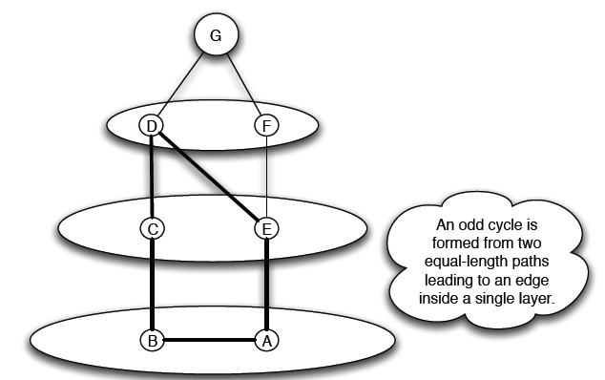
Balance Characterization

Slide 30
Status theory in practice
Epinions: product review Web site, where users can indicate their trust or distrust of the reviews
Slashdot: the social network of the blog where a signed link indicates that one user likes or dislikes the comments
Wikipedia: its voting network where a signed link indicates a positive or negative vote by one user on the promotion to admin status of another.

Slide 31
Structural balance theory in practice
All-positive triad T₃ is heavily overrepresented in all three datasets. T₃ tends to be over represented by about 40% in all three datasets
Triad T₂ consisting of two enemies with a common friend is heavily underrepresented. T₂ is underrepresented by about 75%in Epinions and Slashdot and 50% in Wikipedia
More consistent with weak structural balance

Slide 32
A theory of status
Directed networks
A positive edge (A, B) means that A regards B as having higher status than herself
A negative edge (A, B) means that A regards B as having lower status than herself
A
A
+
-
B
B
Assuming that all participants agree on status ordering, status theory predicts that when the direction of an edge is flipped,
its sign should flip as well.
A
-
+
B

Slide 33
A theory of status
+
?
+
A
A
A
B
B
B
+
-
+
+
+
+
X
X
+
X
Structural balance
?
-
A
A
B
B
+
+
+
+
+
X
X

Slide 34
A theory of status: local property
For any edge (u, v), and any third node w, possible to assign distinct numerical “status values” to u, v, and w in such a way that the positive edges among them (if any) go from nodes of lower status to nodes of higher status, and the negative edges among them (if any) go from nodes of higher status to nodes of lower status.
Three nodes u, v, and w are status-consistent if this condition holds.

Slide 35
A theory of status: global property
Let G be a signed, directed graph, and suppose that all sets of three nodes in G are status-consistent.
Then it possible to order the nodes of G as v₁, v₂, . . . , v_{n} in such a way that each positive edge (v_{i}, v_{j}) satisfies i < j, and each negative edge (v_{i}, v_{j} ) satisfies i > j.

Slide 36
References
Networks, Crowds, and Markets (Chapter 5)

Slide 37
Strong AND WEAK TIES

Slide 38
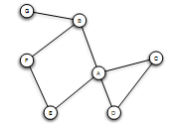
Triadic Closure
If two people in a social network have a friend in common, then there is an increased likelihood that they will become friends themselves at some point in the future
Triangle

Slide 39
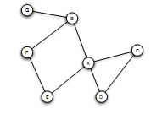
Triadic Closure
Snapshots over time:

Slide 40
Clustering Coefficient
(Local) clustering coefficient for a node is the probability that two randomly selected friends of the node are friends with each other (i.e., form a triangle)
Fraction of the friends of a node that are friends with each other (i.e., connected)

Slide 41
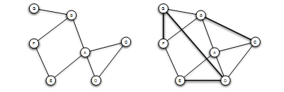
Clustering Coefficient
1/6
1/2
Ranges from 0 to 1

Slide 42
Triadic Closure
If A knows B and C, B and C are likely to become friends, but WHY?
B
A
C
Opportunity
Trust
Incentive of A (latent stress for A, if B and C are not friends, dating back to social psychology, e.g., relating low clustering coefficient to suicides)

Slide 43
The Strength of Weak Ties Hypothesis
Mark Granovetter, in the late 1960s
Many people learned information leading to their current job through personal contacts, often described as acquaintances rather than closed friends
Two aspects
Structural
Local (interpersonal)

Slide 44
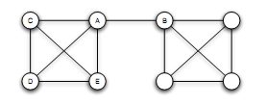
Bridges and Local Bridges
Bridge
(aka cut-edge)
An edge between A and B is a bridge if deleting that edge would cause A and B to lie in two different components
AB the only “route” between A and B
Extremely rare in social networks

Slide 45
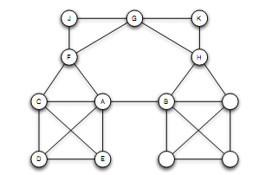
Bridges and Local Bridges
Local Bridge
An edge between A and B is a local bridge if deleting that edge would increase the distance between A and B to a value strictly more than 2
A and B have no friends in common
Span of a local bridge: distance of the its endpoints if the edge is deleted

Slide 46
Bridges and Local Bridges
An edge is a local bridge, if an only if, it is not part of any triangle in the graph

Slide 47
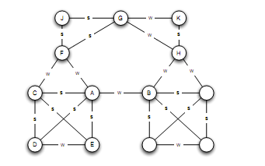
The Strong Triadic Closure Property
Not all links the same
Levels of strength of a link: Strong and Weak ties
May vary across times and situations
Annotated graph

Slide 48
The Strong Triadic Closure Property
If a node A has edges to nodes B and C, then the B-C edge is especially likely to form if both A-B and A-C are strong ties
A node A violates the Strong Triadic Closure Property, if it has strong ties to two other nodes B and C, and there is no edge (strong or weak tie) between B and C.
A node A satisfies the Strong Triadic Property if it does not violate it
B
S
A
X
S
C

Slide 49
The Strong Triadic Closure Property

Slide 50
Local Bridges and Weak Ties
If a node A in a network satisfies the Strong Triadic Closure and A is involved in at least two strong ties, then any local bridge A is involved in must be a weak tie
B
S
Proof: by contradiction
A
S
C
local distinction (weak and strong ties) related to global structural distinction (local bridges or not)
Relation to job seeking?
Notes:
Assume that A is involved in a local bridge with B and this is S Since two, also S with C then there is an edge BC not a local bridge

Slide 51
Tie Strength and Network Structure in Large-Scale Data
How to test these prediction on large social networks?

Slide 52
Tie Strength and Network Structure in Large-Scale Data
Cell-phone study [Omnela et. al., 2007]
“who-talks-to-whom network”, covering 20% of the national population
Nodes: cell phone users
Edge: if they make phone calls to each other in both directions over 18-week observation periods
Strength of the tie: time spent talking during an observation period
Is it a social network?
Cells generally used for personal communication + no central directory, thus cell-phone numbers exchanged among people who already know each other
Broad structural features of large social networks (giant component, 84% of nodes)

Slide 53
Generalizing Weak Ties and Local Bridges
So far:
Either weak or strong
Local bridge or not
Tie Strength: Numerical quantity (= number of min spent on the phone)
How to quantify “local bridges”?

Slide 54
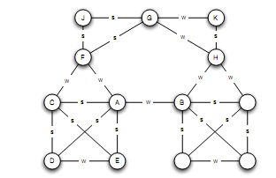
Generalizing Weak Ties and Local Bridges
Bridges
“almost” local bridges
Neighborhood overlap of an edge e_{ij}
(*) In the denominator we do not count A or B themselves
Jaccard coefficient
A: B, E, D, C
F: C, J, G
1/6
When is this value 0?

Slide 55
Generalizing Weak Ties and Local Bridges
Neighborhood overlap = 0: edge is a local bridge
Small value: “almost” local bridges
1/6
?

Slide 56
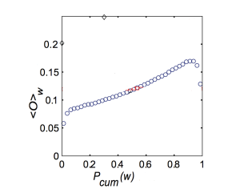
Generalizing Weak Ties and Local Bridges: Empirical Results
Hypothesis: the strength of weak ties predicts that neighborhood overlap should grow as tie strength grows
(*) Some deviation at the right-hand edge of the plot
sort the edges -> for each edge at which percentile
Strength of connection (function of the percentile in the sorted order)

Slide 57
Generalizing Weak Ties and Local Bridges: Empirical Results
How to test the following global (macroscopic) level hypothesis:
Hypothesis: weak ties serve to link different tightly-knit communities that each contain a large number of stronger ties

Slide 58
Generalizing Weak Ties and Local Bridges: Empirical Results
Delete edges from the network one at a time
Starting with the strongest ties and working downwards in order of tie strength
  giant component shrank steadily
Starting with the weakest ties and upwards in order of tie strength
  giant component shrank more rapidly, broke apart abruptly as a critical number of weak ties were removed

Slide 59
Social Media and Passive Engagement
People maintain large explicit lists of friends
Test:
How online activity is distributed across links of different strengths

Slide 60
Tie Strength on Facebook
Cameron Marlow, et al, 2009
At what extent each link was used for social interactions
Three (not exclusive) kinds of ties (links)
Reciprocal (mutual) communication: both send and received messages to friends at the other end of the link
One-way communication: the user send one or more message to the friend at the other end of the link (including reciprocal)
Maintained relationship: the user followed information about the friend at the other end of the link (click on content via News feed or visit the friend profile more than once)

Slide 61
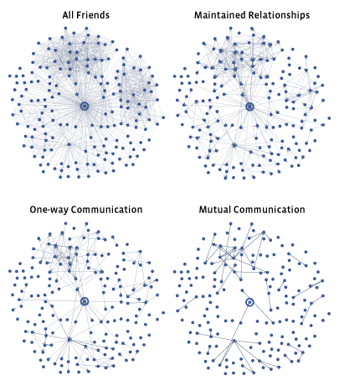
Tie Strength on Facebook
More recent connections

Slide 62
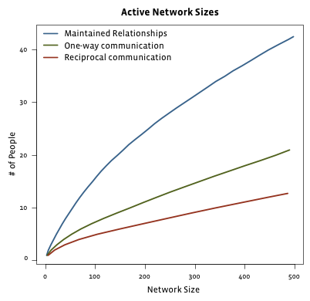
Tie Strength on Facebook
Even for users with very large number of friends
actually communicate : 10-20
number of friends follow even passively <50
Passive engagement: keep up with friends by reading about them even in the absence of communication
Total number of friends

Slide 63
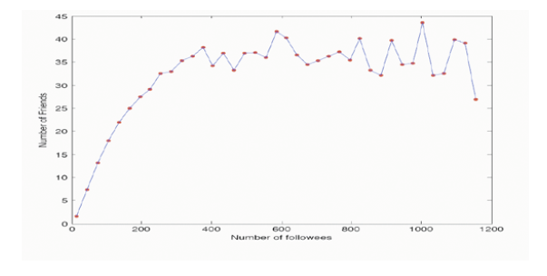
Tie Strength on Twitter
Huberman, Romero and Wu, 2009
Two kinds of links
Follow
Strong ties (friends): users to whom the user has directed at least two messages over the course if the observation period

Slide 64
Social Media and Passive Engagement
Strong ties require continuous investment of time and effort to maintain (as opposed to weak ties)
Network of strong ties still remain sparse
How different links are used to convey information

Slide 65
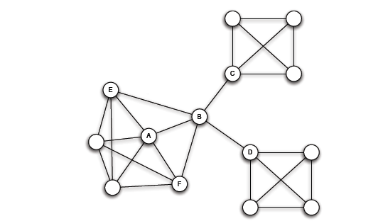
Closure, Structural Holes and Social Capital
Different roles that nodes play in this structure
Access to edges that span different groups is not equally distributed across all nodes

Slide 66
Embeddedness
A has a large clustering coefficient
Embeddedness of an edge: number of common neighbors of its endpoints (neighborhood overlap, local bridge if 0)
For A, all its edges have significant embeddedness
3
2
3
(sociology) if two individuals are connected by an embedded edge => trust
  “Put the interactions between two people on display”

Slide 67
Structural Holes
(sociology) B-C, B-D much riskier, also, possible contradictory constraints
Success in a large cooperation correlated to access to local bridges
B spans a structural hole
  B has access to information originating in multiple, non interacting parts of the network
  An amplifier for creativity
  Source of power as a social “gate-keeping”
  Social capital

Slide 68
References
Networks, Crowds, and Markets (Chapter 3)

