Slide 1
Online Social Networks and Media
Network Measurements and Models

Slide 2
Measuring and Modeling Networks
There are networks everywhere
What do they look like?
  How do you measure and describe a billion node network?
What are the process that generate them?
  Can we create models for real-life networks?
These two questions are related: We need to measure the characteristics that we want to model

Slide 3
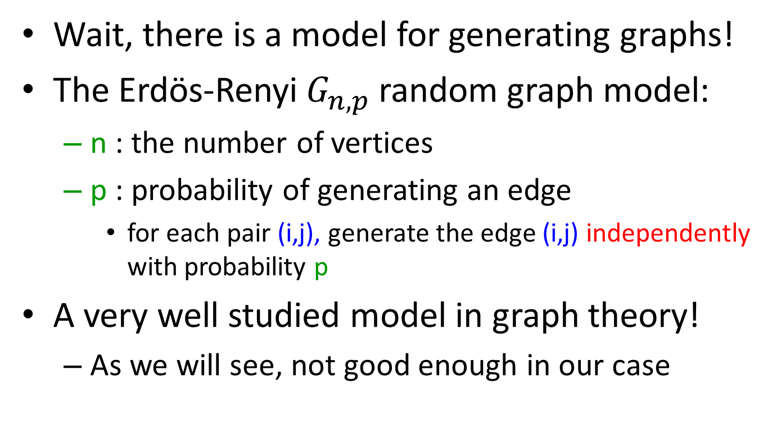
Before we start
Wait, there is a model for generating graphs!
The Erdös-Renyi $G_{n,p}$ random graph model:
  n : the number of vertices
  p : probability of generating an edge
    for each pair (i,j), generate the edge (i,j) independently with probability p
A very well studied model in graph theory!
  As we will see, not good enough in our case

Slide 4
Measuring Networks
Degree distributions and power-laws
Clustering Coefficient
Small world phenomena
Components
Motifs
Homophily

Slide 5
Degree distributions
frequency
f_{k} = fraction of nodes with degree k
= probability of a randomly
selected node to have degree k
f_{k}
k
degree

Slide 6
It all started with some Greeks
Faloutsos, Faloutsos, Faloutsos, “On the power-law relationships of the internet topology”, SIGCOMM 1999.
Degree distributions for the internet graph

Slide 7
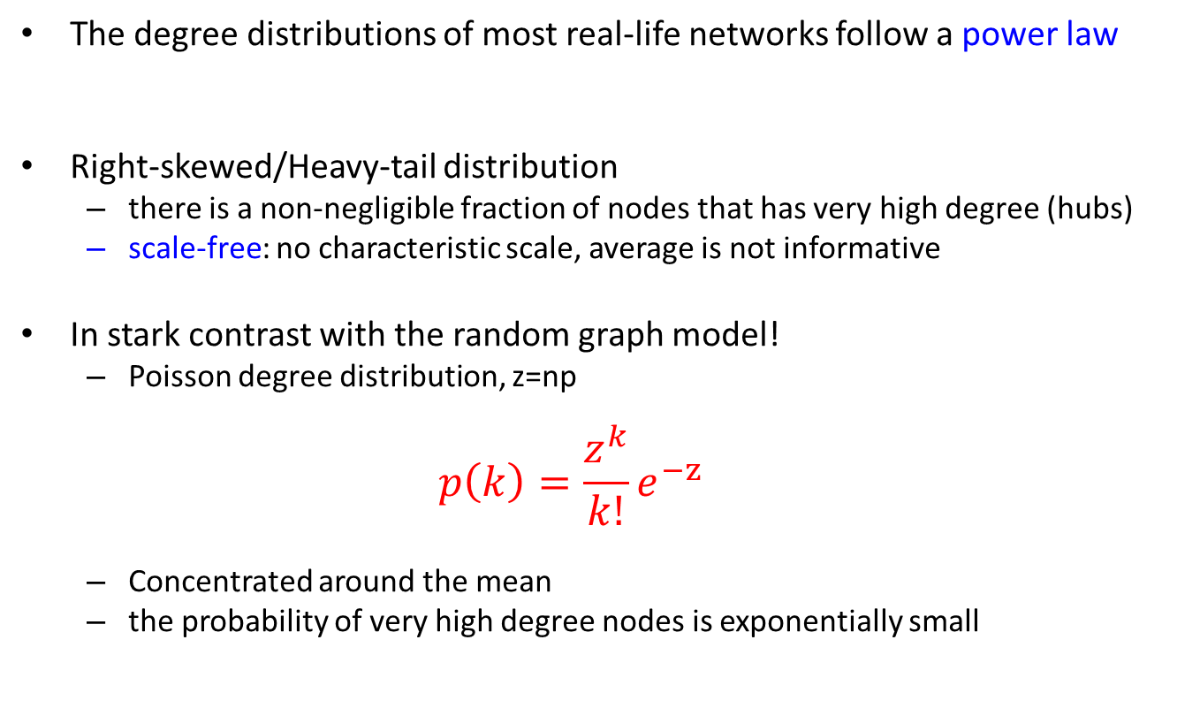

Power-law distributions
The degree distributions of most real-life networks follow a power law
Right-skewed/Heavy-tail distribution
  there is a non-negligible fraction of nodes that has very high degree (hubs)
  scale-free: no characteristic scale, average is not informative
In stark contrast with the random graph model!
  Poisson degree distribution, z=np
  $$p\left(k\right)=\frac{z^{k}}{k!}e^{−z}$$
  Concentrated around the mean
  the probability of very high degree nodes is exponentially small
$p(k) =Ck^{−α}$

Slide 8
Power-law signature
Power-law distribution gives a line in the log-log plot
α : power-law exponent (typically 2 ≤ α ≤ 3)
log p(k) = -α logk + logC
frequency
log frequency
α
degree
log degree

Slide 9
A random graph example

Slide 10
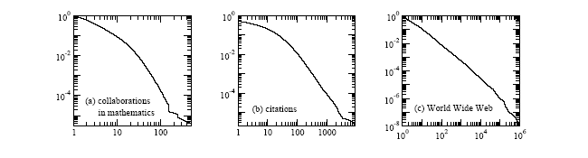
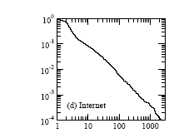
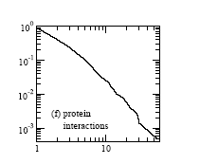
Power-laws appear in all networks!
Taken from [Newman 2003]

Slide 11
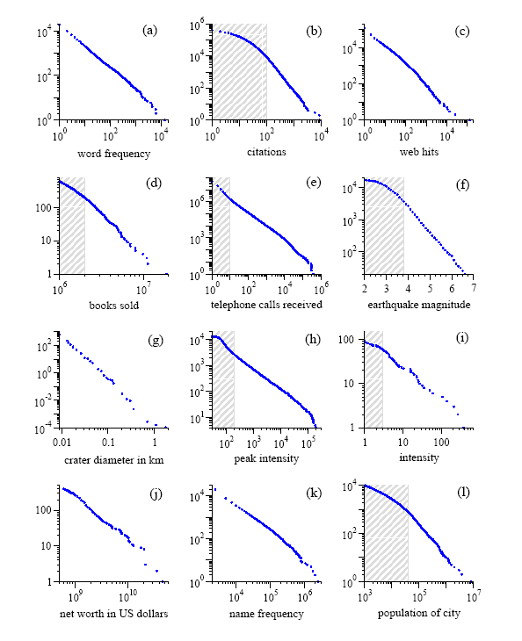
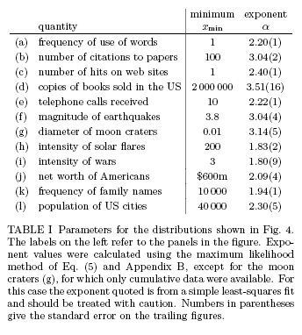
And not only in networks!

Slide 12
Measuring power-laws
How do we create these plots? How do we measure the power-law exponent?
Collect a set of measurements:
  E.g., the degree of each page, the number of appearances of each word in a document, the size of solar flares(continuous)
Create a value histogram
  For discrete values, number of times each value appears
  For continuous values (but also for discrete):
    Break the range of values into bins of equal width
    Sum the count of values in the bin
    Represent the bin by the mean (median) value
Plot the histogram in log-log scale
  Bin representatives vs Value in the bin

Slide 13
Discrete Counts

Slide 14
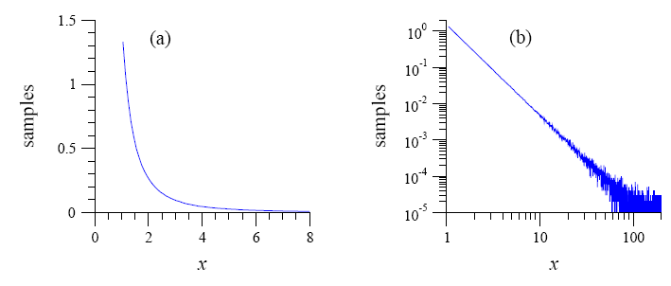
Measuring power laws
Simple binning produces a noisy plot

Slide 15
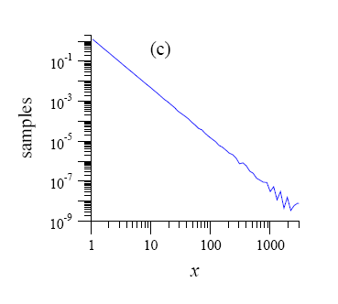
Logarithmic binning
Exponential binning
  Create bins that grow exponentially in size
  In each bin divide the sum of counts by the bin length (number of observations per bin unit)
Still some noise at the tail

Slide 16
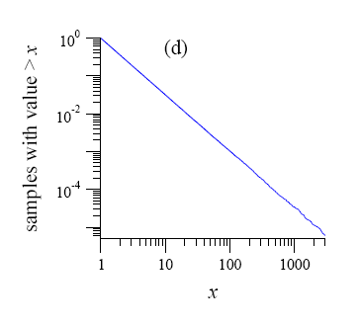
Cumulative distribution
Compute the cumulative distribution
  P[X≥x]: fraction (or number) of observations that have value at least x
  It also follows a power-law with exponent α-1

Slide 17
Pareto distribution
A random variable follows a Pareto distribution if
Power law distribution with exponent α=1+β

Slide 18
Zipf plot
There is another easy way to see the power-law, by doing the Zipf plot
  Order the values in decreasing order
  Plot the values against their rank in log-log scale
    i.e., for the r-th value x_{r}, plot the point (log(r),log(x_{r}))
  If there is a power-law you should see something like a straight line

Slide 19
Zipf’s Law
A random variable X follows Zipf’s law if the r-th largest value x_{r} satisfies
Same as Pareto distribution
X follows a power-law distribution with α=1+1/γ
Named after Zipf, who studied the distribution of words in English language and found Zipf law with exponent 1

Slide 20
Zipf vs Pareto

Slide 21
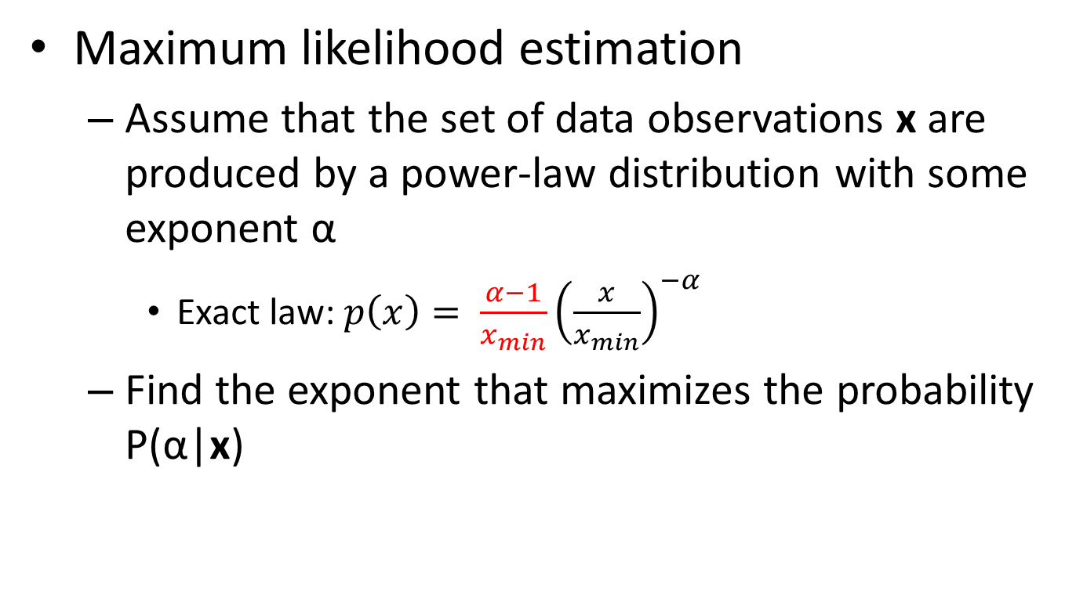
Computing the exponent
Maximum likelihood estimation
  Assume that the set of data observations x are produced by a power-law distribution with some exponent α
    Exact law: $p\left(x\right)= \frac{α−1}{x_{min}}{\left(\frac{x}{x_{min}}\right)}^{−α}$
  Find the exponent that maximizes the probability P(α|x)
Proof in M. E. J. Newman, Power laws, Pareto distributions and Zipf's law, Contemporary Physics.

Slide 22
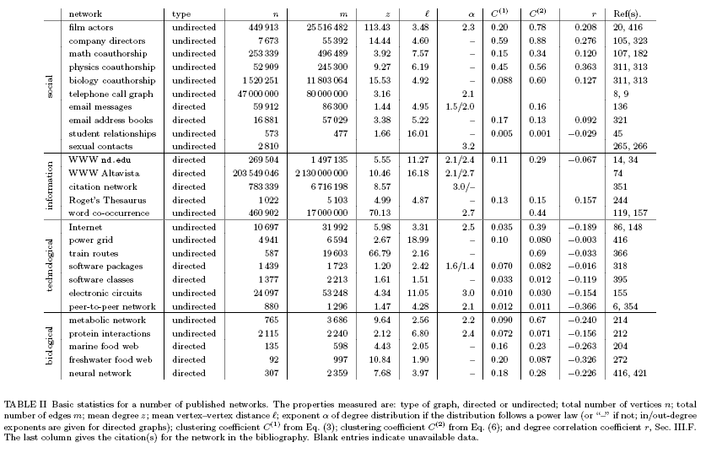
Collective Statistics (M. Newman 2003)

Slide 23
Power Laws - Recap
A (continuous) random variable X follows a power-law distribution if it has density function
A (continuous) random variable X follows a Pareto distribution if it has cumulative function
A (discrete) random variable X follows Zipf’s law if the the r-th largest value satisfies
power-law with α=1+β
power-law with α=1+1/γ

Slide 24
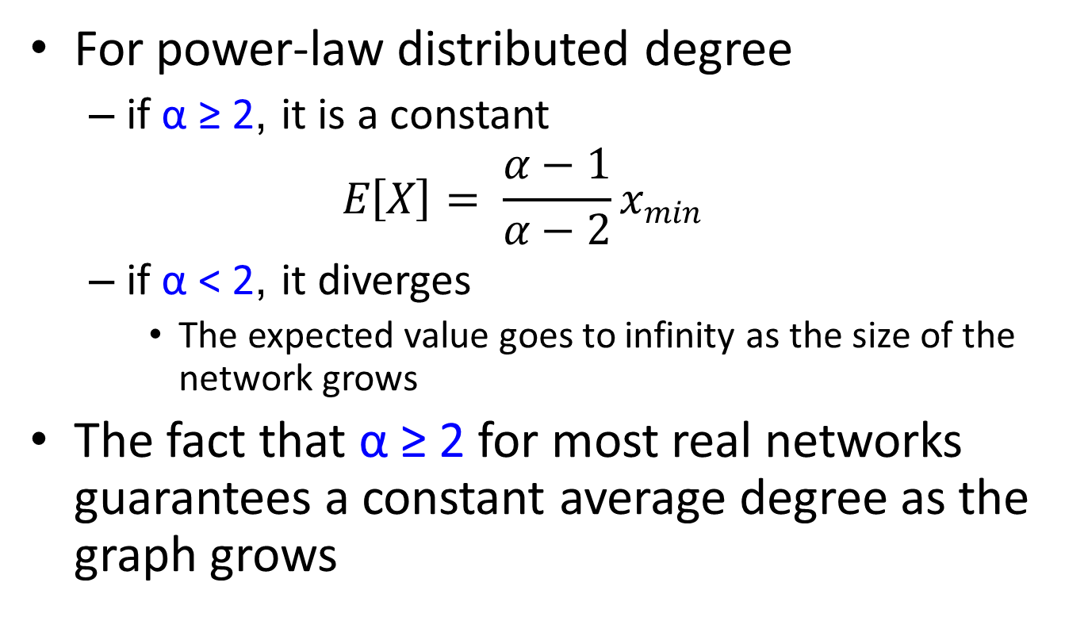
Average/Expected degree
For power-law distributed degree
  if α ≥ 2, it is a constant
  $$E\left[X\right]= \frac{α−1}{α−2}x_{min}$$
  if α < 2, it diverges
    The expected value goes to infinity as the size of the network grows
The fact that α ≥ 2 for most real networks guarantees a constant average degree as the graph grows

Slide 25
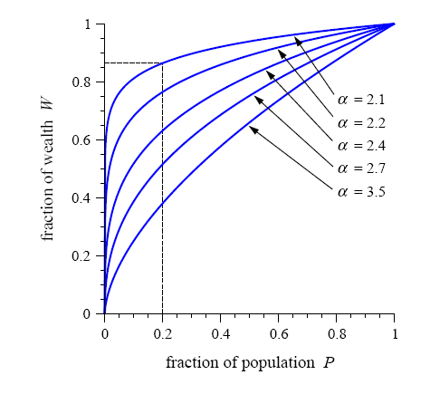
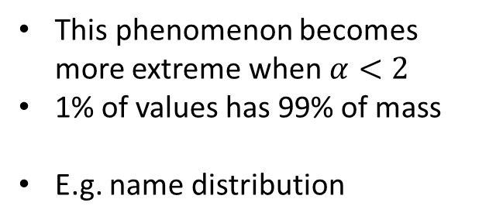
The 80/20 rule
Top-heavy: Small fraction of values collect most of distribution mass
This phenomenon becomes more extreme when $α<2$
1% of values has 99% of mass
E.g. name distribution

Slide 26
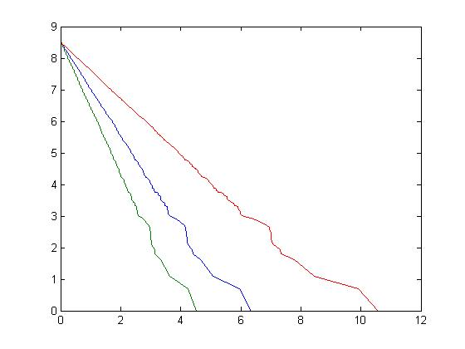



The effect of exponent
As the exponent increases the probability of observing an extreme value decreases
$$α=1.9$$
$$α=3.1$$
$$α=2.5$$

Slide 27
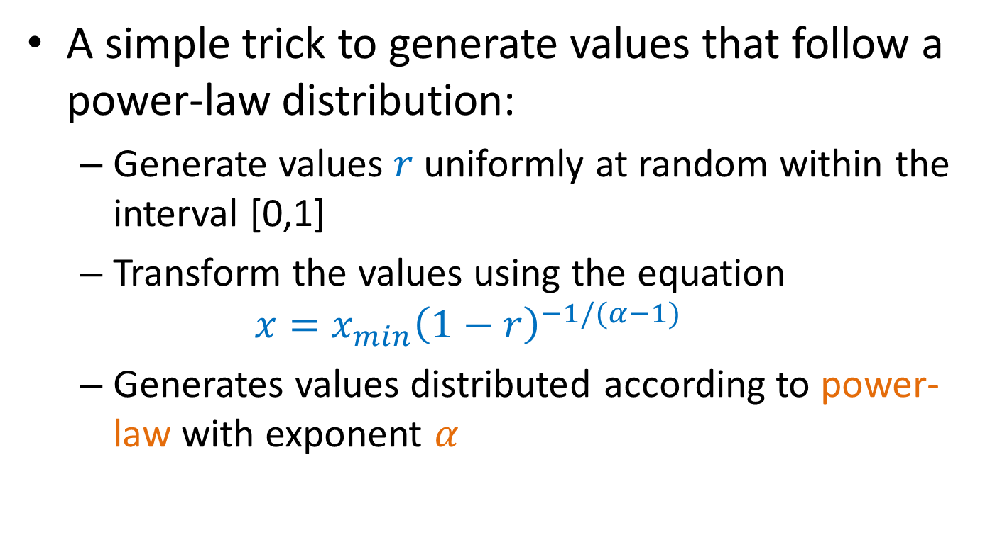
Generating power-law values
A simple trick to generate values that follow a power-law distribution:
  Generate values $r$ uniformly at random within the interval [0,1]
  Transform the values using the equation
  $$x=x_{min}{\left(1−r\right)}^{−1/(α−1)}$$
  Generates values distributed according to power-law with exponent $α$

Slide 28
Clustering (Transitivity) coefficient
Measures the density of triangles (local clusters) in the graph
Two different ways to measure it:
The ratio of the means

Slide 29
Example
1
4
3
2
5

Slide 30
Clustering (Transitivity) coefficient
Clustering coefficient for node i
The mean of the ratios

Slide 31
Example
The two clustering coefficients give different measures
C⁽²⁾ increases with nodes with low degree
1
4
3
2
5

Slide 32
Collective Statistics (M. Newman 2003)

Slide 33
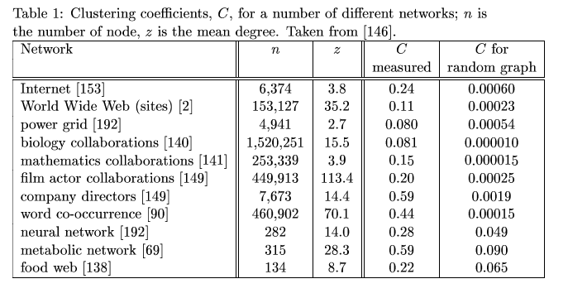
Clustering coefficient for random graphs
The probability of two of your neighbors also being neighbors is p, independent of local structure
  clustering coefficient C = p
  when the average degree z=np is constant C =O(1/n)

Slide 34
Small worlds
Millgram’s experiment: Letters were handed out to people in Nebraska to be sent to a target in Boston
People were instructed to pass on the letters to someone they knew on first-name basis
The letters that reached the destination followed paths of length around 6
Six degrees of separation: (play of John Guare)
Also:
  The Kevin Bacon game
  The Erdös number

Slide 35
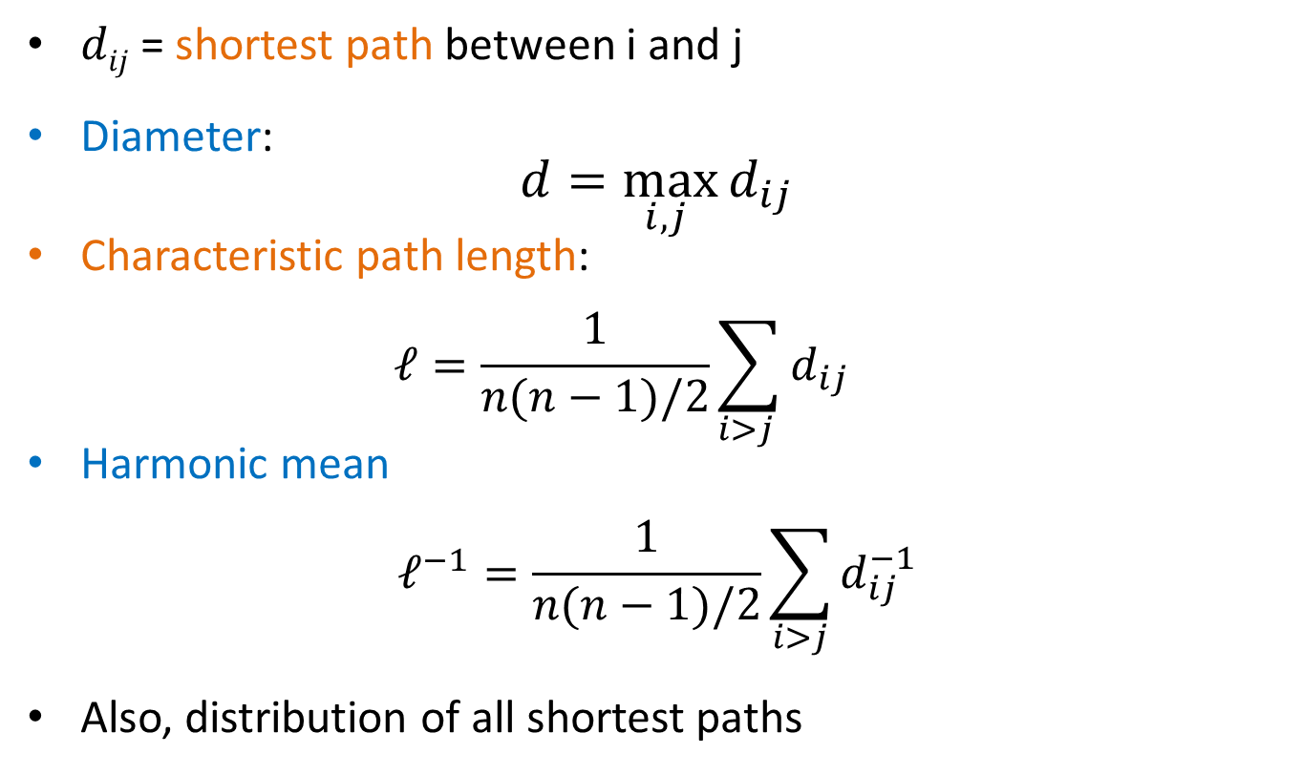
Measuring the small world phenomenon
$dij$ = shortest path between i and j
Diameter:
$$d=\max_{i,j }{d_{ij}}$$
Characteristic path length:
  $$ℓ=\frac{1}{n(n−1)/2}\sum_{i>j }{d_{ij}}$$
Harmonic mean
$$ℓ^{−1}=\frac{1}{n(n−1)/2}\sum_{i>j}{d_{ij}^{−1}}$$
Also, distribution of all shortest paths
Problem if no path between two nodes

Slide 36
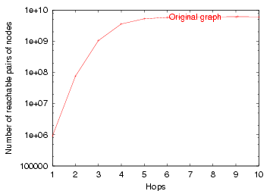
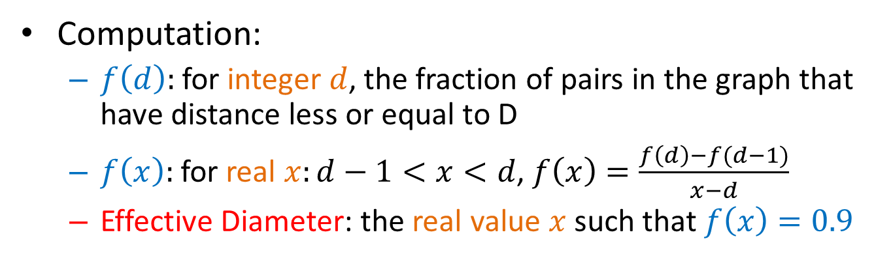
Effective Diameter
Disconnected components or isolated long paths can throw off the computation of the diameter.
Effective diameter: the interpolated value where 90% of node pairs are reachable
# reachable pairs
Effective Diameter
hops
Computation:
  $f\left(d\right):$ for integer $d$, the fraction of pairs in the graph that have distance less or equal to D
  $f\left(x\right):$ for real $x:d−1<x<d$, $f\left(x\right)=\frac{f\left(d\right)−f(d−1)}{x−d}$
  Effective Diameter: the real value $x$ such that $f\left(x\right)=0.9$

Slide 37
Collective Statistics (M. Newman 2003)

Slide 38
Small worlds in real networks
For all real networks there are (on average) short paths between nodes of the network.
  Largest path found in the IMDB actor network: 7
Is this interesting?
  Random graphs also have small diameter
  (d=logn/loglogn when z=ω(logn))
Short paths are not surprising and should be combined with other properties
  ease of navigation
  high clustering coefficient

Slide 39
Connected components
For undirected graphs, the size and distribution of the connected components
  is there a giant component?
  Most known real undirected networks have a giant component
For directed graphs, the size and distribution of strongly and weakly connected components

Slide 40
Connected components – definitions
Weakly connected components (WCC)
  Set of nodes such that from any node can go to any node via an undirected path
Strongly connected components (SCC)
  Set of nodes such that from any node can go to any node via a directed path.
  IN: Nodes that can reach the SCC (but not in the SCC)
  OUT: Nodes reachable by the SCC (but not in the SCC)
WCC
SCC

Slide 41
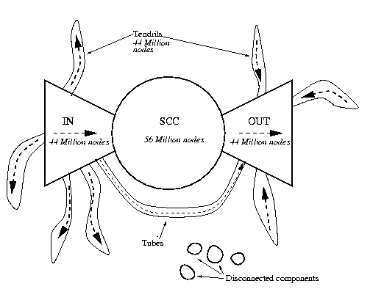
The bow-tie structure of the Web
The largest weakly connected component contains 90% of the nodes

Slide 42
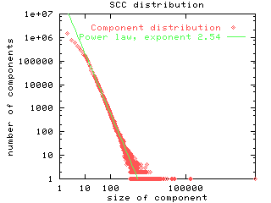
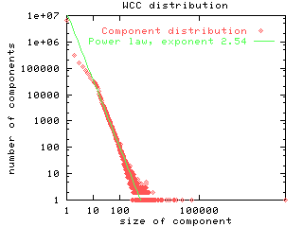
SCC and WCC distribution
The SCC and WCC sizes follows a power law distribution
  the second largest SCC is significantly smaller

Slide 43
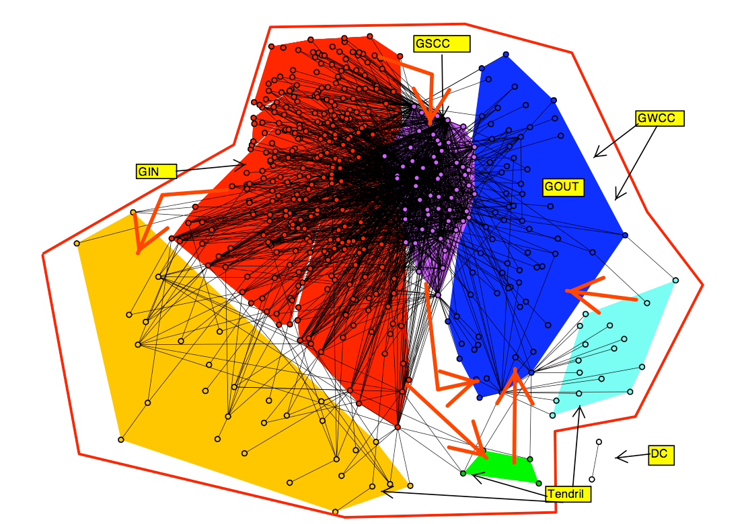
Another bow-tie
Who lends to whom

Slide 44
Web Cores
Cores: Small complete bipartite graphs (of size 3x3, 4x3, 4x4)
  Similar to the triangles for undirected graphs
Found more frequently than expected on the Web graph
Correspond to communities of enthusiasts (e.g., fans of japanese rock bands)

Slide 45
Motifs
Most networks have the same characteristics with respect to global measurements
  can we say something about the local structure of the networks?
Motifs: Find small subgraphs that over-represented in the network

Slide 46
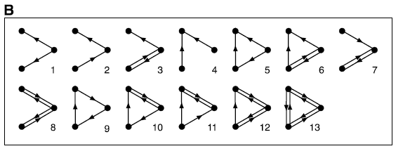
Example
Motifs of size 3 in a directed graph

Slide 47
Finding interesting motifs
Sample a part of the graph of size S
Count the frequency of the motifs of interest
Compare against the frequency of the motif in a random graph with the same number of nodes and the same degree distribution

Slide 48
Generating a random graph
Find edges (i,j) and (x,y) such that edges (i,y) and (x,j) do not exist, and swap them
  repeat for a large enough number of times
i
j
i
j
y
y
x
x
G
degrees of i,j,x,y
are preserved
G-swapped

Slide 49
The feed-forward loop
Over-represented in gene-regulation networks
  a signal delay mechanism
X
Y
Z
Milo et al. 2002

Slide 50
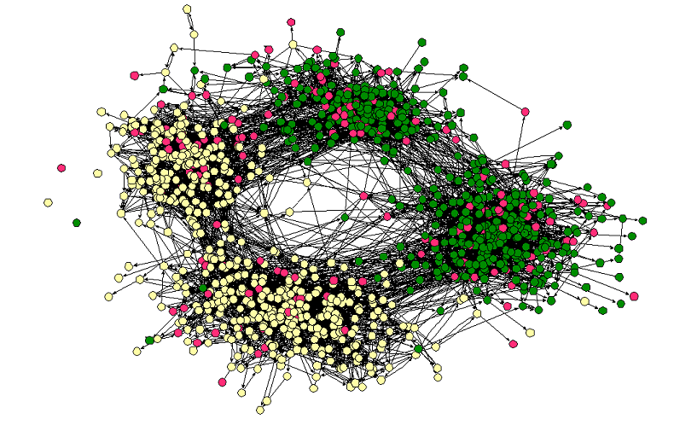
Homophily
Love of the same: People tend to have friends with common interests
  Students separated by race and age
Middle – High School
Race

Slide 51
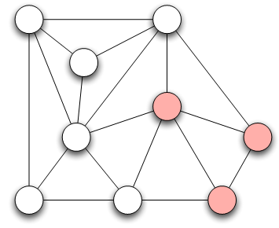
Measuring Homophily
If the fraction of cross-gender edges is significantly less than expected, then there is evidence for homophily
gender male with probability p (fraction of males)
gender female with probability q (fraction of females)
Probability of cross-gender edge?

Slide 52
Measuring Homophily
“significantly” less than
Inverse homophily
Characteristics with more than two values:
  Number of heterogeneous edges (edge between two nodes that are different)

Slide 53
Mechanisms Underlying Homophily: Selection and Social Influence
Selection: tendency of people to form friendships with others who are like then
Socialization or Social Influence: the existing social connections in a network are influencing the individual characteristics of the individuals
Social Influence as the inverse of Selection
Mutable & immutable characteristics

Slide 54
The Interplay of Selection and Social Influence
Longitudinal studies in which the social connections and the behaviors within a group are tracked over a period of time
Why?
Study teenagers, scholastic achievements/drug use (peer pressure and selection)
Relative impact?
- Effect of possible interventions (example, drug use)

Slide 55
The Interplay of Selection and Social Influence
Christakis and Fowler on obesity, 12,000 people over a period of 32-years
People more similar on obesity status to the network neighbors than if assigned randomly
Why?
(i) Because of selection effects, choose friends of similar obesity status,
(ii) Because of confounding effects of homophily according to other characteristics that correlate with obesity
(iii) Because changes in the obesity status of person’s friends was exerting an influence that affected her
(iii) As well -> “contagion” in a social sense

Slide 56
Tracking Link Formation in Online Data: interplay between selection and social influence
Underlying social network
Measure for behavioral similarity
Wikipedia
Node: Wikipedia editor who maintains a user account and user talk page
Link: if they have communicated with one writing on the user talk page of the other
Editor’s behavior: set of articles she has edited
Neighborhood overlap in the bipartite affiliation network of editors and articles consisting only of edges between editors and the articles they have edited
FACT: Wikipedia editors who have communicated are significantly more similar in their behavior than pairs of Wikipedia editors who have not (homomphily), why?
Selection (editors form connections with those have edited the same articles) vs Social Influence (editors are led to the articles of people they talk to)

Slide 57
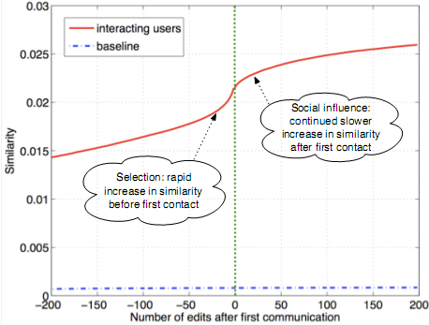
Tracking Link Formation in Online Data: interplay between selection and social influence
Actions in Wikipedia are time-stamped
For each pair of editors A and B who have ever communicated,
  Record their similarity over time
  Time 0 when they first communicated -- Time moves in discrete units, advancing by one “tick” whenever either A or B performs an action on Wikipedia
  Plot one curve for each pair of editors
Average, single plot: average level of similarity relative to the time of first interaction
Similarity is clearly increasing both before and after the moment of first interaction
(both selection and social influence)
Not symmetric around time 0 (particular role on similarity): Significant increase before they meet
Blue line shows similarity of a random pair (non-interacting)

Slide 58
References
M. E. J. Newman, Power laws, Pareto distributions and Zipf's law, Contemporary Physics.
M. E. J. Newman, The structure and function of complex networks, SIAM Reviews, 45(2): 167-256, 2003
R. Albert and A.-L. Barabási, Statistical mechanics of complex networks, Reviews of Modern Physics 74, 47-97 (2002).
S. N. Dorogovstev and J. F. F. Mendez, Evolution of Networks: From Biological Nets to the Internet and WWW.
Michalis Faloutsos, Petros Faloutsos and Christos Faloutsos. On Power-Law Relationships of the Internet Topology. ACM SIGCOMM 1999.
E. Ravasz, A. L. Somera, D. A. Mongru, Z. N. Oltvai, and A.-L. Barabási, Hierarchical organization of modularity in metabolic networks, Science 297, 1551-1555 (2002).
R Milo, S Shen-Orr, S Itzkovitz, N Kashtan, D Chklovskii & U Alon, Network Motifs: Simple Building Blocks of Complex Networks. Science, 298:824-827 (2002).
R Milo, S Itzkovitz, N Kashtan, R Levitt, S Shen-Orr, I Ayzenshtat, M Sheffer & U Alon, Superfamilies of designed and evolved networks. Science, 303:1538-42 (2004).

Slide 59
NETWORK MODELS

Slide 60
What is a network model?
Informally, a network model is a process (randomized or deterministic) for generating a graph of arbitrary size.
Models of static graphs
  input: a set of parameters Π, and the size of the graph n
  output: a graph G(Π,n)
Models of evolving graphs
  input: a set of parameters Π, and an initial graph G₀
  output: a graph G_{t} for each time t

Slide 61
Families of random graphs
A deterministic model D defines a single graph for each value of n (or t)
A randomized model R defines a probability space ‹G_{n},P› where G_{n} is the set of all graphs of size n, and P a probability distribution over the set G_{n} (similarly for t)
  we call this a family of random graphs R, or a random graph R

Slide 62
Why do we care?
Creating models for real-life graphs is important for several reasons
  Create data for simulations of processes on networks
  Identify the underlying mechanisms that govern the network generation
  Predict the evolution of networks

Slide 63
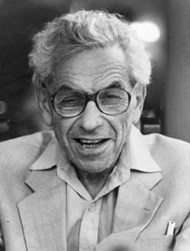
Erdös-Renyi Random graphs
Paul Erdös (1913-1996)
Notes:
Biographic information for Erdos, mostly from wikipedia

Slide 64
Erdös-Renyi Random Graphs
The G_{n,p} model
  input: the number of vertices n, and a parameter p, 0 ≤ p ≤ 1
  process: for each pair (i,j), generate the edge (i,j) independently with probability p
Related, but not identical: The G_{n,m} model
  process: select m edges uniformly at random

Slide 65
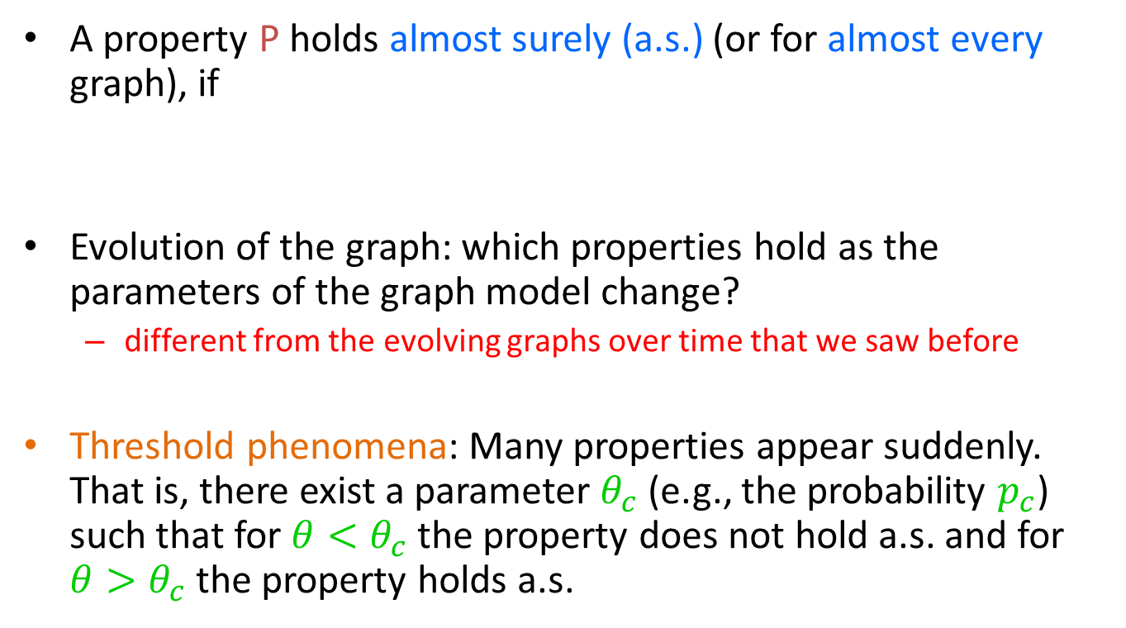
Graph properties
A property P holds almost surely (a.s.) (or for almost every graph), if
Evolution of the graph: which properties hold as the parameters of the graph model change?
  different from the evolving graphs over time that we saw before
Threshold phenomena: Many properties appear suddenly. That is, there exist a parameter $θ_{c}$ (e.g., the probability $p_{c}$) such that for $θ<θ_{c}$ the property does not hold a.s. and for $θ>θ_{c}$ the property holds a.s.

Slide 66
The giant component
Let z=np be the average degree
If z < 1, then almost surely, the largest component has size at most O(ln n)
if z > 1, then almost surely, the largest component has size Θ(n). The second largest component has size O(ln n)
if z =ω(ln n), then the graph is almost surely connected.

Slide 67
The phase transition
When z=1, there is a phase transition
  The largest component is O(n^{2/3})
  The sizes of the components follow a power-law distribution.

Slide 68
Random graphs degree distributions
The degree distribution follows a binomial
Assuming z=np is fixed, as n→∞, B(n,k,p) is approximated by a Poisson distribution
Highly concentrated around the mean, with a tail that drops exponentially

Slide 69
Phase transitions
Phase transitions (a.k.a. Threshold Phenomena, Critical phenomena) are observed in a variety of natural or human processes, and they have been studied extensively by Physicists and Mathematicians
  Also, in popular science: “The tipping point”
Examples
  Water becoming ice
  Percolation
  Giant components in graphs
In all of these examples, the transition from one state to another (e.g., from water to ice) happens almost instantaneously when a parameter crosses a threshold
At the threshold value we have critical phenomena, and the appearance of Power Laws
  There is no characteristic scale.

Slide 70
Other properties
Clustering coefficient
  C = p
Diameter (maximum path)
  L = log n / log z

Slide 71
Random graphs and real life
A beautiful and elegant theory studied exhaustively
Random graphs had been used as idealized network models
Unfortunately, they don’t capture reality…

Slide 72
Departing from the ER model
We need models that better capture the characteristics of real graphs
  degree sequences
  clustering coefficient
  short paths

Slide 73
Graphs with given degree sequences
The configuration model
  input: the degree sequence [d₁,d₂,…,d_{n}]
  process:
    Create d_{i} copies of node i
    Take a random matching (pairing) of the copies
      self-loops and multiple edges are allowed
Uniform distribution over the graphs with the given degree sequence

Slide 74
Example
Suppose that the degree sequence is
Create multiple copies of the nodes
Pair the nodes uniformly at random
Generate the resulting network
4
1
3
2

Slide 75
Power-law graphs
The critical value for the exponent α is
The clustering coefficient is
When α<7/3 the clustering coefficient increases with n

Slide 76
Graphs with given expected degree sequences
Input: the degree sequence [d₁, d₂, … ,d_{n}]
m = total number of edges
Process: generate edge (i,j) with probability d_{i}d_{j}/m
  preserves the expected degrees
  easier to analyze

Slide 77
However…
The problem is that these models are too contrived
It would be more interesting if the network structure emerged as a side product of a stochastic process rather than fixing its properties in advance.

Slide 78
Preferential Attachment in Networks
First considered by [Price 65] as a model for citation networks (directed)
  each new paper is generated with m citations (mean)
  new papers cite previous papers with probability proportional to their in-degree (citations)
  what about papers without any citations?
    each paper is considered to have a “default” a citations
    probability of citing a paper with degree k, proportional to k+a
Power law with exponent α = 2+a/m

Slide 79
Practical Issues
The model is equivalent to the following:
  With probability m/(m+a) link to a node with probability proportional to the degree.
  With probability a/(m+a) link to a node selected uniformly at random.
How do we select a node with probability proportional to the degree in practice:
  Maintain a list with the endpoints of all the edges seen so far, and select a node from this list uniformly at random
  Append the list each time new edges are created.

Slide 80
Barabasi-Albert model
The BA model (undirected graph)
  input: some initial subgraph G₀, and m the number of edges per new node
  the process:
    nodes arrive one at the time
    each node connects to m other nodes selecting them with probability proportional to their degree
    if [d₁,…,d_{t}] is the degree sequence at time t, the node t+1 links to node i with probability
Results in power-law with exponent α = 3

Slide 81
The mathematicians point of view [Bollobas-Riordan]
Self loops and multiple edges are allowed
For the single edge problem:
  At time t, a new vertex v, connects to an existing vertex u with probability
  it creates a self-loop with probability
If m edges, then they are inserted sequentially, as if inserting m nodes
  the problem reduces to studying the single edge problem.
Notes:
From Bollobas paper that we have on the web page of the course. The idea: how to simulate the preferential attachment process on a static graph. Useful for the analysis of the model. Interesting as a construction.

Slide 82
Preferential attachment graphs
Expected diameter
  if m = 1, the diameter is Θ(log n)
  if m > 1, the diameter is Θ(log n/loglog n)
Expected clustering coefficient is small

Slide 83
Weaknesses of the BA model
Technical issues:
  It is not directed (not good as a model for the Web) and when directed it gives acyclic graphs
  It focuses mainly on the (in-) degree and does not take into account other parameters (out-degree distribution, components, clustering coefficient)
  It correlates age with degree which is not always the case
Academic issues
  the model rediscovers the wheel
  preferential attachment is not the answer to every power-law
  what does “scale-free” mean exactly?
Yet, it was a breakthrough in the network research, that popularized the area

Slide 84
Variations of the BA model
Many variations have been considered some in order to address the problems with the vanilla BA model
  edge rewiring, appearance and disappearance
  fitness parameters
  variable mean degree
  non-linear preferential attachment
    surprisingly, only linear preferential attachment yields power-law graphs

Slide 85
Empirical observations for the Web graph
In a large scale experimental study by
Kumar et al, they observed that the
Web contains a large number of
small bipartite cliques (cores)
  the topical structure of the Web
a K_{3,2} clique
Such subgraphs are highly unlikely in random graphs
They are also unlikely in the BA model
Can we create a model that will have high concentration of small cliques?

Slide 86
Copying model
Input:
  the out-degree d (constant) of each node
  a parameter α
The process:
  Nodes arrive one at the time
  A new node selects uniformly one of the existing nodes as a prototype
  The new node creates d outgoing links. For the i^{th} link
    with probability α it copies the i-th link of the prototype node
    with probability 1- α it selects the target of the link uniformly at random

Slide 87


An example
d = 3

Slide 88
Copying model properties
Power law degree distribution with exponent β = (2-α)/(1- α)
Number of bipartite cliques of size i x d is ne^{-i}
The model has also found applications in biological networks
  copying mechanism in gene mutations

Slide 89
Small world Phenomena
So far we focused on obtaining graphs with power-law distributions on the degrees. What about other properties?
  Clustering coefficient: real-life networks tend to have high clustering coefficient
  Short paths: real-life networks are “small worlds”
    this property is easy to generate
  Can we combine these two properties?

Slide 90
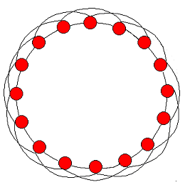
Clustering Coefficient
How can you create a graph with high clustering coefficient?
High clustering coefficient but long paths

Slide 91
Small-world Graphs
According to Watts [W99]
  Large networks (n >> 1)
  Sparse connectivity (avg degree z << n)
  No central node (k_{max} << n)
  Large clustering coefficient (larger than in random graphs of same size)
  Short average paths (~log n, close to those of random graphs of the same size)

Slide 92
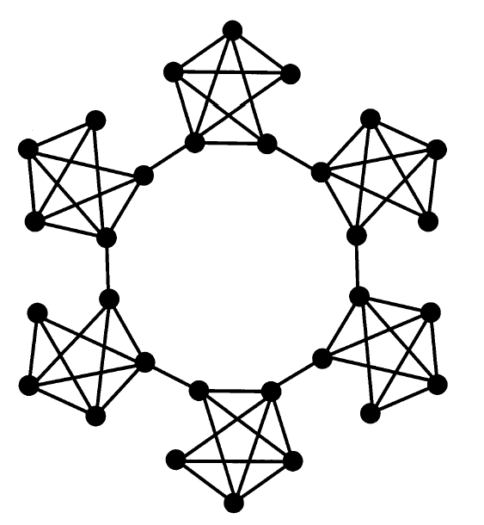
The Caveman Model [W99]
The random graph
  edges are generated completely at random
  low avg. path length L ≤ logn/logz
  low clustering coefficient C ~ z/n
The Caveman model
  edges follow a structure
  high avg. path length L ~ n/z
  high clustering coefficient C ~ 1-O(1/z)
Can we interpolate between the two?
Notes:
From the paper of Watts (by himself)

Slide 93
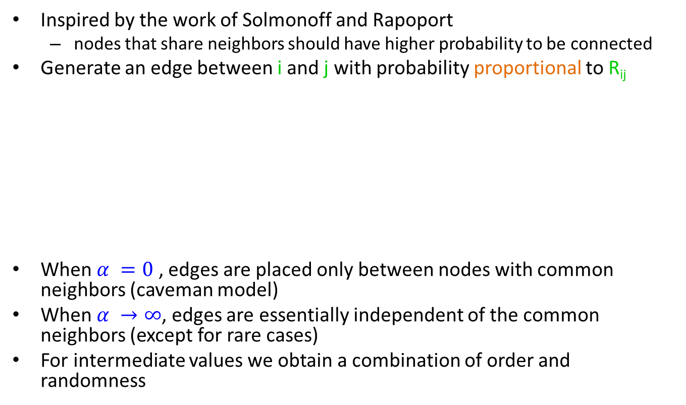
Mixing order with randomness
Inspired by the work of Solmonoff and Rapoport
  nodes that share neighbors should have higher probability to be connected
Generate an edge between i and j with probability proportional to R_{ij}
When $α =0$ , edges are placed only between nodes with common neighbors (caveman model)
When $α →∞$, edges are essentially independent of the common neighbors (except for rare cases)
For intermediate values we obtain a combination of order and randomness
m_{ij} = number of common
neighbors of i and j
z = average degree (high)
p = very small value

Slide 94
Algorithm
Start with a ring
For i = 1 … n
  Select a vertex j with probability proportional to R_{ij} and generate an edge (i,j)
Repeat until z edges are added to each vertex

Slide 95
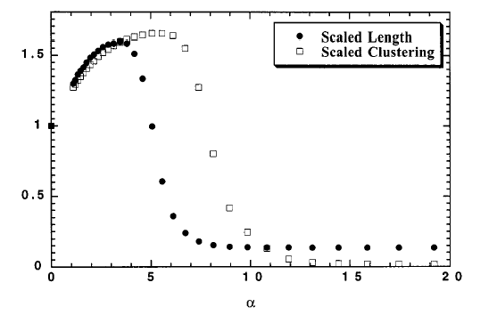
Clustering coefficient – Avg path length
small world graphs

Slide 96
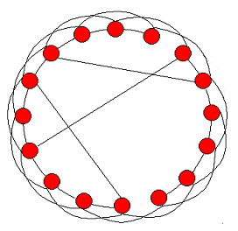
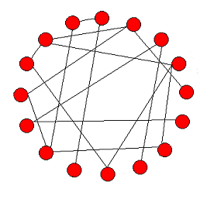
Watts and Strogatz model [WS98]
Start with a ring, where every node is connected to the next z nodes
With probability p, rewire every edge (or, add a shortcut) to a uniformly chosen destination.
  Granovetter, “The strength of weak ties”
order
randomness
p = 0
0 < p < 1
p = 1
Notes:
From the paper of Watts and Strogatz

Slide 97
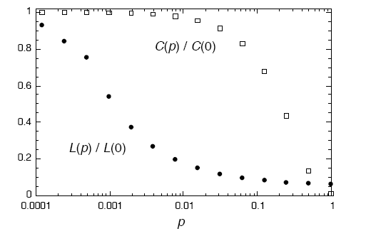
Clustering Coefficient – Characteristic Path Length
log-scale in p
When p = 0, C = 3(k-2)/4(k-1) ~ ¾
L = n/k
For small p, C ~ ¾
L ~ logn

Slide 98
Graph Theory Results
Graph theorist failed to be impressed. Most of these results were known.

Slide 99
Network models and temporal evolution
For most of the existing models it is assumed that
  number of edges grows linearly with the number of nodes
  the diameter grows at rate logn, or loglogn
What about real graphs?
  Leskovec, Kleinberg, Faloutsos 2005

Slide 100

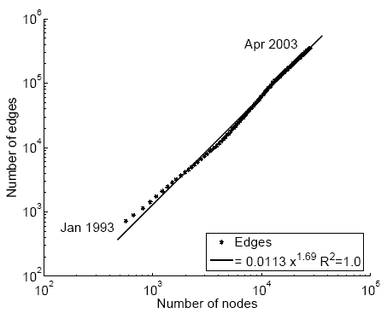
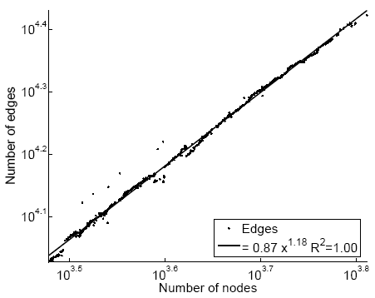
Densification laws
In real-life networks the average degree increases! – networks become denser!
α = densification exponent
E(t)
E(t)
1.69
1.18
scientific
citation network
Internet
N(t)
N(t)
Notes:
From Leskovek, Kleinberg, Faloutsos the remaining

Slide 101
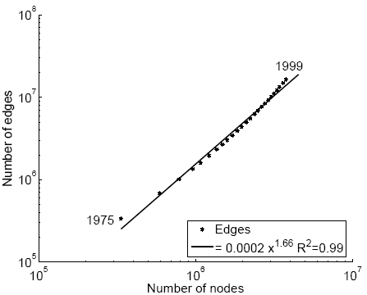
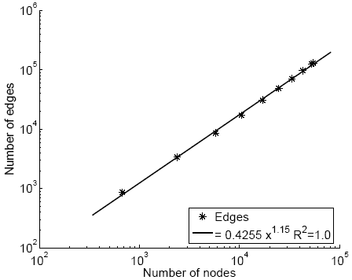
More examples
The densification exponent 1≤α≤2
  α = 1: linear growth – constant out degree
  α = 2: quadratic growth - clique
E(t)
patent citation network
movies affiliation network
E(t)
1.66
1.15
N(t)
N(t)

Slide 102
What about diameter?
Effective diameter: the interpolated value where 90% of node pairs are reachable
# reachable pairs
Effective Diameter
hops

Slide 103
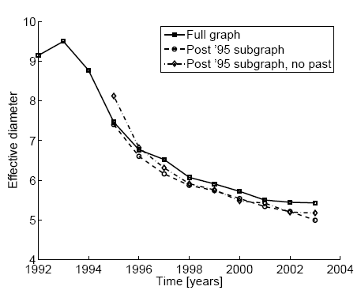
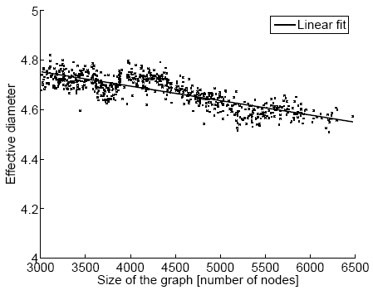
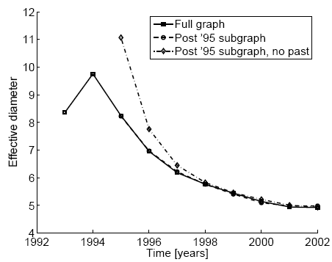
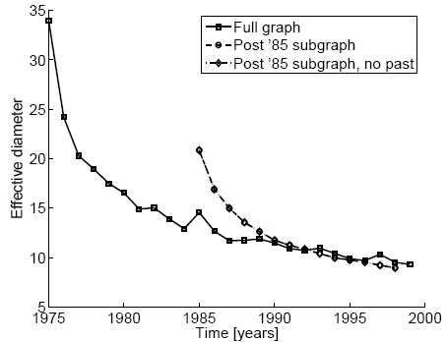
Diameter shrinks
scientific
citation network
Internet
affiliation network
patent citation network

Slide 104
Densification – Possible Explanation
Existing graph generation models do not capture the Densification Power Law and Shrinking diameters
Can we find a simple model of local behavior, which naturally leads to observed phenomena?
Two proposed models
  Community Guided Attachment – obeys Densification
  Forest Fire model – obeys Densification, Shrinking diameter (and Power Law degree distribution)

Slide 105
Community structure
Let’s assume the community structure
One expects many within-group friendships and fewer cross-group ones
How hard is it to cross communities?
University
Science
Arts
CS
Math
Drama
Music
Self-similar university
community structure
Notes:
Animation: first faces, then comminities, then edges

Slide 106

Fundamental Assumption
The cross-community linking probability of nodes at tree-distance h (the height of the least common ancestor) is scale-free
We propose cross-community linking probability:
where: c ≥ 1 … the Difficulty constant
h … tree-distance
Notes:
Animation with communities: f(1), f(2), … f(h)
Scale-free: given a subtree the probabilities are the same regardless of the remaining graph.

Slide 107

Densification Power Law
Theorem: The Community Guided Attachment leads to Densification Power Law with exponent
α … densification exponent
b … community structure branching factor
c … difficulty constant
Notes:
Animation for a,b,c

Slide 108
Difficulty Constant
Theorem:
Gives any non-integer Densification exponent
If c = 1: easy to cross communities
  Then: α = 2, quadratic growth of edges – near clique
If c = b: hard to cross communities
  Then: α = 1, linear growth of edges – constant out-degree

Slide 109
Room for Improvement
Community Guided Attachment explains Densification Power Law
Issues:
  Requires explicit Community structure
  Does not obey Shrinking Diameters
The ”Forrest Fire” model

Slide 110
“Forest Fire” model – Wish List
We want:
  no explicit Community structure
  Shrinking diameters
  and:
    “Rich get richer” attachment process, to get heavy-tailed in-degrees
    “Copying” model, to lead to communities
    Community Guided Attachment, to produce Densification Power Law
Notes:
Animation with people connected
New person
Add hierarchy
Connect
Remove hierarchy

Slide 111
“Forest Fire” model – Intuition
How do authors identify references?
  Find first paper and cite it
  Follow a few citations, make citations
  Continue recursively
  From time to time use bibliographic tools (e.g. Google Scholar) and chase back-links

Slide 112
“Forest Fire” model – Intuition
How do people make friends in a new environment?
  Find first a person and make friends
  From time to time get introduced to their friends
  Continue recursively
Forest Fire model imitates exactly this process

Slide 113
“Forest Fire” – the Model
A node arrives
Randomly chooses an “ambassador”
Starts burning nodes (with probability p) and adds links to burned nodes
“Fire” spreads recursively
Notes:
End the red line

Slide 114
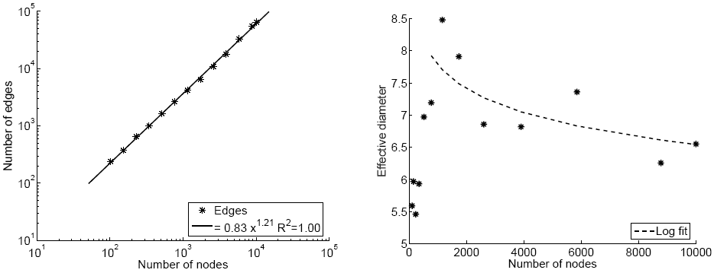
Forest Fire in Action (1)
Forest Fire generates graphs that Densify and have Shrinking Diameter
E(t)
densification
diameter
1.21
diameter
N(t)
N(t)

Slide 115
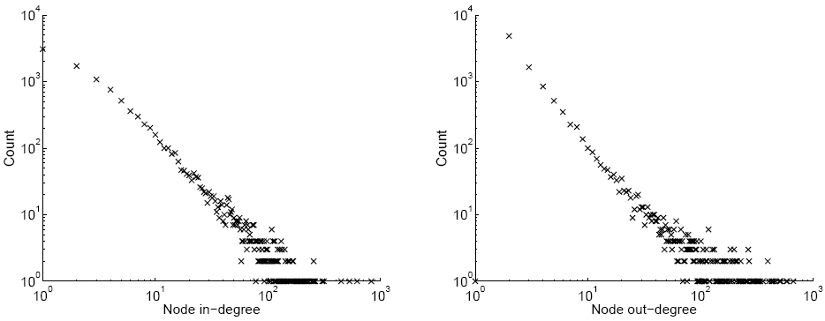
Forest Fire in Action (2)
Forest Fire also generates graphs with heavy-tailed degree distribution
in-degree
out-degree
count vs. in-degree
count vs. out-degree
Notes:
Label the axis

Slide 116
Forest Fire model – Justification
Densification Power Law:
  Similar to Community Guided Attachment
  The probability of linking decays exponentially with the distance – Densification Power Law
Power law out-degrees:
  From time to time we get large fires
Power law in-degrees:
  The fire is more likely to reach hubs

Slide 117
Forest Fire model – Justification
Communities:
  Newcomer copies neighbors’ links
Shrinking diameter

Slide 118
Kronecker graphs
Kronecker graphs are a model for generating graphs using the Kronecker product matrix operation
  Leskovec, Chakrabarti, Kleinberg, Faloutsos, PKDD 2005
Kronecker graphs have rich properties:
  Static Patterns
    Power Law Degree Distribution
    Small Diameter
    Power Law Eigenvalue and Eigenvector Distribution
  Temporal Patterns
    Densification Power Law
    Shrinking/Constant Diameter
Kronecker graphs are analytically tractable

Slide 119
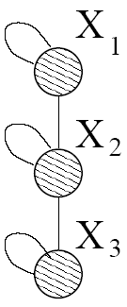
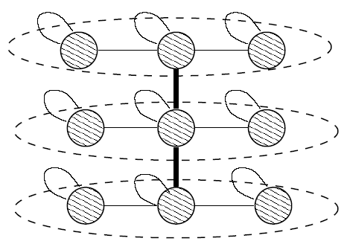
Idea: Recursive graph generation
Intuition: self-similarity leads to power-laws
Try to mimic recursive graph / community growth
There are many obvious (but wrong) ways:
Kronecker Product is a way of generating self-similar matrices
Initial graph
Recursive expansion

Slide 120





Kronecker product: Graph
Intermediate stage
(3x3)
(9x9)
Adjacency matrix
Adjacency matrix

Slide 121

Kronecker product: Definition
The Kronecker product of matrices A and B is given by
We define a Kronecker product of two graphs as a Kronecker product of their adjacency matrices
N x M
K x L
N*K x M*L

Slide 122

Kronecker graphs
We create the self-similar graphs recursively
  Start with an initiator graph G₁ on N₁ nodes and E₁ edges
  The recursion will then produce larger graphs G₂, G₃, …G_{k} on N₁^{k} nodes
We obtain a growing sequence of graphs by iterating the Kronecker product

Slide 123
Kronecker product: Graph
Continuing multypling with G₁ we obtain G₂ and so on …
0
0
0
0
0
0
0
0
0
0
0
0
0
0
0
0
0
0
G₂ adjacency matrix

Slide 124






Kronecker product: Graph
Continuing multiplying with G₁ we obtain G₂ and so on …
$$N_{1}^{2}$$
0
0
0
$$N_{1}$$
0
0
0
0
0
0
$$N_{1}$$
$$⊗$$
1
$$N_{1}^{2}$$
1
0
0
0
0
0
0
1
0
0
0
Each cell in $G_{2}$ is the product by two cells in $G_{1}$
Each cell in $G_{3}$ is the product of three cells in $G_{1}$ and so on
G₂ adjacency matrix

Slide 125
Example

Slide 126
Examples

Slide 127



Kronecker graphs: Intuition
Recursive growth of graph communities
  Nodes get expanded to micro communities
  Nodes in sub-community link among themselves and to nodes from different communities as determined by the original graph $G_{1}$
Notes:
Little graph, super-graph (g1, g2)

Slide 128
Kronecker graphs
Kronecker graphs have nice properties but they are deterministic and the distributions we obtain are not smooth:

Slide 129
Stochastic Kronecker graphs
Create N₁×N₁ probability matrix Θ₁
Compute the k^{th} Kronecker power Θ_{k}
For each entry p_{uv} of Θ_{k} include an edge (u,v) with probability p_{uv}
Probability of edge p_{uv}
Kronecker
multiplication
0.25 | 0.10 | 0.10 | 0.04
0.05 | 0.15 | 0.02 | 0.06
0.05 | 0.02 | 0.15 | 0.06
0.01 | 0.03 | 0.03 | 0.09
0.5 | 0.2
0.1 | 0.3
Instance
matrix K₂
Θ₁
For each p_{uv} flip Bernoulli coin
Θ₂=Θ₁⊗Θ₁

Slide 130

Stochastic Kronecker graphs: Intuition
Node attribute representation
  Nodes are described by $k$features
    [in Ioannina, student, computer science]
    u=[1,1,0], v=[1, 1,1]
  Parameter matrix gives the linking probability
    p(u,v) = 0.5 * 0.5* 0.1 = 0.025
1 0
Both in Ioannina
Both students
One CS one not
Θ₁
1
0
0.5 | 0.1
0.1 | 0.3
We could have different probabilities for different attributes
Notes:
Little graph, super-graph (g1, g2)

Slide 131
Kronecker graph construction
We can construct the graph by flipping a coin for each of the possible edges.
  But this is expensive, quadratic number of coins to flip.
We can exploit the recursive/hierarchical nature of Kronecker graphs

Slide 132

Kronecker graph construction
If for $P_{1}$ we have that $E_{1}=\sum_{ij}{θ_{ij}}$ then the number of edges is normally distributed with expectation $E_{1}^{k}$
Process:
  Sample the number of edges from the normal distribution
  For each edge to be added, descend to the position of the edge:
    Pick a top-level cell with probability $θ_{ij}/E_{1}$
    Within the top-level cell repeat recursively
    Until you have gone down $k$ levels

Slide 133

Example
To generate the edge $(v_{2},v_{3})$ first we pick the top quadrant
Then within that we pick the exact cell of the matrix.

Slide 134
Properties of Kronecker graphs
We prove that Kronecker multiplication generates graphs that obey [PKDD’05]
  Properties of static networks
    Power Law Degree Distribution
    Power Law eigenvalue and eigenvector distribution
    Small Diameter
  Properties of dynamic networks
    Densification Power Law
    Shrinking/Stabilizing Diameter
Good news: Kronecker graphs have the necessary expressive power
✓
✓
✓
✓
✓

Slide 135


Experiments
Use a 4-star as the graph $G_{1}$
Make the matrix stochastic by having probability α for all edges and β for all non-edges in the matrix
1
1
1
1
α
α
α
α
1
1
0
0
α
α
β
β
1
0
1
0
α
β
α
β
1
0
0
1
α
β
β
α

Slide 136


Slide 137


Slide 138


Slide 139

Threshold phenomena

Slide 140

Model estimation: approach
How do we choose the parameters to match the properties of a real network?
Maximum likelihood estimation
  Given real graph G
  Estimate Kronecker initiator graph Θ (e.g., ) which
We need to (efficiently) calculate
And maximize over Θ (e.g., using gradient descent)

Slide 141
Fitting Kronecker graphs
G
Given a graph G and Kronecker matrix Θ we calculate probability that Θ generated G P(G|Θ)
0.25 | 0.10 | 0.10 | 0.04
0.05 | 0.15 | 0.02 | 0.06
0.05 | 0.02 | 0.15 | 0.06
0.01 | 0.03 | 0.03 | 0.09
1 | 0 | 1 | 1
0 | 1 | 0 | 1
1 | 0 | 1 | 1
1 | 1 | 1 | 1
0.5 | 0.2
0.1 | 0.3
Θ
Θ_{k}
G
P(G|Θ)

Slide 142
Challenge 1: Node correspondence
Θ_{k}
Θ
0.25 | 0.10 | 0.10 | 0.04
0.05 | 0.15 | 0.02 | 0.06
0.05 | 0.02 | 0.15 | 0.06
0.01 | 0.03 | 0.03 | 0.09
Nodes are unlabeled
Graphs G’ and G” should have the same probability
P(G’|Θ) = P(G”|Θ)
One needs to consider all node correspondences σ
All correspondences are a priori equally likely
There are O(N!) correspondences
Solution: Sample from the possible distributions
0.5 | 0.2
0.1 | 0.3
σ
G’
1
1 | 0 | 1 | 0
0 | 1 | 1 | 1
1 | 1 | 1 | 1
0 | 0 | 1 | 1
3
2
4
G”
2
1 | 0 | 1 | 1
0 | 1 | 0 | 1
1 | 0 | 1 | 1
1 | 1 | 1 | 1
4
1
3
P(G’|Θ) = P(G”|Θ)

Slide 143
Challenge 2: Calculating P(G|Θ,σ)
Calculating naively P(G|Θ,σ) takes O(N²)
Idea:
  First calculate likelihood of empty graph, a graph with 0 edges
  Correct the likelihood for edges that we observe in the graph
By exploiting the structure of Kronecker product we obtain closed form for likelihood of an empty graph

Slide 144
Challenge 2: Calculating P(G|Θ,σ)
We approximate the likelihood:
The sum goes only over the edges
Evaluating P(G|Θ,σ) takes O(E) time
Real graphs are sparse, E << N²
Empty graph
No-edge likelihood
Edge likelihood
Notes:
ADD ANIMATION

Slide 145
Experiments: real networks
Experimental setup:
  Given real graph
  Stochastic gradient descent from random initial point
  Obtain estimated parameters
  Generate synthetic graphs
  Compare properties of both graphs
We do not fit the properties themselves
We fit the likelihood and then compare the graph properties

Slide 146
AS graph (N=6500, E=26500)
Autonomous systems (internet)
We search the space of ~10^{50,000} permutations
Fitting takes 20 minutes
AS graph is undirected and estimated parameter matrix is symmetric:
0.98 | 0.58
0.58 | 0.06

Slide 147

AS: comparing graph properties
Generate synthetic graph using estimated parameters
Compare the properties of two graphs
Degree distribution
Hop plot
log # of reachable pairs
diameter=4
log count
log degree
number of hops

Slide 148

AS: comparing graph properties
Spectral properties of graph adjacency matrices
Scree plot
Network value
log eigenvalue
log value
log rank
log rank

Slide 149


Epinions graph (N=76k, E=510k)
We search the space of ~10^{1,000,000} permutations
Fitting takes 2 hours
The structure of the estimated parameter gives insight into the structure of the graph
0.99 | 0.54
0.49 | 0.13
Degree distribution
Hop plot
log count
log # of reachable pairs
log degree
number of hops

Slide 150

Epinions graph (N=76k, E=510k)
Scree plot
Network value
log eigenvalue
log rank
log rank

Slide 151
Scalability
Fitting scales linearly with the number of edges

Slide 152
Conclusion
Kronecker Graph model has
  provable properties
  small number of parameters
We developed scalable algorithms for fitting Kronecker Graphs
We can efficiently search large space (~10^{1,000,000}) of permutations
Kronecker graphs fit well real networks using few parameters
We match graph properties without a priori deciding on which ones to fit

Slide 153
References
  Graphs over Time: Densification Laws, Shrinking Diameters and Possible Explanations, by Jure Leskovec, Jon Kleinberg, Christos Faloutsos, ACM KDD 2005
  Graph Evolution: Densification and Shrinking Diameters, by Jure Leskovec, Jon Kleinberg and Christos Faloutsos, ACM TKDD 2007
  Realistic, Mathematically Tractable Graph Generation and Evolution, Using Kronecker Multiplication, by Jure Leskovec, Deepay Chakrabarti, Jon Kleinberg and Christos Faloutsos, PKDD 2005
  Scalable Modeling of Real Graphs using Kronecker Multiplication, by Jure Leskovec and Christos Faloutsos, ICML 2007
Acknowledgements: Christos Faloutsos, Jon Kleinberg, Zoubin Gharamani, Pall Melsted, Alan Frieze, Larry Wasserman, Carlos Guestrin, Deepay Chakrabarti

Slide 154
Acknowledgements
Many thanks to Jure Leskovec for his slides from the KDD 2005 paper and his slides on Kronecker graphs

Slide 155
References
M. E. J. Newman, The structure and function of complex networks, SIAM Reviews, 45(2): 167-256, 2003
R. Albert and L.A. Barabasi, Statistical Mechanics of Complex Networks, Rev. Mod. Phys. 74, 47-97 (2002).
B. Bollobas, Mathematical Results in Scale-Free random Graphs
D.J. Watts. Networks, Dynamics and Small-World Phenomenon, American Journal of Sociology, Vol. 105, Number 2, 493-527, 1999
Watts, D. J. and S. H. Strogatz. Collective dynamics of 'small-world' networks. Nature 393:440-42, 1998
Michael T. Gastner and M. E. J. Newman, Optimal design of spatial distribution networks, Phys. Rev. E 74, 016117 (2006).J.
Leskovec, J. Kleinberg, C. Faloutsos. Graphs over Time: Densification Laws, Shrinking Diameters and Possible Explanations. Proc. 11th ACM SIGKDD Intl. Conf. on Knowledge Discovery and Data Mining, 2005.
Jure Leskovec, Deepayan Chakrabarti, Jon M. Kleinberg, Christos Faloutsos, Zoubin Ghahramani, Kronecker Graphs: An Approach to Modeling Networks. Journal of Machine Learning Research 11: 985-1042 (2010)

