Slide 1
Online Social Networks and Media
Diffusion:
Epidemic Spread
Influence Maximization

Slide 2
Introduction
Diffusion: process by which a piece of information is spread and reaches individuals through interactions

Slide 3
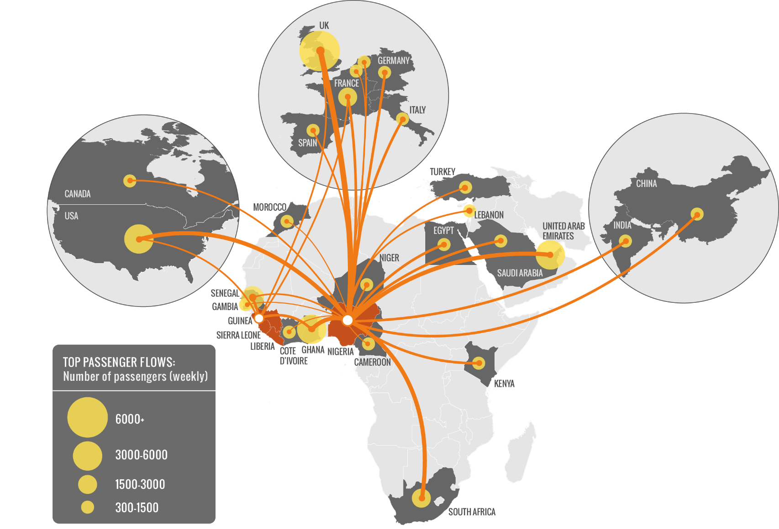
Why do we care?
Modeling epidemics

Slide 4
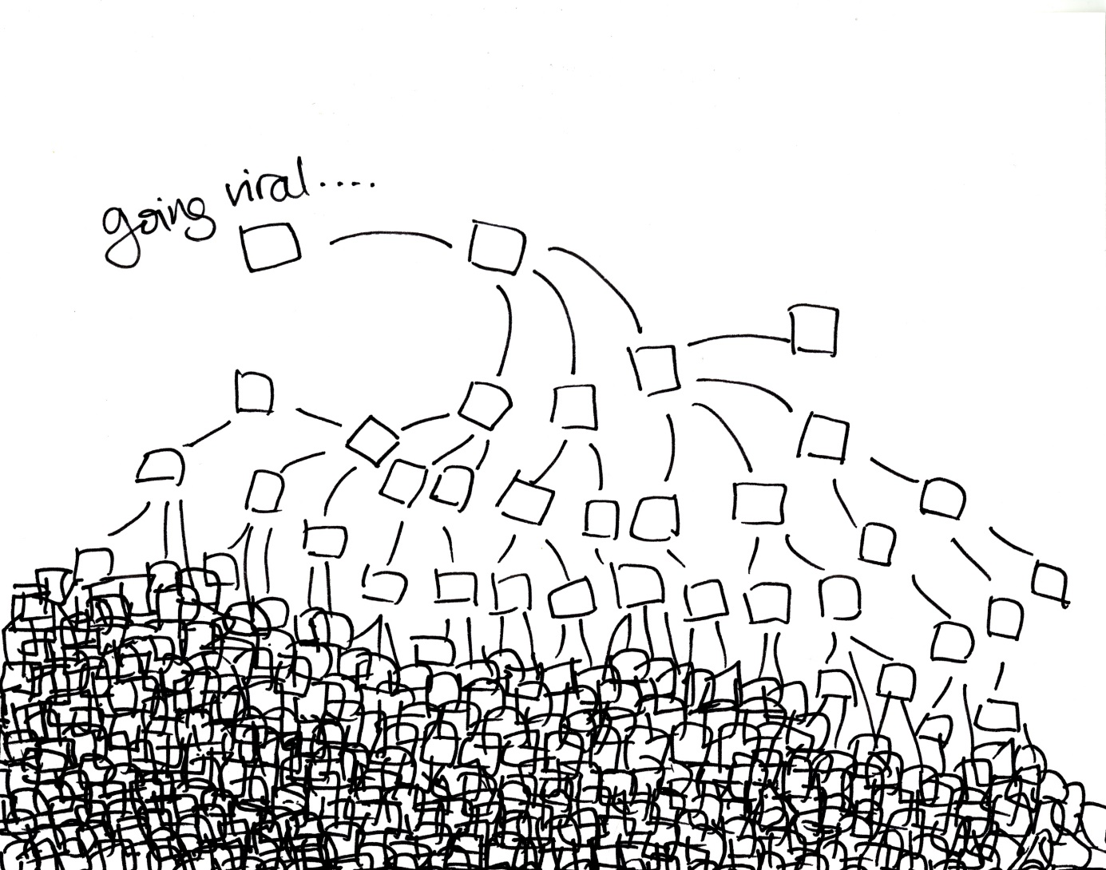
Why do we care?
Viral marketing

Slide 5
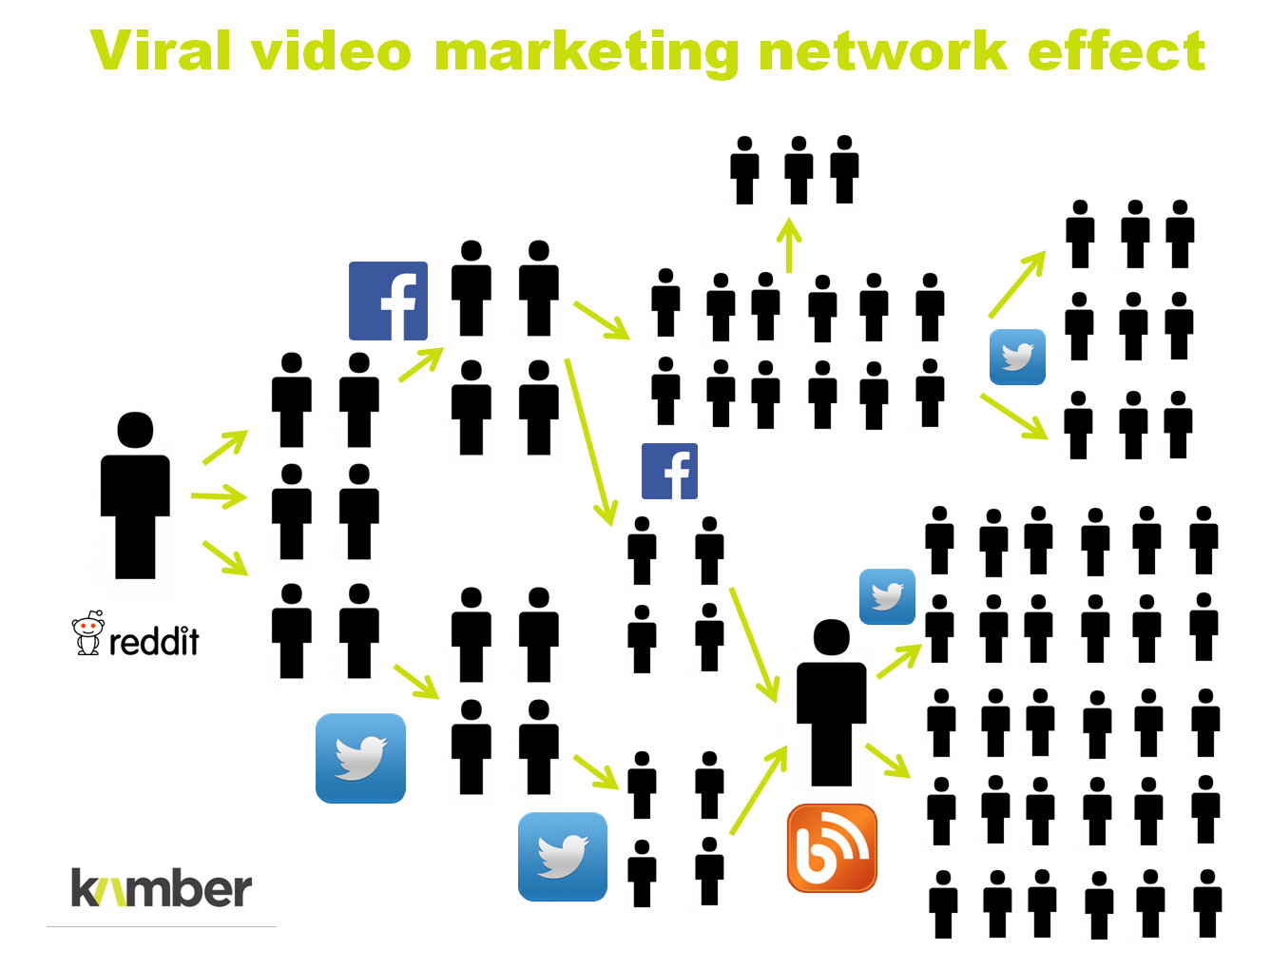
Why do we care?
Viral marketing

Slide 6
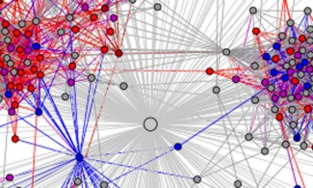
Why do we care?
Spread of innovation

Slide 7

Why do we care?
Opinion dynamics

Slide 8
Outline
Epidemic models
Influence maximization
Opinion formation models

Slide 9
Epidemic Spread

Slide 10

Epidemics
Understanding the spread of viruses and epidemics is of great interest to
Health officials
Sociologists
Mathematicians
Hollywood
The underlying contact network clearly affects the spread of an epidemic

Slide 11
Epidemics
Model epidemic spread as a random process on the graph and study its properties
Questions that we can answer:
  What is the projected growth of the infected population?
  Will the epidemic take over most of the network?
  How can we contain the epidemic spread?
Diffusion of ideas and the spread of influence can also be modeled as epidemics

Slide 12
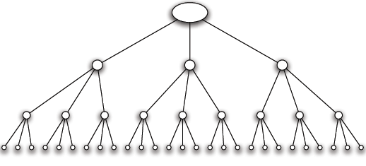
A simple model
Branching process: A person transmits the disease to each people she meets independently with a probability p
An infected person meets k (new) people while she is contagious
Infection proceeds in waves.
Contact network is a tree with branching factor k

Slide 13
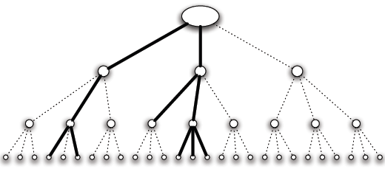
Infection Spread
We are interested in the number of people infected (spread) and the duration of the infection
This depends on the infection probability p and the branching factor k
An aggressive epidemic with high infection probability
The epidemic survives after three steps

Slide 14
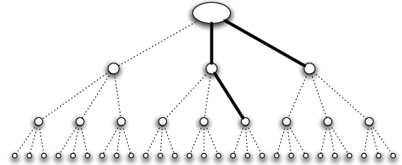
Infection Spread
We are interested in the number of people infected (spread) and the duration of the infection
This depends on the infection probability p and the branching factor k
A mild epidemic with low infection probability
The epidemic dies out after two steps

Slide 15
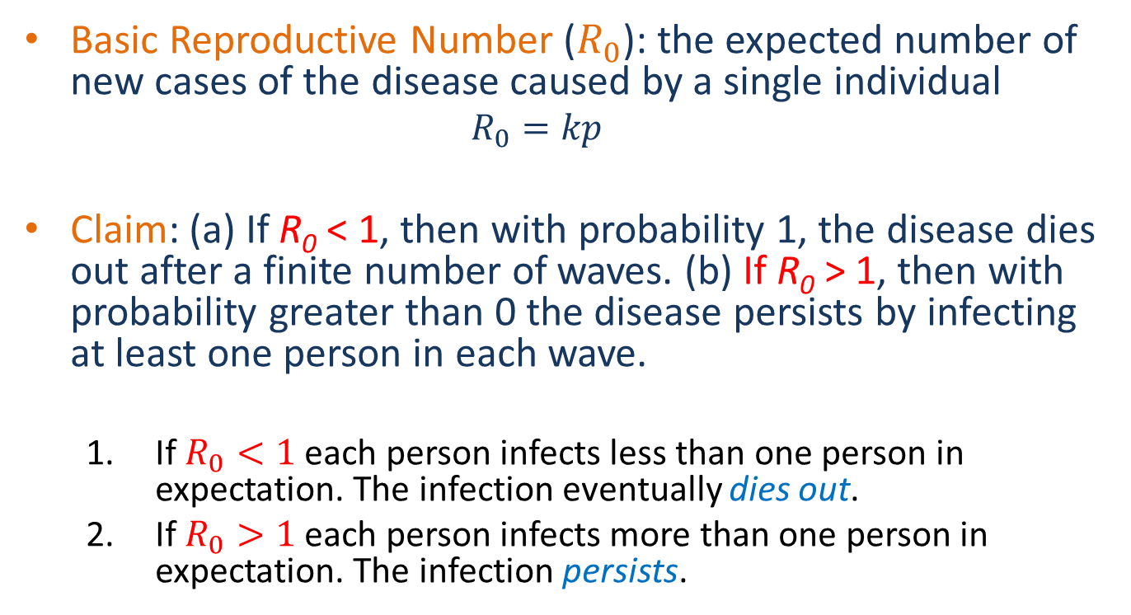
Basic Reproductive Number
Basic Reproductive Number ($R_{0}$): the expected number of new cases of the disease caused by a single individual
  $$R_{0}=kp$$
Claim: (a) If R₀ < 1, then with probability 1, the disease dies out after a finite number of waves. (b) If R₀ > 1, then with probability greater than 0 the disease persists by infecting at least one person in each wave.
  If $R_{0}<1$ each person infects less than one person in expectation. The infection eventually dies out.
  If $R_{0}>1$ each person infects more than one person in expectation. The infection persists.
Application: Reduce k, or p to combat an epidemic

Slide 16
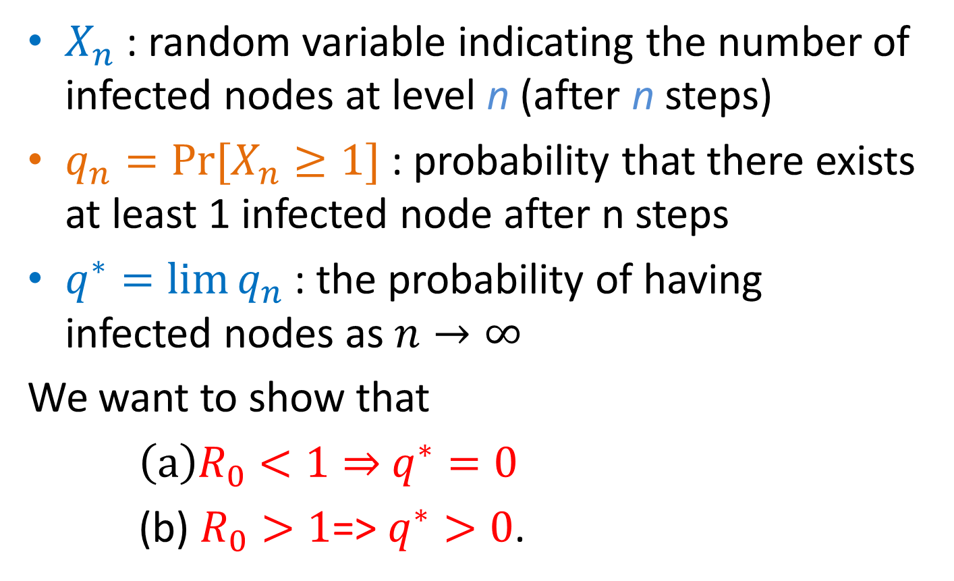
Analysis
$X_{n}$ : random variable indicating the number of infected nodes at level n (after n steps)
$q_{n}=Pr⁡[X_{n}≥1]$ : probability that there exists at least 1 infected node after n steps
$q^{∗}=lim⁡q_{n}$ : the probability of having infected nodes as $n→∞$
We want to show that
$\left(a\right)R_{0}<1⇒$ $q^{∗}=0$
(b) $R_{0}>1$=> $q^{∗}>0$.

Slide 17
Proof
At level n, k^{n} nodes
Y_{nj}: 1 if node j at level n is infected, 0 otherwise E[Y_{nj}] = p^{n}
E[X_{n}] = R₀^{n}
E[X_{n}] ≥ Pr[X_{n} ≥ 1] => q_{n} ≤ R₀^{n}
This proves (a) but not (b)

Slide 18
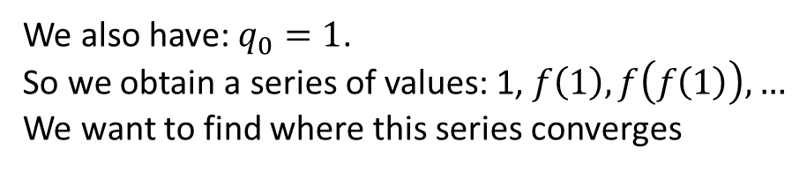

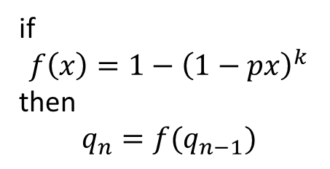




Proof
Each child of the root starts a branching process of length n-1
p
p
p
$$q_{n}=1−{\left(1−pq_{n−1}\right)}^{k}$$
if
$$f\left(x\right)=1−{\left(1−px\right)}^{k}$$
then
$$q_{n}=f(q_{n−1})$$
n-1
$$q_{n−1}$$
$$q_{n−1}$$
$$q_{n−1}$$
We also have: $q_{0}=1$.
So we obtain a series of values: 1, $f\left(1\right), f\left(f\left(1\right)\right),…$
We want to find where this series converges
$$q_{n}$$

Slide 19
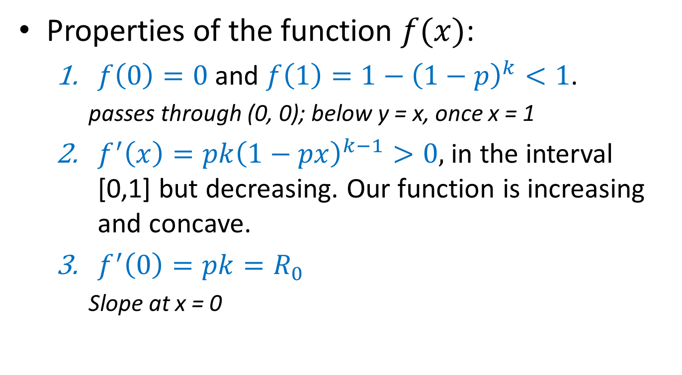
Proof
Properties of the function $f(x)$:
  $f\left(0\right)=0$ and $f\left(1\right)=1−{\left(1−p\right)}^{k}<1$.
    passes through (0, 0); below y = x, once x = 1
  $f^{′}\left(x\right)=pk{\left(1−px\right)}^{k−1}>0,$ in the interval [0,1] but decreasing. Our function is increasing and concave.
  $f^{′}\left(0\right)=pk=R_{0}$
    Slope at x = 0

Slide 20

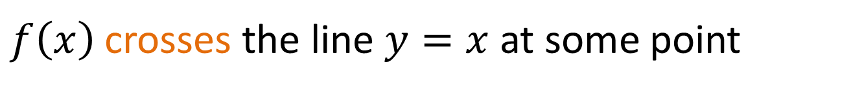
Proof
Case 1: $R_{0}=pk>1$. The function starts with above the line $y=x$ but then drops below the line.
$f\left(x\right)$ crosses the line $y=x$ at some point

Slide 21

Proof
Starting from the value 1, repeated applications of the function $f\left(x\right)$ will converge to the value $q^{∗}=q_{n}=f(q_{n})$

Slide 22

Proof
Case 2: $R_{0}=pk<1$. The function starts with below the line $y=x.$ Repeated applications of $f(x)$ converge to zero.

Slide 23
Branching process
Assumes no network structure, no triangles or shared neighbors

Slide 24
The SIR model
Each node may be in the following states
  Susceptible: healthy but not immune
  Infected: has the virus and can actively propagate it
  Removed: (Immune or Dead) had the virus but it is no longer active
Parameter p: the probability of an Infected node to infect a Susceptible neighbor

Slide 25
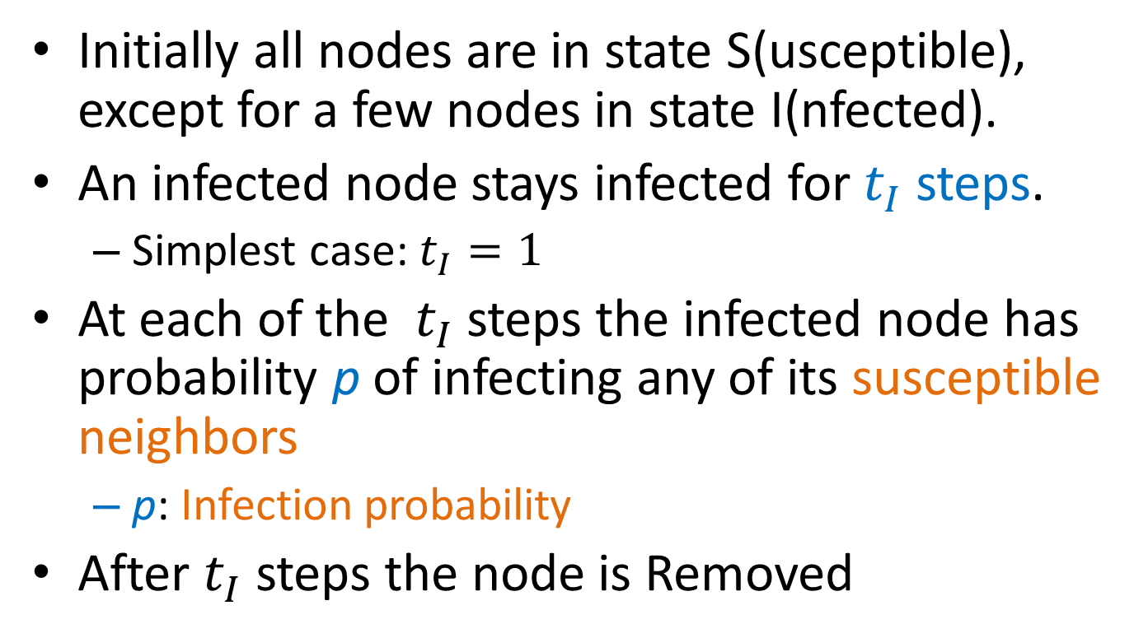
The SIR process
Initially all nodes are in state S(usceptible), except for a few nodes in state I(nfected).
An infected node stays infected for $t_{I}$ steps.
  Simplest case: $t_{I}=1$
At each of the $t_{I}$ steps the infected node has probability p of infecting any of its susceptible neighbors
  p: Infection probability
After $t_{I}$ steps the node is Removed

Slide 26
Example

Slide 27
Example

Slide 28
Example

Slide 29
Example

Slide 30
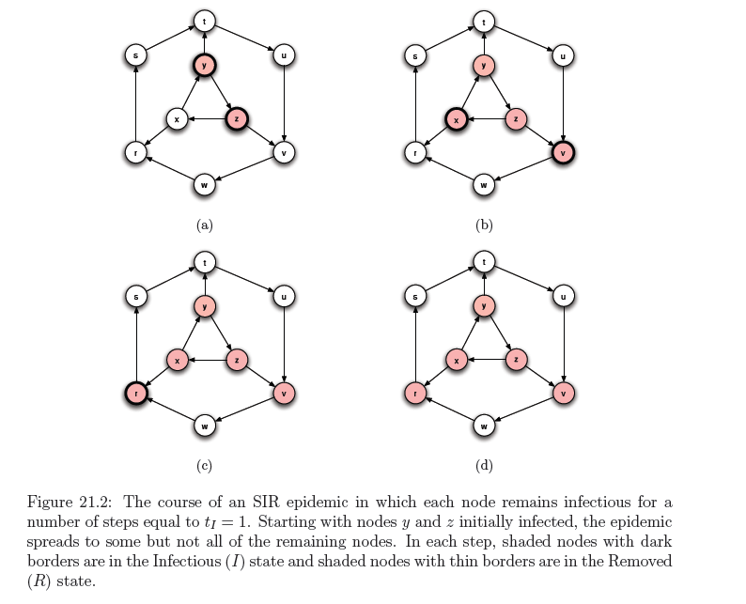

Slide 31
Extensions
Probability per pair of nodes
Sequence of several states (e.g. early, middle, and late periods of the infection), and allowing the contagion probabilities to vary across these states
Mutating, change the characteristics

Slide 32
SIR and the Branching process
The branching process is a special case where the graph is a tree (and the infected node is the root)
  The existence of triangles shared neighbors makes a big difference
The basic reproductive number is not necessarily informative in the general case

Slide 33
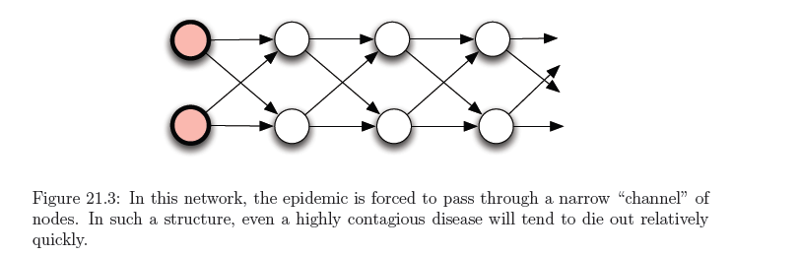
SIR and the Branching process
Example
R₀ the expected number of new cases caused by a single node
assume
p = 2/3,
R₀ = 4/3 > 1
Probability to fail at each level and stop (1/3)⁴ = 1/81
Notes:
In each layer, there are four edges leading to the next layer, and each will independently fail to transmit the disease with probability 1/3. Therefore, with probability (1/3)4 = 1/81, all four edges will fail to transmit the disease — and at this point, these four edges become a “roadblock” guaranteeing the disease can never reach the portion of the network beyond them.
Thus, as the disease moves along layer-by-layer, there is a probability of at least 1/81 that each layer will be its last. Therefore, with probability 1, it must come to an end after a finite number of layers.

Slide 34
Percolation
Percolation: we have a network of “pipes” which can carry liquids, and they can be either open, or closed
  The pipes can be pathways within a material
If liquid enters the network from some nodes, does it reach most of the network?
  The network percolates

Slide 35
SIR and Percolation
There is a connection between SIR model and percolation
When a virus is transmitted from u to v, the edge (u, v) is activated with probability p
We can assume that all edge activations have happened in advance, and the input graph has only the active edges.
Which nodes will be infected?
  The nodes reachable from the initial infected nodes
In this way we transformed the dynamic SIR process into a static one.
  This is essentially percolation in the graph.

Slide 36
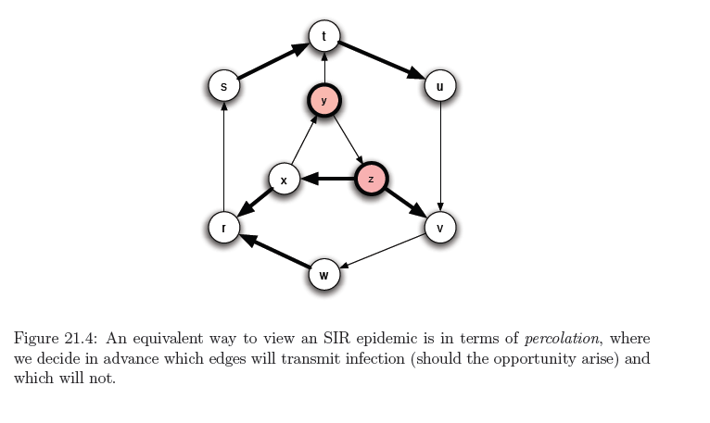
Example

Slide 37
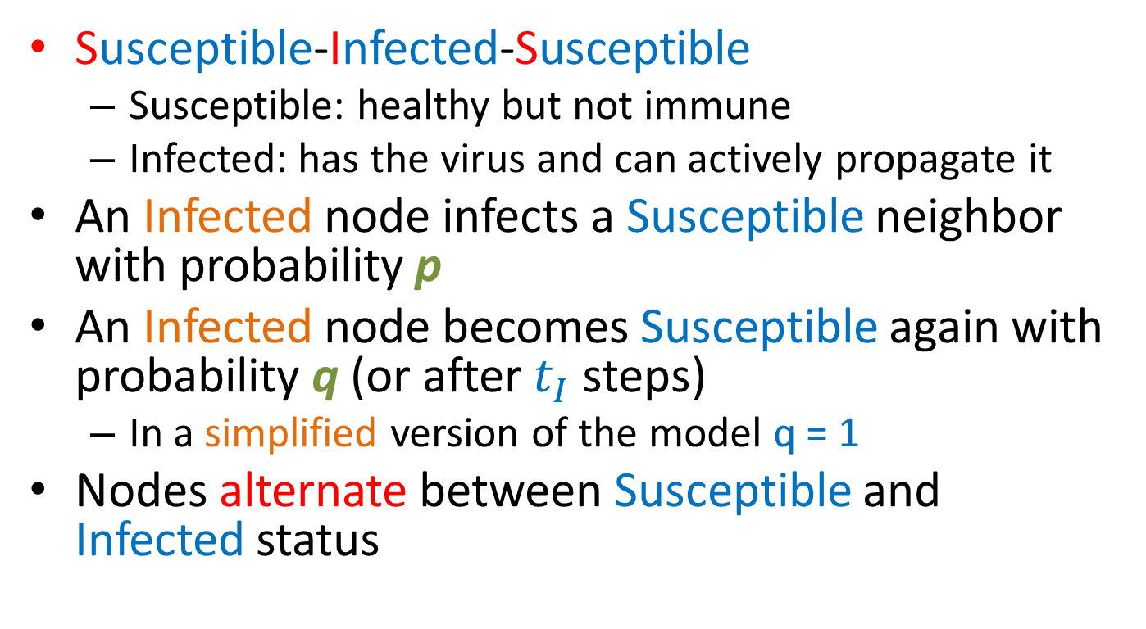
The SIS model
Susceptible-Infected-Susceptible
  Susceptible: healthy but not immune
  Infected: has the virus and can actively propagate it
An Infected node infects a Susceptible neighbor with probability p
An Infected node becomes Susceptible again with probability q (or after $t_{I}$ steps)
  In a simplified version of the model q = 1
Nodes alternate between Susceptible and Infected status

Slide 38
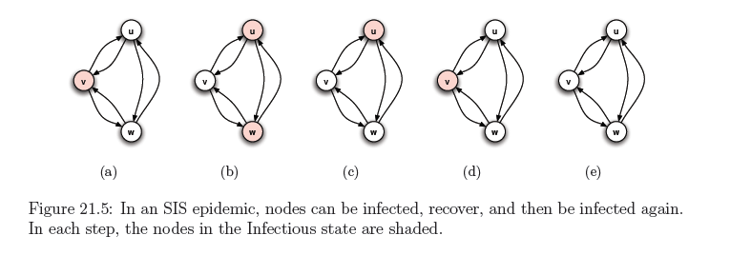
Example
When no Infected nodes, virus dies out
Question: will the virus die out?

Slide 39

An eigenvalue point of view
If A is the adjacency matrix of the network, then the virus dies out if
$$λ_{1}\left(A\right)≤\frac{q}{p}$$
Where $λ_{1}(A)$ is the first eigenvalue of A
Y. Wang, D. Chakrabarti, C. Wang, C. Faloutsos. Epidemic Spreading in Real Networks: An Eigenvalue Viewpoint. SRDS 2003

Slide 40
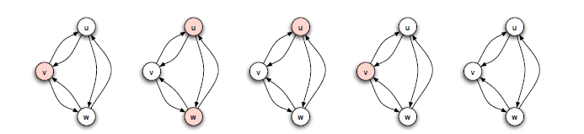
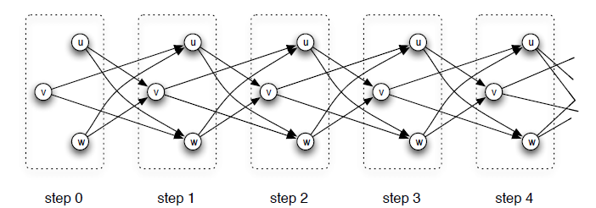
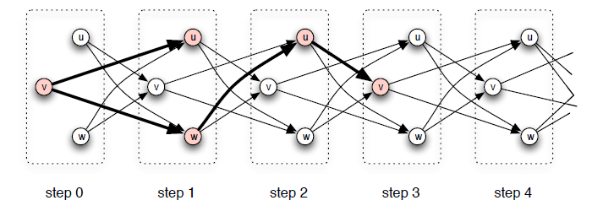
SIS and SIR
Time expanded network
Notes:
Specifically, given an instance of the SIS model with tI = 1, we create a separate copy of each node for each time step t = 0, 1, 2, 3 and onward
for each edge in the original contact network, linking a node v to a node w, we create edges in the time-expanded contact network from the copy of v at time t to the copy of w at time t + 1;

Slide 41
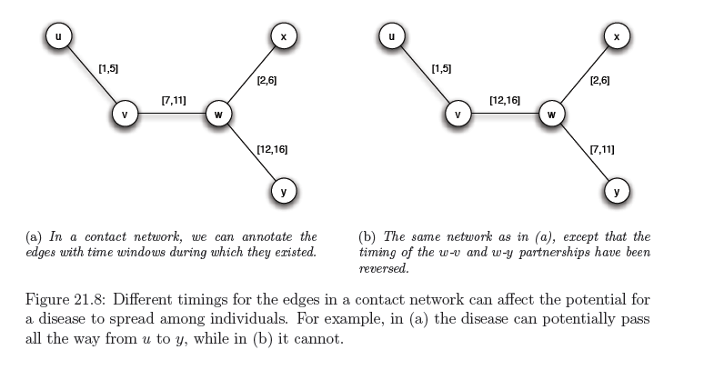
Including time
Infection can only happen within the active window

Slide 42
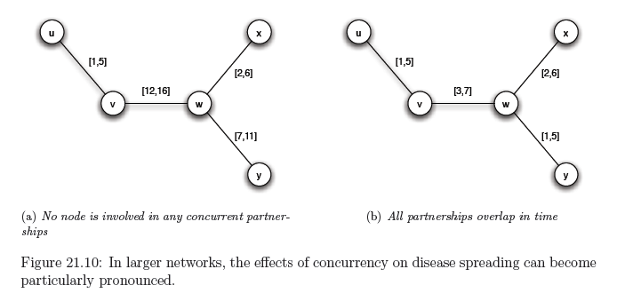
Concurrency
Importance of concurrency – enables branching

Slide 43
SIRS
Initially, some nodes e in the I state and all others in the S state.
Each node u that enters the I state remains infectious for a fixed number of steps t_{I} During each of these t_{I} steps, u has a probability p of infected each of its susceptible neighbors.
After t_{I} steps, u is no longer infectious. Enters the R state for a fixed number of steps t_{R}. During each of these t_{R} steps, u cannot be infected nor transmit the disease.
After t_{R} steps in the R state, node u returns to the S state.

Slide 44
References
D. Easley, J. Kleinberg. Networks, Crowds and Markets: Reasoning about a highly connected world. Cambridge University Press, 2010 – Chapter 21
Y. Wang, D. Chakrabarti, C. Wang, C. Faloutsos. Epidemic Spreading in Real Networks: An Eigenvalue Viewpoint. SRDS 2003

Slide 45
Influence maximization

Slide 46
Maximizing spread
Suppose that instead of a virus we have an item (product, idea, video) that propagates through contact
  Word of mouth propagation.
An advertiser is interested in maximizing the spread of the item in the network
  The holy grail of “viral marketing”
Question: which nodes should we “infect” so that we maximize the spread? [KKT2003]

Slide 47
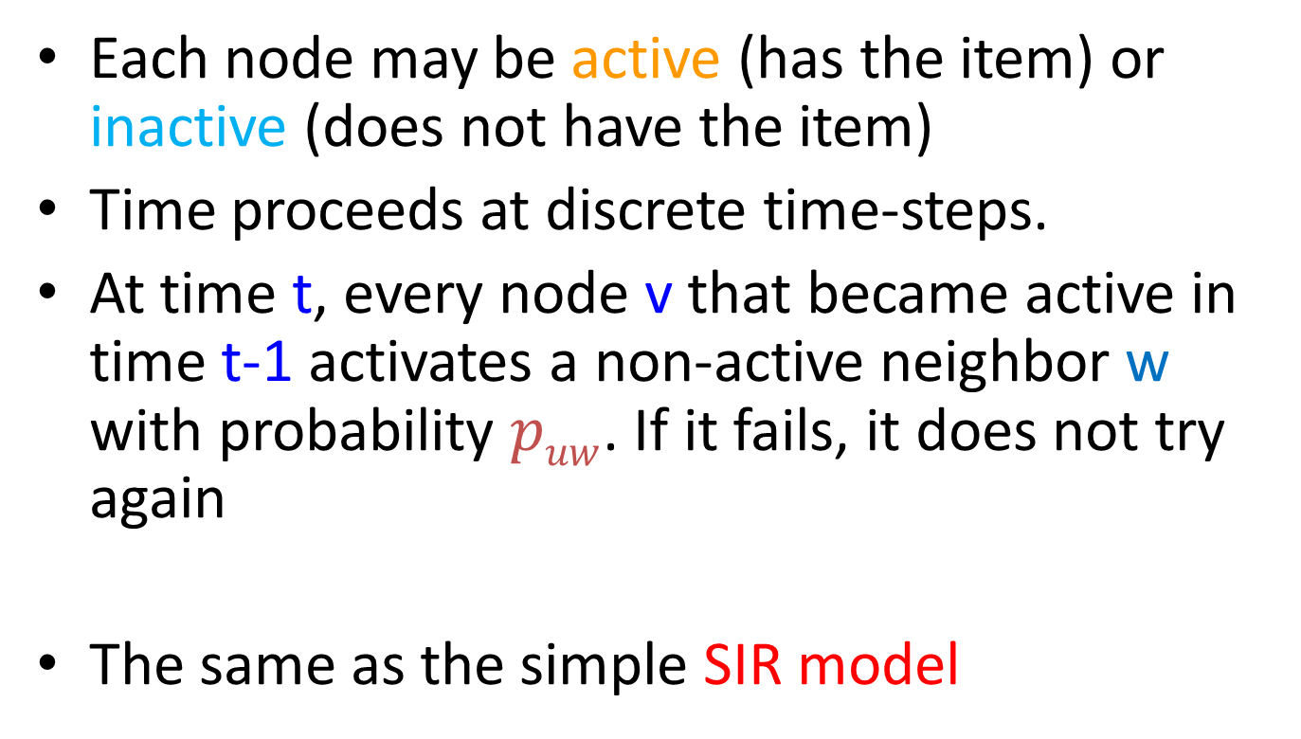
Independent cascade model
Each node may be active (has the item) or inactive (does not have the item)
Time proceeds at discrete time-steps.
At time t, every node v that became active in time t-1 activates a non-active neighbor w with probability $puw$. If it fails, it does not try again
The same as the simple SIR model

Slide 48
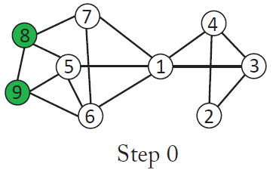
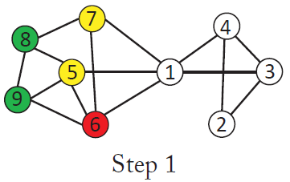
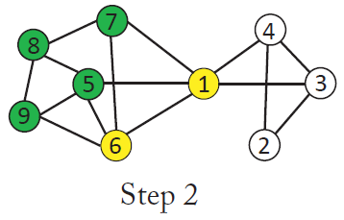
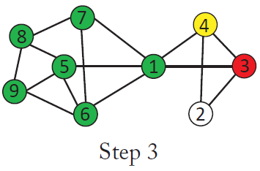
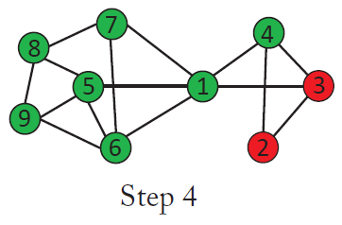
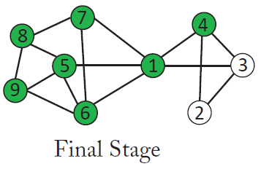
Independent cascade

Slide 49
Influence maximization
Influence function: for a set of nodes S (target set) the influence s(S) (spread) is the expected number of active nodes at the end of the diffusion process if the item is originally placed in the nodes in S.
Influence maximization problem [KKT03]: Given a network, a diffusion model, and a value k, identify a set S of k nodes in the network that maximizes s(S).
The problem is NP-hard

Slide 50
A Greedy algorithm
What is a simple algorithm for selecting the set S?
Computing s(S): perform multiple Monte-Carlo simulations of the process and take the average.
How good is the solution of this algorithm compared to the optimal solution?
Greedy algorithm
  Start with an empty set S
  Proceed in k steps
    At each step add the node u to the set S the maximizes the increase in function s(S)
      The node that activates the most additional nodes

Slide 51
Approximation Algorithms
Suppose we have a (combinatorial) optimization problem, and X is an instance of the problem, OPT(X) is the value of the optimal solution for X, and ALG(X) is the value of the solution of an algorithm ALG for X
  In our case: X = (G, k) is the input instance, OPT(X) is the spread s(A*) of the optimal solution, GREEDY(X) is the spread s(A) of the solution of the Greedy algorithm
ALG is a good approximation algorithm if the ratio of OPT and ALG is bounded.

Slide 52
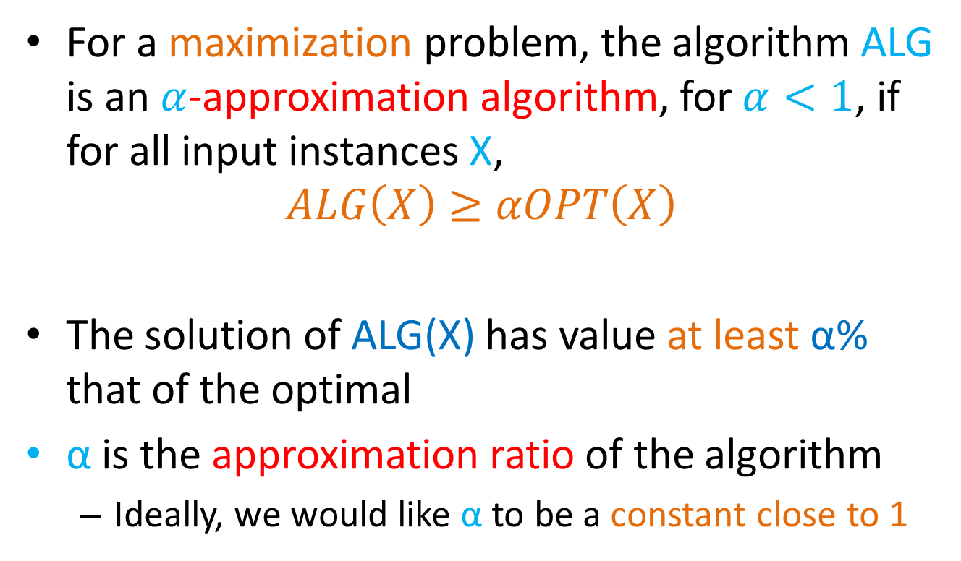
Approximation Ratio
For a maximization problem, the algorithm ALG is an $α$-approximation algorithm, for $α<1$, if for all input instances X,
$$ALG\left(X\right)≥αOPT\left(X\right)$$
The solution of ALG(X) has value at least α% that of the optimal
α is the approximation ratio of the algorithm
  Ideally, we would like α to be a constant close to 1

Slide 53
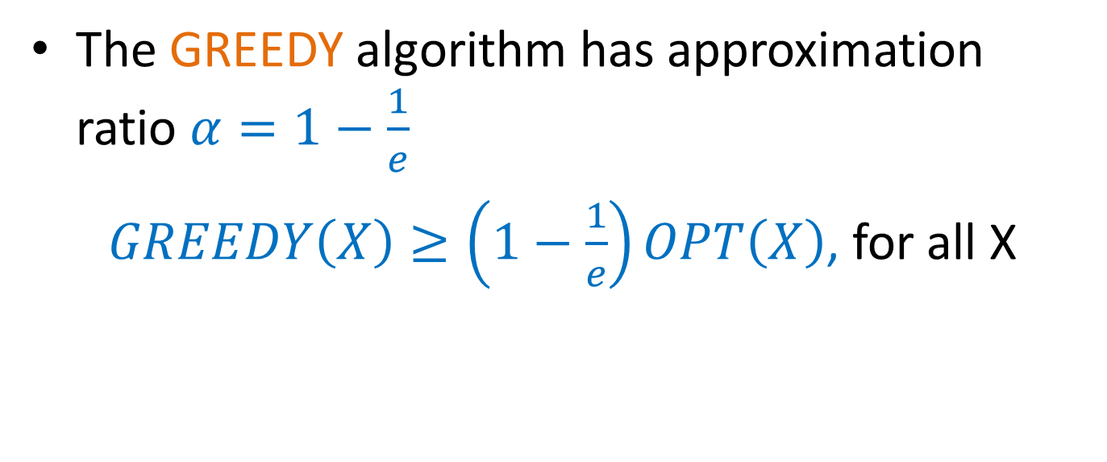
Approximation Ratio for Influence Maximization
The GREEDY algorithm has approximation ratio $α=1−\frac{1}{e}$
$GREEDY\left(X\right)≥\left(1−\frac{1}{e}\right)OPT\left(X\right)$, for all X

Slide 54
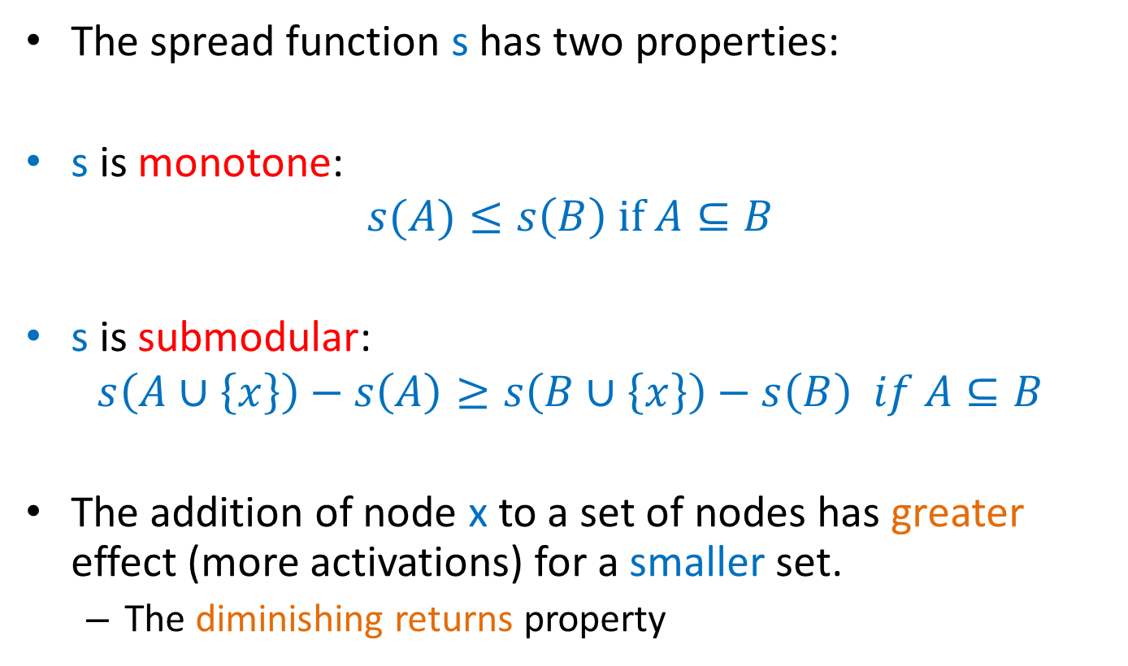
Proof of approximation ratio
The spread function s has two properties:
s is monotone:
$$s(A)≤s\left(B\right) if A⊆B$$
s is submodular:
$$s\left(A∪\left\{x\right\}\right)−s\left(A\right)≥s\left(B∪\left\{x\right\}\right)−s\left(B\right) if A⊆B$$
The addition of node x to a set of nodes has greater effect (more activations) for a smaller set.
  The diminishing returns property

Slide 55
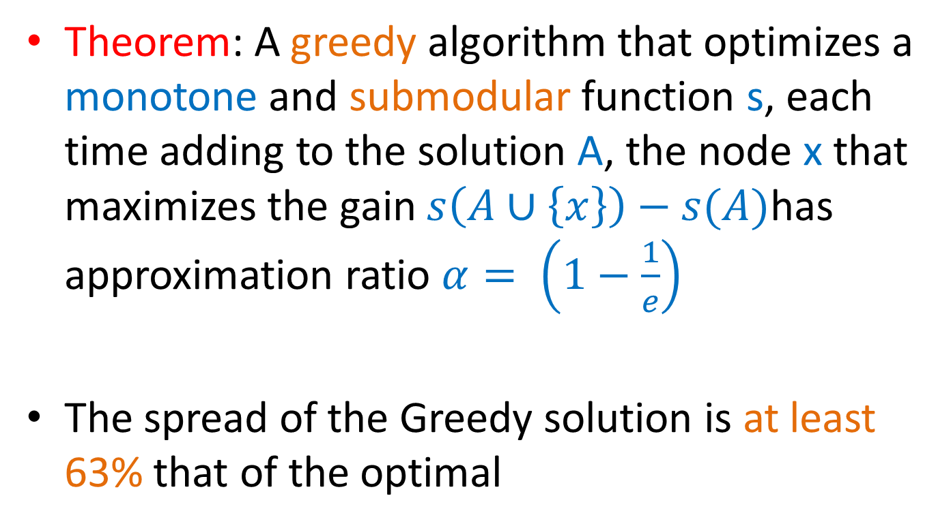
Optimizing submodular functions
Theorem: A greedy algorithm that optimizes a monotone and submodular function s, each time adding to the solution A, the node x that maximizes the gain $s\left(A∪\left\{x\right\}\right)−s(A)$has approximation ratio $α= \left(1−\frac{1}{e}\right)$
The spread of the Greedy solution is at least 63% that of the optimal

Slide 56
Submodularity of influence
Why is s(A) submodular?
  How do we deal with the fact that influence is defined as an expectation?
We will use the fact that probabilistic propagation on a fixed graph can be viewed as deterministic propagation over a randomized graph
  Express s(A) as an expectation over the input graph rather than the choices of the algorithm

Slide 57
Independent cascade model
Each edge (u,v) is considered only once, and it is “activated” with probability p_{uv}.
We can assume that all random choices have been made in advance
  generate a sample subgraph of the input graph where edge (u, v) is included with probability p_{uv}
  propagate the item deterministically on the input graph
  the active nodes at the end of the process are the nodes reachable from the target set A
The influence function is obviously(?) submodular when propagation is deterministic
The linear combination of submodular functions is also a submodular function

Slide 58
Computation of Expected Spread
Computing s(S): perform multiple Monte-Carlo simulations of the process and take the average.
To estimate the influence spread of S ∪ {u}, R repeated simulations of RanCas(S ∪ {u}) are used
Each run takes O(m)
Complexity for computing the marginal gain of adding u:
O(Rm)
For each k, all n nodes are tested, thus
O(knRm)

Slide 59
Improvements
Computation of Expected Spread
  Performing simulations for estimating the spread on multiple instances is very slow. Several techniques have been developed for speeding up the process.
    CELF: exploiting the submodularity property
    Maximum Influence Paths: store paths for computation
    Sketches: compute sketches for each node for approximate estimation of spread
(the marginal gain of a node in the current iteration cannot be better than its marginal gain in the previous iteration) J. Leskovec, A. Krause, C. Guestrin, C. Faloutsos, J. M. VanBriesen, N. S. Glance. Cost-effective outbreak detection in networks. KDD 2007
W. Chen, C. Wang, and Y. Wang. Scalable influence maximization for prevalent viral marketing in large-scale social networks. KDD 2010.
Edith Cohen, Daniel Delling, Thomas Pajor, Renato F. Werneck. Sketch-based Influence Maximization and Computation: Scaling up with Guarantees. CIKM 2014

Slide 60
Degree discount
General idea
Select seed nodes based on their degree
If node v is selected, decrease the degree of all its neighbors
Wei Chen, Yajun Wang, Siyu Yang: Efficient influence maximization in social networks. KDD 2009: 199-208

Slide 61
Maximum influence path
General idea
For each node, use the maximum influence paths (paths with the largest probability) to all other nodes
  Shortest weighted path
Assumption: influence propagates through these paths
Given this assumption, estimate the probability that a node is activated
Wei Chen, Chi Wang, Yajun Wang: Scalable influence maximization for prevalent viral marketing in large-scale social networks. KDD 2010: 1029-1038

Slide 62
Reverse Reachable Sets
Construct graph X from G by removing each edge e in G with 1 − p(e) probability.
Let v be a node in G, the reverse reachable (RR) set for v in X is the set of nodes in X that can reach v.
That is, for each node u in the RR set, there is a directed path from u to v in X.
Youze Tang, Xiaokui Xiao, Yanchen Shi: Influence maximization: near-optimal time complexity meets practical efficiency. SIGMOD Conference 2014: 75-86

Slide 63
Reverse Reachable Sets
Let p be the probability for an RR set generated for v to overlap with a node set S, then when we use S as the seed set to run an influence propagation process on G, we have probability p to activate v
A random RR set is an RR set generated on an instance of X randomly sampled from G, for a node selected uniformly at random from X.

Slide 64
Reverse Reachable Sets
Generate a certain number of random RR sets from G.
Select k nodes to cover the maximum number of RR sets generated. (maximum coverage)
Return the k nodes as seed

Slide 65
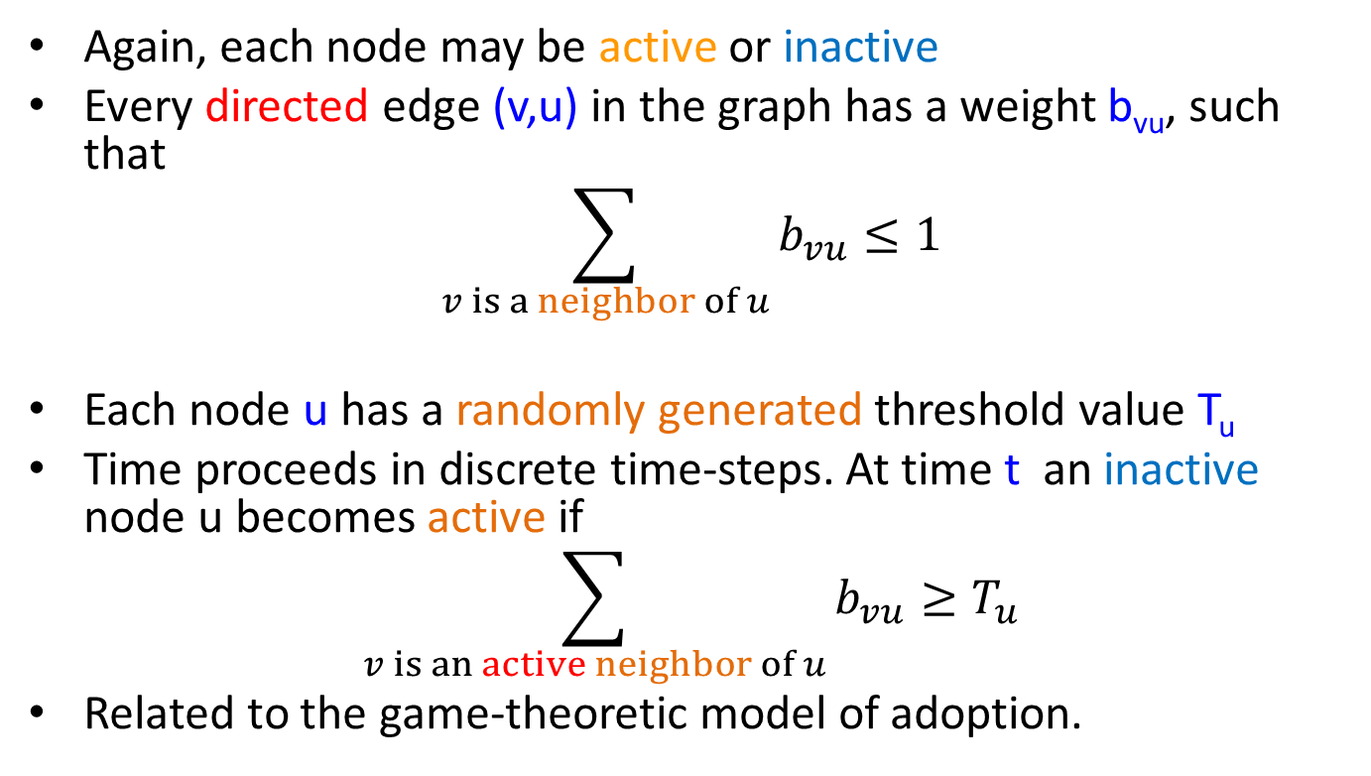
Linear threshold model
Again, each node may be active or inactive
Every directed edge (v,u) in the graph has a weight b_{vu}, such that
$$\sum_{v is a neighbor of u}{b_{vu}}≤1$$
Each node u has a randomly generated threshold value T_{u}
Time proceeds in discrete time-steps. At time t an inactive node u becomes active if
$$\sum_{v is an active neighbor of u}{b_{vu}}≥T_{u}$$
Related to the game-theoretic model of adoption.

Slide 66
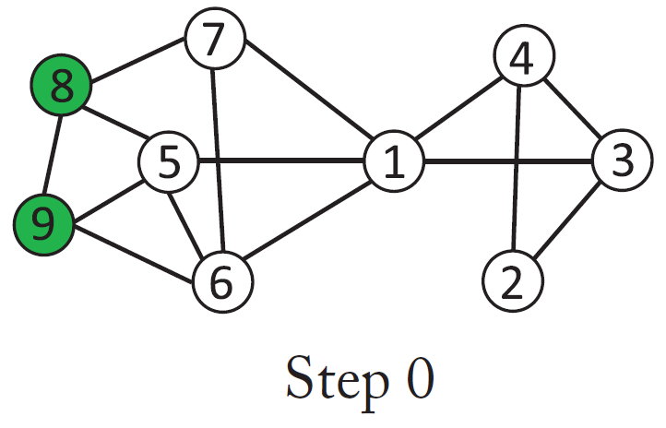
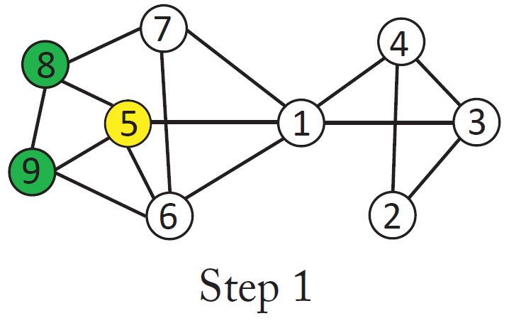
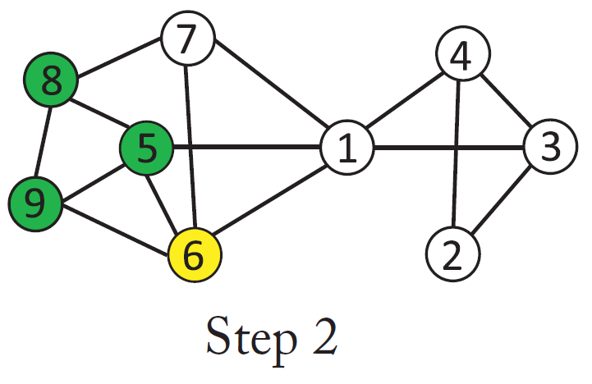
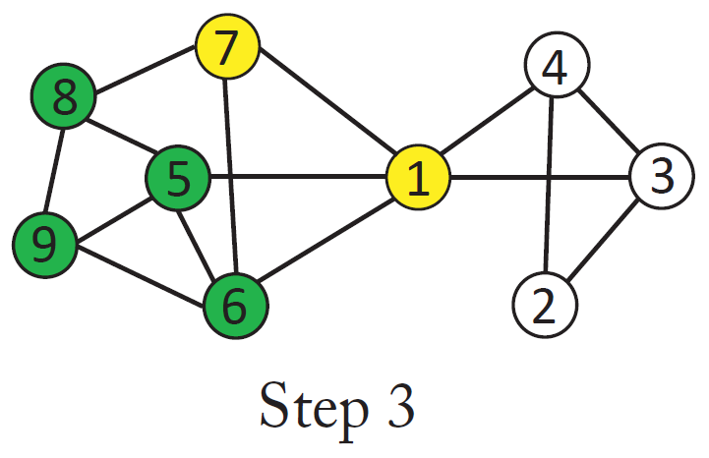
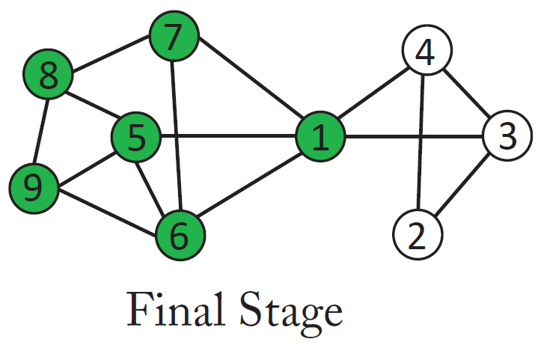
Linear threshold model

Slide 67
Influence Maximization
KKT03 showed that in this case the influence s(A) is still a submodular function, using a similar technique
  Assumes uniform random thresholds
The Greedy algorithm achieves a (1-1/e) approximation

Slide 68
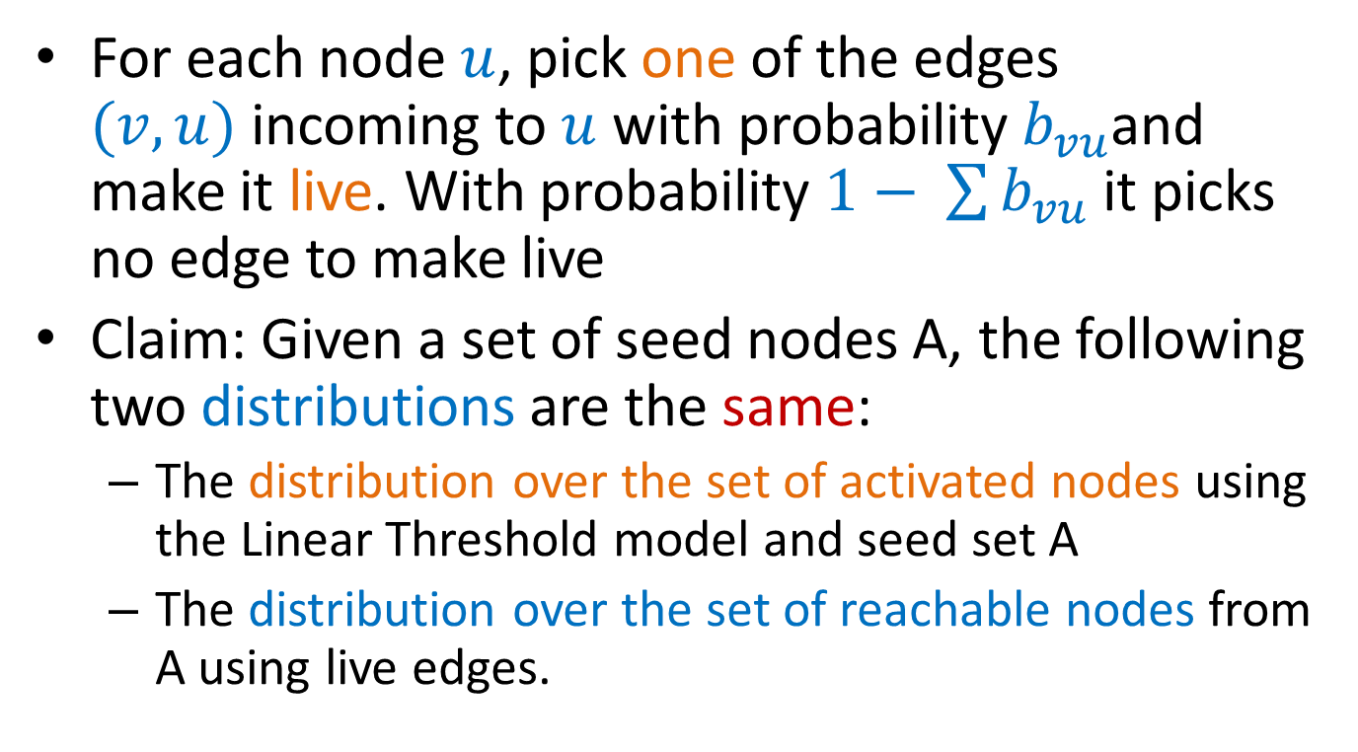
Proof idea
For each node $u$, pick one of the edges $(v,u)$incoming to $u$ with probability $b_{vu}$and make it live. With probability $1− \sum{b_{vu}}$ it picks no edge to make live
Claim: Given a set of seed nodes A, the following two distributions are the same:
  The distribution over the set of activated nodes using the Linear Threshold model and seed set A
  The distribution over the set of reachable nodes from A using live edges.

Slide 69
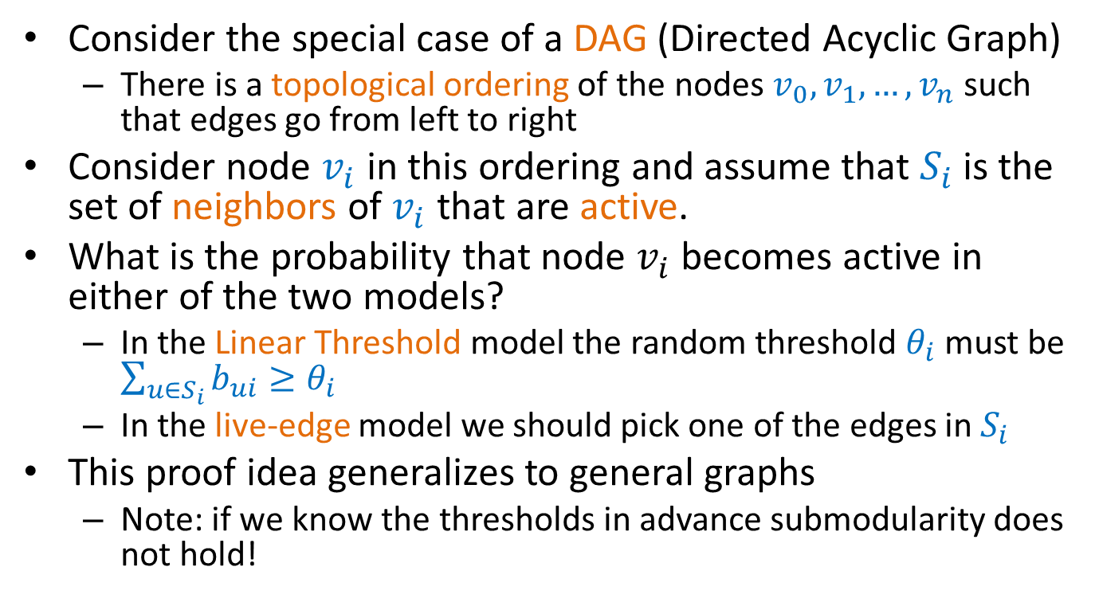
Proof idea (submodularity LT model)
Consider the special case of a DAG (Directed Acyclic Graph)
  There is a topological ordering of the nodes $v_{0}, v_{1},…, v_{n}$ such that edges go from left to right
Consider node $v_{i}$ in this ordering and assume that $S_{i}$ is the set of neighbors of $v_{i}$ that are active.
What is the probability that node $v_{i}$ becomes active in either of the two models?
  In the Linear Threshold model the random threshold $θ_{i}$ must be $\sum_{u∈S_{i}}{b_{ui}≥θ_{i}}$
  In the live-edge model we should pick one of the edges in $S_{i}$
This proof idea generalizes to general graphs
  Note: if we know the thresholds in advance submodularity does not hold!

Slide 70


Example
$$v_{2}$$
$$v_{5}$$
$$v_{4}$$
$$v_{1}$$
$$v_{6}$$
$$v_{3}$$
Assume that all edge weights incoming to any node sum to 1

Slide 71

Example
$$v_{2}$$
$$v_{5}$$
$$v_{4}$$
$$v_{1}$$
$$v_{6}$$
$$v_{3}$$
The nodes select a single incoming edge with probability equal to the weight (uniformly at random in this case)

Slide 72

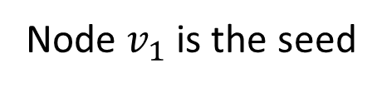
Example
$$v_{2}$$
$$v_{5}$$
$$v_{4}$$
$$v_{1}$$
$$v_{6}$$
$$v_{3}$$
Node $v_{1}$ is the seed

Slide 73
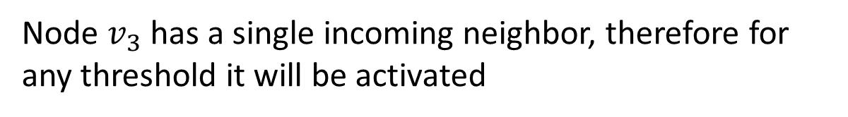

Example
$$v_{2}$$
$$v_{5}$$
$$v_{4}$$
$$v_{1}$$
$$v_{6}$$
$$v_{3}$$
Node $v_{3}$ has a single incoming neighbor, therefore for any threshold it will be activated

Slide 74
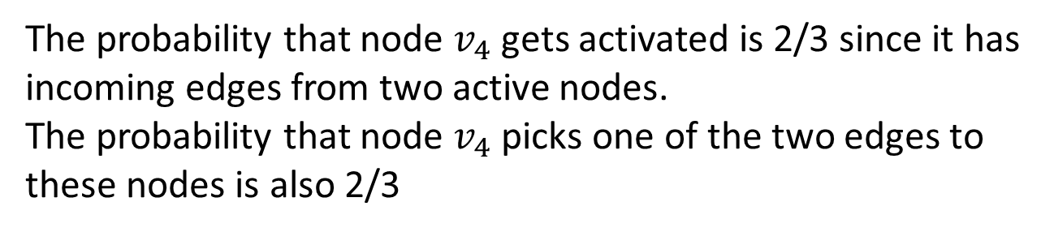
Example
$$v_{2}$$
$$v_{5}$$
$$v_{4}$$
$$v_{1}$$
$$v_{6}$$
$$v_{3}$$
The probability that node $v_{4}$ gets activated is 2/3 since it has incoming edges from two active nodes.
The probability that node $v_{4}$ picks one of the two edges to these nodes is also 2/3

Slide 75

Example
$$v_{2}$$
$$v_{5}$$
$$v_{4}$$
$$v_{1}$$
$$v_{6}$$
$$v_{3}$$
Similarly the probability that node $v_{6}$ gets activated is 2/3 since it has incoming edges from two active nodes.
The probability that node $v_{6}$ picks one of the two edges to these nodes is also 2/3

Slide 76

Example
$$v_{2}$$
$$v_{5}$$
$$v_{4}$$
$$v_{1}$$
$$v_{6}$$
$$v_{3}$$
The set of active nodes is the set of nodes reachable from $v_{1}$ with live edges (orange).

Slide 77


One-slide summary
Influence maximization: Given a graph $G$ and a budget $k$, for some diffusion model, find a subset of $k$ nodes $A$, such that when activating these nodes, the spread of the diffusion $s(A)$ in the network is maximized.
Diffusion models:
  Independent Cascade model
  Linear Threshold model
Algorithm: Greedy algorithm that adds to the set each time the node with the maximum marginal gain, i.e., the node that causes the maximum increase in the diffusion spread.
The Greedy algorithm gives a $\left(1−\frac{1}{e}\right)$ approximation of the optimal solution
  Follows from the fact that the spread function $s\left(A\right)$ is
    Monotone
    Submodular
$$s\left(A\right)≤s\left(B\right), if A⊆B$$
$$s\left(A∪\{x\}\right)−s\left(A\right)≥s\left(B∪\left\{x\right\}\right)−s\left(B\right), ∀x if A⊆B$$

Slide 78

Evolving network
Consider a network that changes over time
  Edges and nodes can appear and disappear at discrete time steps
Model:
  The evolving network is a sequence of graphs $\{G_{1},G_{2},…,G_{n}\}$ defined over the same set of vertices $V$, with different edge sets $E_{1},E_{2},…,E_{n}$
    Graph snapshot $G_{i}$ is the graph at time-step $i$.
N. Gayraud, E. Pitoura, P. Tsaparas. Maximizing Diffusion in Evolving Networks. ACM COSN 2015

Slide 79

















Example
$$v_{1}$$
$$v_{1}$$
$$v_{1}$$
$$v_{2}$$
$$v_{4}$$
$$v_{2}$$
$$v_{4}$$
$$v_{2}$$
$$v_{4}$$
$$v_{3}$$
$$v_{3}$$
$$v_{3}$$
$$u_{1}$$
$$u_{3}$$
$$u_{1}$$
$$u_{3}$$
$$u_{1}$$
$$u_{3}$$
$$u_{2}$$
$$u_{2}$$
$$u_{2}$$
$$G^{1}$$
$$G^{2}$$
$$G^{3}$$

Slide 80

Time
How does the evolution of the network relates to the evolution of the diffusion?
  How much physical time does a diffusion step last?
Assumption: The two processes are in sync. One diffusion step happens in on one graph snapshot
Evolving IC model: at time-step $t$, the infectious nodes try to infect their neighbors in the graph $G_{t}$.
Evolving LT model: at time-step $t$ if the weight of the active neighbors of node $v$in graph $G_{t}$ is greater than the threshold the nodes gets activated.

Slide 81
Submodularity
Will the spread function remain monotone and submodular?
No!

Slide 82
Monotonicity for the EIC model
$$v_{1}$$
$$v_{1}$$
$$v_{1}$$
$$v_{2}$$
$$v_{4}$$
$$v_{2}$$
$$v_{4}$$
$$v_{2}$$
$$v_{4}$$
$$v_{3}$$
$$v_{3}$$
$$v_{3}$$
$$u_{1}$$
$$u_{3}$$
$$u_{1}$$
$$u_{3}$$
$$u_{1}$$
$$u_{3}$$
$$u_{2}$$
$$u_{2}$$
$$u_{2}$$
$$G^{1}$$
$$G^{2}$$
$$G^{3}$$

Slide 83





Monotonicity for the EIC model
$$G^{0}$$
$$G^{1}$$
$$G^{2}$$
$$G^{3}$$
$$G^{0}$$
$$G^{1}$$
$$G^{2}$$
$$G^{3}$$
The spread is not monotone in the case of the Evolving IC model

Slide 84
























Submodularity for the EIC model
$$v_{1}$$
$$v_{5}$$
$$v_{1}$$
$$v_{5}$$
$$v_{1}$$
$$v_{5}$$
$$v_{1}$$
$$v_{5}$$
$$v_{2}$$
$$v_{2}$$
$$v_{2}$$
$$v_{2}$$
$$v_{3}$$
$$v_{6}$$
$$v_{3}$$
$$v_{6}$$
$$v_{3}$$
$$v_{6}$$
$$v_{3}$$
$$v_{6}$$
$$v_{4}$$
$$v_{4}$$
$$v_{4}$$
$$v_{4}$$
$$u_{1}$$
$$u_{3}$$
$$u_{1}$$
$$u_{3}$$
$$u_{1}$$
$$u_{3}$$
$$u_{1}$$
$$u_{3}$$
$$u_{2}$$
$$u_{2}$$
$$u_{2}$$
$$u_{2}$$
$$G^{1}$$
$$G^{2}$$
$$G^{3}$$
$$G^{4}$$

Slide 85





















Submodularity for the EIC model
$$v_{5}$$
$$v_{1}$$
$$v_{5}$$
$$v_{1}$$
$$v_{5}$$
$$v_{1}$$
$$v_{1}$$
$$v_{5}$$
$$v_{1}$$
$$v_{5}$$
$$v_{2}$$
$$v_{2}$$
$$v_{2}$$
$$v_{2}$$
$$v_{2}$$
$$v_{6}$$
$$v_{6}$$
$$v_{3}$$
$$v_{6}$$
$$v_{3}$$
$$v_{6}$$
$$v_{6}$$
$$v_{3}$$
$$v_{3}$$
$$v_{3}$$
$$v_{4}$$
$$v_{4}$$
$$v_{4}$$
$$v_{4}$$
$$v_{4}$$
$$u_{1}$$
$$u_{1}$$
$$u_{1}$$
$$u_{3}$$
$$u_{3}$$
$$u_{1}$$
$$u_{1}$$
$$u_{3}$$
$$u_{3}$$
$$u_{3}$$
$$u_{2}$$
$$u_{2}$$
$$u_{2}$$
$$u_{2}$$
$$u_{2}$$
$$G^{0}$$
$$G^{1}$$
$$G^{2}$$
$$G^{3}$$
$$G^{4}$$
Activating node $v_{1}$ at time $t=0$ has spread 7

Slide 86










Submodularity for the EIC model
$$v_{1}$$
$$v_{5}$$
$$v_{1}$$
$$v_{5}$$
$$v_{1}$$
$$v_{5}$$
$$v_{1}$$
$$v_{5}$$
$$v_{2}$$
$$v_{2}$$
$$v_{2}$$
$$v_{2}$$
$$v_{3}$$
$$v_{6}$$
$$v_{3}$$
$$v_{6}$$
$$v_{3}$$
$$v_{6}$$
$$v_{3}$$
$$v_{6}$$
$$v_{4}$$
$$v_{4}$$
$$v_{4}$$
$$v_{4}$$
$$u_{1}$$
$$u_{3}$$
$$u_{1}$$
$$u_{3}$$
$$u_{1}$$
$$u_{3}$$
$$u_{1}$$
$$u_{3}$$
$$u_{2}$$
$$u_{2}$$
$$u_{2}$$
$$u_{2}$$
$$G^{1}$$
$$G^{2}$$
$$G^{3}$$
$$G^{4}$$
Activating node $v_{1}$ at time $t=0$ has spread 7
Adding node $v_{6}$ at time $t=3$ does not increase the spread

Slide 87









Submodularity for the EIC model
$$v_{1}$$
$$v_{1}$$
$$v_{5}$$
$$v_{5}$$
$$v_{5}$$
$$v_{1}$$
$$v_{1}$$
$$v_{5}$$
$$v_{1}$$
$$v_{5}$$
$$v_{2}$$
$$v_{2}$$
$$v_{2}$$
$$v_{2}$$
$$v_{2}$$
$$v_{6}$$
$$v_{6}$$
$$v_{3}$$
$$v_{6}$$
$$v_{3}$$
$$v_{6}$$
$$v_{6}$$
$$v_{3}$$
$$v_{3}$$
$$v_{3}$$
$$v_{4}$$
$$v_{4}$$
$$v_{4}$$
$$v_{4}$$
$$v_{4}$$
$$u_{1}$$
$$u_{1}$$
$$u_{1}$$
$$u_{3}$$
$$u_{3}$$
$$u_{1}$$
$$u_{1}$$
$$u_{3}$$
$$u_{3}$$
$$u_{3}$$
$$u_{2}$$
$$u_{2}$$
$$u_{2}$$
$$u_{2}$$
$$u_{2}$$
$$G^{0}$$
$$G^{1}$$
$$G^{2}$$
$$G^{3}$$
$$G^{4}$$
Activating nodes $v_{1}$ and $v_{5}$ at time $t=0$ has spread 4

Slide 88




Submodularity for the EIC model
$$v_{1}$$
$$v_{5}$$
$$v_{1}$$
$$v_{5}$$
$$v_{1}$$
$$v_{5}$$
$$v_{1}$$
$$v_{5}$$
$$v_{2}$$
$$v_{2}$$
$$v_{2}$$
$$v_{2}$$
$$v_{3}$$
$$v_{6}$$
$$v_{3}$$
$$v_{6}$$
$$v_{3}$$
$$v_{6}$$
$$v_{3}$$
$$v_{6}$$
$$v_{4}$$
$$v_{4}$$
$$v_{4}$$
$$v_{4}$$
$$u_{1}$$
$$u_{3}$$
$$u_{1}$$
$$u_{3}$$
$$u_{1}$$
$$u_{3}$$
$$u_{1}$$
$$u_{3}$$
$$u_{2}$$
$$u_{2}$$
$$u_{2}$$
$$u_{2}$$
$$G^{1}$$
$$G^{2}$$
$$G^{3}$$
$$G^{4}$$
Activating nodes $v_{1}$ and $v_{5}$ at time $t=0$ has spread 4
Adding node $v_{6}$ at time $t=3$ increases the spread to 9

Slide 89














Evolving LT model
The evolving LT model is monotone but it is not submodular
Expected Spread: the probability that $u$ gets infected
  Adding node $v_{3}$ has a larger effect if added to the set $\{v_{1},v_{2}\}$ than to set $\{v_{1}\}$.
$$v_{2}$$
$$v_{2}$$
$$v_{2}$$
$$v_{1}$$
$$v_{3}$$
$$v_{1}$$
$$v_{3}$$
$$v_{1}$$
$$v_{3}$$
$$u$$
$$u$$
$$u$$
$$G_{U}$$
$$G^{1}$$
$$G^{2}$$

Slide 90
Extensions
Other models for diffusion
  Deadline model: There is a deadline by which a node can be infected
  Time-decay model: The probability of an infected node to infect its neighbors decays over time
  Timed influence: Each edge has a speed of infection, and you want to maximize the speed by which nodes are infected.
Competing diffusions
  Maximize the spread while competing with other products that are being diffused.
W. Chen, W. Lu, N. Zhang. Time-critical influence maximization in social networks with time-delayed diffusion process. AAAI, 2012.
B. Liu, G. Cong, D. Xu, and Y. Zeng. Time constrained influence maximization in social networks. ICDM 2012.
N. Du, L. Song, M. Gomez-Rodriguez, H. Zha. Scalable influence estimation in continuous-time diffusion networks. NIPS 2013.
A. Borodin, Y. Filmus, and J. Oren. Threshold models for competitive influence in social networks. WINE, 2010.
M. Draief and H. Heidari. M. Kearns. New Models for Competitive Contagion. AAAI 2014.

Slide 91
Extensions
Reverse problems:
  Initiator discovery: Given the state of the diffusion, find the nodes most likely to have initiated the diffusion
  Diffusion trees: Identify the most likely tree of diffusion tree given the output
  Infection probabilities: estimate the true infection probabilities
H. Mannila, E. Terzi. Finding Links and Initiators: A Graph-Reconstruction Problem. SDM 2009
M. Gomez Rodriguez, J. Leskovec, A. Krause. Inferring networks of diffusion and influence. KDD 2010
M. Gomez-Rodriguez, D. Balduzzi, B. Scholkopf. Uncovering the temporal dynamics of diffusion networks. ICML, 2011.

Slide 92
References
D. Kempe, J. Kleinberg, E. Tardos. Maximizing the Spread of Influence through a Social Network. Proc. 9th ACM SIGKDD Intl. Conf. on Knowledge Discovery and Data Mining, 2003.
N. Gayraud, E. Pitoura, P. Tsaparas. Maximizing Diffusion in Evolving Networks. ICCSS 2015
J. Leskovec, A. Krause, C. Guestrin, C. Faloutsos, J. M. VanBriesen, Natalie S. Glance. Cost-effective outbreak detection in networks. KDD 2007
W. Chen, C.Wang, and Y.Wang. Scalable influence maximization for prevalent viral marketing in large-scale social networks. In 16th ACM SIGKDD international conference on Knowledge discovery and data mining, KDD 2010.
B. Liu, G. Cong, D. Xu, and Y. Zeng. Time constrained influence maximization in social networks. ICDM 2012.
Edith Cohen, Daniel Delling, Thomas Pajor, Renato F. Werneck. Sketch-based Influence Maximization and Computation: Scaling up with Guarantees. CIKM 2014
W. Chen, W. Lu, N. Zhang. Time-critical influence maximization in social networks with time-delayed diffusion process. AAAI, 2012.
N. Du, L. Song, M. Gomez-Rodriguez, H. Zha. Scalable influence estimation in continuous-time diffusion networks. NIPS 2013.
A. Borodin, Y. Filmus, and J. Oren. Threshold models for competitive influence in social networks. In Proceedings of the 6th international conference on Internet and network economics, WINE’10, 2010.
M. Draief and H. Heidari. M. Kearns. New Models for Competitive Contagion. AAAI 2014.
H. Mannila, E. Terzi. Finding Links and Initiators: A Graph-Reconstruction Problem. SDM 2009
Manuel Gomez Rodriguez, Jure Leskovec, Andreas Krause. Inferring networks of diffusion and influence. KDD 2010
M. Gomez-Rodriguez, D. Balduzzi, B. Scholkopf. Uncovering the temporal dynamics of diffusion networks. ICML, 2011.

Slide 93
EXTRA SLIDES

Slide 94
Multiple copies model
Each node may have multiple copies of the same virus
  $v$: state vector : $vi$ : number of virus copies at node $i$
At time $t=0$, the state vector is initialized to $v0$
At time t,
  For each node i
    For each of the $vit$virus copies at node $i$
    the copy is copied to a neighbor $j$ with prob $p$
    the copy dies with probability $q$
G. Giakkoupis, A. Gionis, E. Terzi, P. T. Models and algorithms for network immunization. Technical Report C-2005-75, Department of Computer Science, University of Helsinki, 2005

Slide 95

Analysis
The expected state of the system at time t is given by
$$\overline{v^{t}}=\left(pA+\left(1−q\right)I\right)\overline{v^{t−1}}=M\overline{v^{t−1}}$$
$$v_{2}$$
$$M= \left[\begin{matrix}\begin{matrix}1−q & p \\ 0 & 1−q\end{matrix} & \begin{matrix}p & 0 \\ p & p\end{matrix} \\ \begin{matrix}0 & 0 \\ p & 0\end{matrix} & \begin{matrix}1−q & p \\ 0 & 1−q\end{matrix}\end{matrix}\right]$$
$$v_{1}$$
$$v_{4}$$
$$v_{3}$$
Probability that the copy from node $v_{4}$is copied to node $v_{1}$
Probability that the copy from node $v_{4}$survives at $v_{4}$

Slide 96
Analysis
As $t→∞$
  if $λ_{1}\left(M\right)<1⇔λ_{1}\left(A\right)<q/p$ then $\overline{v^{t}}→0$
    the probability that all copies die converges to 1
  if $λ_{1}\left(M\right)=1⇔λ_{1}\left(A\right)=q/p$ then $\overline{v^{t}}→c$
    the probability that all copies die converges to 1
  if $λ_{1}\left(M\right)>1⇔λ_{1}\left(A\right)>q/p$ then $\overline{v^{t}}→∞$
    the probability that all copies die converges to a constant < 1

Slide 97
Another example
What is the spread from the red node?
Inclusion of time changes the problem of influence maximization
  N. Gayraud, E. Pitoura, P. Tsaparas, Diffusion Maximization on Evolving networks

