Slide 1
Online Social Networks and Media
Graph Partitioning (cuts, spectral clustering, density),
Community evolution

Slide 2
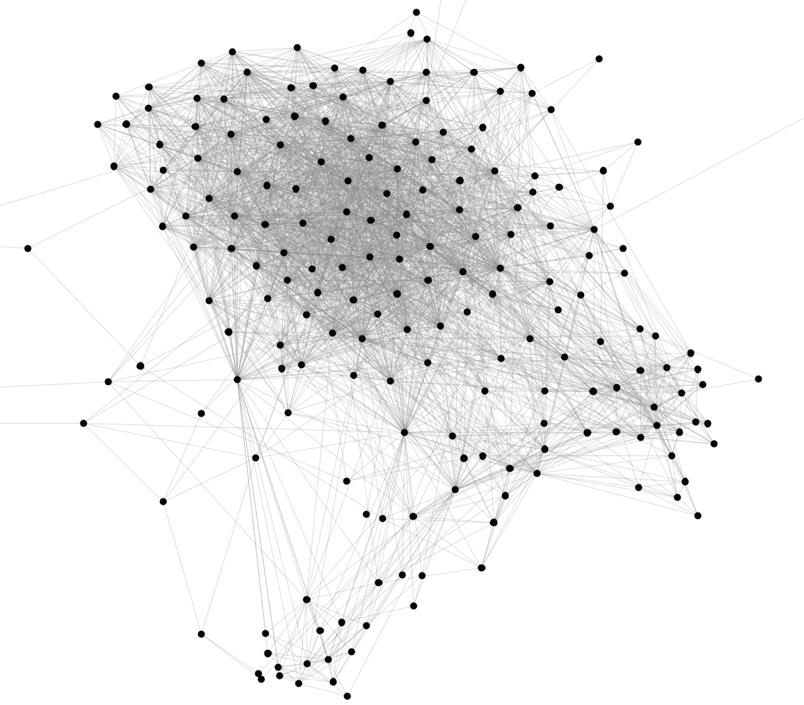
Introduction
Notes:
Graphs are not random – identify their structure

Slide 3
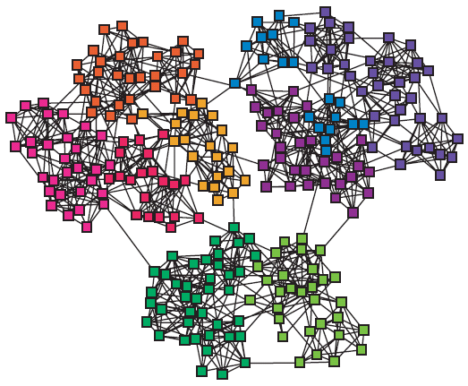
Introduction
modules, cluster, communities, groups, partitions (more on this today)

Slide 4
Outline
Summary of Part I
PART II
Cuts
Spectral Clustering
Dense Subgraphs
Community Evaluation
partitions

Slide 5
Summary of Part I

Slide 6
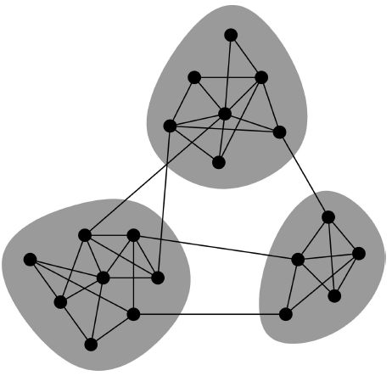
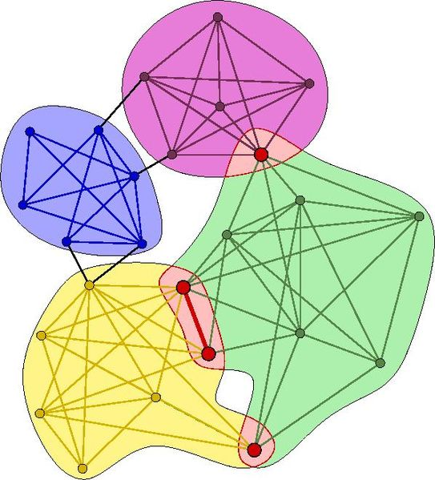
Community Types
Non-overlapping vs. overlapping communities

Slide 7
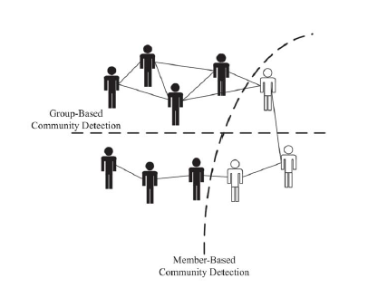
Community Types
Member-based (local) vs. group-based

Slide 8
Clique Percolation Method (CPM): Using cliques as seeds
Given k, find all cliques of size k.
Create graph (clique graph) where all cliques are vertices, and two cliques that share k - 1 vertices are connected via an edge.
Communities are the connected components of this graph.

Slide 9
Finding clusters
Group nodes such that nodes in a group are similar (or related) to one another and different from (or unrelated to) nodes in other groups
Intra-cluster distances are minimized
Inter-cluster distances are maximized
Node similarity based on structural information (e.g., common neighbors)

Slide 10
Types of Clustering
Partitional Clustering (e.g., k-means)
  Division of data objects into subsets (clusters)
  Assumes that the number of clusters is given
Hierarchical clustering
  A set of nested clusters organized as a hierarchical tree
    Agglomerative
      Each node a single cluster
      Merge “similar” nodes until a single cluster
    Divisive
      A single cluster
      Split clusters until single nodes
Besides node similarity, split/merge based on other objectives

Slide 11
Hierarchical Clustering
Produces a set of nested clusters organized as a hierarchical tree
Can be visualized as a dendrogram
  A tree like diagram that records the sequences of merges or splits

Slide 12
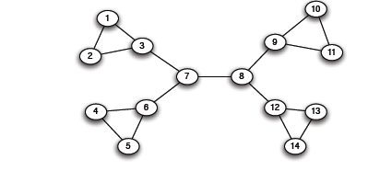
Edge Betweenness
3x11 = 33
1x12 = 12
b=16
1
b=7.5
7x7 = 49
Notes:
To 7.5 είναι
Για το δεξί άκρο
όλοι οι αριστεροι + το αριστερό άκρο = 5
+ ο πάνω δεξιά με αυτούς του 5 δια 2

Slide 13
The Girvan Newman method
[Girvan-Newman ‘02]
        Hierarchical divisive algorithm
  Repeat until no edges are left:
    Calculate betweenness of edges
    Remove edges with highest betweenness
  Connected components are communities
  Gives a hierarchical decomposition of the network

Slide 14
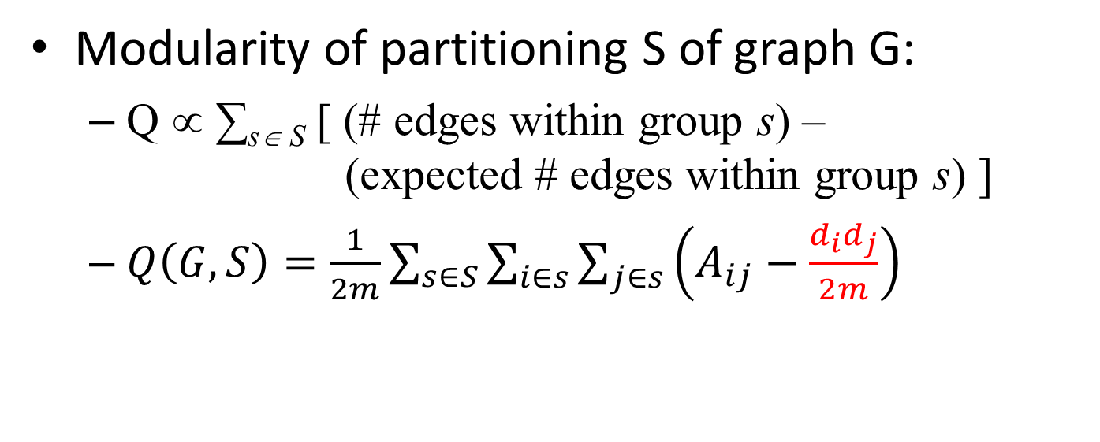
Modularity
Modularity of partitioning S of graph G:
  Q ∝ ∑_{s∈ S} [ (# edges within group s) –
  (expected # edges within group s) ]
  $Q\left(G,S\right)=\frac{1}{2m}\sum_{s∈S}{\sum_{i∈s}{\sum_{j∈s}{\left(A_{ij}−\frac{d_{i}d_{j}}{2m}\right)}}}$
A_{ij} = 1 if i→j,
0 else
Modularity of cluster S

Slide 15
Modularity
Greedy method of Newman (one of the many ways to use modularity)
Agglomerative hierarchical clustering method
Start with a state in which each vertex is the sole member of one of n communities
Repeatedly join communities together in pairs, choosing at each step the join that results in the greatest increase (or smallest decrease) in Q.

Slide 16
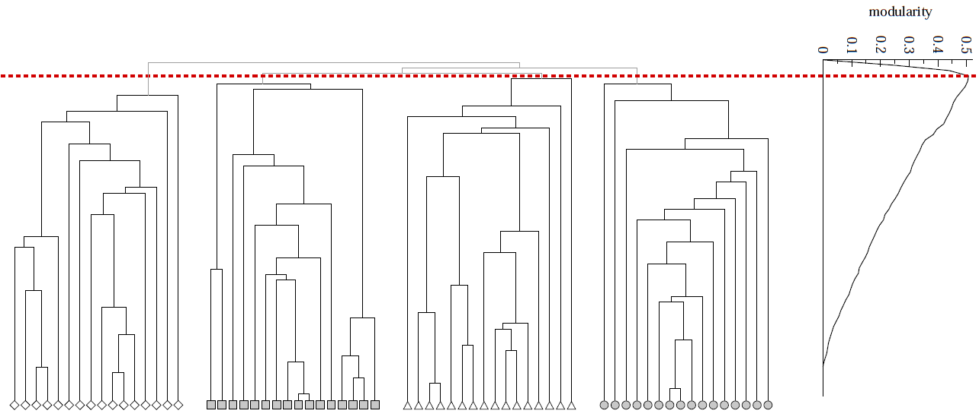
Modularity: Number of clusters
Modularity is useful for selecting the
number of clusters:
Q
Notes:
HW: Question – come up with a graph where GIRVAN-NEWMAN MODULARITY IS NOT UNIMODAL

Slide 17
Label propagation
Vertices are initially given unique labels (e.g. their vertex labels).
At each iteration,
sweep over all vertices, in random sequential order:
each vertex takes the label shared by the majority of its neighbors.
If no unique majority, one of the majority labels is picked at random.
Stop (convergence) when each vertex has the majority label of its neighbors
Communities: groups of vertices having identical labels at convergence

Slide 18
Label propagation
Labels propagate across the graph: most labels will disappear, others will dominate.
By construction, each vertex has more neighbors in its community than in any other community.
Due to many possible ties, different partitions
  Perform many propagations from the same initial condition, with different random seeds
  Aggregate partition label each vertex with the set of all labels it has in different partitions → overlapping communities

Slide 19
Outline
Summary of Part I
PART II
Cuts
Spectral Clustering
Dense Subgraphs
Community Evaluation
partitions

Slide 20
Graph partitioning
The general problem
  Input: a graph G = (V, E)
    edge (u, v) denotes similarity between u and v
    weighted graphs: weight of edge captures the degree of similarity (or, strength of connection)
  Partitioning as an optimization problem:
    Partition the nodes in the graph such that
    nodes within clusters are well interconnected (high edge weights),
    nodes across clusters are sparsely interconnected (low edge weights)
    most graph partitioning problems are NP hard

Slide 21
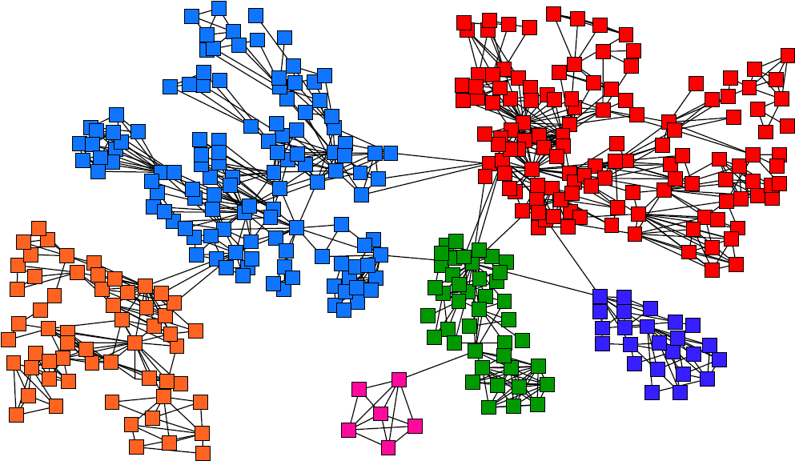
Graph Partitioning

Slide 22
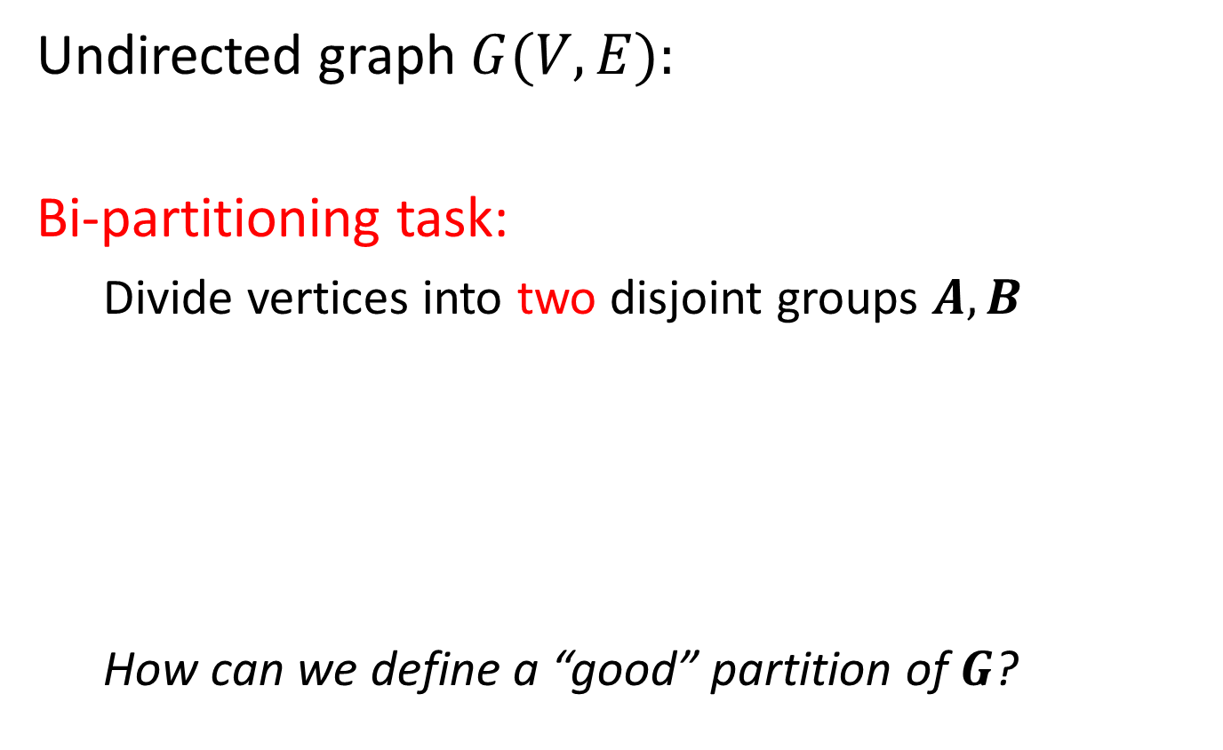
Graph Partitioning
Undirected graph $G(V,E):$
Bi-partitioning task:
  Divide vertices into two disjoint groups $A, B$
  How can we define a “good” partition of $G$?
1
5
2
6
4
3
A
5
B
1
2
6
3
4

Slide 23
Graph Partitioning
What makes a good partition?
  Maximize the number of within-group
  connections
  Minimize the number of between-group connections
5
1
2
6
4
3
A
B

Slide 24
Graph Cuts
Express partitioning objectives as a function of the “edge cut” of the partition
Cut: Set of edges with only one vertex in a group:
A
B
5
1
cut(A,B) = 2
2
6
4
3

Slide 25
Min Cut
min-cut: the min number of edges such that when removed cause the graph to become disconnected
Minimizes the number of connections between partition
arg min_{A,B} cut(A,B)
This problem can be solved in polynomial time
Min-cut/Max-flow algorithm
U
V-U

Slide 26
Does this work?

Slide 27
Min Cut
“Optimal cut”
Minimum cut
Problem:
  Only considers external cluster connections
  Does not consider internal cluster connectivity

Slide 28
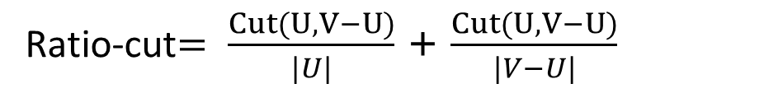
Cut Ratio
Ratio Cut
  Normalize cut by the size of the groups
Ratio-cut$= \frac{Cut(U,V−U)}{|U|}$ + $\frac{Cut(U,V−U)}{|V−U|}$

Slide 29
Graph Bisection
Since the minimum cut does not always yield good results we need extra constraints to make the problem meaningful.
Graph Bisection refers to the problem of partitioning the nodes of the graph into two equal sets.
Kernighan-Lin algorithm: Start with random equal partitions and then swap nodes to improve some quality metric (e.g., cut, modularity, etc).
Notes:
The problem find a partition with equal number of nodes and minimum cut is NP-hard

Slide 30
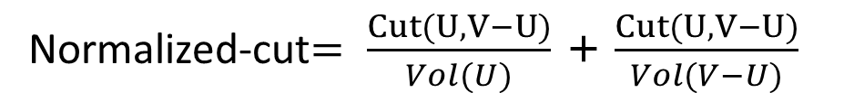
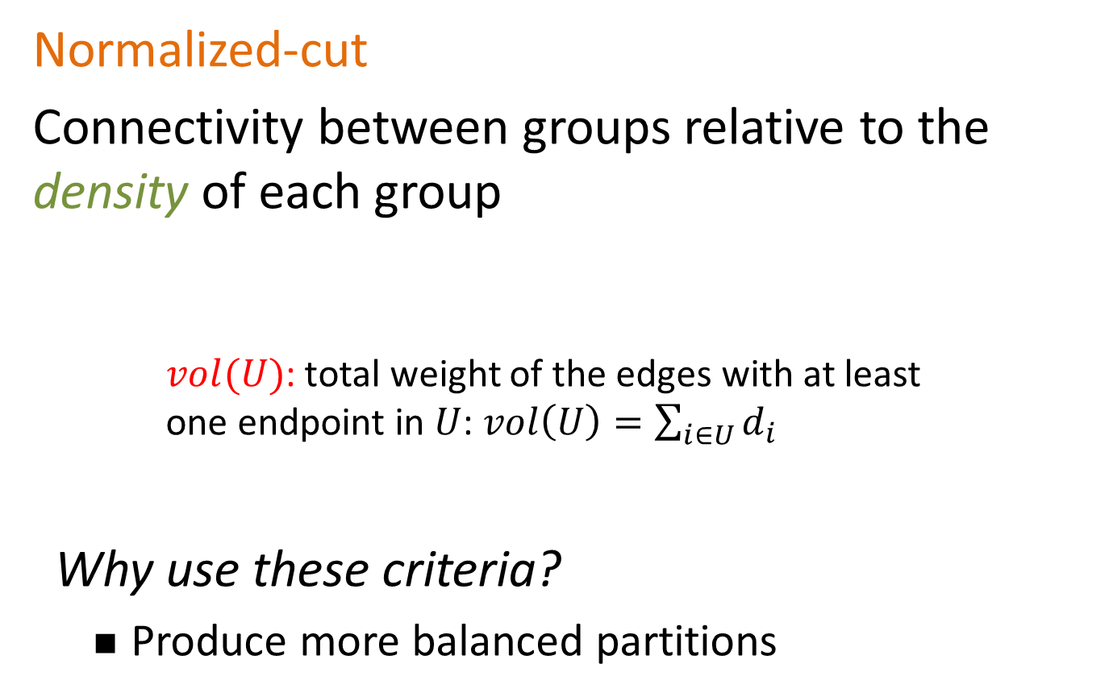
Normalized Cut
Normalized-cut
Connectivity between groups relative to the density of each group
    $vol(U)$: total weight of the edges with at least
    one endpoint in $U$: $vol\left(U\right)=\sum_{i∈U}{d_{i}}$
Why use these criteria?
  Produce more balanced partitions
Normalized-cut$= \frac{Cut(U,V−U)}{Vol(U)}$ + $\frac{Cut(U,V−U)}{Vol(V−U)}$

Slide 31

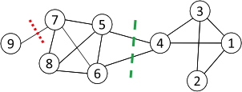
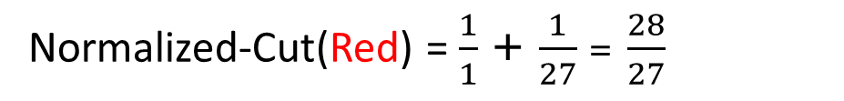
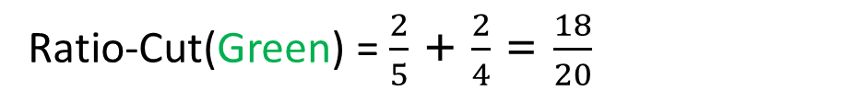
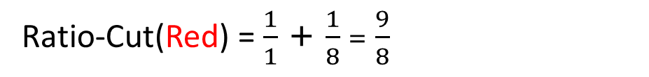
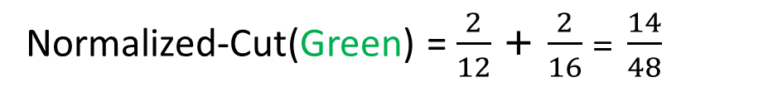
Red is Min-Cut
Ratio-Cut(Red) = $\frac{1}{1}$ + $\frac{1}{8}$ = $\frac{9}{8}$
Normalized-Cut(Red) = $\frac{1}{1}$ + $\frac{1}{27}$ = $\frac{28}{27}$
Ratio-Cut(Green) = $\frac{2}{5}$ + $\frac{2}{4}$ = $\frac{18}{20}$
Normalized-Cut(Green) = $\frac{2}{12}$ + $\frac{2}{16}$ = $\frac{14}{48}$
Normalized is even better for Green due to density

Slide 32
Graph conductance
Connectivity of group A with the rest of the network relative to the density of the group
The lower the conductance, the better the cluster
Notes:
Min, A is less than half the nodes

Slide 33
Graph expansion

Slide 34
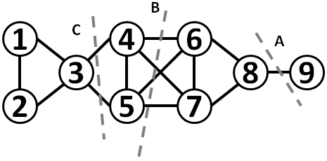
An example
Which of the three cuts has the best (min, normalized, ratio) cut?

Slide 35
Graph Cuts
Ratio and normalized cuts can be reformulated in matrix format and solved using spectral clustering

Slide 36
SPECTRAL CLUSTERING

Slide 37
Finding clusters
Simplest form: Split the graph into two pieces, many connections within, few across
Nodes
Nodes
Network
Adjacency matrix
How do we identify this structure?
Partition the graph, so that the resulting pieces have low conductance

Slide 38
Matrix Representation
Adjacency matrix (A):
  n× n matrix
  A=[a_{ij}], a_{ij}=1 if edge between node i and j
 | 1 | 2 | 3 | 4 | 5 | 6
1 | 0 | 1 | 1 | 0 | 1 | 0
2 | 1 | 0 | 1 | 0 | 0 | 0
3 | 1 | 1 | 0 | 1 | 0 | 0
4 | 0 | 0 | 1 | 0 | 1 | 1
5 | 1 | 0 | 0 | 1 | 0 | 1
6 | 0 | 0 | 0 | 1 | 1 | 0
5
1
2
6
4
3
How many non-zeros in each row?
If the graph is weighted, a_{ij}= w_{ij}

Slide 39

Spectral Graph Partitioning
x is a vector in ℜ^{n} with components $(x1,…, xn)$
  Think of it as a label/value of each node of $G$
    Value x_{i} corresponds to node i in the graph
What is the meaning of A⋅ x?
Entry y_{i} is a sum of labels x_{j} of neighbors of i

Slide 40

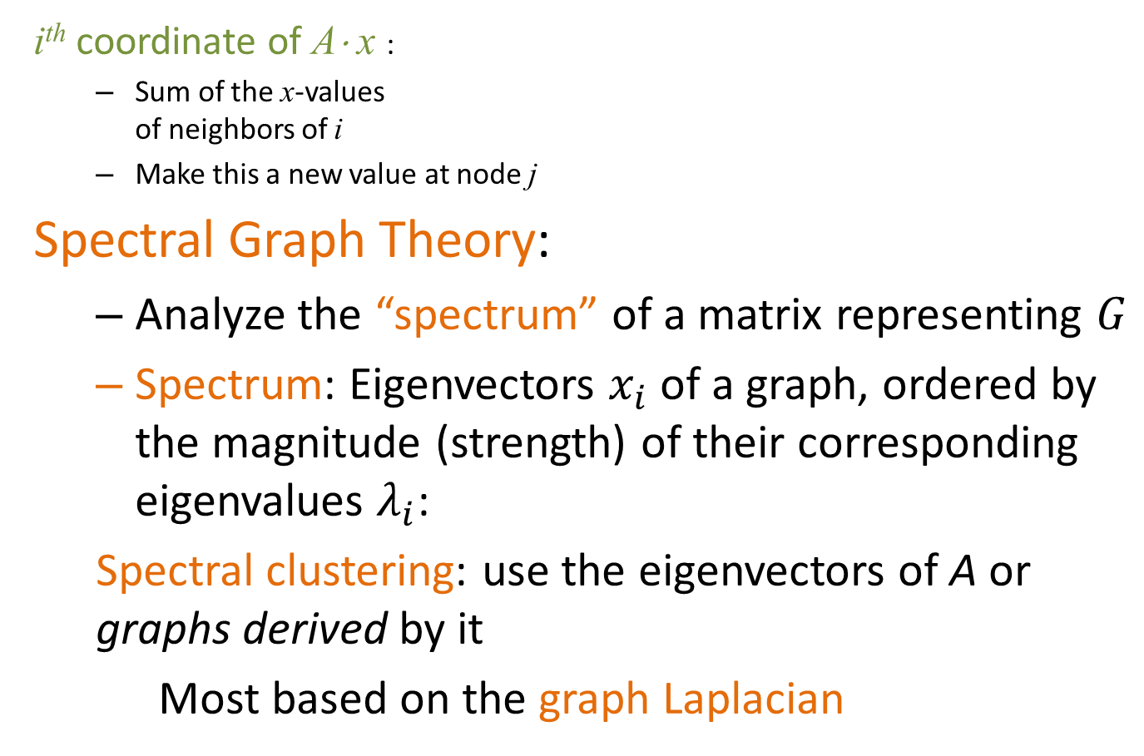
Spectral Analysis
i^{th} coordinate of A⋅ x :
  Sum of the x-values
  of neighbors of i
  Make this a new value at node j
Spectral Graph Theory:
  Analyze the “spectrum” of a matrix representing $G$
  Spectrum: Eigenvectors $x_{i}$ of a graph, ordered by the magnitude (strength) of their corresponding eigenvalues $λ_{i}$:
  Spectral clustering: use the eigenvectors of A or graphs derived by it
  Most based on the graph Laplacian
$$A⋅x=λ⋅x$$
Notes:
Eigenvectors are vectors that survive when I multiple them with the matrix

Slide 41
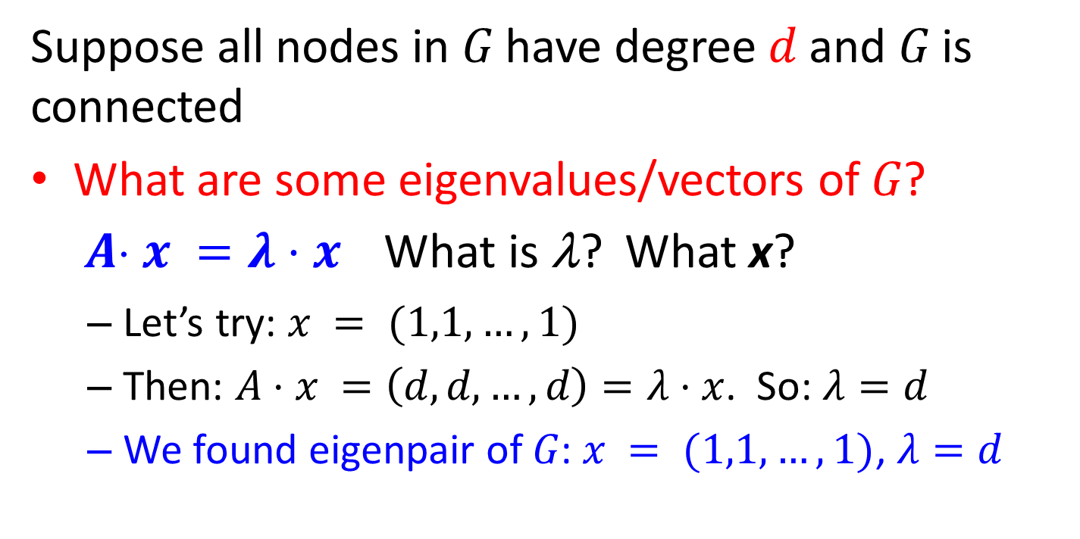
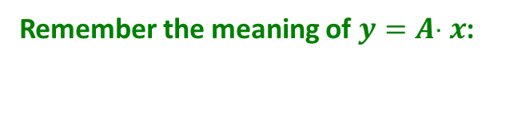
Example: d-regular graph
Suppose all nodes in $G$ have degree $d$ and $G$ is connected
What are some eigenvalues/vectors of $G$? $A x =λ⋅x$ What is λ? What x?
  Let’s try: $x = (1,1,…,1)$
  Then: $A⋅x =\left(d,d,…,d\right)=λ⋅x$. So: $λ=d$
  We found eigenpair of $G$: $x = (1,1,…,1)$, $λ=d$
Remember the meaning of $y=A x$:

Slide 42
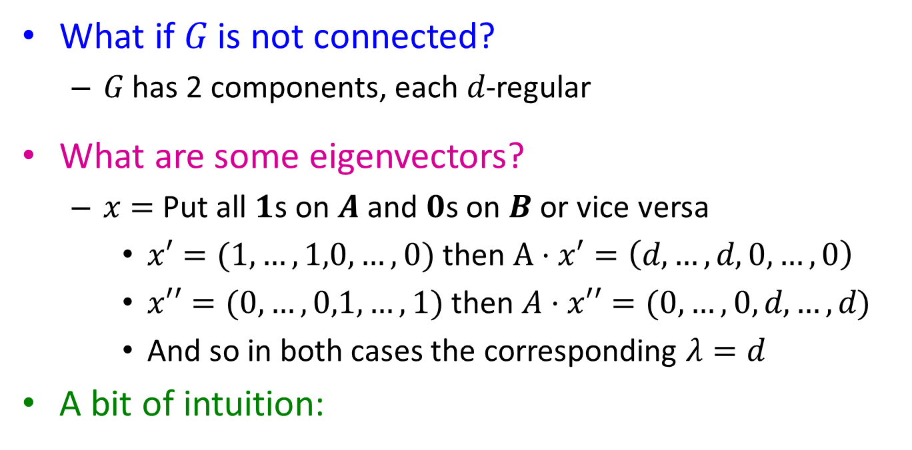
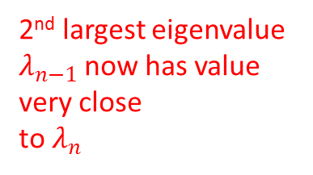


Example: Graph on 2 components
What if $G$ is not connected?
  $G$ has 2 components, each $d$-regular
What are some eigenvectors?
  $x=$ Put all $1$s on $A$ and $0$s on $B$ or vice versa
    $x′=(1,…,1,0,…,0)$ then $A⋅x′=\left(d,…,d,0,…,0\right)$
    $x′′=(0,…,0,1,…,1)$ then $A⋅x′′=(0,…,0,d,…,d)$
    And so in both cases the corresponding $λ=d$
A bit of intuition:
A
B
|A|
|B|
A
B
A
B
2nd largest eigenvalue $λ_{n−1}$now has value very close
to $λ_{n}$
$$λ_{n}=λ_{n−1}$$
$$λ_{n}−λ_{n−1}≈0$$
What is the right matrix to apply this intuition?
Notes:
regular graph with 2 connected components, I have the eigenvalue d with multiplicity 2, this means that this corresponds to two eigenvectors.
What if the two components are barely connected?
The two eigenvalues similar values – if disconnected, we know what the eigenvectors will be 1s for A, 0s for B, if barely connected, we hope they do not change too much
Block A 0
0 B

Slide 43
Matrix Representations
Adjacency matrix (A):
  n× n matrix
  A=[a_{ij}], a_{ij}=1 if edge between node i and j
Important properties:
  Symmetric matrix
  Eigenvectors are real and orthogonal
5
 | 1 | 2 | 3 | 4 | 5 | 6
1 | 0 | 1 | 1 | 0 | 1 | 0
2 | 1 | 0 | 1 | 0 | 0 | 0
3 | 1 | 1 | 0 | 1 | 0 | 0
4 | 0 | 0 | 1 | 0 | 1 | 1
5 | 1 | 0 | 0 | 1 | 0 | 1
6 | 0 | 0 | 0 | 1 | 1 | 0
1
2
6
4
3
If the graph is weighted, a_{ij}= w_{ij}
Notes:
Orthogonal: dot product is zero

Slide 44
Matrix Representations
Degree matrix (D):
  n× n diagonal matrix
  D=[d_{ii}], d_{ii} = degree of node i
 | 1 | 2 | 3 | 4 | 5 | 6
1 | 3 | 0 | 0 | 0 | 0 | 0
2 | 0 | 2 | 0 | 0 | 0 | 0
3 | 0 | 0 | 3 | 0 | 0 | 0
4 | 0 | 0 | 0 | 3 | 0 | 0
5 | 0 | 0 | 0 | 0 | 3 | 0
6 | 0 | 0 | 0 | 0 | 0 | 2
5
1
2
6
4
3

Slide 45
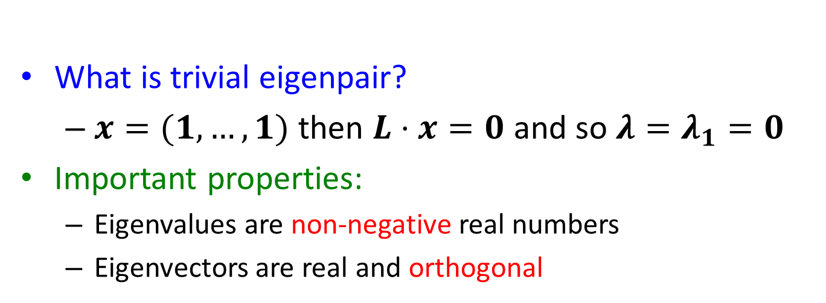

Graph Laplacian
Laplacian matrix (L):
  n× n symmetric matrix
 | 1 | 2 | 3 | 4 | 5 | 6
1 | 3 | -1 | -1 | 0 | -1 | 0
2 | -1 | 2 | -1 | 0 | 0 | 0
3 | -1 | -1 | 3 | -1 | 0 | 0
4 | 0 | 0 | -1 | 3 | -1 | -1
5 | -1 | 0 | 0 | -1 | 3 | -1
6 | 0 | 0 | 0 | -1 | -1 | 2
$$L = D − A$$
1
5
2
6
4
3
What is trivial eigenpair?
  $x=(1,…,1)$ then $L⋅x=0$ and so ${λ=λ}_{1}=0$
Important properties:
  Eigenvalues are non-negative real numbers
  Eigenvectors are real and orthogonal
Notes:
Sum of entries at each row (and column) equal to 0

Slide 46
Graph Laplacian
If the graph is disconnected
If there are two connected components, the same argument as for the adjacency matrix applies, and λ₁ = λ₂ = 0
The multiplicity of eigenvalue 0 is equal to the number of connected components

Slide 47
The second smallest eigenvalue
Fact: For a symmetric matrix M
What is the meaning of min x^{T} L x on G?

Slide 48
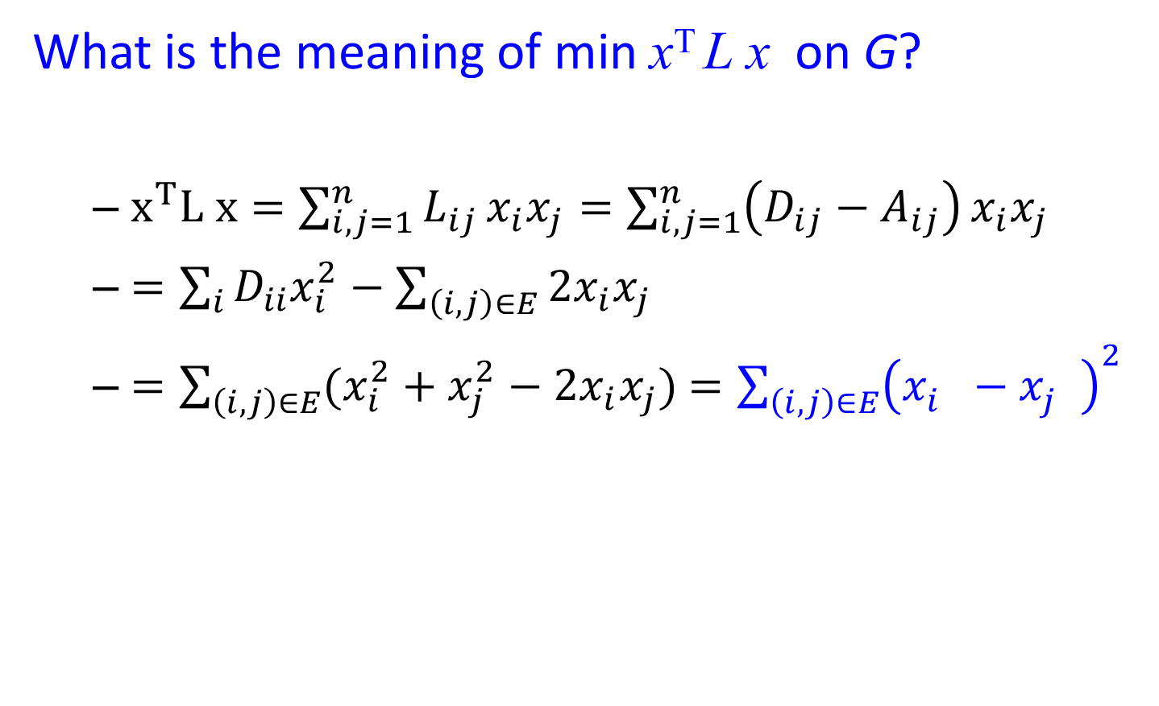
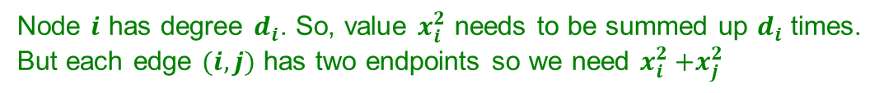
λ₂ as an optimization problem
What is the meaning of min x^{T} L x on G?
  $x^{T}L x=\sum_{i,j=1}^{n}{L_{ij}}x_{i}x_{j}=\sum_{i,j=1}^{n}{\left(D_{ij}−A_{ij}\right)}x_{i}x_{j}$
  $=\sum_{i}{D_{ii}x_{i}^{2}}−\sum_{\left(i,j\right)∈E}{2x_{i}x_{j}}$
  $=\sum_{\left(i,j\right)∈E}{(x_{i}^{2}+x_{j}^{2}−2x_{i}x_{j})}$ $=\sum_{\left(i,j\right)∈E}{{\left(x_{i}^{}−x_{j}^{}\right)}^{2}}$
Node $i$ has degree $d_{i}$. So, value $x_{i}^{2}$ needs to be summed up $d_{i}$ times.
But each edge $(i,j)$ has two endpoints so we need $x_{i}^{2}{+x}_{j}^{2}$
Notes:
Sum_i Dii xi^2 = \sum_ij xi^2 + xj^2
Node i has degree Dii so for each edge I sum xi^2 once.
But edge has 2 endpoints so I have to take + xj^2

Slide 49
λ₂ as an optimization problem
The expression:
is

Slide 50

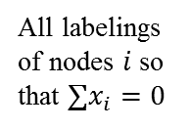

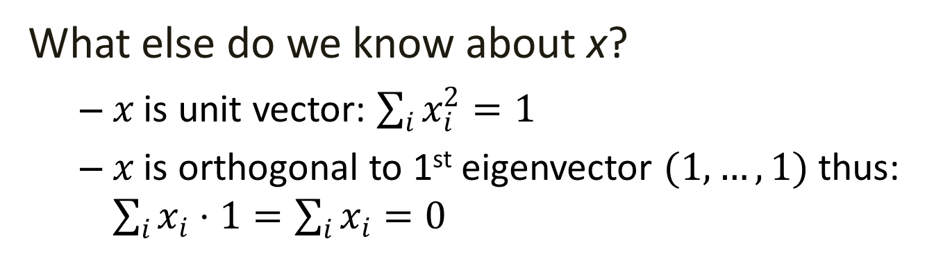

λ₂ as an optimization problem
What else do we know about x?
  $x$ is unit vector: $\sum_{i}{x_{i}^{2}=1}$
  $x$ is orthogonal to 1st eigenvector $(1,…,1)$thus: $\sum_{i}{x_{i}⋅1}=\sum_{i}{x_{i}}=0$
All labelings of nodes $i$ so that $∑x_{i}=0$
=1
We want to assign values $x_{i}$ to nodes i such that few edges cross 0.
(we want x_{i} and x_{j} to subtract each other)
i
j
x
$$x_{i}$$
0
$$x_{j}$$
Balance to minimize
Notes:
Dots are the nodes of the graph – want to put some of the left side of zero, some of the right side of zero – why sum must be equal to 1, not all left not all right because some must be zero
Need to minimize sum of the differences of labels of endpoints of all edges – better to have the same sign, penalty for edges that cross zero
Put them in a real lines, in such a way

Slide 51
λ₂ as an optimization problem
All labelings of nodes $i$ so that $∑x_{i}=0$
Minimum when connected nodes get the same sign (similar values)
This minimization problem tries to place (embed) nodes of the graph on the real line so that the number of edges that span across 0 is as small as possible
Tightly connected nodes on the same side of the real line
i
j
x
$$x_{i}$$
0
$$x_{j}$$
Balance to minimize
Notes:
Dots are the nodes of the graph – want to put some of the left side of zero, some of the right side of zero – why sum must be equal to 1, not all left not all right because some must be zero
Need to minimize sum of the differences of labels of endpoints of all edges – better to have the same sign, penalty for edges that cross zero
Put them in a real lines, in such a way

Slide 52
0

Slide 53


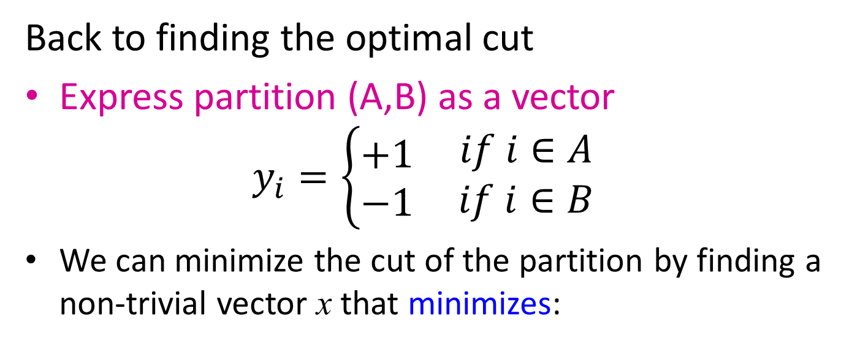
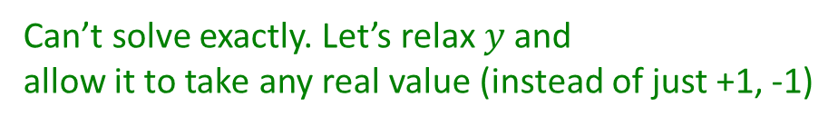
Find Optimal Cut [Fiedler’73]
Back to finding the optimal cut
Express partition (A,B) as a vector
$$y_{i}=\left\{\begin{matrix}+1 \\ −1\end{matrix} \begin{matrix}if i∈A \\ if i∈B\end{matrix}\right.$$
We can minimize the cut of the partition by finding a non-trivial vector x that minimizes:
Can’t solve exactly. Let’s relax $y$ and
allow it to take any real value (instead of just +1, -1)
$$y_{i}=−1$$
0
j
$$y_{j}=+1$$
Notes:
Example

Slide 54
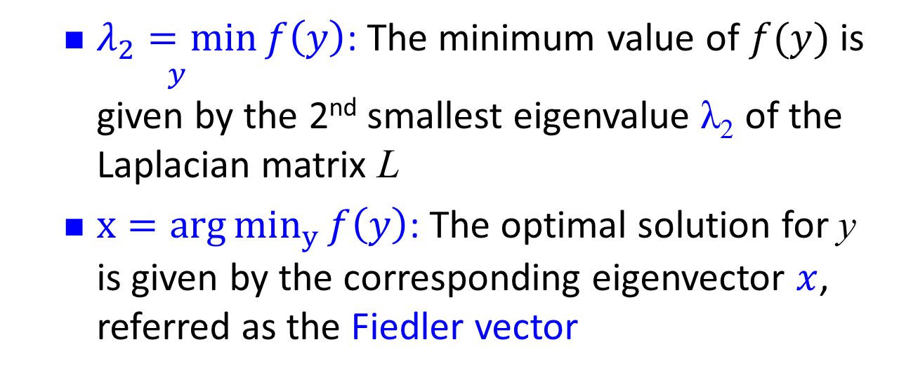


Rayleigh Theorem
i
0
j
x
$$x_{i}$$
$$x_{j}$$
  $\underset{y}{λ_{2}=min}{f\left(y\right)}$: The minimum value of $f(y)$ is given by the 2nd smallest eigenvalue λ₂ of the Laplacian matrix L
  $x=arg{min_{y}{f\left(y\right)}}$: The optimal solution for y is given by the corresponding eigenvector $x$, referred as the Fiedler vector

Slide 55
1
1
-1
1
-1

Slide 56
2
7
1
8
3
6
4
5

Slide 57
2
7
1
8
3
6
4
5
-0.383
-0.247
0
0.247
0.383

Slide 58
2
7
1
8
3
6
4
5
-0.383
-0.247
0
0.247
0.383

Slide 59
Example
1
5
2
6
4
3
Eigenvalues
0.0
1.0
3.0
3..0
4..0
5.0
0.4
0.3
-0.5
-0.2
-0.4
-0.5
0.4
0.6
0.4
-0.4
0.4
0.0
Eigenvectors
0.4
0.3
0.1
0.6
-0.4
0.5
0.4
-0.3
0.1
0.6
0.4
-0.5
0.4
-0.3
-0.5
-0.2
0.4
0.5
0.4
-0.6
0.4
-0.4
-0.4
0.0

Slide 60
Spectral Partitioning Algorithm
Three basic stages:
  Pre-processing
    Construct a matrix representation of the graph
  Decomposition
    Compute eigenvalues and eigenvectors of the matrix
  Grouping
    Assign points to two or more clusters, based on the new representation

Slide 61
Spectral Partitioning Algorithm
Pre-processing:
  Build Laplacian
  matrix L of the
  graph
Decomposition:
  Find eigenvalues λ
  and eigenvectors x
  of the matrix L
  Map vertices to
  corresponding
  components of λ₂
 | 1 | 2 | 3 | 4 | 5 | 6
1 | 3 | -1 | -1 | 0 | -1 | 0
2 | -1 | 2 | -1 | 0 | 0 | 0
3 | -1 | -1 | 3 | -1 | 0 | 0
4 | 0 | 0 | -1 | 3 | -1 | -1
5 | -1 | 0 | 0 | -1 | 3 | -1
6 | 0 | 0 | 0 | -1 | -1 | 2
0.0
0.4
0.3
-0.5
-0.2
-0.4
-0.5
1.0
0.4
0.6
0.4
-0.4
0.4
0.0
λ =
3.0
X =
0.4
0.3
0.1
0.6
-0.4
0.5
3.0
0.4
-0.3
0.1
0.6
0.4
-0.5
4.0
0.4
-0.3
-0.5
-0.2
0.4
0.5
5.0
0.4
-0.6
0.4
-0.4
-0.4
0.0
1
0.3
2
0.6
3
0.3
How do we now find the clusters?
4
-0.3
5
-0.3
6
-0.6

Slide 62
Spectral Partitioning Algorithm
Grouping:
  Sort components of reduced 1-dimensional vector
  Identify clusters by splitting the sorted vector in two
How to choose a splitting point?
  Naïve approaches:
    Split at 0 or median value
  More expensive approaches:
    Attempt to minimize normalized cut in 1-dimension
    (sweep over ordering of nodes induced by the eigenvector)
Split at 0:
Cluster A: Positive points
Cluster B: Negative points
1
0.3
A
B
2
0.6
3
0.3
4
-0.3
1
0.3
4
-0.3
5
-0.3
2
0.6
5
-0.3
6
-0.6
3
0.3
6
-0.6

Slide 63
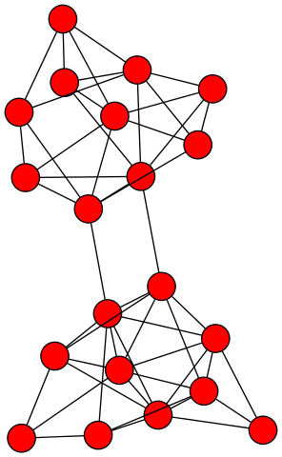
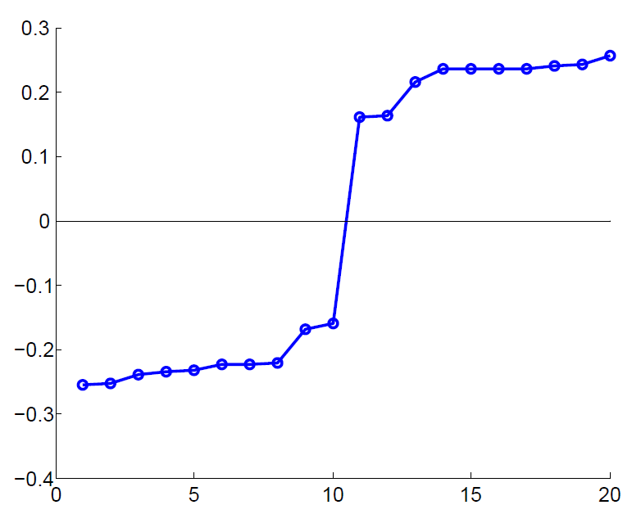
Example: Spectral Partitioning
Value of x₂
Rank in x₂

Slide 64
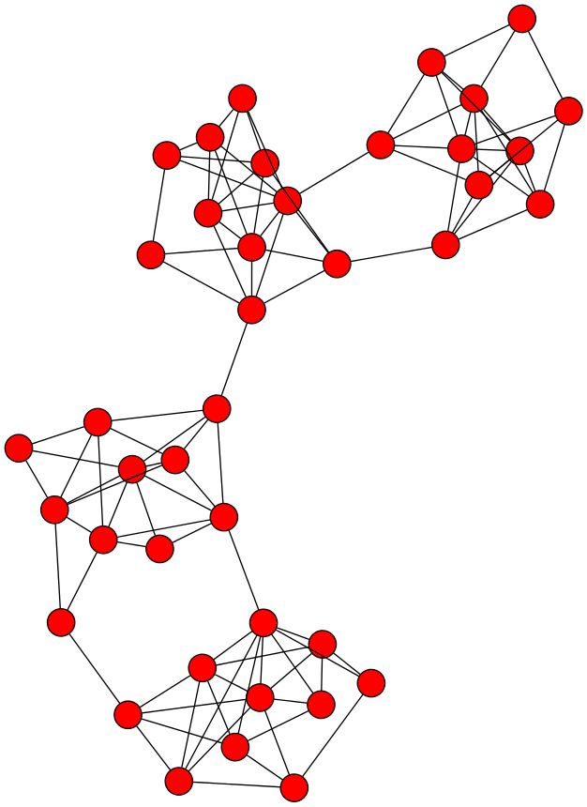
k-Way Spectral Clustering
How do we partition a graph into k clusters?

Slide 65
k-Way Spectral Clustering
How do we partition a graph into k clusters?
Recursively apply a bi-partitioning algorithm in a hierarchical divisive manner
    Disadvantages: Inefficient, unstable

Slide 66
k-Way Spectral Clustering
Use several of the eigenvectors to partition the graph.
Use m eigenvectors, and set a threshold for each,
Get a partition into 2^{m} groups, each group consisting of the nodes that are above or below threshold for each of the eigenvectors, in a particular pattern.

Slide 67
Example
1
5
2
6
4
3
Eigenvalues
0.0
1.0
3.0
3..0
4..0
5.0
0.4
0.3
-0.5
-0.2
-0.4
-0.5
0.4
0.6
0.4
-0.4
0.4
0.0
Eigenvectors
0.4
0.3
0.1
0.6
-0.4
0.5
0.4
-0.3
0.1
0.6
0.4
-0.5
0.4
-0.3
-0.5
-0.2
0.4
0.5
0.4
-0.6
0.4
-0.4
-0.4
0.0
If we use both the 2nd and 3rd eigenvectors,
nodes 5 and 6 (negative in both) 2 and 3 (positive in both)
1 and 4 alone
Note that each eigenvector except the first is the vector x that minimizes x^{T}Lx, subject to the constraint that it is orthogonal to all previous eigenvectors.
Thus, while each eigenvector tries to produce a minimum-sized cut, successive eigenvectors have to satisfy more and more constraints => the cuts progressively worse.

Slide 68
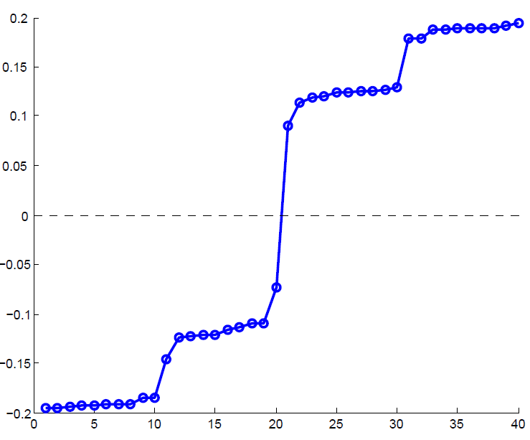
Example: Spectral Partitioning
Components of x₂
Value of x₂
Rank in x₂

Slide 69
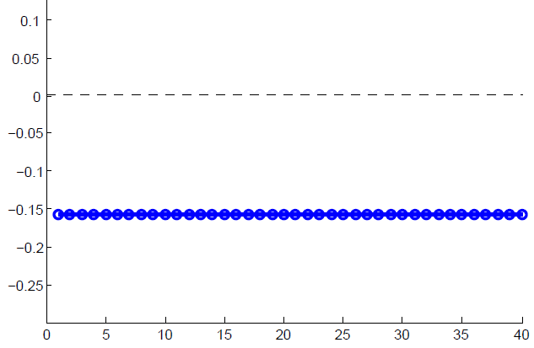
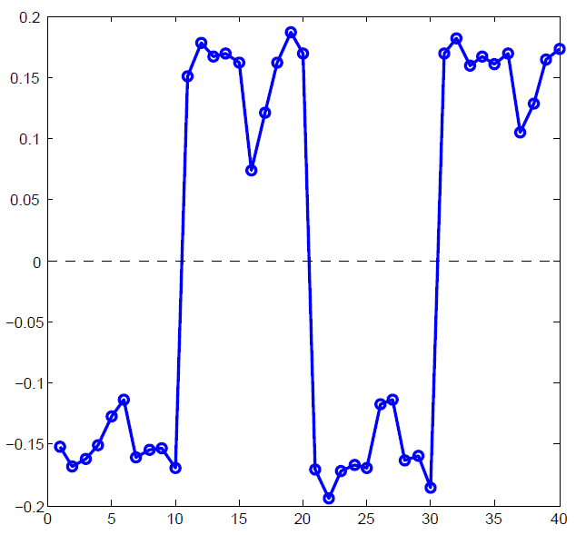
Example: Spectral partitioning
Components of x₁
Components of x₃

Slide 70
Spectral Clustering
Use the lowest k eigenvalues of L to construct the n x k graph G’ that has these eigenvectors as columns
The n-rows represent the graph vertices in a k-dimensional Euclidean space
Group these vertices in k clusters using k-means clustering or similar techniques

Slide 71
k-Way Spectral Clustering
Pre-processing:
  Build Laplacian
  matrix L of the
  graph
Decomposition:
  Find eigenvalues λ and eigenvectors x
  of the matrix L
 | 1 | 2 | 3 | 4 | 5 | 6
1 | 3 | -1 | -1 | 0 | -1 | 0
2 | -1 | 2 | -1 | 0 | 0 | 0
3 | -1 | -1 | 3 | -1 | 0 | 0
4 | 0 | 0 | -1 | 3 | -1 | -1
5 | -1 | 0 | 0 | -1 | 3 | -1
6 | 0 | 0 | 0 | -1 | -1 | 2
0.0
0.4
0.3
-0.5
-0.2
-0.4
-0.5
1.0
0.4
0.6
0.4
-0.4
0.4
0.0
λ =
3.0
X =
0.4
0.3
0.1
0.6
-0.4
0.5
3.0
0.4
-0.3
0.1
0.6
0.4
-0.5
4.0
0.4
-0.3
-0.5
-0.2
0.4
0.5
5.0
0.4
-0.6
0.4
-0.4
-0.4
0.0
k = 3

Slide 72



Cuts and spectral clustering
Relaxing Ncut leads to normalized spectral clustering, while relaxing RatioCut leads to unnormalized spectral clustering

Slide 73
Normalized Graph Laplacians
L_{rw} closely connected to random walks (to be discussed in future lectures)

Slide 74
Spectral clustering (besides graphs)
Can be used to cluster any points (not just vertices), as long as there is an appropriate similarity matrix
Needs to be symmetric and non-negative
How to construct a graph:
ε-neighborhood graph: connect all points whose pairwise distances are smaller than ε
k-nearest neighbor graph: connect each point with each k nearest neighbor
full graph: connect all points with weight in the edge (i, j) equal to the similarity of i and j

Slide 75
Summary
The values of x minimize
For weighted matrices
The ordering according to the x_{i} values will group similar (connected) nodes together

Slide 76
Outline
Summary of Part I
PART II
Cuts
Spectral Clustering
Dense Subgraphs
Community Evaluation

Slide 77
Maximum Densest SUBGRAPH
Thanks to Aris Gionis

Slide 78
Finding Dense Subgraphs
Dense subgraph: A collection of vertices such that there are a lot of edges between them
  E.g., find the subset of email users that talk the most between them
  Or, find the subset of genes that are most commonly expressed together
Similar to community identification but we do not require that the dense subgraph is sparsely connected with the rest of the graph.

Slide 79
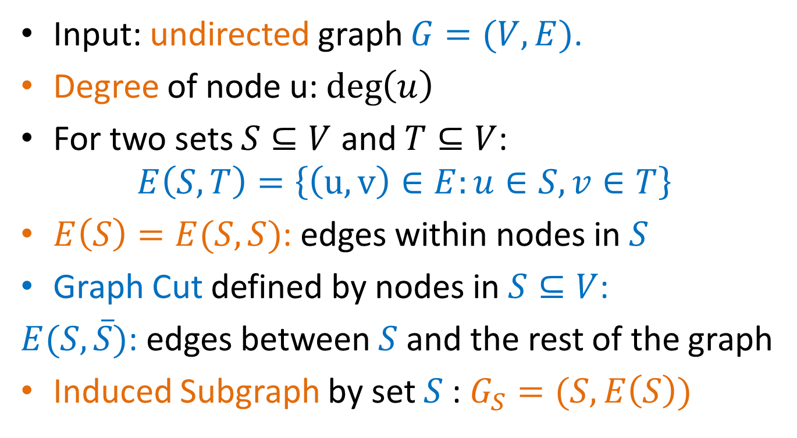
Definitions
Input: undirected graph $G=(V,E)$.
Degree of node u: $\deg\left(u\right)$
For two sets $S⊆V$ and $T⊆V$:
$$E\left(S,T\right)=\left\{\left(u,v\right)∈E:u∈S, v∈T\right\}$$
$E\left(S\right)=E(S,S)$: edges within nodes in $S$
Graph Cut defined by nodes in $S⊆V$:
$E(S,\overline{S})$: edges between $S$ and the rest of the graph
Induced Subgraph by set $S$: $G_{S}=(S,E\left(S\right))$

Slide 80
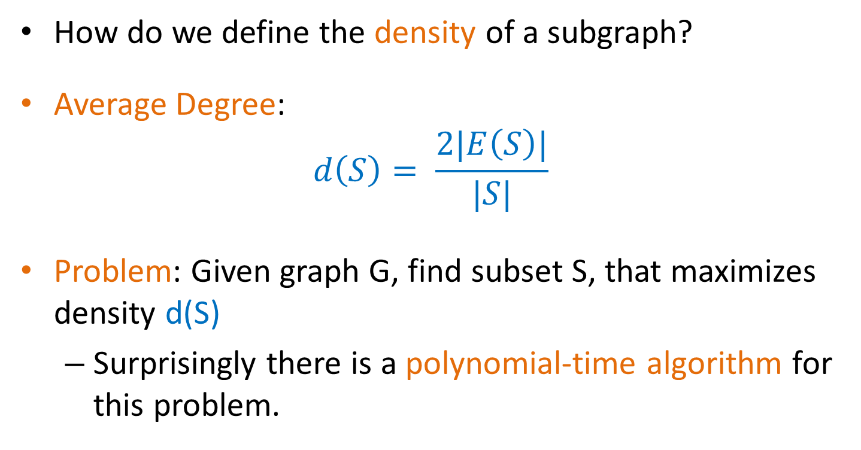
Definitions
How do we define the density of a subgraph?
Average Degree:
$$d\left(S\right)= \frac{2|E\left(S\right)|}{|S|}$$
Problem: Given graph G, find subset S, that maximizes density d(S)
  Surprisingly there is a polynomial-time algorithm for this problem.

Slide 81
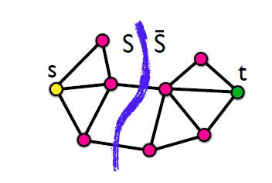
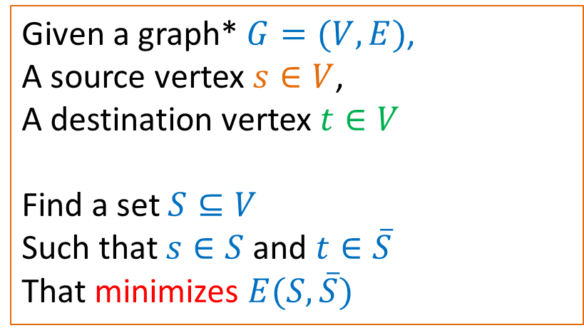
Min-Cut Problem
Given a graph* $G=(V,E)$,
A source vertex $s∈V$,
A destination vertex $t∈V$
Find a set $S⊆V$
Such that $s∈S$ and $t∈\overline{S}$
That minimizes $E(S,\overline{S})$
* The graph may be weighted
Min-Cut = Max-Flow: the minimum cut maximizes the flow that can be sent from s to t. There is a polynomial time solution.
the maximum amount of flow passing from the source to the sink is equal to the total weight of the edges in the minimum cut

Slide 82
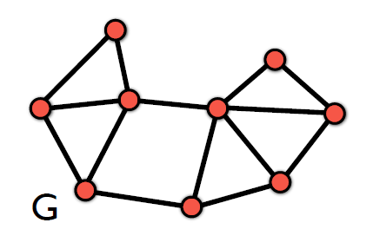
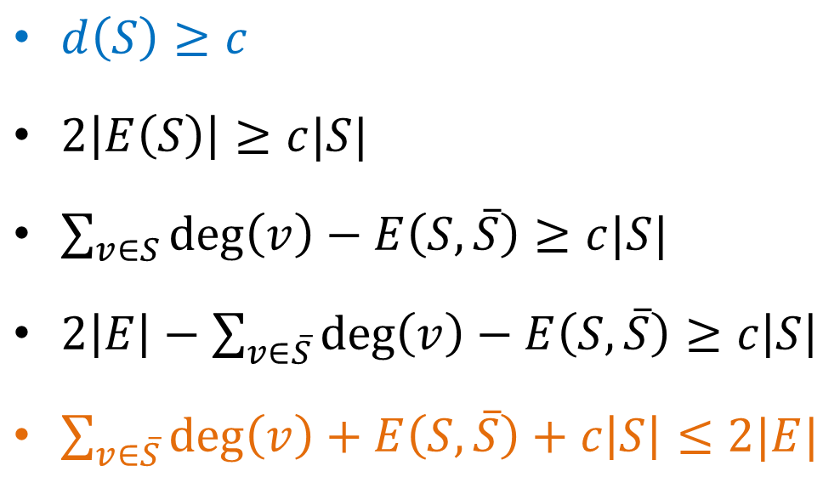
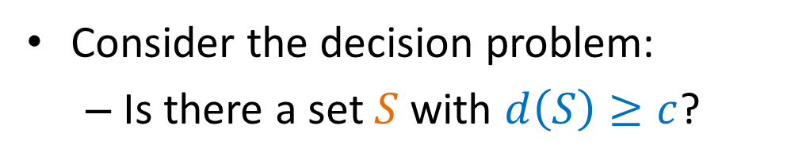
Decision problem
Consider the decision problem:
  Is there a set $S$ with $d\left(S\right)≥c$?
$d\left(S\right)≥c$
$2\left|E\left(S\right)\right|≥c|S|$
$\sum_{v∈S}{\deg\left(v\right)−E\left(S,\overline{S}\right)≥c|S|}$
$2\left|E\right|−\sum_{v∈\overline{S}}{\deg\left(v\right)}−E\left(S,\overline{S}\right)≥c\left|S\right|$
$\sum_{v∈\overline{S}}{\deg\left(v\right)}+E\left(S,\overline{S}\right)+c\left|S\right|≤2|E|$

Slide 83
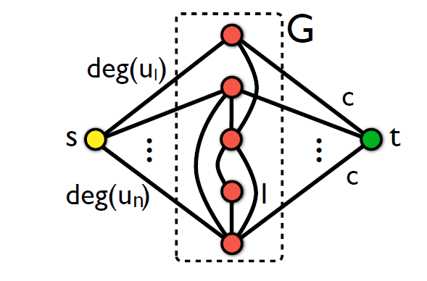

Transform to min-cut
For a value $c$ we do the following transformation
We ask for a min s-t cut in the new graph

Slide 84
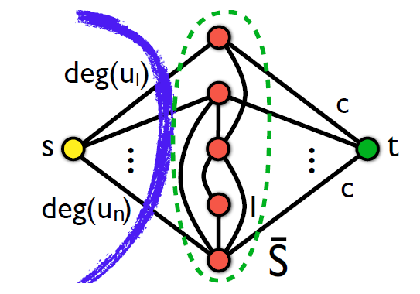

Transformation to min-cut
There is a cut that has value $2|E|$

Slide 85


Transformation to min-cut
Every other cut has value:
$\sum_{v∈\overline{S}}{\deg\left(v\right)}+E\left(S,\overline{S}\right)+c\left|S\right|$

Slide 86

Transformation to min-cut
If $\sum_{v∈\overline{S}}{\deg\left(v\right)}+E\left(S,\overline{S}\right)+c\left|S\right|≤2|E|$ then $S≠∅$ and $d\left(S\right)≥c$

Slide 87
Algorithm (Goldberg)
Given the input graph G, and value c
Create the min-cut instance graph
Compute the min-cut
If the set S is not empty, return YES
Else return NO
How do we find the set with maximum density?

Slide 88
Min-cut algorithm
The min-cut algorithm finds the optimal solution in polynomial time O(nm), but this is too expensive for real networks.
We will now describe a simpler approximation algorithm that is very fast
  Approximation algorithm: the ratio of the density of the set produced by our algorithm and that of the optimal is bounded.
    We will show that the ratio is at most ½
    The optimal set is at most twice as dense as that of the approximation algorithm.
Any ideas for the algorithm?

Slide 89

Greedy Algorithm
Given the graph $G =(V,E)$
$S_{0}=V$
For $i=1…|V|$
  Find node $v∈S$ with the minimum degree
  $S_{i}=S_{i−1}∖\{v\}$
3. Output the densest set $S_{i}$

Slide 90










Example

Slide 91

Analysis
We will prove that the optimal set has density at most 2 times that of the set produced by the Greedy algorithm.
Density of optimal set: $d_{opt}=\max_{S⊆V}{d(S)}$
Density of greedy algorithm $d_{g}$
We want to show that $d_{opt}≤{2⋅d}_{g}$

Slide 92


Upper bound
We will first upper-bound the solution of optimal
Assume an arbitrary assignment of an edge $(u,v)$to either $u$ or $v$
Define:
  $IN\left(u\right)$= # edges assigned to u
  $Δ=\max_{u∈V}{IN(u)}$
We can prove that
  $d_{opt}≤2⋅Δ$
This is true for any assignment of the edges!
Notes:
Let S be the set with maximum density each edge of S must be assigned to a node in S thus
|E(S)| <= (|S| d_max) (Δ = d_max))
Thus d_max >= |E(S)|/|S|

Slide 93

Lower bound
We will now prove a lower bound for the density of the set produced by the greedy algorithm.
For the lower bound we consider a specific assignment of the edges that we create as the greedy algorithm progresses:
  When removing node $u$ from $S$, assign all the edges to $u$
So: $IN\left(u\right)=$ degree of $u$ in $S$ $≤d\left(S\right)≤d_{g}$
This is true for all $u$ so $Δ≤d_{g}$
It follows that $d_{opt}≤2⋅d_{g}$
Notes:
Initially, all edges are unassigned – when a minimum node u is removed from S all edges from u to S are assigned to u
Each time we delete the minimum degree thus the density of the remaining d_g is the largest of all

Slide 94

The k-densest subgraph
The k-densest subgraph problem: Find the set of $k$ nodes $S$, such that the density $d(S)$ is maximized.
  The k-densest subgraph problem is NP-hard!

Slide 95
Outline
Summary of Part I
PART II
Cuts
Spectral Clustering
Dense Subgraphs
Community Evaluation

Slide 96
Community Evaluation
With ground truth
Without ground truth

Slide 97

Evaluation with ground truth
Zachary’s Karate Club
Club president (34) (circles) and instructor (1) (rectangles)

Slide 98


Metrics: purity
the fraction of instances that have labels equal to the label of the community’s majority
(5+6+4)/20 = 0.75

Slide 99
Metrics
Based on pair counting: the number of pairs of vertices which are classified in the same (different) clusters in the two partitions.
True Positive (TP) Assignment: when similar members are assigned to the same community. This is a correct decision.
True Negative (TN) Assignment: when dissimilar members are assigned to different communities. This is a correct decision.
False Negative (FN) Assignment: when similar members are assigned to different communities. This is an incorrect decision.
False Positive (FP) Assignment: when dissimilar members are assigned to the same community. This is an incorrect decision.
Notes:
St

Slide 100

Metrics: pairs
For TP, we need to compute the number of pairs with the same label that are in the same community

Slide 101

Metrics: pairs
For TN: compute the number of dissimilar pairs in dissimilar communities

Slide 102


Metrics: pairs
For FP, compute dissimilar pairs that are in the same community.
For FN, compute similar pairs that are in different communities.

Slide 103
Metrics: pairs
Precision (P): the fraction of pairs that have been correctly assigned to the same community.
TP/(TP+FP)
Recall (R): the fraction of pairs assigned to the same community of all the pairs that should have been in the same community.
TP/(TP+FN)
F-measure
2PR/(P+R)

Slide 104
Evaluation without ground truth
Cluster Cohesion: Measures how closely related are objects in a cluster
Cluster Separation: Measure how distinct or well-separated a cluster is from other clusters
Example: Squared Error
  Cohesion is measured by the within cluster sum of squares (SSE)
  Separation is measured by the between cluster sum of squares
      Where |C_{i}| is the size of cluster i

Slide 105


Evaluation without ground truth
Cut, density, conductance

Slide 106
Evaluation without ground truth
Modularity
Both as a local (per individual community) and as a global measure

Slide 107

Evaluation without ground truth
With semantics:
(ad hoc) analyze other attributes (e.g., profile, content generated) for coherence
human subjects (user study) Mechanical Turk
Visual representation (similarity/adjacency matric, word clouds, etc)

Slide 108
Basic References
Jure Leskovec, Anand Rajaraman, Jeff Ullman, Mining of Massive Datasets, Chapter 10, http://www.mmds.org/
Reza Zafarani, Mohammad Ali Abbasi, Huan Liu, Social Media Mining: An Introduction, Chapter 6, http://dmml.asu.edu/smm/
Santo Fortunato: Community detection in graphs. CoRR abs/0906.0612v2 (2010)
Ulrike von Luxburg: A Tutorial on Spectral Clustering. CoRR abs/0711.0189 (2007)
G Palla, A. L. Barabási, T Vicsek, Quantyfying Social Group Evolution. Nature 446 (7136), 664-667

Slide 109
Questions?

