Slide 1
DATA MINING
LECTURE 3
Frequent Itemsets and Association Rules

Slide 2
This is how it all started…
Rakesh Agrawal, Tomasz Imielinski, Arun N. Swami: Mining Association Rules between Sets of Items in Large Databases. SIGMOD Conference 1993: 207-216
Rakesh Agrawal, Ramakrishnan Srikant: Fast Algorithms for Mining Association Rules in Large Databases. VLDB 1994: 487-499
These two papers are credited with the birth of Data Mining
For a long time people were fascinated with Association Rules and Frequent Itemsets
  Some people (in industry and academia) still are.

Slide 3
Market-Basket Data
A large set of items, e.g., things sold in a supermarket.
A large set of baskets, each of which is a small subset of the items, e.g., the things one customer buys on one day.
Items: {Bread, Milk, Diaper, Beer, Eggs, Coke}
Baskets: Transactions

Slide 4
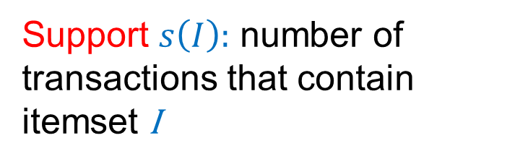

Frequent itemsets
Goal: find combinations of items (itemsets) that occur frequently
  Called Frequent Itemsets
Support $s\left(I\right)$: number of transactions that contain itemset I
Examples of frequent itemsets$s\left(I\right)$ ≥ 3
{Bread}: 4
{Milk} : 4
{Diaper} : 4
{Beer}: 3
{Diaper, Beer} : 3
{Milk, Bread} : 3

Slide 5
Market-Baskets – (2)
Really, a general many-to-many mapping (association) between two kinds of things, where the one (the baskets) is a set of the other (the items)
  But we ask about connections among “items,” not “baskets.”
The technology focuses on common/frequent events, not rare events (“long tail”).

Slide 6
Applications – (1)
Items = products; baskets = sets of products someone bought in one trip to the store.
Example application: given that many people buy beer and diapers together:
  Run a sale on diapers; raise price of beer.
Only useful if many buy diapers & beer.

Slide 7
Applications – (2)
Baskets = Web pages; items = words.
Example application: Unusual words appearing together in a large number of documents, e.g., “Brad” and “Angelina,” may indicate an interesting relationship.

Slide 8
Applications – (3)
Baskets = sentences; items = documents containing those sentences.
Example application: Items that appear together too often could represent plagiarism.
Notice items do not have to be “in” baskets.

Slide 9
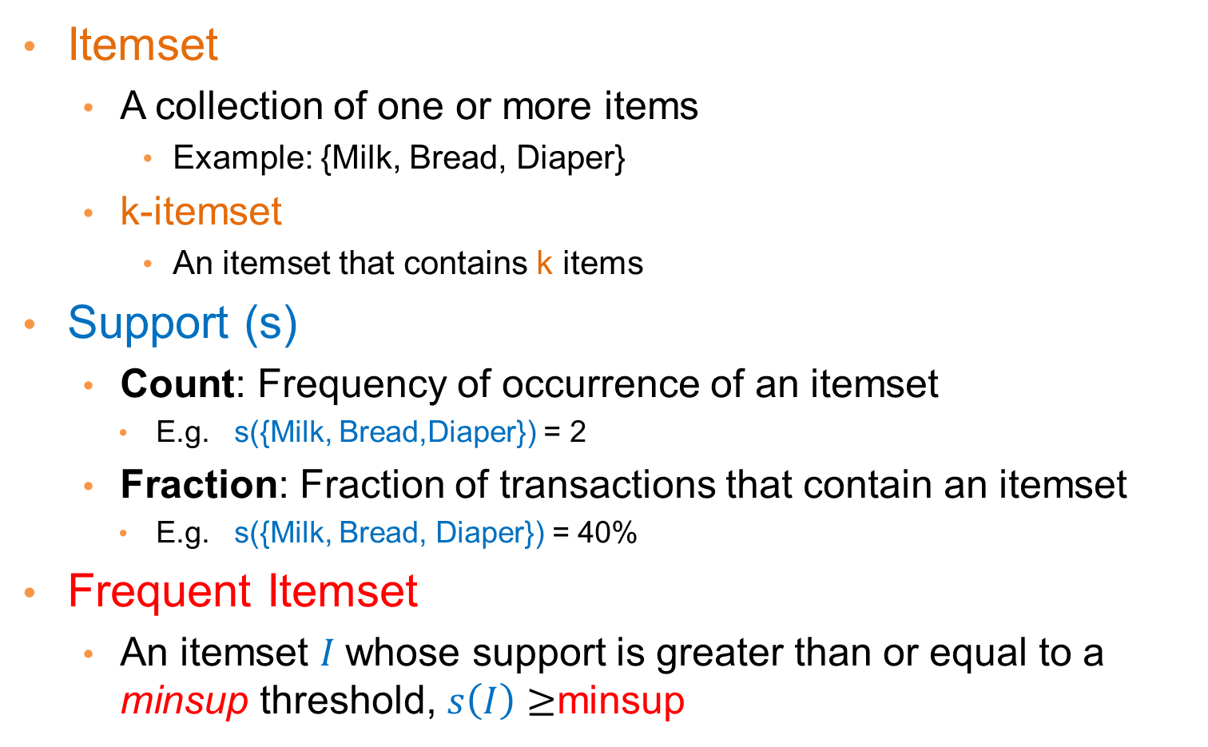
Definitions
Itemset
  A collection of one or more items
    Example: {Milk, Bread, Diaper}
  k-itemset
    An itemset that contains k items
Support (s)
  Count: Frequency of occurrence of an itemset
    E.g. s({Milk, Bread,Diaper}) = 2
  Fraction: Fraction of transactions that contain an itemset
    E.g. s({Milk, Bread, Diaper}) = 40%
Frequent Itemset
  An itemset $I$whose support is greater than or equal to a minsup threshold, $s\left(I\right)≥$minsup

Slide 10

Mining Frequent Itemsets task
Input: Market basket data, threshold minsup
Output: All frequent itemsets with support ≥ minsup
Problem parameters:
  N (size): number of transactions
    Wallmart: billions of baskets per year
    Web: billions of pages
  d (dimension): number of (distinct) items
    Wallmart sells more than 100,000 items
    Web: billions of words
  w: max size of a basket
  M: Number of possible itemsets.
$$M=2^{d}$$

Slide 11
The itemset lattice
Representation of all possible itemsets and their relationships
Given d items, there are 2^{d} possible itemsets

Slide 12
A Naïve Algorithm
Brute-force approach: Every itemset is a candidate :
  Consider all itemsets in the lattice, and scan the data for each candidate to compute the support
  Time Complexity ~ O(NMw) , Space Complexity ~ O(d)
OR
  Scan the data, and for each transaction generate all possible itemsets. Keep a count for each itemset in the data.
  Time Complexity ~ O(N2^{w}) , Space Complexity ~ O(M)
Expensive since M = 2^{d} !!!
  No solution that considers all candidates is acceptable!

Slide 13
Computation Model
Typically, data is kept in flat files rather than in a database system.
  Stored on disk.
  Stored basket-by-basket.
  We can expand a basket into pairs, triples, etc. as we read the data.
    Use k nested loops, or recursion to generate all itemsets of size k.
Data is too large to be loaded in memory.

Slide 14
Example file: retail
0 1 2 3 4 5 6 7 8 9 10 11 12 13 14 15 16 17 18 19 20 21 22 23 24 25 26 27 28 29
30 31 32
33 34 35
36 37 38 39 40 41 42 43 44 45 46
38 39 47 48
38 39 48 49 50 51 52 53 54 55 56 57 58
32 41 59 60 61 62
3 39 48
63 64 65 66 67 68
32 69
48 70 71 72
39 73 74 75 76 77 78 79
36 38 39 41 48 79 80 81
82 83 84
41 85 86 87 88
39 48 89 90 91 92 93 94 95 96 97 98 99 100 101
36 38 39 48 89
39 41 102 103 104 105 106 107 108
38 39 41 109 110
39 111 112 113 114 115 116 117 118
119 120 121 122 123 124 125 126 127 128 129 130 131 132 133
48 134 135 136
39 48 137 138 139 140 141 142 143 144 145 146 147 148 149
39 150 151 152
38 39 56 153 154 155
Example: items are positive integers, and each basket corresponds to a line in the file of space-separated integers

Slide 15
Computation Model – (2)
The true cost of mining disk-resident data is usually the number of disk I/O’s.
In practice, association-rule algorithms read the data in passes – all baskets read in turn.
Thus, we measure the cost by the number of passes an algorithm takes.

Slide 16
Main-Memory Bottleneck
For many frequent-itemset algorithms, main memory is the critical resource.
  As we read baskets, we need to count something, e.g., occurrences of pairs.
  The number of different things we can count is limited by main memory.
  Swapping counts in/out is too slow

Slide 17
Computational Model - Summary
There are two quantities that capture the cost of our algorithm
  [Time] The number of passes we make over the data
  [Space] The amount of memory that we use
As it is usually the case, there is a trade-off between the two.

Slide 18

The Apriori Principle
Apriori principle (Main observation):
  If an itemset is frequent, then all of its subsets must also be frequent
  If an itemset is not frequent, then all of its supersets cannot be frequent
  The support of an itemset never exceeds the support of its subsets
  This is known as the anti-monotone property of support
$$∀X,Y:X⊆Y⇒s\left(X\right)≥s(Y)$$
Notes:
18

Slide 19
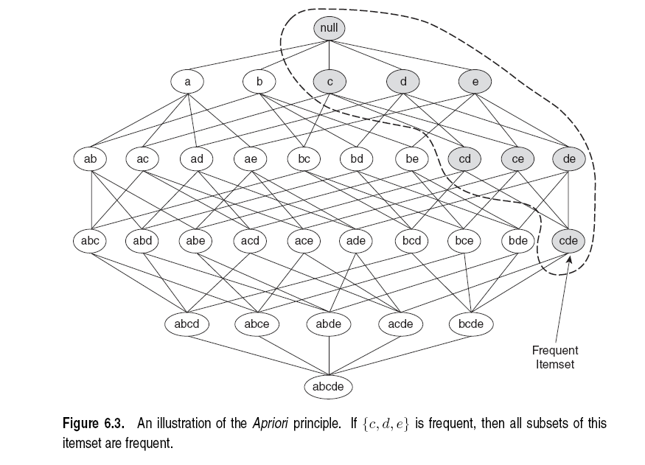
Illustration of the Apriori principle
Frequent subsets
Found to be frequent

Slide 20
Illustration of the Apriori principle
Found to be Infrequent
Infrequent supersets
Pruned

Slide 21
The Apriori algorithm
C_{k} = candidate itemsets of size k
L_{k} = frequent itemsets of size k
Level-wise approach
k = 1, C₁ = all items
While C_{k} not empty
  Scan the database to find which itemsets in C_{k} are frequent and put them into L_{k}
  Generate the candidate itemsets C_{k+1} of size k+1‏ using L_{k}
  k = k+1
Frequent itemset generation
Candidate generation
R. Agrawal, R. Srikant: "Fast Algorithms for Mining Association Rules",
Proc. of the 20th Int'l Conference on Very Large Databases, 1994.
Notes:
21

Slide 22
Candidate Generation
Apriori principle:
  An itemset of size k+1 is candidate to be frequent only if all of its subsets of size k are known to be frequent
Candidate generation:
Construct a candidate of size k+1 by combining frequent itemsets of size k
  If k = 1, take the all pairs of frequent items
  If k > 1, join pairs of itemsets that differ by just one item
  For each generated candidate itemset ensure that all subsets of size k are frequent.

Slide 23
Generate Candidates C_{k+1}
Assumption: The items in an itemset are ordered
  Integers ordered in increasing order, strings ordered lexicographicly
  The order ensures that if item y > x appears before x, then x is not in the itemset
The itemsets in L_{k} are also ordered
Create a candidate itemset of size k+1, by joining two itemsets of size k, that share the first k-1 items
Item 1 | Item 2 | Item 3
1 | 2 | 3
1 | 2 | 5
1 | 4 | 5
Notes:
23

Slide 24
Generate Candidates C_{k+1}
Assumption: The items in an itemset are ordered
  Integers ordered in increasing order, strings ordered in lexicographicly
  The order ensures that if item y > x appears before x, then x is not in the itemset
The itemsets in L_{k} are also ordered
Create a candidate itemset of size k+1, by joining two itemsets of size k, that share the first k-1 items
Item 1 | Item 2 | Item 3
1 | 2 | 3
1 | 2 | 5
1 | 4 | 5
1 | 2 | 3 | 5
Notes:
24

Slide 25
Generate Candidates C_{k+1}
Assumption: The items in an itemset are ordered
  Integers ordered in increasing order, strings ordered in lexicographicly
  The order ensures that if item y > x appears before x, then x is not in the itemset
The itemsets in L_{k} are also ordered
Create a candidate itemset of size k+1, by joining two itemsets of size k, that share the first k-1 items
Item 1 | Item 2 | Item 3
1 | 2 | 3
1 | 2 | 5
1 | 4 | 5
Are we missing something?
What about this candidate?
1 | 2 | 4 | 5
Notes:
25
Since we did not generate this candidate it means that the itemsets 1,2,4 and 1,2,5 are not frequent. Therefore, the itemset 1,2,4,5 cannot be frequent.

Slide 26
Generating Candidates C_{k+1} in SQL
self-join L_{k} ‏
  insert into C_{k+1}
  select p.item₁, p.item₂, …, p.item_{k}, q.item_{k}
  from L_{k} p, L_{k} q
  where p.item₁=q.item₁, …, p.item_{k-1}=q.item_{k-1}, p.item_{k} < q.item_{k}

Slide 27
Example
L₃={abc, abd, acd, ace, bcd}
Generating candidate set C₄
  Self-join: L₃*L₃
item1 | item2 | item3
a | b | c
a | b | d
a | c | d
a | c | e
b | c | d
item1 | item2 | item3
a | b | c
a | b | d
a | c | d
a | c | e
b | c | d
  p.item₁=q.item₁,p.item₂=q.item₂, p.item₃< q.item₃
Notes:
27

Slide 28
Example
L₃={abc, abd, acd, ace, bcd}
Generating candidate set C₄
  Self-join: L₃*L₃
item1 | item2 | item3
a | b | c
a | b | d
a | c | d
a | c | e
b | c | d
item1 | item2 | item3
a | b | c
a | b | d
a | c | d
a | c | e
b | c | d
  p.item₁=q.item₁,p.item₂=q.item₂, p.item₃< q.item₃
Notes:
28

Slide 29
Example
L₃={abc, abd, acd, ace, bcd}
Generating candidate set C₄
  Self-join: L₃*L₃
C₄ ={abcd}
item1 | item2 | item3
a | b | c
a | b | d
a | c | d
a | c | e
b | c | d
item1 | item2 | item3
a | b | c
a | b | d
a | c | d
a | c | e
b | c | d
{a,b,c}
{a,b,d}
{a,b,c,d}
  p.item₁=q.item₁,p.item₂=q.item₂, p.item₃< q.item₃
Notes:
29

Slide 30
Example
L₃={abc, abd, acd, ace, bcd}
Generating candidate set C₄
  Self-join: L₃*L₃
C₄ ={abcd
acde}
item1 | item2 | item3
a | b | c
a | b | d
a | c | d
a | c | e
b | c | d
item1 | item2 | item3
a | b | c
a | b | d
a | c | d
a | c | e
b | c | d
{a,c,d}
{a,c,e}
{a,c,d,e}
  p.item₁=q.item₁,p.item₂=q.item₂, p.item₃< q.item₃
Notes:
30

Slide 31
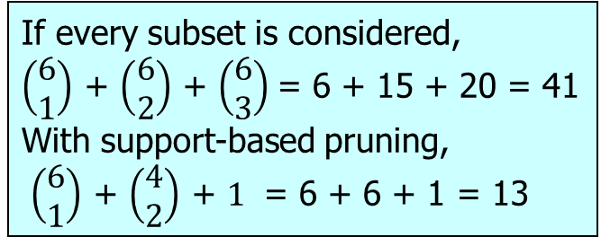
Illustration of the Apriori principle
minsup = 3
Items (1-itemsets)‏
Pairs (2-itemsets)‏
(No need to generate
candidates involving Coke
or Eggs)‏
Triplets (3-itemsets)‏
If every subset is considered,
$\left(\begin{matrix}6 \\ 1\end{matrix}\right)$ + $\left(\begin{matrix}6 \\ 2\end{matrix}\right)$ + $\left(\begin{matrix}6 \\ 3\end{matrix}\right)$= 6 + 15 + 20 = 41
With support-based pruning,
$\left(\begin{matrix}6 \\ 1\end{matrix}\right)$ + $\left(\begin{matrix}4 \\ 2\end{matrix}\right)$ + $1$ = 6 + 6 + 1 = 13
Only this triplet has all subsets to be frequent
But it is below the minsup threshold
Notes:
31

Slide 32
Generate Candidates C_{k+1}
Are we done? Are all the candidates valid?
Pruning step:
  For each candidate (k+1)-itemset create all subset k-itemsets
  Remove a candidate if it contains a subset k-itemset that is not frequent
Item 1 | Item 2 | Item 3
1 | 2 | 3
1 | 2 | 5
1 | 4 | 5
1 | 2 | 3 | 5
Is this a valid candidate?
No. Subsets (1,3,5) and (2,3,5) should also be frequent
Apriori principle

Slide 33
Example
L₃={abc, abd, acd, ace, bcd}
Self-joining: L₃*L₃
  abcd from abc and abd
  acde from acd and ace
C₄={abcd, acde}
Pruning:
  abcd is kept since all subset itemsets are in L₃
  acde is removed because ade is not in L₃
C₄={abcd}
{a,b,c}
{a,b,d}
{a,b,c,d}
abc
abd
acd
bcd
√
√
√
√
{a,c,d}
{a,c,e}
{a,c,d,e}
acd
ace
ade
cde
√
√
X
Notes:
33

Slide 34
Example II
{Bread,Diaper}
√
{Bread,Milk}
√
{Diaper, Milk}
√

Slide 35
Generate Candidates C_{k+1}
We have all frequent k-itemsets L_{k}
Step 1: self-join L_{k}‏
  Create set C_{k+1} by joining frequent k-itemsets that share the first k-1 items
Step 2: prune
  Remove from C_{k+1} the itemsets that contain a subset k-itemset that is not frequent
Notes:
35

Slide 36
Computing Frequent Itemsets
Given the set of candidate itemsets C_{k}, we need to compute the support and find the frequent itemsets L_{k}.
Scan the data, and use a hash structure to keep a counter for each candidate itemset that appears in the data
C_{k}

Slide 37
A simple hash structure
Create a dictionary (hash table) that stores the candidate itemsets as keys, and the number of appearances as the value.
  Initialize with zero
Increment the counter for each itemset that you see in the data

Slide 38
Example
Key | Value
{3 6 7} | 0
{3 4 5} | 1
{1 3 6} | 3
{1 4 5} | 5
{2 3 4} | 2
{1 5 9} | 1
{3 6 8} | 0
{4 5 7} | 2
{6 8 9} | 0
{5 6 7} | 3
{1 2 4} | 8
{3 5 7} | 1
{1 2 5} | 0
{3 5 6} | 1
{4 5 8} | 0
Suppose you have 15 candidate itemsets of length 3:
C₃ = {
{1 4 5}, {1 2 4}, {4 5 7}, {1 2 5}, {4 5 8},
{1 5 9}, {1 3 6}, {2 3 4}, {5 6 7}, {3 4 5},
{3 5 6}, {3 5 7}, {6 8 9}, {3 6 7}, {3 6 8}
}
Hash table stores the counts of the candidate itemsets as they have been computed so far

Slide 39
Example
Key | Value
{3 6 7} | 0
{3 4 5} | 1
{1 3 6} | 3
{1 4 5} | 5
{2 3 4} | 2
{1 5 9} | 1
{3 6 8} | 0
{4 5 7} | 2
{6 8 9} | 0
{5 6 7} | 3
{1 2 4} | 8
{3 5 7} | 1
{1 2 5} | 0
{3 5 6} | 1
{4 5 8} | 0
A new tuple {1,2,3,5,6} generates the following itemsets of length 3:
{1 2 3}, {1 2 5}, {1 2 6}, {1 3 5}, {1 3 6},
{1 5 6}, {2 3 5}, {2 3 6}, {3 5 6},
Increment the counters for the itemsets in the dictionary

Slide 40
Example
Key | Value
{3 6 7} | 0
{3 4 5} | 1
{1 3 6} | 4
{1 4 5} | 5
{2 3 4} | 2
{1 5 9} | 1
{3 6 8} | 0
{4 5 7} | 2
{6 8 9} | 0
{5 6 7} | 3
{1 2 4} | 8
{3 5 7} | 1
{1 2 5} | 1
{3 5 6} | 2
{4 5 8} | 0
A new tuple {1,2,3,5,6} generates the following itemsets of length 3:
{1 2 3}, {1 2 5}, {1 2 6}, {1 3 5}, {1 3 6},
{1 5 6}, {2 3 5}, {2 3 6}, {3 5 6},
Increment the counters for the itemsets in the dictionary

Slide 41
The frequent itemset algorithm
Count
the items
All pairs
of items
from L₁
Count
the pairs
All
items
Filter
Construct
Filter
Construct
C₁
L₁
C₂
L₂
C₃
First
pass
Second
pass
Frequent
items
Frequent
pairs

Slide 42
A-Priori for All Frequent Itemsets
One pass for each k.
Needs room in main memory to count each candidate k -set.
For typical market-basket data and reasonable support (e.g., 1%), k = 2 requires the most memory.

Slide 43
Picture of A-Priori
Item counts
Frequent items
Counts of
pairs of
frequent
items
Pass 1
Pass 2

Slide 44
Details of Main-Memory Counting
Two approaches:
  Count all pairs, using a “triangular matrix” = one dimensional array that stores the lower diagonal.
  Keep a table of triples [i, j, c] = “the count of the pair of items {i, j } is c.”
(1) requires only 4 bytes/pair.
  Note: always assume integers are 4 bytes.
(2) requires 12 bytes/pair, but only for those pairs with count > 0.

Slide 45
4 per pair
12 per
occurring pair
Method (1)
Method (2)

Slide 46
Triangular-Matrix Approach
Number items 1, 2,…
  Requires table of size O(n) to convert item names to consecutive integers.
Count {i, j } only if i < j.
Keep pairs in the order {1,2}, {1,3},…, {1,n }, {2,3}, {2,4},…,{2,n }, {3,4},…, {3,n },…{n -1,n }.
Find pair {i, j } at the position
(i –1)(n –i /2) + j – i.
Total number of pairs n (n –1)/2; total bytes about 2n².

Slide 47
A-Priori Using Triangular Matrix for Counts
Item counts
Freq-
quent
items
Old
item
#’s
Counts of
pairs of
frequent
items
Pass 1
Pass 2

Slide 48
Details of Approach #2
Total bytes used is about 12p, where p is the number of pairs that actually occur.
  Beats triangular matrix if no more than1/3 of possible pairs actually occur.
May require extra space for retrieval structure, e.g., a hash table.

Slide 49
ASSOCIATION RULES

Slide 50
Association Rule Mining
Given a set of transactions, find rules that will predict the occurrence of an item based on the occurrences of other items in the transaction
Market-Basket transactions
Example of Association Rules
{Diaper} → {Beer},
{Milk, Bread} → {Eggs,Coke},
{Beer, Bread} → {Milk},
Implication means co-occurrence, not causality!

Slide 51
Mining Association Rules
Association Rule
  An implication expression of the form X → Y, where X and Y are itemsets
    {Milk, Diaper} → {Beer}
Rule Evaluation Metrics
  Support (s)
    Fraction of transactions that contain both X and Y = the probability P(X,Y) that X and Y occur together
  Confidence (c)
    Fraction of transactions that contain X, that also contain Y = the conditional probability P(Y|X) that Y occurs given that X has occurred.
Example:
Problem Definition
  Input: Market-basket data, minsup, minconf values
  Output: All rules with itemsets having s ≥ minsup and c≥ minconf

Slide 52
Mining Association Rules
Two-step approach:
  Frequent Itemset Generation
    Generate all itemsets whose support ≥ minsup
  Rule Generation
    Generate high confidence rules from each frequent itemset, where each rule is a partitioning of a frequent itemset into Left-Hand-Side (LHS) and Right-Hand-Side (RHS)
Frequent itemset: {A,B,C,D}
E.g., Rule: AB→CD
All Candidate rules:
  BCD →A, ACD →B , ABD →C, ABC →D,
  CD →AB, BD →AC, BC →AD, AD → BC, AB →CD, AC → BD,
  D →ABC, C →ABD, B →ACD, A →BCD

Slide 53
Association Rule anti-monotonicity
In general, confidence does not have an anti-monotone property with respect to the size of the itemset:
  c(ABC →D) can be larger or smaller than c(AB →D)
But confidence is anti-monotone w.r.t. number of items on the RHS of the rule (or monotone with respect to the LHS of the rule)
e.g., L = {A,B,C,D}:
c(ABC → D) ≥ c(AB → CD) ≥ c(A → BCD)

Slide 54
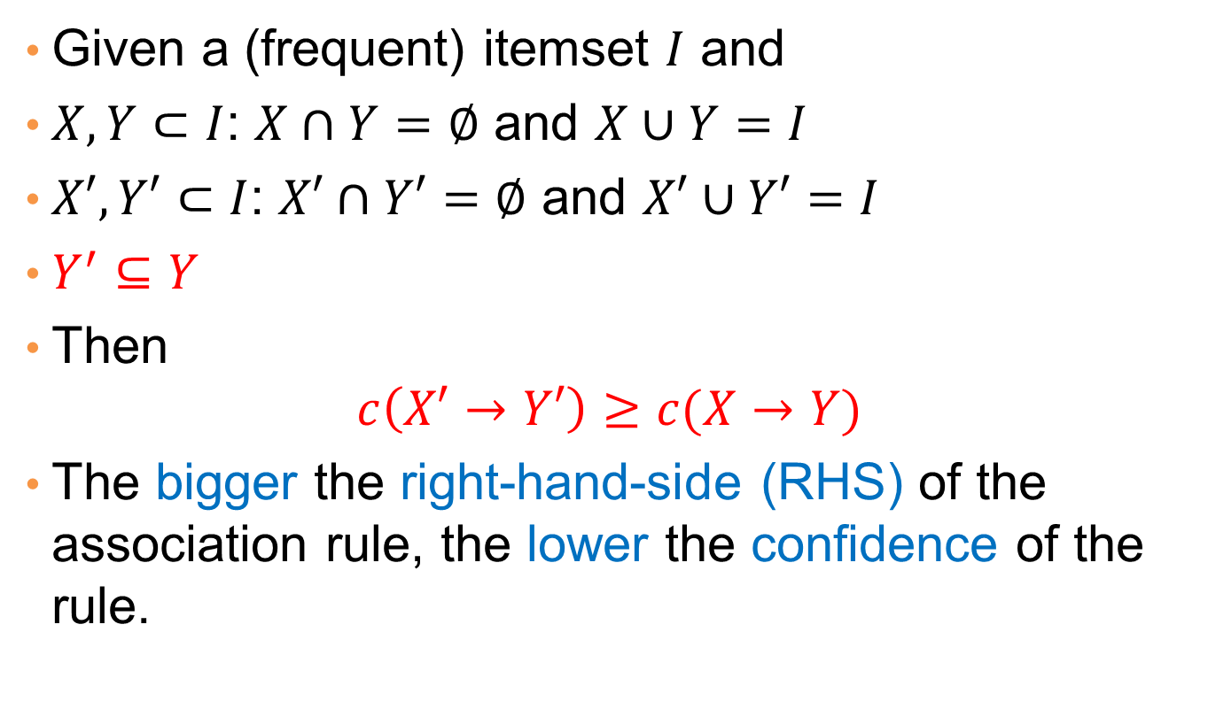
Confidence anti-monotonicity
Given a (frequent) itemset $I$ and
$X,Y⊂I$: $X∩Y=∅$ and $X∪Y=I$
$X′,Y′⊂I$: $X′∩Y′=∅$ and $X′∪Y′=I$
$Y^{′}⊆Y$
Then
$$c\left(X′→Y′\right)≥c(X→Y)$$
The bigger the right-hand-side (RHS) of the association rule, the lower the confidence of the rule.

Slide 55
Rule Generation for Apriori Algorithm
Low Confidence Rule
Pruned Rules
Lattice of rules created by the RHS

Slide 56
Rule Generation for APriori Algorithm
Candidate rule is generated by merging two rules that share the same prefix
in the RHS
join(CD→AB,BD→AC)
would produce the candidate
rule D → ABC
Prune rule D → ABC if its
subset AD→BC does not have
high confidence
Essentially we are doing APriori on the RHS

Slide 57
RESULT
POST-PROCESSING

Slide 58
Compact Representation of Frequent Itemsets
Some itemsets are redundant because they have identical support as their supersets
Number of frequent itemsets
Need a compact representation

Slide 59
Maximal Frequent Itemsets
Maximal itemsets: An itemset is maximally frequent if none of its immediate supersets is frequent
Maximal Itemsets
Maximal itemsets = positive border
Infrequent Itemsets
Border
Maximal: no superset has this property

Slide 60
Negative Border
Minimal itemsets: Itemsets that are not frequent, but all their immediate subsets are frequent.
Infrequent Itemsets
Border
Minimal: no subset has this property

Slide 61
Border
Border = Positive Border + Negative Border
  Itemsets such that all their immediate subsets are frequent and all their immediate supersets are infrequent.
Either the positive, or the negative border is sufficient to summarize all frequent itemsets.

Slide 62
Closed Itemsets
An itemset is closed if none of its immediate supersets has the same support as the itemset

Slide 63
Maximal vs Closed Itemsets
Transaction Ids
Not supported by any transactions

Slide 64
Maximal vs Closed Frequent Itemsets
Closed but not maximal
Minimum support = 2
Closed and maximal
# Closed = 9
# Maximal = 4

Slide 65
Maximal vs Closed Itemsets

Slide 66
Pattern Evaluation
Association rule algorithms tend to produce too many rules but many of them are uninteresting or redundant
  Redundant if {A,B,C} → {D} and {A,B} → {D} have same support & confidence
    Summarization techniques
  Uninteresting, if the pattern that is revealed does not offer useful information.
    Interestingness measures: a hard problem to define
Interestingness measures can be used to prune/rank the derived patterns
  Subjective measures: require human analyst
  Objective measures: rely on the data.
In the original formulation of association rules, support & confidence were the only measures used

Slide 67
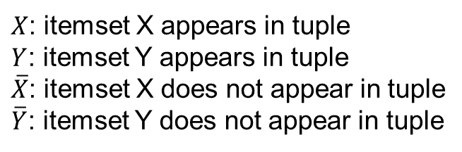
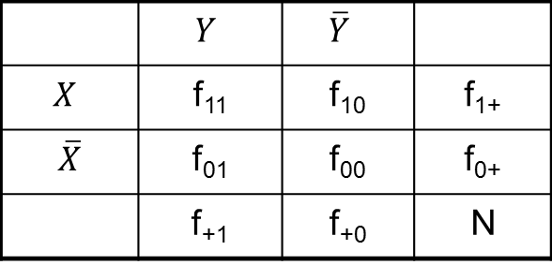
Computing Interestingness Measure
Given a rule X → Y, information needed to compute rule interestingness can be obtained from a contingency table
Contingency table for X → Y
 | $$Y$$ | $$\overline{Y}$$
$$X$$ | f₁₁ | f₁₀ | f₁₊
$$\overline{X}$$ | f₀₁ | f₀₀ | f₀₊
 | f₊₁ | f₊₀ | N
f₁₁: support of X and Y
f₁₀: support of X and Y
f₀₁: support of X and Y
f₀₀: support of X and Y
$X$: itemset X appears in tuple
$Y$: itemset Y appears in tuple
$\overline{X}$: itemset X does not appear in tuple
$\overline{Y}$: itemset Y does not appear in tuple
Used to define various measures
support, confidence, lift, Gini,
J-measure, etc.

Slide 68
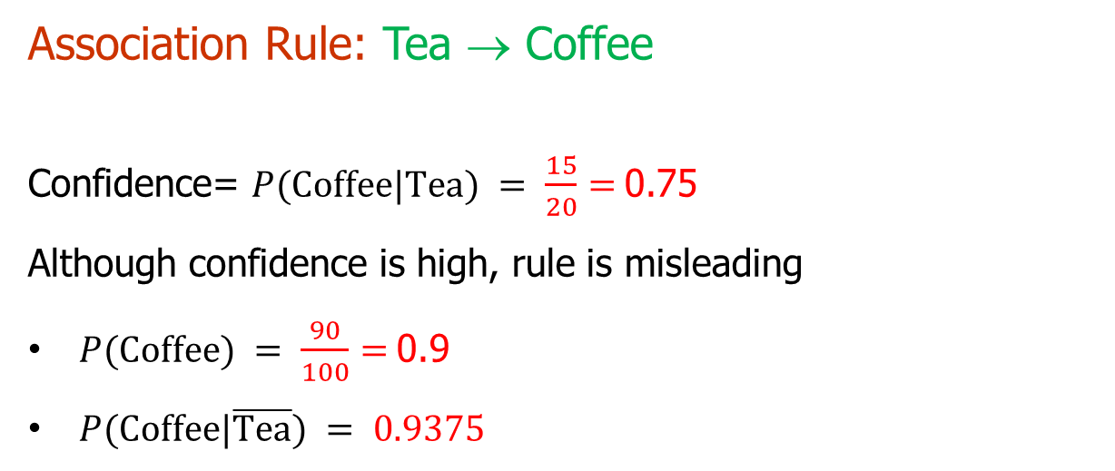
Drawback of Confidence
Number of people that drink tea
 | Coffee | Coffee
Tea | 15 | 5 | 20
Tea | 75 | 5 | 80
 | 90 | 10 | 100
Number of people that drink coffee and tea
Number of people that drink coffee but not tea
Number of people that drink coffee
Association Rule: Tea → Coffee
Confidence= $P(\text{Coffee}\text{|}\text{Tea}) = \frac{15}{20}=$0.75
Although confidence is high, rule is misleading
$P(\text{Coffee}) = \frac{90}{100}=$0.9
$P(\text{Coffee}\text{|}\overline{\text{Tea}}) = 0.9375$

Slide 69
Statistical Independence
Population of 1000 students
  600 students know how to swim (S)
  700 students know how to bike (B)
  420 students know how to swim and bike (S,B)
  P(S,B) = 420/1000 = 0.42
  P(S) × P(B) = 0.6 × 0.7 = 0.42
  P(S,B) = P(S) × P(B) => Statistical independence

Slide 70
Statistical Independence
Population of 1000 students
  600 students know how to swim (S)
  700 students know how to bike (B)
  500 students know how to swim and bike (S,B)
  P(S,B) = 500/1000 = 0.5
  P(S) × P(B) = 0.6 × 0.7 = 0.42
  P(S,B) > P(S) × P(B) => Positively correlated

Slide 71
Statistical Independence
Population of 1000 students
  600 students know how to swim (S)
  700 students know how to bike (B)
  300 students know how to swim and bike (S,B)
  P(S,B) = 300/1000 = 0.3
  P(S) × P(B) = 0.6 × 0.7 = 0.42
  P(S,B) < P(S) × P(B) => Negatively correlated

Slide 72
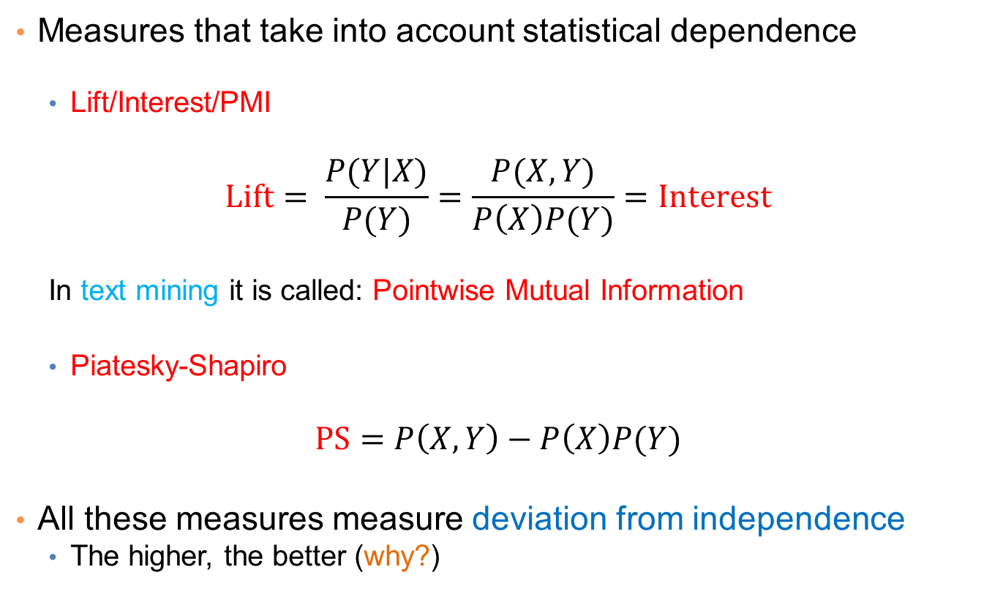
Statistical-based Measures
Measures that take into account statistical dependence
  Lift/Interest/PMI
$$Lift= \frac{P(Y|X)}{P(Y)}=\frac{P(X,Y)}{P\left(X\right)P(Y)}=Interest$$
  In text mining it is called: Pointwise Mutual Information
  Piatesky-Shapiro
$$PS=P\left(X,Y\right)−P\left(X\right)P(Y)$$
All these measures measure deviation from independence
  The higher, the better (why?)

Slide 73
Example: Lift/Interest
 | Coffee | Coffee
Tea | 15 | 5 | 20
Tea | 75 | 5 | 80
 | 90 | 10 | 100
Association Rule: Tea → Coffee
Confidence= P(Coffee|Tea) = 0.75
but P(Coffee) = 0.9
Lift = 0.75/0.9= 0.8333 (< 1, therefore is negatively associated)
= 0.15/(0.9*0.2)

Slide 74


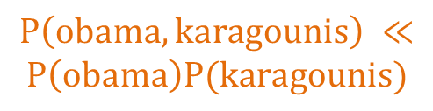
Another Example
 | of | the | of, the
Fraction of documents | 0.9 | 0.9 | 0.8
$$P(of,the) ≈P\left(of\right)P(the)$$
If I was creating a document by picking words randomly, (of, the) have more or less the same probability of appearing together by chance
No correlation
 | hong | kong | hong, kong
Fraction of documents | 0.2 | 0.2 | 0.19
$$P\left(hong,kong\right) ≫P\left(hong\right)P(kong)$$
(hong, kong) have much lower probability to appear together by chance. The two words appear almost always only together
Positive correlation
 | obama | karagounis | obama, karagounis
Fraction of documents | 0.2 | 0.2 | 0.001
$$P\left(obama,karagounis\right) ≪$$
$$P\left(obama\right)P(karagounis)$$
(obama, karagounis) have much higher probability to appear together by chance. The two words appear almost never together
Negative correlation

Slide 75
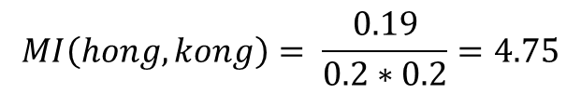
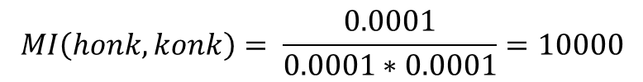
Drawbacks of Lift/Interest/Mutual Information
 | honk | konk | honk, konk
Fraction of documents | 0.0001 | 0.0001 | 0.0001
$$MI\left(honk,konk\right)= \frac{0.0001}{0.0001∗0.0001}=10000$$
 | hong | kong | hong, kong
Fraction of documents | 0.2 | 0.2 | 0.19
$$MI\left(hong,kong\right)= \frac{0.19}{0.2∗0.2}=4.75$$
Rare co-occurrences are deemed more interesting.
But this is not always what we want

Slide 76
ALTERNATIVE FREQUENT ITEMSET COMPUTATION
Slides taken from Mining Massive Datasets course by Anand Rajaraman and Jeff Ullman.

Slide 77
Finding the frequent pairs is usually the most expensive operation
Count
the items
All pairs
of items
from L₁
Count
the pairs
All
items
Filter
Construct
Filter
Construct
C₁
L₁
C₂
L₂
C₃
First
pass
Second
pass
Frequent
items
Frequent
pairs

Slide 78
Picture of A-Priori
Item counts
Frequent items
Counts of
pairs of
frequent
items
Pass 1
Pass 2

Slide 79
PCY Algorithm
Item counts
During Pass 1 (computing frequent items) of Apriori, most memory is idle.
Use that memory to keep a hash table where pairs of items are hashed.
The hash table keeps just counts of the number of pairs hashed in each bucket, not the pairs themselves.
Pass 1

Slide 80
Needed Extensions
Pairs of items need to be generated from the input file; they are not present in the file.
Memory organization:
    Space to count each item.
      One (typically) 4-byte integer per item.
    Use the rest of the space for as many integers, representing buckets, as we can.

Slide 81
Picture of PCY
Item counts
Hash
table
Pass 1

Slide 82
Picture of PCY
Item counts
Bucket Counts
Pass 1

Slide 83
PCY Algorithm – Pass 1
FOR (each basket) {
FOR (each item in the basket)
add 1 to item’s count;
FOR (each pair of items in the basket) {
hash the pair to a bucket;
add 1 to the count for that bucket
}
}

Slide 84
Observations About Buckets
A bucket is frequent if its count is at least the support threshold.
A bucket that a frequent pair hashes to is surely frequent.
  We cannot use the hash table to eliminate any member of this bucket.
Even without any frequent pair, a bucket can be frequent.
  Again, nothing in the bucket can be eliminated.
But in the best case, the count for a bucket is less than the support s.
  Now, all pairs that hash to this bucket can be eliminated as candidates, even if the pair consists of two frequent items.
On Pass 2 (frequent pairs), we only count pairs that hash to frequent buckets.

Slide 85
PCY Algorithm – Between Passes
Replace the buckets by a bit-vector:
  1 means the bucket is frequent; 0 means it is not.
4-byte integers are replaced by bits, so the bit-vector requires 1/32 of memory.
Also, find which items are frequent and list them for the second pass.
  Same as with Apriori

Slide 86
Picture of PCY
Hash
table
Item counts
Frequent items
Bitmap
Counts of
candidate
pairs
Pass 1
Pass 2

Slide 87
PCY Algorithm – Pass 2
Count all pairs {i, j } that meet the conditions for being a candidate pair:
  Both i and j are frequent items.
  The pair {i, j }, hashes to a bucket number whose bit in the bit vector is 1.
Notice both these conditions are necessary for the pair to have a chance of being frequent.

Slide 88
All (Or Most) Frequent Itemsets in less than 2 Passes
A-Priori, PCY, etc., take k passes to find frequent itemsets of size k.
Other techniques use 2 or fewer passes for all sizes:
  Simple sampling algorithm.
  SON (Savasere, Omiecinski, and Navathe).
  Toivonen.

Slide 89
Simple Sampling Algorithm – (1)
Take a random sample of the market baskets.
Run Apriori or one of its improvements (for sets of all sizes, not just pairs) in main memory, so you don’t pay for disk I/O each time you increase the size of itemsets.
  Make sure the sample is such that there is enough space for counts.

Slide 90
Main-Memory Picture
Copy of
sample
baskets
Space
for
counts

Slide 91
Simple Algorithm – (2)
Use as your support threshold a suitable, scaled-back number.
  E.g., if your sample is 1/100 of the baskets, use s /100 as your support threshold instead of s.
You could stop here (single pass)
  What could be the problem?

Slide 92
Simple Algorithm – Option
Optionally, verify that your guesses are truly frequent in the entire data set by a second pass (eliminate false positives)
But you don’t catch sets frequent in the whole but not in the sample. (false negatives)
  Smaller threshold, e.g., s /125, helps catch more truly frequent itemsets.
    But requires more space.

Slide 93
SON Algorithm – (1)
First pass: Break the data into chunks that can be processed in main memory.
Read one chunk at the time
  Find all frequent itemsets for each chunk.
  Threshold = s/number of chunks
An itemset becomes a candidate if it is found to be frequent in any one or more chunks of the baskets.

Slide 94
SON Algorithm – (2)
Second pass: count all the candidate itemsets and determine which are frequent in the entire set.
Key “monotonicity” idea: an itemset cannot be frequent in the entire set of baskets unless it is frequent in at least one subset.
  Why?

Slide 95
SON Algorithm – Distributed Version
This idea lends itself to distributed data mining.
If baskets are distributed among many nodes, compute frequent itemsets at each node, then distribute the candidates from each node.
Finally, accumulate the counts of all candidates.

Slide 96
Toivonen’s Algorithm – (1)
Start as in the simple sampling algorithm, but lower the threshold slightly for the sample.
  Example: if the sample is 1% of the baskets, use s /125 as the support threshold rather than s /100.
  Goal is to avoid missing any itemset that is frequent in the full set of baskets.

Slide 97
Toivonen’s Algorithm – (2)
Add to the itemsets that are frequent in the sample the negative border of these itemsets.
An itemset is in the negative border if it is not deemed frequent in the sample, but all its immediate subsets are.

Slide 98
Reminder: Negative Border
Itemset ABCD is in the negative border if and only if:
  It is not frequent in the sample, but
  All of ABC, BCD, ACD, and ABD are.
Item A is in the negative border if and only if it is not frequent in the sample.
  Because the empty set is always frequent.
    Unless there are fewer baskets than the support threshold (silly case).

Slide 99
Picture of Negative Border
Negative Border
…
triples
pairs
singletons
Frequent Itemsets
from Sample

Slide 100
Toivonen’s Algorithm – (3)
In a second pass, compute the support for all candidate frequent itemsets from the first pass, and also for their negative border.
If no itemset from the negative border turns out to be frequent, then the candidates found to be frequent in the whole data are exactly the frequent itemsets.

Slide 101
Toivonen’s Algorithm – (4)
What if we find that something in the negative border is actually frequent?
  We must start over again!
Try to choose the support threshold so the probability of failure is low, while the number of itemsets checked on the second pass fits in main-memory.

Slide 102
If Something in the Negative Border is Frequent . . .
We broke through the
negative border. How
far does the problem
go?
…
tripletons
doubletons
singletons
Negative Border
Frequent Itemsets
from Sample

Slide 103
Theorem:
If there is an itemset that is frequent in the whole, but not frequent in the sample, then there is a member of the negative border for the sample that is frequent in the whole.

Slide 104
Proof: Suppose not; i.e.;
  There is an itemset S frequent in the whole but not frequent in the sample, and
  Nothing in the negative border is frequent in the whole.
Let T be a smallest subset of S that is not frequent in the sample.
T is frequent in the whole (S is frequent + monotonicity).
T is in the negative border (else not “smallest”).

Slide 105
Example
Border

Slide 106
FREQUENT ITEMSET RESEARCH

