Slide 1
Online Social Networks and Media
Graph Partitioning (cuts, spectral clustering, density),
Community evolution

Slide 2
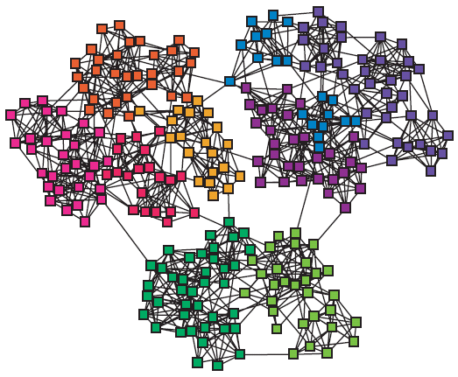
Introduction
modules, cluster, communities, groups, partitions (more on this today)

Slide 3
Outline
Summary of Part I
PART II
Cuts
Spectral Clustering
Dense Subgraphs
Community Evolution
partitions

Slide 4
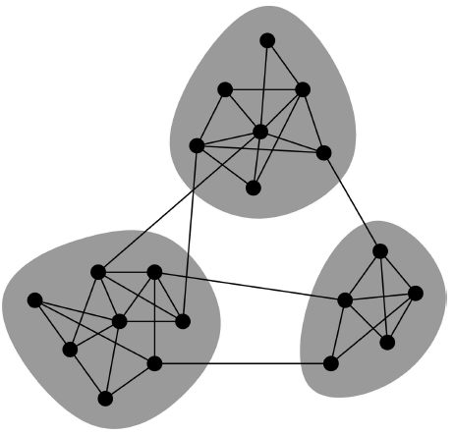
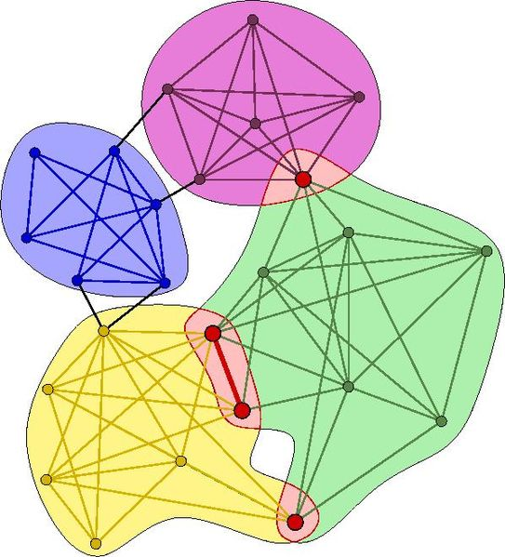
Community Types
Non-overlapping vs. overlapping communities

Slide 5
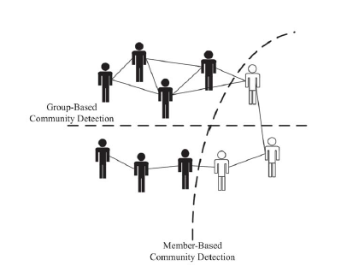
Community Types
Member-based (local) vs. group-based

Slide 6
What is Cluster Analysis?
Finding groups of objects such that the objects in a group are similar (or related) to one another and different from (or unrelated to) the objects in other groups
Inter-cluster distances are maximized
Intra-cluster distances are minimized

Slide 7
Types of Clustering
Important distinction between hierarchical and partitional sets of clusters
Partitional Clustering
  Division of data objects into subsets (clusters)
  Assumes that the number of clusters is given
Hierarchical clustering
  A set of nested clusters organized as a hierarchical tree

Slide 8
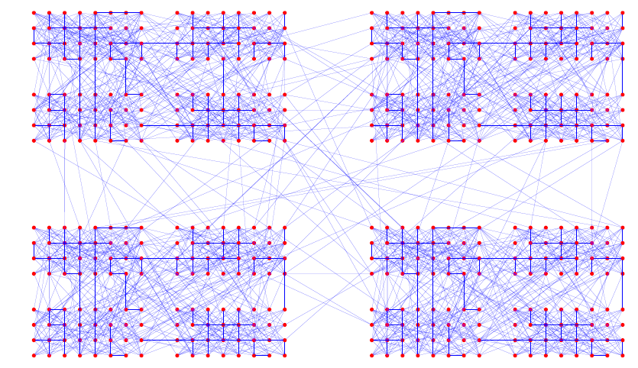
Example of a Hierarchically Structured Graph

Slide 9
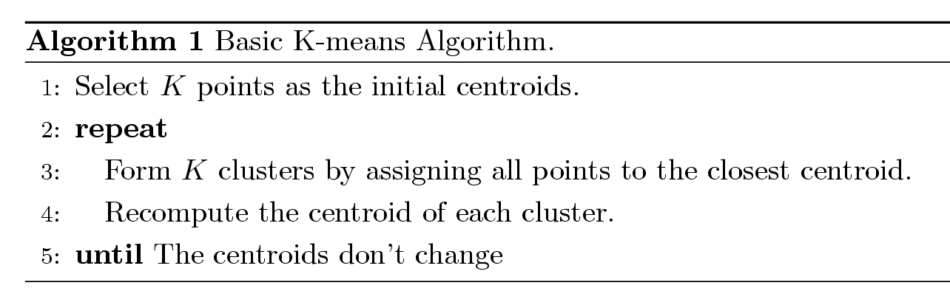
Example Partitioning:
K-means Clustering
Input: Number of clusters, K
Each cluster is associated with a centroid (center point)
Each point is assigned to the cluster with the closest centroid

Slide 10
Sum of Squared Error (SSE)
Most common measure is Sum of Squared Error (SSE)
  For each point, the error is the distance to the nearest cluster
  To get SSE, we square these errors and sum them.
  x is a data point in cluster C_{i} and m_{i} is the representative point for cluster C_{i}
    can show that m_{i} corresponds to the center (mean) of the cluster
Notes:
In contrast to the k-means algorithm, k-medoids chooses datapoints as centers (medoids or exemplars) and works with a generalization of the Manhattan Norm to define distance between datapoints instead of l2
Medoid point with the minimal average dissimilarity

Slide 11
Hierarchical Clustering
Two main types of hierarchical clustering
  Agglomerative:
    Start with the points (vertices) as individual clusters
    At each step, merge the closest pair of clusters until only one cluster (or k clusters) left
  Divisive:
    Start with one, all-inclusive cluster (the whole graph)
    At each step, split a cluster until each cluster contains a point (vertex) (or there are k clusters)
Traditional hierarchical algorithms use a similarity or distance matrix
  Merge or split one cluster at a time

Slide 12
Agglomerative Clustering Algorithm
Popular hierarchical clustering technique
Basic algorithm is straightforward
  [Compute the proximity matrix]
  Let each data point be a cluster
  Repeat
  Merge the two closest clusters
  [Update the proximity matrix]
  Until only a single cluster remains
Key operation is the computation of the proximity of two clusters
  Different approaches to defining the distance between clusters distinguish the different algorithms

Slide 13
Hierarchical Clustering
Produces a set of nested clusters organized as a hierarchical tree
Can be visualized as a dendrogram
  A tree like diagram that records the sequences of merges or splits

Slide 14
Pre-processing and Post-processing
Pre-processing
  Normalize the data
  Eliminate outliers
  Find connected components
Post-processing
  Eliminate small clusters that may represent outliers
  Split ‘loose’ clusters, i.e., clusters with relatively high SSE
  Merge clusters that are ‘close’ and that have relatively low SSE
  Can use these steps during the clustering process

Slide 15
Communities
Algorithms
Cliques (PCM)
Vertex similarity
Divisive hierarchical clustering using betweenness
Modularity
Label Propagation
Evaluation

Slide 16
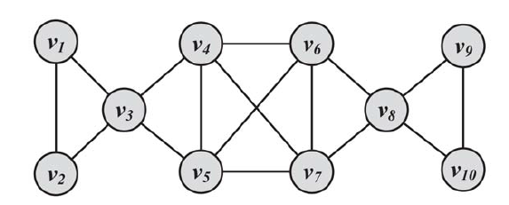
Clique Percolation Method (CPM): Using cliques as seeds
Input graph, let k = 3

Slide 17
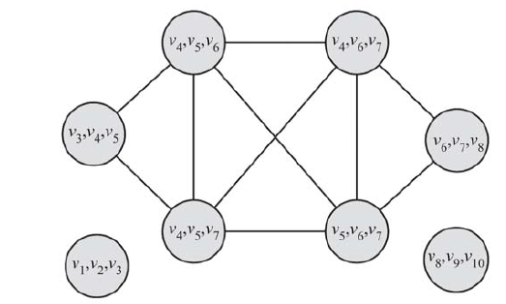
Clique Percolation Method (CPM): Using cliques as seeds
Clique graph for k = 3
(v1, v2, ,v3), (v8, v9, v10), and (v3, v4, v5, v6, v7, v8)

Slide 18
Clique Percolation Method (CPM): Using cliques as seeds
Result
(v1, v2, ,v3), (v8, v9, v10), and (v3, v4, v5, v6, v7, v8)

Slide 19
Vertex similarity
Define similarity between two vertices
Place similar vertices in the same cluster
Use traditional cluster analysis

Slide 20
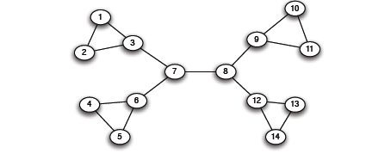
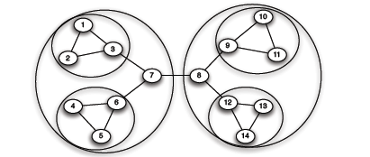
Graph Partitioning
Divisive methods: try to identify and remove the “spanning links” between densely-connected regions
Agglomerative methods: Find nodes that are likely to belong to the same region and merge them together (bottom-up)

Slide 21
Edge Betweenness
3x11 = 33
1x12 = 12
b=16
1
b=7.5
7x7 = 49
Notes:
To 7.5 είναι
Για το δεξί άκρο
όλοι οι αριστεροι + το αριστερό άκρο = 5
+ ο πάνω δεξιά με αυτούς του 5 δια 2

Slide 22
The Girvan Newman method
[Girvan-Newman ‘02]
        Undirected unweighted networks
  Repeat until no edges are left:
    Calculate betweenness of edges
    Remove edges with highest betweenness
  Connected components are communities
  Gives a hierarchical decomposition of the network

Slide 23
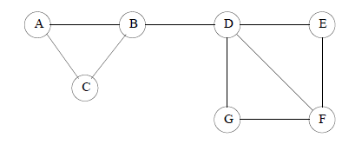
Computing Betweenness
Perform a BFS starting from A
Determine the number of shortest path from A to each other node
Based on these numbers, determine the amount of flow from A to all other nodes that uses each edge
Repeat the process for all nodes
Sum over all BFSs

Slide 24
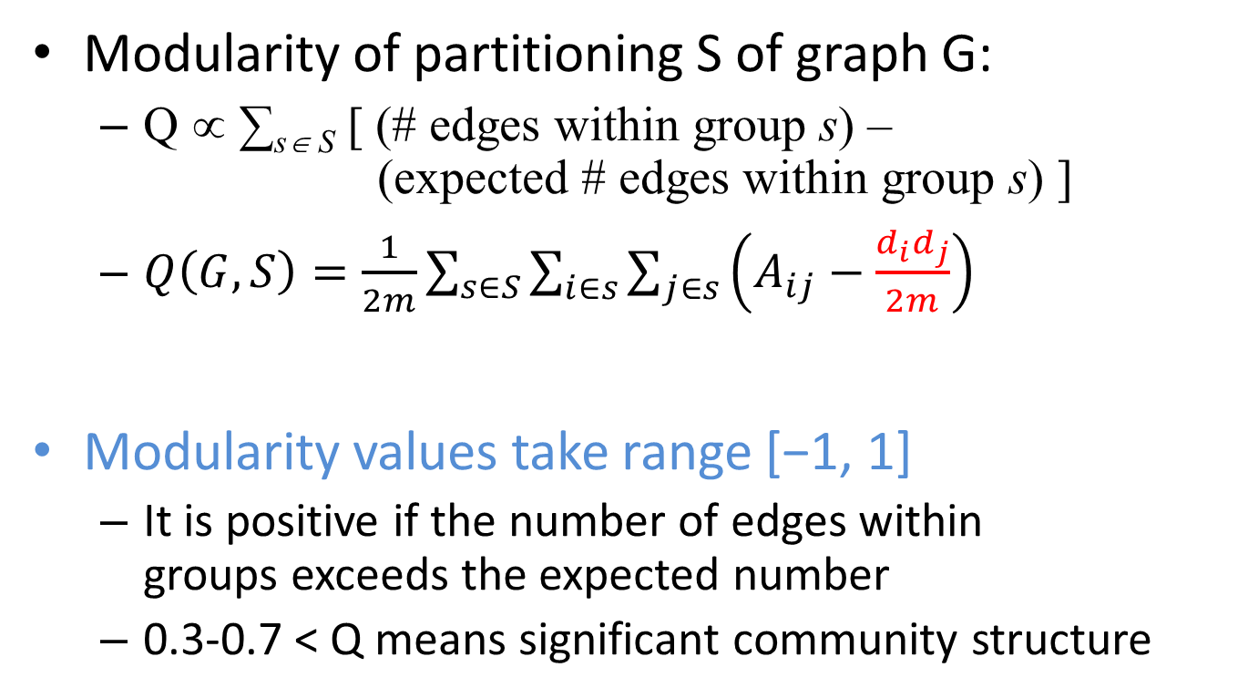
Modularity
Modularity of partitioning S of graph G:
  Q ∝ ∑_{s∈ S} [ (# edges within group s) –
  (expected # edges within group s) ]
  $Q\left(G,S\right)=\frac{1}{2m}\sum_{s∈S}{\sum_{i∈s}{\sum_{j∈s}{\left(A_{ij}−\frac{d_{i}d_{j}}{2m}\right)}}}$
Modularity values take range [−1, 1]
  It is positive if the number of edges within
  groups exceeds the expected number
  0.3-0.7 < Q means significant community structure
A_{ij} = 1 if i→j,
0 else
Normalizing cost.: -1<Q<1

Slide 25
Modularity
Greedy method of Newman (one of the many ways to use modularity)
Agglomerative hierarchical clustering method
Start with a state in which each vertex is the sole member of one of n communities
Repeatedly join communities together in pairs, choosing at each step the join that results in the greatest increase (or smallest decrease) in Q.

Slide 26
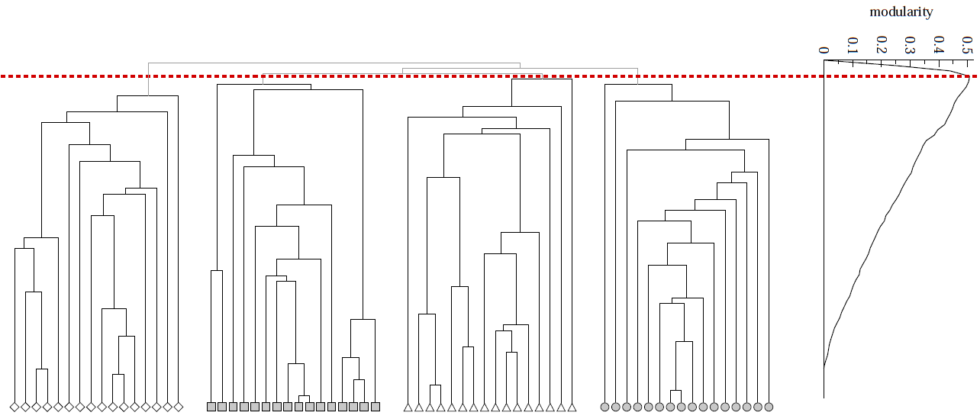
Modularity: Number of clusters
Modularity is useful for selecting the
number of clusters:
Q
Notes:
HW: Question – come up with a graph where GIRVAN-NEWMAN MODULARITY IS NOT UNIMODAL

Slide 27
Label propagation
Vertices are initially given unique labels (e.g. their vertex labels).
At each iteration,
sweep over all vertices, in random sequential order:
each vertex takes the label shared by the majority of its neighbors.
If no unique majority, one of the majority labels is picked at random.
Stop (convergence) when each vertex has the majority label of its neighbors
Communities: groups of vertices having identical labels at convergence

Slide 28
Label propagation
Labels propagate across the graph: most labels will disappear, others will dominate.
By construction, each vertex has more neighbors in its community than in any other community.
Due to many possible ties, different partitions starting from the same initial condition, with different random seeds
  Aggregate partition label each vertex with the
  set of all labels it has in different partitions → overlapping communities

Slide 29
Cluster quality
When a given clustering is “good”?
With ground truth
Without ground truth
Notes:
HW: Question – come up with a graph where GIRVAN-NEWMAN MODULARITY IS NOT UNIMODAL

Slide 30

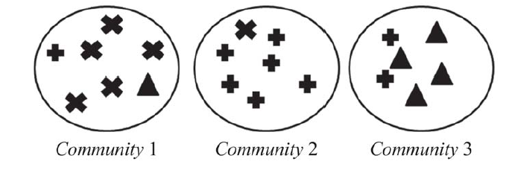
Metrics: purity
the fraction of instances that have labels equal to the label of the community’s majority
(5+6+4)/20 = 0.75

Slide 31
Metrics: pairs
Precision (P): the fraction of pairs that have been correctly assigned to the same community.
TP/(TP+FP)
Recall (R): the fraction of pairs assigned to the same community of all the pairs that should have been in the same community.
TP/(TP+FN)
F-measure
2PR/(P+R)

Slide 32
Metrics
Based on pair counting: the number of pairs of vertices which are classified in the same (different) clusters in the two partitions.
True Positive (TP) Assignment: when similar members are assigned to the same community. This is a correct decision.
True Negative (TN) Assignment: when dissimilar members are assigned to different communities. This is a correct decision.
False Negative (FN) Assignment: when similar members are assigned to different communities. This is an incorrect decision.
False Positive (FP) Assignment: when dissimilar members are assigned to the same community. This is an incorrect decision.

Slide 33


Evaluation without ground truth
Modularity

Slide 34

Evaluation without ground truth
With semantics:
(ad hoc) analyze other attributes (e.g., profile, content generated) for coherence
human subjects (user study) Mechanical Turk
Visual representation (similarity/adjacency matric, word clouds, etc)

Slide 35
Outline
PART II
Cuts
Spectral Clustering
Dense Subgraphs
Community Evolution
partitions

Slide 36
Graph partitioning
The general problem
  Input: a graph G = (V, E)
    edge (u, v) denotes similarity between u and v
    weighted graphs: weight of edge captures the degree of similarity
  Partitioning as an optimization problem:
    Partition the nodes in the graph such that nodes within clusters are well interconnected (high edge weights), and nodes across clusters are sparsely interconnected (low edge weights)
    most graph partitioning problems are NP hard

Slide 37
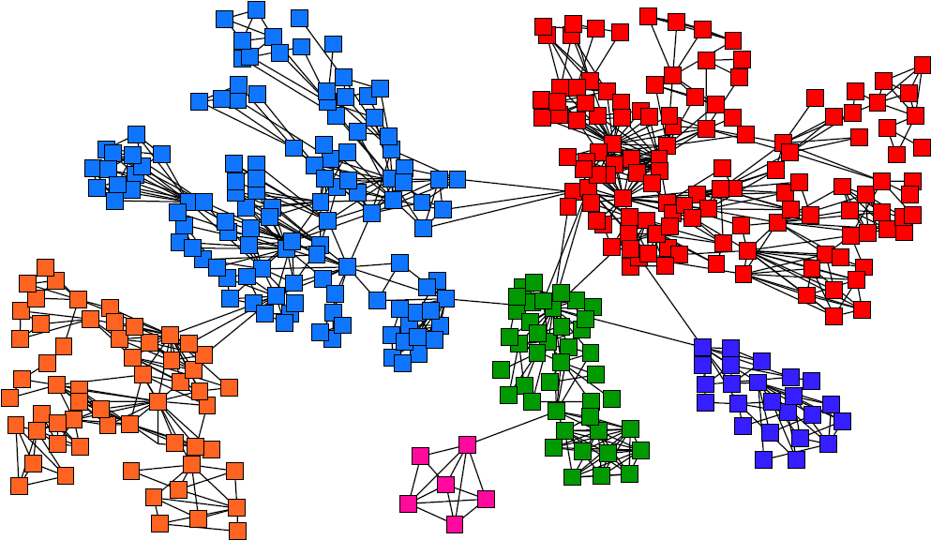
Graph Partitioning

Slide 38
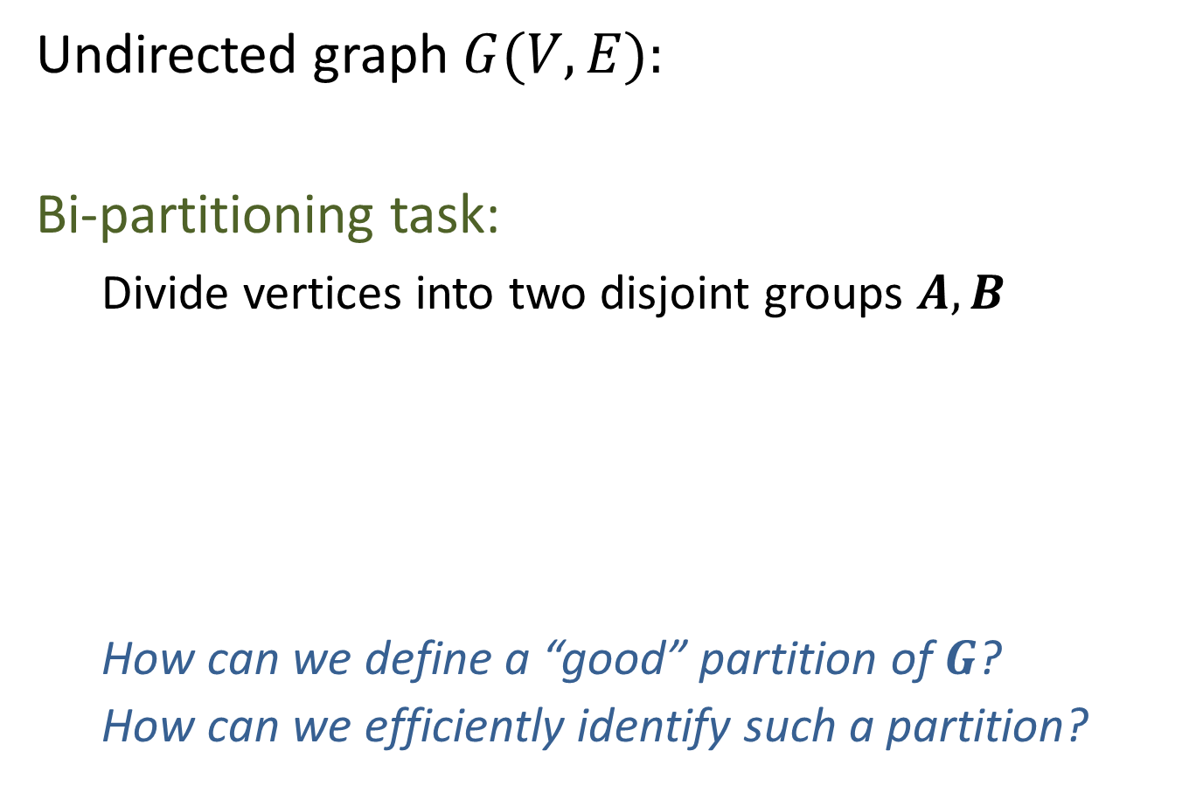
Graph Partitioning
Undirected graph $G(V,E):$
Bi-partitioning task:
  Divide vertices into two disjoint groups $A, B$
  How can we define a “good” partition of $G$?
  How can we efficiently identify such a partition?
1
5
2
6
4
3
A
5
B
1
2
6
3
4

Slide 39
Graph Partitioning
What makes a good partition?
  Maximize the number of within-group
  connections
  Minimize the number of between-group connections
5
1
2
6
4
3
A
B

Slide 40
Graph Cuts
Express partitioning objectives as a function of the “edge cut” of the partition
Cut: Set of edges with only one vertex in a group:
A
B
5
1
cut(A,B) = 2
2
6
4
3

Slide 41
Min Cut
min-cut: the min number of edges such that when removed cause the graph to become disconnected
Minimizes the number of connections between partition
arg min_{A,B} cut(A,B)
This problem can be solved in polynomial time
Min-cut/Max-flow algorithm
U
V-U

Slide 42
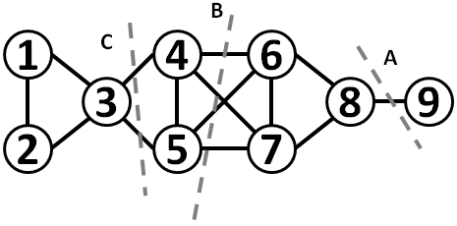
An example

Slide 43
Min Cut
“Optimal cut”
Minimum cut
Problem:
  Only considers external cluster connections
  Does not consider internal cluster connectivity

Slide 44
Graph Bisection
Since the minimum cut does not always yield good results we need extra constraints to make the problem meaningful.
Graph Bisection refers to the problem of partitioning the nodes of the graph into two equal sets.
Kernighan-Lin algorithm: Start with random equal partitions and then swap nodes to improve some quality metric (e.g., cut, modularity, etc).

Slide 45
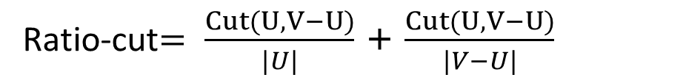
Cut Ratio
Ratio Cut
  Normalize cut by the size of the groups
Ratio-cut$= \frac{Cut(U,V−U)}{|U|}$ + $\frac{Cut(U,V−U)}{|V−U|}$

Slide 46
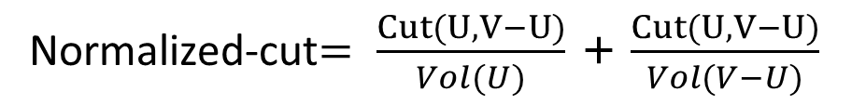
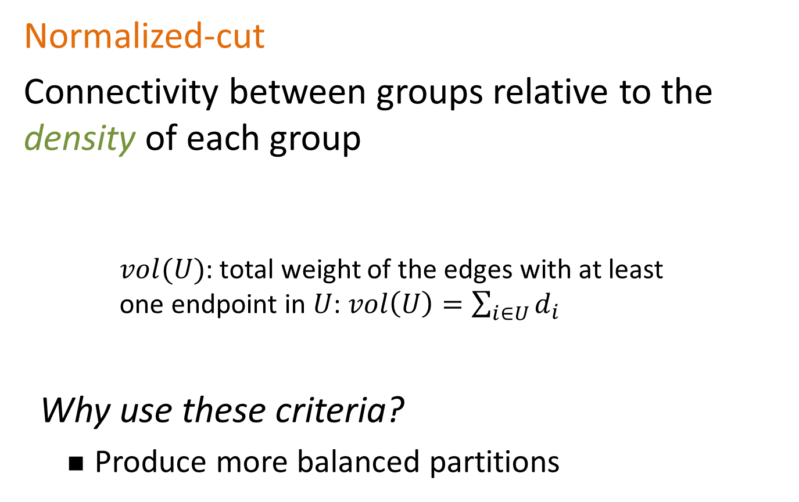
Normalized Cut
Normalized-cut
Connectivity between groups relative to the density of each group
    $vol(U)$: total weight of the edges with at least
    one endpoint in $U$: $vol\left(U\right)=\sum_{i∈U}{d_{i}}$
Why use these criteria?
  Produce more balanced partitions
Normalized-cut$= \frac{Cut(U,V−U)}{Vol(U)}$ + $\frac{Cut(U,V−U)}{Vol(V−U)}$

Slide 47

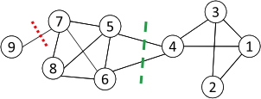
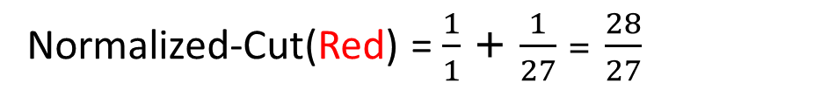
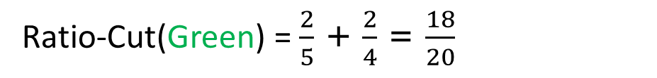
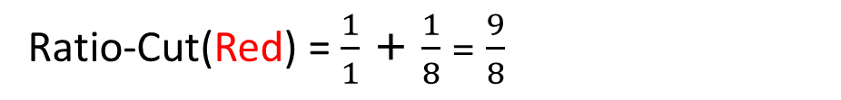
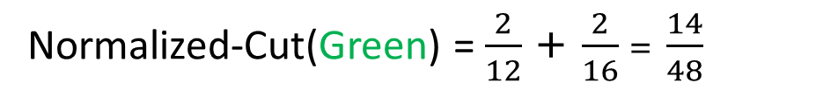
Red is Min-Cut
Ratio-Cut(Red) = $\frac{1}{1}$ + $\frac{1}{8}$ = $\frac{9}{8}$
Ratio-Cut(Green) = $\frac{2}{5}$ + $\frac{2}{4}$ = $\frac{18}{20}$
Normalized-Cut(Red) = $\frac{1}{1}$ + $\frac{1}{27}$ = $\frac{28}{27}$
Normalized-Cut(Green) = $\frac{2}{12}$ + $\frac{2}{16}$ = $\frac{14}{48}$
Normalized is even better for Green due to density

Slide 48
An example
Which of the three cuts has the best (min, normalized, ratio) cut?

Slide 49
Graph expansion
Graph expansion:
Graph conductance (similar for volume)

Slide 50
Graph Cuts
Ratio and normalized cuts can be reformulated in matrix format and solved using spectral clustering

Slide 51
SPECTRAL CLUSTERING

Slide 52
Matrix Representation
Adjacency matrix (A):
  n× n matrix
  A=[a_{ij}], a_{ij}=1 if edge between node i and j
Important properties:
  Symmetric matrix
  Eigenvectors are real and orthogonal
 | 1 | 2 | 3 | 4 | 5 | 6
1 | 0 | 1 | 1 | 0 | 1 | 0
2 | 1 | 0 | 1 | 0 | 0 | 0
3 | 1 | 1 | 0 | 1 | 0 | 0
4 | 0 | 0 | 1 | 0 | 1 | 1
5 | 1 | 0 | 0 | 1 | 0 | 1
6 | 0 | 0 | 0 | 1 | 1 | 0
5
1
2
6
4
3
If the graph is weighted, a_{ij}= w_{ij}

Slide 53
Matrix Representation
Degree matrix (D):
  n× n diagonal matrix
  D=[d_{ii}], d_{ii} = degree of node i
 | 1 | 2 | 3 | 4 | 5 | 6
1 | 3 | 0 | 0 | 0 | 0 | 0
2 | 0 | 2 | 0 | 0 | 0 | 0
3 | 0 | 0 | 3 | 0 | 0 | 0
4 | 0 | 0 | 0 | 3 | 0 | 0
5 | 0 | 0 | 0 | 0 | 3 | 0
6 | 0 | 0 | 0 | 0 | 0 | 2
5
1
2
6
4
3

Slide 54

Matrix Representation
Laplacian matrix (L):
  n× n symmetric matrix
$$L = D − A$$
 | 1 | 2 | 3 | 4 | 5 | 6
1 | 3 | -1 | -1 | 0 | -1 | 0
2 | -1 | 2 | -1 | 0 | 0 | 0
3 | -1 | -1 | 3 | -1 | 0 | 0
4 | 0 | 0 | -1 | 3 | -1 | -1
5 | -1 | 0 | 0 | -1 | 3 | -1
6 | 0 | 0 | 0 | -1 | -1 | 2
1
5
2
6
4
3

Slide 55
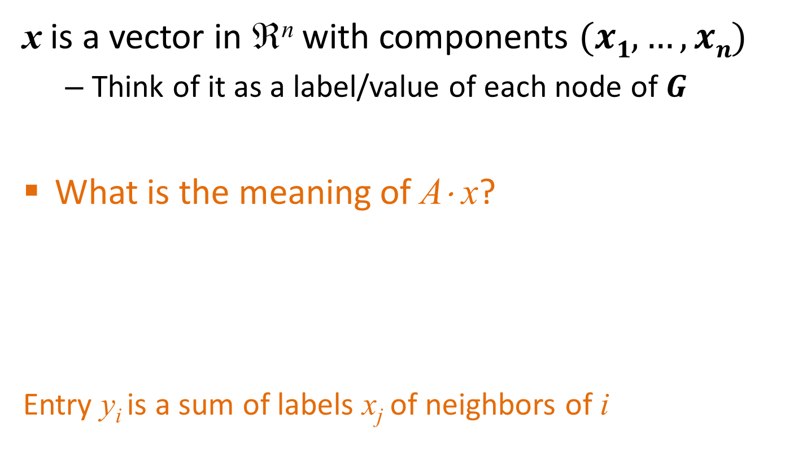
Spectral Graph Partitioning
x is a vector in ℜ^{n} with components $(x1,…, xn)$
  Think of it as a label/value of each node of $G$
What is the meaning of A⋅ x?
Entry y_{i} is a sum of labels x_{j} of neighbors of i

Slide 56
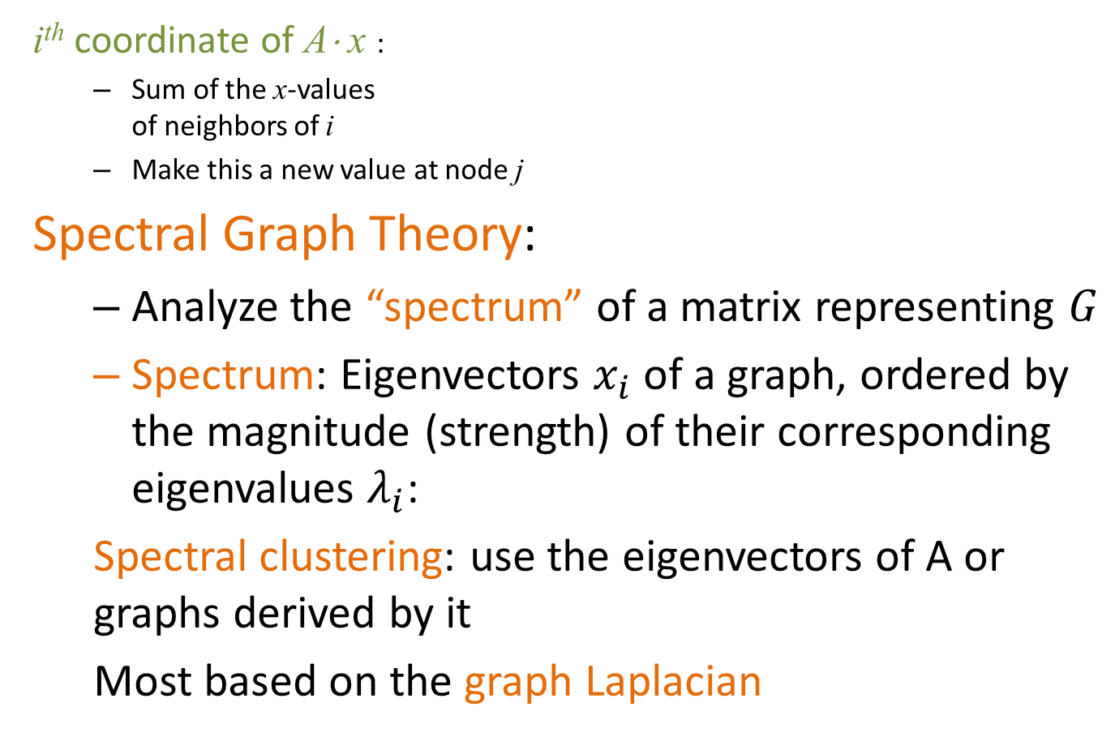

Spectral Analysis
i^{th} coordinate of A⋅ x :
  Sum of the x-values
  of neighbors of i
  Make this a new value at node j
Spectral Graph Theory:
  Analyze the “spectrum” of a matrix representing $G$
  Spectrum: Eigenvectors $x_{i}$ of a graph, ordered by the magnitude (strength) of their corresponding eigenvalues $λ_{i}$:
  Spectral clustering: use the eigenvectors of A or graphs derived by it
  Most based on the graph Laplacian
$$A⋅x=λ⋅x$$

Slide 57
Laplacian Matrix properties
The matrix L is symmetric and positive semi-definite
  all eigenvalues of L are positive
The matrix L has 0 as an eigenvalue, and corresponding eigenvector w₁ = (1,1,…,1)
  λ₁ = 0 is the smallest eigenvalue
  Proof: Let w₁ be the column vector with all 1s -- show Lw₁ = 0w₁
positive definite: if z^{T}Mz is non-negative, for every non-zero column vector z

Slide 58
The second smallest eigenvalue
The second smallest eigenvalue (also known as Fielder value) λ₂ satisfies

Slide 59
The second smallest eigenvalue
For the Laplacian
The expression:
is

Slide 60
The second smallest eigenvalue
Thus, the eigenvector for eigenvalue λ₂ (called the Fielder vector) minimizes
where
Intuitively, minimum when x_{i} and x_{j} close whenever there is an edge between nodes i and j in the graph.
x must have some positive and some negative components

Slide 61
Cuts + eigenvalues: intuition
A partition of the graph by taking:
  one set to be the nodes i whose corresponding vector component x_{i} is positive and
  the other set to be the nodes whose corresponding vector component is negative.
The cut between the two sets will have a small number of edges because (x_{i}−x_{j})² is likely to be smaller if both x_{i} and x_{j} have the same sign than if they have different signs.
Thus, minimizing x^{T}Lx under the required constraints will end giving x_{i} and x_{j} the same sign if there is an edge (i, j).

Slide 62

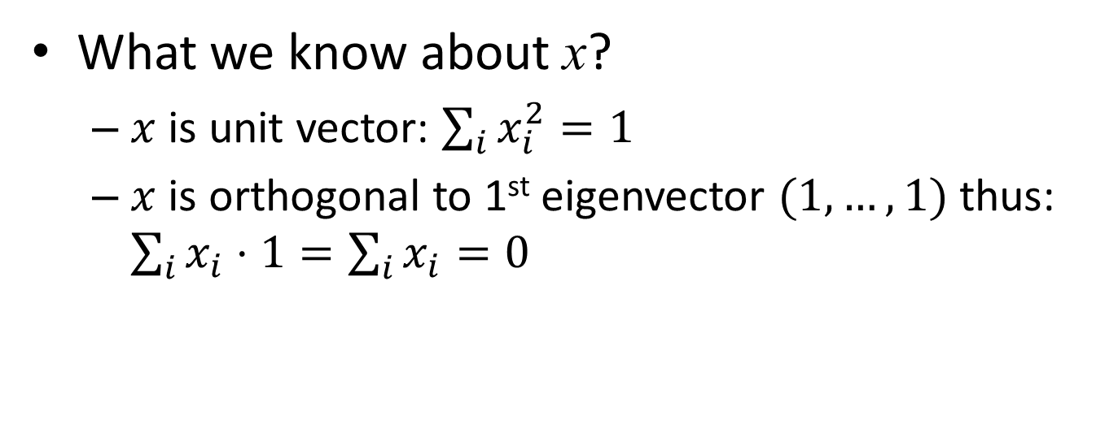
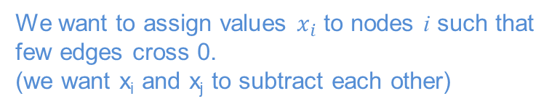
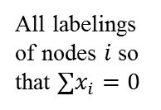

Cuts + eigenvalues: summary
What we know about x?
  $x$ is unit vector: $\sum_{i}{x_{i}^{2}=1}$
  $x$ is orthogonal to 1st eigenvector $(1,…,1)$thus: $\sum_{i}{x_{i}⋅1}=\sum_{i}{x_{i}}=0$
All labelings of nodes $i$ so that $∑x_{i}=0$
We want to assign values $x_{i}$ to nodes i such that few edges cross 0.
(we want x_{i} and x_{j} to subtract each other)
i
j
x
$$x_{i}$$
0
$$x_{j}$$
Balance to minimize

Slide 63
Example
1
5
2
6
4
3

Slide 64
Spectral Partitioning Algorithm
Three basic stages:
  Pre-processing
    Construct a matrix representation of the graph
  Decomposition
    Compute eigenvalues and eigenvectors of the matrix
  Grouping
    Assign points to two or more clusters, based on the new representation

Slide 65
Spectral Partitioning Algorithm
Pre-processing:
  Build Laplacian
  matrix L of the
  graph
Decomposition:
  Find eigenvalues λ
  and eigenvectors x
  of the matrix L
  Map vertices to
  corresponding
  components of λ₂
 | 1 | 2 | 3 | 4 | 5 | 6
1 | 3 | -1 | -1 | 0 | -1 | 0
2 | -1 | 2 | -1 | 0 | 0 | 0
3 | -1 | -1 | 3 | -1 | 0 | 0
4 | 0 | 0 | -1 | 3 | -1 | -1
5 | -1 | 0 | 0 | -1 | 3 | -1
6 | 0 | 0 | 0 | -1 | -1 | 2
0.0
0.4
0.3
-0.5
-0.2
-0.4
-0.5
1.0
0.4
0.6
0.4
-0.4
0.4
0.0
λ =
3.0
X =
0.4
0.3
0.1
0.6
-0.4
0.5
3.0
0.4
-0.3
0.1
0.6
0.4
-0.5
4.0
0.4
-0.3
-0.5
-0.2
0.4
0.5
5.0
0.4
-0.6
0.4
-0.4
-0.4
0.0
1
0.3
2
0.6
3
0.3
How do we now find the clusters?
4
-0.3
5
-0.3
6
-0.6

Slide 66
Spectral Partitioning Algorithm
Grouping:
  Sort components of reduced 1-dimensional vector
  Identify clusters by splitting the sorted vector in two
How to choose a splitting point?
  Naïve approaches:
    Split at 0 or median value
  More expensive approaches:
    Attempt to minimize normalized cut in 1-dimension
    (sweep over ordering of nodes induced by the eigenvector)
1
0.3
Split at 0:
Cluster A: Positive points
Cluster B: Negative points
A
B
2
0.6
3
0.3
4
-0.3
1
0.3
4
-0.3
5
-0.3
2
0.6
5
-0.3
6
-0.6
3
0.3
6
-0.6

Slide 67
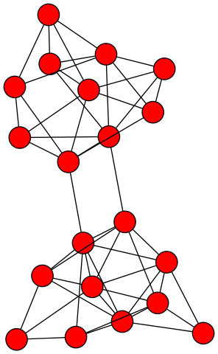
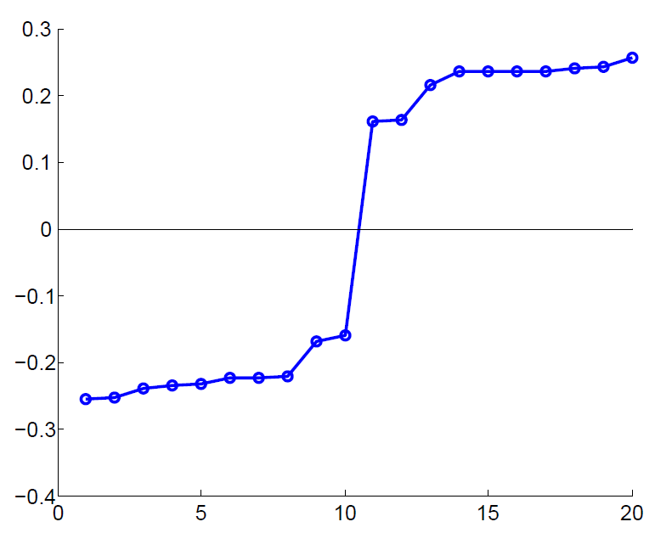
Example: Spectral Partitioning
Value of x₂
Rank in x₂

Slide 68
k-Way Spectral Clustering
How do we partition a graph into k clusters?
Recursively apply a bi-partitioning algorithm in a hierarchical divisive manner
    Disadvantages: Inefficient, unstable

Slide 69
k-Way Spectral Clustering
Use several of the eigenvectors to partition the graph.
Use m eigenvectors, and set a threshold for each,
Get a partition into 2^{m} groups, each group consisting of the nodes that are above or below threshold for each of the eigenvectors, in a particular pattern.

Slide 70
Example
1
5
2
6
4
3
If we use both the 2nd and 3rd eigenvectors,
nodes 2 and 3 (negative in both)
5 and 6 (negative in 2nd, positive in 3rd)
1 and 4 alone
Note that each eigenvector except the first is the vector x that minimizes x^{T}Lx, subject to the constraint that it is orthogonal to all previous eigenvectors.
Thus, while each eigenvector tries to produce a minimum-sized cut, successive eigenvectors have to satisfy more and more constraints => the cuts progressively worse.

Slide 71
Other properties of L
Let G be an undirected graph with non-negative weights. Then
the multiplicity k of the eigenvalue 0 of L equals the number of connected components A₁, . . . , A_{k} in the graph
the eigenspace of eigenvalue 0 is spanned by the indicator vectors 1A₁ , . . . , 1A_{k} of those components

Slide 72
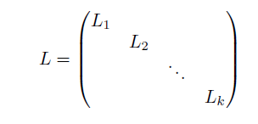
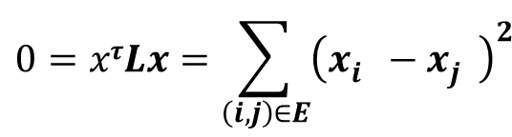
Proof (sketch)
If connected (k = 1)
$$0=xτLx=\sum_{\left(i,j\right)∈E}{{\left(x_{i}^{}−x_{j}^{}\right)}^{2}}$$
Assume k connected components, both A and L block diagonal, if we order vertices based on the connected component they belong to (recall the “tile” matrix)
L_{i} Laplacian of the i-th component
For all block diagonal matrices, the spectrum is given by the union of the spectra of each block, and the corresponding eigenvectors are the eigenvectors of the block, filled with 0 at the positions of the other blocks.

Slide 73
Normalized Graph Laplacians
L_{rw} closely connected to random walks (to be discussed in future lectures)

Slide 74



Cuts and spectral clustering
Relaxing Ncut leads to normalized spectral clustering, while relaxing RatioCut leads to unnormalized spectral clustering

Slide 75
Spectral Clustering
Use the lowest k eigenvalues of L to construct the nxk graph G’ that has these eigenvectors as columns
The n-rows represent the graph vertices in a k-dimensional Euclidean space
Group these vertices in k clusters using k-means clustering or similar techniques

Slide 76
Spectral clustering (besides graphs)
Can be used to cluster any points (not just vertices), as long as an appropriate similarity matrix
Needs to be symmetric and non-negative
How to construct a graph:
ε-neighborhood graph: connect all points whose pairwise distances are smaller than ε
k-nearest neighbor graph: connect each point with each k nearest neighbor
full graph: connect all points with weight in the edge (i, j) equal to the similarity of i and j

Slide 77
Summary
The values of x minimize
For weighted matrices
The ordering according to the x_{i} values will group similar (connected) nodes together
Physical interpretation: The stable state of springs placed on the edges of the graph

Slide 78
Parallel computation
Edge cuts -> Vertex partition
Vertex cuts -> Edge partition

Slide 79
Maximum Densest SUBGRAPH
Thanks to Aris Gionis

Slide 80
Finding dense subgraphs
Dense subgraph: A collection of vertices such that there are a lot of edges between them
  E.g., find the subset of email users that talk the most between them
  Or, find the subset of genes that are most commonly expressed together
Similar to community identification but we do not require that the dense subgraph is sparsely connected with the rest of the graph.

Slide 81
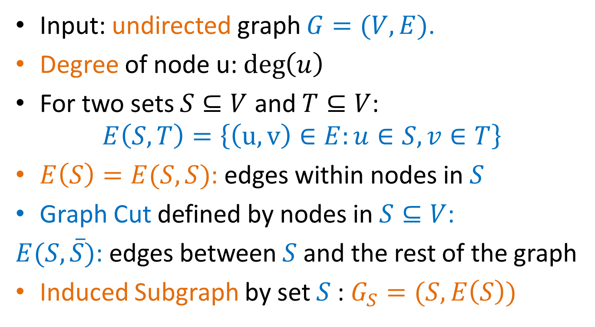
Definitions
Input: undirected graph $G=(V,E)$.
Degree of node u: $\deg\left(u\right)$
For two sets $S⊆V$ and $T⊆V$:
$$E\left(S,T\right)=\left\{\left(u,v\right)∈E:u∈S, v∈T\right\}$$
$E\left(S\right)=E(S,S)$: edges within nodes in $S$
Graph Cut defined by nodes in $S⊆V$:
$E(S,\overline{S})$: edges between $S$ and the rest of the graph
Induced Subgraph by set $S$: $G_{S}=(S,E\left(S\right))$

Slide 82
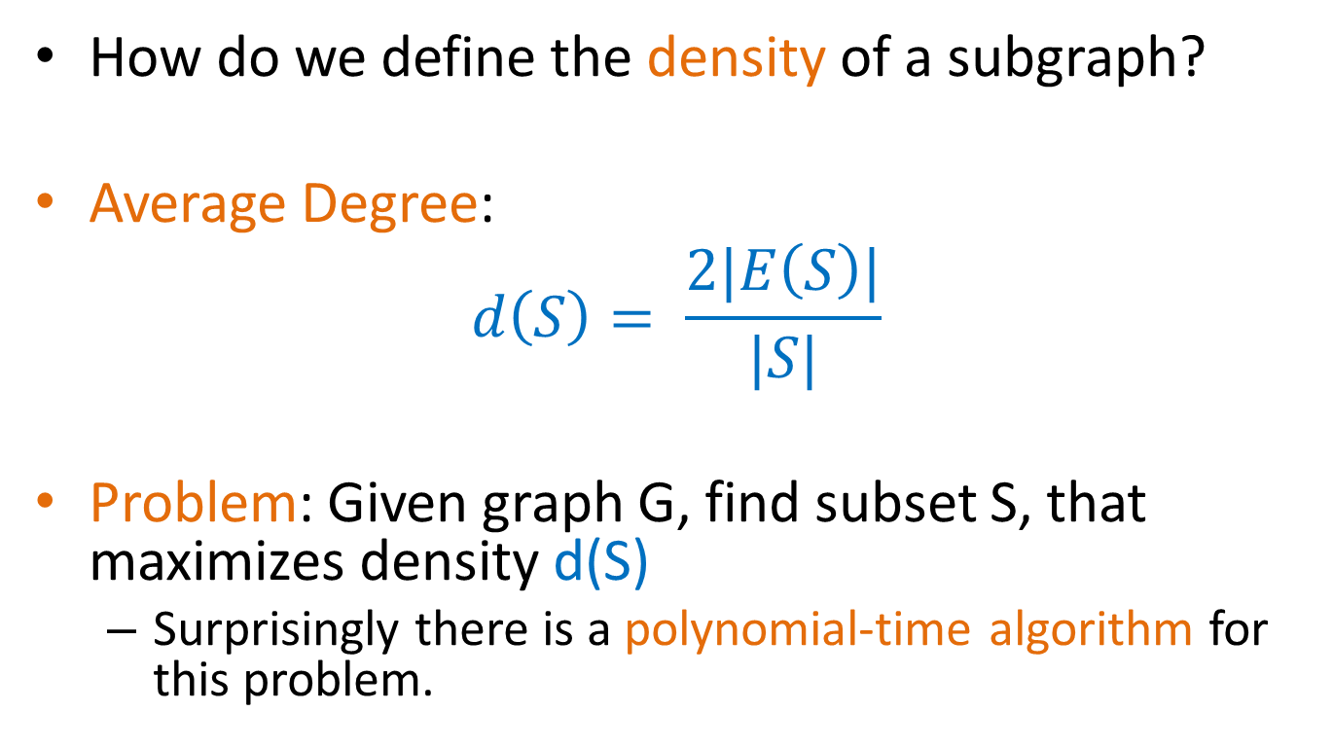
Definitions
How do we define the density of a subgraph?
Average Degree:
$$d\left(S\right)= \frac{2|E\left(S\right)|}{|S|}$$
Problem: Given graph G, find subset S, that maximizes density d(S)
  Surprisingly there is a polynomial-time algorithm for this problem.

Slide 83
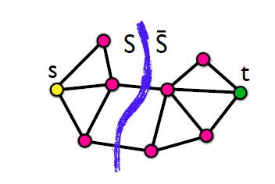
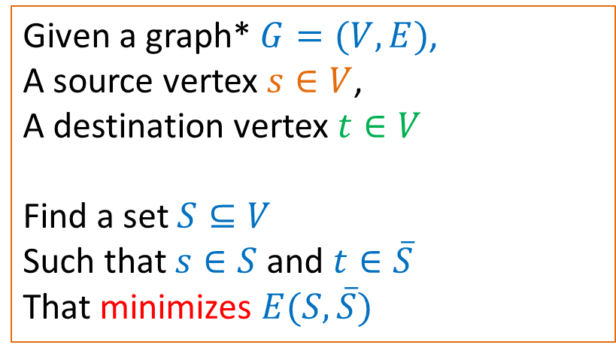
Min-Cut Problem
Given a graph* $G=(V,E)$,
A source vertex $s∈V$,
A destination vertex $t∈V$
Find a set $S⊆V$
Such that $s∈S$ and $t∈\overline{S}$
That minimizes $E(S,\overline{S})$
* The graph may be weighted
Min-Cut = Max-Flow: the minimum cut maximizes the flow that can be sent from s to t. There is a polynomial time solution.

Slide 84
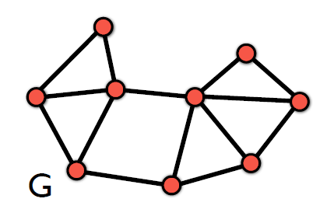
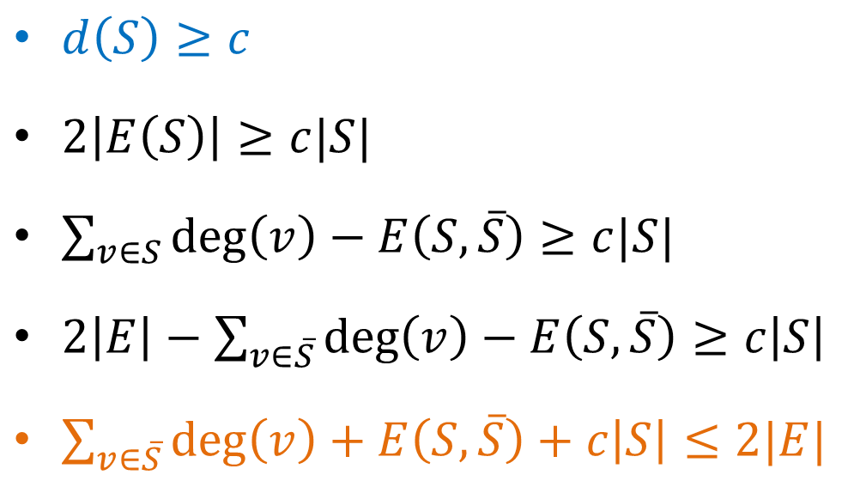
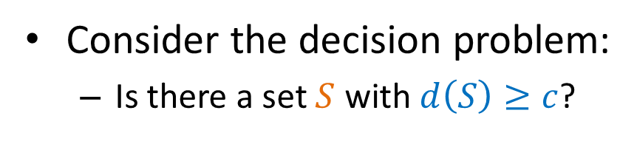
Decision problem
Consider the decision problem:
  Is there a set $S$ with $d\left(S\right)≥c$?
$d\left(S\right)≥c$
$2\left|E\left(S\right)\right|≥c|S|$
$\sum_{v∈S}{\deg\left(v\right)−E\left(S,\overline{S}\right)≥c|S|}$
$2\left|E\right|−\sum_{v∈\overline{S}}{\deg\left(v\right)}−E\left(S,\overline{S}\right)≥c\left|S\right|$
$\sum_{v∈\overline{S}}{\deg\left(v\right)}+E\left(S,\overline{S}\right)+c\left|S\right|≤2|E|$

Slide 85
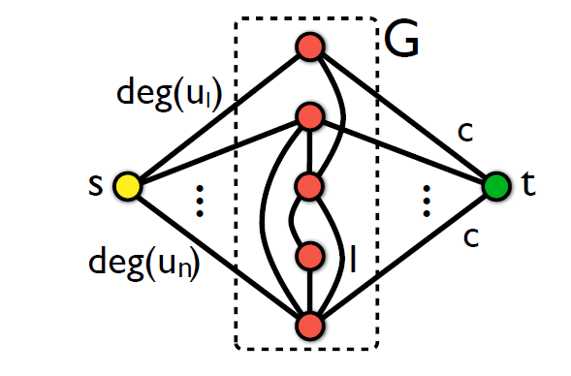

Transform to min-cut
For a value $c$ we do the following transformation
We ask for a min s-t cut in the new graph

Slide 86
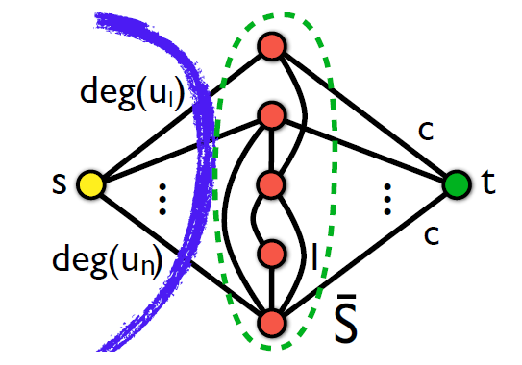

Transformation to min-cut
There is a cut that has value $2|E|$

Slide 87
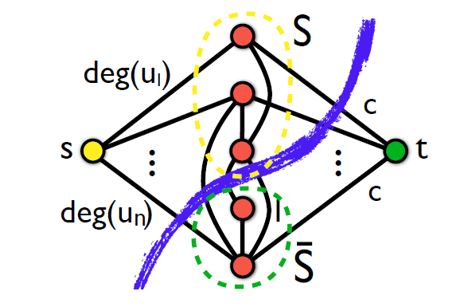

Transformation to min-cut
Every other cut has value:
$\sum_{v∈\overline{S}}{\deg\left(v\right)}+E\left(S,\overline{S}\right)+c\left|S\right|$

Slide 88

Transformation to min-cut
If $\sum_{v∈\overline{S}}{\deg\left(v\right)}+E\left(S,\overline{S}\right)+c\left|S\right|≤2|E|$ then $S≠∅$ and $d\left(S\right)≥c$

Slide 89
Algorithm (Goldberg)
Given the input graph G, and value c
Create the min-cut instance graph
Compute the min-cut
If the set S is not empty, return YES
Else return NO
How do we find the set with maximum density?

Slide 90
Min-cut algorithm
The min-cut algorithm finds the optimal solution in polynomial time O(nm), but this is too expensive for real networks.
We will now describe a simpler approximation algorithm that is very fast
  Approximation algorithm: the ratio of the density of the set produced by our algorithm and that of the optimal is bounded.
    We will show that the ratio is at most ½
    The optimal set is at most twice as dense as that of the approximation algorithm.
Any ideas for the algorithm?

Slide 91
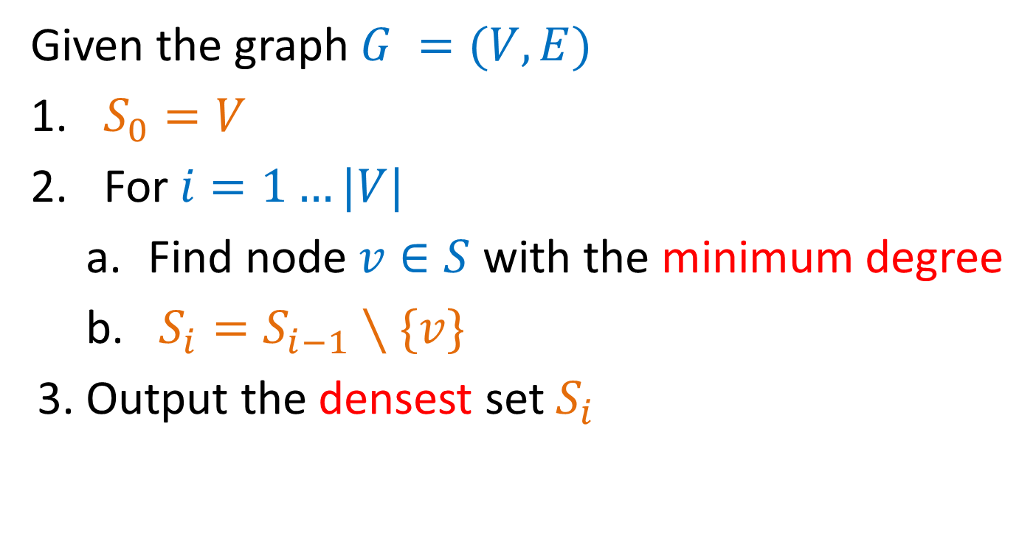
Greedy Algorithm
Given the graph $G =(V,E)$
$S_{0}=V$
For $i=1…|V|$
  Find node $v∈S$ with the minimum degree
  $S_{i}=S_{i−1}∖\{v\}$
3. Output the densest set $S_{i}$

Slide 92
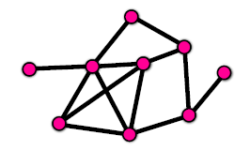









Example

Slide 93

Analysis
We will prove that the optimal set has density at most 2 times that of the set produced by the Greedy algorithm.
Density of optimal set: $d_{opt}=\max_{S⊆V}{d(S)}$
Density of greedy algorithm $d_{g}$
We want to show that $d_{opt}≤{2⋅d}_{g}$

Slide 94


Upper bound
We will first upper-bound the solution of optimal
Assume an arbitrary assignment of an edge $(u,v)$to either $u$ or $v$
Define:
  $IN\left(u\right)$= # edges assigned to u
  $Δ=\max_{u∈V}{IN(u)}$
We can prove that
  $d_{opt}≤2⋅Δ$
This is true for any assignment of the edges!

Slide 95

Lower bound
We will now prove a lower bound for the density of the set produced by the greedy algorithm.
For the lower bound we consider a specific assignment of the edges that we create as the greedy algorithm progresses:
  When removing node $u$ from $S$, assign all the edges to $u$
So: $IN\left(u\right)=$ degree of $u$ in $S$ $≤d\left(S\right)≤d_{g}$
This is true for all $u$ so $Δ≤d_{g}$
It follows that $d_{opt}≤2⋅d_{g}$

Slide 96

The k-densest subgraph
The k-densest subgraph problem: Find the set of $k$ nodes $S$, such that the density $d(S)$ is maximized.
  The k-densest subgraph problem is NP-hard!

Slide 97
Quantifying social group evolution
G Palla, AL Barabási, T Vicsek, Nature 446 (7136), 664-667

Slide 98
Datasets
monthly list of articles in the Cornell University Library e-print condensed matter (cond-mat) archive spanning 142 months, with over 30,000 authors,
phone calls between the customers of a mobile phone company spanning 52 weeks (accumulated over two-week-long periods) containing the communication patterns of over 4 million users.

Slide 99
Datasets
black nodes/edges do not belong to any community,
red nodes belong to two or more communities

Slide 100
Datasets
Different local structure:
Co-authorship: dense network with significant overlap among communities (co-authors of an article form cliques) -- Phone-call: communities less interconnected, often separated by one or more inter-community node/edge
Co-authorship long-term collaborations -- Phone-call: the links correspond to instant communication events
Fundamental differences suggest that any common features represent potentially generic characteristics

Slide 101
Approach
Communities at each time step extracted using the clique percolation method (CPM)
Why CPM?
their members can be reached through well connected subsets of nodes, and communities may overlap
Parameters
k = 4
Weighted graph – use a weight threshold w* (links weaker than w* are ignored)

Slide 102
Evaluation
1. compare the average weight of the links inside communities, to the average weight of the inter-community links (2.9 authors – 5.9 phone)
2. (homogeneity)
n_{real}: the size of the largest subset of people having the same zipcode averaged over time steps and the set of available communities,
n_{rand} represents the same average but with randomly selected users
s: size
Notes:
significantly larger than 1 for both the zip-code and the age, indicating that communities have a tendency to contain people from the same generation and living in the same neighborhood
the zip-code has a prominent peak at community size s<35, suggesting that communities of this size are geographically the most homogeneous ones.

Slide 103

Basic Events

Slide 104
Identifying Events
Run CPM on snapshot t
Run CPM on snapshot t+1
For each pair of consecutive time steps t and t+1, construct a joint graph consisting of the union of links from the corresponding two networks, and extract the CPM community structure of this joint network
Any community from either the t or the t+1 snapshot is contained in exactly one community in the joint graph (since we only add edges, communities can only grow larger)
If a community in the joint graph contains a single community from t and a single community from t+1, then they are matched.
If the joint group contains more than one community from either time steps, the communities are matched in descending order of their relative node overlap
Notes:
The links at t (blue) and the links at t11 (yellow) are merged into a joint graph (green).

Slide 105
Results
s: size
t: age
s and t are positively correlated: larger communities are on average older
s

Slide 106


Results
Auto-correlation function
where A(t) members of community A at t
the collaboration network is more “dynamic” (decays faster)
in both networks, the auto-correlation function decays faster for the larger communities, showing that the membership of the larger communities is changing at a higher rate.

Slide 107


Results
co-authorship
ζ stationarity: average correlation between two states
1-ζ: the average ratio of members changed in one step
τ*: life-span
the average life-span <t*> (color coded) as a function of ζ and s
for small communities optimal ζ near 1, better to have static, time-independent
For large communities, the peak is shifted towards low ζ values, better to have continually changing membership
phone-call

Slide 108

Results

Slide 109

Results
Notes:
The height of the columns corresponds to the actual community size, s, and within one column the yellow colour indicates the number of ‘old’ nodes (that have been present in the community at least in the previous time
step as well), while newcomers are shown with green. The members abandoning the community in the next time step are shown with orange or purple colour, depending on whether they are old or new. (This latter type of
member joins the community for only one time step)

Slide 110

Can we predict the evolution?
w_{out}: individual commitment to outside the community
w_{in}: individual commitment inside the community
p: probability to abandon the community

Slide 111

Can we predict the evolution?
W_{out}: total weight of links to nodes outside the community
W_{in}: total weight of links inside the community
p: probability of a community to disintegrate in the next step
for co-authorship max lifetime at intermediate values

Slide 112
Conclusions
Significant difference between smaller collaborative or friendship circles and institutions.
At the heart of small communities are a few strong relationships, and as long as these persist, the community around them is stable.
The condition for stability of large communities is continuous change, so that after some time practically all members are exchanged.
Loose, rapidly changing communities reminiscent of institutions, which can continue to exist even after all members have been replaced by new members (e.g., members of a school).

Slide 113
Basic References
Jure Leskovec, Anand Rajaraman, Jeff Ullman, Mining of Massive Datasets, Chapter 10, http://www.mmds.org/
Reza Zafarani, Mohammad Ali Abbasi, Huan Liu, Social Media Mining: An Introduction, Chapter 6, http://dmml.asu.edu/smm/
Santo Fortunato: Community detection in graphs. CoRR abs/0906.0612v2 (2010)
Ulrike von Luxburg: A Tutorial on Spectral Clustering. CoRR abs/0711.0189 (2007)
G Palla, A. L. Barabási, T Vicsek, Quantyfying Social Group Evolution. Nature 446 (7136), 664-667

Slide 114
Questions?

