Slide 1
DATA MINING
LECTURE 10
Classification
Nearest Neighbor Classification
Support Vector Machines
Logistic Regression
Naïve Bayes Classifier
Supervised Learning

Slide 2
Illustrating Classification Task

Slide 3
NEAREST NEIGHBOR CLASSIFICATION

Slide 4
Instance-Based Classifiers
Store the training records
Use training records to
predict the class label of
unseen cases

Slide 5
Instance Based Classifiers
Examples:
  Rote-learner
    Memorizes entire training data and performs classification only if attributes of record match one of the training examples exactly
  Nearest neighbor classifier
    Uses k “closest” points (nearest neighbors) for performing classification

Slide 6
Nearest Neighbor Classifiers
Basic idea:
  “If it walks like a duck, quacks like a duck, then it’s probably a duck”
Compute Distance
Test Record
Training Records
Choose k of the “nearest” records

Slide 7
Nearest-Neighbor Classifiers
Requires three things
  The set of stored records
  Distance Metric to compute distance between records
  The value of k, the number of nearest neighbors to retrieve
To classify an unknown record:
  Compute distance to other training records
  Identify k nearest neighbors
  Use class labels of nearest neighbors to determine the class label of unknown record (e.g., by taking majority vote)

Slide 8
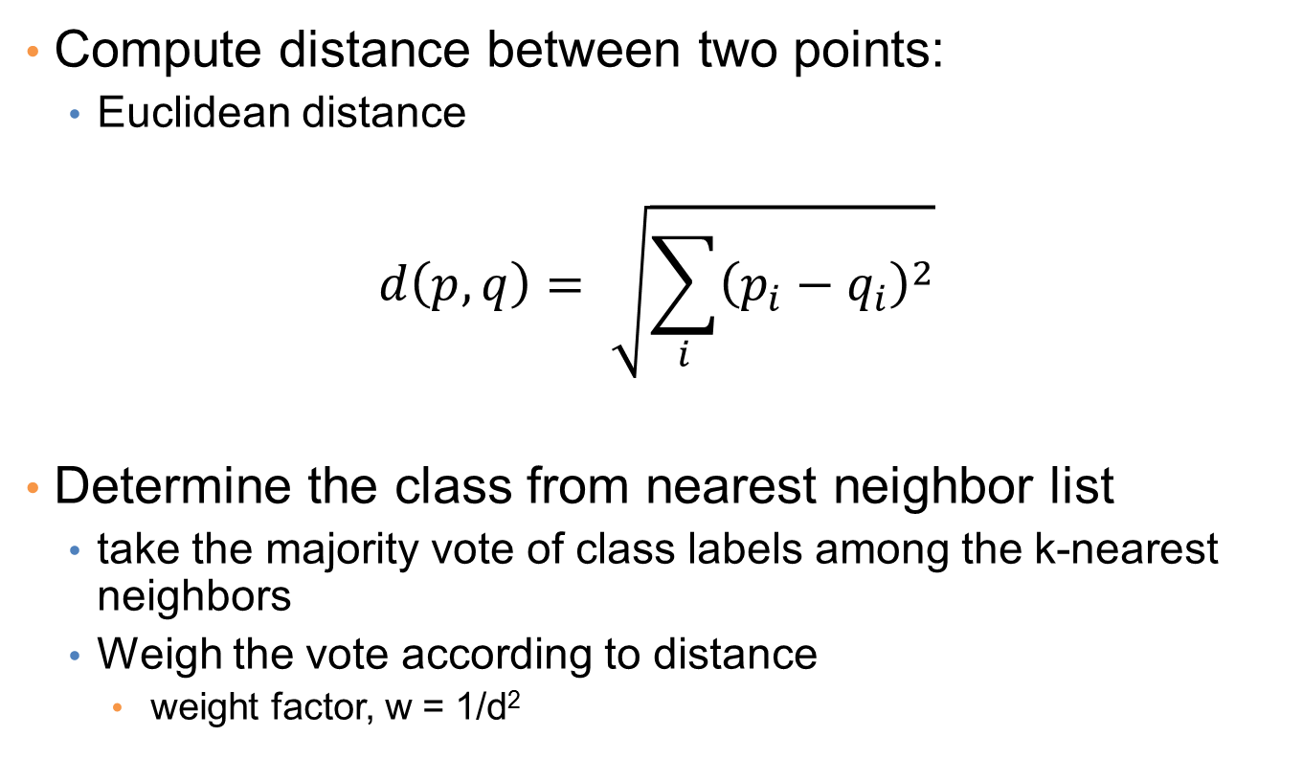
Nearest Neighbor Classification
Compute distance between two points:
  Euclidean distance
$$d\left(p,q\right)= \sqrt{\sum_{i}{{\left(p_{i}−q_{i}\right)}^{2}}}$$
Determine the class from nearest neighbor list
  take the majority vote of class labels among the k-nearest neighbors
  Weigh the vote according to distance
    weight factor, w = 1/d²

Slide 9
Definition of Nearest Neighbor
K-nearest neighbors of a record x are data points that have the k smallest distance to x

Slide 10
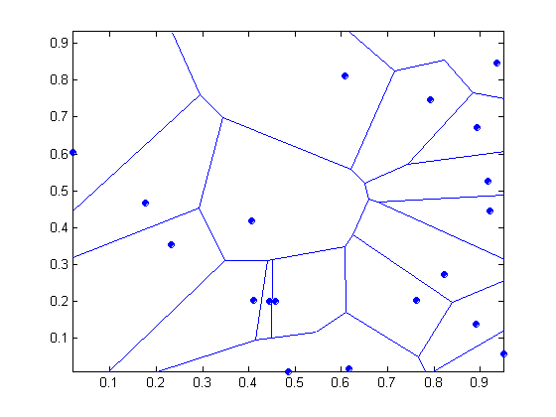
1 nearest-neighbor
Voronoi Diagram defines the classification boundary
The area takes the class of the green point

Slide 11
Nearest Neighbor Classification…
Choosing the value of k:
  If k is too small, sensitive to noise points
  If k is too large, neighborhood may include points from other classes
The value of k is the complexity of the model

Slide 12
Nearest Neighbor Classification…
Scaling issues
  Attributes may have to be scaled to prevent distance measures from being dominated by one of the attributes
  Example:
    height of a person may vary from 1.5m to 1.8m
    weight of a person may vary from 90lb to 300lb
    income of a person may vary from $10K to $1M

Slide 13
Nearest Neighbor Classification…
Problem with Euclidean measure:
  High dimensional data
    curse of dimensionality
  Can produce counter-intuitive results
1 1 1 1 1 1 1 1 1 1 1 0
1 0 0 0 0 0 0 0 0 0 0 0
vs
0 1 1 1 1 1 1 1 1 1 1 1
0 0 0 0 0 0 0 0 0 0 0 1
d = 1.4142
d = 1.4142
    Solution: Normalize the vectors to unit length

Slide 14
Nearest neighbor Classification…
k-NN classifiers are lazy learners
  It does not build models explicitly
  Unlike eager learners such as decision trees
Classifying unknown records are relatively expensive
  Naïve algorithm: O(n)
  Need for structures to retrieve nearest neighbors fast.
    The Nearest Neighbor Search problem.
    Also, Approximate Nearest Neighbor Search

Slide 15
SUPPORT VECTOR MACHINES

Slide 16
Support Vector Machines
Find a linear hyperplane (decision boundary) that will separate the data

Slide 17
Support Vector Machines
One Possible Solution

Slide 18
Support Vector Machines
Another possible solution

Slide 19
Support Vector Machines
Other possible solutions

Slide 20
Support Vector Machines
Which one is better? B1 or B2?
How do you define better?

Slide 21
Support Vector Machines
Find hyperplane maximizes the margin => B1 is better than B2

Slide 22
Support Vector Machines

Slide 23
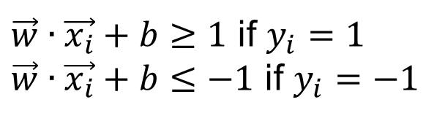
Support Vector Machines
We want to maximize:
  Which is equivalent to minimizing:
  But subjected to the following constraints:
    This is a constrained optimization problem
      Numerical approaches to solve it (e.g., quadratic programming)
$\vec{w}∙\vec{x_{i}}+b≥1$ if $y_{i}=1$
$\vec{w}∙\vec{x_{i}}+b≤−1$ if $y_{i}=−1$

Slide 24
Support Vector Machines
What if the problem is not linearly separable?

Slide 25


Support Vector Machines
What if the problem is not linearly separable?
$$\vec{w}⋅\vec{x}+b=−1+ξ_{i}$$
$$\frac{ξ_{i}}{\left\|w\right\|}$$

Slide 26
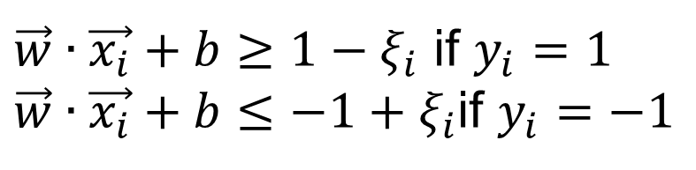
Support Vector Machines
What if the problem is not linearly separable?
  Introduce slack variables
    Need to minimize:
    Subject to:
$\vec{w}∙\vec{x_{i}}+b≥1−ξ_{i}$ if $y_{i}=1$
$\vec{w}∙\vec{x_{i}}+b≤−1+ξ_{i}$if $y_{i}=−1$

Slide 27
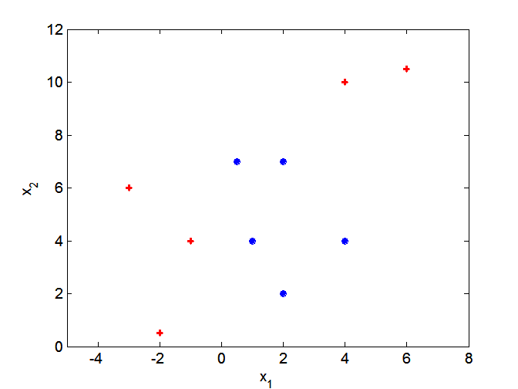
Nonlinear Support Vector Machines
What if decision boundary is not linear?

Slide 28
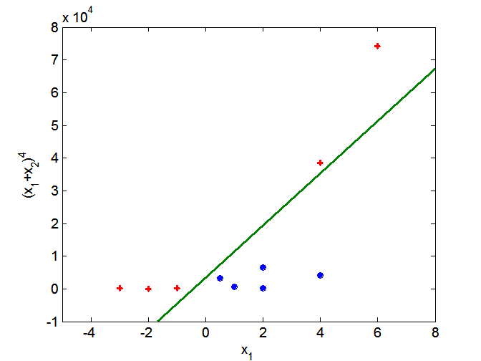
Nonlinear Support Vector Machines
Transform data into higher dimensional space
Use the Kernel Trick

Slide 29
LOGISTIC REGRESSION

Slide 30
Classification via regression
Instead of predicting the class of an record we want to predict the probability of the class given the record
The problem of predicting continuous values is called regression problem
General approach: find a continuous function that models the continuous points.

Slide 31
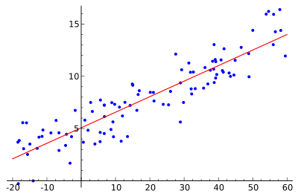
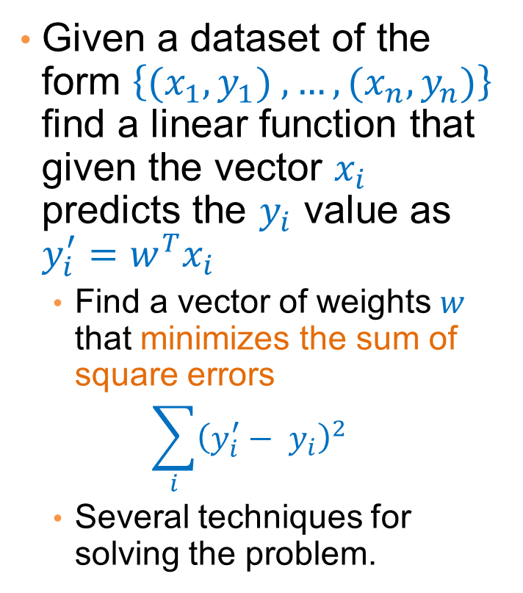
Example: Linear regression
Given a dataset of the form $\left\{{(x}_{1},y_{1}) ,…,{(x}_{n},y_{n})\right\}$ find a linear function that given the vector $x_{i}$ predicts the $y_{i}$ value as $y_{i}^{′}=w^{T}x_{i}$
  Find a vector of weights $w$ that minimizes the sum of square errors
  $$\sum_{i}{{\left(y_{i}^{′}− y_{i}\right)}^{2}}$$
  Several techniques for solving the problem.

Slide 32





Classification via regression
Assume a linear classification boundary
$$w⋅x>0$$
For the positive class the bigger the value of $w⋅x$, the further the point is from the classification boundary, the higher our certainty for the membership to the positive class
Define $P(C_{+}|x)$ as an increasing function of $w⋅x$
$$w⋅x=0$$
For the negative class the smaller the value of $w⋅x$, the further the point is from the classification boundary, the higher our certainty for the membership to the negative class
Define $P(C_{−}|x)$ as a decreasing function of $w⋅x$
$$w⋅x<0$$

Slide 33
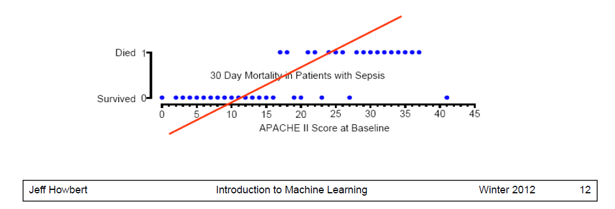
Linear regression
A linear function is not good
  It may produce negative probabilities, or probabilities that are greater than 1.

Slide 34
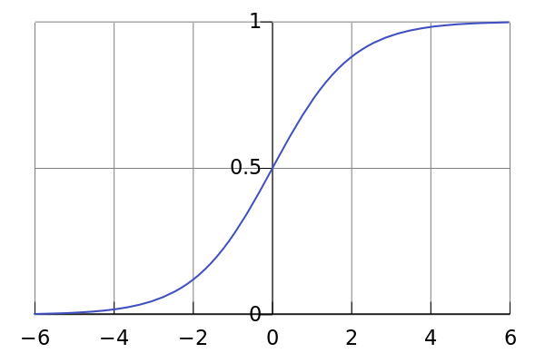
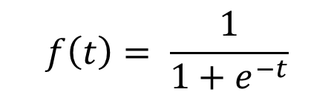
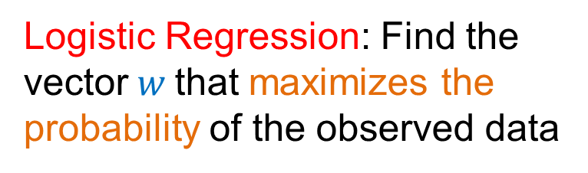
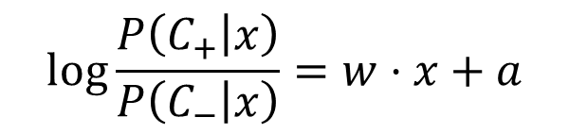
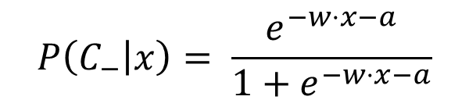
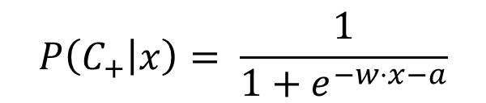
Logistic Regression
The logistic function
$$f\left(t\right)= \frac{1}{1+e^{−t}}$$
$$P\left(C_{+} | x\right)= \frac{1}{1+e^{−w⋅x−a}}$$
$$P\left(C_{−} | x\right)= \frac{e^{−w⋅x−a}}{1+e^{−w⋅x−a}}$$
$$\log{\frac{P\left(C_{+} | x\right)}{P\left(C_{−} | x\right)}}=w⋅x+a$$
Logistic Regression: Find the vector$w$that maximizes the probability of the observed data
Linear regression on the log-odds ratio

Slide 35
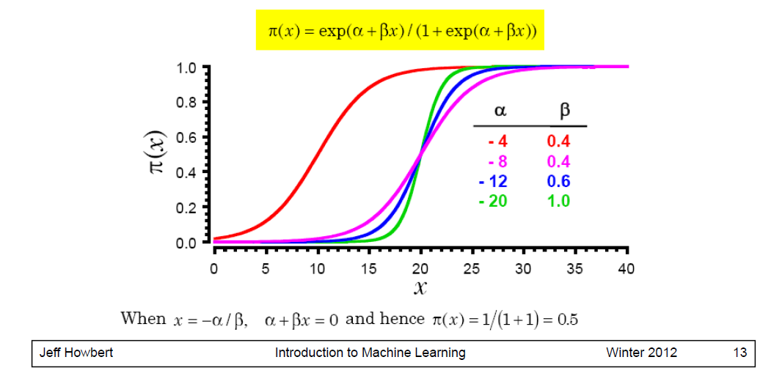
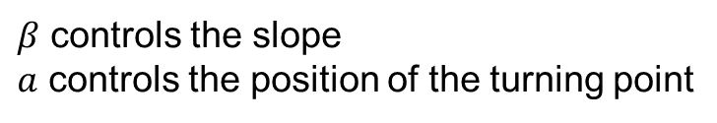
The logistic function
$β$ controls the slope
$a$ controls the position of the turning point

Slide 36
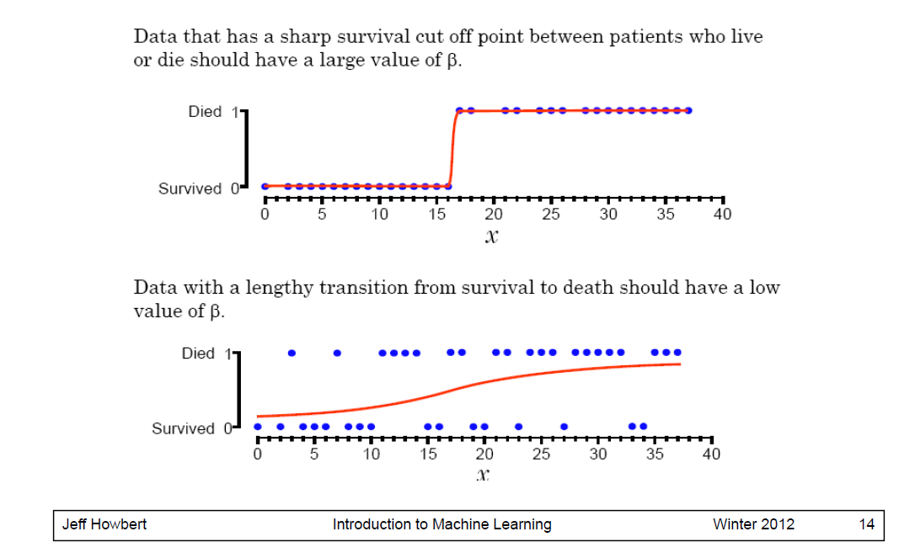
Logistic Regression in one dimension

Slide 37
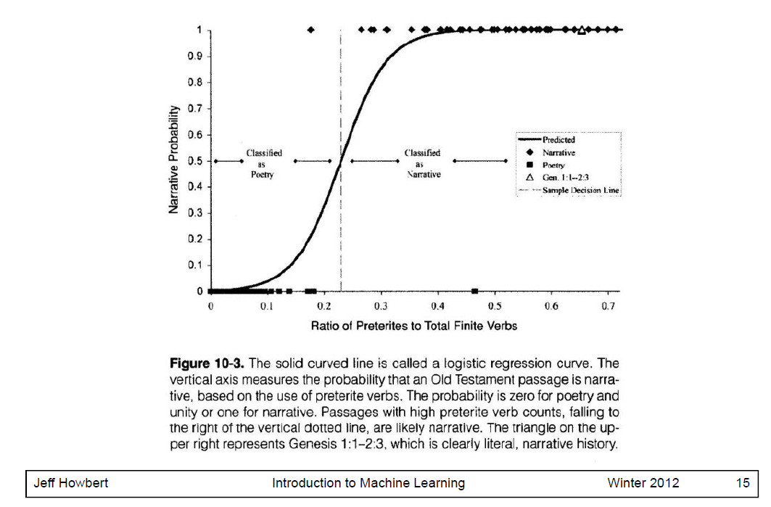
Logistic Regression in one dimension

Slide 38
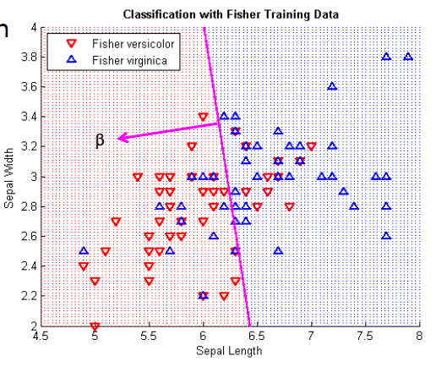
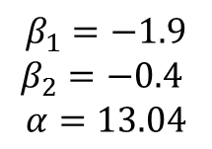
Logistic regression in 2-d
Coefficients
$$β_{1}=−1.9$$
$$β_{2}=−0.4$$
$$α=13.04$$

Slide 39
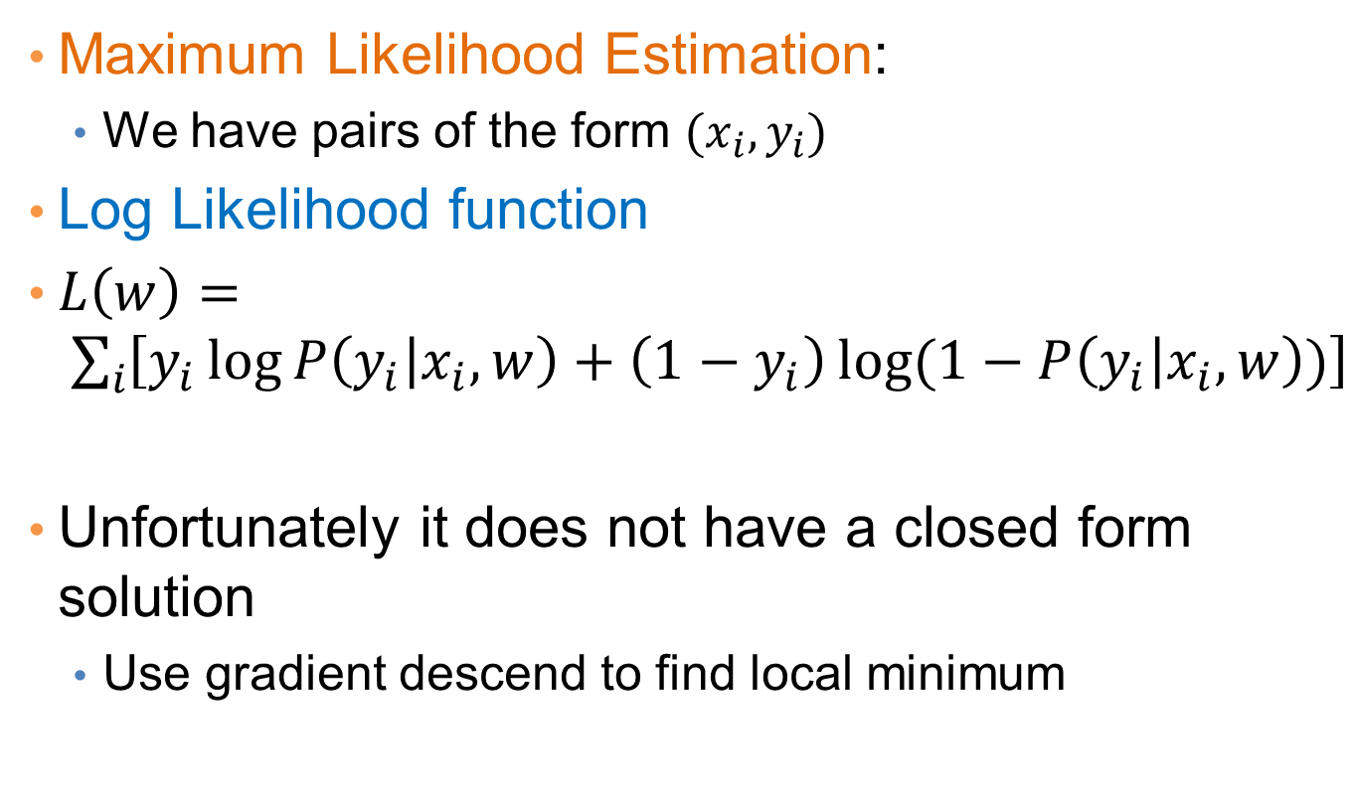
Estimating the coefficients
Maximum Likelihood Estimation:
  We have pairs of the form $(x_{i},y_{i})$
Log Likelihood function
$L\left(w\right)= \sum_{i}{\left[y_{i}\log{P\left(y_{i} | x_{i},w\right)+\left(1−y_{i}\right)\log{(1−P\left(y_{i} | x_{i},w\right))}}\right]}$
Unfortunately it does not have a closed form solution
  Use gradient descend to find local minimum

Slide 40
Logistic Regression
Produces a probability estimate for the class membership which is often very useful.
The weights can be useful for understanding the feature importance.
Works for relatively large datasets
Fast to apply.

Slide 41
NAÏVE BAYES CLASSIFIER

Slide 42
Bayes Classifier
A probabilistic framework for solving classification problems
A, C random variables
Joint probability: Pr(A=a,C=c)
Conditional probability: Pr(C=c | A=a)
Relationship between joint and conditional probability distributions
Bayes Theorem:

Slide 43
Bayesian Classifiers
  How to classify the new record X = (‘Yes’, ‘Single’, 80K)
Find the class with the highest probability given the vector values.
    Maximum Aposteriori Probability estimate:
  Find the value c for class C that maximizes P(C=c| X)
How do we estimate P(C|X) for the different values of C?
  We want to estimate P(C=Yes| X)
  and P(C=No| X)

Slide 44
Bayesian Classifiers
In order for probabilities to be well defined:
  Consider each attribute and the class label as random variables
  Probabilities are determined from the data
Evade C
Event space: {Yes, No}
P(C) = (0.3, 0.7)
Refund A₁
Event space: {Yes, No}
P(A₁) = (0.3,0.7)
Martial Status A₂
Event space: {Single, Married, Divorced}
P(A₂) = (0.4,0.4,0.2)
Taxable Income A₃
Event space: R
P(A₃) ~ Normal(μ,σ²)
μ = 104:sample mean, σ²=1874:sample var

Slide 45
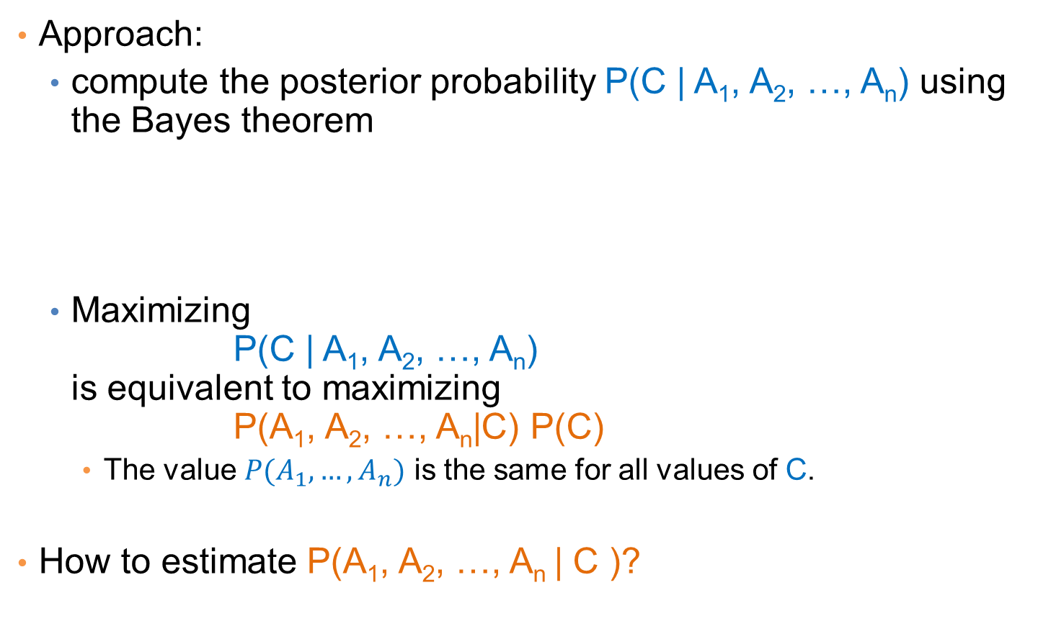
Bayesian Classifiers
Approach:
  compute the posterior probability P(C | A₁, A₂, …, A_{n}) using the Bayes theorem
  Maximizing
  P(C | A₁, A₂, …, A_{n})
  is equivalent to maximizing
  P(A₁, A₂, …, A_{n}|C) P(C)
    The value $P(A_{1},…,A_{n})$ is the same for all values of C.
How to estimate P(A₁, A₂, …, A_{n} | C )?

Slide 46
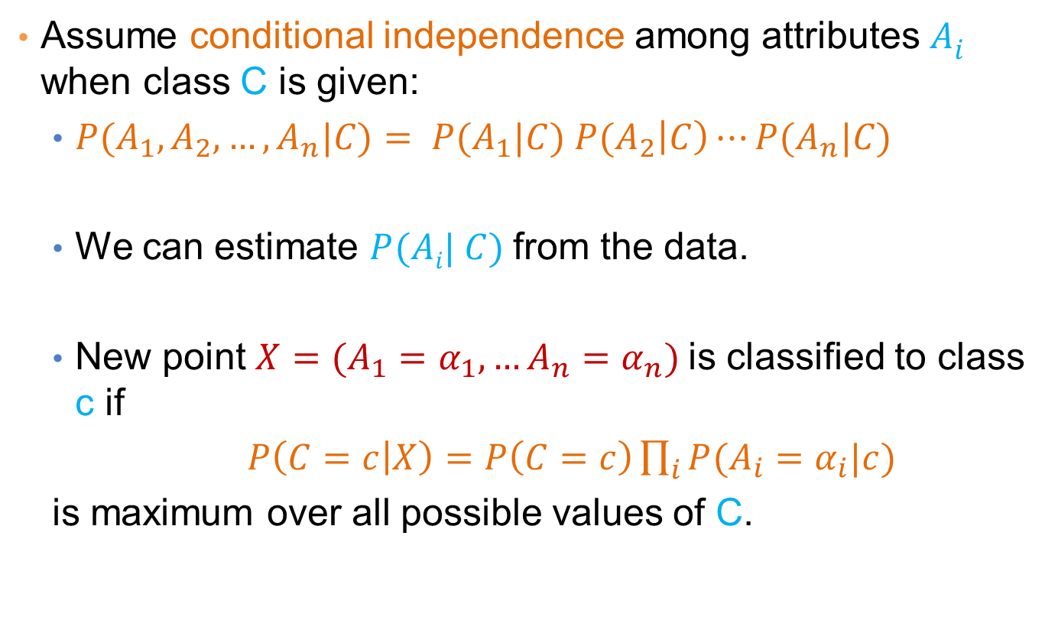
Naïve Bayes Classifier
Assume conditional independence among attributes $Ai$ when class C is given:
  $P(A_{1},A_{2},…,A_{n}|C)= P(A_{1}|C) P(A_{2}\left|C\right)⋯P(A_{n}|C)$
  We can estimate $P(Ai| C)$from the data.
  New point $X=(A_{1}=α_{1}, …A_{n}=α_{n})$is classified to class c if
  $P\left(C=c | X\right)=P\left(C=c\right)\prod_{i}{P(A_{i}=α_{i}|c)}$
  is maximum over all possible values of C.

Slide 47
Example
  Record
    X = (Refund = Yes, Status = Single, Income =80K)
For the class C = ‘Evade’, we want to compute:
  P(C = Yes|X) and P(C = No| X)
We compute:
  P(C = Yes|X) = P(C = Yes)*P(Refund = Yes |C = Yes)
  *P(Status = Single |C = Yes)
  *P(Income =80K |C= Yes)
  P(C = No|X) = P(C = No)*P(Refund = Yes |C = No)
  *P(Status = Single |C = No)
  *P(Income =80K |C= No)

Slide 48
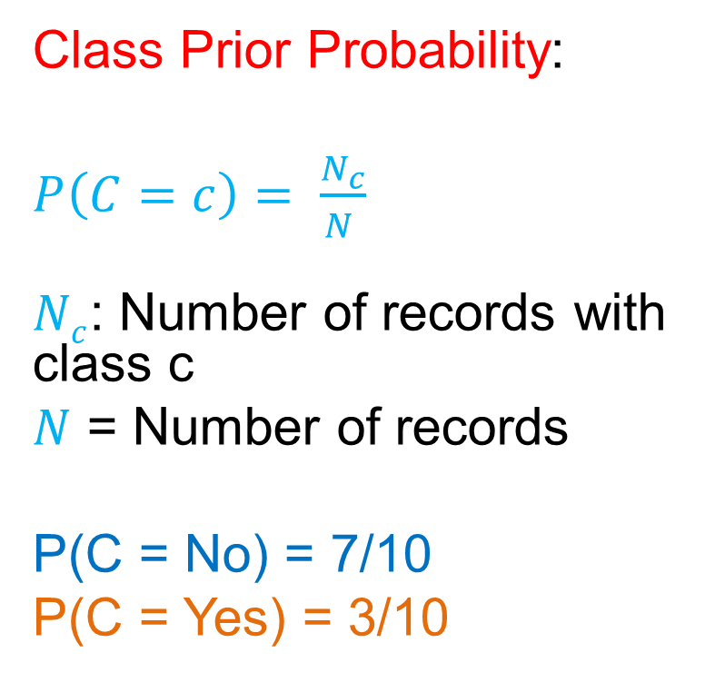
How to Estimate Probabilities from Data?
Class Prior Probability:
$P\left(C=c\right)= \frac{N_{c}}{N }$
$Nc$: Number of records with class c
$N$ = Number of records
P(C = No) = 7/10
P(C = Yes) = 3/10

Slide 49
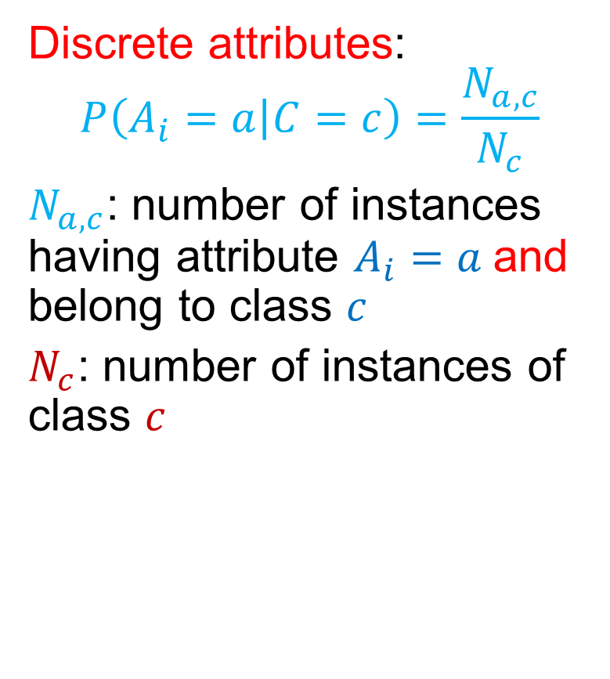
How to Estimate Probabilities from Data?
Discrete attributes:
$$P\left(A_{i}=a | C=c\right)=\frac{N_{a,c}}{N_{c}}$$
$N_{a,c}$: number of instances having attribute $A_{i}=a$and belong to class $c$
$N_{c}$: number of instances of class $c$

Slide 50
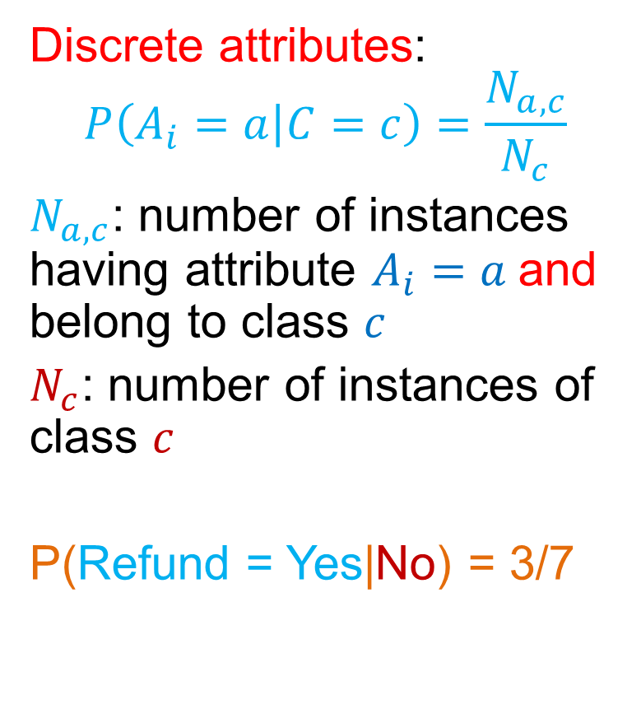
How to Estimate Probabilities from Data?
Discrete attributes:
$$P\left(A_{i}=a | C=c\right)=\frac{N_{a,c}}{N_{c}}$$
$N_{a,c}$: number of instances having attribute $A_{i}=a$and belong to class $c$
$N_{c}$: number of instances of class $c$
P(Refund = Yes|No) = 3/7

Slide 51
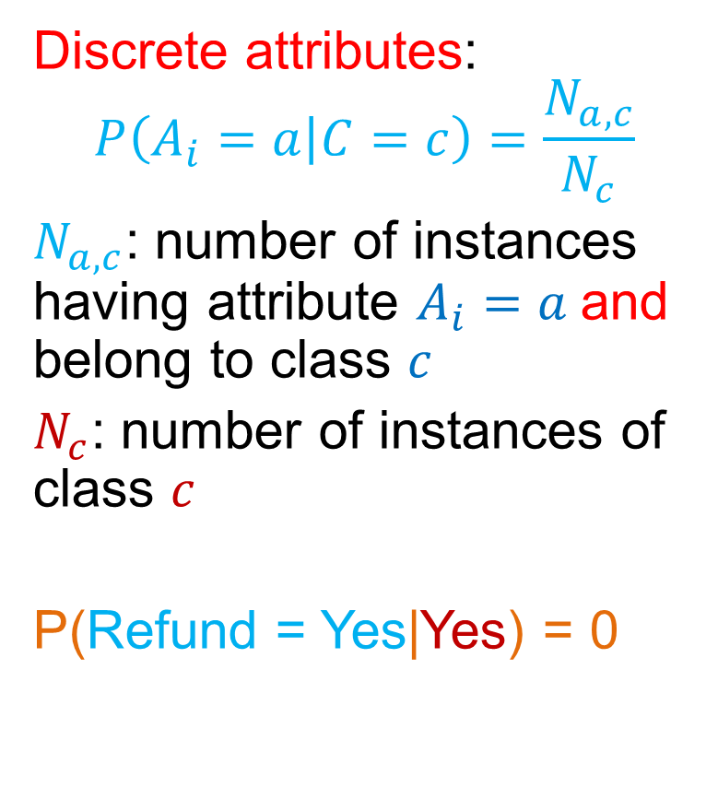
How to Estimate Probabilities from Data?
Discrete attributes:
$$P\left(A_{i}=a | C=c\right)=\frac{N_{a,c}}{N_{c}}$$
$N_{a,c}$: number of instances having attribute $A_{i}=a$and belong to class $c$
$N_{c}$: number of instances of class $c$
P(Refund = Yes|Yes) = 0

Slide 52
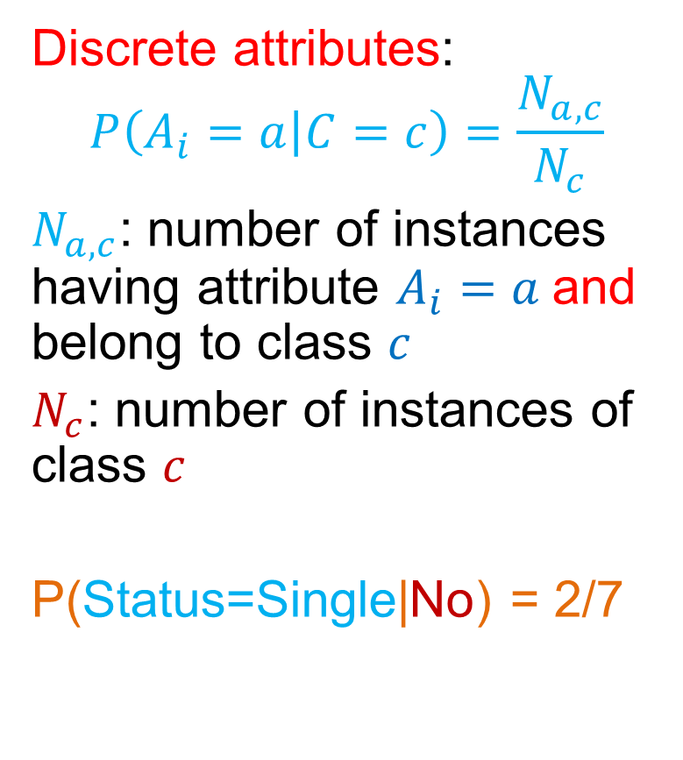
How to Estimate Probabilities from Data?
Discrete attributes:
$$P\left(A_{i}=a | C=c\right)=\frac{N_{a,c}}{N_{c}}$$
$N_{a,c}$: number of instances having attribute $A_{i}=a$and belong to class $c$
$N_{c}$: number of instances of class $c$
P(Status=Single|No) = 2/7

Slide 53
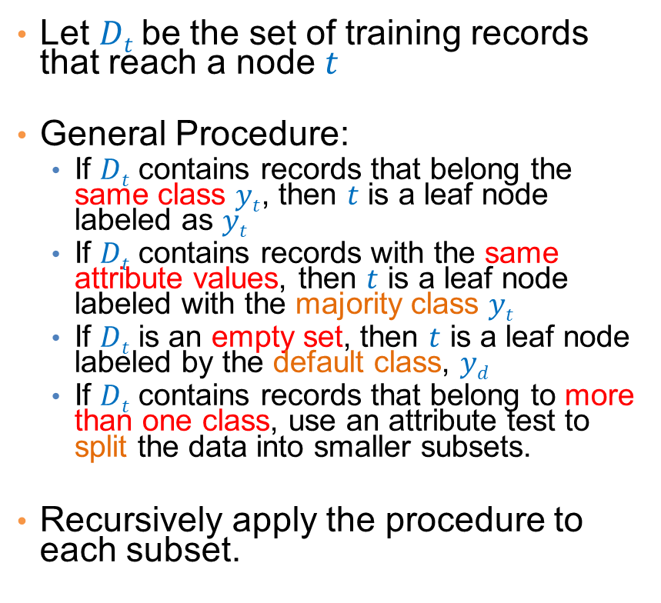
How to Estimate Probabilities from Data?
Discrete attributes:
$$P\left(A_{i}=a | C=c\right)=\frac{N_{a,c}}{N_{c}}$$
$N_{a,c}$: number of instances having attribute $A_{i}=a$and belong to class $c$
$N_{c}$: number of instances of class $c$
P(Status=Single|Yes) = 2/3

Slide 54
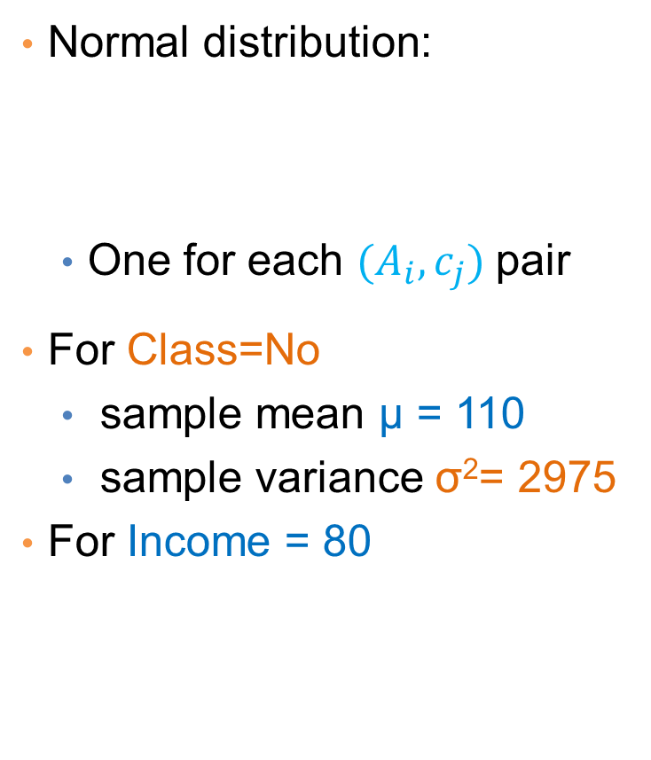
How to Estimate Probabilities from Data?
Normal distribution:
  One for each $(A_{i},c_{j})$pair
For Class=No
  sample mean μ = 110
  sample variance σ²= 2975
For Income = 80

Slide 55
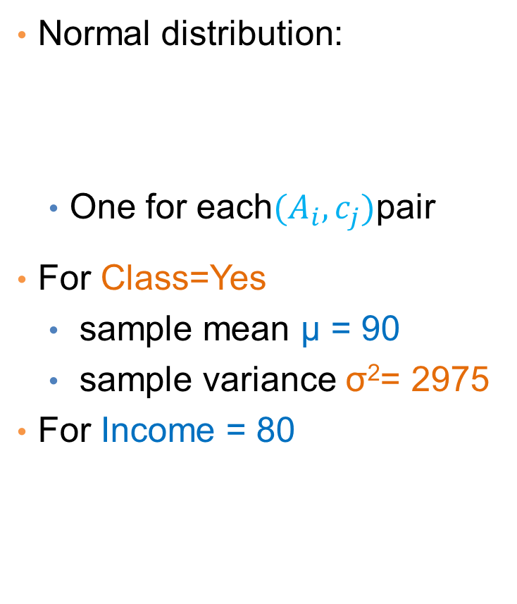
How to Estimate Probabilities from Data?
Normal distribution:
  One for each$(A_{i},c_{j})$pair
For Class=Yes
  sample mean μ = 90
  sample variance σ²= 2975
For Income = 80

Slide 56
Example
  Record
    X = (Refund = Yes, Status = Single, Income =80K)
We compute:
  P(C = Yes|X) = P(C = Yes)*P(Refund = Yes |C = Yes)
  *P(Status = Single |C = Yes)
  *P(Income =80K |C= Yes)
  = 3/10* 0 * 2/3 * 0.01 = 0
  P(C = No|X) = P(C = No)*P(Refund = Yes |C = No)
  *P(Status = Single |C = No)
  *P(Income =80K |C= No)
  = 7/10 * 3/7 * 2/7 * 0.0062 = 0.0005

Slide 57
Example of Naïve Bayes Classifier
Creating a Naïve Bayes Classifier, essentially means to compute counts:
Total number of records: N = 10
Class No:
Number of records: 7
Attribute Refund:
Yes: 3
No: 4
Attribute Marital Status:
Single: 2
Divorced: 1
Married: 4
Attribute Income:
mean: 110
variance: 2975
Class Yes:
Number of records: 3
Attribute Refund:
Yes: 0
No: 3
Attribute Marital Status:
Single: 2
Divorced: 1
Married: 0
Attribute Income:
mean: 90
variance: 25

Slide 58
Example of Naïve Bayes Classifier
Given a Test Record:
    X = (Refund = Yes, Status = Single, Income =80K)
P(X|Class=No) = P(Refund=Yes|Class=No)
× P(Married| Class=No)
× P(Income=120K| Class=No)
= 3/7 * 2/7 * 0.0062 = 0.00075
P(X|Class=Yes) = P(Refund=No| Class=Yes)
× P(Married| Class=Yes)
× P(Income=120K| Class=Yes)
= 0 * 2/3 * 0.01 = 0
P(No) = 0.3, P(Yes) = 0.7
Since P(X|No)P(No) > P(X|Yes)P(Yes)
Therefore P(No|X) > P(Yes|X)
=> Class = No

Slide 59
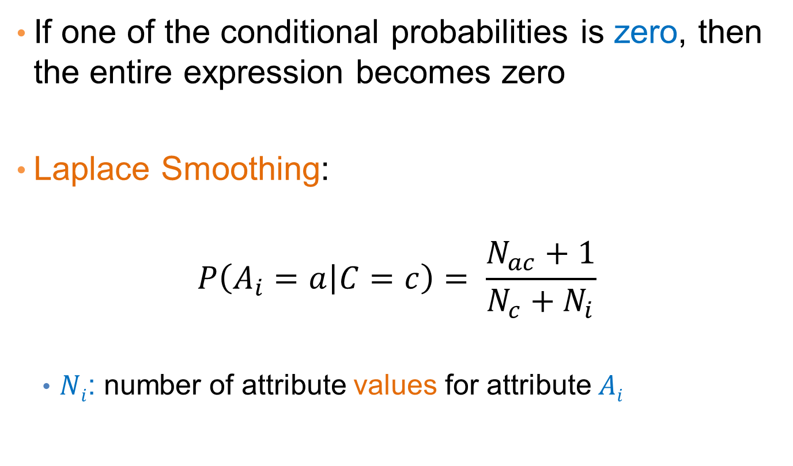
Naïve Bayes Classifier
If one of the conditional probabilities is zero, then the entire expression becomes zero
Laplace Smoothing:
$$P\left(A_{i}=a | C=c\right)= \frac{N_{ac}+1}{N_{c}+N_{i}}$$
  $Ni$: number of attribute values for attribute $Ai$

Slide 60
Example of Naïve Bayes Classifier
Creating a Naïve Bayes Classifier, essentially means to compute counts:
With Laplace Smoothing
Total number of records: N = 10
Class No:
Number of records: 7
Attribute Refund:
Yes: 3
No: 4
Attribute Marital Status:
Single: 2
Divorced: 1
Married: 4
Attribute Income:
mean: 110
variance: 2975
Class Yes:
Number of records: 3
Attribute Refund:
Yes: 0
No: 3
Attribute Marital Status:
Single: 2
Divorced: 1
Married: 0
Attribute Income:
mean: 90
variance: 25

Slide 61
Example of Naïve Bayes Classifier
Given a Test Record:
With Laplace Smoothing
    X = (Refund = Yes, Status = Single, Income =80K)
P(X|Class=No) = P(Refund=No|Class=No)
× P(Married| Class=No)
× P(Income=120K| Class=No)
= 4/9 × 3/10 × 0.0062 = 0.00082
P(X|Class=Yes) = P(Refund=No| Class=Yes)
× P(Married| Class=Yes)
× P(Income=120K| Class=Yes)
= 1/5 × 3/6 × 0.01 = 0.001
P(No) = 0.7, P(Yes) = 0.3
P(X|No)P(No) = 0.0005
P(X|Yes)P(Yes) = 0.0003
=> Class = No

Slide 62
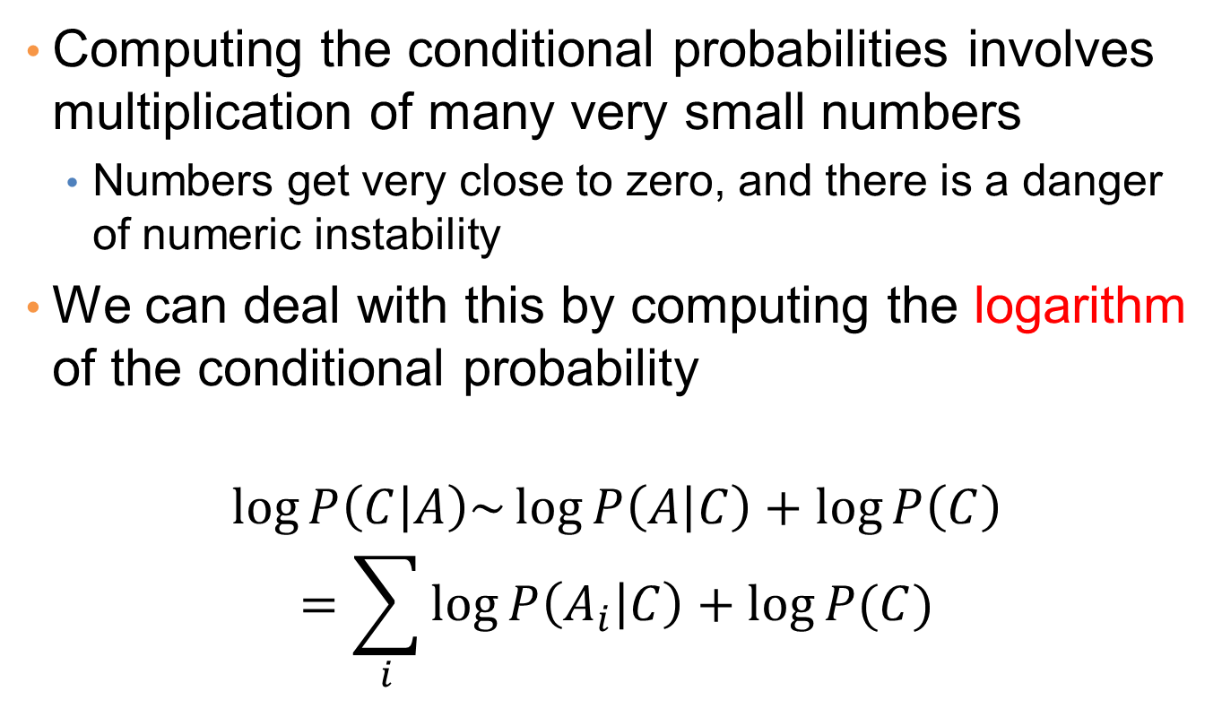
Implementation details
Computing the conditional probabilities involves multiplication of many very small numbers
  Numbers get very close to zero, and there is a danger of numeric instability
We can deal with this by computing the logarithm of the conditional probability
$$\log{P\left(C | A\right)\sim \log{P\left(A | C\right)+\log{P\left(C\right)}}}$$
$$=\sum_{i}{\log{P\left(A_{i} | C\right)}+\log{P(C)}}$$

Slide 63
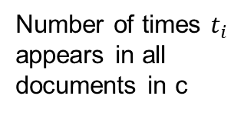
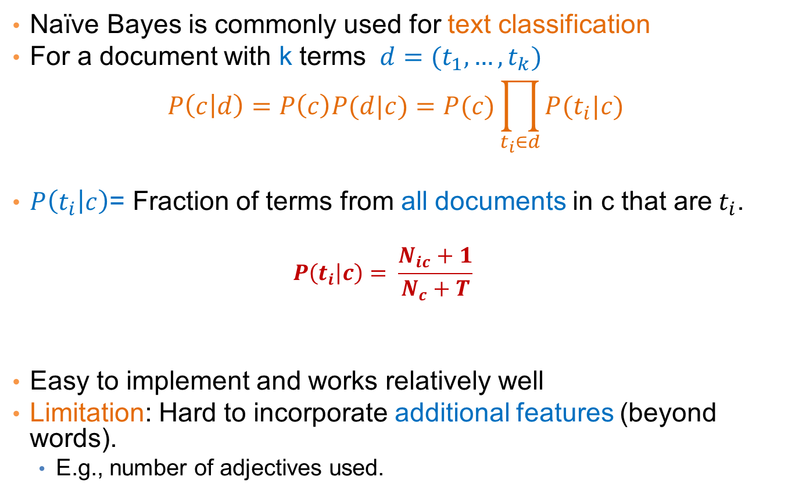
Naïve Bayes for Text Classification
Naïve Bayes is commonly used for text classification
For a document with k terms $d=(t_{1},…, t_{k})$
$$P\left(c | d\right)=P\left(c\right)P(d|c)=P(c)\prod_{t_{i}∈d}{P(t_{i}|c)}$$
$P\left(t_{i} | c\right)$= Fraction of terms from all documents in c that are$t_{i}$.
  $$P\left(t_{i} | c\right)= \frac{N_{ic}+1}{N_{c}+T}$$
Easy to implement and works relatively well
Limitation: Hard to incorporate additional features (beyond words).
  E.g., number of adjectives used.
Fraction of documents in c
Number of times $t_{i}$ appears in all documents in c
Laplace Smoothing
Number of unique words
(vocabulary size)
Total number of terms in all documents in c

Slide 64
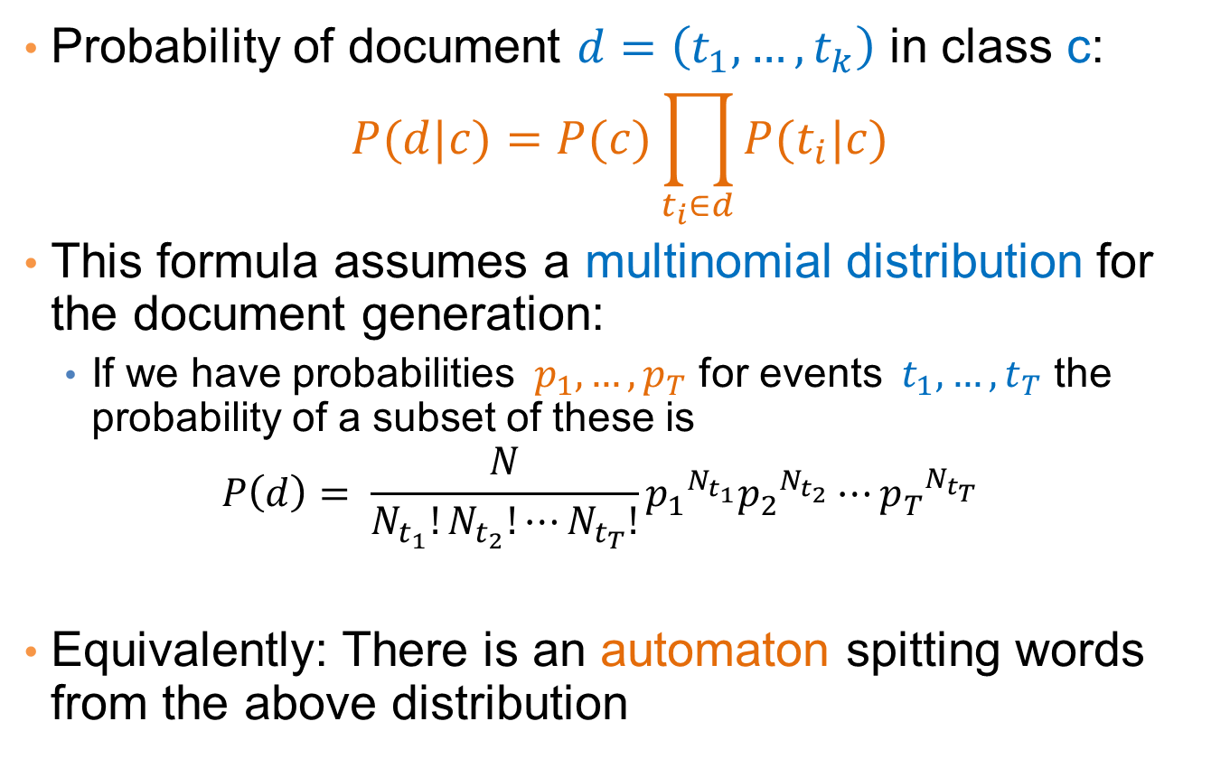
Multinomial document model
Probability of document $d=\left(t_{1},…, t_{k}\right)$ in class c:
$$P(d|c)=P(c)\prod_{t_{i}∈d}{P(t_{i}|c)}$$
This formula assumes a multinomial distribution for the document generation:
  If we have probabilities $p_{1},…, p_{T}$ for events $t_{1},…, t_{T}$ the probability of a subset of these is
  $$P\left(d\right)= \frac{N}{N_{t_{1}}!N_{t_{2}}!⋯N_{t_{T}}!}{p_{1}^{}}^{N_{t_{1}}}{p_{2}^{}}^{N_{t_{2}}}⋯{p_{T}^{}}^{N_{t_{T}}}$$
Equivalently: There is an automaton spitting words from the above distribution
w

Slide 65
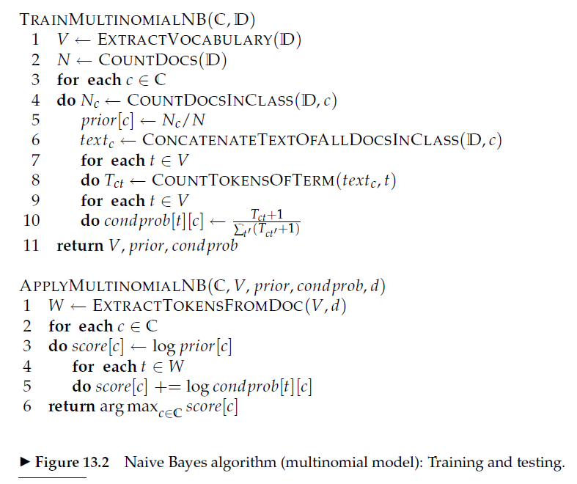

Slide 66
Example
News titles for Politics and Sports
Politics
Sports
“Obama meets Merkel”
“Obama elected again”
“Merkel visits Greece again”
“OSFP European basketball champion”
“Miami NBA basketball champion”
“Greece basketball coach?”
documents
P(p) = 0.5
P(s) = 0.5
terms
obama:2, meets:1, merkel:2, elected:1, again:2, visits:1, greece:1
OSFP:1, european:1, basketball:3, champion:2, miami:1, nba:1, greece:1, coach:1
Vocabulary size: 14
Total terms: 10
Total terms: 11
New title:
X = “Obama likes basketball”
P(Politics|X) ~ P(p)*P(obama|p)*P(likes|p)*P(basketball|p)
= 0.5 * 3/(10+14) *1/(10+14) * 1/(10+14) = 0.000108
P(Sports|X) ~ P(s)*P(obama|s)*P(likes|s)*P(basketball|s)
= 0.5 * 1/(11+14) *1/(11+14) * 4/(11+14) = 0.000128

Slide 67
Naïve Bayes (Summary)
Robust to isolated noise points
Handle missing values by ignoring the instance during probability estimate calculations
Robust to irrelevant attributes
Independence assumption may not hold for some attributes
  Use other techniques such as Bayesian Belief Networks (BBN)
Naïve Bayes can produce a probability estimate, but it is usually a very biased one
  Logistic Regression is better for obtaining probabilities.

Slide 68



Generative vs Discriminative models
Naïve Bayes is a type of a generative model
  Generative process:
    First pick the category of the record
    Then given the category, generate the attribute values from the distribution of the category
    Conditional independence given C
We use the training data to learn the distribution of the values in a class
C
$$A_{1}$$
$$A_{2}$$
$$A_{n}$$

Slide 69
Generative vs Discriminative models
Logistic Regression and SVM are discriminative models
  The goal is to find the boundary that discriminates between the two classes from the training data
In order to classify the language of a document, you can
  Either learn the two languages and find which is more likely to have generated the words you see
  Or learn what differentiates the two languages.

Slide 70
Supervised Learning

Slide 71
Learning
Supervised Learning: learn a model from the data using labeled data.
  Classification and Regression are the prototypical examples of supervised learning tasks. Other are possible (e.g., ranking)
Unsupervised Learning: learn a model – extract structure from unlabeled data.
  Clustering and Association Rules are prototypical examples of unsupervised learning tasks.
Semi-supervised Learning: learn a model for the data using both labeled and unlabeled data.

Slide 72
Supervised Learning Steps
Model the problem
  What is you are trying to predict? What kind of optimization function do you need? Do you need classes or probabilities?
Extract Features
  How do you find the right features that help to discriminate between the classes?
Obtain training data
  Obtain a collection of labeled data. Make sure it is large enough, accurate and representative. Ensure that classes are well represented.
Decide on the technique
  What is the right technique for your problem?
Apply in practice
  Can the model be trained for very large data? How do you test how you do in practice? How do you improve?

Slide 73
Modeling the problem
Sometimes it is not obvious. Consider the following three problems
  Detecting if an email is spam
  Categorizing the queries in a search engine
  Ranking the results of a web search

Slide 74
Feature extraction
Feature extraction, or feature engineering is the most tedious but also the most important step
  How do you separate the players of the Greek national team from those of the Swedish national team?
One line of thought: throw features to the classifier and the classifier will figure out which ones are important
  More features, means that you need more training data
Another line of thought: Feature Selection: Select carefully the features using various functions and techniques
  Computationally intensive

Slide 75
Training data
An overlooked problem: How do you get labeled data for training your model?
  E.g., how do you get training data for ranking?
  Chicken and egg problem
Usually requires a lot of manual effort and domain expertise and carefully planned labeling
  Results are not always of high quality (lack of expertise)
  And they are not sufficient (low coverage of the space)
Recent trends:
  Find a source that generates the labeled data for you.
  Crowd-sourcing techniques

Slide 76
Dealing with small amount of labeled data
Semi-supervised learning techniques have been developed for this purpose.
Self-training: Train a classifier on the data, and then feed back the high-confidence output of the classifier as input
Co-training: train two “independent” classifiers and feed the output of one classifier as input to the other.
Regularization: Treat learning as an optimization problem where you define relationships between the objects you want to classify, and you exploit these relationships
  Example: Image restoration

Slide 77
Technique
The choice of technique depends on the problem requirements (do we need a probability estimate?) and the problem specifics (does independence assumption hold? do we think classes are linearly separable?)
For many cases finding the right technique may be trial and error
For many cases the exact technique does not matter.

Slide 78
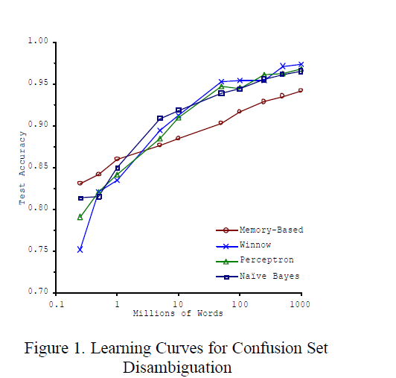
Big Data Trumps Better Algorithms
If you have enough data then the algorithms are not so important
The web has made this possible.
  Especially for text-related tasks
  Search engine uses the collective human intelligence
Google lecture: Theorizing from the Data

Slide 79
Apply-Test
How do you scale to very large datasets?
  Distributed computing – map-reduce implementations of machine learning algorithms (Mahaut, over Hadoop)
How do you test something that is running online?
  You cannot get labeled data in this case
  A/B testing
How do you deal with changes in data?
  Active learning

