Slide 1
Online Social Networks and Media
Diffusion:
Cascading Behavior in Networks
Epidemic Spread
Influence Maximization

Slide 2
Introduction
Diffusion: process by which a piece of information is spread and reaches individuals through interactions

Slide 3
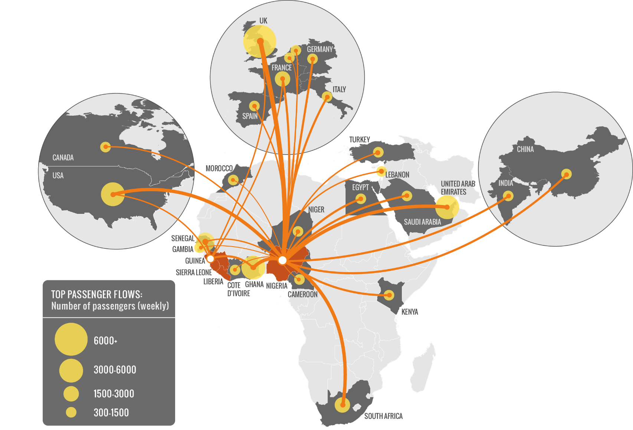
Why do we care?
Modeling epidemics

Slide 4
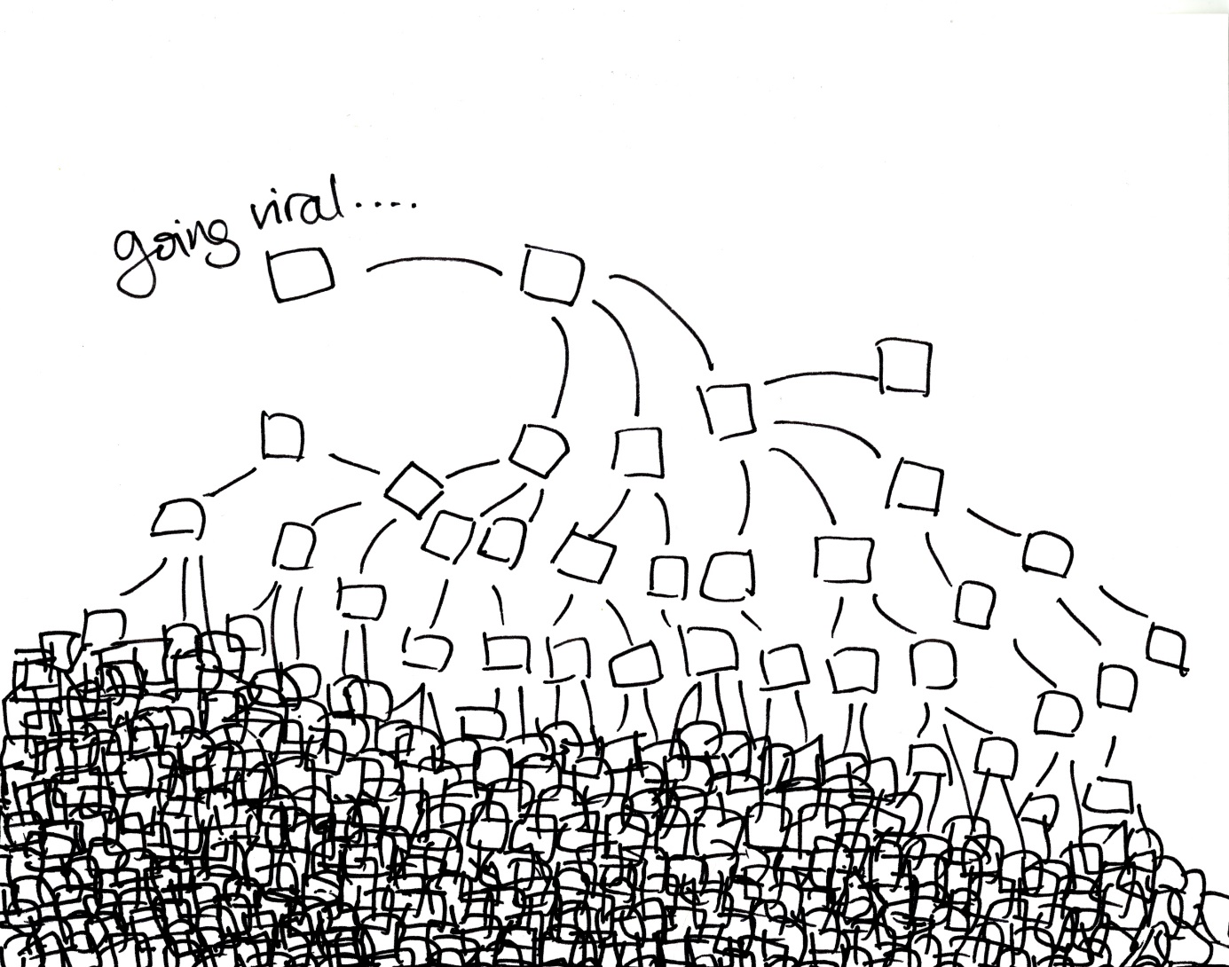
Why do we care?
Viral marketing

Slide 5
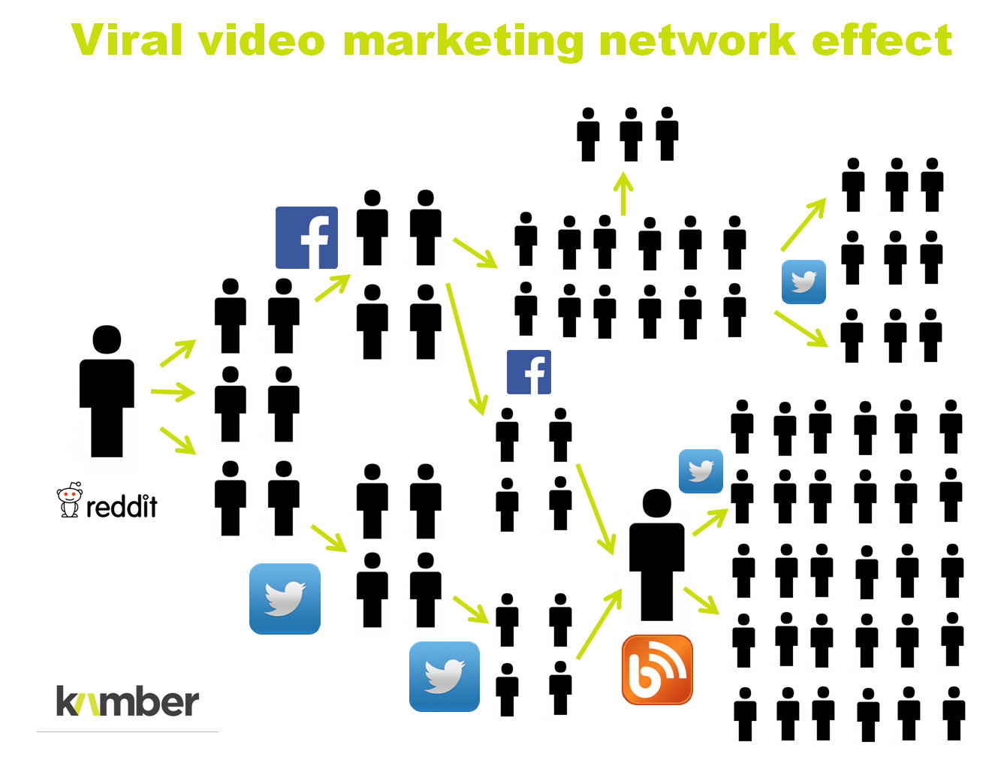
Why do we care?
Viral marketing

Slide 6
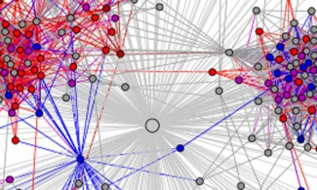
Why do we care?
Spread of innovation

Slide 7
Outline
Cascading behavior
Epidemic models
Influence maximization

Slide 8
Cascading Behavior in Networks

Slide 9
Innovation Diffusion in Networks
How new behaviors, practices, opinions and technologies spread from person to person through a social network as people influence their friends to adopt new ideas
Why? Two classes of rational reasons:
Direct-Benefit Effect: there are direct payoffs from copying the decisions of others (relative advantage)
    E.g., Phone becomes more useful if more people use it
Informational effect

Slide 10
Informational Effect
Informational effect:
choices made by others can provide indirect information about what they know (e.g., choosing restaurants)
Informational social influence (social proof):
a psychological phenomenon where people assume the actions of others in an attempt to reflect correct behavior for a given situation
  prominent in ambiguous social situations where people are unable to determine the appropriate mode of behavior
  driven by the assumption that surrounding people possess more knowledge about the situation

Slide 11
Spread of Innovation
Diffusion of innovation
Old studies
(mainly informational effect):
  Adoption of hybrid seed corn among farmers in Iowa
  Adoption of tetracycline by physicians in US
(mainly direct benefit)
    Technology (phone, email, etc)
Basic observations:
  High risk but high benefit
  Characteristics of early adopters
  Decisions made in the context of social structure

Slide 12
Spread of Innovation
Common principles:
Complexity of people to understand and implement
Observability, so that people can become aware that others are using it
Trialability, so that people can mitigate its risks by adopting it gradually and incrementally
Compatibility with the social system that is entering (homophily as a barrier?)

Slide 13
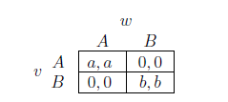
A Direct-Benefit Model
An individual level model of direct-benefit effects in networks due to S. Morris
The benefits of adopting a new behavior increase as more and more of the social network neighbors adopt it
A Coordination Game
Two players (nodes), u and w linked by an edge
Two possible behaviors (strategies): A and B
  If both u and w adapt A, get payoff a > 0
  If both u and w adapt B, get payoff b > 0
  If opposite behaviors, each gets a payoff 0

Slide 14
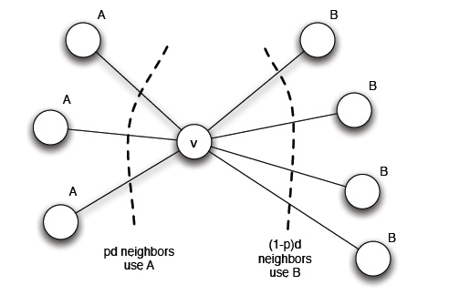
Modeling Diffusion through a Network
u plays a copy of the game with each of its neighbors, its payoff is the sum of the payoffs in the games played on each edge
Say p of the d neighbors of u neighbors adopt A and the other (1- p) adopt B, what should u do to maximize its payoff?
Threshold q for preferring A
(at least q of the neighbors follow A)
q = b/(a+b)
Two obvious equilibria, which ones?

Slide 15
Modeling Diffusion through a Network: Cascading Behavior
Suppose that initially everyone is using B as a default behavior
A small set of “initial adopters” decide to use A
When will this result in everyone eventually switching to A?
If this does not happen, what causes the spread of A to stop?

Slide 16
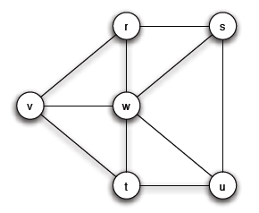
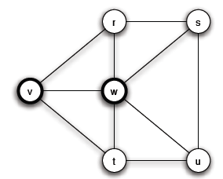
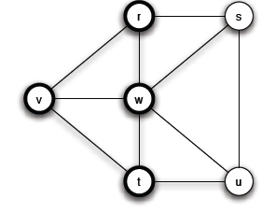
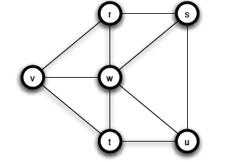
Modeling Diffusion through a Network: Cascading Behavior
a = 3, b = 2, q = 2/5
A
A
Step 1
Chain reaction of switches to B -> A
cascade of adoptions of A
Step 2

Slide 17
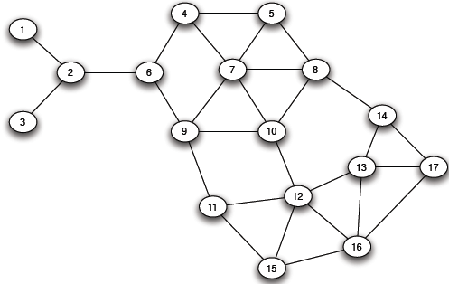
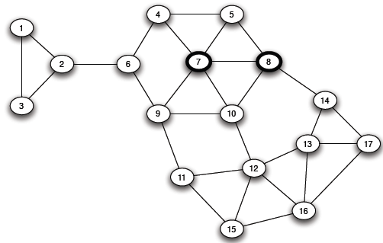
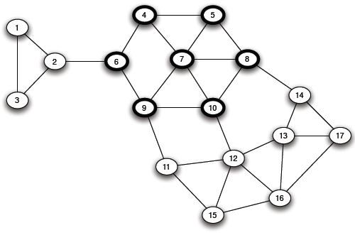
Modeling Diffusion through a Network: Cascading Behavior
a = 3, b = 2, q = 2/5
Step 3

Slide 18
Modeling Diffusion through a Network: Cascading Behavior
Observation: strictly progressive sequence of switches from B to A
Depends on the choice of the initial adapters and threshold q

Slide 19
Modeling Diffusion through a Network: Cascading Behavior
A set of initial adopters who start with a new behavior A, while every other node starts with behavior B.
Nodes repeatedly evaluate the decision to switch from B to A using a threshold of q.
If the resulting cascade of adoptions of A eventually causes every node to switch from B to A, then we say that the set of initial adopters causes a complete cascade at threshold q.

Slide 20
Modeling Diffusion through a Network: Cascading Behavior and “Viral Marketing”
Tightly-knit communities in the network can work to hinder the spread of an innovation
(examples, age groups and life-styles in social networking sites, Mac users, political opinions)
Strategies
  Improve the quality of A (increase the payoff a) (in the example, set a = 4)
  Convince a small number of key people to switch to A
Network-level cascade innovation adoption models vs population-level (decisions based on the entire population)

Slide 21
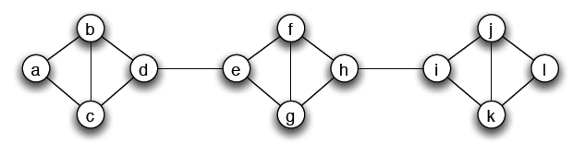
Cascades and Clusters
A cluster of density p is a set of nodes such that each node in the set has at least a p fraction of its neighbors in the set
Does not imply that any two nodes in the same cluster necessarily have much in common (what is the density of a cluster with all nodes?)
The union of any two cluster of density p is also a cluster of density at least p

Slide 22
Cascades and Clusters

Slide 23
Cascades and Clusters
Claim: Consider a set of initial adopters of behavior A, with a threshold q for nodes in the remaining network to adopt behavior A.
(clusters as obstacles to cascades)
If the remaining network contains a cluster of density > 1 − q =>
the set of initial adopters will not cause a complete cascade.
(ii) (clusters are the only obstacles to cascades)
Whenever a set of initial adopters does not cause a complete cascade =>
the remaining network contains a cluster of density > 1 − q.

Slide 24
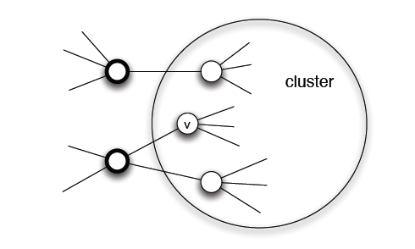
Cascades and Clusters
Proof of (i) (clusters as obstacles to cascades)
Proof by contradiction
Let v be the first node in the cluster that adopts A

Slide 25
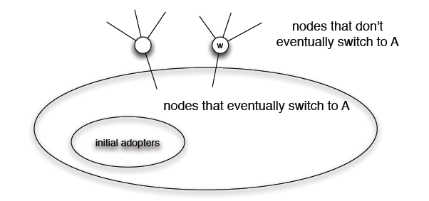
Cascades and Clusters
Proof of (ii) (clusters are the only obstacles to cascades)
Let S be the set of all nodes using B at the end of the process
Show that S is a cluster of density > 1 - q

Slide 26
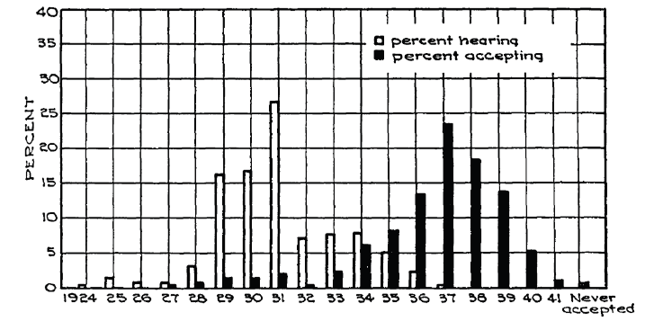
Innovation Adoption Characteristics
A crucial difference between learning a new idea and actually deciding to accept it (awareness vs adoption of an idea)

Slide 27
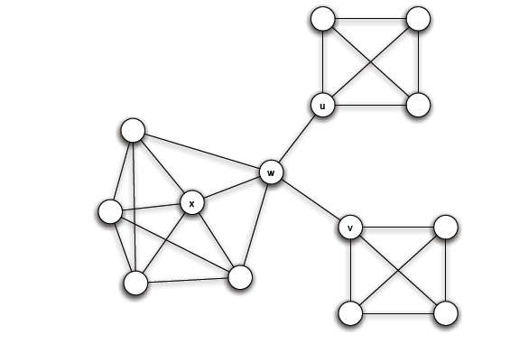
Diffusion, Thresholds and the Role of Weak Ties
Relation to weak ties and local bridges
q = 1/2
Bridges convey awareness but are weak at transmitting costly to adopt behaviors

Slide 28

Extensions of the Basic Cascade Model: Heterogeneous Thresholds
Each person values behaviors A and B differently:
  If both u and w adapt A, u gets a payoff a_{u} > 0 and w a payoff a_{w} > 0
  If both u and w adapt B, u gets a payoff b_{u} > 0 and w a payoff b_{w} > 0
  If opposite behaviors, each gets a payoff 0
Each node u has its own personal threshold q_{u} ≥ b_{u} /(a_{u}+ b_{u})

Slide 29
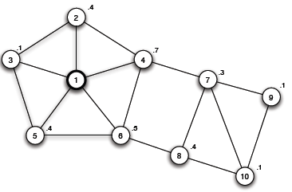
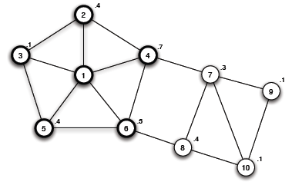
Extensions of the Basic Cascade Model: Heterogeneous Thresholds
Not just the power of influential people, but also the extent to which they have access to easily influenceable people
What about the role of clusters?
A blocking cluster in the network is a set of nodes for which each node u has more that 1 – q_{u} fraction of its friends also in the set.

Slide 30
Knowledge, Thresholds and Collective Action: Collective Action and Pluralistic Ignorance
A collective action problem: an activity produces benefits only if enough people participate (population level effect)
Pluralistic ignorance: a situation in which people have wildly erroneous estimates about the prevalence of certain opinions in the population at large (lack of knowledge)

Slide 31
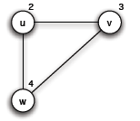
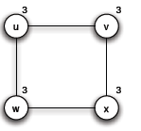
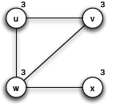
Knowledge, Thresholds and Collective Action:
A model for the effect of knowledge on collective actions
Each person has a personal threshold which encodes her willingness to participate
A threshold of k means that she will participate if at least k people in total (including herself) will participate
Each person in the network knows the thresholds of her neighbors in the network
w will never join, since there are only 3 people
v
u
Is it safe for u to join?
Is it safe for u to join? (common knowledge)

Slide 32
Knowledge, Thresholds and Collective Action:
Common Knowledge and Social Institutions
Not just transmit a message, but also make the listeners or readers aware that many others have gotten the message as well (Apple Macintosh introduced in a Ridley-Scott-directed commercial during the 1984 Super Bowl)
Social networks do not simply allow for interaction and flow of information, but these processes in turn allow individuals to base decisions on what other knows and on how they expect others to behave as a result

Slide 33
Cascade Capacity
Given a network, what is the largest threshold at which any “small” set of initial adopters can cause a complete cascade?
Called cascade capacity of the network
Infinite network in which each node has a finite number of neighbors
Small means finite set of nodes

Slide 34
Cascade Capacity
Same model as before:
Initially, a finite set S of nodes has behavior A and all others adopt B
Time runs forwards in steps, t = 1, 2, 3, …
In each step t, each node other than those in S uses the decision rule with threshold q to decide whether to adopt behavior A or B
The set S causes a complete cascade if, starting from S as the early adopters of A, every node in the network eventually switched permanently to A.
The cascade capacity of the network is the largest value of the threshold q for which some finite set of early adopters can cause a complete cascade.

Slide 35

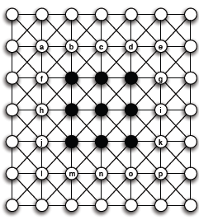
Cascade Capacity
An infinite path
Spreads if ≤ 1/2
An infinite grid
Spreads if ≤ 3/8
An intrinsic property of the network
Even if A better than B, for q strictly between 3/8 and 1/2, A cannot win

Slide 36
Cascade Capacity
How large can a cascade capacity be?
  At least 1/2
Is there any network with a higher cascade capacity?
This will mean that an inferior technology can displace a superior one, even when the inferior technology starts at only a small set of initial adopters.

Slide 37
Cascade Capacity
Claim: There is no network in which the cascade capacity exceeds 1/2

Slide 38
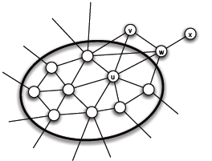
Cascade Capacity
Interface: the set of A-B edges
In each step the size of the interface strictly decreases
Why is this enough?

Slide 39
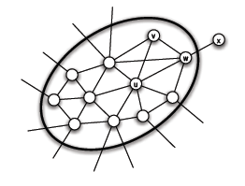
Cascade Capacity
At some step, a number of nodes decide to switch from B to A
General Remark: In this simple model, a worse technology cannot displace a better and wide-spread one

Slide 40

Compatibility and Cascades
Extension: an individual can sometimes choose a combination of two available behaviors -> three strategies A, B and AB
Coordination game with a bilingual option
  Two bilingual nodes can interact using the better of the two behaviors
  A bilingual and a monolingual node can only interact using the behavior of the monolingual node
AB is a dominant strategy?
Cost c associated with the AB strategy

Slide 41

Compatibility and Cascades
Example (a = 2, b =3, c =1)
B: 0+b = 3
A: 0+a = 2
AB: b+a-c = 4 √
B: b+b = 6 √
A: 0+a = 2
AB: b+b-c = 5

Slide 42
Compatibility and Cascades
Example (a = 5, b =3, c =1)
B: 0+b = 3
A: 0+a = 5
AB: b+a-c = 7 √
B: 0+b = 3
A: 0+a = 5
AB: b+a-c = 7 √
B: 0+b = 3
A: α+a = 10 √
AB: a+a-c = 9

Slide 43

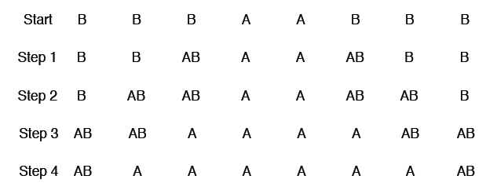
Compatibility and Cascades
Example (a = 5, b =3, c =1)
Strategy AB spreads, then behind it, nodes switch permanently from AB to A
Strategy B becomes vestigial

Slide 44
Compatibility and Cascades
Given an infinite graph, for which payoff values of a, b and c, is it possible for a finite set of nodes to cause a complete cascade of A?
Set b = 1 (default technology)
Given an infinite graph, for which payoff values of a (how much better the new behavior A) and c (how compatible should it be with B), is it possible for a finite set of nodes to cause a complete cascade of A?
A does better when it has a higher payoff, but in general hard time cascading when the level of compatibility is “intermediate” (value of c neither too high nor too low)

Slide 45

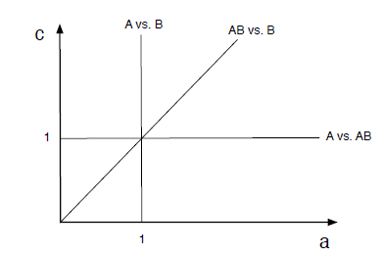
Compatibility and Cascades
Example: Infinite path
(for two strategies) Spreads when q ≤ 1/2, a ≥ b (a better technology always spreads)
Assume that the set of initial adopters forms a contiguous interval of nodes on the path
Because of the symmetry, strategy changes to the right of the initial adopters
Initially,
B better than AB
Break-even:
a + 1 – c = 1 => c = a
A: 0+a = a
B: 0+b = 1
AB: a+b-c = a+1-c

Slide 46
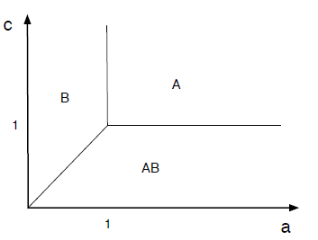
Compatibility and Cascades
A: 0+a = a
B: 0+b = 1
AB: a+b-c = a+1-c

Slide 47

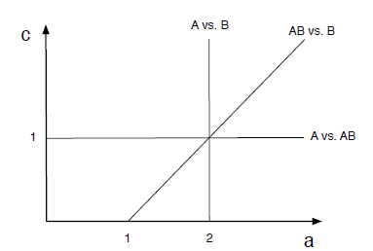
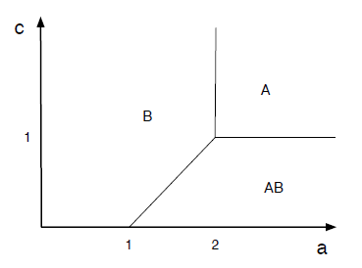
Compatibility and Cascades
a < 1,
A: 0+a = a
B: b+b = 2 √
AB: b+b-c = 2-c
a ≥ 1
A: a
B: 2
AB: a+1-c

Slide 48
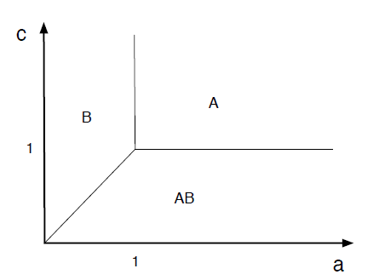
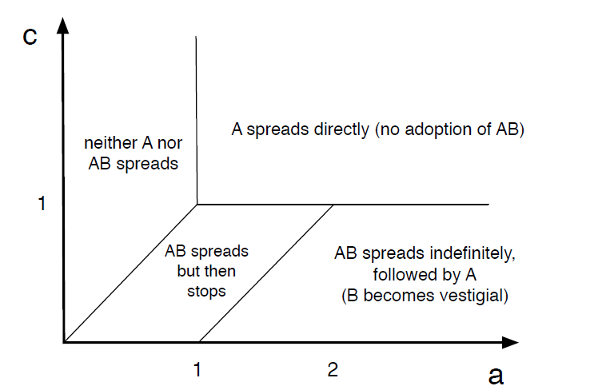
Compatibility and Cascades

Slide 49
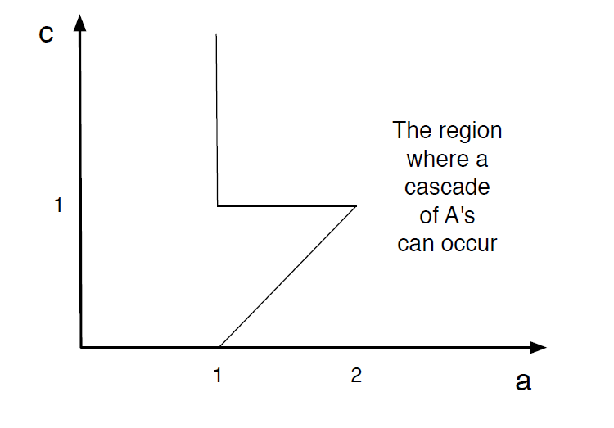
Compatibility and Cascades
What does the triangular cut-out mean?
If too easy, infiltration
If too hard, direct conquest
In between, “buffer” of AB

Slide 50
Reference
Networks, Crowds, and Markets (Chapter 19)

Slide 51
Epidemic Spread

Slide 52

Epidemics
Understanding the spread of viruses and epidemics is of great interest to
Health officials
Sociologists
Mathematicians
Hollywood
The underlying contact network clearly affects the spread of an epidemic

Slide 53
Epidemics
Model epidemic spread as a random process on the graph and study its properties
Questions that we can answer:
  What is the projected growth of the infected population?
  Will the epidemic take over most of the network?
  How can we contain the epidemic spread?
Diffusion of ideas and the spread of influence can also be modeled as epidemics

Slide 54
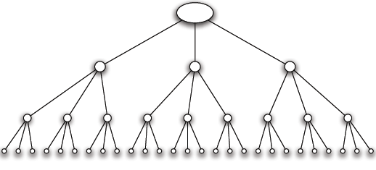
A simple model
Branching process: A person transmits the disease to each people she meets independently with a probability p
An infected person meets k (new) people while she is contagious
Infection proceeds in waves.
Contact network is a tree with branching factor k

Slide 55
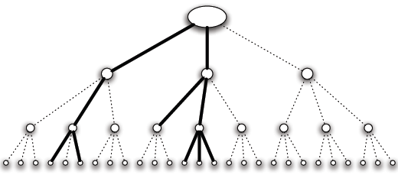
Infection Spread
We are interested in the number of people infected (spread) and the duration of the infection
This depends on the infection probability p and the branching factor k
An aggressive epidemic with high infection probability
The epidemic survives after three steps

Slide 56
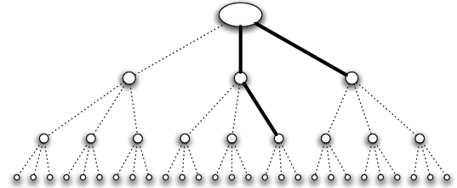
Infection Spread
We are interested in the number of people infected (spread) and the duration of the infection
This depends on the infection probability p and the branching factor k
A mild epidemic with low infection probability
The epidemic dies out after two steps

Slide 57
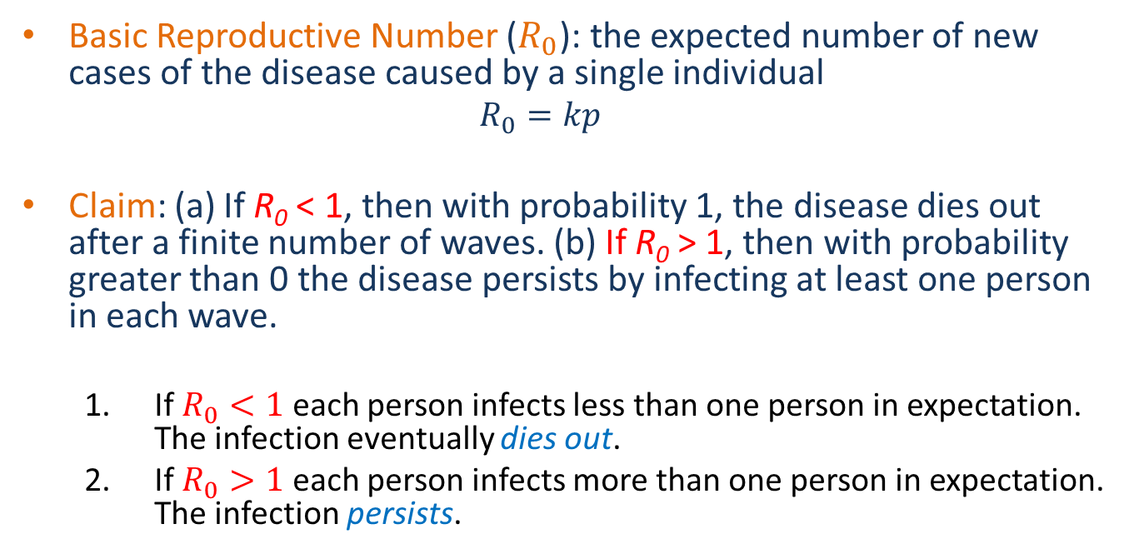
Basic Reproductive Number
Basic Reproductive Number ($R_{0}$): the expected number of new cases of the disease caused by a single individual
  $$R_{0}=kp$$
Claim: (a) If R₀ < 1, then with probability 1, the disease dies out after a finite number of waves. (b) If R₀ > 1, then with probability greater than 0 the disease persists by infecting at least one person in each wave.
  If $R_{0}<1$ each person infects less than one person in expectation. The infection eventually dies out.
  If $R_{0}>1$ each person infects more than one person in expectation. The infection persists.
Reduce k, or p

Slide 58
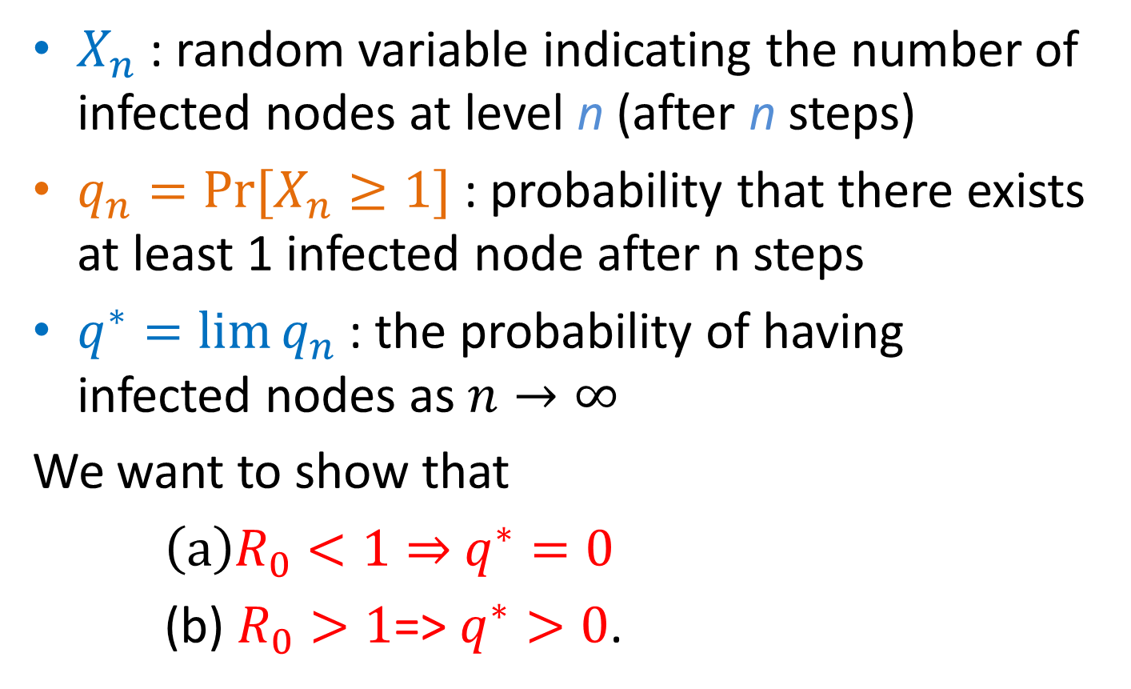
Analysis
$X_{n}$ : random variable indicating the number of infected nodes at level n (after n steps)
$q_{n}=Pr⁡[X_{n}≥1]$ : probability that there exists at least 1 infected node after n steps
$q^{∗}=lim⁡q_{n}$ : the probability of having infected nodes as $n→∞$
We want to show that
$\left(a\right)R_{0}<1⇒$ $q^{∗}=0$
(b) $R_{0}>1$=> $q^{∗}>0$.

Slide 59
Proof
At level n, k^{n} nodes
Y_{nj}: 1 if node j at level n is infected, 0 otherwise E[Y_{nj}] = p^{n}
E[X_{n}] = R₀^{n}
E[X_{n}] ≥ Pr[X_{n} ≥ 1] => q_{n} ≤ R₀^{n}
This proves (a) but not (b)

Slide 60
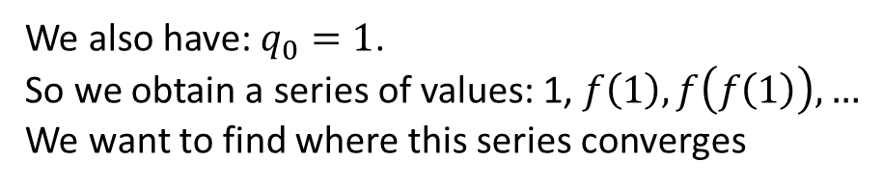

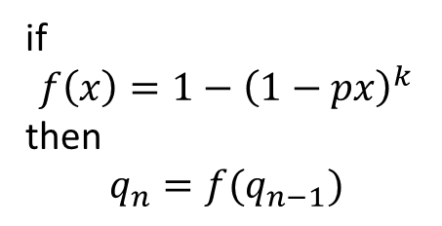




Proof
Each child of the root starts a branching process of length n-1
p
p
p
$$q_{n}=1−{\left(1−pq_{n−1}\right)}^{k}$$
if
$$f\left(x\right)=1−{\left(1−px\right)}^{k}$$
then
$$q_{n}=f(q_{n−1})$$
n-1
$$q_{n−1}$$
$$q_{n−1}$$
$$q_{n−1}$$
We also have: $q_{0}=1$.
So we obtain a series of values: 1, $f\left(1\right), f\left(f\left(1\right)\right),…$
We want to find where this series converges
$$q_{n}$$

Slide 61
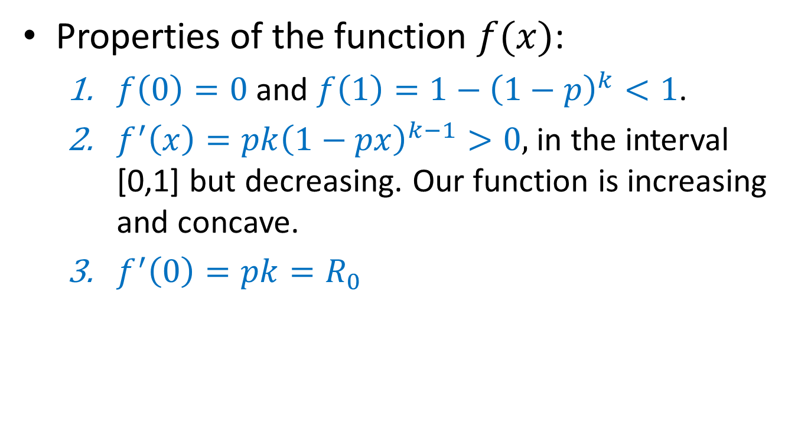
Proof
Properties of the function $f(x)$:
  $f\left(0\right)=0$ and $f\left(1\right)=1−{\left(1−p\right)}^{k}<1$.
  $f^{′}\left(x\right)=pk{\left(1−px\right)}^{k−1}>0,$ in the interval [0,1] but decreasing. Our function is increasing and concave.
  $f^{′}\left(0\right)=pk=R_{0}$

Slide 62

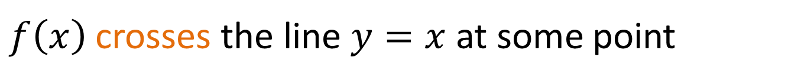
Proof
Case 1: $R_{0}=pk>1$. The function starts with above the line $y=x$ but then drops below the line.
$f\left(x\right)$ crosses the line $y=x$ at some point

Slide 63

Proof
Starting from the value 1, repeated applications of the function $f\left(x\right)$ will converge to the value $q^{∗}=q_{n}=f(q_{n})$

Slide 64

Proof
Case 2: $R_{0}=pk<1$. The function starts with below the line $y=x.$ Repeated applications of $f(x)$ converge to zero.

Slide 65
Branching process
Assumes no network structure, no triangles or shared neighbors

Slide 66
The SIR model
Each node may be in the following states
  Susceptible: healthy but not immune
  Infected: has the virus and can actively propagate it
  Removed: (Immune or Dead) had the virus but it is no longer active
Parameter p: the probability of an Infected node to infect a Susceptible neighbor

Slide 67
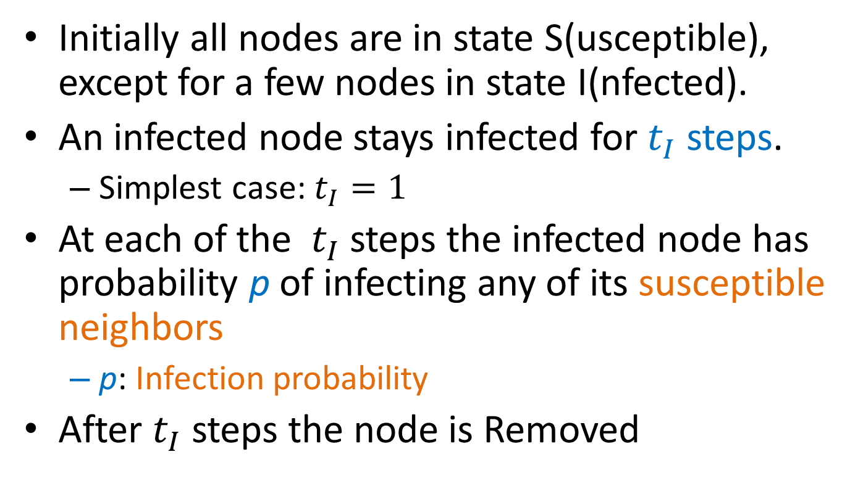
The SIR process
Initially all nodes are in state S(usceptible), except for a few nodes in state I(nfected).
An infected node stays infected for $t_{I}$ steps.
  Simplest case: $t_{I}=1$
At each of the $t_{I}$ steps the infected node has probability p of infecting any of its susceptible neighbors
  p: Infection probability
After $t_{I}$ steps the node is Removed

Slide 68
Example

Slide 69
Example

Slide 70
Example

Slide 71
Example

Slide 72
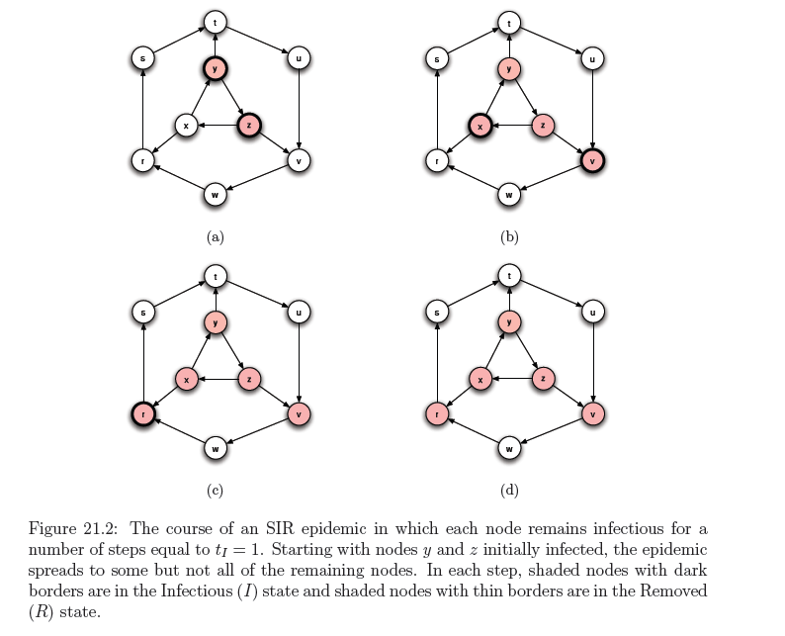

Slide 73
SIR and the Branching process
The branching process is a special case where the graph is a tree (and the infected node is the root)
  The existence of triangles shared neighbors makes a big difference
The basic reproductive number is not necessarily informative in the general case

Slide 74
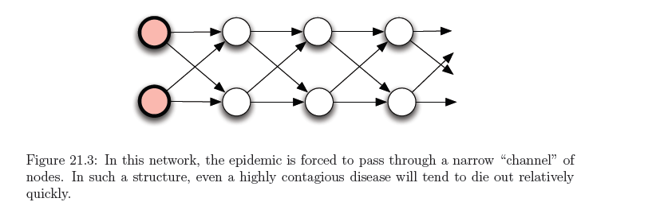
SIR and the Branching process
Example
R₀ the expected number of new cases caused by a single node
assume p = 2/3, R₀ = 4/3 > 1
Probability to fail at each level and stop (1/3)⁴ = 1/81

Slide 75
Percolation
Percolation: we have a network of “pipes” which can carry liquids, and they can be either open, or closed
  The pipes can be pathways within a material
If liquid enters the network from some nodes, does it reach most of the network?
  The network percolates

Slide 76
SIR and Percolation
There is a connection between SIR model and percolation
When a virus is transmitted from u to v, the edge (u, v) is activated with probability p
We can assume that all edge activations have happened in advance, and the input graph has only the active edges.
Which nodes will be infected?
  The nodes reachable from the initial infected nodes
In this way we transformed the dynamic SIR process into a static one.
  This is essentially percolation in the graph.

Slide 77
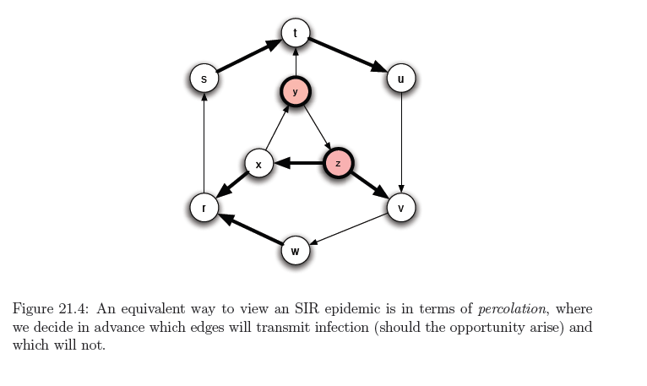
Example

Slide 78

The SIS model
Susceptible-Infected-Susceptible
  Susceptible: healthy but not immune
  Infected: has the virus and can actively propagate it
An Infected node infects a Susceptible neighbor with probability p
An Infected node becomes Susceptible again with probability q (or after $t_{I}$ steps)
  In a simplified version of the model q = 1
Nodes alternate between Susceptible and Infected status

Slide 79

Example
When no Infected nodes, virus dies out
Question: will the virus die out?

Slide 80

An eigenvalue point of view
If A is the adjacency matrix of the network, then the virus dies out if
$$λ_{1}\left(A\right)≤\frac{q}{p}$$
Where $λ_{1}(A)$ is the first eigenvalue of A
Y. Wang, D. Chakrabarti, C. Wang, C. Faloutsos. Epidemic Spreading in Real Networks: An Eigenvalue Viewpoint. SRDS 2003

Slide 81

SIS and SIR

Slide 82

Including time
Infection can only happen within the active window

Slide 83

Concurrency
Importance of concurrency – enables branching

Slide 84
SIRS
Initially, some nodes e in the I state and all others in the S state.
Each node u that enters the I state remains infectious for a fixed number of steps t_{I} During each of these t_{I} steps, u has a probability p of infected each of its susceptible neighbors.
After t_{I} steps, u is no longer infectious. Enters the R state for a fixed number of steps t_{R}. During each of these t_{R} steps, u cannot be infected nor transmit the disease.
After t_{R} steps in the R state, node u returns to the S state.

Slide 85
References
D. Easley, J. Kleinberg. Networks, Crowds and Markets: Reasoning about a highly connected world. Cambridge University Press, 2010 – Chapter 21
Y. Wang, D. Chakrabarti, C. Wang, C. Faloutsos. Epidemic Spreading in Real Networks: An Eigenvalue Viewpoint. SRDS 2003

Slide 86
Influence maximization

Slide 87
Maximizing spread
Suppose that instead of a virus we have an item (product, idea, video) that propagates through contact
  Word of mouth propagation.
An advertiser is interested in maximizing the spread of the item in the network
  The holy grail of “viral marketing”
Question: which nodes should we “infect” so that we maximize the spread? [KKT2003]

Slide 88

Independent cascade model
Each node may be active (has the item) or inactive (does not have the item)
Time proceeds at discrete time-steps.
At time t, every node v that became active in time t-1 activates a non-active neighbor w with probability $puw$. If it fails, it does not try again
The same as the simple SIR model

Slide 89






Independent cascade

Slide 90
Influence maximization
Influence function: for a set of nodes A (target set) the influence s(A) (spread) is the expected number of active nodes at the end of the diffusion process if the item is originally placed in the nodes in A.
Influence maximization problem [KKT03]: Given an network, a diffusion model, and a value k, identify a set A of k nodes in the network that maximizes s(A).
The problem is NP-hard

Slide 91
A Greedy algorithm
What is a simple algorithm for selecting the set A?
Computing s(A): perform multiple Monte-Carlo simulations of the process and take the average.
How good is the solution of this algorithm compared to the optimal solution?
Greedy algorithm
  Start with an empty set A
  Proceed in k steps
    At each step add the node u to the set A the maximizes the increase in function s(A)
      The node that activates the most additional nodes

Slide 92
Approximation Algorithms
Suppose we have a (combinatorial) optimization problem, and X is an instance of the problem, OPT(X) is the value of the optimal solution for X, and ALG(X) is the value of the solution of an algorithm ALG for X
  In our case: X = (G, k) is the input instance, OPT(X) is the spread S(A*) of the optimal solution, GREEDY(X) is the spread S(A) of the solution of the Greedy algorithm
ALG is a good approximation algorithm if the ratio of OPT and ALG is bounded.

Slide 93

Approximation Ratio
For a maximization problem, the algorithm ALG is an $α$-approximation algorithm, for $α<1$, if for all input instances X,
$$ALG\left(X\right)≥αOPT\left(X\right)$$
The solution of ALG(X) has value at least α% that of the optimal
α is the approximation ratio of the algorithm
  Ideally we would like α to be a constant close to 1

Slide 94

Approximation Ratio for Influence Maximization
The GREEDY algorithm has approximation ratio $α=1−\frac{1}{e}$
$GREEDY\left(X\right)≥\left(1−\frac{1}{e}\right)OPT\left(X\right)$, for all X

Slide 95

Proof of approximation ratio
The spread function s has two properties:
S is monotone:
$$S(A)≤S\left(B\right) if A⊆B$$
S is submodular:
$$S\left(A∪\left\{x\right\}\right)−S\left(A\right)≥S\left(B∪\left\{x\right\}\right)−S\left(B\right) if A⊆B$$
The addition of node x to a set of nodes has greater effect (more activations) for a smaller set.
  The diminishing returns property

Slide 96

Optimizing submodular functions
Theorem: A greedy algorithm that optimizes a monotone and submodular function S, each time adding to the solution A, the node x that maximizes the gain $S\left(A∪\left\{x\right\}\right)−s(A)$has approximation ratio $α= \left(1−\frac{1}{e}\right)$
The spread of the Greedy solution is at least 63% that of the optimal

Slide 97
Submodularity of influence
Why is S(A) submodular?
  How do we deal with the fact that influence is defined as an expectation?
We will use the fact that probabilistic propagation on a fixed graph can be viewed as deterministic propagation over a randomized graph
  Express S(A) as an expectation over the input graph rather than the choices of the algorithm

Slide 98
Independent cascade model
Each edge (u,v) is considered only once, and it is “activated” with probability p_{uv}.
We can assume that all random choices have been made in advance
  generate a sample subgraph of the input graph where edge (u, v) is included with probability p_{uv}
  propagate the item deterministically on the input graph
  the active nodes at the end of the process are the nodes reachable from the target set A
The influence function is obviously(?) submodular when propagation is deterministic
The linear combination of submodular functions is also a submodular function

Slide 99

Linear threshold model
Again, each node may be active or inactive
Every directed edge (v,u) in the graph has a weight b_{vu}, such that
$$\sum_{v is a neighbor of u}{b_{vu}}≤1$$
Each node u has a randomly generated threshold value T_{u}
Time proceeds in discrete time-steps. At time t an inactive node u becomes active if
$$\sum_{v is an active neighbor of u}{b_{vu}}≥T_{u}$$
Related to the game-theoretic model of adoption.

Slide 100





Linear threshold model

Slide 101
Influence Maximization
KKT03 showed that in this case the influence S(A) is still a submodular function, using a similar technique
  Assumes uniform random thresholds
The Greedy algorithm achieves a (1-1/e) approximation

Slide 102

Proof idea
For each node $u$, pick one of the edges $(v,u)$incoming to $u$ with probability $b_{vu}$and make it live. With probability $1− \sum{b_{vu}}$ it picks no edge to make live
Claim: Given a set of seed nodes A, the following two distributions are the same:
  The distribution over the set of activated nodes using the Linear Threshold model and seed set A
  The distribution over the set of reachable nodes from A using live edges.

Slide 103

Proof idea
Consider the special case of a DAG (Directed Acyclic Graph)
  There is a topological ordering of the nodes $v_{0}, v_{1},…, v_{n}$ such that edges go from left to right
Consider node $v_{i}$ in this ordering and assume that $S_{i}$ is the set of neighbors of $v_{i}$ that are active.
What is the probability that node $v_{i}$ becomes active in either of the two models?
  In the Linear Threshold model the random threshold $θ_{i}$ must be greater than $\sum_{u∈S_{i}}{b_{ui}≥θ_{i}}$
  In the live-edge model we should pick one of the edges in $S_{i}$
This proof idea generalizes to general graphs
  Note: if we know the thresholds in advance submodularity does not hold!

Slide 104


Example
$$v_{2}$$
$$v_{5}$$
$$v_{4}$$
$$v_{1}$$
$$v_{6}$$
$$v_{3}$$
Assume that all edge weights incoming to any node sum to 1

Slide 105

Example
$$v_{2}$$
$$v_{5}$$
$$v_{4}$$
$$v_{1}$$
$$v_{6}$$
$$v_{3}$$
The nodes select a single incoming edge with probability equal to the weight (uniformly at random in this case)

Slide 106


Example
$$v_{2}$$
$$v_{5}$$
$$v_{4}$$
$$v_{1}$$
$$v_{6}$$
$$v_{3}$$
Node $v_{1}$ is the seed

Slide 107


Example
$$v_{2}$$
$$v_{5}$$
$$v_{4}$$
$$v_{1}$$
$$v_{6}$$
$$v_{3}$$
Node $v_{3}$ has a single incoming neighbor, therefore for any threshold it will be activated

Slide 108

Example
$$v_{2}$$
$$v_{5}$$
$$v_{4}$$
$$v_{1}$$
$$v_{6}$$
$$v_{3}$$
The probability that node $v_{4}$ gets activated is 2/3 since it has incoming edges from two active nodes.
The probability that node $v_{4}$ picks one of the two edges to these nodes is also 2/3

Slide 109

Example
$$v_{2}$$
$$v_{5}$$
$$v_{4}$$
$$v_{1}$$
$$v_{6}$$
$$v_{3}$$
Similarly the probability that node $v_{6}$ gets activated is 2/3 since it has incoming edges from two active nodes.
The probability that node $v_{6}$ picks one of the two edges to these nodes is also 2/3

Slide 110

Example
$$v_{2}$$
$$v_{5}$$
$$v_{4}$$
$$v_{1}$$
$$v_{6}$$
$$v_{3}$$
The set of active nodes is the set of nodes reachable from $v_{1}$ with live edges (orange).

Slide 111
Improvements
Computation of Expected Spread
  Performing simulations for estimating the spread on multiple instances is very slow. Several techniques have been developed for speeding up the process.
    CELF: exploiting the submodularity property
    Maximum Influence Paths: store paths for computation
    Sketches: compute sketches for each node for approximate estimation of spread
(the marginal gain of a node in the current iteration cannot be better than its marginal gain in the previous iteration) J. Leskovec, A. Krause, C. Guestrin, C. Faloutsos, J. M. VanBriesen, N. S. Glance. Cost-effective outbreak detection in networks. KDD 2007
W. Chen, C. Wang, and Y. Wang. Scalable influence maximization for prevalent viral marketing in large-scale social networks. KDD 2010.
Edith Cohen, Daniel Delling, Thomas Pajor, Renato F. Werneck. Sketch-based Influence Maximization and Computation: Scaling up with Guarantees. CIKM 2014

Slide 112


Experiments

Slide 113


One-slide summary
Influence maximization: Given a graph $G$ and a budget $k$, for some diffusion model, find a subset of $k$ nodes $A$, such that when activating these nodes, the spread of the diffusion $s(A)$ in the network is maximized.
Diffusion models:
  Independent Cascade model
  Linear Threshold model
Algorithm: Greedy algorithm that adds to the set each time the node with the maximum marginal gain, i.e., the node that causes the maximum increase in the diffusion spread.
The Greedy algorithm gives a $\left(1−\frac{1}{e}\right)$ approximation of the optimal solution
  Follows from the fact that the spread function $s\left(A\right)$ is
    Monotone
    Submodular
$$s\left(A\right)≤s\left(B\right), if A⊆B$$
$$s\left(A∪\{x\}\right)−s\left(A\right)≥s\left(B∪\left\{x\right\}\right)−s\left(B\right), ∀x if A⊆B$$

Slide 114
Another example
What is the spread from the red node?
Inclusion of time changes the problem of influence maximization
  N. Gayraud, E. Pitoura, P. Tsaparas, Diffusion Maximization on Evolving networks

Slide 115

Evolving network
Consider a network that changes over time
  Edges and nodes can appear and disappear at discrete time steps
Model:
  The evolving network is a sequence of graphs $\{G_{1},G_{2},…,G_{n}\}$ defined over the same set of vertices $V$, with different edge sets $E_{1},E_{2},…,E_{n}$
    Graph snapshot $G_{i}$ is the graph at time-step $i$.
N. Gayraud, E. Pitoura, P. Tsaparas. Maximizing Diffusion in Evolving Networks. COSN 2015

Slide 116

















Example
$$v_{1}$$
$$v_{1}$$
$$v_{1}$$
$$v_{2}$$
$$v_{4}$$
$$v_{2}$$
$$v_{4}$$
$$v_{2}$$
$$v_{4}$$
$$v_{3}$$
$$v_{3}$$
$$v_{3}$$
$$u_{1}$$
$$u_{3}$$
$$u_{1}$$
$$u_{3}$$
$$u_{1}$$
$$u_{3}$$
$$u_{2}$$
$$u_{2}$$
$$u_{2}$$
$$G^{1}$$
$$G^{2}$$
$$G^{3}$$

Slide 117

Time
How does the evolution of the network relates to the evolution of the diffusion?
  How much physical time does a diffusion step last?
Assumption: The two processes are in sync. One diffusion step happens in on one graph snapshot
Evolving IC model: at time-step $t$, the infectious nodes try to infect their neighbors in the graph $G_{t}$.
Evolving LT model: at time-step $t$ if the weight of the active neighbors of node $v$in graph $G_{t}$ is greater than the threshold the nodes gets activated.

Slide 118
Submodularity
Will the spread function remain monotone and submodular?
No!

Slide 119
Monotonicity for the EIC model
$$v_{1}$$
$$v_{1}$$
$$v_{1}$$
$$v_{2}$$
$$v_{4}$$
$$v_{2}$$
$$v_{4}$$
$$v_{2}$$
$$v_{4}$$
$$v_{3}$$
$$v_{3}$$
$$v_{3}$$
$$u_{1}$$
$$u_{3}$$
$$u_{1}$$
$$u_{3}$$
$$u_{1}$$
$$u_{3}$$
$$u_{2}$$
$$u_{2}$$
$$u_{2}$$
$$G^{1}$$
$$G^{2}$$
$$G^{3}$$

Slide 120





Monotonicity for the EIC model
$$G^{0}$$
$$G^{1}$$
$$G^{2}$$
$$G^{3}$$
$$G^{0}$$
$$G^{1}$$
$$G^{2}$$
$$G^{3}$$
The spread is not monotone in the case of the Evolving IC model

Slide 121
























Submodularity for the EIC model
$$v_{1}$$
$$v_{5}$$
$$v_{1}$$
$$v_{5}$$
$$v_{1}$$
$$v_{5}$$
$$v_{1}$$
$$v_{5}$$
$$v_{2}$$
$$v_{2}$$
$$v_{2}$$
$$v_{2}$$
$$v_{3}$$
$$v_{6}$$
$$v_{3}$$
$$v_{6}$$
$$v_{3}$$
$$v_{6}$$
$$v_{3}$$
$$v_{6}$$
$$v_{4}$$
$$v_{4}$$
$$v_{4}$$
$$v_{4}$$
$$u_{1}$$
$$u_{3}$$
$$u_{1}$$
$$u_{3}$$
$$u_{1}$$
$$u_{3}$$
$$u_{1}$$
$$u_{3}$$
$$u_{2}$$
$$u_{2}$$
$$u_{2}$$
$$u_{2}$$
$$G^{1}$$
$$G^{2}$$
$$G^{3}$$
$$G^{4}$$

Slide 122





















Submodularity for the EIC model
$$v_{5}$$
$$v_{1}$$
$$v_{5}$$
$$v_{1}$$
$$v_{5}$$
$$v_{1}$$
$$v_{1}$$
$$v_{5}$$
$$v_{1}$$
$$v_{5}$$
$$v_{2}$$
$$v_{2}$$
$$v_{2}$$
$$v_{2}$$
$$v_{2}$$
$$v_{6}$$
$$v_{6}$$
$$v_{3}$$
$$v_{6}$$
$$v_{3}$$
$$v_{6}$$
$$v_{6}$$
$$v_{3}$$
$$v_{3}$$
$$v_{3}$$
$$v_{4}$$
$$v_{4}$$
$$v_{4}$$
$$v_{4}$$
$$v_{4}$$
$$u_{1}$$
$$u_{1}$$
$$u_{1}$$
$$u_{3}$$
$$u_{3}$$
$$u_{1}$$
$$u_{1}$$
$$u_{3}$$
$$u_{3}$$
$$u_{3}$$
$$u_{2}$$
$$u_{2}$$
$$u_{2}$$
$$u_{2}$$
$$u_{2}$$
$$G^{0}$$
$$G^{1}$$
$$G^{2}$$
$$G^{3}$$
$$G^{4}$$
Activating node $v_{1}$ at time $t=0$ has spread 7

Slide 123










Submodularity for the EIC model
$$v_{1}$$
$$v_{5}$$
$$v_{1}$$
$$v_{5}$$
$$v_{1}$$
$$v_{5}$$
$$v_{1}$$
$$v_{5}$$
$$v_{2}$$
$$v_{2}$$
$$v_{2}$$
$$v_{2}$$
$$v_{3}$$
$$v_{6}$$
$$v_{3}$$
$$v_{6}$$
$$v_{3}$$
$$v_{6}$$
$$v_{3}$$
$$v_{6}$$
$$v_{4}$$
$$v_{4}$$
$$v_{4}$$
$$v_{4}$$
$$u_{1}$$
$$u_{3}$$
$$u_{1}$$
$$u_{3}$$
$$u_{1}$$
$$u_{3}$$
$$u_{1}$$
$$u_{3}$$
$$u_{2}$$
$$u_{2}$$
$$u_{2}$$
$$u_{2}$$
$$G^{1}$$
$$G^{2}$$
$$G^{3}$$
$$G^{4}$$
Activating node $v_{1}$ at time $t=0$ has spread 7
Adding node $v_{6}$ at time $t=3$ does not increase the spread

Slide 124









Submodularity for the EIC model
$$v_{1}$$
$$v_{1}$$
$$v_{5}$$
$$v_{5}$$
$$v_{5}$$
$$v_{1}$$
$$v_{1}$$
$$v_{5}$$
$$v_{1}$$
$$v_{5}$$
$$v_{2}$$
$$v_{2}$$
$$v_{2}$$
$$v_{2}$$
$$v_{2}$$
$$v_{6}$$
$$v_{6}$$
$$v_{3}$$
$$v_{6}$$
$$v_{3}$$
$$v_{6}$$
$$v_{6}$$
$$v_{3}$$
$$v_{3}$$
$$v_{3}$$
$$v_{4}$$
$$v_{4}$$
$$v_{4}$$
$$v_{4}$$
$$v_{4}$$
$$u_{1}$$
$$u_{1}$$
$$u_{1}$$
$$u_{3}$$
$$u_{3}$$
$$u_{1}$$
$$u_{1}$$
$$u_{3}$$
$$u_{3}$$
$$u_{3}$$
$$u_{2}$$
$$u_{2}$$
$$u_{2}$$
$$u_{2}$$
$$u_{2}$$
$$G^{0}$$
$$G^{1}$$
$$G^{2}$$
$$G^{3}$$
$$G^{4}$$
Activating nodes $v_{1}$ and $v_{5}$ at time $t=0$ has spread 4

Slide 125




Submodularity for the EIC model
$$v_{1}$$
$$v_{5}$$
$$v_{1}$$
$$v_{5}$$
$$v_{1}$$
$$v_{5}$$
$$v_{1}$$
$$v_{5}$$
$$v_{2}$$
$$v_{2}$$
$$v_{2}$$
$$v_{2}$$
$$v_{3}$$
$$v_{6}$$
$$v_{3}$$
$$v_{6}$$
$$v_{3}$$
$$v_{6}$$
$$v_{3}$$
$$v_{6}$$
$$v_{4}$$
$$v_{4}$$
$$v_{4}$$
$$v_{4}$$
$$u_{1}$$
$$u_{3}$$
$$u_{1}$$
$$u_{3}$$
$$u_{1}$$
$$u_{3}$$
$$u_{1}$$
$$u_{3}$$
$$u_{2}$$
$$u_{2}$$
$$u_{2}$$
$$u_{2}$$
$$G^{1}$$
$$G^{2}$$
$$G^{3}$$
$$G^{4}$$
Activating nodes $v_{1}$ and $v_{5}$ at time $t=0$ has spread 4
Adding node $v_{6}$ at time $t=3$ increases the spread to 9

Slide 126














Evolving LT model
The evolving LT model is monotone but it is not submodular
Expected Spread: the probability that $u$ gets infected
  Adding node $v_{3}$ has a larger effect if added to the set $\{v_{1},v_{2}\}$ than to set $\{v_{1}\}$.
$$v_{2}$$
$$v_{2}$$
$$v_{2}$$
$$v_{1}$$
$$v_{3}$$
$$v_{1}$$
$$v_{3}$$
$$v_{1}$$
$$v_{3}$$
$$u$$
$$u$$
$$u$$
$$G_{U}$$
$$G^{1}$$
$$G^{2}$$

Slide 127
Extensions
Other models for diffusion
  Deadline model: There is a deadline by which a node can be infected
  Time-decay model: The probability of an infected node to infect its neighbors decays over time
  Timed influence: Each edge has a speed of infection, and you want to maximize the speed by which nodes are infected.
Competing diffusions
  Maximize the spread while competing with other products that are being diffused.
W. Chen, W. Lu, N. Zhang. Time-critical influence maximization in social networks with time-delayed diffusion process. AAAI, 2012.
B. Liu, G. Cong, D. Xu, and Y. Zeng. Time constrained influence maximization in social networks. ICDM 2012.
N. Du, L. Song, M. Gomez-Rodriguez, H. Zha. Scalable influence estimation in continuous-time diffusion networks. NIPS 2013.
A. Borodin, Y. Filmus, and J. Oren. Threshold models for competitive influence in social networks. WINE, 2010.
M. Draief and H. Heidari. M. Kearns. New Models for Competitive Contagion. AAAI 2014.

Slide 128
Extensions
Reverse problems:
  Initiator discovery: Given the state of the diffusion, find the nodes most likely to have initiated the diffusion
  Diffusion trees: Identify the most likely tree of diffusion tree given the output
  Infection probabilities: estimate the true infection probabilities
H. Mannila, E. Terzi. Finding Links and Initiators: A Graph-Reconstruction Problem. SDM 2009
M. Gomez Rodriguez, J. Leskovec, A. Krause. Inferring networks of diffusion and influence. KDD 2010
M. Gomez-Rodriguez, D. Balduzzi, B. Scholkopf. Uncovering the temporal dynamics of diffusion networks. ICML, 2011.

Slide 129
References
D. Kempe, J. Kleinberg, E. Tardos. Maximizing the Spread of Influence through a Social Network. Proc. 9th ACM SIGKDD Intl. Conf. on Knowledge Discovery and Data Mining, 2003.
N. Gayraud, E. Pitoura, P. Tsaparas. Maximizing Diffusion in Evolving Networks. ICCSS 2015
J. Leskovec, A. Krause, C. Guestrin, C. Faloutsos, J. M. VanBriesen, Natalie S. Glance. Cost-effective outbreak detection in networks. KDD 2007
W. Chen, C.Wang, and Y.Wang. Scalable influence maximization for prevalent viral marketing in large-scale social networks. In 16th ACM SIGKDD international conference on Knowledge discovery and data mining, KDD 2010.
B. Liu, G. Cong, D. Xu, and Y. Zeng. Time constrained influence maximization in social networks. ICDM 2012.
Edith Cohen, Daniel Delling, Thomas Pajor, Renato F. Werneck. Sketch-based Influence Maximization and Computation: Scaling up with Guarantees. CIKM 2014
W. Chen, W. Lu, N. Zhang. Time-critical influence maximization in social networks with time-delayed diffusion process. AAAI, 2012.
N. Du, L. Song, M. Gomez-Rodriguez, H. Zha. Scalable influence estimation in continuous-time diffusion networks. NIPS 2013.
A. Borodin, Y. Filmus, and J. Oren. Threshold models for competitive influence in social networks. In Proceedings of the 6th international conference on Internet and network economics, WINE’10, 2010.
M. Draief and H. Heidari. M. Kearns. New Models for Competitive Contagion. AAAI 2014.
H. Mannila, E. Terzi. Finding Links and Initiators: A Graph-Reconstruction Problem. SDM 2009
Manuel Gomez Rodriguez, Jure Leskovec, Andreas Krause. Inferring networks of diffusion and influence. KDD 2010
M. Gomez-Rodriguez, D. Balduzzi, B. Scholkopf. Uncovering the temporal dynamics of diffusion networks. ICML, 2011.

Slide 130
EXTRA SLIDES

Slide 131

Innovation Adoption Characteristics
Category of Adopters in the corn study

Slide 132
Multiple copies model
Each node may have multiple copies of the same virus
  $v$: state vector : $vi$ : number of virus copies at node $i$
At time $t=0$, the state vector is initialized to $v0$
At time t,
  For each node i
    For each of the $vit$virus copies at node $i$
    the copy is copied to a neighbor $j$ with prob $p$
    the copy dies with probability $q$
G. Giakkoupis, A. Gionis, E. Terzi, P. T. Models and algorithms for network immunization. Technical Report C-2005-75, Department of Computer Science, University of Helsinki, 2005

Slide 133

Analysis
The expected state of the system at time t is given by
$$\overline{v^{t}}=\left(pA+\left(1−q\right)I\right)\overline{v^{t−1}}=M\overline{v^{t−1}}$$
$$v_{2}$$
$$M= \left[\begin{matrix}\begin{matrix}1−q & p \\ 0 & 1−q\end{matrix} & \begin{matrix}p & 0 \\ p & p\end{matrix} \\ \begin{matrix}0 & 0 \\ p & 0\end{matrix} & \begin{matrix}1−q & p \\ 0 & 1−q\end{matrix}\end{matrix}\right]$$
$$v_{1}$$
$$v_{4}$$
$$v_{3}$$
Probability that the copy from node $v_{4}$is copied to node $v_{1}$
Probability that the copy from node $v_{4}$survives at $v_{4}$

Slide 134
Analysis
As $t→∞$
  if $λ_{1}\left(M\right)<1⇔λ_{1}\left(A\right)<q/p$ then $\overline{v^{t}}→0$
    the probability that all copies die converges to 1
  if $λ_{1}\left(M\right)=1⇔λ_{1}\left(A\right)=q/p$ then $\overline{v^{t}}→c$
    the probability that all copies die converges to 1
  if $λ_{1}\left(M\right)>1⇔λ_{1}\left(A\right)>q/p$ then $\overline{v^{t}}→∞$
    the probability that all copies die converges to a constant < 1

