Slide 1
Online Social Networks and Media
Network Measurements

Slide 2
Measuring Networks
Degree distributions and power-laws
Clustering Coefficient
Small world phenomena
Components
Motifs
Homophily

Slide 3
The basic random graph model
The measurements on real networks are usually compared against those on “random networks”
The basic G_{n,p} (Erdös-Renyi) random graph model:
  n : the number of vertices
  0 ≤ p ≤ 1
  for each pair (i,j), generate the edge (i,j) independently with probability p
  Expected degree of a node: z = np

Slide 4
Degree distributions
frequency
f_{k} = fraction of nodes with degree k
= probability of a randomly
selected node to have degree k
f_{k}
k
degree
Problem: find the probability distribution that best fits the observed data

Slide 5
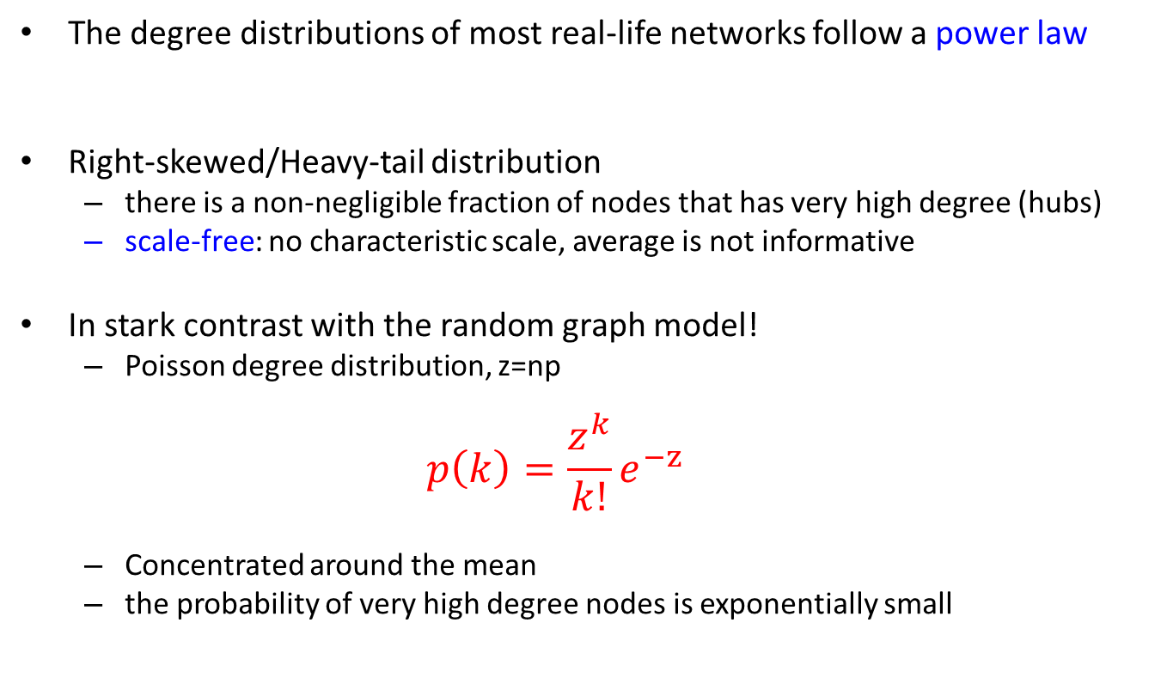

Power-law distributions
The degree distributions of most real-life networks follow a power law
Right-skewed/Heavy-tail distribution
  there is a non-negligible fraction of nodes that has very high degree (hubs)
  scale-free: no characteristic scale, average is not informative
In stark contrast with the random graph model!
  Poisson degree distribution, z=np
  $$p\left(k\right)=\frac{z^{k}}{k!}e^{−z}$$
  Concentrated around the mean
  the probability of very high degree nodes is exponentially small
$p(k) =Ck^{−α}$

Slide 6
Power-law signature
Power-law distribution gives a line in the log-log plot
α : power-law exponent (typically 2 ≤ α ≤ 3)
log p(k) = -α logk + logC
frequency
log frequency
α
degree
log degree

Slide 7
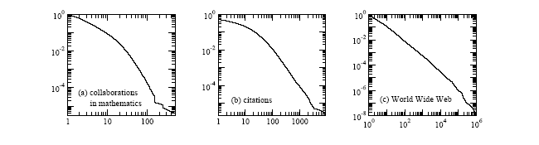
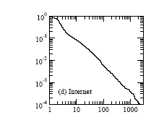
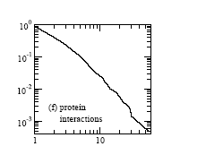
Examples
Taken from [Newman 2003]

Slide 8
A random graph example

Slide 9
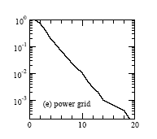
Exponential distribution
Observed in some technological or collaboration networks
Identified by a line in the log-linear plot
p(k) = λe^{-λk}
log p(k) = - λk + log λ
log frequency
λ
degree

Slide 10
Measuring power-laws
How do we create these plots? How do we measure the power-law exponent?
Collect a set of measurements:
  E.g., the degree of each page, the number of appearances of each word in a document, the size of solar flares(continuous)
Create a value histogram
  For discrete values, number of times each value appears
  For continuous values (but also for discrete):
    Break the range of values into bins of equal width
    Sum the count of values in the bin
    Represent the bin by the mean (median) value
Plot the histogram in log-log scale
  Bin representatives vs Value in the bin

Slide 11
Discrete Counts

Slide 12
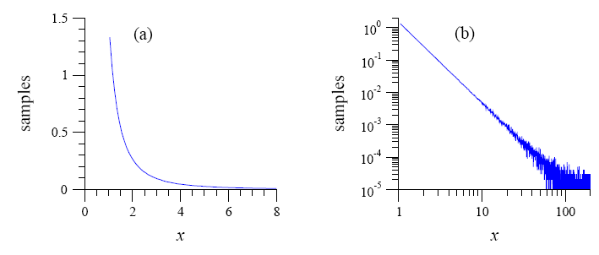
Measuring power laws
Simple binning produces a noisy plot

Slide 13
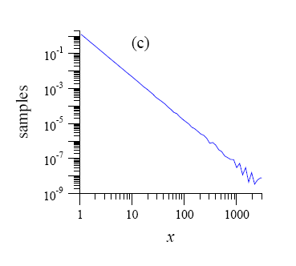
Logarithmic binning
Exponential binning
  Create bins that grow exponentially in size
  In each bin divide the sum of counts by the bin length (number of observations per bin unit)
Still some noise at the tail

Slide 14
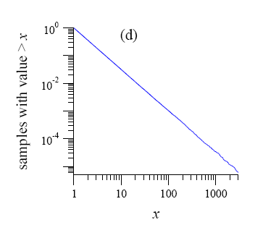
Cumulative distribution
Compute the cumulative distribution
  P[X≥x]: fraction (or number) of observations that have value at least x
  It also follows a power-law with exponent α-1

Slide 15
Pareto distribution
A random variable follows a Pareto distribution if
Power law distribution with exponent α=1+β

Slide 16
Zipf plot
There is another easy way to see the power-law, by doing the Zipf plot
  Order the values in decreasing order
  Plot the values against their rank in log-log scale
    i.e., for the r-th value x_{r}, plot the point (log(r),log(x_{r}))
  If there is a power-law you should see something like a straight line

Slide 17
Zipf’s Law
A random variable X follows Zipf’s law if the r-th largest value x_{r} satisfies
Same as Pareto distribution
X follows a power-law distribution with α=1+1/γ
Named after Zipf, who studied the distribution of words in English language and found Zipf law with exponent 1

Slide 18
Zipf vs Pareto

Slide 19
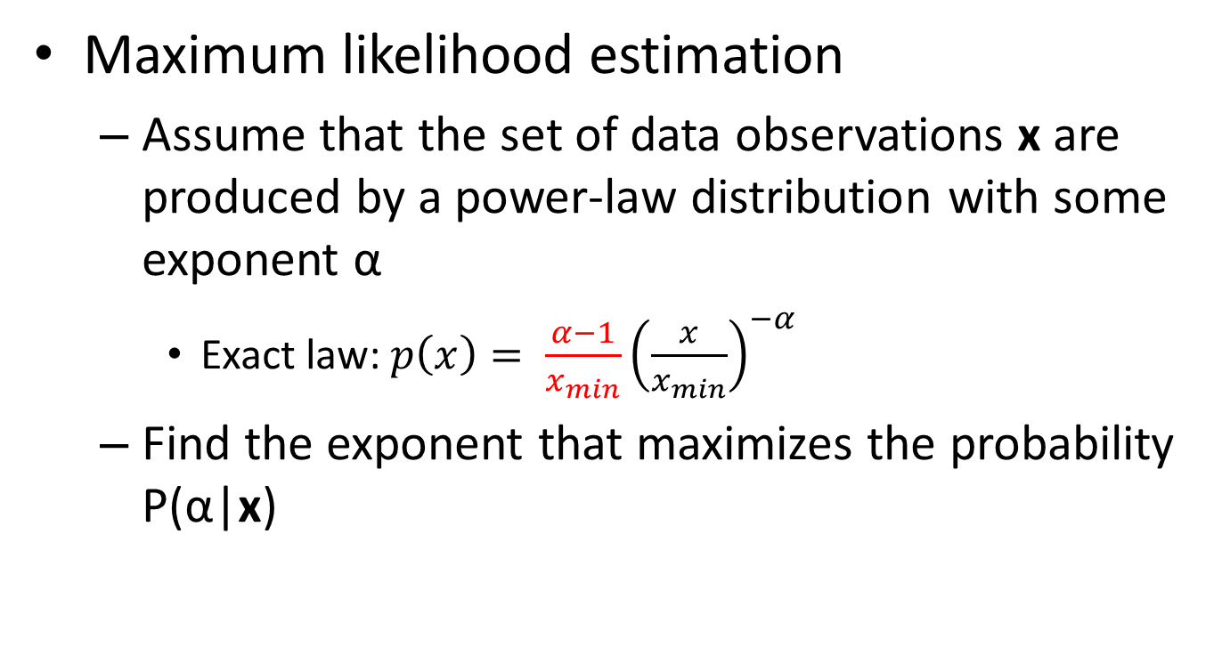
Computing the exponent
Maximum likelihood estimation
  Assume that the set of data observations x are produced by a power-law distribution with some exponent α
    Exact law: $p\left(x\right)= \frac{α−1}{x_{min}}{\left(\frac{x}{x_{min}}\right)}^{−α}$
  Find the exponent that maximizes the probability P(α|x)
Proof in M. E. J. Newman, Power laws, Pareto distributions and Zipf's law, Contemporary Physics.

Slide 20
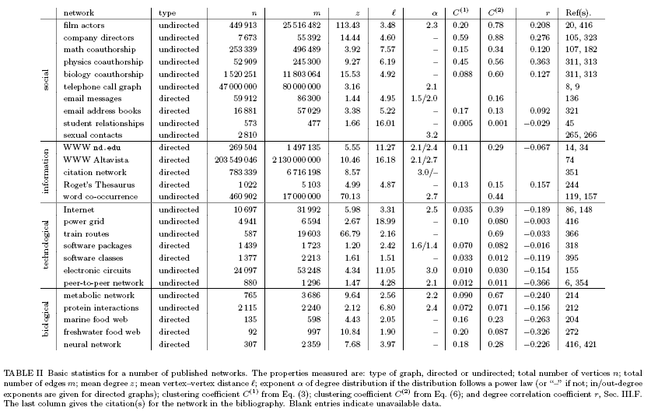
Collective Statistics (M. Newman 2003)

Slide 21
Power Laws - Recap
A (continuous) random variable X follows a power-law distribution if it has density function
A (continuous) random variable X follows a Pareto distribution if it has cumulative function
A (discrete) random variable X follows Zipf’s law if the the r-th largest value satisfies
power-law with α=1+β
power-law with α=1+1/γ

Slide 22
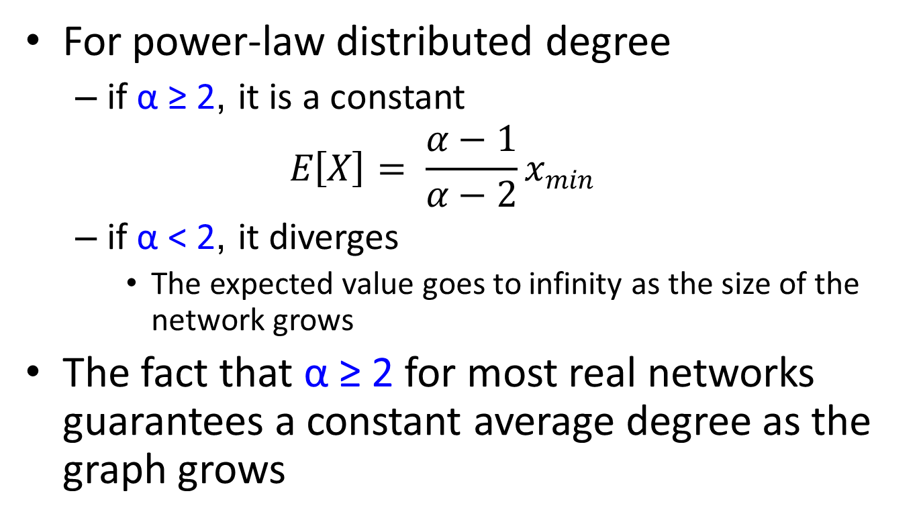
Average/Expected degree
For power-law distributed degree
  if α ≥ 2, it is a constant
  $$E\left[X\right]= \frac{α−1}{α−2}x_{min}$$
  if α < 2, it diverges
    The expected value goes to infinity as the size of the network grows
The fact that α ≥ 2 for most real networks guarantees a constant average degree as the graph grows

Slide 23
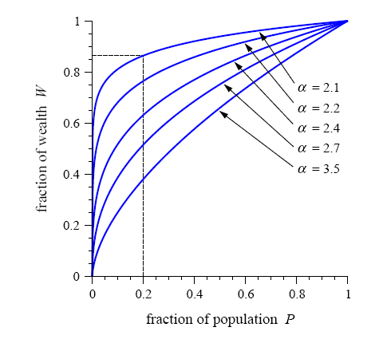
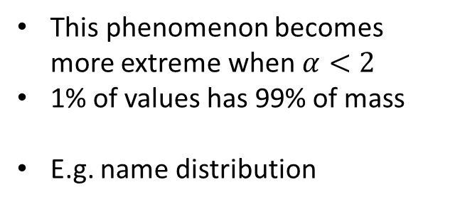
The 80/20 rule
Top-heavy: Small fraction of values collect most of distribution mass
This phenomenon becomes more extreme when $α<2$
1% of values has 99% of mass
E.g. name distribution

Slide 24
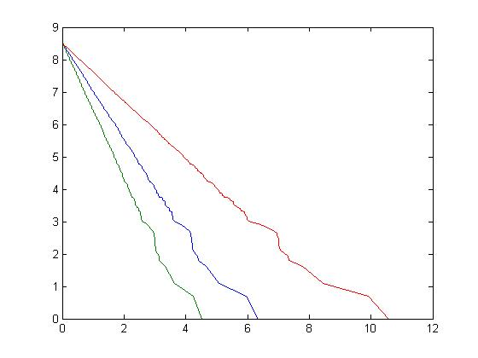



The effect of exponent
As the exponent increases the probability of observing an extreme value decreases
$$α=1.9$$
$$α=3.1$$
$$α=2.5$$

Slide 25
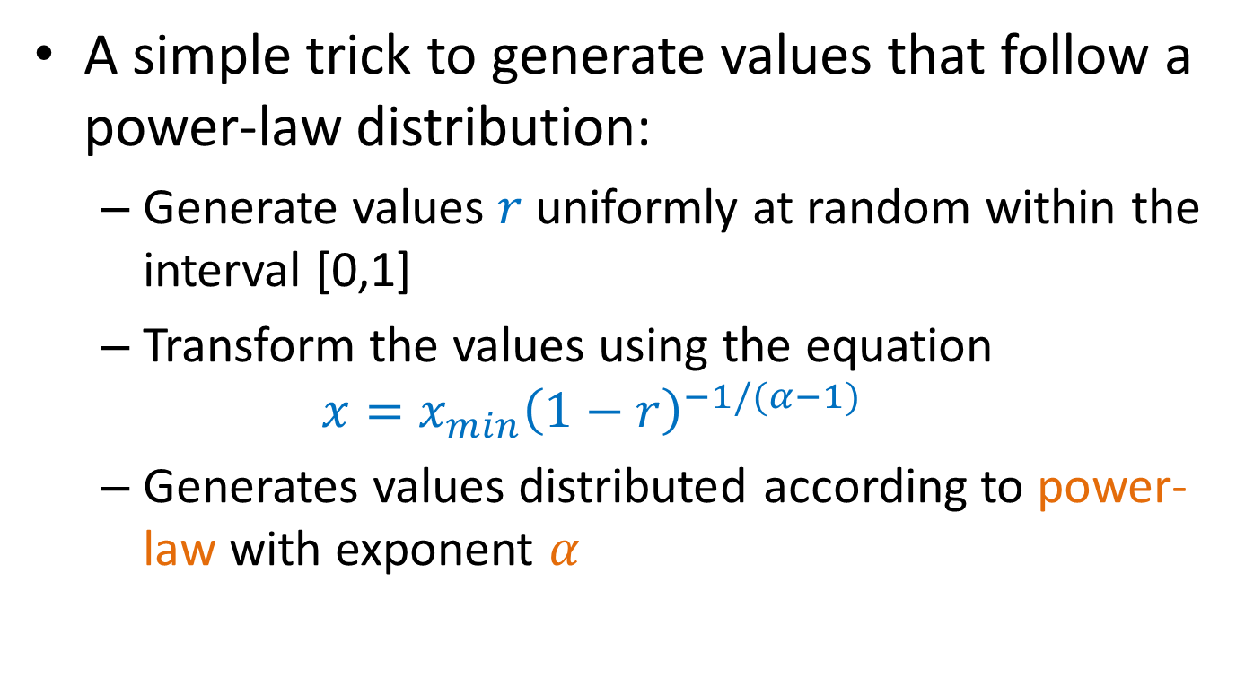
Generating power-law values
A simple trick to generate values that follow a power-law distribution:
  Generate values $r$ uniformly at random within the interval [0,1]
  Transform the values using the equation
  $$x=x_{min}{\left(1−r\right)}^{−1/(α−1)}$$
  Generates values distributed according to power-law with exponent $α$

Slide 26
Clustering (Transitivity) coefficient
Measures the density of triangles (local clusters) in the graph
Two different ways to measure it:
The ratio of the means

Slide 27
Example
1
4
3
2
5

Slide 28
Clustering (Transitivity) coefficient
Clustering coefficient for node i
The mean of the ratios

Slide 29
Example
The two clustering coefficients give different measures
C⁽²⁾ increases with nodes with low degree
1
4
3
2
5

Slide 30
Collective Statistics (M. Newman 2003)

Slide 31
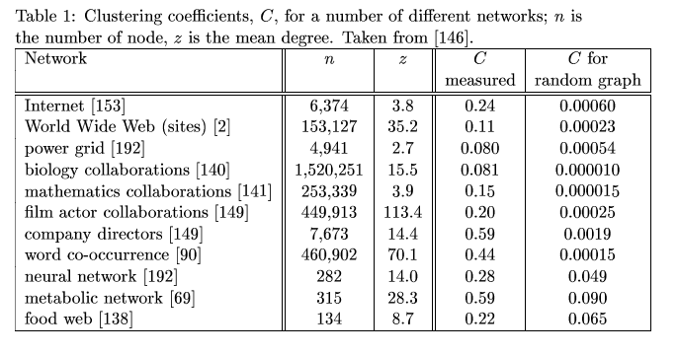
Clustering coefficient for random graphs
The probability of two of your neighbors also being neighbors is p, independent of local structure
  clustering coefficient C = p
  when the average degree z=np is constant C =O(1/n)

Slide 32
Small worlds
Millgram’s experiment: Letters were handed out to people in Nebraska to be sent to a target in Boston
People were instructed to pass on the letters to someone they knew on first-name basis
The letters that reached the destination followed paths of length around 6
Six degrees of separation: (play of John Guare)
Also:
  The Kevin Bacon game
  The Erdös number

Slide 33
Measuring the small world phenomenon
d_{ij} = shortest path between i and j
Diameter:
Characteristic path length:
Harmonic mean
Also, distribution of all shortest paths
Problem if no path between two nodes

Slide 34
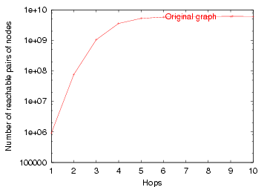
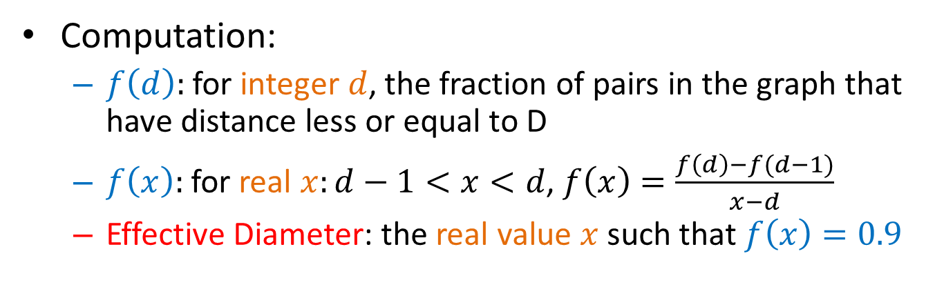
Effective Diameter
Disconnected components or isolated long paths can throw off the computation of the diameter.
Effective diameter: the interpolated value where 90% of node pairs are reachable
# reachable pairs
Effective Diameter
hops
Computation:
  $f\left(d\right):$ for integer $d$, the fraction of pairs in the graph that have distance less or equal to D
  $f\left(x\right):$ for real $x:d−1<x<d$, $f\left(x\right)=\frac{f\left(d\right)−f(d−1)}{x−d}$
  Effective Diameter: the real value $x$ such that $f\left(x\right)=0.9$

Slide 35
Collective Statistics (M. Newman 2003)

Slide 36
Small worlds in real networks
For all real networks there are (on average) short paths between nodes of the network.
  Largest path found in the IMDB actor network: 7
Is this interesting?
  Random graphs also have small diameter
  (d=logn/loglogn when z=ω(logn))
Short paths are not surprising and should be combined with other properties
  ease of navigation
  high clustering coefficient

Slide 37
Connected components
For undirected graphs, the size and distribution of the connected components
  is there a giant component?
  Most known real undirected networks have a giant component
For directed graphs, the size and distribution of strongly and weakly connected components

Slide 38
Connected components – definitions
Weakly connected components (WCC)
  Set of nodes such that from any node can go to any node via an undirected path
Strongly connected components (SCC)
  Set of nodes such that from any node can go to any node via a directed path.
  IN: Nodes that can reach the SCC (but not in the SCC)
  OUT: Nodes reachable by the SCC (but not in the SCC)
WCC
SCC

Slide 39
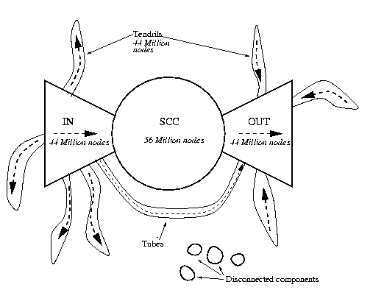
The bow-tie structure of the Web
The largest weakly connected component contains 90% of the nodes

Slide 40
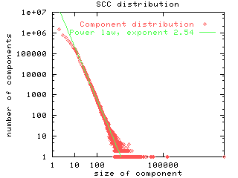
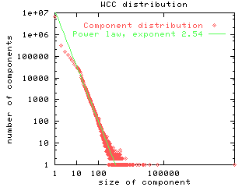
SCC and WCC distribution
The SCC and WCC sizes follows a power law distribution
  the second largest SCC is significantly smaller

Slide 41
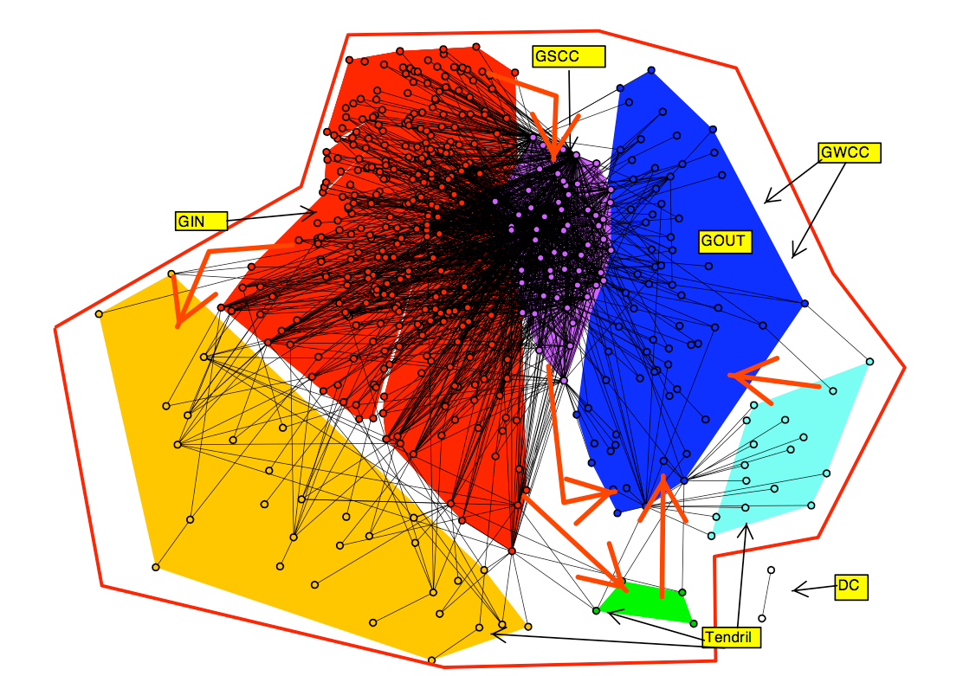
Another bow-tie
Who lends to whom

Slide 42
Web Cores
Cores: Small complete bipartite graphs (of size 3x3, 4x3, 4x4)
  Similar to the triangles for undirected graphs
Found more frequently than expected on the Web graph
Correspond to communities of enthusiasts (e.g., fans of japanese rock bands)

Slide 43
Motifs
Most networks have the same characteristics with respect to global measurements
  can we say something about the local structure of the networks?
Motifs: Find small subgraphs that over-represented in the network

Slide 44
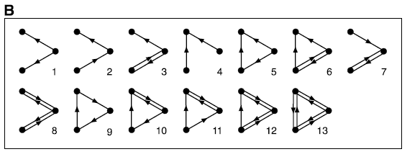
Example
Motifs of size 3 in a directed graph

Slide 45
Finding interesting motifs
Sample a part of the graph of size S
Count the frequency of the motifs of interest
Compare against the frequency of the motif in a random graph with the same number of nodes and the same degree distribution

Slide 46
Generating a random graph
Find edges (i,j) and (x,y) such that edges (i,y) and (x,j) do not exist, and swap them
  repeat for a large enough number of times
i
j
i
j
y
y
x
x
G
degrees of i,j,x,y
are preserved
G-swapped

Slide 47
The feed-forward loop
Over-represented in gene-regulation networks
  a signal delay mechanism
X
Y
Z
Milo et al. 2002

Slide 48
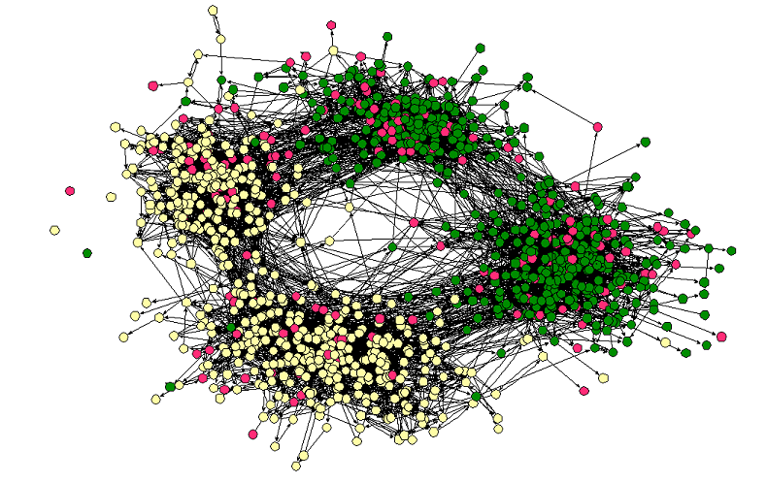
Homophily
Love of the same: People tend to have friends with common interests
  Students separated by race and age
Middle – High School
Race

Slide 49
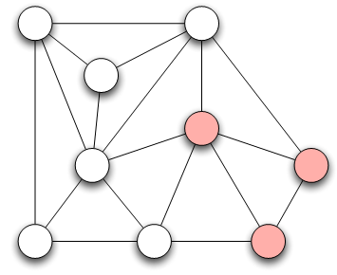
Measuring Homophily
If the fraction of cross-gender edges is significantly less than expected, then there is evidence for homophily
gender male with probability p
gender female with probability q
Probability of cross-gender edge?

Slide 50
Measuring Homophily
“significantly” less than
Inverse homophily
Characteristics with more than two values:
  Number of heterogeneous edges (edge between two nodes that are different)

Slide 51
Mechanisms Underlying Homophily: Selection and Social Influence
Selection: tendency of people to form friendships with others who are like then
Socialization or Social Influence: the existing social connections in a network are influencing the individual characteristics of the individuals
Social Influence as the inverse of Selection
Mutable & immutable characteristics

Slide 52
The Interplay of Selection and Social Influence
Longitudinal studies in which the social connections and the behaviors within a group are tracked over a period of time
Why?
Study teenagers, scholastic achievements/drug use (peer pressure and selection)
Relative impact?
- Effect of possible interventions (example, drug use)

Slide 53
The Interplay of Selection and Social Influence
Christakis and Fowler on obesity, 12,000 people over a period of 32-years
People more similar on obesity status to the network neighbors than if assigned randomly
Why?
(i) Because of selection effects, choose friends of similar obesity status,
(ii) Because of confounding effects of homophily according to other characteristics that correlate with obesity
(iii) Because changes in the obesity status of person’s friends was exerting an influence that affected her
(iii) As well -> “contagion” in a social sense

Slide 54
Tracking Link Formation in Online Data: interplay between selection and social influence
Underlying social network
Measure for behavioral similarity
Wikipedia
Node: Wikipedia editor who maintains a user account and user talk page
Link: if they have communicated with one writing on the user talk page of the other
Editor’s behavior: set of articles she has edited
Neighborhood overlap in the bipartite affiliation network of editors and articles consisting only of edges between editors and the articles they have edited
FACT: Wikipedia editors who have communicated are significantly more similar in their behavior than pairs of Wikipedia editors who have not (homomphily), why?
Selection (editors form connections with those have edited the same articles) vs Social Influence (editors are led to the articles of people they talk to)

Slide 55
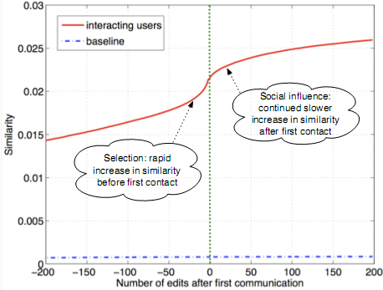
Tracking Link Formation in Online Data: interplay between selection and social influence
Actions in Wikipedia are time-stamped
For each pair of editors A and B who have ever communicated,
  Record their similarity over time
  Time 0 when they first communicated -- Time moves in discrete units, advancing by one “tick” whenever either A or B performs an action on Wikipedia
  Plot one curve for each pair of editors
Average, single plot: average level of similarity relative to the time of first interaction
Similarity is clearly increasing both before and after the moment of first interaction
(both selection and social influence)
Not symmetric around time 0 (particular role on similarity): Significant increase before they meet
Blue line shows similarity of a random pair (non-interacting)

Slide 56
References
M. E. J. Newman, Power laws, Pareto distributions and Zipf's law, Contemporary Physics.
M. E. J. Newman, The structure and function of complex networks, SIAM Reviews, 45(2): 167-256, 2003
R. Albert and A.-L. Barabási, Statistical mechanics of complex networks, Reviews of Modern Physics 74, 47-97 (2002).
S. N. Dorogovstev and J. F. F. Mendez, Evolution of Networks: From Biological Nets to the Internet and WWW.
Michalis Faloutsos, Petros Faloutsos and Christos Faloutsos. On Power-Law Relationships of the Internet Topology. ACM SIGCOMM 1999.
E. Ravasz, A. L. Somera, D. A. Mongru, Z. N. Oltvai, and A.-L. Barabási, Hierarchical organization of modularity in metabolic networks, Science 297, 1551-1555 (2002).
R Milo, S Shen-Orr, S Itzkovitz, N Kashtan, D Chklovskii & U Alon, Network Motifs: Simple Building Blocks of Complex Networks. Science, 298:824-827 (2002).
R Milo, S Itzkovitz, N Kashtan, R Levitt, S Shen-Orr, I Ayzenshtat, M Sheffer & U Alon, Superfamilies of designed and evolved networks. Science, 303:1538-42 (2004).

