Slide 1
Online Social Networks and Media
Network Ties

Slide 2
Strong AND WEAK TIES

Slide 3
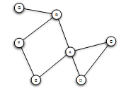
Triadic Closure
If two people in a social network have a friend in common, then there is an increased likelihood that they will become friends themselves at some point in the future
Triangle

Slide 4
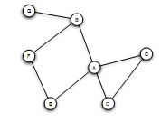
Triadic Closure
Snapshots over time:

Slide 5
Clustering Coefficient
(Local) clustering coefficient for a node is the probability that two randomly selected friends of a node are friends with each other (form a triangle)
Fraction of the friends of a node that are friends with each other (i.e., connected)

Slide 6
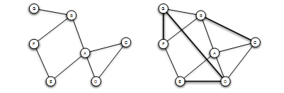
Clustering Coefficient
1/6
1/2
Ranges from 0 to 1

Slide 7
Triadic Closure
If A knows B and C, B and C are likely to become friends, but WHY?
B
A
C
Opportunity
Trust
Incentive of A (latent stress for A, if B and C are not friends, dating back to social psychology, e.g., relating low clustering coefficient to suicides)

Slide 8
The Strength of Weak Ties Hypothesis
Mark Granovetter, in the late 1960s
Many people learned information leading to their current job through personal contacts, often described as acquaintances rather than closed friends
Two aspects
Structural
Local (interpersonal)

Slide 9
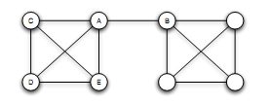
Bridges and Local Bridges
Bridge
(aka cut-edge)
An edge between A and B is a bridge if deleting that edge would cause A and B to lie in two different components
AB the only “route” between A and B
extremely rare in social networks

Slide 10
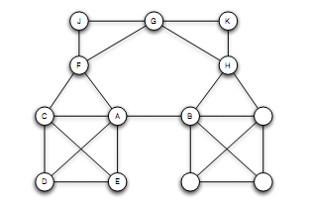
Bridges and Local Bridges
Local Bridge
An edge between A and B is a local bridge if deleting that edge would increase the distance between A and B to a value strictly more than 2
Span of a local bridge: distance of the its endpoints if the edge is deleted

Slide 11
Bridges and Local Bridges
An edge is a local bridge, if an only if, it is not part of any triangle in the graph

Slide 12
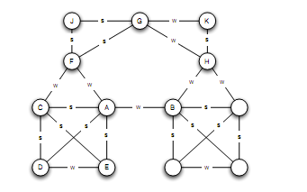
The Strong Triadic Closure Property
Levels of strength of a link
Strong and weak ties
May vary across different times and situations
Annotated graph

Slide 13
The Strong Triadic Closure Property
If a node A has edges to nodes B and C, then the B-C edge is especially likely to form if both A-B and A-C are strong ties
A node A violates the Strong Triadic Closure Property, if
it has strong ties to two other nodes B and C, and there is no edge (strong or weak tie) between B and C.
A node A satisfies the Strong Triadic Property if it does not violate it
B
S
A
X
S
C

Slide 14
The Strong Triadic Closure Property

Slide 15
Local Bridges and Weak Ties
Local distinction: weak and strong ties ->
Global structural distinction: local bridges or not
Claim:
If a node A in a network satisfies the Strong Triadic Closure and is involved in at least two strong ties, then any local bridge it is involved in must be a weak tie
Proof: by contradiction
Relation to job seeking?

Slide 16
The role of simplifying assumptions:
Useful when they lead to statements robust in practice, making sense as qualitative conclusions that hold in approximate forms even when the assumptions are relaxed
Stated precisely, so possible to test them in real-world data
A framework to explain surprising facts

Slide 17
Tie Strength and Network Structure in Large-Scale Data
How to test these prediction on large social networks?

Slide 18
Tie Strength and Network Structure in Large-Scale Data
Communication network: “who-talks-to-whom”
Strength of the tie: time spent talking during an observation period
Cell-phone study [Omnela et. al., 2007]
“who-talks-to-whom network”, covering 20% of the national population
Nodes: cell phone users
Edge: if they make phone calls to each other in both directions over 18-week observation periods
Is it a “social network”?
Cells generally used for personal communication + no central directory, thus cell-phone numbers exchanged among people who already know each other
Broad structural features of large social networks (giant component, 84% of nodes)

Slide 19
Generalizing Weak Ties and Local Bridges
So far:
Either weak or strong
Local bridge or not
Tie Strength: Numerical quantity (= number of min spent on the phone)
Quantify “local bridges”, how?

Slide 20
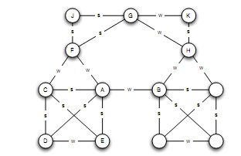
Generalizing Weak Ties and Local Bridges
Bridges
“almost” local bridges
Neighborhood overlap of an edge e_{ij}
(*) In the denominator we do not count A or B themselves
Jaccard coefficient
A: B, E, D, C
F: C, J, G
1/6
When is this value 0?

Slide 21
Generalizing Weak Ties and Local Bridges
Neighborhood overlap = 0: edge is a local bridge
Small value: “almost” local bridges
1/6
?

Slide 22
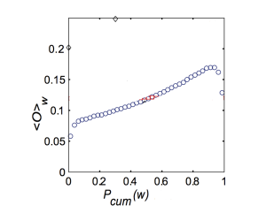
Generalizing Weak Ties and Local Bridges: Empirical Results
How the neighborhood overlap of an edge depends on its strength
(Hypothesis: the strength of weak ties predicts that neighborhood overlap should grow as tie strength grows)
(*) Some deviation at the right-hand edge of the plot
sort the edges -> for each edge at which percentile
Strength of connection (function of the percentile in the sorted order)

Slide 23
Generalizing Weak Ties and Local Bridges: Empirical Results
How to test the following global (macroscopic) level hypothesis:
Hypothesis: weak ties serve to link different tightly-knit communities that each contain a large number of stronger ties

Slide 24
Generalizing Weak Ties and Local Bridges: Empirical Results
Delete edges from the network one at a time
Starting with the strongest ties and working downwards in order of tie strength
  giant component shrank steadily
Starting with the weakest ties and upwards in order of tie strength
  giant component shrank more rapidly, broke apart abruptly as a critical number of weak ties were removed

Slide 25
Social Media and Passive Engagement
People maintain large explicit lists of friends
Test:
How online activity is distributed across links of different strengths

Slide 26
Tie Strength on Facebook
Cameron Marlow, et al, 2009
At what extent each link was used for social interactions
Three (not exclusive) kinds of ties (links)
Reciprocal (mutual) communication: both send and received messages to friends at the other end of the link
One-way communication: the user send one or more message to the friend at the other end of the link
Maintained relationship: the user followed information about the friend at the other end of the link (click on content via News feed or visit the friend profile more than once)

Slide 27
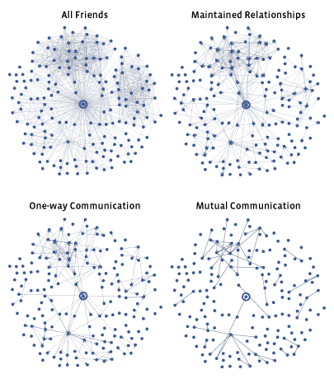
Tie Strength on Facebook
More recent connections

Slide 28
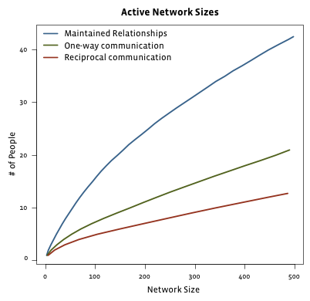
Tie Strength on Facebook
Even for users with very large number of friends
actually communicate : 10-20
number of friends follow even passively <50
Passive engagement (keep up with friends by reading about them even in the absence of communication)
Total number of friends

Slide 29
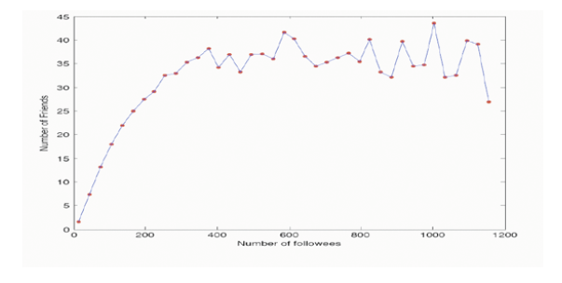
Tie Strength on Twitter
Huberman, Romero and Wu, 2009
Two kinds of links
Follow
Strong ties (friends): users to whom the user has directed at least two messages over the course if the observation period

Slide 30
Social Media and Passive Engagement
Strong ties require continuous investment of time and effort to maintain (as opposed to weak ties)
Network of strong ties still remain sparse
How different links are used to convey information

Slide 31
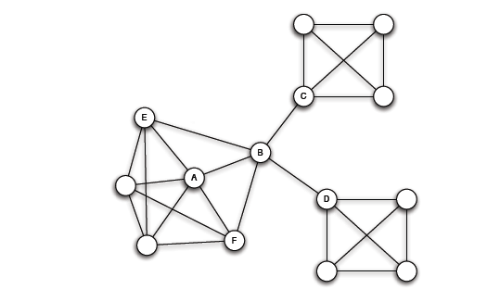
Closure, Structural Holes and Social Capital
Different roles that nodes play in this structure
Access to edges that span different groups is not equally distributed across all nodes

Slide 32
Embeddedness
A has a large clustering coefficient
Embeddedness of an edge: number of common neighbors of its endpoints (neighborhood overlap, local bridge if 0)
For A, all its edges have significant embeddedness
3
2
3
(sociology) if two individuals are connected by an embedded edge => trust
  “Put the interactions between two people on display”

Slide 33
Structural Holes
(sociology) B-C, B-D much riskier, also, possible contradictory constraints
Success in a large cooperation correlated to access to local bridges
B “spans a structural hole”
  B has access to information originating in multiple, non interacting parts of the network
  An amplifier for creativity
  Source of power as a social “gate-keeping”
  Social capital

Slide 34
ENFORCING STRONG TRIADIC CLOSURE

Slide 35
The Strong Triadic Closure Property
If we do not have the labels, how can we label the edges so as to satisfy the
Strong Triadic Closure Property?

Slide 36
Problem Definition
Goal: Label (color) ties of a social network as Strong or Weak so that the Strong Triadic Closure property holds.
MaxSTC Problem: Find an edge labeling (S, W) that satisfies the STC property and maximizes the number of Strong edges.
MinSTC Problem: Find an edge labeling (S, W) that satisfies the STC property and minimizes the number of Weak edges.
Notes:
A natural question is how we can label ties of a social network as Strong or Weak so that STC property holds. A trivial solution to that problem is to characterize every edge weak. However, we believe that creating strong relationships is what motivates peopla to join and engage with social networks. So we consider the following problem: Find a labeling of the edges of the graph as Strong or Weak, that satisfies the STC property AND maximizes the number of Strong ties. We call that problem MaxSTC. Equivalently, we define the MinSTC problem where we aim to minimize the number of Weak edges. Note that the optimal solution of these two problems is obviously the same.

Slide 37
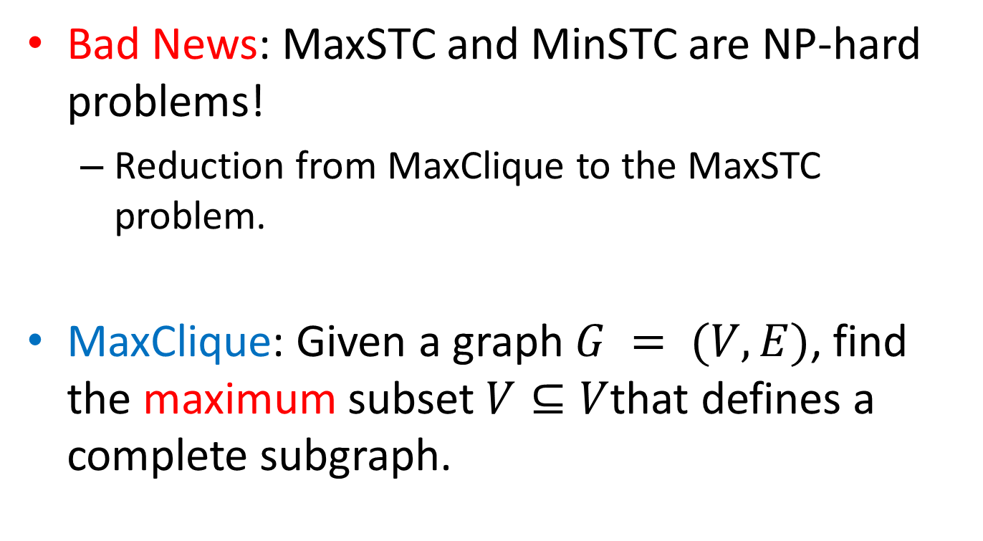
Complexity
Bad News: MaxSTC and MinSTC are NP-hard problems!
  Reduction from MaxClique to the MaxSTC problem.
MaxClique: Given a graph $G = (V,E)$, find the maximum subset $V⊆V$that defines a complete subgraph.
Notes:
Unfortunately, as you would expect MaxSTC and MinSTC problems are NP-hard. The proof uses a reduction from the Maximum Clique problem to the MaxSTC problem

Slide 38
Reduction
Given a graph G as input to the MaxClique problem
Input of MaxClique problem

Slide 39

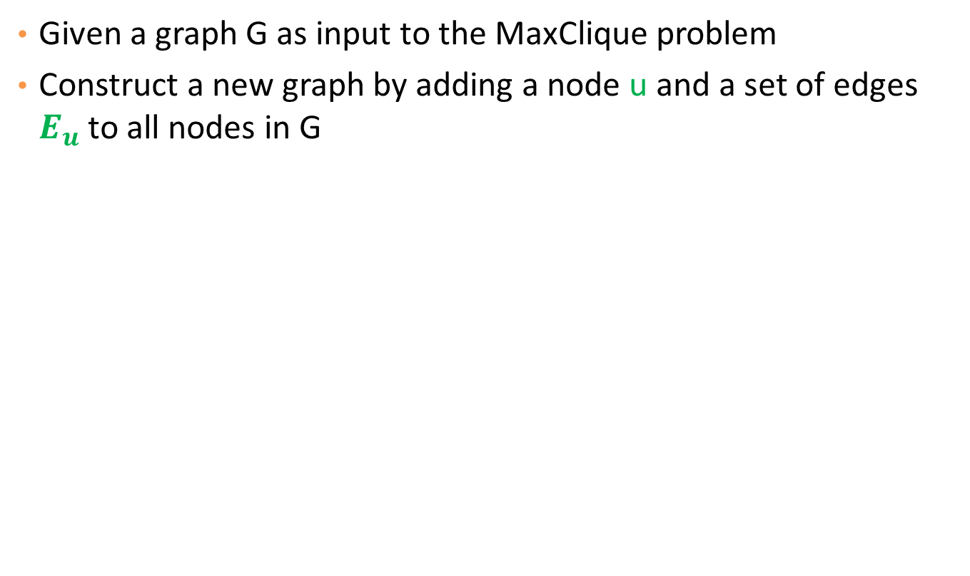
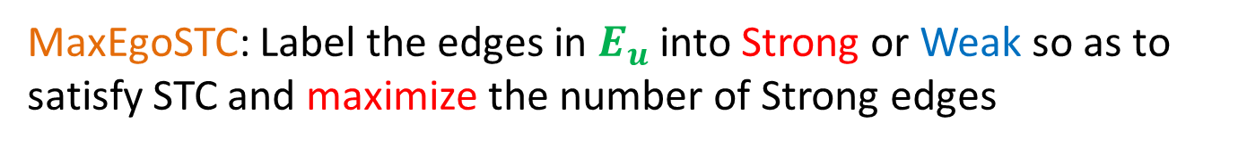
Reduction
Given a graph G as input to the MaxClique problem
Construct a new graph by adding a node u and a set of edges $E_{u}$ to all nodes in G
MaxEgoSTC is at least as hard as MaxSTC
The labelings of pink and green edges are independent
$$u$$
MaxEgoSTC: Label the edges in $E_{u}$ into Strong or Weak so as to satisfy STC and maximize the number of Strong edges

Slide 40
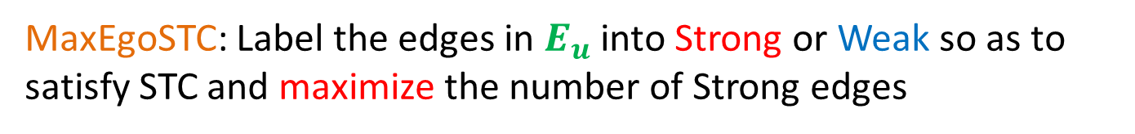
Reduction
Given a graph G as input to the MaxClique problem
Construct a new graph by adding a node u and a set of edges $E_{u}$ to all nodes in G
Input to the MaxEgoSTC problem
$$u$$
MaxEgoSTC: Label the edges in $E_{u}$ into Strong or Weak so as to satisfy STC and maximize the number of Strong edges

Slide 41
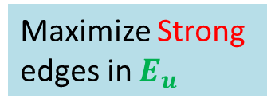
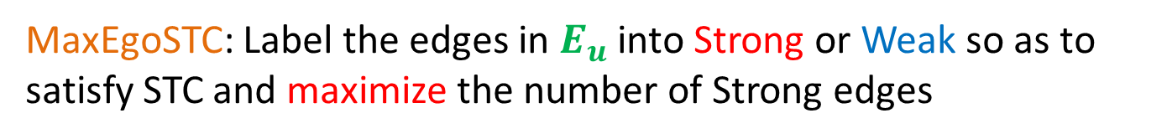
Reduction
Given a graph G as input to the MaxClique problem
Construct a new graph by adding a node u and a set of edges $E_{u}$ to all nodes in G
Q
Find the max clique Q in G
Maximize Strong edges in $E_{u}$
$$u$$
MaxEgoSTC: Label the edges in $E_{u}$ into Strong or Weak so as to satisfy STC and maximize the number of Strong edges

Slide 42
Approximation Algorithms
Bad News: MaxSTC is hard to approximate.
Good News: There exists a 2-approximation algorithm for the MinSTC problem.
  The number of weak edges it produces is at most two times those of the optimal solution.
The algorithm comes by reducing our problem to a coverage problem
Notes:
Since our problems are NP-hard, we look for approximate solutions. Using the reduction from MaxClique, we can show that the MaxSTC problem is hard to approximate. On the other hand the good news is that there is a 2-approximation algorithm for MinSTC problem.

Slide 43
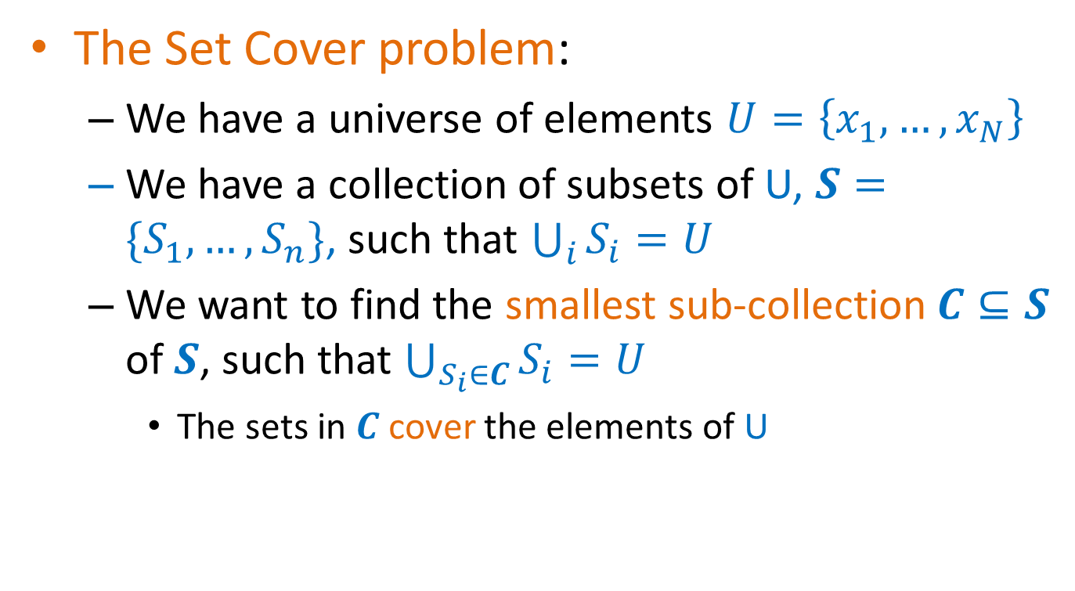
Set Cover
The Set Cover problem:
  We have a universe of elements $U=\left\{x_{1},…,x_{N}\right\}$
  We have a collection of subsets of U, $S=\{S_{1},…,S_{n}\}$, such that $\bigcup_{i}{S_{i}}=U$
  We want to find the smallest sub-collection$C⊆S$ of $S$, such that $\bigcup_{S_{i}∈C}{S_{i}=U}$
    The sets in $C$cover the elements of U

Slide 44
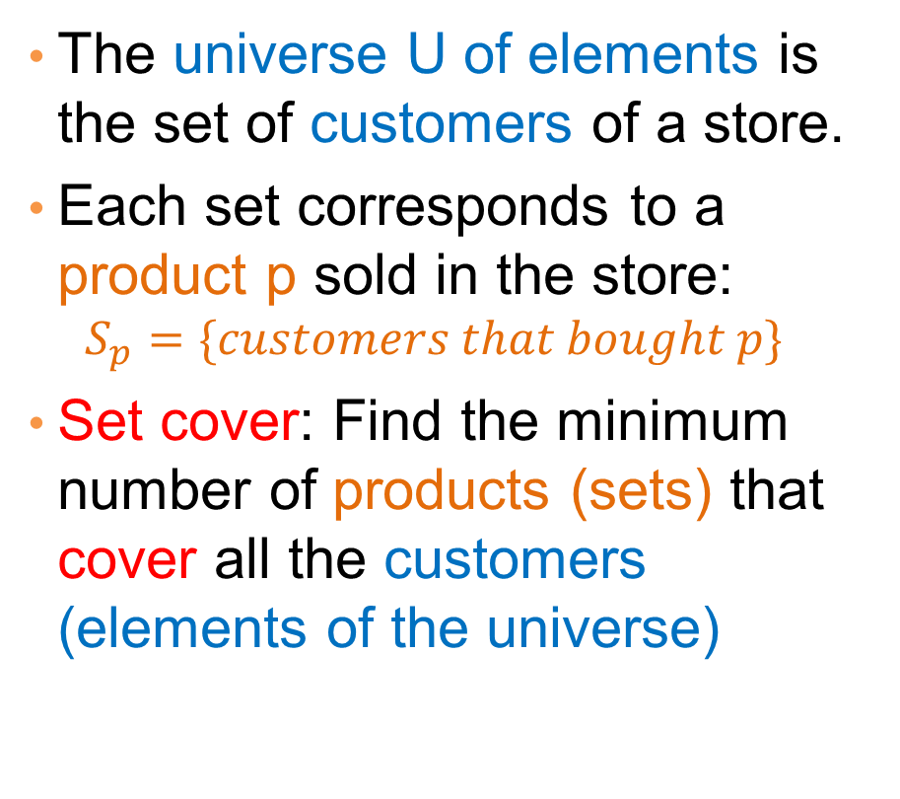
Example
milk
The universe U of elements is the set of customers of a store.
Each set corresponds to a product p sold in the store:
  $$S_{p}=\{customers that bought p\}$$
Set cover: Find the minimum number of products (sets) that cover all the customers (elements of the universe)
coffee
coke
beer
tea

Slide 45
Example
milk
The universe U of elements is the set of customers of a store.
Each set corresponds to a product p sold in the store:
  $$S_{p}=\{customers that bought p\}$$
Set cover: Find the minimum number of products (sets) that cover all the customers (elements of the universe)
coffee
coke
beer
tea

Slide 46
Example
milk
The universe U of elements is the set of customers of a store.
Each set corresponds to a product p sold in the store:
  $$S_{p}=\{customers that bought p\}$$
Set cover: Find the minimum number of products (sets) that cover all the customers (elements of the universe)
coffee
coke
beer
tea

Slide 47
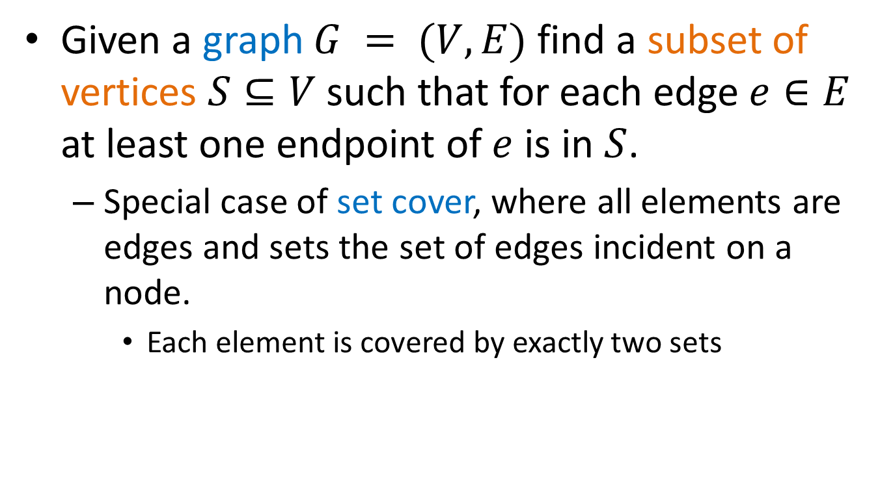
Vertex Cover
Given a graph $G = (V,E)$find a subset of vertices $S⊆V$ such that for each edge $e∈E$ at least one endpoint of $e$ is in $S$.
  Special case of set cover, where all elements are edges and sets the set of edges incident on a node.
    Each element is covered by exactly two sets

Slide 48
Vertex Cover
Given a graph $G = (V,E)$find a subset of vertices $S⊆V$ such that for each edge $e∈E$ at least one endpoint of $e$ is in $S$.
  Special case of set cover, where all elements are edges and sets the set of edges incident on a node.
    Each element is covered by exactly two sets

Slide 49

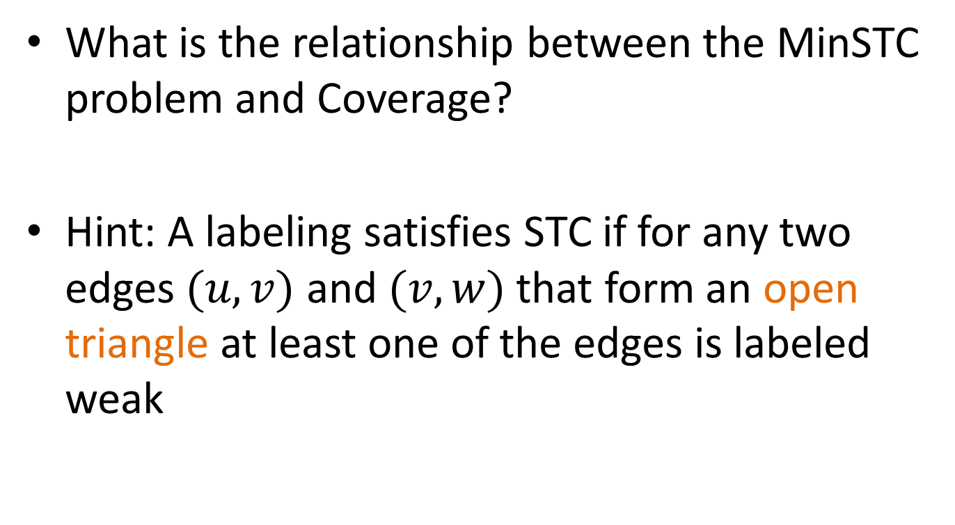


MinSTC and Coverage
What is the relationship between the MinSTC problem and Coverage?
Hint: A labeling satisfies STC if for any two edges $(u,v)$ and $(v,w)$ that form an open triangle at least one of the edges is labeled weak
$$u$$
$$v$$
$$w$$

Slide 50
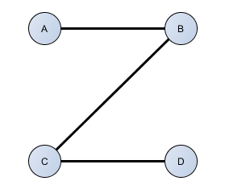
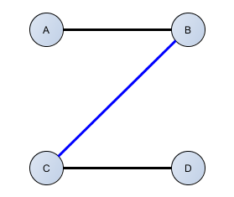
Coverage
Intuition
  STC property implies that there cannot be an open triangle with both strong edges
  For every open triangle: a weak edge must cover the triangle
  MinSTC can be mapped to the Minimum Vertex Cover problem.
Notes:
The intuition for the approximation algorithm is the following. Recall that the STC property stipulates that we cannot have an open triangle with two strong edges. So for every open triangle at least one edge must be labeled weak. We say that this weak edge COVERS this triangle. For example, this subgraph consists of two open triangles. If we make the BC weak, then it covers both of the open triangles.
Using the idea of covering open triangles with weak edges, we will map the MinSTC problem to a coverage problem and more specifically to Minimum Vertex cover problem.

Slide 51
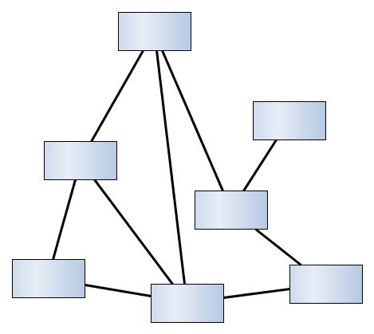
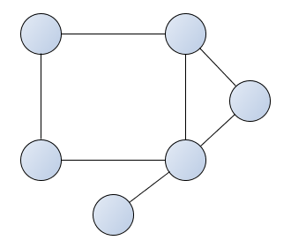
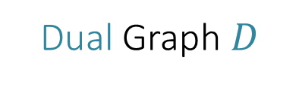

Dual Graph
Given a graph 𝐺, we create the dual graph 𝐷:
  For every edge in 𝐺 we create a node in 𝐷.
  Two nodes in 𝐷 are connected if the corresponding edges in 𝐺 participate in an open triangle.
Initial Graph $G$
$$AC$$
Dual Graph $D$
$$E$$
$$A$$
$$AB$$
$$B$$
$$CF$$
$$AE$$
$$D$$
$$C$$
$$BC$$
$$DE$$
$$F$$
$$CD$$
Notes:
In oder to map MinSTC to MVC problem we construct the DUAL graph D of the input graph G. We construct the dual graph as follows,
For every edge in the input graph, for example edge CD, we create a node CD in the dual graph.
We connect two nodes in the dual graph, for example the nodes CD and CF, if the corresponding edges in the input graph G participate in an open triangle. Here you can see that edges CD-CF in our initial graph form an open triangle, since there is no edge between nodes D, and F.

Slide 52
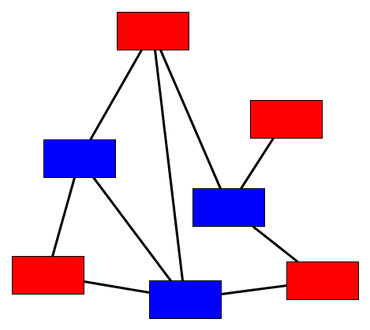
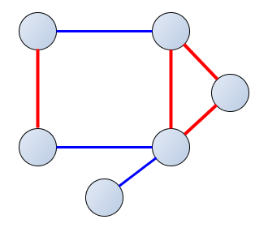
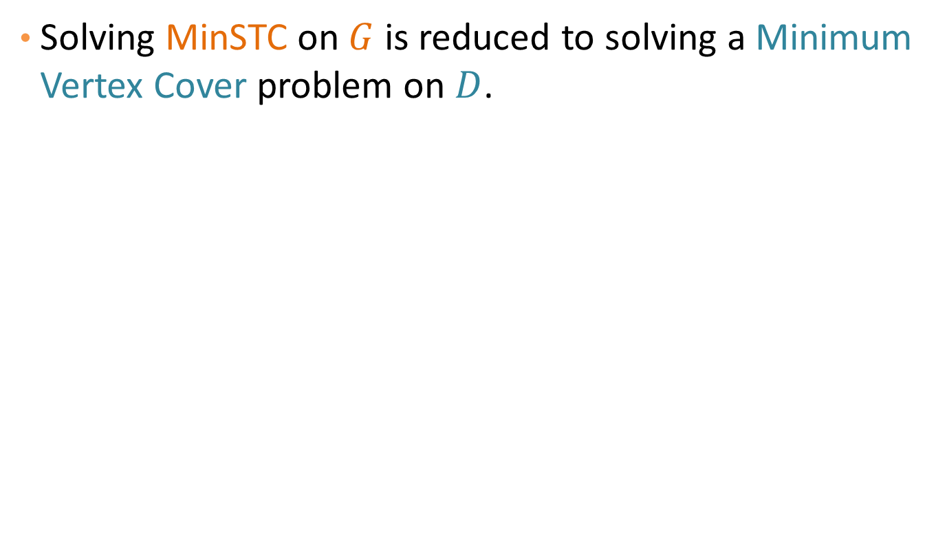
Minimum Vertex Cover - MinSTC
Solving MinSTC on $G$ is reduced to solving a Minimum Vertex Cover problem on $D$.
$$AC$$
$$E$$
$$A$$
$$AB$$
$$B$$
$$CF$$
$$AE$$
$$D$$
$$C$$
$$BC$$
$$DE$$
$$F$$
$$CD$$
Notes:
Finding a vertex cover for the dual graph, means that for every edge in the dual graph, there is a node in the vertex cover that covers it. This means that in the original graph, for every open triangle, there is an edge that covers it. For example, for our example dual graph a minimum vertex cover consists of the blue nodes. We map the solution for the MVC problem in the Dual graph to a solution of MinSTC in G by characterizing the corresponding edges as weak and the remaining as strong. Note that all the open triangles in the original graph are covered.

Slide 53
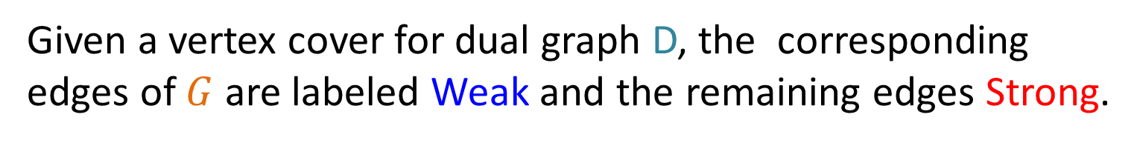
Approximation Algorithms
Approximation algorithms for the Minimum Vertex Cover problem:
Maximal Matching Algorithm
Output a maximal matching
  Maximal Matching: A collection of non-adjacent edges of the graph where no additional edges can be added.
Approximation Factor: 2
Greedy Algorithm
Greedily select each time the vertex that covers most uncovered edges.
Approximation Factor: log n
Given a vertex cover for dual graph D, the corresponding edges of $G$ are labeled Weak and the remaining edges Strong.
Notes:
For the MVC problem there are known approximation algorithms with guaranteed approximation factor. So we can use these algorithms to approximate the solution of our MinSTC problem. The first algorithm produces a maximal matching on the dual graph D. Recall that a maximal matching is a collection of adjacent edges where no additional edge can be added. It has a constant approximation factor equals to 2. The second algorithm is a greedy algorithm which, at every step, greedily selects each time the vertex that covers the most uncovered edges. This algorithm has approximation ratio logn. Given a vertex cover for the dual graph, D, we characterize the corresponding edges in original graph as weak and the remaining as Strong.

Slide 54
Experiments
Experimental Goal: Does our labeling have any practical utility?
Notes:
The overall goal of our experiments is to test if the labeling that we obtain by enforcing the STC property has any practical utility. That is, if the labels Strong and Weak that we assign, correspond to empirical notions of strength and weakness.

Slide 55
Datasets
Actors: Collaboration network between movie actors. (IMDB)
Authors: Collaboration network between authors. (DBLP)
Les Miserables: Network of co-appearances between characters of Victor Hugo's novel. (D. E. Knuth)
Karate Club: Social network of friendships between 34 members of a karate club. (W. W. Zachary)
Amazon Books: Co-purchasing network between books about US politics. (http://www.orgnet.com/)
Dataset | Number of Nodes | Number of Edges
Actors | 1,986 | 103,121
Authors | 3,418 | 9,908
Les Miserables | 77 | 254
Karate Club | 34 | 78
Amazon Books | 105 | 441
Notes:
For our experiments we use 5 datasets. Actors and Authors datasets are collaboration networks between movie actors and authors respectively. Les miserable is a network of co-appearances between characters of Victor Hugo’s novel. Karate club is a toy example of a social network and amazon books is a co-purchasing network. In this table you can see some statistics about size of the graphs in terms of number of nodes and edges.

Slide 56
Comparison of Greedy and MaximalMatching
 | Greedy |  |  | Maximal Matching
 | Strong | Weak |  | Strong | Weak
Actors | 11,184 | 91,937 |  | 8,581 | 94,540
Authors | 3,608 | 6,300 |  | 2,676 | 7,232
Les Miserables | 128 | 126 |  | 106 | 148
Karate Club | 25 | 53 |  | 14 | 64
Amazon Books | 114 | 327 |  | 71 | 370
Notes:
In this table you can see the number of strong and weak edges produced by the Greedy and Maximal matching algorithms. Even though maximal matching algorithm has a better approximation factor, Greedy algorithm produces more strong edges. So, in the following we present only the results for Greedy algorithm. All our observations also hold for maximal matching algorithm. (if you are interested you can see the results for maximal matching algorithm in our paper).

Slide 57
Measuring Tie Strength
Question: Is there a correlation between the assigned labels and the empirical strength of the edges?
Three weighted graphs: Actors, Authors, Les Miserables.
  Strength: amount of common activity.
Mean activity intersection for Strong, Weak Edges
 | Strong | Weak
Actors | 1.4 | 1.1
Authors | 1.34 | 1.15
Les Miserables | 3.83 | 2.61
The differences are statistically signicant
Notes:
For the first set of experiments we want to understand if there is a correlation between the assigned label and an empirical measure of tie strength. For this experiment we use the Actors, Authors and Les Miserables datasets for which we can compute edge weights. The edge weights measure the amount of common activity between the nodes. More specifically, weights in actors dataset represent the number of movies in common, in authors, the number of papers in common, and in Les Miserables the number of co-appearances between two characters in the same chapter. Ideally we want the mean weight of strong edges to be higher than the mean weight of weak edges. And this is actually the case for all datasets. Using the t-test we verified that the differences we observe are statistically significant.

Slide 58
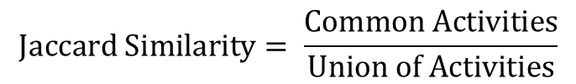
Measuring Tie Strength
Frequent common activity may be an artifact of frequent activity.
Fraction of activity devoted to the relationship
  Strength: Jaccard Similarity of activity
$$Jaccard Similarity= \frac{Common Activities}{Union of Activities}$$
Mean Jaccard similarity for Strong, Weak Edges
 | Strong | Weak
Actors | 0.06 | 0.04
Authors | 0.145 | 0.084
The differences are statistically signicant
Notes:
The frequency of common activity between two users is obviously a strong indicator of tie strength but it may also be an artifact of the general frequent activity. For example two researchers may have a lot of papers together, and the reason is just because they have written many papers in general. So, another indicator of Tie strength is the fraction of the activity of two individuals that is devoted to their relationship, Specifically, we use Jaccard Similarity of the activity sets. For example for authors dataset the jaccard similarity between two authors is defined as the number of papers they have together over the total number of papers that they have written. Again, in that table you can see that the Jaccard Similarity of Strong edges, is higher than the Jaccard Similarity of Weak edges. Here we do not have results for Les Miserables dataset because we do not have the information about the set of chapters in which a character appears.

Slide 59
The Strength of Weak Ties
[Granovetter] People learn information leading to jobs through acquaintances (Weak ties) rather than close friends (Strong ties).
[Easly and Kleinberg] Graph theoretic formalization:
  Acquaintances (Weak ties) act as bridges between different groups of people with access to different sources of information.
  Close friends (Strong ties) belong to the same group of people, and are exposed to similar sources of information.
Notes:
For the second set of experiments we check whether the labeling that we obtain validates the idea behind the strength of weak ties. Granoveter in his seminal paper The Stregth of Weak Ties, observed that people tend to learn information leading to new jobs through acquaintances, that is, weak relationships, rather than from close friends, that is, strong relationships. Easley and Kleinberg explain that using a graph theoretic formalization. They view the social network as partitioned into communities, where each community has access to different information. Their claim is that acquaintances act as bridges between then different communities, giving access to new information. On the other hand, most of close friends belong to the same community, and thus they cannot provide new information.

Slide 60
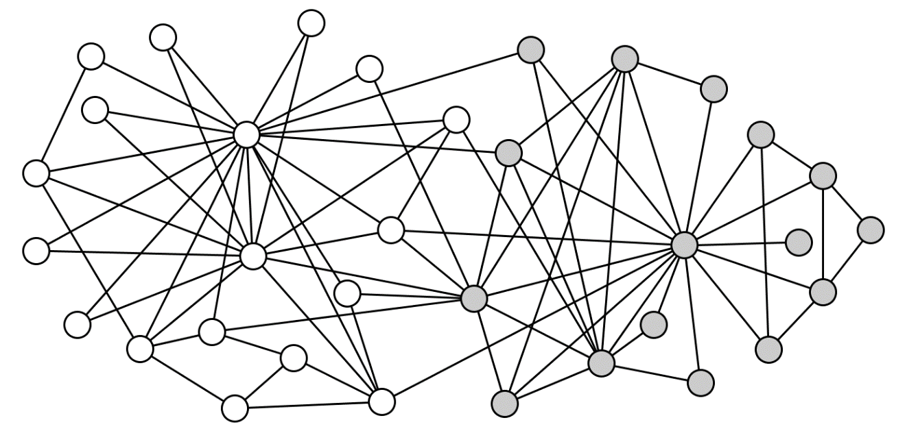
Datasets with known communities
Amazon Books
  US Politics books : liberal, conservative, neutral.
Karate Club
  Two fractions within the members of the club.
Notes:
Our goal is to see if our labeling agrees with the hypothesis of Easley and Kleinberg. For this experiment we use two datasets with known communities. Amazon books dataset contains a set of books about US politics. There are three communities depending of the political view of the books: liberal, conservative and neutral.
The second one is the. Karate Club graph which consists of two different fractions within the members of a karate club centered around the two trainers. The figure shows the graph and the two communities in different color.

Slide 61
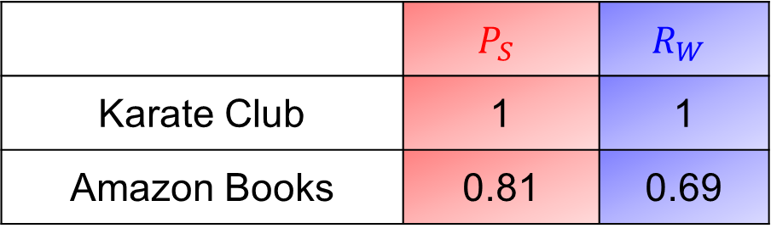
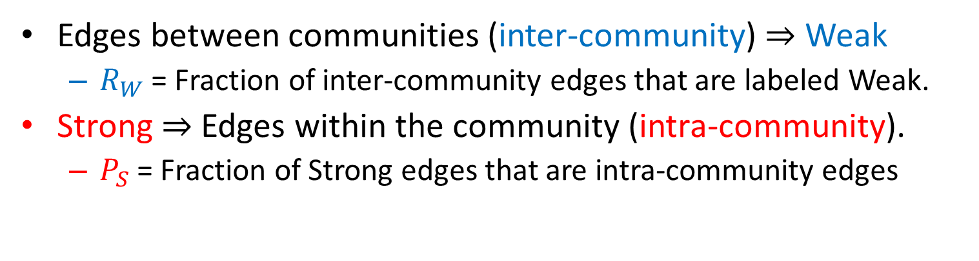
Weak Edges as Bridges
Edges between communities (inter-community) ⇒ Weak
  $R_{W}$= Fraction of inter-community edges that are labeled Weak.
Strong ⇒ Edges within the community (intra-community).
  $P_{S}$= Fraction of Strong edges that are intra-community edges
 | $$P_{S}$$ | $$R_{W}$$
Karate Club | 1 | 1
Amazon Books | 0.81 | 0.69
Notes:
Given a labeling of the edges as Strong or Weak, in accordance with the hypothesis of Easley and Kleinberg the weak edges should act as bridges in a graph. More specifically, we want most of edges between communities, the inter-community edges to be labeled weak.
To measure this we define R_w as the fraction of inter-community edges that are labeled weak, and we would like this to be close to 1.
Furthermore, we would like most of the strong edges to be confined within a community, to be intra community edges.
In order to measure this, we define P_s as the fraction of Strong edges that are intra-community edges. Again we want this to be close to 1.
In this table you see the results for our 2 datasets. For the Karate Club we have a perfect precision and a perfect recall. That means that all inter-community edges are weak, and all of strong labels are on intra-community edges. For the Amazon Book Dataset we have P_s greater than 80% and R_w close to 70%. The Rw value is affected by the fact that there are many strong inter community edges between neutral books and books from another category. It is intuitive that people often buy neutral books with conservatives or liberal books leading to this high number of strong connections across communities.

Slide 62
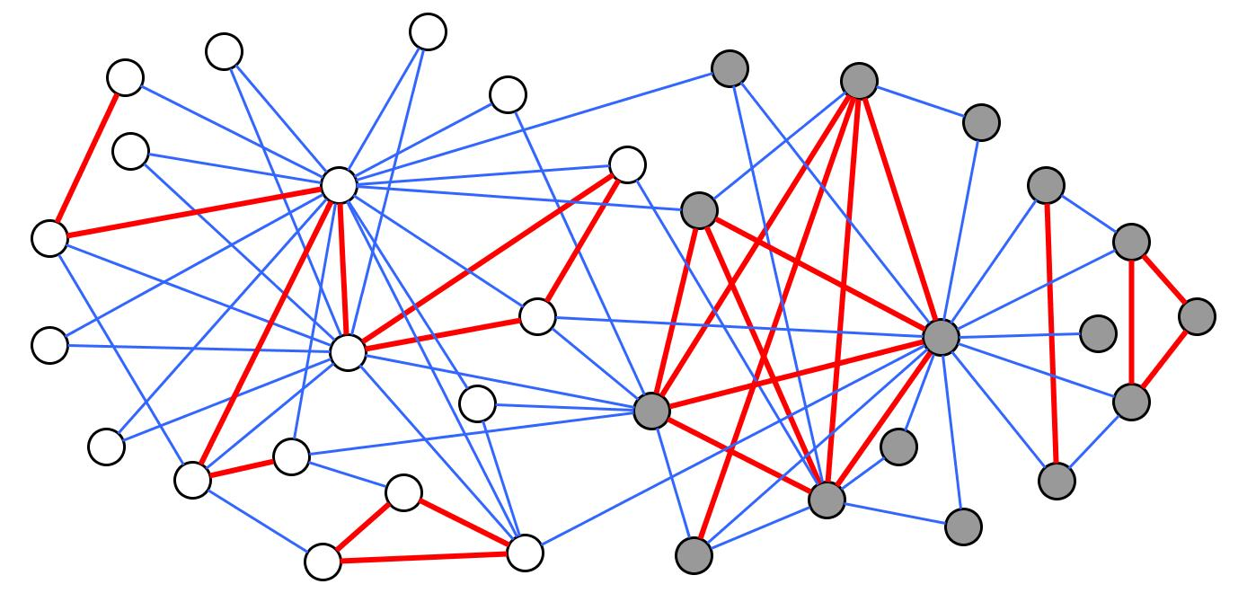
Karate Club graph
Notes:
Here, we visualize the results of the greedy algorithm for the karate club dataset. You can observe that all of the red strong edges are within the communities, while all of the edges that connect nodes from different fractions are weak.

Slide 63
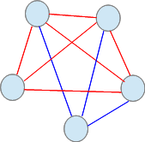
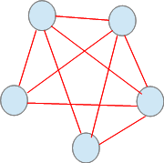
Extensions
Allow for edge additions
  Still a coverage problem: an open triangle can be covered with either a weak edge or an added edge
Allow k types of strong of edges
  Vertex Coloring of the dual graph with a neutral color
  Approximation algorithm for k=2 types, hard to approximate for k > 2

Slide 64
POSITIVE AND NEGATIVE TIES

Slide 65
Structural Balance
What about negative edges?
Initially, a complete graph (or clique): every edge either + or -
  Let us first look at individual triangles
  Lets look at 3 people => 4 cases
  See if all are equally possible (local property)

Slide 66
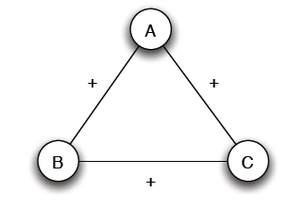
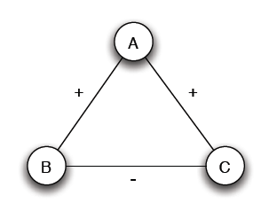
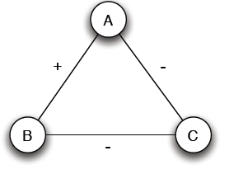
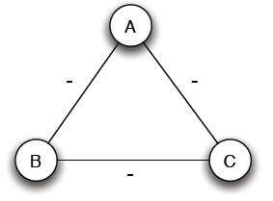
Structural Balance
Case (a): 3 +
Case (b): 2 +, 1 -
Mutual friends
A is friend with B and C, but B and C do not get well together
Case (c): 1 +, 2 -
Case (d): 3 -
Mutual enemies
A and B are friends with a mutual enemy

Slide 67
Structural Balance
Case (a): 3 +
Case (b): 2 +, 1 -
Stable or balanced
Unstable
Mutual friends
A is friend with B and C, but B and C do not get well together
Implicit force to make B and C friends (- => +) or turn one of the + to -
Case (c): 1 +, 2 -
Case (d): 3 -
Stable or balanced
Unstable
Mutual enemies
Forces to team up against the third (turn 1 – to +)
A and B are friends with a mutual enemy

Slide 68
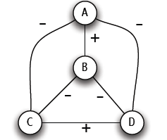
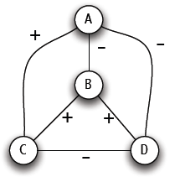
Structural Balance
A labeled complete graph is balanced if every one of its triangles is balanced
Structural Balance Property: For every set of three nodes, if we consider the three edges connecting them, either all three of these are labeled +, or else exactly one of them is labeled – (odd number of +)
What does a balanced network look like?

Slide 69
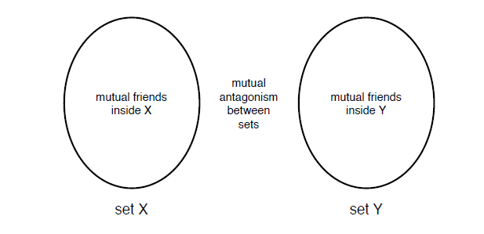
The Structure of Balanced Networks
Balance Theorem: If a labeled complete graph is balanced,
all pairs of nodes are friends, or
the nodes can be divided into two groups X and Y, such that every pair of nodes in X like each other, every pair of nodes in Y like each other, and every one in X is the enemy of every one in Y.
From a local to a global property
Proof ...

Slide 70
Applications of Structural Balance
How a network evolves over time
Political science: International relationships (I)
The conflict of Bangladesh’s separation from Pakistan in 1972 (1)
₋
USSR
N. Vietnam
USA
Pakistan
-
-
-
₊
Bangladesh
China
-
India
USA support to Pakistan?

Slide 71
Applications of Structural Balance
International relationships (I)
The conflict of Bangladesh’s separation from Pakistan in 1972 (II)
₊
₋
USSR
N. Vietnam
USA
Pakistan
-
-
₊
-
Bangladesh
China
-
India
China?

Slide 72
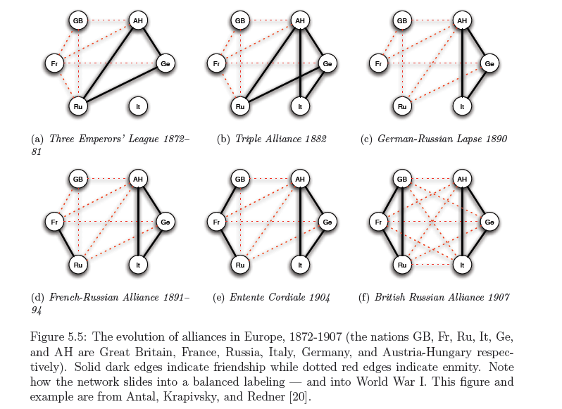
Applications of Structural Balance
International relationships (II)

Slide 73
A Weaker Form of Structural Balance
Allow this
Weak Structural Balance Property: There is no set of three nodes such that the edges among them consist of exactly two positive edges and one negative edge

Slide 74
A Weaker Form of Structural Balance
Weakly Balance Theorem: If a labeled complete graph is weakly balanced, its nodes can be divided into groups in such a way that every two nodes belonging to the same group are friends, and every two nodes belonging to different groups are enemies.
Proof …

Slide 75
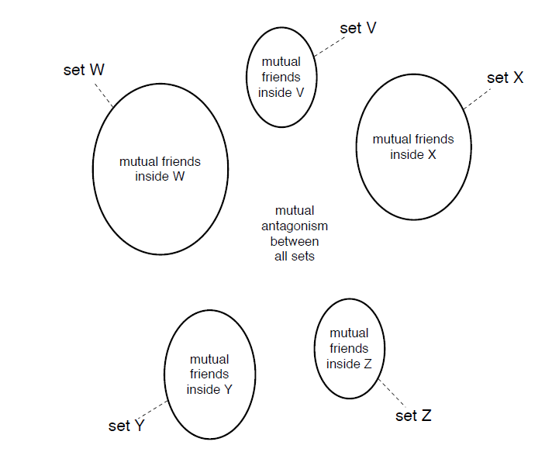
A Weaker Form of Structural Balance

Slide 76
Trust, distrust and directed graphs
Evaluation of products and trust/distrust of other users
Directed Graphs
A
A
C
C
+
-
+
-
B
B
A trusts B, B trusts C, A ? C
A distrusts B, B distrusts C, A ? C
If distrust enemy relation, +
A distrusts means that A is better than B, -
Depends on the application
Rating political books or
Consumer rating electronics products

Slide 77
Generalizing
Non-complete graphs
Instead of all triangles, “most” triangles, approximately divide the graph
We shall use the original (“non-weak” definition of structural balance)

Slide 78
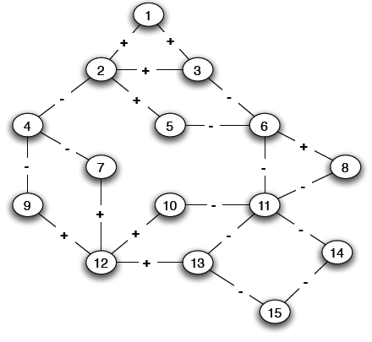
Structural Balance in Arbitrary Graphs
Thee possible relations
Positive edge
Negative edge
Absence of an edge
What is a good definition of balance in a non-complete graph?

Slide 79
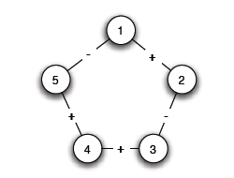
Balance Definition for General Graphs
Based on triangles (local view)
Division of the network (global view)
A (non-complete) graph is balanced if it can be completed by adding edges to form a signed complete graph that is balanced
-
+

Slide 80
Balance Definition for General Graphs
+

Slide 81
Balance Definition for General Graphs
Based on triangles (local view)
Division of the network (global view)
A (non-complete) graph is balanced if it possible to divide the nodes into two sets X and Y, such that any edge with both ends inside X or both ends inside Y is positive and any edge with one end in X and one end in Y is negative
The two definition are equivalent:
An arbitrary signed graph is balanced under the first definition, if and only if, it is balanced under the second definitions

Slide 82
Balance Definition for General Graphs
Algorithm for dividing the nodes?

Slide 83
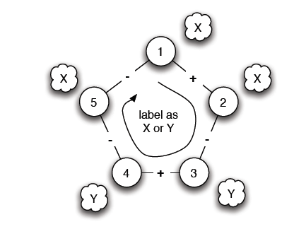
Balance Characterization
What prevents a network from being balanced?
Start from a node and place nodes in X or Y
Every time we cross a negative edge, change the set
Cycle with odd number of negative edges

Slide 84
Balance Definition for General Graphs
Cycle with odd number of - => unbalanced
Is there such a cycle with an odd number of -?

Slide 85
Balance Characterization
Claim: A signed graph is balanced, if and only if, it contains no cycles with an odd number of negative edges
(proof by construction)
Find a balanced division: partition into sets X and Y, all edges inside X and Y positive, crossing edges negative
Either succeeds or Stops with a cycle containing an odd number of -
Two steps:
Convert the graph into a reduced one with only negative edges
Solve the problem in the reduced graph

Slide 86

Balance Characterization: Step 1
a. Find connected components (supernodes) by considering only positive edges
b. Check: Do supernodes contain a negative edge between any pair of their nodes
(a) Yes -> odd cycle (1)
(b) No -> each supernode either X or Y

Slide 87


Balance Characterization: Step 1
3. Reduced problem: a node for each supernode, an edge between two supernodes if an edge in the original

Slide 88

Balance Characterization: Step 2
Note: Only negative edges among supernodes
Start labeling by either X and Y
If successful, then label the nodes of the supernode correspondingly
A cycle with an odd number, corresponds to a (possibly larger) odd cycle in the original

Slide 89
Balance Characterization: Step 2
Determining whether the graph is bipartite (there is no edge between nodes in X or Y, the only edges are from nodes in X to nodes in Y)
Use Breadth-First-Search (BFS)
Two type of edges: (1) between nodes in adjacent levels (2) between nodes in the same level
If only type (1), alternate X and Y labels at each level
If type (2), then odd cycle

Slide 90

Balance Characterization

Slide 91
Generalizing
Non-complete graphs
Instead of all triangles, “most” triangles, approximately divide the graph

Slide 92
Approximately Balance Networks
a complete graph (or clique): every edge either + or -
Claim: If all triangles in a labeled complete graph are balanced, than either
all pairs of nodes are friends or,
the nodes can be divided into two groups X and Y, such that
  every pair of nodes in X like each other,
  every pair of nodes in Y like each other, and
  every one in X is the enemy of every one in Y.
Not all, but most, triangles are balanced
Claim: If at least 99.9% of all triangles in a labeled compete graph are balanced, then either,
There is a set consisting of at least 90% of the nodes in which at least 90% of all pairs are friends, or,
the nodes can be divided into two groups X and Y, such that
  at least 90% of the pairs in X like each other,
  at least 90% of the pairs in Y like each other, and
  at least 90% of the pairs with one end in X and one in Y are enemies

Slide 93
Approximately Balance Networks
Claim: If at least 99.9% of all triangles in a labeled complete graph are balanced, then either,
There is a set consisting of at least 90% of the nodes in which at least 90% of all pairs are friends, or,
the nodes can be divided into two groups X and Y, such that
  at least 90% of the pairs in X like each other,
  at least 90% of the pairs in Y like each other, and
  at least 90% of the pairs with one end in X and one in Y are enemies
Claim: Let ε be any number, such that 0 ≤ ε < 1/8. If at least 1 – ε of all triangles in a labeled complete graph are balanced, then either
There is a set consisting of at least 1-δ of the nodes in which at least 1-δ of all pairs are friends, or,
the nodes can be divided into two groups X and Y, such that
  at least 1-δ of the pairs in X like each other,
  at least 1-δ of the pairs in Y like each other, and
  at least 1-δ of the pairs with one end in X and one in Y are enemies

Slide 94
References
Networks, Crowds, and Markets (Chapter 3, 5)
S. Sintos, P. Tsaparas, Using Strong Triadic Closure to Characterize Ties in Social Networks. ACM International Conference on Knowledge Discovery and Data Mining (KDD), August 2014

