Slide 1
Λ14 Διαδικτυακά Κοινωνικά Δίκτυα και Μέσα
Link Prediction

Slide 2
Motivation
Recommending new friends in online social networks.
Predicting the participation of actors in events
Suggesting interactions between the members of a company/organization that are external to the hierarchical structure of the organization itself.
Predicting connections between members of terrorist organizations who have not been directly observed to work together.
Suggesting collaborations between researchers based on co-authorship.
Overcoming the data-sparsity problem in recommender systems using collaborative filtering

Slide 3
Motivation
In social networks:
Increases user engagement
Controls the growth of the network

Slide 4
Outline
Estimating a score for each edge (seminal work of Liben-Nowell&Kleinberg)
Classification approach
The who to follow service at Twitter

Slide 5
Problem Definition
Link prediction problem: Given the links in a social network at time t, predict the edges that will be added to the network during the time interval from time t to a given future time t’
Based solely on the topology of the network (social proximity) (the more general problem also considers attributes of the nodes and links)
Different from the problem of inferring missing (hidden) links (there is a temporal aspect)
  To save experimental effort in the laboratory or in the field

Slide 6
Problem Formulation (details)
Consider a social network G = (V, E) where each edge e = <u, v> ∈ E represents an interaction between u and v that took place at a particular time t(e)
(multiple interactions between two nodes as parallel edges with different timestamps)
For two times, t < t′, let G[t, t′] denote subgraph of G consisting of all edges with a timestamp between t and t′
For four times, t₀ < t′₀ < t₁ < t′₁, given G[t₀, t′₀], we wish to output a list of edges not in G[t₀, t′ ₀] that are predicted to appear in G[t₁, t′₁]
[t₀, t′₀] training interval
[t₁, t′₁] test interval

Slide 7
Problem Formulation (details)
Prediction for a subset of nodes
Two parameters: κ_{training} and κ_{test}
Core: all nodes that are incident to at least κ_{training} edges in G[t₀, t′₀], and at least κ_{test} edges in G[t₁, t′₁]
Predict new edges between the nodes in Core

Slide 8
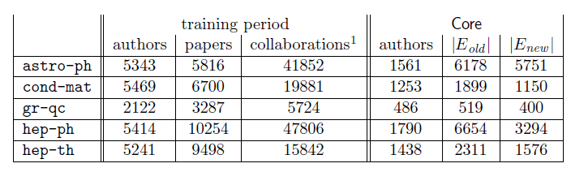
Example Dataset: co-authorship
t₀ = 1994, t′₀ = 1996: training interval -> [1994, 1996]
t₁ = 1997, t′₁ = 1999: test interval -> [1997, 1999]
- G_{collab} = <V, E_{old}> = G[1994, 1996]
- E_{new}: authors in V that co-author a paper during the test interval but not during the training interval
κ_{training} = 3, κ_{test} = 3: Core consists of all authors who have written at least 3 papers during the training period and at least 3 papers during the test period
Predict E_{new}

Slide 9
Methods for Link Prediction (outline)
Assign a connection weight score(x, y) to each pair of nodes <x, y> based on the input graph
Produce a ranked list of decreasing order of score
We can consider all links incident to a specific node x, and recommend to x the top ones
If we focus to a specific x, the score can be seen as a centrality measure for x

Slide 10
Methods for Link Prediction (outline)
How to assign the score(x, y) between two nodes x and y?
Some form of similarity or node proximity

Slide 11
Methods for Link Prediction: Neighborhood-based
The larger the overlap of the neighbors of two nodes, the more likely the nodes to be linked in the future

Slide 12


Methods for Link Prediction: Neighborhood-based
Let Γ(x) denote the set of neighbors of x in G_{old}
Common neighbors:
A adjacency matrix
A_{x,y}² :Number of different paths of length 2
Jaccard coefficient:
The probability that both x and y have a feature for a randomly selected feature that either x or y has

Slide 13

Methods for Link Prediction: Neighborhood-based
Adamic/Adar
Assigns large weights to common neighbors z of x and y which themselves have few neighbors (weight rare features more heavily)
Neighbors who are linked with 2 nodes are assigned weight = 1/log(2) = 1.4
Neighbors who are linked with 5 nodes are assigned weight = 1/log(5) = 0.62

Slide 14
Methods for Link Prediction: Neighborhood-based
Preferential attachment
Based on the premise that the probability that a new edge has node x as its endpoint is proportional to |Γ(x)|, i.e., nodes like to form ties with ‘popular’ nodes
Researchers found empirical evidence to suggest that co-authorship is correlated with the product of the neighborhood sizes
This depends on the degrees of the nodes not on their neighbors per se

Slide 15
Methods for Link Prediction: Neighborhood-based
Overlap
Jaccard
Adamic/Adar
Preferential attachment

Slide 16
Methods for Link Prediction: Shortest Path
For x, y ∈ V × V − E_{old},
score(x, y) = (negated) length of shortest path between x and y
If there are more than n pairs of nodes tied for the shortest path length, order them at random.

Slide 17
Methods for Link Prediction: based on the ensemble of all paths
Not just the shortest, but all paths between two nodes

Slide 18

Methods for Link Prediction: based on the ensemble of all paths
Katz_{β} measure
Sum over all paths of length l
β > 0 (< 1) is a parameter of the predictor, exponentially damped to count short paths more heavily
Small β predictions much like common neighbors
β = 0, degree, maximal β, eigenvalue

Slide 19


Methods for Link Prediction: based on the ensemble of all paths
Katz_{β} measure
Closed form:
Unweighted version, in which path_{x,y}⁽¹⁾ = 1, if x and y have collaborated, 0 otherwise
Weighted version, in which path_{x,y}⁽¹⁾ = #times x and y have collaborated

Slide 20
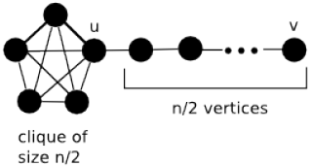

Methods for Link Prediction: based on the ensemble of all paths
Consider a random walk on G_{old} that starts at x and iteratively moves to a neighbor of x chosen uniformly at random from Γ(x).
The Hitting Time H_{x,y} from x to y is the expected number of steps it takes for the random walk starting at x to reach y.
score(x, y) = − H_{x,y}
The Commute Time C_{x,y} from x to y is the expected number of steps to travel from x to y and from y to x
score(x, y) = − (H_{x,y} + H_{y,x})
Not symmetric, can be shown

Slide 21
Methods for Link Prediction: based on the ensemble of all paths
Example: hit time in a line
1
i-1 i i+1
n
Can also consider stationary-normed versions:
(to counteract the fact that H_{x,y} is rather small when y is a node with a large stationary probability)
score(x, y) = − H_{x,y} π_{y}
score(x, y) = −(H_{x,y} π_{y} + H_{y,x} π_{x})

Slide 22
Methods for Link Prediction: based on the ensemble of all paths
The hitting time and commute time measures are sensitive to parts of the graph far away from x and y -> periodically reset the walk
Random walk on G_{old} that starts at x and has a probability α of returning to x at each step
Rooted Page Rank: Starts from x, with probability (1 – a) moves to a random neighbor and with probability a returns to x
score(x, y) = stationary probability of y in a rooted PageRank

Slide 23

Methods for Link Prediction: based on the ensemble of all paths
SimRank
Two objects are similar, if they are related to similar objects
Two objects x and y are similar, if they are related to objects a and b respectively and a and b are themselves similar
Base case: similarity(x, x) = 1
Average similarity between neighbors of x and neighbors of y
score(x, y) = similarity(x, y)

Slide 24

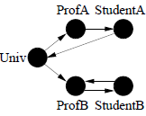
SimRank
Introduced for directed graphs, I(x): in-neighbors of x
Average similarity between in-neighbors of a and in-neighbors of b
C a constant between 0 and 1
n² equations
Iterative computation
s₀(x, y) = 1 if x = y and 0 otherwise
s_{k+1} based on the s_{k} values of its (in-neighbors) computed at iteration k

Slide 25
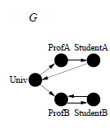
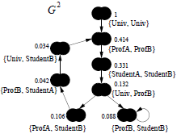
SimRank
Graph G²:
A node for each pair of nodes
(x, y) → (a, b), if x → a and y → b
Scores flow from a node to its neighbors
C gives the rate of decay as similarity flows across edges (C = 0.8 in the example)
Self-loops
Prune by considering only nodes within a a radius

Slide 26
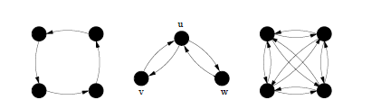
SimRank
Expected Meeting Distance (EMD): how soon two random surfers are expected to meet at the same node if they started at nodes x and y and randomly walked (in lock step) the graph backwards
m(u, v) = m(u,w) = ∞, m(v, w) = 1
v and w are much more similar than u is to v or w.
= ∞
= 3,
a lower similarity than between v and w but higher than between u and v (or u and w).

Slide 27
SimRank
Let us consider G²
A node (a, b) as a state of the tour in G: if a moves to c, b moves to d in G, then (a, b) moves to (c, d) in G²
A tour in G² of length n represents a pair of tours in G where each has length n
What are the states in G² that correspond to “meeting” points?

Slide 28
SimRank
What are the states in G² that correspond to “meeting” points?
Singleton nodes (common neighbors)
The EMD m(a, b) is just the expected distance (hitting time) in G² between (a, b) and any singleton node
The sum is taken over all walks that start from (a, b) and end at a singleton node

Slide 29
SimRank for bipartite graphs

Slide 30
SimRank
…
…
Q: What is most related
conference to ICDM?
…
…
Author
Conference

Slide 31
SimRank

Slide 32
Methods for Link Prediction: based on paths
Shortest paths
Katz
Hitting and commute time
Rooted page rank
SimRank

Slide 33
Methods for Link Prediction: other
Low rank approximations
M adjacency matrix , represent M with a lower rank matrix M_{k}
Apply SVD (singular value decomposition)
The rank-k matrix that best approximates M

Slide 34
Singular Value Decomposition
r : rank of matrix A
σ₁≥ σ₂≥ … ≥σ_{r} : singular values (square roots of eig-vals AA^{T}, A^{T}A)
: left singular vectors (eig-vectors of AA^{T})
: right singular vectors (eig-vectors of A^{T}A)
[n×r]
[r×r]
[r×n]

Slide 35


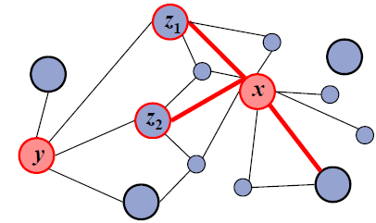
Methods for Link Prediction: other
Unseen Bigrams
Unseen bigrams: pairs of word that co-occur in a test corpus, but not in the corresponding training corpus
Not just score(x, y) but score(z, y) for nodes z that are similar to x --- S_{x}^{(δ)} the δ nodes most related to x

Slide 36
Methods for Link Prediction: High-level approaches
Clustering
Compute score(x, y) for al edges in E_{old}
Delete the (1-p) fraction of the edges whose score is the lowest, for some parameter p
Recompute score(x, y) for all pairs in the subgraph

Slide 37
How to Evaluate the Prediction (outline)
Each link predictor p outputs a ranked list L_{p} of pairs in V × V − E_{old}: predicted new collaborations in decreasing order of confidence
In this paper, focus on Core, thus
E∗_{new} = E_{new} ∩ (Core × Core) = |E∗_{new}|
Evaluation method: Size of the intersection of
  the first n edge predictions from L_{p} that are in Core × Core, and
  the set E∗_{new}
How many of the (relevant) top-n predictions are correct (precision?)

Slide 38
Evaluation: baseline
Baseline: random predictor
Randomly select pairs of authors who did not collaborate in the training interval
Probability that a random prediction is correct:
In the datasets, from 0.15% (cond-mat) to 0.48% (astro-ph)

Slide 39
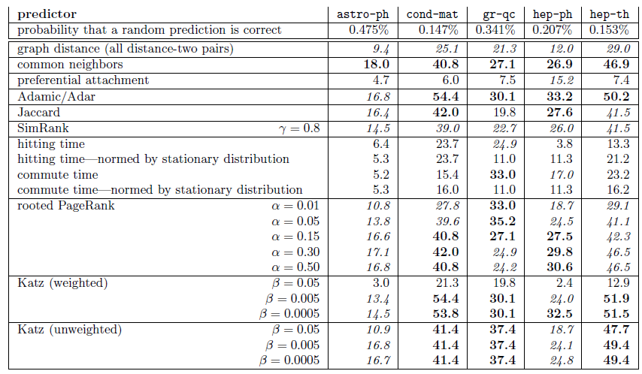
Evaluation: Factor improvement over random

Slide 40
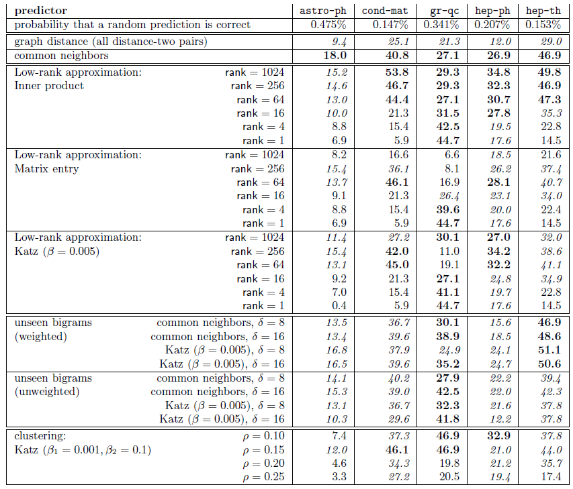
Evaluation: Factor improvement over random

Slide 41
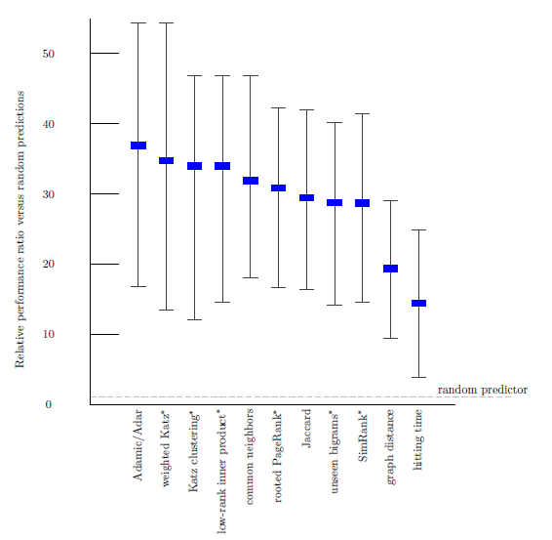
Evaluation: Average relevance performance (random)
average ratio over the five datasets of the given predictor's performance versus a baseline predictor's performance.
the error bars indicate the minimum and maximum of this ratio over the five datasets.
the parameters for the starred predictors are: (1) for weighted Katz, β= 0.005; (2) for Katz clustering, β1 = 0.001; ρ = 0.15; β2 = 0.1; (3) for low-rank inner product, rank = 256; (4) for rooted Pagerank, α = 0.15; (5) for unseen bigrams, unweighted, common neighbors with δ = 8; and (6) for SimRank, C ( γ) = 0.8.

Slide 42
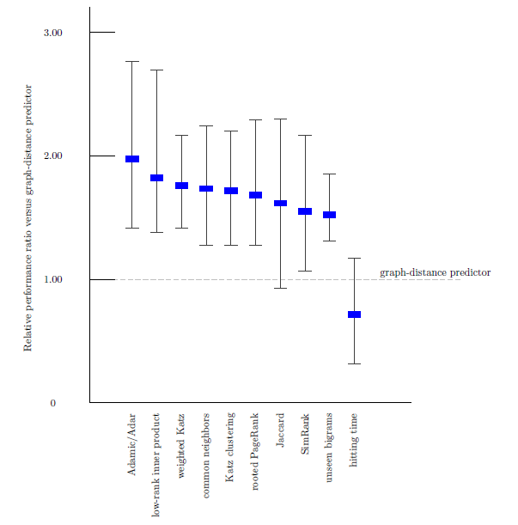
Evaluation: Average relevance performance (distance)

Slide 43
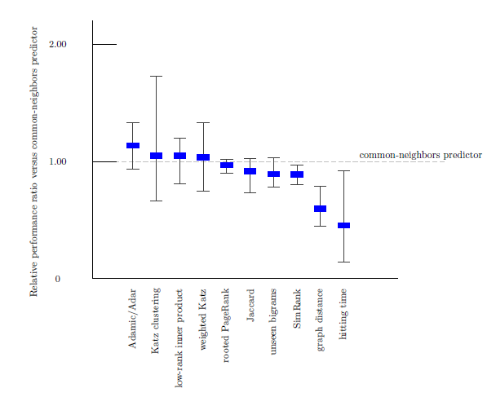
Evaluation: Average relevance performance (neighbors)

Slide 44
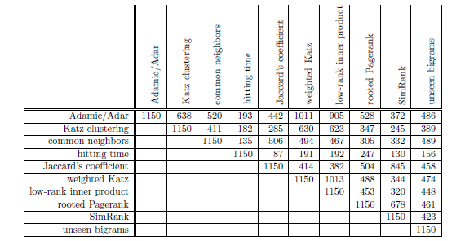
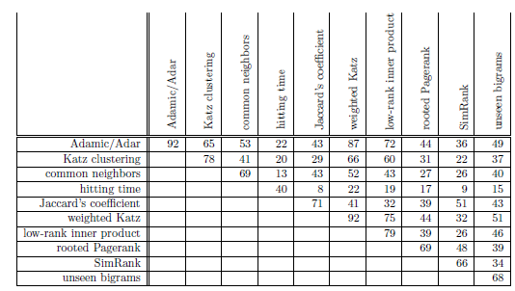
Evaluation: prediction overlap
How much similar are the predictions made by the different methods?
Why?
correct

Slide 45
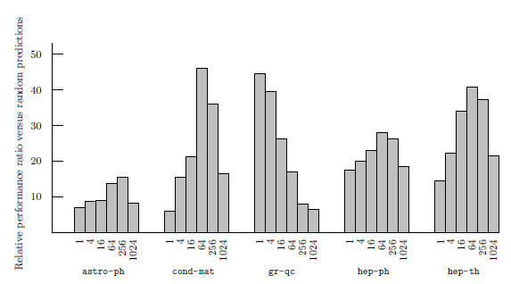
Evaluation: datasets
How much does the performance of the different methods depends on the dataset?
(rank) On 4 of the 5 datasets best at an intermediate rank
On qr-qc, best at rank 1, does it have a “simpler” structure”?
On hep-ph, preferential attachment the best
Why is astro-ph “difficult”?
The culture of physicists and physics collaboration

Slide 46
Evaluation: small world
The shortest path even in unrelated disciplines is often very short
Basic classifier on graph distances does not work

Slide 47
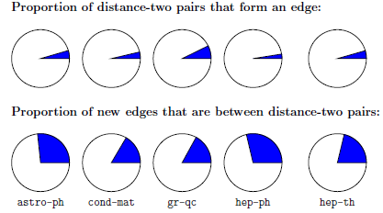
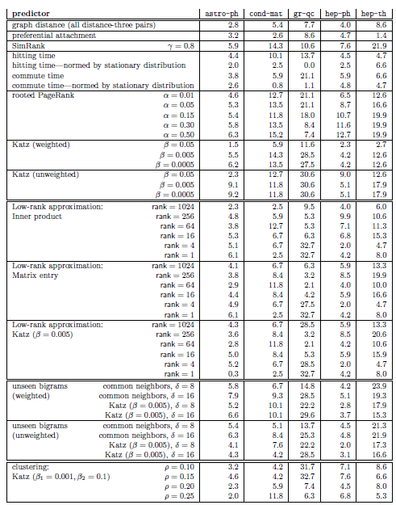

Evaluation: restricting to distance three
Many pairs of authors separated by a graph distance of 2 will not collaborate and
Many pairs who collaborate are at distance greater than 2
Disregard all distance 2 pairs (do not just “close” triangles)

Slide 48
Evaluation: the breadth of data
Three additional datasets
Proceedings of STOC and FOCS
Papers for Citeseer
All five of the arXiv sections
Common neighbors vs Random
Suggests that is easier to predict links within communities

Slide 49
Extensions
Improve performance. Even the best (Katz clustering on gr-qc) correct on only about 16% of its prediction
Improve efficiency on very large networks (approximation of distances)
Treat more recent collaborations as more important
Additional information (paper titles, author institutions, etc)
To some extent latently present in the graph

Slide 50
Outline
Estimating a score for each edge (seminal work of Liben-Nowell&Kleinberg
  Neighbors measures, Distance measures, Other methods
  Evaluation
Classification approach
Twitter

Slide 51
Using Supervised Learning
Given a collection of records (training set )
Each record contains
a set of attributes (features) + the class attribute.
Find a model for the class attribute as a function of the values of other attributes.
Goal: previously unseen records should be assigned a class as accurately as possible.
A test set is used to determine the accuracy of the model.
Usually, the given data set is divided into training and test sets, with training set used to build the model and test set used to validate it.

Slide 52
Illustrating the Classification Task

Slide 53
Classification Techniques
Decision Tree based Methods
Rule-based Methods
Memory based reasoning
Neural Networks
Naïve Bayes and Bayesian Belief Networks
Support Vector Machines
Logistic Regression

Slide 54
Example of a Decision Tree
categorical
categorical
continuous
class
Splitting Attributes
Refund
Yes
No
NO
MarSt
Single, Divorced
Married
TaxInc
NO
< 80K
> 80K
NO
YES
Training Data
Model: Decision Tree

Slide 55
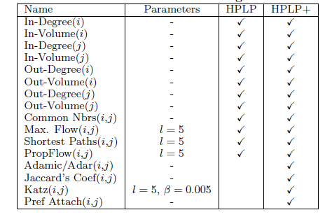
Classification for Link Prediction
Class?
Features (predictors)?
PropFlow: random walks, stops at l or when cycle

Slide 56
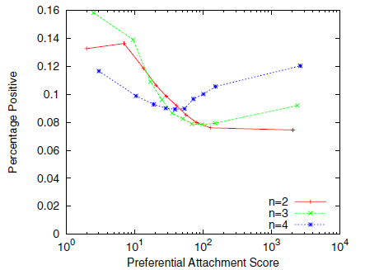
Using Supervised Learning: why?
Even training on a single feature may outperform ranking (restriction to n-neighborhoods)
Dependencies between features

Slide 57
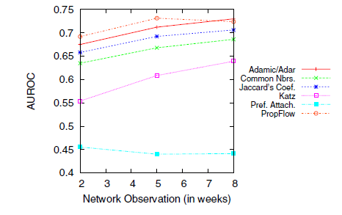
How to split the graph to get train data
tx length of computing features – ty length of determining the class attribute
Large tx => better quality of features as the network reaches saturation
Increasing ty increases positives

Slide 58
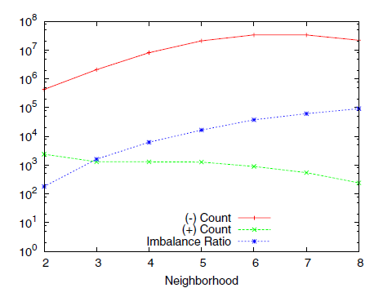
Imbalance
Sparse networks: |E| = k |V| for constant k << |V|
The class imbalance ratio for link prediction in a sparse network is Ω(|V|/1) when at most |V| nodes are added
Missing links is |V|²
Positives V
Treat each neighborhood as a separate problem

Slide 59
Metrics for Performance Evaluation
Confusion Matrix:
 | PREDICTED CLASS
ACTUAL CLASS |  | Class=Yes | Class=No
 | Class=Yes | TP | FN
 | Class=No | FP | TN

Slide 60
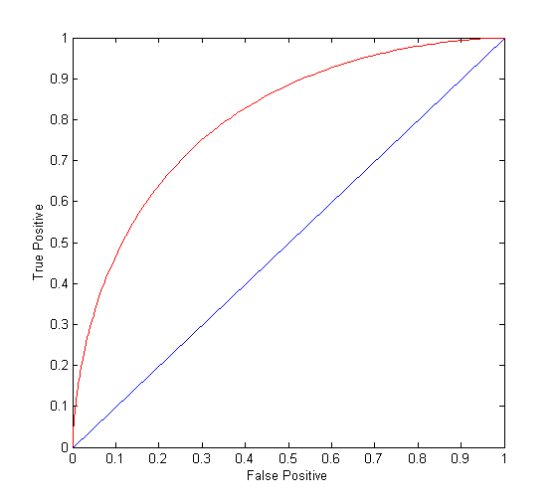
ROC Curve
TPR (sensitivity)=TP/(TP+FN) (percentage of positive classified as such)
FPR = FP/(TN+FP) (percentage of negative classified as positive)
(0,0): declare everything
to be negative class
(1,1): declare everything
to be positive class
(0,1): ideal
Diagonal line: Random guessing
Below diagonal line: prediction is opposite of the true class
AUC: area under the ROC

Slide 61
Results
Ensemble of classifiers: Random Forest
Random forest: Ensemble classifier that constructs a multitude of decision trees at training time and output the class that is the mode (most frequent) of the classes (classification) or mean prediction (regression) of the individual trees.

Slide 62
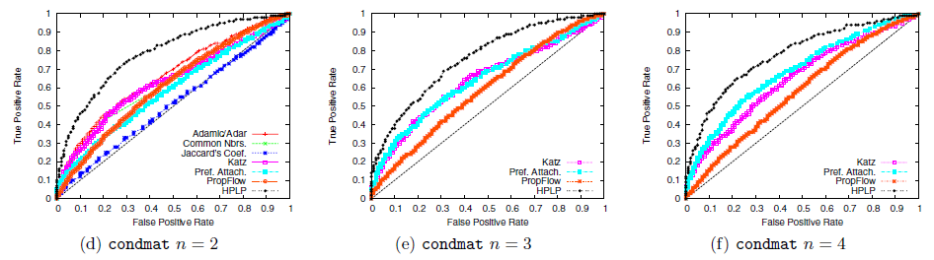
Results

Slide 63
Outline
Estimating a score for each edge (seminal work of Liben-Nowell&Kleinberg
  Neighbors measures, distance measures, other methods
  Evaluation
Classification approach
  Brief background on classification
  Issues
The who to follow service at Twitter
    Some practical considerations
    Overall architecture of a real social network
    SALSA (yet another link analysis algorithm
    Some evaluation issues

Slide 64
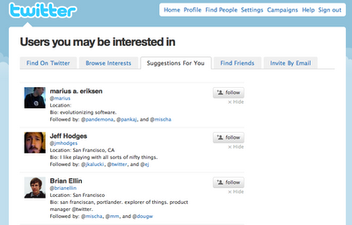
Introduction
Wtf (“Who to Follow"): the Twitter user recommendation service
Twitter: 200 million users, 400 million tweets every day (as of early 2013)
http://www.internetlivestats.com/twitter-statistics/
Twitter needs to help existing and new users to discover connections to sustain and grow
Also used for search relevance, discovery, promoted products, etc.

Slide 65
Introduction
Difference between:
Interested in
Similar to
Is it a “social” network as Facebook?

Slide 66
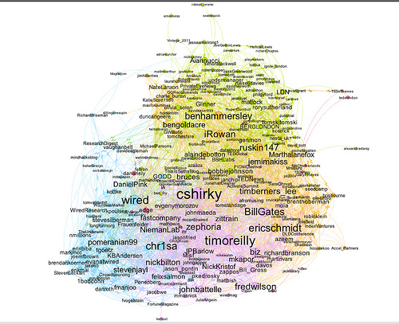
The Twitter graph
Node: user (directed) edge: follows
Statistics (August 2012)
  over 20 billion edges (only active users)
  power law distributions of in-degrees and out-degrees.
  over 1000 with more than 1 million followers,
  25 users with more than 10 million followers.
http://blog.ouseful.info/2011/07/07/visualising-twitter-friend-connections-using-gephi-an-example-using-wireduk-friends-network/

Slide 67
The Twitter graph: storage
Stored in a graph database called FlockDB which uses MySQL as the underlying storage engine
Sharding and replication by a framework called Gizzard
Both custom solutions developed internally but open sourced
FlockDB holds the “ground truth" for the state of the graph
Optimized for low-latency, high-throughput reads and writes, and efficient intersection of adjacency lists (needed to deliver @-replies, or messages targeted to a specific user received mutual followers of the sender and recipient)
  hundreds of thousands of reads per second and tens of thousands of writes per second.

Slide 68
The Twitter graph: analysis
Instead of simple get/put queries, many graph algorithms involve large sequential scans over many vertices followed by self-joins (for example, to materialize egocentric follower neighborhoods)
not time sensitive unlike graph manipulations tied directly to user actions (adding a follower) which have tight latency bounds.
OLAP (online analytical processing) vs. OLTP (online transaction processing)
analytical workloads that depend on sequential scans vs. short, primarily seek-based workloads that provide an interactive service

Slide 69
The Twitter graph: analysis
Instead of simple get/put queries, many graph algorithms involve large sequential scans over many vertices followed by self-joins (for example, to materialize egocentric follower neighborhoods)
not time sensitive unlike graph manipulations tied directly to user actions (adding a follower) which have tight latency bounds.
OLAP (online analytical processing) vs. OLTP (online transaction processing)
analytical workloads that depend on sequential scans vs. short, primarily seek-based workloads that provide a user-facing service

Slide 70
History of WTF
3 engineers, project started in spring 2010, product delivered in summer 2010
Basic assumption: the whole graph fits into memory of a single server

Slide 71
Design Decisions: To Hadoop or not?
Case study: MapReduce implementation of PageRank
Each iteration a MapReduce job
Serialize the graph as adjacency lists for each vertex, along with the current PageRank value.
Mappers process all vertices in parallel: for each vertex on the adjacency list, the mapper emits an intermediate key-value pair: (destination vertex, partial PageRank)
Gather all key-value pairs with the same destination vertex, and each Reducer sums up the partial PageRank contributions
Convergence requires dozens of iterations. A control program sets up the MapReduce job, waits for it to complete, and checks for convergence by reading in the updated PageRank vector and comparing it with the previous.
This basic structure can be applied to a large class of “message-passing" graph (e.g., breadth-first search)

Slide 72
Design Decisions: To Hadoop or not?
Shortcomings of MapReduce implementation of PageRank
MapReduce jobs have relatively high startup costs (in Hadoop, on a large, busy cluster, can be tens of seconds) , this places a lower bound on iteration time.
Scale-free graphs, whose edge distributions follow power laws, create stragglers in the reduce phase. (e.g., the reducer assigned to google.com) Combiners and other local aggregation techniques help
Must shuffle the graph structure (i.e., adjacency lists) from the mappers to the reducers at each iteration. Since in most cases the graph structure is static, wasted effort (sorting, network traffic, etc.).
The PageRank vector is serialized to HDFS, along with the graph structure, at each iteration. Excellent fault tolerance, but at the cost of performance.

Slide 73
Design Decisions: To Hadoop or not?
Besides Hadoop:
Improvements: HaLoop Twister, and PrIter
Alternatives:
Google's Pregel implements the Bulk Synchronous Parallel model : computations at graph vertices that dispatch “messages" to other vertices. Processing proceeds in supersteps with synchronization barriers between each.
GraphLab and its distributed variant: computations either through an update function which defines local computations (on a single vertex) or through a sync mechanism which defines global aggregation in the context of different consistency models.

Slide 74
Design Decisions: To Hadoop or not?
Decided to build their own system
Hadoop reconsidered:
new architecture completely on Hadoop
in Pig a high-level dataflow language for large, semi-structured datasets compiled into physical plans executed on Hadoop
Pig Latin primitives for projection, selection, group, join, etc.
Why not some other graph processing system?
For compatibility, e.g., to use existing analytics hooks for job scheduling, dependency management, etc.

Slide 75
Design Decisions: How much memory?
in-memory processing on a single server
Why?
The alternative (a partitioned, distributed graph processing engine) significantly more complex and difficult to build,
It was feasible (72GB -> 144GB, 5 bytes per edge (no metadata); 24-36 months lead time)
In memory – not uncommon (google indexes + Facebook, Twitter many cache servers
A single machine
  Graph distribution still hard (hash partitioning, minimize the number of edges that cross-partition (two stage, over partition #clusters>>#servers, still skew problems), use replication to provide n-hop guarantee (all n-neighbors in a singe site)
  Avoids extra protocols (e.g., replication for fault-tolerance)

Slide 76
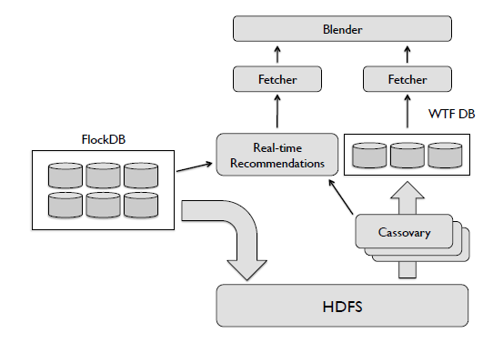
Overall Architecture

Slide 77
Overall Architecture: Cassovary
In memory graph processing engine, written in Scala
Once loaded into memory, graph is immutable
Fault tolerance provided by replication, i.e., running many instances of Cassovary, each holding a complete copy of the graph in memory.
Access to the graph via vertex-based queries such as retrieving the set of outgoing edges for a vertex and sampling a random outgoing edge.
Multi-threaded: each query is handled by a separate thread.
Graph stored as optimized adjacency lists: the adjacency lists of all vertices in large shared arrays plus indexes (start, length) into these shared arrays
No compression
Random walks implemented using the Monte-Carlo method,
  the walk is carried out from a vertex by repeatedly choosing a random outgoing edge and updating a visit counter.
  Slower than a standard matrix-based implementation, but low runtime memory overhead

Slide 78
Overall Architecture: Flow
Daily snapshots of the Twitter graph imported from FlockDB into the Hadoop data warehouse
The entire graph loaded into memory onto the Cassovary servers, each holds a complete copy of the graph in memory.
Constantly generate recommendations for users consuming from a distributed queue containing all Twitter users sorted by a “last refresh" timestamp (~500 ms per thread to generate ~100 recommendations for a user)
Output from the Cassovary servers inserted into a sharded MySQL database, called, WTF DB.
Once recommendations have been computed for a user, the user is enqueued again with an updated timestamp. Active users who consume (or are estimated to soon exhaust) all their recommendations are requeued with much higher priority; typically, these users receive new suggestions within an hour.

Slide 79
Overall Architecture: Flow
Graph loaded once a day, what about new users?
Link prediction for new users
Challenging due to sparsity: their egocentric networks small and not well connected to the rest of the graph (cold start problem)
Important for social media services: user retention strongly affected by ability to find a community with which to engage.
Any system intervention is only effective within a relatively short time window. (if users are unable to find value in a service, they are unlikely to return)
new users are given high priority in the Cassovary queue,
a completely independent set of algorithms for real-time recommendations, specifically targeting new users.

Slide 80
Algorithms: Circle of trust
Circle of trust: the result of an egocentric random walk (similar to personalized (rooted) PageRank)
Computed in an online fashion (from scratch each time) given a set of parameters (# of random walk steps, reset probability, pruning settings to discard low probability vertices, parameters to control sampling of outgoing edges at vertices with large out-degrees, etc.)
Used in a variety of Twitter products, e.g., in search and discovery, content from users in one's circle of trust upweighted

Slide 81
Algorithms
Asymmetric nature of the follow relationship (other social networks e.g., Facebook or LinkedIn require the consent of both participating members)
Directed edge case is similar to the user-item recommendations problem where the “item” is also a user.

Slide 82
Algorithms: SALSA
SALSA (Stochastic Approach for Link-Structure Analysis)
a variation of HITS
As in HITS
  hubs
  authorities
HITS
Good hubs point to good authorities
Good authorities are pointed by good hubs
hub weight = sum of the authority weights of the authorities pointed to by the hub
authority weight = sum of the hub weights that point to this authority.
hubs
authorities

Slide 83
Algorithms: SALSA
Random walks to rank hubs and authorities
Two different random walks (Markov chains): a chain of hubs and a chain of authorities
Each walk traverses nodes only in one side by traversing two links in each step h->a-h, a->h->a
Transition matrices of each Markov chain: H and A
W: the adjacency of the directed graph
W_{r}: divide each entry by the sum of its row
W_{c}: divide each entry by the sum of its column
H = W_{r}W_{c}^{T}
A = W_{c}^{T} W_{r}
Proportional to the degree
hubs
authorities

Slide 84
Algorithms: SALSA
Reduces the problem of HITS with tightly knit communities (TKC effect)
Better for single-topic communities
More efficient implementation

Slide 85
HITS and the TKC effect
The HITS algorithm favors the most dense community of hubs and authorities
  Tightly Knit Community (TKC) effect

Slide 86
HITS and the TKC effect
The HITS algorithm favors the most dense community of hubs and authorities
  Tightly Knit Community (TKC) effect
1
1
1
1
1
1

Slide 87
HITS and the TKC effect
The HITS algorithm favors the most dense community of hubs and authorities
  Tightly Knit Community (TKC) effect
3
3
3
3
3

Slide 88
HITS and the TKC effect
The HITS algorithm favors the most dense community of hubs and authorities
  Tightly Knit Community (TKC) effect
3²
3²
3²
3∙2
3∙2
3∙2

Slide 89
HITS and the TKC effect
The HITS algorithm favors the most dense community of hubs and authorities
  Tightly Knit Community (TKC) effect
3³
3³
3³
3² ∙ 2
3² ∙ 2

Slide 90
HITS and the TKC effect
The HITS algorithm favors the most dense community of hubs and authorities
  Tightly Knit Community (TKC) effect
3⁴
3⁴
3⁴
3² ∙ 2²
3² ∙ 2²
3² ∙ 2²

Slide 91
HITS and the TKC effect
The HITS algorithm favors the most dense community of hubs and authorities
  Tightly Knit Community (TKC) effect
3^{2n}
3^{2n}
weight of node p is
proportional to the number
of (BF)^{n} paths that leave
node p
after n iterations
3^{2n}
3^{n} ∙ 2^{n}
3^{n} ∙ 2^{n}
3^{n} ∙ 2^{n}

Slide 92
HITS and the TKC effect
The HITS algorithm favors the most dense community of hubs and authorities
  Tightly Knit Community (TKC) effect
1
1
after normalization
with the max
element as n → ∞
1
0
0
0

Slide 93
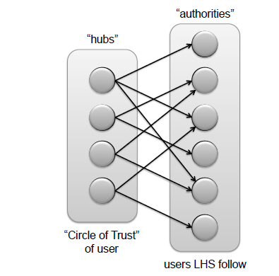
Algorithms: SALSA
Hubs: 500 top-ranked nodes from the user's circle of trust Authorities: users that the hubs follow
Hub vertices: user similarity (based on homophily, also useful)
Authority vertices : “interested in" user recommendations.

Slide 94
Algorithms: SALSA
How it works
SALSA mimics the recursive nature of the problem:
A user u is likely to follow those who are followed by users that are similar to u.
A user is similar to u if the user follow the same (or similar) users.
SALSA provides similar users to u on the LHS and similar followings of those on the RHS.
The random walk ensures equitable distribution of scores in both directions
Similar users are selected from the circle of trust of the user through personalized PageRank.

Slide 95
Evaluation
Offline experiments on retrospective data
Online A/B testing on live traffic
Various parameters may interfere:
How the results are rendered (e.g., explanations)
Platform (mobile, etc.)
New vs old users

Slide 96
Evaluation: metrics
Follow-through rate (FTR) (precision)
Does not capture recall
Does not capture lifecycle effects (newer users more receptive, etc. )
Does not measure the quality of the recommendations: all follow edges are not equal
Engagement per impression (EPI):
After a recommendation is accepted, the amount of engagement by the user on that recommendation in a specified time interval called the observation interval.

Slide 97
Extensions
Add metadata to vertices (e.g., user profile information) and edges (e.g., edge weights, timestamp, etc.)
Consider interaction graphs (e.g., graphs defined in terms of retweets, favorites, replies, etc.)

Slide 98
Extensions
Two phase algorithm
Candidate generation: produce a list of promising recommendations for each user, using any algorithm
Rescoring: apply a machine-learned model to the candidates, binary classification problem (logistic regression)
First phase: recall + diversity
Second phase: precision + maintain diversity

Slide 99
References
D. Liben-Nowell, and J. Kleinberg, The link-prediction problem for social networks. Journal of the American Society for Information Science and Technology, 58(7) 1019–1031 (2007)
R. Lichtenwalter, J. T. Lussier, N. V. Chawla: New perspectives and methods in link prediction. KDD 2010: 243-252
G. Jeh, J. Widom: SimRank: a measure of structural-context similarity. KDD 2002: 538-543
P-N Tan, . Steinbach, V. Kumar. Introduction to Data Mining (Chapter 4)
P. Gupta, A. Goel, J. Lin, A. Sharma, D. Wang, R.Zadeh. WTF: The Who to Follow Service at Twitter, WWW 2013
R. Lempel, S. Moran: SALSA: the stochastic approach for link-structure analysis. ACM Trans. Inf. Syst. 19(2): 131-160 (2001)

