Slide 1
Online Social Networks and Media
Community detection

Slide 2
Notes on Homework 1
You should write your own code for generating the graphs.
You may use SNAP graph primitives (e.g., add node/edge)
2. For the degree distribution:
you should produce 5 plots (simple distribution, bins of equal size, bins of exponential size, cumulative, zipf)
3. For all your measurements, generate a number, say 100, different graphs and report average values (this refers to the graphs in cases (a) and (c))

Slide 3
Introduction
Real networks are not random graphs
Communities
aka: groups, clusters, cohesive subgroups, modules
(informal) Definition: groups of vertices which probably share common properties and/or play similar roles within the graph
Some are explicit (emic) (e.g., Facebook (groups), LinkedIn (groups, associations), etc), we are interested in implicit (etic) ones

Slide 4
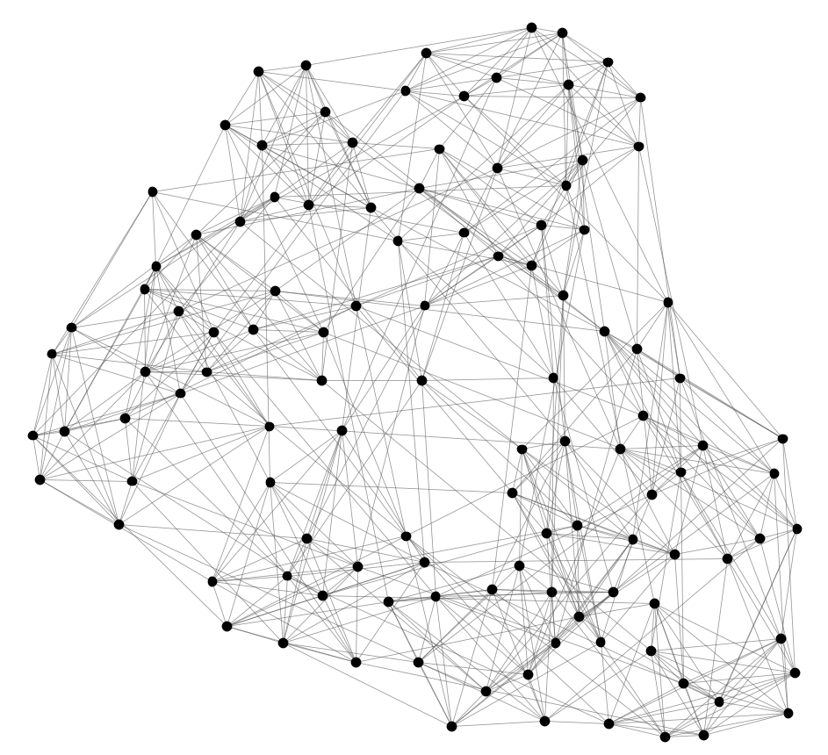
Can we identify node groups?
(communities, modules, clusters)
Nodes: Football Teams
Edges: Games played

Slide 5
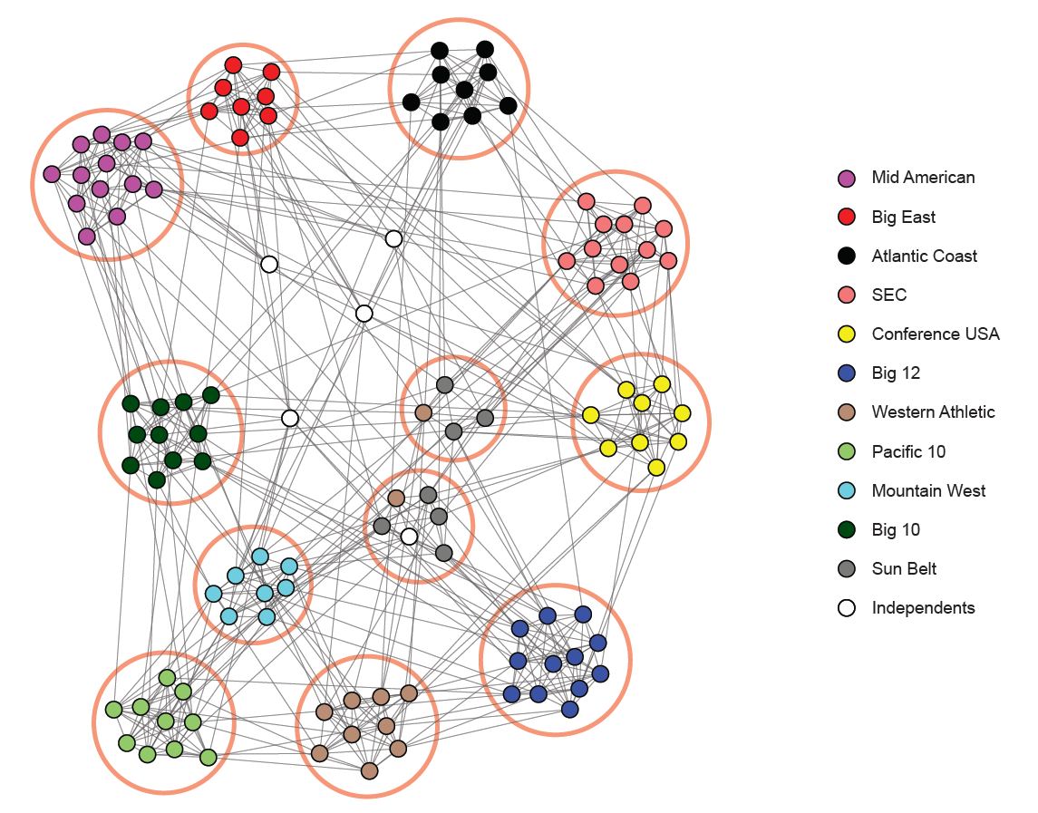
NCAA Football Network
NCAA conferences
Nodes: Football Teams
Edges: Games played

Slide 6
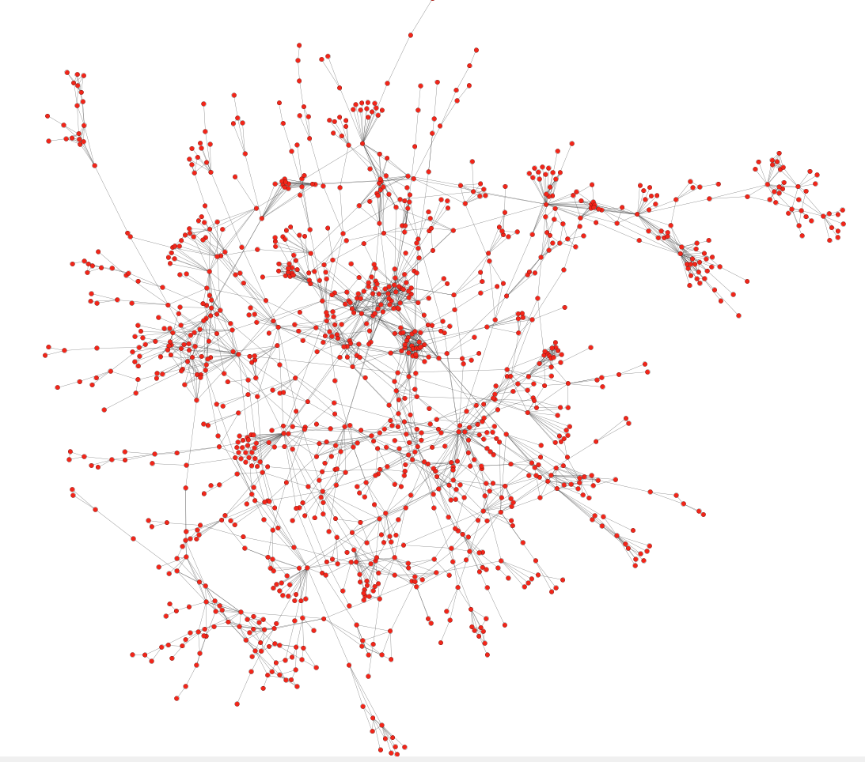
Protein-Protein Interactions
Can we identify functional modules?
Nodes: Proteins
Edges: Physical interactions

Slide 7
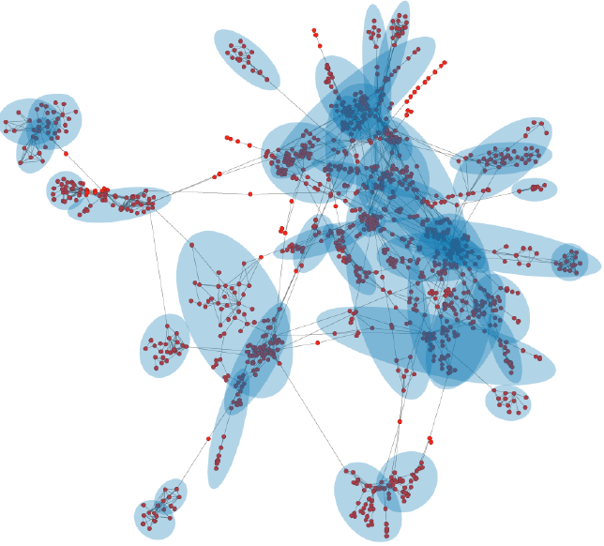
Protein-Protein Interactions
Functional modules
Nodes: Proteins
Edges: Physical interactions

Slide 8
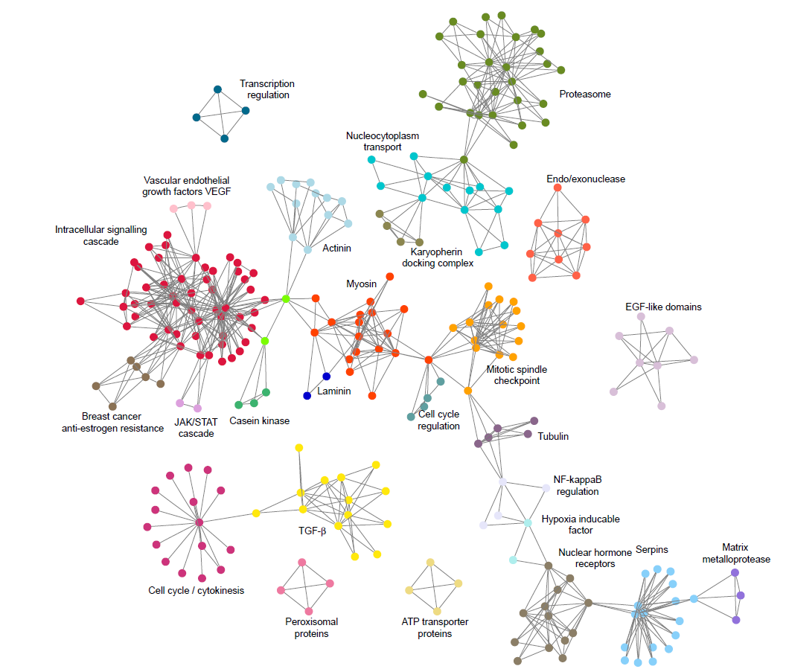
Protein-Protein Interactions

Slide 9
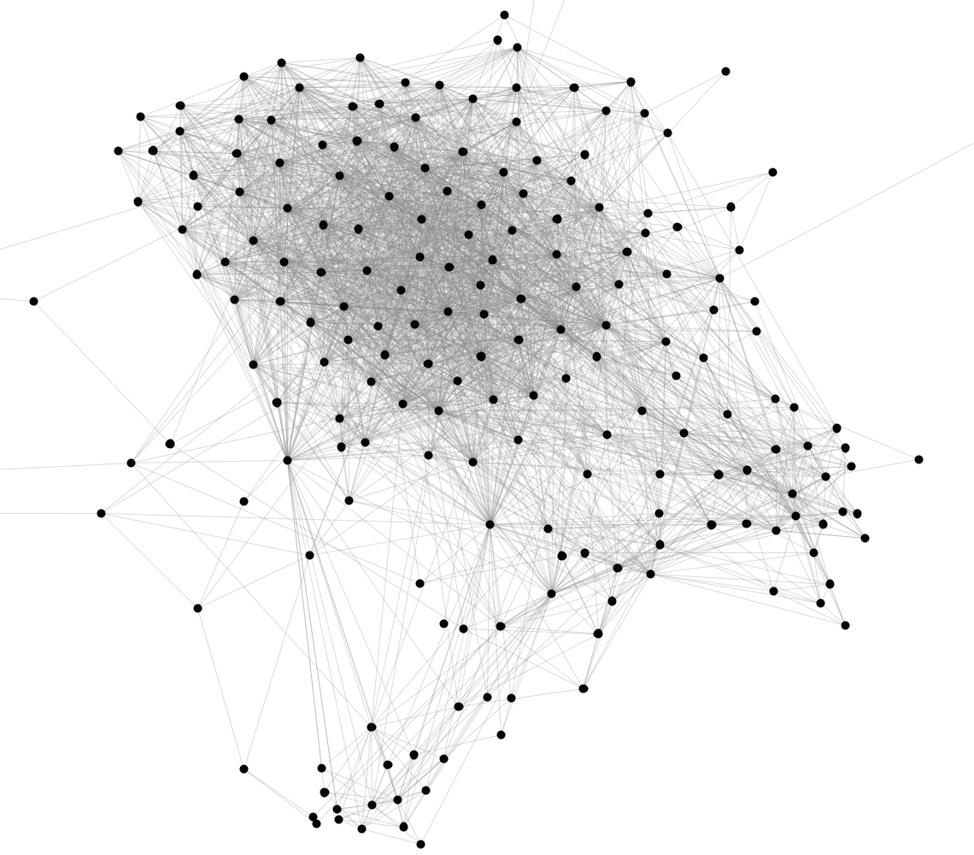
Facebook Network
Can we identify social communities?
Nodes: Facebook Users
Edges: Friendships

Slide 10
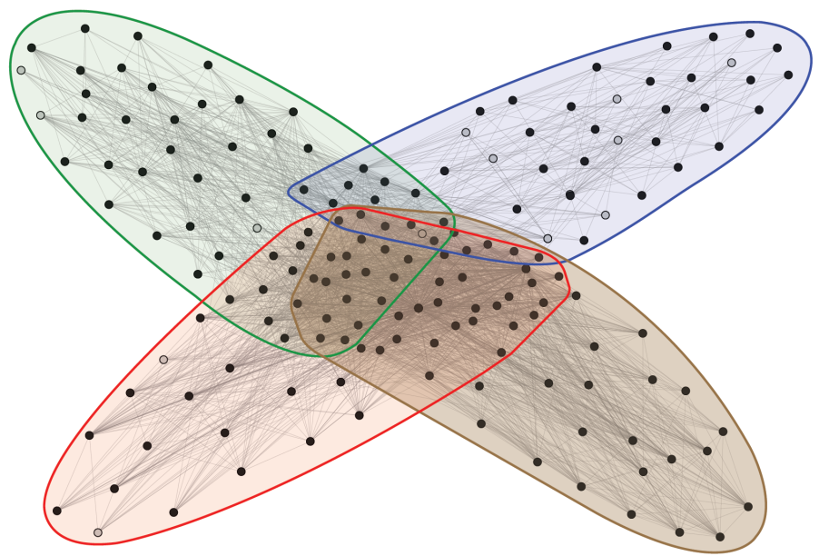
Facebook Network
Social communities
High school
Summer
internship
Stanford (Squash)
Stanford (Basketball)
Nodes: Facebook Users
Edges: Friendships

Slide 11
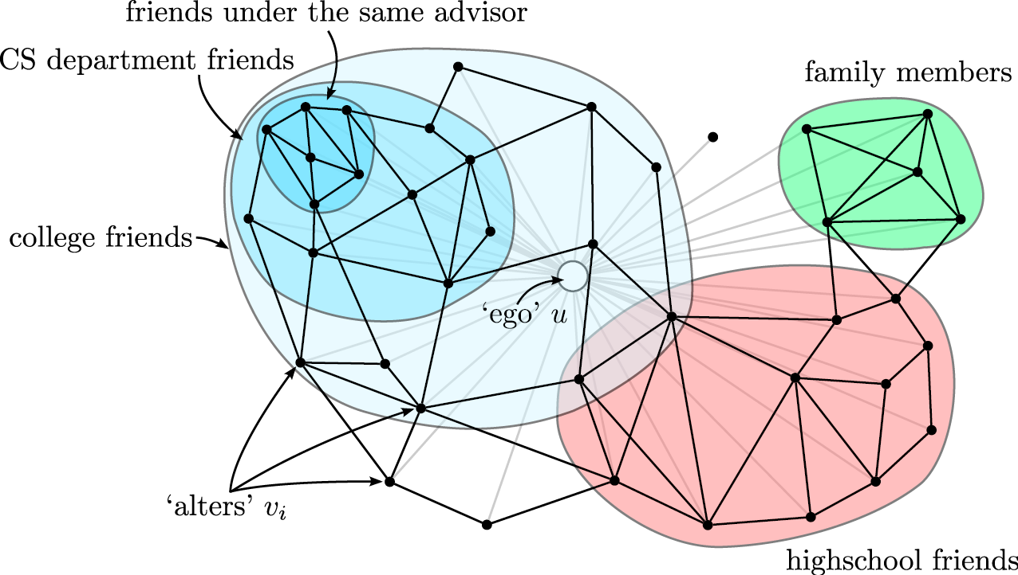
Twitter & Facebook
social circles, circles of trust

Slide 12
Outline
PART I
Introduction: what, why, types?
Cliques and vertex similarity
Background: How it relates to “cluster analysis”
Hierarchical clustering (betweenness)
Modularity
How to evaluate (if time allows)
PART II
Cuts, Spectral clustering, Denser subgraphs, community evolution

Slide 13
Why? (some applications)
Knowledge discovery
Groups based on common interests, behavior, etc (e.g., Canadians who call USA, readings tastes, etc)
  Recommendations, marketing
Collective behavior (observable at the group, not the individual level, local view is noisy and ad hoc)
Performance-wise (partition a large graph into many machines, assigning web clients to web servers, routing in ad hoc networks, etc)
Classification of the nodes (by identifying modules and their boundaries)
Summary, visual representation of the graph

Slide 14
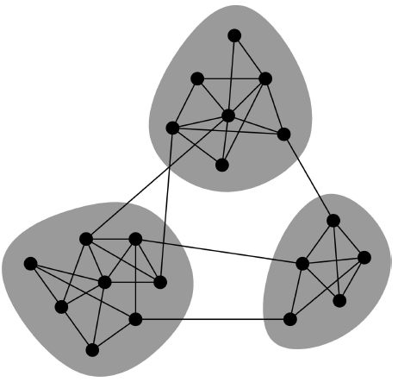
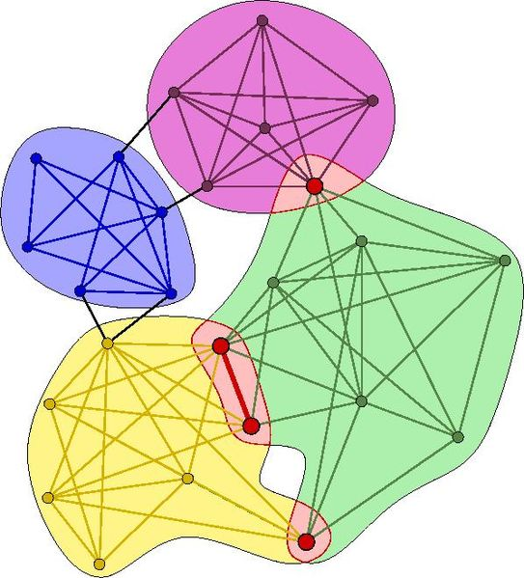
Community Types
Non-overlapping vs. overlapping communities

Slide 15
Non-overlapping Communities
Nodes
Nodes
Network
Adjacency matrix

Slide 16
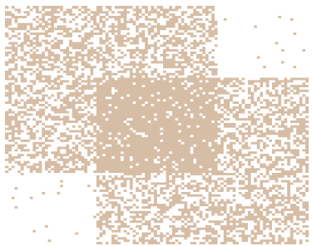
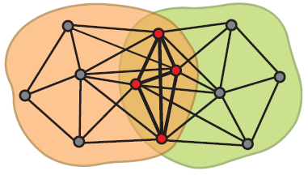
Overlapping Communities
What is the structure of community overlaps:
Edge density in the overlaps is higher!
Communities as “tiles”

Slide 17
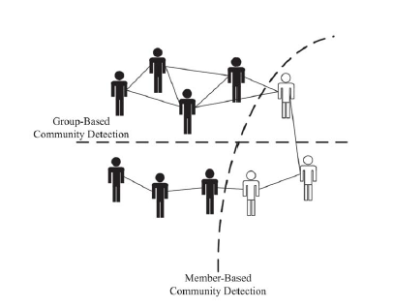
Community Types
Member-based (local) vs. group-based

Slide 18
Community Detection
Given a graph G(V, E), find subsets C_{i} of V,
such that ∪_{i} C_{i} ⊆ V
Edges can also represent content or attributes shared by individuals (in the same location, of the same gender, etc)
Undirected graphs
Unweighted (easily extended)
Attributed, or labeled graphs
Multipartite graphs – e.g., affiliation networks, citation networks, customers-products: reduced to unipartited projections of each vertex class

Slide 19
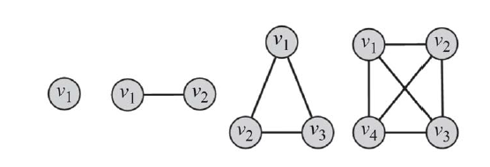
Cliques (degree similarity)
Clique: a maximum complete subgraph in which all pairs of vertices are connected by an edge.
A clique of size k is a subgraph of k vertices where the degree of all vertices in the induced subgraph is k -1 .
Cliques vs complete graphs

Slide 20
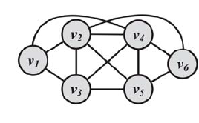
Cliques (degree similarity)
Search for
the maximum clique (the one with the largest number of vertices) or
for all maximal cliques (cliques that are not subgraphs of a larger clique; i.e., cannot be expanded further).
Both problems are NP-hard, as is verifying whether a graph
contains a clique larger than size k.

Slide 21
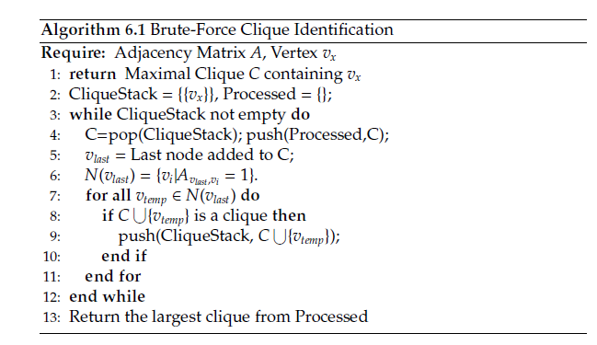
Cliques
Enumerate all cliques.
Checks all permutations!
For 100 vertices, 2⁹⁹- 1 different cliques

Slide 22
Cliques
Pruning
Prune all vertices (and incident edges) with degrees less than k - 1.
Effective due to the power-law distribution of vertex degrees
“Exact cliques” are rarely observed in real networks.
E.g., a clique of 1,000 vertices has (999x1000)/2 = 499,500 edges.
A single edge removal results in a subgraph that is no longer a clique.
That represents less than 0.0002% of the edges

Slide 23
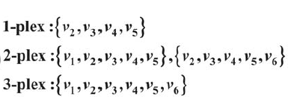
Relaxing Cliques
All vertices have a minimum degree but not necessarily k -1
k-plex
For a set of vertices V, for all u, d_{u} ≥ |V| - k
where d_{u} is the degree of v in the induced subgraph
What is k for a clique?
Maximal

Slide 24
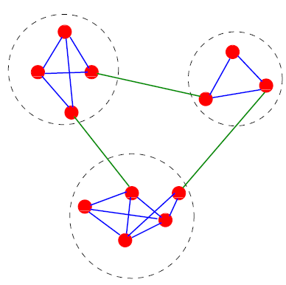
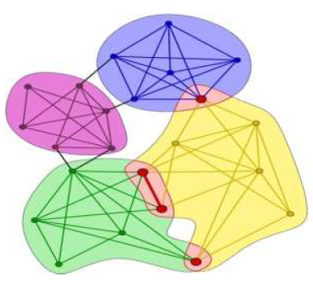
Clique Percolation Method (CPM): Using cliques as seeds
Assumption: communities are formed from a set of cliques and edges that connect these cliques.

Slide 25
Clique Percolation Method (CPM): Using cliques as seeds
Two k-cliques are adjacent if they share k - 1 vertices.
The union of adjacent k-cliques is called k-clique chain.
Two k-cliques are connected if they are part of a k-clique chain.
A k-clique community is the largest connected subgraph obtained by the union of a k-clique and of all k-cliques which are connected to it.

Slide 26
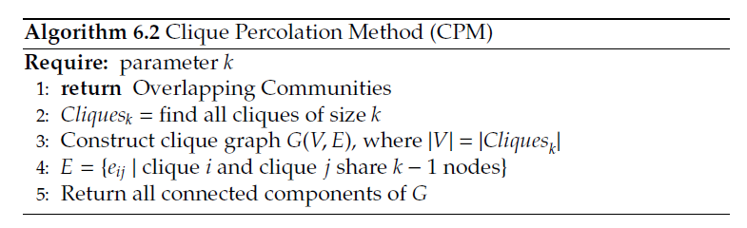
Clique Percolation Method (CPM): Using cliques as seeds
Given k, find all cliques of size k.
Create graph (clique graph) where all cliques are vertices, and two cliques that share k - 1 vertices are connected via an edge.
Communities are the connected components of this graph.

Slide 27
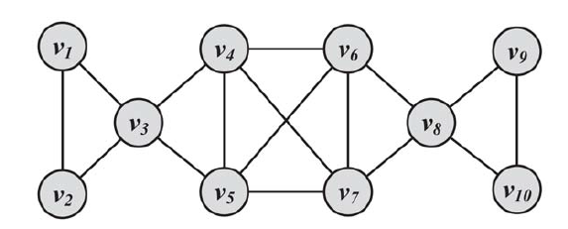
Clique Percolation Method (CPM): Using cliques as seeds
Input graph, let k = 3

Slide 28
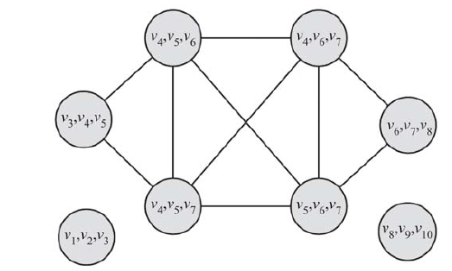
Clique Percolation Method (CPM): Using cliques as seeds
Clique graph for k = 3
(v1, v2, ,v3), (v8, v9, v10), and (v3, v4, v5, v6, v7, v8)

Slide 29
Clique Percolation Method (CPM): Using cliques as seeds
Result
(v1, v2, ,v3), (v8, v9, v10), and (v3, v4, v5, v6, v7, v8)
Note: the example protein network was detected using a CPM algorithm

Slide 30
Clique Percolation Method (CPM): Using cliques as seeds
A k-clique community is identified by making a k-clique “roll" over adjacent k-cliques, where rolling means rotating a k-clique about the k-1 vertices it shares with any adjacent k-clique.
By construction, overlapping.
There may be vertices belonging to nonadjacent k-cliques, which could be reached by different paths and end up in different clusters.
There are also vertices that cannot be reached by any k-clique
In the example, if instead of k = 3, for the maximal cliques?
Theoretical complexity grows exponential with size, but efficient on sparse graphs

Slide 31
Vertex similarity
Define similarity between two vertices
Place similar vertices in the same cluster
Use traditional cluster analysis

Slide 32


Vertex similarity
Structural equivalence: based on the overlap between their neighborhoods
Normalized to [0, 1], e.g.,

Slide 33
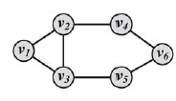

Vertex similarity

Slide 34

Other definitions of vertex similarity
Use the adjacency matrix A,

Slide 35




Other definitions of vertex similarity
If we map vertices u, v to n-dimensional points A, B in the Euclidean space,

Slide 36
Other definitions of vertex similarity
Many more – we shall revisit this issue when we talk about link prediction

Slide 37
Outline
PART I
Introduction: what, why, types?
Cliques and vertex similarity
Background: cluster analysis
Hierarchical clustering (betweenness)
Modularity
How to evaluate

Slide 38
What is Cluster Analysis?
Finding groups of objects such that the objects in a group will be similar (or related) to one another and different from (or unrelated to) the objects in other groups
Inter-cluster distances are maximized
Intra-cluster distances are minimized

Slide 39
Notion of a cluster can be ambiguous
How many clusters?
Six Clusters
Two Clusters
Four Clusters

Slide 40
Types of Clustering
A clustering is a set of clusters
Important distinction between hierarchical and partitional sets of clusters
Partitional Clustering
  Division of data objects into non-overlapping subsets (clusters) such that each data object is in exactly one subset
  Assumes that the number of clusters is given
Hierarchical clustering
  A set of nested clusters organized as a hierarchical tree

Slide 41
Partitional Clustering
Original Points
A Partitional Clustering

Slide 42
Hierarchical Clustering
Produces a set of nested clusters organized as a hierarchical tree
Can be visualized as a dendrogram
  A tree like diagram that records the sequences of merges or splits

Slide 43
Other Distinctions Between Sets of Clusters
Exclusive versus non-exclusive
  In non-exclusive clustering, points may belong to multiple clusters.
  Can represent multiple classes or ‘border’ points
Fuzzy versus non-fuzzy
  In fuzzy clustering, a point belongs to every cluster with some weight between 0 and 1
  Weights must sum to 1
  Probabilistic clustering has similar characteristics
Partial versus complete
  In some cases, we only want to cluster some of the data
Heterogeneous versus homogeneous
  Cluster of widely different sizes, shapes, and densities

Slide 44
Clusters defined by an objective function
  Finds clusters that minimize or maximize an objective function.
  Enumerate all possible ways of dividing the points into clusters and evaluate the `goodness' of each potential set of clusters by using the given objective function. (NP Hard)
  Can have global or local objectives.
    Hierarchical clustering algorithms typically have local objectives
    Partitional algorithms typically have global objectives
  A variation of the global objective function approach is to fit the data to a parameterized model.
    Parameters for the model are determined from the data.
    Mixture models assume that the data is a ‘mixture' of a number of statistical distributions.

Slide 45
Clustering Algorithms
K-means
Hierarchical clustering
Density clustering

Slide 46
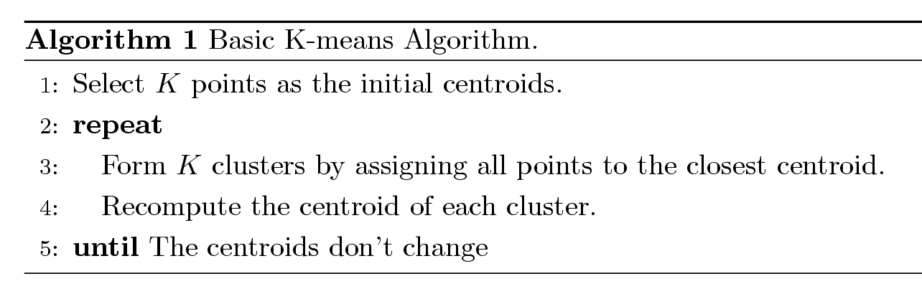
K-means Clustering
Partitional clustering approach
Each cluster is associated with a centroid (center point)
Each point is assigned to the cluster with the closest centroid
Number of clusters, K, must be specified
The basic algorithm is very simple

Slide 47
K-means Clustering
Initial centroids are often chosen randomly.
  Clusters produced vary from one run to another.
The centroid is (typically) the mean of the points in the cluster.
‘Closeness’ is measured by Euclidean distance, cosine similarity, correlation, etc.
K-means will converge for common similarity measures mentioned above.
Most of the convergence happens in the first few iterations.
  Often the stopping condition is changed to ‘Until relatively few points change clusters’
Complexity is O( n * K * I * d )
  n = number of points, K = number of clusters,
  I = number of iterations, d = number of attributes

Slide 48
Example

Slide 49
Example

Slide 50
Two different K-means clusterings
Original Points
Optimal Clustering
Sub-optimal Clustering
Importance of choosing initial points

Slide 51
K-means Clusters
Most common measure is Sum of Squared Error (SSE)
  For each point, the error is the distance to the nearest cluster
  To get SSE, we square these errors and sum them.
  x is a data point in cluster C_{i} and m_{i} is the representative point for cluster C_{i}
    can show that m_{i} corresponds to the center (mean) of the cluster
  Given two clusters, we can choose the one with the smallest error
  One easy way to reduce SSE is to increase K, the number of clusters
    A good clustering with smaller K can have a lower SSE than a poor clustering with higher K

Slide 52
Limitations of K-means
K-means has problems when clusters are of differing
  Sizes
  Densities
  Non-globular shapes
K-means has problems when the data contains outliers.

Slide 53
Pre-processing and Post-processing
Pre-processing
  Normalize the data
  Eliminate outliers
Post-processing
  Eliminate small clusters that may represent outliers
  Split ‘loose’ clusters, i.e., clusters with relatively high SSE
  Merge clusters that are ‘close’ and that have relatively low SSE
  Can use these steps during the clustering process

Slide 54
Hierarchical Clustering
Two main types of hierarchical clustering
  Agglomerative:
    Start with the points (vertices) as individual clusters
    At each step, merge the closest pair of clusters until only one cluster (or k clusters) left
  Divisive:
    Start with one, all-inclusive cluster (the whole graph)
    At each step, split a cluster until each cluster contains a point (vertex) (or there are k clusters)
Traditional hierarchical algorithms use a similarity or distance matrix
  Merge or split one cluster at a time

Slide 55
Strengths of Hierarchical Clustering
Do not have to assume any particular number of clusters
  Any desired number of clusters can be obtained by ‘cutting’ the dendogram at the proper level
They may correspond to meaningful taxonomies
  Example in biological sciences (e.g., animal kingdom, phylogeny reconstruction, …)

Slide 56
Agglomerative Clustering Algorithm
Popular hierarchical clustering technique
Basic algorithm is straightforward
  [Compute the proximity matrix]
  Let each data point be a cluster
  Repeat
  Merge the two closest clusters
  [Update the proximity matrix]
  Until only a single cluster remains
Key operation is the computation of the proximity of two clusters
  Different approaches to defining the distance between clusters distinguish the different algorithms

Slide 57
How to Define Inter-Cluster Similarity
p1
p2
p3
p4
p5
. . .
p1
p2
p3
p4
p5
Similarity?
.
.
.
Proximity Matrix

Slide 58
How to Define Inter-Cluster Similarity
p1
p2
p3
p4
p5
. . .
p1
p2
p3
p4
p5
MIN or single link
based on the two most similar (closest) points in the different clusters
(sensitive to outliers)
.
.
.
Proximity Matrix

Slide 59
How to Define Inter-Cluster Similarity
p1
p2
p3
p4
p5
. . .
p1
p2
p3
p4
p5
MAX or complete linkage
Similarity of two clusters is based on the two least similar (most distant) points in the different clusters
.
.
.
Proximity Matrix
(Tends to break large clusters
Biased towards globular clusters)

Slide 60
How to Define Inter-Cluster Similarity
p1
p2
p3
p4
p5
. . .
p1
p2
p3
p4
p5
.
.
.
Group Average
Proximity of two clusters is the average of pairwise proximity between points in the two clusters.
Proximity Matrix

Slide 61
How to Define Inter-Cluster Similarity
p1
p2
p3
p4
p5
. . .
p1
×
×
p2
p3
p4
Distance Between Centroids
p5
.
.
.
Proximity Matrix

Slide 62
Cluster Similarity: Ward’s Method
Similarity of two clusters is based on the increase in squared error when two clusters are merged
  Similar to group average if distance between points is distance squared
Less susceptible to noise and outliers
Biased towards globular clusters
Hierarchical analogue of K-means
  Can be used to initialize K-means

Slide 63
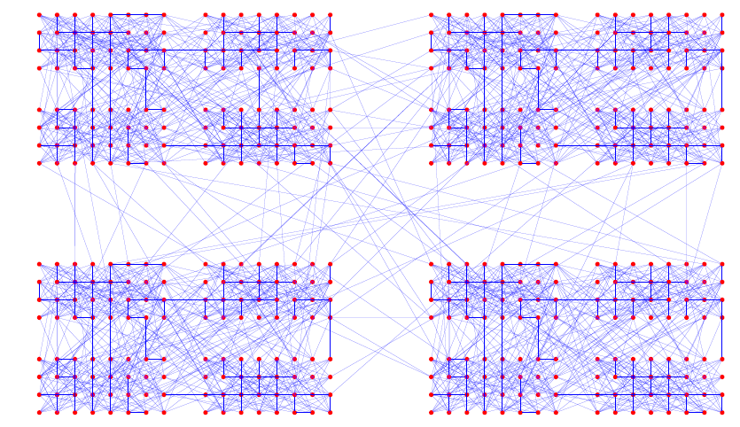
Example of a Hierarchically Structured Graph

Slide 64
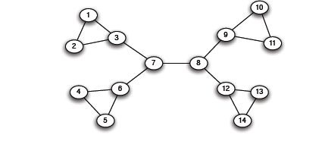
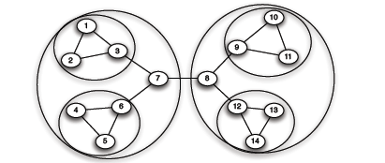
Graph Partitioning
Divisive methods: try to identify and remove the “spanning links” between densely-connected regions
Agglomerative methods: Find nodes that are likely to belong to the same region and merge them together (bottom-up)

Slide 65
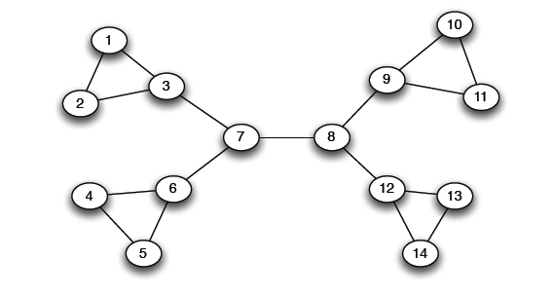
The Girvan Newman method
Hierarchical divisive method
  Start with the whole graph
  Find edges whose removal “partitions” the graph
  Repeat with each subgraph until single vertices
Which edge?

Slide 66
The Girvan Newman method
Use bridges or cut-edge (if removed, the nodes become disconnected)
Which one to choose?

Slide 67
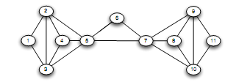
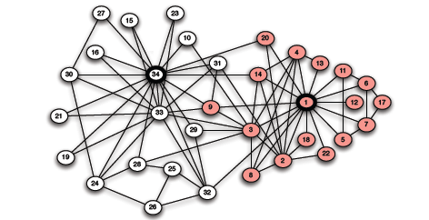
The Girvan Newman method
There may be none!

Slide 68
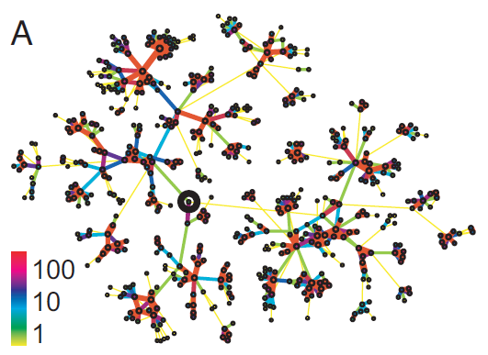
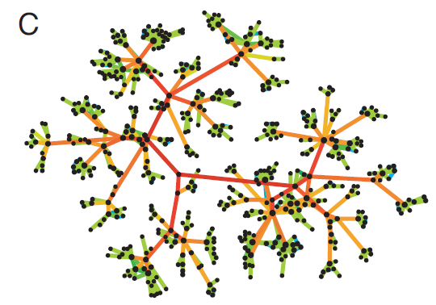
Strength of Weak Ties
Edge betweenness: Number of
shortest paths passing over the edge
Intuition:
Edge strengths (call volume)
in a real network
Edge betweenness
in a real network

Slide 69
Edge Betweenness
Betweenness of an edge (a, b): number of pairs of nodes x and y such that the edge (a, b) lies on the shortest path between x and y - since there can be several such shortest paths edge (a, b) is credited with the fraction of those shortest paths that include (a, b).
3x11 = 33
1x12 = 12
b=16
1
b=7.5
7x7 = 49
Edges that have a high probability to occur on a randomly chosen shortest path between two randomly chosen nodes have a high betweenness.
Traffic (unit of flow)

Slide 70
The Girvan Newman method
[Girvan-Newman ‘02]
        Undirected unweighted networks
  Repeat until no edges are left:
    Calculate betweenness of edges
    Remove edges with highest betweenness
  Connected components are communities
  Gives a hierarchical decomposition of the network

Slide 71
Girvan Newman method: An example
Betweenness(7, 8)= 7x7 = 49
Betweenness(1, 3) = 1X12=12
Betweenness(3, 7)=Betweenness(6, 7)=Betweenness(8, 9) = Betweenness(8, 12)= 3X11=33

Slide 72
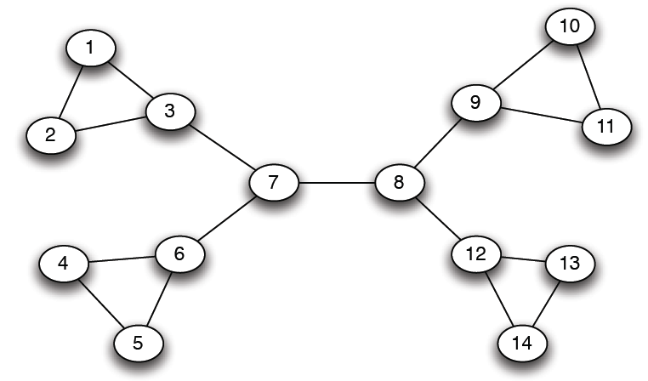
Girvan-Newman: Example
12
1
33
49
Need to re-compute betweenness at every step

Slide 73
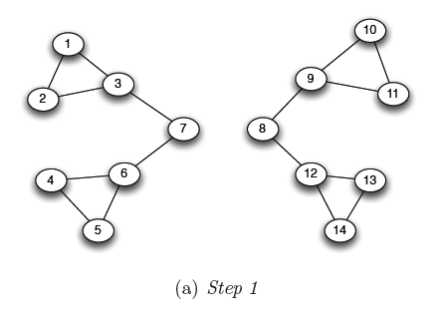
Girvan Newman method: An example
Betweenness(1, 3) = 1X5=5
Betweenness(3,7)=Betweenness(6,7)=Betweenness(8,9) = Betweenness(8,12)= 3X4=12

Slide 74
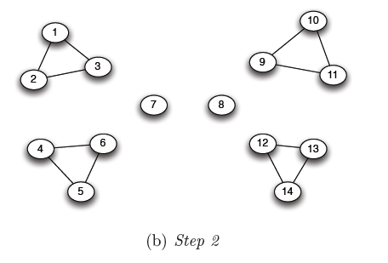
Girvan Newman method: An example
Betweenness of every edge = 1

Slide 75
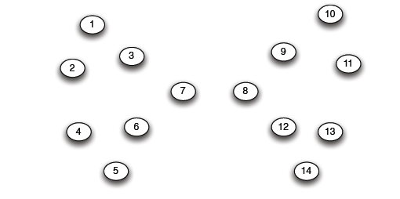
Girvan Newman method: An example

Slide 76
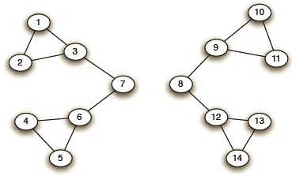
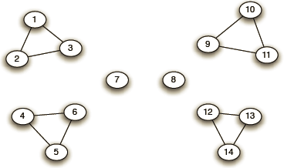
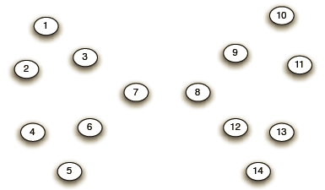
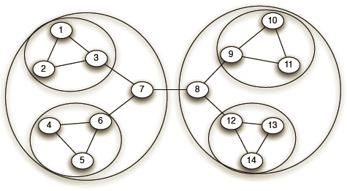
Girvan-Newman: Example
Step 1:
Step 2:
Step 3:
Hierarchical network decomposition:

Slide 77
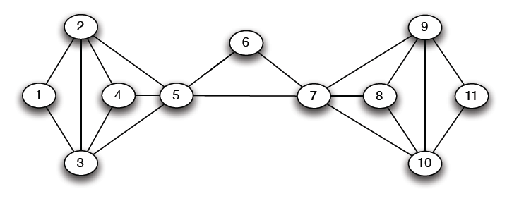
Another example
5X5=25

Slide 78
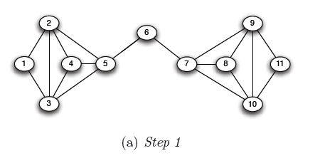
Another example
5X6=30
5X6=30

Slide 79
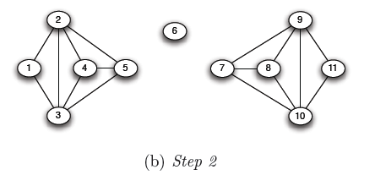
Another example

Slide 80
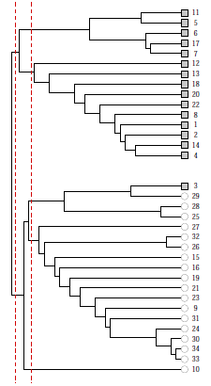
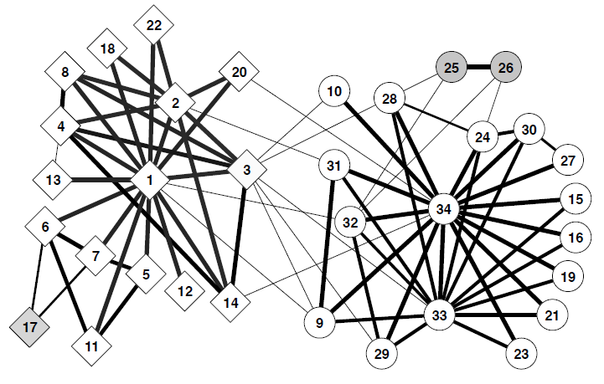
Girvan-Newman: Results
Zachary’s Karate club:
Hierarchical decomposition

Slide 81
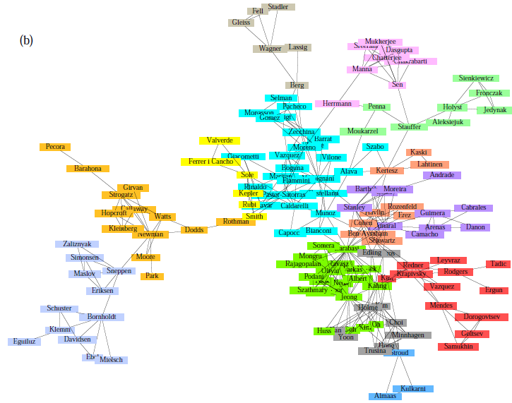
Girvan-Newman: Results
Communities in physics collaborations

Slide 82
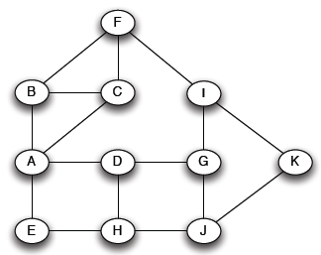
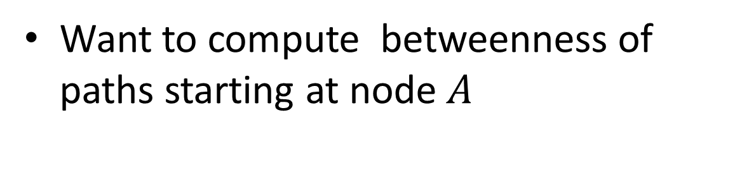
How to Compute Betweenness?
Want to compute betweenness of paths starting at node $A$

Slide 83
Computing Betweenness
Perform a BFS starting from A
Determine the number of shortest path from A to each other node
Based on these numbers, determine the amount of flow from A to all other nodes that uses each edge

Slide 84
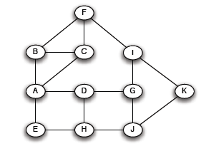
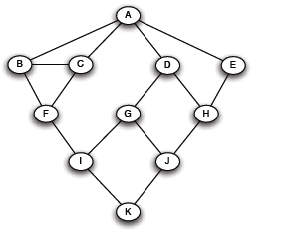
Computing Betweenness: step 1
Initial network
BFS on A

Slide 85

Computing Betweenness: step 2
Count how many shortest paths from A to a specific node
Level 1
Level 2
Level 3
Level 4
Top-down

Slide 86

Computing Betweenness: step 3
Compute betweenness by working up the tree: If there are multiple paths count them fractionally
For each edge e: calculate the sum over all nodes Y of the fraction of shortest paths from the root A to Y that go through e.
Each edge (X, Y) participates in the shortest-paths from the root to Y and to nodes (at levels) below Y -> Bottom up calculation
e

Slide 87
Computing Betweenness: step 3
Count the flow through each edge
Portion of the shortest paths to I that go through (F, I) = 2/3 +
Portion of the shortest paths to K that go through (F, I)
(1/2)(2/3) = 1/3
= 1
1/3+(1/3)1/2 = 1/2
Portion of the shortest paths to K that go through (I, K) = 3/6 = 1/2

Slide 88


Computing Betweenness: step 3
The algorithm:
Add edge flows:
-- node flow =
1+∑child edges
-- split the flow up based on the parent value
Repeat the BFS procedure for each starting node $U$
1+1 paths to H
Split evenly
1+0.5 paths to J
Split 1:2
1 path to K.
Split evenly

Slide 89
Computing Betweenness: step 3
(X, Y)
p_{X}
X
Y
p_{Y}
.. .
Y₁
Y_{m}

Slide 90
Computing Betweenness
Repeat the process for all nodes
Sum over all BFSs

Slide 91




Example

Slide 92


Example

Slide 93
Computing Betweenness
Issues
Test for connectivity?
Re-compute all paths, or only those affected
Parallel computation
Sampling

Slide 94
Outline
PART I
Introduction: what, why, types?
Cliques and vertex similarity
Background: Cluster analysis
Hierarchical clustering (betweenness)
Modularity
How to evaluate

Slide 95

Modularity
Communities: sets of
tightly connected nodes
Define: Modularity $Q$
  A measure of how well
  a network is partitioned
  into communities
  Given a partitioning of the
  network into groups $s  S$:
  Q ∝ ∑_{s∈ S} [ (# edges within group s) –
  (expected # edges within group s) ]
Need a null model!
a copy of the original graph keeping some of its structural properties but without community structure

Slide 96



Null Model: Configuration Model
Given real $G$ on $n$ nodes and $m$ edges,
construct rewired network $G’$
  Same degree distribution but
  random connections
  Consider $G’$ as a multigraph
  The expected number of edges between nodes
  $i$ and $j$ of degrees $d_{i}$and $d_{j}$ equals to: $d_{i}⋅\frac{d_{j}}{2m}=\frac{d_{i}d_{j}}{2m}$
i
j
For any edge going out of i randomly, the probability of this edge getting connected to node j is $\frac{d_{j}}{2m}$
Because the degree for i is d_{i}, we have d_{i} number of such edges
Note:
$$\sum_{u∈N}{d_{u}}=2m$$

Slide 97


Null Model: Configuration Model
i
j
    The expected number of edges in (multigraph) G’:
      $=\frac{1}{2}\sum_{i∈N}{\sum_{j∈N}{\frac{d_{i}d_{j}}{2m}}}=\frac{1}{2}⋅\frac{1}{2m}\sum_{i∈N}{d_{i}\left(\sum_{j∈N}{d_{j}}\right)}=$
      $=\frac{1}{4m}2m⋅2m=m$
Note:
$$\sum_{u∈N}{d_{u}}=2m$$

Slide 98

Modularity
Modularity of partitioning S of graph G:
  Q ∝ ∑_{s∈ S} [ (# edges within group s) –
  (expected # edges within group s) ]
  $Q\left(G,S\right)=\frac{1}{2m}\sum_{s∈S}{\sum_{i∈s}{\sum_{j∈s}{\left(A_{ij}−\frac{d_{i}d_{j}}{2m}\right)}}}$
Modularity values take range [−1, 1]
  It is positive if the number of edges within
  groups exceeds the expected number
  0.3-0.7 < Q means significant community structure
A_{ij} = 1 if i→j,
0 else
Normalizing cost.: -1<Q<1

Slide 99
Modularity
Greedy method of Newman (one of the many ways to use modularity)
Agglomerative hierarchical clustering method
Start with a state in which each vertex is the sole member of one of n communities
Repeatedly join communities together in pairs, choosing at each step the join that results in the greatest increase (or smallest decrease) in Q.
Since the joining of a pair of communities between which there are no edges can never result in an increase in modularity, we need only consider those pairs between which there are edges, of which there will at any time be at most m

Slide 100

Modularity: Number of clusters
Modularity is useful for selecting the
number of clusters:
Q
Notes:
HW: Question – come up with a graph where GIRVAN-NEWMAN MODULARITY IS NOT UNIMODAL

Slide 101
Modularity: Cluster quality
When a given clustering is “good”?
Also, it is both a local (per individual cluster) and global measure
Notes:
HW: Question – come up with a graph where GIRVAN-NEWMAN MODULARITY IS NOT UNIMODAL

Slide 102
Community Evaluation
With ground truth
Without ground truth

Slide 103

Evaluation with ground truth
Zachary’s Karate Club
Club president (34) (circles) and instructor (1) (rectangles)

Slide 104


Metrics: purity
the fraction of instances that have labels equal to the label of the community’s majority
(5+6+4)/20 = 0.75

Slide 105
Metrics
Based on pair counting: the number of pairs of vertices which are classified in the same (different) clusters in the two partitions.
True Positive (TP) Assignment: when similar members are assigned to the same community. This is a correct decision.
True Negative (TN) Assignment: when dissimilar members are assigned to different communities. This is a correct decision.
False Negative (FN) Assignment: when similar members are assigned to different communities. This is an incorrect decision.
False Positive (FP) Assignment: when dissimilar members are assigned to the same community. This is an incorrect decision.

Slide 106

Metrics: pairs
For TP, we need to compute the number of pairs with the same label that are in the same community

Slide 107

Metrics: pairs
For TN: compute the number of dissimilar pairs in dissimilar communities

Slide 108


Metrics: pairs
For FP, compute dissimilar pairs that are in the same community.
For FN, compute similar members that are in different communities.

Slide 109
Metrics: pairs
Precision (P): the fraction of pairs that have been correctly assigned to the same community.
TP/(TP+FP)
Recall (R): the fraction of pairs assigned to the same community of all the pairs that should have been in the same community.
TP/(TP+FN)
F-measure
2PR/(P+R)

Slide 110
Evaluation without ground truth
Cluster Cohesion: Measures how closely related are objects in a cluster
Cluster Separation: Measure how distinct or well-separated a cluster is from other clusters
Example: Squared Error
  Cohesion is measured by the within cluster sum of squares (SSE)
  Separation is measured by the between cluster sum of squares
      Where |C_{i}| is the size of cluster i

Slide 111


Evaluation without ground truth

Slide 112

Evaluation without ground truth
With semantics:
(ad hoc) analyze other attributes (e.g., profile, content generated) for coherence
human subjects (user study) Mechanical Turk
Visual representation (similarity/adjacency matrix, word clouds, etc)

Slide 113
Basic References
Jure Leskovec, Anand Rajaraman, Jeff Ullman, Mining of Massive Datasets, Chapter 10, http://www.mmds.org/
Reza Zafarani, Mohammad Ali Abbasi, Huan Liu, Social Media Mining: An Introduction, Chapter 6, http://dmml.asu.edu/smm/
Santo Fortunato: Community detection in graphs. CoRR abs/0906.0612v2 (2010)
Pang-Ning Tan, Michael Steinbach, Vipin Kumar, Introduction to Data Mining, Chapter 8, http://www.users.cs.umn.edu/~kumar/dmbook/index.php

Slide 114
Questions?

