Slide 1
Online Social Networks and Media
Team formation in Social Networks
Recommender Systems and Social Recommendations
Thanks to:
Evimaria Terzi
Jure Leskovec, Anand Rajaraman, Jeff Ullman

Slide 2
Algorithms for Team Formation
Thanks to Evimari Terzi

Slide 3
Team-formation problems
Boston University Slideshow Title Goes Here
Given a task and a set of experts (organized in a network) find the subset of experts that can effectively perform the task
Task: set of required skills and potentially a budget
Expert: has a set of skills and potentially a price
Network: represents strength of relationships
evimaria@cs.bu.edu

Slide 4


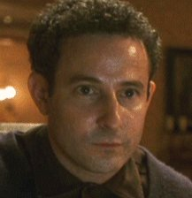
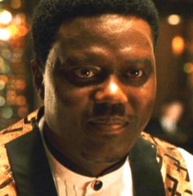
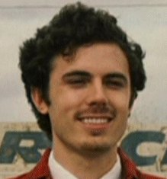




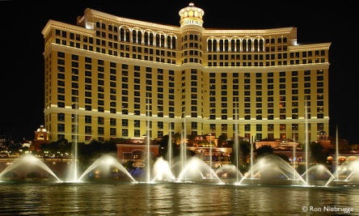

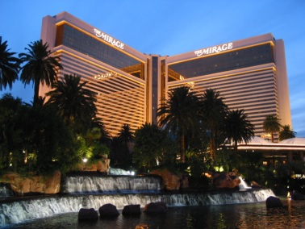
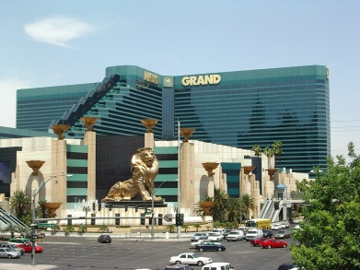
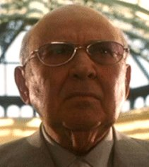
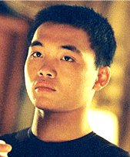
2001
Security expert
Boston University Slideshow Title Goes Here
Electronics expert
Insider
Mechanic
Organizer
Pick-pocket thief
Co-organizer
Mechanic
Explosives expert
Con-man
Acrobat

Slide 5
2001
Security expert
Boston University Slideshow Title Goes Here
Electronics expert
Insider
Mechanic
Organizer
Pick-pocket thief
Co-organizer
Mechanic
Explosives expert
Con-man
Acrobat

Slide 6
Applications
Boston University Slideshow Title Goes Here
Collaboration networks (e.g., scientists, actors)
Organizational structure of companies
LinkedIn, UpWork, FreeLance
Geographical (map) of experts

Slide 7
Simple Team formation Problem
Boston University Slideshow Title Goes Here
Input:
  A task T, consisting of a set of skills
  A set of candidate experts each having a subset of skills
Problem: Given a task and a set of experts, find the smallest subset (team) of experts that together have all the required skills for the task
T = {algorithms, java, graphics, python}
Alice
Bob
Cynthia
David
Eleanor
Eleanor
{algorithms}
{python}
{graphics, java}
{graphics}
{graphics,java,python}
{graphics,java,python}

Slide 8

Coverage
The Simple Team Formation Problem is a just an instance of the Set Cover problem
  Universe $U$ of elements = Set of all skills
  Collection $S$ of subsets = The set of experts and the subset of skills they possess.
T = {algorithms, java, graphics, python}
Alice
Bob
Cynthia
David
Eleanor
Eleanor
{algorithms}
{python}
{graphics, java}
{graphics}
{graphics,java,python}
{graphics,java,python}

Slide 9
Team formation in the presence of a social network
Boston University Slideshow Title Goes Here
Given a task and a set of experts organized in a network find the subset of experts that can effectively perform the task
Task: set of required skills
Expert: has a set of skills
Network: represents strength of relationships
Effectively: There is good communication between the team members

Slide 10
Coverage is NOT enough
T={algorithms,java,graphics,python}
Boston University Slideshow Title Goes Here
Alice
Bob
Cynthia
David
Eleanor
{algorithms}
{python}
{graphics, java}
{graphics}
{graphics,java,python}
A
A,E could perform the task if they could communicate
A,B,C form an effective group that can communicate
A
D
B
B
C
C
E
E
Communication: the members of the team must be able to
efficiently communicate and work together

Slide 11
How to measure effective communication?
Boston University Slideshow Title Goes Here
The longest shortest path between any two nodes in the subgraph
Diameter of the subgraph defined by the group members
A
A
D
B
B
C
C
E
E
diameter = infty
diameter = 1

Slide 12
How to measure effective communication?
Boston University Slideshow Title Goes Here
The total weight of the edges of a tree that spans all the team nodes
MST (Minimum spanning tree) of the subgraph defined by the group members
A
A
D
B
B
C
C
E
E
MST = infty
MST = 2

Slide 13
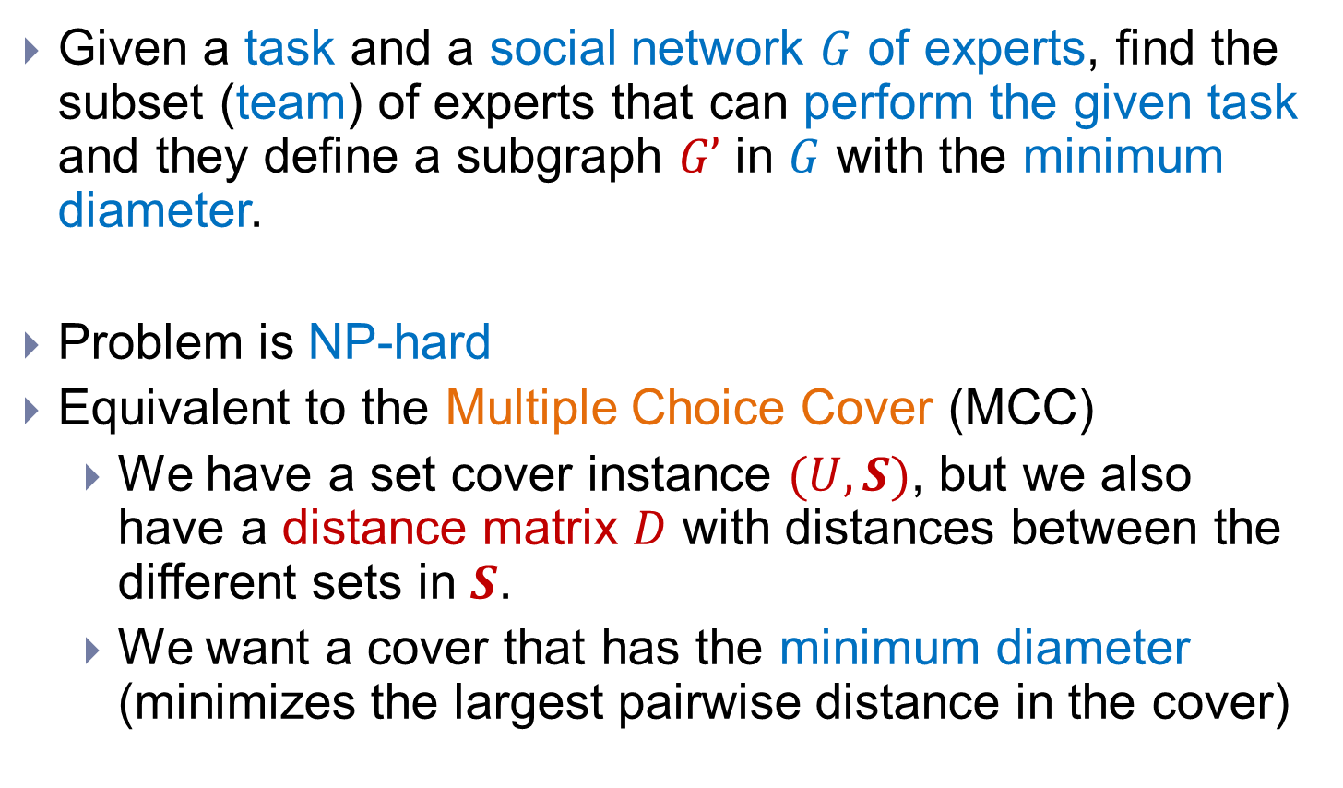
Problem definition (MinDiameter)
Boston University Slideshow Title Goes Here
Given a task and a social network $G$ of experts, find the subset (team) of experts that can perform the given task and they define a subgraph $G’$ in $G$ with the minimum diameter.
Problem is NP-hard
Equivalent to the Multiple Choice Cover (MCC)
  We have a set cover instance $(U,S)$, but we also have a distance matrix $D$ with distances between the different sets in $S$.
  We want a cover that has the minimum diameter (minimizes the largest pairwise distance in the cover)

Slide 14
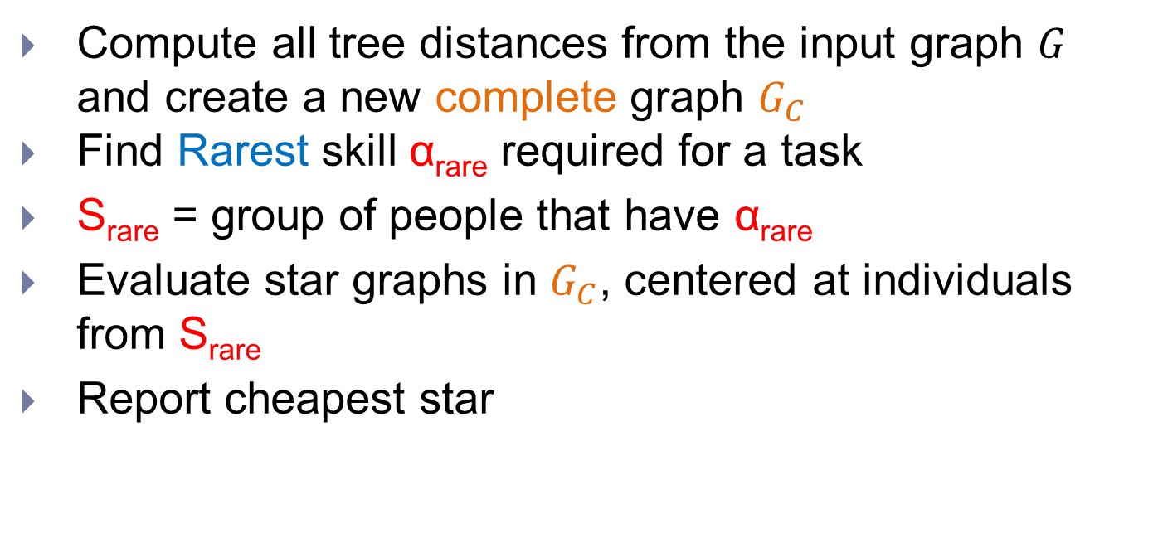
The RarestFirst algorithm
Boston University Slideshow Title Goes Here
Compute all tree distances from the input graph $G$ and create a new complete graph $G_{C}$
Find Rarest skill α_{rare} required for a task
S_{rare} = group of people that have α_{rare}
Evaluate star graphs in $G_{C}$, centered at individuals from S_{rare}
Report cheapest star
Running time: Quadratic to the number of nodes
Approximation factor: 2xOPT

Slide 15
The RarestFirst algorithm
T={algorithms,java,graphics,python}
Boston University Slideshow Title Goes Here
{graphics,python,java}
{algorithms,graphics}
A
B
A
B
Skills:
algorithms
graphics
java
python
E
{algorithms,graphics,java}
E
C
D
{python,java}
{python}
α_{rare} = algorithms
S_{rare} ={Bob, Eleanor}
Diameter = 2

Slide 16
The RarestFirst algorithm
T={algorithms,java,graphics,python}
Boston University Slideshow Title Goes Here
{graphics,python,java}
{algorithms,graphics}
A
B
Skills:
algorithms
graphics
java
python
E
E
{algorithms,graphics,java}
C
C
D
{python,java}
{python}
α_{rare} = algorithms
S_{rare} ={Bob, Eleanor}
Diameter = 1

Slide 17
Analysis of RarestFirst
Boston University Slideshow Title Goes Here
S₁
The diameter is
  either D = d_{k}, for some node k,
  or D = d_{ℓk} for some pair of nodes ℓ, k
Fact: OPT ≥ d_{k}
Fact: OPT ≥ d_{ℓ}
D ≤ d_{ℓk} ≤ d_{ℓ} + d_{k} ≤ 2*OPT
d₁
….
S_{rare}
d_{ℓ}
S_{ℓ}
….
d_{k}
d_{ℓk}
S_{k}

Slide 18
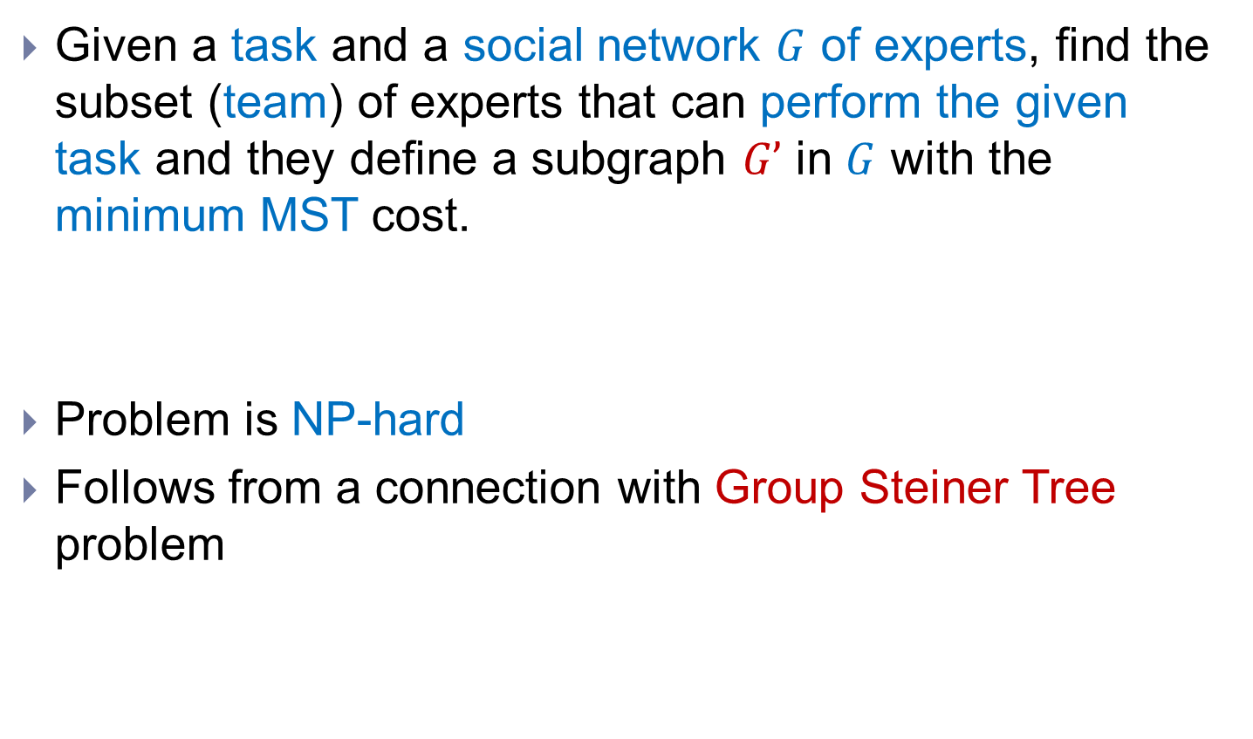
Problem definition (MinMST)
Boston University Slideshow Title Goes Here
Given a task and a social network $G$ of experts, find the subset (team) of experts that can perform the given task and they define a subgraph $G’$ in $G$ with the minimum MST cost.
Problem is NP-hard
Follows from a connection with Group Steiner Tree problem

Slide 19
The SteinerTree problem
Boston University Slideshow Title Goes Here
Graph G(V,E)
Partition of V into V = {R,N}
Find G’ subgraph of G such that G’ contains all the required vertices (R) and MST(G’) is minimized
  Find the cheapest tree that contains all the required nodes.
Required vertices

Slide 20
The EnhancedSteiner algorithm
T={algorithms,java,graphics,python}
Boston University Slideshow Title Goes Here
graphics
{graphics,python,java}
{algorithms,graphics}
java
A
B
E
{algorithms,graphics,java}
algorithms
E
C
D
python
D
{python,java}
{python}
MST Cost = 1

Slide 21
The CoverSteiner algorithm
T={algorithms,java,graphics,python}
Boston University Slideshow Title Goes Here
{graphics,python,java}
{algorithms,graphics}
A
B
Solve SetCover
Solve Steiner
E
{algorithms,graphics,java}
E
C
D
D
{python,java}
{python}
MST Cost = 1

Slide 22
How good is CoverSteiner?
T={algorithms,java,graphics,python}
Boston University Slideshow Title Goes Here
{graphics,python,java}
{algorithms,graphics}
A
B
A
B
Solve SetCover
Solve Steiner
E
{algorithms,graphics,java}
C
D
{python,java}
{python}
MST Cost = Infty

Slide 23
References
Theodoros Lappas, Kun Liu, Evimaria Terzi, Finding a team of experts in social networks. KDD 2009: 467-476

Slide 24
Recommendation Systems and Social Recommendations
Thanks to: Jure Leskovec, Anand Rajaraman, Jeff Ullman

Slide 25
Recommendation Systems
Recommendation systems
  When a user buys an item (initially books) we want to recommend other items that the user may like
  When a user rates a movie, we want to recommend movies that the user may like
  When a user likes a song, we want to recommend other songs that they may like
A big success of data mining
Exploits the long tail
  How Into Thin Air made Touching the Void popular

Slide 26
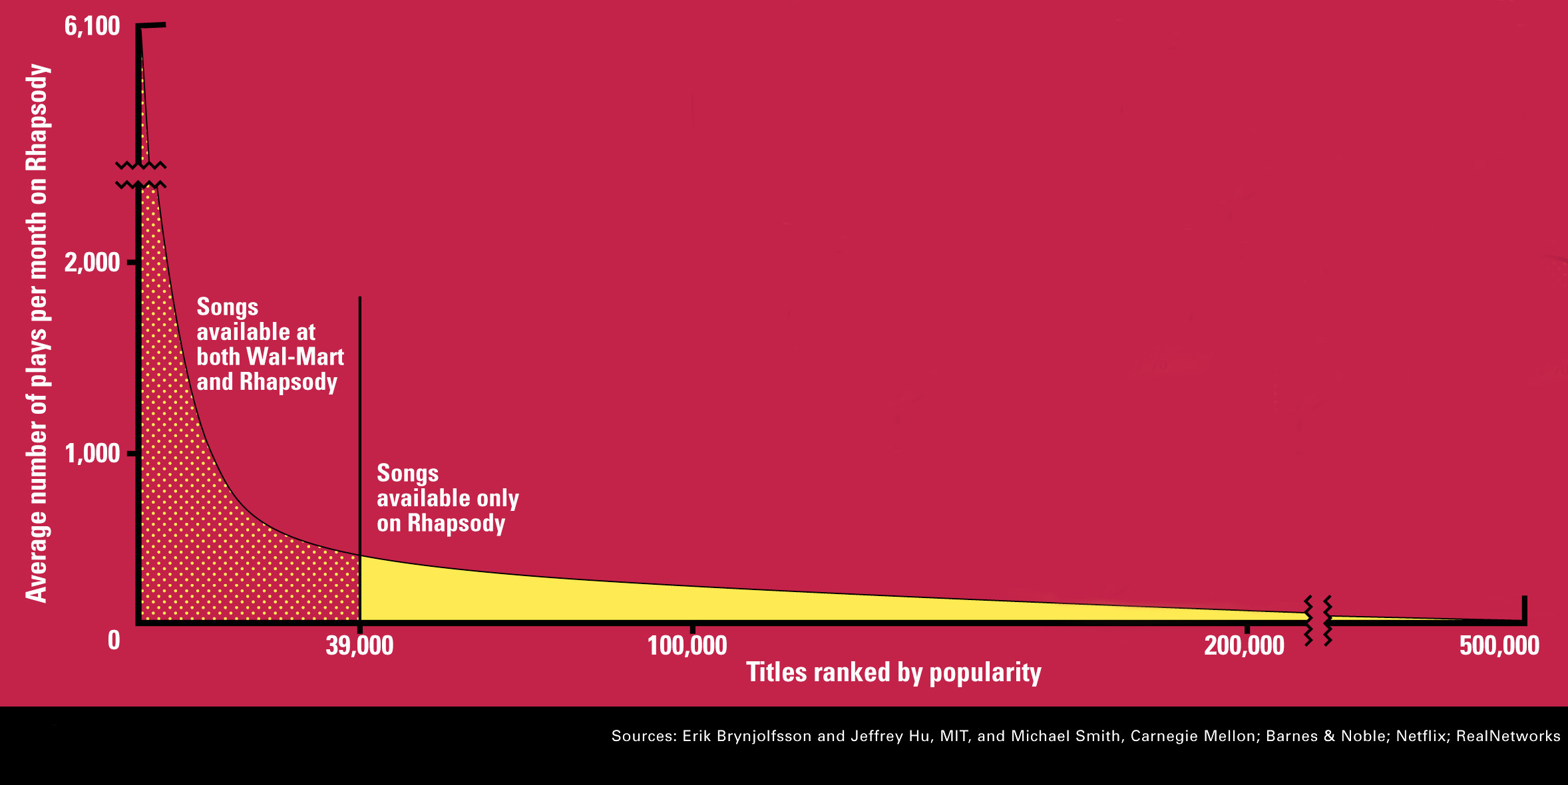
The Long Tail
Source: Chris Anderson (2004)

Slide 27
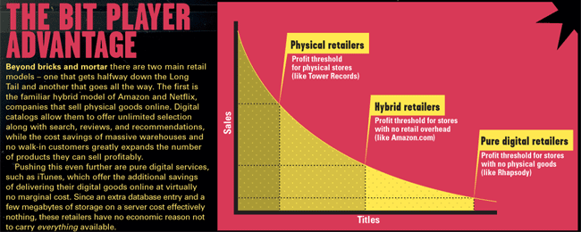
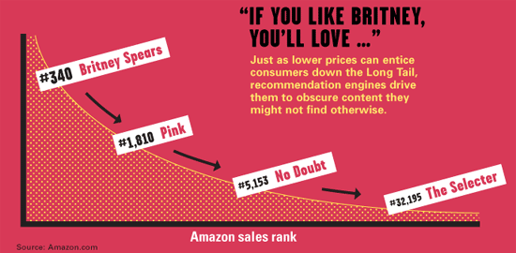
Physical vs. Online
    Read http://www.wired.com/wired/archive/12.10/tail.html to learn more!

Slide 28
Utility (Preference) Matrix
 | Harry Potter 1 | Harry Potter 2 | Harry Potter 3 | Twilight | Star Wars 1 | Star Wars 2 | Star Wars 3
A | 4 |  |  | 5 | 1
B | 5 | 5 | 4
C |  |  |  | 2 | 4 | 5
D |  | 3 |  |  |  |  | 3
How can we fill the empty entries of the matrix?

Slide 29
Recommendation Systems
Content-based:
  Represent the items into a feature space and recommend items to customer C similar to previous items rated highly by C
    Movie recommendations: recommend movies with same actor(s), director, genre, …
    Websites, blogs, news: recommend other sites with “similar” content

Slide 30
Content-based prediction
 | Harry Potter 1 | Harry Potter 2 | Harry Potter 3 | Twilight | Star Wars 1 | Star Wars 2 | Star Wars 3
A | 4 | 4 | 4 | 5 | 1 | 1 | 1
B | 5 | 5 | 4
C |  |  |  | 2 | 4 | 5 | 5
D |  | 3 |  |  |  |  | 3
Someone who likes one of the Harry Potter (or Star Wars)
movies is likely to like the rest
  Same actors, similar story, same genre

Slide 31
Intuition
Item profiles
likes
build
recommend
match
Red
Circles
Triangles
User profile

Slide 32
Extracting features for Items
Map items into a feature space:
  For movies:
    Actors, directors, genre, rating, year,…
  For documents?
Items are now real vectors in a multidimensional feature space
  Challenge: Make all feature values compatible
Alternatively we can view a movie as a set of features:
  Star Wars = {1977, Action, Sci-Fi, Lucas, H.Ford}
Year | Action | Sci-Fi | Romance | Lucas | H. Ford | Pacino
1977 | 1 | 1 | 0 | 1 | 1 | 0
Star Wars

Slide 33
Extracting Features for Users
To compare items with users we need to map users to the same feature space. How?
  Take all the movies that the user has seen and take the average vector
    Other aggregation functions are also possible.
Recommend to user C the most similar item i computing similarity in the common feature space
  How do we measure similarity?

Slide 34
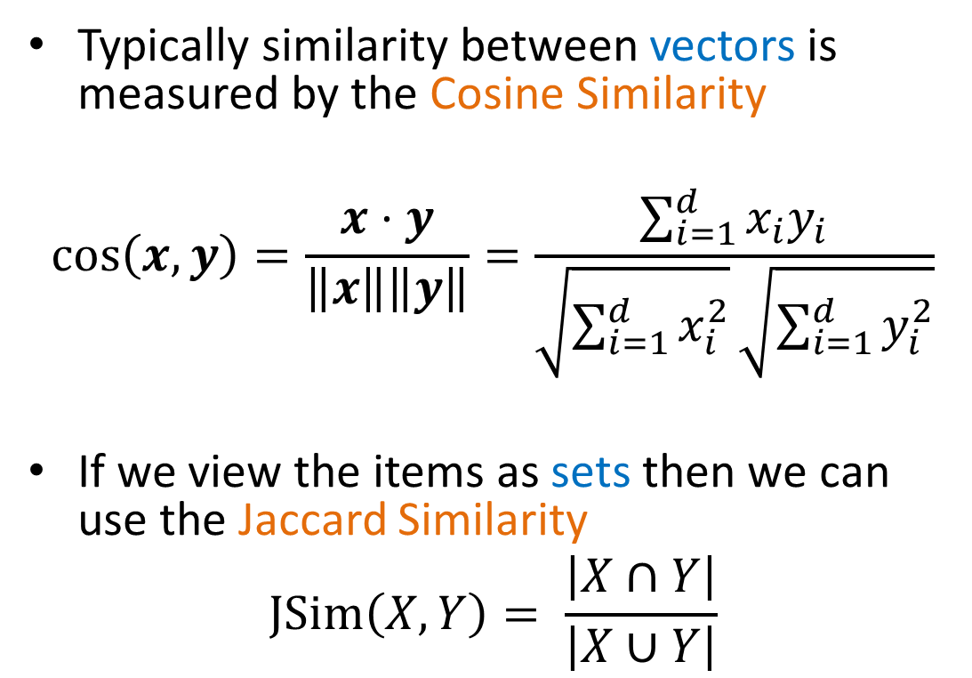
Similarity
Typically similarity between vectors is measured by the Cosine Similarity
$$\cos\left(x,y\right)=\frac{x⋅y}{\left\|x\right\|\left\|y\right\|}=\frac{\sum_{i=1}^{d}{x_{i}y_{i}}}{\sqrt{\sum_{i=1}^{d}{x_{i}^{2}}}\sqrt{\sum_{i=1}^{d}{y_{i}^{2}}}}$$
If we view the items as sets then we can use the Jaccard Similarity
$$JSim\left(X,Y\right)= \frac{\left|X∩Y\right|}{\left|X∪Y\right|}$$
X
Y

Slide 35
Classification approach
Using the user and item features we can construct a classifier that tries to predict if a user will like a new item

Slide 36
Limitations of content-based approach
Finding the appropriate features
  e.g., images, movies, music
Overspecialization
  Never recommends items outside user’s content profile
  People might have multiple interests

Slide 37
Collaborative filtering
 | Harry Potter 1 | Harry Potter 2 | Harry Potter 3 | Twilight | Star Wars 1 | Star Wars 2 | Star Wars 3
A | 4 |  |  | 5 | 1
B | 5 | 5 | 4
C |  |  |  | 2 | 4 | 5
D |  | 3 |  |  |  |  | 3
Two users are similar if they rate the same items in a similar way
Recommend to user C, the items
liked by many of the most similar users.

Slide 38
User Similarity
 | Harry Potter 1 | Harry Potter 2 | Harry Potter 3 | Twilight | Star Wars 1 | Star Wars 2 | Star Wars 3
A | 4 |  |  | 5 | 1
B | 5 | 5 | 4
C |  |  |  | 2 | 4 | 5
D |  | 3 |  |  |  |  | 3
Which pair of users do you consider as the most similar?
What is the right definition of similarity?

Slide 39
User Similarity
 | Harry Potter 1 | Harry Potter 2 | Harry Potter 3 | Twilight | Star Wars 1 | Star Wars 2 | Star Wars 3
A | 1 |  |  | 1 | 1
B | 1 | 1 | 1
C |  |  |  | 1 | 1 | 1
D |  | 1 |  |  |  |  | 1
Jaccard Similarity: users are sets of movies
Disregards the ratings.
Jsim(A,B) = 1/5
Jsim(A,C) = 1/2
Jsim(B,D) = 1/4

Slide 40
User Similarity
 | Harry Potter 1 | Harry Potter 2 | Harry Potter 3 | Twilight | Star Wars 1 | Star Wars 2 | Star Wars 3
A | 4 |  |  | 5 | 1
B | 5 | 5 | 4
C |  |  |  | 2 | 4 | 5
D |  | 3 |  |  |  |  | 3
Cosine Similarity:
Assumes zero entries are negatives:
Cos(A,B) = 0.38
Cos(A,C) = 0.32

Slide 41
User Similarity
 | Harry Potter 1 | Harry Potter 2 | Harry Potter 3 | Twilight | Star Wars 1 | Star Wars 2 | Star Wars 3
A | 2/3 |  |  | 5/3 | -7/3
B | 1/3 | 1/3 | -2/3
C |  |  |  | -5/3 | 1/3 | 4/3
D |  | 0 |  |  |  |  | 0
Normalized Cosine Similarity:
  Subtract the mean rating per user and then compute Cosine (correlation coefficient)
Corr(A,B) = 0.092
Corr(A,C) = -0.559

Slide 42
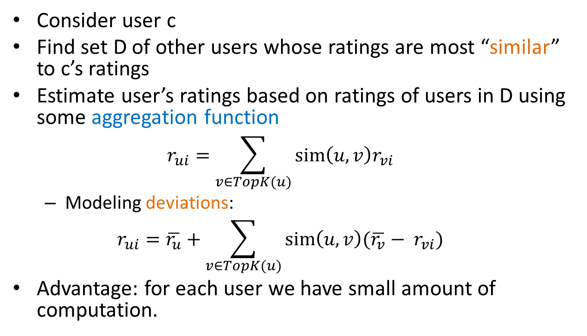
User-User Collaborative Filtering
Consider user c
Find set D of other users whose ratings are most “similar” to c’s ratings
Estimate user’s ratings based on ratings of users in D using some aggregation function
  $$r_{ui}=\sum_{v∈TopK(u)}{sim\left(u,v\right)r_{vi}}$$
  Modeling deviations:
  $$r_{ui}=\overline{r_{u}}+\sum_{v∈TopK(u)}{sim\left(u,v\right){(\overline{r_{v}}− r}_{vi})}$$
Advantage: for each user we have small amount of computation.

Slide 43
Item-Item Collaborative Filtering
We can transpose (flip) the matrix and perform the same computation as before to define similarity between items
  Intuition: Two items are similar if they are rated in the same way by many users.
  Better defined similarity since it captures the notion of genre of an item
    Users may have multiple interests.
Algorithm: For each user c and item i
  Find the set D of most similar items to item i that have been rated by user c.
  Aggregate their ratings to predict the rating for item i.
Disadvantage: we need to consider each user-item pair separately

Slide 44
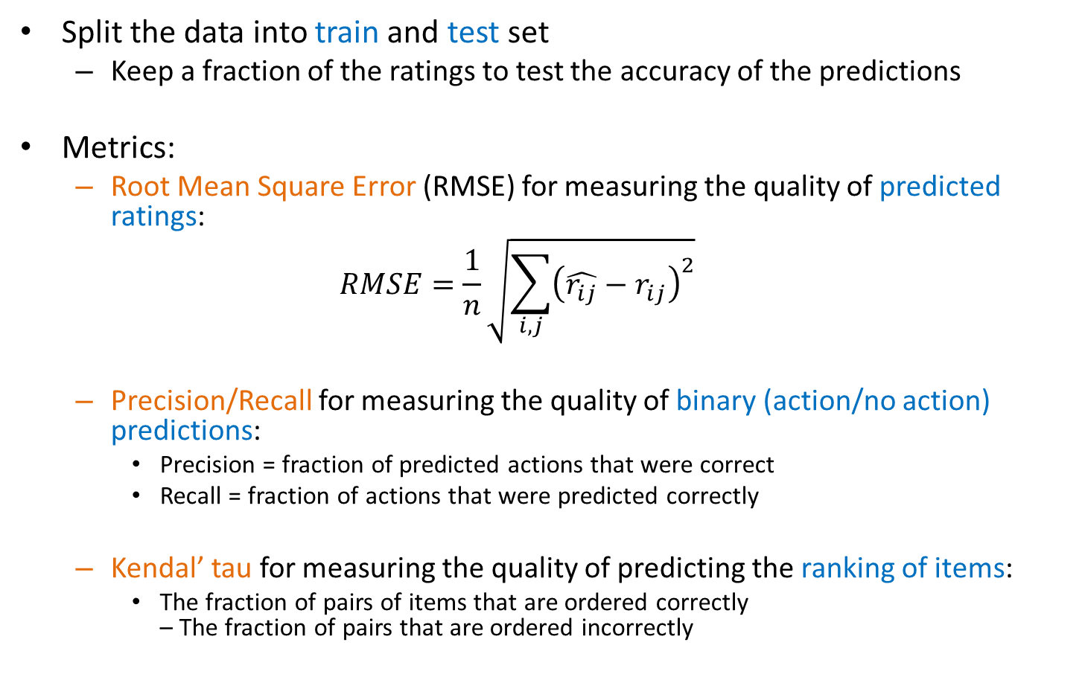
Evaluation
Split the data into train and test set
  Keep a fraction of the ratings to test the accuracy of the predictions
Metrics:
  Root Mean Square Error (RMSE) for measuring the quality of predicted ratings:
  $$RMSE=\frac{1}{n}\sqrt{\sum_{i,j}{{\left(\hat{r_{ij}}−r_{ij}\right)}^{2}}}$$
  Precision/Recall for measuring the quality of binary (action/no action) predictions:
    Precision = fraction of predicted actions that were correct
    Recall = fraction of actions that were predicted correctly
  Kendal’ tau for measuring the quality of predicting the ranking of items:
    The fraction of pairs of items that are ordered correctly – The fraction of pairs that are ordered incorrectly

Slide 45
Model-Based Collaborative Filtering
So far we have looked at specific user-item combinations
A different approach looks at the full user-item matrix and tries to find a model that explains how the ratings of the matrix are generated
  If we have such a model, we can predict the ratings that we do not observe.
Latent factor model:
  (Most) models assume that there are few (K) latent factors that define the behavior of the users and the characteristics of the items

Slide 46






Latent Factor Models
Serious
Braveheart
The Color Purple
Amadeus
Lethal Weapon
Sense and Sensibility
Geared towards
females
Ocean’s 11
Geared towards
males
The Lion King
The Princess
Diaries
Independence Day
Dumb and Dumber
Funny

Slide 47
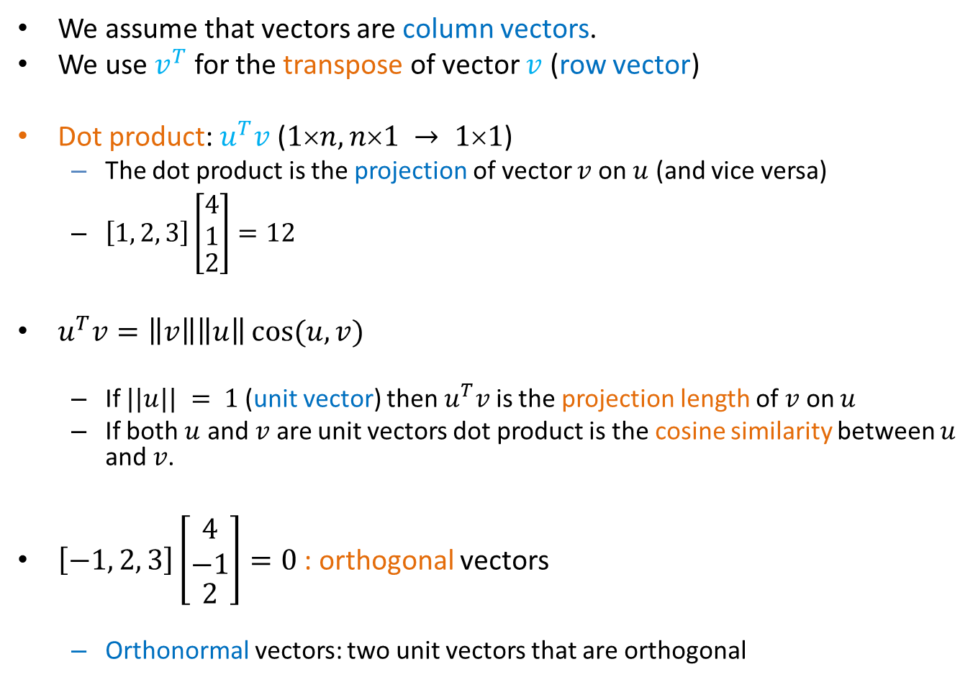
Linear algebra
We assume that vectors are column vectors.
We use $v^{T}$ for the transpose of vector $v$ (row vector)
Dot product: $u^{T}v$ ($1n, n1 → 11$)
  The dot product is the projection of vector $v$ on $u$ (and vice versa)
  $\left[1, 2, 3\right]\left[\begin{matrix}\begin{matrix}4 \\ 1\end{matrix} \\ 2\end{matrix}\right]=12$
$u^{T}v=\left\|v\right\|\left\|u\right\|\cos{(u,v)}$
  If $||u|| = 1$(unit vector) then $u^{T}v$ is the projection length of $v$ on $u$
  If both $u$ and $v$ are unit vectors dot product is the cosine similarity between $u$ and $v$.
$\left[−1, 2, 3\right]\left[\begin{matrix}\begin{matrix}4 \\ −1\end{matrix} \\ 2\end{matrix}\right]=0$: orthogonal vectors
  Orthonormal vectors: two unit vectors that are orthogonal

Slide 48

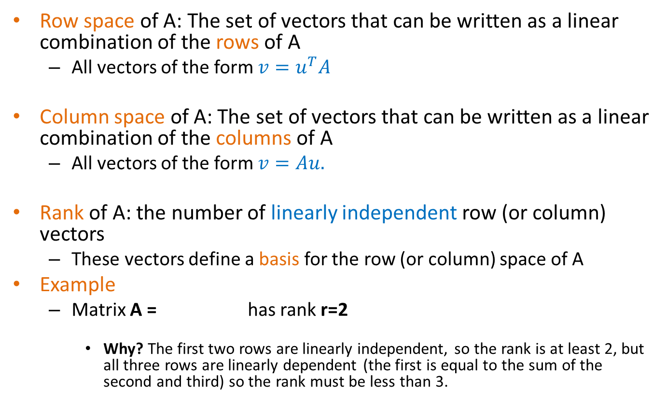
Rank
Row space of A: The set of vectors that can be written as a linear combination of the rows of A
  All vectors of the form $v=u^{T}A$
Column space of A: The set of vectors that can be written as a linear combination of the columns of A
  All vectors of the form $v=Au.$
Rank of A: the number of linearly independent row (or column) vectors
  These vectors define a basis for the row (or column) space of A
Example
  Matrix A = has rank r=2
    Why? The first two rows are linearly independent, so the rank is at least 2, but all three rows are linearly dependent (the first is equal to the sum of the second and third) so the rank must be less than 3.

Slide 49
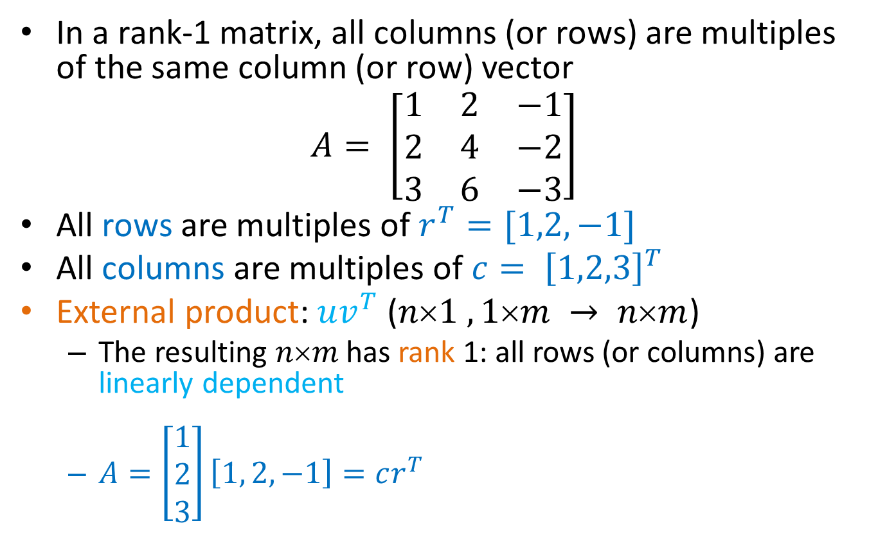
Rank-1 matrices
In a rank-1 matrix, all columns (or rows) are multiples of the same column (or row) vector
$$A= \left[\begin{matrix}1 & 2 & −1 \\ 2 & 4 & −2 \\ 3 & 6 & −3\end{matrix}\right]$$
All rows are multiples of $r^{T}=[1,2,−1]$
All columns are multiples of ${c= \left[1,2,3\right]}^{T}$
External product: $uv^{T}$ ($n1 ,1m → nm$)
  The resulting $nm$ has rank 1: all rows (or columns) are linearly dependent
  $A=\left[\begin{matrix}1 \\ 2 \\ 3\end{matrix}\right]\left[1, 2, −1\right]=cr^{T}$

Slide 50
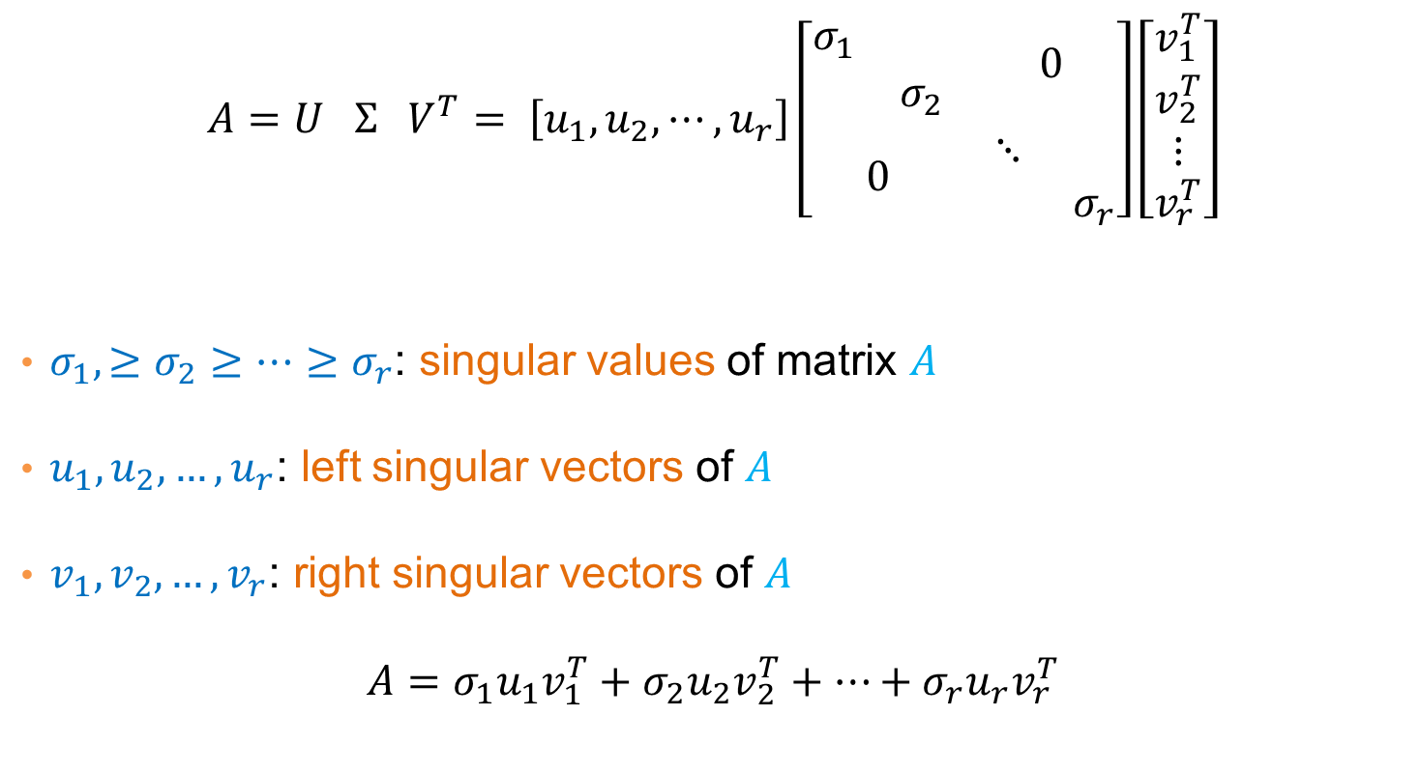
Singular Value Decomposition
$$A=U Σ{ V}^{T}= \left[u_{1}, u_{2}, ⋯,u_{r}\right]\left[\begin{matrix}\begin{matrix}σ_{1} & \\ & σ_{2}\end{matrix} & 0 \\ 0 & \begin{matrix}⋱ & \\ & σ_{r}\end{matrix}\end{matrix}\right]\left[\begin{matrix}\begin{matrix}v_{1}^{T} \\ v_{2}^{T}\end{matrix} \\ ⋮ \\ v_{r}^{T}\end{matrix}\right]$$
$σ_{1},≥σ_{2}≥…≥σ_{r}$: singular values of matrix $A$
$u_{1},u_{2},…,u_{r}$: left singular vectors of $A$
$v_{1},v_{2},…,v_{r}$: right singular vectors of $A$
$$A=σ_{1}u_{1}v_{1}^{T}+σ_{2}u_{2}v_{2}^{T}+⋯+σ_{r}u_{r}v_{r}^{T}$$
[n×m] =
[n×r]
[r×r]
[r×m]
r: rank of matrix A

Slide 51
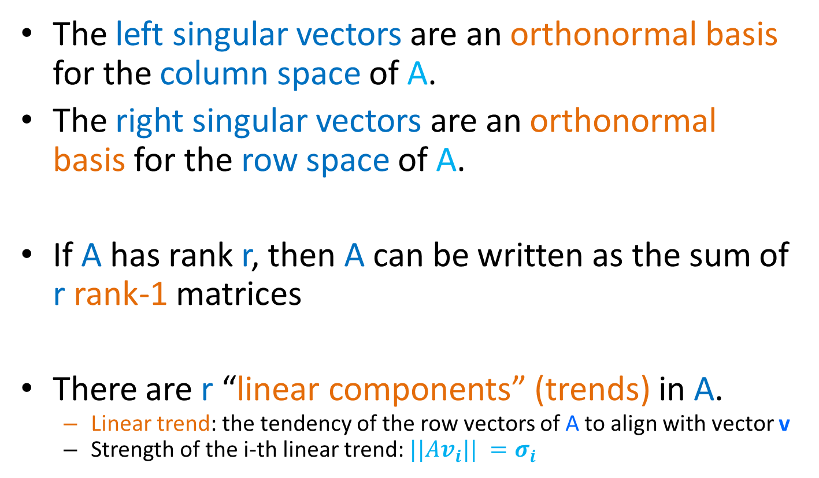
Singular Value Decomposition
The left singular vectors are an orthonormal basis for the column space of A.
The right singular vectors are an orthonormal basis for the row space of A.
If A has rank r, then A can be written as the sum of r rank-1 matrices
There are r “linear components” (trends) in A.
  Linear trend: the tendency of the row vectors of A to align with vector v
  Strength of the i-th linear trend: $||Av_{i}|| =σ_{i}$

Slide 52
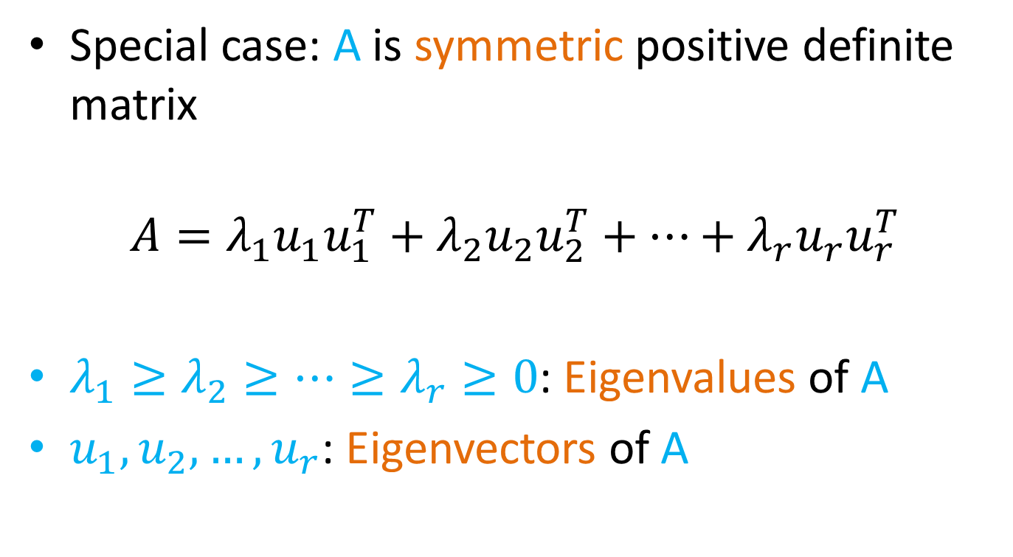
Symmetric matrices
Special case: A is symmetric positive definite matrix
$$A=λ_{1}u_{1}u_{1}^{T}+λ_{2}u_{2}u_{2}^{T}+⋯+λ_{r}u_{r}u_{r}^{T}$$
$λ_{1}≥λ_{2}≥⋯≥λ_{r}≥0$: Eigenvalues of A
$u_{1},u_{2},…, u_{r}$: Eigenvectors of A

Slide 53
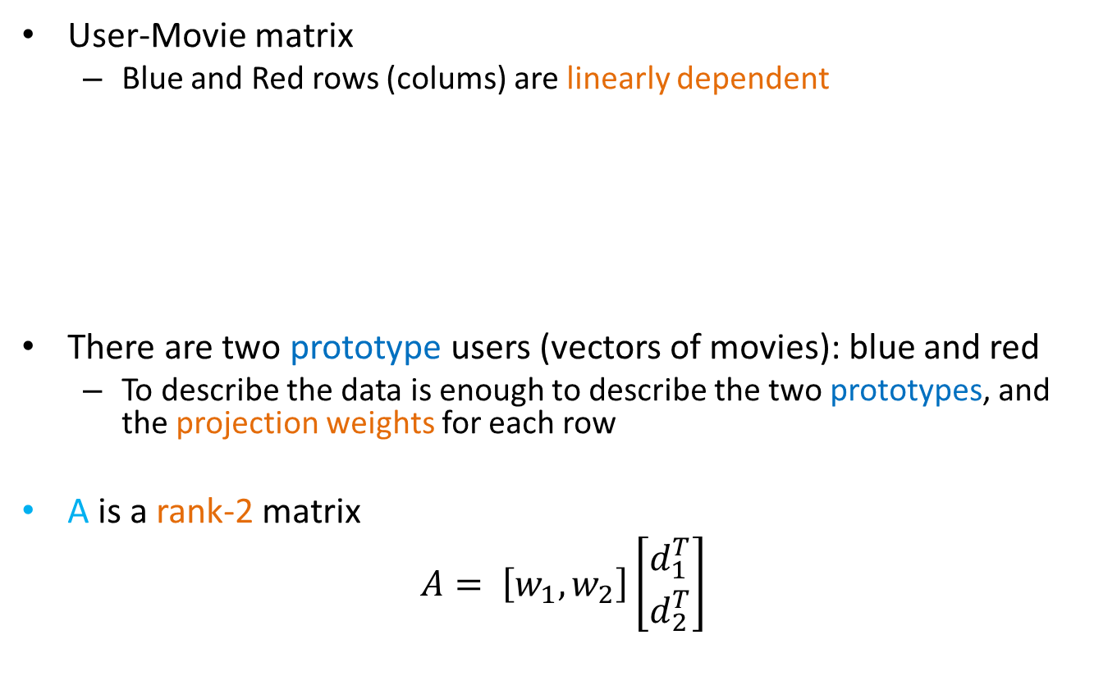
An (extreme) example
User-Movie matrix
  Blue and Red rows (colums) are linearly dependent
There are two prototype users (vectors of movies): blue and red
  To describe the data is enough to describe the two prototypes, and the projection weights for each row
A is a rank-2 matrix
$$A= \left[w_{1},w_{2}\right]\left[\begin{matrix}d_{1}^{T} \\ d_{2}^{T}\end{matrix}\right]$$
A =

Slide 54
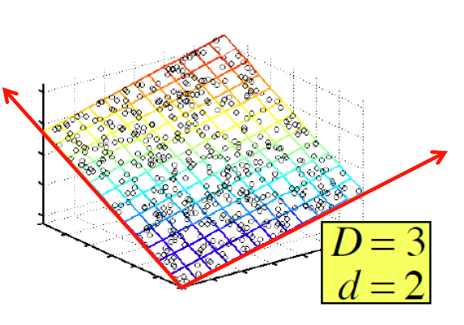
SVD – Example: Users-to-Movies
A = U Σ V^{T} - example: Users to Movies
Matrix
Alien
Serenity
Casablanca
Amelie
n
1 1 1 0 0
3 3 3 0 0
4 4 4 0 0
5 5 5 0 0
0 0 0 4 4
0 0 0 5 5
0 0 0 2 2
SciFi
Σ
V^{T}
=
m
Romance
U
“Concepts”
AKA Latent dimensions
AKA Latent factors

Slide 55
SVD – Example: Users-to-Movies
A = U Σ V^{T} - example: Users to Movies
Matrix
Alien
Serenity
Casablanca
Amelie
SciFi-concept
Romance-concept
1 1 1 0 0
3 3 3 0 0
4 4 4 0 0
5 5 5 0 0
0 0 0 4 4
0 0 0 5 5
0 0 0 2 2
0.14 0.00
0.42 0.00
0.56 0.00
0.70 0.00
0.00 0.60
0.00 0.75
0.00 0.30
SciFi
=
x
12.4 0
0 9.5
x
Romance
0.58 0.58 0.58 0.00 0.00
0.00 0.00 0.00 0.71 0.71

Slide 56
SVD – Example: Users-to-Movies
A = U Σ V^{T} - example: Users to Movies
Matrix
Alien
Serenity
Casablanca
Amelie
SciFi-concept
Romance-concept
U is “user-to-concept”
similarity matrix
1 1 1 0 0
3 3 3 0 0
4 4 4 0 0
5 5 5 0 0
0 0 0 4 4
0 0 0 5 5
0 0 0 2 2
0.14 0.00
0.42 0.00
0.56 0.00
0.70 0.00
0.00 0.60
0.00 0.75
0.00 0.30
SciFi
=
x
12.4 0
0 9.5
x
Romance
0.58 0.58 0.58 0.00 0.00
0.00 0.00 0.00 0.71 0.71

Slide 57
SVD – Example: Users-to-Movies
A = U Σ V^{T} - example: Users to Movies
Matrix
Alien
Serenity
Casablanca
Amelie
SciFi-concept
Romance-concept
V is “movie to concept” similarity matrix
1 1 1 0 0
3 3 3 0 0
4 4 4 0 0
5 5 5 0 0
0 0 0 4 4
0 0 0 5 5
0 0 0 2 2
0.14 0.00
0.42 0.00
0.56 0.00
0.70 0.00
0.00 0.60
0.00 0.75
0.00 0.30
SciFi
=
x
12.4 0
0 9.5
x
Romance
0.58 0.58 0.58 0.00 0.00
0.00 0.00 0.00 0.71 0.71

Slide 58
SVD – Example: Users-to-Movies
A = U Σ V^{T} - example: Users to Movies
Matrix
Alien
Serenity
Casablanca
Amelie
SciFi-concept
Romance-concept
Σ is the “concept strength” matrix
1 1 1 0 0
3 3 3 0 0
4 4 4 0 0
5 5 5 0 0
0 0 0 4 4
0 0 0 5 5
0 0 0 2 2
0.14 0.00
0.42 0.00
0.56 0.00
0.70 0.00
0.00 0.60
0.00 0.75
0.00 0.30
SciFi
=
x
12.4 0
0 9.5
x
Romance
0.58 0.58 0.58 0.00 0.00
0.00 0.00 0.00 0.71 0.71

Slide 59
An (more realistic) example
User-Movie matrix
There are two prototype users and movies but they are noisy
A =

Slide 60
SVD – Example: Users-to-Movies
A = U Σ V^{T} - example: Users to Movies
Matrix
Alien
Serenity
Casablanca
Amelie
A more realistic scenario
n
1 1 1 0 0
3 3 3 0 0
4 4 4 0 0
5 5 5 0 0
0 2 0 4 4
0 0 0 5 5
0 1 0 2 2
SciFi
Σ
V^{T}
=
m
Romnce
U
“Concepts”
AKA Latent dimensions
AKA Latent factors

Slide 61
SVD – Example: Users-to-Movies
A = U Σ V^{T} - example: Users to Movies
Matrix
Alien
Serenity
Casablanca
Amelie
1 1 1 0 0
3 3 3 0 0
4 4 4 0 0
5 5 5 0 0
0 2 0 4 4
0 0 0 5 5
0 1 0 2 2
0.13 -0.02 -0.01
0.41 -0.07 -0.03
0.55 -0.09 -0.04
0.68 -0.11 -0.05
0.15 0.59 0.65
0.07 0.73 -0.67
0.07 0.29 0.32
SciFi
12.4 0 0
0 9.5 0
0 0 1.3
=
x
x
Romance
0.56 0.59 0.56 0.09 0.09
-0.12 0.02 -0.12 0.69 0.69
0.40 -0.80 0.40 0.09 0.09

Slide 62
SVD – Example: Users-to-Movies
A = U Σ V^{T} - example: Users to Movies
Matrix
Alien
Serenity
Casablanca
Amelie
SciFi-concept
Romance-concept
The first two vectors are more or less unchanged
1 1 1 0 0
3 3 3 0 0
4 4 4 0 0
5 5 5 0 0
0 2 0 4 4
0 0 0 5 5
0 1 0 2 2
0.13 -0.02 -0.01
0.41 -0.07 -0.03
0.55 -0.09 -0.04
0.68 -0.11 -0.05
0.15 0.59 0.65
0.07 0.73 -0.67
0.07 0.29 0.32
SciFi
12.4 0 0
0 9.5 0
0 0 1.3
=
x
x
Romance
0.56 0.59 0.56 0.09 0.09
-0.12 0.02 -0.12 0.69 0.69
0.40 -0.80 0.40 0.09 0.09

Slide 63
SVD – Example: Users-to-Movies
A = U Σ V^{T} - example: Users to Movies
Matrix
Alien
Serenity
Casablanca
Amelie
The third vector has a very low singular value
1 1 1 0 0
3 3 3 0 0
4 4 4 0 0
5 5 5 0 0
0 2 0 4 4
0 0 0 5 5
0 1 0 2 2
0.13 -0.02 -0.01
0.41 -0.07 -0.03
0.55 -0.09 -0.04
0.68 -0.11 -0.05
0.15 0.59 0.65
0.07 0.73 -0.67
0.07 0.29 0.32
SciFi
12.4 0 0
0 9.5 0
0 0 1.3
=
x
x
Romance
0.56 0.59 0.56 0.09 0.09
-0.12 0.02 -0.12 0.69 0.69
0.40 -0.80 0.40 0.09 0.09

Slide 64
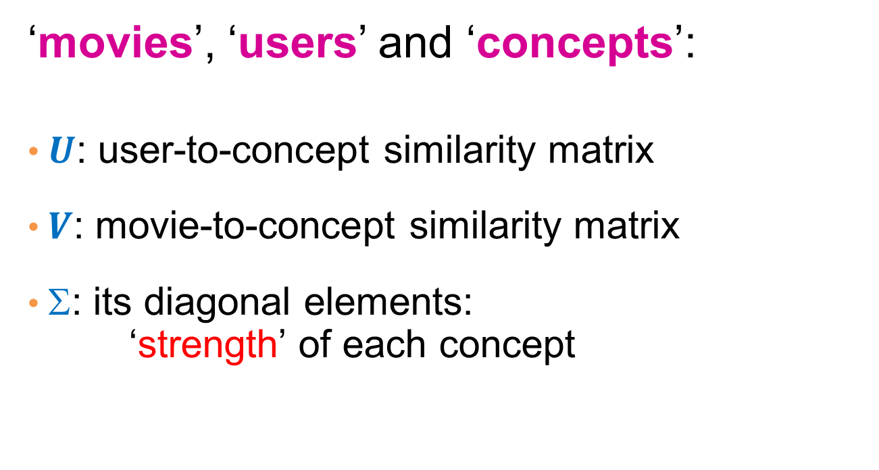
SVD - Interpretation
‘movies’, ‘users’ and ‘concepts’:
$U$: user-to-concept similarity matrix
$V$: movie-to-concept similarity matrix
$$: its diagonal elements:
‘strength’ of each concept

Slide 65
Rank-k approximation
In the last User-Movie matrix we have more than two singular vectors, but the strongest ones are still about the two types.
  The third models the noise in the data
By keeping the two strongest singular vectors we obtain most of the information in the data.
  This is a rank-2 approximation of the matrix A
  This is the best rank-2 approximation of A
    The best two latent factors

Slide 66
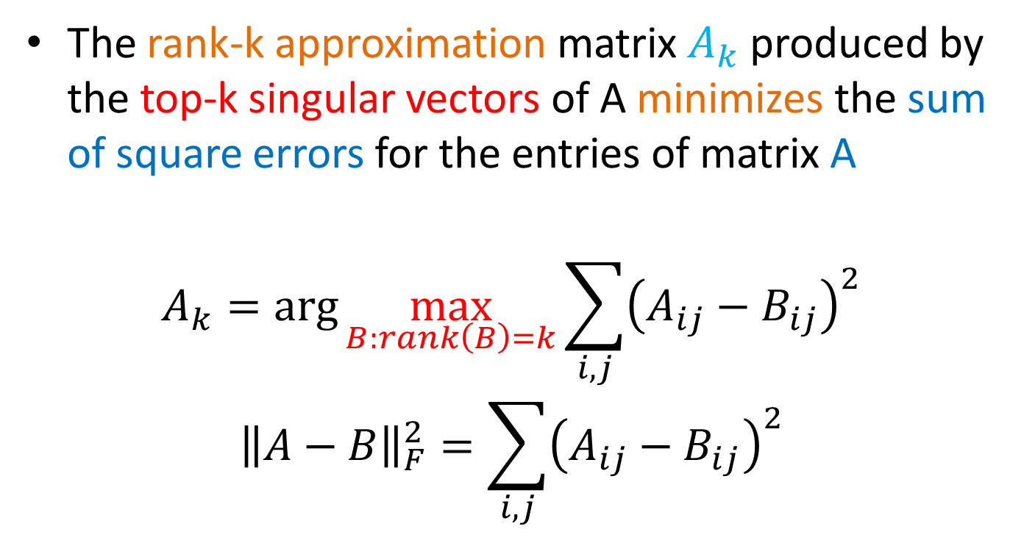
SVD as an optimization
The rank-k approximation matrix $A_{k}$ produced by the top-k singular vectors of A minimizes the sum of square errors for the entries of matrix A
$$A_{k}=\arg{\max_{B:rank\left(B\right)=k}{\sum_{i,j}{{\left(A_{ij}−B_{ij}\right)}^{2}}}}$$
$${\left\|A−B\right\|}_{F}^{2}=\sum_{i,j}{{\left(A_{ij}−B_{ij}\right)}^{2}}$$

Slide 67
Example
1 1 1 0 0
3 3 3 0 0
4 4 4 0 0
5 5 5 0 0
0 2 0 4 4
0 0 0 5 5
0 1 0 2 2
0.13 -0.02 -0.01
0.41 -0.07 -0.03
0.55 -0.09 -0.04
0.68 -0.11 -0.05
0.15 0.59 0.65
0.07 0.73 -0.67
0.07 0.29 0.32
12.4 0 0
0 9.5 0
0 0 1.3
≈
x
x
0.56 0.59 0.56 0.09 0.09
-0.12 0.02 -0.12 0.69 0.69
0.40 -0.80 0.40 0.09 0.09

Slide 68
Example
1 1 1 0 0
3 3 3 0 0
4 4 4 0 0
5 5 5 0 0
0 2 0 4 4
0 0 0 5 5
0 1 0 2 2
0.13 -0.02
0.41 -0.07
0.55 -0.09
0.68 -0.11
0.15 0.59
0.07 0.73
0.07 0.29
12.4 0
0 9.5
≈
x
x
0.56 0.59 0.56 0.09 0.09
-0.12 0.02 -0.12 0.69 0.69

Slide 69
Example
1 1 1 0 0
3 3 3 0 0
4 4 4 0 0
5 5 5 0 0
0 2 0 4 4
0 0 0 5 5
0 1 0 2 2
0.92 0.95 0.92 0.01 0.01
2.91 3.01 2.91 -0.01 -0.01
3.90 4.04 3.90 0.01 0.01
4.82 5.00 4.82 0.03 0.03
0.70 0.53 0.70 4.11 4.11
-0.69 1.34 -0.69 4.78 4.78
0.32 0.23 0.32 2.01 2.01
≈
Frobenius norm:
ǁMǁ_{F} = √Σ_{ij} M_{ij}²
ǁA-Bǁ_{F} = √ Σ_{ij} (A_{ij}-B_{ij})²
^{is “small”}

Slide 70
Latent Factor Models
“SVD” on Netflix data: R ≈ Q · P^{T}
For now let’s assume we can approximate the rating matrix R as a product of “thin” Q · P^{T}
  R has missing entries but let’s ignore that for now!
    Basically, we will want the reconstruction error to be small on known ratings and we don’t care about the values on the missing ones
SVD: A = U Σ V^{T}
users
factors
 | 4 |  | 5 |  |  | 5 |  |  | 3 |  | 1
3 | 1 | 2 |  |  | 4 |  |  | 4 | 5
 | 5 | 3 | 4 |  | 3 |  | 2 | 1 |  | 4 | 2
 | 2 |  |  | 4 |  |  | 5 |  | 4 | 2
5 | 2 |  |  |  |  | 2 | 4 | 3 | 4
 | 4 |  |  | 2 |  |  | 3 |  | 3 |  | 1
.2 | -.4 | .1
.5 | .6 | -.5
.5 | .3 | -.2
.3 | 2.1 | 1.1
-2 | 2.1 | -.7
.3 | .7 | -1
users
items
≈
-.9 | 2.4 | 1.4 | .3 | -.4 | .8 | -.5 | -2 | .5 | .3 | -.2 | 1.1
1.3 | -.1 | 1.2 | -.7 | 2.9 | 1.4 | -1 | .3 | 1.4 | .5 | .7 | -.8
.1 | -.6 | .7 | .8 | .4 | -.3 | .9 | 2.4 | 1.7 | .6 | -.4 | 2.1
factors
items
P^{T}
R
Q
Notes:
Difference with SVD:
-- can multiply sigma with V and get the UV decomposition
-- SVD will count errors also on missing entries (zeros)
-- SVD insists U,V are orthonormal. We do not want this here, we do not care, we just want something that works

Slide 71

Ratings as Products of Factors
How to estimate the missing rating of
user x for item i?
users
$${\hat{r}}_{xi}=q_{i}⋅p_{x}^{} \\ =\sum_{f}{q_{if}⋅p_{xf}}$$
 | 4 |  | 5 |  |  | 5 |  |  | 3 |  | 1
3 | 1 | 2 |  |  | 4 |  |  | 4 | 5
 | 5 | 3 | 4 |  | 3 |  | 2 | 1 |  | 4 | 2
 | 2 |  |  | 4 |  |  | 5 |  | 4 | 2
5 | 2 |  |  |  |  | 2 | 4 | 3 | 4
 | 4 |  |  | 2 |  |  | 3 |  | 3 |  | 1
?
items
≈
q_{i} = row i of Q
p_{x} = column x of P^{T}
.2 | -.4 | .1
.5 | .6 | -.5
.5 | .3 | -.2
.3 | 2.1 | 1.1
-2 | 2.1 | -.7
.3 | .7 | -1
users
-.9 | 2.4 | 1.4 | .3 | -.4 | .8 | -.5 | -2 | .5 | .3 | -.2 | 1.1
1.3 | -.1 | 1.2 | -.7 | 2.9 | 1.4 | -1 | .3 | 1.4 | .5 | .7 | -.8
.1 | -.6 | .7 | .8 | .4 | -.3 | .9 | 2.4 | 1.7 | .6 | -.4 | 2.1
items
factors
P^{T}
factors
Q

Slide 72

Ratings as Products of Factors
How to estimate the missing rating of
user x for item i?
users
$${\hat{r}}_{xi}=q_{i}⋅p_{x}^{} \\ =\sum_{f}{q_{if}⋅p_{xf}}$$
 | 4 |  | 5 |  |  | 5 |  |  | 3 |  | 1
3 | 1 | 2 |  |  | 4 |  |  | 4 | 5
 | 5 | 3 | 4 |  | 3 |  | 2 | 1 |  | 4 | 2
 | 2 |  |  | 4 |  |  | 5 |  | 4 | 2
5 | 2 |  |  |  |  | 2 | 4 | 3 | 4
 | 4 |  |  | 2 |  |  | 3 |  | 3 |  | 1
?
items
≈
q_{i} = row i of Q
p_{x} = column x of P^{T}
.2 | -.4 | .1
.5 | .6 | -.5
.5 | .3 | -.2
.3 | 2.1 | 1.1
-2 | 2.1 | -.7
.3 | .7 | -1
users
-.9 | 2.4 | 1.4 | .3 | -.4 | .8 | -.5 | -2 | .5 | .3 | -.2 | 1.1
1.3 | -.1 | 1.2 | -.7 | 2.9 | 1.4 | -1 | .3 | 1.4 | .5 | .7 | -.8
.1 | -.6 | .7 | .8 | .4 | -.3 | .9 | 2.4 | 1.7 | .6 | -.4 | 2.1
items
factors
P^{T}
factors
Q

Slide 73

Ratings as Products of Factors
How to estimate the missing rating of
user x for item i?
users
$${\hat{r}}_{xi}=q_{i}⋅p_{x}^{} \\ =\sum_{f}{q_{if}⋅p_{xf}}$$
 | 4 |  | 5 |  |  | 5 |  |  | 3 |  | 1
3 | 1 | 2 |  |  | 4 |  |  | 4 | 5
 | 5 | 3 | 4 |  | 3 |  | 2 | 1 |  | 4 | 2
 | 2 |  |  | 4 |  |  | 5 |  | 4 | 2
5 | 2 |  |  |  |  | 2 | 4 | 3 | 4
 | 4 |  |  | 2 |  |  | 3 |  | 3 |  | 1
?
2.4
items
≈
q_{i} = row i of Q
p_{x} = column x of P^{T}
.2 | -.4 | .1
.5 | .6 | -.5
.5 | .3 | -.2
.3 | 2.1 | 1.1
-2 | 2.1 | -.7
.3 | .7 | -1
users
-.9 | 2.4 | 1.4 | .3 | -.4 | .8 | -.5 | -2 | .5 | .3 | -.2 | 1.1
1.3 | -.1 | 1.2 | -.7 | 2.9 | 1.4 | -1 | .3 | 1.4 | .5 | .7 | -.8
.1 | -.6 | .7 | .8 | .4 | -.3 | .9 | 2.4 | 1.7 | .6 | -.4 | 2.1
items
f factors
P^{T}
f factors
Q

Slide 74
Latent Factor Models
Serious
Braveheart
The Color Purple
Amadeus
Lethal Weapon
Sense and Sensibility
Geared towards
females
Ocean’s 11
Factor 1
Geared towards
males
The Lion King
The Princess
Diaries
Factor 2
Independence Day
Dumb and Dumber
Funny
Notes:
This graph shows a hypothetical layout of movies in two dimensions.
In the example, the horizontal dimension contrasts “chick flicks” from “macho movies”, while the vertical dimension measures the seriousness of the movie.
In a real application of SVD, an algorithm would determine the layout, so it night not be easy to label the axes.
Feel free to disagree with my placement of the various movies.

Slide 75
Latent Factor Models
Serious
Braveheart
The Color Purple
Amadeus
Lethal Weapon
Sense and Sensibility
Geared towards
females
Ocean’s 11
Factor 1
Geared towards
males
The Lion King
The Princess
Diaries
Factor 2
Independence Day
Dumb and Dumber
Funny
Notes:
Users fall into the same space as movies, where a user’s position in a dimension reflects the user’s preference for (or against) movies that score high on that dimension.
For example, BLUE tends to like male-oriented movies, but dislikes serious movies. Therefore, we would expect him to love “Dumb and Dumber” and hate “The Color Purple”.
Note that these two dimensions do not characterize Dave’s (DOCTOR) interests very well; additional dimensions would be needed.

Slide 76
Example
Missing ratings
1 1 1 0 0
0 3 3 0 0
4 4 0 0 0
5 5 5 0 0
0 2 0 4 4
0 0 0 5 5
0 1 0 2 2
0.14 -0.06 -0.04
0.30 -0.11 -0.61
0.43 -0.16 0.76
0.74 -0.31 -0.18
0.15 0.53 0.02
0.07 0.70 -0.03
0.07 0.27 0.01
12.4 0 0
0 9.5 0
0 0 1.3
=
x
x
0.51 0.66 0.44 0.23 0.23
-0.24 -0.13 -0.21 0.66 0.66
0.59 0.08 -0.80 0.01 0.01

Slide 77
Example
Reconstruction of missing ratings
0.96 1.14 0.82 -0.01 -0.01
1.94 2.32 1.66 0.07 0.07
2.77 3.32 2.37 0.08 0.08
4.84 5.74 4.14 -0.08 0.08
0.40 1.42 0.33 4.06 4.06
-0.42 0.63 -0.38 4.92 4.92
0.20 0.71 0.16 2.03 2.03

Slide 78

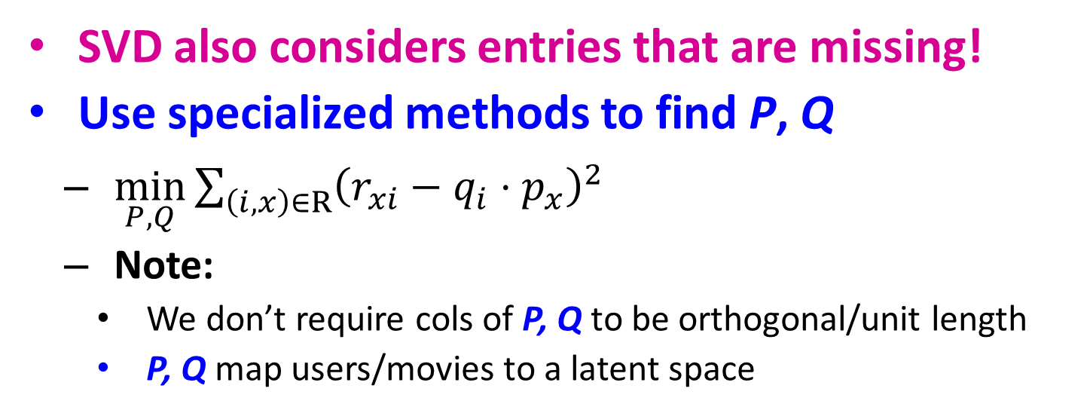
Latent Factor Models
users
factors
 | 4 |  | 5 |  |  | 5 |  |  | 3 |  | 1
3 | 1 | 2 |  |  | 4 |  |  | 4 | 5
 | 5 | 3 | 4 |  | 3 |  | 2 | 1 |  | 4 | 2
 | 2 |  |  | 4 |  |  | 5 |  | 4 | 2
5 | 2 |  |  |  |  | 2 | 4 | 3 | 4
 | 4 |  |  | 2 |  |  | 3 |  | 3 |  | 1
.2 | -.4 | .1
.5 | .6 | -.5
.5 | .3 | -.2
.3 | 2.1 | 1.1
-2 | 2.1 | -.7
.3 | .7 | -1
users
items
≈
-.9 | 2.4 | 1.4 | .3 | -.4 | .8 | -.5 | -2 | .5 | .3 | -.2 | 1.1
1.3 | -.1 | 1.2 | -.7 | 2.9 | 1.4 | -1 | .3 | 1.4 | .5 | .7 | -.8
.1 | -.6 | .7 | .8 | .4 | -.3 | .9 | 2.4 | 1.7 | .6 | -.4 | 2.1
factors
items
P^{T}
Q
SVD also considers entries that are missing!
Use specialized methods to find P, Q
  $\min_{P,Q}\sum_{\left(i,x\right)∈R}{{\left(r_{xi}−q_{i}⋅p_{x}^{}\right)}^{2}}$
  Note:
    We don’t require cols of P, Q to be orthogonal/unit length
    P, Q map users/movies to a latent space
$${\hat{r}}_{xi}=q_{i}⋅p_{x}^{}$$

Slide 79
Back to Our Problem
Want to minimize SSE for unseen test data
Idea: Minimize SSE on training data
  Want large k (# of factors) to capture all the signals
  But, SSE on test data begins to rise for k > 2
This is a classical example of overfitting:
  With too much freedom (too many free parameters) the model starts fitting noise
    That is it fits too well the training data and thus not generalizing well to unseen test data
1 | 3 | 4
 | 3 | 5 |  |  | 5
 |  | 4 | 5 |  | 5
 |  | 3
 |  | 3
2 |  |  | ? |  | ?
 |  |  |  | ?
 | 2 | 1 |  |  | ?
 | 3 |  |  | ?
1

Slide 80
Dealing with Missing Entries
1 | 3 | 4
 | 3 | 5 |  |  | 5
 |  | 4 | 5 |  | 5
 |  | 3
 |  | 3
2 |  |  | ? |  | ?
 |  |  |  | ?
 | 2 | 1 |  |  | ?
 | 3 |  |  | ?
1
To solve overfitting we introduce regularization:
  Allow rich model where there are sufficient data
  Shrink aggressively where data are scarce
“error”
“length”
λ₁, λ₂ … user set regularization parameters
Note: We do not care about the “raw” value of the objective function,
but we care in P,Q that achieve the minimum of the objective

Slide 81
The Effect of Regularization
serious
Braveheart
The Color Purple
Amadeus
Lethal Weapon
Sense and Sensibility
Geared towards
females
Ocean’s 11
Geared towards
males
Factor 1
The Princess
Diaries
The Lion King
Dumb and Dumber
Independence Day
Factor 2
min_{factors} “error” + λ “length”
funny
Notes:
Consider Gus.
This slide shows the position for Gus that best explains his ratings for the Training data—i.e., that minimizes his sum of squared errors.
If Gus has rated hundreds of movies, we could probably be confident of that we have estimated his true preferences accurately.
But what if Gus has only rated a few movies—say the ten on this slide? We should not be so confident.

Slide 82
The Effect of Regularization
serious
Braveheart
The Color Purple
Amadeus
Lethal Weapon
Sense and Sensibility
Geared towards
females
Ocean’s 11
Geared towards
males
Factor 1
The Princess
Diaries
The Lion King
Dumb and Dumber
Independence Day
Factor 2
min_{factors} “error” + λ “length”
funny
Notes:
We hedge our bet by tethering Gus to origin with an elastic cord that tries to pull Gus back towards the origin.
If Gus has rated hundreds of movies, he stays about where the data places him.

Slide 83
The Effect of Regularization
serious
Braveheart
The Color Purple
Amadeus
Lethal Weapon
Sense and Sensibility
Geared towards
females
Ocean’s 11
Geared towards
males
Factor 1
The Princess
Diaries
The Lion King
Dumb and Dumber
Independence Day
Factor 2
min_{factors} “error” + λ “length”
funny
Notes:
But if he has hated only a few dozen, he is pulled back towards the origin.

Slide 84
The Effect of Regularization
serious
Braveheart
The Color Purple
Amadeus
Lethal Weapon
Sense and Sensibility
Geared towards
females
Ocean’s 11
Geared towards
males
Factor 1
The Princess
Diaries
The Lion King
Dumb and Dumber
Independence Day
Factor 2
min_{factors} “error” + λ “length”
funny
Notes:
And if he has rated only a handful, he is pulled even further.

Slide 85
Latent factors
To find the P,Q that minimize the error function we can use (stochastic) gradient descent
We can define different latent factor models that apply the same idea in different ways
  Probabilistic/Generative models.
The latent factor methods work well in practice, and they are employed by most sophisticated recommendation systems

Slide 86
Pros and cons of collaborative filtering
Works for any kind of item
  No feature selection needed
Cold-Start problem:
  New user problem
  New item problem
Sparsity of rating matrix
  Cluster-based smoothing?

Slide 87

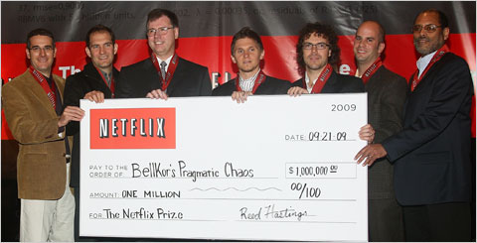
The Netflix Challenge
1M prize to improve the prediction accuracy by 10%

Slide 88
Extensions
Social Recommendations

Slide 89
Social Recommendations
Suppose that except for the rating matrix, you are also given a social network of all the users
  Such social networks exist in sites like Yelp, Foursquare, Epinions, etc
How can we use the social network to improve recommendations?
  Homophily: connected users are likely to have similar ratings.

Slide 90
Social Recommendations
Serious
Braveheart
The Color Purple
Amadeus
Lethal Weapon
Sense and Sensibility
Geared towards
females
Ocean’s 11
Geared towards
males
We do not have enough information for Dave to predict
The Lion King
The Princess
Diaries
Independence Day
Dumb and Dumber
Funny

Slide 91
Social Recommendations
Serious
Braveheart
The Color Purple
Amadeus
Lethal Weapon
Sense and Sensibility
Geared towards
females
Ocean’s 11
Geared towards
males
But we know that he is good friends with Charlie for whom we know what he likes
The Lion King
The Princess
Diaries
Independence Day
Dumb and Dumber
Funny

Slide 92
Social Recommendations
Serious
Braveheart
The Color Purple
Amadeus
Lethal Weapon
Sense and Sensibility
Geared towards
females
Ocean’s 11
Geared towards
males
This can help us adjust the ratings for Dave to be closer to those of Charlie
The Lion King
The Princess
Diaries
Independence Day
Dumb and Dumber
Funny

Slide 93
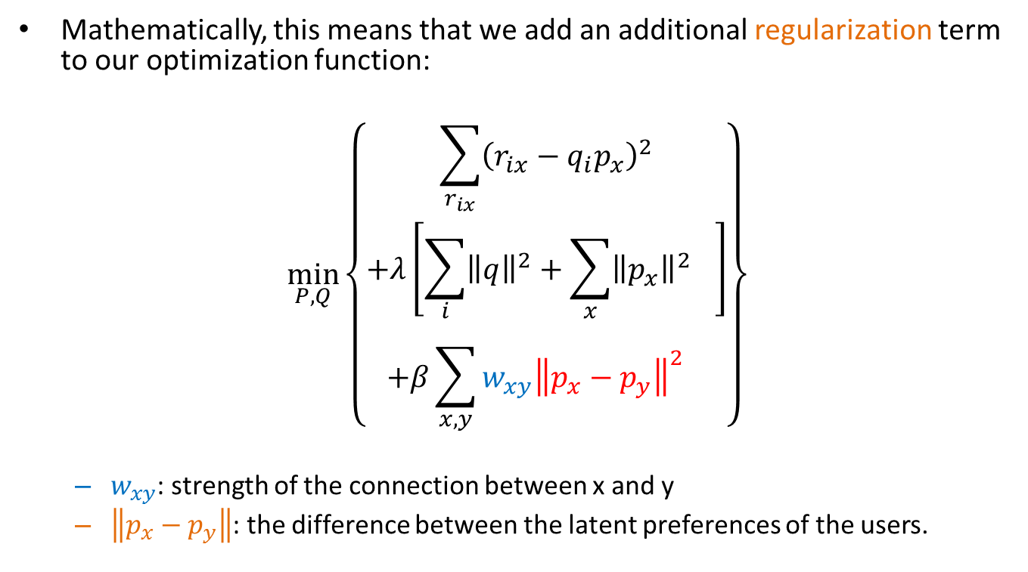
Social Regularization
Mathematically, this means that we add an additional regularization term to our optimization function:
$$\min_{P,Q}\left\{\begin{aligned}\sum_{r_{ix}}{{\left(r_{ix}−q_{i}p_{x}\right)}^{2}} \\ +λ\left[{\sum_{i}{{\left\|q\right\|}^{2}+\sum_{x}{{\left\|p_{x}\right\|}^{2}}}}^{}\right] \\ +β{\sum_{x,y}{w_{xy}{\left\|p_{x}−p_{y}\right\|}^{2}}}^{}\end{aligned}\right\}$$
  $w_{xy}$: strength of the connection between x and y
  $\left\|p_{x}−p_{y}\right\|$: the difference between the latent preferences of the users.

Slide 94
Social Regularization
Helps in giving additional information about the preferences of the users
Helps with sparse data since it allows us to make inferences for users for whom we have little data.
The same idea can be applied in different settings

Slide 95
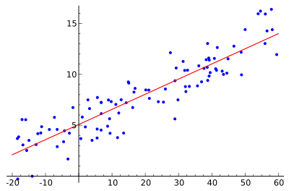
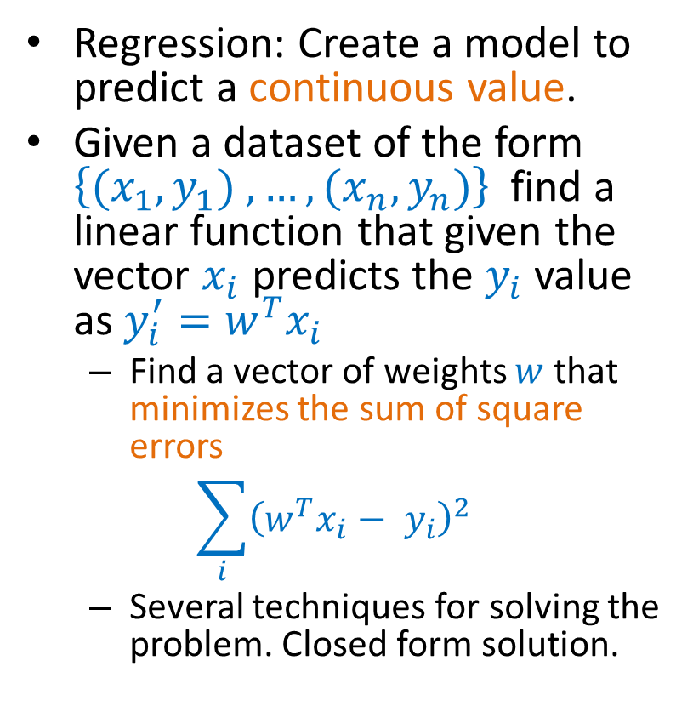
Example: Linear regression
Regression: Create a model to predict a continuous value.
Given a dataset of the form $\left\{{(x}_{1},y_{1}) ,…,{(x}_{n},y_{n})\right\}$ find a linear function that given the vector $x_{i}$ predicts the $y_{i}$ value as $y_{i}^{′}=w^{T}x_{i}$
  Find a vector of weights $w$ that minimizes the sum of square errors
  $$\sum_{i}{{\left(w^{T}x_{i}− y_{i}\right)}^{2}}$$
  Several techniques for solving the problem. Closed form solution.

Slide 96
Linear regression task
Example application: we want to predict the popularity of a blogger.
  We can create features about the text of the posts, length, frequency, topics, etc.
  Using training data we can find the linear function that best predicts the popularity

Slide 97

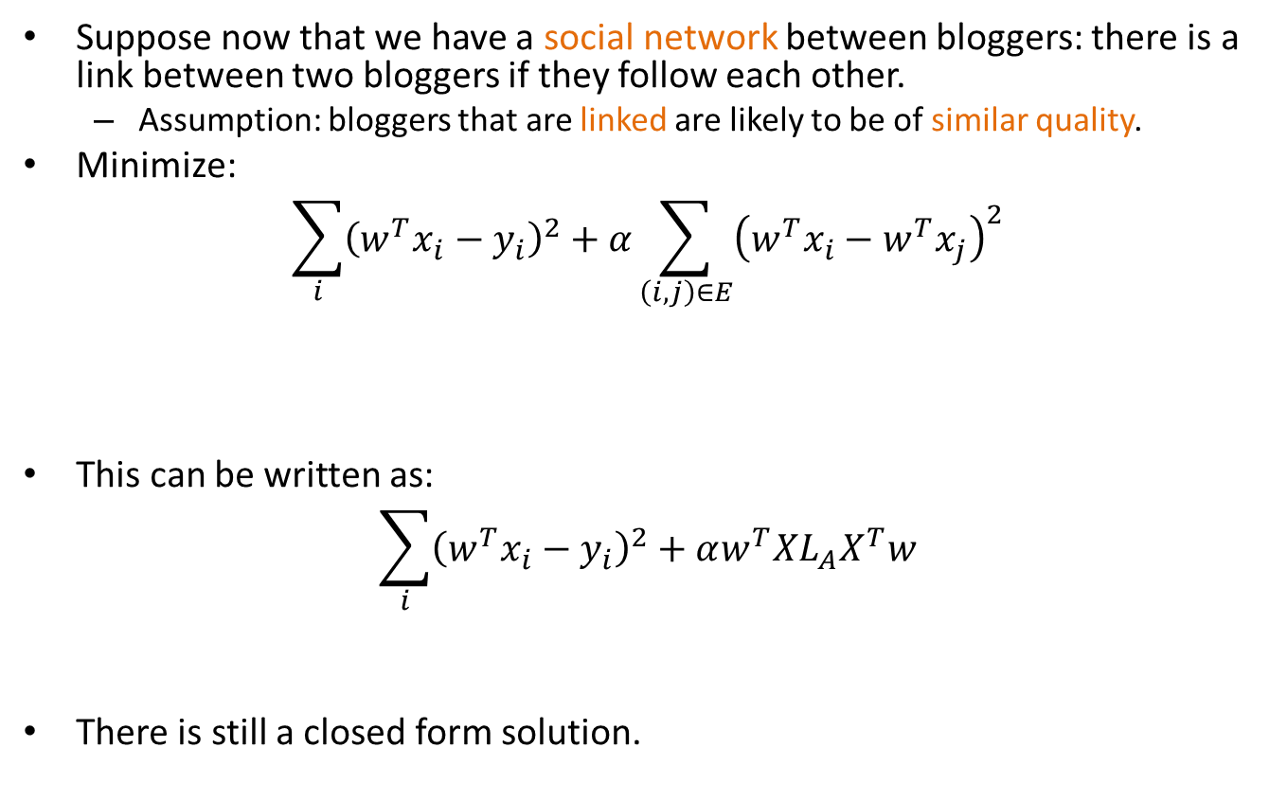
Linear regression with social regularization
Suppose now that we have a social network between bloggers: there is a link between two bloggers if they follow each other.
  Assumption: bloggers that are linked are likely to be of similar quality.
Minimize:
$$\sum_{i}{{\left(w^{T}x_{i}−y_{i}\right)}^{2}+α\sum_{\left(i,j\right)∈E}{{\left(w^{T}x_{i}−w^{T}x_{j}\right)}^{2}}}$$
This can be written as:
$$\sum_{i}{{\left(w^{T}x_{i}−y_{i}\right)}^{2}+αw^{T}XL_{A}X^{T}w}$$
There is still a closed form solution.
Regression Cost
Regularization Cost
This is sometimes also called network smoothing
$L_{A}$: The Laplacian of the adjacency matrix

Slide 98
Collective Classification
The same idea can be applied to classification problems:
  Classification: create a model that given a set of features predicts a discrete class label
    E.g. predict what a facebook user will vote in the next election.
    We can use the postings of the user to train a model that predicts among the existing parties (independent classification)
We also have the Facebook social network information:
  It is reasonable to assume that people that are connected are more likely to vote the same or similar way
  We want to collectively assign labels so that connected nodes are likely to get similar labels

Slide 99
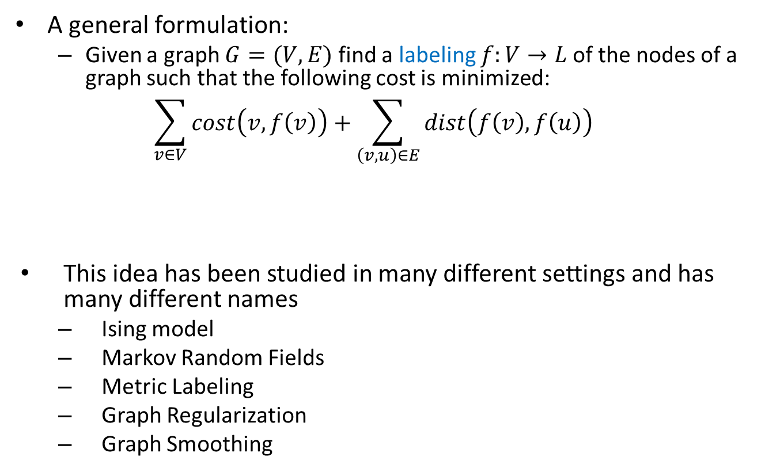
Collective Classification
A general formulation:
  Given a graph $G=(V,E)$ find a labeling $f:V→L$of the nodes of a graph such that the following cost is minimized:
  $$\sum_{v∈V}{cost\left(v,f\left(v\right)\right)}+\sum_{\left(v,u\right)∈E}{dist\left(f\left(v\right),f\left(u\right)\right)}$$
This idea has been studied in many different settings and has many different names
  Ising model
  Markov Random Fields
  Metric Labeling
  Graph Regularization
  Graph Smoothing
Classification Cost
Separation Cost

