Slide 1
DATA MINING
LECTURE 4
Frequent Itemsets, Association Rules
Evaluation
Alternative Algorithms

Slide 2
RECAP

Slide 3
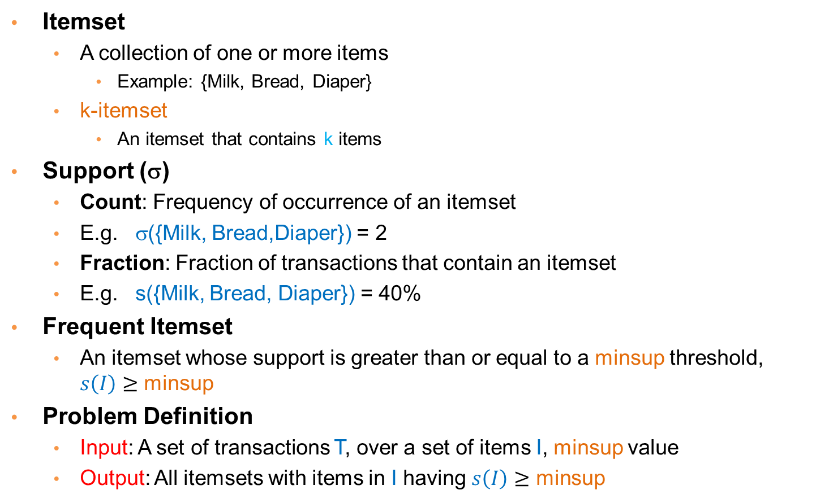
Mining Frequent Itemsets
Itemset
  A collection of one or more items
    Example: {Milk, Bread, Diaper}
  k-itemset
    An itemset that contains k items
Support (σ)
  Count: Frequency of occurrence of an itemset
  E.g. σ({Milk, Bread,Diaper}) = 2
  Fraction: Fraction of transactions that contain an itemset
  E.g. s({Milk, Bread, Diaper}) = 40%
Frequent Itemset
  An itemset whose support is greater than or equal to a minsup threshold, $s\left(I\right)≥$ minsup
Problem Definition
  Input: A set of transactions T, over a set of items I, minsup value
  Output: All itemsets with items in I having $s\left(I\right)≥$ minsup

Slide 4
The itemset lattice
Given d items, there are 2^{d} possible itemsets
Too expensive to test all!

Slide 5
The Apriori Principle
Apriori principle (Main observation):
  If an itemset is frequent, then all of its subsets must also be frequent
  If an itemset is not frequent, then all of its supersets cannot be frequent
  The support of an itemset never exceeds the support of its subsets
  This is known as the anti-monotone property of support
Notes:
5

Slide 6
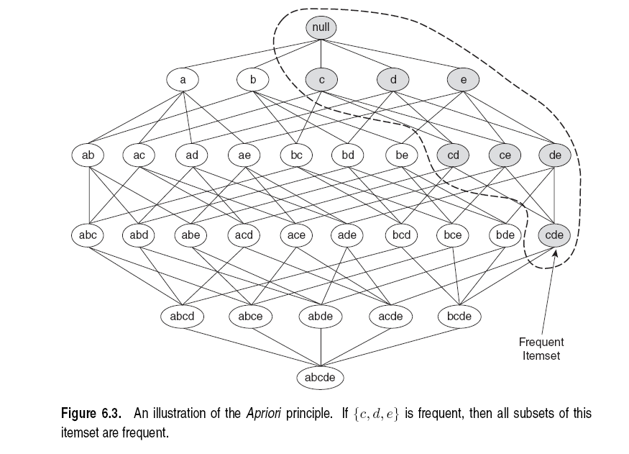
Illustration of the Apriori principle
Frequent subsets
Found to be frequent

Slide 7
Illustration of the Apriori principle
Found to be Infrequent
Infrequent supersets
Pruned

Slide 8
The Apriori algorithm
C_{k} = candidate itemsets of size k
L_{k} = frequent itemsets of size k
Level-wise approach
k = 1, C₁ = all items
While C_{k} not empty
  Scan the database to find which itemsets in C_{k} are frequent and put them into L_{k}
  Use L_{k} to generate a collection of candidate itemsets C_{k+1} of size k+1‏
  k = k+1
Frequent itemset generation
Candidate generation
R. Agrawal, R. Srikant: "Fast Algorithms for Mining Association Rules",
Proc. of the 20th Int'l Conference on Very Large Databases, 1994.
Notes:
8

Slide 9
Candidate Generation
Basic principle (Apriori):
  An itemset of size k+1 is candidate to be frequent only if all of its subsets of size k are known to be frequent
Main idea:
  Construct a candidate of size k+1 by combining two frequent itemsets of size k
  Prune the generated k+1-itemsets that do not have all k-subsets to be frequent

Slide 10
Computing Frequent Itemsets
Given the set of candidate itemsets C_{k}, we need to compute the support and find the frequent itemsets L_{k}.
Scan the data, and use a hash structure to keep a counter for each candidate itemset that appears in the data
C_{k}

Slide 11
A simple hash structure
Create a dictionary (hash table) that stores the candidate itemsets as keys, and the number of appearances as the value.
  Initialize with zero
Increment the counter for each itemset that you see in the data

Slide 12
Example
Key | Value
{3 6 7} | 0
{3 4 5} | 1
{1 3 6} | 3
{1 4 5} | 5
{2 3 4} | 2
{1 5 9} | 1
{3 6 8} | 0
{4 5 7} | 2
{6 8 9} | 0
{5 6 7} | 3
{1 2 4} | 8
{3 5 7} | 1
{1 2 5} | 0
{3 5 6} | 1
{4 5 8} | 0
Suppose you have 15 candidate itemsets of length 3:
{1 4 5}, {1 2 4}, {4 5 7}, {1 2 5}, {4 5 8},
{1 5 9}, {1 3 6}, {2 3 4}, {5 6 7}, {3 4 5},
{3 5 6}, {3 5 7}, {6 8 9}, {3 6 7}, {3 6 8}
Hash table stores the counts of the candidate itemsets as they have been computed so far

Slide 13
Example
Key | Value
{3 6 7} | 0
{3 4 5} | 1
{1 3 6} | 3
{1 4 5} | 5
{2 3 4} | 2
{1 5 9} | 1
{3 6 8} | 0
{4 5 7} | 2
{6 8 9} | 0
{5 6 7} | 3
{1 2 4} | 8
{3 5 7} | 1
{1 2 5} | 0
{3 5 6} | 1
{4 5 8} | 0
Tuple {1,2,3,5,6} generates the following itemsets of length 3:
{1 2 3}, {1 2 5}, {1 2 6}, {1 3 5}, {1 3 6},
{1 5 6}, {2 3 5}, {2 3 6}, {3 5 6},
Increment the counters for the itemsets in the dictionary

Slide 14
Example
Key | Value
{3 6 7} | 0
{3 4 5} | 1
{1 3 6} | 4
{1 4 5} | 5
{2 3 4} | 2
{1 5 9} | 1
{3 6 8} | 0
{4 5 7} | 2
{6 8 9} | 0
{5 6 7} | 3
{1 2 4} | 8
{3 5 7} | 1
{1 2 5} | 1
{3 5 6} | 2
{4 5 8} | 0
Tuple {1,2,3,5,6} generates the following itemsets of length 3:
{1 2 3}, {1 2 5}, {1 2 6}, {1 3 5}, {1 3 6},
{1 5 6}, {2 3 5}, {2 3 6}, {3 5 6},
Increment the counters for the itemsets in the dictionary

Slide 15
Mining Association Rules
Association Rule
  An implication expression of the form X → Y, where X and Y are itemsets
    {Milk, Diaper} → {Beer}
Rule Evaluation Metrics
  Support (s)
    Fraction of transactions that contain both X and Y = the probability P(X,Y) that X and Y occur together
  Confidence (c)
    How often Y appears in transactions that contain X = the conditional probability P(Y|X) that Y occurs given that X has occurred.
Example:
Problem Definition
  Input A set of transactions T, over a set of items I, minsup, minconf values
  Output: All rules with items in I having s ≥ minsup and c≥ minconf

Slide 16
Mining Association Rules
Two-step approach:
  Frequent Itemset Generation
    Generate all itemsets whose support ≥ minsup
  Rule Generation
    Generate high confidence rules from each frequent itemset, where each rule is a partitioning of a frequent itemset into Left-Hand-Side (LHS) and Right-Hand-Side (RHS)
Frequent itemset: {A,B,C,D}
Rule: AB→CD

Slide 17
Association Rule anti-monotonicity
Confidence is anti-monotone w.r.t. number of items on the RHS of the rule (or monotone with respect to the LHS of the rule)
e.g., L = {A,B,C,D}:
c(ABC → D) ≥ c(AB → CD) ≥ c(A → BCD)

Slide 18
Rule Generation for APriori Algorithm
Candidate rule is generated by merging two rules that share the same prefix
in the RHS
join(CD→AB,BD→AC)
would produce the candidate
rule D → ABC
Prune rule D → ABC if its
subset AD→BC does not have
high confidence
Essentially we are doing APriori on the RHS

Slide 19
RESULT
POST-PROCESSING

Slide 20
Compact Representation of Frequent Itemsets
Some itemsets are redundant because they have identical support as their supersets
Number of frequent itemsets
Need a compact representation

Slide 21
Maximal Frequent Itemsets
An itemset is maximal frequent if none of its immediate supersets is frequent
Maximal Itemsets
Maximal itemsets = positive border
Infrequent Itemsets
Border
Maximal: no superset has this property

Slide 22
Negative Border
Itemsets that are not frequent, but all their immediate subsets are frequent.
Infrequent Itemsets
Border
Minimal: no subset has this property

Slide 23
Border
Border = Positive Border + Negative Border
  Itemsets such that all their immediate subsets are frequent and all their immediate supersets are infrequent.
Either the positive, or the negative border is sufficient to summarize all frequent itemsets.

Slide 24
Closed Itemsets
An itemset is closed if none of its immediate supersets has the same support as the itemset

Slide 25
Maximal vs Closed Itemsets
Transaction Ids
Not supported by any transactions

Slide 26
Maximal vs Closed Frequent Itemsets
Closed but not maximal
Minimum support = 2
Closed and maximal
# Closed = 9
# Maximal = 4

Slide 27
Maximal vs Closed Itemsets

Slide 28
Pattern Evaluation
Association rule algorithms tend to produce too many rules but many of them are uninteresting or redundant
  Redundant if {A,B,C} → {D} and {A,B} → {D} have same support & confidence
    Summarization techniques
  Uninteresting, if the pattern that is revealed does not offer useful information.
    Interestingness measures: a hard problem to define
Interestingness measures can be used to prune/rank the derived patterns
  Subjective measures: require human analyst
  Objective measures: rely on the data.
In the original formulation of association rules, support & confidence are the only measures used

Slide 29
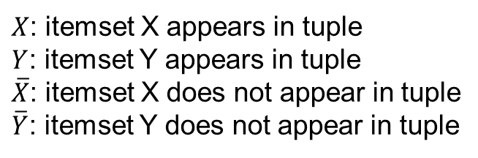
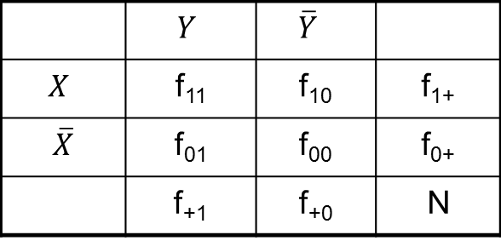
Computing Interestingness Measure
Given a rule X → Y, information needed to compute rule interestingness can be obtained from a contingency table
Contingency table for X → Y
 | $$Y$$ | $$\overline{Y}$$
$$X$$ | f₁₁ | f₁₀ | f₁₊
$\overline{X}$ | f₀₁ | f₀₀ | f₀₊
 | f₊₁ | f₊₀ | N
f₁₁: support of X and Y
f₁₀: support of X and Y
f₀₁: support of X and Y
f₀₀: support of X and Y
$X$: itemset X appears in tuple
$Y$: itemset Y appears in tuple
$\overline{X}$: itemset X does not appear in tuple
$\overline{Y}$: itemset Y does not appear in tuple
Used to define various measures
support, confidence, lift, Gini,
J-measure, etc.

Slide 30
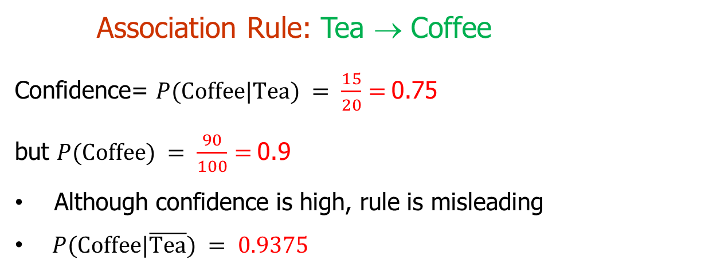
Drawback of Confidence
Number of people that drink tea
 | Coffee | Coffee
Tea | 15 | 5 | 20
Tea | 75 | 5 | 80
 | 90 | 10 | 100
Number of people that drink coffee and tea
Number of people that drink coffee but not tea
Number of people that drink coffee
Association Rule: Tea → Coffee
Confidence= $P(\text{Coffee}\text{|}\text{Tea}) = \frac{15}{20}=$0.75
but $P(\text{Coffee}) = \frac{90}{100}=$0.9
Although confidence is high, rule is misleading
$P(\text{Coffee}\text{|}\overline{\text{Tea}}) = 0.9375$

Slide 31
Statistical Independence
Population of 1000 students
  600 students know how to swim (S)
  700 students know how to bike (B)
  420 students know how to swim and bike (S,B)
  P(S,B) = 420/1000 = 0.42
  P(S) × P(B) = 0.6 × 0.7 = 0.42
  P(S,B) = P(S) × P(B) => Statistical independence

Slide 32
Statistical Independence
Population of 1000 students
  600 students know how to swim (S)
  700 students know how to bike (B)
  500 students know how to swim and bike (S,B)
  P(S,B) = 500/1000 = 0.5
  P(S) × P(B) = 0.6 × 0.7 = 0.42
  P(S,B) > P(S) × P(B) => Positively correlated

Slide 33
Statistical Independence
Population of 1000 students
  600 students know how to swim (S)
  700 students know how to bike (B)
  300 students know how to swim and bike (S,B)
  P(S,B) = 300/1000 = 0.3
  P(S) × P(B) = 0.6 × 0.7 = 0.42
  P(S,B) < P(S) × P(B) => Negatively correlated

Slide 34
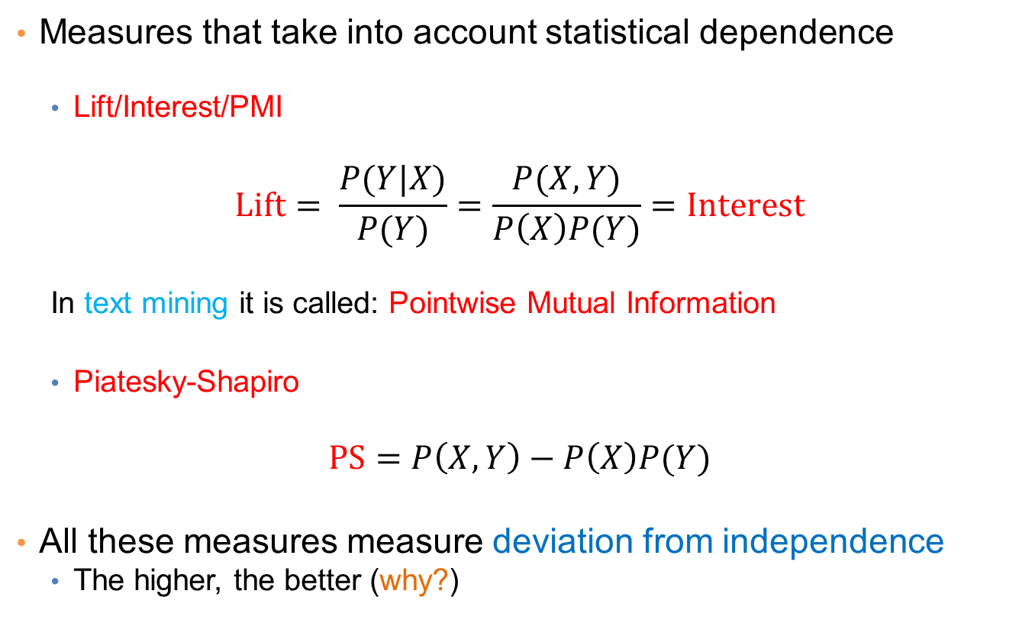
Statistical-based Measures
Measures that take into account statistical dependence
  Lift/Interest/PMI
$$Lift= \frac{P(Y|X)}{P(Y)}=\frac{P(X,Y)}{P\left(X\right)P(Y)}=Interest$$
  In text mining it is called: Pointwise Mutual Information
  Piatesky-Shapiro
$$PS=P\left(X,Y\right)−P\left(X\right)P(Y)$$
All these measures measure deviation from independence
  The higher, the better (why?)

Slide 35
Example: Lift/Interest
 | Coffee | Coffee
Tea | 15 | 5 | 20
Tea | 75 | 5 | 80
 | 90 | 10 | 100
Association Rule: Tea → Coffee
Confidence= P(Coffee|Tea) = 0.75
but P(Coffee) = 0.9
Lift = 0.75/0.9= 0.8333 (< 1, therefore is negatively associated)
= 0.15/(0.9*0.2)

Slide 36


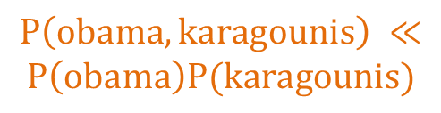
Another Example
 | of | the | of, the
Fraction of documents | 0.9 | 0.9 | 0.8
$$P(of,the) ≈P\left(of\right)P(the)$$
If I was creating a document by picking words randomly, (of, the) have more or less the same probability of appearing together by chance
No correlation
 | hong | kong | hong, kong
Fraction of documents | 0.2 | 0.2 | 0.19
$$P\left(hong,kong\right) ≫P\left(hong\right)P(kong)$$
(hong, kong) have much lower probability to appear together by chance. The two words appear almost always only together
Positive correlation
 | obama | karagounis | obama, karagounis
Fraction of documents | 0.2 | 0.2 | 0.001
$$P\left(obama,karagounis\right) ≪$$
$$P\left(obama\right)P(karagounis)$$
(obama, karagounis) have much higher probability to appear together by chance. The two words appear almost never together
Negative correlation

Slide 37
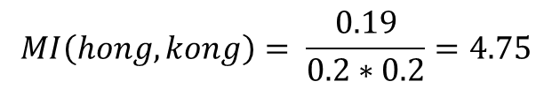
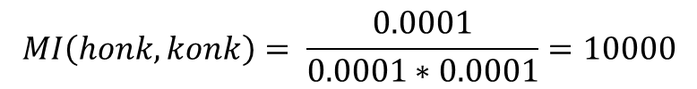
Drawbacks of Lift/Interest/Mutual Information
 | honk | konk | honk, konk
Fraction of documents | 0.0001 | 0.0001 | 0.0001
$$MI\left(honk,konk\right)= \frac{0.0001}{0.0001∗0.0001}=10000$$
 | hong | kong | hong, kong
Fraction of documents | 0.2 | 0.2 | 0.19
$$MI\left(hong,kong\right)= \frac{0.19}{0.2∗0.2}=4.75$$
Rare co-occurrences are deemed more interesting.
But this is not always what we want

Slide 38
ALTERNATIVE FREQUENT ITEMSET COMPUTATION
Slides taken from Mining Massive Datasets course by Anand Rajaraman and Jeff Ullman.

Slide 39
Finding the frequent pairs is usually the most expensive operation
Count
the items
All pairs
of items
from L₁
Count
the pairs
All
items
Filter
Construct
Filter
Construct
C₁
L₁
C₂
L₂
C₃
First
pass
Second
pass
Frequent
items
Frequent
pairs

Slide 40
Picture of A-Priori
Item counts
Frequent items
Counts of
pairs of
frequent
items
Pass 1
Pass 2

Slide 41
PCY Algorithm
Item counts
During Pass 1 (computing frequent items) of Apriori, most memory is idle.
Use that memory to keep a hash table where pairs of items are hashed.
The hash table keeps just counts of the number of pairs hashed in each bucket, not the pairs themselves.
Pass 1

Slide 42
Needed Extensions
Pairs of items need to be generated from the input file; they are not present in the file.
We are not just interested in the presence of a pair, but we need to see whether it is present at least s (support) times.

Slide 43
PCY Algorithm – (2)
A bucket is frequent if its count is at least the support threshold.
If a bucket is not frequent, no pair that hashes to that bucket could possibly be a frequent pair.
  The opposite is not true, a bucket may be frequent but hold infrequent pairs
On Pass 2 (frequent pairs), we only count pairs that hash to frequent buckets.

Slide 44
PCY Algorithm –
Before Pass 1 Organize Main Memory
Space to count each item.
  One (typically) 4-byte integer per item.
Use the rest of the space for as many integers, representing buckets, as we can.

Slide 45
Picture of PCY
Item counts
Hash
table
Pass 1

Slide 46
Picture of PCY
Item counts
Bucket Counts
Pass 1

Slide 47
PCY Algorithm – Pass 1
FOR (each basket) {
FOR (each item in the basket)
add 1 to item’s count;
FOR (each pair of items in the basket) {
hash the pair to a bucket;
add 1 to the count for that bucket
}
}

Slide 48
Observations About Buckets
A bucket that a frequent pair hashes to is surely frequent.
  We cannot use the hash table to eliminate any member of this bucket.
Even without any frequent pair, a bucket can be frequent.
  Again, nothing in the bucket can be eliminated.
3. But in the best case, the count for a bucket is less than the support s.
  Now, all pairs that hash to this bucket can be eliminated as candidates, even if the pair consists of two frequent items.

Slide 49
PCY Algorithm – Between Passes
Replace the buckets by a bit-vector:
  1 means the bucket is frequent; 0 means it is not.
4-byte integers are replaced by bits, so the bit-vector requires 1/32 of memory.
Also, find which items are frequent and list them for the second pass.
  Same as with Apriori

Slide 50
Picture of PCY
Hash
table
Item counts
Frequent items
Bitmap
Counts of
candidate
pairs
Pass 1
Pass 2

Slide 51
PCY Algorithm – Pass 2
Count all pairs {i, j } that meet the conditions for being a candidate pair:
  Both i and j are frequent items.
  The pair {i, j }, hashes to a bucket number whose bit in the bit vector is 1.
Notice both these conditions are necessary for the pair to have a chance of being frequent.

Slide 52
All (Or Most) Frequent Itemsets in less than 2 Passes
A-Priori, PCY, etc., take k passes to find frequent itemsets of size k.
Other techniques use 2 or fewer passes for all sizes:
  Simple sampling algorithm.
  SON (Savasere, Omiecinski, and Navathe).
  Toivonen.

Slide 53
Simple Sampling Algorithm – (1)
Take a random sample of the market baskets.
Run Apriori or one of its improvements (for sets of all sizes, not just pairs) in main memory, so you don’t pay for disk I/O each time you increase the size of itemsets.
  Make sure the sample is such that there is enough space for counts.

Slide 54
Main-Memory Picture
Copy of
sample
baskets
Space
for
counts

Slide 55
Simple Algorithm – (2)
Use as your support threshold a suitable, scaled-back number.
  E.g., if your sample is 1/100 of the baskets, use s /100 as your support threshold instead of s.
You could stop here (single pass)
  What could be the problem?

Slide 56
Simple Algorithm – Option
Optionally, verify that your guesses are truly frequent in the entire data set by a second pass (eliminate false positives)
But you don’t catch sets frequent in the whole but not in the sample. (false negatives)
  Smaller threshold, e.g., s /125, helps catch more truly frequent itemsets.
    But requires more space.

Slide 57
SON Algorithm – (1)
First pass: Break the data into chunks that can be processed in main memory.
Read one chunk at the time
  Find all frequent itemsets for each chunk.
  Threshold = s/number of chunks
An itemset becomes a candidate if it is found to be frequent in any one or more chunks of the baskets.

Slide 58
SON Algorithm – (2)
Second pass: count all the candidate itemsets and determine which are frequent in the entire set.
Key “monotonicity” idea: an itemset cannot be frequent in the entire set of baskets unless it is frequent in at least one subset.
  Why?

Slide 59
SON Algorithm – Distributed Version
This idea lends itself to distributed data mining.
If baskets are distributed among many nodes, compute frequent itemsets at each node, then distribute the candidates from each node.
Finally, accumulate the counts of all candidates.

Slide 60
Toivonen’s Algorithm – (1)
Start as in the simple sampling algorithm, but lower the threshold slightly for the sample.
  Example: if the sample is 1% of the baskets, use s /125 as the support threshold rather than s /100.
  Goal is to avoid missing any itemset that is frequent in the full set of baskets.

Slide 61
Toivonen’s Algorithm – (2)
Add to the itemsets that are frequent in the sample the negative border of these itemsets.
An itemset is in the negative border if it is not deemed frequent in the sample, but all its immediate subsets are.

Slide 62
Reminder: Negative Border
ABCD is in the negative border if and only if:
  It is not frequent in the sample, but
  All of ABC, BCD, ACD, and ABD are.
A is in the negative border if and only if it is not frequent in the sample.
  Because the empty set is always frequent.
    Unless there are fewer baskets than the support threshold (silly case).

Slide 63
Picture of Negative Border
Negative Border
…
triples
pairs
singletons
Frequent Itemsets
from Sample

Slide 64
Toivonen’s Algorithm – (3)
In a second pass, count all candidate frequent itemsets from the first pass, and also count their negative border.
If no itemset from the negative border turns out to be frequent, then the candidates found to be frequent in the whole data are exactly the frequent itemsets.

Slide 65
Toivonen’s Algorithm – (4)
What if we find that something in the negative border is actually frequent?
  We must start over again!
Try to choose the support threshold so the probability of failure is low, while the number of itemsets checked on the second pass fits in main-memory.

Slide 66
If Something in the Negative Border is Frequent . . .
We broke through the
negative border. How
far does the problem
go?
…
tripletons
doubletons
singletons
Negative Border
Frequent Itemsets
from Sample

Slide 67
Theorem:
If there is an itemset that is frequent in the whole, but not frequent in the sample, then there is a member of the negative border for the sample that is frequent in the whole.

Slide 68
Proof: Suppose not; i.e.;
  There is an itemset S frequent in the whole but not frequent in the sample, and
  Nothing in the negative border is frequent in the whole.
Let T be a smallest subset of S that is not frequent in the sample.
T is frequent in the whole (S is frequent + monotonicity).
T is in the negative border (else not “smallest”).

Slide 69
Example
Border

Slide 70
THE FP-TREE AND THE FP-GROWTH ALGORITHM
Slides from course lecture of E. Pitoura

Slide 71
Overview
The FP-tree contains a compressed representation of the transaction database.
  A trie (prefix-tree) data structure is used
  Each transaction is a path in the tree – paths can overlap.
Once the FP-tree is constructed the recursive, divide-and-conquer FP-Growth algorithm is used to enumerate all frequent itemsets.

Slide 72
FP-tree Construction
The FP-tree is a trie (prefix tree)
Since transactions are sets of items, we need to transform them into ordered sequences so that we can have prefixes
  Otherwise, there is no common prefix between sets {A,B} and {B,C,A}
We need to impose an order to the items
  Initially, assume a lexicographic order.

Slide 73
FP-tree Construction
Initially the tree is empty
null

Slide 74
FP-tree Construction
Reading transaction TID = 1
Each node in the tree has a label consisting of the item and the support (number of transactions that reach that node, i.e. follow that path)
null
A:1
B:1
Node label = item:support

Slide 75
FP-tree Construction
Reading transaction TID = 2
We add pointers between nodes that refer to the same item
null
A:1
B:1
B:1
C:1
D:1
Each transaction is a path in the tree

Slide 76
FP-tree Construction
null
After reading transactions TID=1, 2:
A:1
B:1
B:1
C:1
Header Table
D:1
The Header Table and the pointers assist in computing the itemset support

Slide 77
FP-tree Construction
null
Reading transaction TID = 3
A:1
A:1
B:1
B:1
C:1
D:1

Slide 78
FP-tree Construction
null
Reading transaction TID = 3
A:2
B:1
B:1
C:1
C:1
D:1
D:1
E:1

Slide 79
FP-tree Construction
null
Reading transaction TID = 3
A:2
B:1
B:1
C:1
C:1
D:1
D:1
E:1
Each transaction is a path in the tree

Slide 80
FP-Tree Construction
Transaction Database
Each transaction is a path in the tree
null
A:7
B:3
B:5
C:3
C:1
D:1
E:1
Header table
D:1
C:3
D:1
E:1
D:1
E:1
D:1
Pointers are used to assist frequent itemset generation

Slide 81
FP-tree size
Every transaction is a path in the FP-tree
The size of the tree depends on the compressibility of the data
  Extreme case: All transactions are the same, the FP-tree is a single branch
  Extreme case: All transactions are different the size of the tree is the same as that of the database (bigger actually since we need additional pointers)

Slide 82
Item ordering
The size of the tree also depends on the ordering of the items.
Heuristic: order the items according to their frequency from larger to smaller.
  We would need to do an extra pass over the dataset to count frequencies
Example:
TID
Items
σ(Α)=7, σ(Β)=8, σ(C)=7, σ(D)=5, σ(Ε)=3
Ordering : Β,Α,C,D,E
1
{Β,Α}
2
{B,C,D}
3
{A,C,D,E}
4
{A,D,E}
5
{Β,Α,C}
6
{Β,Α,C,D}
7
{B,C}
8
{Β,Α,C}
9
{Β,Α,D}
10
{B,C,E}

Slide 83
Finding Frequent Itemsets
Input: The FP-tree
Output: All Frequent Itemsets and their support
Method:
  Divide and Conquer:
  Consider all itemsets that end in: E, D, C, B, A
    For each possible ending item, consider the itemsets with last items one of items preceding it in the ordering
    E.g, for E, consider all itemsets with last item D, C, B, A. This way we get all the itesets ending at DE, CE, BE, AE
    Proceed recursively this way.
    Do this for all items.

Slide 84
Frequent itemsets
All Itemsets
Ε D C B A
DE CE BE AE
CD BD AD
BC AC
AB
CDE BDE ADE
BCE ACE
ABE
BCD ACD
ABD
ABC
ACDE BCDE
ABDE
ABCE
ABCD
ABCDE

Slide 85
Frequent Itemsets
All Itemsets
Ε D C B A
Frequent?;
DE CE BE AE
CD BD AD
BC AC
AB
Frequent?;
CDE BDE ADE
BCE ACE
ABE
BCD ACD
ABD
ABC
Frequent?
ACDE BCDE
ABDE
ABCE
ABCD
Frequent?
ABCDE

Slide 86
Frequent Itemsets
All Itemsets
Ε D C B A
Frequent?
DE CE BE AE
CD BD AD
BC AC
AB
Frequent?
CDE BDE ADE
BCE ACE
ABE
BCD ACD
ABD
ABC
Frequent?
Frequent?
ACDE BCDE
ABDE
ABCE
ABCD
Frequent?
ABCDE

Slide 87
Frequent Itemsets
All Itemsets
Ε D C B A
Frequent?
DE CE BE AE
CD BD AD
BC AC
AB
Frequent?
CDE BDE ADE
BCE ACE
ABE
BCD ACD
ABD
ABC
Frequent?
ACDE BCDE
ABDE
ABCE
ABCD
ABCDE
We can generate all itemsets this way
We expect the FP-tree to contain a lot less

Slide 88
Using the FP-tree to find frequent itemsets
Transaction Database
null
A:7
B:3
B:5
C:3
C:1
D:1
E:1
Header table
D:1
C:3
D:1
E:1
D:1
E:1
D:1
Bottom-up traversal of the tree.
First, itemsets ending in E, then D, etc, each time a suffix-based class

Slide 89
Finding Frequent Itemsets
null
Subproblem: find frequent itemsets ending in E
A:7
B:3
B:5
C:3
C:1
D:1
Header table
D:1
C:3
D:1
E:1
E:1
D:1
E:1
D:1
We will then see how to compute the support for the possible itemsets

Slide 90
Finding Frequent Itemsets
null
Ending in D
A:7
B:3
B:5
C:3
C:1
D:1
Header table
D:1
C:3
D:1
E:1
E:1
D:1
E:1
D:1

Slide 91
Finding Frequent Itemsets
null
Ending in C
A:7
B:3
B:5
C:3
C:1
D:1
Header table
D:1
C:3
D:1
E:1
E:1
D:1
E:1
D:1

Slide 92
Finding Frequent Itemsets
null
Ending in B
A:7
B:3
B:5
C:3
C:1
D:1
Header table
D:1
C:3
D:1
E:1
E:1
D:1
E:1
D:1

Slide 93
Finding Frequent Itemsets
null
Ending in Α
A:7
B:3
B:5
C:3
C:1
D:1
Header table
D:1
C:3
D:1
E:1
E:1
D:1
E:1
D:1

Slide 94
Algorithm
For each suffix X
Phase 1
  Construct the prefix tree for X as shown before, and compute the support using the header table and the pointers
Phase 2
  If X is frequent, construct the conditional FP-tree for X in the following steps
    Recompute support
    Prune infrequent items
    Prune leaves and recurse

Slide 95
Example
null
Phase 1 – construct prefix tree
Find all prefix paths that contain E
A:7
B:3
B:5
C:3
C:1
D:1
Header table
D:1
C:3
D:1
E:1
E:1
D:1
E:1
D:1
Suffix Paths for Ε:
{A,C,D,E}, {A,D,Ε}, {B,C,E}

Slide 96
Example
null
Phase 1 – construct prefix tree
Find all prefix paths that contain E
A:7
B:3
C:3
C:1
D:1
D:1
E:1
E:1
E:1
Prefix Paths for Ε:
{A,C,D,E}, {A,D,Ε}, {B,C,E}

Slide 97
Example
null
Compute Support for E (minsup = 2)
How?
Follow pointers while summing up counts: 1+1+1 = 3 > 2
E is frequent
A:7
B:3
C:3
C:1
D:1
D:1
E:1
E:1
E:1
{E} is frequent so we can now consider suffixes DE, CE, BE, AE

Slide 98
Example
null
E is frequent so we proceed with Phase 2
Phase 2
Convert the prefix tree of E into a conditional FP-tree
Two changes
(1) Recompute support
(2) Prune infrequent
A:7
B:3
C:3
C:1
D:1
D:1
E:1
E:1
E:1

Slide 99
Example
null
Recompute Support
A:7
B:3
The support counts for some of the nodes include transactions that do not end in E
For example in null->B->C->E we count {B, C}
The support of any node is equal to the sum of the support of leaves with label E in its subtree
C:3
C:1
D:1
D:1
E:1
E:1
E:1

Slide 100
Example
null
A:7
B:3
C:3
C:1
D:1
D:1
E:1
E:1
E:1

Slide 101
Example
null
A:7
B:3
C:1
C:1
D:1
D:1
E:1
E:1
E:1

Slide 102
Example
null
A:7
B:1
C:1
C:1
D:1
D:1
E:1
E:1
E:1

Slide 103
Example
null
A:7
B:1
C:1
C:1
D:1
D:1
E:1
E:1
E:1

Slide 104
Example
null
A:7
B:1
C:1
C:1
D:1
D:1
E:1
E:1
E:1

Slide 105
Example
null
A:2
B:1
C:1
C:1
D:1
D:1
E:1
E:1
E:1

Slide 106
Example
null
A:2
B:1
C:1
C:1
D:1
D:1
E:1
E:1
E:1

Slide 107
Example
null
A:2
B:1
Truncate
Delete the nodes of Ε
C:1
C:1
D:1
D:1
E:1
E:1
E:1

Slide 108
Example
null
A:2
B:1
Truncate
Delete the nodes of Ε
C:1
C:1
D:1
D:1
E:1
E:1
E:1

Slide 109
Example
null
A:2
B:1
Truncate
Delete the nodes of Ε
C:1
C:1
D:1
D:1

Slide 110
Example
null
A:2
B:1
Prune infrequent
In the conditional FP-tree some nodes may have support less than minsup
e.g., B needs to be pruned
This means that B appears with E less than minsup times
C:1
C:1
D:1
D:1

Slide 111
Example
null
A:2
B:1
C:1
C:1
D:1
D:1

Slide 112
Example
null
A:2
C:1
C:1
D:1
D:1

Slide 113
Example
null
A:2
C:1
C:1
D:1
D:1
The conditional FP-tree for E
Repeat the algorithm for {D, E}, {C, E}, {A, E}

Slide 114
Example
null
A:2
C:1
C:1
D:1
D:1
Phase 1
Find all prefix paths that contain D (DE) in the conditional FP-tree

Slide 115
Example
null
A:2
C:1
D:1
D:1
Phase 1
Find all prefix paths that contain D (DE) in the conditional FP-tree

Slide 116
Example
null
A:2
C:1
D:1
D:1
Compute the support of {D,E} by following the pointers in the tree
1+1 = 2 ≥ 2 = minsup
{D,E} is frequent

Slide 117
Example
null
A:2
C:1
D:1
D:1
Phase 2
Construct the conditional FP-tree
Recompute Support
Prune nodes

Slide 118
Example
null
A:2
Recompute support
C:1
D:1
D:1

Slide 119
Example
null
A:2
Prune nodes
C:1
D:1
D:1

Slide 120
Example
null
A:2
Prune nodes
C:1

Slide 121
Example
null
A:2
Prune nodes
C:1
Small support

Slide 122
Example
null
A:2
Final condition FP-tree for {D,E}
The support of A is ≥ minsup so {A,D,E} is frequent
Since the tree has a single node we return to the next subproblem

Slide 123
Example
null
A:2
C:1
C:1
D:1
D:1
The conditional FP-tree for E
We repeat the algorithm for {D,E}, {C,E}, {A,E}

Slide 124
Example
null
A:2
C:1
C:1
D:1
D:1
Phase 1
Find all prefix paths that contain C (CE) in the conditional FP-tree

Slide 125
Example
null
A:2
C:1
C:1
Phase 1
Find all prefix paths that contain C (CE) in the conditional FP-tree

Slide 126
Example
null
A:2
C:1
C:1
Compute the support of {C,E} by following the pointers in the tree
1+1 = 2 ≥ 2 = minsup
{C,E} is frequent

Slide 127
Example
null
A:2
C:1
C:1
Phase 2
Construct the conditional FP-tree
Recompute Support
Prune nodes

Slide 128
Example
null
A:1
C:1
Recompute support
C:1

Slide 129
Example
null
A:1
C:1
Prune nodes
C:1

Slide 130
Example
null
A:1
Prune nodes

Slide 131
Example
null
A:1
Prune nodes

Slide 132
Example
null
Prune nodes
Return to the previous subproblem

Slide 133
Example
null
A:2
C:1
C:1
D:1
D:1
The conditional FP-tree for E
We repeat the algorithm for {D,E}, {C,E}, {A,E}

Slide 134
Example
null
A:2
C:1
C:1
D:1
D:1
Phase 1
Find all prefix paths that contain A (AE) in the conditional FP-tree

Slide 135
Example
null
A:2
Phase 1
Find all prefix paths that contain A (AE) in the conditional FP-tree

Slide 136
Example
null
A:2
Compute the support of {A,E} by following the pointers in the tree
2 ≥ minsup
{A,E} is frequent
There is no conditional FP-tree for {A,E}

Slide 137
Example
So for E we have the following frequent itemsets
{E}, {D,E}, {A,D,E} , {C,E}, {A,E}
We proceed with D

Slide 138
Example
null
Ending in D
A:7
B:3
B:5
C:3
C:1
D:1
Header table
D:1
C:3
D:1
E:1
E:1
D:1
E:1
D:1

Slide 139
Example
null
Phase 1 – construct prefix tree
Find all prefix paths that contain D
Support 5 > minsup, D is frequent
Phase 2
Convert prefix tree into conditional FP-tree
A:7
B:3
B:5
C:3
C:1
D:1
D:1
C:3
D:1
D:1
D:1

Slide 140
Example
null
A:7
B:3
B:5
C:3
C:1
D:1
D:1
C:1
D:1
D:1
D:1
Recompute support

Slide 141
Example
null
A:7
B:3
B:2
C:3
C:1
D:1
D:1
C:1
D:1
D:1
D:1
Recompute support

Slide 142
Example
null
A:3
B:3
B:2
C:3
C:1
D:1
D:1
C:1
D:1
D:1
D:1
Recompute support

Slide 143
Example
null
A:3
B:3
B:2
C:1
C:1
D:1
D:1
C:1
D:1
D:1
D:1
Recompute support

Slide 144
Example
null
A:3
B:1
B:2
C:1
C:1
D:1
D:1
C:1
D:1
D:1
D:1
Recompute support

Slide 145
Example
null
A:3
B:1
B:2
C:1
C:1
D:1
D:1
C:1
D:1
D:1
D:1
Prune nodes

Slide 146
Example
null
A:3
B:1
B:2
C:1
C:1
C:1
Prune nodes

Slide 147
Example
null
A:3
B:1
B:2
C:1
C:1
C:1
Construct conditional FP-trees for {C,D}, {B,D}, {A,D}
And so on….

Slide 148
Observations
At each recursive step we solve a subproblem
  Construct the prefix tree
  Compute the new support
  Prune nodes
Subproblems are disjoint so we never consider the same itemset twice
Support computation is efficient – happens together with the computation of the frequent itemsets.

Slide 149
Observations
The efficiency of the algorithm depends on the compaction factor of the dataset
If the tree is bushy then the algorithm does not work well, it increases a lot of number of subproblems that need to be solved.

Slide 150
FREQUENT ITEMSET RESEARCH

