Slide 1
Λ14 Διαδικτυακά Κοινωνικά Δίκτυα και Μέσα
Link Prediction

Slide 2
Motivation
Recommending new friends in online social networks.
Predicting the participation of actors in events
Suggesting interactions between the members of a company/organization that are external to the hierarchical structure of the organization itself.
Predicting connections between members of terrorist organizations who have not been directly observed to work together.
Suggesting collaborations between researchers based on co-authorship.

Slide 3
Problem Definition
Link prediction problem: Given the links in a social network at time t, predict the edges that will be added to the network during the time interval from time t to a given future time t’
Based solely on the topology of the network (social proximity) (the more general problem also considers attributes of the nodes and links)
Different from the problem of inferring missing (hidden) links (there is a temporal aspect)
To save experimental effort in the laboratory or in the field

Slide 4
Problem Formulation
Consider a social network G = (V, E) where each edge e = <u, v> ∈ E represents an interaction between u and v that took place at a particular time t(e)
(multiple interactions between two nodes as parallel edges with different timestamps)
For two times, t < t′, let G[t, t′] denote subgraph of G consisting of all edges with a timestamp between t and t′
For four times, t₀ < t′₀ < t₁ < t′₁, given G[t₀, t′₀], we wish to output a list of edges not in G[t₀, t′ ₀] that are predicted to appear in G[t₁, t′₁]
[t₀, t′₀] training interval
[t₁, t′₁] test interval
What about new nodes?
Two parameters: κ_{training} and κ_{test}
Core: all nodes that are incident to at least κ_{training} edges in G[t₀, t′₀], and at least κ_{test} edges in G[t₁, t′₁]
Predict new edges between the nodes in Core

Slide 5
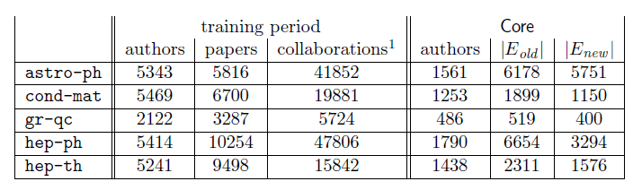
Example Dataset: co-authorship
t₀ = 1994, t′₀ = 1996: training interval -> [1994, 1996]
t₁ = 1997, t′₁ = 1999: test interval -> [1997, 1999]
- G_{collab} = <V, E_{old}> = G[1994, 1996]
- E_{new}: authors in V that co-author a paper during the test interval but not during the training interval
κ_{training} = 3, κ_{test} = 3: Core consists of all authors who have written at least 3 papers during the training period and at least 3 papers during the test period
Predict E_{new}

Slide 6
Methods for Link Prediction
Assign a connection weight score(x, y) to pairs of nodes <x, y> based on the input graph (G_{collab}) and produce a ranked list of decreasing order of score
How to assign the score between two nodes x and y?
Some form of similarity or node proximity

Slide 7
How to Evaluate the Prediction
Each link predictor p outputs a ranked list L_{p} of pairs in V × V − E_{old} : predicted new collaborations in decreasing order of confidence
In this paper, focus on Core, thus
E∗_{new} = E_{new} ∩ (Core × Core), n = |E∗_{new}|
Evaluation method: Size of the intersection of
the first n edge predictions from L_{p} that are in Core × Core, and
the set E∗_{new}
How many of the (relevant) top-n predictions are correct (precision?)

Slide 8
Methods for Link Prediction: Shortest Path
For x, y ∈ V × V − E_{old},
score(x, y) = (negated) length of shortest path between x and y
If there are more than n pairs of nodes tied for the shortest path length, order them at random.

Slide 9


Methods for Link Prediction: Neighborhood-based
The “larger” the overlap of the neighbors of two nodes, the more likely the nodes to be linked in the future
Let Γ(x) denote the set of neighbors of x in G_{collab}
Common neighbors:
A adjacency matrix -> A_{x,y}²
Number of different paths of length 2
Jaccard coefficient:
The probability that both x and y have a feature f, for a randomly selected feature that either x or y has

Slide 10

Methods for Link Prediction: Neighborhood-based
Adamic/Adar:
Assigns large weights to common neighbors z of x and y which themselves have few neighbors
(weight rare features more heavily)
Neighbors who are linked with 2 nodes are assigned weight = 1/log(2) = 1.4
Neighbors who are linked with 5 nodes are assigned weight = 1/log(5) = 0.62

Slide 11
Methods for Link Prediction: Neighborhood-based
Preferential attachment:
Based on the premise that the probability that a new edge has node x as its endpoint is proportional to |Γ(x)|, i.e., nodes like to form ties with ‘popular’ nodes
Researchers found empirical evidence to suggest that co-authorship is correlated with the product of the neighborhood sizes
This depends on the degrees of the nodes not on their neighbors per se

Slide 12
Methods for Link Prediction: based on the ensemble of all paths
Not just the shortest, but all paths between two nodes

Slide 13



Methods for Link Prediction: based on the ensemble of all paths
Katz_{β} measure:
Sum over all paths of length l, β > 0 is a parameter of the predictor, exponentially damped to count short paths more heavily
Small β predictions much like common neighbors
Closed form:
Unweighted version, in which path_{x,y}⁽¹⁾ = 1, if x and y have collaborated, 0 otherwise
Weighted version, in which path_{x,y}⁽¹⁾ = #times x and y have collaborated

Slide 14
Methods for Link Prediction: based on the ensemble of all paths
Consider a random walk on G_{collab} that starts at x and iteratively moves to a neighbor of x chosen uniformly at random from Γ(x).
The Hitting Time H_{x,y} from x to y is the expected number of steps it takes for the random walk starting at x to reach y.
score(x, y) = − H_{x,y}
The Commute Time C_{x,y} from x to y is the expected number of steps to travel from x to y and from y to x
score(x, y) = − (H_{x,y} + H_{y,x})
Can also consider stationary-normed versions:
score(x, y) = − H_{x,y} π_{y}
score(x, y) = −(H_{x,y} π_{y} + H_{y,x} π_{x})

Slide 15
Methods for Link Prediction: based on the ensemble of all paths
The hitting time and commute time measures are sensitive to parts of the graph far away from x and y -> periodically reset the walk
Random walk on G_{collab} that starts at x and has a probability of α of returning to x at each step
Rooted Page Rank: Starts from x, with probability (1 – a) moves to a random neighbor and with probability a returns to x
score(x, y) = stationary probability of y in a rooted PageRank

Slide 16
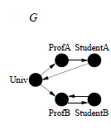

Methods for Link Prediction: based on the ensemble of all paths
SimRank
Two objects are similar, if they are related to similar objects
Two objects x and y are similar, if respectively they are related to objects a and b, and a and b are themselves similar
similarity(x, y) = 1, if x = y
Average similarity between in- neighbors of x and in-neighbors of y
A set of n² equations for a graph of size n
score(x, y) = similarity(x, y)

Slide 17
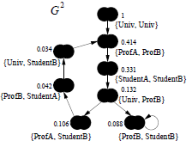
SimRank
Graph G²:
A node for each pair of nodes
(x, y) → (a, b), if x → a and y → b
Scores flow from a node to its neighbors
γ gives the rate of decay as similarity flows across edges (γ = 0.8 in the example)
Iterative computation
s₀(x, y) = 1 if x = y and 0 otherwise
s_{k+1} based on the s_{k} values of its (in-neighbors) computed at iteration k

Slide 18
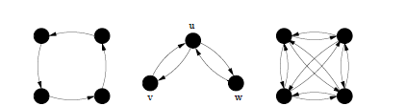
SimRank: Random surfer model
How soon two random surfers are expected to meet at the same node if they started at nodes x and y and randomly walked the graph backwards
Let us consider G²
A node (a, b) as a state of the tour in G, a moves to c, b moves to d in G, then (a, b) moves to (c, d) in G²
A tour in G² of length n represents a pair of tours in G where each has length n
What are the states in G² that correspond to “meeting” points?
Singleton nodes (common neighbors)
Hitting time (expected distance over all tours) d(u, v) : the expected number of steps that it would take a random surfer who at each step follows a random out-edge before it reaches v starting from u
The sum is taken over all walks that start from (x, y) which end at a singleton node

Slide 19
Methods for Link Prediction: High-level approaches
Low rank approximations
M adjacency matrix
Apply SVD (singular value decomposition)
The rank-k matrix that best approximates M

Slide 20


Methods for Link Prediction: High-level approaches
Unseen Bigrams
Unseen bigrams: pairs of word that co-occur in a test corpus, but not in the corresponding training corpus
Not just score(x, y) but score(z, y) for nodes z that are similar to x
S_{x}^{(δ)} the δ nodes most related to x

Slide 21
Methods for Link Prediction: High-level approaches
Clustering
Compute score(x, y) for al edges in E_{old}
Delete the (1-p) fraction of the edges whose score is the lowest, for some parameter p
Recompute score(x, y) for all pairs in the subgraph

Slide 22
Evaluation: baseline
Baseline: random predictor
Randomly select pairs of authors who did not collaborate in the training interval
Probability that a random prediction is correct:
In the datasets, from 0.15% (cond-mat) to 0.48% (astro-ph)

Slide 23
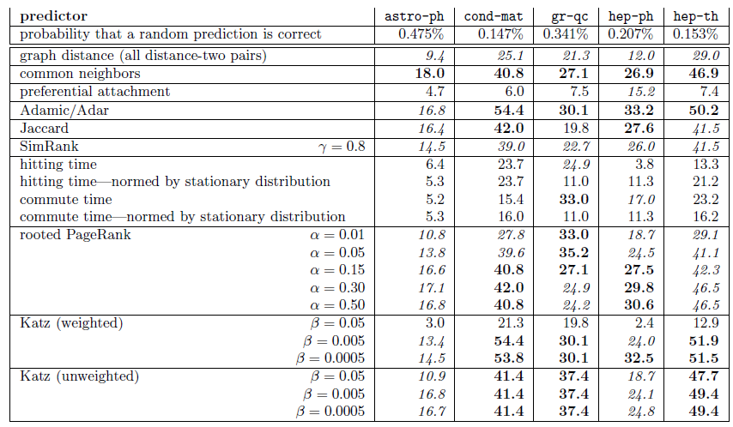
Evaluation: Factor improvement over random

Slide 24
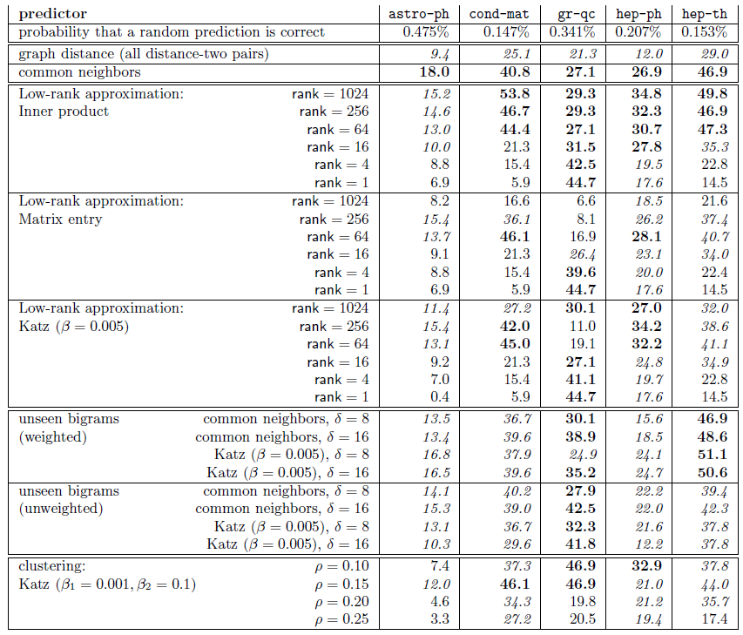
Evaluation: Factor improvement over random

Slide 25
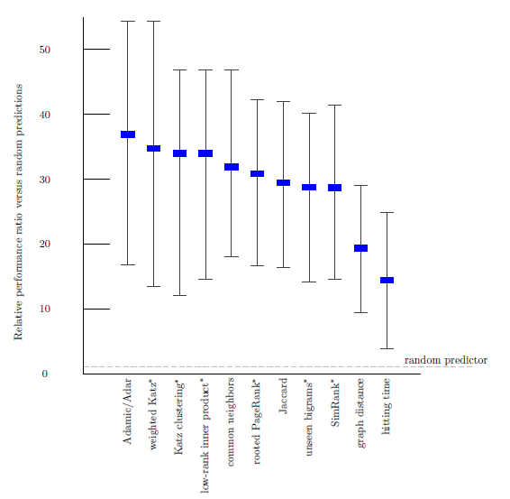
Evaluation: Average relevance performance (random)
average ratio over the five datasets of the given predictor's performance versus a baseline predictor's performance.
the error bars indicate the minimum and maximum of this ratio over the five datasets.
the parameters for the starred predictors are as follows: (1) for weighted Katz, β= 0.005; (2) for Katz clustering, β1 = 0.001; ρ = 0.15; β2 = 0.1; (3) for low-rank inner product, rank = 256; (4) for rooted Pagerank, α = 0.15; (5) for unseen bigrams, unweighted
common neighbors with δ = 8; and (6) for SimRank, γ = 0.8.

Slide 26
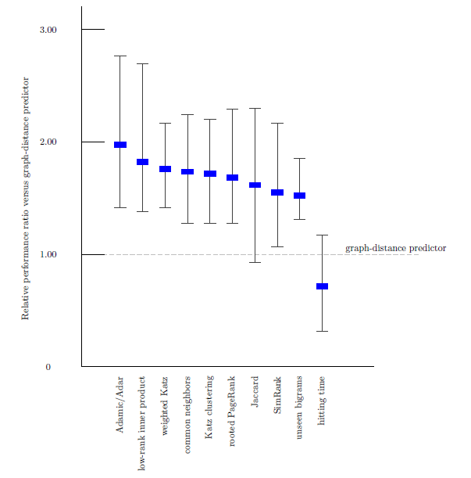
Evaluation: Average relevance performance (distance)

Slide 27
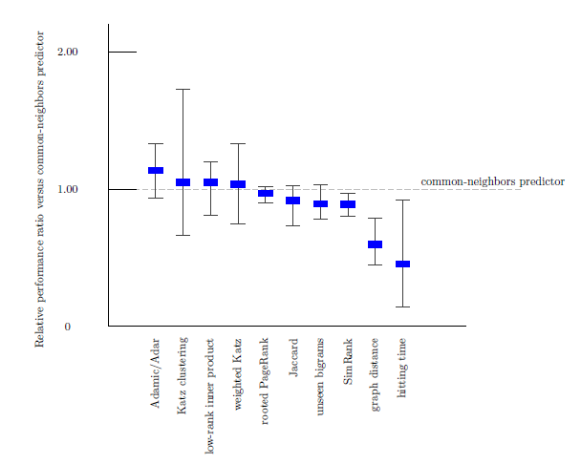
Evaluation: Average relevance performance (neighbors)

Slide 28
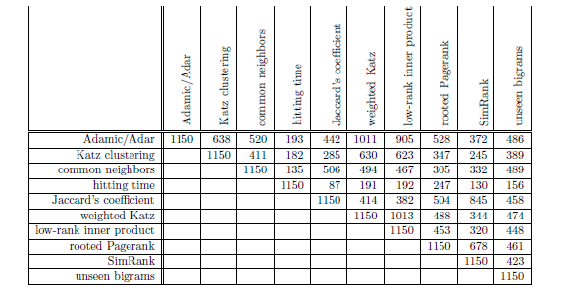
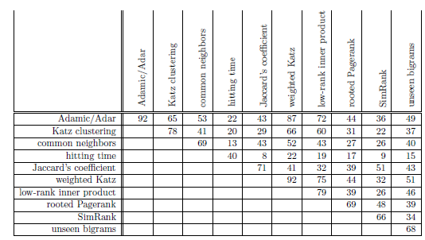
Evaluation: prediction overlap
How much similar are the predictions made by the different methods?
Why?
correct

Slide 29
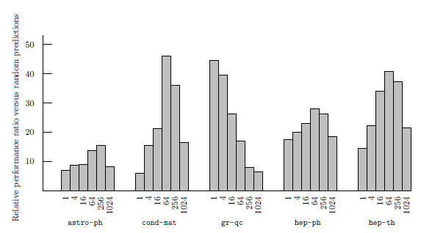
Evaluation: datasets
How much does the performance of the different methods depends on the dataset?
(rank) On 4 of the 5 datasets best at an intermediate rank
On qr-qc, best at rank 1, does it have a “simpler” structure”?
On hep-ph, preferential attachment the best
Why is astro-ph “difficult”?
The culture of physicists and physics collaboration

Slide 30
Evaluation: small world
The shortest path even in unrelated disciplines is often very short
Basic classifier on graph distances does not work

Slide 31
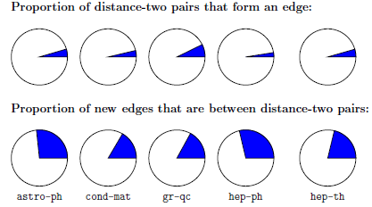
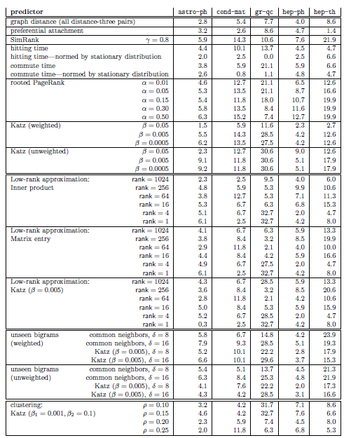

Evaluation: restricting to distance three
Many pairs of authors separated by a graph distance of 2 will not collaborate and
Many pairs who collaborate at distance greater than 2
Disregard all distance 2 pairs

Slide 32
Evaluation: the breadth of data
Three additional datasets
Proceedings of STOC and FOCS
Papers for Citeseer
All five of the arXiv sections
Common neighbors vs Random
Suggests that is easier to predict links within communities

Slide 33
Extensions
Improve performance. Even the best (Katz clustering on gr-qc) correct on only about 16% of its prediction
Improve efficiency on very large networks (approximation of distances)
Treat more recent collaborations as more important
Additional information (paper titles, author institutions, etc)
To some extent latently present in the graph

Slide 34


Extensions
Consider bipartite graph (e.g., some form of an affiliation network)
author
paper
Coauthor graph

Slide 35
Using Supervised Learning
Given a collection of records (training set )
Each record contains
a set of attributes (features) + the class attribute.
Find a model for class attribute as a function of the values of other attributes.
Goal: previously unseen records should be assigned a class as accurately as possible.
A test set is used to determine the accuracy of the model.
Usually, the given data set is divided into training and test sets, with training set used to build the model and test set used to validate it.

Slide 36
Illustrating the Classification Task

Slide 37
Classification Techniques
Decision Tree based Methods
Rule-based Methods
Memory based reasoning
Neural Networks
Naïve Bayes and Bayesian Belief Networks
Support Vector Machines

Slide 38
Example of a Decision Tree
categorical
categorical
continuous
class
Splitting Attributes
Refund
Yes
No
NO
MarSt
Single, Divorced
Married
TaxInc
NO
< 80K
> 80K
NO
YES
Training Data
Model: Decision Tree

Slide 39
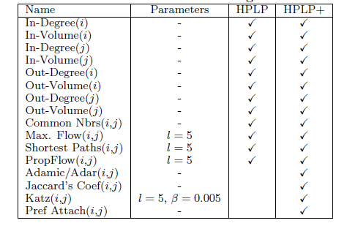
Classification for Link Prediction
Class?
Features (predictors)?
PropFlow: random walks, stops at l or when cycle

Slide 40
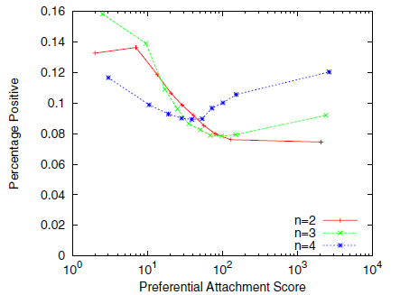
Using Supervised Learning: why?
Even training on a single feature may outperform ranking (restriction to n-neighborhoods)
Dependencies between features

Slide 41
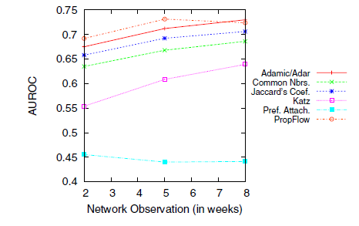
How to split data
Observations in [t1, t2] split at tx
Large tx => better quality of features
But less positives

Slide 42
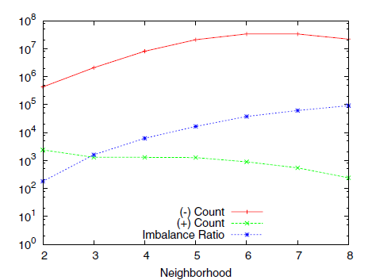
Imbalance
Sparse networks: |E| = k |V| for constant k << |V|
The class imbalance ration for link prediction in a sparse network is Ω(|V|/1) when at most |V| nodes are added
Missing links is |V|²
Positives V
Treat each neighborhood as a separate problem

Slide 43
Metrics for Performance Evaluation
Confusion Matrix:
 | PREDICTED CLASS
ACTUAL CLASS |  | Class=Yes | Class=No
 | Class=Yes | TP | FN
 | Class=No | FP | TN

Slide 44
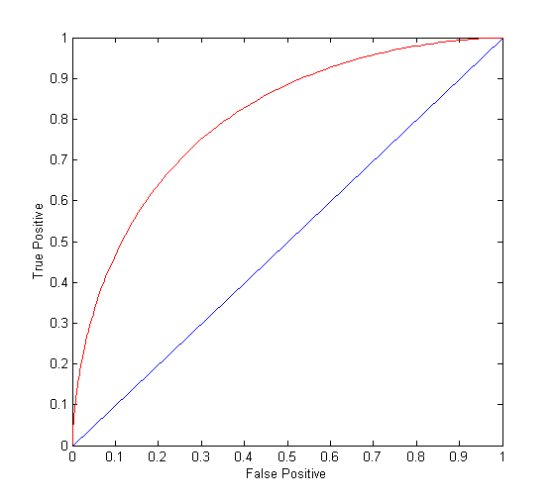
ROC Curve
(TP,FP):
(0,0): declare everything to be negative class
(1,1): declare everything to be positive class
(1,0): ideal
Diagonal line:
Random guessing
Below diagonal line:
prediction is opposite of the true class
AUC: area under the ROC

Slide 45
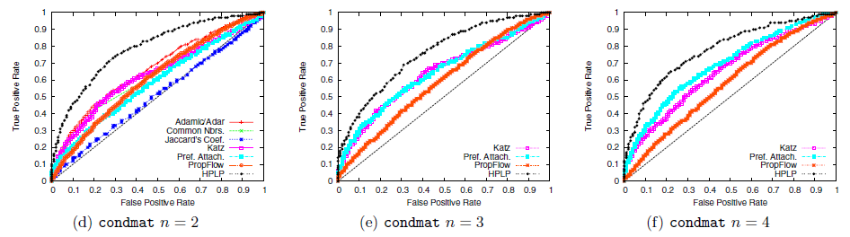
Results
Ensemble of classifiers: Random Forest

Slide 46
References
Liben-Nowell, D. and Kleinberg, J. The link-prediction problem for social networks. Journal of the American Society for Information Science and Technology, 58(7) 1019–1031 (2007)
Ryan Lichtenwalter, Jake T. Lussier, Nitesh V. Chawla: New perspectives and methods in link prediction. KDD 2010: 243-252
Glen Jeh, Jennifer Widom: SimRank: a measure of structural-context similarity. KDD 2002: 538-543
P-N Tan, . Steinbach, V. Kumar. Introduction to Data Mining (Chapter 4)

