Slide 1
Online Social Networks and Media
Network Ties

Slide 2
Introduction
How simple processes at the level of individual nodes and links can have complex effects at the whole population
How information flows within the network
How links/ties are formed and the distinct roles that structurally different nodes play in link formation

Slide 3
Assortativity
similar nodes are connected with each other
more often than with dissimilar nodes

Slide 4
Why are friendship networks assortative (similar)?
(Social) Influence (or, socialization): an individual (the influential) affects another individual such that the influenced individual becomes more similar to the influential figure
Selection (Homophily): similar individuals become friends due to their high similarity
Confounding: the environment’s effect on making individuals similar/Surrounding context: factors other than node and edges that affect how the network structure evolves (for instance, individuals who live in Russia speak Russian fluently)
Mutable & immutable characteristics

Slide 5
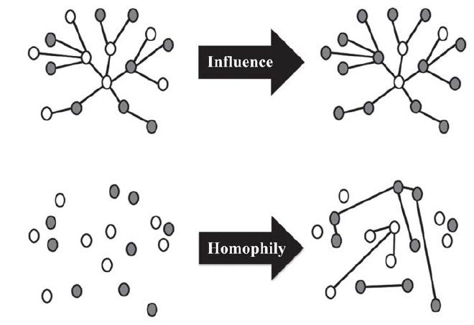
Influence vs Homophily
Individuals already linked together change the values of their attributes
Connections are formed due to similarity

Slide 6
Influence vs Homophily
Which social force (influence or homophily) resulted in an assortative network?

Slide 7
Strong AND WEAK TIES

Slide 8
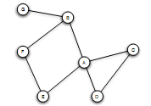
Triadic Closure
If two people in a social network have a friend in common, then there is an increased likelihood that they will become friends themselves at some point in the future
Triangle

Slide 9
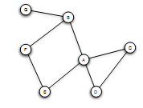
Triadic Closure
Snapshots over time:

Slide 10
Clustering Coefficient
(Local) clustering coefficient for a node is the probability that two randomly selected friends of a node are friends with each other (form a triangle)
Fraction of the friends of a node that are friends with each other (i.e., connected)

Slide 11
Clustering Coefficient
1/6
1/2
Ranges from 0 to 1

Slide 12
Triadic Closure
If A knows B and C, B and C are likely to become friends, but WHY?
B
A
C
Opportunity
Trust
Incentive of A (latent stress for A, if B and C are not friends, dating back to social psychology, e.g., relating low clustering coefficient to suicides)

Slide 13
The Strength of Weak Ties Hypothesis
Mark Granovetter, in the late 1960s
Many people learned information leading to their current job through personal contacts, often described as acquaintances rather than closed friends
Two aspects
Structural
Local (interpersonal)

Slide 14
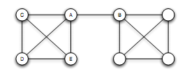
Bridges and Local Bridges
Bridge
(aka cut-edge)
An edge between A and B is a bridge if deleting that edge would cause A and B to lie in two different components
AB the only “route” between A and B
extremely rare in social networks

Slide 15
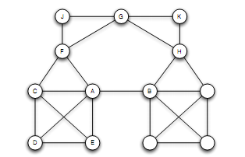
Bridges and Local Bridges
Local Bridge
An edge between A and B is a local bridge if deleting that edge would increase the distance between A and B to a value strictly more than 2
Span of a local bridge: distance of the its endpoints if the edge is deleted

Slide 16
Bridges and Local Bridges
An edge is a local bridge, if an only if, it is not part of any triangle in the graph

Slide 17
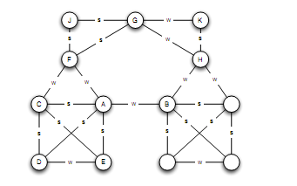
The Strong Triadic Closure Property
Levels of strength of a link
Strong and weak ties
May vary across different times and situations
Annotated graph

Slide 18
The Strong Triadic Closure Property
If a node A has edges to nodes B and C, then the B-C edge is especially likely to form if both A-B and A-C are strong ties
A node A violates the Strong Triadic Closure Property, if
it has strong ties to two other nodes B and C, and there is no edge (strong or weak tie) between B and C.
A node A satisfies the Strong Triadic Property if it does not violate it
B
S
A
X
S
C

Slide 19
The Strong Triadic Closure Property

Slide 20
Local Bridges and Weak Ties
Local distinction: weak and strong ties ->
Global structural distinction: local bridges or not
Claim:
If a node A in a network satisfies the Strong Triadic Closure and is involved in at least two strong ties, then any local bridge it is involved in must be a weak tie
Proof: by contradiction
Relation to job seeking?

Slide 21
The role of simplifying assumptions:
Useful when they lead to statements robust in practice, making sense as qualitative conclusions that hold in approximate forms even when the assumptions are relaxed
Stated precisely, so possible to test them in real-world data
A framework to explain surprising facts

Slide 22
Tie Strength and Network Structure in Large-Scale Data
How to test these prediction on large social networks?

Slide 23
Tie Strength and Network Structure in Large-Scale Data
Communication network: “who-talks-to-whom”
Strength of the tie: time spent talking during an observation period
Cell-phone study [Omnela et. al., 2007]
“who-talks-to-whom network”, covering 20% of the national population
Nodes: cell phone users
Edge: if they make phone calls to each other in both directions over 18-week observation periods
Is it a “social network”?
Cells generally used for personal communication + no central directory, thus cell-phone numbers exchanged among people who already know each other
Broad structural features of large social networks (giant component, 84% of nodes)

Slide 24
Generalizing Weak Ties and Local Bridges
So far:
Either weak or strong
Local bridge or not
Tie Strength: Numerical quantity (= number of min spent on the phone)
Quantify “local bridges”, how?

Slide 25
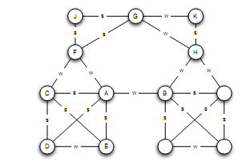
Generalizing Weak Ties and Local Bridges
Bridges
“almost” local bridges
Neighborhood overlap of an edge e_{ij}
(*) In the denominator we do not count A or B themselves
Jaccard coefficient
A: B, E, D, C
F: C, J, G
1/6
When is this value 0?

Slide 26
Generalizing Weak Ties and Local Bridges
Neighborhood overlap = 0: edge is a local bridge
Small value: “almost” local bridges
1/6
?

Slide 27
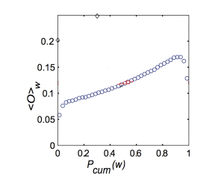
Generalizing Weak Ties and Local Bridges: Empirical Results
How the neighborhood overlap of an edge depends on its strength
(Hypothesis: the strength of weak ties predicts that neighborhood overlap should grow as tie strength grows)
(*) Some deviation at the right-hand edge of the plot
sort the edges -> for each edge at which percentile
Strength of connection (function of the percentile in the sorted order)

Slide 28
Generalizing Weak Ties and Local Bridges: Empirical Results
How to test the following global (macroscopic) level hypothesis:
Hypothesis: weak ties serve to link different tightly-knit communities that each contain a large number of stronger ties

Slide 29
Generalizing Weak Ties and Local Bridges: Empirical Results
Delete edges from the network one at a time
Starting with the strongest ties and working downwards in order of tie strength
giant component shrank steadily
Starting with the weakest ties and upwards in order of tie strength
giant component shrank more rapidly, broke apart abruptly as a critical number of weak ties were removed

Slide 30
Social Media and Passive Engagement
People maintain large explicit lists of friends
Test:
How online activity is distributed across links of different strengths

Slide 31
Tie Strength on Facebook
Cameron Marlow, et al, 2009
At what extent each link was used for social interactions
Three (not exclusive) kinds of ties (links)
Reciprocal (mutual) communication: both send and received messages to friends at the other end of the link
One-way communication: the user send one or more message to the friend at the other end of the link
Maintained relationship: the user followed information about the friend at the other end of the link (click on content via News feed or visit the friend profile more than once)

Slide 32
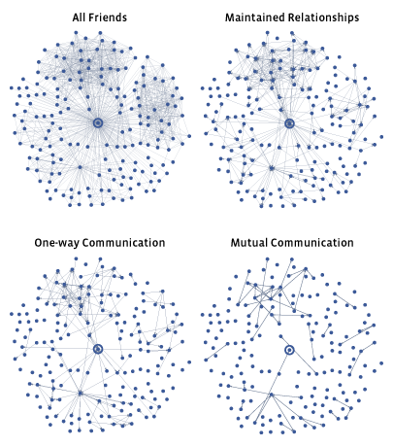
Tie Strength on Facebook
More recent connections

Slide 33
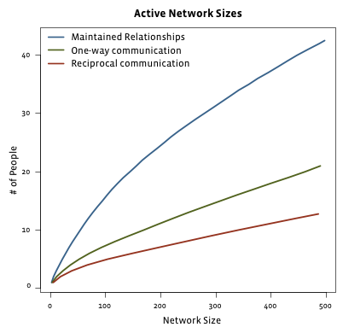
Tie Strength on Facebook
Even for users with very large number of friends
actually communicate : 10-20
number of friends follow even passively <50
Passive engagement (keep up with friends by reading about them even in the absence of communication)
Total number of friends

Slide 34
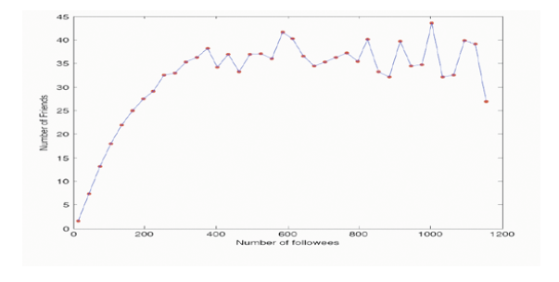
Tie Strength on Twitter
Huberman, Romero and Wu, 2009
Two kinds of links
Follow
Strong ties (friends): users to whom the user has directed at least two messages over the course if the observation period

Slide 35
Social Media and Passive Engagement
Strong ties require continuous investment of time and effort to maintain (as opposed to weak ties)
Network of strong ties still remain sparse
How different links are used to convey information

Slide 36
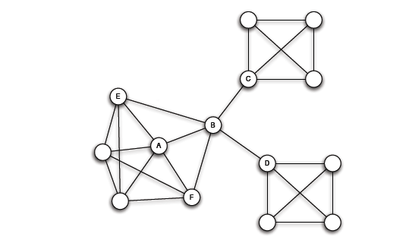
Closure, Structural Holes and Social Capital
Different roles that nodes play in this structure
Access to edges that span different groups is not equally distributed across all nodes

Slide 37
Embeddedness
A has a large clustering coefficient
Embeddedness of an edge: number of common neighbors of its endpoints (neighborhood overlap, local bridge if 0)
For A, all its edges have significant embeddedness
3
2
3
(sociology) if two individuals are connected by an embedded edge => trust
“Put the interactions between two people on display”

Slide 38
Structural Holes
(sociology) B-C, B-D much riskier, also, possible contradictory constraints
Success in a large cooperation correlated to access to local bridges
B “spans a structural hole”
B has access to information originating in multiple, non interacting parts of the network
An amplifier for creativity
Source of power as a social “gate-keeping”
Social capital

Slide 39
MoRE oN lINK FormatiON: Affiliations and MEASUREMENTS

Slide 40
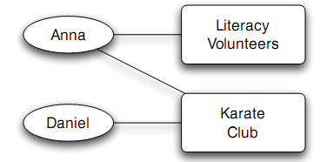
Affiliation
A larger network that contains both people and context as nodes
foci
Affiliation network:
A bipartite graph
A node for each person and a node for each focus
An edge between a person A and focus X, if A participates in X

Slide 41
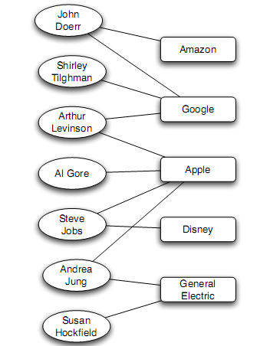
Affiliation
Example:
Board of directors
Companies implicitly links by having the same person sit on both their boards
People implicitly linked by serving together on a aboard
Other contexts, president of two major universities and a former Vice-President

Slide 42
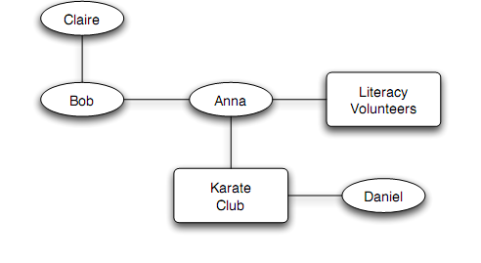
Co-evolution of Social and Affiliation Networks
Social Affiliation Network
Two type of edges:
Friendship: between two people
Participation: between a person and a focus
Co-evolution reflect the interplay of selection and social influence: if two people in a shared focus opportunity to become friends, if friends, influence each other foci.

Slide 43
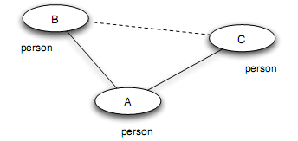
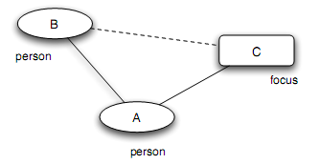
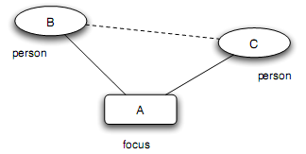
Co-evaluation of Social and Affiliation Networks: Closure process
Triadic closure: (two people with a friend in common - A introduces B to C)
Membership closure: (a person joining a focus that a friend is already involved in - A introduces focus C to B) (social influence)
Focal closure: (two people with a focus in common - focus A introduces B to C) (selection)

Slide 44
Co-evaluation of Social and Affiliation Networks

Slide 45
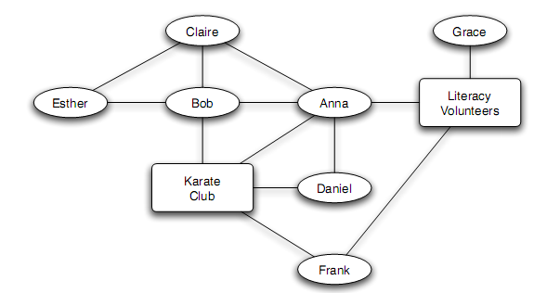
Example

Slide 46
Tracking Link Formation in Online Data: triadic closure
Triadic closure:
How much more likely is a link to form between two people if they have a friend in common
How much more likely is a link to form between two people if they have multiple friends in common?

Slide 47
Tracking Link Formation in Online Data: triadic closure
Take two snapshots of the network at different times:
For each k, identify all pairs of nodes that have exactly k friends in common in the first snapshot, but who are not directly connected
Define T(k) to be the fraction of these pairs that have formed an edge by the time of the second snapshot
Plot T(k) as a function of k
T(0): rate at which link formation happens when it does not close any triangle
T(k): the rate at which link formation happens when it does close a triangle (k common neighbors, triangles)

Slide 48
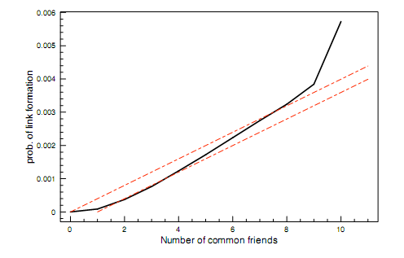
Tracking Link Formation in Online Data: triadic closure
E-mail (“who-talks-to-whom” dataset type)
Among 22,000 undergrad and grad students (large US university)
For 1-year
Network evolving over time
At each instance (snapshot), two people join, if they have exchanged e-mail in each direction at some point in the past 60 days
Multiple pairs of snapshots ->
Built a curve for T(k) on each pair, then average all the curves
Snapshots – one day apart (average probability that two people form a link per day)
From 0 to 1 to 2 friends
From 8 to 9 to 10 friend (but occurs on a much smaller population)
Almost linear
Having two common friends produces significantly more than twice the effect compared to a single common friend

Slide 49
Tracking Link Formation in Online Data: triadic closure
Baseline model:
Assume triadic closure:
Each common friend two people have gives them an independent probability p of forming a link each day
For two people with k friend in common,
Probability not forming a link on any given day
(1-p)^{k}
Probability forming a link on any given day
T_{baseline1}(k) = 1 - (1-p)^{k}
Given the small absolute effect of the first common friend in the data
T_{baseline2}(k) = 1 - (1-p)^{k-1}
Qualitative similar (linear), but independent assumption too simple

Slide 50
Tracking Link Formation in Online Data: focal and membership closure
Focal closure: what is the probability that two people form a link as a function of the number of foci that are jointly affiliated with
Membership closure: what is the probability that a person becomes involved with a particular focus as a function of the number of friends who are already involved in it?

Slide 51
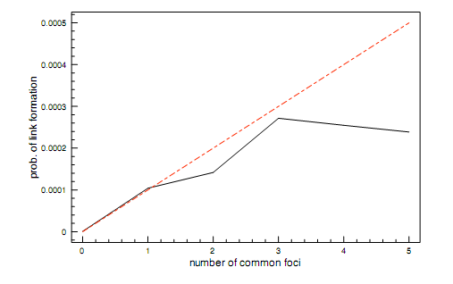
Tracking Link Formation in Online Data: focal closure
E-mail (“who-talks-to-whom” dataset type)
Use the class schedule of each student
Focus: class (common focus – a class together)
A single shared class same effect as a single shared friend, then different
Subsequent shared classes after the first produce a diminishing returns effect

Slide 52
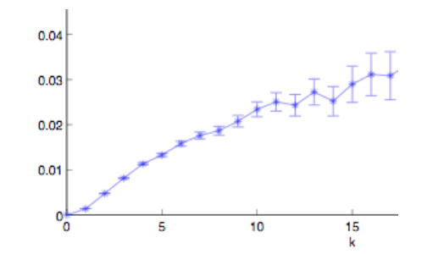
Tracking Link Formation in Online Data: membership closure
Node: Wikipedia editor who maintains a user account and user talk page
Link: if they have communicated by one user writing on the user talk page of the other
Focus: Wikipedia article
Association to focus: edited the article
Again, an initial increasing effect: the probability of editing a Wikipedia article is more than twice as large when you have two connections into the focus than one
Also, multiple effects can operate simultaneously

Slide 53
POSITIVE AND NEGATIVE TIES

Slide 54
Structural Balance
What about negative edges?
Initially, a complete graph (or clique): every edge either + or -
Let us first look at individual triangles
Lets look at 3 people => 4 cases
See if all are equally possible (local property)

Slide 55
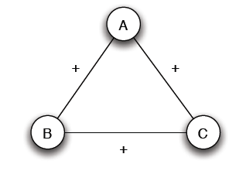
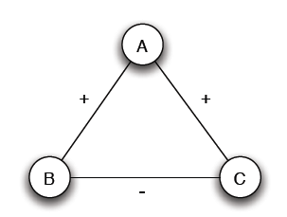
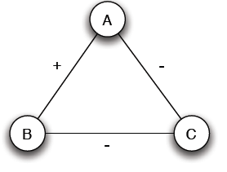
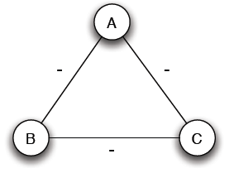
Structural Balance
Case (a): 3 +
Case (b): 2 +, 1 -
Mutual friends
A is friend with B and C, but B and C do not get well together
Case (c): 1 +, 2 -
Case (d): 3 -
Mutual enemies
A and B are friends with a mutual enemy

Slide 56
Structural Balance
Case (a): 3 +
Case (b): 2 +, 1 -
Stable or balanced
Unstable
Mutual friends
A is friend with B and C, but B and C do not get well together
Implicit force to make B and C friends (- => +) or turn one of the + to -
Case (c): 1 +, 2 -
Case (d): 3 -
Stable or balanced
Unstable
Mutual enemies
Forces to team up against the third (turn 1 – to +)
A and B are friends with a mutual enemy

Slide 57
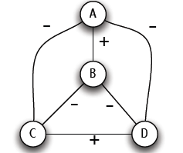
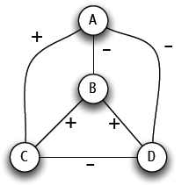
Structural Balance
A labeled complete graph is balanced if every one of its triangles is balanced
Structural Balance Property: For every set of three nodes, if we consider the three edges connecting them, either all three of these are labeled +, or else exactly one of them is labeled – (odd number of +)
What does a balanced network look like?

Slide 58
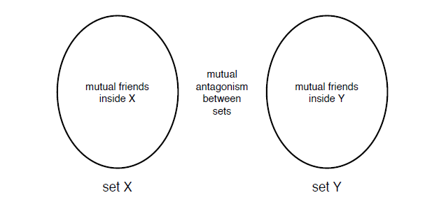
The Structure of Balanced Networks
Balance Theorem: If a labeled complete graph is balanced,
all pairs of nodes are friends, or
the nodes can be divided into two groups X and Y, such that every pair of nodes in X like each other, every pair of nodes in Y like each other, and every one in X is the enemy of every one in Y.
From a local to a global property
Proof ...

Slide 59
Applications of Structural Balance
How a network evolves over time
Political science: International relationships (I)
The conflict of Bangladesh’s separation from Pakistan in 1972 (1)
₋
USSR
N. Vietnam
USA
Pakistan
-
-
-
₊
Bangladesh
China
-
India
USA support to Pakistan?

Slide 60
Applications of Structural Balance
International relationships (I)
The conflict of Bangladesh’s separation from Pakistan in 1972 (II)
₊
₋
USSR
N. Vietnam
USA
Pakistan
-
-
₊
-
Bangladesh
China
-
India
China?

Slide 61
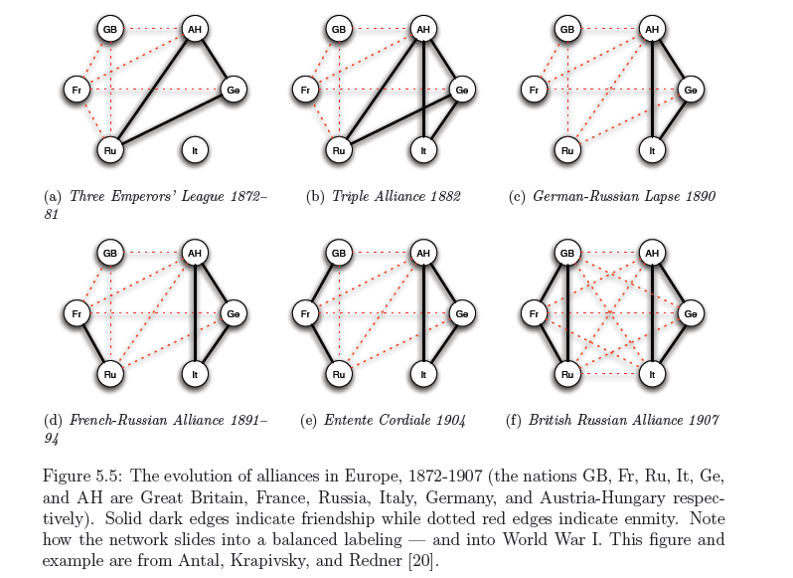
Applications of Structural Balance
International relationships (II)

Slide 62
A Weaker Form of Structural Balance
Allow this
Weak Structural Balance Property: There is no set of three nodes such that the edges among them consist of exactly two positive edges and one negative edge

Slide 63
A Weaker Form of Structural Balance
Weakly Balance Theorem: If a labeled complete graph is weakly balanced, its nodes can be divided into groups in such a way that every two nodes belonging to the same group are friends, and every two nodes belonging to different groups are enemies.
Proof …

Slide 64
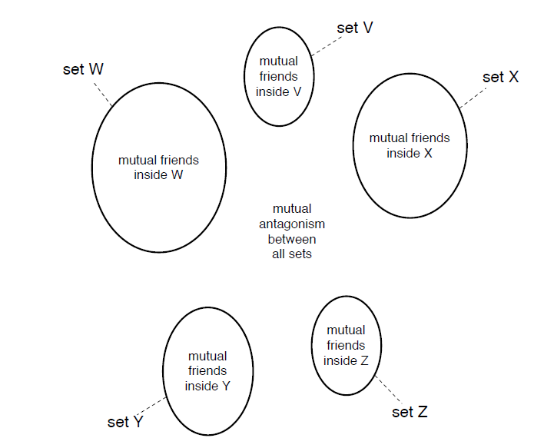
A Weaker Form of Structural Balance

Slide 65
Trust, distrust and online ratings
Evaluation of products and trust/distrust of other users
Directed Graphs
A
A
C
C
+
-
+
-
B
B
A trusts B, B trusts C, A ? C
A distrusts B, B distrusts C, A ? C
If distrust enemy relation, +
A distrusts means that A is better than B, -
Depends on the application
Rating political books or
Consumer rating electronics products

Slide 66
Generalizing
Non-complete graphs
Instead of all triangles, “most” triangles, approximately divide the graph
We shall use the original (“non-weak” definition of structural balance)

Slide 67
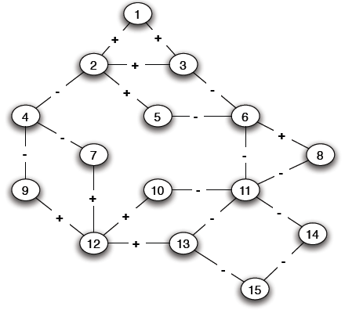
Structural Balance in Arbitrary Graphs
Thee possible relations
Positive edge
Negative edge
Absence of an edge
What is a good definition of balance in a non-complete graph?

Slide 68
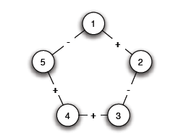
Balance Definition for General Graphs
Based on triangles (local view)
Division of the network (global view)
A (non-complete) graph is balanced if it can be completed by adding edges to form a signed complete graph that is balanced
-
+

Slide 69
Balance Definition for General Graphs
+

Slide 70
Balance Definition for General Graphs
Based on triangles (local view)
Division of the network (global view)
A (non-complete) graph is balanced if it possible to divide the nodes into two sets X and Y, such that any edge with both ends inside X or both ends inside Y is positive and any edge with one end in X and one end in Y is negative
The two definition are equivalent:
An arbitrary signed graph is balanced under the first definition, if and only if, it is balanced under the second definitions

Slide 71
Balance Definition for General Graphs
Algorithm for dividing the nodes?

Slide 72
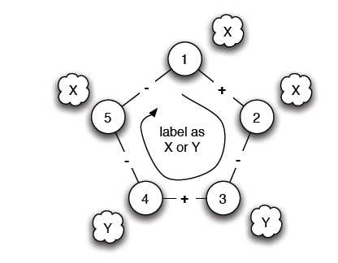
Balance Characterization
What prevents a network from being balanced?
Start from a node and place nodes in X or Y
Every time we cross a negative edge, change the set
Cycle with odd number of negative edges

Slide 73
Balance Definition for General Graphs
Cycle with odd number of - => unbalanced
Is there such a cycle with an odd number of -?

Slide 74
Balance Characterization
Claim: A signed graph is balanced, if and only if, it contains no cycles with an odd number of negative edges
(proof by construction)
Find a balanced division: partition into sets X and Y, all edges inside X and Y positive, crossing edges negative
Either succeeds or Stops with a cycle containing an odd number of -
Two steps:
Convert the graph into a reduced one with only negative edges
Solve the problem in the reduced graph

Slide 75
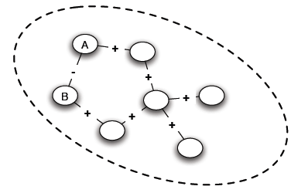
Balance Characterization: Step 1
a. Find connected components (supernodes) by considering only positive edges
b. Check: Do supernodes contain a negative edge between any pair of their nodes
(a) Yes -> odd cycle (1)
(b) No -> each supernode either X or Y

Slide 76
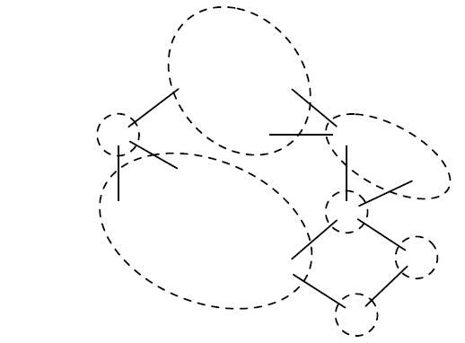
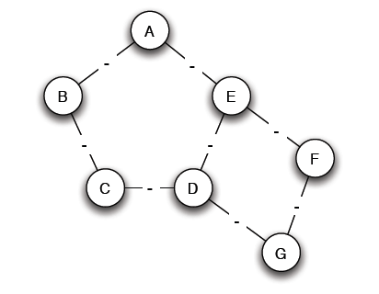
Balance Characterization: Step 1
3. Reduced problem: a node for each supernode, an edge between two supernodes if an edge in the original

Slide 77
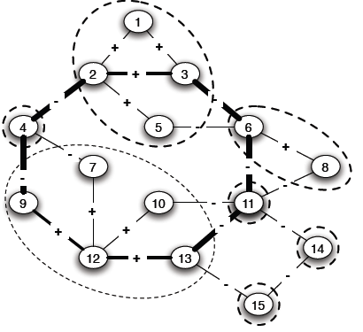
Balance Characterization: Step 2
Note: Only negative edges among supernodes
Start labeling by either X and Y
If successful, then label the nodes of the supernode correspondingly
A cycle with an odd number, corresponds to a (possibly larger) odd cycle in the original

Slide 78
Balance Characterization: Step 2
Determining whether the graph is bipartite (there is no edge between nodes in X or Y, the only edges are from nodes in X to nodes in Y)
Use Breadth-First-Search (BFS)
Two type of edges: (1) between nodes in adjacent levels (2) between nodes in the same level
If only type (1), alternate X and Y labels at each level
If type (2), then odd cycle

Slide 79
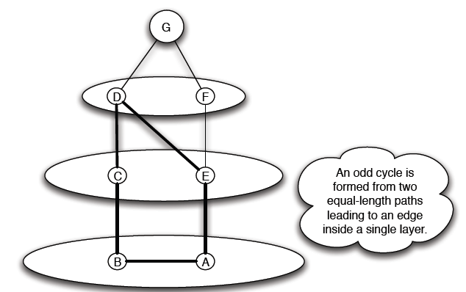
Balance Characterization

Slide 80
Generalizing
Non-complete graphs
Instead of all triangles, “most” triangles, approximately divide the graph

Slide 81
Approximately Balance Networks
a complete graph (or clique): every edge either + or -
Claim: If all triangles in a labeled complete graph are balanced, than either
all pairs of nodes are friends or,
the nodes can be divided into two groups X and Y, such that
every pair of nodes in X like each other,
every pair of nodes in Y like each other, and
every one in X is the enemy of every one in Y.
Not all, but most, triangles are balanced
Claim: If at least 99.9% of all triangles in a labeled compete graph are balanced, then either,
There is a set consisting of at least 90% of the nodes in which at least 90% of all pairs are friends, or,
the nodes can be divided into two groups X and Y, such that
at least 90% of the pairs in X like each other,
at least 90% of the pairs in Y like each other, and
at least 90% of the pairs with one end in X and one in Y are enemies

Slide 82
Approximately Balance Networks
Claim: If at least 99.9% of all triangles in a labeled complete graph are balanced, then either,
There is a set consisting of at least 90% of the nodes in which at least 90% of all pairs are friends, or,
the nodes can be divided into two groups X and Y, such that
at least 90% of the pairs in X like each other,
at least 90% of the pairs in Y like each other, and
at least 90% of the pairs with one end in X and one in Y are enemies
Claim: Let ε be any number, such that 0 ≤ ε < 1/8. If at least 1 – ε of all triangles in a labeled complete graph are balanced, then either
There is a set consisting of at least 1-δ of the nodes in which at least 1-δ of all pairs are friends, or,
the nodes can be divided into two groups X and Y, such that
at least 1-δ of the pairs in X like each other,
at least 1-δ of the pairs in Y like each other, and
at least 1-δ of the pairs with one end in X and one in Y are enemies

Slide 83
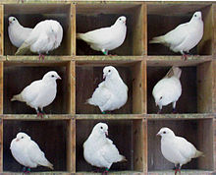
Approximately Balance Networks
Basic idea – find a “good” node A (s.t., it does not belong to too many unbalanced triangles) to partition into X and Y
Pigeonhole principle: if n items are put into m pigeonholes with n > m, then at least one pigeonhole must contain more than one item
Counting argument based on pigeonhole: compute the average value of a set of objects and then argue that there must be at least one node that is equal to the average or below (or equal and above)

Slide 84
References
Networks, Crowds, and Markets (Chapter 3, 4, 5)

