Slide 1
Online Social Networks and Media
Mining Content

Slide 2
Content

Slide 3
Eduardo J. Ruiz, Vagelis Hristidis, Carlos Castillo, Aristides Gionis, Alejandro Jaimes: Correlating financial time series with micro-blogging activity. WSDM 2012: 513-522

Slide 4
Goal
How data from micro-blogging (Twitter) is correlated to time series from the financial domain (prices and traded volume)
Which features from tweets are more correlated with changes in the stocks?

Slide 5
Stock Market Data
Stock data from Yahoo! Finance for 150 (randomly selected) companies in the S&P 500 index for the first half of 2010.
For each stock, the daily closing price and daily traded volume
Transform the price series into its daily relative change, i.e., if the series for price is pi, we used pi – pi-1/pi-1.
Normalized traded volume by dividing the volume of each day by the mean traded volume observed for that company during the entire half of the year.

Slide 6
Twitter Data
Obtain all the relevant tweets on the first half of 2010
Use a series of regular expressions
For example, the filter expression for Yahoo is: “#YHOO | $YHOO | #Yahoo”.
Manual Refinement
Randomly select 30 tweets from each company, and re-wrote the extraction rules for those sets that had less that 50% of tweets related to the company.
If a rule-based approach not feasible, the company was removed from the dataset
Example companies with expressions rewritten: YHOO, AAPL, APOL
YHOO used in many tweets related with the news service (Yahoo! News).
Apple is a common noun and also used for spamming (“Win a free iPad” scams).
Apollo also the name of a deity in Greek mythology

Slide 7
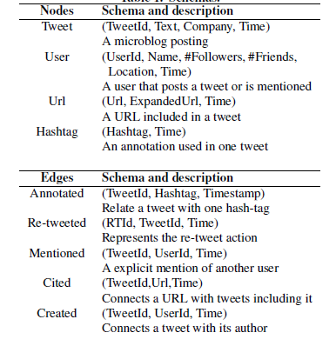
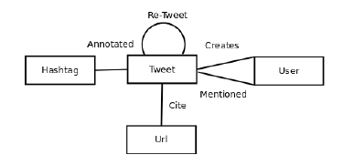
Graph Representation

Slide 8
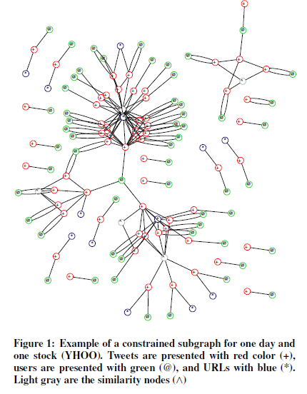
Constrained Subgraph
G^{c}_{t1,t2} about company c at time interval [t1, t2]
induced subgraph of G that contains the nodes that are either tweets with timestamps in interval [t1,t2], or non-tweet nodes connected through an edge to the selected tweet nodes.

Slide 9
Features
Activity features count the number of nodes of a particular type, such as number of tweets, number of users, number of hashtags, etc.
Graph features measure properties of the link structure of the graph.
For scalability, feature computation done using Map-Reduce

Slide 10
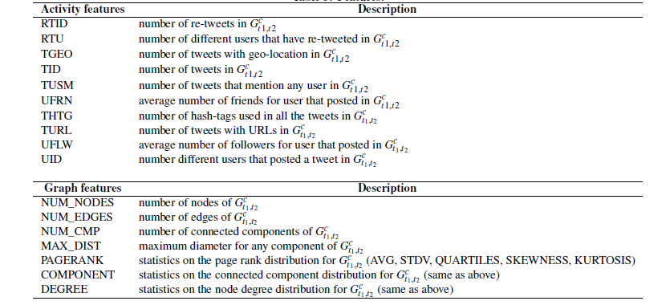
Features

Slide 11
Features normalization and seasonability
Most values normalized in [0, 1]
The number of tweets is increasing and has a weekly seasonal effect.
normalize the feature values with a time-dependent normalization factor that considers seasonality, i.e., is proportional to the total number of messages on each day.

Slide 12

Time Series Correlation
Cross-correlation coefficient (CCF) at lag τ between series X, Y measures the correlation of the first series with respect to the second series shifted by τ
If correlation at a negative lag, then input features can be used to predict the outcome series

Slide 13
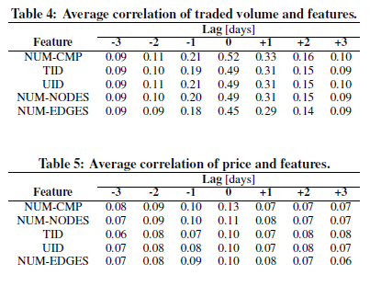
Results

Slide 14
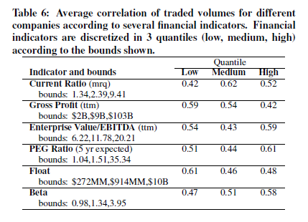
Results

Slide 15
Results
Index graph with data related to the 20 biggest companies (appropriately weighted)
Centrality measures (PageRank, Degree) work better

Slide 16
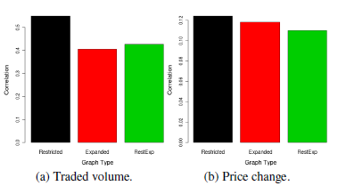
Expanding the graph
Restricted Graph
Expanded Graph: all tweets that contain $ticker or #ticker, the full name of the company, short name version after removing common suffixes (e.g., inc or corp), or short name as a hash-tag.
Example: “#YHOO | $YHOO | #Yahoo | Yahoo | Yahoo Inc”.
RestExp: Add to the restricted graph the tweets of the expanded graph that are reachable from the nodes of the restricted graph through a path (e.g., through a common author or a re-tweet).
NUM_COMP

Slide 17
Simulation
Goal: simulate daily trading to see if using twitter helps
Description of the Simulator
An investor
1. starts with an initial capital endowment C₀.
2. in the morning of every day t, buys K different stocks using all of the available capital C_{t} using a number of stock selection strategies
3. holds the stocks all day
4. sells all the stocks at the closing time of day t. The amount obtained is the new capital C_{t+1} used again in step 2.
This process finishes on the last day of the simulation.
Plot the percent of money win or lost each day against the original investment.

Slide 18

Stock selection strategies
Random: buys K stocks at random, spends Ct/K per stock (uniformly shared).
Fixed: buys K stocks using a particular financial indicator (market capitalization, company size, total debt), from the same companies every day, spends Ct/K per stock(uniformly shared).
Auto Regression: buys the K stocks whose price changes will be larger, predicted using an auto-regression (AR(s)) model.
spends Ct/K per stock(uniformly shared) or use a price-weight ratio

Slide 19

Stock selection strategies
Twitter-Augmented Regression: buys the best K stocks
that are predicted using a vector auto-regressive (VAR(s)) model that considers, in addition to price, a Twitter feature
spends Ct/K per stock(uniformly shared) or use a price-weight ratio

Slide 20
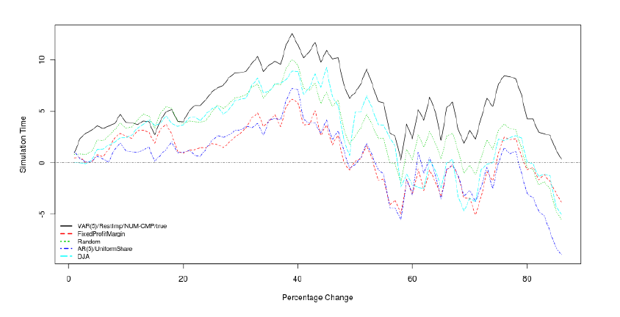
Results
average loss for Random is -5.52%, for AR -8.9% (Uniform) and -13.08% (Weighted), for Profit Margin - 3.8%, Best use NUN-CMP on RestExp with uniform share + 0.32% (on restricted graph -2.4% loss )
Includes tDow Jones Index he Average (DJA) (consistent)

Slide 21
Summary
Present filtering methods to create graphs of postings about a company during a time interval and a suite of features that can be computed from these graphs
Study the correlation of the proposed features with the time series of stock price and traded volume also show how these correlations can be stronger or weaker depending on financial indicators of companies (e.g., on current level of debt)
Perform a study on the application of the correlation patterns found to guide a stock trading strategy and show that it can lead to a strategy that is competitive when compared to other automatic trading strategies

Slide 22
Takeshi Sakaki, Makoto Okazaki, Yutaka Matsuo: Earthquake shakes Twitter users: real-time event detection by social sensors. WWW 2010: 851-860
Slides based on the authors’ presentation

Slide 23
Goal
investigate the real-time interaction of events such as earthquakes, in Twitter, and
propose an algorithm to monitor tweets and to detect a target event.

Slide 24
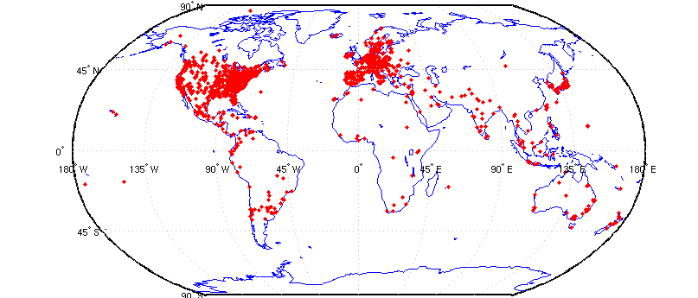
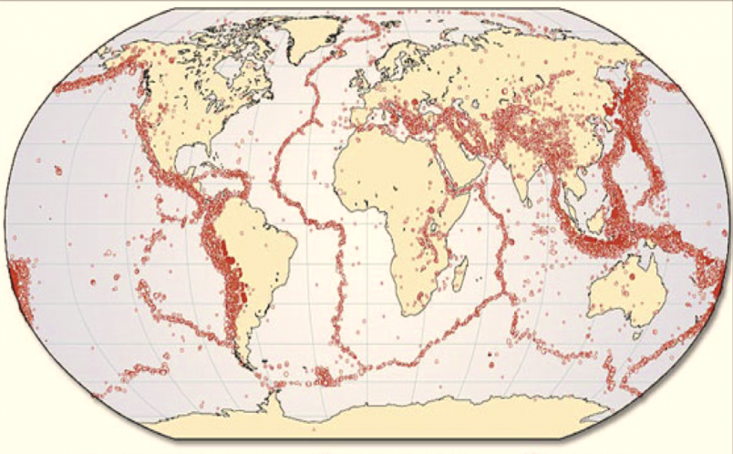
Twitter and Earthquakes in Japan
a map of Twitter user
world wide
a map of earthquake occurrences world wide
The intersection is regions with many earthquakes and large twitter users.

Slide 25
Twitter and Earthquakes in Japan
Other regions:
Indonesia, Turkey, Iran, Italy, and Pacific coastal US cities

Slide 26
Events
What is an event?
an arbitrary classification of a space/time region.
Example social events: large parties, sports events, exhibitions, accidents, political campaigns.
Example natural events: storms, heavy rainfall, tornadoes, typhoons/hurricanes/cyclones, earthquakes.
Several properties:
large scale (many users experience the event),
influence daily life (for that reason, many tweets)
have spatial and temporal regions (so that real-time location estimation would be possible).

Slide 27
Event detection algorithms
do semantic analysis on tweets
  to obtain tweets on the target event precisely
regard Twitter user as a sensor
  to detect the target event
  to estimate location of the target

Slide 28
Semantic Analysis on Tweets
Search tweets including keywords related to a target event – query keywords
  Example: In the case of earthquakes
    “shaking”, “earthquake”
Classify tweets into a positive class (real time reports of the event) or a negative class
  Example:
    “Earthquake right now!!” ---positive
    “Someone is shaking hands with my boss” --- negative
    “Three earthquakes in four days. Japan scares me” --- negative
    Build a classifier

Slide 29
Semantic Analysis on Tweets
Create classifier for tweets
  use Support Vector Machine (SVM)
Features (Example: I am in Japan, earthquake right now!)
  Statistical features (A) (7 words, the 5th word)
  the number of words in a tweet message and the position of the query within a tweet
  Keyword features (B) ( I, am, in, Japan, earthquake, right, now)
  the words in a tweet
  Word context features (C) (Japan, right)
  the words before and after the query word

Slide 30






Tweet as a Sensory Value
Event detection from twitter
Object detection in
ubiquitous environment
Probabilistic model
Probabilistic model
Classifier
values
tweets
・・・
・・・
・・・
・・・
・・・
observation by twitter users
observation by sensors
target event
target object
the correspondence between tweets processing and sensory data detection

Slide 31
Tweet as a Sensory Value
Event detection from twitter
Object detection in
ubiquitous environment
detect an earthquake
detect an earthquake
search and classify them into positive class
some earthquake sensors responses positive value
Probabilistic model
Probabilistic model
Classifier
values
tweets
・・・
・・・
・・・
・・・
・・・
some users posts
“earthquake right now!!”
observation by twitter users
observation by sensors
earthquake occurrence
target event
target object
We can apply methods for sensory data detection to tweets processing

Slide 32
Tweet as a Sensory Value
We make two assumptions to apply methods for observation by sensors
Assumption 1: Each Twitter user is regarded as a sensor
  a tweet → a sensor reading
  a sensor detects a target event and makes a report probabilistically
  Example:
    make a tweet about an earthquake occurrence
    “earthquake sensor” return a positive value
Assumption 2: Each tweet is associated with a time and location
  a time : post time
  location : GPS data or location information in user’s profile
Processing time information and location information, we can detect target events and estimate location of target events

Slide 33
Probabilistic Model
Why a probabilistic model?
  Sensor values (tweets) are noisy and sometimes sensors work incorrectly
  We cannot judge whether a target event occurred or not from one tweet
  We have to calculate the probability of an event occurrence from a series of data
We propose probabilistic models for
  detecting events from time-series data
  estimating the location of an event from sensor readings

Slide 34
Temporal Model
We must calculate the probability of an event occurrence from multiple sensor values
We examine the actual time-series data to create a temporal model

Slide 35
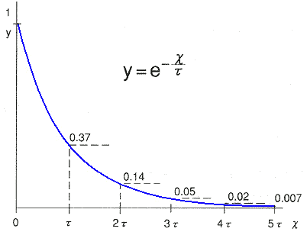
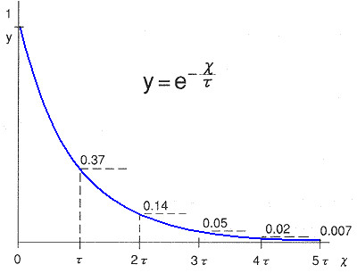
Temporal Model
Notes:
.

Slide 36
Temporal Model
the data fits very well to an exponential function with probability density function
Inter-arrival time (time between events) of a Poisson process, i.e., a process in which events occur continuously and independently at a constant average rate
  If a user detects an event at time 0, the probability of a tweet from t to Δt is fixed (λ)

Slide 37
Temporal Model
Combine data from many sensors (tweets) based on two assumptions
  false-positive ratio p_{f} of a sensor (approximately 0.35)
  sensors are assumed to be independent and identically distributed (i.i.d.)
The probability of an event occurrence at time t
n(t) total number of sensors (tweets) expected at time t

Slide 38
Temporal Model
the probability of an event occurrence at time t
  sensors at time 0 → sensors at time t
  the number of sensors at time t
expected wait time to deliver notification to achieve false positive 1% have to wait for
  parameter

Slide 39
Location Estimation
Compute the target location given a sequence of locations and an i.i.d process noise sequence
Estimate target recursively

Slide 40
Bayesian Filters for Location Estimation
Kalman Filters
  are the most widely used variant of Bayes filters
  Assume that the posterior density at every time is Gaussian, parameterized by a mean and covariance
  For earthquakes: (longitude, latitude) for typhoons also velocity
  advantages: computational efficiency
  disadvantages: being limited to accurate sensors or sensors with high update rates

Slide 41
Particle Filters
Particle Filters
  represent the probability distribution by sets of samples, or particles
  advantages: the ability to represent arbitrary probability densities
    particle filters can converge to the true posterior even in non-Gaussian, nonlinear dynamic systems.
  disadvantages: the difficulty in applying to high-dimensional estimation problems

Slide 42
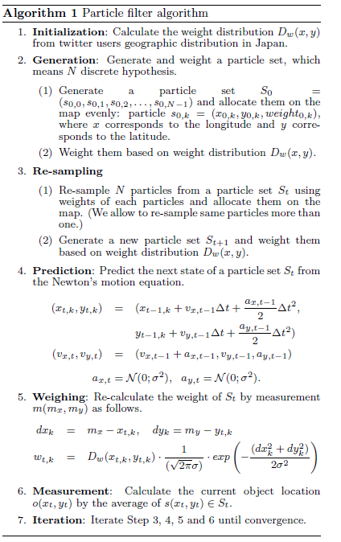
Step 1:
Sample tweets associated with locations and get user distribution proportional to the number of tweets in each region

Slide 43
Information Diffusion
Proposed spatiotemporal models need to meet one condition that
  Sensors are assumed to be independent
We check if information diffusion about target events happens because
  if an information diffusion happened among users, Twitter user sensors are not independent . They affect each other

Slide 44
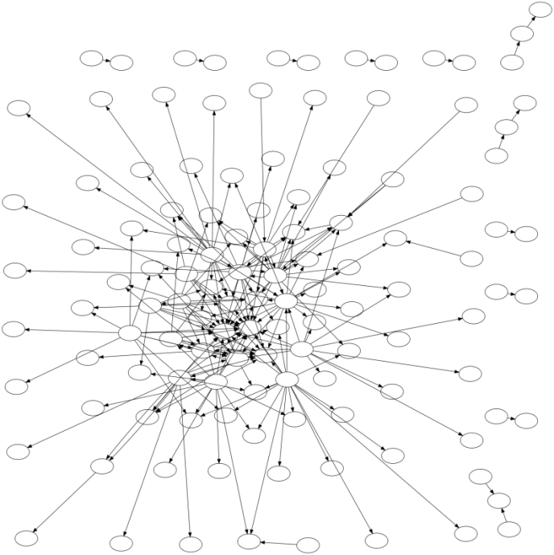
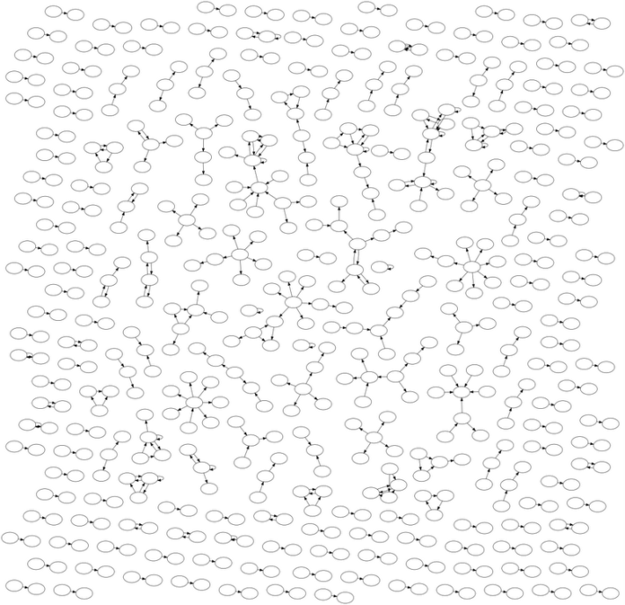
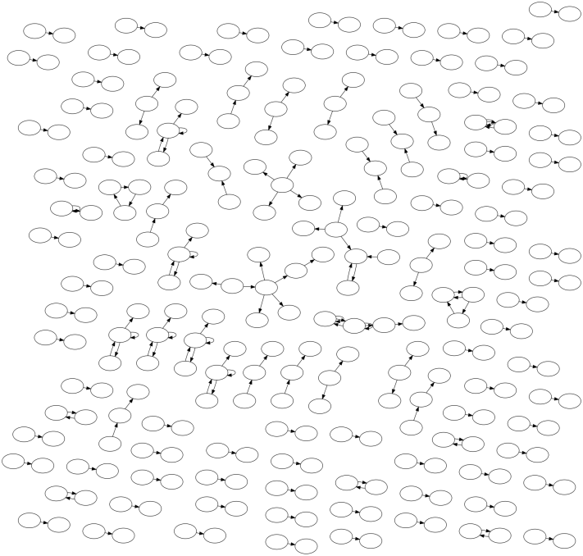
Information Flow Networks on Twitter
Nintendo DS Game
an earthquake
a typhoon
In the case of an earthquakes and a typhoons, very little information diffusion takes place on Twitter, compared to Nintendo DS Game
→ We assume that Twitter user sensors are independent about earthquakes and typhoons

Slide 45
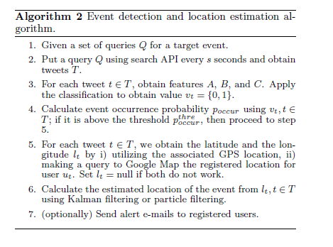
General Algorithm

Slide 46
Evaluation of Semantic Analysis
Queries
  Earthquake query: “shaking” and “earthquake”
  Typhoon query:”typhoon”
Examples to create classifier
  597 positive examples

Slide 47
Evaluation of Semantic Analysis
“earthquake” query
“shaking” query
Features | Recall | Precision | F-Value
Statistical | 87.50% | 63.64% | 73.69%
Keywords | 87.50% | 38.89% | 53.85%
Context | 50.00% | 66.67% | 57.14%
All | 87.50% | 63.64% | 73.69%
Features | Recall | Precision | F-Value
Statistical | 66.67% | 68.57% | 67.61%
Keywords | 86.11% | 57.41% | 68.89%
Context | 52.78% | 86.36% | 68.20%
All | 80.56% | 65.91% | 72.50%
Notes:
The classification performance is presented in these tables.
We obtain highest F-value when we use feature A and all features.
Surprisingly, feature B and feature C don’t contribute much to the classification performance
When an earthquake occurs, a user becomes surprised and might produce a very short tweet.
and It’s apparent that the precision is not so high as the recall.

Slide 48
Evaluation of Spatial Estimation
Target events
  earthquakes
    25 earthquakes from August 2009 to October 2009
  typhoons
    name: Melor
Baseline methods
  weighed average
    simply takes the average of latitude and longitude
  the median
    simply takes the median of latitude and longitude
We evaluate methods by distances from actual centers
  a method works better if the distance from an actual center is smaller

Slide 49
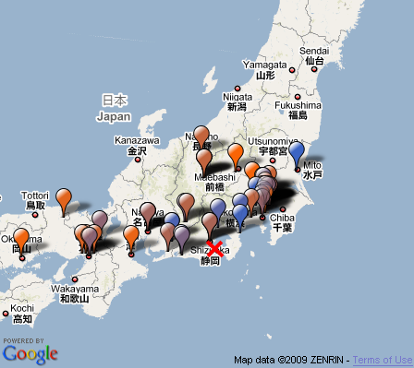
Evaluation of Spatial Estimation
balloon: each tweet
color : post time
Kyoto
Tokyo
estimation
by median
estimation
by particle filter
Osaka
actual earthquake center

Slide 50
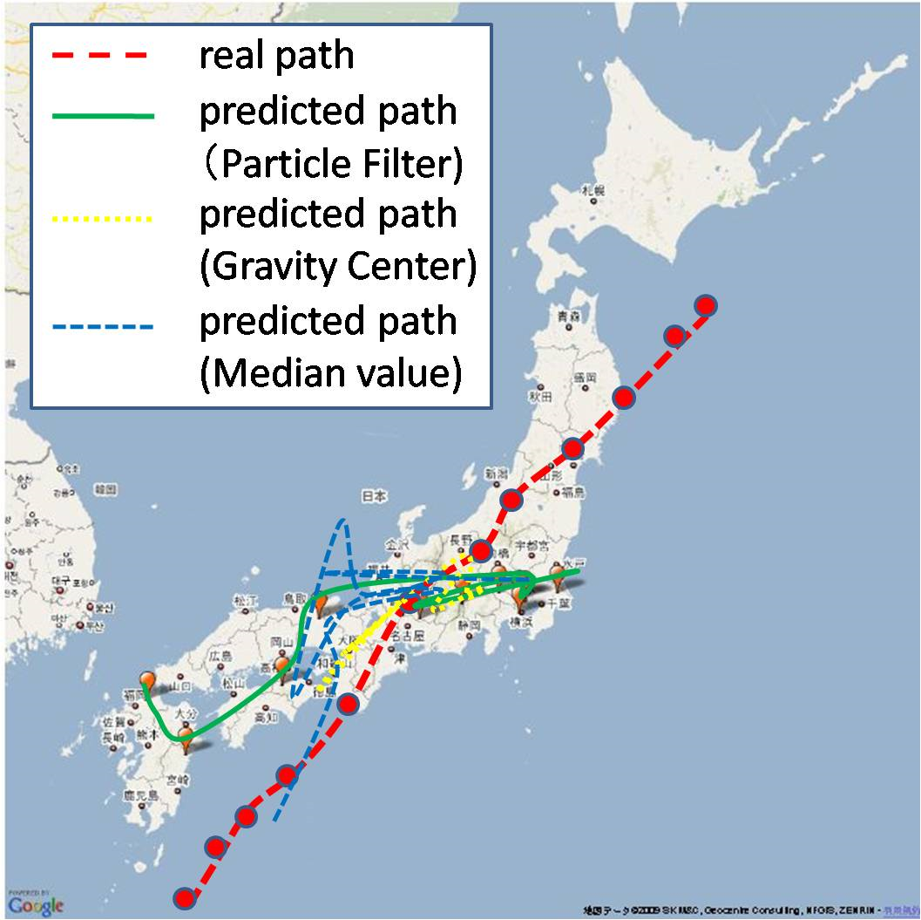
Evaluation of Spatial Estimation

Slide 51
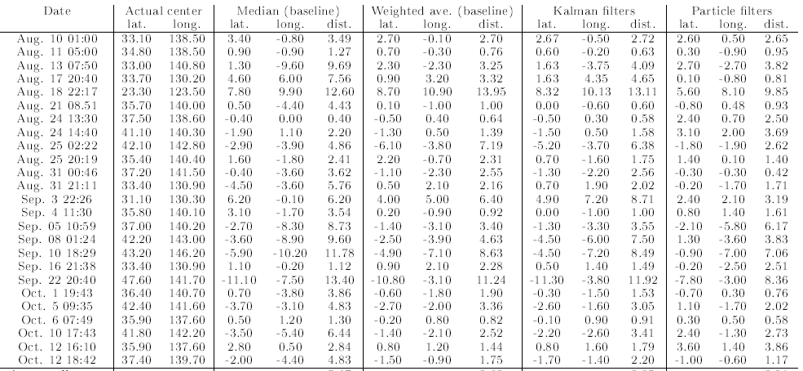
Evaluation of Spatial Estimation
Earthquakes
Date | Actual Center | Median | Weighed Average | Kalman Filter | Particle Filter
mean square errors of latitudes and longitude
Average | － | 5.47 | 3.62 | 3.85 | 3.01
Particle filters works better than other methods

Slide 52
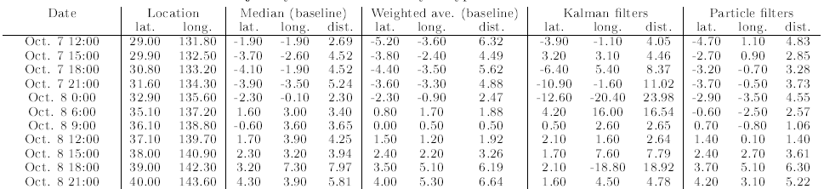
Evaluation of Spatial Estimation
A typhoon
Date | Actual Center | Median | Weighed Average | Kalman Filter | Particle Filter
mean square errors of latitudes and longitude
Average | － | 4.39 | 4.02 | 9.56 | 3.58
Particle Filters works better than other methods

Slide 53
Discussions of Experiments
Particle filters performs better than other methods
If the center of a target event is in the sea, it is more difficult to locate it precisely from tweets
It becomes more difficult to make good estimation in less populated areas

Slide 54
Earthquake Reporting System
Toretter ( http://toretter.com)
  Earthquake reporting system using the event detection algorithm
  All users can see the detection of past earthquakes
  Registered users can receive e-mails of earthquake detection reports
Dear Alice,
We have just detected an earthquake
around Chiba. Please take care.
Toretter Alert System

Slide 55
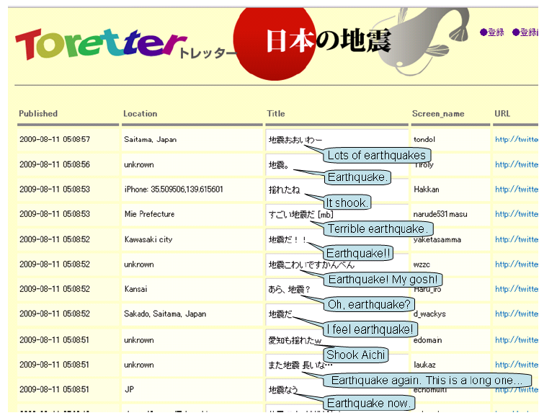
Screenshot of Toretter.com

Slide 56
Earthquake Reporting System
Effectiveness of alerts of this system
  Alert E-mails urges users to prepare for the earthquake if they are received by a user shortly before the earthquake actually arrives.
Is it possible to receive the e-mail before the earthquake actually arrives?
  An earthquake is transmitted through the earth's crust at about 3~7 km/s.
  a person has about 20~30 sec before its arrival at a point that is 100 km distant from an actual center

Slide 57
Results of Earthquake Detection
Date | Magnitude | Location | Time | E-mail sent time | time gap [sec] | # tweets within 10 minutes | Announce of JMA
Aug. 18 | 4.5 | Tochigi | 6:58:55 | 7:00:30 | 95 | 35 | 7:08
Aug. 18 | 3.1 | Suruga-wan | 19:22:48 | 19:23:14 | 26 | 17 | 19:28
Aug. 21 | 4.1 | Chiba | 8:51:16 | 8:51:35 | 19 | 52 | 8:56
Aug. 25 | 4.3 | Uraga-oki | 2:22:49 | 2:23:21 | 31 | 23 | 2:27
Aug.25 | 3.5 | Fukushima | 2:21:15 | 22:22:29 | 73 | 13 | 22:26
Aug. 27 | 3.9 | Wakayama | 17:47:30 | 17:48:11 | 41 | 16 | 1:7:53
Aug. 27 | 2.8 | Suruga-wan | 20:26:23 | 20:26:45 | 22 | 14 | 20:31
Ag. 31 | 4.5 | Fukushima | 00:45:54 | 00:46:24 | 30 | 32 | 00:51
Sep. 2 | 3.3 | Suruga-wan | 13:04:45 | 13:05:04 | 19 | 18 | 13:10
Sep. 2 | 3.6 | Bungo-suido | 17:37:53 | 17:38:27 | 34 | 3 | 17:43
In all cases, we sent E-mails before announces of JMA
In the earliest cases, we can sent E-mails in 19 sec.

Slide 58
Experiments And Evaluation
We demonstrate performances of
  tweet classification
  event detection from time-series data
  → show this results in “application”
  location estimation from a series of spatial information

Slide 59
Results of Earthquake Detection
JMA intensity scale | 2 or more | 3 or more | 4 or more
Num of earthquakes | 78 | 25 | 3
Detected | 70 (89.7%) | 24 (96.0%) | 3 (100.0%)
Promptly detected* | 53 (67.9%) | 20 (80.0%) | 3 (100.0%)
Promptly detected: detected in a minutes
JMA intensity scale: the original scale of earthquakes by Japan Meteorology Agency
Period: Aug.2009 – Sep. 2009
Tweets analyzed : 49,314 tweets
Positive tweets : 6291 tweets by 4218 users
We detected 96% of earthquakes that were stronger than scale 3 or more during the period.

Slide 60
Summary
We investigated the real-time nature of Twitter for event detection
Semantic analysis were applied to tweets classification
We consider each Twitter user as a sensor and set a problem to detect an event based on sensory observations
Location estimation methods such as Kaman filters and particle filters are used to estimate locations of events
We developed an earthquake reporting system, which is a novel approach to notify people promptly of an earthquake event
We plan to expand our system to detect events of various kinds such as rainbows, traffic jam etc.

Slide 61
Jure Leskovec, Lars Backstrom, Jon M. Kleinberg: Meme-tracking and the dynamics of the news cycle. KDD 2009: 497-506
Some slides are from Jure Leskovec’s course
“On Social Information Network Analysis”

Slide 62
Goal
  Track units of information as the evolve over time
  How? Extract textual fragments that travel relatively unchanged, through many articles:
  Look for phrases inside quotes: “…” About 1.25 quotes per document in our data
  Why it works?
  Quotes are
  integral parts of journalistic practices
  tend to follow iterations of a story as it evolves
  are attributed to individuals and have time and location

Slide 63
Approach
Item: a news article or blog post
Phrase: a quoted string that occurs in one or more items
Produce phrase clusters, which are collections of phrases that are close textual variants of one another.
Build a phrase graph where each phrase is represented by a node and directed edges connect related phrases.
Partition the graph in such a way that its components are the phrase clusters.

Slide 64
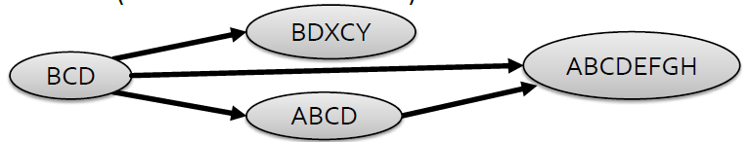
Phrase Graph
A graph G on the set of quoted phrases:
V = phrases
An edge (p, q)
p is strictly shorter than q, and
p has directed edit distance to q less than a small threshold or there is at least a k-word consecutive overlap between the phrases
Weights w(p, q): decrease with edit distance from p to q, and increase in the frequency of q in the corpus (the inclusion of p in q is supported by many occurrences of q)
G is a DAG

Slide 65
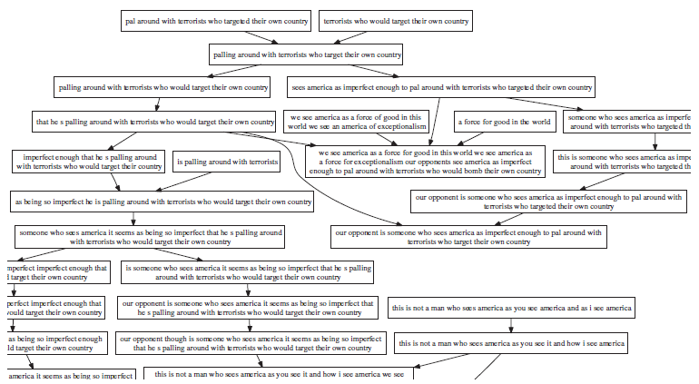
Phrase Graph
Quote: Our opponent is someone who sees America, it seems, as being so imperfect, imperfect enough that he’s palling around with terrorists who would target their own country.”

Slide 66
Phrase Graph Construction
Preprocessing:
a lower bound L on the word-length of phrases
a lower bound M on their frequency
eliminate phrases for which at least an ε fraction occurs on a single domain (produced by spammers.)

Slide 67
Phrase Graph Partitioning
Central idea: look for a collection of phrases that “belong” either to a single long phrase q, or to a single collection of phrases.
The outgoing paths from all phrases in the cluster should flow into a single root node q (node with no outgoing edges) -> look for a subgraph for which all paths terminate in a single root node.
How?
Delete edges of small total weight from the phrase graph, so it falls apart into disjoint pieces, where each piece “feeds into” a single root phrase that can serve as the exemplar for the phrase cluster.

Slide 68
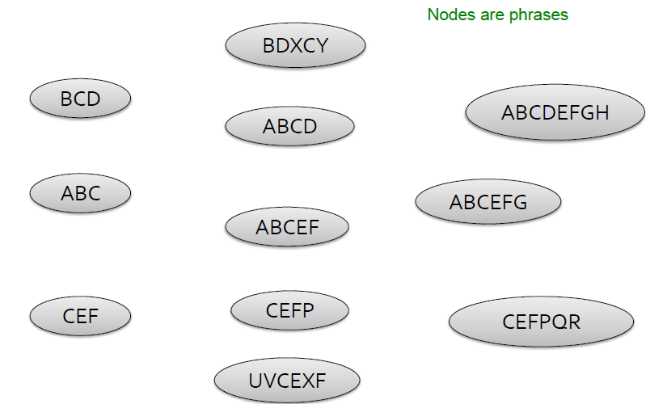
Phrase Graph

Slide 69
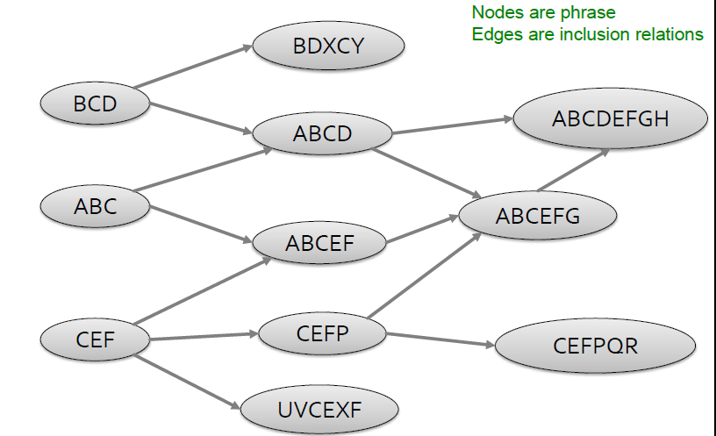
Phrase Graph

Slide 70
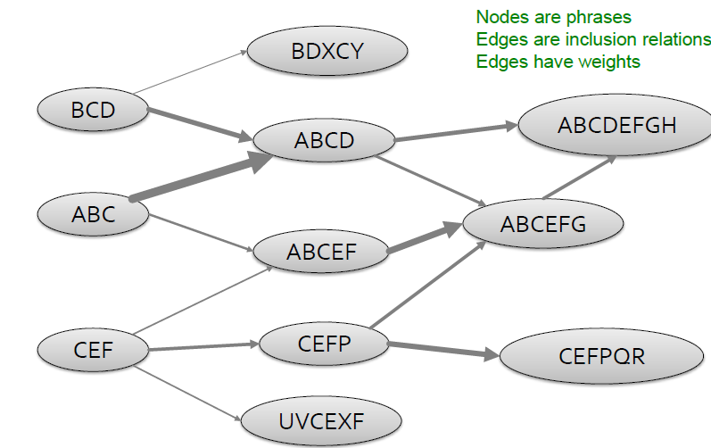
Phrase Graph

Slide 71
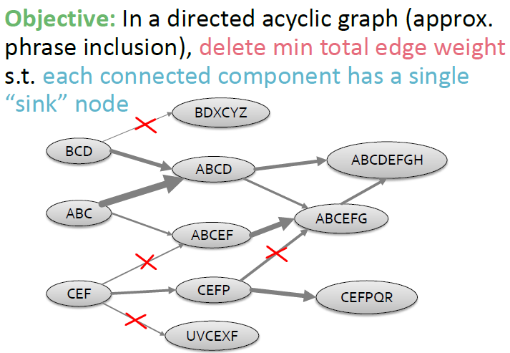
Phrase Graph

Slide 72
Phrase Graph Partitioning
The DAG Partitioning Problem: Given a directed acyclic graph with edge weights, delete a set of edges of minimum total weight so that each of the resulting components is single-rooted.
DAG Partitioning is NP-hard.

Slide 73
Phrase Graph Partitioning
In any optimal solution, there is at least one outgoing edge from each non-root node that has not been deleted.
A subgraph of the DAG where each non-root node has only a single out-edge must necessarily have single-rooted components, since the edge sets of the components will all be in-branching trees.
If for each node we happened to know just a single edge that was not deleted in the optimal solution, then the subgraph consisting of all these edges would have the same components (when viewed as node sets) as the components in the optimal solution of DAG Partitioning
It is enough to find a single edge out of each node that is included in the optimal solution to identify the optimal components.

Slide 74
Phrase Graph Partitioning Heuristic
Choose for each non-root node a single outgoing edge.
Which one?
When compared to the total amount of edge weight kept in the clusters, if a random edge out of each phrase is kept.
an edge to the shortest phrase gives 9% improvement,
an edge to the most frequent phrase gives 12%
Proceed from the roots down the DAG and greedily assign each node to the cluster to which it has the most edges (gives 13% improvement)
simulated annealing did not improve the solution

Slide 75
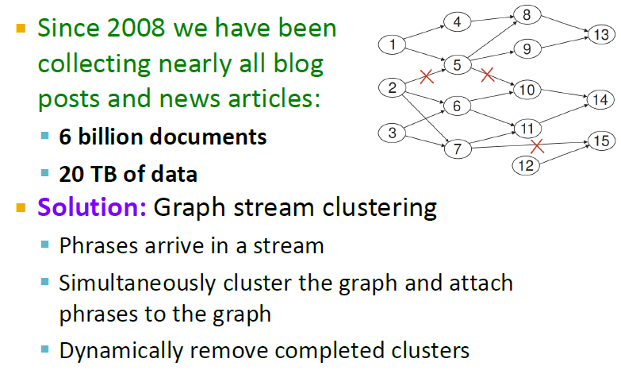
Data Set

Slide 76
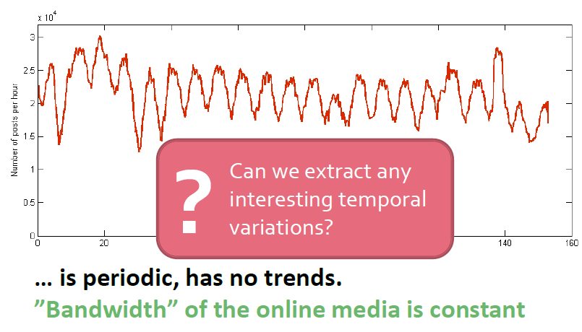
Temporal variation

Slide 77
Temporal variation
Thread associated with a given phrase cluster: the set of all items (news articles or blog posts) containing some phrase from the cluster
Track all threads over time, considering both their individual temporal dynamics as well as their interactions with one another.

Slide 78
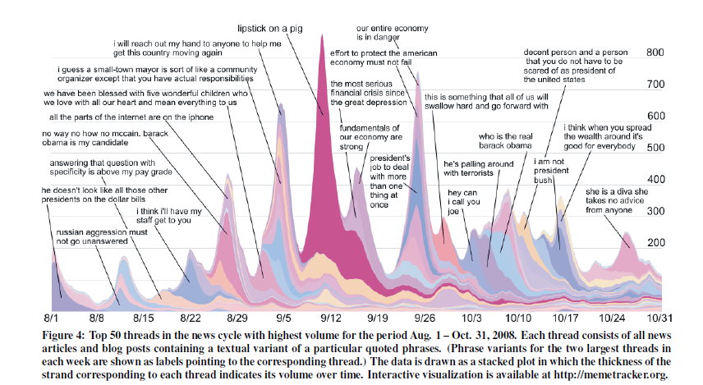
Temporal variation

Slide 79
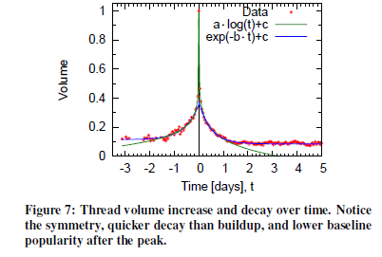
Thread volume increase and decay
Peak time of a thread: median time
one would expect the overall volume of a thread to be very low initially; then the volume would rise; and slowly decay.
But rise and drop in volume surprisingly symmetric around the peak
Two distinct types of behavior:
the volume outside an 8-hour window centered at the peak modeled by an exponential function
the 8-hour time window around the peak is best modeled by a logarithmic function

Slide 80
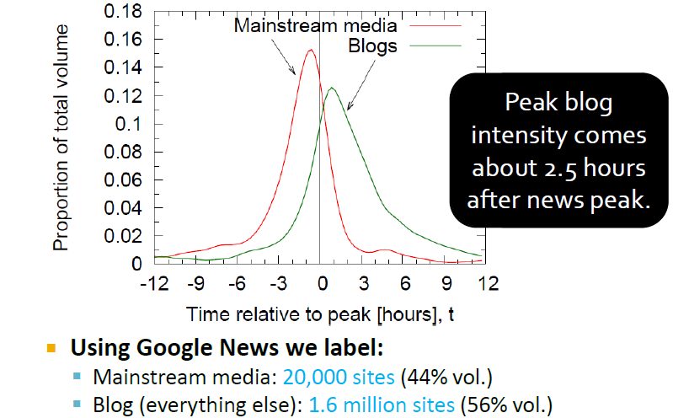
Lag between news and blogs

Slide 81
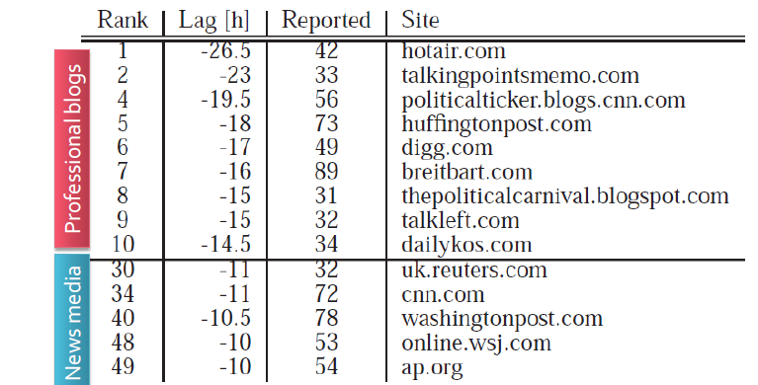
Lag of individual sites

Slide 82
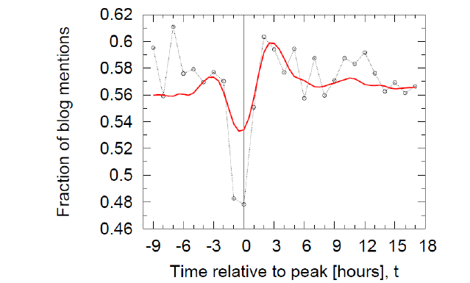
Oscillation of attention
ratio of blog volume to total volume for each thread as a function of time.
a “heartbeat”-like like dynamics where the phrase “oscillates” between blogs and mainstream media

Slide 83

Phrases discovered by blogs (3.5%)

Slide 84
Conclusions
a framework for tracking short, distinctive phrases
scalable algorithms for identifying and clustering textual variants of such phrases that scale to a collection of 90 million articles

Slide 85
Jure Leskovec, Mary McGlohon, Christos Faloutsos, Natalie S. Glance, Matthew Hurst: Patterns of Cascading Behavior in Large Blog Graphs. SDM 2007
Slides are from Jure Leskovec’s course
“On Social Information Network Analysis”

Slide 86
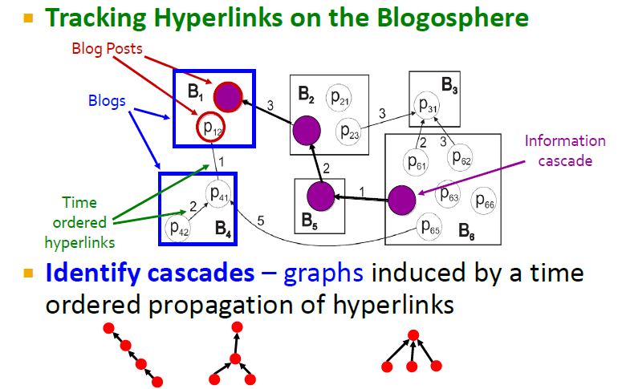

Slide 87
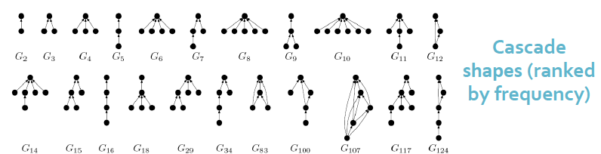

Slide 88
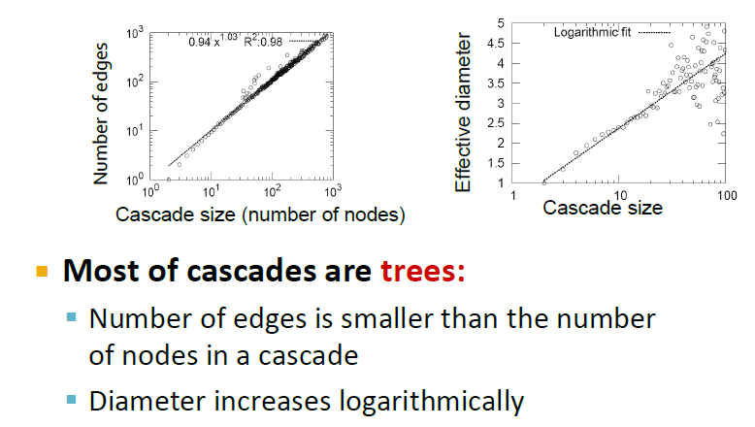

Slide 89
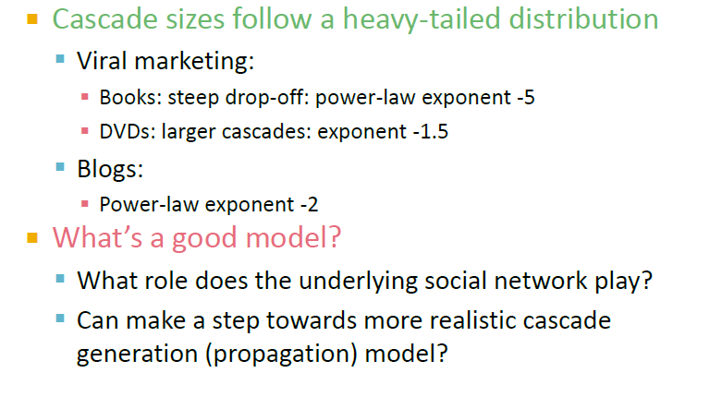

Slide 90
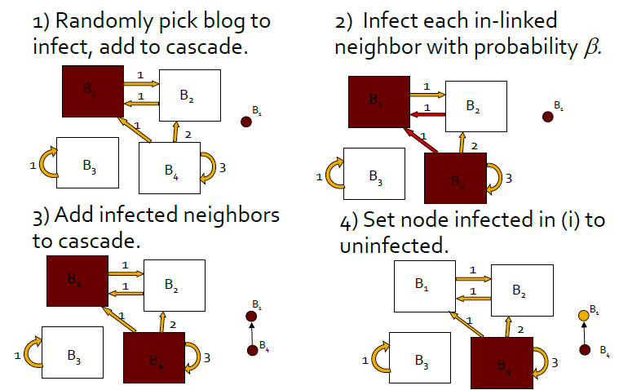

Slide 91
