Slide 1
Online Social Networks and Media
Introduction

Slide 2
Instructors:
Ευαγγελία Πιτουρά
http://www.cs.uoi.gr/~pitoura
Παναγιώτης Τσαπάρας
http://www.cs.uoi.gr/~tsap
Goal
Understand the importance of networks in life, technology and applications
Study the theory underlying social networks
Learn about algorithms that make use of network structure
Learn about the tools to analyze them
Today:
A taste of the topics to be covered
Some logistics
Some (very) basic graph theory

Slide 3
What do the Following complex Systems Have in Common?

Slide 4

The Economy

Slide 5
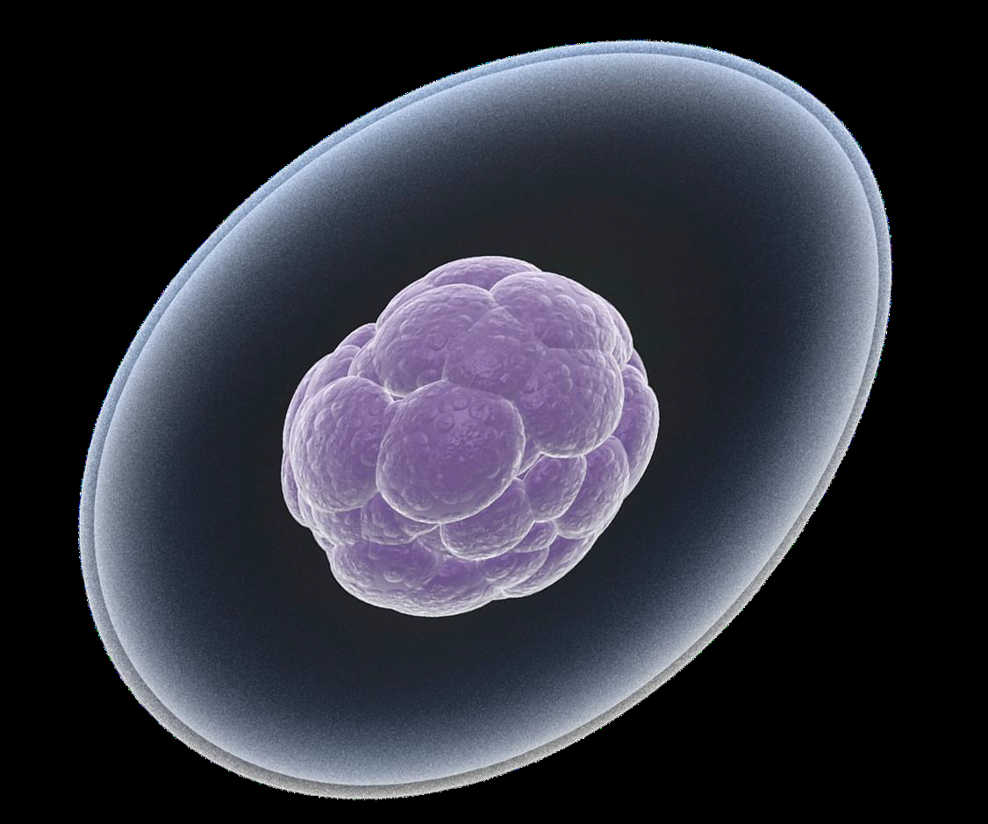
The Human Cell

Slide 6
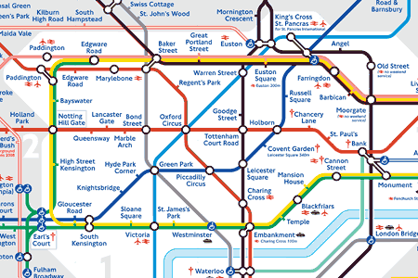
Traffic and roads

Slide 7
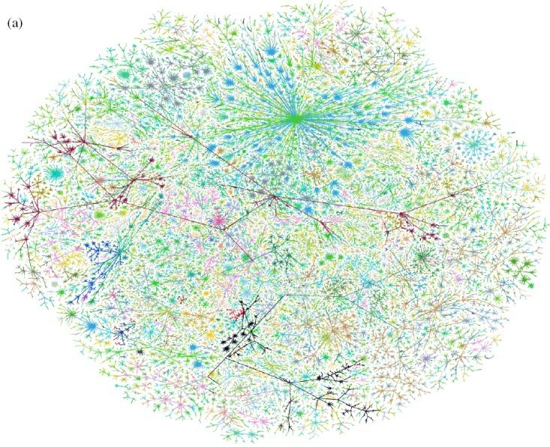
Internet

Slide 8
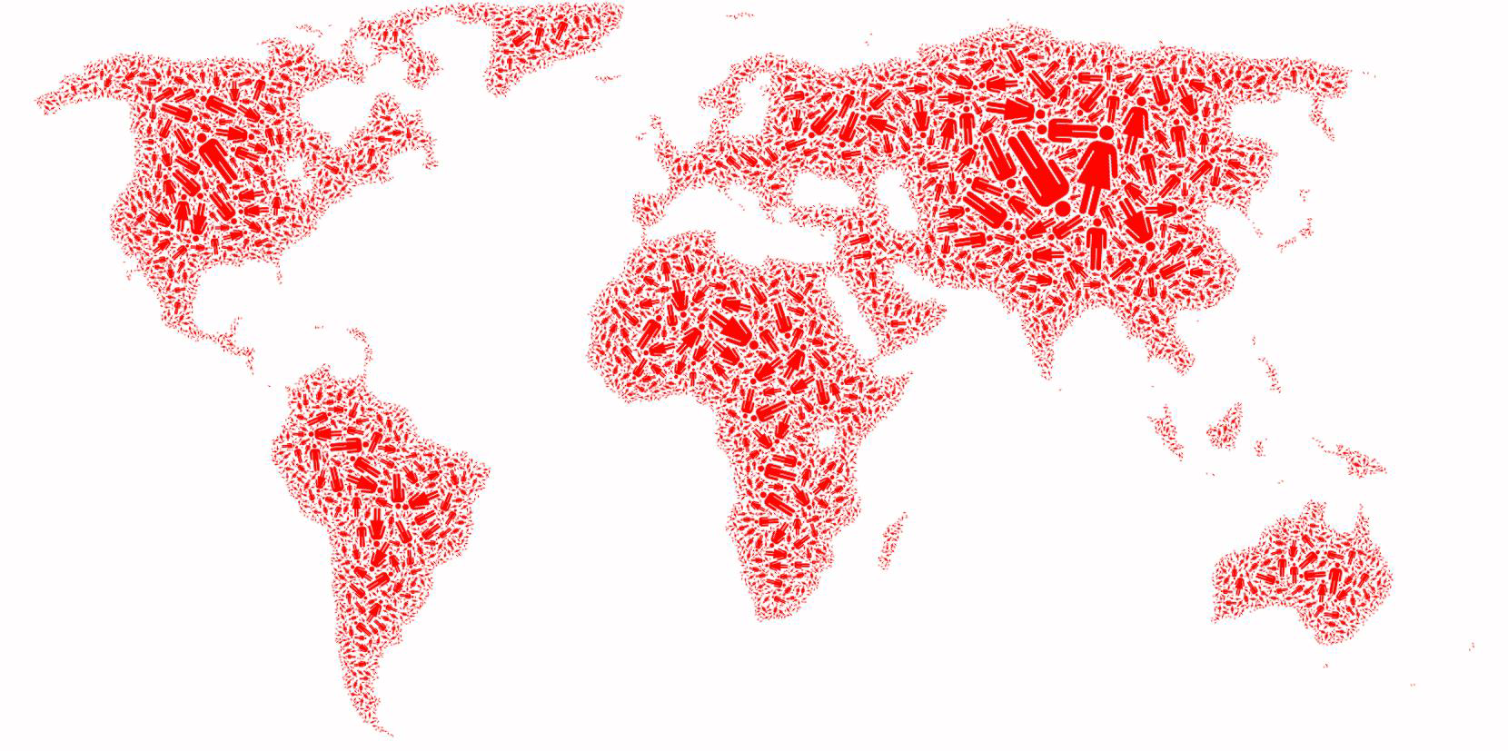
Society

Slide 9
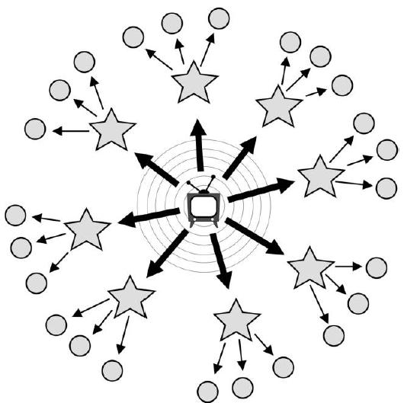
Media and Information

Slide 10
The Network!
All of these systems can be modeled as networks

Slide 11
What is a network?
Network: a collection of entities that are interconnected with links.

Slide 12
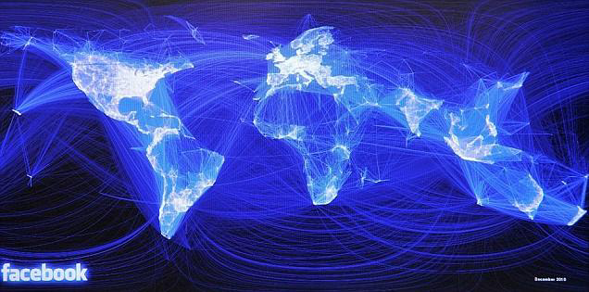
Social networks
Entities: People
Links: Friendships

Slide 13
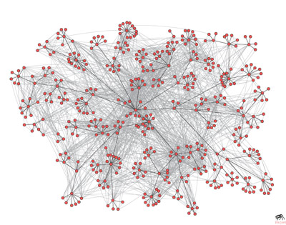
Communication networks
Entities: People
Links: email exchange

Slide 14
Cimmunication networks
Entities: Internet nodes
Links: communication between nodes

Slide 15
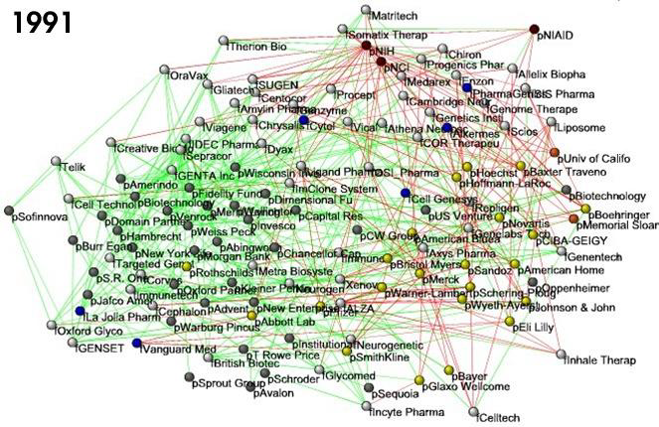
Financial Networks
Entities: Companies
Links: relationships (financial, collaboration)

Slide 16
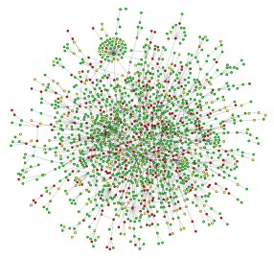
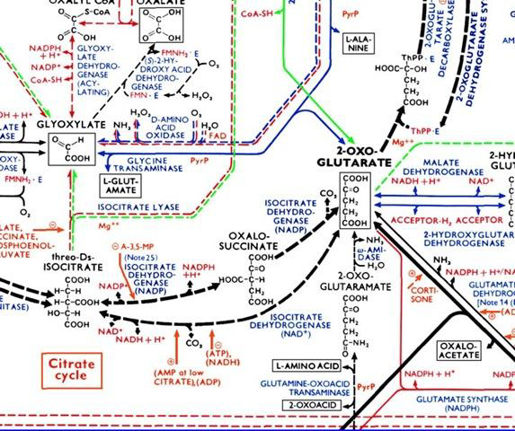
Biological networks
Entities: Proteins
Links: interactions
Entities: metabolites, enzymes
Links: chemical reactions

Slide 17
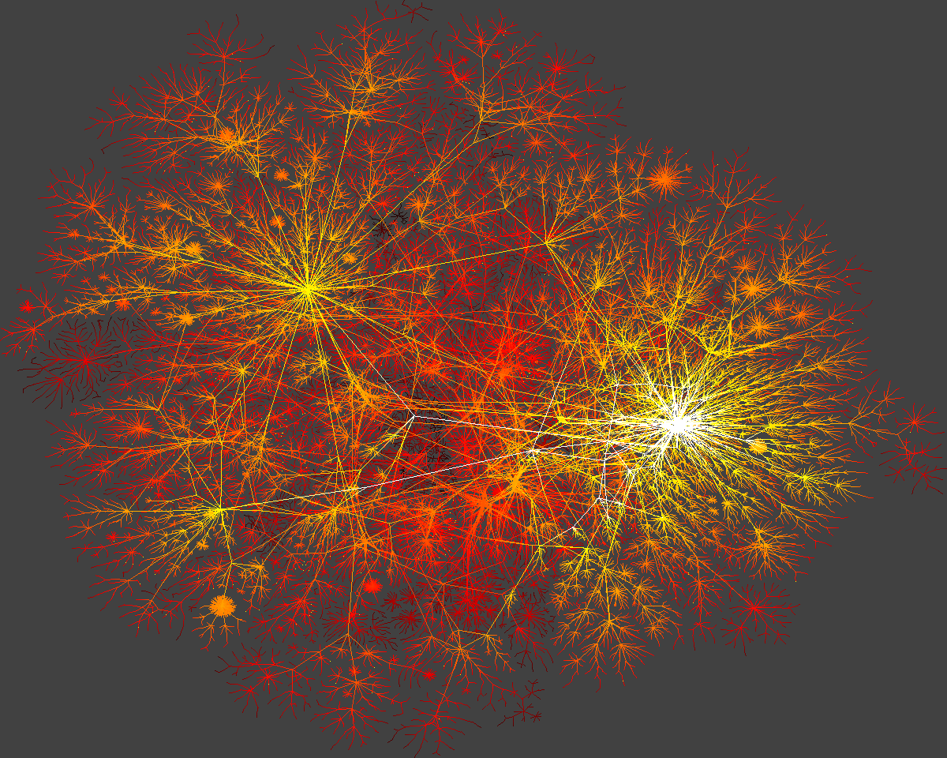
Information networks
Entities: Web Pages
Links: Links

Slide 18
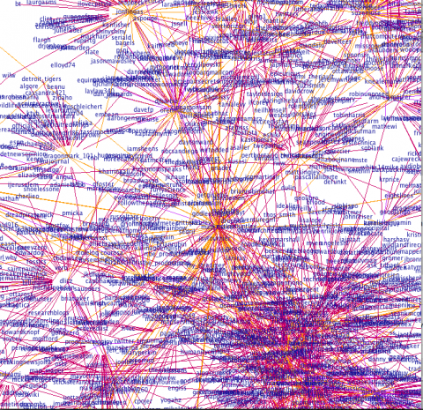
Information/Media networks
Entities: Twitter users
Links: Follows/conversations

Slide 19
Many more
Wikipedia
Brain
Highways
Software
Etc…

Slide 20
Why networks are important?
We cannot truly understand a complex network unless we understand the underlying network.
  Everything is connected, studying individual entities gives only a partial view of a system
Two main themes:
  What is the structure of the network?
  How do processes happen in the network?

Slide 21
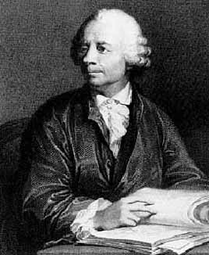
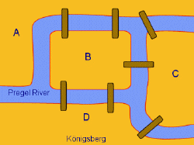
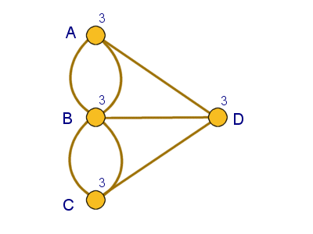
Graphs
In mathematics, networks are called graphs, the entities are nodes, and the links are edges
Graph theory starts in the 18th century, with Leonhard Euler
  The problem of Königsberg bridges
  Since then graphs have been studied extensively.

Slide 22
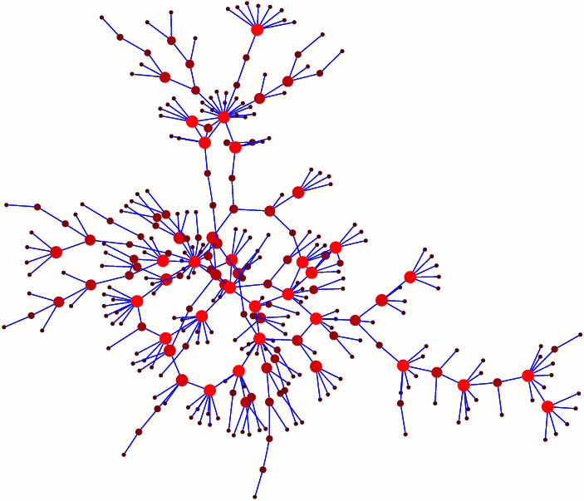
Networks in the past
Graphs have been used in the past to model existing networks (e.g., networks of highways, social networks)
  usually these networks were small
  network can be studied visual inspection can reveal a lot of information

Slide 23
Networks now
More and larger networks appear
  Products of technology
    e.g., Internet, Web, Facebook, Twitter
  Result of our ability to collect more, better, and more complex data
    e.g., gene regulatory networks
Networks of thousands, millions, or billions of nodes
  Impossible to process visually
  Problems become harder

Slide 24
Topics
Measuring Real Networks
Modeling the evolution and creation of networks
Identifying important nodes in the graph
Understanding information cascades and virus contagions
Finding communities in graphs
Link Prediction
Storing and processing huge networks
Other special topics

Slide 25
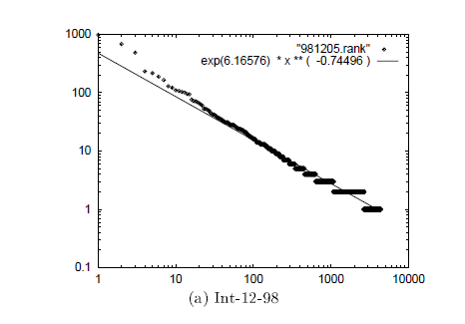
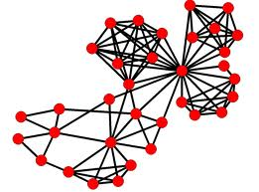
Understanding large graphs
What does a network look like?
  Measure different properties to understand the structure
degree of nodes
Triangles in the graph

Slide 26
Real network properties
Most nodes have only a small number of neighbors (degree), but there are some nodes with very high degree (power-law degree distribution)
  scale-free networks
If a node x is connected to y and z, then y and z are likely to be connected
  high clustering coefficient
Most nodes are just a few edges away on average.
  small world networks
Networks from very diverse areas (from internet to biological networks) have similar properties
  Is it possible that there is a unifying underlying generative process?

Slide 27
Generating random graphs
Classic graph theory model (Erdös-Renyi)
  each edge is generated independently with probability p
Very well studied model but:
  most vertices have about the same degree
  the probability of two nodes being linked is independent of whether they share a neighbor
  the average paths are short

Slide 28
Modeling real networks
Real life networks are not “random”
Can we define a model that generates graphs with statistical properties similar to those in real life?
The rich-get-richer model

Slide 29

Ranking of nodes on the Web
Is my home page as important as the facebook page?
We need algorithms to compute the importance of nodes in a graph
The PageRank Algorithm
  A success story of network use
It is impossible to create a web search engine without understanding the web graph

Slide 30
Information/Virus Cascade
How do viruses spread between individuals? How can we stop them?
How does information propagates in social and information networks? What items become viral? Who are the influencers and trend-setters?
We need models and algorithms to answer these questions
Online advertising relies heavily on online social networks and word-of-mouth marketing

Slide 31
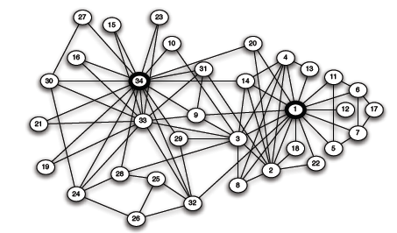
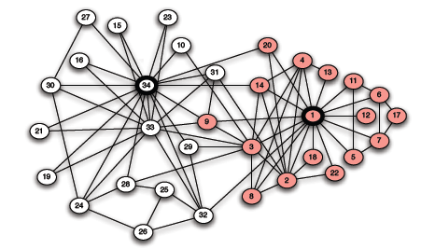
Clustering and Finding Communities
What is community?
  “Cohesive subgroups are subsets of actors among whom there are relatively strong, direct, intense, frequent, or positive ties.” [Wasserman & Faust ‘97]
Karate club example [W. Zachary, 1970]

Slide 32
Clustering and Finding Communities
Input: a graph G=(V,E)
  edge (u, v) denotes similarity between u and v
  weighted graphs: weight of edge captures the degree of similarity
Clustering: Partition the nodes in the graph such that nodes within clusters are well interconnected (high edge weights), and nodes across clusters are sparsely interconnected (low edge weights)

Slide 33
Community Evolution
Homophily:“Birds of a feather flock together”
Caused by two related social forces [Friedkin98, Lazarsfeld54]
  Social influence: People become similar to those they interact with
  Selection: People seek out similar people to interact with
Both processes contribute to homophily, but
  Social influence leads to community-wide homogeneity
  Selection leads to fragmentation of the community
Applications in online marketing
  viral marketing relies upon social influence affecting behavior
  recommender systems predict behavior based on similarity

Slide 34
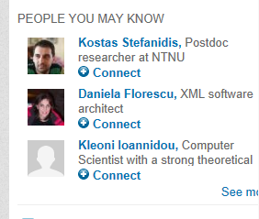

Link Prediction
Given a snapshot of a social network at time t, we seek to accurately predict the edges that will be added to the network during the interval from time t to a given future time t'.
Applications:
  Accelerate the growth of a social network (e.g., Facebook, LinkedIn, Twitter) that would otherwise take longer to form.
  Identify the structure of a criminal network

Slide 35
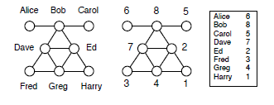
Privacy
Anonymization problem (or data publishing)
Given a network G construct an anonymized network G in which private information is hidden.
3 different entities:
users of the social network whose private data needs to be protected,
adversary or attacker that attempts to combine G with any external information that she owns or can attain to deduce private information,
benign analyst who wants to use G to extract useful information.
Analysis (Utility) vs Privacy
What do participants in an OSN consider as private information that needs to be protected?
Active vs passive attacks
Combining information from many networks
Specify and measure privacy

Slide 36
Network content
Users on online social networks generate content.
Mining the content in conjunction with the network can be useful
  Do friends post similar content on Facebook?
  Can we understand a user’s interests by looking at those of their friends?
  Can we predict a movie rating using the social network?

Slide 37
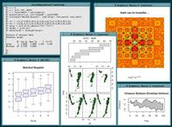


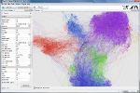

Tools
R: free software environment for statistical computing and graphics. http://www.r-project.org/
Gephi: interactive visualization and exploration platform for all kinds of networks and complex systems, dynamic and hierarchical graphs
http://gephi.org/
Stanford Network Analysis Platform (SNAP): general purpose, high performance system for analysis and manipulation of large networks written in C++ http://snap.stanford.edu/snap/index.html
NetworkX: a Python language software package for the creation, manipulation, and study of the structure, dynamics, and functions of complex networks. http://networkx.lanl.gov/

Slide 38
Frameworks for Processing Large Graphs
Large scale (in some cases billions of vertices, trillions of edges)
How to process graphs in parallel?
Write your own code
Use MapReduce (general parallel processing) *
Pregel (bulk synchronous parallel model) introduced by Google in 2010*
  Input: a (directed) graph
  In supersteps:
runs your algorithm at each vertex
until each vertex votes to halt
  Output: a (directed graph)
  Giraph http://incubator.apache.org/giraph/ (part of Hadoop software)
Storage?
*J. Dean, S. Ghemawat. MapReduce: Simplified Data Processing on Large Clusters. OSDI 2004: 137-150
** G. Malewicz, M. H. Austern, A. J. C. Bik, J. C. Dehnert, I. Horn, N. Leiser: Pregel: a system for large-scale graph processing. SIGMOD Conference 2010: 135-146

Slide 39
Data
Collected using available APIs (Twitter, Facebook, etc)
Using existing collections, e.g., from SNAP (more in the webpage), permission may be required
Stanford Large Network Dataset Collection
60 large social and information network datasets
Coauthorship and Citation Networks
DBLP: Collaboration network of computer scientists
KDD Cup Dataset
Internet Topology
AS Graphs: AS-level connectivities inferred from Oregon route-views, Looking glass data and Routing registry data
Yelp Data
Yelp Review Data: reviews of the 250 closest businesses for 30 universities for students and academics to explore and research
Youtube dataset
Youtube data: YouTube videos as nodes. Edge a->b means video b is in the related video list (first 20 only) of a video a.
Amazon product copurchasing networks and metadata
Amazon Data: The data was collected by crawling Amazon website and contains product metadata and review information about 548,552 different products (Books, music CDs, DVDs and VHS video tapes).
Wikipedia
Wikipedia page to page link data: A list of all page-to-page links in Wikipedia
DBPedia: The DBpedia data set uses a large multi-domain ontology which has been derived from Wikipedia.
Edits and talks: Complete edit history (all revisions, all pages) of Wikipedia since its inception till January 2008.
Movie Ratings
IMDB database: Movie ratings from IMDB
User rating data: Movie ratings from MovieLens

Slide 40
Logistics
Textbooks:
Easley and Kleinberg free text on Networks, Crowds and Markets
M. E. J. Newman, The structure and function of complex networks, SIAM Reviews, 45(2): 167-256, 2003
Web page:
www.cs.uoi.gr/~tsap/teaching/cs-l14
25% Presentations and class participation
25% Assignments
50% Term Project (in 2 Phases)
No Final Exam

Slide 41
Graph Theory Reminder

Slide 42
Graph Theory
Graph G=(V,E)
  V = set of vertices (nodes)
  E = set of edges
2
1
3
undirected graph
E={(1,2),(1,3),(2,3),(3,4),(4,5)}
5
4

Slide 43
Graph Theory
Graph G=(V,E)
  V = set of vertices (nodes)
  E = set of edges
2
1
3
directed graph
E={‹1,2›, ‹2,1› ‹1,3›, ‹3,2›, ‹3,4›, ‹4,5›}
5
4

Slide 44
Undirected graph
2
degree d(i) of node i
  number of edges incident on node i
1
degree sequence
  [d(i),d(2),d(3),d(4),d(5)]
  [2,2,3,2,1]
3
degree distribution
  [(1:1),(2:3),(3,1)]
5
4

Slide 45
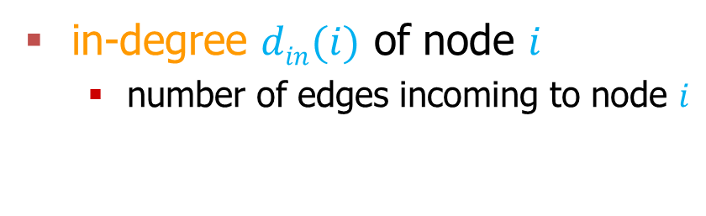
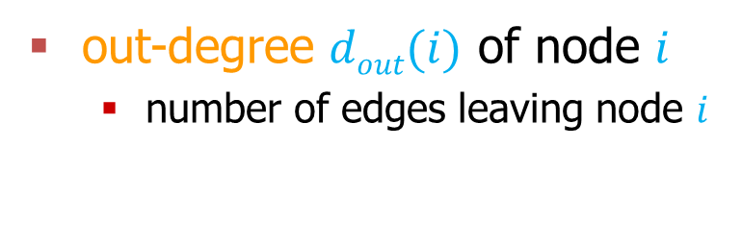
Directed Graph
in-degree $din(i)$ of node $i$
  number of edges incoming to node $i$
2
out-degree $dout(i)$ of node $i$
  number of edges leaving node $i$
1
3
in-degree sequence
  [1,2,1,1,1]
out-degree sequence
  [2,1,2,1,0]
in-degree distribution
  [(1:3),(2:1)]
out-degree distribution
  [(0:1),(1:2),(2:2)]
5
4

Slide 46
Paths
Path from node i to node j: a sequence of edges (directed or undirected) from node i to node j
  path length: number of edges on the path
  nodes i and j are connected
  cycle: a path that starts and ends at the same node
2
2
1
1
3
3
5
4
5
4

Slide 47
Shortest Paths
Shortest Path from node i to node j
  also known as BFS path, or geodesic path
2
2
1
1
3
3
5
4
5
4

Slide 48
Diameter
The longest shortest path in the graph
2
2
1
1
3
3
5
4
5
4

Slide 49
Undirected graph
Connected graph: a graph where there every pair of nodes is connected
Disconnected graph: a graph that is not connected
Connected Components: subsets of vertices that are connected
2
1
3
5
4

Slide 50
Fully Connected Graph
Clique K_{n}
A graph that has all possible n(n-1)/2 edges
2
1
3
5
4

Slide 51
Directed Graph
2
Strongly connected graph: there exists a path from every i to every j
1
Weakly connected graph: If edges are made to be undirected the graph is connected
3
5
4

Slide 52
Subgraphs
Subgraph: Given V’ ⊆ V, and E’ ⊆ E, the graph G’=(V’,E’) is a subgraph of G.
Induced subgraph: Given V’ ⊆ V, let E’ ⊆ E is the set of all edges between the nodes in V’. The graph G’=(V’,E’), is an induced subgraph of G
2
1
3
5
4

Slide 53
Trees
Connected Undirected graphs without cycles
2
1
3
5
4

Slide 54
Bipartite graphs
Graphs where the set of nodes V can be partitioned into two sets L and R, such that there are edges only between nodes in L and R, and there is no edge within L or R

Slide 55
Graph Representation
Adjacency Matrix
  symmetric matrix for undirected graphs
2
1
3
5
4

Slide 56
Graph Representation
Adjacency Matrix
  unsymmetric matrix for undirected graphs
2
1
3
5
4

Slide 57
Graph Representation
Adjacency List
  For each node keep a list with neighboring nodes
2
1: [2, 3]
2: [1, 3]
3: [1, 2, 4]
4: [3, 5]
5: [4]
1
3
5
4

Slide 58
Graph Representation
Adjacency List
  For each node keep a list of the nodes it points to
2
1: [2, 3]
2: [1]
3: [2, 4]
4: [5]
5: [null]
1
3
5
4

Slide 59
P and NP
P: the class of problems that can be solved in polynomial time
NP: the class of problems that can be verified in polynomial time, but there is no known solution in polynomial time
NP-hard: problems that are at least as hard as any problem in NP

Slide 60
Acknowledgements
Thanks to Jure Leskovec for borrowing some of the material from his course notes.
M. E. J. Newman, The structure and function of complex networks, SIAM Reviews, 45(2): 167-256, 2003

