Slide 1
DATA MINING LECTURE 9
Classification
Decision Trees
Evaluation

Slide 2
Illustrating Classification Task

Slide 3
Examples of Classification Task
Predicting tumor cells as benign or malignant
Classifying credit card transactions as legitimate or fraudulent
Categorizing news stories as finance, weather, entertainment, sports, etc
Identifying spam email, spam web pages, adult content
Categorizing web users, and web queries

Slide 4
Evaluation of classification models
Counts of test records that are correctly (or incorrectly) predicted by the classification model
Confusion matrix
Predicted Class
 | Class = 1 | Class = 0
Class = 1 | f₁₁ | f₁₀
Class = 0 | f₀₁ | f₀₀
Actual Class

Slide 5
Example of a Decision Tree
categorical
categorical
continuous
class
Splitting Attributes
Refund
Yes
No
NO
MarSt
Single, Divorced
Married
TaxInc
NO
< 80K
> 80K
NO
YES
Training Data
Model: Decision Tree

Slide 6
Apply Model to Test Data
Test Data
Start from the root of tree.
Refund
Yes
No
NO
MarSt
Single, Divorced
Married
TaxInc
NO
< 80K
> 80K
NO
YES

Slide 7
Apply Model to Test Data
Test Data
Refund
Yes
No
NO
MarSt
Single, Divorced
Married
TaxInc
NO
< 80K
> 80K
NO
YES

Slide 8
Apply Model to Test Data
Test Data
Refund
Yes
No
NO
MarSt
Single, Divorced
Married
TaxInc
NO
< 80K
> 80K
NO
YES

Slide 9
Apply Model to Test Data
Test Data
Refund
Yes
No
NO
MarSt
Single, Divorced
Married
TaxInc
NO
< 80K
> 80K
NO
YES

Slide 10
Apply Model to Test Data
Test Data
Refund
Yes
No
NO
MarSt
Single, Divorced
Married
TaxInc
NO
< 80K
> 80K
NO
YES

Slide 11
Apply Model to Test Data
Test Data
Refund
Yes
No
NO
MarSt
Single, Divorced
Married
Assign Cheat to “No”
TaxInc
NO
< 80K
> 80K
NO
YES

Slide 12
Decision Tree Classification Task
Decision Tree

Slide 13
Decision Tree Induction
Many Algorithms:
Hunt’s Algorithm (one of the earliest)
CART
ID3, C4.5
SLIQ,SPRINT

Slide 14
General Structure of Hunt’s Algorithm
Let D_{t} be the set of training records that reach a node t
General Procedure:
If D_{t} contains records that belong the same class y_{t}, then t is a leaf node labeled as y_{t}
If D_{t} is an empty set, then t is a leaf node labeled by the default class, y_{d}
If D_{t} contains records that belong to more than one class, use an attribute test to split the data into smaller subsets.
Recursively apply the procedure to each subset.
D_{t}
?

Slide 15
Constructing decision-trees (pseudocode)
GenDecTree(Sample S, Features F)
If stopping_condition(S,F) = true then
leaf = createNode()
leaf.label= Classify(S)
return leaf
root = createNode()
root.test_condition = findBestSplit(S,F)
V = {v| v a possible outcome of root.test_condition}
for each value vєV:
S_{v}: = {s | root.test_condition(s) = v and s є S};
child = TreeGrowth(S_{v} ,F) ;
Add child as a descent of root and label the edge (root→child) as v
return root

Slide 16
Tree Induction
Greedy strategy.
At each node pick the best split
How to determine the best split?
Find the split that minimizes impurity
How to decide when to stop splitting?

Slide 17
How to determine the Best Split
Greedy approach:
Nodes with homogeneous class distribution are preferred
Need a measure of node impurity:
Non-homogeneous,
High degree of impurity
Homogeneous,
Low degree of impurity

Slide 18
Measuring Node Impurity
p(i|t): fraction of records associated with node t belonging to class i

Slide 19
Gain
Gain of an attribute split: compare the impurity of the parent node with the impurity of the child nodes
Maximizing the gain ⇔ Minimizing the weighted average impurity measure of children nodes
If I() = Entropy(), then Δ_{info} is called information gain

Slide 20
Splitting based on impurity
Impurity measures favor attributes with large number of values
A test condition with large number of outcomes may not be desirable
# of records in each partition is too small to make predictions

Slide 21
Gain Ratio
Gain Ratio:
Parent Node, p is split into k partitions
n_{i} is the number of records in partition i
Adjusts Information Gain by the entropy of the partitioning (SplitINFO). Higher entropy partitioning (large number of small partitions) is penalized!
Used in C4.5
Designed to overcome the disadvantage of Information Gain

Slide 22
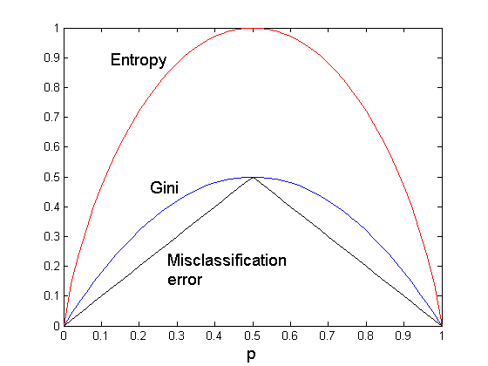
Comparison among Splitting Criteria
For a 2-class problem:
The different impurity measures are consistent

Slide 23
Stopping Criteria for Tree Induction
Stop expanding a node when all the records belong to the same class
Stop expanding a node when all the records have similar attribute values
Early termination (to be discussed later)

Slide 24
Decision Tree Based Classification
Advantages:
Inexpensive to construct
Extremely fast at classifying unknown records
Easy to interpret for small-sized trees
Accuracy is comparable to other classification techniques for many simple data sets

Slide 25
Example: C4.5
Simple depth-first construction.
Uses Information Gain
Sorts Continuous Attributes at each node.
Needs entire data to fit in memory.
Unsuitable for Large Datasets.
Needs out-of-core sorting.
You can download the software from: http://www.cse.unsw.edu.au/~quinlan/c4.5r8.tar.gz

Slide 26
Other Issues
Data Fragmentation
Search Strategy
Expressiveness
Tree Replication

Slide 27
Data Fragmentation
Number of instances gets smaller as you traverse down the tree
Number of instances at the leaf nodes could be too small to make any statistically significant decision

Slide 28
Search Strategy
Finding an optimal decision tree is NP-hard
The algorithm presented so far uses a greedy, top-down, recursive partitioning strategy to induce a reasonable solution
Other strategies?
Bottom-up
Bi-directional

Slide 29
Expressiveness
Decision tree provides expressive representation for learning discrete-valued function
But they do not generalize well to certain types of Boolean functions
Example: parity function:
Class = 1 if there is an even number of Boolean attributes with truth value = True
Class = 0 if there is an odd number of Boolean attributes with truth value = True
For accurate modeling, must have a complete tree
Not expressive enough for modeling continuous variables
Particularly when test condition involves only a single attribute at-a-time

Slide 30
Decision Boundary
Border line between two neighboring regions of different classes is known as decision boundary
Decision boundary is parallel to axes because test condition involves a single attribute at-a-time
The type of decision boundary of the classifier captures the expressiveness of the classifier

Slide 31
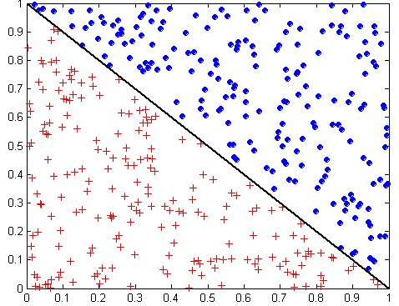
Oblique Decision Trees
x + y < 1
Class = +
Class =
Test condition may involve multiple attributes
More expressive representation
Finding optimal test condition is computationally expensive

Slide 32
Tree Replication
Same subtree appears in multiple branches

Slide 33
Practical Issues of Classification
Underfitting and Overfitting
Missing Values
Costs of Classification

Slide 34
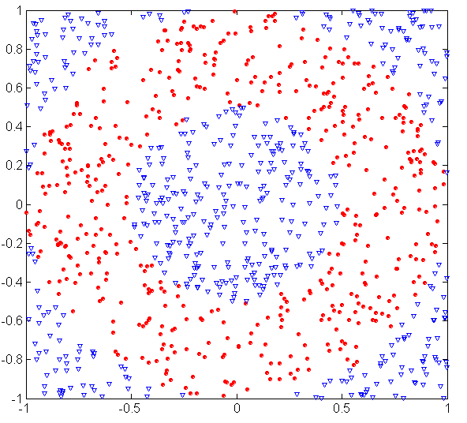
Underfitting and Overfitting (Example)
500 circular and 500 triangular data points.
Circular points:
0.5 ≤ sqrt(x₁²+x₂²) ≤ 1
Triangular points:
sqrt(x₁²+x₂²) > 0.5 or
sqrt(x₁²+x₂²) < 1

Slide 35
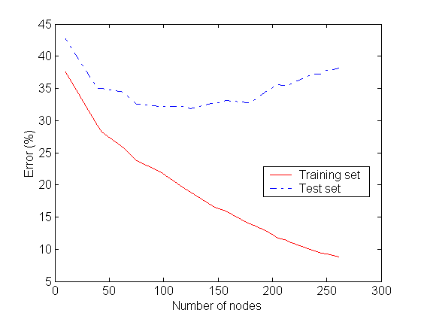
Underfitting and Overfitting
Overfitting
Underfitting: when model is too simple, both training and test errors are large

Slide 36
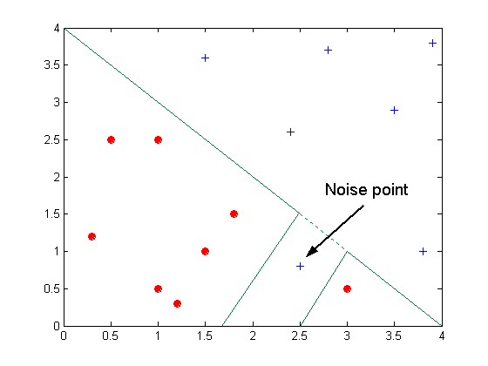
Overfitting due to Noise
Decision boundary is distorted by noise point

Slide 37
Overfitting due to Insufficient Examples
Lack of data points in the lower half of the diagram makes it difficult to predict correctly the class labels of that region
- Insufficient number of training records in the region causes the decision tree to predict the test examples using other training records that are irrelevant to the classification task

Slide 38
Notes on Overfitting
Overfitting results in decision trees that are more complex than necessary
Training error no longer provides a good estimate of how well the tree will perform on previously unseen records
The model does not generalize well
Need new ways for estimating errors

Slide 39
Estimating Generalization Errors
Re-substitution errors: error on training (Σ e(t) )
Generalization errors: error on testing (Σ e’(t))
Methods for estimating generalization errors:
Optimistic approach: e’(t) = e(t)
Pessimistic approach:
For each leaf node: e’(t) = (e(t)+0.5)
Total errors: e’(T) = e(T) + N × 0.5 (N: number of leaf nodes)
For a tree with 30 leaf nodes and 10 errors on training (out of 1000 instances): Training error = 10/1000 = 1%
Generalization error = (10 + 30×0.5)/1000 = 2.5%
Reduced error pruning (REP):
uses validation dataset to estimate generalization error
Validation set reduces the amount of training data.

Slide 40
Occam’s Razor
Given two models of similar generalization errors, one should prefer the simpler model over the more complex model
For complex models, there is a greater chance that it was fitted accidentally by errors in data
Therefore, one should include model complexity when evaluating a model

Slide 41
Minimum Description Length (MDL)
Cost(Model,Data) = Cost(Data|Model) + Cost(Model)
Cost is the number of bits needed for encoding.
Search for the least costly model.
Cost(Data|Model) encodes the misclassification errors.
Cost(Model) uses node encoding (number of children) plus splitting condition encoding.

Slide 42
How to Address Overfitting
Pre-Pruning (Early Stopping Rule)
Stop the algorithm before it becomes a fully-grown tree
Typical stopping conditions for a node:
Stop if all instances belong to the same class
Stop if all the attribute values are the same
More restrictive conditions:
Stop if number of instances is less than some user-specified threshold
Stop if class distribution of instances are independent of the available features (e.g., using χ ² test)
Stop if expanding the current node does not improve impurity measures (e.g., Gini or information gain).

Slide 43
How to Address Overfitting…
Post-pruning
Grow decision tree to its entirety
Trim the nodes of the decision tree in a bottom-up fashion
If generalization error improves after trimming, replace sub-tree by a leaf node.
Class label of leaf node is determined from majority class of instances in the sub-tree
Can use MDL for post-pruning

Slide 44
Example of Post-Pruning
Training Error (Before splitting) = 10/30
Pessimistic error = (10 + 0.5)/30 = 10.5/30
Training Error (After splitting) = 9/30
Pessimistic error (After splitting)
= (9 + 4 × 0.5)/30 = 11/30
PRUNE!
Class = Yes | 20
Class = No | 10
Error = 10/30
Class = Yes | 8
Class = No | 4
Class = Yes | 3
Class = No | 4
Class = Yes | 4
Class = No | 1
Class = Yes | 5
Class = No | 1

Slide 45
Handling Missing Attribute Values
Missing values affect decision tree construction in three different ways:
Affects how impurity measures are computed
Affects how to distribute instance with missing value to child nodes
Affects how a test instance with missing value is classified

Slide 46
Computing Impurity Measure
Before Splitting: Entropy(Parent) = -0.3 log(0.3)-(0.7)log(0.7) = 0.8813
Split on Refund:
Entropy(Refund=Yes) = 0
Entropy(Refund=No) = -(2/6)log(2/6) – (4/6)log(4/6) = 0.9183
Entropy(Children) = 0.3 (0) + 0.6 (0.9183) = 0.551
Gain = 0.9 × (0.8813 – 0.551) = 0.3303
Missing value

Slide 47
Distribute Instances
Refund
Yes
No
Probability that Refund=Yes is 3/9
Probability that Refund=No is 6/9
Assign record to the left child with weight = 3/9 and to the right child with weight = 6/9
Refund
Yes
No

Slide 48
Classify Instances
New record:
 | Married | Single | Divorced | Total
Class=No | 3 | 1 | 0 | 4
Class=Yes | 6/9 | 1 | 1 | 2.67
Total | 3.67 | 2 | 1 | 6.67
Refund
Yes
No
NO
MarSt
Single, Divorced
Married
Probability that Marital Status = Married is 3.67/6.67
Probability that Marital Status ={Single,Divorced} is 3/6.67
TaxInc
NO
< 80K
> 80K
NO
YES

Slide 49
Model Evaluation
Metrics for Performance Evaluation
How to evaluate the performance of a model?
Methods for Performance Evaluation
How to obtain reliable estimates?
Methods for Model Comparison
How to compare the relative performance among competing models?

Slide 50
Model Evaluation
Metrics for Performance Evaluation
How to evaluate the performance of a model?
Methods for Performance Evaluation
How to obtain reliable estimates?
Methods for Model Comparison
How to compare the relative performance among competing models?

Slide 51
Metrics for Performance Evaluation
Focus on the predictive capability of a model
Rather than how fast it takes to classify or build models, scalability, etc.
Confusion Matrix:
 | PREDICTED CLASS
ACTUAL CLASS |  | Class=Yes | Class=No
 | Class=Yes | a | b
 | Class=No | c | d
a: TP (true positive)
b: FN (false negative)
c: FP (false positive)
d: TN (true negative)

Slide 52
Metrics for Performance Evaluation…
 | PREDICTED CLASS
ACTUAL CLASS |  | Class=Yes | Class=No
 | Class=Yes | a (TP) | b (FN)
 | Class=No | c (FP) | d (TN)
Most widely-used metric:

Slide 53
Limitation of Accuracy
Consider a 2-class problem
Number of Class 0 examples = 9990
Number of Class 1 examples = 10
If model predicts everything to be class 0, accuracy is 9990/10000 = 99.9 %
Accuracy is misleading because model does not detect any class 1 example

Slide 54
Cost Matrix
 | PREDICTED CLASS
ACTUAL CLASS | C(i|j) | Class=Yes | Class=No
 | Class=Yes | C(Yes|Yes) | C(No|Yes)
 | Class=No | C(Yes|No) | C(No|No)
C(i|j): Cost of misclassifying class j example as class i

Slide 55
Computing Cost of Classification
Cost Matrix | PREDICTED CLASS
ACTUAL CLASS | C(i|j) | + | -
 | + | -1 | 100
 | - | 1 | 0
Model M₁ | PREDICTED CLASS
ACTUAL CLASS |  | + | -
 | + | 150 | 40
 | - | 60 | 250
Model M₂ | PREDICTED CLASS
ACTUAL CLASS |  | + | -
 | + | 250 | 45
 | - | 5 | 200
Accuracy = 80%
Cost = 3910
Accuracy = 90%
Cost = 4255

Slide 56
Cost vs Accuracy
Count | PREDICTED CLASS
ACTUAL CLASS |  | Class=Yes | Class=No
 | Class=Yes | a | b
 | Class=No | c | d
Accuracy is proportional to cost if 1. C(Yes|No)=C(No|Yes) = q 2. C(Yes|Yes)=C(No|No) = p
N = a + b + c + d
Accuracy = (a + d)/N
Cost = p (a + d) + q (b + c)
= p (a + d) + q (N – a – d)
= q N – (q – p)(a + d)
= N [q – (q-p) × Accuracy]
Cost | PREDICTED CLASS
ACTUAL CLASS |  | Class=Yes | Class=No
 | Class=Yes | p | q
 | Class=No | q | p

Slide 57
Cost-Sensitive Measures
Precision is biased towards C(Yes|Yes) & C(Yes|No)
Recall is biased towards C(Yes|Yes) & C(No|Yes)
F-measure is biased towards all except C(No|No)

Slide 58
Model Evaluation
Metrics for Performance Evaluation
How to evaluate the performance of a model?
Methods for Performance Evaluation
How to obtain reliable estimates?
Methods for Model Comparison
How to compare the relative performance among competing models?

Slide 59
Methods for Performance Evaluation
How to obtain a reliable estimate of performance?
Performance of a model may depend on other factors besides the learning algorithm:
Class distribution
Cost of misclassification
Size of training and test sets

Slide 60
Dealing with class Imbalance
If the class we are interested in is very rare, then the classifier will ignore it.
The class imbalance problem
Solution
We can modify the optimization criterion by using a cost sensitive metric
We can balance the class distribution
Sample from the larger class so that the size of the two classes is the same
Replicate the data of the class of interest so that the classes are balanced
Over-fitting issues

Slide 61
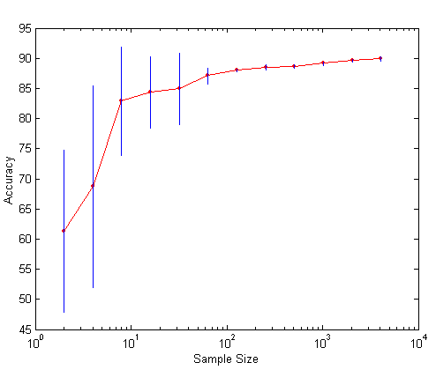
Learning Curve
Learning curve shows how accuracy changes with varying sample size
Requires a sampling schedule for creating learning curve
Effect of small sample size:
Bias in the estimate
Variance of estimate

Slide 62
Methods of Estimation
Holdout
Reserve 2/3 for training and 1/3 for testing
Random subsampling
Repeated holdout
Cross validation
Partition data into k disjoint subsets
k-fold: train on k-1 partitions, test on the remaining one
Leave-one-out: k=n
Bootstrap
Sampling with replacement

Slide 63
Model Evaluation
Metrics for Performance Evaluation
How to evaluate the performance of a model?
Methods for Performance Evaluation
How to obtain reliable estimates?
Methods for Model Comparison
How to compare the relative performance among competing models?

Slide 64
ROC (Receiver Operating Characteristic)
Developed in 1950s for signal detection theory to analyze noisy signals
Characterize the trade-off between positive hits and false alarms
ROC curve plots TPR (on the y-axis) against FPR (on the x-axis)
 | PREDICTED CLASS
Actual |  | Yes | No
 | Yes | a (TP) | b (FN)
 | No | c (FP) | d (TN)

Slide 65
ROC (Receiver Operating Characteristic)
Performance of each classifier represented as a point on the ROC curve
changing the threshold of algorithm, sample distribution or cost matrix changes the location of the point

Slide 66
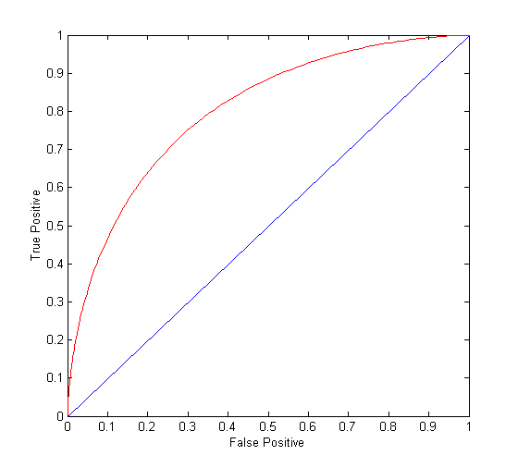
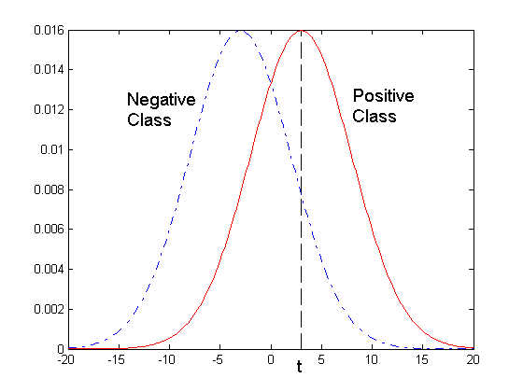
ROC Curve
- 1-dimensional data set containing 2 classes (positive and negative)
- any points located at x > t is classified as positive
At threshold t:
TP=0.5, FN=0.5, FP=0.12, FN=0.88

Slide 67
ROC Curve
(TP,FP):
(0,0): declare everything to be negative class
(1,1): declare everything to be positive class
(1,0): ideal
Diagonal line:
Random guessing
Below diagonal line:
prediction is opposite of the true class
 | PREDICTED CLASS
Actual |  | Yes | No
 | Yes | a (TP) | b (FN)
 | No | c (FP) | d (TN)

Slide 68
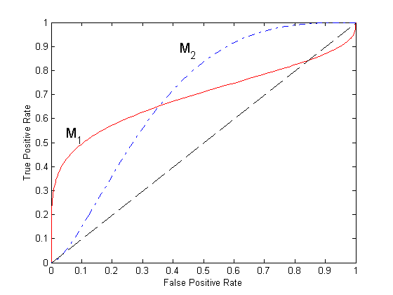
Using ROC for Model Comparison
No model consistently outperform the other
M₁ is better for small FPR
M₂ is better for large FPR
Area Under the ROC curve (AUC)
Ideal: Area = 1
Random guess:
Area = 0.5

Slide 69
How to Construct an ROC curve
Use classifier that produces posterior probability for each test instance P(+|A)
Sort the instances according to P(+|A) in decreasing order
Apply threshold at each unique value of P(+|A)
Count the number of TP, FP, TN, FN at each threshold
TP rate, TPR = TP/(TP+FN)
FP rate, FPR = FP/(FP + TN)
Instance | P(+|A) | True Class
1 | 0.95 | +
2 | 0.93 | +
3 | 0.87 | -
4 | 0.85 | -
5 | 0.85 | -
6 | 0.85 | +
7 | 0.76 | -
8 | 0.53 | +
9 | 0.43 | -
10 | 0.25 | +

Slide 70
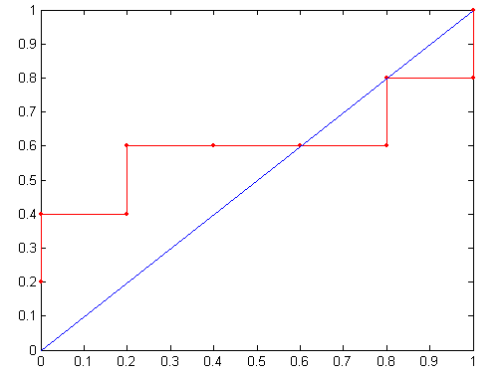
How to construct an ROC curve
Threshold >=
ROC Curve:

Slide 71
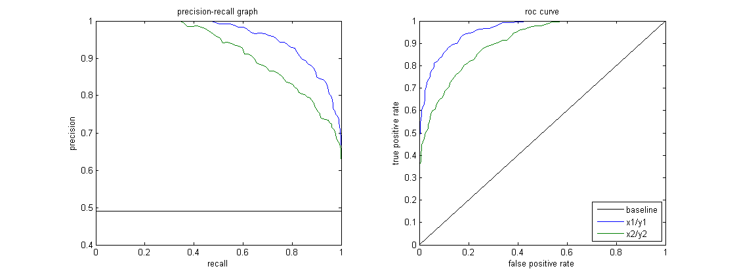
ROC curve vs Precision-Recall curve
Area Under the Curve (AUC) as a single number for evaluation

Slide 72
Test of Significance
Given two models:
Model M1: accuracy = 85%, tested on 30 instances
Model M2: accuracy = 75%, tested on 5000 instances
Can we say M1 is better than M2?
How much confidence can we place on accuracy of M1 and M2?
Can the difference in performance measure be explained as a result of random fluctuations in the test set?

Slide 73
Confidence Interval for Accuracy
Prediction can be regarded as a Bernoulli trial
A Bernoulli trial has 2 possible outcomes
Possible outcomes for prediction: correct or wrong
Collection of Bernoulli trials has a Binomial distribution:
x ∼ Bin(N, p) x: number of correct predictions
e.g: Toss a fair coin 50 times, how many heads would turn up? Expected number of heads = N×p = 50 × 0.5 = 25
Given x (# of correct predictions) or equivalently, acc=x/N, and N (# of test instances), Can we predict p (true accuracy of model)?

Slide 74
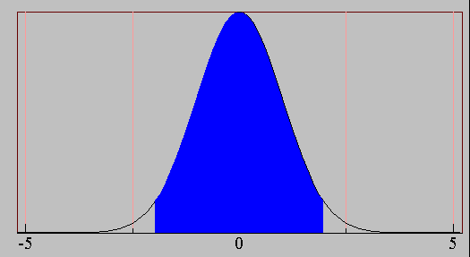
Confidence Interval for Accuracy
Area = 1 - α
For large test sets (N > 30),
acc has a normal distribution with mean p and variance p(1-p)/N
Confidence Interval for p:
Z_{α/2}
Z_{1- α /2}

Slide 75
Confidence Interval for Accuracy
Consider a model that produces an accuracy of 80% when evaluated on 100 test instances:
N=100, acc = 0.8
Let 1-α = 0.95 (95% confidence)
From probability table, Z_{α/2}=1.96
1-α | Z
0.99 | 2.58
0.98 | 2.33
0.95 | 1.96
0.90 | 1.65
N | 50 | 100 | 500 | 1000 | 5000
p(lower) | 0.670 | 0.711 | 0.763 | 0.774 | 0.789
p(upper) | 0.888 | 0.866 | 0.833 | 0.824 | 0.811

Slide 76
Comparing Performance of 2 Models
Given two models, say M1 and M2, which is better?
M1 is tested on D1 (size=n1), found error rate = e₁
M2 is tested on D2 (size=n2), found error rate = e₂
Assume D1 and D2 are independent
If n1 and n2 are sufficiently large, then
Approximate:

Slide 77
Comparing Performance of 2 Models
To test if performance difference is statistically significant: d = e1 – e2
d ~ N(d_{t},σ_{t}) where d_{t} is the true difference
Since D1 and D2 are independent, their variance adds up:
At (1-α) confidence level,

Slide 78
An Illustrative Example
Given: M1: n1 = 30, e1 = 0.15 M2: n2 = 5000, e2 = 0.25
d = |e2 – e1| = 0.1 (2-sided test)
At 95% confidence level, Z_{α/2}=1.96 => Interval contains 0 => difference may not be statistically significant

