Slide 1
DATA MINING
LECTURE 9
Classification
Basic Concepts
Decision Trees

Slide 2
What is classification?
Tax-return data

Slide 3
What is classification?
Classification is the task of learning a target function f that maps attribute set x to one of the predefined class labels y
categorical
categorical
continuous
class
One of the attributes is the class attribute
In this case: Cheat
Two class labels: Yes, No

Slide 4
What is classification?

Slide 5
Why classification?
The target function f is known as a classification model
Descriptive modeling: Explanatory tool to distinguish between objects of different classes (e.g., description of who can pay back his loan)
Predictive modeling: Predict a class of a previously unseen record

Slide 6
Examples of Classification Task
Predicting tumor cells as benign or malignant
Classifying credit card transactions as legitimate or fraudulent
Categorizing news stories as finance,
weather, entertainment, sports, etc
Identifying spam email, spam web pages, adult content
Categorizing web users, and web queries

Slide 7
General approach to classification
Training set consists of records with known class labels
Training set is used to build a classification model
The classification model is applied to new records with unknown class labels
  A test set of previously unseen data records is used to evaluate the quality of the model.

Slide 8
Illustrating Classification Task

Slide 9
Evaluation of classification models
Counts of test records that are correctly (or incorrectly) predicted by the classification model
Confusion matrix
Predicted Class
 | Class = 1 | Class = 0
Class = 1 | f₁₁ | f₁₀
Class = 0 | f₀₁ | f₀₀
Actual Class

Slide 10
Classification Techniques
Decision Tree based Methods
Rule-based Methods
Memory based reasoning
Neural Networks
Naïve Bayes and Bayesian Belief Networks
Support Vector Machines

Slide 11
Classification Techniques
Decision Tree based Methods
Rule-based Methods
Memory based reasoning
Neural Networks
Naïve Bayes and Bayesian Belief Networks
Support Vector Machines

Slide 12
Decision Trees
Decision tree
  A flow-chart-like tree structure
  Internal node denotes a test on an attribute
  Branch represents an outcome of the test
  Leaf nodes represent class labels or class distribution

Slide 13
Example of a Decision Tree
categorical
categorical
continuous
class
Splitting Attributes
Refund
Yes
No
NO
MarSt
Single, Divorced
Married
TaxInc
NO
< 80K
> 80K
NO
YES
Training Data
Model: Decision Tree

Slide 14
Another Example of Decision Tree
categorical
categorical
continuous
class
MarSt
Single, Divorced
Married
NO
Refund
Yes
No
NO
TaxInc
< 80K
> 80K
NO
YES
There could be more than one tree that fits the same data!

Slide 15
Decision Tree Classification Task
Decision Tree

Slide 16
Apply Model to Test Data
Test Data
Start from the root of tree.
Refund
Yes
No
NO
MarSt
Single, Divorced
Married
TaxInc
NO
< 80K
> 80K
NO
YES

Slide 17
Apply Model to Test Data
Test Data
Refund
Yes
No
NO
MarSt
Single, Divorced
Married
TaxInc
NO
< 80K
> 80K
NO
YES

Slide 18
Apply Model to Test Data
Test Data
Refund
Yes
No
NO
MarSt
Single, Divorced
Married
TaxInc
NO
< 80K
> 80K
NO
YES

Slide 19
Apply Model to Test Data
Test Data
Refund
Yes
No
NO
MarSt
Single, Divorced
Married
TaxInc
NO
< 80K
> 80K
NO
YES

Slide 20
Apply Model to Test Data
Test Data
Refund
Yes
No
NO
MarSt
Single, Divorced
Married
TaxInc
NO
< 80K
> 80K
NO
YES

Slide 21
Apply Model to Test Data
Test Data
Refund
Yes
No
NO
MarSt
Single, Divorced
Married
Assign Cheat to “No”
TaxInc
NO
< 80K
> 80K
NO
YES

Slide 22
Decision Tree Classification Task
Decision Tree

Slide 23
Decision Tree Induction
Many Algorithms:
  Hunt’s Algorithm (one of the earliest)
  CART
  ID3, C4.5
  SLIQ,SPRINT

Slide 24
General Structure of Hunt’s Algorithm
Let D_{t} be the set of training records that reach a node t
General Procedure:
  If D_{t} contains records that belong the same class y_{t}, then t is a leaf node labeled as y_{t}
  If D_{t} is an empty set, then t is a leaf node labeled by the default class, y_{d}
  If D_{t} contains records that belong to more than one class, use an attribute test to split the data into smaller subsets.
    Recursively apply the procedure to each subset.
D_{t}
?

Slide 25
Hunt’s Algorithm
Refund
Don’t
Cheat
Yes
No
Don’t
Cheat
Don’t
Cheat
Refund
Refund
Yes
No
Yes
No
Don’t
Cheat
Marital
Status
Don’t
Cheat
Marital
Status
Single,
Divorced
Single,
Divorced
Married
Married
Cheat
Don’t
Cheat
Taxable
Income
Don’t
Cheat
< 80K
>= 80K
Don’t
Cheat
Cheat

Slide 26
Tree Induction
Finding the best decision tree is NP-hard
Greedy strategy.
  Split the records based on an attribute test that optimizes certain criterion.

Slide 27
Constructing decision-trees (pseudocode)
GenDecTree(Sample S, Features F)
If stopping_condition(S,F) = true then
  leaf = createNode()
  leaf.label= Classify(S)
  return leaf
root = createNode()
root.test_condition = findBestSplit(S,F)
V = {v| v a possible outcome of root.test_condition}
for each value vєV:
  S_{v}: = {s | root.test_condition(s) = v and s є S};
  child = TreeGrowth(S_{v} ,F) ;
  Add child as a descent of root and label the edge (root→child) as v
return root

Slide 28
Tree Induction
Greedy strategy.
  Split the records based on an attribute test that optimizes certain criterion.
Issues
  Determine how to split the records
    How to specify the attribute test condition?
    How to determine the best split?
  Determine when to stop splitting

Slide 29
How to Specify Test Condition?
Depends on attribute types
  Nominal
  Ordinal
  Continuous
Depends on number of ways to split
  2-way split
  Multi-way split

Slide 30
Splitting Based on Nominal Attributes
Multi-way split: Use as many partitions as distinct values.
Binary split: Divides values into two subsets.
Need to find optimal partitioning.
CarType
Family
Luxury
Sports
CarType
OR
CarType
{Sports, Luxury}
{Family,
Luxury}
{Family}
{Sports}

Slide 31
Splitting Based on Ordinal Attributes
Multi-way split: Use as many partitions as distinct values.
Binary split: Divides values into two subsets.
Need to find optimal partitioning.
What about this split?
Size
Small
Large
Medium
Size
Size
{Small, Medium}
OR
{Medium,
Large}
{Large}
{Small}
Size
{Small, Large}
{Medium}

Slide 32
Splitting Based on Continuous Attributes
Different ways of handling
  Discretization to form an ordinal categorical attribute
    Static – discretize once at the beginning
    Dynamic – ranges can be found by equal interval bucketing, equal frequency bucketing
    (percentiles), or clustering.
  Binary Decision: (A < v) or (A ≥ v)
    consider all possible splits and finds the best cut
    can be more compute intensive

Slide 33
Splitting Based on Continuous Attributes

Slide 34
Tree Induction
Greedy strategy.
  Split the records based on an attribute test that optimizes certain criterion.
Issues
  Determine how to split the records
    How to specify the attribute test condition?
    How to determine the best split?
  Determine when to stop splitting

Slide 35
How to determine the Best Split
Before Splitting: 10 records of class 0,
10 records of class 1
Which test condition is the best?

Slide 36
How to determine the Best Split
Greedy approach:
  Nodes with homogeneous class distribution are preferred
Need a measure of node impurity:
Non-homogeneous,
High degree of impurity
Homogeneous,
Low degree of impurity

Slide 37
Measuring Node Impurity
p(i|t): fraction of records associated with node t belonging to class i

Slide 38
Gain
Gain of an attribute split: compare the impurity of the parent node with the impurity of the child nodes
Maximizing the gain ⇔ Minimizing the weighted average impurity measure of children nodes
If I() = Entropy(), then Δ_{info} is called information gain

Slide 39
Measure of Impurity: GINI
Gini Index for a given node t :
    (Reminder: p( j | t) is the relative frequency of class j at node t).
  Maximum (1 - 1/n_{c}) when records are equally distributed among all classes, implying least interesting information
  Minimum (0.0) when all records belong to one class, implying most interesting information

Slide 40
Examples for computing GINI
P(C1) = 0/6 = 0 P(C2) = 6/6 = 1
Gini = 1 – P(C1)² – P(C2)² = 1 – 0 – 1 = 0
P(C1) = 1/6 P(C2) = 5/6
Gini = 1 – (1/6)² – (5/6)² = 0.278
P(C1) = 2/6 P(C2) = 4/6
Gini = 1 – (2/6)² – (4/6)² = 0.444

Slide 41
Splitting Based on GINI
Used in CART, SLIQ, SPRINT.
When a node p is split into k partitions (children), the quality of split is computed as,
where, n_{i} = number of records at child i,
n = number of records at node p.

Slide 42
Binary Attributes: Computing GINI Index
Splits into two partitions
Effect of Weighing partitions:
  Larger and Purer Partitions are sought for.
B?
Yes
No
Node N1
Node N2
Gini(N1)
= 1 – (5/6)² – (2/6)²
= 0.194
Gini(N2)
= 1 – (1/6)² – (4/6)²
= 0.528
Gini(Children)
= 7/12 * 0.194 +
5/12 * 0.528
= 0.333

Slide 43
Categorical Attributes: Computing Gini Index
For each distinct value, gather counts for each class in the dataset
Use the count matrix to make decisions
Multi-way split
Two-way split
(find best partition of values)

Slide 44
Continuous Attributes: Computing Gini Index
Use Binary Decisions based on one value
Several Choices for the splitting value
  Number of possible splitting values
  = Number of distinct values
Each splitting value has a count matrix associated with it
  Class counts in each of the partitions, A < v and A ≥ v
Simple method to choose best v
  For each v, scan the database to gather count matrix and compute its Gini index
  Computationally Inefficient! Repetition of work.

Slide 45
Continuous Attributes: Computing Gini Index...
For efficient computation: for each attribute,
  Sort the attribute on values
  Linearly scan these values, each time updating the count matrix and computing gini index
  Choose the split position that has the least gini index
Sorted Values
Split Positions

Slide 46
Alternative Splitting Criteria based on INFO
Entropy at a given node t:
    (NOTE: p( j | t) is the relative frequency of class j at node t).
  Measures homogeneity of a node.
    Maximum (log n_{c}) when records are equally distributed among all classes implying least information
    Minimum (0.0) when all records belong to one class, implying most information
  Entropy based computations are similar to the GINI index computations

Slide 47
Examples for computing Entropy
P(C1) = 0/6 = 0 P(C2) = 6/6 = 1
Entropy = – 0 log 0 – 1 log 1 = – 0 – 0 = 0
P(C1) = 1/6 P(C2) = 5/6
Entropy = – (1/6) log₂ (1/6) – (5/6) log₂ (1/6) = 0.65
P(C1) = 2/6 P(C2) = 4/6
Entropy = – (2/6) log₂ (2/6) – (4/6) log₂ (4/6) = 0.92

Slide 48
Splitting Based on INFO...
Information Gain:
    Parent Node, p is split into k partitions;
    n_{i} is number of records in partition i
  Measures Reduction in Entropy achieved because of the split. Choose the split that achieves most reduction (maximizes GAIN)
  Used in ID3 and C4.5
  Disadvantage: Tends to prefer splits that result in large number of partitions, each being small but pure.

Slide 49
Splitting based on INFO

Slide 50
Splitting based on INFO
Impurity measures favor attributes with large number of values
A test condition with large number of outcomes may not be desirable
  # of records in each partition is too small to make predictions

Slide 51
Splitting Based on INFO...
Gain Ratio:
    Parent Node, p is split into k partitions
    n_{i} is the number of records in partition i
  Adjusts Information Gain by the entropy of the partitioning (SplitINFO). Higher entropy partitioning (large number of small partitions) is penalized!
  Used in C4.5
  Designed to overcome the disadvantage of Information Gain

Slide 52
Splitting Criteria based on Classification Error
Classification error at a node t :
Measures misclassification error made by a node.
    Maximum (1 - 1/n_{c}) when records are equally distributed among all classes, implying least interesting information
    Minimum (0.0) when all records belong to one class, implying most interesting information

Slide 53
Examples for Computing Error
P(C1) = 0/6 = 0 P(C2) = 6/6 = 1
Error = 1 – max (0, 1) = 1 – 1 = 0
P(C1) = 1/6 P(C2) = 5/6
Error = 1 – max (1/6, 5/6) = 1 – 5/6 = 1/6
P(C1) = 2/6 P(C2) = 4/6
Error = 1 – max (2/6, 4/6) = 1 – 4/6 = 1/3

Slide 54
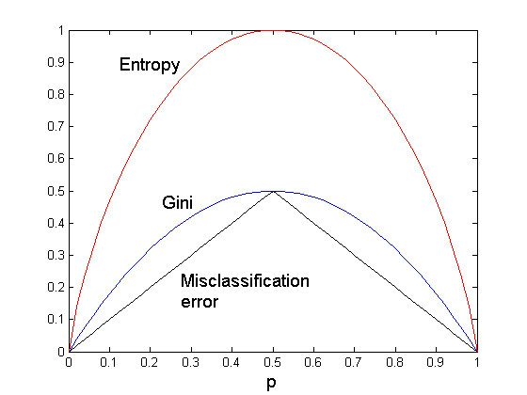
Comparison among Splitting Criteria
For a 2-class problem:

Slide 55
Misclassification Error vs Gini
A?
Yes
No
Node N1
Node N2
Gini(N1)
= 1 – (3/3)² – (0/3)² = 0
Error(N1)
= 1-max(0,1) = 0
Gini(N2)
= 1 – (4/7)² – (3/7)² = 0.489
Error(N2)
= 1- max(3/7,4/7) = 3/7
Gini(Children)
= 3/10 * 0 + 7/10 * 0.489
= 0.342
Error(Children)
= 3/10*0 + 7/10*3/7 = 0.3
Gini improves !!

Slide 56
Tree Induction
Greedy strategy.
  Split the records based on an attribute test that optimizes certain criterion.
Issues
  Determine how to split the records
    How to specify the attribute test condition?
    How to determine the best split?
  Determine when to stop splitting

Slide 57
Stopping Criteria for Tree Induction
Stop expanding a node when all the records belong to the same class
Stop expanding a node when all the records have similar attribute values
Early termination (to be discussed later)

Slide 58
Decision Tree Based Classification
Advantages:
  Inexpensive to construct
  Extremely fast at classifying unknown records
  Easy to interpret for small-sized trees
  Accuracy is comparable to other classification techniques for many simple data sets

Slide 59
Example: C4.5
Simple depth-first construction.
Uses Information Gain
Sorts Continuous Attributes at each node.
Needs entire data to fit in memory.
Unsuitable for Large Datasets.
  Needs out-of-core sorting.
You can download the software from:
http://www.cse.unsw.edu.au/~quinlan/c4.5r8.tar.gz

Slide 60
Practical Issues of Classification
Underfitting and Overfitting
Missing Values
Costs of Classification

Slide 61
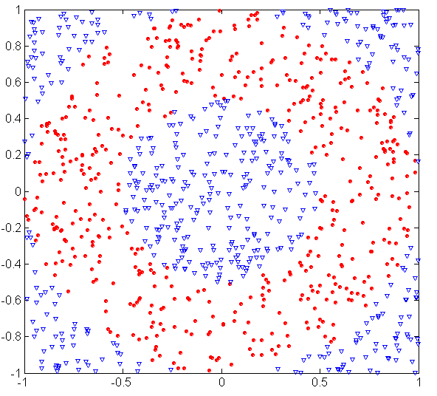
Underfitting and Overfitting (Example)
500 circular and 500 triangular data points.
Circular points:
0.5 ≤ sqrt(x₁²+x₂²) ≤ 1
Triangular points:
sqrt(x₁²+x₂²) > 0.5 or
sqrt(x₁²+x₂²) < 1

Slide 62
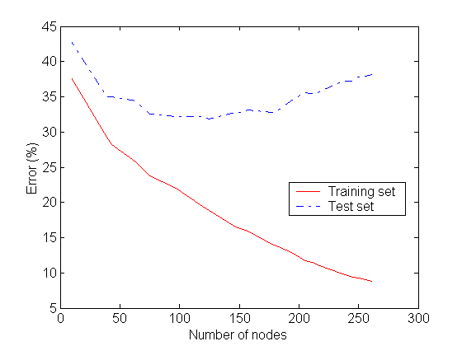
Underfitting and Overfitting
Overfitting
Underfitting: when model is too simple, both training and test errors are large

Slide 63
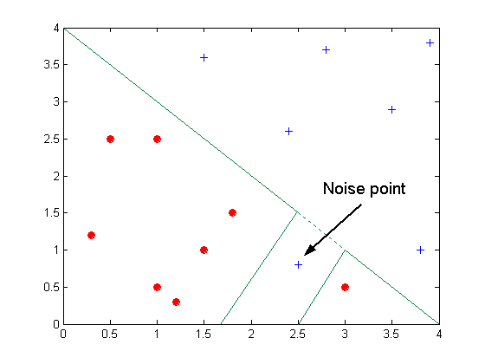
Overfitting due to Noise
Decision boundary is distorted by noise point

Slide 64
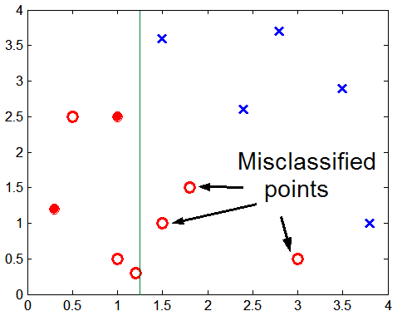
Overfitting due to Insufficient Examples
Lack of data points in the lower half of the diagram makes it difficult to predict correctly the class labels of that region
- Insufficient number of training records in the region causes the decision tree to predict the test examples using other training records that are irrelevant to the classification task

Slide 65
Notes on Overfitting
Overfitting results in decision trees that are more complex than necessary
Training error no longer provides a good estimate of how well the tree will perform on previously unseen records
  The model does not generalize well
Need new ways for estimating errors

Slide 66
Estimating Generalization Errors
Re-substitution errors: error on training (Σ e(t) )
Generalization errors: error on testing (Σ e’(t))
Methods for estimating generalization errors:
  Optimistic approach: e’(t) = e(t)
  Pessimistic approach:
    For each leaf node: e’(t) = (e(t)+0.5)
    Total errors: e’(T) = e(T) + N × 0.5 (N: number of leaf nodes)
    For a tree with 30 leaf nodes and 10 errors on training
    (out of 1000 instances):
    Training error = 10/1000 = 1%
    Generalization error = (10 + 30×0.5)/1000 = 2.5%
  Reduced error pruning (REP):
    uses validation dataset to estimate generalization
    error

Slide 67
Occam’s Razor
Given two models of similar generalization errors, one should prefer the simpler model over the more complex model
For complex models, there is a greater chance that it was fitted accidentally by errors in data
Therefore, one should include model complexity when evaluating a model

Slide 68
Minimum Description Length (MDL)
Cost(Model,Data) = Cost(Data|Model) + Cost(Model)
  Cost is the number of bits needed for encoding.
  Search for the least costly model.
Cost(Data|Model) encodes the misclassification errors.
Cost(Model) uses node encoding (number of children) plus splitting condition encoding.

Slide 69
How to Address Overfitting
Pre-Pruning (Early Stopping Rule)
  Stop the algorithm before it becomes a fully-grown tree
  Typical stopping conditions for a node:
    Stop if all instances belong to the same class
    Stop if all the attribute values are the same
  More restrictive conditions:
    Stop if number of instances is less than some user-specified threshold
    Stop if class distribution of instances are independent of the available features (e.g., using χ ² test)
    Stop if expanding the current node does not improve impurity
    measures (e.g., Gini or information gain).

Slide 70
How to Address Overfitting…
Post-pruning
  Grow decision tree to its entirety
  Trim the nodes of the decision tree in a bottom-up fashion
  If generalization error improves after trimming, replace sub-tree by a leaf node.
  Class label of leaf node is determined from majority class of instances in the sub-tree
  Can use MDL for post-pruning

Slide 71
Example of Post-Pruning
Training Error (Before splitting) = 10/30
Pessimistic error = (10 + 0.5)/30 = 10.5/30
Training Error (After splitting) = 9/30
Pessimistic error (After splitting)
= (9 + 4 × 0.5)/30 = 11/30
PRUNE!
Class = Yes | 20
Class = No | 10
Error = 10/30
Class = Yes | 8
Class = No | 4
Class = Yes | 3
Class = No | 4
Class = Yes | 4
Class = No | 1
Class = Yes | 5
Class = No | 1

Slide 72
Handling Missing Attribute Values
Missing values affect decision tree construction in three different ways:
  Affects how impurity measures are computed
  Affects how to distribute instance with missing value to child nodes
  Affects how a test instance with missing value is classified

Slide 73
Computing Impurity Measure
Before Splitting:
Entropy(Parent)
= -0.3 log(0.3)-(0.7)log(0.7) = 0.8813
Split on Refund:
Entropy(Refund=Yes) = 0
Entropy(Refund=No)
= -(2/6)log(2/6) – (4/6)log(4/6) = 0.9183
Entropy(Children)
= 0.3 (0) + 0.6 (0.9183) = 0.551
Gain = 0.9 × (0.8813 – 0.551) = 0.3303
Missing value

Slide 74
Distribute Instances
Refund
Yes
No
Probability that Refund=Yes is 3/9
Probability that Refund=No is 6/9
Assign record to the left child with weight = 3/9 and to the right child with weight = 6/9
Refund
Yes
No

Slide 75
Classify Instances
New record:
 | Married | Single | Divorced | Total
Class=No | 3 | 1 | 0 | 4
Class=Yes | 6/9 | 1 | 1 | 2.67
Total | 3.67 | 2 | 1 | 6.67
Refund
Yes
No
NO
MarSt
Single,
Divorced
Married
Probability that Marital Status
= Married is 3.67/6.67
Probability that Marital Status ={Single,Divorced} is 3/6.67
TaxInc
NO
< 80K
> 80K
NO
YES

Slide 76
Other Issues
Data Fragmentation
Search Strategy
Expressiveness
Tree Replication

Slide 77
Data Fragmentation
Number of instances gets smaller as you traverse down the tree
Number of instances at the leaf nodes could be too small to make any statistically significant decision

Slide 78
Search Strategy
Finding an optimal decision tree is NP-hard
The algorithm presented so far uses a greedy, top-down, recursive partitioning strategy to induce a reasonable solution
Other strategies?
  Bottom-up
  Bi-directional

Slide 79
Expressiveness
Decision tree provides expressive representation for learning discrete-valued function
  But they do not generalize well to certain types of Boolean functions
    Example: parity function:
      Class = 1 if there is an even number of Boolean attributes with truth value = True
      Class = 0 if there is an odd number of Boolean attributes with truth value = True
    For accurate modeling, must have a complete tree
Not expressive enough for modeling continuous variables
  Particularly when test condition involves only a single attribute at-a-time

Slide 80
Decision Boundary
Border line between two neighboring regions of different classes is known as decision boundary
Decision boundary is parallel to axes because test condition involves a single attribute at-a-time

Slide 81
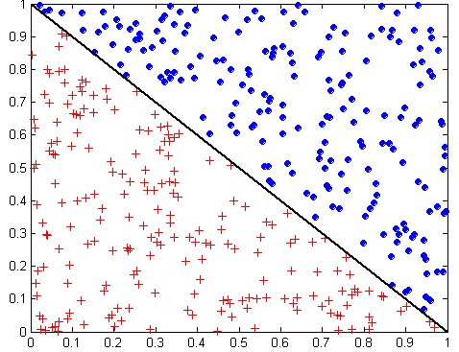
Oblique Decision Trees
x + y < 1
Class = +
Class =
Test condition may involve multiple attributes
More expressive representation
Finding optimal test condition is computationally expensive

Slide 82
Tree Replication
Same subtree appears in multiple branches

