Slide 1
DATA MINING
LECTURE 8
Sequence Segmentation
Dimensionality Reduction

Slide 2
SEQUENCE SEGMENTATION

Slide 3
Why deal with sequential data?
Because all data is sequential ☺
  All data items arrive in the data store in some order
Examples
  transaction data
  documents and words
In some (many) cases the order does not matter
In many cases the order is of interest

Slide 4
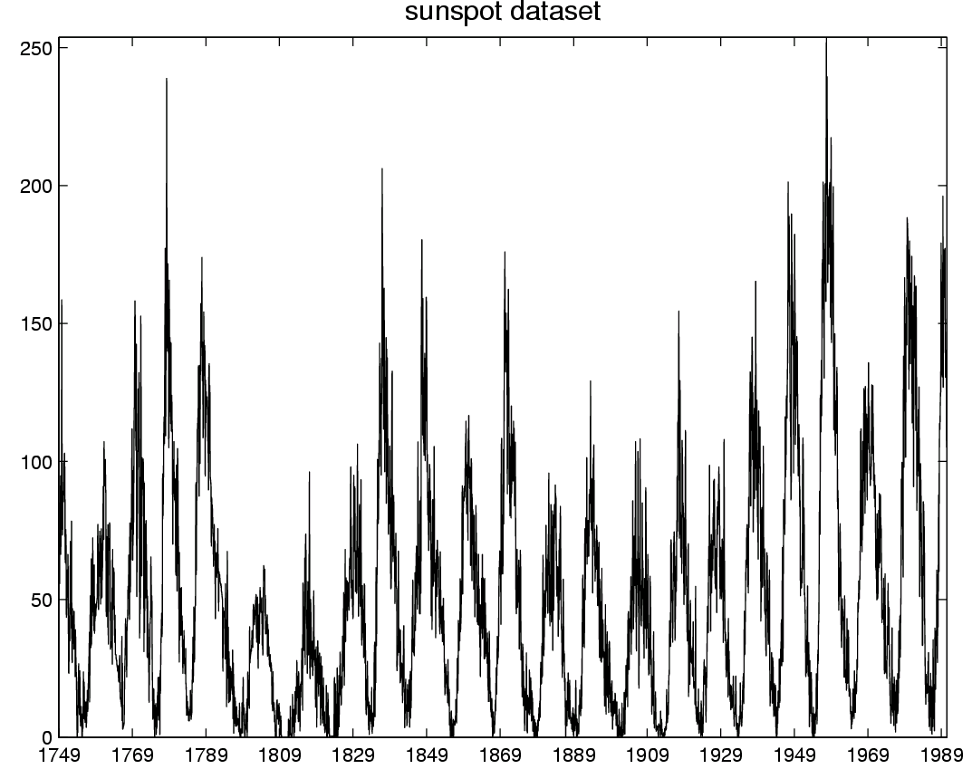
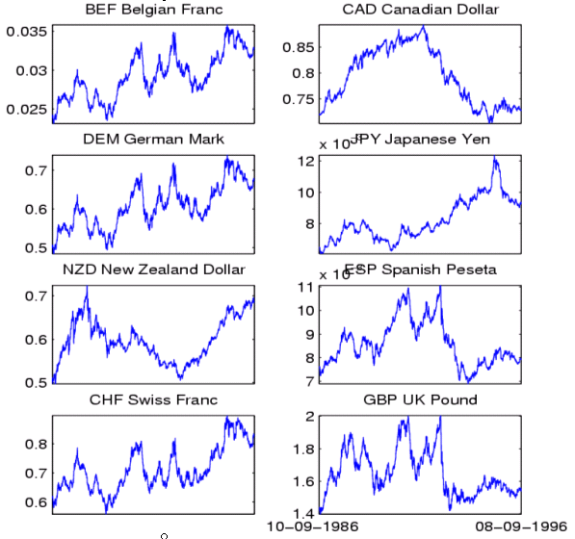
Time-series data
Financial time series, process monitoring…

Slide 5
Sequence Segmentation
Goal: discover structure in the sequence and provide a concise summary
Given a sequence T, segment it into K contiguous segments that are as homogeneous as possible
Similar to clustering but now we require the points in the cluster to be contiguous

Slide 6
Example
R
t
R
t

Slide 7
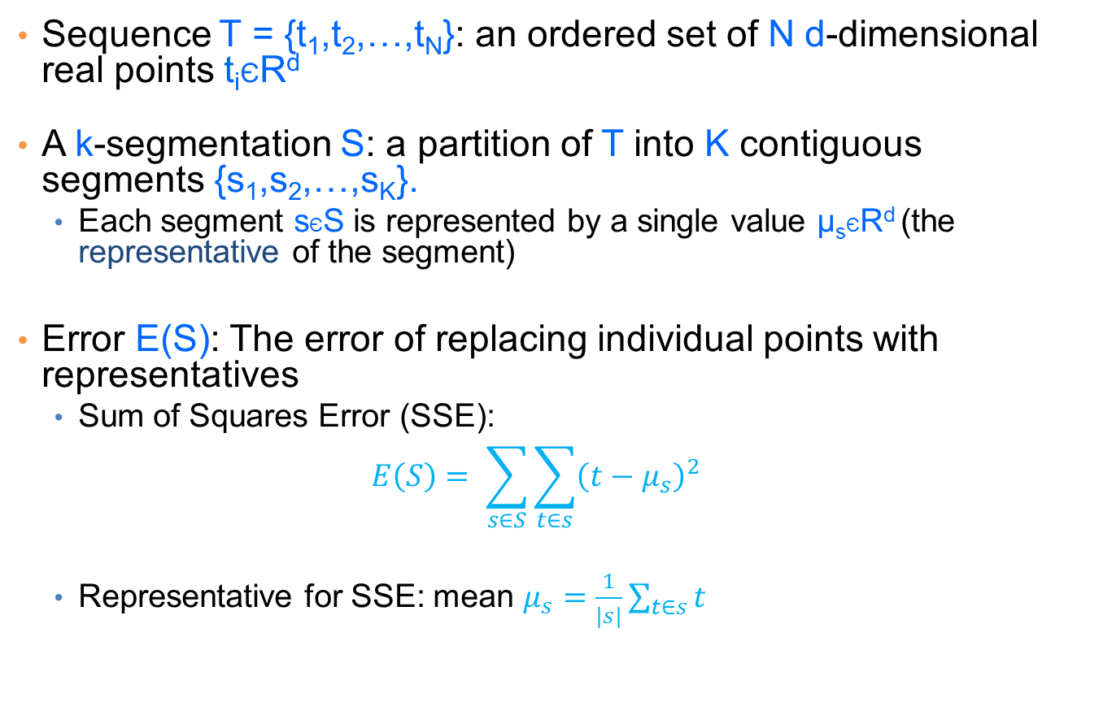
Basic definitions
Sequence T = {t₁,t₂,…,t_{N}}: an ordered set of N d-dimensional real points t_{i}ЄR^{d}
A k-segmentation S: a partition of T into K contiguous segments {s₁,s₂,…,s_{K}}.
  Each segment sЄS is represented by a single value μ_{s}ЄR^{d} (the representative of the segment)
Error E(S): The error of replacing individual points with representatives
  Sum of Squares Error (SSE):
  $$E\left(S\right)= \sum_{s∈S}{\sum_{t∈s}{{\left(t−μ_{s}\right)}^{2}}}$$
  Representative for SSE: mean $μ_{s}=\frac{1}{|s|}\sum_{t∈s}{t}$

Slide 8
The K-segmentation problem
Given a sequence T of length N and a value K, find a K-segmentation S = {s₁, s₂, …,s_{K}} of T such that the SSE error E is minimized.
Similar to K-means clustering, but now we need the points in the clusters to respect the order of the sequence.
  This actually makes the problem easier.

Slide 9
Optimal solution for the k-segmentation problem
[Bellman’61: The k-segmentation problem can be solved optimally using a standard dynamic-programming algorithm
Dynamic Programming:
  Construct the solution of the problem by using solutions to problems of smaller size
    Define the dynamic programming recursion
  Build the solution bottom up from smaller to larger instances
    Define the dynamic programming table that stores the solutions to the sub-problems

Slide 10
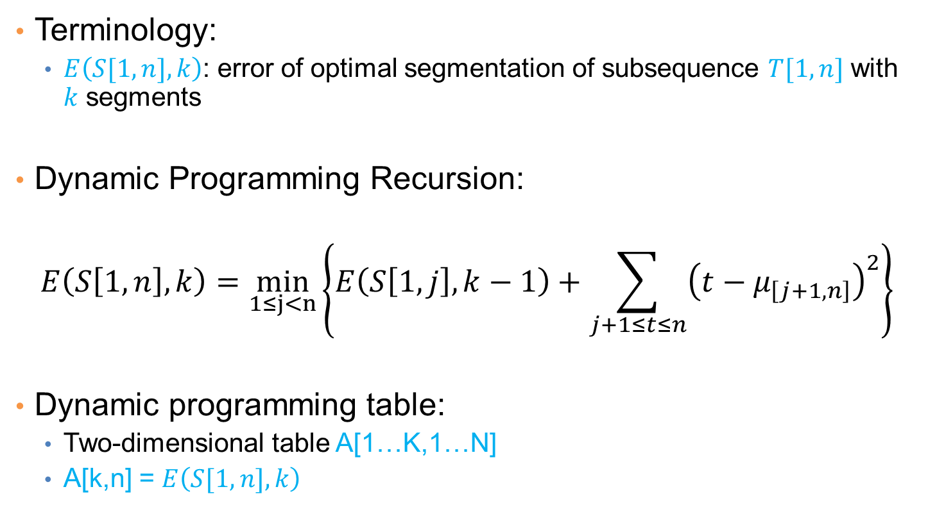
Dynamic Programming Solution
Terminology:
  $E\left(S[1,n],k\right)$: error of optimal segmentation of subsequence $T[1,n]$ with $k$ segments
Dynamic Programming Recursion:
$$E\left(S\left[1,n\right],k\right)=\min_{1≤j<n}\left\{E\left(S\left[1,j\right],k−1\right)+\sum_{j+1≤t≤n}{{\left(t−μ_{\left[j+1,n\right]}\right)}^{2}}\right\}$$
Dynamic programming table:
  Two-dimensional table A[1…K,1…N]
  A[k,n] = $E\left(S[1,n],k\right)$

Slide 11

Dynamic programming solution
$$E\left(S\left[1,n\right],k\right)=\min_{1≤j<n}\left\{E\left(S\left[1,j\right],k−1\right)+\sum_{j+1≤t≤n}{{\left(t−μ_{\left[j+1,n\right]}\right)}^{2}}\right\}$$
Fill the table row to tow from smaller to larger values of k
1
n
N
1
k
K

Slide 12
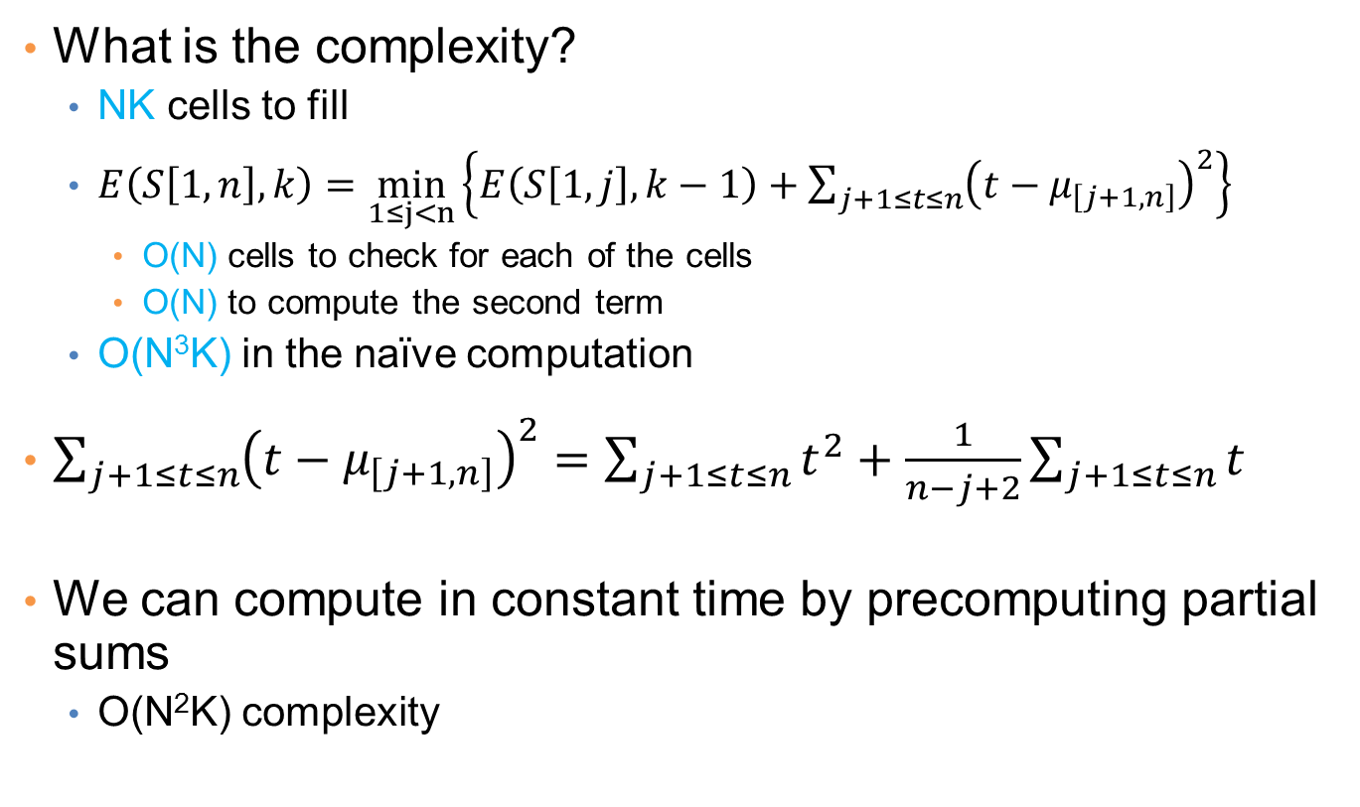
Algorithm Complexity
What is the complexity?
  NK cells to fill
  $E\left(S\left[1,n\right],k\right)=\min_{1≤j<n}\left\{E\left(S\left[1,j\right],k−1\right)+\sum_{j+1≤t≤n}{{\left(t−μ_{\left[j+1,n\right]}\right)}^{2}}\right\}$
    O(N) cells to check for each of the cells
    O(N) to compute the second term
  O(N³K) in the naïve computation
$\sum_{j+1≤t≤n}{{\left(t−μ_{\left[j+1,n\right]}\right)}^{2}}=\sum_{j+1≤t≤n}{{t^{2}+\frac{1}{n−j+2}\sum_{j+1≤t≤n}{t}}^{}}$
We can compute in constant time by precomputing partial sums
  O(N²K) complexity

Slide 13
Heuristics
Bottom-up greedy (BU): O(NlogN)
  Merge adjacent points each time selecting the two points that cause the smallest increase in the error until K segments
  [Keogh and Smyth’97, Keogh and Pazzani’98]
Top-down greedy (TD): O(NK)
  Introduce breakpoints so that you get the largest decrease in error, until K segments are created.
  [Douglas and Peucker’73, Shatkay and Zdonik’96, Lavrenko et. al’00]
Local Search Heuristics: O(NKI)
  Assign the breakpoints randomly and then move them so that you reduce the error
  [Himberg et. al ’01]

Slide 14
DIMENSIONALITY REDUCTION

Slide 15
The curse of dimensionality
Real data usually have thousands, or millions of dimensions
  E.g., web documents, where the dimensionality is the vocabulary of words
  Facebook graph, where the dimensionality is the number of users
Huge number of dimensions causes many problems
  Data becomes very sparse, some algorithms become meaningless (e.g. density based clustering)
  The complexity of several algorithms depends on the dimensionality and they become infeasible.

Slide 16
Dimensionality Reduction
Usually the data can be described with fewer dimensions, without losing much of the meaning of the data.
  The data reside in a space of lower dimensionality
Essentially, we assume that some of the data is noise, and we can approximate the useful part with a lower dimensionality space.
  Dimensionality reduction does not just reduce the amount of data, it often brings out the useful part of the data

Slide 17
Data in the form of a matrix
We are given n objects and d attributes describing the objects. Each object has d numeric values describing it.
We will represent the data as a n×d real matrix A.
  We can now use tools from linear algebra to process the data matrix
Our goal is to produce a new n×k matrix B such that
  It preserves as much of the information in the original matrix A as possible
  It reveals something about the structure of the data in A

Slide 18
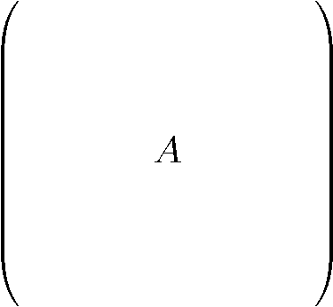
Example: Document matrices
d terms
(e.g., theorem, proof, etc.)
n documents
A_{ij} = frequency of the j-th term in the i-th document
Find subsets of terms that bring documents together

Slide 19
Example: Recommendation systems
d movies
n customers
A_{ij} = rating of j-th product by the i-th customer
Find subsets of movies that capture the behavior or the customers

Slide 20
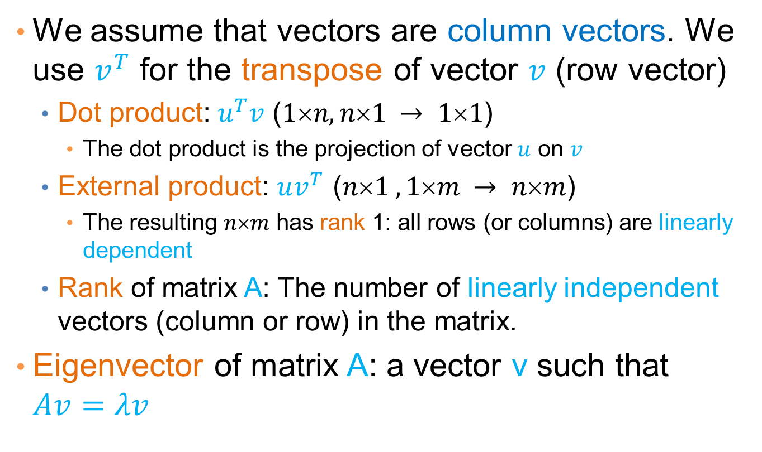
Some linear algebra basics
We assume that vectors are column vectors. We use $v^{T}$ for the transpose of vector $v$ (row vector)
  Dot product: $u^{T}v$ ($1n, n1 → 11$)
    The dot product is the projection of vector $u$ on $v$
  External product: $uv^{T}$ ($n1 ,1m → nm$)
    The resulting $nm$ has rank 1: all rows (or columns) are linearly dependent
  Rank of matrix A: The number of linearly independent vectors (column or row) in the matrix.
Eigenvector of matrix A: a vector v such that $Av=λv$

Slide 21
Singular Value Decomposition
r : rank of matrix A
σ₁≥ σ₂≥ … ≥σ_{r} : singular values (square roots of eig-vals AA^{T}, A^{T}A)
: left singular vectors (eig-vectors of AA^{T})
: right singular vectors (eig-vectors of A^{T}A)
[n×r]
[r×r]
[r×n]

Slide 22
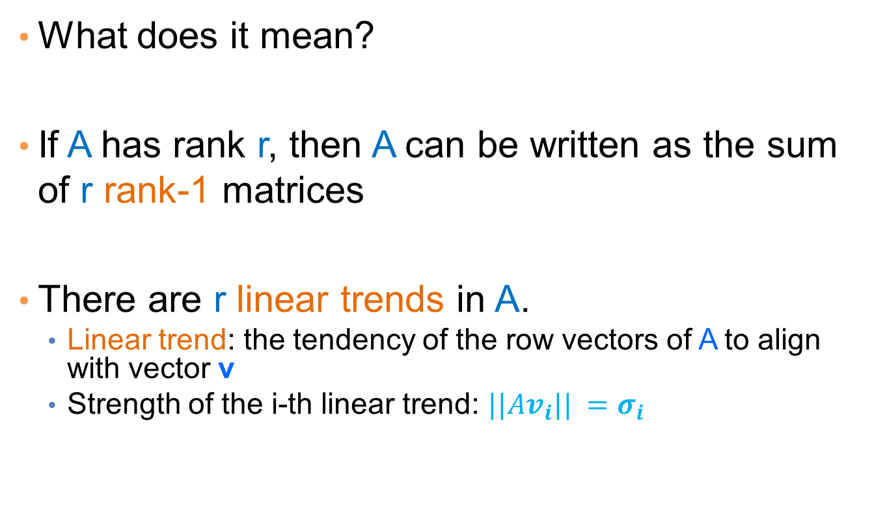
Singular Value Decomposition
What does it mean?
If A has rank r, then A can be written as the sum of r rank-1 matrices
There are r linear trends in A.
  Linear trend: the tendency of the row vectors of A to align with vector v
  Strength of the i-th linear trend: $||Av_{i}|| =σ_{i}$

Slide 23
An (extreme) example
Document-term matrix
  Blue and Red rows (colums) are linearly depedent
There are two types of documents (words): blue and red
  To describe the data is enough to describe the two types, and the projection weights for each row
  A is a rank-2 matrix
A =

Slide 24
An (more realistic) example
Document-term matrix
There are two types of documents and words but they are mixed
  We now have more than two singular vectors, but the strongest ones are still about the two types.
  By keeping the two strongest singular vectors we obtain most of the information in the data.
    This is a rank-2 approximation of the matrix A
A =

Slide 25
SVD and Rank-k approximations
A
=
U
Σ
V^{T}
features
sig.
significant
=
noise
noise
significant
noise
objects

Slide 26
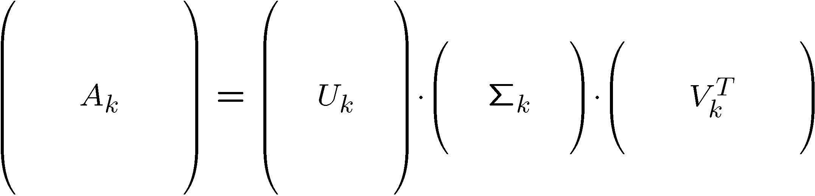
Rank-k approximations (A_{k})
n x d
n x k
k x k
k x d
U_{k} (V_{k}): orthogonal matrix containing the top k left (right) singular vectors of A.
_{k}: diagonal matrix containing the top k singular values of A
A_{k} is an approximation of A
A_{k} is the best approximation of A

Slide 27
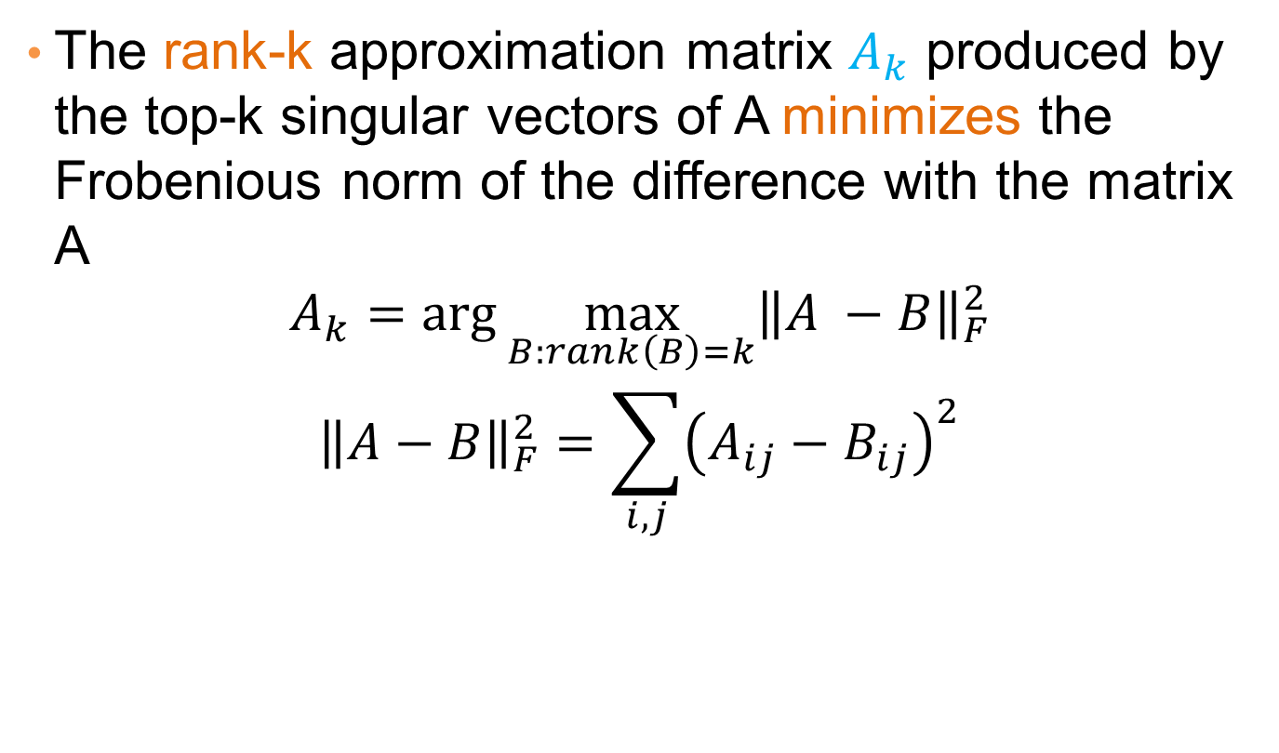
SVD as an optimization
The rank-k approximation matrix $A_{k}$ produced by the top-k singular vectors of A minimizes the Frobenious norm of the difference with the matrix A
$$A_{k}=\arg{\max_{B:rank\left(B\right)=k}{{\left\|A −B\right\|}_{F}^{2}}}$$
$${\left\|A−B\right\|}_{F}^{2}=\sum_{i,j}{{\left(A_{ij}−B_{ij}\right)}^{2}}$$

Slide 28
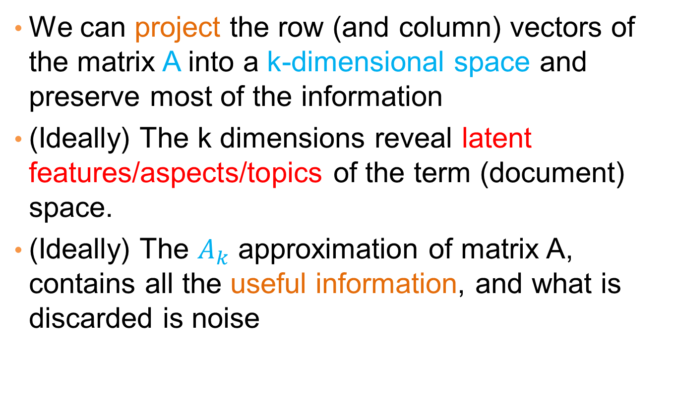
What does this mean?
We can project the row (and column) vectors of the matrix A into a k-dimensional space and preserve most of the information
(Ideally) The k dimensions reveal latent features/aspects/topics of the term (document) space.
(Ideally) The $A_{k}$ approximation of matrix A, contains all the useful information, and what is discarded is noise

Slide 29
Two applications
Latent Semantic Indexing (LSI):
  Apply SVD on the document-term space, and index the k-dimensional vectors
  When a query comes, project it onto the low dimensional space and compute similarity cosine similarity in this space
  Singular vectors capture main topics, and enrich the document representation
Recommender systems and collaborative filtering
  In a movie-rating system there are just a few types of users.
  What we observe is an incomplete and noisy version of the true data
  The rank-k approximation reconstructs the “true” matrix and we can provide ratings for movies that are not rated.

Slide 30
SVD and PCA
PCA is a special case of SVD on the centered covariance matrix.

Slide 31
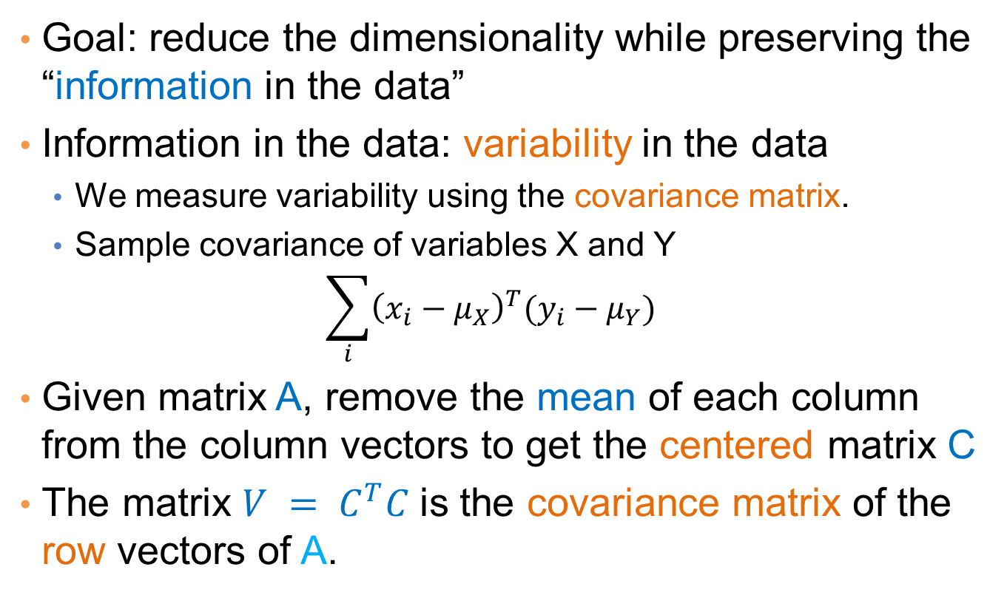
Covariance matrix
Goal: reduce the dimensionality while preserving the “information in the data”
Information in the data: variability in the data
  We measure variability using the covariance matrix.
  Sample covariance of variables X and Y
  $$\sum_{i}{{\left(x_{i}−μ_{X}\right)}^{T}(y_{i}−μ_{Y})}$$
Given matrix A, remove the mean of each column from the column vectors to get the centered matrix C
The matrix $V = C^{T}C$is the covariance matrix of the row vectors of A.

Slide 32
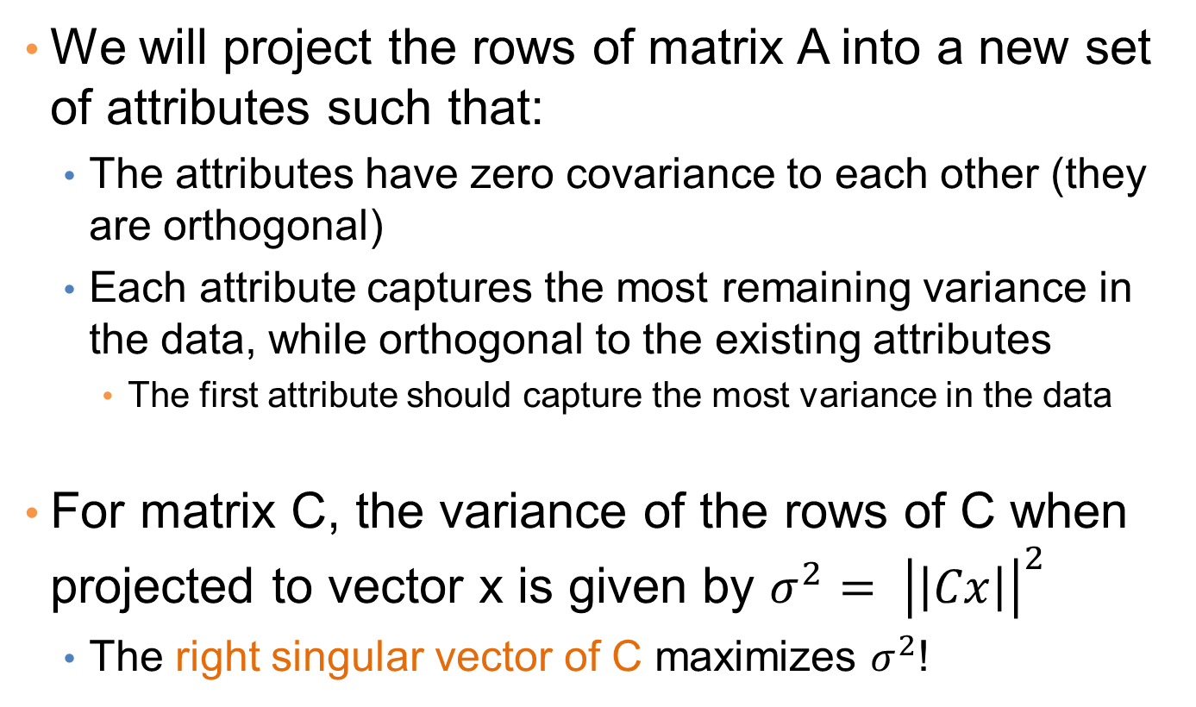
PCA: Principal Component Analysis
We will project the rows of matrix A into a new set of attributes such that:
  The attributes have zero covariance to each other (they are orthogonal)
  Each attribute captures the most remaining variance in the data, while orthogonal to the existing attributes
    The first attribute should capture the most variance in the data
For matrix C, the variance of the rows of C when projected to vector x is given by ${σ^{2}= \left|\left|Cx\right|\right|}^{2}$
  The right singular vector of C maximizes $σ^{2}$!

Slide 33
PCA
Input: 2-d dimensional points
Output:
2nd (right) singular vector
1st (right) singular vector:
direction of maximal variance,
2nd (right) singular vector:
direction of maximal variance, after removing the projection of the data along the first singular vector.
1st (right) singular vector

Slide 34
Singular values
2nd (right) singular vector
σ₁: measures how much of the data variance is explained by the first singular vector.
σ₂: measures how much of the data variance is explained by the second singular vector.
σ₁
1st (right) singular vector

Slide 35
Another property of PCA/SVD
The chosen vectors are such that minimize the sum of square differences between the data vectors and the low-dimensional projections
1st (right) singular vector

Slide 36
SVD is “the Rolls-Royce and the Swiss Army Knife of Numerical Linear Algebra.”*
*Dianne O’Leary, MMDS ’06

