Slide 1
DATA MINING
LECTURE 7
Minimum Description Length Principle
Information Theory
Co-Clustering

Slide 2
MINIMUM DESCRIPTION LENGTH

Slide 3
Occam’s razor
Most data mining tasks can be described as creating a model for the data
  E.g., the EM algorithm models the data as a mixture of Gaussians, the K-means models the data as a set of centroids.
  Model vs Hypothesis
What is the right model?
Occam’s razor: All other things being equal, the simplest model is the best.
  A good principle for life as well

Slide 4
Occam's Razor and MDL
What is a simple model?
Minimum Description Length Principle: Every model provides a (lossless) encoding of our data. The model that gives the shortest encoding (best compression) of the data is the best.
  Related: Kolmogorov complexity. Find the shortest program that produces the data (uncomputable).
  MDL restricts the family of models considered
  Encoding cost: cost of party A to transmit to party B the data.

Slide 5
Minimum Description Length (MDL)
The description length consists of two terms
  The cost of describing the model (model cost)
  The cost of describing the data given the model (data cost).
  L(D) = L(M) + L(D|M)
There is a tradeoff between the two costs
  Very complex models describe the data in a lot of detail but are expensive to describe
  Very simple models are cheap to describe but require a lot of work to describe the data given the model

Slide 6
Example
Regression: find the polynomial for describing the data
  Complexity of the model vs. Goodness of fit
Low model cost
High data cost
High model cost
Low data cost
Low model cost
Low data cost
MDL avoids overfitting automatically!
Source: Grnwald et al. (2005) Advances in Minimum Description Length: Theory and Applications.

Slide 7
MDL and Data Mining
Why does the shorter encoding make sense?
  Shorter encoding implies regularities in the data
  Regularities in the data imply patterns
  Patterns are interesting
Example
00001000010000100001000010000100001000010001000010000100001
Short description length, just repeat 12 times 00001
0100111001010011011010100001110101111011011010101110010011100
Random sequence, no patterns, no compression

Slide 8
MDL and Clustering
If we have a clustering of the data, we can transmit the clusters instead of the data
  We need to transmit the description of the clusters
  And the data within each cluster.
If we have a good clustering the transmission cost is low
  Why?
  What happens if all elements of the cluster are identical?
  What happens if we have very few elements per cluster?
Homogeneous clusters are cheaper to encode
But we should not have too many

Slide 9
Issues with MDL
What is the right model family?
  This determines the kind of solutions that we can have
    E.g., polynomials
    Clusterings
What is the encoding cost?
  Determines the function that we optimize
  Information theory

Slide 10
INFORMATION THEORY
A short introduction

Slide 11
Encoding
Consider the following sequence
AAABBBAAACCCABACAABBAACCABAC
Suppose you wanted to encode it in binary form, how would you do it?
50% A
25% B
25% C
A → 0
B → 10
C → 11
A is 50% of the sequence
We should give it a shorter representation
This is actually provably the best encoding!

Slide 12
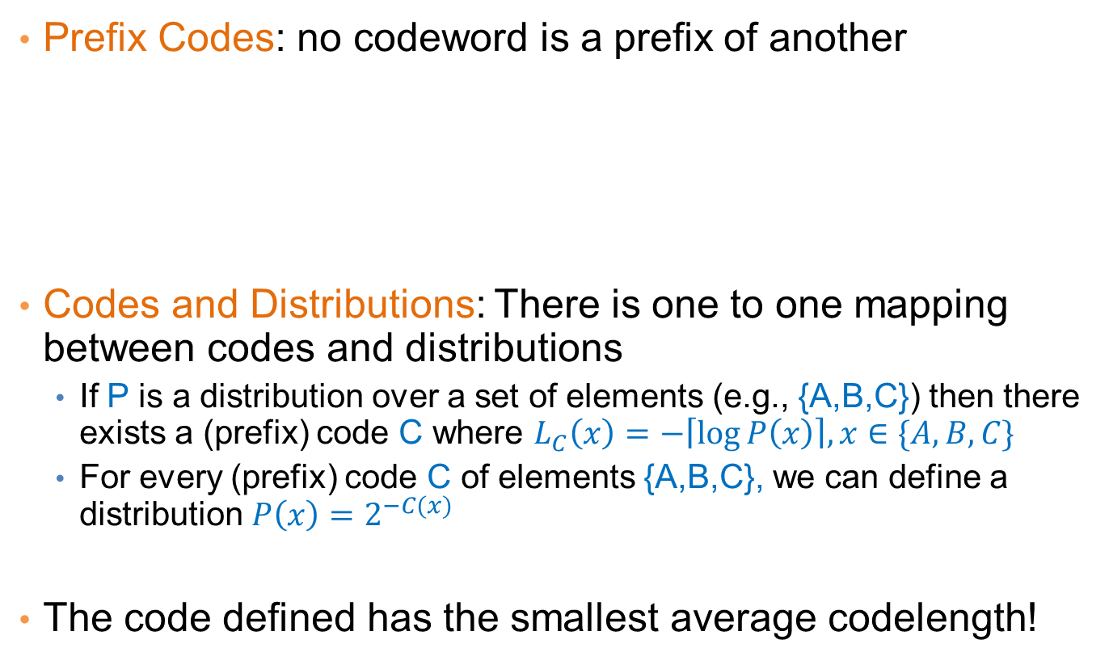
Encoding
Prefix Codes: no codeword is a prefix of another
Codes and Distributions: There is one to one mapping between codes and distributions
  If P is a distribution over a set of elements (e.g., {A,B,C}) then there exists a (prefix) code C where $L_{C}\left(x\right)=−\left\lceil \log{P\left(x\right)}\right\rceil , x∈\{A,B,C\}$
  For every (prefix) code C of elements {A,B,C}, we can define a distribution $P\left(x\right)=2^{−C(x)}$
The code defined has the smallest average codelength!
A → 0
B → 10
C → 11
Uniquely directly decodable
For every code we can find a prefix code of equal length

Slide 13
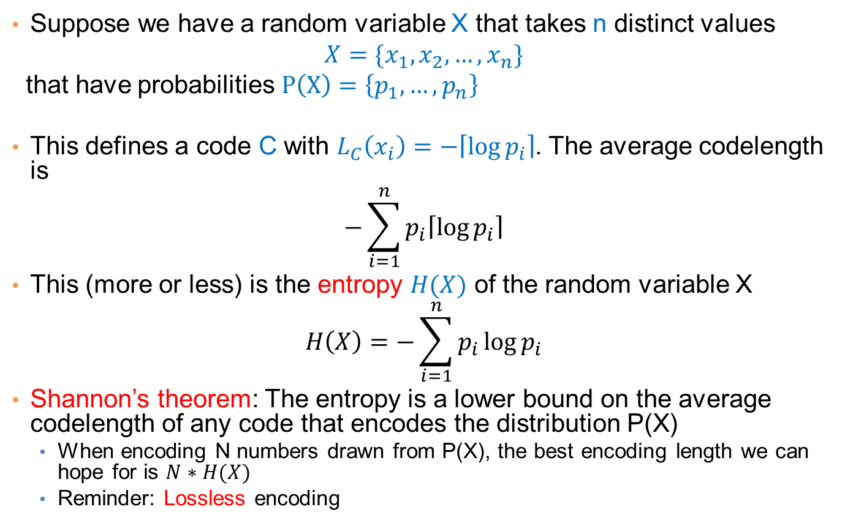
Entropy
Suppose we have a random variable X that takes n distinct values
$$X=\{x_{1},x_{2},…, x_{n}\}$$
that have probabilities $P\left(X\right)=\left\{p_{1},…, p_{n}\right\}$
This defines a code C with $L_{C}\left(x_{i}\right)=−\left\lceil \log{p_{i}}\right\rceil$. The average codelength is
$$−\sum_{i=1}^{n}{p_{i}\left\lceil \log{p_{i}}\right\rceil }$$
This (more or less) is the entropy $H(X)$ of the random variable X
$$H\left(X\right)=−\sum_{i=1}^{n}{p_{i}\log{p_{i}}}$$
Shannon’s theorem: The entropy is a lower bound on the average codelength of any code that encodes the distribution P(X)
  When encoding N numbers drawn from P(X), the best encoding length we can hope for is $N∗H(X)$
  Reminder: Lossless encoding

Slide 14
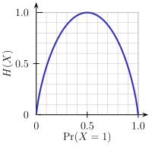
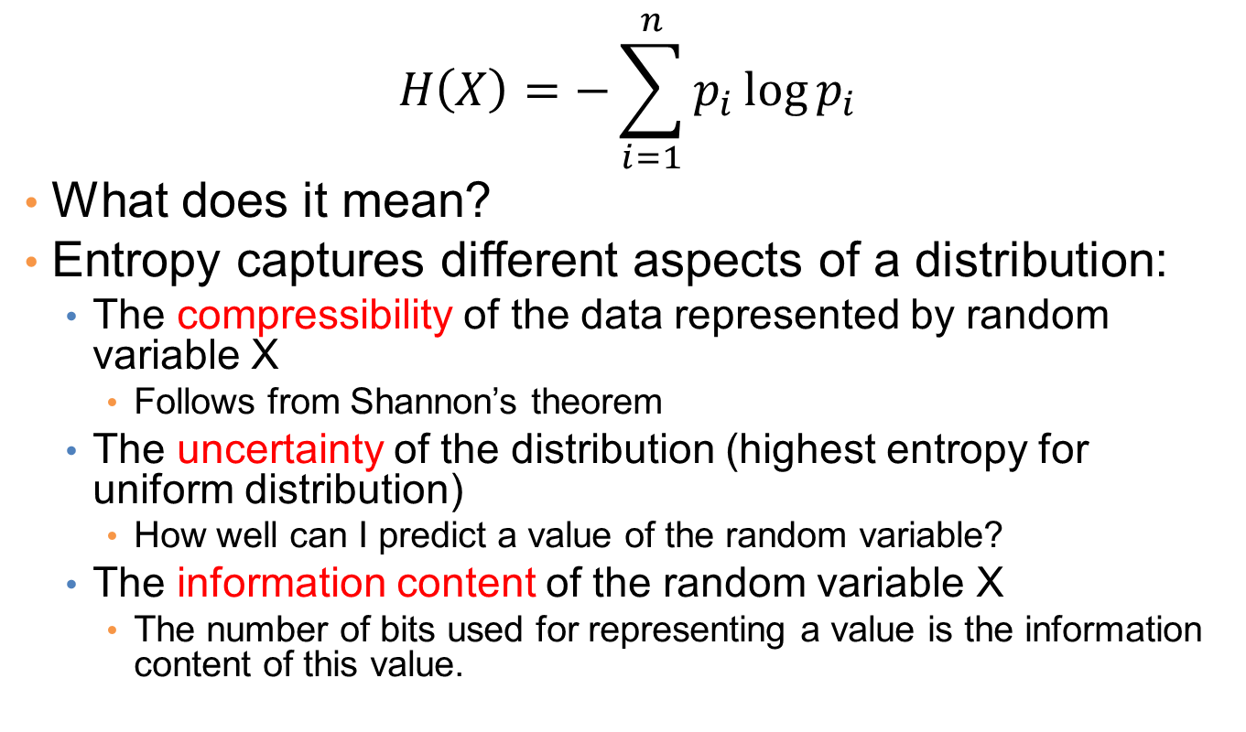
Entropy
$$H\left(X\right)=−\sum_{i=1}^{n}{p_{i}\log{p_{i}}}$$
What does it mean?
Entropy captures different aspects of a distribution:
  The compressibility of the data represented by random variable X
    Follows from Shannon’s theorem
  The uncertainty of the distribution (highest entropy for uniform distribution)
    How well can I predict a value of the random variable?
  The information content of the random variable X
    The number of bits used for representing a value is the information content of this value.

Slide 15
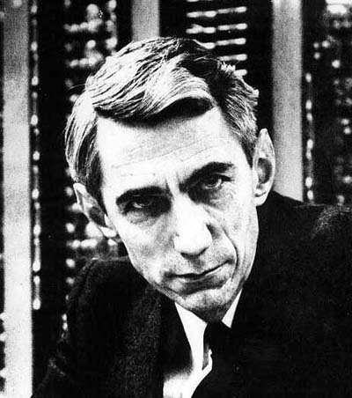
Claude Shannon
Father of Information Theory
Envisioned the idea of communication of information with 0/1 bits
Introduced the word “bit”
The word entropy was suggested by Von Neumann
  Similarity to physics, but also “nobody really knows what entropy really is, so in any conversation you will have an advantage”

Slide 16
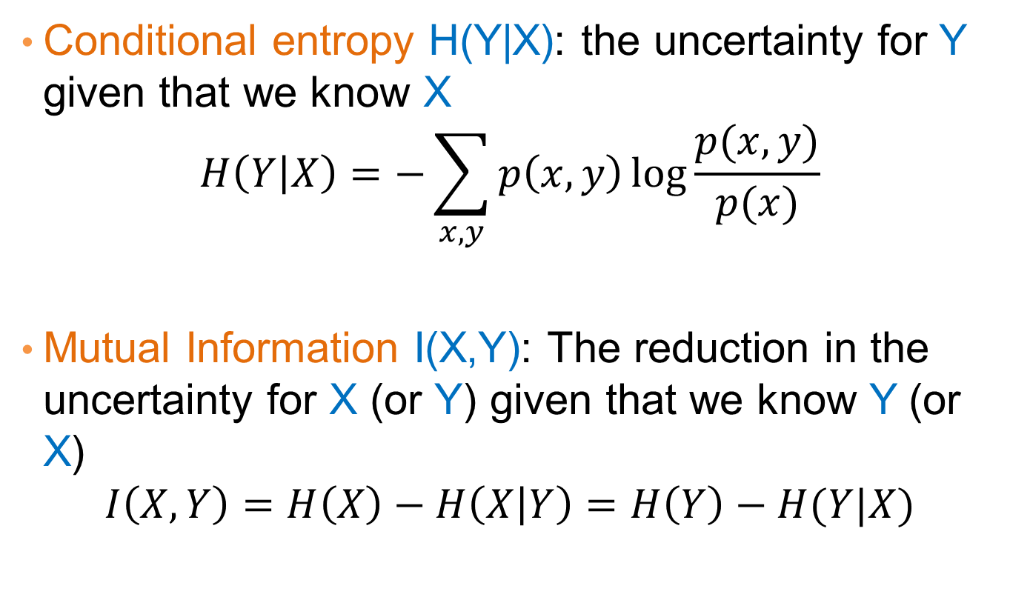
Some information theoretic measures
Conditional entropy H(Y|X): the uncertainty for Y given that we know X
$$H\left(Y | X\right)=−\sum_{x,y}{p\left(x,y\right)\log{\frac{p(x,y)}{p(x)}}}$$
Mutual Information I(X,Y): The reduction in the uncertainty for X (or Y) given that we know Y (or X)
$$I\left(X,Y\right)=H\left(X\right)−H\left(X | Y\right)=H\left(Y\right)−H(Y|X)$$

Slide 17
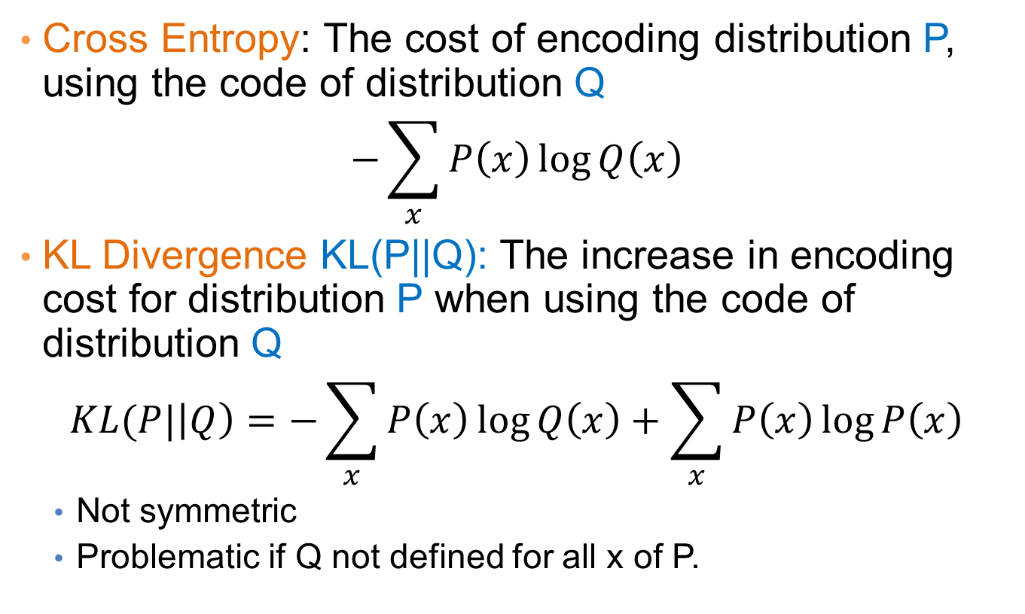
Some information theoretic measures
Cross Entropy: The cost of encoding distribution P, using the code of distribution Q
$$−\sum_{x}{P\left(x\right)\log{Q\left(x\right)}}$$
KL Divergence KL(P||Q): The increase in encoding cost for distribution P when using the code of distribution Q
$$KL(P|\left|Q\right)=−\sum_{x}{P\left(x\right)\log{Q\left(x\right)}}+\sum_{x}{P\left(x\right)\log{P\left(x\right)}}$$
  Not symmetric
  Problematic if Q not defined for all x of P.

Slide 18
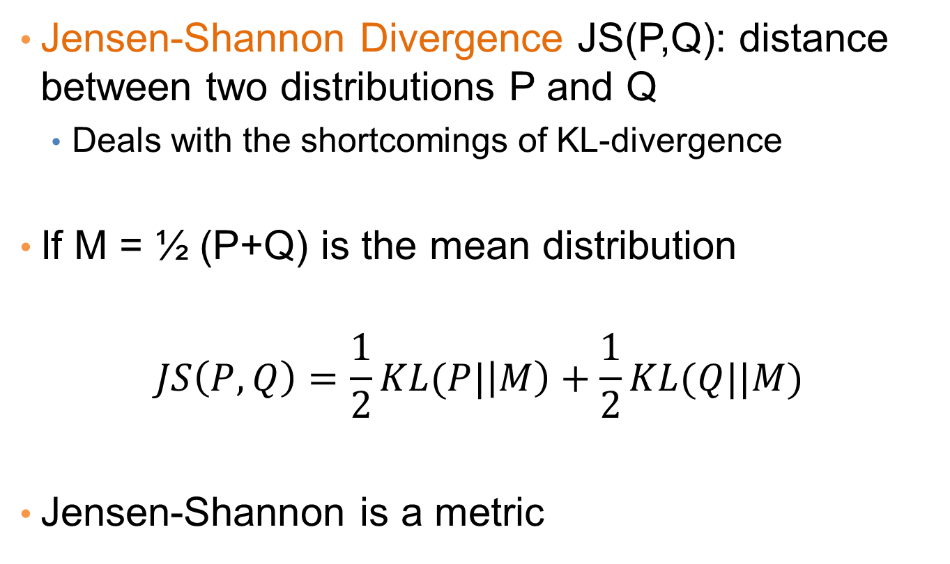
Some information theoretic measures
Jensen-Shannon Divergence JS(P,Q): distance between two distributions P and Q
  Deals with the shortcomings of KL-divergence
If M = ½ (P+Q) is the mean distribution
$$JS\left(P,Q\right)=\frac{1}{2}KL(P|\left|M\right)+\frac{1}{2}KL(Q||M)$$
Jensen-Shannon is a metric

Slide 19
Using MDL for
Co-CLUSTERING
(CROSS-ASSOCIATIONS)
Thanks to Spiros Papadimitriou.

Slide 20

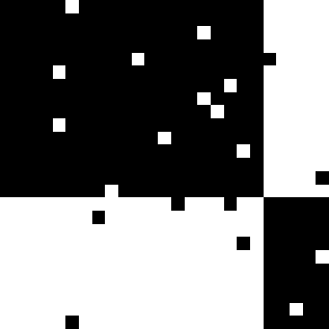
Co-clustering
Simultaneous grouping of rows and columns of a matrix into homogeneous groups
Students buying books
5
5
97%
3%
10
10
Customers
54%
Customer groups
15
15
20
20
3%
96%
25
25
5
10
15
20
25
5
10
15
20
25
Product groups
Products
CEOs buying BMWs

Slide 21
Co-clustering
Step 1: How to define a “good” partitioning?
Intuition and formalization
Step 2: How to find it?

Slide 22
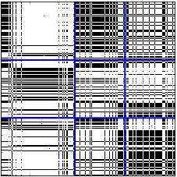
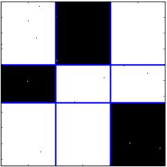
Co-clustering
Intuition
Why is this better?
Row groups
Row groups
versus
Column groups
Column groups
Good Clustering
Similar nodes are grouped together
As few groups as necessary
A few, homogeneous blocks
Good Compression
implies

Slide 23
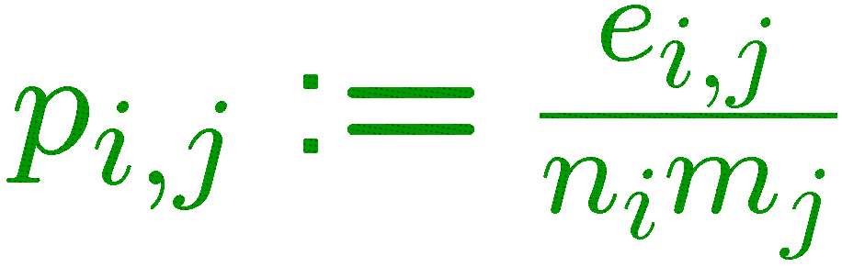
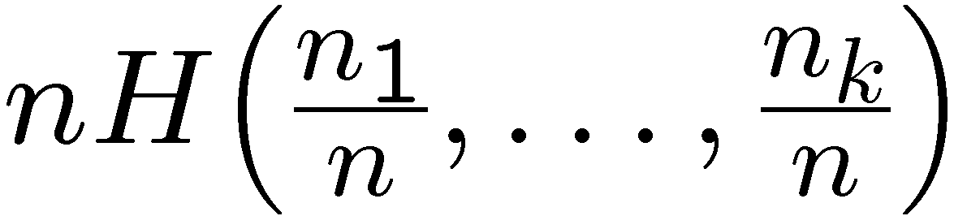
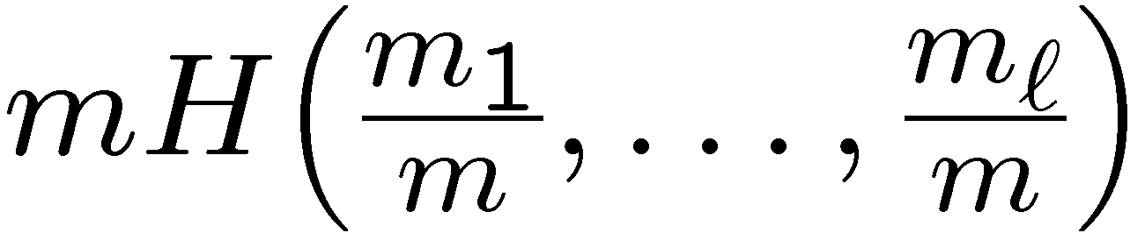
Co-clustering
MDL formalization—Cost objective
ℓ = 3 col. groups
m₁
m₂
m₃
density of ones
n₁
n₁m₂ H(p_{1,2}) bits for (1,2)
p_{1,1}
p_{1,2}
p_{1,3}
block size
entropy
∑_{i,j} n_{i}m_{j} H(p_{i,j})
bits total
k = 3 row groups
n₂
p_{2,1}
p_{2,2}
p_{2,3}
data cost
+
model cost
n₃
p_{3,1}
p_{3,2}
p_{3,3}
+
row-partition
description
col-partition
description
∑_{i,j}
+
log*k + log*ℓ
+
⎡log n_{i}m_{j}⎤
n × m matrix
transmit
#partitions
transmit
#ones e_{i,j}

Slide 24
Co-clustering
MDL formalization—Cost objective
✗
✗
one row group
one col group
n row groups
m col groups
high
low
code cost
(block contents)
+
low
high
description cost
(block structure)

Slide 25
Co-clustering
MDL formalization—Cost objective
✓
k = 3 row groups
ℓ = 3 col groups
low
code cost
(block contents)
+
low
description cost
(block structure)

Slide 26
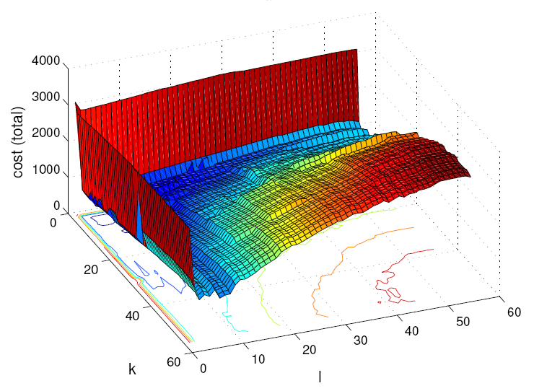
Co-clustering
MDL formalization—Cost objective
Cost vs. number of groups
one row group
one col group
total bit cost
n row groups
m col groups
k
ℓ
k = 3 row groups
ℓ = 3 col groups

Slide 27
Co-clustering
Step 1: How to define a “good” partitioning?
Intuition and formalization
Step 2: How to find it?

Slide 28
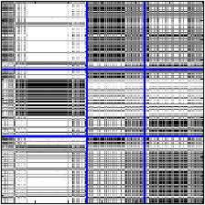
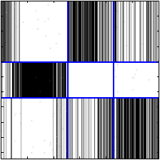
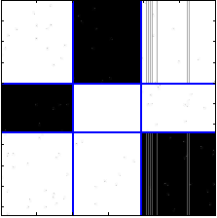
Search for solution
Overview: assignments w/ fixed number of groups (shuffles)
original groups
row shuffle
column shuffle
row shuffle
reassign all rows,
holding column
assignments fixed
reassign all columns,
holding row
assignments fixed
No cost improvement:
Discard

Slide 29
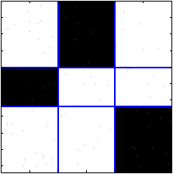
Search for solution
Overview: assignments w/ fixed number of groups (shuffles)
Final shuffle result
row shuffle
column shuffle
column shuffle
column shuffle
row shuffle
No cost improvement:
Discard

Slide 30
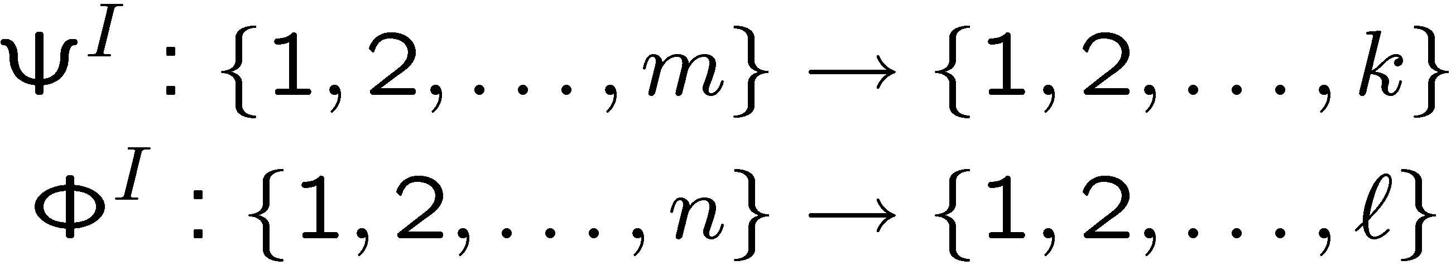
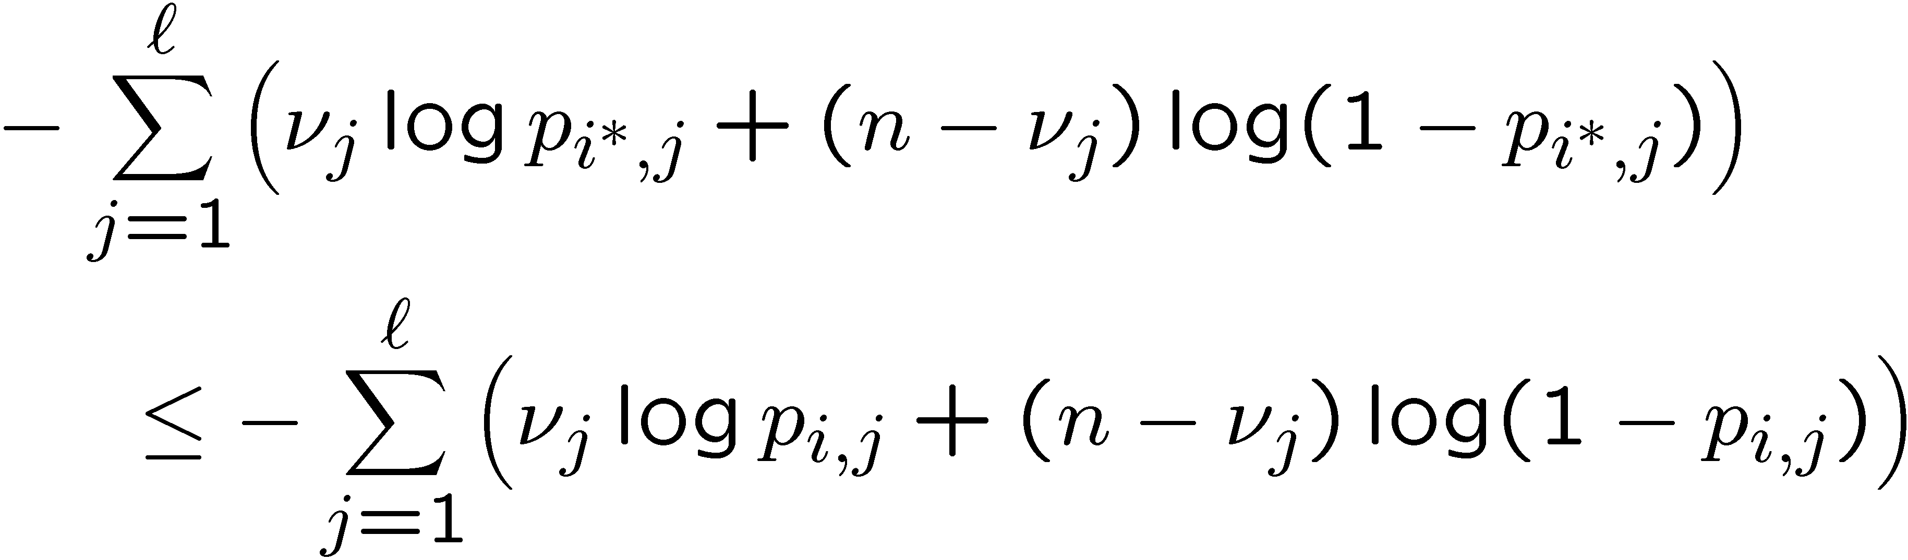
Search for solution
Shuffles
Let
denote row and col. partitions at the I-th iteration
Fix Φ^{I} and for every row x:
  Splice into ℓ parts, one for each column group
  Let ν_{j}, for j = 1,…,ℓ, be the number of ones in each part
  Assign row x to the row group i¤ ≡ Ψ^{I+1}(x) such that, for all i = 1,…,k,
Similarity (“KL-divergences”)
of row fragments
to blocks of a row group
p_{1,1}
p_{1,2}
p_{1,3}
p_{2,1}
p_{2,2}
p_{2,3}
Assign to second row-group
p_{3,1}
p_{3,2}
p_{3,3}

Slide 31
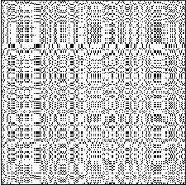
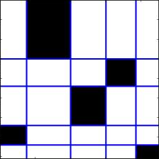
Search for solution
Overview: number of groups k and ℓ (splits & shuffles)
k = 5, ℓ = 5

Slide 32
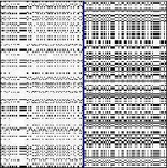
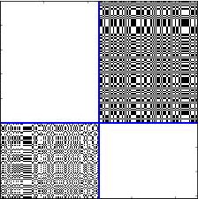
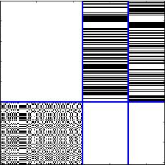
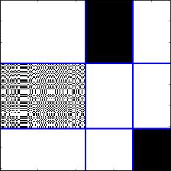
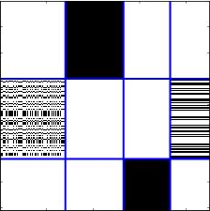
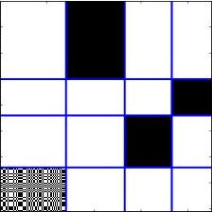
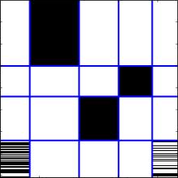
Search for solution
Overview: number of groups k and ℓ (splits & shuffles)
k = 1, ℓ = 1
shuffle
shuffle
col. split
row split
row split
No cost improvement:
Discard
k = 5, ℓ = 6
k = 6, ℓ = 5
k = 5, ℓ = 5
shuffle
shuffle
shuffle
shuffle
shuffle
shuffle
shuffle
col. split
row split
col. split
row split
col. split
row split
col. split
k=1, ℓ=2
k=2, ℓ=2
k=2, ℓ=3
k=3, ℓ=3
k=3, ℓ=4
k=4, ℓ=4
k=4, ℓ=5
Split:
Increase k or ℓ
Shuffle:
Rearrange rows or cols

Slide 33
Search for solution
Overview: number of groups k and ℓ (splits & shuffles)
k = 1, ℓ = 1
k = 5, ℓ = 5
k = 5, ℓ = 5
Final result
k=1, ℓ=2
k=2, ℓ=2
k=2, ℓ=3
k=3, ℓ=3
k=3, ℓ=4
k=4, ℓ=4
k=4, ℓ=5
Split:
Increase k or ℓ
Shuffle:
Rearrange rows or cols

Slide 34
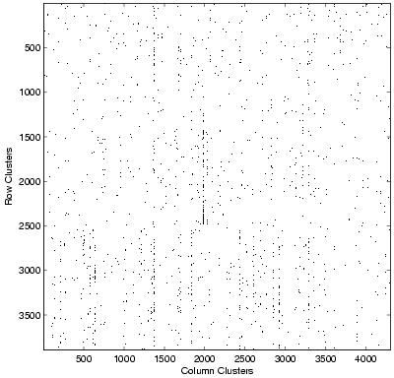
Co-clustering
CLASSIC
CLASSIC corpus
3,893 documents
4,303 words
176,347 “dots” (edges)
Combination of 3 sources:
MEDLINE (medical)
CISI (info. retrieval)
CRANFIELD (aerodynamics)
Documents
Words

Slide 35
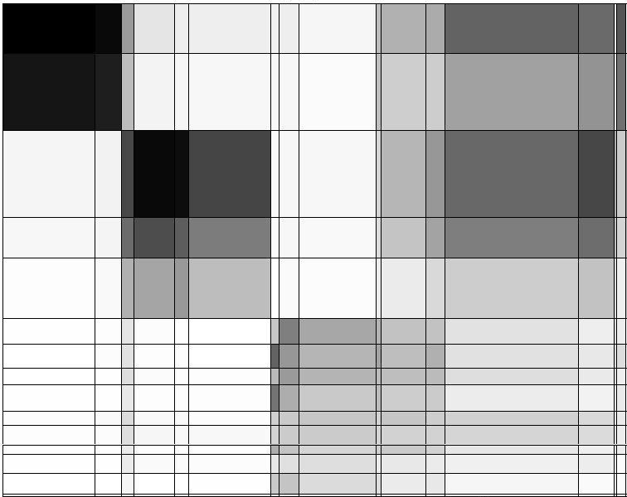
Graph co-clustering
CLASSIC
Documents
Words
“CLASSIC” graph of documents & words:
k = 15, ℓ = 19

Slide 36
Co-clustering
CLASSIC
insipidus, alveolar, aortic, death, prognosis, intravenous
blood, disease, clinical, cell, tissue, patient
paint, examination, fall, raise, leave, based
MEDLINE
(medical)
CISI
(Information Retrieval)
CRANFIELD (aerodynamics)
providing, studying, records, development, students, rules
abstract, notation, works, construct, bibliographies
shape, nasa, leading, assumed, thin
“CLASSIC” graph of documents & words:
k = 15, ℓ = 19

Slide 37
Co-clustering
CLASSIC
Document cluster # | Document class |  |  | Precision
 | CRANFIELD | CISI | MEDLINE
1 | 0 | 1 | 390 | 0.997
2 | 0 | 0 | 610 | 1.000
3 | 2 | 676 | 9 | 0.984
4 | 1 | 317 | 6 | 0.978
5 | 3 | 452 | 16 | 0.960
6 | 207 | 0 | 0 | 1.000
7 | 188 | 0 | 0 | 1.000
8 | 131 | 0 | 0 | 1.000
9 | 209 | 0 | 0 | 1.000
10 | 107 | 2 | 0 | 0.982
11 | 152 | 3 | 2 | 0.968
12 | 74 | 0 | 0 | 1.000
13 | 139 | 9 | 0 | 0.939
14 | 163 | 0 | 0 | 1.000
15 | 24 | 0 | 0 | 1.000
Recall | 0.996 | 0.990 | 0.968
0.999
0.975
0.94-1.00
0.987
0.97-0.99

