Slide 1
DATA MINING
LECTURE 6
Mixture of Gaussians and the EM algorithm
DBSCAN: A Density-Based Clustering Algorithm
Clustering Validation

Slide 2
Ανακοινώσεις
Η προθεσμία για τη παράδοση των θεωρητικών ασκήσεων είναι Τετάρτη 4/4
  Καθυστερημένες ασκήσεις σε μετέπειτα ημέρες θα πρέπει να παραδοθούν στην κα. Σουλίου, η οποία θα σημειώνει την ημέρα παράδοσης (Πέμπτη-Παρασκευή μέχρι τις 2:30, ή κάτω από την πόρτα μετά).
  Μπορείτε να τις παραδώσετε και ηλεκτρονικά αν θέλετε.
WEKA: Αν σας βγάλει out-of-memory error, ακολουθείστε τις οδηγίες και αλλάξτε το .ini αρχείο. Θα σας πει ότι δεν επιτρέπεται, οπότε πρέπει να το αντιγράψετε αλλού να το αλλάξετε και μετά να το αντιγράψετε ξανά.
LSH Implementation: Για την υλοποίηση θα χρειαστείτε μια υλοποίηση ενός Dictionary και List. Η C++ έχει μια βιβλιοθήκη (STL), και η Java τα έχει ως built-in data types.

Slide 3
Συντομο Μαθημα για HASH TABLE IMPLEMENTATIONS

Slide 4
Vector, map
Container | Χαρακτηριστικά
vector | Δυναμικός πίνακας
map | Κρατάει ζεύγη κλειδιών και τιμών (key-value pairs). Συσχετίζει αντικείμενα-κλειδιά με αντικείμενα-τιμές. Το κάθε κλειδί μπορεί να συσχετίζεται με μόνο μία τιμή

Slide 5
vector
Μέθοδος | Λειτουργία
size() | επιστρέφει τον αριθμό των στοιχείων μέσα στον πίνακα
push_back() | προσθέτει ένα στοιχείο στο τέλος του πίνακα
pop_back() | αφαιρεί το τελευταίο στοιχείο του πίνακα
back() | επιστρέφει το τελευταίο στοιχείο του πίνακα
operator [] | τυχαία πρόσβαση στα στοιχεία του πίνακα
empty() | επιστρέφει true αν το vector είναι άδειο
insert() | προσθέτει ένα στοιχείο σε ενδιάμεση θέση (χρησιμοποιώντας iterator)
erase() | αφαιρεί ένα στοιχείο από ενδιάμεση θέση (χρησιμοποιώντας iterator)

Slide 6
Παράδειγμα
#include <iostream>
#include <vector>
using namespace std;
int main(){
vector<int> v;
int x;
do{
cin >> x;
v.push_back(x);
}while (x != -1);
v[v.size() - 1] = 0;
cout << "vector elements: ";
for (int i = 0; i < v.size(); i ++){
cout << v[i] << " ";
}
cout << endl;
}

Slide 7
Παραδειγμα map
#include <iostream>
#include <map>
using namespace std;
int main(){
map<string,Person*> M;
string fname,lname;
while (!cin.eof()){
cin >> fname >> lname;
Person *p =new Person(fname,lname);
M[lname] = p;
}
map<string,Person*>::iterator iter = M.find(“marley");
if (iter == M.end()){
cout << “marley is not in\n";
}else{
M[“marley"]->PrintPersonalDetails();
}
}

Slide 8
Iterators map
#include <iostream>
#include <map>
using namespace std;
int main(){
map<string,Person*> M;
string fname,lname;
while (!cin.eof()){
cin >> fname >> lname;
Person *p =new Person(fname,lname);
M[lname] = p;
}
map<string,Person*>::iterator iter;
for (iter = M.begin(); iter != M.end(); i++){
cout << (*iter).first << “:”;
(*iter).second->PrintPersonalDetails();
}
}
(*iter).first: Το κλειδί του map στη θέση στην οποία δείχνει ο iterator
(*iter).second: Η τιμή του map στη θέση στην οποία δείχνει ο iterator

Slide 9
ArrayList
O Container ArrayList κληρονομει από το List και αυτό από το Collection.
Προσφέρει σειριακή αποθήκευση δεδομένων και έχει όλα τα πλεονεκτήματα και μειονεκτήματα του vector στην C++.
Στην Java δεν επιτρέπεται υπερφόρτωση τελεστών οπότε χρησιμοποιούμε την μέθοδο get(index) για να διαβάσουμε ένα στοιχείο.
Διάσχιση του ArrayList με την foreach εντολή είναι πιο απλή απ ότι με τον iterator.

Slide 10
import java.io.*;
import java.util.*;
public class arraylist {
public static void main(String[] args) {
ArrayList<Integer> A = new ArrayList<Integer>();
for (int i = 0; i < 10; i ++){
Random r = new Random();
A.add(r.nextInt(100));
System.out.println(A.get(i));
}
Collections.sort(A);
System.out.println("");
for (int x: A){
System.out.println(x);
}
System.out.println("");
System.out.println(A.toString());
}
}

Slide 11
HashMap
To HashMap ορίζει ένα συνειρμικό αποθηκευτή (associative container) ο οποίος συσχετίζει κλειδιά με τιμές, κληρονομεί από την πιο γενική κλάση Map.
  Π.χ., ο βαθμός ενός φοιτητή, η συχνότητα με την οποία εμφανίζεται μια λέξη σε ένα κείμενο.
H βιβλιοθήκη της Java μας δίνει πιο εύκολη πρόσβαση στα κλειδιά και τις τιμές του map.
Χρήσιμες μέθοδοι:
  put(key,value): προσθέτει ένα νέο key-value ζεύγος
  containsKey(key): επιστρέφει αληθές αν υπάρχει το κλειδί
  containsValue(value): επιστρέφει αληθές αν υπάρχει η τιμή
  values(): επιστρέφει ένα Collection με τις τιμές
  keySet(): επιστρέφει ένα Set με τις τιμές.

Slide 12
import java.io.*;
import java.util.*;
public class mapexample {
public static void main(String[] args) {
String line;
Map<String,Integer> namesGrades = new HashMap<String,Integer>();
try{
FileReader fr = new FileReader("Files/in.txt");
BufferedReader inReader = new BufferedReader(fr);
while((line = inReader.readLine())!=null){
System.out.println(line);
String [] words = line.split("\t");
Integer grade = Integer.parseInt(words[1]);
namesGrades.put(words[0],grade);
}
} catch(IOException ex){
System.out.println("IO Error" + ex);
}
for(String x: namesGrades.keySet()){
System.out.println(x + " -- " + namesGrades.get(x));
}
}
}

Slide 13
Mixture Models and the EM Algorithm

Slide 14
Model-based clustering
In order to understand our data, we will assume that there is a generative process (a model) that creates/describes the data, and we will try to find the model that best fits the data.
  Models of different complexity can be defined, but we will assume that our model is a distribution from which data points are sampled
  Example: the data is the height of all people in Greece
In most cases, a single distribution is not good enough to describe all data points: different parts of the data follow a different distribution
  Example: the data is the height of all people in Greece and China
  We need a mixture model
  Different distributions correspond to different clusters in the data.

Slide 15
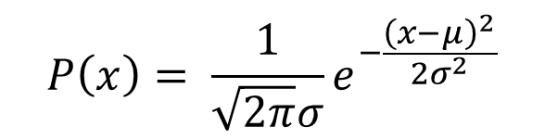
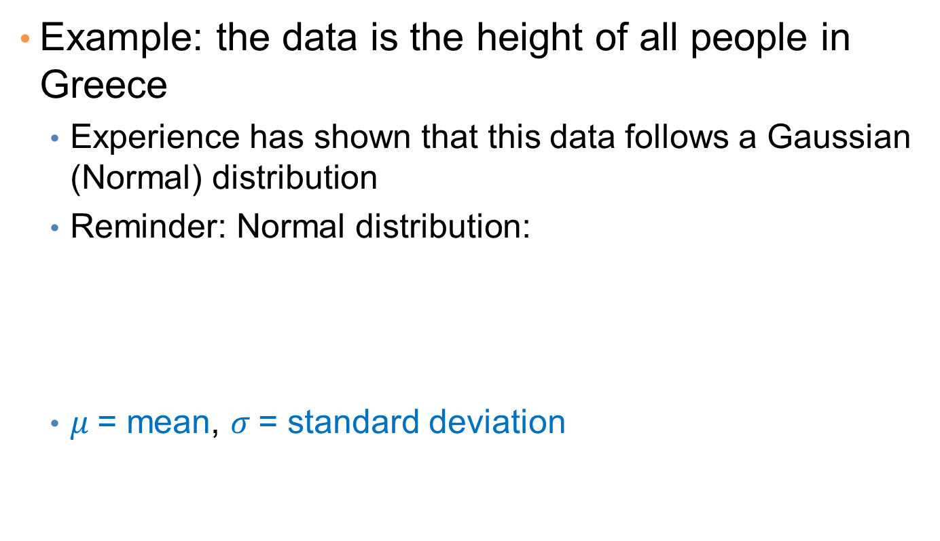
Gaussian Distribution
Example: the data is the height of all people in Greece
  Experience has shown that this data follows a Gaussian (Normal) distribution
  Reminder: Normal distribution:
  $μ$= mean, $σ$= standard deviation
$$P\left(x\right)= \frac{1}{\sqrt{2π}σ}e^{−\frac{{\left(x−μ\right)}^{2}}{2σ^{2}}}$$

Slide 16
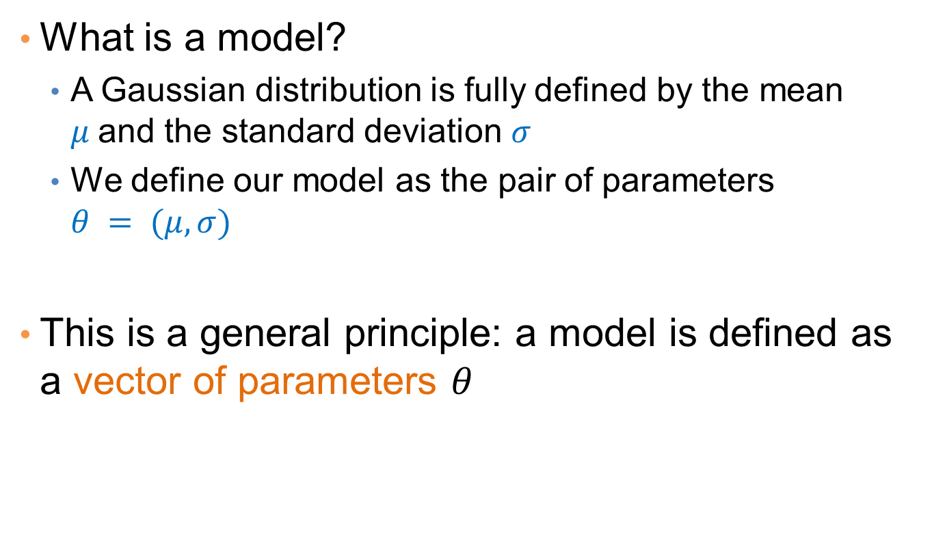
Gaussian Model
What is a model?
  A Gaussian distribution is fully defined by the mean $μ$and the standard deviation $σ$
  We define our model as the pair of parameters $θ = (μ, σ)$
This is a general principle: a model is defined as a vector of parameters $θ$

Slide 17

Fitting the model
We want to find the normal distribution that best fits our data
  Find the best values for $μ$and $σ$
  But what does best fit mean?

Slide 18
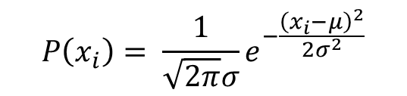
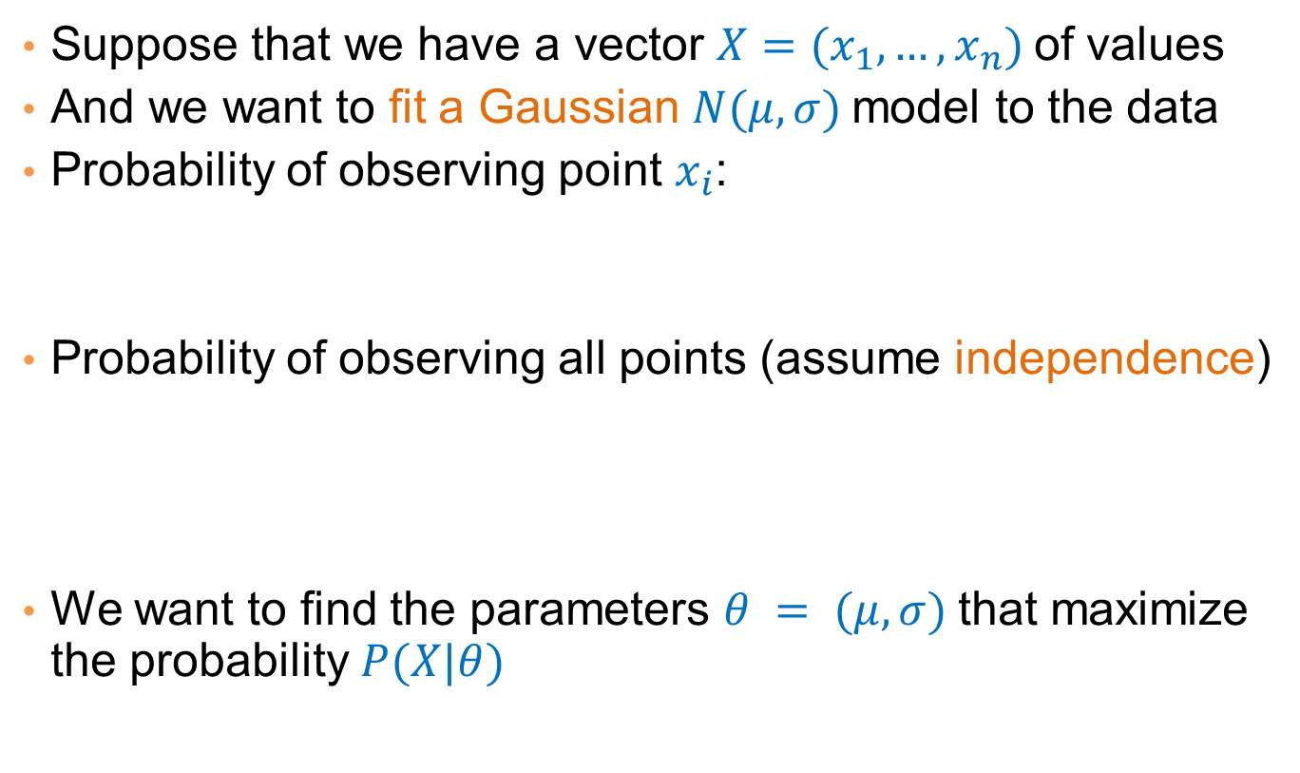
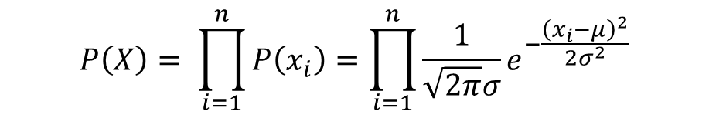
Maximum Likelihood Estimation (MLE)
Suppose that we have a vector $X=(x_{1},…,x_{n})$of values
And we want to fit a Gaussian $N(μ,σ)$model to the data
Probability of observing point $x_{i}$:
Probability of observing all points (assume independence)
We want to find the parameters $θ = (μ, σ)$that maximize the probability $P(X|θ)$
$$P\left(x_{i}\right)= \frac{1}{\sqrt{2π}σ}e^{−\frac{{\left(x_{i}−μ\right)}^{2}}{2σ^{2}}}$$
$$P\left(X\right)= \prod_{i=1}^{n}{P\left(x_{i}\right)}=\prod_{i=1}^{n}{\frac{1}{\sqrt{2π}σ}e^{−\frac{{\left(x_{i}−μ\right)}^{2}}{2σ^{2}}}}$$

Slide 19

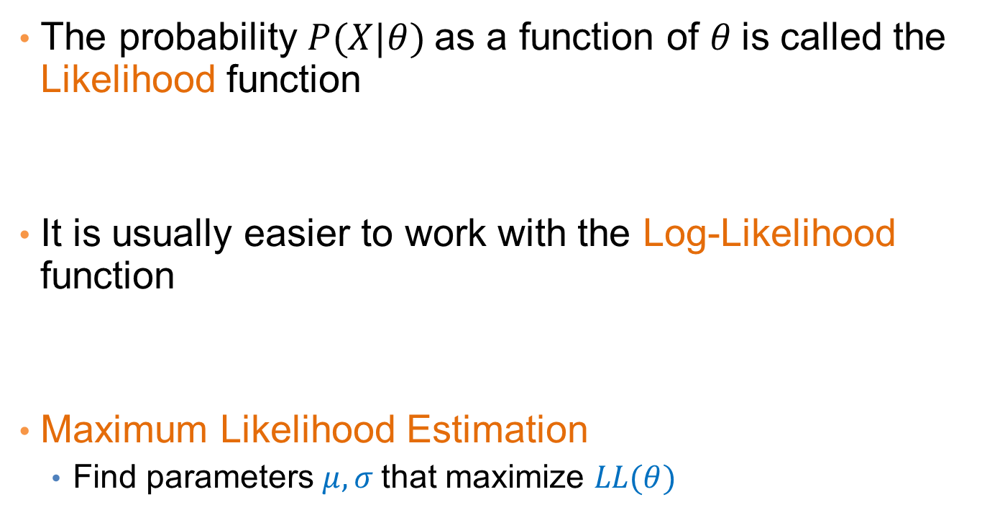
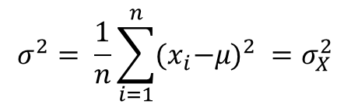
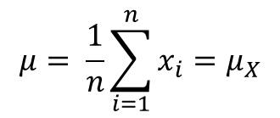
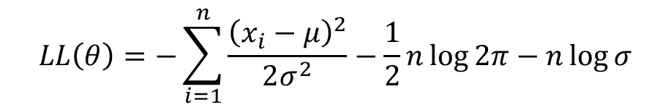
Maximum Likelihood Estimation (MLE)
The probability $P(X|θ)$as a function of $θ$is called the Likelihood function
It is usually easier to work with the Log-Likelihood function
Maximum Likelihood Estimation
  Find parameters $μ, σ$that maximize $LL(θ)$
$$L(θ)=\prod_{i=1}^{n}{\frac{1}{\sqrt{2π}σ}e^{−\frac{{\left(x_{i}−μ\right)}^{2}}{2σ^{2}}}}$$
$$LL\left(θ\right)=−\sum_{i=1}^{n}{\frac{{\left(x_{i}−μ\right)}^{2}}{2σ^{2}}−\frac{1}{2}n\log{2π}−n\log{σ}}$$
$$μ= \frac{1}{n}\sum_{i=1}^{n}{x_{i}=μ_{X}}$$
$$σ^{2}= \frac{1}{n}\sum_{i=1}^{n}{{{(x}_{i}−μ)}^{2} }=σ_{X}^{2}$$
Sample Mean
Sample Variance

Slide 20
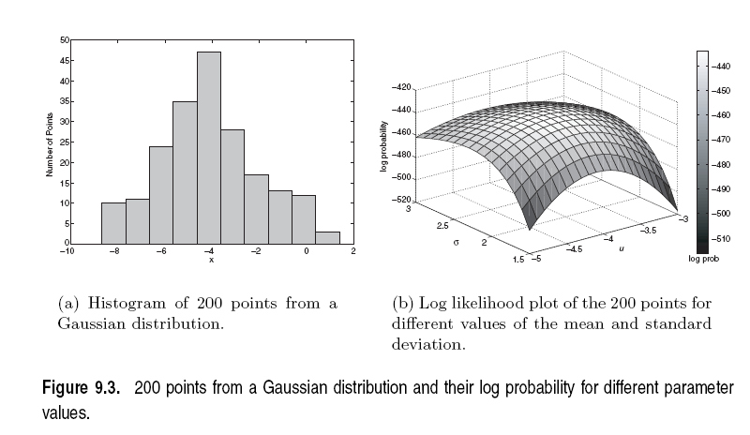

Slide 21
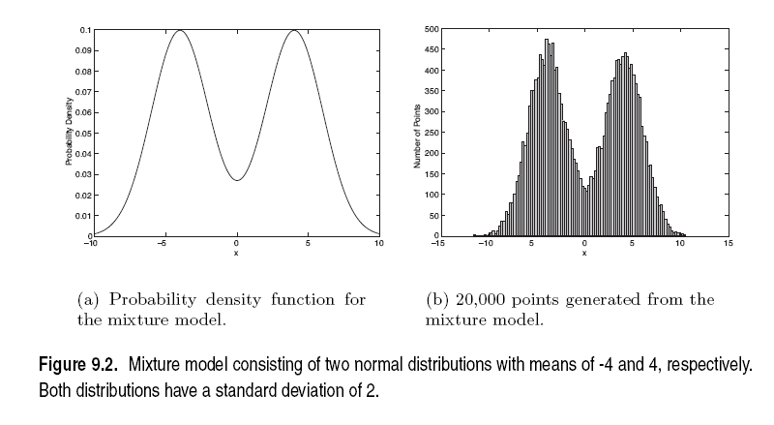
Mixture of Gaussians
Suppose that you have the heights of people from Greece and China and the distribution looks like the figure below (dramatization)

Slide 22
Mixture of Gaussians
In this case the data is the result of the mixture of two Gaussians
  One for Greek people, and one for Chinese people
  Identifying for each value which Gaussian is most likely to have generated it will give us a clustering.

Slide 23
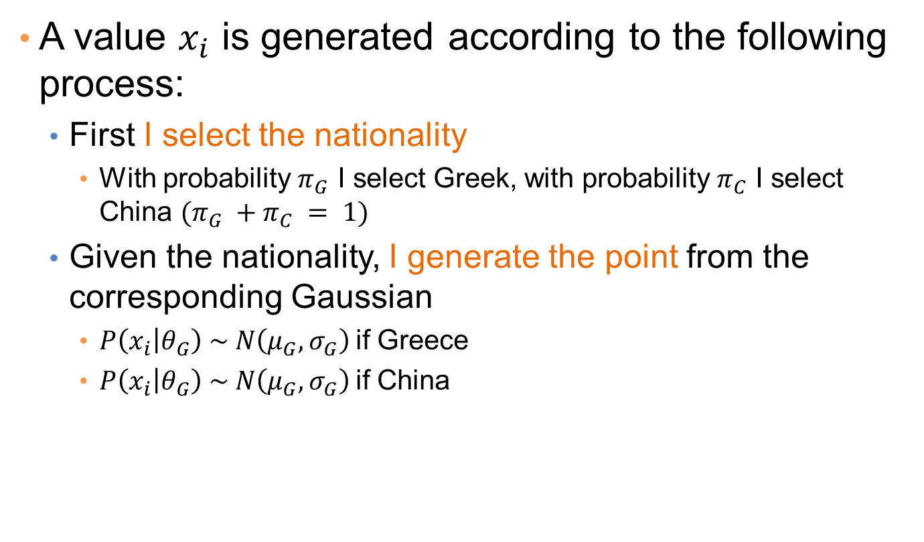
Mixture model
A value $x_{i}$ is generated according to the following process:
  First I select the nationality
    With probability $π_{G}$ I select Greek, with probability $π_{C}$ I select China $(π_{G} +π_{C} = 1)$
  Given the nationality, I generate the point from the corresponding Gaussian
    $P\left(x_{i} | θ_{G}\right) \sim N\left(μ_{G},σ_{G}\right)$if Greece
    $P\left(x_{i} | θ_{G}\right) \sim N\left(μ_{G},σ_{G}\right)$if China

Slide 24
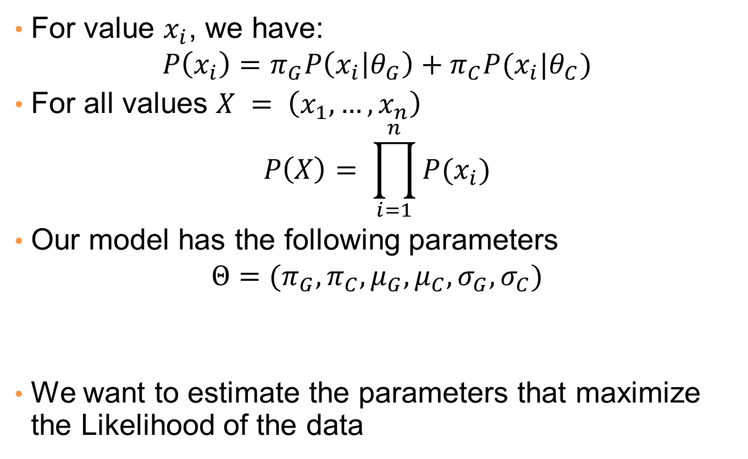
Mixture Model
For value $x_{i}$, we have:
$$P\left(x_{i}\right)=π_{G}P\left(x_{i} | θ_{G}\right)+π_{C}P(x_{i}|θ_{C})$$
For all values $X = \left(x_{1},…,x_{n}\right)$
$$P\left(X\right)= \prod_{i=1}^{n}{P(x_{i})}$$
Our model has the following parameters
$$Θ=(π_{G},π_{C},μ_{G},μ_{C}, σ_{G},σ_{C})$$
We want to estimate the parameters that maximize the Likelihood of the data
Mixture probabilities
Distribution Parameters

Slide 25
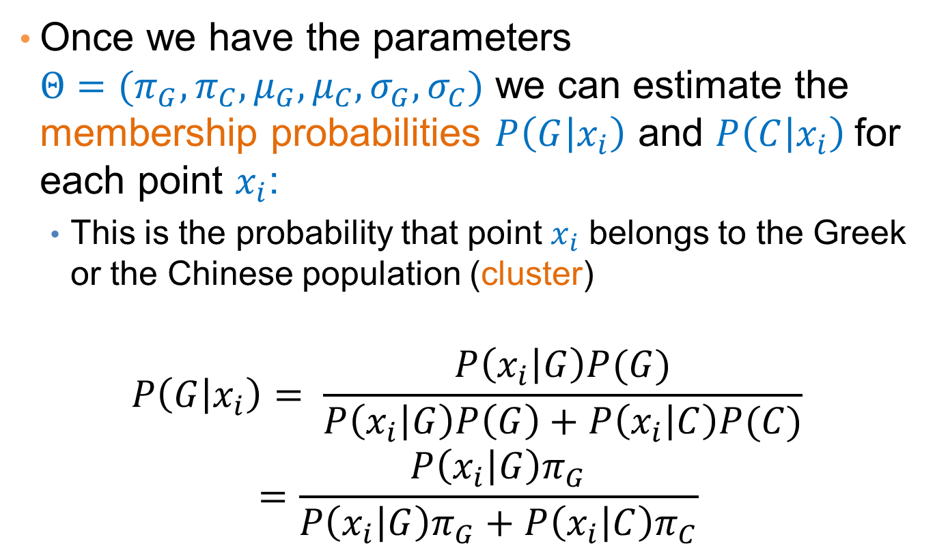
Mixture Models
Once we have the parameters $Θ=(π_{G},π_{C},μ_{G},μ_{C}, σ_{G},σ_{C})$ we can estimate the membership probabilities $P\left(G | x_{i}\right)$ and $P\left(C | x_{i}\right)$for each point $x_{i}$:
  This is the probability that point $x_{i}$ belongs to the Greek or the Chinese population (cluster)
$$P\left(G | x_{i}\right)= \frac{P\left(x_{i} | G\right)P(G)}{P\left(x_{i} | G\right)P\left(G\right)+P\left(x_{i} | C\right)P(C)} =\frac{P\left(x_{i} | G\right)π_{G}}{P\left(x_{i} | G\right)π_{G}+P\left(x_{i} | C\right)π_{C}}$$

Slide 26
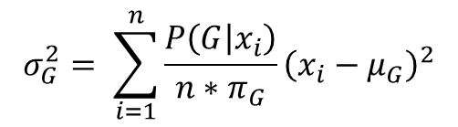
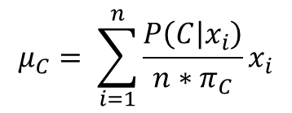
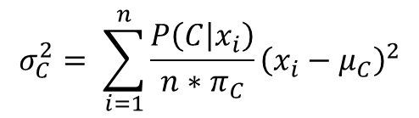
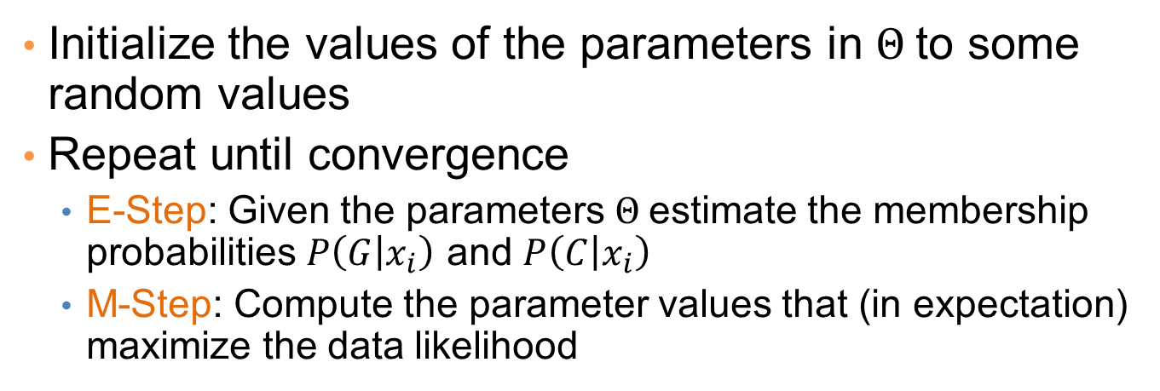
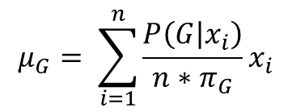
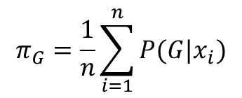
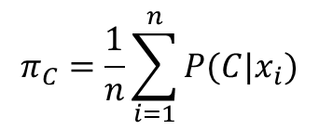
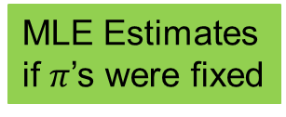
EM (Expectation Maximization) Algorithm
Initialize the values of the parameters in $Θ$to some random values
Repeat until convergence
  E-Step: Given the parameters $Θ$estimate the membership probabilities $P\left(G | x_{i}\right)$ and $P\left(C | x_{i}\right)$
  M-Step: Compute the parameter values that (in expectation) maximize the data likelihood
$$π_{G}=\frac{1}{n}\sum_{i=1}^{n}{P(G|x_{i})}$$
$$π_{C}=\frac{1}{n}\sum_{i=1}^{n}{P(C|x_{i})}$$
$$μ_{C}= \sum_{i=1}^{n}{\frac{P\left(C | x_{i}\right)}{n{∗π}_{C}}x_{i}}$$
$$μ_{G}= \sum_{i=1}^{n}{\frac{P\left(G | x_{i}\right)}{n{∗π}_{G}}x_{i}}$$
MLE Estimates
if $π$’s were fixed
$$σ_{C}^{2}= \sum_{i=1}^{n}{\frac{P\left(C | x_{i}\right)}{n{∗π}_{C}}{\left(x_{i}−μ_{C}\right)}^{2}}$$
$$σ_{G}^{2}= \sum_{i=1}^{n}{\frac{P\left(G | x_{i}\right)}{n{∗π}_{G}}{\left(x_{i}−μ_{G}\right)}^{2}}$$

Slide 27
Relationship to K-means
E-Step: Assignment of points to clusters
  K-means: hard assignment, EM: soft assignment
M-Step: Computation of centroids
  K-means assumes common fixed variance (spherical clusters)
  EM: can change the variance for different clusters or different dimensions (elipsoid clusters)
If the variance is fixed then both minimize the same error function

Slide 28
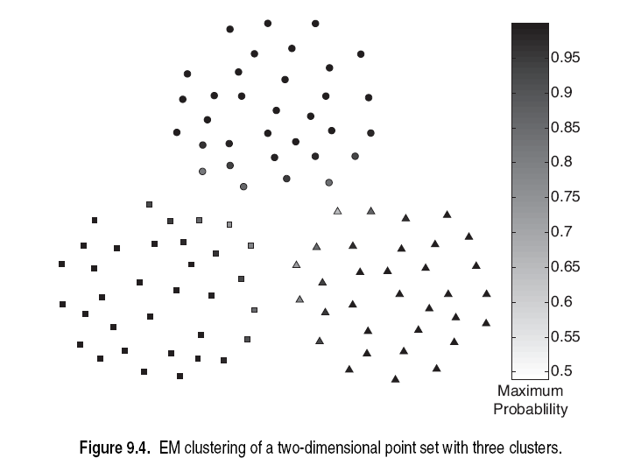

Slide 29
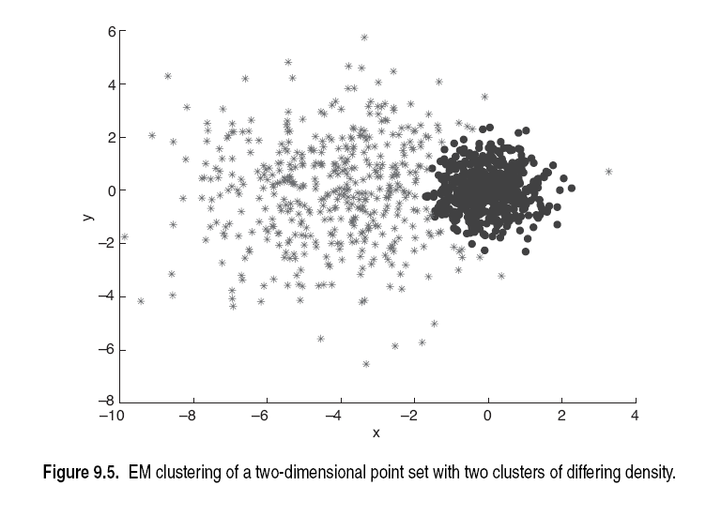

Slide 30
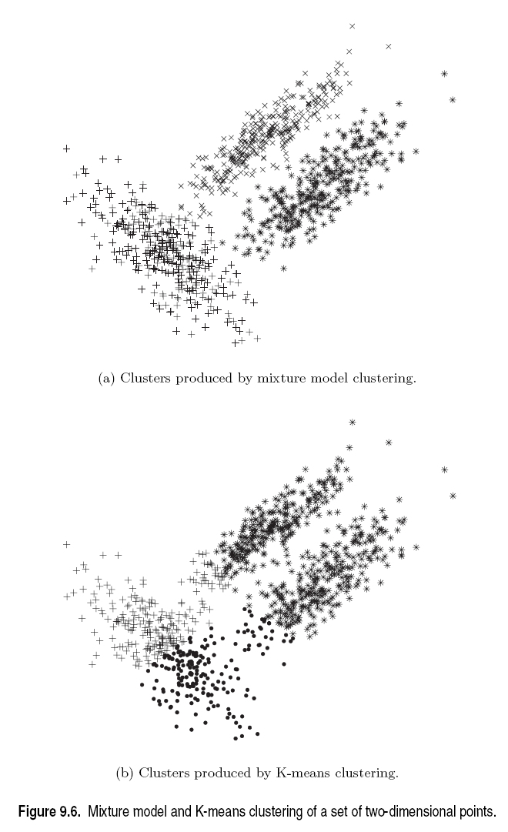

Slide 31
DBSCAN: A DENSITY-BASED Clustering Algorithm
Thanks to:
“Introduction to Data Mining” by Tan, Steinbach, Kumar.

Slide 32
DBSCAN: Density-Based Clustering
DBSCAN is a Density-Based Clustering algorithm
Reminder: In density based clustering we partition points into dense regions separated by not-so-dense regions.
Important Questions:
  How do we measure density?
  What is a dense region?
DBSCAN:
  Density at point p: number of points within a circle of radius Eps
  Dense Region: A circle of radius Eps that contains at least MinPts points

Slide 33
DBSCAN
Characterization of points
  A point is a core point if it has more than a specified number of points (MinPts) within Eps
    These points belong in a dense region and are at the interior of a cluster
  A border point has fewer than MinPts within Eps, but is in the neighborhood of a core point.
  A noise point is any point that is not a core point or a border point.

Slide 34
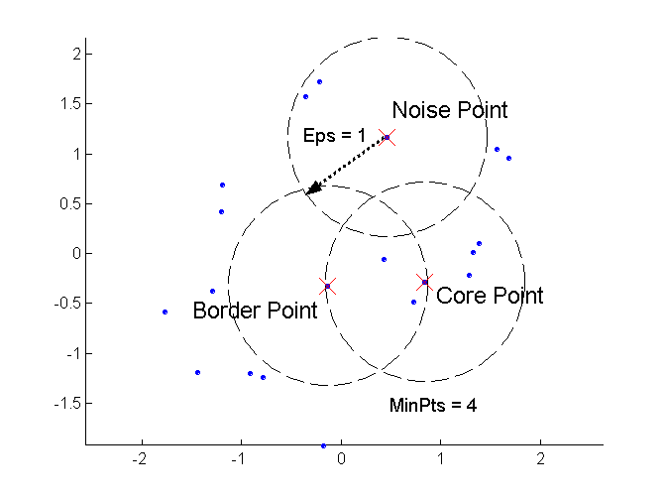
DBSCAN: Core, Border, and Noise Points

Slide 35
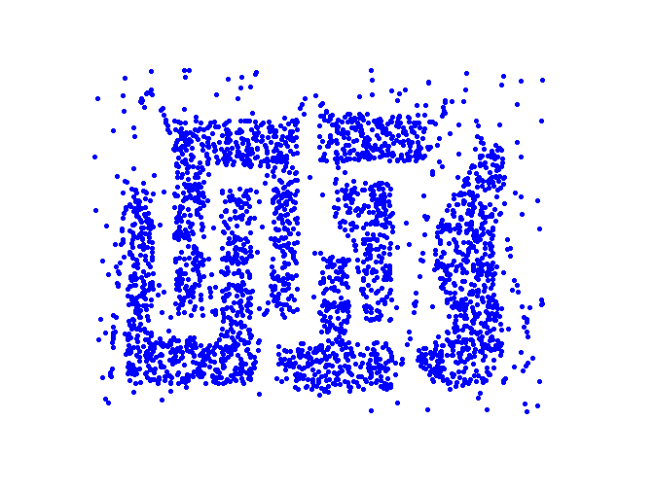
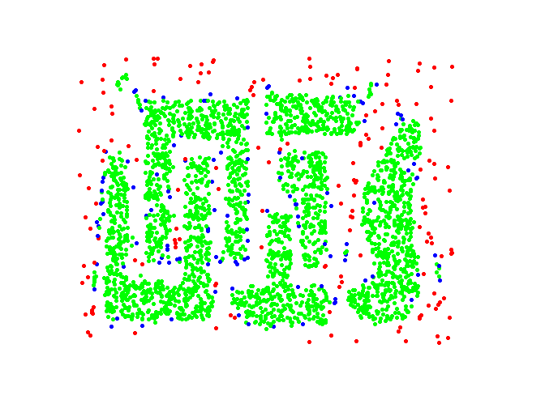
DBSCAN: Core, Border and Noise Points
Point types: core, border and noise
Original Points
Eps = 10, MinPts = 4

Slide 36
Density-Connected points
Density edge
  We place an edge between two core points q and p if they are within distance Eps.
Density-connected
  A point p is density-connected to a point q if there is a path of edges from p to q
p
p₁
q
p
q
o

Slide 37
DBSCAN Algorithm
Label points as core, border and noise
Eliminate noise points
For every core point p that has not been assigned to a cluster
  Create a new cluster with the point p and all the points that are density-connected to p.
Assign border points to the cluster of the closest core point.

Slide 38
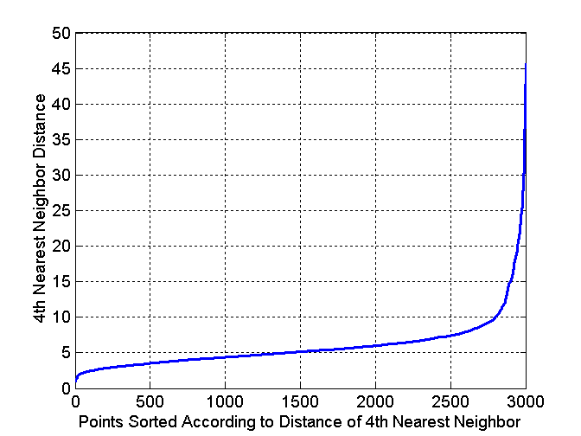
DBSCAN: Determining Eps and MinPts
Idea is that for points in a cluster, their k^{th} nearest neighbors are at roughly the same distance
Noise points have the k^{th} nearest neighbor at farther distance
So, plot sorted distance of every point to its k^{th} nearest neighbor
Find the distance d where there is a “knee” in the curve
  Eps = d, MinPts = k
Eps ~ 7-10
MinPts = 4

Slide 39
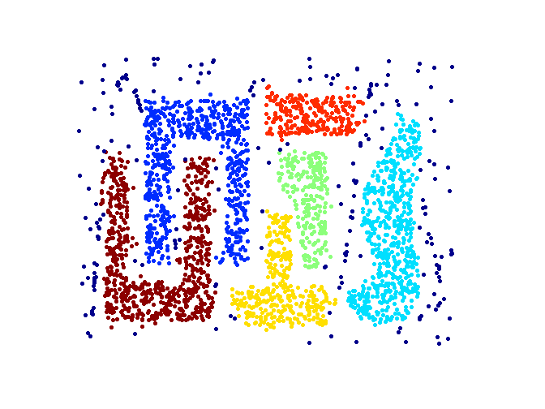
When DBSCAN Works Well
Original Points
Clusters
Resistant to Noise
Can handle clusters of different shapes and sizes

Slide 40
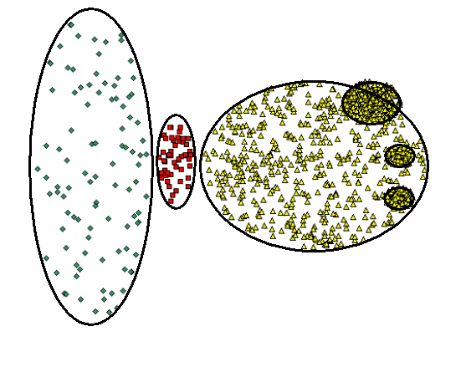
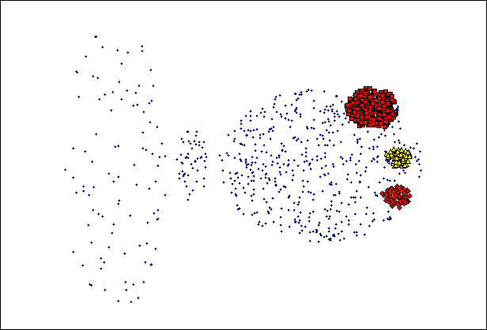
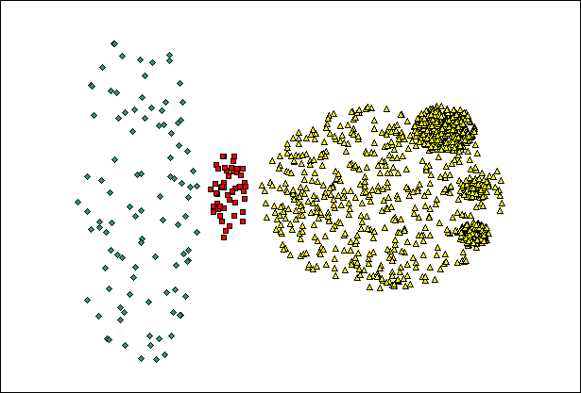
When DBSCAN Does NOT Work Well
(MinPts=4, Eps=9.75).
Original Points
Varying densities
High-dimensional data
(MinPts=4, Eps=9.92)

Slide 41
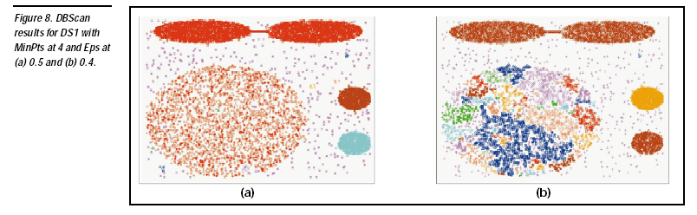

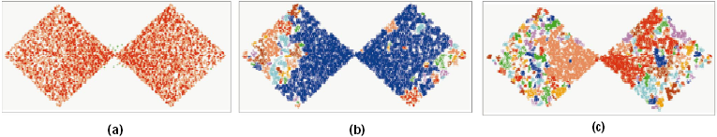
DBSCAN: Sensitive to Parameters

Slide 42
Other algorithms
PAM, CLARANS: Solutions for the k-medoids problem
BIRCH: Constructs a hierarchical tree that acts a summary of the data, and then clusters the leaves.
MST: Clustering using the Minimum Spanning Tree.
ROCK: clustering categorical data by neighbor and link analysis
LIMBO, COOLCAT: Clustering categorical data using information theoretic tools.
CURE: Hierarchical algorithm uses different representation of the cluster
CHAMELEON: Hierarchical algorithm uses closeness and interconnectivity for merging

Slide 43
CLUSTERING VALIDITY

Slide 44
Cluster Validity
How do we evaluate the “goodness” of the resulting clusters?
But “clusters are in the eye of the beholder”!
Then why do we want to evaluate them?
  To avoid finding patterns in noise
  To compare clustering algorithms
  To compare two sets of clusters
  To compare two clusters

Slide 45
Clusters found in Random Data
Random Points
DBSCAN
K-means
Complete Link

Slide 46
Different Aspects of Cluster Validation
Determining the clustering tendency of a set of data, i.e., distinguishing whether non-random structure actually exists in the data.
Comparing the results of a cluster analysis to externally known results, e.g., to externally given class labels.
Evaluating how well the results of a cluster analysis fit the data without reference to external information.
  - Use only the data
Comparing the results of two different sets of cluster analyses to determine which is better.
Determining the ‘correct’ number of clusters.
For 2, 3, and 4, we can further distinguish whether we want to evaluate the entire clustering or just individual clusters.

Slide 47
Measures of Cluster Validity
Numerical measures that are applied to judge various aspects of cluster validity, are classified into the following three types.
  External Index: Used to measure the extent to which cluster labels match externally supplied class labels.
    Entropy
  Internal Index: Used to measure the goodness of a clustering structure without respect to external information.
    Sum of Squared Error (SSE)
  Relative Index: Used to compare two different clusterings or clusters.
    Often an external or internal index is used for this function, e.g., SSE or entropy
Sometimes these are referred to as criteria instead of indices
  However, sometimes criterion is the general strategy and index is the numerical measure that implements the criterion.

Slide 48
Measuring Cluster Validity Via Correlation
Two matrices
  Proximity Matrix
  “Incidence” Matrix
    One row and one column for each data point
    An entry is 1 if the associated pair of points belong to the same cluster
    An entry is 0 if the associated pair of points belongs to different clusters
Compute the correlation between the two matrices
  Since the matrices are symmetric, only the correlation between
  n(n-1) / 2 entries needs to be calculated.
High correlation indicates that points that belong to the same cluster are close to each other.
Not a good measure for some density or contiguity based clusters.

Slide 49
Measuring Cluster Validity Via Correlation
Correlation of incidence and proximity matrices for the K-means clusterings of the following two data sets.
Corr = -0.9235
Corr = -0.5810

Slide 50
Using Similarity Matrix for Cluster Validation
Order the similarity matrix with respect to cluster labels and inspect visually.

Slide 51
Using Similarity Matrix for Cluster Validation
Clusters in random data are not so crisp
DBSCAN

Slide 52
Using Similarity Matrix for Cluster Validation
Clusters in random data are not so crisp
K-means

Slide 53
Using Similarity Matrix for Cluster Validation
Clusters in random data are not so crisp
Complete Link

Slide 54
Using Similarity Matrix for Cluster Validation
DBSCAN

Slide 55
Internal Measures: SSE
Clusters in more complicated figures aren’t well separated
Internal Index: Used to measure the goodness of a clustering structure without respect to external information
  SSE
SSE is good for comparing two clusterings or two clusters (average SSE).
Can also be used to estimate the number of clusters

Slide 56
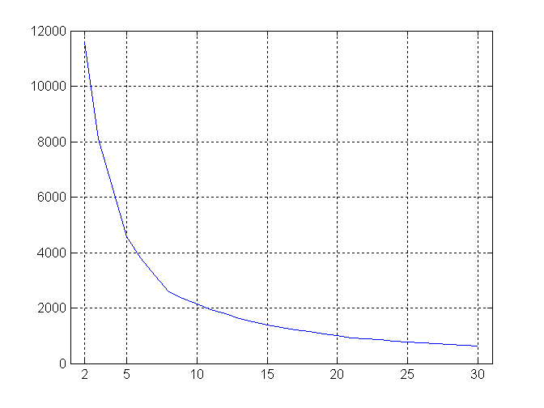
Internal Measures: SSE
SSE curve for a more complicated data set
SSE of clusters found using K-means

Slide 57
Framework for Cluster Validity
Need a framework to interpret any measure.
  For example, if our measure of evaluation has the value, 10, is that good, fair, or poor?
Statistics provide a framework for cluster validity
  The more “atypical” a clustering result is, the more likely it represents valid structure in the data
  Can compare the values of an index that result from random data or clusterings to those of a clustering result.
    If the value of the index is unlikely, then the cluster results are valid
  These approaches are more complicated and harder to understand.
For comparing the results of two different sets of cluster analyses, a framework is less necessary.
  However, there is the question of whether the difference between two index values is significant

Slide 58
Statistical Framework for SSE
Example
  Compare SSE of 0.005 against three clusters in random data
  Histogram shows SSE of three clusters in 500 sets of random data points of size 100 distributed over the range 0.2 – 0.8 for x and y values

Slide 59
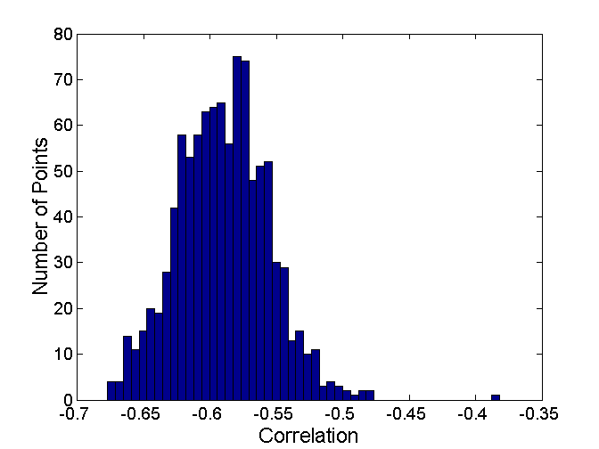
Statistical Framework for Correlation
Correlation of incidence and proximity matrices for the K-means clusterings of the following two data sets.
Corr = -0.9235
Corr = -0.5810

Slide 60
Internal Measures: Cohesion and Separation
Cluster Cohesion: Measures how closely related are objects in a cluster
  Example: SSE
Cluster Separation: Measure how distinct or well-separated a cluster is from other clusters
Example: Squared Error
  Cohesion is measured by the within cluster sum of squares (SSE)
  Separation is measured by the between cluster sum of squares
      Where |C_{i}| is the size of cluster i

Slide 61
Internal Measures: Cohesion and Separation
A proximity graph based approach can also be used for cohesion and separation.
  Cluster cohesion is the sum of the weight of all links within a cluster.
  Cluster separation is the sum of the weights between nodes in the cluster and nodes outside the cluster.
cohesion
separation

Slide 62
External Measures for Clustering Validity
Assume that the data is labeled with some class labels
  E.g., documents are classified into topics, people classified according to their income, senators classified as republican or democrat.
In this case we want the clusters to be homogeneous with respect to classes
  Each cluster should contain elements of mostly one class
  Also each class should ideally be assigned to a single cluster
This does not always make sense
  Clustering is not the same as classification
But this is what people use most of the time

Slide 63
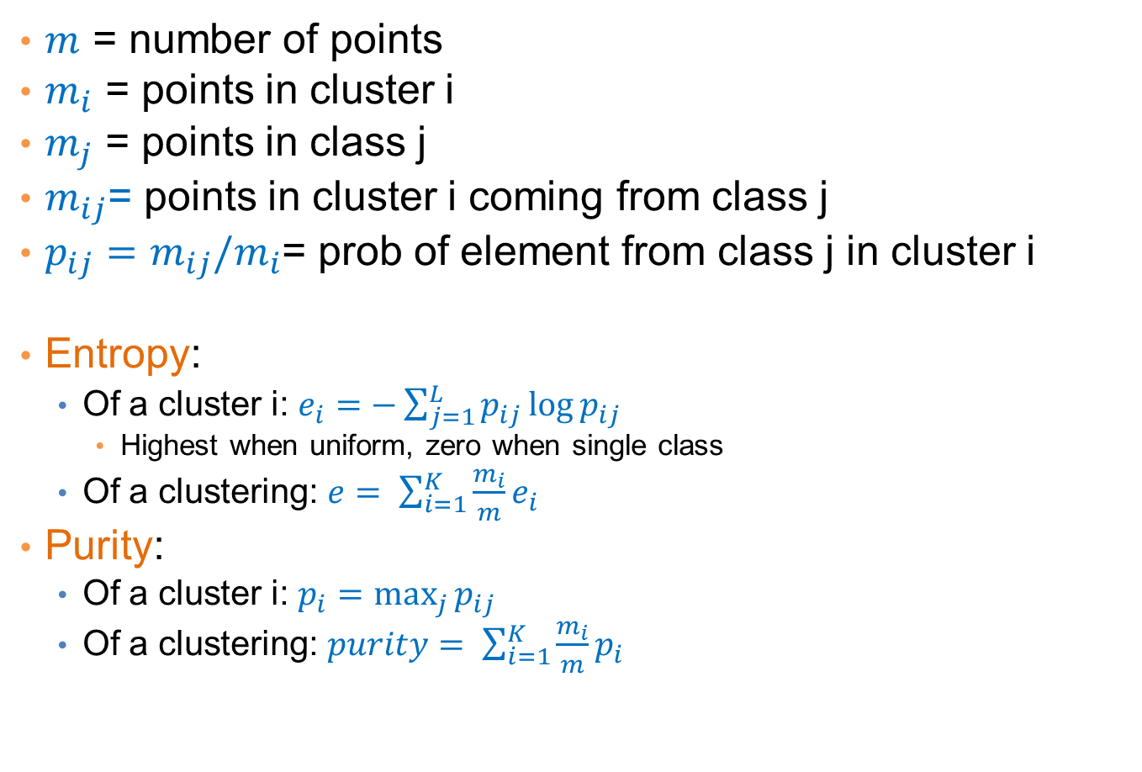
Measures
$m$ = number of points
$m_{i}$ = points in cluster i
$m_{j}$ = points in class j
$m_{ij}$= points in cluster i coming from class j
$p_{ij}=m_{ij}/m_{i}$= prob of element from class j in cluster i
Entropy:
  Of a cluster i: $e_{i}=−\sum_{j=1}^{L}{p_{ij}\log{p_{ij}}}$
    Highest when uniform, zero when single class
  Of a clustering: $e= \sum_{i=1}^{K}{\frac{m_{i}}{m}e_{i}}$
Purity:
  Of a cluster i: $p_{i}=\max_{j}{p_{ij}}$
  Of a clustering: $purity= \sum_{i=1}^{K}{\frac{m_{i}}{m}p_{i}}$

Slide 64
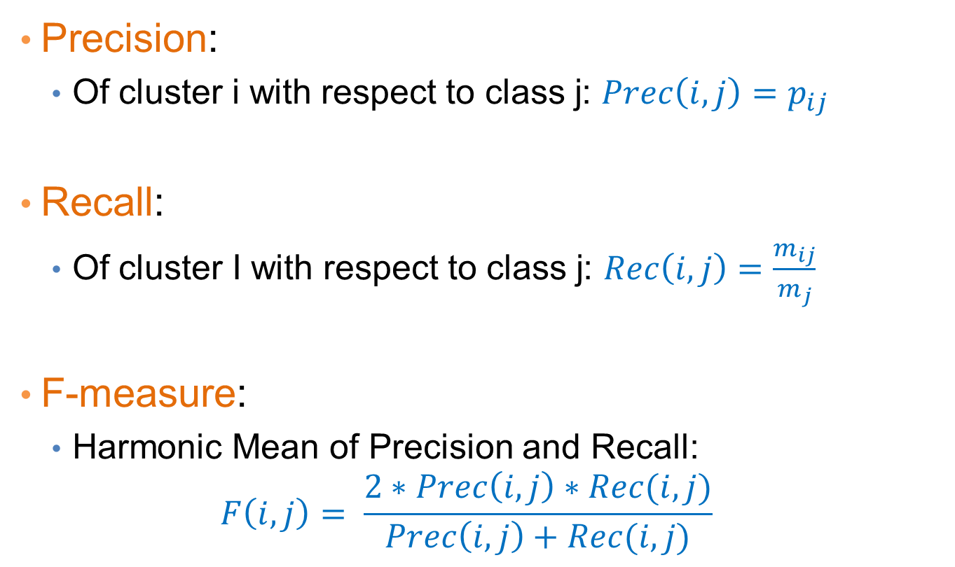
Measures
Precision:
  Of cluster i with respect to class j: $Prec\left(i,j\right)=p_{ij}$
Recall:
  Of cluster I with respect to class j: $Rec\left(i,j\right)=\frac{m_{ij}}{m_{j}}$
F-measure:
  Harmonic Mean of Precision and Recall:
  $$F\left(i,j\right)= \frac{2∗Prec\left(i,j\right)∗Rec(i,j)}{Prec\left(i,j\right)+Rec(i,j)}$$

Slide 65
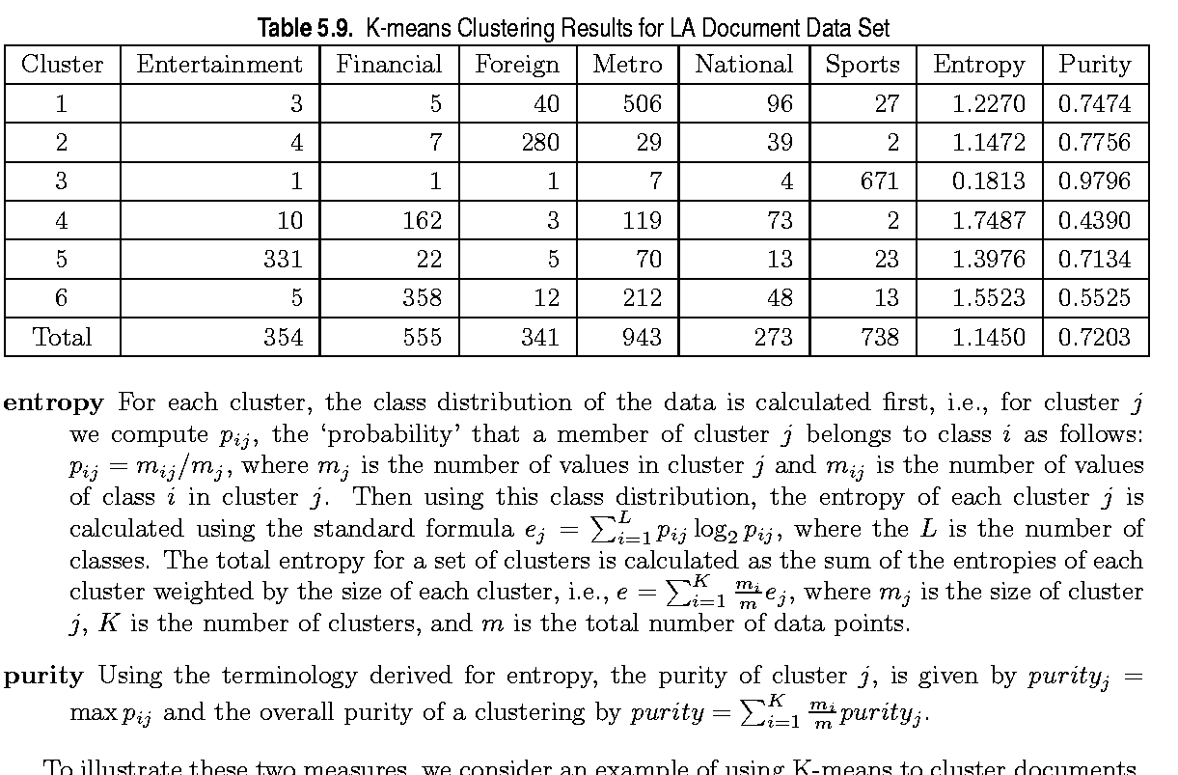
External Measures of Cluster Validity: Entropy and Purity

Slide 66
Final Comment on Cluster Validity
“The validation of clustering structures is the most difficult and frustrating part of cluster analysis.
Without a strong effort in this direction, cluster analysis will remain a black art accessible only to those true believers who have experience and great courage.”
Algorithms for Clustering Data, Jain and Dubes

