Slide 1
DATA MINING
LECTURE 5
MinHashing,
Locality Sensitive Hashing,
Clustering

Slide 2
SKETCHING
AND
LOCALITY SENSITIVE HASHING
Thanks to:
Rajaraman and Ullman, “Mining Massive Datasets”
Evimaria Terzi, slides for Data Mining Course.

Slide 3
Finding similar documents
Problem: Find similar documents from a web crawl
Main issues to address:
  What is the right representation and similarity function?
    Shingling: reduce a document to a set of shingles
    Similarity function: Jaccard similarity
    Sim (C₁, C₂) = |C₁∩C₂|/|C₁∪C₂|
  Compress the sets so that we can fit more in memory
    Min-Hashing: create a signature/sketch of a document
  Find similar pairs without checking all possible pairs
    Locality Sensitive Hashing (LSH)

Slide 4
Shingling
Shingle: a sequence of k contiguous characters
a rose is a rose is a rose
a rose is
rose is a
rose is a
ose is a r
se is a ro
e is a ros
is a rose
is a rose
s a rose i
a rose is
a rose is
Represent a document as a set of shingles

Slide 5
Fingerprinting
Hash shingles to 64-bit integers
Set of Shingles
Set of 64-bit integers
Hash function
(Rabin’s fingerprints)
a rose is
rose is a
rose is a
ose is a r
se is a ro
e is a ros
is a rose
is a rose
s a rose i
a rose is
aaaa
bbbb
cccc
dddd
eeee
ffff
gggg
hhhh
iiii
jjjj

Slide 6
Document processing
D
Shingles
set S of
64-bit
integers
Shingling
Rabin’s
fingerprints

Slide 7
Document Similarity
D₁
D₂
S₁
S₂
Jaccard coefficient

Slide 8
Compacting the data
Problem: shingle sets are too large to be kept in memory.
Key idea: “hash” each set S to a small signature Sig (S), such that:
  Sig (S) is small enough that we can fit a signature in main memory for each set.
  Sim (S₁, S₂) is (almost) the same as the “similarity” of Sig (S₁) and Sig (S₂). (signature preserves similarity).
Warning: This method can produce false negatives, and false positives (if an additional check is not made).

Slide 9
From Sets to Boolean Matrices
Represent the data as a boolean matrix M
  Rows = the universe of all possible set elements
    In our case, shingle fingerprints take values in [0…2⁶⁴-1]
  Columns = the sets
    In our case, the sets of shingle fingerprints
  M(e,S) = 1 in row e and column S if and only if e is a member of S.
Typical matrix is sparse.
  We do not really materialize the matrix

Slide 10

Example
Universe: U = {A,B,C,D,E,F,G}
X = {A,B,F,G}
Y = {A,E,F,G}
Sim(X,Y) = $\frac{3}{5}$
 | X | Y
A | 1 | 1
B | 1 | 0
C | 0 | 0
D | 0 | 0
E | 0 | 1
F | 1 | 1
G | 1 | 1

Slide 11

Example
Universe: U = {A,B,C,D,E,F,G}
X = {A,B,F,G}
Y = {A,E,F,G}
Sim(X,Y) = $\frac{3}{5}$
 | X | Y
A | 1 | 1
B | 1 | 0
C | 0 | 0
D | 0 | 0
E | 0 | 1
F | 1 | 1
G | 1 | 1
At least one of the columns has value 1

Slide 12

Example
Universe: U = {A,B,C,D,E,F,G}
X = {A,B,F,G}
Y = {A,E,F,G}
Sim(X,Y) = $\frac{3}{5}$
 | X | Y
A | 1 | 1
B | 1 | 0
C | 0 | 0
D | 0 | 0
E | 0 | 1
F | 1 | 1
G | 1 | 1
Both columns have value 1

Slide 13
Minhashing
Pick a random permutation of the rows (the universe U).
Define “hash” function
  h(S) = the index of the first row (in the permuted order) in which column S has 1.
  h(S) = the index of the first element of S in the permuted order.
Use k (e.g., k = 100) independent random permutations to create a signature.

Slide 14
Example of minhash signatures
Input matrix
 | S₁ | S₂ | S₃ | S₄
A | 1 | 0 | 1 | 0
B | 1 | 0 | 0 | 1
C | 0 | 1 | 0 | 1
D | 0 | 1 | 0 | 1
E | 0 | 1 | 1 | 1
F | 1 | 0 | 1 | 0
G | 1 | 0 | 1 | 0
 | S₁ | S₂ | S₃ | S₄
A | 1 | 0 | 1 | 0
C | 0 | 1 | 0 | 1
G | 1 | 0 | 1 | 0
F | 1 | 0 | 1 | 0
B | 1 | 0 | 0 | 1
E | 0 | 1 | 1 | 1
D | 0 | 1 | 0 | 1
A
C
G
F
B
E
D
1 | 2 | 1 | 2

Slide 15
Example of minhash signatures
Input matrix
 | S₁ | S₂ | S₃ | S₄
A | 1 | 0 | 1 | 0
B | 1 | 0 | 0 | 1
C | 0 | 1 | 0 | 1
D | 0 | 1 | 0 | 1
E | 0 | 1 | 1 | 1
F | 1 | 0 | 1 | 0
G | 1 | 0 | 1 | 0
 | S₁ | S₂ | S₃ | S₄
D | 0 | 1 | 0 | 1
B | 1 | 0 | 0 | 1
A | 1 | 0 | 1 | 0
C | 0 | 1 | 0 | 1
F | 1 | 0 | 1 | 0
G | 1 | 0 | 1 | 0
E | 0 | 1 | 1 | 1
D
B
A
C
F
G
E
2 | 1 | 3 | 1

Slide 16
Example of minhash signatures
Input matrix
 | S₁ | S₂ | S₃ | S₄
A | 1 | 0 | 1 | 0
B | 1 | 0 | 0 | 1
C | 0 | 1 | 0 | 1
D | 0 | 1 | 0 | 1
E | 0 | 1 | 1 | 1
F | 1 | 0 | 1 | 0
G | 1 | 0 | 1 | 0
 | S₁ | S₂ | S₃ | S₄
C | 0 | 1 | 0 | 1
D | 0 | 1 | 0 | 1
G | 1 | 0 | 1 | 0
F | 1 | 0 | 1 | 0
A | 1 | 0 | 1 | 0
B | 1 | 0 | 0 | 1
E | 0 | 1 | 1 | 1
C
D
G
F
A
B
E
3 | 1 | 3 | 1

Slide 17
Example of minhash signatures
Input matrix
 | S₁ | S₂ | S₃ | S₄
A | 1 | 0 | 1 | 0
B | 1 | 0 | 0 | 1
C | 0 | 1 | 0 | 1
D | 0 | 1 | 0 | 1
E | 0 | 1 | 1 | 1
F | 1 | 0 | 1 | 0
G | 1 | 0 | 1 | 0
Signature matrix
 | S₁ | S₂ | S₃ | S₄
h₁ | 1 | 2 | 1 | 2
h₁ | 2 | 1 | 3 | 1
h₁ | 3 | 1 | 3 | 1
≈
Sig(S,i) = value of the i-th hash function for set S

Slide 18
Hash function Property
Pr(h(S₁) = h(S₂)) = Sim(S₁,S₂)
where the probability is over all choices of permutations.
Why?
  The first row where one of the two sets has value 1 belongs to the union.
  We have equality if both columns have value 1.

Slide 19
Example
Universe: U = {A,B,C,D,E,F,G}
X = {A,B,F,G}
Y = {A,E,F,G}
Union =
{A,B,E,F,G}
Intersection =
{A,F,G}
Rows C,D could be anywhere they do not affect the probability
 | X | Y
A | 1 | 1
B | 1 | 0
C | 0 | 0
D | 0 | 0
E | 0 | 1
F | 1 | 1
G | 1 | 1
 | X | Y
D | 0 | 0
C | 0 | 0
D
*
*
C
*
*
*

Slide 20
Example
Universe: U = {A,B,C,D,E,F,G}
X = {A,B,F,G}
Y = {A,E,F,G}
Union =
{A,B,E,F,G}
Intersection =
{A,F,G}
The * rows belong to the union
 | X | Y
A | 1 | 1
B | 1 | 0
C | 0 | 0
D | 0 | 0
E | 0 | 1
F | 1 | 1
G | 1 | 1
 | X | Y
D | 0 | 0
C | 0 | 0
D
*
*
C
*
*
*

Slide 21
Example
Universe: U = {A,B,C,D,E,F,G}
X = {A,B,F,G}
Y = {A,E,F,G}
Union =
{A,B,E,F,G}
Intersection =
{A,F,G}
The question is what is the value of the first * element
 | X | Y
A | 1 | 1
B | 1 | 0
C | 0 | 0
D | 0 | 0
E | 0 | 1
F | 1 | 1
G | 1 | 1
 | X | Y
D | 0 | 0
C | 0 | 0
D
*
*
C
*
*
*

Slide 22
Example
Universe: U = {A,B,C,D,E,F,G}
X = {A,B,F,G}
Y = {A,E,F,G}
Union =
{A,B,E,F,G}
Intersection =
{A,F,G}
If it belongs to the intersection then h(X) = h(Y)
 | X | Y
A | 1 | 1
B | 1 | 0
C | 0 | 0
D | 0 | 0
E | 0 | 1
F | 1 | 1
G | 1 | 1
 | X | Y
D | 0 | 0
C | 0 | 0
D
*
*
C
*
*
*

Slide 23
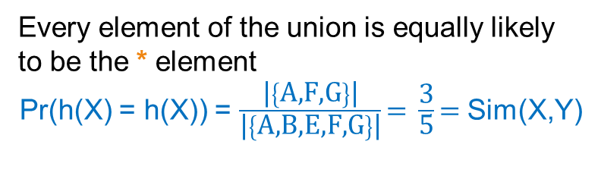
Example
Universe: U = {A,B,C,D,E,F,G}
X = {A,B,F,G}
Y = {A,E,F,G}
Union =
{A,B,E,F,G}
Intersection =
{A,F,G}
Every element of the union is equally likely to be the * element
Pr(h(X) = h(X)) = $\frac{\text{|}\left\{\text{A}\text{,}\text{F}\text{,}\text{G}\right\}\text{|}}{\text{|}\left\{\text{A}\text{,}\text{B}\text{,}\text{E}\text{,}\text{F}\text{,}\text{G}\right\}\text{|}}\text{= }\frac{\text{3}}{\text{5}}\text{= }$Sim(X,Y)
 | X | Y
A | 1 | 1
B | 1 | 0
C | 0 | 0
D | 0 | 0
E | 0 | 1
F | 1 | 1
G | 1 | 1
 | X | Y
D | 0 | 0
C | 0 | 0
D
*
*
C
*
*
*

Slide 24
Similarity for Signatures
The similarity of signatures is the fraction of the hash functions in which they agree.
With multiple signatures we get a good approximation
 | S₁ | S₂ | S₃ | S₄
A | 1 | 0 | 1 | 0
B | 1 | 0 | 0 | 1
C | 0 | 1 | 0 | 1
D | 0 | 1 | 0 | 1
E | 0 | 1 | 1 | 1
F | 1 | 0 | 1 | 0
G | 1 | 0 | 1 | 0
Signature matrix
 | actual | Sig
(x1,x2) | 0 | 0
(x1,x3) | 3/5 | 2/3
(x1,x4) | 1/7 | 0
(x2,x3) | 0 | 0
(x2,x4) | 3/4 | 1
(x3,x4) | 0 | 0
S₁ | S₂ | S₃ | S₄
1 | 2 | 1 | 2
2 | 1 | 3 | 1
3 | 1 | 3 | 1
≈

Slide 25
Is it now feasible?
Assume a billion rows
Hard to pick a random permutation of 1…billion
Even representing a random permutation requires 1 billion entries!!!
How about accessing rows in permuted order?
☹

Slide 26
Being more practical
Approximating row permutations: pick k=100 hash functions (h₁,…,h_{k})
for each row r
for each hash function h_{i}
compute h_{i} (r )
for each column S that has 1 in row r
if h_{i} (r ) is a smaller value than Sig(S,i) then
  Sig(S,i) = h_{i} (r);
Sig(S,i) will become the smallest value of h_{i}(r) among all rows for which column S has value 1; i.e., h_{i} (r) gives the min index for the i-th permutation

Slide 27
Example
Sig1 Sig2
h(0) = 1 1 -
g(0) = 3 3 -
x
0
1
2
3
4
Row S1 S2
A 1 0
B 0 1
C 1 1
D 1 0
E 0 1
h(1) = 2 1 2
g(1) = 0 3 0
h(2) = 3 1 2
g(2) = 2 2 0
h(x) = x+1 mod 5
g(x) = 2x+1 mod 5
h(3) = 4 1 2
g(3) = 4 2 0
Row S1 S2
E 0 1
A 1 0
B 0 1
C 1 1
D 1 0
Row S1 S2
B 0 1
E 0 1
C 1 0
A 1 1
D 1 0
h(4) = 0 1 0
g(4) = 1 2 0

Slide 28
Finding similar pairs
Problem: Find all pairs of documents with similarity at least t = 0.8
While the signatures of all columns may fit in main memory, comparing the signatures of all pairs of columns is quadratic in the number of columns.
Example: 10⁶ columns implies 5*10¹¹ column-comparisons.
At 1 microsecond/comparison: 6 days.

Slide 29
Locality-Sensitive Hashing
What we want: a function f(X,Y) that tells whether or not X and Y is a candidate pair: a pair of elements whose similarity must be evaluated.
A simple idea: X and Y are a candidate pair if they have the same min-hash signature.
  Easy to test by hashing the signatures.
  Similar sets are more likely to have the same signature.
  Likely to produce many false negatives.
Making it more complex: Perform this process multiple times; candidate pairs should have at least one common signature.
  Reduce the probability for false negatives.

Slide 30
The signature matirx
b*r hash functions
r rows
per band
b bands
b mini-signatures
One
signature
Matrix Sig

Slide 31
Partition into Bands – (2)
Divide the signature matrix Sig into b bands of r rows.
  Each band is a mini-signature with r hash functions.
For each band, hash the mini-signature to a hash table with k buckets.
  Make k as large as possible so that mini-signatures that hash to the same bucket are almost certainly identical.
Candidate column pairs are those that hash to the same bucket for ≥ 1 band.
Tune b and r to catch most similar pairs, but few non-similar pairs.

Slide 32
Buckets
Columns 2 and 6
are (almost certainly) identical.
Columns 6 and 7 are
surely different.
Matrix M
r rows
b bands

Slide 33
Suppose S₁, S₂ are 80% Similar
We want all 80%-similar pairs. Choose 20 bands of 5 integers/band.
Probability S₁, S₂ identical in one particular band: (0.8)⁵ = 0.328.
Probability S₁, S₂ are not similar in any of the 20 bands:
(1-0.328)²⁰ = .00035 .
  i.e., about 1/3000-th of the 80%-similar column pairs are false negatives.

Slide 34
Suppose S₁, S₂ Only 40% Similar
Probability S₁, S₂ identical in any one particular band:
(0.4)⁵ = 0.01 .
Probability S₁, S₂ identical in at least 1 of 20 bands:
≤ 20 * 0.01 = 0.2 .
But false positives much lower for similarities << 40%.

Slide 35
LSH Involves a Tradeoff
Pick the number of minhashes, the number of bands, and the number of rows per band to balance false positives/negatives.
Example: if we had only 15 bands of 5 rows, the number of false positives would go down, but the number of false negatives would go up.

Slide 36
Analysis of LSH – What We Want
Probability
= 1 if s > t
Probability
of sharing
a bucket
No chance
if s < t
t
Similarity s of two sets

Slide 37
What One Band of One Row Gives You
Probability
of sharing
a bucket
Remember:
probability of
equal hash-values
= similarity
t
Similarity s of two sets

Slide 38
What b Bands of r Rows Gives You
At least
one band
identical
No bands
identical
(
s ^{r}
t ~ (1/b)^{1/r}
1 -
1 -
)^{b}
Probability
of sharing
a bucket
Some row
of a band
unequal
All rows
of a band
are equal
t
Similarity s of two sets

Slide 39
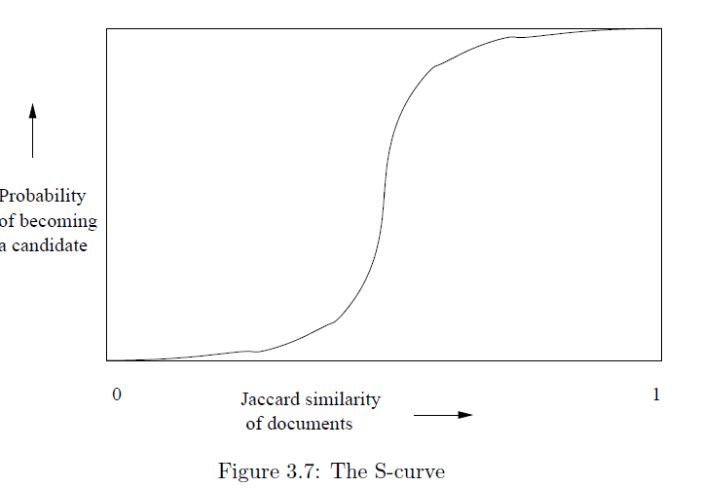
Example: b = 20; r = 5
t = 0.5
s | 1-(1-s^{r})^{b}
.2 | .006
.3 | .047
.4 | .186
.5 | .470
.6 | .802
.7 | .975
.8 | .9996

Slide 40
Locality-sensitive hashing (LSH)
Big Picture: Construct hash functions h: R^{d}→ U such that for any pair of points p,q, for distance function D we have:
  If D(p,q)≤r, then Pr[h(p)=h(q)] is high
  If D(p,q)≥cr, then Pr[h(p)=h(q)] is small
Then, we can find close pairs by hashing
LSH is a general framework: for a given distance function D we need to find the right h

Slide 41
Clustering
Thanks to
Tan, Steinbach, Kumar, “Introduction to Data Mining”

Slide 42
What is Cluster Analysis?
Finding groups of objects such that the objects in a group will be similar (or related) to one another and different from (or unrelated to) the objects in other groups
Inter-cluster distances are maximized
Intra-cluster distances are minimized

Slide 43
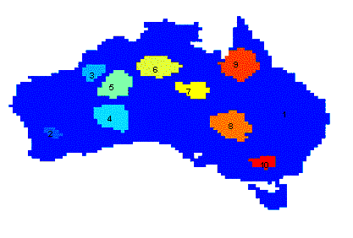
Applications of Cluster Analysis
Understanding
  Group related documents for browsing, group genes and proteins that have similar functionality, or group stocks with similar price fluctuations
Summarization
  Reduce the size of large data sets
Clustering precipitation in Australia

Slide 44
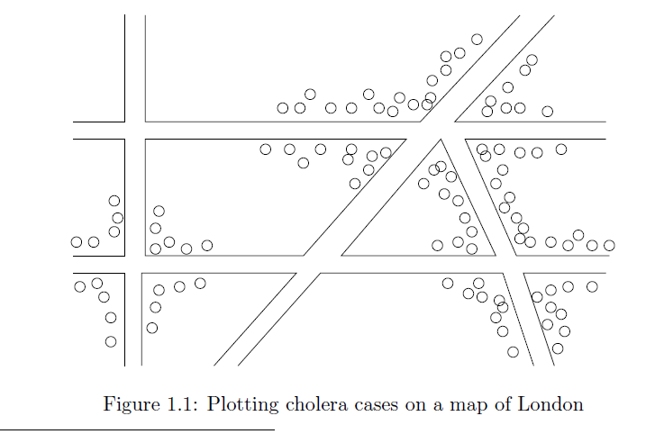
Early applications of cluster analysis
John Snow, London 1854

Slide 45
Notion of a Cluster can be Ambiguous
How many clusters?
Six Clusters
Two Clusters
Four Clusters

Slide 46
Types of Clusterings
A clustering is a set of clusters
Important distinction between hierarchical and partitional sets of clusters
Partitional Clustering
  A division data objects into non-overlapping subsets (clusters) such that each data object is in exactly one subset
Hierarchical clustering
  A set of nested clusters organized as a hierarchical tree

Slide 47
Partitional Clustering
Original Points
A Partitional Clustering

Slide 48
Hierarchical Clustering
Traditional Hierarchical Clustering
Traditional Dendrogram
Non-traditional Hierarchical Clustering
Non-traditional Dendrogram

Slide 49
Other Distinctions Between Sets of Clusters
Exclusive versus non-exclusive
  In non-exclusive clusterings, points may belong to multiple clusters.
  Can represent multiple classes or ‘border’ points
Fuzzy versus non-fuzzy
  In fuzzy clustering, a point belongs to every cluster with some weight between 0 and 1
  Weights must sum to 1
  Probabilistic clustering has similar characteristics
Partial versus complete
  In some cases, we only want to cluster some of the data

Slide 50
Types of Clusters
Well-separated clusters
Center-based clusters
Contiguous clusters
Density-based clusters
Property or Conceptual
Described by an Objective Function

Slide 51
Types of Clusters: Well-Separated
Well-Separated Clusters:
  A cluster is a set of points such that any point in a cluster is closer (or more similar) to every other point in the cluster than to any point not in the cluster.
3 well-separated clusters

Slide 52
Types of Clusters: Center-Based
Center-based
  A cluster is a set of objects such that an object in a cluster is closer (more similar) to the “center” of a cluster, than to the center of any other cluster
  The center of a cluster is often a centroid, the average of all the points in the cluster, or a medoid, the most “representative” point of a cluster
4 center-based clusters

Slide 53
Types of Clusters: Contiguity-Based
Contiguous Cluster (Nearest neighbor or Transitive)
  A cluster is a set of points such that a point in a cluster is closer (or more similar) to one or more other points in the cluster than to any point not in the cluster.
8 contiguous clusters

Slide 54
Types of Clusters: Density-Based
Density-based
  A cluster is a dense region of points, which is separated by low-density regions, from other regions of high density.
  Used when the clusters are irregular or intertwined, and when noise and outliers are present.
6 density-based clusters

Slide 55
Types of Clusters: Conceptual Clusters
Shared Property or Conceptual Clusters
  Finds clusters that share some common property or represent a particular concept.
  .
2 Overlapping Circles

Slide 56
Types of Clusters: Objective Function
Clusters Defined by an Objective Function
  Finds clusters that minimize or maximize an objective function.
  Enumerate all possible ways of dividing the points into clusters and evaluate the `goodness' of each potential set of clusters by using the given objective function. (NP Hard)
  Can have global or local objectives.
    Hierarchical clustering algorithms typically have local objectives
    Partitional algorithms typically have global objectives
  A variation of the global objective function approach is to fit the data to a parameterized model.
    Parameters for the model are determined from the data.
    Mixture models assume that the data is a ‘mixture' of a number of statistical distributions.

Slide 57
Clustering Algorithms
K-means and its variants
Hierarchical clustering

Slide 58
K-means Clustering
Partitional clustering approach
Each cluster is associated with a centroid (center point)
Each point is assigned to the cluster with the closest centroid
Number of clusters, K, must be specified
The objective is to minimize the sum of distances of the points to their respective centroid

Slide 59
K-means Clustering
Most common definition is with euclidean distance, minimizing the Sum of Squares Error (SSE) function
  Sometimes K-means is defined like that
Problem: Given a set X of n points in a d-dimensional space and an integer K group the points into K clusters {C₁, C₂,…,C_{k}} such that
is minimized, where c_{i} is the mean of the points in cluster C_{i}
Sum of Squares Error (SSE)

Slide 60
Algorithmic properties of the k-means problem
NP-hard if the dimensionality of the data is at least 2 (d>=2)
Finding the best solution in polynomial time is infeasible
For d=1 the problem is solvable in polynomial time (how?)
A simple iterative algorithm works quite well in practice

Slide 61
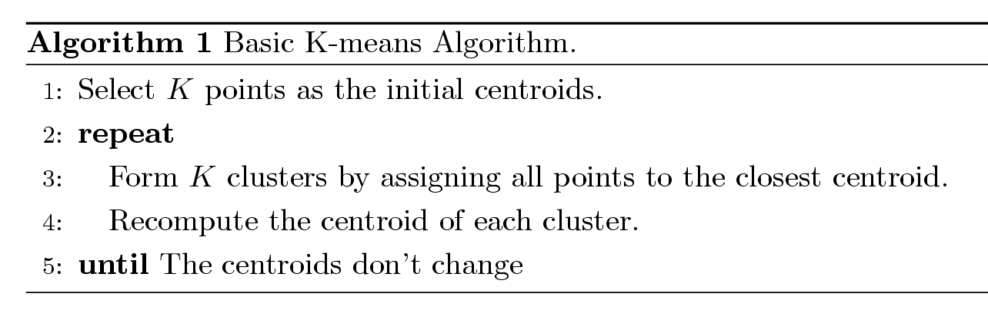
K-means Algorithm
Also known as Lloyd’s algorithm.
K-means is sometimes synonymous with this algorithm

Slide 62
K-means Algorithm – Details
Initial centroids are often chosen randomly.
  Clusters produced vary from one run to another.
‘Closeness’ is measured by Euclidean distance, cosine similarity, correlation, etc.
The centroid depends on the distance function
  The mean of the points in the cluster for SSE, the median for Manhattan distance.
K-means will converge for common similarity measures mentioned above.
Most of the convergence happens in the first few iterations.
  Often the stopping condition is changed to ‘Until relatively few points change clusters’
Complexity is O( n * K * I * d )
  n = number of points, K = number of clusters,
  I = number of iterations, d = number of attributes

Slide 63
Two different K-means Clusterings
Original Points
Optimal Clustering
Sub-optimal Clustering

Slide 64
Importance of Choosing Initial Centroids

Slide 65
Importance of Choosing Initial Centroids

Slide 66
Importance of Choosing Initial Centroids

Slide 67
Importance of Choosing Initial Centroids …

Slide 68
Dealing with Initialization
Do multiple runs and select the clustering with the smallest error
Select original set of points by methods other than random . E.g., pick the most distant (from each other) points as cluster centers (K-means++ algorithm)

Slide 69
Limitations of K-means
K-means has problems when clusters are of different
  Sizes
  Densities
  Non-globular shapes
K-means has problems when the data contains outliers.

Slide 70
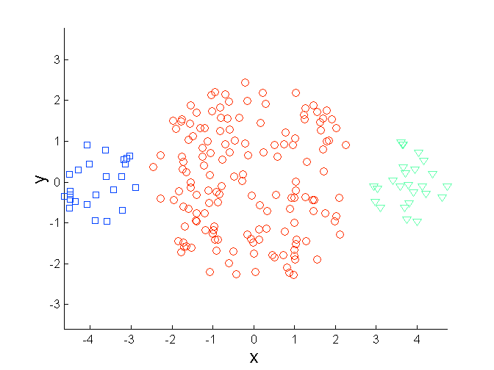
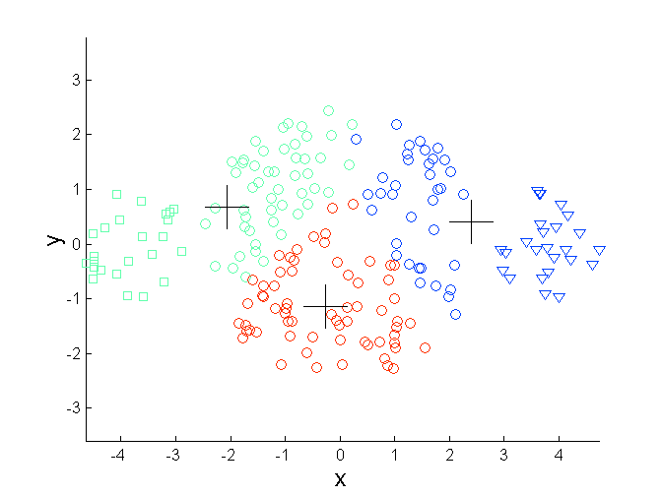
Limitations of K-means: Differing Sizes
Original Points
K-means (3 Clusters)

Slide 71
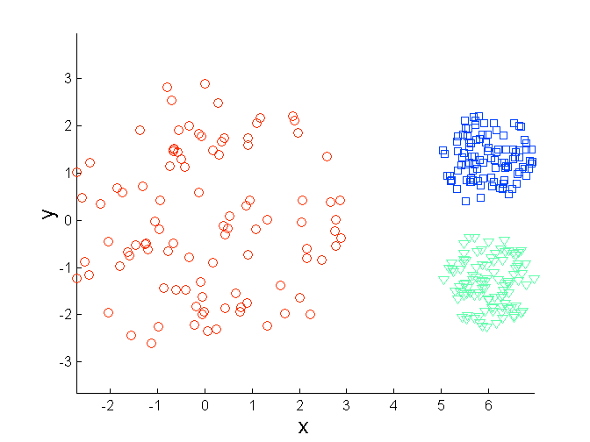
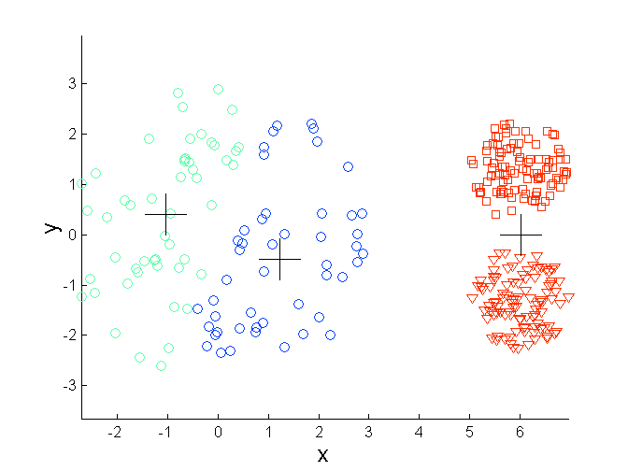
Limitations of K-means: Differing Density
Original Points
K-means (3 Clusters)

Slide 72
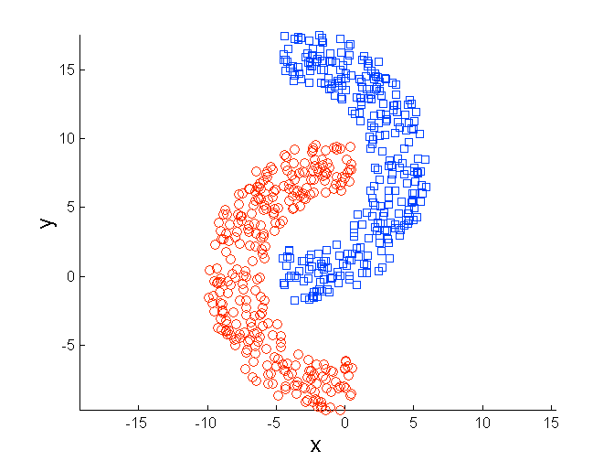
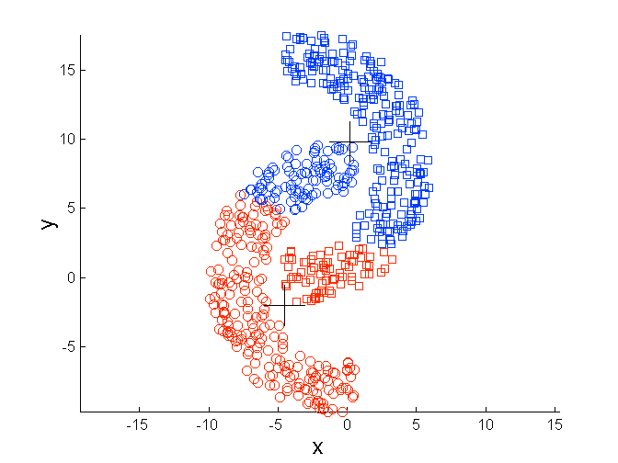
Limitations of K-means: Non-globular Shapes
Original Points
K-means (2 Clusters)

Slide 73
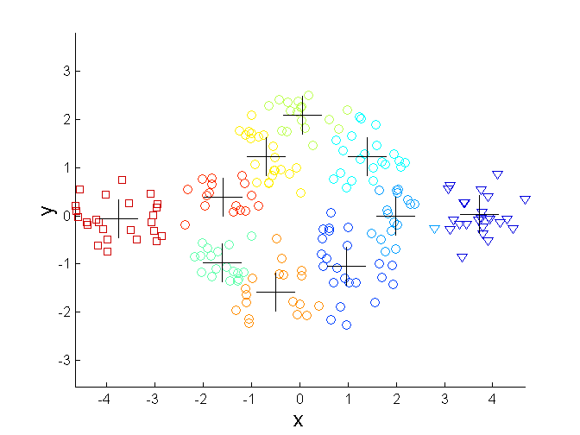
Overcoming K-means Limitations
Original Points K-means Clusters
One solution is to use many clusters.
  Find parts of clusters, but need to put together.

Slide 74
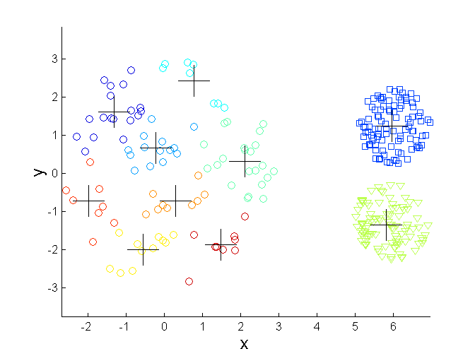
Overcoming K-means Limitations
Original Points K-means Clusters

Slide 75
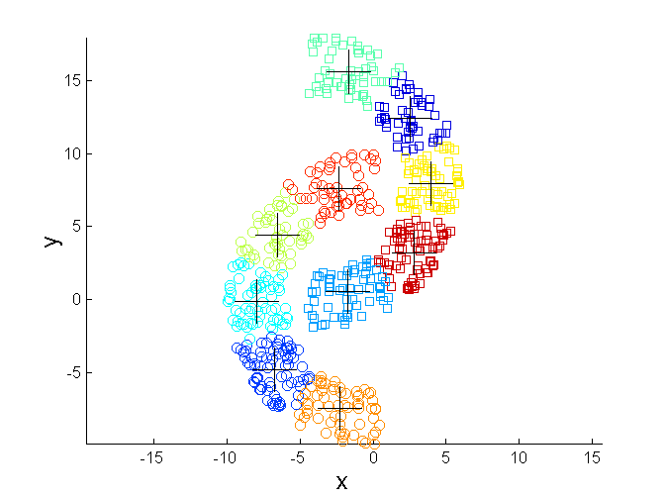
Overcoming K-means Limitations
Original Points K-means Clusters

Slide 76
Variations
K-medoids: Similar problem definition as in K-means, but the centroid of the cluster is defined to be one of the points in the cluster (the medoid).
K-centers: Similar problem definition as in K-means, but the goal now is to minimize the maximum diameter of the clusters (diameter of a cluster is maximum distance between any two points in the cluster).

Slide 77
Hierarchical Clustering
Produces a set of nested clusters organized as a hierarchical tree
Can be visualized as a dendrogram
  A tree like diagram that records the sequences of merges or splits

Slide 78
Strengths of Hierarchical Clustering
Do not have to assume any particular number of clusters
  Any desired number of clusters can be obtained by ‘cutting’ the dendogram at the proper level
They may correspond to meaningful taxonomies
  Example in biological sciences (e.g., animal kingdom, phylogeny reconstruction, …)

Slide 79
Hierarchical Clustering
Two main types of hierarchical clustering
  Agglomerative:
    Start with the points as individual clusters
    At each step, merge the closest pair of clusters until only one cluster (or k clusters) left
  Divisive:
    Start with one, all-inclusive cluster
    At each step, split a cluster until each cluster contains a point (or there are k clusters)
Traditional hierarchical algorithms use a similarity or distance matrix
  Merge or split one cluster at a time

Slide 80
Agglomerative Clustering Algorithm
More popular hierarchical clustering technique
Basic algorithm is straightforward
  Compute the proximity matrix
  Let each data point be a cluster
  Repeat
  Merge the two closest clusters
  Update the proximity matrix
  Until only a single cluster remains
Key operation is the computation of the proximity of two clusters
  Different approaches to defining the distance between clusters distinguish the different algorithms

Slide 81
Starting Situation
Start with clusters of individual points and a proximity matrix
p1
p2
p3
p4
p5
. . .
p1
p2
p3
p4
p5
.
.
.
Proximity Matrix

Slide 82
Intermediate Situation
After some merging steps, we have some clusters
C1
C2
C3
C4
C5
C1
C2
C3
C3
C4
C4
C5
C1
Proximity Matrix
C2
C5

Slide 83
Intermediate Situation
We want to merge the two closest clusters (C2 and C5) and update the proximity matrix.
C1
C2
C3
C4
C5
C1
C2
C3
C3
C4
C4
C5
Proximity Matrix
C1
C2
C5

Slide 84
After Merging
The question is “How do we update the proximity matrix?”
C2 U C5
C1
C3
C4
C1
?
C2 U C5
? ? ? ?
C3
C3
?
C4
C4
?
C1
Proximity Matrix
C2 U C5

Slide 85
How to Define Inter-Cluster Similarity
p1
p2
p3
p4
p5
. . .
p1
Similarity?
p2
p3
p4
p5
MIN
MAX
Group Average
Distance Between Centroids
Other methods driven by an objective function
  Ward’s Method uses squared error
.
.
.
Proximity Matrix

Slide 86
How to Define Inter-Cluster Similarity
p1
p2
p3
p4
p5
. . .
p1
p2
p3
p4
p5
MIN
MAX
Group Average
Distance Between Centroids
Other methods driven by an objective function
  Ward’s Method uses squared error
.
.
.
Proximity Matrix

Slide 87
How to Define Inter-Cluster Similarity
p1
p2
p3
p4
p5
. . .
p1
p2
p3
p4
p5
MIN
MAX
Group Average
Distance Between Centroids
Other methods driven by an objective function
  Ward’s Method uses squared error
.
.
.
Proximity Matrix

Slide 88
How to Define Inter-Cluster Similarity
p1
p2
p3
p4
p5
. . .
p1
p2
p3
p4
p5
MIN
MAX
Group Average
Distance Between Centroids
Other methods driven by an objective function
  Ward’s Method uses squared error
.
.
.
Proximity Matrix

Slide 89
How to Define Inter-Cluster Similarity
p1
p2
p3
p4
p5
. . .
p1
×
×
p2
p3
p4
p5
MIN
MAX
Group Average
Distance Between Centroids
Other methods driven by an objective function
  Ward’s Method uses squared error
.
.
.
Proximity Matrix

Slide 90
Cluster Similarity: MIN or Single Link
Similarity of two clusters is based on the two most similar (closest) points in the different clusters
  Determined by one pair of points, i.e., by one link in the proximity graph.
1
2
3
4
5

Slide 91
Hierarchical Clustering: MIN
5
1
3
5
2
1
2
3
6
4
4
Nested Clusters
Dendrogram

Slide 92
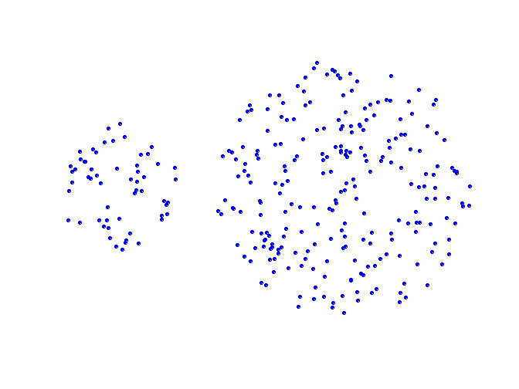
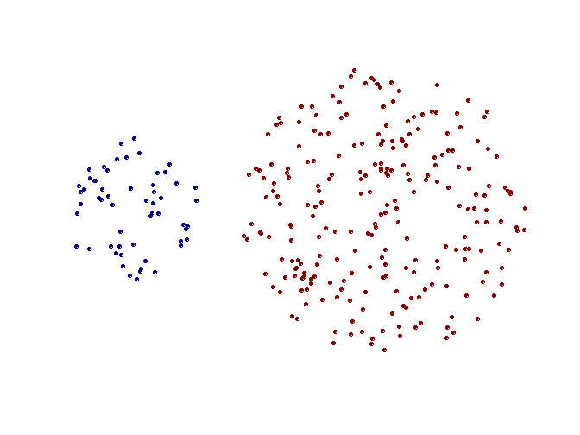
Strength of MIN
Original Points
Two Clusters
Can handle non-elliptical shapes

Slide 93
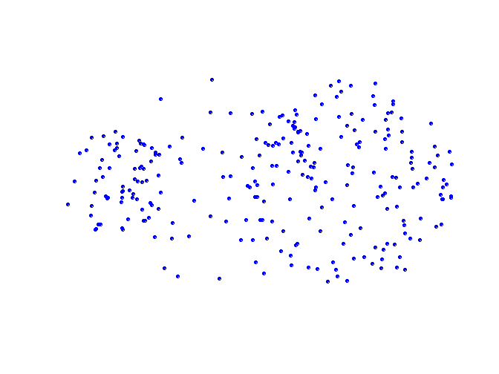
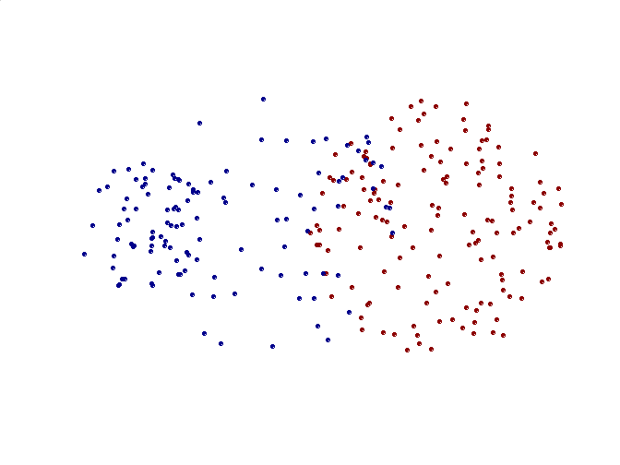
Limitations of MIN
Original Points
Two Clusters
Sensitive to noise and outliers

Slide 94
Cluster Similarity: MAX or Complete Linkage
Similarity of two clusters is based on the two least similar (most distant) points in the different clusters
  Determined by all pairs of points in the two clusters
1
2
3
4
5

Slide 95
Hierarchical Clustering: MAX
4
1
2
5
5
2
3
6
3
1
4
Nested Clusters
Dendrogram

Slide 96
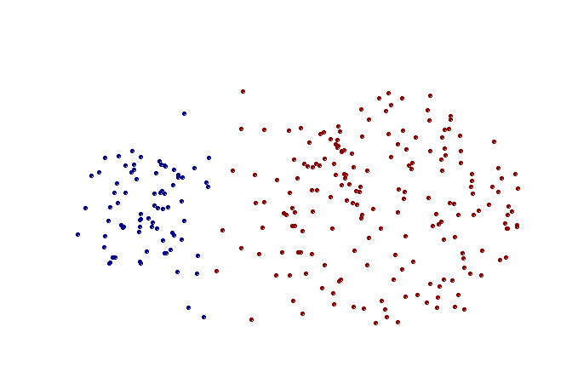
Strength of MAX
Original Points
Two Clusters
Less susceptible to noise and outliers

Slide 97
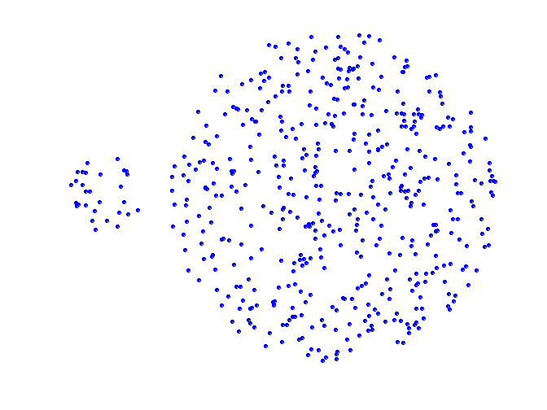
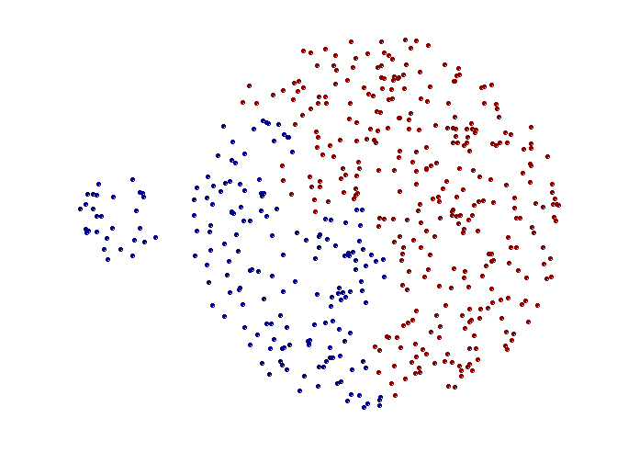
Limitations of MAX
Original Points
Two Clusters
Tends to break large clusters
Biased towards globular clusters

Slide 98
Cluster Similarity: Group Average
Proximity of two clusters is the average of pairwise proximity between points in the two clusters.
Need to use average connectivity for scalability since total proximity favors large clusters
1
2
3
4
5

Slide 99
Hierarchical Clustering: Group Average
5
4
1
2
5
2
3
6
1
4
3
Nested Clusters
Dendrogram

Slide 100
Hierarchical Clustering: Group Average
Compromise between Single and Complete Link
Strengths
  Less susceptible to noise and outliers
Limitations
  Biased towards globular clusters

Slide 101
Cluster Similarity: Ward’s Method
Similarity of two clusters is based on the increase in squared error when two clusters are merged
  Similar to group average if distance between points is distance squared
Less susceptible to noise and outliers
Biased towards globular clusters
Hierarchical analogue of K-means
  Can be used to initialize K-means

Slide 102
Hierarchical Clustering: Comparison
5
1
4
1
3
2
5
5
5
2
1
MIN
2
MAX
2
3
6
3
3
6
1
4
4
4
5
5
1
4
1
2
2
5
2
Ward’s Method
5
2
3
6
Group Average
3
3
6
4
1
1
4
4
3

Slide 103
Hierarchical Clustering:
Time and Space requirements
O(N²) space since it uses the proximity matrix.
  N is the number of points.
O(N³) time in many cases
  There are N steps and at each step the size, N², proximity matrix must be updated and searched
  Complexity can be reduced to O(N² log(N) ) time for some approaches

Slide 104
Hierarchical Clustering:
Problems and Limitations
Once a decision is made to combine two clusters, it cannot be undone
No objective function is directly minimized
Different schemes have problems with one or more of the following:
  Sensitivity to noise and outliers
  Difficulty handling different sized clusters and convex shapes
  Breaking large clusters

