Slide 1
DATA MINING
LECTURE 4
Similarity and Distance
Sketching, Locality Sensitive Hashing

Slide 2
SIMILARITY AND DISTANCE
Thanks to:
Tan, Steinbach, and Kumar, “Introduction to Data Mining”
Rajaraman and Ullman, “Mining Massive Datasets”

Slide 3
Similarity and Distance
For many different problems we need to quantify how close two objects are.
Examples:
  For an item bought by a customer, find other similar items
  Group together the customers of site so that similar customers are shown the same ad.
  Group together web documents so that you can separate the ones that talk about politics and the ones that talk about sports.
  Find all the near-duplicate mirrored web documents.
  Find credit card transactions that are very different from previous transactions.
To solve these problems we need a definition of similarity, or distance.
  The definition depends on the type of data that we have

Slide 4
What is Data?
Attributes
Collection of data objects and their attributes
An attribute is a property or characteristic of an object
  Examples: eye color of a person, temperature, etc.
  Attribute is also known as variable, field, characteristic, or feature
A collection of attributes describe an object
  Object is also known as record, point, case, sample, entity, or instance
Objects
Dimensionality: Number of attributes

Slide 5
Types of Attributes
There are different types of attributes
  Nominal – Categorical
    Examples: ID numbers, eye color, zip codes
    There is no known ordering or comparison
  Ordinal
    Examples: rankings (e.g, good, fair, bad), grades (A,B,C), height in {tall, medium, short}
    We can order, but not always clear how to compare
  Interval
    Examples: calendar dates, temperatures in Celsius or Fahrenheit.
    We can take the difference in order to compare
  Ratio
    Examples: temperature in Kelvin, length, time, counts
    We can take differences as well as ratios.
Numeric

Slide 6
Discrete and Continuous Attributes
Discrete Attribute
  Has only a finite or countably infinite set of values
  Examples: zip codes, counts, or the set of words in a collection of documents
  Often represented as integer variables.
  Note: binary attributes are a special case of discrete attributes
Continuous Attribute
  Has real numbers as attribute values
  Examples: temperature, height, or weight.
  Practically, real values can only be measured and represented using a finite number of digits.
  Continuous attributes are typically represented as floating-point variables.

Slide 7
Numeric Data
If data objects have the same fixed set of numeric attributes, then the data objects can be thought of as points in a multi-dimensional space, where each dimension represents a distinct attribute
Such data set can be represented by an m by n matrix, where there are m rows, one for each object, and n columns, one for each attribute

Slide 8
Categorical Data
Data that consists of a collection of records, each of which consists of a fixed set of categorical attributes

Slide 9
Document Data
Each document becomes a `term' vector,
  each term is a component (attribute) of the vector,
  the value of each component is the number of times the corresponding term occurs in the document.
  Bag-of-words representation – no ordering

Slide 10
Transaction Data
Each record (transaction) is a set of items.
A set of items can also be represented as a binary vector, where each attribute is an item.
A document can also be represented as a set of words (no counts)

Slide 11
Ordered Data
Genomic sequence data
Data is a long ordered string

Slide 12
Types of data
Numeric data: Each object is a point in a multidimensional space
Categorical data: Each object is a vector of categorical values
Set data: Each object is a set of values (with or without counts)
  Sets can also be represented as binary vectors, or vectors of counts
Ordered sequences: Each object is an ordered sequence of values.

Slide 13
Similarity and Distance
Similarity
  Numerical measure of how alike two data objects are.
    A function that maps pairs of objects to real values
  Is higher when objects are more alike.
  Often falls in the range [0,1]
  Sometimes in [-1,1]
Distance
  Numerical measure of how different are two data objects
    A function that maps pairs of objects to real values
  Lower when objects are more alike
  Minimum dissimilarity is often 0
  Upper limit varies
Closeness refers to a similarity or distance

Slide 14
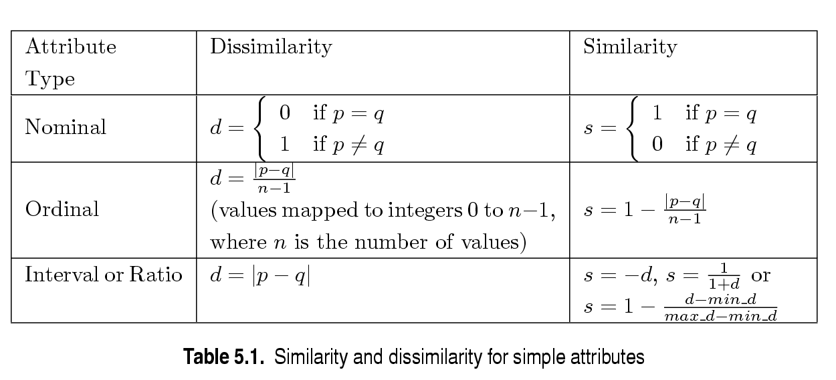
Similarity/Dissimilarity for Simple Attributes
p and q are the attribute values for two data objects.

Slide 15
Distance Metric
A distance function d is a distance metric if it is a function from pairs of objects to real numbers such that:
  d(x,y) > 0. (non-negativity)
  d(x,y) = 0 iff x = y. (identity)
  d(x,y) = d(y,x). (symmetry)
  d(x,y) < d(x,z) + d(z,y) (triangle inequality ).

Slide 16
Triangle Inequality
Triangle inequality guarantees that the distance function is well-behaved.
  The direct connection is the shortest distance
It is useful also for proving properties about the data
  For example, suppose I want to find an object that minimizes the sum of distances to all points in my dataset
  If I select the best point from my dataset, the sum of distances I get is at most twice that of the optimal point.

Slide 17
Properties of Similarity
Desirable properties for similarity
  s(p, q) = 1 (or maximum similarity) only if p = q. (Identity)
  s(p, q) = s(q, p) for all p and q. (Symmetry)

Slide 18
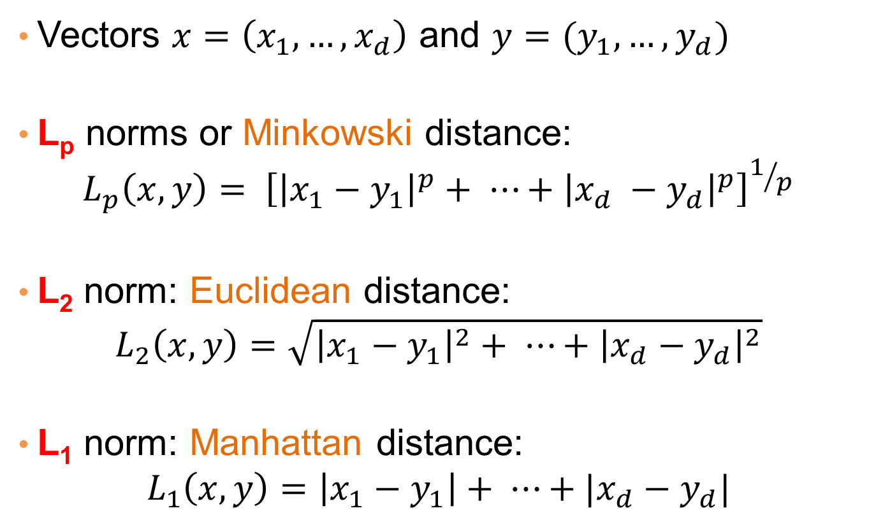
Distances for real vectors
Vectors $x=\left(x_{1},…,x_{d}\right)$ and $y=(y_{1},…,y_{d})$
L_{p} norms or Minkowski distance:
$$L_{p}\left(x,y\right)= {\left[{\left|x_{1}−y_{1}\right|}^{p}+ ⋯+{\left|x_{d} −y_{d}\right|}^{p}\right]}^{1/p}$$
L₂ norm: Euclidean distance:
$$L_{2}\left(x,y\right)=\sqrt{{\left|x_{1}−y_{1}\right|}^{2}+ ⋯+{\left|x_{d}−y_{d}\right|}^{2}}$$
L₁ norm: Manhattan distance:
$$L_{1}\left(x,y\right)=\left|x_{1}−y_{1}\right|+ ⋯+|x_{d}−y_{d}|$$

Slide 19
Example of Distances
b = (9,8)
L₂-norm:
dist(x,y) =
√(4²+3²)
= 5
5
3
L₁-norm:
dist(x,y) =
4+3 = 7
4
a = (5,5)

Slide 20
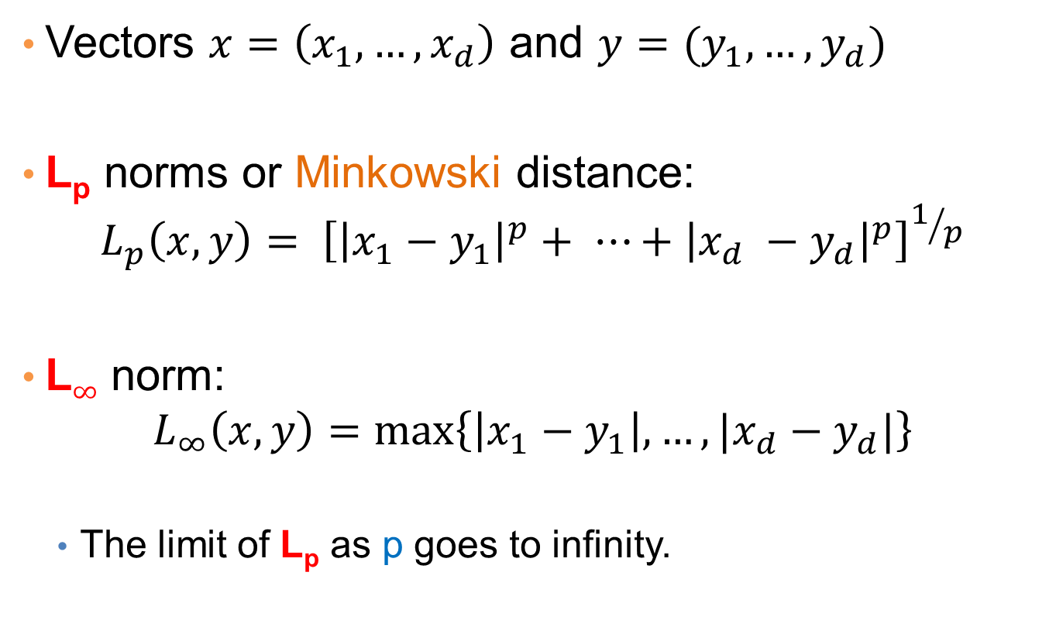
Another Minkowski distance
Vectors $x=\left(x_{1},…,x_{d}\right)$ and $y=(y_{1},…,y_{d})$
L_{p} norms or Minkowski distance:
$$L_{p}\left(x,y\right)= {\left[{\left|x_{1}−y_{1}\right|}^{p}+ ⋯+{\left|x_{d} −y_{d}\right|}^{p}\right]}^{1/p}$$
L$∞$ norm:
$$L_{∞}\left(x,y\right)=\max\left\{\left|x_{1}−y_{1}\right|,…,|x_{d}−y_{d}|\right\}$$
  The limit of L_{p} as p goes to infinity.

Slide 21
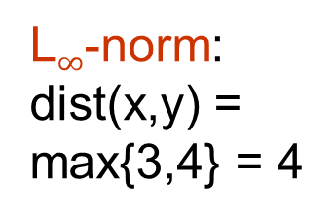
Example of Distances
b = (9,8)
L₂-norm:
dist(x,y) =
√(4²+3²)
= 5
5
3
L₁-norm:
dist(x,y) =
4+3 = 7
4
a = (5,5)
L$∞$-norm:
dist(x,y) =
max{3,4} = 4

Slide 22
Minkowski Distance
Distance Matrix

Slide 23

Example
r
$$x= (x_{1},…,x_{n})$$
Green: All points y at distance L₁(x,y) = r from point x
Blue: All points y at distance L₂(x,y) = r from point x
Red: All points y at distance L$∞$(x,y) = r from point x

Slide 24
L_{p} distances for sets
We can apply all the L_{p} distances to the cases of sets of attributes, with or without counts, if we represent the sets as vectors
  E.g., a transaction is a 0/1 vector
  E.g., a document is a vector of counts.

Slide 25
Cosine Similarity
If d₁ and d₂ are two vectors, then
cos( d₁, d₂ ) = (d₁ • d₂) / ||d₁|| ||d₂|| ,
where • indicates vector dot product and || d || is the length of vector d.
Example:
d₁ = 3 2 0 5 0 0 0 2 0 0
d₂ = 1 0 0 0 0 0 0 1 0 2
d₁ • d₂= 3*1 + 2*0 + 0*0 + 5*0 + 0*0 + 0*0 + 0*0 + 2*1 + 0*0 + 0*2 = 5
||d₁|| = (3*3+2*2+0*0+5*5+0*0+0*0+0*0+2*2+0*0+0*0)^{0.5} = (42) ^{0.5} = 6.481
||d₂|| = (1*1+0*0+0*0+0*0+0*0+0*0+0*0+1*1+0*0+2*2) ^{0.5} = (6) ^{0.5} = 2.245
cos( d₁, d₂ ) = .3150

Slide 26
Cosine Similarity
Geometric Interpretation
If the vectors are correlated angle is zero degrees and cosine is 1
If the vectors are orthogonal (no common coordinates) angle is 90 degrees and cosine is 0
Note that if one vector is a multiple of another cosine is still 1 (maximum)
Cosine is commonly used for comparing documents, where we assume that the vectors are normalized by the document length.

Slide 27
Example
document | Apple | Microsoft | Obama | Election
D1 | 10 | 20 | 0 | 0
D2 | 20 | 40 | 0 | 0
D2 | 0 | 0 | 10 | 20
cos(D1,D2) = 1
cos(D1,D3) = cos(D2,D3) = 0

Slide 28
Example
document | Apple | Microsoft | Obama | Election
D1 | 1/3 | 2/3 | 0 | 0
D2 | 1/3 | 2/3 | 0 | 0
D2 | 0 | 0 | 1/3 | 2/3
cos(D1,D2) = 1
cos(D1,D3) = cos(D2,D3) = 0

Slide 29
Jaccard Similarity of Sets
The Jaccard similarity (Jaccard coefficient) of two sets C₁, C₂ is the size of their intersection divided by the size of their union.
  JSim (C₁, C₂) = |C₁∩C₂|/|C₁∪C₂|.
Jaccard distance Jdist = 1 - JSim
3 in intersection.
8 in union.
Jaccard similarity
= 3/8

Slide 30
Example with documents
D1 = {apple, released, new, iPhone}
D2 = {apple, released, new, iPad}
D3 = {new, apple, pie, recipie}
JSim(D1,D2) = 3/5
JSim(D1,D3) = JSim(D2,D3) = 2/6

Slide 31
Similarity Between Binary Vectors
Objects, p and q, have only binary attributes
  We can view them as sets and compute Jaccard
  We also compute the Simple Matching Coefficient
Compute similarities using the following quantities
M₀₁ = the number of attributes where p was 0 and q was 1
M₁₀ = the number of attributes where p was 1 and q was 0
M₀₀ = the number of attributes where p was 0 and q was 0
M₁₁ = the number of attributes where p was 1 and q was 1
Simple Matching and Jaccard Coefficients
SMC = number of matches / number of attributes
= (M₁₁ + M₀₀) / (M₀₁ + M₁₀ + M₁₁ + M₀₀)
J = number of 11 matches / number of not-both-zero attributes values
= (M₁₁) / (M₀₁ + M₁₀ + M₁₁)
Jaccard treats 1’s asymmetrically

Slide 32
SMC versus Jaccard: Example
p = 1 0 0 0 0 0 0 0 0 0
q = 0 0 0 0 0 0 1 0 0 1
M₀₁ = 2 (the number of attributes where p was 0 and q was 1)
M₁₀ = 1 (the number of attributes where p was 1 and q was 0)
M₀₀ = 7 (the number of attributes where p was 0 and q was 0)
M₁₁ = 0 (the number of attributes where p was 1 and q was 1)
SMC = (M₁₁ + M₀₀)/(M₀₁ + M₁₀ + M₁₁ + M₀₀) = (0+7) / (2+1+0+7) = 0.7
J = (M₁₁) / (M₀₁ + M₁₀ + M₁₁) = 0 / (2 + 1 + 0) = 0

Slide 33
Hamming Distance
Hamming distance is the number of positions in which bit-vectors differ.
Example: p₁ = 10101; p₂ = 10011.
  d(p₁, p₂) = 2 because the bit-vectors differ in the 3rd and 4th positions.
  The L₁ norm for the binary vectors
Hamming distance between two vectors of categorical attributes is the number of positions in which they differ.
Example: x = (married, low income, cheat), y = (single, low income, not cheat)
  d(x,y) = 2

Slide 34
Why Hamming Distance Is a Distance Metric
d(x,x) = 0 since no positions differ.
d(x,y) = d(y,x) by symmetry of “different from.”
d(x,y) > 0 since strings cannot differ in a negative number of positions.
Triangle inequality: changing x to z and then to y is one way to change x to y.

Slide 35
Edit Distance for strings
The edit distance of two strings is the number of inserts and deletes of characters needed to turn one into the other.
Exampe: x = abcde ; y = bcduve.
  Turn x into y by deleting a, then inserting u and v after d.
  Edit distance = 3.
Minimum number of operations can be computed using dynamic programming
Common distance measure for comparing DNA sequences

Slide 36
Why Edit Distance Is a Distance Metric
d(x,x) = 0 because 0 edits suffice.
d(x,y) = d(y,x) because insert/delete are inverses of each other.
d(x,y) > 0: no notion of negative edits.
Triangle inequality: changing x to z and then to y is one way to change x to y.

Slide 37
Variant Edit Distances
Allow insert, delete, and mutate.
  Change one character into another.
Minimum number of inserts, deletes, and mutates also forms a distance measure.
Same for any set of operations on strings.
  Example: substring reversal or block transposition OK for DNA sequences
  Example: character transposition is used for spelling

Slide 38
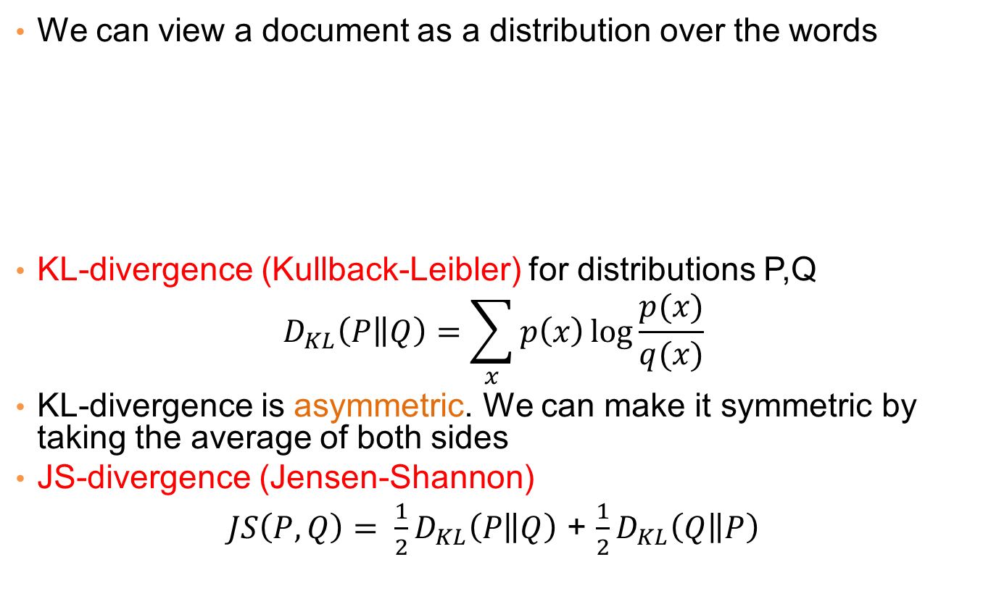
Distances between distributions
We can view a document as a distribution over the words
KL-divergence (Kullback-Leibler) for distributions P,Q
$$D_{KL}\left(P\left\|Q\right.\right)=\sum_{x}{p\left(x\right)\log{\frac{p(x)}{q(x)}}}$$
KL-divergence is asymmetric. We can make it symmetric by taking the average of both sides
JS-divergence (Jensen-Shannon)
$JS\left(P,Q\right)= \frac{1}{2}D_{KL}\left(P\left\|Q\right.\right)$ + $\frac{1}{2}D_{KL}\left(Q\left\|P\right.\right)$
document | Apple | Microsoft | Obama | Election
D1 | 0.35 | 0.5 | 0.1 | 0.05
D2 | 0.4 | 0.4 | 0.1 | 0.1
D2 | 0.05 | 0.05 | 0.6 | 0.3

Slide 39
SKETCHING
AND
LOCALITY SENSITIVE HASHING
Thanks to:
Rajaraman and Ullman, “Mining Massive Datasets”
Evimaria Terzi, slides for Data Mining Course.

Slide 40
Finding near-duplicates documents
We will now consider the problem of finding duplicate and near-duplicate documents from a web crawl.
Why is it important:
  Identify mirrored web pages, and avoid indexing them, or serving them multiple times
  Identify plagiarism
  Find replicated stories in news and cluster them under a single story.
What if we wanted exact duplicates?

Slide 41
Main issues
What is the right representation of the document when we check for similarity?
  E.g., representing a document as a set of characters will not do
When we have billions of documents, keeping the full text in memory is not an option.
  We need to find a shorter representation
How do we do pairwise comparisons we billions of documents?
  If exact match was the issue it would be ok, can we replicate this idea?

Slide 42
Three Essential Techniques for Similar Documents
Shingling : convert documents, emails, etc., to sets.
Minhashing : convert large sets to short signatures, while preserving similarity.
Locality-sensitive hashing : focus on pairs of signatures likely to be similar.

Slide 43
The Big Picture
Candidate
pairs :
those pairs
of signatures
that we need
to test for
similarity.
Shingling
Minhash-
ing
Locality-
sensitive
Hashing
Docu-
ment
The set
of strings
of length k
that appear
in the doc-
ument
Signatures :
short integer
vectors that
represent the
sets, and
reflect their
similarity

Slide 44
Shingles
A k -shingle (or k -gram) for a document is a sequence of k characters that appears in the document.
Example: k=2; doc = abcab. Set of 2-shingles = {ab, bc, ca}.
  Option: regard shingles as a bag, and count ab twice.
Represent a doc by its set of k-shingles.

Slide 45
Shingling
Shingle: a sequence of k contiguous characters
a rose is a rose is a rose
a rose is
rose is a
rose is a
ose is a r
se is a ro
e is a ros
is a rose
is a rose
s a rose i
a rose is
a rose is

Slide 46
Working Assumption
Documents that have lots of shingles in common have similar text, even if the text appears in different order.
Careful: you must pick k large enough, or most documents will have most shingles.
  k = 5 is OK for short documents; k = 10 is better for long documents.

Slide 47
Shingles: Compression Option
To compress long shingles, we can hash them to (say) 4 bytes.
Represent a doc by the set of hash values of its k-shingles.
Two documents could (rarely) appear to have shingles in common, when in fact only the hash-values were shared.

Slide 48
Rabin’s fingerprinting technique
Comparing two strings of size n
if a=b then f(a)=f(b)
if f(a)=f(b) then a=b with high probability
a = 10110
b = 11010
a=b?
O(n) too expensive!
f(a)=f(b)?
f(a)= A mod p
f(b)= B mod p
p = small random prime
size O(logn loglogn)

Slide 49
Thought Question
Why is it better to hash 9-shingles (say) to 4 bytes than to use 4-shingles?
Hint: How random are the 32-bit sequences that result from 4-shingling?

Slide 50
Basic Data Model: Sets
Document: A document is represented as a set shingles (more accurately, hashes of shingles)
Document similarity: Jaccard similarity of the sets of shingles.
  Common shingles over the union of shingles
  Sim (C₁, C₂) = |C₁∩C₂|/|C₁∪C₂|.
Although we use the documents as our driving example the techniques we will describe apply to any kind of sets.
  E.g., similar customers or products.

Slide 51
From Sets to Boolean Matrices
Rows = elements of the universal set (shingles)
Columns = sets (documents)
1 in row e and column S if and only if e is a member of S.
Column similarity is the Jaccard similarity of the sets of their rows with 1.
Typical matrix is sparse.

Slide 52
Example: Jaccard Similarity of Columns
C₁ C₂
0 1
1 0
1 1 Sim (C₁, C₂) =
0 0 2/5 = 0.4
1 1
0 1
*
*
*
*
*
*
*

Slide 53
Aside
We might not really represent the data by a boolean matrix.
Sparse matrices are usually better represented by the list of places where there is a non-zero value.
But the matrix picture is conceptually useful.

Slide 54
Outline: Finding Similar Columns
Compute signatures of columns = small summaries of columns.
Examine pairs of signatures to find similar signatures.
  Essential: similarities of signatures and columns are related. The signatures preserve similarity.
Optional: check that columns with similar signatures are really similar.

Slide 55
Warnings
Comparing all pairs of signatures may take too much time, even if not too much space.
  A job for Locality-Sensitive Hashing.
These methods can produce false negatives, and even false positives (if the optional check is not made).

Slide 56
Signatures
Key idea: “hash” each column C to a small signature Sig (C), such that:
  1. Sig (C) is small enough that we can fit a signature in main memory for each column.
  Sim (C₁, C₂) is (almost) the same as the “similarity” of Sig (C₁) and Sig (C₂).

Slide 57
Four Types of Rows
Given documents X and Y,
Rows may be classified as:
X | Y
1 | 1
1 | 0
0 | 0
0 | 0
0 | 0
1 | 1
1 | 1
type | X bit | Y bit
R₁₁ | 1 | 1
R₁₀ | 1 | 0
R₀₁ | 0 | 1
R₀₀ | 0 | 0

Slide 58
Four Types of Rows
Given documents X and Y,
Rows may be classified as:
X | Y
1 | 1
1 | 0
0 | 0
0 | 0
0 | 0
1 | 1
1 | 1
type | X bit | Y bit
R₁₁ | 1 | 1 | 3
R₁₀ | 1 | 0
R₀₁ | 0 | 1
R₀₀ | 0 | 0

Slide 59
Four Types of Rows
Given documents X and Y,
Rows may be classified as:
X | Y
1 | 1
1 | 0
0 | 0
0 | 0
0 | 0
1 | 1
1 | 1
type | X bit | Y bit
R₁₁ | 1 | 1 | 3
R₁₀ | 1 | 0 | 1
R₀₁ | 0 | 1
R₀₀ | 0 | 0

Slide 60
Four Types of Rows
Given documents X and Y,
Rows may be classified as:
X | Y
1 | 1
1 | 0
0 | 0
0 | 0
0 | 0
1 | 1
1 | 1
type | X bit | Y bit
R₁₁ | 1 | 1 | 3
R₁₀ | 1 | 0 | 1
R₀₁ | 0 | 1 | 0
R₀₀ | 0 | 0

Slide 61
Four Types of Rows
Given documents X and Y,
Rows may be classified as:
X | Y
1 | 1
1 | 0
0 | 0
0 | 0
0 | 0
1 | 1
1 | 1
type | X bit | Y bit
R₁₁ | 1 | 1 | 3
R₁₀ | 1 | 0 | 1
R₀₁ | 0 | 1 | 0
R₀₀ | 0 | 0 | 3

Slide 62
Four Types of Rows
Given documents X and Y,
Rows may be classified as:
Also, R₁₁ = # rows of type R₁₁ , etc.
Note Sim (X,Y) = R₁₁ /(R₁₁ + R₁₀ + R₀₁).
X | Y
1 | 1
1 | 0
0 | 0
0 | 0
0 | 0
1 | 1
1 | 1
type | X bit | Y bit
R₁₁ | 1 | 1 | 3
R₁₀ | 1 | 0 | 1
R₀₁ | 0 | 1 | 0
R₀₀ | 0 | 0 | 3

Slide 63
Minhashing
Imagine the rows permuted randomly.
Define “hash” function h (C ) = the number of the first (in the permuted order) row in which column C has 1.
Use several (e.g., 100) independent hash functions to create a signature.

Slide 64
Example of minhash signatures
Input matrix
 | x1 | x2 | x3 | X4
A | 1 | 0 | 1 | 0
B | 1 | 0 | 0 | 1
C | 0 | 1 | 0 | 1
D | 0 | 1 | 0 | 1
E | 0 | 1 | 0 | 1
F | 1 | 0 | 1 | 0
G | 1 | 0 | 1 | 0
 | x1 | x2 | x3 | X4
A | 1 | 0 | 1 | 0
C | 0 | 1 | 0 | 1
G | 1 | 0 | 1 | 0
F | 1 | 0 | 1 | 0
B | 1 | 0 | 0 | 1
E | 0 | 1 | 0 | 1
D | 0 | 1 | 0 | 1
A
C
G
F
B
E
D
1 | 2 | 1 | 2

Slide 65
Example of minhash signatures
Input matrix
 | x1 | x2 | x3 | X4
A | 1 | 0 | 1 | 0
B | 1 | 0 | 0 | 1
C | 0 | 1 | 0 | 1
D | 0 | 1 | 0 | 1
E | 0 | 1 | 0 | 1
F | 1 | 0 | 1 | 0
G | 1 | 0 | 1 | 0
 | x1 | x2 | x3 | X4
D | 0 | 1 | 0 | 1
B | 1 | 0 | 0 | 1
A | 1 | 0 | 1 | 0
C | 0 | 1 | 0 | 1
F | 1 | 0 | 1 | 0
G | 1 | 0 | 1 | 0
E | 0 | 1 | 0 | 1
D
B
A
C
F
G
E
2 | 1 | 3 | 1

Slide 66
Example of minhash signatures
Input matrix
 | x1 | x2 | x3 | X4
A | 1 | 0 | 1 | 0
B | 1 | 0 | 0 | 1
C | 0 | 1 | 0 | 1
D | 0 | 1 | 0 | 1
E | 0 | 1 | 0 | 1
F | 1 | 0 | 1 | 0
G | 1 | 0 | 1 | 0
 | x1 | x2 | x3 | X4
C | 0 | 1 | 0 | 1
D | 0 | 1 | 0 | 1
G | 1 | 0 | 1 | 0
F | 1 | 0 | 1 | 0
A | 1 | 0 | 1 | 0
B | 1 | 0 | 0 | 1
E | 0 | 1 | 0 | 1
C
D
G
F
A
B
E
3 | 1 | 3 | 1

Slide 67
Surprising Property
The probability (over all permutations of the rows) that h (C₁) = h (C₂) is the same as Sim (C₁, C₂).
Both are R₁₁ /(R₁₁ + R₁₀ + R₀₁)!
Why?
  Look down the permuted columns C₁ and C₂ until we see a 1.
  If it’s a type-R₁₁ row, then h (C₁) = h (C₂). If a type-R₁₀ or type-R₀₁ row, then not.

Slide 68
Similarity for Signatures
The similarity of signatures is the fraction of the hash functions in which they agree.

Slide 69
Example of minhash signatures
Input matrix
 | actual | Sig
(x1,x2) | 0 | 0
(x1,x3) | 0.75 | 2/3
(x1,x4) | 1/7 | 0
(x2,x3) | 0 | 0
(x2,x4) | 0.75 | 1
(x3,x4) | 0 | 0
 | x1 | x2 | x3 | X4
A | 1 | 0 | 1 | 0
B | 1 | 0 | 0 | 1
C | 0 | 1 | 0 | 1
D | 0 | 1 | 0 | 1
E | 0 | 1 | 0 | 1
F | 1 | 0 | 1 | 0
G | 1 | 0 | 1 | 0
x1 | x2 | x3 | X4
1 | 2 | 1 | 2
2 | 1 | 3 | 1
3 | 1 | 3 | 1
≈

Slide 70
Minhash algorithm
Pick k (e.g., 100) permutations of the rows
Think of Sig(x) as a new vector
Let Sig(x)[i]: in the i-th permutation, the index of the first row that has 1 for object x

Slide 71
Is it now feasible?
Assume a billion rows
Hard to pick a random permutation of 1…billion
Even representing a random permutation requires 1 billion entries!!!
How about accessing rows in permuted order?
☹

Slide 72
Being more practical
Approximating row permutations: pick k=100 (?) hash functions (h₁,…,h_{k})
for each row r
for each column c
if c has 1 in row r
for each hash function h_{i} do
  if h_{i} (r ) is a smaller value than M(i,c) then
  M (i,c) = h_{i} (r);
M(i,c) will become the smallest value of h_{i}(r) for which column c has 1 in row r; i.e., h_{i} (r) gives order of rows for i-th permutation

Slide 73
Example
Sig1 Sig2
h(1) = 1 1 -
g(1) = 3 3 -
Row C1 C2
1 1 0
2 0 1
3 1 1
4 1 0
5 0 1
h(2) = 2 1 2
g(2) = 0 3 0
h(3) = 3 1 2
g(3) = 2 2 0
h(4) = 4 1 2
g(4) = 4 2 0
h(x) = x mod 5
g(x) = 2x+1 mod 5
h(5) = 0 1 0
g(5) = 1 2 0

Slide 74
Implementation – (4)
Often, data is given by column, not row.
  E.g., columns = documents, rows = shingles.
If so, sort matrix once so it is by row.
And always compute h_{i} (r ) only once for each row.

Slide 75
Finding Similar Pairs
Suppose we have, in main memory, data representing a large number of objects.
  May be the objects themselves .
  May be signatures as in minhashing.
We want to compare each to each, finding those pairs that are sufficiently similar.

Slide 76
Checking All Pairs is Hard
While the signatures of all columns may fit in main memory, comparing the signatures of all pairs of columns is quadratic in the number of columns.
Example: 10⁶ columns implies 5*10¹¹ column-comparisons.
At 1 microsecond/comparison: 6 days.

Slide 77
Locality-Sensitive Hashing
General idea: Use a function f(x,y) that tells whether or not x and y is a candidate pair: a pair of elements whose similarity must be evaluated.
For minhash matrices: Hash columns to many buckets, and make elements of the same bucket candidate pairs.

Slide 78
Candidate Generation From Minhash Signatures
Pick a similarity threshold s, a fraction < 1.
A pair of columns x and y is a candidate pair if their signatures agree in at least fraction s of the rows.
  I.e., M (i, c ) = M (i, d ) for at least fraction s values of i.

Slide 79
LSH for Minhash Signatures
Big idea: hash columns of signature matrix M several times.
Arrange that (only) similar columns are likely to hash to the same bucket.
While dissimilar columns are less likely to hash to the same bucket
Candidate pairs are those that hash at least once to the same bucket.

Slide 80
Partition Into Bands
r rows
per band
b bands
One
signature
Matrix M

Slide 81
Partition into Bands – (2)
Divide matrix M into b bands of r rows.
For each band, hash its portion of each column to a hash table with k buckets.
  Make k as large as possible.
Candidate column pairs are those that hash to the same bucket for ≥ 1 band.
Tune b and r to catch most similar pairs, but few non-similar pairs.

Slide 82
Buckets
Columns 2 and 6
are probably identical.
Columns 6 and 7 are
surely different.
Matrix M
r rows
b bands

Slide 83
Simplifying Assumption
There are enough buckets that columns are unlikely to hash to the same bucket unless they are identical in a particular band.
Hereafter, we assume that “same bucket” means “identical in that band.”

Slide 84
Example: Effect of Bands
Suppose 100,000 columns.
Signatures of 100 integers.
Therefore, signatures take 40Mb.
Want all 80%-similar pairs.
5,000,000,000 pairs of signatures can take a while to compare.
Choose 20 bands of 5 integers/band.
b
r

Slide 85
Suppose C₁, C₂ are 80% Similar
Probability C₁, C₂ identical in one particular band: (0.8)⁵ = 0.328.
Probability C₁, C₂ are not similar in any of the 20 bands: (1-0.328)²⁰ = .00035 .
  i.e., about 1/3000th of the 80%-similar column pairs are false negatives.

Slide 86
Suppose C₁, C₂ Only 40% Similar
Probability C₁, C₂ identical in any one particular band: (0.4)⁵ = 0.01 .
Probability C₁, C₂ identical in ≥ 1 of 20 bands: ≤ 20 * 0.01 = 0.2 .
But false positives much lower for similarities << 40%.

Slide 87
LSH Involves a Tradeoff
Pick the number of minhashes, the number of bands, and the number of rows per band to balance false positives/negatives.
Example: if we had only 15 bands of 5 rows, the number of false positives would go down, but the number of false negatives would go up.

Slide 88
Analysis of LSH – What We Want
Probability
= 1 if s > t
Probability
of sharing
a bucket
No chance
if s < t
t
Similarity s of two sets

Slide 89
What One Band of One Row Gives You
Probability
of sharing
a bucket
Remember:
probability of
equal hash-values
= similarity
t
Similarity s of two sets

Slide 90
What b Bands of r Rows Gives You
At least
one band
identical
No bands
identical
(
s ^{r}
t ~ (1/b)^{1/r}
1 -
1 -
)^{b}
Probability
of sharing
a bucket
Some row
of a band
unequal
All rows
of a band
are equal
t
Similarity s of two sets

Slide 91
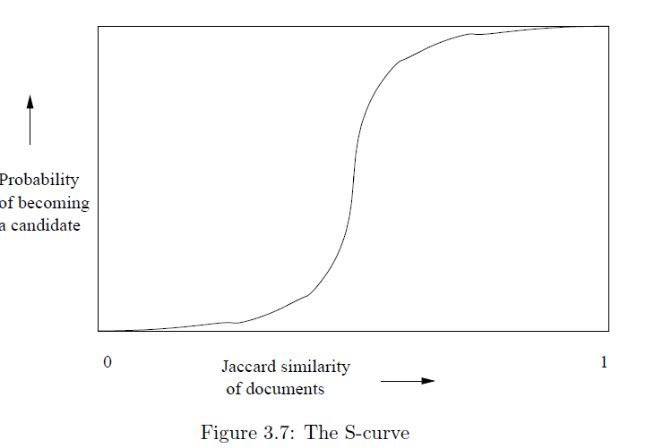
Example: b = 20; r = 5
t = 0.5
s | 1-(1-s^{r})^{b}
.2 | .006
.3 | .047
.4 | .186
.5 | .470
.6 | .802
.7 | .975
.8 | .9996

Slide 92
LSH Summary
Tune to get almost all pairs with similar signatures, but eliminate most pairs that do not have similar signatures.
Check in main memory that candidate pairs really do have similar signatures.
Optional: In another pass through data, check that the remaining candidate pairs really represent similar sets .

Slide 93
Locality-sensitive hashing (LSH)
Big Picture: Construct hash functions h: R^{d}→ U such that for any pair of points p,q:
  If D(p,q)≤r, then Pr[h(p)=h(q)] is high
  If D(p,q)≥cr, then Pr[h(p)=h(q)] is small
Then, we can solve the “approximate NN” problem by hashing
LSH is a general framework; for a given distance function D we need to find the right h

