Slide 1
DATA MINING
LECTURE 2
Frequent Itemsets
Association Rules

Slide 2
INTRODUCTION SUMMARY

Slide 3
What is Data Mining?
Data mining is the use of efficient techniques for the analysis of very large collections of data and the extraction of useful and possibly unexpected patterns in data.
“Data mining is the analysis of (often large) observational data sets to find unsuspected relationships and to summarize the data in novel ways that are both understandable and useful to the data analyst” (Hand, Mannila, Smyth)
“Data mining is the discovery of models for data” (Rajaraman, Ullman)
  We can have the following types of models
    Models that explain the data (e.g., a single function)
    Models that predict the future data instances.
    Models that summarize the data
    Models the extract the most prominent features of the data.

Slide 4
Why do we need data mining?
Really huge amounts of complex data generated from multiple sources and interconnected in different ways
  Scientific data from different disciplines
    Weather, astronomy, physics, biological microarrays, genomics
  Huge text collections
    The Web, scientific articles, news, tweets, facebook postings.
  Transaction data
    Retail store records, credit card records
  Behavioral data
    Mobile phone data, query logs, browsing behavior, ad clicks
  Networked data
    The Web, Social Networks, IM networks, email network, biological networks.
  All these types of data can be combined in many ways
    Facebook has a network, text, images, user behavior, ad transactions.
We need to analyze this data to extract knowledge
  Knowledge can be used for commercial or scientific purposes.
  Our solutions should scale to the size of the data

Slide 5
Data Mining: Confluence of Multiple Disciplines
Database
Technology
Statistics
Machine
Learning
Data Mining
Visualization
Pattern
Recognition
Other
Disciplines
Algorithm

Slide 6
An example of a data mining challenge
We are given a stream of numbers (identifiers, etc). We want to answer simple questions:
  How many numbers are there?
  How many distinct numbers are there?
  What are the most frequent numbers?
  What is the mean of the numbers? Or the median?
  How many numbers appear at least K times?
  Etc.
These questions are simple if we have resources (time and memory).
In our case we have neither, since the data is streaming.

Slide 7
Finding the majority element
A stream of identifiers; one of them occurs more than 50% of the time
How can you find it using no more than a few memory locations?
Suggestions?

Slide 8
Finding the majority element (solution)
A = first item you see; count = 1
for each subsequent item x
  if (A == x) count = count + 1
  else {
  count = count - 1
  if (count == 0) {A=x; count = 1}
  }
  endfor
  return A
Why does this work correctly?

Slide 9
Finding the majority element (solution and correctness proof)
An occurrence of an identifier u is discarded if
  A=u and the counter is decreased.
  The identifier u causes the counter to decrease
Basic observation: Whenever we discard an occurrence of the majority element m we also discard an occurrence of an element u different from m
A = first item you see; count = 1
for each subsequent item x
  if (A==x) count = count + 1
  else {
  count = count - 1
  if (count == 0) {A=x; count = 1}
  }
endfor
return A

Slide 10
Finding a number in the top half
Given a set of N numbers (N is very large)
Find a number x such that x is *likely* to be larger than the median of the numbers
Simple solution
  Sort the numbers and store them in sorted array A
  Any value larger than A[N/2] is a solution
Other solutions?

Slide 11
Finding a number in the top half efficiently
A solution that uses small number of operations
  Randomly sample K numbers from the file
  Output their maximum
Failure probability (1/2)^K
median
N/2 items
N/2 items

Slide 12
FREQUENT ITEMSETS &
ASSOCIATION RULES
Thanks to:
Tan, Steinbach, Kumar, “Introduction to Data Mining”
Evimaria Terzi
Evaggelia Pitoura

Slide 13
This is how it all started…
Rakesh Agrawal, Tomasz Imielinski, Arun N. Swami: Mining Association Rules between Sets of Items in Large Databases. SIGMOD Conference 1993: 207-216
Rakesh Agrawal, Ramakrishnan Srikant: Fast Algorithms for Mining Association Rules in Large Databases. VLDB 1994: 487-499
These two papers are credited with the birth of Data Mining
For a long time people were fascinated with Association Rules and Frequent Itemsets
  Some people (in industry and academia) still are.

Slide 14
Frequent Itemsets
Given a set of transactions, find combinations of items (itemsets) that occur frequently
Market-Basket transactions
Examples of frequent itemsets
{Diaper, Beer} : 3
{Milk, Bread} : 3
{Milk, Bread, Diaper}: 2
Notes:
14

Slide 15
Binary matrix representation
Our data can also be represented as a 0/1 matrix
  Rows: transactions
  Columns: items
  1: item bought, 0: item not bought
    Asymmetric: we care more about 1’s than 0’s
  We lose information about counts
A variety of data can be represented like that
  E.g., Document-words data, biological data, etc

Slide 16
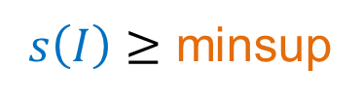
Definition: Frequent Itemset
Itemset
  A collection of one or more items
    Example: {Milk, Bread, Diaper}
  k-itemset
    An itemset that contains k items
Support count (σ)
  Frequency of occurrence of an itemset
  E.g. σ({Milk, Bread,Diaper}) = 2
Support
  Fraction of transactions that contain an itemset
  E.g. s({Milk, Bread, Diaper}) = 2/5
Frequent Itemset
  An itemset whose support is greater than or equal to a minsup threshold
$s\left(I\right)≥$ minsup

Slide 17
Mining Frequent Itemsets task
Input: A set of transactions T, over a set of items I
Output: All itemsets with items in I having
  support ≥ minsup threshold
Problem parameters:
  N = |T|: number of transactions
  d = |I|: number of (distinct) items
  w: max width of a transaction
  Number of possible itemsets?
= 2^{d}

Slide 18
The itemset lattice
Given d items, there are 2^{d} possible itemsets

Slide 19
A Naïve Algorithm
Brute-force approach:
  Each itemset in the lattice is a candidate frequent itemset
  Count the support of each candidate by scanning the database
  Match each transaction against every candidate
  Time Complexity ~ O(NMw) , Space Complexity ~ O(M)
    Expensive since M = 2^{d} !!!

Slide 20
Frequent Itemset Generation Strategies
Reduce the number of candidates (M)
  Complete search: M=2^{d}
  Use pruning techniques to reduce M
Reduce the number of transactions (N)
  Reduce size of N as the size of itemset increases
  Used by DHP and vertical-based mining algorithms
Reduce the number of comparisons (NM)
  Use efficient data structures to store the candidates or transactions
  No need to match every candidate against every transaction
Any ideas?

Slide 21
Reduce the number of candidates
Apriori principle (Main observation):
  If an itemset is frequent, then all of its subsets must also be frequent
Apriori principle holds due to the following property of the support measure:
  The support of an itemset never exceeds the support of its subsets
  This is known as the anti-monotone property of support
Notes:
21

Slide 22
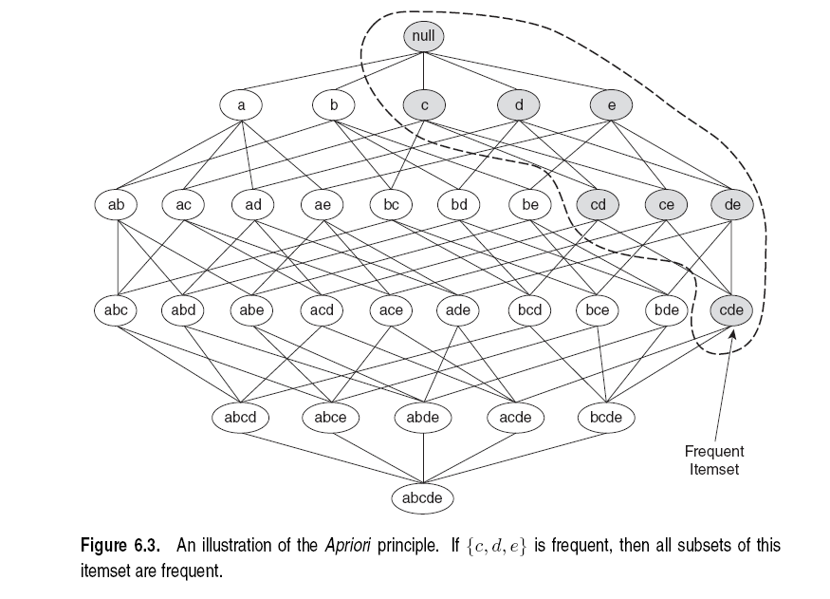
Illustration of the Apriori principle
Frequent subsets
Found to be frequent

Slide 23
Illustration of the Apriori principle
Found to be Infrequent
Infrequent supersets
Pruned

Slide 24
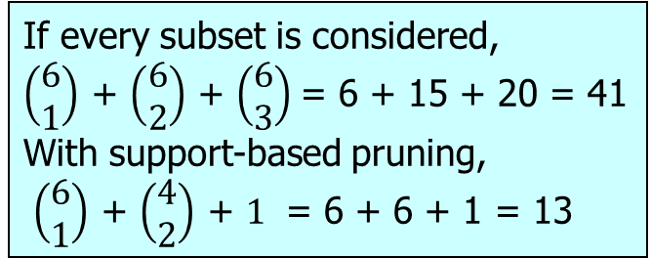
Illustration of the Apriori principle
minsup = 3
Items (1-itemsets)‏
Pairs (2-itemsets)‏
(No need to generate
candidates involving Coke
or Eggs)‏
Triplets (3-itemsets)‏
If every subset is considered,
$\left(\begin{matrix}6 \\ 1\end{matrix}\right)$ + $\left(\begin{matrix}6 \\ 2\end{matrix}\right)$ + $\left(\begin{matrix}6 \\ 3\end{matrix}\right)$= 6 + 15 + 20 = 41
With support-based pruning,
$\left(\begin{matrix}6 \\ 1\end{matrix}\right)$ + $\left(\begin{matrix}4 \\ 2\end{matrix}\right)$ + $1$ = 6 + 6 + 1 = 13
Only this triplet has all subsets to be frequent
But it is below the minsup threshold
Notes:
24

Slide 25
The Apriori algorithm
Find frequent 1-items and put them to L_{k} (k=1)‏
Use L_{k} to generate a collection of candidate itemsets C_{k+1} with size (k+1)‏
Scan the database to find which itemsets in C_{k+1} are frequent and put them into L_{k+1}
If L_{k+1} is not empty
  k=k+1
  Goto step 2
R. Agrawal, R. Srikant: "Fast Algorithms for Mining Association Rules",
Proc. of the 20th Int'l Conference on Very Large Databases, 1994.
Notes:
25

Slide 26
The Apriori algorithm
C_{k}: Candidate itemsets of size k
L_{k} : frequent itemsets of size k
L₁ = {frequent 1-itemsets};
for (k = 2; L_{k} !=∅; k++)
C_{k+1} = GenerateCandidates(L_{k})‏
for each transaction t in database do
increment count of candidates in C_{k+1} that are contained in t
endfor
L_{k+1} = candidates in C_{k+1} with support ≥min_sup
endfor
return ∪_{k} L_{k};

Slide 27
Generate Candidates C_{k+1}
Any ideas?
We know the frequent itemsets of size k, L_{k}
We know that every itemset in C_{k+1} should have frequent subsets
Construct C_{k+1} from the itemsets in L_{k}

Slide 28
Generate Candidates C_{k+1}
Assume the items in L_{k} are listed in an order (e.g., alphabetical)‏
Step 1: self-joining L_{k} (IN SQL)‏
  insert into C_{k+1}
  select p.item₁, p.item₂, …, p.item_{k}, q.item_{k}
  from L_{k} p, L_{k} q
  where p.item₁=q.item₁, …, p.item_{k-1}=q.item_{k-1}, p.item_{k} < q.item_{k}
Create an itemset of size k+1, by joining two itemsets of size k, that share the first k-1 items
Notes:
28

Slide 29
Example I
L₃={abc, abd, acd, ace, bcd}
Self-joining: L₃*L₃
  abcd from abc and abd
  acde from acd and ace
{a,b,c}
{a,b,d}
{a,b,c,d}
{a,c,d}
{a,c,e}
{a,c,d,e}
Notes:
29

Slide 30
Example II

Slide 31
Generate Candidates C_{k+1}
Assume the items in L_{k} are listed in an order (e.g., alphabetical)‏
Step 1: self-joining L_{k} (IN SQL)‏
  insert into C_{k+1}
  select p.item₁, p.item₂, …, p.item_{k}, q.item_{k}
  from L_{k} p, L_{k} q
  where p.item₁=q.item₁, …, p.item_{k-1}=q.item_{k-1}, p.item_{k} < q.item_{k}
Step 2: pruning
  forall itemsets c in C_{k+1} do
    forall k-subsets s of c do
      if (s is not in L_{k}) then delete c from C_{k+1}
All itemsets of size k that are subsets of a new (k+1)-itemset should be frequent
Notes:
31

Slide 32
Example I
{a,b,c}
{a,b,d}
L₃={abc, abd, acd, ace, bcd}
Self-joining: L₃*L₃
  abcd from abc and abd
  acde from acd and ace
Pruning:
  abcd is kept since all subset itemsets are in L₃
  acde is removed because ade is not in L₃
C₄={abcd}
{a,b,c,d}
abc
abd
acd
bcd
√
√
√
√
{a,c,d}
{a,c,e}
{a,c,d,e}
acd
ace
ade
cde
√
√
X
Notes:
32

Slide 33
Example II
{Bread,Diaper}
√
{Bread,Milk}
√
{Diaper, Milk}
√

Slide 34
Example II – Alternative
Joining with the L₁ set generates more candidates that need to be pruned.

Slide 35
The Apriori algorithm
C_{k}: Candidate itemsets of size k
L_{k} : frequent itemsets of size k
L₁ = {frequent 1-itemsets};
for (k = 2; L_{k} !=∅; k++)
C_{k+1} = GenerateCandidates(L_{k})‏
for each transaction t in database do
increment count of candidates in C_{k+1} that are contained in t
endfor
L_{k+1} = candidates in C_{k+1} with support ≥min_sup
endfor
return ∪_{k} L_{k};

Slide 36
Reducing Number of Comparisons
Candidate counting:
  Scan the database of transactions to determine the support of each candidate itemset
  To reduce the number of comparisons, store the candidates in a hash structure
    Instead of matching each transaction against every candidate, match it against candidates contained in the hashed buckets

Slide 37
How to Count Supports of Candidates?
Method:
  Candidate itemsets are stored in a hash-tree
  Leaf node of hash-tree contains a list of itemsets and counts
  Interior node contains a hash table
  Subset operation: finds all the candidates contained in a transaction
Notes:
37

Slide 38
Generate Hash Tree
Suppose you have 15 candidate itemsets of length 3:
{1 4 5}, {1 2 4}, {4 5 7}, {1 2 5}, {4 5 8}, {1 5 9}, {1 3 6}, {2 3 4}, {5 6 7}, {3 4 5}, {3 5 6}, {3 5 7}, {6 8 9}, {3 6 7}, {3 6 8}
You need:
Hash function
Max leaf size: max number of itemsets stored in a leaf node (if number of candidate itemsets exceeds max leaf size, split the node)
Hash function = mod 3
2 3 4
5 6 7
3,6,9
1,4,7
1 4 5
3 4 5
3 5 6
3 5 7
6 8 9
3 6 7
3 6 8
1 3 6
2,5,8
1 2 4
4 5 7
1 2 5
4 5 8
1 5 9
At the i-th level we hash at the i-th item

Slide 39
Association Rule Discovery: Hash tree
Hash Function
Candidate Hash Tree
1,4,7
3,6,9
2,5,8
2 3 4
5 6 7
1 4 5
1 3 6
3 4 5
3 5 6
3 6 7
Hash on 1, 4 or 7
3 5 7
3 6 8
1 2 4
1 5 9
6 8 9
1 2 5
4 5 7
4 5 8

Slide 40
Association Rule Discovery: Hash tree
Hash Function
Candidate Hash Tree
1,4,7
3,6,9
2,5,8
2 3 4
5 6 7
1 4 5
1 3 6
3 4 5
3 5 6
3 6 7
Hash on 2, 5 or 8
3 5 7
3 6 8
1 2 4
1 5 9
6 8 9
1 2 5
4 5 7
4 5 8

Slide 41
Association Rule Discovery: Hash tree
Hash Function
Candidate Hash Tree
1,4,7
3,6,9
2,5,8
2 3 4
5 6 7
1 4 5
1 3 6
3 4 5
3 5 6
3 6 7
Hash on 3, 6 or 9
3 5 7
3 6 8
1 2 4
1 5 9
6 8 9
1 2 5
4 5 7
4 5 8

Slide 42
Subset Operation
Given a transaction t, what are the possible subsets of size 3?

Slide 43
Subset Operation Using Hash Tree
1 2 3 5 6
transaction
Hash Function
1 +
2 3 5 6
2 +
3 5 6
1,4,7
3,6,9
3 +
5 6
2,5,8
2 3 4
5 6 7
1 4 5
1 3 6
3 4 5
3 5 6
3 6 7
3 5 7
3 6 8
1 2 4
1 2 5
1 5 9
6 8 9
4 5 7
4 5 8

Slide 44
Subset Operation Using Hash Tree
1 2 3 5 6
transaction
Hash Function
1 +
2 3 5 6
2 +
3 5 6
1,4,7
3,6,9
1 2 +
3 5 6
3 +
5 6
2,5,8
1 3 +
5 6
2 3 4
1 5 +
6
5 6 7
1 4 5
1 3 6
3 4 5
3 5 6
3 6 7
3 5 7
3 6 8
1 2 4
1 2 5
1 5 9
6 8 9
4 5 7
4 5 8

Slide 45
Subset Operation Using Hash Tree
1 2 3 5 6
transaction
Hash Function
1 +
2 3 5 6
2 +
3 5 6
1,4,7
3,6,9
1 2 +
3 5 6
3 +
5 6
2,5,8
1 3 +
5 6
2 3 4
1 5 +
6
5 6 7
1 4 5
1 3 6
3 4 5
3 5 6
3 6 7
3 5 7
3 6 8
1 2 4
1 2 5
1 5 9
6 8 9
4 5 7
4 5 8
Match transaction against 9 out of 15 candidates
Hash-tree enables to enumerate itemsets in transaction
and match them against candidates

Slide 46
Factors Affecting Complexity
Choice of minimum support threshold
  lowering support threshold results in more frequent itemsets
  this may increase number of candidates and max length of frequent itemsets
Dimensionality (number of items) of the data set
  more space is needed to store support count of each item
  if number of frequent items also increases, both computation and I/O costs may also increase
Size of database
  since Apriori makes multiple passes, run time of algorithm may increase with number of transactions
Average transaction width
  transaction width increases with denser data sets
  This may increase max length of frequent itemsets and traversals of hash tree (number of subsets in a transaction increases with its width)

Slide 47
ASSOCIATION RULES

Slide 48
Association Rule Mining
Given a set of transactions, find rules that will predict the occurrence of an item based on the occurrences of other items in the transaction
Market-Basket transactions
Example of Association Rules
{Diaper} → {Beer},
{Milk, Bread} → {Eggs,Coke},
{Beer, Bread} → {Milk},
Implication means co-occurrence, not causality!

Slide 49
Definition: Association Rule
Association Rule
  An implication expression of the form X → Y, where X and Y are itemsets
  Example:
  {Milk, Diaper} → {Beer}
Rule Evaluation Metrics
  Support (s)
    Fraction of transactions that contain both X and Y
  Confidence (c)
    Measures how often items in Y
    appear in transactions that
    contain X
Example:

Slide 50
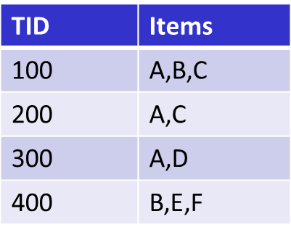
Support and Confidence
For association rule X → Y:
  Support s(X→Y): the probability P(X,Y) that X and Y occur together
  Confidence c(X → Y): the conditional probability P(X|Y) that X occurs given that Y has occurred.
Customer
buys both
Customer
buys diaper
  Support, Confidence of rule
  A ◊ C (50%, 66.6%)‏
  C ◊ A (50%, 100%)‏
Customer
buys beer

Slide 51
Association Rule Mining Task
Input: A set of transactions T, over a set of items I
Output: All rules with items in I having
  support ≥ minsup threshold
  confidence ≥ minconf threshold

Slide 52
Mining Association Rules
Example of Rules:
{Milk,Diaper} → {Beer} (s=0.4, c=0.67)
{Milk,Beer} → {Diaper} (s=0.4, c=1.0)
{Diaper,Beer} → {Milk} (s=0.4, c=0.67)
{Beer} → {Milk,Diaper} (s=0.4, c=0.67)
{Diaper} → {Milk,Beer} (s=0.4, c=0.5)
{Milk} → {Diaper,Beer} (s=0.4, c=0.5)
Observations:
All the above rules are binary partitions of the same itemset:
{Milk, Diaper, Beer}
Rules originating from the same itemset have identical support but
can have different confidence
Thus, we may decouple the support and confidence requirements

Slide 53
Mining Association Rules
Two-step approach:
  Frequent Itemset Generation
    Generate all itemsets whose support ≥ minsup
  Rule Generation
    Generate high confidence rules from each frequent itemset, where each rule is a binary partitioning of a frequent itemset

Slide 54
Rule Generation
Given a frequent itemset L, find all non-empty subsets f ⊂ L such that f → L – f satisfies the minimum confidence requirement
  If {A,B,C,D} is a frequent itemset, candidate rules:
    ABC →D, ABD →C, ACD →B, BCD →A,
    A →BCD, B →ACD, C →ABD, D →ABC
    AB →CD, AC → BD, AD → BC, BC →AD,
    BD →AC, CD →AB,
If |L| = k, then there are 2^{k} – 2 candidate association rules (ignoring L → ∅ and ∅ → L)

Slide 55
Rule Generation
How to efficiently generate rules from frequent itemsets?
  In general, confidence does not have an anti-monotone property
    c(ABC →D) can be larger or smaller than c(AB →D)
  But confidence of rules generated from the same itemset has an anti-monotone property
  e.g., L = {A,B,C,D}:
  c(ABC → D) ≥ c(AB → CD) ≥ c(A → BCD)
    Confidence is anti-monotone w.r.t. number of items on the RHS of the rule

Slide 56
Rule Generation for Apriori Algorithm
Low Confidence Rule
Pruned Rules
Lattice of rules

Slide 57
Rule Generation for Apriori Algorithm
Candidate rule is generated by merging two rules that share the same prefix
in the rule consequent
join(CD=>AB,BD=>AC)
would produce the candidate
rule D => ABC
Prune rule D=>ABC if its
subset AD=>BC does not have
high confidence

Slide 58
RESULT
POST-PROCESSING

Slide 59
Compact Representation of Frequent Itemsets
Some itemsets are redundant because they have identical support as their supersets
Number of frequent itemsets
Need a compact representation

Slide 60
Maximal Frequent Itemset
An itemset is maximal frequent if none of its immediate supersets is frequent
Maximal Itemsets
Infrequent Itemsets
Border

Slide 61
Closed Itemset
An itemset is closed if none of its immediate supersets has the same support as the itemset

Slide 62
Maximal vs Closed Itemsets
Transaction Ids
Not supported by any transactions

Slide 63
Maximal vs Closed Frequent Itemsets
Closed but not maximal
Minimum support = 2
Closed and maximal
# Closed = 9
# Maximal = 4

Slide 64
Maximal vs Closed Itemsets

Slide 65
Pattern Evaluation
Association rule algorithms tend to produce too many rules
  many of them are uninteresting or redundant
  Redundant if {A,B,C} → {D} and {A,B} → {D}
  have same support & confidence
Interestingness measures can be used to prune/rank the derived patterns
In the original formulation of association rules, support & confidence are the only measures used

Slide 66
Computing Interestingness Measure
Given a rule X → Y, information needed to compute rule interestingness can be obtained from a contingency table
Contingency table for X → Y
 | Y | Y
X | f₁₁ | f₁₀ | f₁₊
X | f₀₁ | f₀₀ | f_{o+}
 | f₊₁ | f₊₀ | |T|
f₁₁: support of X and Y
f₁₀: support of X and Y
f₀₁: support of X and Y
f₀₀: support of X and Y
Used to define various measures
support, confidence, lift, Gini,
J-measure, etc.

Slide 67
Drawback of Confidence
 | Coffee | Coffee
Tea | 15 | 5 | 20
Tea | 75 | 5 | 80
 | 90 | 10 | 100
Association Rule: Tea → Coffee
Confidence= P(Coffee|Tea) = 0.75
but P(Coffee) = 0.9
Although confidence is high, rule is misleading
P(Coffee|Tea) = 0.9375

Slide 68
Statistical Independence
Population of 1000 students
  600 students know how to swim (S)
  700 students know how to bike (B)
  420 students know how to swim and bike (S,B)
  P(S∧B) = 420/1000 = 0.42
  P(S) × P(B) = 0.6 × 0.7 = 0.42
  P(S∧B) = P(S) × P(B) => Statistical independence
  P(S∧B) > P(S) × P(B) => Positively correlated
  P(S∧B) < P(S) × P(B) => Negatively correlated

Slide 69
Statistical-based Measures
Measures that take into account statistical dependence
Text mining: Pointwise Mutual Information

Slide 70
Example: Lift/Interest
 | Coffee | Coffee
Tea | 15 | 5 | 20
Tea | 75 | 5 | 80
 | 90 | 10 | 100
Association Rule: Tea → Coffee
Confidence= P(Coffee|Tea) = 0.75
but P(Coffee) = 0.9
Lift = 0.75/0.9= 0.8333 (< 1, therefore is negatively associated)

Slide 71
Drawback of Lift & Interest
 | Y | Y
X | 10 | 0 | 10
X | 0 | 90 | 90
 | 10 | 90 | 100
 | Y | Y
X | 90 | 0 | 90
X | 0 | 10 | 10
 | 90 | 10 | 100
Statistical independence:
If P(X,Y)=P(X)P(Y) => Lift = 1
Rare co-occurrences are deemed more interesting

