Slide 1
DATA MINING
LECTURE 13
Pagerank, Absorbing Random Walks
Coverage Problems

Slide 2
PAGERANK

Slide 3

PageRank algorithm
The PageRank random walk
  Start from a page chosen uniformly at random
  With probability α follow a random outgoing link
  With probability 1- α jump to a random page chosen uniformly at random
  Repeat until convergence
The PageRank Update Equations
$α = 0.85$in most cases

Slide 4
The PageRank random walk
What about sink nodes?
  When at a node with no outgoing links jump to a page chosen uniformly at random

Slide 5
The PageRank random walk
The PageRank transition probability matrix
  P was sparse, P’’ is dense.
P’’ = αP’ + (1-α)uv^{T},
where u is the vector of all 1s, u = (1,1,…,1)
and v is the uniform vector, v = (1/n,1/n,…,1/n)

Slide 6
A PageRank implementation
Performing vanilla power method is now too expensive – the matrix is not sparse
q⁰ = v
t = 1
repeat
t = t +1
until δ < ε
Efficient computation of q^{t} = (P’’)^{T} q^{t-1}
P = normalized adjacency matrix
P’ = P + dv^{T}, where d_{i} is 1 if i is sink and 0 o.w.
P’’ = αP’ + (1-α)uv^{T}, where u is the vector of all 1s

Slide 7
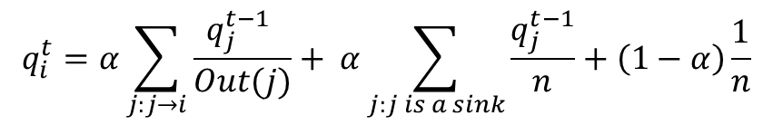
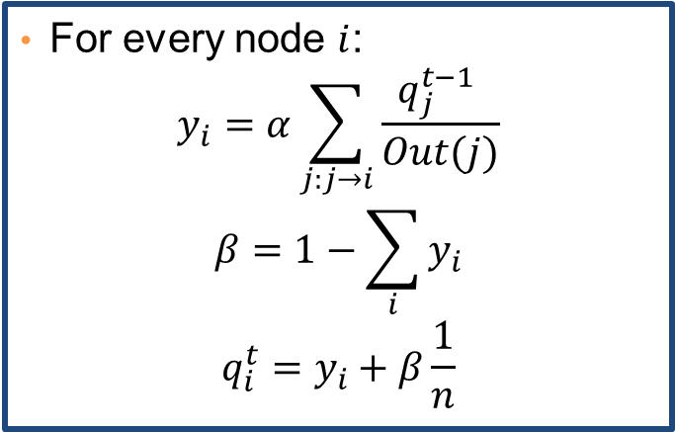
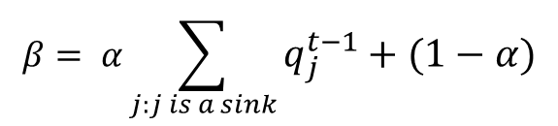
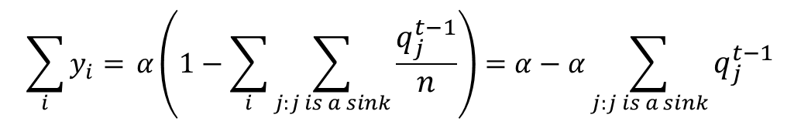
A PageRank implementation
For every node $i$:
$$y_{i}=α\sum_{j:j→i}{\frac{q_{j}^{t−1} }{Out(j)}}$$
$$β=1−\sum_{i}{y_{i}}$$
$$q_{i}^{t}=y_{i}+β\frac{1}{n}$$
Why does this work?
$$\sum_{i}{y_{i}= }α\left(1−\sum_{i}{\sum_{j:j is a sink}{\frac{q_{j}^{t−1}}{n}}}\right)=α−α\sum_{j:j is a sink}{q_{j}^{t−1}}$$
$$β= α\sum_{j:j is a sink}{q_{j}^{t−1}}+(1−α)$$
$$q_{i}^{t}=α\sum_{j:j→i}{\frac{q_{j}^{t−1} }{Out(j)}}+ α\sum_{j:j is a sink}{\frac{q_{j}^{t−1}}{n}}+\left(1−α\right)\frac{1}{n}$$

Slide 8
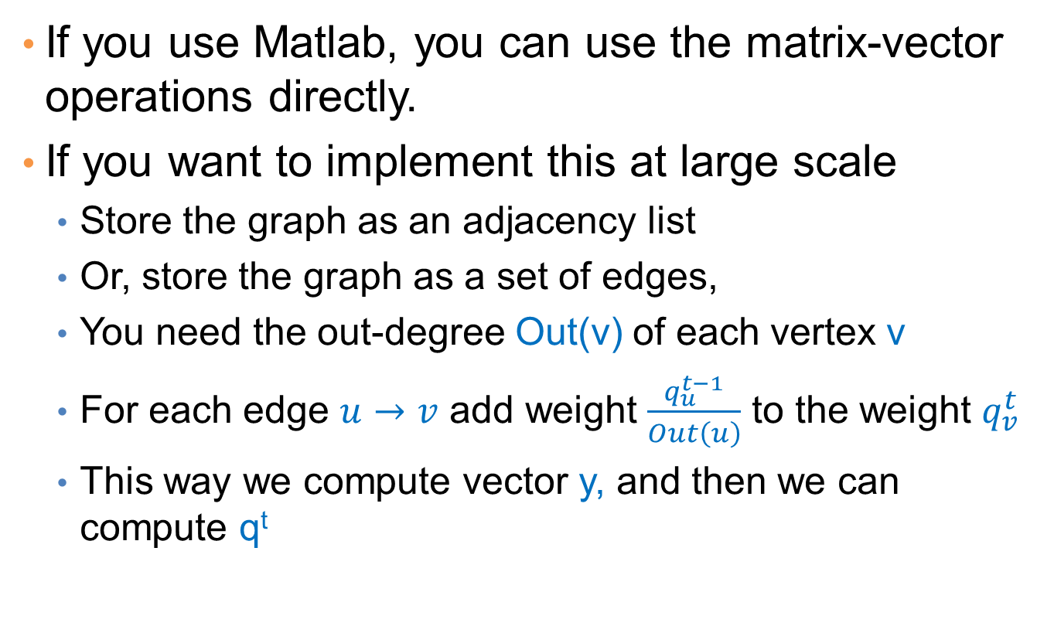
Implementation details
If you use Matlab, you can use the matrix-vector operations directly.
If you want to implement this at large scale
  Store the graph as an adjacency list
  Or, store the graph as a set of edges,
  You need the out-degree Out(v) of each vertex v
  For each edge $u→v$add weight $\frac{q_{u}^{t−1}}{Out\left(u\right)}$ to the weight $q_{v}^{t}$
  This way we compute vector y, andthen we can compute q^{t}

Slide 9
ABSORBING RANDOM WALKS

Slide 10
Random walk with absorbing nodes
What happens if we do a random walk on this graph? What is the stationary distribution?
All the probability mass on the red sink node:
  The red node is an absorbing node

Slide 11
Random walk with absorbing nodes
What happens if we do a random walk on this graph? What is the stationary distribution?
There are two absorbing nodes: the red and the blue.
The probability mass will be divided between the two

Slide 12
Absorption probability
If there are more than one absorbing nodes in the graph a random walk that starts from a non-absorbing node will be absorbed in one of them with some probability
  The probability of absorption gives an estimate of how close the node is to red or blue

Slide 13
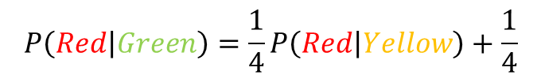
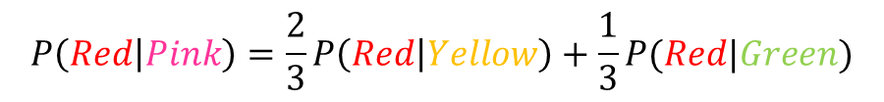
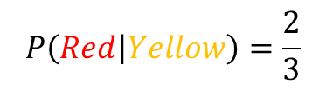
Absorption probability
Computing the probability of being absorbed is very easy
  Take the (weighted) average of the absorption probabilities of your neighbors
    if one of the neighbors is the absorbing node, it has probability 1
  Repeat until convergence (very small change in probs)
  The absorbing nodes have probability 1 of being absorbed in themselves and zero of being absorbed in another node.
$$P\left(Red | Pink\right)=\frac{2}{3}P\left(Red | Yellow\right)+\frac{1}{3}P(Red|Green)$$
2
1
$$P\left(Red | Green\right)=\frac{1}{4}P\left(Red | Yellow\right)+\frac{1}{4}$$
1
1
2
$$P\left(Red | Yellow\right)=\frac{2}{3}$$
2
1

Slide 14
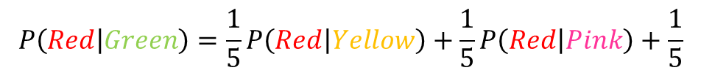
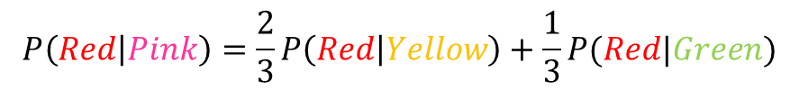
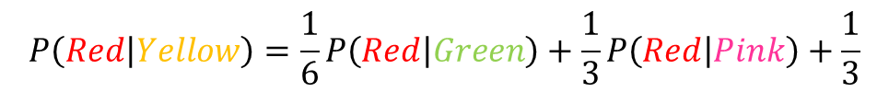
Absorption probability
The same idea can be applied to the case of undirected graphs
  The absorbing nodes are still absorbing, so the edges to them are (implicitly) directed.
$$P\left(Red | Pink\right)=\frac{2}{3}P\left(Red | Yellow\right)+\frac{1}{3}P(Red|Green)$$
0.57
2
1
$$P\left(Red | Green\right)=\frac{1}{5}P\left(Red | Yellow\right)+\frac{1}{5}P\left(Red | Pink\right)+\frac{1}{5}$$
1
2
1
2
$$P\left(Red | Yellow\right)=\frac{1}{6}P\left(Red | Green\right)+\frac{1}{3}P\left(Red | Pink\right)+\frac{1}{3}$$
1
0.52
0.42

Slide 15
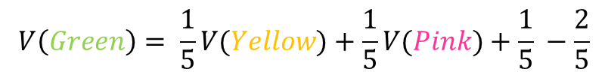
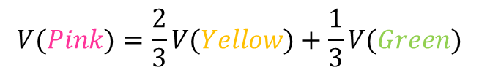
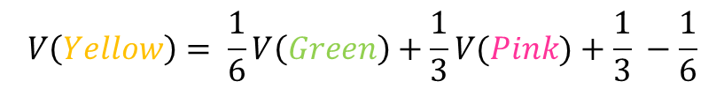
Propagating values
Assume that Red has a positive value and Blue a negative value
  Positive/Negative class, Positive/Negative opinion
We can compute a value for all the other nodes in the same way
  This is the expected value for the node
+1
$$V(Pink)=\frac{2}{3}V(Yellow)+\frac{1}{3}V(Green)$$
0.16
2
-1
1
$$V\left(Green\right)= \frac{1}{5}V(Yellow)+\frac{1}{5}V(Pink)+\frac{1}{5} −\frac{2}{5}$$
1
2
1
2
$$V\left(Yellow\right)= \frac{1}{6}V\left(Green\right)+\frac{1}{3}V(Pink)+\frac{1}{3} −\frac{1}{6}$$
1
0.05
-0.16

Slide 16

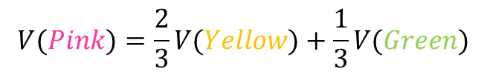
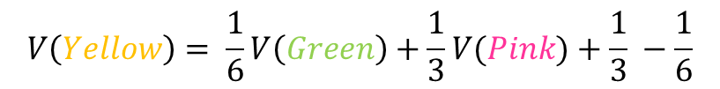
Electrical networks and random walks
Our graph corresponds to an electrical network
There is a positive voltage of +1 at the Red node, and a negative voltage -1 at the Blue node
There are resistances on the edges inversely proportional to the weights (or conductance proportional to the weights)
The computed values are the voltages at the nodes
+1
+1
0.16
2
$$V(Pink)=\frac{2}{3}V(Yellow)+\frac{1}{3}V(Green)$$
-1
1
$$V\left(Green\right)= \frac{1}{5}V(Yellow)+\frac{1}{5}V(Pink)+\frac{1}{5} −\frac{2}{5}$$
1
1
2
2
$$V\left(Yellow\right)= \frac{1}{6}V\left(Green\right)+\frac{1}{3}V(Pink)+\frac{1}{3} −\frac{1}{6}$$
1
0.05
-0.16

Slide 17
Transductive learning
If we have a graph of relationships and some labels on these edges we can propagate them to the remaining nodes
  E.g., a social network where some people are tagged as spammers
  E.g., the movie-actor graph where some movies are tagged as action or comedy.
This is a form of semi-supervised learning
  We make use of the unlabeled data, and the relationships
It is also called transductive learning because it does not produce a model, but just labels the unlabeled data that is at hand.
  Contrast to inductive learning that learns a model and can label any new example

Slide 18
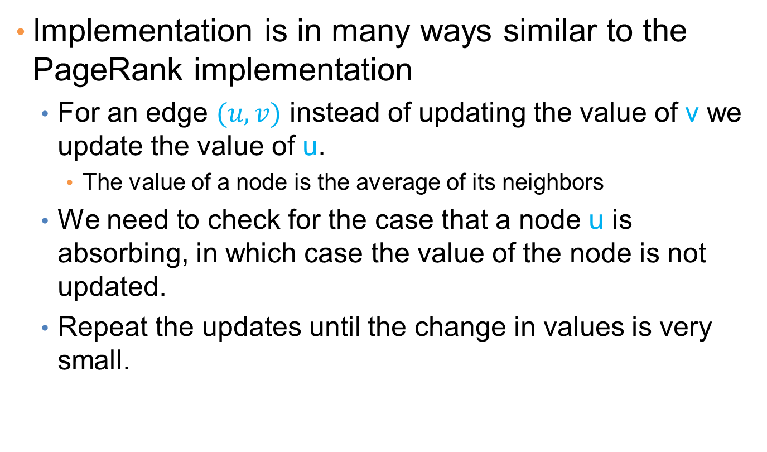
Implementation details
Implementation is in many ways similar to the PageRank implementation
  For an edge $(u,v)$instead of updating the value of v we update the value of u.
    The value of a node is the average of its neighbors
  We need to check for the case that a node u is absorbing, in which case the value of the node is not updated.
  Repeat the updates until the change in values is very small.

Slide 19
Coverage

Slide 20
Example
Promotion campaign on a social network
  We have a social network as a graph.
  People are more likely to buy a product if they have a friend who has bought it.
  We want to offer the product for free to some people such that every person in the graph is covered (they have a friend who has the product).
  We want the number of free products to be as small as possible

Slide 21
Example
Promotion campaign on a social network
  We have a social network as a graph.
  People are more likely to buy a product if they have a friend who has bought it.
  We want to offer the product for free to some people such that every person in the graph is covered (they have a friend who has the product).
  We want the number of free products to be as small as possible
One possible selection

Slide 22
Example
Promotion campaign on a social network
  We have a social network as a graph.
  People are more likely to buy a product if they have a friend who has bought it.
  We want to offer the product for free to some people such that every person in the graph is covered (they have a friend who has the product).
  We want the number of free products to be as small as possible
A better selection

Slide 23
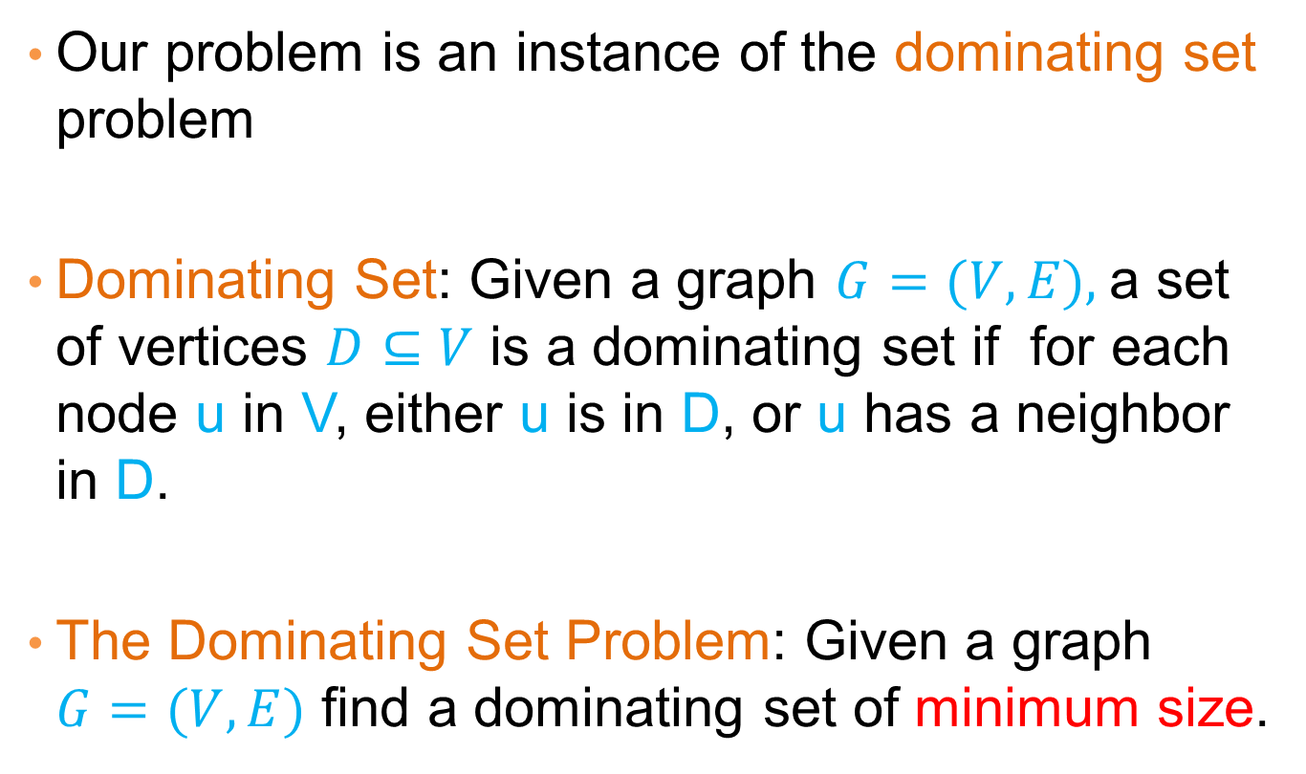
Dominating set
Our problem is an instance of the dominating set problem
Dominating Set: Given a graph $G=(V,E),$a set of vertices $D⊆V$ is a dominating set if for each node u in V, either u is in D, or u has a neighbor in D.
The Dominating Set Problem: Given a graph $G=(V,E)$ find a dominating set of minimum size.

Slide 24
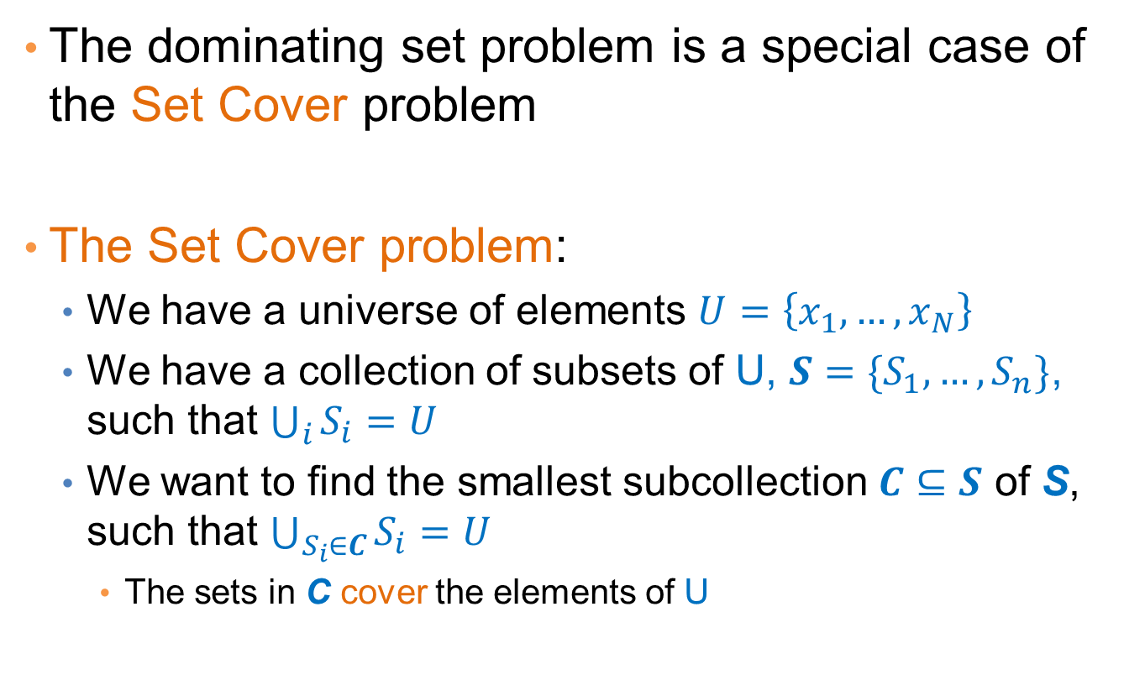
Set Cover
The dominating set problem is a special case of the Set Cover problem
The Set Cover problem:
  We have a universe of elements $U=\left\{x_{1},…,x_{N}\right\}$
  We have a collection of subsets of U, $S=\{S_{1},…,S_{n}\}$, such that $\bigcup_{i}{S_{i}}=U$
  We want to find the smallest subcollection$C⊆S$of S, such that $\bigcup_{S_{i}∈C}{S_{i}=U}$
    The sets in Ccover the elements of U

Slide 25
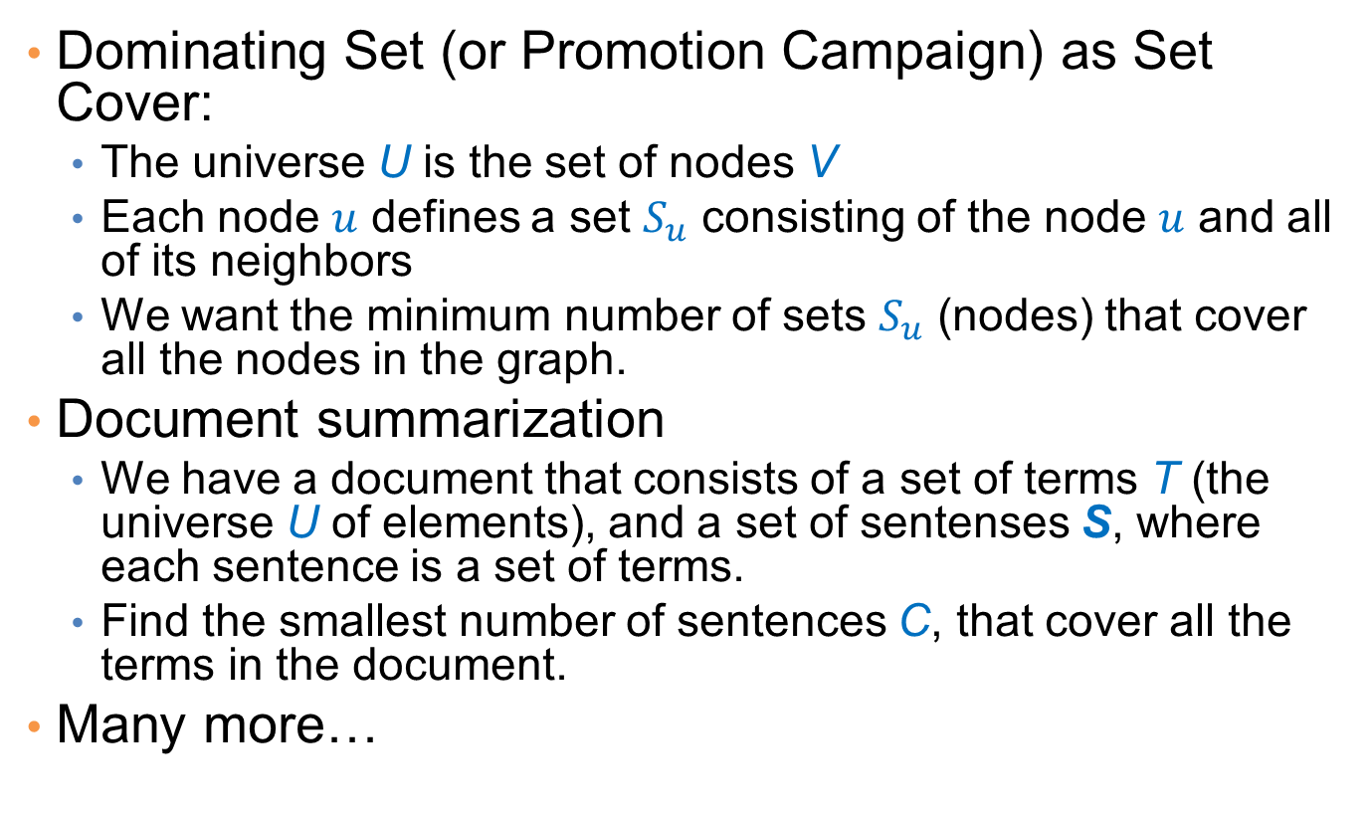
Applications
Dominating Set (or Promotion Campaign) as Set Cover:
  The universe U is the set of nodes V
  Each node $u$ defines a set $S_{u}$ consisting of the node $u$ and all of its neighbors
  We want the minimum number of sets $S_{u}$ (nodes) that cover all the nodes in the graph.
Document summarization
  We have a document that consists of a set of terms T (the universe U of elements), and a set of sentensesS, where each sentence is a set of terms.
  Find the smallest number of sentences C, that cover all the terms in the document.
Many more…

Slide 26
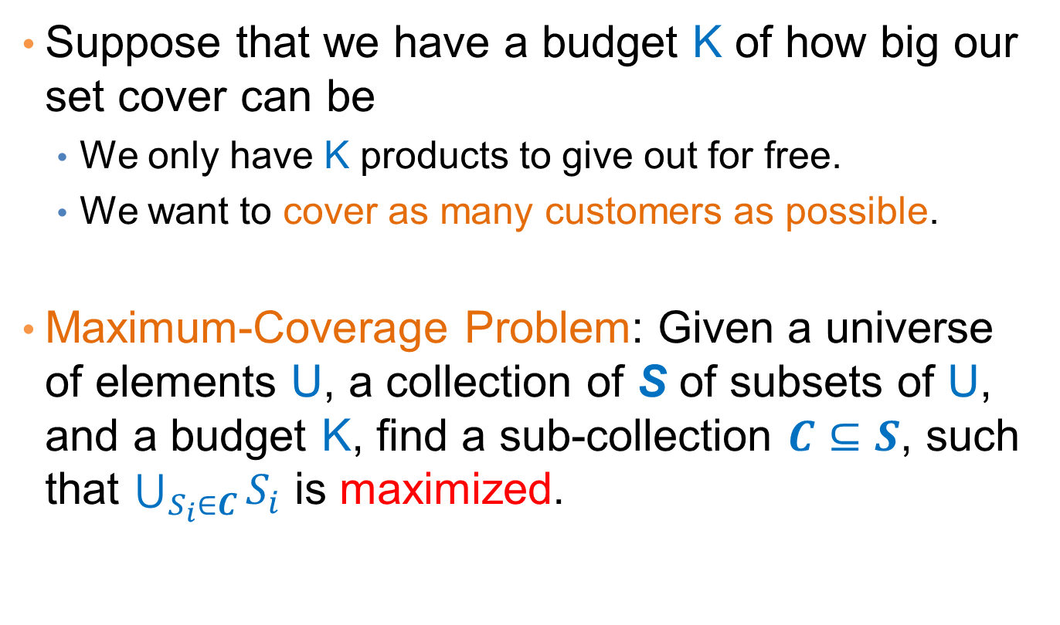
Best selection variant
Suppose that we have a budget K of how big our set cover can be
  We only have K products to give out for free.
  We want to cover as many customers as possible.
Maximum-Coverage Problem: Given a universe of elements U, a collection of S of subsets of U, and a budget K, find a sub-collection $C⊆S$, such that $\bigcup_{S_{i}∈C}{S_{i}}$ is maximized.

Slide 27
Complexity
Both the Set Cover and the Maximum Coverage problems are NP-complete
  What does this mean?
  Why do we care?
There is no algorithm that can guarantee to find the best solution in polynomial time
  Can we find an algorithm that can guarantee to find a solution that is close to the optimal?
  Approximation Algorithms.

Slide 28
Approximation Algorithms
Suppose you have an (combinatorial) optimization problem
  E.g., find the minimum set cover
  E.g., find the set that maximizes coverage
If X is an instance of the problem, let OPT(X) be the value of the optimal solution, and ALG(X) the value of an algorithm ALG.
ALG is a good approximation algorithm if the ratio of OPT and ALG is bounded.

Slide 29
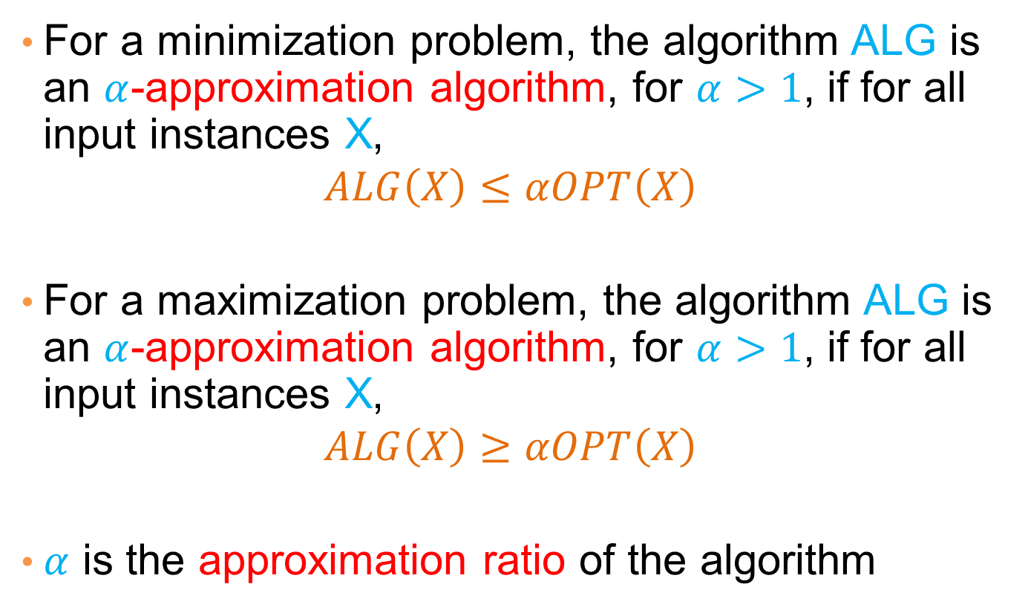
Approximation Algorithms
For a minimization problem, the algorithm ALG is an $α$-approximation algorithm, for $α>1$, if for all input instances X,
$$ALG\left(X\right)≤αOPT\left(X\right)$$
For a maximization problem, the algorithm ALG is an $α$-approximation algorithm, for $α>1$, if for all input instances X,
$$ALG\left(X\right)≥αOPT\left(X\right)$$
$α$ is the approximation ratio of the algorithm

Slide 30
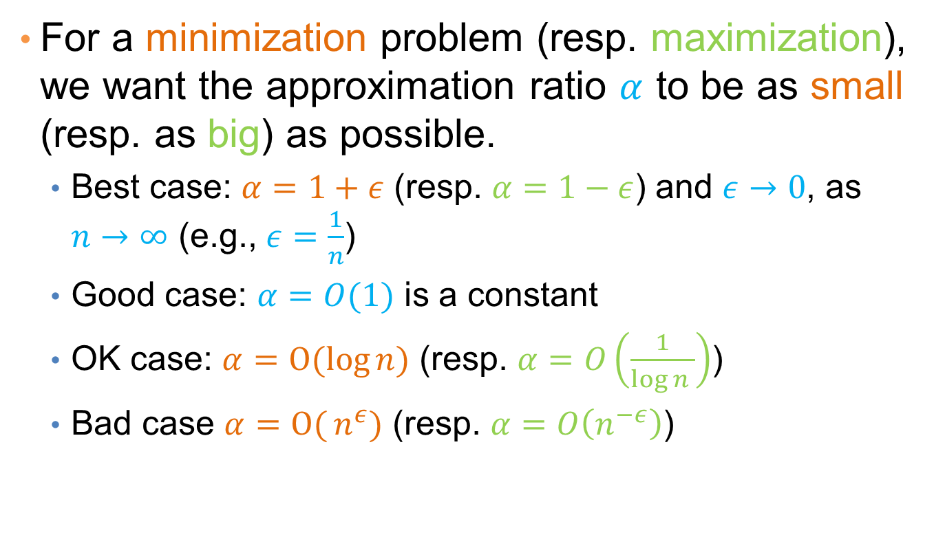
Approximation ratio
For a minimization problem (resp. maximization), we want the approximation ratio $α$ to be as small (resp. as big) as possible.
  Best case: $α=1+ε$(resp. $α=1−ε$) and $ε→0$, as $n→∞$(e.g., $ε=\frac{1}{n}$)
  Good case: $α=O(1)$is a constant
  OK case: $α=O(log{n)}$ (resp. $α=O\left(\frac{1}{\log{n }}\right)$)
  Bad case $α=O({n^{ε})}$ (resp. $α=O\left(n^{−ε}\right)$)

Slide 31
A simple approximation ratio for set cover
Any algorithm for set cover has approximation ratio α = |S_{max}|, where S_{max} is the set in S with the largest cardinality
Proof:
  OPT(X)≥N/|S_{max}| ⇒ N ≤ |s_{max}|OPT(I)
  ALG(X) ≤ N ≤ |s_{max}|OPT(X)
This is true for any algorithm.
Not a good bound since it can be that |S_{max}|=O(N)

Slide 32
An algorithm for Set Cover
What is the most natural algorithm for Set Cover?
Greedy: each time add to the collection C the set S_{i} from S that covers the most of the remaining elements.

Slide 33
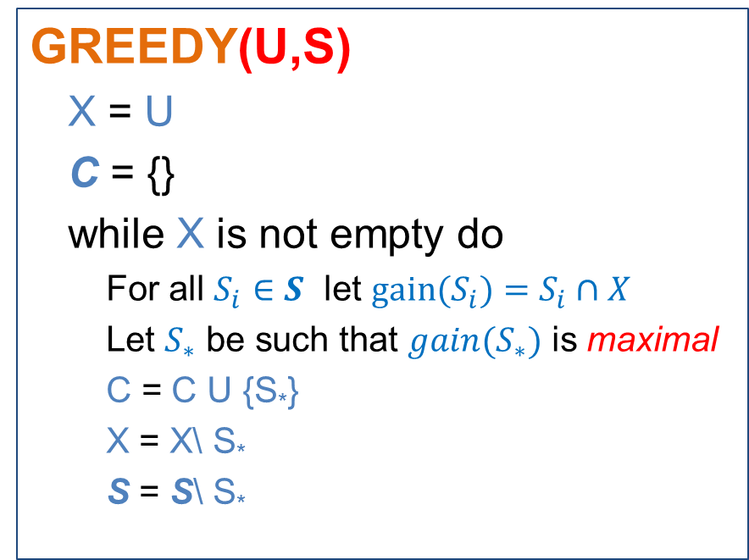
The GREEDY algorithm
GREEDY(U,S)
  X= U
  C = {}
  while X is not empty do
    For all $S_{i}∈S$let $gain(S_{i})=S_{i}∩X$
    Let $S_{∗}$be such that $gain(S_{∗})$ is maximal
    C = C U {S*}
    X = X\ S*
    S = S\ S*

Slide 34
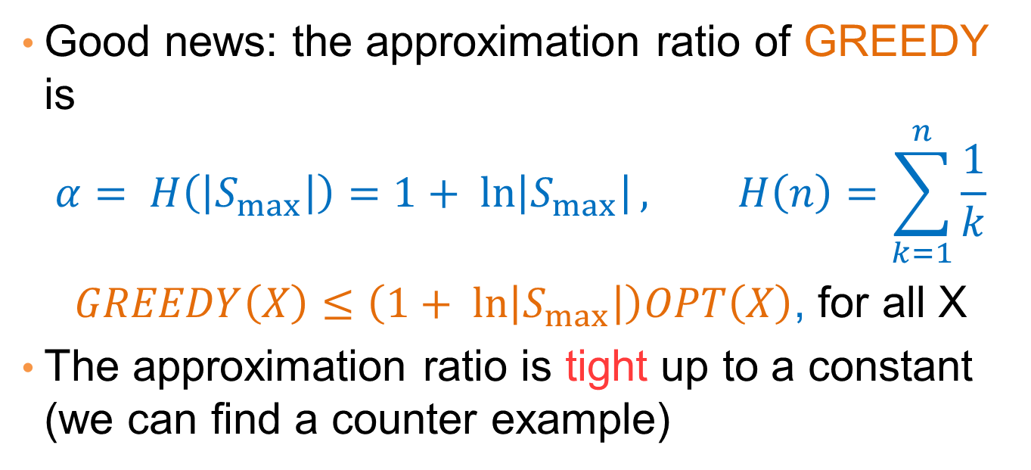
Approximation ratio of GREEDY
Good news: the approximation ratio of GREEDY is
$$α= H\left(\left|S_{max}\right|\right)=1+ ln\left|S_{max}\right|, H\left(n\right)=\sum_{k=1}^{n}{\frac{1}{k}}$$
$GREEDY\left(X\right)≤\left(1+ ln\left|S_{max}\right|\right)OPT\left(X\right)$, for all X
The approximation ratio is tight up to a constant (we can find a counter example)
OPT(X) = 2
GREEDY(X) = logN
α=½logN

Slide 35

Maximum Coverage
What is a reasonable algorithm?
GREEDY(U,S,K)
  X = U
  C = {}
  while |C| < K
    For all $S_{i}∈S$let $gain(S_{i})=S_{i}∩X$
    Let $S_{∗}$ be such that $gain(S_{∗})$ is maximal
    C = C U {S*}
    X = X\ S*
    S= S\ S*

Slide 36

Approximation Ratio for Max-K Coverage
Better news! The GREEDY algorithm has approximation ratio $α=1−\frac{1}{e}$
$GREEDY\left(X\right)≥\left(1−\frac{1}{e}\right)OPT\left(X\right)$, for all X

Slide 37
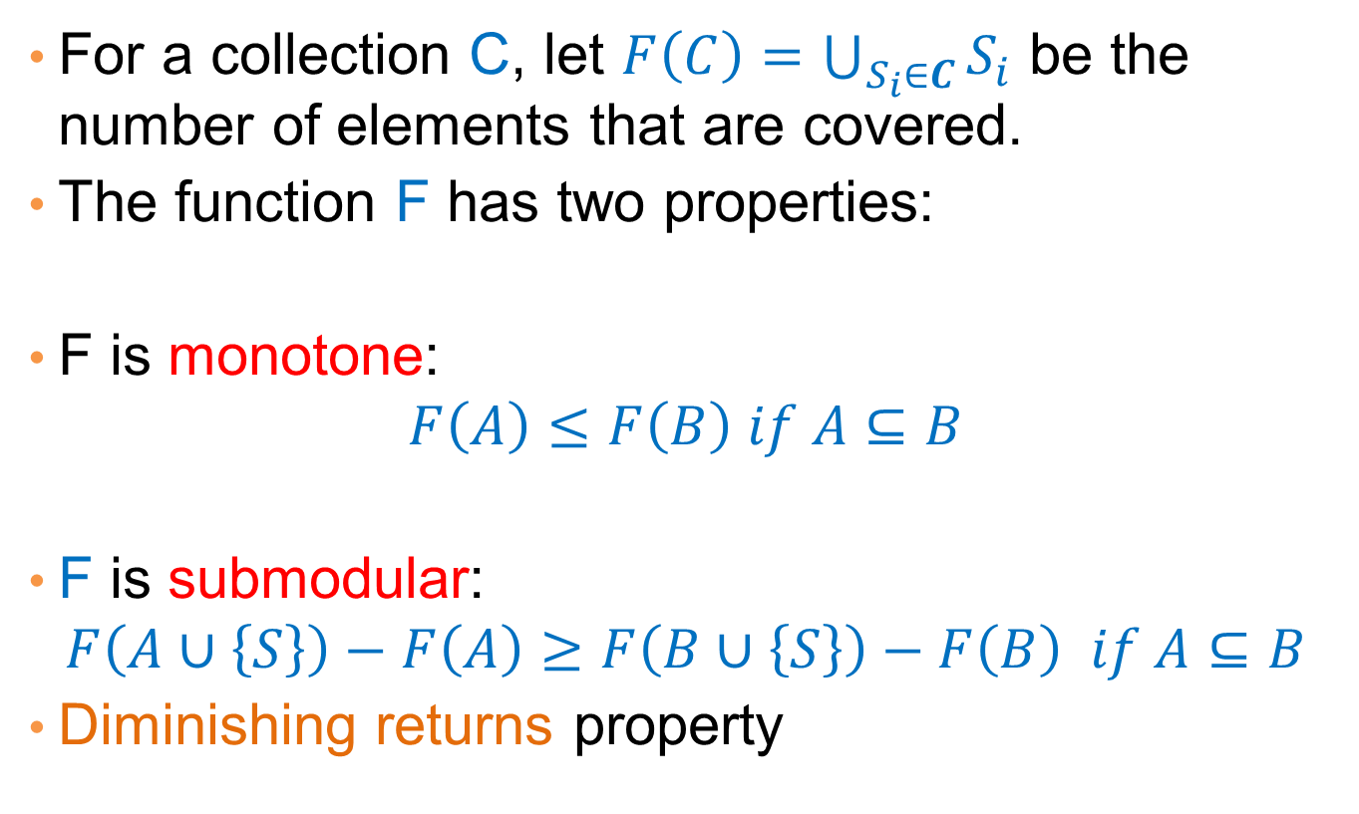
Proof of approximation ratio
For a collection C, let $F\left(C\right)=\bigcup_{S_{i}∈C}{S_{i}}$ be the number of elements that are covered.
The function F has two properties:
F is monotone:
$$F\left(A\right)≤F\left(B\right) if A⊆B$$
F is submodular:
$$F\left(A∪\left\{S\right\}\right)−F\left(A\right)≥F\left(B∪\left\{S\right\}\right)−F\left(B\right) if A⊆B$$
Diminishing returns property

Slide 38

Optimizing submodular functions
Theorem: A greedy algorithm that optimizes a monotone and submodularfunction F, each time adding to the solution C, the set S that maximizes the gain $F\left(C∪\left\{S\right\}\right)−F(C)$has approximation ratio $α= \left(1−\frac{1}{e}\right)$

Slide 39
Other variants of Set Cover
Hitting Set: select a set of elements so that you hit all the sets (the same as the set cover, reversing the roles)
Vertex Cover: Select a subset of vertices such that you cover all edges (an endpoint of each edge is in the set)
  There is a 2-approximation algorithm
Edge Cover: Select a set of edges that cover all vertices (there is one edge that has endpoint the vertex)
  There is a polynomial algorithm

Slide 40
Parting thoughts
In this class you saw a set of tools for analyzing data
  Association Rules
  Sketching
  Clustering
  Classification
  Signular Value Decomposition
  Random Walks
  Coverage
All these are useful when trying to make sense of the data. A lot more variants exist.

