Slide 1
DATA MINING
LECTURE 12
Graphs, Node importance, Link Analysis Ranking, Random walks

Slide 2
RANDOM WALKS AND PAGERANK

Slide 3





Graphs
A graph is a powerful abstraction for modeling entities and their pairwise relationships.
Examples:
  Social network
  Collaboration graphs
  Twitter Followers
  Web
$$v_{1}$$
$$v_{5}$$
$$v_{2}$$
$$v_{4}$$
$$v_{3}$$

Slide 4





Graphs
A graph is a powerful abstraction for modeling entities and their pairwise relationships.
Examples:
  Social network
  Collaboration graphs
  Twitter Followers
  Web
$$v_{1}$$
$$v_{5}$$
$$v_{2}$$
$$v_{4}$$
$$v_{3}$$

Slide 5
Mining the graph structure
A graph is a combinatorial object, with a certain structure.
Mining the structure of the graph reveals information about the entities in the graph
  E.g., if in the Facebook graph I find that there are 100 people that are all linked to each other, then these people are likely to be a community
    The community discovery problem
  By measuring the number of friends in the facebook graph I can find the most important nodes
    The node importance problem
We will now focus on the node importance problem

Slide 6
Link Analysis
First generation search engines
  view documents as flat text files
  could not cope with size, spamming, user needs
Second generation search engines
  Ranking becomes critical
  shift from relevance to authoritativeness
    authoritativeness: the static importance of the page
  use of Web specific data: Link Analysis of the Web graph
  a success story for the network analysis + a huge commercial success
  it all started with two graduate students at Stanford

Slide 7
Link Analysis: Intuition
A link from page p to page q denotes endorsement
  page p considers page q an authority on a subject
  use the graph of recommendations
  assign an authority value to every page
The same idea applies to other graphs as well
  Twitter graph, where user p follows user q

Slide 8
Constructing the graph
w
w
w
w
w
Goal: output an authority weight for each node
  Also known as centrality, or importance

Slide 9
Rank by Popularity
Rank pages according to the number of incoming edges (in-degree, degree centrality)
w=3
w=2
Red Page
Yellow Page
Blue Page
Purple Page
Green Page
w=2
w=1
w=1

Slide 10
Popularity
It is not important only how many link to you, but how important are the people that link to you.
Good authorities are pointed by good authorities
  Recursive definition of importance

Slide 11
PageRank
w
Assume that we have a unity of authority to distribute to all nodes.
Each node distributes the authority value they have to all their neighbors
The authority value of each node is the sum of the fractions it collects from its neighbors.
Solving the system of equations we get the authority values for the nodes
  w = ½ , w = ¼ , w = ¼
w
w
w + w + w = 1
w = w + w
w = ½ w
w = ½ w

Slide 12
A more complex example
v₂
v₁
w₁ = 1/3 w₄ + 1/2 w₅
v₃
w₂ = 1/2 w₁ + w₃ + 1/3 w₄
w₃ = 1/2 w₁ + 1/3 w₄
w₄ = 1/2 w₅
w₅ = w₂
v₅
v₄

Slide 13

Random walks on graphs
The equations above describe a step of a random walk on the graph
  Random walk: start from some node uniformly at random and then from each node pick a random link to follow.
  Question: what is the probability of being at a specific node?
    $p_{i}$: probability of being at node i at this step
    $p_{i}′$: probability of being at node i in the next step
After many steps the probabilities converge to the stationary distribution of the random walk.
v₂
p’₁ = 1/3 p₄ + 1/2 p₅
v₁
p’₂ = 1/2 p₁ + p₃ + 1/3 p₄
v₃
p’₃ = 1/2 p₁ + 1/3 p₄
p’₄ = 1/2 p₅
p’₅ = p₂
v₅
v₄

Slide 14
PageRank algorithm [BP98]
Good authorities should be pointed by good authorities
  The value of a page is the value of the people that link to you
How do we implement that?
  Each page has a value.
  Proceed in iterations,
    in each iteration every page distributes the value to the neighbors
  Continue until there is convergence.
Red Page
Purple Page
Yellow Page
Blue Page
Green Page

Slide 15
Markov chains
A Markov chain describes a discrete time stochastic process over a set of states
according to a transition probability matrix
  P_{ij} = probability of moving to state j when at state i
    ∑_{j}P_{ij} = 1 (stochastic matrix)
Memorylessness property: The next state of the chain depends only at the current state and not on the past of the process (first order MC)
  higher order MCs are also possible
S = {s₁, s₂, … s_{n}}
P = {P_{ij}}

Slide 16
Random walks
Random walks on graphs correspond to Markov Chains
  The set of states S is the set of nodes of the graph G
  The transition probability matrix is the probability that we follow an edge from one node to another

Slide 17
An example
v₂
v₁
v₃
v₅
v₄

Slide 18
State probability vector
The vector q^{t} = (q^{t}₁,q^{t}₂, … ,q^{t}_{n}) that stores the probability of being at state i at time t
  q⁰_{i} ⁼ the probability of starting from state i
q^{t} = q^{t-1} P

Slide 19
An example
q^{t} = q^{t-1} P
v₂
v₁
v₃
q^{t+1}₁ = 1/3 q^{t}₄ + 1/2 q^{t}₅
q^{t+1}₂ = 1/2 q^{t}₁ + q^{t}₃ + 1/3 q^{t}₄
v₅
v₄
q^{t+1}₃ = 1/2 q^{t}₁ + 1/3 q^{t}₄
q^{t+1}₄ = 1/2 q^{t}₅
Same equations as before!
q^{t+1}₅ = q^{t}₂

Slide 20
Stationary distribution
A stationary distribution for a MC with transition matrix P, is a probability distribution π, such that π = πP
A MC has a unique stationary distribution if
  it is irreducible
    the underlying graph is strongly connected
  it is aperiodic
    for random walks, the underlying graph is not bipartite
The probability π_{i} is the fraction of times that we visited state i as t → ∞
The stationary distribution is an eigenvector of matrix P
  the principal left eigenvector of P – stochastic matrices have maximum eigenvalue 1

Slide 21
Computing the stationary distribution
The Power Method
  Initialize to some distribution q⁰
  Iteratively compute q^{t} = q^{t-1}P
  After enough iterations q^{t} ≈ π
  Power method because it computes q^{t} = q⁰P^{t}
Why does it converge?
  follows from the fact that any vector can be written as a linear combination of the eigenvectors
    q⁰ = v₁ + c₂v₂ + … c_{n}v_{n}
Rate of convergence
  determined by λ₂^{t}

Slide 22
The PageRank random walk
Vanilla random walk
  make the adjacency matrix stochastic and run a random walk

Slide 23
The PageRank random walk
What about sink nodes?
  what happens when the random walk moves to a node without any outgoing inks?

Slide 24
The PageRank random walk
Replace these row vectors with a vector v
  typically, the uniform vector
P’ = P + dv^{T}

Slide 25
The PageRank random walk
How do we guarantee irreducibility?
How do we guarantee not getting stuck in loops?
  add a random jump to vector v with prob α
    typically, to a uniform vector
P’’ = αP’ + (1-α)uv^{T}, where u is the vector of all 1s
Random walk with restarts

Slide 26

PageRank algorithm [BP98]
The Random Surfer model
  pick a page at random
  with probability 1- α jump to a random page
  with probability α follow a random outgoing link
Rank according to the stationary distribution
Red Page
Purple Page
Yellow Page
Blue Page
Green Page
$α = 0.85$in most cases

Slide 27
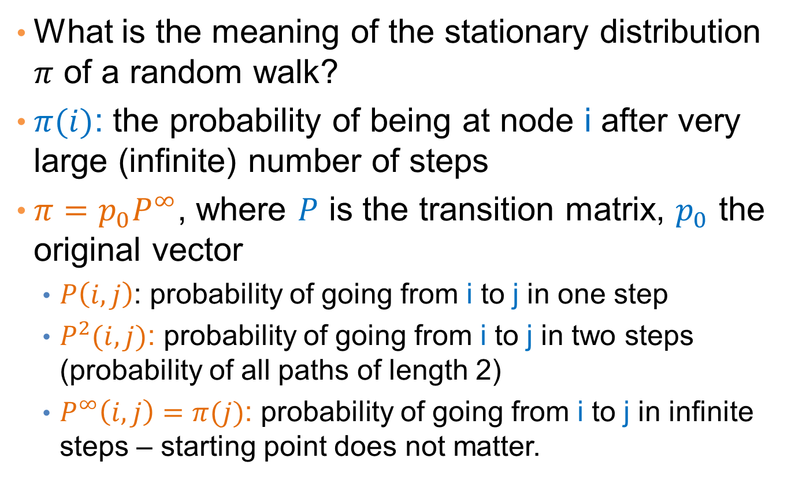
The stationary distribution
What is the meaning of the stationary distribution $π$ of a random walk?
$π(i)$: the probability of being at node i after very large (infinite) number of steps
$π=p_{0}P^{∞}$, where $P$ is the transition matrix, $p_{0}$ the original vector
  $P\left(i,j\right)$: probability of going from i to j in one step
  $P^{2}(i,j)$: probability of going from i to j in two steps (probability of all paths of length 2)
  $P^{∞}\left(i,j\right)=π(j)$: probability of going from i to j in infinite steps – starting point does not matter.

Slide 28
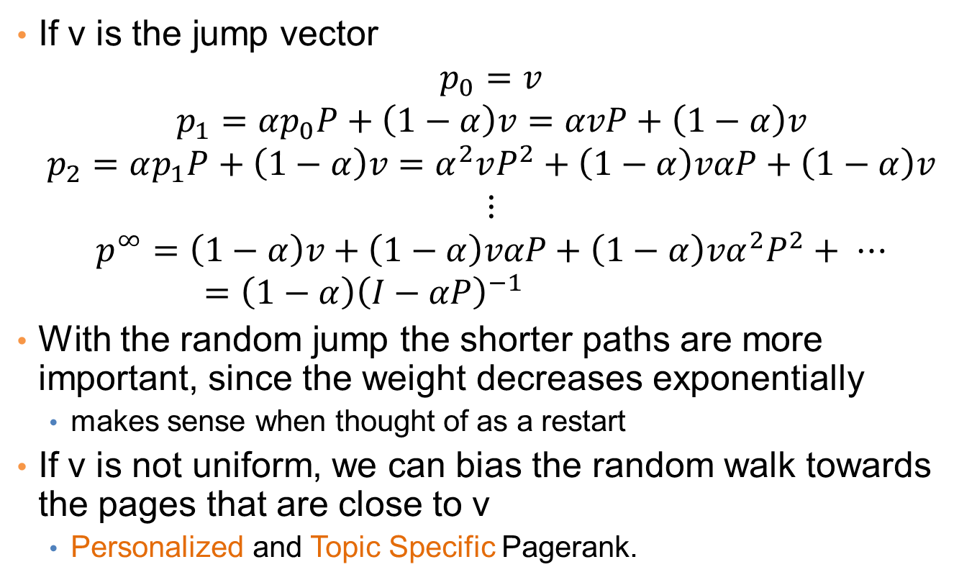
Stationary distribution with random jump
If v is the jump vector
$$p_{0}=v$$
$$p_{1}=αp_{0}P+\left(1−α\right)v=αvP+\left(1−α\right)v$$
$$p_{2}=αp_{1}P+\left(1−α\right)v=α^{2}vP^{2}+\left(1−α\right)vαP+\left(1−α\right)v$$
$$⋮$$
$$p^{∞}=\left(1−α\right)v+\left(1−α\right)vαP+\left(1−α\right)vα^{2}P^{2}+ ⋯=\left(1−α\right){\left(I−αP\right)}^{−1}$$
With the random jump the shorter paths are more important, since the weight decreases exponentially
  makes sense when thought of as a restart
If v is not uniform, we can bias the random walk towards the pages that are close to v
  Personalized and Topic Specific Pagerank.

Slide 29
Effects of random jump
Guarantees irreducibility
Motivated by the concept of random surfer
Offers additional flexibility
  personalization
  anti-spam
Controls the rate of convergence
  the second eigenvalue of matrix P’’ is α

Slide 30
Random walks on undirected graphs
For undirected graphs, the stationary distribution is proportional to the degrees of the nodes
  Thus in this case a random walk is the same as degree popularity
This is not longer true if we do random jumps
  Now the short paths play a greater role, and the previous distribution does not hold.

Slide 31
A PageRank algorithm
Performing vanilla power method is now too expensive – the matrix is not sparse
q⁰ = v
t = 1
repeat
t = t +1
until δ < ε
Efficient computation of y = (P’’)^{T} x
P = normalized adjacency matrix
P’ = P + dv^{T}, where d_{i} is 1 if i is sink and 0 o.w.
P’’ = αP’ + (1-α)uv^{T}, where u is the vector of all 1s

Slide 32
Pagerank history
Huge advantage for Google in the early days
  It gave a way to get an idea for the value of a page, which was useful in many different ways
    Put an order to the web.
  After a while it became clear that the anchor text was probably more important for ranking
  Also, link spam became a new (dark) art
Flood of research
  Numerical analysis got rejuvenated
  Huge number of variations
  Efficiency became a great issue.
  Huge number of applications in different fields
    Random walk is often referred to as PageRank.

Slide 33
THE HITS ALGORITHM

Slide 34
The HITS algorithm
Another algorithm proposed around the same time as Pagerank for using the hyperlinks to rank pages
  Kleinberg: then an intern at IBM Almaden
  IBM never made anything out of it

Slide 35
Query dependent input
Root set obtained from a text-only search engine
Root Set

Slide 36
Query dependent input
Root Set
IN
OUT

Slide 37
Query dependent input
Root Set
IN
OUT

Slide 38
Query dependent input
Base Set
Root Set
IN
OUT

Slide 39
Hubs and Authorities [K98]
Authority is not necessarily transferred directly between authorities
Pages have double identity
  hub identity
  authority identity
Good hubs point to good authorities
Good authorities are pointed by good hubs
hubs
authorities

Slide 40
Hubs and Authorities
Two kind of weights:
  Hub weight
  Authority weight
The hub weight is the sum of the authority weights of the authorities pointed to by the hub
The authority weight is the sum of the hub weights that point to this authority.

Slide 41
HITS Algorithm
Initialize all weights to 1.
Repeat until convergence
  O operation : hubs collect the weight of the authorities
  I operation: authorities collect the weight of the hubs
  Normalize weights under some norm

Slide 42
HITS and eigenvectors
The HITS algorithm is a power-method eigenvector computation
  in vector terms a^{t} = A^{T}h^{t-1} and h^{t} = Aa^{t-1}
  so a = A^{T}Aa^{t-1} and h^{t} = AA^{T}h^{t-1}
  The authority weight vector a is the eigenvector of A^{T}A and the hub weight vector h is the eigenvector of AA^{T}
  Why do we need normalization?
The vectors a and h are singular vectors of the matrix A

Slide 43
Singular Value Decomposition
r : rank of matrix A
σ₁≥ σ₂≥ … ≥σ_{r} : singular values (square roots of eig-vals AA^{T}, A^{T}A)
: left singular vectors (eig-vectors of AA^{T})
: right singular vectors (eig-vectors of A^{T}A)
[n×r]
[r×r]
[r×n]

Slide 44
Singular Value Decomposition
Linear trend v in matrix A:
  the tendency of the row vectors of A to align with vector v
  strength of the linear trend: Av
SVD discovers the linear trends in the data
u_{i} , v_{i} : the i-th strongest linear trends
σ_{i} : the strength of the i-th strongest linear trend
σ₂
v₂
v₁
σ₁
HITS discovers the strongest linear trend in the authority space

Slide 45
HITS and the TKC effect
The HITS algorithm favors the most dense community of hubs and authorities
  Tightly Knit Community (TKC) effect

Slide 46
HITS and the TKC effect
The HITS algorithm favors the most dense community of hubs and authorities
  Tightly Knit Community (TKC) effect
1
1
1
1
1
1

Slide 47
HITS and the TKC effect
The HITS algorithm favors the most dense community of hubs and authorities
  Tightly Knit Community (TKC) effect
3
3
3
3
3

Slide 48
HITS and the TKC effect
The HITS algorithm favors the most dense community of hubs and authorities
  Tightly Knit Community (TKC) effect
3²
3²
3²
3∙2
3∙2
3∙2

Slide 49
HITS and the TKC effect
The HITS algorithm favors the most dense community of hubs and authorities
  Tightly Knit Community (TKC) effect
3³
3³
3³
3² ∙ 2
3² ∙ 2

Slide 50
HITS and the TKC effect
The HITS algorithm favors the most dense community of hubs and authorities
  Tightly Knit Community (TKC) effect
3⁴
3⁴
3⁴
3² ∙ 2²
3² ∙ 2²
3² ∙ 2²

Slide 51
HITS and the TKC effect
The HITS algorithm favors the most dense community of hubs and authorities
  Tightly Knit Community (TKC) effect
3^{2n}
3^{2n}
weight of node p is
proportional to the number
of (BF)^{n} paths that leave
node p
after n iterations
3^{2n}
3^{n} ∙ 2^{n}
3^{n} ∙ 2^{n}
3^{n} ∙ 2^{n}

Slide 52
HITS and the TKC effect
The HITS algorithm favors the most dense community of hubs and authorities
  Tightly Knit Community (TKC) effect
1
1
after normalization
with the max
element as n → ∞
1
0
0
0

Slide 53
OTHER ALGORITHMS

Slide 54
The SALSA algorithm [LM00]
Perform a random walk alternating between hubs and authorities
What does this random walk converge to?
The graph is essentially undirected, so it will be proportional to the degree.
hubs
authorities

Slide 55
Social network analysis
Evaluate the centrality of individuals in social networks
  degree centrality
    the (weighted) degree of a node
  distance centrality
    the average (weighted) distance of a node to the rest in the graph
  betweenness centrality
    the average number of (weighted) shortest paths that use node v

Slide 56
Counting paths – Katz 53
The importance of a node is measured by the weighted sum of paths that lead to this node
A^{m}[i,j] = number of paths of length m from i to j
Compute
converges when b < λ₁(A)
Rank nodes according to the column sums of the matrix P

Slide 57
Bibliometrics
Impact factor (E. Garfield 72)
  counts the number of citations received for papers of the journal in the previous two years
Pinsky-Narin 76
  perform a random walk on the set of journals
  P_{ij} = the fraction of citations from journal i that are directed to journal j

Slide 58
ABSORBING RANDOM WALKS

Slide 59
Random walk with absorbing nodes
What happens if we do a random walk on this graph? What is the stationary distribution?
All the probability mass on the red sink node:
  The red node is an absorbing node

Slide 60
Random walk with absorbing nodes
What happens if we do a random walk on this graph? What is the stationary distribution?
There are two absorbing nodes: the red and the blue.
The probability mass will be divided between the two

Slide 61
Absorption probability
If there are more than one absorbing nodes in the graph a random walk that starts from a non-absorbing node will be absorbed in one of them with some probability
  The probability of absorption gives an estimate of how close the node is to red or blue
Why care?
  Red and Blue may be different categories

Slide 62
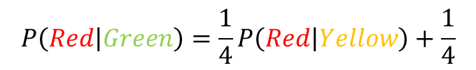
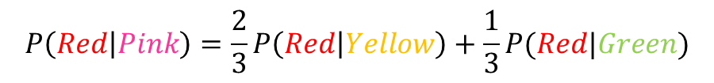
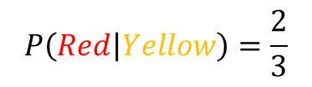
Absorption probability
Computing the probability of being absorbed is very easy
  Take the (weighted) average of the absorption probabilities of your neighbors
    if one of the neighbors is the absorbing node, it has probability 1
  Repeat until convergence
  Initially only the absorbing have prob 1
2
$$P\left(Red | Pink\right)=\frac{2}{3}P\left(Red | Yellow\right)+\frac{1}{3}P(Red|Green)$$
1
1
1
$$P\left(Red | Green\right)=\frac{1}{4}P\left(Red | Yellow\right)+\frac{1}{4}$$
2
2
1
$$P\left(Red | Yellow\right)=\frac{2}{3}$$

Slide 63
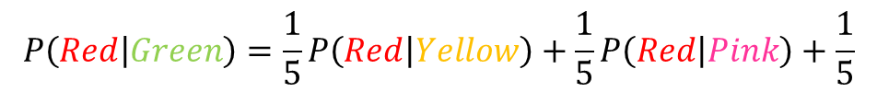
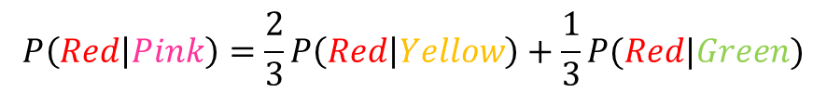
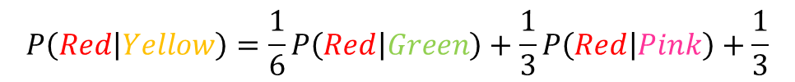
Absorption probability
The same idea can be applied to the case of undirected graphs
  The absorbing nodes are still absorbing, so the edges to them are (implicitely) directed.
$$P\left(Red | Pink\right)=\frac{2}{3}P\left(Red | Yellow\right)+\frac{1}{3}P(Red|Green)$$
0.57
2
1
$$P\left(Red | Green\right)=\frac{1}{5}P\left(Red | Yellow\right)+\frac{1}{5}P\left(Red | Pink\right)+\frac{1}{5}$$
1
2
1
2
$$P\left(Red | Yellow\right)=\frac{1}{6}P\left(Red | Green\right)+\frac{1}{3}P\left(Red | Pink\right)+\frac{1}{3}$$
1
0.52
0.42

Slide 64
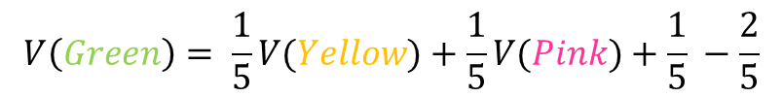
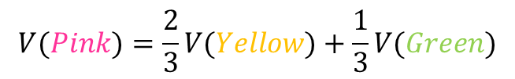
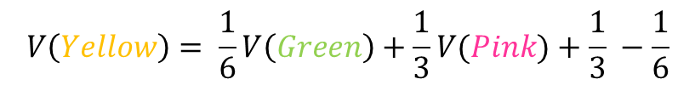
Propagating values
Assume that Red corresponds to a positive class and Blue to a negative class
  We can compute a value for all the other nodes in the same way
    This is the expected value for the node
$$V(Pink)=\frac{2}{3}V(Yellow)+\frac{1}{3}V(Green)$$
+1
0.16
2
-1
1
$$V\left(Green\right)= \frac{1}{5}V(Yellow)+\frac{1}{5}V(Pink)+\frac{1}{5} −\frac{2}{5}$$
1
2
1
2
$$V\left(Yellow\right)= \frac{1}{6}V\left(Green\right)+\frac{1}{3}V(Pink)+\frac{1}{3} −\frac{1}{6}$$
1
0.05
-0.16

Slide 65

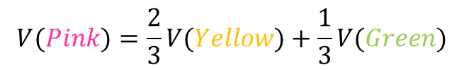

Electrical networks and random walks
If Red corresponds to a positive voltage and Blue to a negative voltage
There are resistances on the edges inversely proportional to the weights
The computed values are the voltages
+1
+1
0.16
2
$$V(Pink)=\frac{2}{3}V(Yellow)+\frac{1}{3}V(Green)$$
-1
1
$$V\left(Green\right)= \frac{1}{5}V(Yellow)+\frac{1}{5}V(Pink)+\frac{1}{5} −\frac{2}{5}$$
1
1
2
2
$$V\left(Yellow\right)= \frac{1}{6}V\left(Green\right)+\frac{1}{3}V(Pink)+\frac{1}{3} −\frac{1}{6}$$
1
0.05
-0.16

Slide 66
Transductive learning
If we have a graph of relationships and some labels on these edges we can propagate them to the remaining nodes
  E.g., a social network where some people are tagged as spammers
This is a form of semi-supervised learning
  We make use of the unlabeled data, and the relationships
It is also called transductive learning because it does not produce a model, and labels only what is at hand.

