Slide 1
DATA MINING
LECTURE 10
Classification
k-nearest neighbor classifier
Naïve Bayes
Logistic Regression
Support Vector Machines

Slide 2
NEAREST NEIGHBOR CLASSIFICATION

Slide 3
Instance-Based Classifiers
Store the training records
Use training records to
predict the class label of
unseen cases

Slide 4
Instance Based Classifiers
Examples:
  Rote-learner
    Memorizes entire training data and performs classification only if attributes of record match one of the training examples exactly
  Nearest neighbor
    Uses k “closest” points (nearest neighbors) for performing classification

Slide 5
Nearest Neighbor Classifiers
Basic idea:
  If it walks like a duck, quacks like a duck, then it’s probably a duck
Compute Distance
Test Record
Training Records
Choose k of the “nearest” records

Slide 6
Nearest-Neighbor Classifiers
Requires three things
  The set of stored records
  Distance Metric to compute distance between records
  The value of k, the number of nearest neighbors to retrieve
To classify an unknown record:
  Compute distance to other training records
  Identify k nearest neighbors
  Use class labels of nearest neighbors to determine the class label of unknown record (e.g., by taking majority vote)

Slide 7
Definition of Nearest Neighbor
K-nearest neighbors of a record x are data points that have the k smallest distance to x

Slide 8
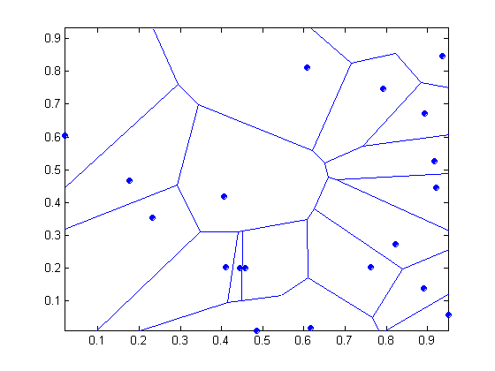
1 nearest-neighbor
Voronoi Diagram defines the classification boundary
The area takes the class of the green point

Slide 9
Nearest Neighbor Classification
Compute distance between two points:
  Euclidean distance
Determine the class from nearest neighbor list
  take the majority vote of class labels among the k-nearest neighbors
  Weigh the vote according to distance
    weight factor, w = 1/d²

Slide 10
Nearest Neighbor Classification…
Choosing the value of k:
  If k is too small, sensitive to noise points
  If k is too large, neighborhood may include points from other classes

Slide 11
Nearest Neighbor Classification…
Scaling issues
  Attributes may have to be scaled to prevent distance measures from being dominated by one of the attributes
  Example:
    height of a person may vary from 1.5m to 1.8m
    weight of a person may vary from 90lb to 300lb
    income of a person may vary from $10K to $1M

Slide 12
Nearest Neighbor Classification…
Problem with Euclidean measure:
  High dimensional data
    curse of dimensionality
  Can produce counter-intuitive results
1 1 1 1 1 1 1 1 1 1 1 0
1 0 0 0 0 0 0 0 0 0 0 0
vs
0 1 1 1 1 1 1 1 1 1 1 1
0 0 0 0 0 0 0 0 0 0 0 1
d = 1.4142
d = 1.4142
    Solution: Normalize the vectors to unit length

Slide 13
Nearest neighbor Classification…
k-NN classifiers are lazy learners
  It does not build models explicitly
  Unlike eager learners such as decision tree induction and rule-based systems
Classifying unknown records are relatively expensive
  Naïve algorithm: O(n)
  Need for structures to retrieve nearest neighbors fast.
    The Nearest Neighbor Search problem.

Slide 14
Nearest Neighbor Search
Two-dimensional kd-trees
  A data structure for answering nearest neighbor queries in R²
kd-tree construction algorithm
  Select the x or y dimension (alternating between the two)
  Partition the space into two with a line passing from the median point
  Repeat recursively in the two partitions as long as there are enough points

Slide 15
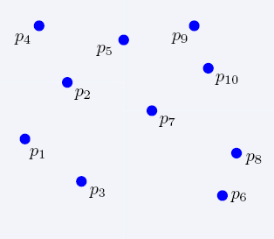
Nearest Neighbor Search
2-dimensional kd-trees

Slide 16
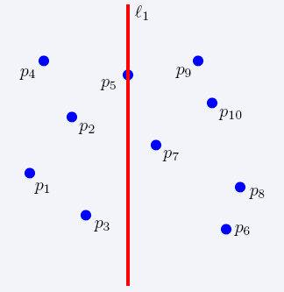
Nearest Neighbor Search
2-dimensional kd-trees

Slide 17
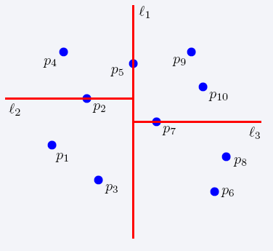
Nearest Neighbor Search
2-dimensional kd-trees

Slide 18
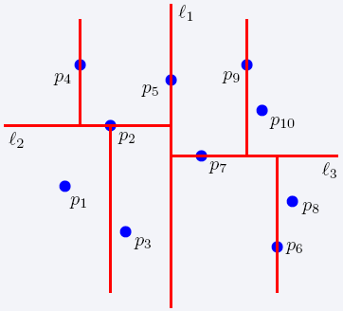
Nearest Neighbor Search
2-dimensional kd-trees

Slide 19
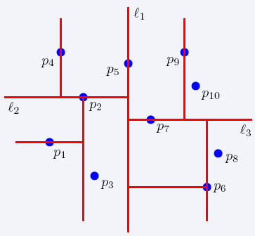
Nearest Neighbor Search
2-dimensional kd-trees

Slide 20
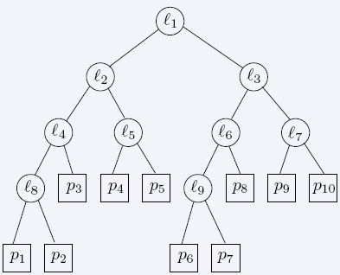
Nearest Neighbor Search
2-dimensional kd-trees

Slide 21
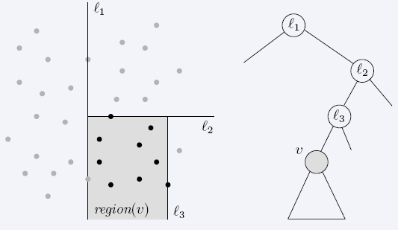
Nearest Neighbor Search
2-dimensional kd-trees
region(u) – all the black points in the subtree of u

Slide 22
Nearest Neighbor Search
2-dimensional kd-trees
A binary tree:
  Size O(n)
  Depth O(logn)
  Construction time O(nlogn)
  Query time: worst case O(n), but for many cases O(logn)
Generalizes to d dimensions
Example of Binary Space Partitioning

Slide 23
SUPPORT VECTOR MACHINES

Slide 24
Support Vector Machines
Find a linear hyperplane (decision boundary) that will separate the data

Slide 25
Support Vector Machines
One Possible Solution

Slide 26
Support Vector Machines
Another possible solution

Slide 27
Support Vector Machines
Other possible solutions

Slide 28
Support Vector Machines
Which one is better? B1 or B2?
How do you define better?

Slide 29
Support Vector Machines
Find hyperplane maximizes the margin => B1 is better than B2

Slide 30
Support Vector Machines

Slide 31
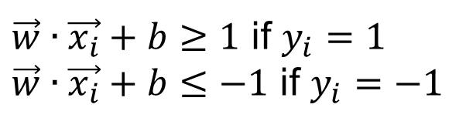
Support Vector Machines
We want to maximize:
  Which is equivalent to minimizing:
  But subjected to the following constraints:
    This is a constrained optimization problem
      Numerical approaches to solve it (e.g., quadratic programming)
$\vec{w}∙\vec{x_{i}}+b≥1$ if $y_{i}=1$
$\vec{w}∙\vec{x_{i}}+b≤−1$ if $y_{i}=−1$

Slide 32
Support Vector Machines
What if the problem is not linearly separable?

Slide 33

Support Vector Machines
What if the problem is not linearly separable?
$$\frac{ξ_{i}}{\left\|w\right\|}$$

Slide 34
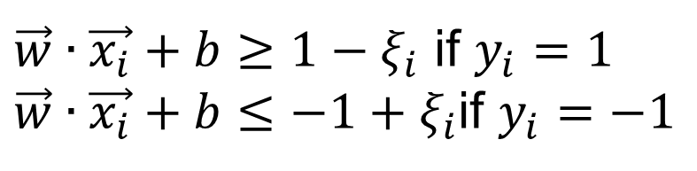
Support Vector Machines
What if the problem is not linearly separable?
  Introduce slack variables
    Need to minimize:
    Subject to:
$\vec{w}∙\vec{x_{i}}+b≥1−ξ_{i}$ if $y_{i}=1$
$\vec{w}∙\vec{x_{i}}+b≤−1+ξ_{i}$if $y_{i}=−1$

Slide 35
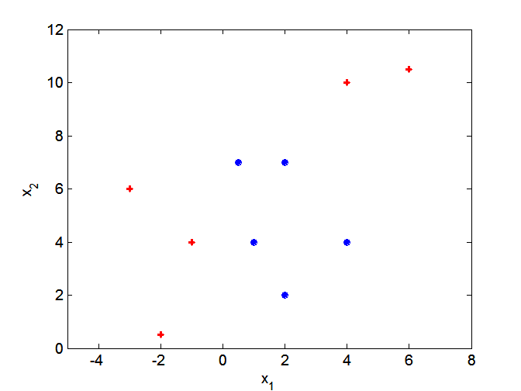
Nonlinear Support Vector Machines
What if decision boundary is not linear?

Slide 36
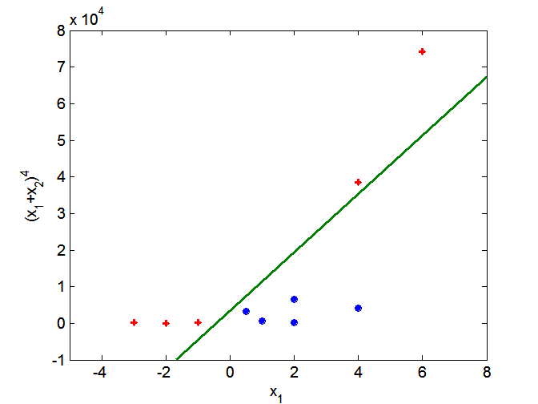
Nonlinear Support Vector Machines
Transform data into higher dimensional space

Slide 37
LOGISTIC REGRESSION

Slide 38
Classification via regression
Instead of predicting the class of an record we want to predict the probability of the class given the record
The problem of predicting continuous values is called regression problem
General approach: find a continuous function that models the continuous points.

Slide 39
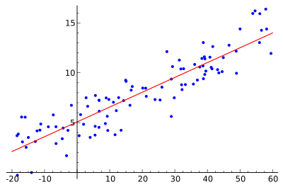
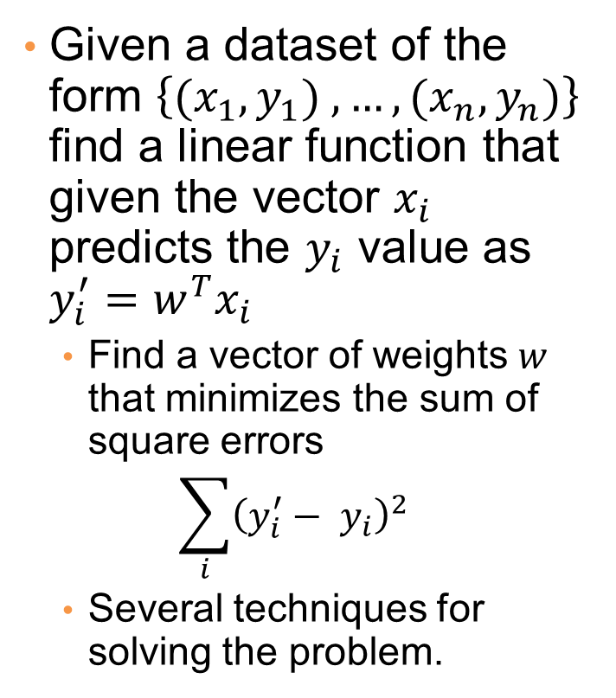
Example: Linear regression
Given a dataset of the form $\left\{{(x}_{1},y_{1}) ,…,{(x}_{n},y_{n})\right\}$ find a linear function that given the vector $x_{i}$ predicts the $y_{i}$ value as $y_{i}^{′}=w^{T}x_{i}$
  Find a vector of weights $w$ that minimizes the sum of square errors
  $$\sum_{i}{{\left(y_{i}^{′}− y_{i}\right)}^{2}}$$
  Several techniques for solving the problem.

Slide 40





Classification via regression
Assume a linear classification boundary
$$w⋅x>0$$
For the positive class the bigger the value of $w⋅x$, the further the point is from the classification boundary, the higher our certainty for the membership to the positive class
Define $P(C_{+}|x)$ as an increasing function of $w⋅x$
$$w⋅x=0$$
For the negative class the smaller the value of $w⋅x$, the further the point is from the classification boundary, the higher our certainty for the membership to the negative class
Define $P(C_{−}|x)$ as a decreasing function of $w⋅x$
$$w⋅x<0$$

Slide 41
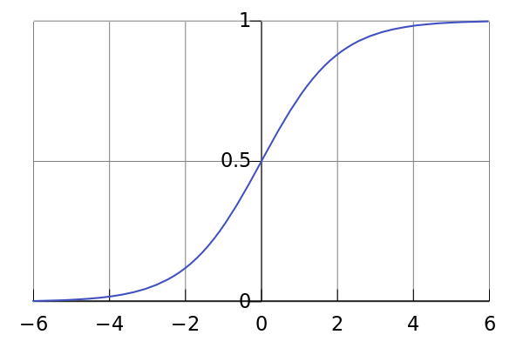
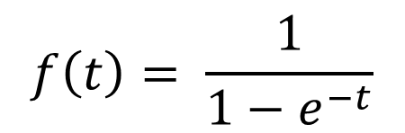
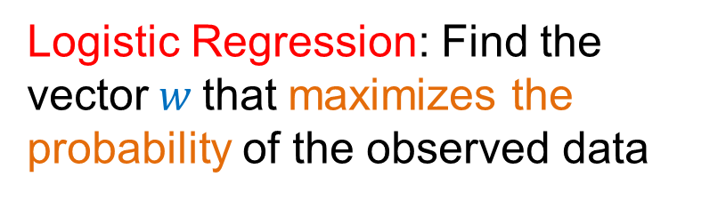
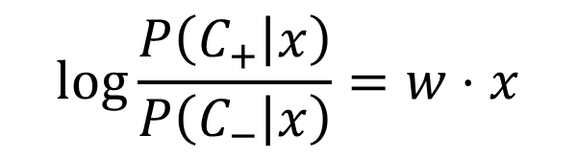
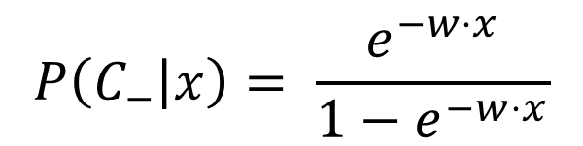
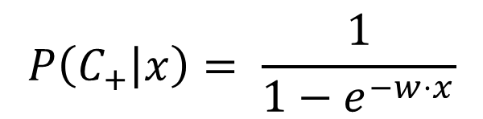
Logistic Regression
The logistic function
$$f\left(t\right)= \frac{1}{1−e^{−t}}$$
$$P\left(C_{+} | x\right)= \frac{1}{1−e^{−w⋅x}}$$
$$P\left(C_{−} | x\right)= \frac{e^{−w⋅x}}{1−e^{−w⋅x}}$$
$$\log{\frac{P\left(C_{+} | x\right)}{P\left(C_{−} | x\right)}}=w⋅x$$
Logistic Regression: Find the vector$w$that maximizes the probability of the observed data

Slide 42
Logistic Regression
Produces a probability estimate for the class membership which is often very useful.
The weights can be useful for understanding the feature importance.
Works for relatively large datasets
Fast to apply.

Slide 43
NAÏVE BAYES CLASSIFIER

Slide 44
Bayes Classifier
A probabilistic framework for solving classification problems
A, C random variables
Joint probability: Pr(A=a,C=c)
Conditional probability: Pr(C=c | A=a)
Relationship between joint and conditional probability distributions
Bayes Theorem:

Slide 45
Example of Bayes Theorem
Given:
  A doctor knows that meningitis causes stiff neck 50% of the time
  Prior probability of any patient having meningitis is 1/50,000
  Prior probability of any patient having stiff neck is 1/20
If a patient has stiff neck, what’s the probability he/she has meningitis?

Slide 46
Bayesian Classifiers
Consider each attribute and class label as random variables
Given a record with attributes (A₁, A₂,…,A_{n})
  Goal is to predict class C
  Specifically, we want to find the value of C that maximizes P(C| A₁, A₂,…,A_{n} )
Can we estimate P(C| A₁, A₂,…,A_{n} ) directly from data?

Slide 47
Bayesian Classifiers
Approach:
  compute the posterior probability P(C | A₁, A₂, …, A_{n}) for all values of C using the Bayes theorem
  Choose value of C that maximizes
  P(C | A₁, A₂, …, A_{n})
  Equivalent to choosing value of C that maximizes
  P(A₁, A₂, …, A_{n}|C) P(C)
How to estimate P(A₁, A₂, …, A_{n} | C )?

Slide 48
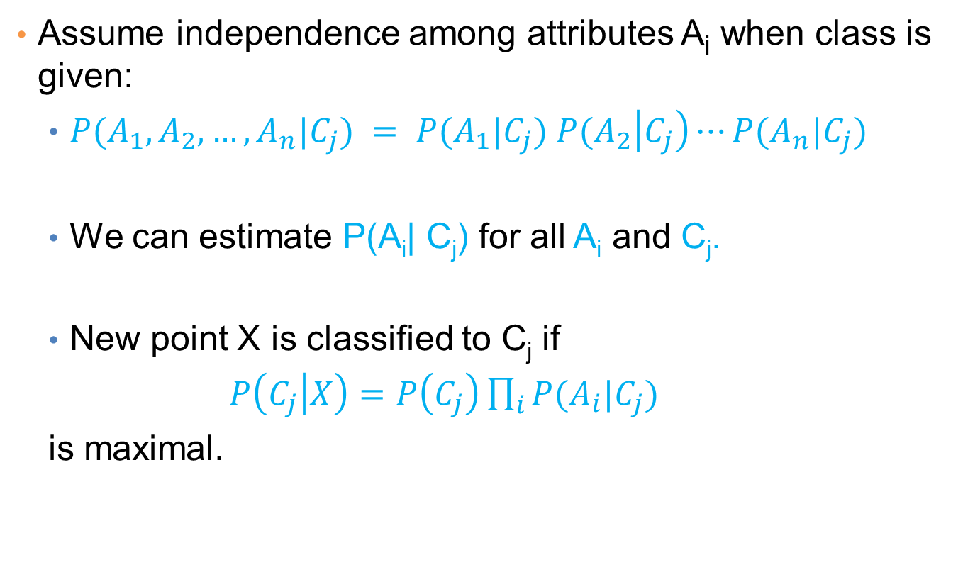
Naïve Bayes Classifier
Assume independence among attributes A_{i} when class is given:
  $P(A_{1},A_{2},…,A_{n}|C_{j}) = P(A_{1}|C_{j}) P(A_{2}\left|C_{j}\right)⋯P(A_{n}|C_{j})$
  We can estimate P(A_{i}| C_{j}) for all A_{i} and C_{j}.
  New point X is classified to C_{j} if
  $P\left(C_{j} | X\right)=P\left(C_{j}\right)\prod_{i}{P(A_{i}|C_{j})}$
  is maximal.

Slide 49
How to Estimate Probabilities from Data?
Class: P(C) = N_{c}/N
  e.g., P(No) = 7/10,
  P(Yes) = 3/10
For discrete attributes:
P(A_{i} | C_{k}) = |A_{ik}|/ N_{c}
  where |A_{ik}| is number of instances having attribute A_{i} and belongs to class C_{k}
  Examples:
  P(Status=Married|No) = 4/7
  P(Refund=Yes|Yes)=0
k

Slide 50
How to Estimate Probabilities from Data?
For continuous attributes:
  Discretize the range into bins
    one ordinal attribute per bin
    violates independence assumption
  Two-way split: (A < v) or (A > v)
    choose only one of the two splits as new attribute
  Probability density estimation:
    Assume attribute follows a normal distribution
    Use data to estimate parameters of distribution
    (e.g., mean and standard deviation)
    Once probability distribution is known, can use it to estimate the conditional probability P(A_{i}|c)

Slide 51
How to Estimate Probabilities from Data?
Normal distribution:
  One for each (A_{i},c_{i}) pair
For (Income, Class=No):
  If Class=No
    sample mean = 110
    sample variance = 2975

Slide 52
Example of Naïve Bayes Classifier
Given a Test Record:
P(X|Class=No) = P(Refund=No|Class=No)
× P(Married| Class=No)
× P(Income=120K| Class=No)
= 4/7 × 4/7 × 0.0072 = 0.0024
P(X|Class=Yes) = P(Refund=No| Class=Yes)
× P(Married| Class=Yes)
× P(Income=120K| Class=Yes)
= 1 × 0 × 1.2 × 10⁻⁹ = 0
Since P(X|No)P(No) > P(X|Yes)P(Yes)
Therefore P(No|X) > P(Yes|X)
=> Class = No

Slide 53
Naïve Bayes Classifier
If one of the conditional probability is zero, then the entire expression becomes zero
Probability estimation:
N_{i}: number of attribute values for attribute A_{i}
p: prior probability
m: parameter

Slide 54
Example of Naïve Bayes Classifier
A: attributes
M: mammals
N: non-mammals
P(A|M)P(M) > P(A|N)P(N)
=> Mammals

Slide 55
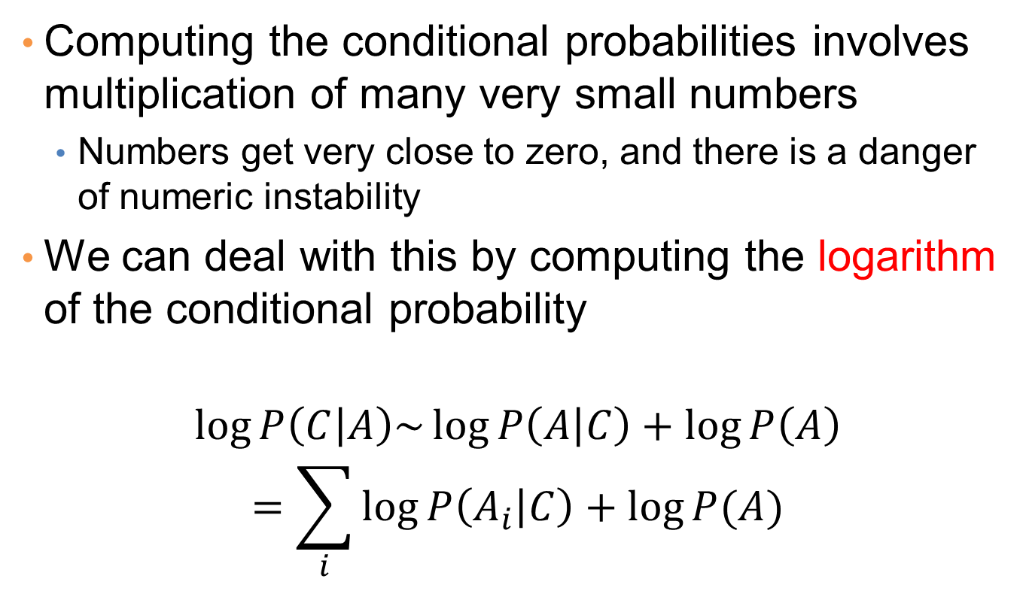
Implementation details
Computing the conditional probabilities involves multiplication of many very small numbers
  Numbers get very close to zero, and there is a danger of numeric instability
We can deal with this by computing the logarithm of the conditional probability
$$\log{P\left(C | A\right)\sim \log{P\left(A | C\right)+\log{P\left(A\right)}}}$$
$$=\sum_{i}{\log{P\left(A_{i} | C\right)}+\log{P(A)}}$$

Slide 56
Naïve Bayes (Summary)
Robust to isolated noise points
Handle missing values by ignoring the instance during probability estimate calculations
Robust to irrelevant attributes
Independence assumption may not hold for some attributes
  Use other techniques such as Bayesian Belief Networks (BBN)
Naïve Bayes can produce a probability estimate, but it is usually a very biased one
  Logistic Regression is better for obtaining probabilities.

Slide 57



Generative vs Discriminative models
Naïve Bayes is a type of a generative model
  Generative process:
    First pick the category of the record
    Then given the category, generate the attribute values from the distribution of the category
    Conditional independence given C
We use the training data to learn the distribution of the values in a class
C
$$A_{1}$$
$$A_{2}$$
$$A_{n}$$

Slide 58
Generative vs Discriminative models
Logistic Regression and SVM are discriminative models
  The goal is to find the boundary that discriminates between the two classes from the training data
In order to classify the language of a document, you can
  Either learn the two languages and find which is more likely to have generated the words you see
  Or learn what differentiates the two languages.

