Slide 1
ΕΞΟΡΥΞΗ ΔΕΔΟΜΕΝΩΝ ΔΙΑΛΕΞΗ 1
Εισαγωγή

Slide 2
Συστάσεις Ι
Ποιός είμαι εγώ:
Email: tsap@cs.uoi.gr
Γραφείο: Β.3
Προτιμώμενες ώρες γραφείου: απογευματινές/βραδινές.
Πράγματα με τα οποία έχω ασχοληθεί στο παρελθόν
Σχεδιασμός και ανάλυση αλγορίθμων για ranking χρησιμοποιώντας τους συνδέσμους του παγκόσμιου ιστού (PageRank-like).
Αλγορίθμους για clustering, ανάλυση βιολογικών δεδομένων, σημασία των αποτελεσμάτων αλγορίθμων εξόρυξης δεδομένων.
Web Information Retrieval, κοινωνικά δίκτυα, User Generated Content.
Πράγματα που με ενδιαφέρουν τώρα
Web mining, Social networks, User Generated Content
Mobile applications, Mining of mobile data.

Slide 3
Συστάσεις ΙΙ
Ποιοί είσαστε εσείς:
Συμπληρώστε τη φόρμα με τα στοιχεία σας για την email λίστα του μαθήματος.
Μετά την εισαγωγή θα κάνουμε ένα εισαγωγικό quiz γνώσεων.

Slide 4
Γενικές πληροφορίες για το μάθημα
Διαλεξεις: Τέταρτη 1-4 μ.μ.
Οι διαφάνειες θα είναι στα αγγλικά, αλλά θα προσπαθήσω να βγάζω και μετάφραση.
Web: http://www.cs.uoi.gr/~tsap/teaching/cs-072/
Ανακοινώσεις, ασκήσεις, υλικό για διάβασμα διαφάνειες από τις διαλέξεις
Βαθμολογία: TBD (To Be Defined)
Θα έχει τουλάχιστον 3 ασκήσεις, ίσως να έχει ένα project, ίσως να έχει τελική εξέταση.
Πολιτική για καθυστερημένες εργασίες:
Μία μέρα καθυστέρηση -10%, δύο μέρες -20%, τρεις μέρες -40%, τέσσερεις μέρες -80%, πέντε μέρες -100%.

Slide 5
«Προαπαιτούμενα»
Δεν υπάρχουν προαπαιτούμενα αλλά καλό θα είναι να έχετε κάποια άνεση με:
Αλγορίθμους: γνώση βασικών αλγορίθμων (π.χ., sorting), και σχεδίασης αλγορίθμων (greedy algorithms, dynamic programming).
Πολυπλοκότητα: NP-hardness, ασυμπτωτική ανάλυση πολυπλοκότητας.
Δομές δεδομένων: χρήση βασικών δομών δεδομένων.
Προγραμματισμός: γρήγορο prototyping για τρέχετε πειράματα (οποιαδήποτε γλώσσα); matlab
Πιθανότητες: Γνώσεις πιθανοτήτων.
Γραφήματα: βασικές έννοιες γραφημάτων
Γραμμική άλγεβρα: πίνακες, διανύσματα, ιδιοδιανύσματα,

Slide 6
Στόχοι του μαθήματος
Να καταλάβετε το είδος των προβλημάτων που μπορείτε να λύσετε χρησιμοποιώντας τεχνικές data mining.
Να μάθετε βασικές έννοιες του data mining, που καλύπτουν και τo θεωρητικό υπόβαθρο, και την εφαρμογή στην πράξη.
Να καταλάβουμε τη θεωρία πίσω από τους αλγόριθμους και τις τεχνικές
Να αποκτήσετε ένα σύνολο από εργαλεία (toolbox) για εξόρυξη δεδομένων.
Να παίξετε με πραγματικά δεδομένα και να δείτε κάποια ενδιαφέροντα πραγματικά προβλήματα (ελπίζω).
Να μάθετε διασκεδάζοντας.

Slide 7
Μάθημα
Η παρακολούθηση και συμμετοχή είναι απαραίτητες
Κάνετε ερωτήσεις. Κάποια πράγματα δεν θα είναι ξεκάθαρα και θα πρέπει να τα επαναλάβω.
Αν κάτι στηρίζεται σε παλαιότερη γνώση που δεν θυμάστε ζητήστε να κάνουμε μια (σύντομη) επισκόπηση.
Αν υπάρχει πρόβλημα με αγγλική ορολογία και τις διαφάνειες μπορούμε να κάνουμε κάποιες ρυθμίσεις.

Slide 8
Θέματα που θα καλύψουμε
Κάποιο υποσύνολο από τα παρακάτω
Frequent itemsets and association rules (συσχετισμοί)
Covering problems
Definitions and Computation of Similarity
Clustering (συσταδiοποίηση), co-clustering, compression
Classification (κατηγοριοποίηση)
Dimensionality Reduction
Ranking (ιεραρχηση/ταξινόμηση)
Recommendation stystems
Graph Analysis
Map-Reduce tools
Time-series analysis
Aggregation
Privacy preserving data mining

Slide 9
Βιβλιογραφία (ελληνικά)
Μ. Βαζιργιάννης και Μ. Χαλκίδη, Εξόρυξη Γνώσης από Βάσεις Δεδομένων. Τυποθήτω, Νοέμβριος 2003
P.-N. Tan, M. Steinbach and V. Kumar, Introduction to Data Mining Addison Wesley, 2006, Β. Βερύκιος και Σ. Σουραβλάς, Εκδόσεις Τζιόλα (2010).
M. H. Dunham, Data Mining, Εισαγωγικά και Προηγμένα Θέματα Εξόρυξης Γνώσης από Δεδομένα. Επιμέλεια Ελληνικής Έκδοσης: Β. Βερύκιος και Γ. Θεοδωρίδης. Εκδόσεις Νέων Τεχνολογιών, 2004.

Slide 10
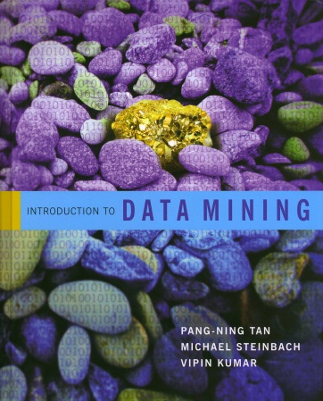
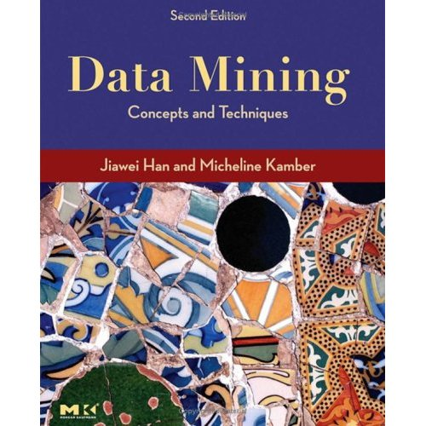
Βιβλιογραφία (αγγλικά)
P.-N. Tan, M. Steinbach and V. Kumar, Introduction to Data Mining, Addison Wesley, 2006
J. Han and M. Kamber. Data Mining: Concepts and Techniques, Morgan Kaufmann, 2006

Slide 11
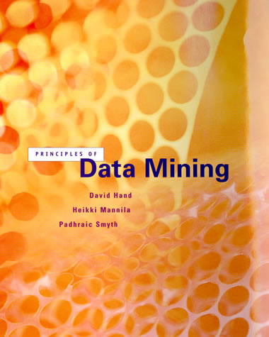
Βιβλιογραφία (αγγλικά)
Hand, Mannila, Smyth. Principles of Data Mining
Toby Segaran, Programming Collective Intelligence. Building Smart Web 2.0 Applications
Anand Rajaraman and Jeff Ullman Mining Massive Datasets.
Διατίθεται δωρεάν online.

Slide 12
Υλικό
Εκτός από βιβλία θα χρησιμοποιήσουμε υλικό και από δημοσιευμένα άρθρα
Για τις διαφάνειες θα δανειστούμε από πολλές πηγές
Εξόρυξη δεδομένων, Ε. Πιτρουρά
Data Mining, E. Terzi
P.-N. Tan, M. Steinbach and V. Kumar, Introduction to Data Mining, Addison Wesley, 2006
J. Han and M. Kamber. Data Mining: Concepts and Techniques, Morgan Kaufmann, 2006
Anand Rajaraman and Jeff Ullman Mining Massive Datasets.

Slide 13
Quiz
Σύντομο quiz με κάποιες βασικές ερωτήσεις γνώσεων
Δεν βαθμολογείστε, ο στόχος είναι να ρυθμίσω το επίπεδο του μαθήματος
Μπορείτε να το δώσετε ανώνυμο, αν και θα προτιμούσα να ξέρω τις αδυναμίες του καθενός
Έχετε όσο χρόνο χρειάζεστε.

Slide 14
DATA MINING LECTURE 1
Introduction

Slide 15
What is data mining?
After years of data mining there is still no unique answer to this question.
A tentative definition:
Data mining is the use of efficient techniques for the analysis of very large collections of data and the extraction of useful and possibly unexpected patterns in data.

Slide 16
Why do we need data mining?
Really, really huge amounts of raw data!!
Moore’s law: more efficient processors, larger memories
Communications have improved too
Measurement technologies have improved dramatically
The web, and mobile devices generate TB of data every minute
It possible to store and collect lots of raw data
The data-analysis methods are lagging behind
Need to analyze the raw data to extract knowledge

Slide 17
The data is also very complex
Multiple types of data: tables, time series, images, graphs, etc
Spatial and temporal aspects
Interconnected data of different types:
From the mobile phone we can collect, location of the user, friendship information, check-ins to venues, opinions through twitter, images though cameras, queries to search engines

Slide 18
Example: transaction data
Billions of real-life customers:
WALMART: 20M transactions per day
AT&T 300 M calls per day
Credit card companies: billions of transactions per day.
The point cards allow companies to collect information about specific users

Slide 19
Example: document data
Web as a document repository: estimated 50 billions of web pages
Wikipedia: 4 million articles (and counting)
Online collections of scientific articles
Online news portals: steady stream of new articles every day
Twitter: ~300 million tweets every day

Slide 20
Example: network data
Web: 50 billion pages linked via hyperlinks
Facebook: 500 million users
Twitter: 300 million users
Instant messenger: ~1billion users
Blogs: 250 million blogs worldwide, presidential candidates run blogs

Slide 21
Example: genomic sequences
http://www.1000genomes.org/page.php
Full sequence of 1000 individuals
3*10^9 nucleotides per person → 3*10^12 nucleotides
Lots more data in fact: medical history of the persons, gene expression data

Slide 22
Example: environmental data
Climate data (just an example)
http://www.ncdc.gov/oa/climate/ghcn-monthly/index.php
“a database of temperature, precipitation and pressure records managed by the National Climatic Data Center, Arizona State University and the Carbon Dioxide Information Analysis Center”
“6000 temperature stations, 7500 precipitation stations, 2000 pressure stations”

Slide 23
Behavioral data
Mobile phones today record a large amount of information about the user behavior
GPS records position
Camera produces images
Communication via phone and SMS
Text via facebook updates
Association with entities via check-ins

Slide 24
Online behavioral data
Amazon collects all the items that you browsed, placed into your basket, read reviews about, purchased.
Google and Bing record all your browsing activity via toolbar plugins. They also record the queries you asked, the pages you saw and the clicks you did.

Slide 25
What can you do with the data?
Suppose that you are the owner of a supermarket and you have collected billions of market basket data. What information would you extract from it and how would you use it?
What if this was an online store?
Product placement
Catalog creation
Recommendations

Slide 26
What can you do with the data?
Suppose you are a search engine and you have a toolbar log consisting of
pages browsed,
queries,
pages clicked,
ads clicked
each with a user id and a timestamp. What information would you like to get our of the data?
Ad click prediction
Query reformulations

Slide 27
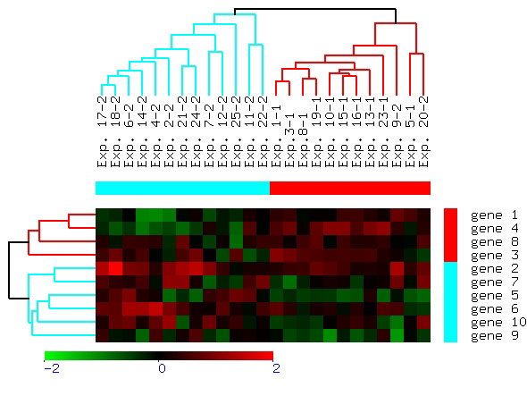
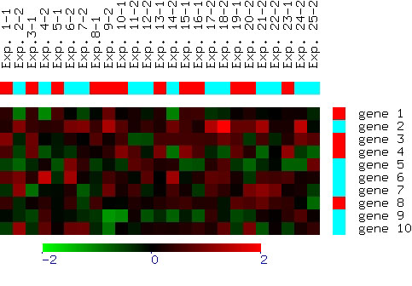
What can you do with the data?
Suppose you are biologist who has microarray expression data: thousands of genes, and their expression values over thousands of different settings (e.g. tissues). What information would you like to get out of your data?
Groups of genes and tissues

Slide 28
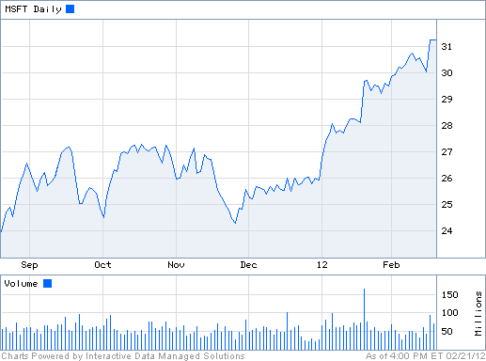
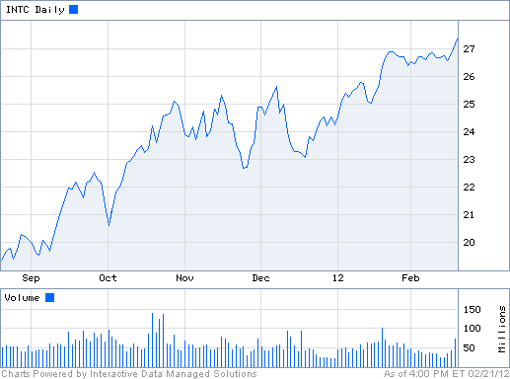
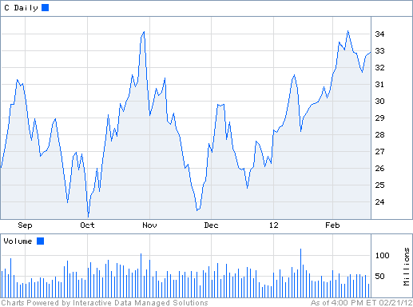
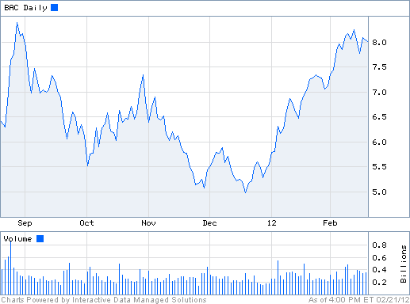
What can you do with the data?
Suppose you are a stock broker and you observe the fluctuations of multiple stocks over time. What information would you like to get our of your data?
Clustering of stocks
Correlation of stocks
Stock Value predicition

Slide 29
What can you do with the data?
You are the owner of a social network, and you have full access to the social graph, what kind of information do you want to get out of your graph?
Who is the most central node in the graph?
What is the shortest path between two nodes?
How many paths there are between two nodes?
How does information spread on the network?

Slide 30
Why data mining?
Commercial point of view
Data has become the key competitive advantage of companies
Examples: Facebook, Google, Amazon
Being able to extract useful information out of the data is key for exploiting them commercially.
Scientific point of view
Scientists are at an unprecedented position where they can collect TB of information
Examples: Sensor data, astronomy data, social network data, gene data
We need the tools to analyze such data and get a better understanding of the world
Scale (in data size and feature dimension)
Why not use traditional analytic methods?
The amount and the complexity of data does not allow for manual processing of the data. We need automated techniques.

Slide 31
What is Data Mining again?
“Data mining is the analysis of (often large) observational data sets to find unsuspected relationships and to summarize the data in novel ways that are both understandable and useful to the data analyst” (Hand, Mannila, Smyth)
“Data mining is the discovery of models for data” (Rajaraman, Ullman)
We can have the following types of models
Models that explain the data (e.g., a single function)
Models that predict the future data instances.
Models that summarize the data
Models the extract the most prominent features of the data.

Slide 32
What can we do with data mining?
Some examples:
Frequent itemsets and Association Rules extraction
Coverage
Clustering
Classification
Ranking
Exploratory analysis

Slide 33
Frequent Itemsets and Association Rules
Given a set of records each of which contain some number of items from a given collection;
Identify sets of items (itemsets) occurring frequently together
Produce dependency rules which will predict occurrence of an item based on occurrences of other items.
Itemsets Discovered:
{Milk,Coke}
{Diaper, Milk}
Rules Discovered:
{Milk} --> {Coke}
{Diaper, Milk} --> {Beer}
Tan, M. Steinbach and V. Kumar, Introduction to Data Mining

Slide 34
Frequent Itemsets: Application
Text mining: finding associated phrases in text
There are lots of documents that contain the phrases “association rules”, “data mining” and “efficient algorithm”

Slide 35
Association Rule Discovery: Application
Supermarket shelf management.
Goal: To identify items that are bought together by sufficiently many customers.
Approach: Process the point-of-sale data collected with barcode scanners to find dependencies among items.
A classic rule --
If a customer buys diaper and milk, then he is very likely to buy beer.
So, don’t be surprised if you find six-packs stacked next to diapers!
Tan, M. Steinbach and V. Kumar, Introduction to Data Mining

Slide 36
Clustering Definition
Given a set of data points, each having a set of attributes, and a similarity measure among them, find clusters such that
Data points in one cluster are more similar to one another.
Data points in separate clusters are less similar to one another.
Similarity Measures:
Euclidean Distance if attributes are continuous.
Other Problem-specific Measures.
Tan, M. Steinbach and V. Kumar, Introduction to Data Mining

Slide 37
Illustrating Clustering
Euclidean Distance Based Clustering in 3-D space.
Intracluster distances
are minimized
Intercluster distances
are maximized
Tan, M. Steinbach and V. Kumar, Introduction to Data Mining

Slide 38
Clustering: Application 1
Market Segmentation:
Goal: subdivide a market into distinct subsets of customers where any subset may conceivably be selected as a market target to be reached with a distinct marketing mix.
Approach:
Collect different attributes of customers based on their geographical and lifestyle related information.
Find clusters of similar customers.
Measure the clustering quality by observing buying patterns of customers in same cluster vs. those from different clusters.
Tan, M. Steinbach and V. Kumar, Introduction to Data Mining

Slide 39
Clustering: Application 2
Document Clustering:
Goal: To find groups of documents that are similar to each other based on the important terms appearing in them.
Approach: To identify frequently occurring terms in each document. Form a similarity measure based on the frequencies of different terms. Use it to cluster.
Gain: Information Retrieval can utilize the clusters to relate a new document or search term to clustered documents.
Tan, M. Steinbach and V. Kumar, Introduction to Data Mining

Slide 40
Illustrating Document Clustering
Clustering Points: 3204 Articles of Los Angeles Times.
Similarity Measure: How many words are common in these documents (after some word filtering).
Tan, M. Steinbach and V. Kumar, Introduction to Data Mining

Slide 41
Clustering of S&P 500 Stock Data
Observe Stock Movements every day.
Clustering points: Stock-{UP/DOWN}
Similarity Measure: Two points are more similar if the events described by them frequently happen together on the same day.
We used association rules to quantify a similarity measure.
Tan, M. Steinbach and V. Kumar, Introduction to Data Mining

Slide 42
Coverage
Given a set of customers and items and the transaction relationship between the two, select a small set of items that “covers” all users.
For each user there is at least one item in the set that the user has bought.
This formulation can be generalized for any two types of entities, and it is very useful in practice.
Application:
Create a catalog to send out that has at least one item of interest for every customer.

Slide 43
Classification: Definition
Given a collection of records (training set )
Each record contains a set of attributes, one of the attributes is the class.
Find a model for class attribute as a function of the values of other attributes.
Goal: previously unseen records should be assigned a class as accurately as possible.
A test set is used to determine the accuracy of the model. Usually, the given data set is divided into training and test sets, with training set used to build the model and test set used to validate it.

Slide 44
Classification Example
categorical
categorical
continuous
class
Test
Set
Learn
Classifier
Training
Set
Model
Tan, M. Steinbach and V. Kumar, Introduction to Data Mining

Slide 45
Classification: Application 1
Ad Click Prediction
Goal: Predict if a user that visits a web page will click on a displayed ad. Use it to target users with high click probability.
Approach:
Collect data for users over a period of time and record who clicks and who does not. The {click, no click} information forms the class attribute.
Use the history of the user (web pages browsed, queries issued) as the features.
Learn a classifier model and test on new users.

Slide 46
Classification: Application 2
Fraud Detection
Goal: Predict fraudulent cases in credit card transactions.
Approach:
Use credit card transactions and the information on its account-holder as attributes.
When does a customer buy, what does he buy, how often he pays on time, etc
Label past transactions as fraud or fair transactions. This forms the class attribute.
Learn a model for the class of the transactions.
Use this model to detect fraud by observing credit card transactions on an account.
Tan, M. Steinbach and V. Kumar, Introduction to Data Mining

Slide 47
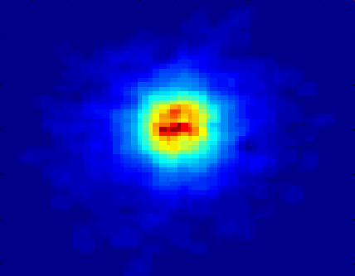
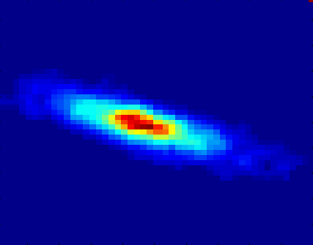
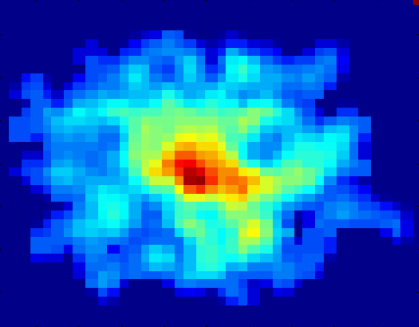
Classifying Galaxies
Courtesy: http://aps.umn.edu
Early
Class:
Stages of Formation
Attributes:
Image features,
Characteristics of light waves received, etc.
Intermediate
Late
Data Size:
72 million stars, 20 million galaxies
Object Catalog: 9 GB
Image Database: 150 GB
Tan, M. Steinbach and V. Kumar, Introduction to Data Mining

Slide 48
Link Analysis Ranking
Given a collection of web pages that are linked to each other, rank the pages according to importance (authoritativeness) in the graph
Intuition: A page gains authority if it is linked to by another page.
Application: When retrieving pages, the authoritativeness is factored in the ranking.

Slide 49
Exploratory Analysis
Trying to understand the data as a physical phenomenon, and describe them with simple metrics
What does the web graph look like?
How often do people repeat the same query?
Are friends in facebook also friends in twitter?
The important thing is to find the right metrics and ask the right questions
It helps our understanding of the world, and can lead to models of the phenomena we observe.

Slide 50
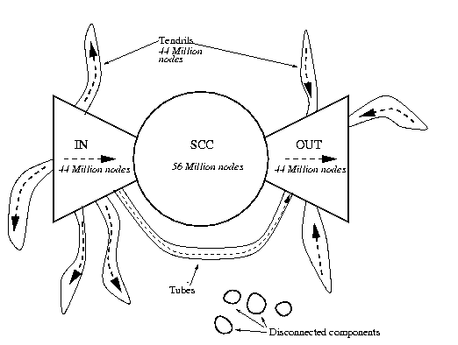
Exploratory Analysis: The Web
What is the structure and the properties of the web?

Slide 51
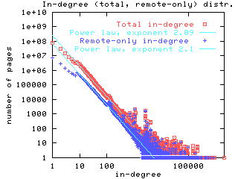
Exploratory Analysis: The Web
What is the distribution of the incoming links?

Slide 52
Connections of Data Mining with other areas
Draws ideas from machine learning/AI, pattern recognition, statistics, and database systems
Traditional Techniques may be unsuitable due to
Enormity of data
High dimensionality of data
Heterogeneous, distributed nature of data
Emphasis on the use of data
Statistics/ AI
Machine Learning/
Pattern Recognition
Data Mining
Database systems
Tan, M. Steinbach and V. Kumar, Introduction to Data Mining

Slide 53
Cultures
Databases: concentrate on large-scale (non-main-memory) data.
AI (machine-learning): concentrate on complex methods, small data.
In today’s world data is more important than algorithms
Statistics: concentrate on models.
CS345A Data Mining on the Web: Anand Rajaraman, Jeff Ullman

Slide 54
Models vs. Analytic Processing
To a database person, data-mining is an extreme form of analytic processing – queries that examine large amounts of data.
Result is the query answer.
To a statistician, data-mining is the inference of models.
Result is the parameters of the model.
CS345A Data Mining on the Web: Anand Rajaraman, Jeff Ullman

Slide 55
(Way too Simple) Example
Given a billion numbers, a DB person would compute their average and standard deviation.
A statistician might fit the billion points to the best Gaussian distribution and report the mean and standard deviation of that distribution.
CS345A Data Mining on the Web: Anand Rajaraman, Jeff Ullman

Slide 56
Data Mining: Confluence of Multiple Disciplines
Database
Technology
Statistics
Machine
Learning
Data Mining
Visualization
Pattern
Recognition
Other
Disciplines
Algorithm

Slide 57
Data Mining: Confluence of Multiple Disciplines
Database
Technology
Statistics
Machine
Learning
Data Mining
Visualization
Pattern
Recognition
Other
Disciplines
Algorithm

Slide 58
The data analysis pipeline
Mining is not the only step in the analysis process
Preprocessing: real data is noisy, incomplete and inconsistent. Data cleaning is required to make sense of the data
Techniques: Sampling, Dimensionality Reduction, Feature selection.
A dirty work, but it is often the most important step for the analysis.
Post-Processing: Make the data actionable and useful to the user
Statistical analysis of importance
Visualization.
Pre- and Post-processing are often data mining tasks as well
Data Preprocessing
Data Mining
Result
Post-processing

Slide 59
Meaningfulness of Answers
A big data-mining risk is that you will “discover” patterns that are meaningless.
Statisticians call it Bonferroni’s principle: (roughly) if you look in more places for interesting patterns than your amount of data will support, you are bound to find crap.
The Rhine Paradox: a great example of how not to conduct scientific research.
CS345A Data Mining on the Web: Anand Rajaraman, Jeff Ullman

Slide 60
Rhine Paradox – (1)
Joseph Rhine was a parapsychologist in the 1950’s who hypothesized that some people had Extra-Sensory Perception.
He devised (something like) an experiment where subjects were asked to guess 10 hidden cards – red or blue.
He discovered that almost 1 in 1000 had ESP – they were able to get all 10 right!
CS345A Data Mining on the Web: Anand Rajaraman, Jeff Ullman

Slide 61
Rhine Paradox – (2)
He told these people they had ESP and called them in for another test of the same type.
Alas, he discovered that almost all of them had lost their ESP.
What did he conclude?
Answer on next slide.
CS345A Data Mining on the Web: Anand Rajaraman, Jeff Ullman

Slide 62
Rhine Paradox – (3)
He concluded that you shouldn’t tell people they have ESP; it causes them to lose it.
CS345A Data Mining on the Web: Anand Rajaraman, Jeff Ullman

