Slide 1
Online Social Networks and Media
Influence Maximization

Slide 2
Maximizing spread
Suppose that instead of a virus we have an item (product, idea, video) that propagates through contact
  Word of mouth propagation.
An advertiser is interested in maximizing the spread of the item in the network
  The holy grail of “viral marketing”
Question: which nodes should we “infect” so that we maximize the spread? [KKT2003]

Slide 3
Independent cascade model
Each node may be active (has the item) or inactive (does not have the item)
Time proceeds at discrete time-steps. At time t, every node v that became active in time t-1 actives a non-active neighbor w with probability p_{uw}. If it fails, it does not try again
The same as the simple SIR model

Slide 4
Influence maximization
Influence function: for a set of nodes A (target set) the influence s(A) is the expected number of active nodes at the end of the diffusion process if the item is originally placed in the nodes in A.
Influence maximization problem [KKT03]: Given an network, a diffusion model, and a value k, identify a set A of k nodes in the network that maximizes s(A).
The problem is NP-hard

Slide 5
A Greedy algorithm
What is a simple algorithm for selecting the set A?
Computing s(A): perform multiple simulations of the process and take the average.
How good is the solution of this algorithm compared to the optimal solution?
Greedy algorithm
  Start with an empty set A
  Proceed in k steps
    At each step add the node u to the set A the maximizes the increase in function s(A)
      The node that activates the most additional nodes

Slide 6
Approximation Algorithms
Suppose we have a (combinatorial) optimization problem, and X is an instance of the problem, OPT(X) is the value of the optimal solution for X, and ALG(X) is the value of the solution of an algorithm ALG for X
  In our case: X = (G,k) is the input instance, OPT(X) is the spread S(A*) of the optimal solution, GREEDY(X) is the spread S(A) of the solution of the Greedy algorithm
ALG is a good approximation algorithm if the ratio of OPT and ALG is bounded.

Slide 7
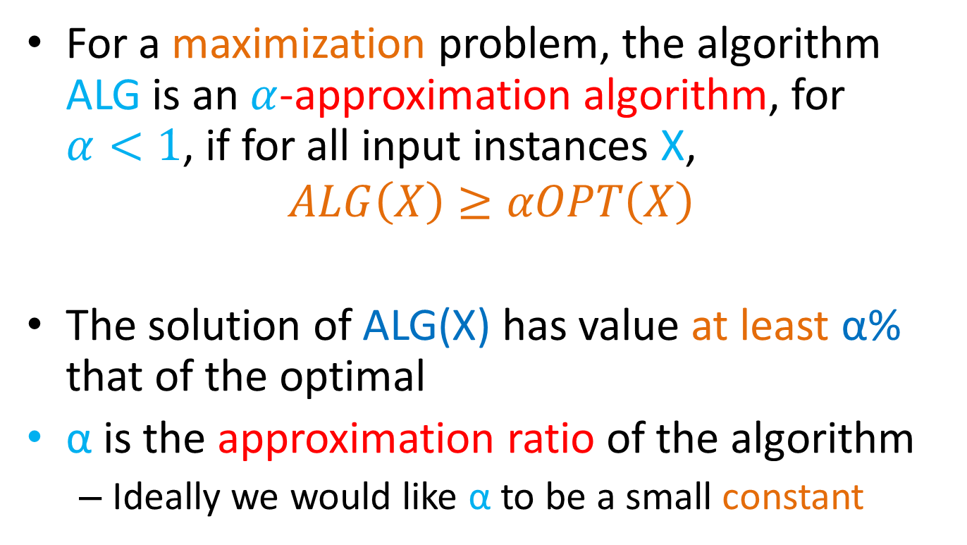
Approximation Ratio
For a maximization problem, the algorithm ALG is an $α$-approximation algorithm, for $α<1$, if for all input instances X,
$$ALG\left(X\right)≥αOPT\left(X\right)$$
The solution of ALG(X) has value at least α% that of the optimal
α is the approximation ratio of the algorithm
  Ideally we would like α to be a small constant

Slide 8

Approximation Ratio for Influence Maximzation
The GREEDY algorithm has approximation ratio $α=1−\frac{1}{e}$
$GREEDY\left(X\right)≥\left(1−\frac{1}{e}\right)OPT\left(X\right)$, for all X

Slide 9
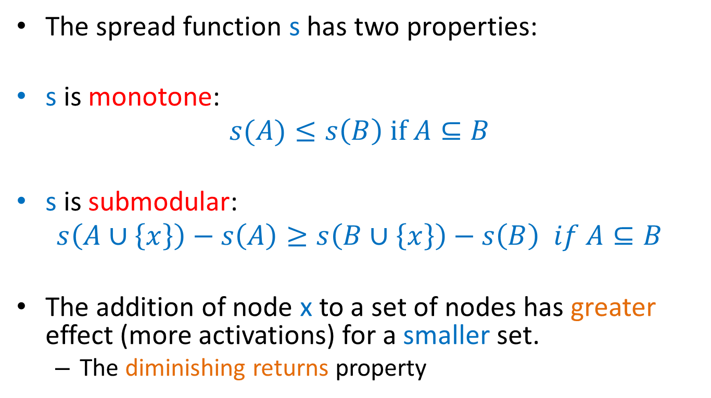
Proof of approximation ratio
The spread function s has two properties:
s is monotone:
$$s(A)≤s\left(B\right) if A⊆B$$
s is submodular:
$$s\left(A∪\left\{x\right\}\right)−s\left(A\right)≥s\left(B∪\left\{x\right\}\right)−s\left(B\right) if A⊆B$$
The addition of node x to a set of nodes has greater effect (more activations) for a smaller set.
  The diminishing returns property

Slide 10
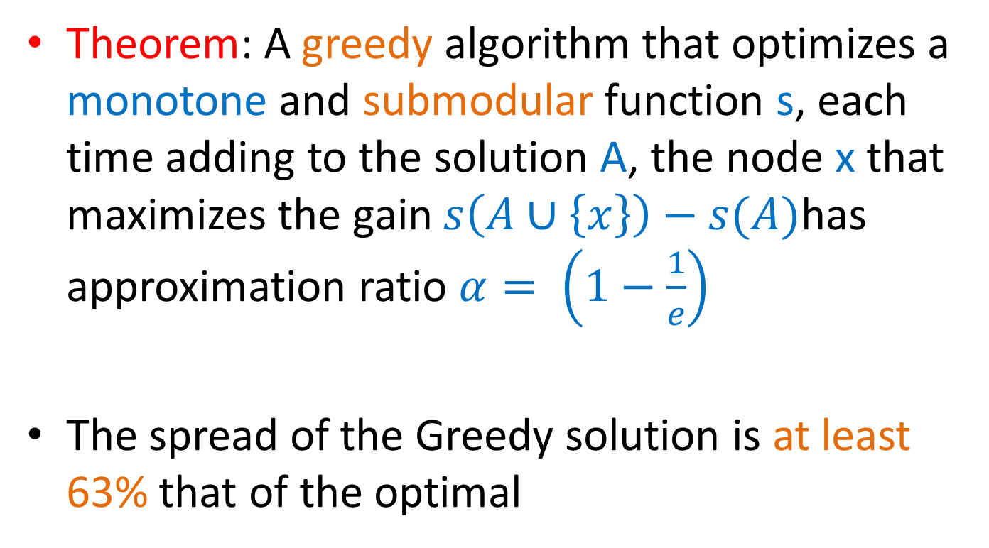
Optimizing submodular functions
Theorem: A greedy algorithm that optimizes a monotone and submodular function s, each time adding to the solution A, the node x that maximizes the gain $s\left(A∪\left\{x\right\}\right)−s(A)$has approximation ratio $α= \left(1−\frac{1}{e}\right)$
The spread of the Greedy solution is at least 63% that of the optimal

Slide 11
Submodularity of influence
Why is s(A) submodular?
  How do we deal with the fact that influence is defined as an expectation?
We will use the fact that probabilistic propagation on a fixed graph can be viewed as deterministic propagation over a randomized graph
  Express s(A) as an expectation over the input graph rather than the choices of the algorithm

Slide 12
Independent cascade model
Each edge (u,v) is considered only once, and it is “activated” with probability p_{uv}.
We can assume that all random choices have been made in advance
  generate a sample subgraph of the input graph where edge (u,v) is included with probability p_{uv}
  propagate the item deterministically on the input graph
  the active nodes at the end of the process are the nodes reachable from the target set A
The influence function is obviously(?) submodular when propagation is deterministic
The weighted combination of submodular functions is also a submodular function

Slide 13
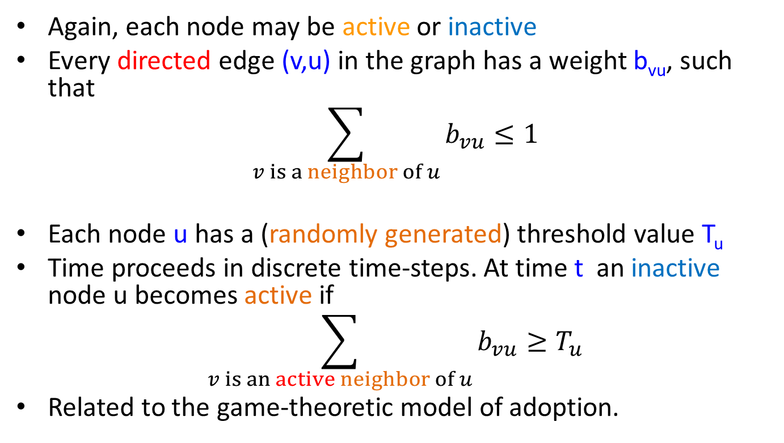
Linear threshold model
Again, each node may be active or inactive
Every directed edge (v,u) in the graph has a weight b_{vu}, such that
$$\sum_{v is a neighbor of u}{b_{vu}}≤1$$
Each node u has a (randomly generated) threshold value T_{u}
Time proceeds in discrete time-steps. At time t an inactive node u becomes active if
$$\sum_{v is an active neighbor of u}{b_{vu}}≥T_{u}$$
Related to the game-theoretic model of adoption.

Slide 14
Influence Maximization
KKT03 showed that in this case the influence s(A) is still a submodular function, using a similar technique
  Assumes uniform random thresholds
The Greedy algorithm achieves a (1-1/e) approximation

