Slide 1
Online Social Networks and Media
Epidemics and Influence

Slide 2
Epidemics
Understanding the spread of viruses and epidemics is of great interest to
Health officials
Sociologists
Mathematicians
Hollywood
The underlying contact network clearly affects the spread of an epidemic
Model epidemic spread as a random process on the graph and study its properties
Main question: will the epidemic take over most of the network?
Diffusion of ideas and the spread of influence can also be modeled as epidemics

Slide 3
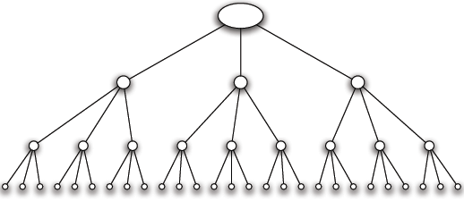
Branching Processes
A person transmits the disease to each people she meets independently with a probability p
Meets k people while she is contagious
A person carrying a new disease enters a population, first wave of k people
Second wave of k² people
Subsequent waves
A contact network with k =3
Tree (root, each node but the root, a single node in the level above it)

Slide 4
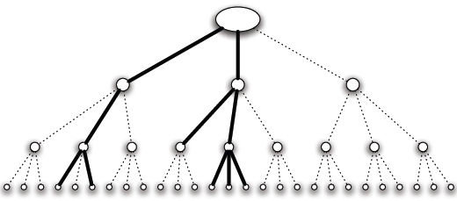
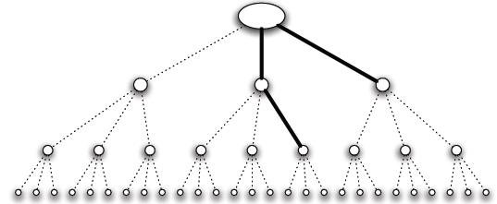
Branching Processes
Aggressive epidemic (high contagion probability)
Mild epidemic (low contagion probability)
If it ever reaches a wave where it infects no one, then it dies out
Or, it continues to infect people in every wave infinitely

Slide 5
Branching Processes: Basic Reproductive Number
Basic Reproductive Number (R₀): the expected number of new cases of the disease caused by a single individual
Claim: (a) If R₀ < 1, then with probability 1, the disease dies out after a finite number of waves. (b) If R₀ > 1, then with probability greater than 0 the disease persists by infecting at least one person in each wave.
R₀ = pk
R₀ < 1 -- Each infected person produces less than one new case in expectation Outbreak constantly trends downwards
R₀ > 1 – trends upwards, and the disease persists with positive probability (when p < 1, the disease can get unlucky!)
A “knife-edge” quality around the critical value of R₀ = 1

Slide 6
Branching process
Assumes no network structure, no triangles or shared neihgbors

Slide 7
The SIR model
Each node may be in the following states
Susceptible: healthy but not immune
Infected: has the virus and can actively propagate it
Removed: (Immune or Dead) had the virus but it is no longer active
probability of an Infected node to infect a Susceptible neighbor

Slide 8
The SIR process
Initially all nodes are in state S(usceptible), except for a few nodes in state I(nfected).
An infected node stays infected for $t_{I}$ steps.
Simplest case: $t_{I}=1$
At each of the $t_{I}$ steps the infected node has probability p of infecting any of its susceptible neighbors
p: Infection probability
After $t_{I}$ steps the node is Removed

Slide 9
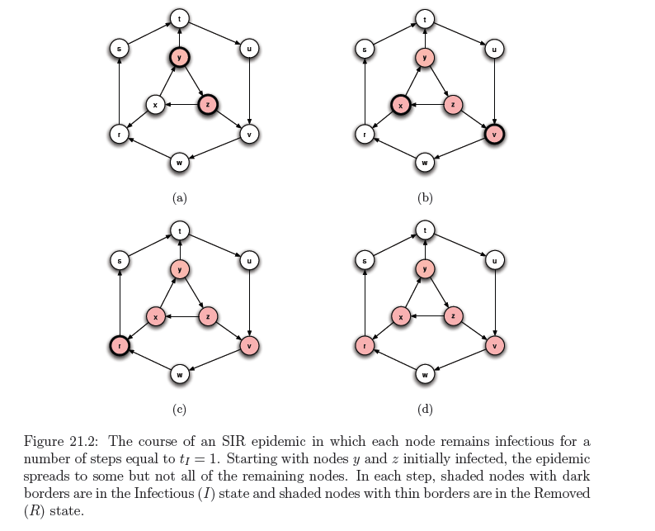

Slide 10
SIR and the Branching process
The branching process is a special case where the graph is a tree (and the infected node is the root)
The basic reproductive number is not necessarily informative in the general case

Slide 11
Percolation
Percolation: we have a network of “pipes” which can curry liquids, and they can be either open with probability p, or close with probability (1-p)
The pipes can be pathways within a material
If liquid enters the network from some nodes, does it reach most of the network?
The network percolates

Slide 12
SIR and Percolation
There is a connection between SIR model and percolation
When a virus is transmitted from u to v, the edge (u,v) is activated with probability p
We can assume that all edge activations have happened in advance, and the input graph has only the active edges.
Which nodes will be infected?
The nodes reachable from the initial infected nodes
In this way we transformed the dynamic SIR process into a static one.

Slide 13
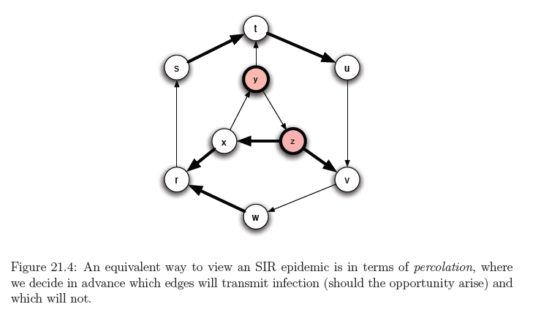
Example

Slide 14
The SIS model
Susceptible-Infected-Susceptible
Susceptible: healthy but not immune
Infected: has the virus and can actively propagate it
An Infected node infects a Susceptible neighbor with probability p
An Infected node becomes Susceptible again with probability q (or after $t_{I}$ steps)
Nodes alternate between Susceptible and Infected status

Slide 15
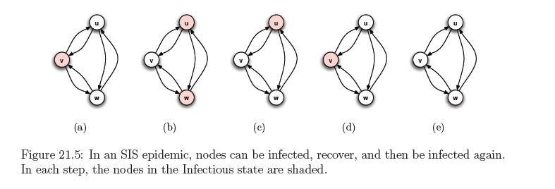
Exampe
When no Infected nodes, virus dies out
Question: will the virus die out?

Slide 16
An eigenvalue point of view
If A is the adjacency matrix of the network, then the virus dies out if
Where $λ_{1}$ is the first eigenvalue of A

Slide 17
Multiple copies model
Each node may have multiple copies of the same virus
v: state vector : v_{i} : number of virus copies at node i
At time t = 0, the state vector is initialized to v⁰
At time t,
For each node i
For each of the v_{i}^{t} virus copies at node i
the copy is copied to a neighbor j with prob p
the copy dies with probability q

Slide 18
Analysis
The expected state of the system at time t is given by
As t → ∞
the probability that all copies die converges to 1
the probability that all copies die converges to 1
the probability that all copies die converges to a constant < 1

Slide 19
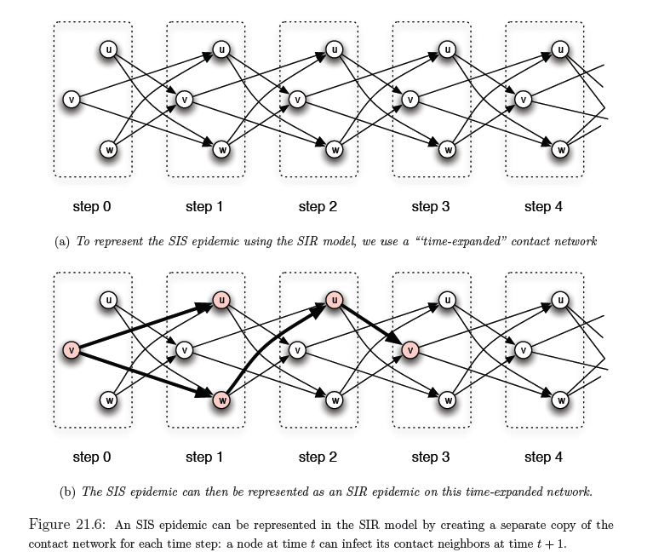
SIS and SIR

Slide 20
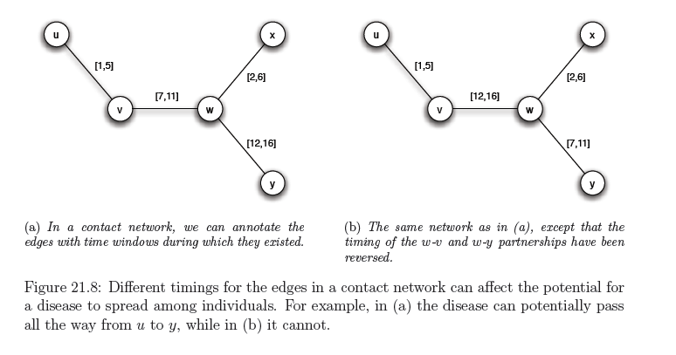
Including time
Infection can only happen within the active window
Importance of concurrency – enables branching

