Slide 1
Λ14 Διαδικτυακά Κοινωνικά Δίκτυα και Μέσα
Cascading Behavior in Networks
Chapter 19, from D. Easley and J. Kleinberg

Slide 2
Diffusion in Networks
How new behaviors, practices, opinions and technologies spread from person to person through a social network as people influence their friends to adopt new ideas
Information effect: choices made by others can provide indirect information about what they know
Old studies:
Adoption of hybrid seed corn among farmers in Iowa
Adoption of tetracycline by physicians in US
Basic observations:
Characteristics of early adopters
Decisions made in the context of social structure

Slide 3
Diffusion in Networks
Direct-benefit Effect: there are direct payoffs from copying the decisions of others
Spread of technologies such as the phone, email, etc
Common principles:
Complexity of people to understand and implement
Observability, so that people can become aware that others are using it
Trialability, so that people can mitigate its risks by adopting it gradually and incrementally
Compatibility with the social system that is entering (homophily?)

Slide 4
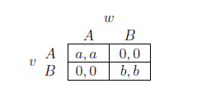
Modeling Diffusion through a Network
An individual level model of direct-benefit effects in networks due to S. Morris
The benefits of adopting a new behavior increase as more and more of the social network neighbors adopt it
A Coordination Game
Two players (nodes), u and w linked by an edge
Two possible behaviors (strategies): A and B
If both u and w adapt A, get payoff a > 0
If both u and w adapt B, get payoff b > 0
If opposite behaviors, than each get a payoff 0

Slide 5
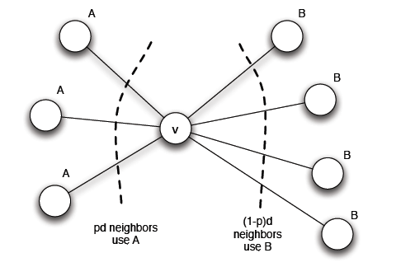
Modeling Diffusion through a Network
u plays a copy of the game with each of its neighbors, its payoff is the sum of the payoffs in the games played on each edge
Say some of its neighbors adopt A and some B, what should u do to maximize its payoff?
Threshold q = b/(a+b) for preferring A
(at least q of the neighbors follow A)

Slide 6
Modeling Diffusion through a Network: Cascading Behavior
Two obvious equlibria, which ones?
Suppose that initially everyone is using B as a default behavior
A small set of “initial adopters” decide to use A
When will this result in everyone eventually switching to A?
If this does not happen, what causes the spread of A to stop?
Observation: strictly progressive sequence of switches from A to B

Slide 7
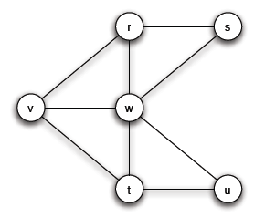
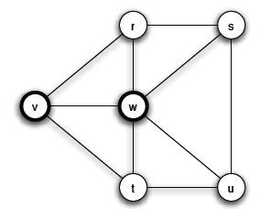
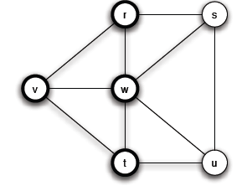
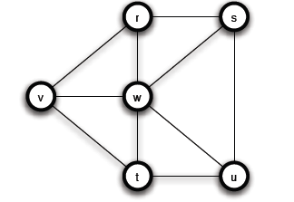
Modeling Diffusion through a Network: Cascading Behavior
a = 3, b = 2, q = 2/5
Step 1
Chain reaction
Step 2

Slide 8
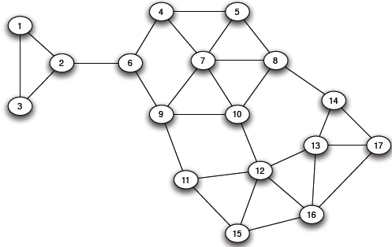
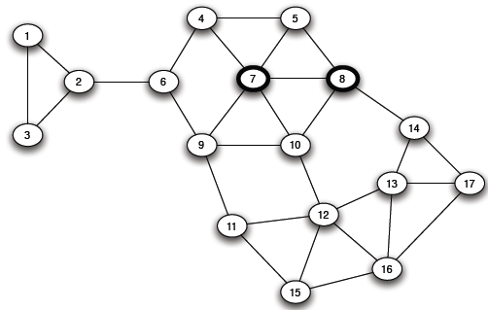
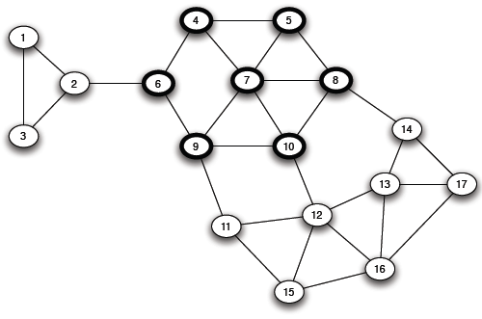
Modeling Diffusion through a Network: Cascading Behavior
a = 3, b = 2, q = 2/5
Step 3

Slide 9
Modeling Diffusion through a Network: Cascading Behavior
Chain reaction of switches to A -> a cascade of adoptions of A
Consider a set of initial adopters who start with a new behavior A, while every other node starts with behavior B.
Nodes then repeatedly evaluate the decision to switch from B to A using a threshold of q.
If the resulting cascade of adoptions of A eventually causes every node to switch from B to A, then we say that the set of initial adopters causes a complete cascade at threshold q.

Slide 10
Modeling Diffusion through a Network: Cascading Behavior and “Viral Marketing”
Tightly-knit communities in the network can work to hinder the spread of an innovation
(examples, age groups and life-styles in social networking sites, Mac users, political opinions)
Strategies
Improve the quality of A (increase the payoff a)
Convince a small number of key people to switch to A

Slide 11
Cascades and Clusters
A cluster of density p is a set of nodes such that each node in the set has at least a p fraction of its neighbors in the set
Ok, but it does not imply that any two nodes in the same cluster necessarily have much in common
The union of any two cluster of density p is also a cluster of density p

Slide 12
Cascades and Clusters

Slide 13
Cascades and Clusters
Claim: Consider a set of initial adopters of behavior A, with a threshold of q for nodes in the remaining network to adopt behavior A.
(clusters as obstacles to cascades)
If the remaining network contains a cluster of density greater than 1 − q, then the set of initial adopters will not cause a complete cascade.
(ii) (clusters are the only obstacles to cascades)
Whenever a set of initial adopters does not cause a complete cascade with threshold q, the remaining network must contain a cluster of density greater than 1 − q.

Slide 14
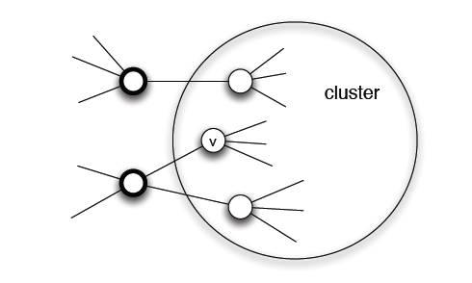
Cascades and Clusters
Proof of (i) (clusters as obstacles to cascades)
Proof by contradiction
Let v be the first node in the cluster that adopts A

Slide 15
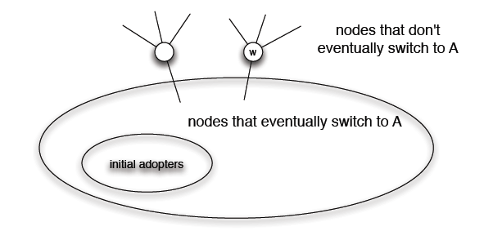
Cascades and Clusters
Proof of (ii) (clusters are the only obstacles to cascades)
Let S be the set of nodes using B at the end of the process
Show that S is a cluster of density > 1 - q

Slide 16
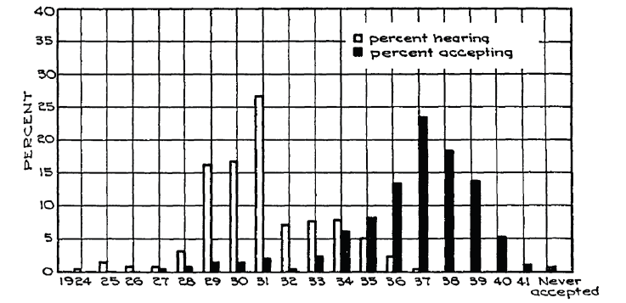
Diffusion, Thresholds and the Role of Weak Ties
A crucial difference between learning a new idea and actually deciding to accept it

Slide 17
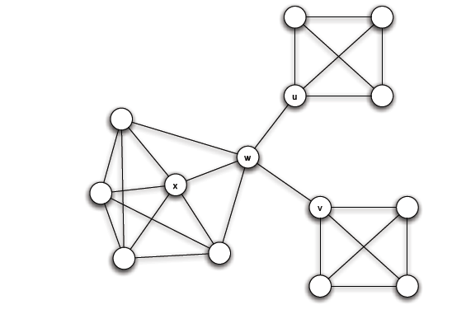
Diffusion, Thresholds and the Role of Weak Ties
Relation to weak ties and local bridges
q = 1/2
Bridges convey awareness but weak at transmitting costly to adopt behaviors

Slide 18
Extensions of the Basic Cascade Model: Heterogeneous Thresholds
Each person values behaviors A and B differently:
If both u and w adapt A, u gets a payoff a_{u} > 0 and w a payoff a_{w} > 0
If both u and w adapt B, u gets a payoff b_{u} > 0 and w a payoff b_{w} > 0
If opposite behaviors, than each gets a payoff 0
Each node u has its own personal threshold q_{u}≥ b_{u} /(a_{u}+ b_{u})

Slide 19
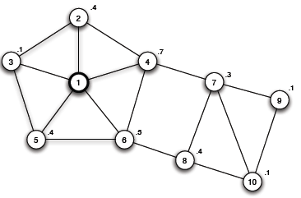
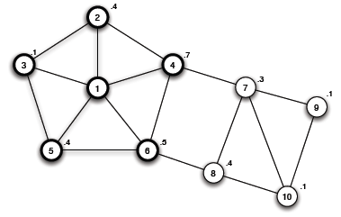
Extensions of the Basic Cascade Model: Heterogeneous Thresholds
Not just the power of influential people, but also the extent to which they have access to easily influenceable people
What about the role of clusters?
A blocking cluster in the network is a set of nodes for which each node u has more that 1 – q_{u} fraction of its friends also in the set.

Slide 20
Knowledge, Thresholds and Collective Action: Collective Action and Pluralistic Ignorance
A collective action problem: an activity produces benefits only if enough people participate
Pluralistic ignorance: a situation in which people have wildly erroneous estimates about the prevalence of certain opinions in the population at large

Slide 21
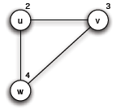
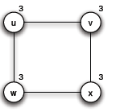
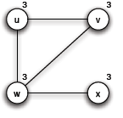
Knowledge, Thresholds and Collective Action:
A model for the effect of knowledge on collective actions
Each person has a personal threshold which encodes her willingness to participate
A threshold of k means that she will participate if at least k people in total (including herself) will participate
Each person in the network knows the thresholds of her neighbors in the network
w will never join, since there are only 3 people
v
u
Is it safe for u to join?
Is it safe for u to join? (common knowledge)

Slide 22
Knowledge, Thresholds and Collective Action:
Common Knowledge and Social Institutions
Not just transmit a message, but also make the listeners or readers aware that many others have gotten the message as well
Social networks do not simply allow or interaction and flow of information, but these processes in turn allow individuals to base decisions on what other knows and on how they expect others to behave as a result

Slide 23
The Cascade Capacity
Given a network, what is the largest threshold at which any “small” set of initial adopters can cause a complete cascade?
Cascade capacity of the network
Infinite network in which each node has a finite number of neighbors
Small means finite set of nodes

Slide 24
The Cascade Capacity: Cascades on Infinite Networks
Initially, a finite set S of nodes has behavior A and all others adopt B
Time runs forwards in steps, t = 1, 2, 3, …
In each step t, each node other than those in S uses the decision rule with threshold q to decide whether to adopt behavior A or B
The set S causes a complete cascade if, starting from S as the early adopters of A, every node in the network eventually switched permanently to A.
The cascade capacity of the network is the largest value of the threshold q for which some finite set of early adopters can cause a complete cascade.

Slide 25
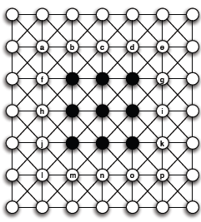
The Cascade Capacity: Cascades on Infinite Networks
An infinite path
Spreads if ≤ 1/2
An infinite grid
Spreads if ≤ 3/8
An intrinsic property of the network
Even if A better, for q strictly between 3/8 and ½, A cannot win

Slide 26
The Cascade Capacity: Cascades on Infinite Networks
How large can a cascade capacity be?
At least 1/2, but is there any network with a higher cascade capacity?
Will mean that an inferior technology can displace a superior one, even when the inferior technology starts at only a small set of initial adopters.

Slide 27
The Cascade Capacity: Cascades on Infinite Networks
Claim: There is no network in which the cascade capacity exceeds 1/2

Slide 28
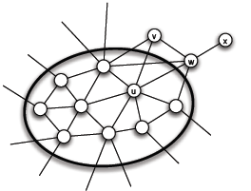
The Cascade Capacity: Cascades on Infinite Networks
Interface: the set of A-B edges
Prove that in each step the size of the interface strictly decreases
Why is this enough?

Slide 29
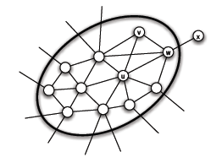
The Cascade Capacity: Cascades on Infinite Networks
At some step, a number of nodes decide to switch from B to A
General Remark: In this simple model, a worse technology cannot displace a better and wide-spread one

Slide 30
Compatibility and its Role in Cascades
An extension where a single individual can sometimes choose a combination of two available behaviors
Coordination game with a bilingual option
Two bilingual nodes can interact using the better of the two behaviors
A bilingual and a monolingual node can only interact using the behavior of the monolingual node
Is there a dominant strategy?
Cost c associated with the AB strategy

Slide 31
Compatibility and its Role in Cascades
Example (a = 2, b =3, c =1)
B: 0+b = 3
A: 0+a = 2
AB: b+a-c = 4 √
B: b+b = 6 √
A: 0+b = 3
AB: b+b-c = 5

Slide 32
Compatibility and its Role in Cascades
Example (a = 5, b =3, c =1)
B: 0+b = 3
A: 0+a = 5
AB: b+a-c = 7 √

Slide 33
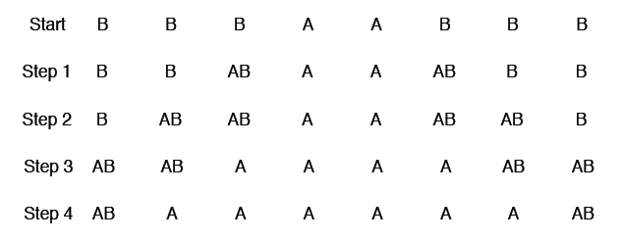
Compatibility and its Role in Cascades
Example (a = 2, b =3, c =1)
First, strategy AB spreads, then behind it, node switch permanently from AB to A
Strategy B becomes vestigial

Slide 34
Compatibility and its Role in Cascades
Given an infinite graph, for which payoff values of a, b and c, is it possible for a finite set of nodes to cause a complete cascade of adoptions of A?
Fixing b = 1
Given an infinite graph, for which payoff values of a (how much better the new behavior A) and c (how compatible should it be with B), is it possible for a finite set of nodes to cause a complete cascade of adoptions of A?
A does better when it has a higher payoff, but in general it has a particularly hard time cascading when the level of compatibility is “intermediate” – when the value of c is neither too high nor too low

Slide 35
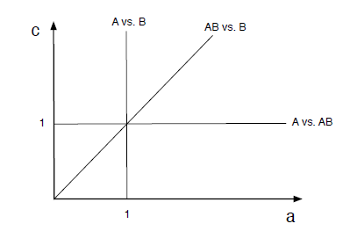
Compatibility and its Role in Cascades
Example: Infinite path
Spreads when q ≤ 1/2, a ≥ b (a better technology always spreads)
Assume that the set of initial adopters forms a contiguous interval of nodes on the path
Because of the symmetry, how strategy changes occur to the right of the initial adopters
Initially,
B better than AB
Break-even:
a + 1 – c = 1 => c = a
A: 0+a = a
B: 0+b = 1
AB: a+b-c = a+1-c

Slide 36
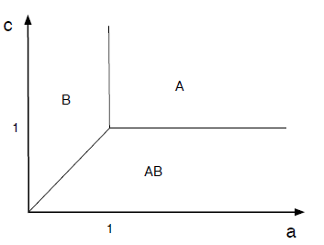
Compatibility and its Role in Cascades
Initially,
A: 0+a = a
B: 0+b = 1
AB: a+b-c = a+1-c
Break-even:
a + 1 – c = 1 => c = a

Slide 37
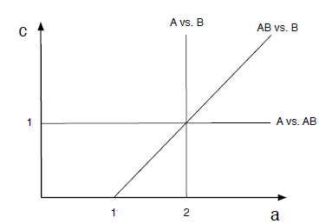
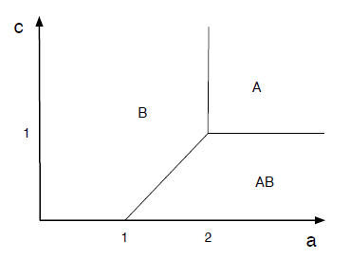
Compatibility and its Role in Cascades
Then,
a < 1,
A: 0+a = a
B: b+b = 2 √
AB: b+b-c = 2-c
a ≥ 1
A: a
B: 2
AB: a+1-c

Slide 38
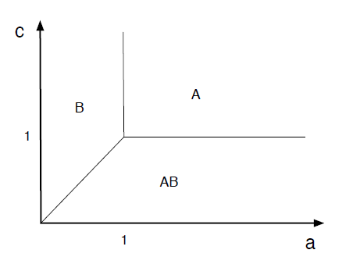
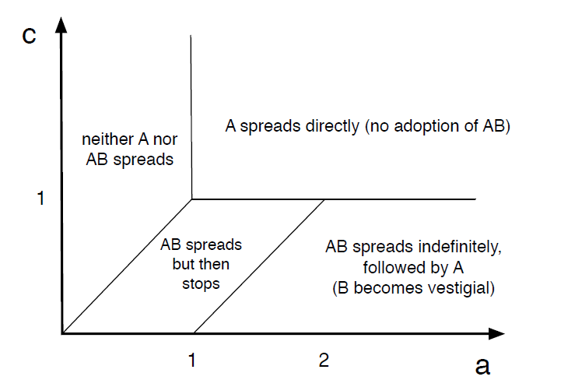
Compatibility and its Role in Cascades

Slide 39
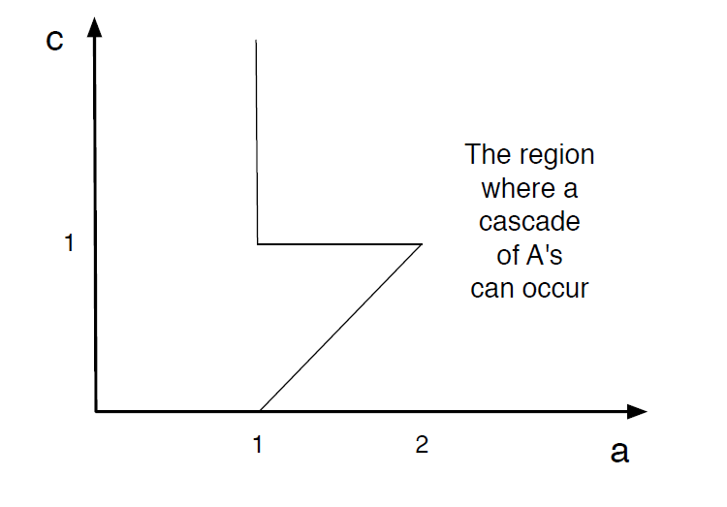
Compatibility and its Role in Cascades
What does the triangular cut-out means?

Slide 40
End of Chapter 19
Diffusion as a network coordination game
Payoff for adopting a behavior
Cascades and the role of clusters
The cascade capacity of a network
“Bilingual” behavior

